Slide 1

JLab‘s LDRD Program
S&T Review, 7/28-30/2015
L. Cardman

Slide 2
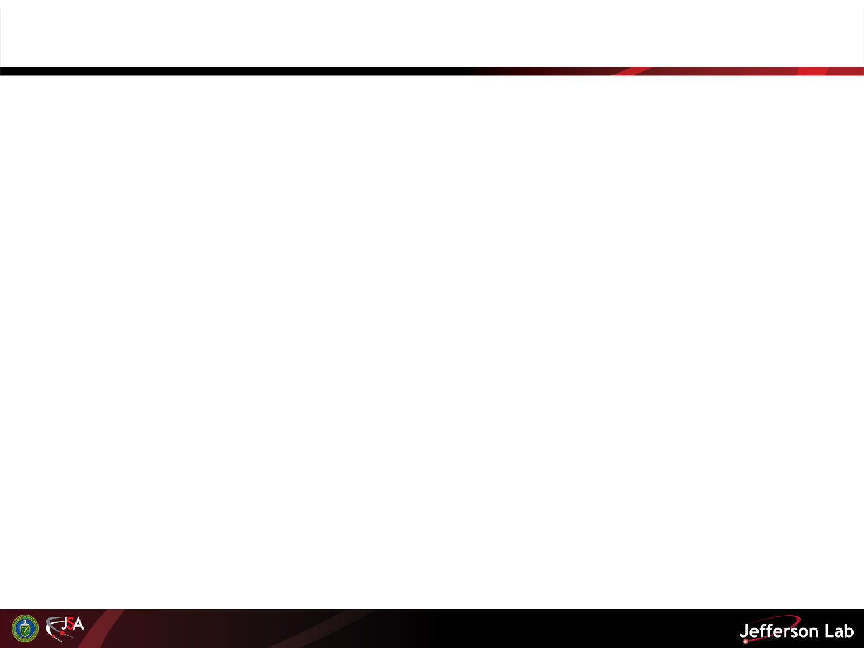
Introduction
JLab initiated an LDRD Program in FY2014
  The scale is modest, ~$800k ( – a 1% “tax” on direct costs)
  It began with three 2-year Projects in November 2014
  (the late start was due to budget delays)
At the time of your last (July, 2014) S&T Visit the three FY2014 projects were underway and the evaluation process for the FY2015 projects was nearly complete.
Since then:
  The three projects started in FY2014 were enthusiastically endorsed for continuation and completion in FY2015; they are progressing nicely toward their finish in two months.
  Three new FY2015 projects were started (Two are 1-year only; one is planned as a 2-year project)
  Evaluation of proposals for FY2016 projects is well underway
My goals today are to:
  Summarize the LDRD projects now underway;
  Describe the funding framework; and
  Introduce the new set of proposals for FY2016 funding that are now under evaluation
2

Slide 3
FY2014 and FY2015 LDRD Projects Underway
 | LDRD Project # | Submitted By | Title | Lead Division |  | FY14 Budget (Actuals) | FY15 Budget | FY16 Budget (Proposed) | Total Budget
 | FY2014 Start
 | 2014-LDRD-3 | Jack McKisson | Physics_Wireless, Data Acquisition System for Imaging Detector | Physics |  | $61,700 | $59,407 |  | $121,107
 | 2014-LDRD-6 | Christian Weiss | Physics potential of polarized light ions with EIC@JLab | Physics / Theory |  | $146,800 | $168,252 |  | $315,052
 | 2014-LDRD-10 | Ed Nissen, then Andrew Kimber | Development of a prototype for a fast RF kicker for the MEIC electron cooler | Accelerator |  | $9,500 | $153,574 |  | $163,074
 | FY2015 Start
 | 2015-LDRD-1a | Yuhong Zhang | Cooling by a bunched beam | Accelerator |  |  | $88,826 |  | $88,826
 | 2015-LDRD-1b | Yves Roblin | Coherent Synchrotron Radiation Suppression experiment | Accelerator |  |  | $198,163 |  | $198,163
 | 2015-LDRD-7 | He Zhang | Enhancing Simulation Capability for Electron Cooling in MEIC Project | Accelerator |  |  | $130,582 | $135,085 | $265,667
 |  | Totals | All Projects |  |  | $218,000 | $798,804 | $135,085 | $1,151,889

Slide 4
FY2014 and FY2015 LDRD Projects Underway
 | LDRD Project # | Submitted By | Title | Lead Division |  | FY14 Budget (Actuals) | FY15 Budget | FY16 Budget (Proposed) | Total Budget
 | FY2014 Start
 | 2014-LDRD-3 | Jack McKisson | Physics_Wireless, Data Acquisition System for Imaging Detector | Physics |  | $61,700 | $59,407 |  | $121,107
 | 2014-LDRD-6 | Christian Weiss | Physics potential of polarized light ions with EIC@JLab | Physics / Theory |  | $146,800 | $168,252 |  | $315,052
 | 2014-LDRD-10 | Ed Nissen, then Andrew Kimber | Development of a prototype for a fast RF kicker for the MEIC electron cooler | Accelerator |  | $9,500 | $153,574 |  | $163,074
 | FY2015 Start
 | 2015-LDRD-1a | Yuhong Zhang | Cooling by a bunched beam | Accelerator |  |  | $88,826 |  | $88,826
 | 2015-LDRD-1b | Yves Roblin | Coherent Synchrotron Radiation Suppression experiment | Accelerator |  |  | $198,163 |  | $198,163
 | 2015-LDRD-7 | He Zhang | Enhancing Simulation Capability for Electron Cooling in MEIC Project | Accelerator |  |  | $130,582 | $135,085 | $265,667
 |  | Totals | All Projects |  |  | $218,000 | $798,804 | $135,085 | $1,151,889
Two Examples (Summaries of all 6 Projects are in Backup Material)

Slide 5
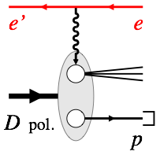
Overview
2014-DRD-4: C. Weiss: Physics Potential of Polarized Light Ions with EIC@JLab
D. Higinbotham, P. Nadel-Turonski (JLab Physics), W. Melnitchouk, C. Weiss* (JLab Theory)
Visiting Scientists: W. Cosyn (Ghent U), V. Guzey (Petersburg NPI), M. Sargsian (FIU)
Postdoc: K. Park (Old Dominion U, 50% FTE)
Objective: Enable next-generation nuclear physics measurements
using polarized light ions (deuteron, 3He) and forward spectator tagging
with the JLab medium–energy Electron–Ion Collider design
Fundamental nuclear physics questions of EIC White Paper: Neutron structure, nuclear binding in QCD, collective fields
Innovative method using unique capabilities of JLab MEIC: Polarized deuteron, forward detection
Strong interest among JLab Users
Tasks
Develop simulation tools: Theoretical models, event generators
Perform process simulations with EIC accelerator and detector configuration
Quantify physics impact and disseminate results

Slide 6
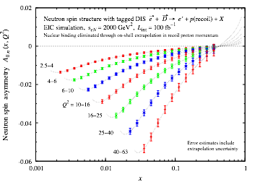
Progress to date
2014-DRD-4: C. Weiss: Physics Potential of Polarized Light Ions with EIC@JLab
Developed theoretical cross section models for high-energy eD scattering at EIC with spectator tagging: unpolarized, polarized, diffractive final state
    FORTRAN/C++ codes, documentation, publicly available at https://www.jlab.org/theory/tag/
Developed Monte-Carlo simulation tools (event generators, analysis tools) for high-energy eD scattering at EIC with spectator tagging
    Maintained on github area, can be adapted by users
Performed process simulations with EIC beam and detector configuration and demonstrated feasibility of precise neutron structure measurements
    Counting rate estimates, statistical errors
    Systematic errors: Momentum resolution, polarization, analysis procedures
    Preliminary results published in proceedings: arXiv:1407.3236, arXiv:1409.5768, journal article in preparation
Reached out to JLab Users and broader nuclear physics community
  Project results presented at 2014 DNP Town Meeting
Recent results: Neutron spin structure with EIC
Precision measurements of neutron spin structure in eD with proton tagging
On-shell extrapolation in recoil proton momentum eliminates nuclear binding and deuteron D-wave contamination
Neutron data permit u-d flavor separation of quark spin and accurate determination of gluon spin
Prepared for EIC Long-Range Plan presentation
6

Slide 7
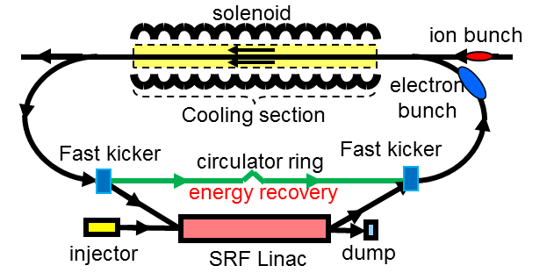
Project outline
2014-LDRD-10: A. Kimber: Fast RF Kicker
One or more fast RF kickers would be employed to kick single electron bunches in and out of a bunch train.
At 750 MHz bunch rate, a kicker would have to operate at sub nanosecond rise and fall times and at much higher repetition rates than has been demonstrated.
Mathematically, the concept works by summing simple sine waves at sub-frequencies of the final beam repetition frequency* to generate the required waveform.
Goals:
  To demonstrate (by experiment) that a stripline kicker can be driven with a waveform shown below and to investigate it’s real world performance.
  To make recommendations as to the technology that should be employed on the full scale MEIC project.
MEIC proposal uses electron cooling to attain design luminosity
Energy recovery and the reuse of cooling bunches help with the design requirements of both the injector and beam dump
*Concept originally proposed by Dr. Hutton
Slide 7/6
Notes:
Blue Interior Page Design 2

Slide 8
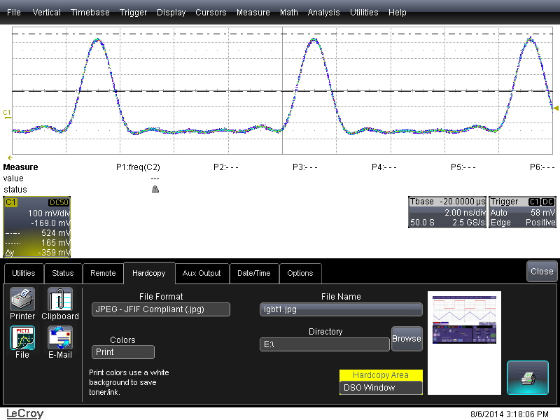
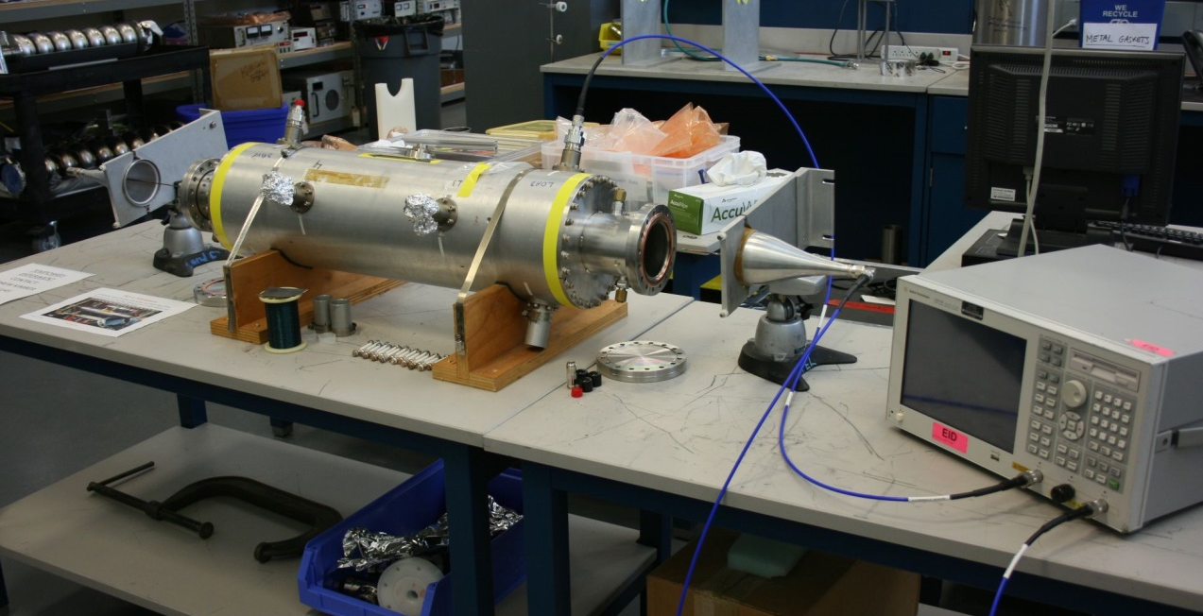
Fast RF kicker update
2014-LDRD-10: A. Kimber: Fast RF Kicker
Summed waveform demonstrated using 5 signal generators, summed, amplified and attenuated, measured by a fast oscilloscope.
Experimental results show good agreement with the simulated waveform
A Goubau line setup on the bench with a stripline cavity, on loan from SLAC
The Goubau line is used at JLab to qualify beam position monitors, it will be used here to simulate the presence of an electron beam.
We will quantify the coupling between the cavity electrodes and the line.
Further studies will be performed by launching the summed waveform along the cavity electrodes and measuring the effect on the ‘simulated’ electron beam.
Slide 8/6
Notes:
Blue Interior Page Design 2

Slide 9
Financial Envelope
Our Goal for the JLab LDRD program has been a budget envelope of ~$800k/year (including overhead)
The total costs of the program to date have been:
  $218k in FY14
  $798k in FY15 (including continuation of 3 projects started in FY14)
Our plan is to keep the budget for FY16 below $800k (including possible continuation of one FY15 project)
We continue to watch the out-year implications of the projects we fund to keep “room” in the budget for new proposals each year
  So, for example, we limited the number of proposals funded in the initial year (FY14) so that the program had room to grow to a total of ~$800k/year including both new and continuing projects
  We anticipate a similar approach this year
Our experience to date suggests that this overall level of LDRD funding is about right for JLab

Slide 10
The FY16 LDRD Program
FY15 Review Cycle was launched on February 13th with Call for Proposals (and optional LOIs)
Five LOIs were received and evaluated
Eight Proposals were received, and are currently under evaluation
The major presentation session and initial rank ordering occurred on July 1
and the formal reviews and recommendations to the Director will be completed by mid-August.
Evaluation of proposals for FY16 includes evaluation of the value of continuing the one multi-year proposal launched in the FY15 cycle (they have submitted a renewal proposal that include a section that is basically a progress report)

Slide 11
8 Proposals Were Received for FY16 Covering a Broad Variety of Topics; Evaluation is Nearing Completion
Proposal # | Submitted By | Title | Lead Division | FY15 Renewal?
2016-LDRD-1 | He Zhang | Enhancing Simulation Capability for Electron Cooling in MEIC Project | Accelerator | Yes
2016-LDRD-2a | Riad Suleiman and Matt Poelker | Generation and Characterization of Magnetized Bunched Electron Beam from DC Photogun for MEIC Cooler (Revised) | Accelerator
2016-LDRD-3 | Alex Bogacz | Lattice Mitigations of Luminosity Limits for MEIC | Accelerator
2016-LDRD-4a | Christian Weiss | Nuclear gluons with charm at EIC | Theory
2016-LDRD-5 | Harut Avagyan | Studies of the Structure of the Nucleon and Hadronization in Correlations of Hadrons in CFR and TFR | Physics
2016-LDRD-6 | Alexandre Camsonne | Superconducting detectors | Physics
2016-LDRD-7 | Rui Li | Experimental Investigation of Longitudinal Space Charge (LSC) and Coherent Synchrotron Radiation (CSR) Induced Microbunching Instability Using LERF | Accelerator
2016-LDRD-8 | Jiquan Guo | Experimental Study of CEBAF Pulsed Beam Operation | Accelerator

Slide 12
Summary
JLab’s LDRD program, which began in FY2014, is now in full swing
A total of six projects are underway (three begun in FY2014 and continued in FY2015, and three begun in FY2015)
Five of these six projects are nearing completion as planned (2 months to go); the sixth plans a second year in FY2016
We are now in our third evaluation cycle, and continue to be impressed by the level of innovation and clear thinking presented in the proposals we have received
The LDRD program is making substantive contributions to the future evolution of the laboratory and its science, and we are delighted with its progress

