Slide 1
Beam Diagnostics R&D
Pavel Evtushenko
Jefferson Lab, accelerator division

Slide 2
Outline
Motivation
Towards Large Dynamic Range (LDR) beam imaging - apodized imaging systems
Wire-scanner electronics for PMT analog mode measurements with dynamic range 10⁸
Cherenkov converter for wire-scanners
Non intercepting, LDR, time resolving laser wire-scanner development
Conclusion

Slide 3
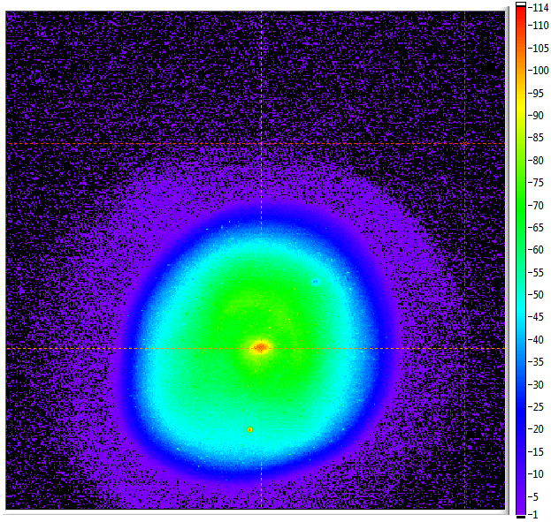
Motivation
CW LINACs with high average current and energy few GeV are envisioned as drivers for next generation of high average brightness facilities
In future we will find applications of such accelerators in Nuclear Physics, High Energy Physics, SR Light Sources, Industry and Defense, e.g MIEC/eRHIC, LHeC, LCLS-II, DarkLight at JLab ERL, etc.
Average beam power for such accelerators will be in the range from MW through few tens of MW
About 1 W of local beam loss is not acceptable in the long term
LINAC beam have non-Gaussian distributions with low intensity, large amplitude (x,y) tails difficult to predict
Low duty cycle (very low average current) diagnostic beams mode(s) must be used for accelerator setup
JLab FEL injector measurement –
transverse beam profile (x,y)
Notes:
The motivation for this program comes from two directions:
On one hand Linacs with the average current …
On the other hand there are existing facilities such as Jefferson Lab FEL that is a high current high average beam power machine that have demonstrated operation with average current of up to 9 MeV and beam power

Slide 4
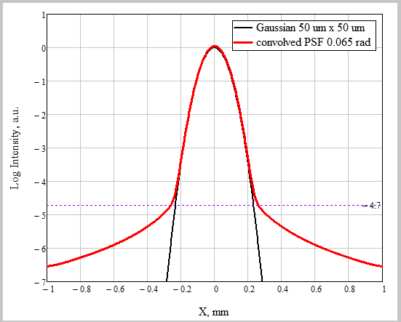
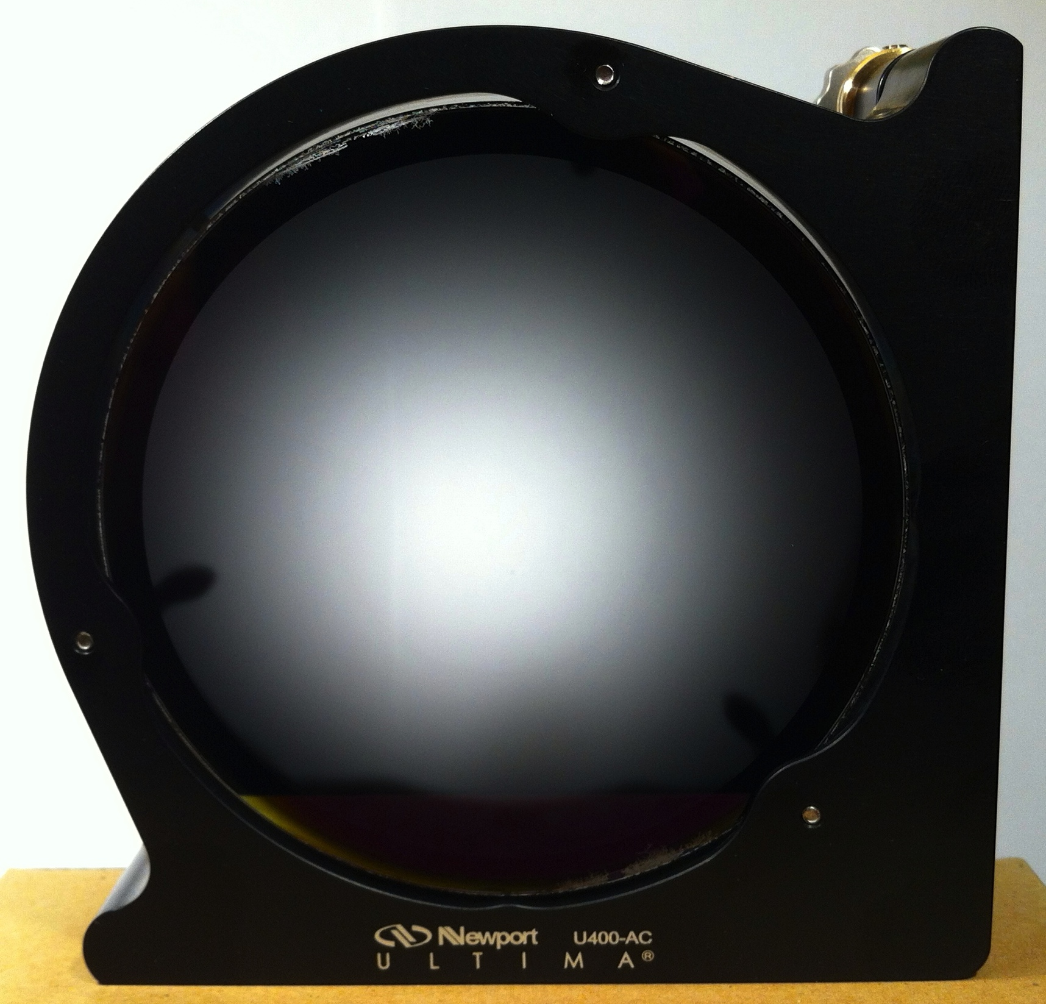
LDR imaging: diffraction limit and PSF
Beam imaging is a commonly used technique for transverse 2D beam distribution measurements; used at many accelerators
Measured distribution is a convolution of the original distribution and Point Spread Function (PSF) of the imaging optical system
PSF determined by system angular acceptance, the source angular distribution, and diffraction in the imaging system
Diffraction sets rather hard limits to the DR
Ways to mitigate: increase angular acceptance, use spatial filter – apodizer
Practically manufacturing – technological challenge
Half-tone dot process - average optical density (OD) adjusted via the average dot density
It is a 2D binary array of 10 µm pixels with transmission of either 0 or 100 %
“Error diffusion” algorithm used to translate required OD to dot density
Power spectrum (spatial frequencies) of a pixelated apodizer is different from an ideal continuously variable one
half-tone dot Gaussian apodizer
Notes:
When we say “low intensity – large amplitude fraction of the beam distribution function”, that is really a description of “beam halo” in technical terms.
One of the thesis of this program is that: when we can measure the transverse beam profile with sufficiently large dynamic range,
there is not need to separate what is halo and not halo – it is just a continuous distribution function.
Transverse beam halo is closely related to the transverse beam profile measurements.
There are several techniques for transverse beam profile measurements. Beam imaging is one of them that delivers 2D picture of a beam.

Slide 5
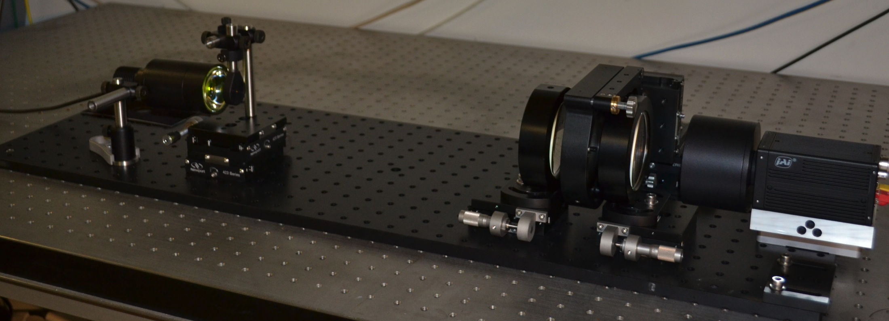
Apodizer bench test
Pinhole
Lens 1
Lens 2
2CCD camera
Apodizer

Slide 6
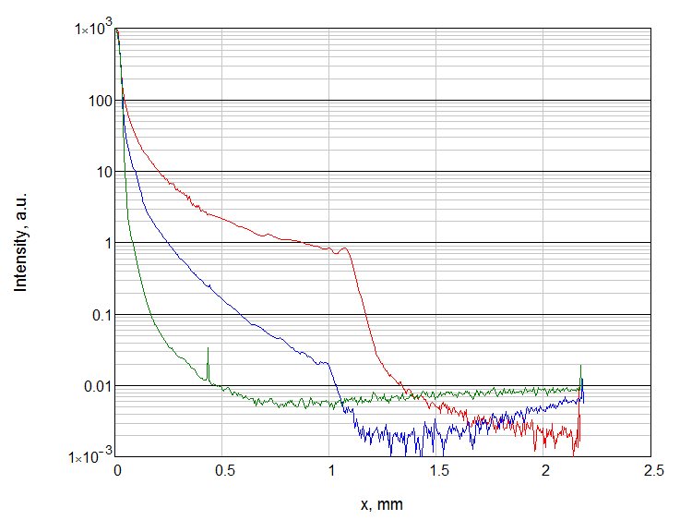
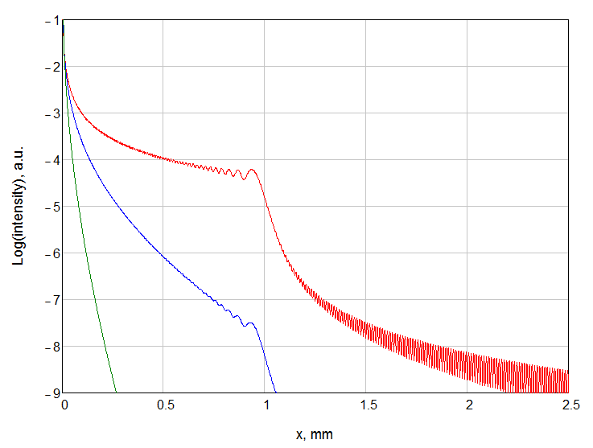
Central line of pinhole images
Measurements
Modeling
10⁶
10⁶
Measurements with dynamic range of ~ 10⁶
Measured large reduction of the PSF “diffraction tails” intensity
Calculations predicting even larger effect
More measurements required to understand the measurements vs. modeling discrepancy
Both apodizer types were tested (halftone dot and reflective) no significant difference found
Possible reasons for discrepancy: optics aberrations, scattering, apodization function accuracy
Second version of the LDR imager has been designed
Notes:
For quantitative analysis and comparison with the modeling we consider one line from the 2D picture going through the center of the PSF.
And we are finding is that …

Slide 7
PMT (for wire-scanner) current range
Typically average PMT current must be ≤ 100 µA (photo cathode live time)
With low duty cycle beam (100 µs @ 60 Hz) PMT current within the 100 µs can be much higher – few mA
PMTs with dark current of a few nA are available (low Q.E. cathode at long wavelength)
When counting is used, 100 MHz and 100 Hz are practical limits, correspond to 30 µA and 30 pA
Both counting and analog mode can have 10⁶ range, but analog mode accesses signals 10³ higher and therefore is correspondently faster and/or have has better signal to noise ratio
For low duty cycle systems, as diagnostic mode beam, gated integrator (GI) is the optimal small signal recovery technique
For a single GI dynamic range of 10⁷ is impossible (sub µV noise for 10 V signals), 10⁴ is realistic

Slide 8
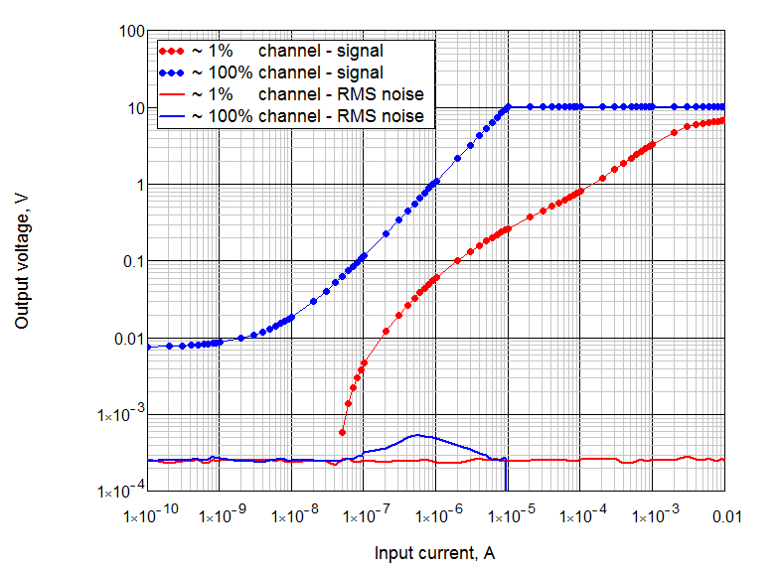
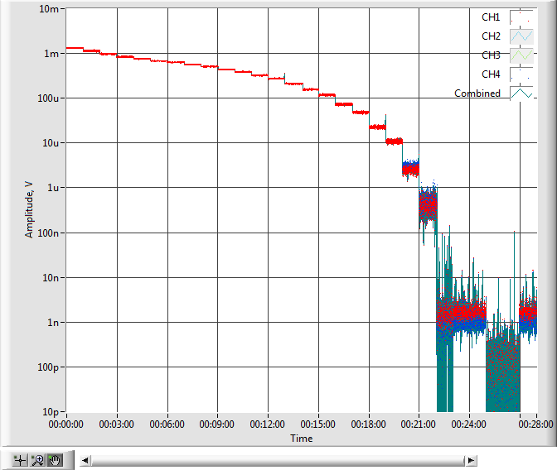
GI practical performance
Output of each GI is digitized with 16-bit ADC at 4 MS/s
Output of a GI is available for digitalization during charge integration – better than the gate width time resolution
Results of GI calibration with a precision current source in the range from 100 pA through 10 mA are shown
Signal level up to 10 V; noise level (RMS) ~ 250 µV
Non linearity of the “1 % channel” (red) is due to nonlinear operation of the current mirror, too little current for bipolar transistors – next iteration to use FET current mirror
GI-x2 measurements of a pulsed PMT signal
Upper limit of 2 mA is due to HV divider (not the GI-x2 )
Low end 2 nA PMT dark current level; specification - (3 nA typical 20 nA max)
Measurements with two gates allows to dynamically measure and subtract the dark current.
Then limiting factor is the GI-x2 intrinsic noise level – equivalent to ~ 100 pA
60 points per sec. ➟ 5 sec. beam profile measurements

Slide 9
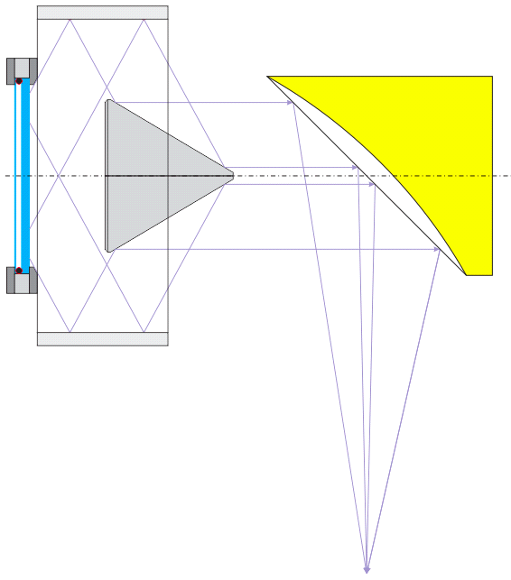
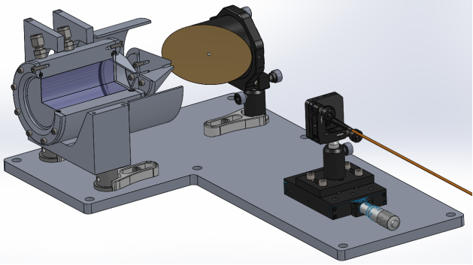
Wire Scanner – Visible photons generation
Visible wavelength photons needed for PMT
Low background (none) required for LDR
Must generate visible photons from wire-beam interaction without generating or seen radiation from other locations, sources
Use high directivity of Cherenkov Radiation to converts e– and e⁺ (E-M shower) to visible photons
PMT located outside of accelerator tunnel
Fiber optics for light delivery from the tunnel
Direction sensitive: CR generated not due to beam-wire interaction is not coupled in to the optical system.
All reflective optics: to use wavelength as short as possible; Quartz windows and optical fiber
Converter thickness (length) can be used to adjust amount generated photons.
Radiator medium H₂0 n=1.333 > sqrt(2); CR is not trapped in the radiator
Special reflective optics is a challenge – high mechanical tolerances
Cherenkov radiator
Cylindrical
reflector #1
Conical
reflector #2
Parabolic
reflector #3
Optical fiber input

Slide 10
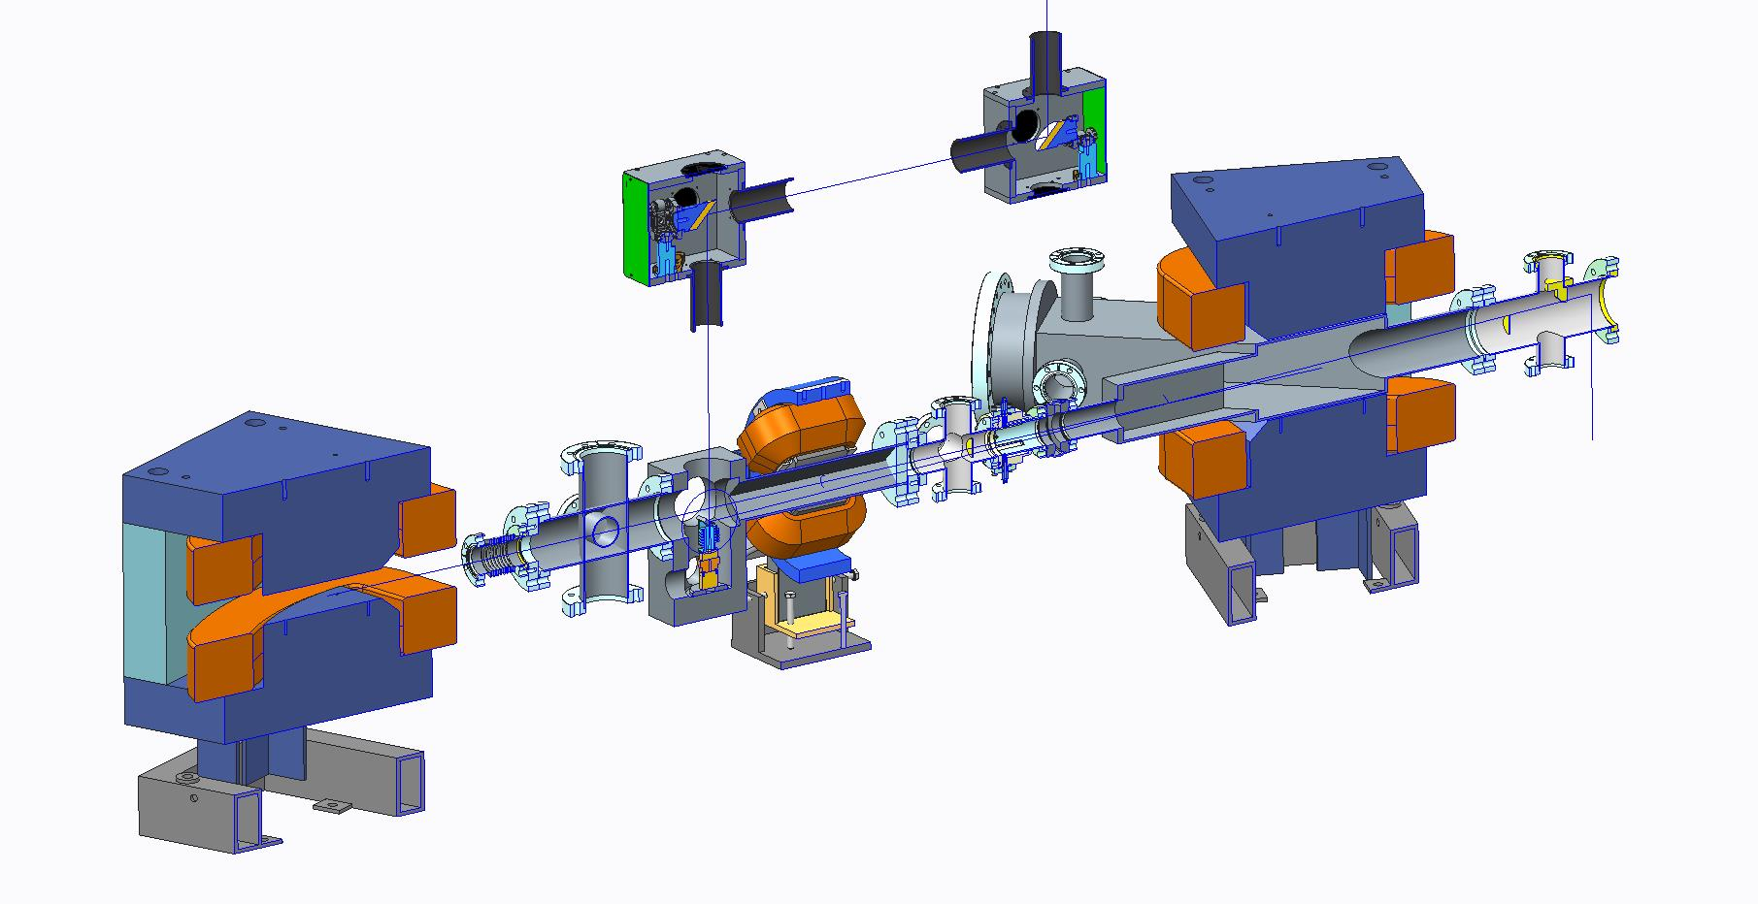
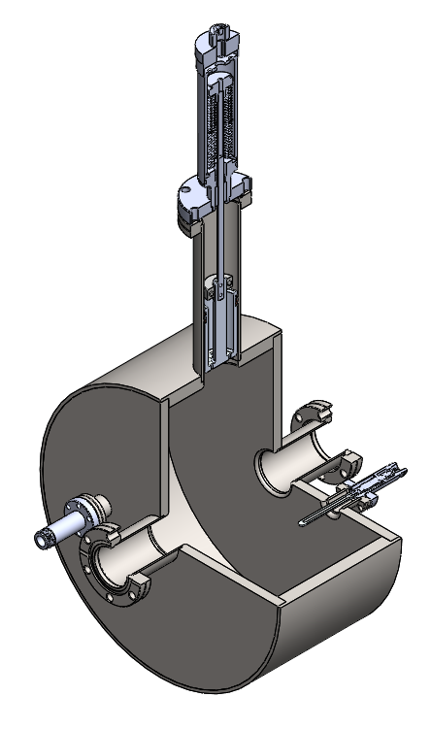
CW laser-wire setup
laser input port
laser output port
45 deg dipole 1
Scattering output port
TM₀₁₀ synchronization cavity
laser – e– beam
interaction point
45 deg dipole 2
e- beam input
e- beam output
Laser system is installed and commissioned: 1032 nm, 25 W, 15-20 µJ, 0.8-1.6 MHz, 300 fs
Accurate beam trajectory in the dipole fringe field were required (done)
Temporal jitter of the e– beam was measured. Can be as high as ps - too large for sub-ps resolution.
Due to the large temporal e– beam jitter, synchronization of the laser via precise reference would not be sufficient
Concept (and detailed designs) for direct laser to e– beam synchronization is developed

Slide 11
Summary
We have developed (designed, built and tested) amplitude apodized imaging system (first in accelerator community)
Demonstrated large reduction of diffraction effect on PSF of the imaging system – allows 100 larger dynamic range
Designed, built and tested PMT analog mode electronics for wire-scanner measurements with dynamic range of 10⁸
Design of Cherenkov radiator-converter for LDR wire-scanner measurements is in progress
Laser system for Thomson scattering based laser wire-wire scanner is installed and commissioned, design and construction of the entire system is in progress

