Slide 1
FRIB Cryogenic Support
Kelly Dixon, JLab Project Engineer for Cryo Plant & Distribution System

Slide 2
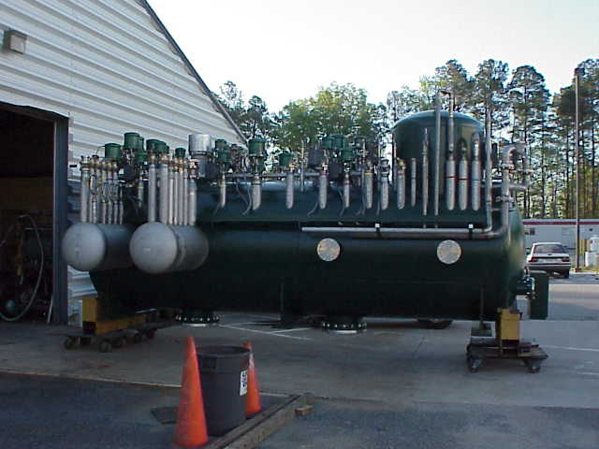
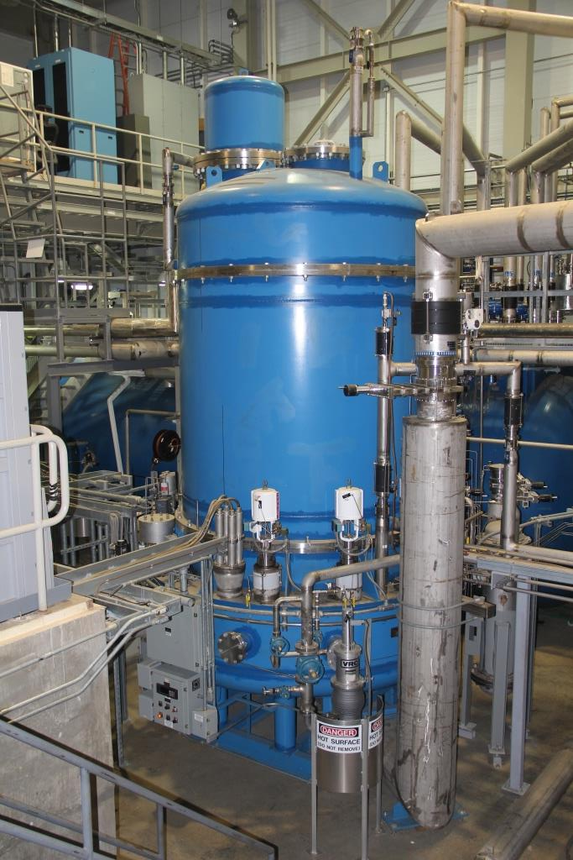
Cryo Support to Other Labs & Agencies
1998-2000: Support upgrade of NSCL Cryo System.
2000-2005: Designed, built and commissioned the 2K cryo system for SNS at ORNL
Continuation of supporting the technical needs of the SNS cryogenic 2K helium system through collaboration
2004-2007: JLab modified the operational process at BNL cryo system to Ganni Cycle-Floating pressure technology, resulting in a power reduction from 9.4 MW to 4.8 MW for the same load
NSCL Distribution Box
SNS ‘2 K’ Cold Box
BNL Power Profile

Slide 3
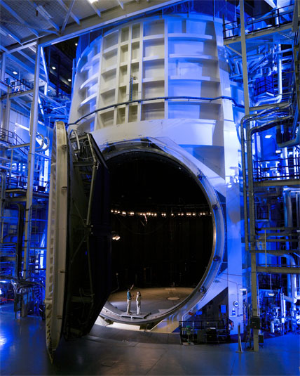
Cryo Support to Other Labs & Agencies
2006-2012: JLab designed, built and commissioned the cryo systems to support James Webb telescope testing at JSC-NASA
LN2 consumption cut in half (91 vs 182 m³/day)
12.5 kW, 20 K plant
input power/load ~ 50% from original (125 to 65 W/W)
Constant efficiency to 33% of full load
12.5 kW, 20 K Cold Box
NASA JSC Chamber-A

Slide 4
FRIB Plant Support
In 2012, JLab came up with a plan to use the flexible CHL2 Cryo system with minor modifications due to added shield and 4.5K loads; this brought the cryo system costs back to the baseline
JLab provided the bottoms up estimate for the loads and other cryo requirements
Equipment to provide includes:
4K and sub-atmospheric (SA) cold boxes
main and recovery compressors
liquid and gas storage
oil removal
warm and cryogenic piping
guard vacuum, instrument air, purifier, ambient air heat exchangers
4-5 JLab FTE’s dedicated to the design +2.0 contractors + 1 FRIB designer/engineer at JLab
Goal is to provide 4 K in Dec ‘17 and 2 K in Mar ‘18
Work for Others Agreement No. JSA 2012W003, Mod 6
(MSU Reference No. MSU RC063215-JSA-6)

Slide 5
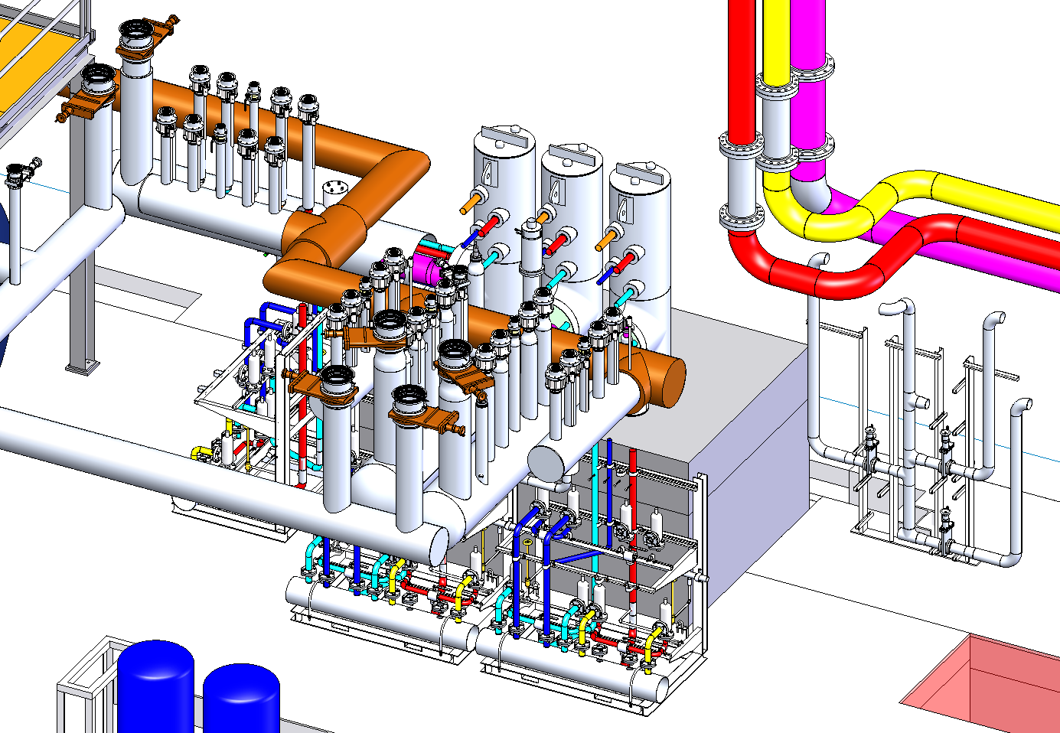
Plant Layout - Cold Box Room
N2 Dewar(s)
Upper Cold Box
Distribution to Linacs
Heat Exchangers
Lower Cold Box
He Dewar
SA Cold Box

Slide 6
Plant Layout - Compressor Room
Gas Mgmt Rack
Guard Vacuum &
Recovery Compressors
Final Oil Removal
LP-L
LP
LP
MP
HP
HP

Slide 7
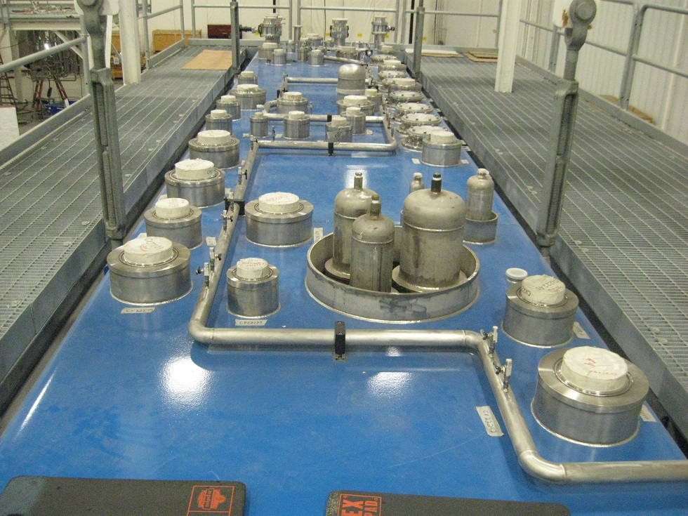
Cold Boxes
4 K cold boxes based on JLab CHL2
Larger shield flow
Specific 4 K load from magnets
Increased 300-80 K heat exchangers
Provides 50% design margin
Designed and built by vendor
Sub-atmospheric (SA) cold box design by JLab
120 g/s nominal flow vs 215 g/s CEBAF (@0.028 atm)
Allows cold compressor upgrade to 225 g/s
Water cooled motors
Horizontal configuration
Heat exchanger moved to CM level

Slide 8
Main Compressors
Baseline design funded by NASA-JSC
Number and size selection based on Ganni Cycle
50% less maintenance to CHL2
Improved efficiency to 51% (highest compared to current industrial systems)
Low equipment cost
Recent changes from CHL2
oil separation and removal
HP frame stiffened
corrugated lines removed
power increased to one LP unit to handle the 4 K load

Slide 9
Miscellaneous Equipment
Gas and liquid storage
Mostly standard equipment. Helium dewar requires neck insert for heaters, valves, and bayonets
Guard vacuum skid
Provides SA seal protection and low CM relief valve backpressure
Based on JLab/SNS design
Purifier
JLab integrates compressor and HX/adsorber skids
Oil removal
Builds upon previous CHL designs with recent experience

Slide 10
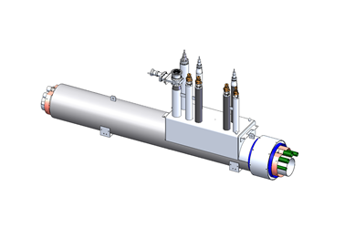
Linac Distribution System
Added to scope in ’14
Combines supply & return
Allows 150% flow margin
Mechanically attached shield
CHL to Linac Piping
Allows independent operations of 3 linacs
JLab design, some similarity to standard sections
Relief piping & valves moved from tunnel
JLab presently constructing some sections for summer ‘15 installation
Prototype and standard transfer line sections designed by JLab
2 prototypes sections were built by JLab
Design package includes detailed drawings, assembly procedure and fixtures
49 standard sections have several different lengths
Now providing support to ensure supplier meets technical and schedule goals

Slide 11
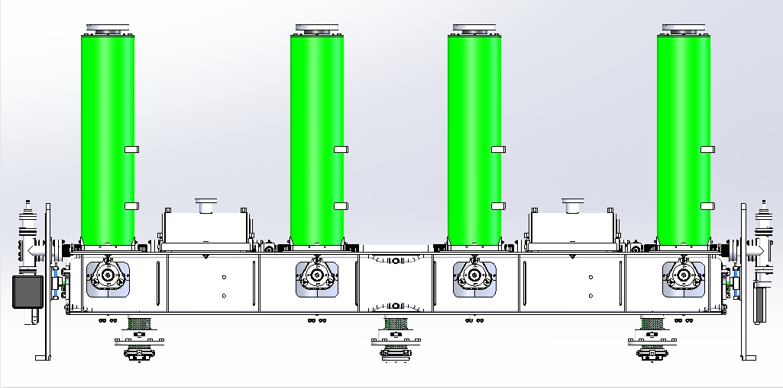
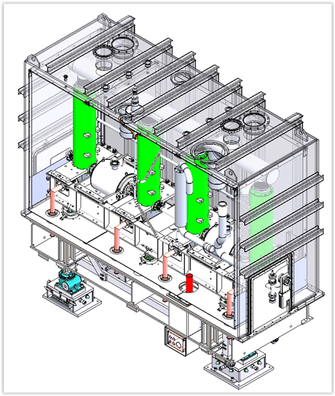
FRIB Cryomodule Design
Agreement began in ‘15 and runs through ‘18
Scope
Review β=0.085 and β=0.53 cryomodule designs
Design β=0.041and β=0.29 CM’s
Includes: distribution piping, thermal and magnetic shielding, vacuum vessel, alignment rails and complete assembly drawings.
Provides a great opportunity for both labs to benefit from the others experience
Expected finish date for the β=0.041design is in February 2016--other design assignments will follow as agreed upon with FRIB
Cavity #4
Cavity #3
Cavity #2
Cavity #1
Solenoid #2
Solenoid #1
Beam
β=0.041 Clean Room Assembly plus G10 support posts
β=0.041 Sectioned View of Vacuum Vessel

Slide 12
Summary
Since 1998, JLab developed valuable design experience for other outside work
JLab support to FRIB cryogenics based on past design and operating experience
JLab able to use or adapt existing equipment and develop new designs

