Slide 1

Jefferson Lab LCLS-II Effort
George R. Neil
Senior Team Lead

Slide 2
JLab Scope
Production of ½ the 1.3 GHz cryomodules
  Modify JLab infrastructure to support production
  Procure ~ ½ components for both FNAL and JLab Production
  Support FNAL design effort with reviews, etc.
  Provide QA and fabrication documentation
  SQAP signed off, QA/QC plans part of every procurement
  Qualification of processing procedure and Q₀ acceptance criteria
LLRF design, R&D, design verification

Slide 3
JLab Scope (continued)
Design and Procurement of Cryogenic Refrigerators
  Specification of all cryoplant components
  Procurement of plant and performance verification at SLAC
  Support SLAC and FNAL with requirements and analyses
  Support conventional facility specification and procurement (SLAC)
  Safety support and analyses

Slide 4
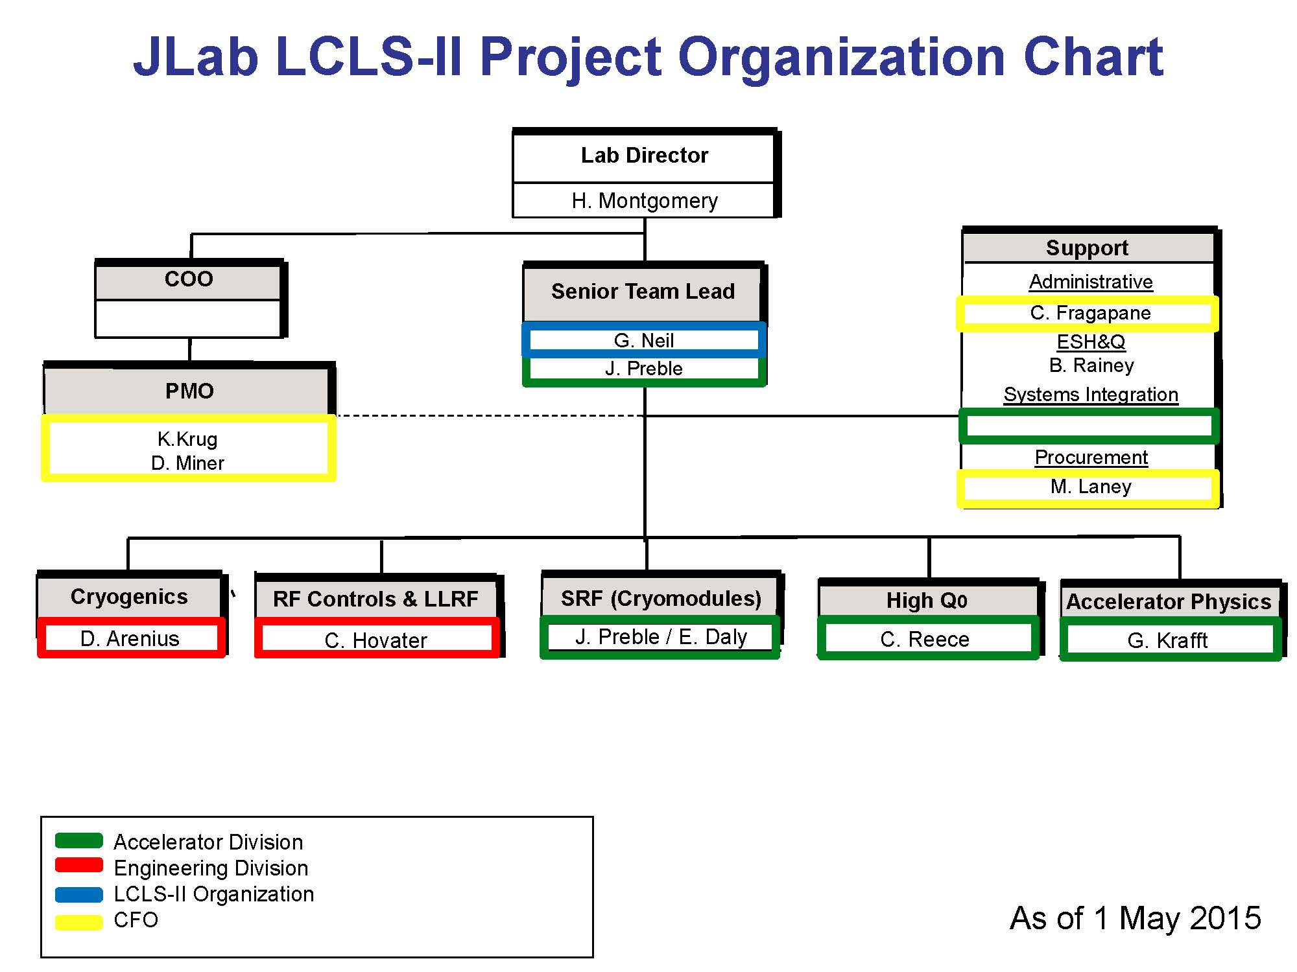
Jlab LCLS-II Org Chart

Slide 5
Project Status
Project is fully funded for FY15 and in submitted budget for FY16 (only $8M cut expected)
DOE CD3b Review April 6-9 including Independent Cost Review
  Submission to DOE approved for $180M in Long Lead Procurements necessary to keep project on track for (almost 1/3 of $180M LLP is JLab)
  Request includes second full CHL-II size cryoplant following first procurement by 9 months with delayed delivery due to obligation limits
Many cryomodule procurements included in approval request.
  Will start assembling prototype early September
  Infrastructure mods well underway
  Cavity award sent to winning vendors

Slide 6
CY15 Activities
Substantial SRF procurement activities
  Infrastructure mods awarded, most parts here
  SRF Cavities awarded, vendor effort underway
  Cryomodule components: many awards; most have prototype quantity delivery with option for production quantities
    Gate valves, flange hardware, feedthroughs, string bellows: awarded
    Tuners
    HOM absorbers
    Shipping frames

Slide 7
CY15 Activities
Other major SRF activities
  Horizontal Test Bed measurements, cavity hardware qualification
  Prototype Cryomodule assembly, process tooling, procedures, and documentation
Major cryoplant procurements
  4.5K Coldbox award at DOE for approval
  He Warm compressors
    Bids in evaluation
  Other Cryoplant major procurements: Cold compressors, controls, gas storage and purification, transfer lines, support conventional facility

Slide 8
Resource Usage by Fiscal Year
Level of effort similar to that required at JLab during 12 GeV CEBAF Upgrade in these systems
Additional cryoplant will add ~5 FTEs in 2018, 2019

Slide 9
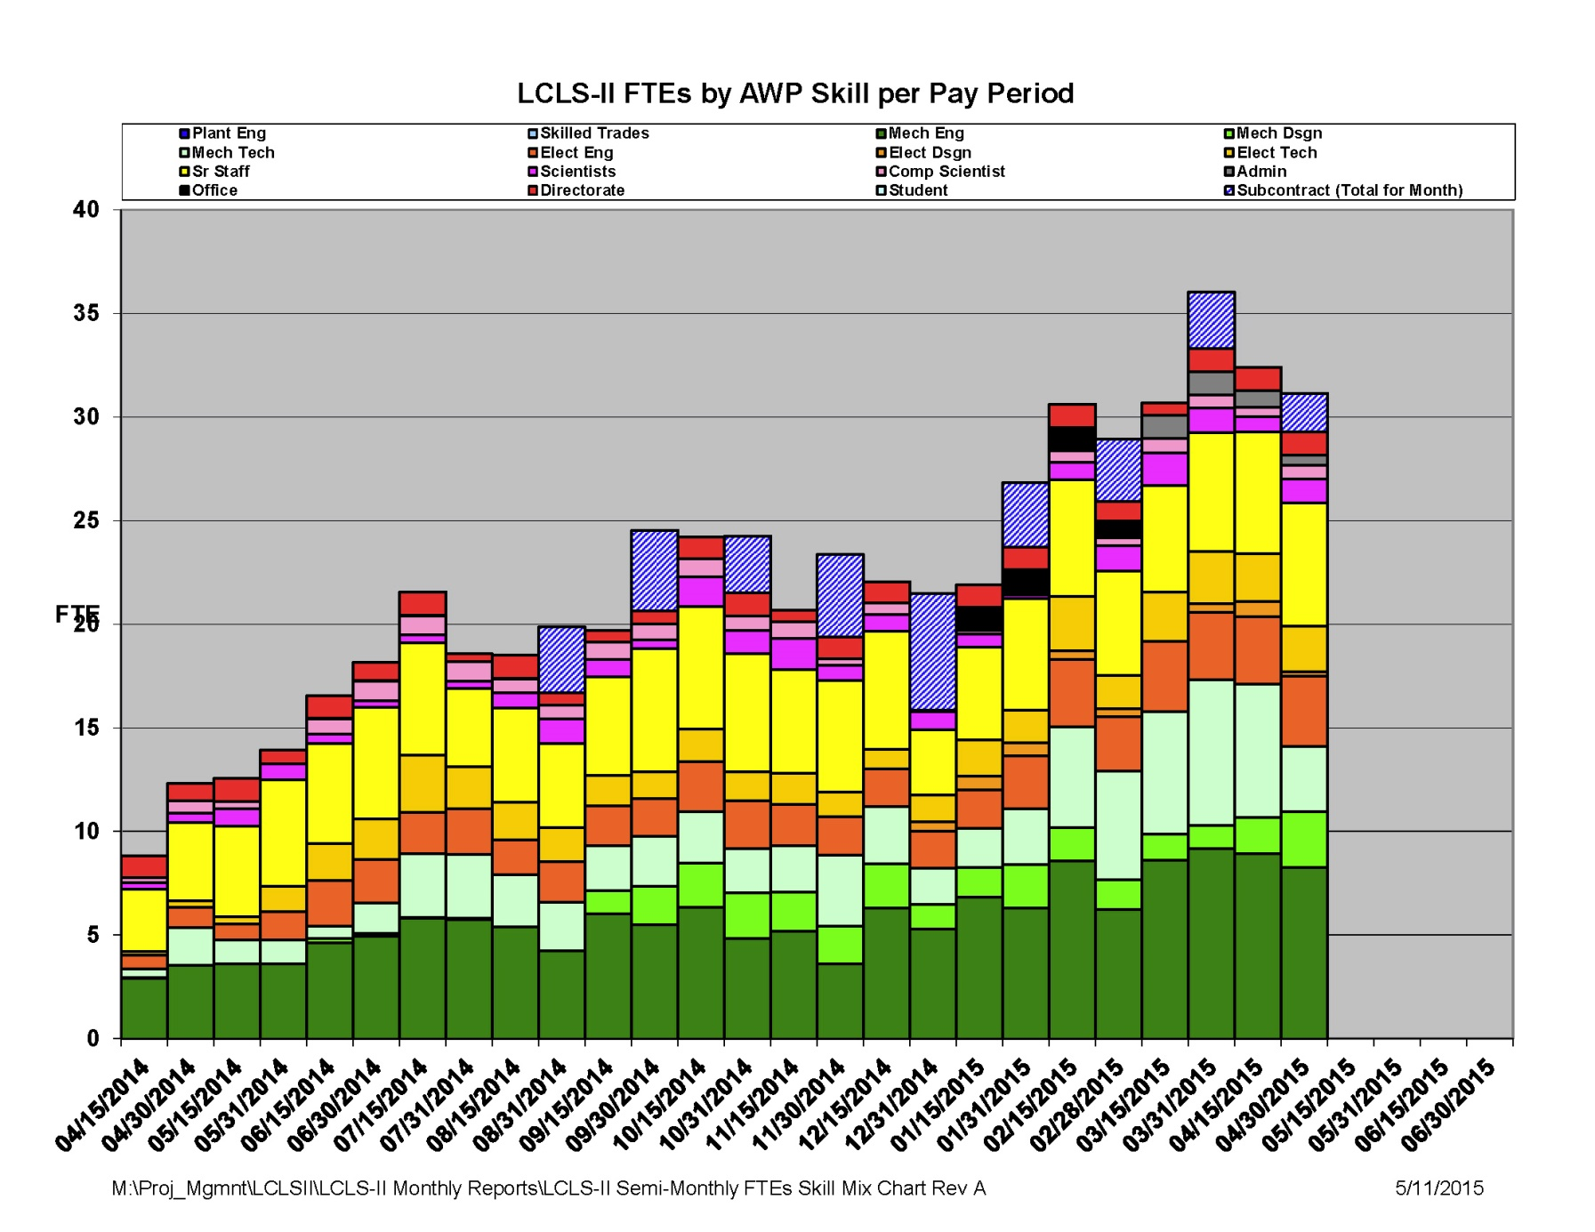
Labor Usage FY15
Will grow to about 50 heads

Slide 10
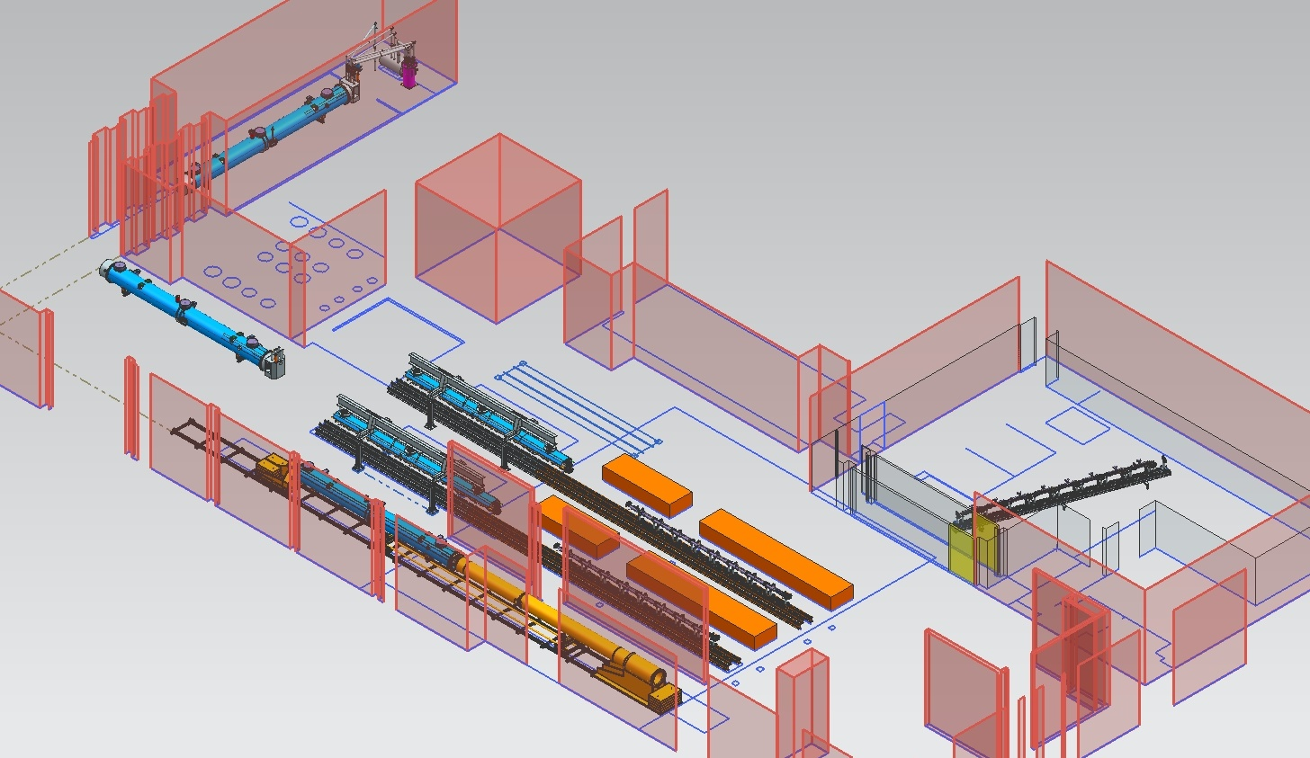
JLab Layout for LCLS-II CM Production
CM Testing
Phase II CM Assembly (2X)
Clean Room String Assembly
Phase I CM Assembly (2X)
Final Assembly / Prep for Testing
Vacuum Vessel Installation
LCLS II FAC 5-6 February, 2015

Slide 11
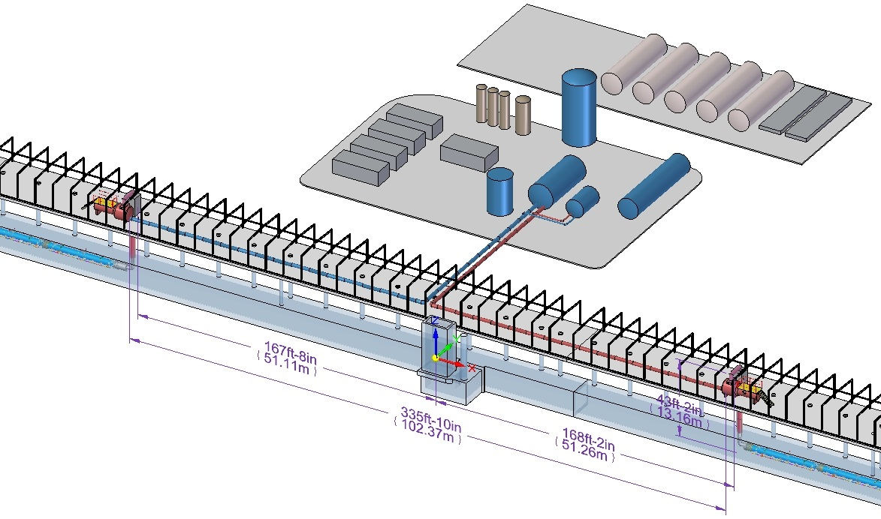
Cryoplant Schematic showing Cryogenic Distribution System (CDS)
Cryoplant 1.04.08 (JLab)
Helium Gas Storage Tanks
Upper 4.5K Cold Box
Oil Removal Skids
Warm Helium Compressors
Upstream Distribution Box
Lower 4.5K Cold Box
Helium Dewar
LN2 Tank
Lines B
2.0K Cold Compressor
Downstream Distribution Box
CDS 1.04.09 (Fermilab)

Slide 12
Upcoming Major Reviews
11-13 August 2015 Cryoplant process model development meeting @ JLAB
13-15 October 2015 Facility Advisory Committee
20-23 October 2015 Director’s CD-3 review
3-4 November 2015 DOE APM-ICE kickoff meeting
17-19 November 2015 DOE-APM-ICE drilldown
8-11 December 2015 DOE-OPA CD-2/3 review

Slide 13
Summary
LCLS-II Project offers JLab an opportunity to participate in a major SRF construction for BES applying and extending our expertise
  50% SRF accelerator
  Two CHL – size 4 kW @ 2K Helium refrigerators
A substantial fraction of the effort is in procurements and those are well underway
Staffing requirements are significant; manageable in SRF but stressing capabilities in cryogenics given commitment to 12 GeV and FRIB

