Slide 1
12 GeV CEBAF
Transverse Emittance
Todd Satogata

Slide 2
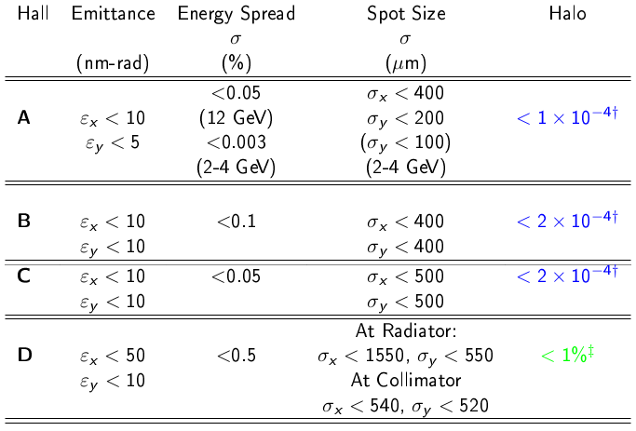
Initial Year’s Beam Requirements
5.0 pass, 11GeV requirements
5.5 pass
12GeV
Physics beam requirements transmitted to CASA in 2007.

Slide 3
12 GeV Transverse Emittance Evolution
End to end elegant simulations with mitigation (Treat as ideal case)
Region | [x10⁻³] | [nm] | [nm]
Chicane | 0.5 | 4.00 | 4.00
Arc 1 | 0.05 | 0.41 | 0.41
Arc 2 | 0.03 | 0.26 | 0.23
Arc 3 | 0.035 | 0.22 | 0.21
Arc 4 | 0.044 | 0.21 | 0.24
Arc 5 | 0.060 | 0.33 | 0.25
Arc 6 | 0.090 | 0.58 | 0.31
Arc 7 | 0.104 | 0.79 | 0.44
Arc 8 | 0.133 | 1.21 | 0.57
Arc 9 | 0.167 | 2.09 | 0.64
Arc 10 | 0.194 | 2.97 | 0.95
Hall D | 0.18 | 2.70 | 1.03
Adiabatic damping
dominated
Arcs 6-10 with optics
reconfigured from
FODO to DBA
Synchrotron radiation
dominated
Emittances are geometric
All quantities are rms
from Y. Roblin
Notes:
Note Hall D line: linac damping, vertical emit / vertical ramp
Note x4 margin in horizontal, x2 margin in vertical

Slide 4
Emittance/Optics Campaign Strategy
Incorporated into 12 GeV optics commissioning
  Measure in all (available) matching regions
  Single quad ➔ single wire scanner measurements
  Improve automation, model integration in 6 GeV tools
    Measurement/match: 6-8 hours (expert) ➔ 1 hour (operators)
Additional benefits
  Matching more systematic and consistent through CEBAF
    ➔ improved operational reproducibility, setup speed
  “Parasitic” beam emittance data from every scan/rematch
Note: following data is for 10.5 GeV CEBAF commissioning
Full 12 GeV commissioning this fall will have similar strategy

Slide 5
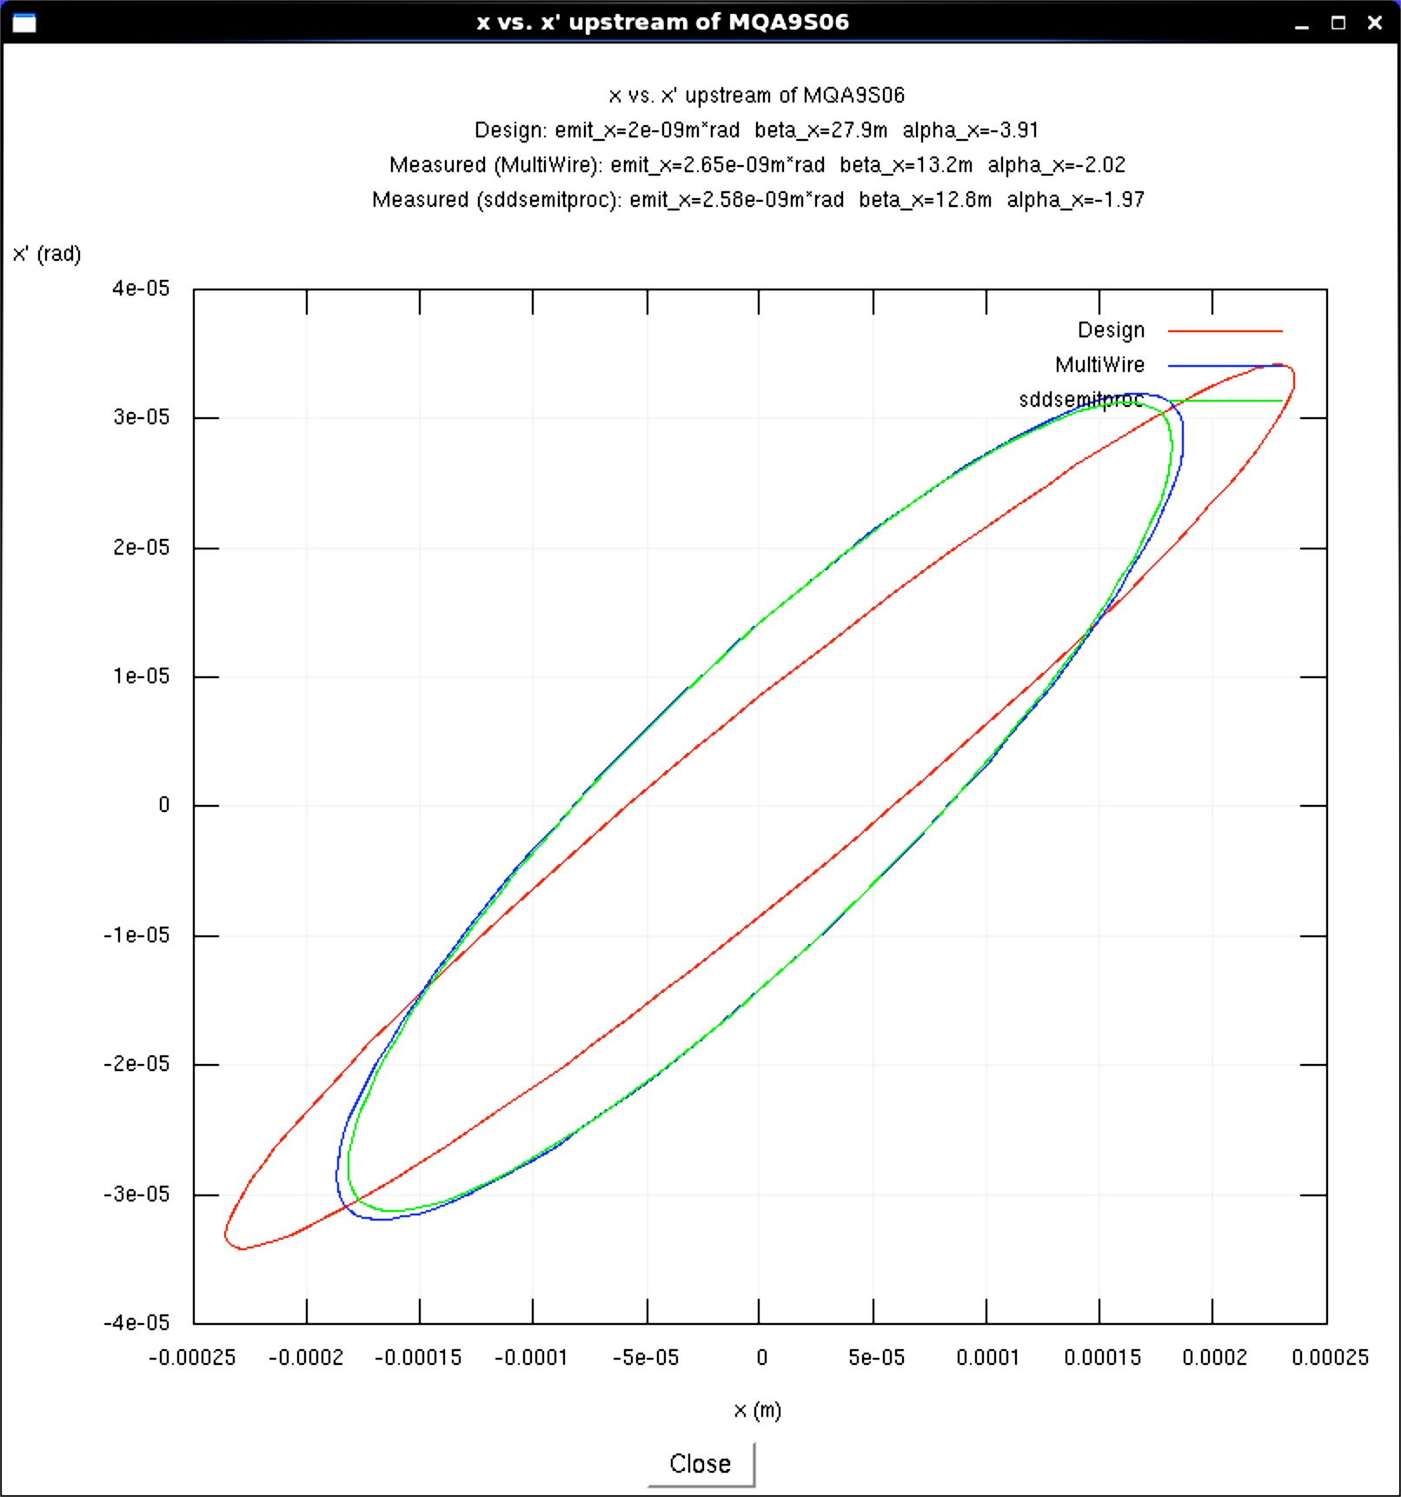
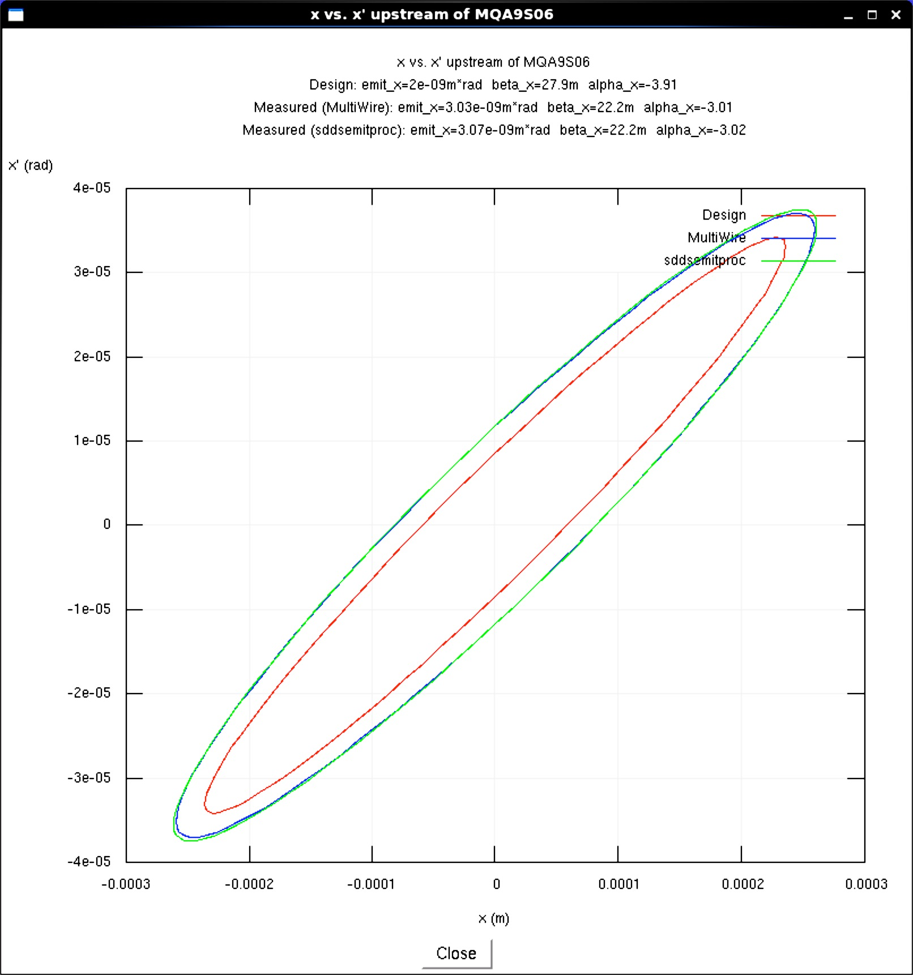
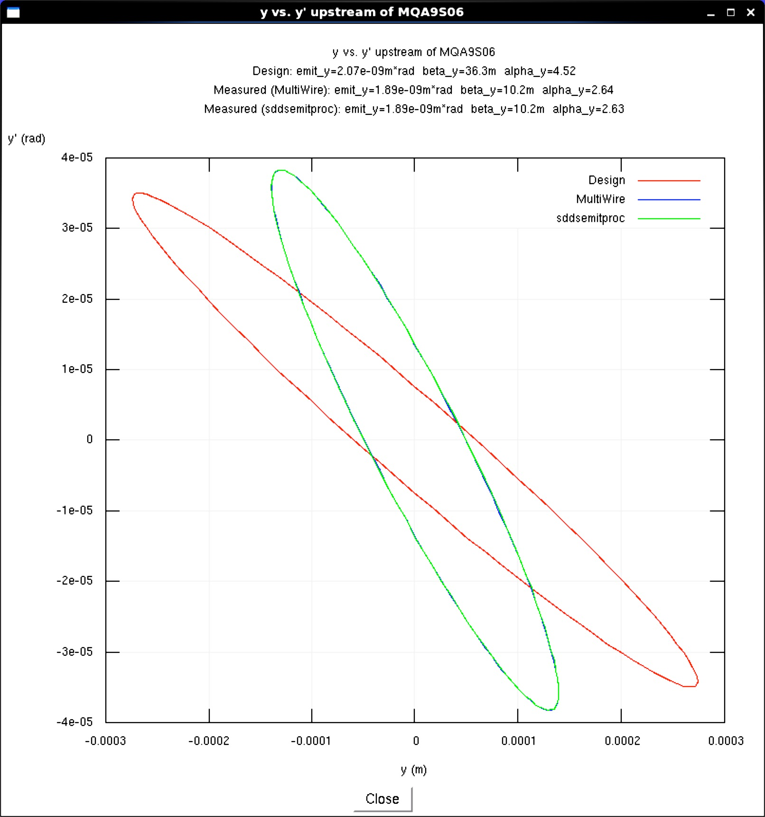
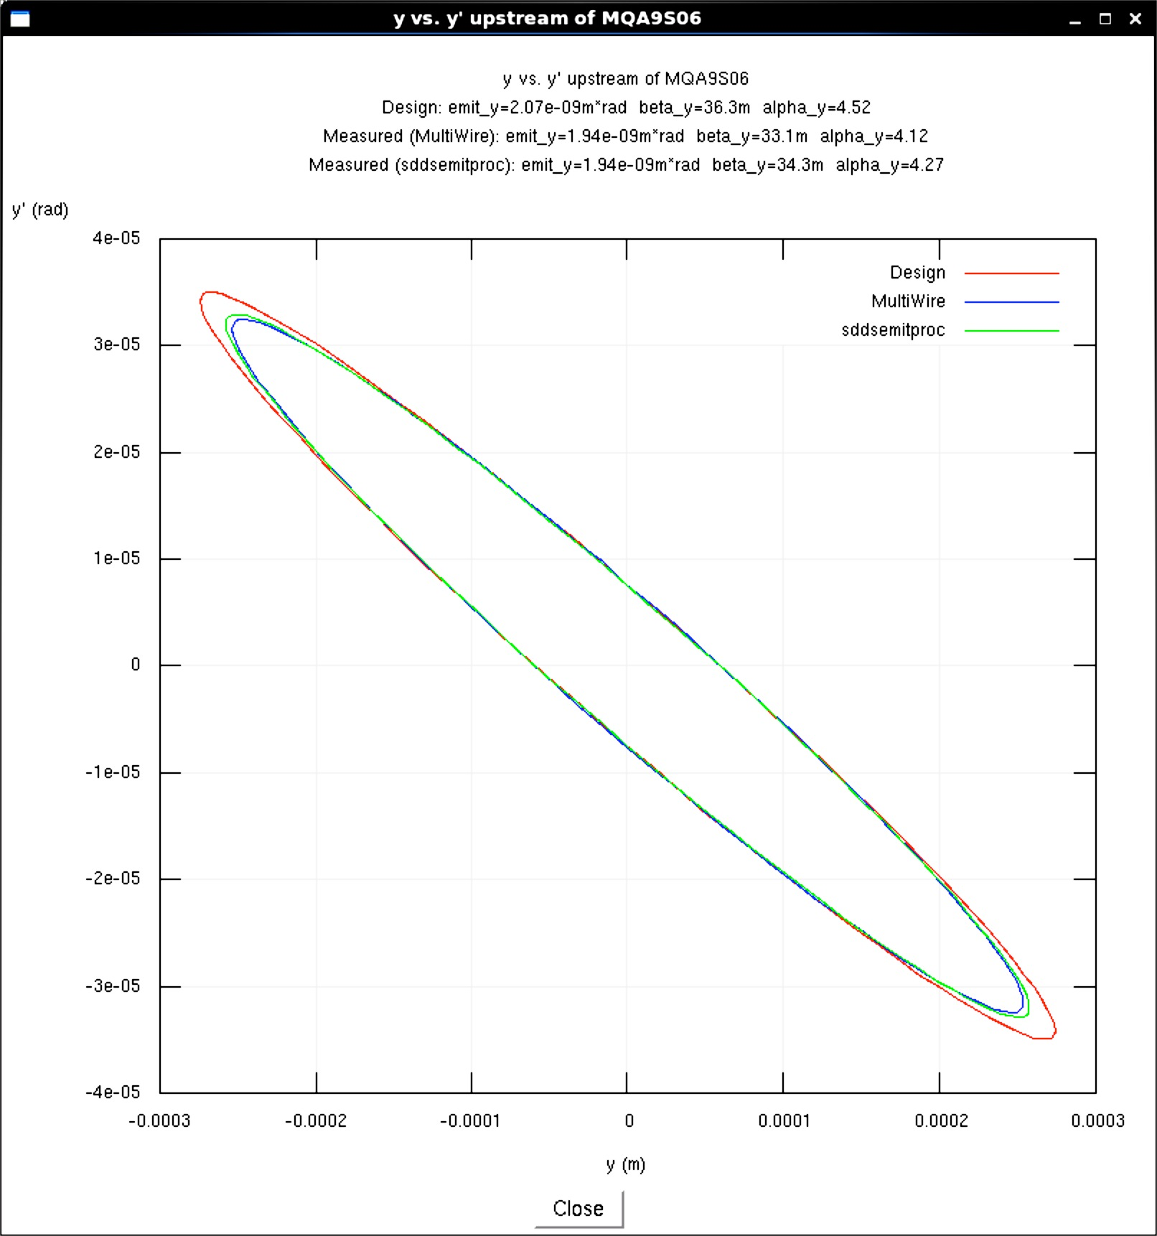
Model-Based Optics Rematch
Before match, as found
x’ [μrad]
x’ [μrad]
40
Horizontal
40
Horizontal
After match
All data plotted is the projected beam ellipse in (x,x’) at start of an upstream scanned quad
This data is for Arc 9 spreader
Blue and green ellipses are online model prediction
Red is measurement
Discrepancy in horizontal after match is only due to measured beam emittance being larger from expected design value
ε_{x}=2.6 nm-rad
ε_{x}=3.0 nm-rad
-40
250
-40
300
-250
x [μm]
-300
x [μm]
y’ [μrad]
y’ [μrad]
40
40
ε_{y}=1.9 nm-rad
ε_{y}=1.9 nm-rad
Vertical
Vertical
-40
300
-40
300
-300
y [μm]
-300
y [μm]

Slide 6
Spring 2015 10.5 GeV Measurements
All geometric rms values, [nm-rad]
Location | Simulated ε_{X} | Meas ε_{X} | Simulated ε_{Y} | Meas ε_{Y}
123 MeV | 4.0 | 2.5±0.9 | 4.0 | 1.9±0.6
Arc 1 | 0.41 | 0.43±0.04 | 0.41 | 0.32±0.05
Arc 2 | 0.26 | 0.50±0.10 | 0.23 | 0.31±0.10
Arc 3 | 0.22 | 0.63±0.05 | 0.21 | 0.72±0.07
Arc 4 | 0.21 | 0.81±0.07 | 0.24 | 0.65±0.10
Arc 5 | 0.33 | -- | 0.25 | --
Arc 6 | 0.58 | 0.48±0.05 | 0.31 | 0.66±0.04
Arc 8 | 1.21 | 1.1±0.1 | 0.57 | 1.0±0.1
Arc 9 | 2.09 | 3.1±0.2 | 0.64 | 1.9±0.3
Arc 10 | 2.97 | 2.4±0.3 | 0.95 | 1.7±0.4
Hall D | 3.0 | 5.16 | 1.19 | 2.64
Coupling?
Wire scanner not installed in Arc 7 in spring 2015; reinstall for fall 2015
Wire scanner in Arc 5 in disrepair, to be repaired summer 2015

Slide 7
Emittance Measurements vs Requirements
All measurements performed at 10.5 GeV 5 pass configuration
  Measurements at 12 GeV planned for Fall 2015
A,B,C emittances inferred from measurements in the 5th pass extraction line, AE region. This is input to hall transport lines.
D emittances measured in the Hall-D transport line.
All measurements on March 23rd 2015.
 | Measured ε_{x} (nm) | Requirement ε_{x} (nm) | Measured ε_{y} (nm) | Requirement ε_{y} (nm)
AE (A,B,C) | 2.4 | <10 | 1.7 | <5
5C (D) | 5.2 | <50 | 2.6 | <10
A. Freyberger

Slide 8
Energy Spread vs Requirements
Energy spread measurements on 5th and 5.5 pass beams have not been performed to date.
Plan to measure Fall 2015 at full energy.
Energy spread on 5th pass will be dominated by synchrotron radiation.
  Expect o(1-10)x10⁻⁴
 | σE_{synch} (MeV) Expected | σE_{RF} (MeV) Worst case | σE_{combined} (MeV) Expected | σE/E (%) Expected | σE/E (%) Requirement
A,B,C | 1.6 | 0.6 | 1.7 | 0.015 | <0.05
D | 2.0 | 0.7 | 2.1 | 0.017 | <0.5
A. Freyberger

Slide 9
Beam Size vs Requirements
 | σ_{x} (μm) Measured | σ_{x} (μm) Requirement | σ_{y} (μm) Measured | σ_{y} (μm) Requirement | Date
A(5-pass) | 520 | <400 | 640 | <200 | 2015-Mar
A(2-pass) | 160 | <400 | 170 | <200 | 2015-April
B | 300 | <400 | 40 | <400 | 2015-May
D | 1000 | <1550 | 780 | <550 | 2015-Mar
A&D beam lines were in the process of setup and optimization at the time of the 2015-Mar measurements.
A. Freyberger
9

Slide 10




Initial Year’s Beam Requirements
A. Freyberger
5.0 pass, 11GeV requirements
5.5 pass
12GeV
Demonstrated at 10.5GeV setup March 2015
Demonstrated at 5.5GeV setup, Hall-A 2-pass April 2015
Not yet verified, but CEBAF energy spread dominated by synchrotron radiation

Slide 11
Summary
12 GeV CEBAF transverse emittance dominated by synchrotron radiation in higher-pass arcs
  Was (somewhat) mitigated with FODO ➔ DBA optics
  Will explore full impact with new optics in Fall 2015
Optics matching and emittance program combined
  Efficient, mature, reproducible to support physics program
Measurements, theory, simulations are consistent
  Within margins to meet program goals at 10.5 GeV
  Full 12 GeV optics commissioning in Fall 2015
    Including energy spread
    Fully expect to meet 12 GeV program goals for all halls

