Slide 1
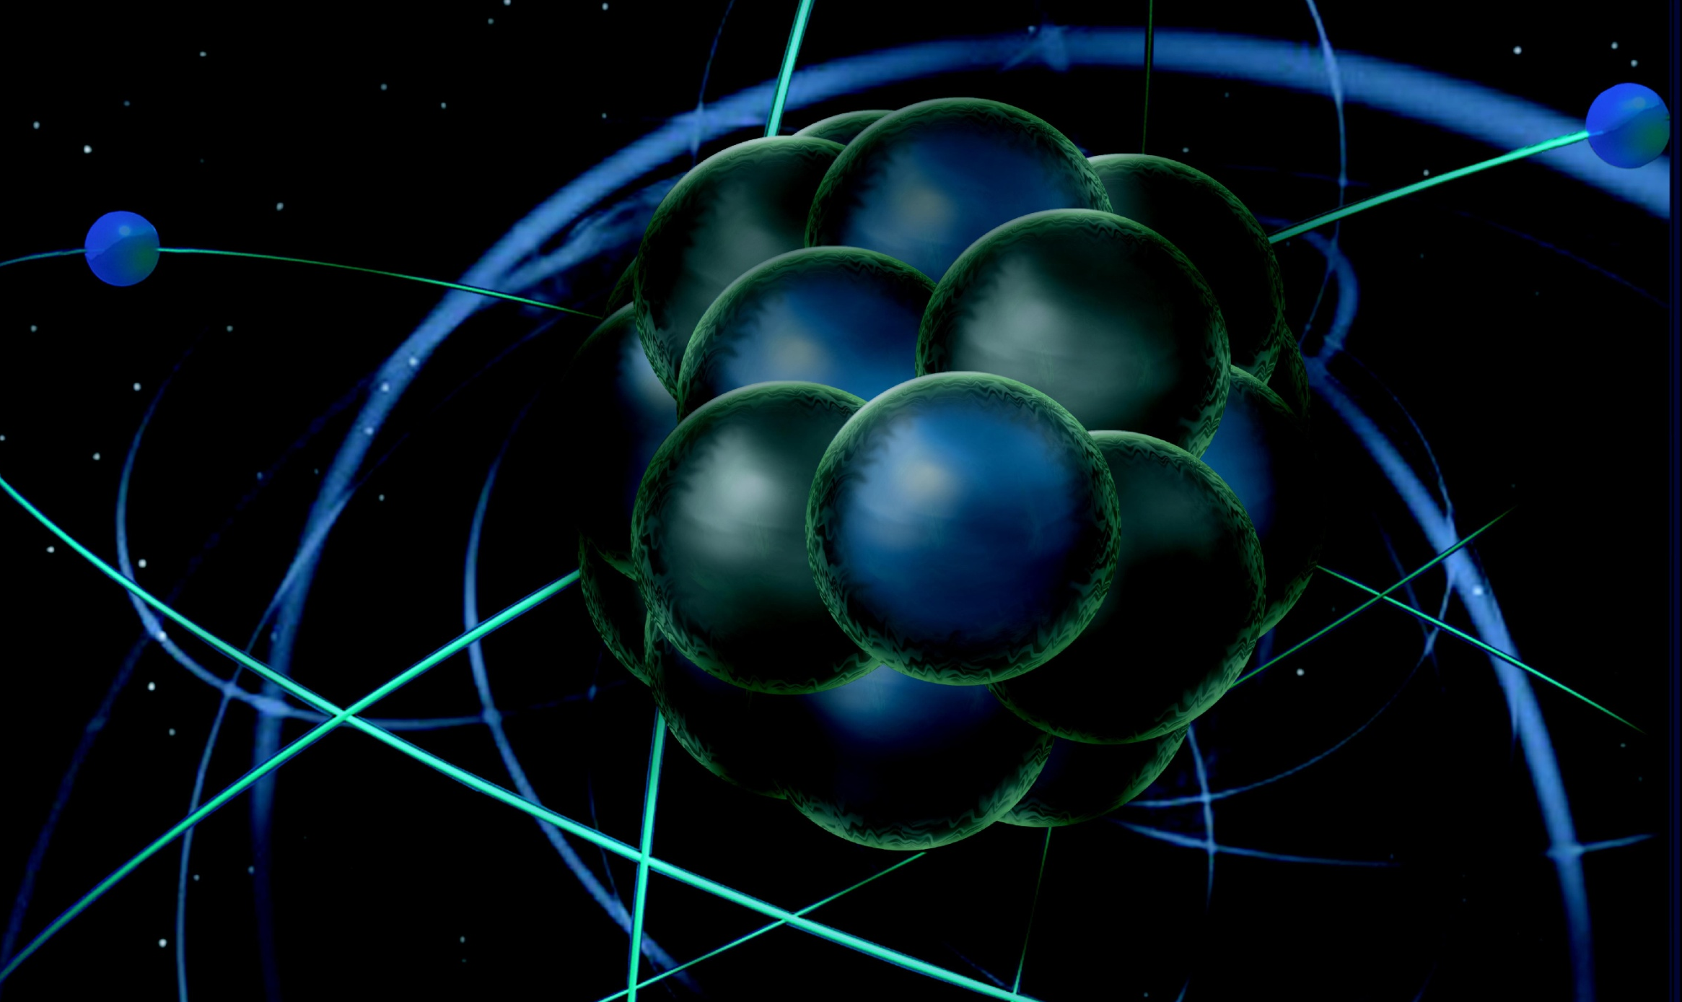
Status of Polarimeters and Polarized Targets: what are the plans for development of polarized targets to meet the needs of the Day 1 and future experimental physics program?

Slide 2
Answer to the question
”Discuss in accelerator breakout: Status of polarimeters and polarized targets; what are the plans for development of polarized targets to meet the needs of the Day 1 and future experimental physics program?”
Day 1: we don’t have any experiments requiring polarized target
Earliest Experimental program that needs polarized targets:
Hall A high-luminosity polarized ³He target: FY19 (maybe FY18)
Hall B Longitudinally NH₃/ND₃ polarized target: FY19
Hall C polarized target: polarized ³He target FY19
Hall D polarized target: not in the program so far
Status of polarimeters and polarized targets – next slides

Slide 3
Hall C – Polarimetry during Qweak
Compton polarimetry uncertainty: 0.59%, Moller polarimeter uncertainty: 0.85%

Slide 4
Hall C – Polarimetry @ 12 GeV
Compton polarimetry uncertainty as determined during Qweak experiment: 0.59%
Limitation due to data acquisition and background → we believe we can reach well below 0.5% and aim for 0.4% (see next slide)
Moller uncertainty dominated by current extrapolation (Moller measurements only possible at low beam currents) - also some Levchuk effect, beam position, target polarization.
Current extrapolation remains main issue: one test during Qweak was a direct comparison of Compton and Moller at low currents. This was limited by Compton statistics to about 1%. With more time investment we can improve.
Present status: bad Moller (quadrupole) magnet coil has been replaced and two Moller magnets refurbished.
Expectation is that with Halls A and C having similar polarimetry, and by comparing systems with each other, we can reach the required polarimetry needs of MOLLER and SoLID with the Compton

Slide 5
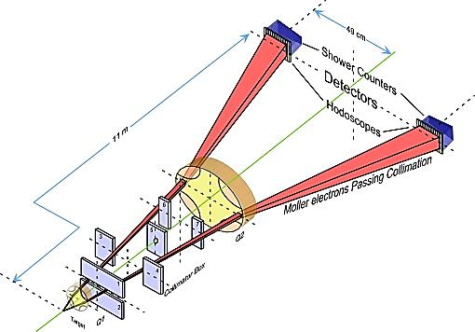
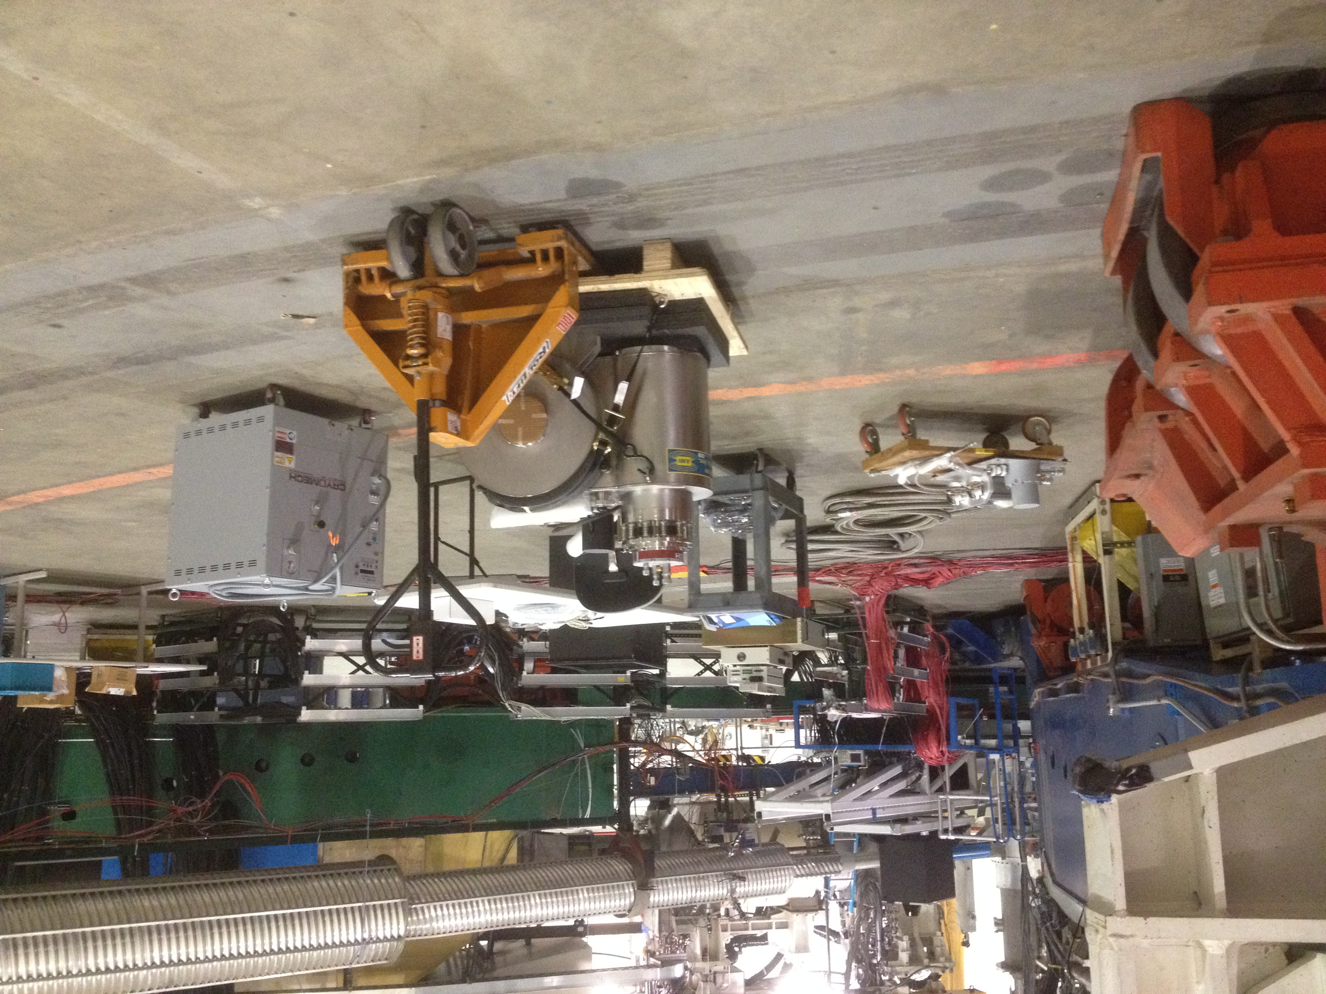
Precision Polarimetry in Hall A - MOLLER, SOLID require precision ≤ 0.5%
Qweak achieved design goal of ΔP/P ≤ 1%
Larger analyzing power at higher energy, ΔP/P < 0.5% within reach at 11 GeV
Strategy: use 2 independent polarimeters
Existing < 1% Hall C Møller polarimeter:
- Low beam currents, invasive.
- Known analyzing power provided by Fe foil in a 3.5 T field
- Create duplicate capability in Hall A (Temple, Kharkhov), new magnet at JLab
Compton polarimetry, new developments and recent running:
- Continuous, non-invasive.
- New high-gain optical cavity for improved resolution and analyzing power
- Diamond microstrip detectors (Qweak)
- Integrating photon analysis (PREX)

Slide 6
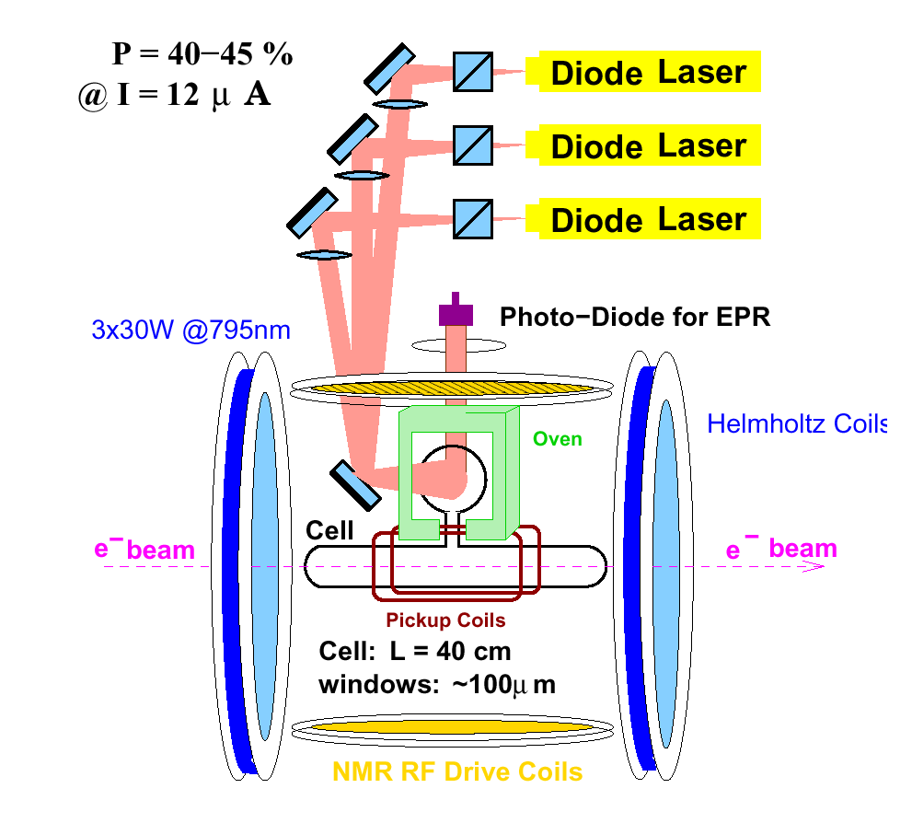
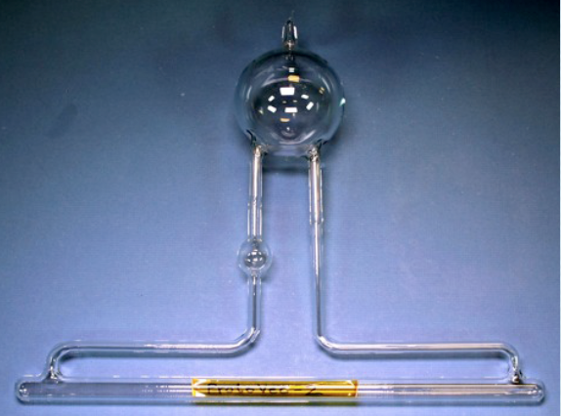
Hall A/C: Polarized ³He Target
 | Stage I | Stage II
Current | 30 μA on 40 cm | 60 μA on 60 cm
Luminosity | L ~ 2.2x10³⁶ cm⁻²s⁻¹ | L ~ 6.6x10³⁶ cm⁻²s⁻¹
Polarization | ~60% | ~60%
Cell | Glass cell | Glass cell metal window
 | convection gas flow pumping chamber 3.5” | convection gas flow pumping chamber 4.4”
Polarimetry (~ 3%) | Pulse NMR/AFP NMR | Pulse NMR/AFP NMR
Hall A/C compatibility | Significant engineering needed to fit into Hall C | Large gradient from SBS fringe field ➔ Magnet shield box
Experiments | A₁^{n} Hall A d₂^{n} Hall C | A₁^{n} Hall C G_{E}^{n} Hall A
“High Impact” Exp.”
JLab CE projects includes:
Stage I) Lasers, optical fibers from laser house to Hall C, NMR for polarization measurements
Stage II) mechanical work to modify for a higher-FOM target
UVA/W&M : developing target cell, filling target cell, contribution to precision polarimetry
UVA convection gas cell successfully tested

Slide 7
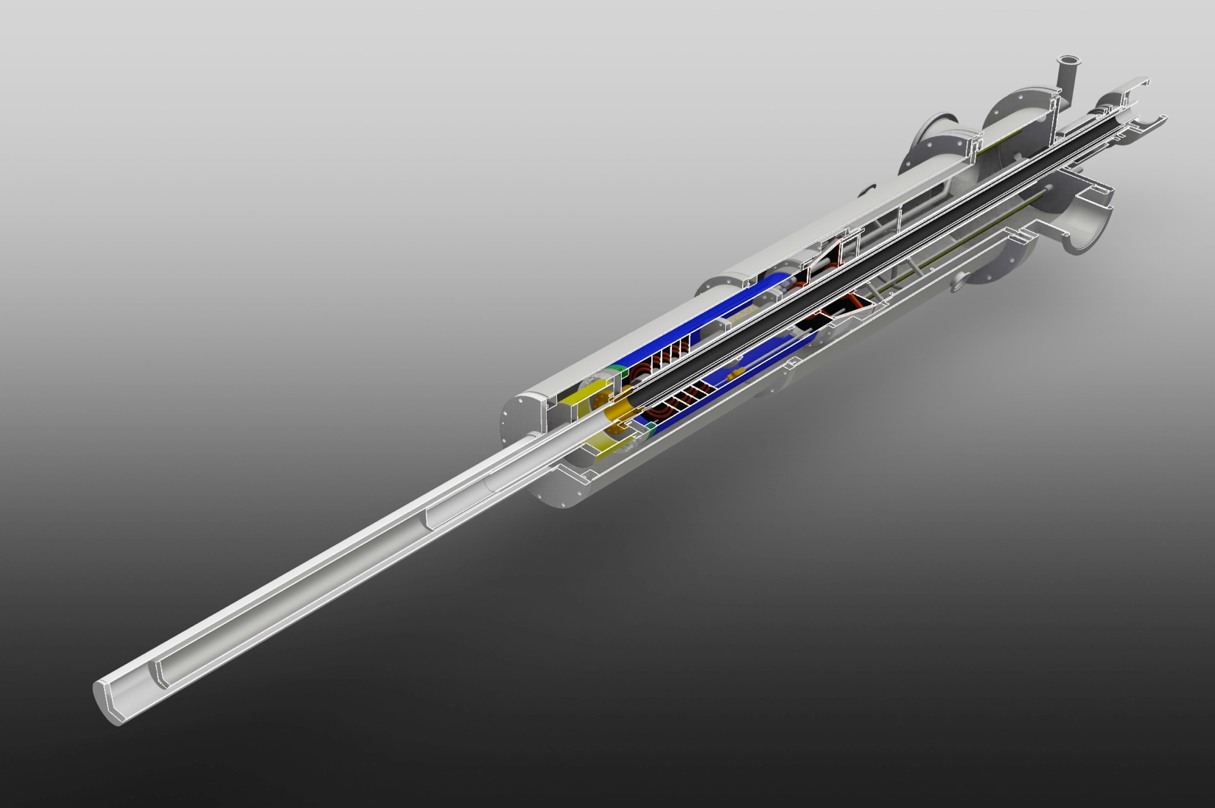
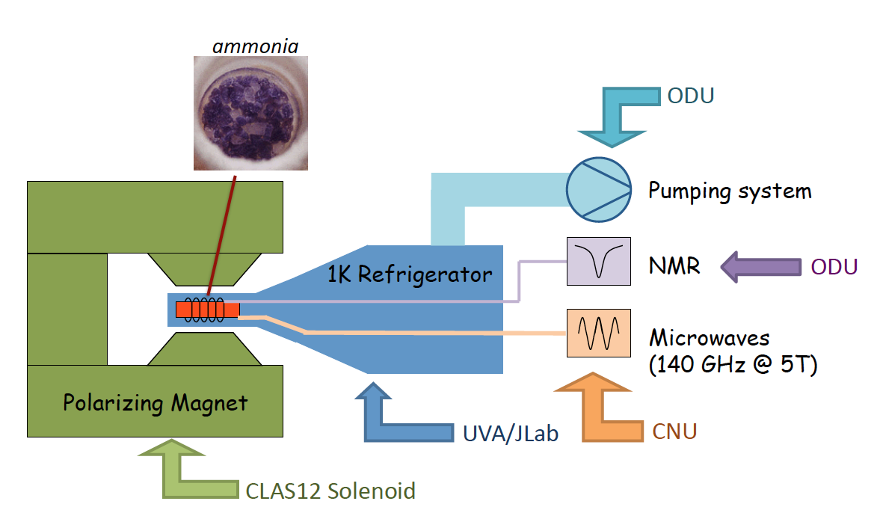
Hall B – Long. Polarized Target
DNP polarized NH₃ /ND₃ using the 5T magnetic field of the CLAS12 solenoid as a holding field
The base target components are developed with an NSF/MRI grant by ODU/CNU/UVA
It will serve 5 approved experiments (240 PAC days)
Target design highly modular ➔ either single or double cells (with opposite pol.) can be utilized with little or no modification to the rest of the system
Expected polarization:
≥ 90% (p); ≥ 40% (d)
Electron beam current operation up to 30 nA.
JLab CE project: infrastructure to integrate the target into CLAS12 + design and engineering of the cryogenic system
Status
Procurement of microwave, NMR, and pumping systems is complete (NSF/MRI)
Construction of outer vacuum chamber is complete
Design of refrigerator is 75% complete
Estimated completion date Spring 2017
7

Slide 8
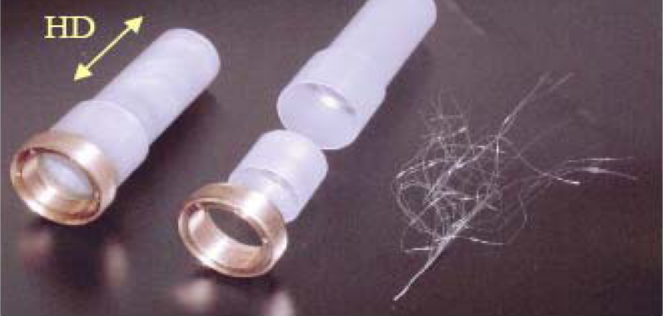
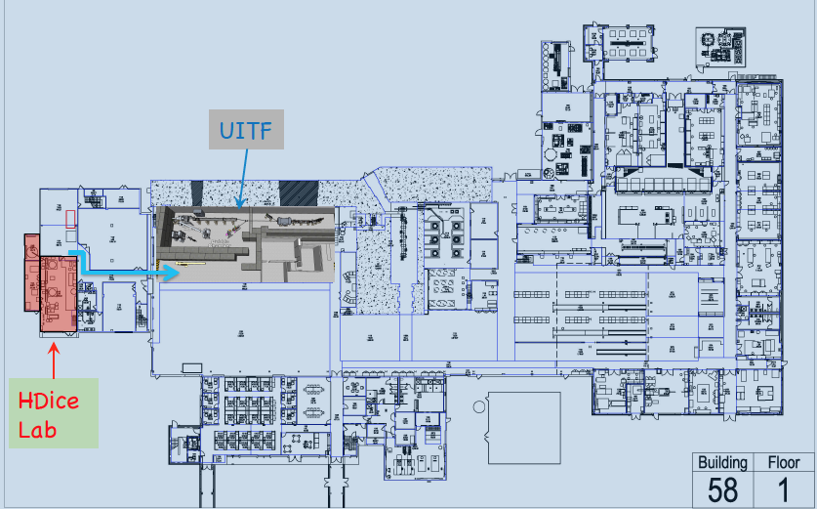
Hall B – HDice Target for transverse config.
Solid HD material placed into a frozen spin state
- requires only modest (~1 T)•short (~15 cm) field
to hold spin in-beam ➔ minimizes sheet of flame
Operating performance with electrons beams requires further beam tests ➔plan to use upgrade of the injector test facility: E_{e} =5 – 10 MeV (~10 MeV beam will test the HD performance at 11 GeV!)
It will serve three C1 approved “High Impact” Experiments
JLab CE project: modifications required to operate the target in transverse polarization mode in the CLAS12 Solenoid, whose strong long. magnetic field must be locally repelled.
Status of ongoing work:
Transport design for 10 MeV rastered ITF beam
R&D for a new “passive” SC diamagnetic shield
to hold spin transverse to beam within solenoid
Improving NMR system for target polarization
measurement
• Design and build new HD gas purification factory
8

