Slide 1





IN CASE OF AN EMERGENCY – F113
Exit the Building for Fire
Take Cover: Severe Weather
Shelter in
Place
Lockdown:
Secure Room
After exiting the room,
find the nearest exterior
door to exit the building.
Stay in F113, or the
F-wing hallway for tornado or severe weather.
Remain in F113. Close all doors and await further instruction until an all
clear message is issued.
Secure F113 against human threat where personal safety is concerned. A lockdown may be associated with the action of Run-Hide-Fight.
Follow actions until receiving an “All Clear” message.

Slide 2


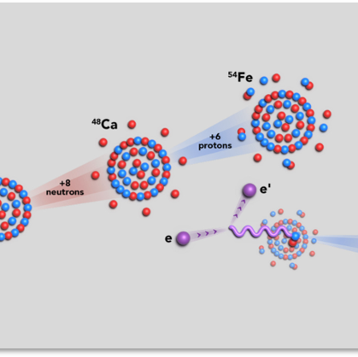
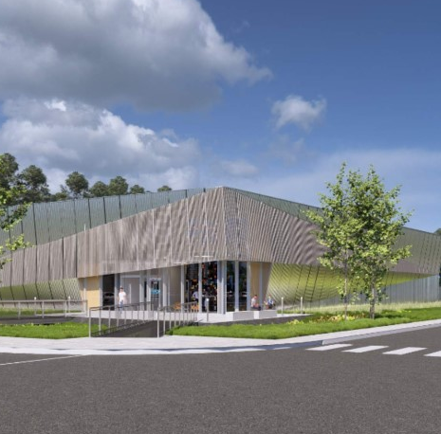
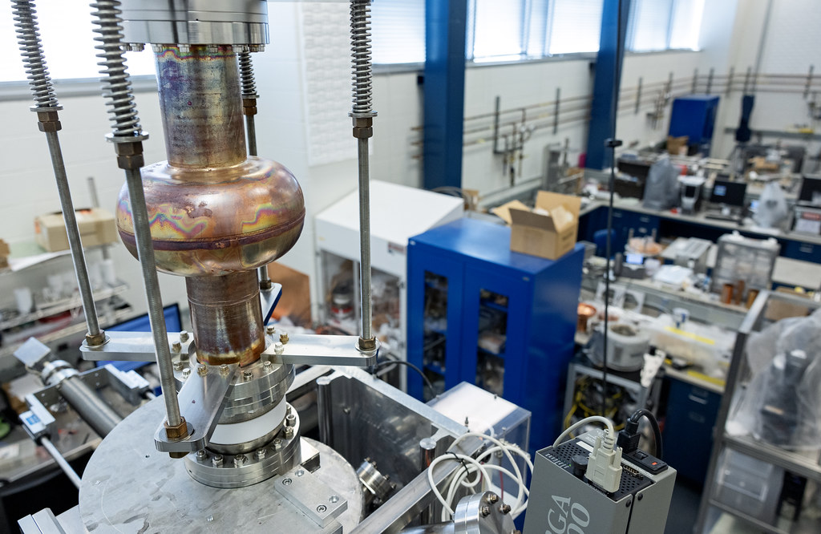



Leading in Nuclear Physics.
Welcome to Jefferson Lab
Driving Data Science and Computing.
Eric Brown, Ph.D.
Deputy Director for S&T & Chief Research Officer
September 16, 2026
Enabling applications for energy and technologies.

Slide 3







Eric Brown
Chief Research Officer / Deputy Director, S&T
22 years of S&T leadership and management experience.
Co-led Nuclear & Particle Futures at LANL.
Fellow of both the American Physical Society and the Society for Experimental Mechanics.
Led 500+ staff across 6 divisions; supported 700 users annually and oversaw a $200M budget.
Led the $1B LANSCE Modernization
Project to achieve CD-1 approval.
3

