Slide 1

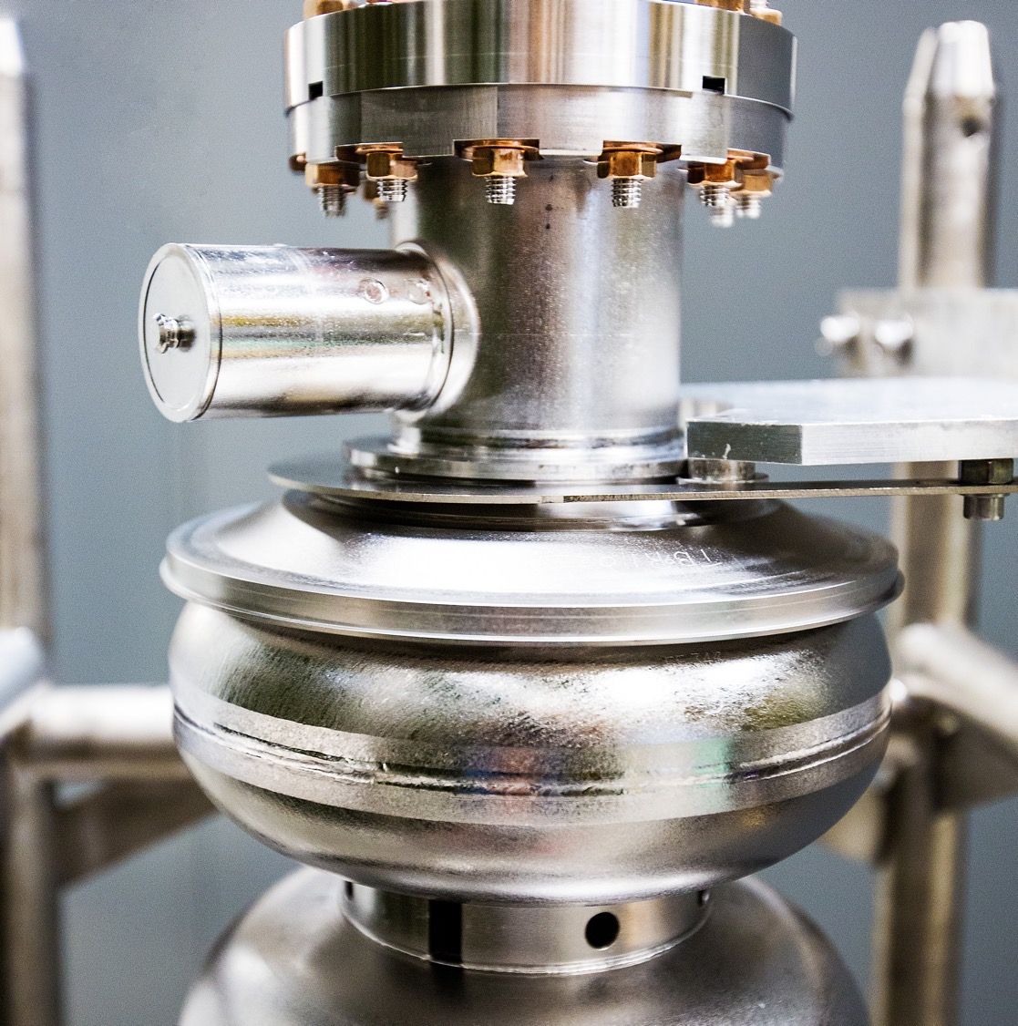
Developments in LLRF control of SRF Cavities
LDRD Program Review Meeting
Jefferson Lab
16 September 2026
Peter Owen
The research described in this presentation was conducted under the Laboratory Directed Research and Development Program at Thomas Jefferson National Accelerator Facility for the U.S. Department of Energy.
powen@jlab.org
Notes:
Tip: Keep titles under 60 characters for readability
To change the photo: Right-click on photo and select change photo

Slide 2
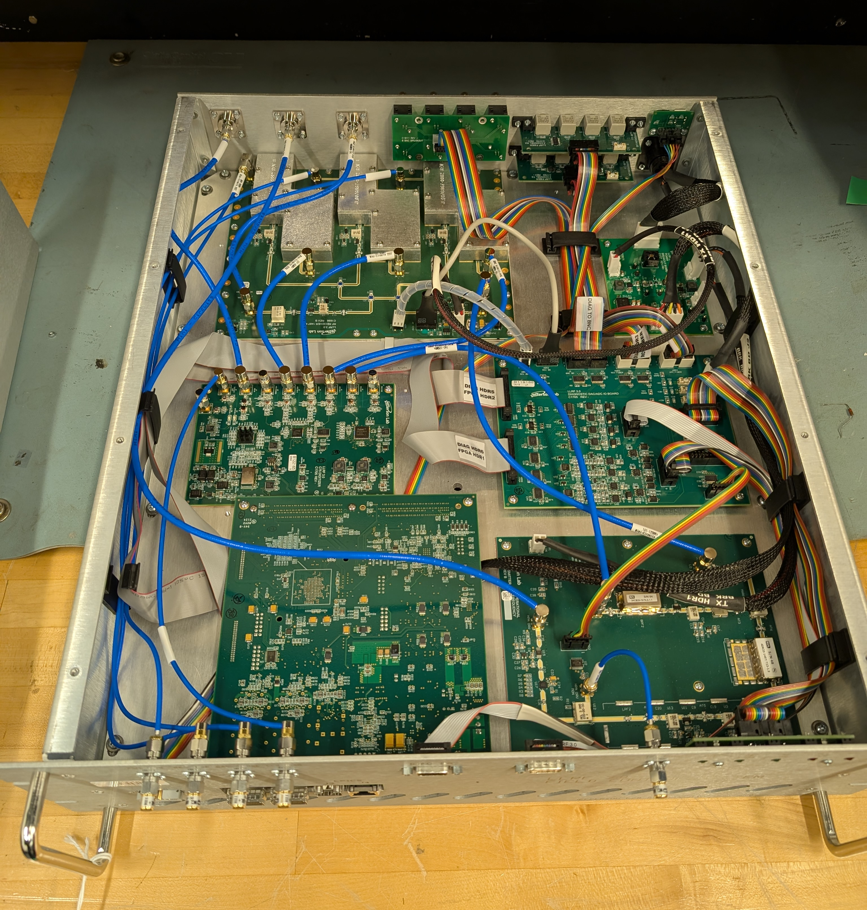
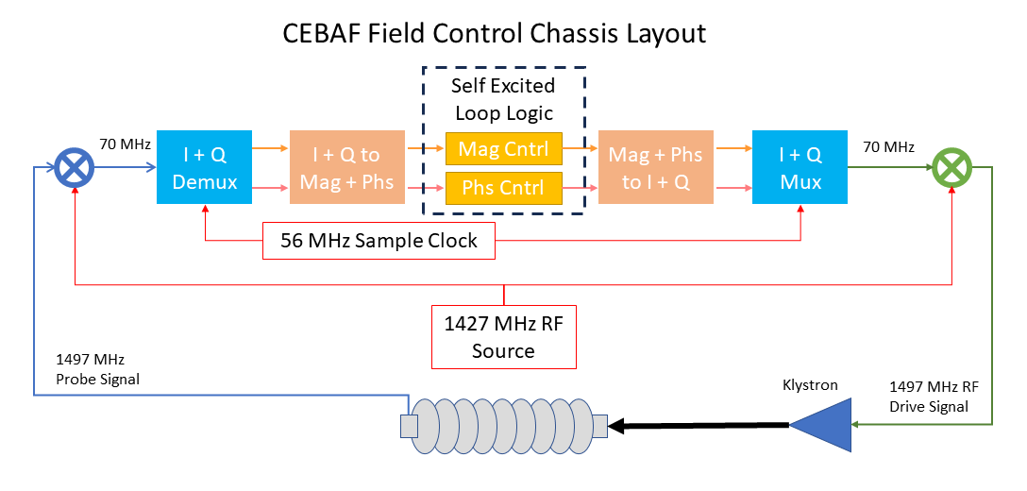
RF Control Systems
LDRD project for FY 25/26 to develop new LLRF control and measurement methods
Perform measurement and control of RF signals to and from cavity
CEBAF FPGA, tuned for one frequency of operation
Connections and interlocks to external systems (tuners, RF permit, master oscillator, EPICS)
FPGA Performs Self Excited Loop controls
  Regulation of Amplitude and Phase (SELAP)
  Other control modes (SEL, Pulse)
Excellent LLRF system at CEBAF, contributing to record machine uptime
LLRF control and measurement systems in CEBAF
Notes:
Guidelines: 6-8 bullets per slide; Use sentence fragments for bullets
To change the photo: Right-click on photo and select change photo

Slide 3
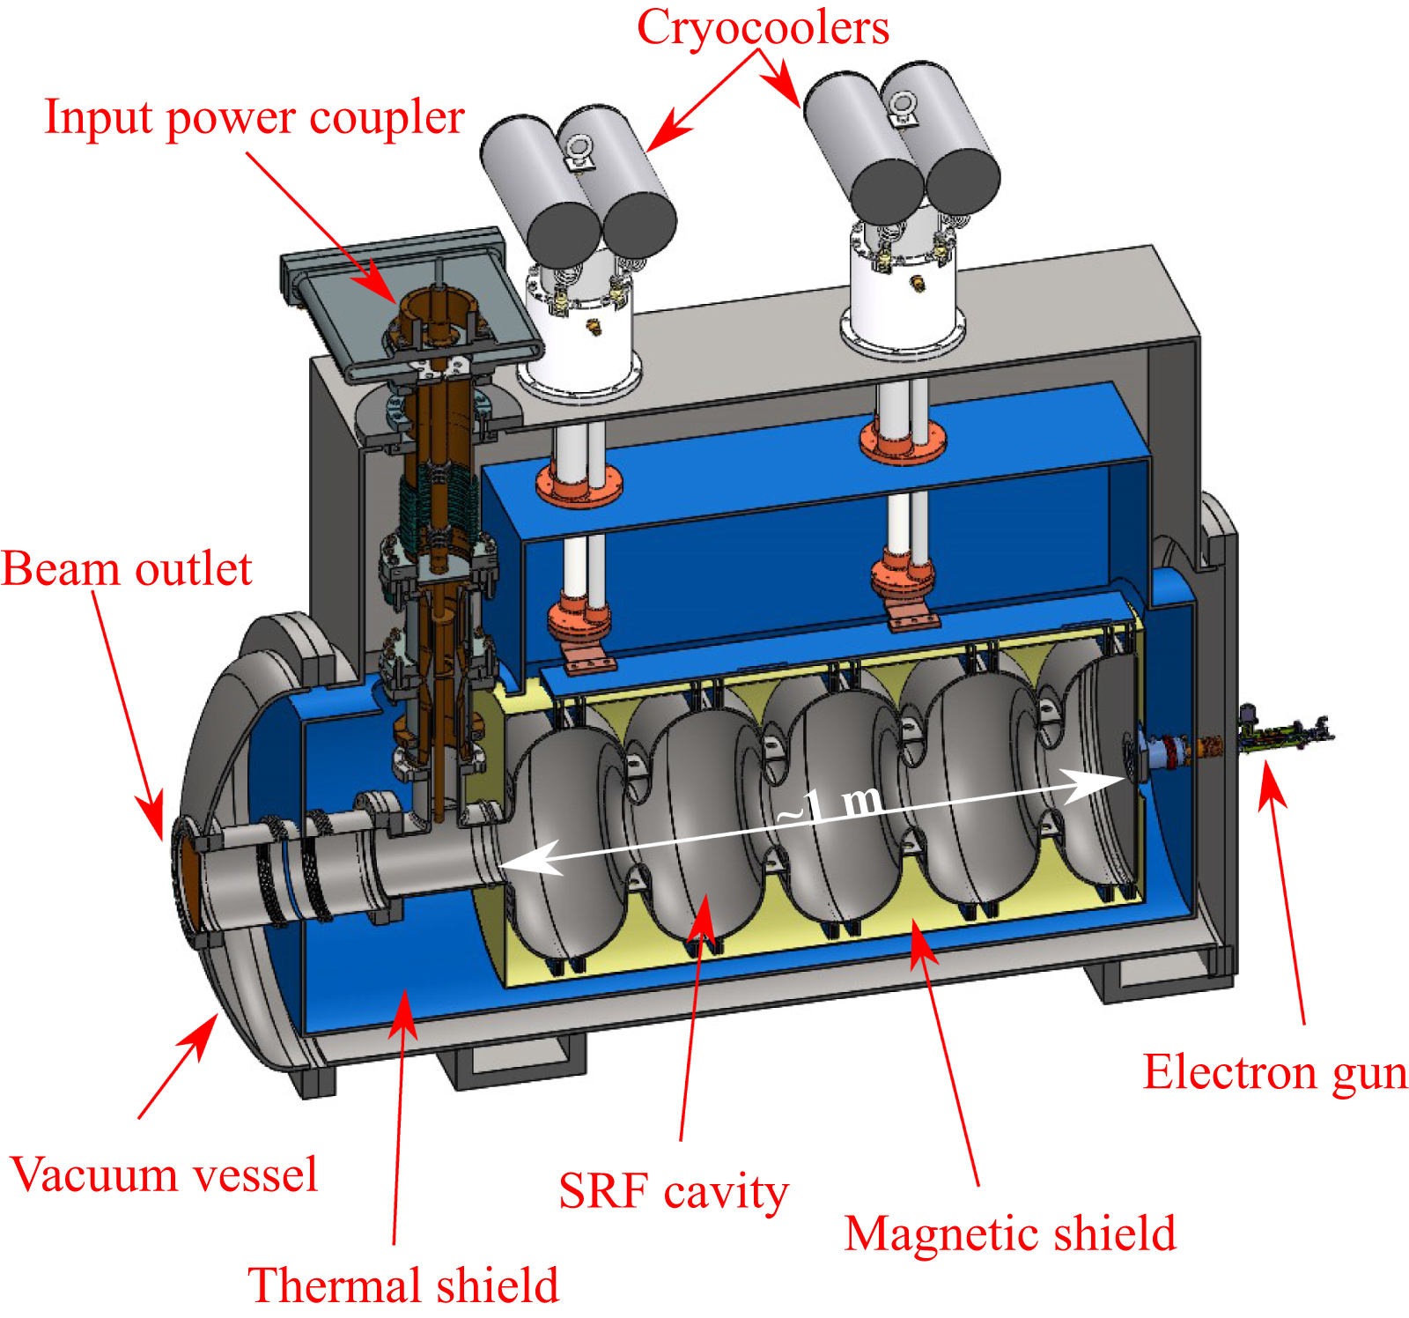
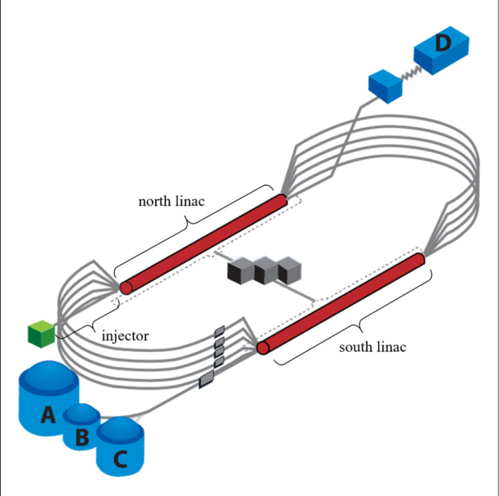
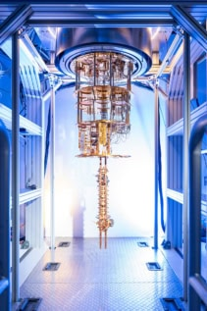
New Applications of SRF
Compact, Conduction-Cooled Accelerator
High-Energy Physics
Quantum Physics
https://www.agilent.com/en/solutions/vacuum-solutions/particle-plasma-physics/particle-accelerators
https://sqmscenter.fnal.gov/
Notes:
Guidelines: 6-8 bullets per slide; Use sentence fragments for bullets
To change the photo: Right-click on photo and select change photo

Slide 4
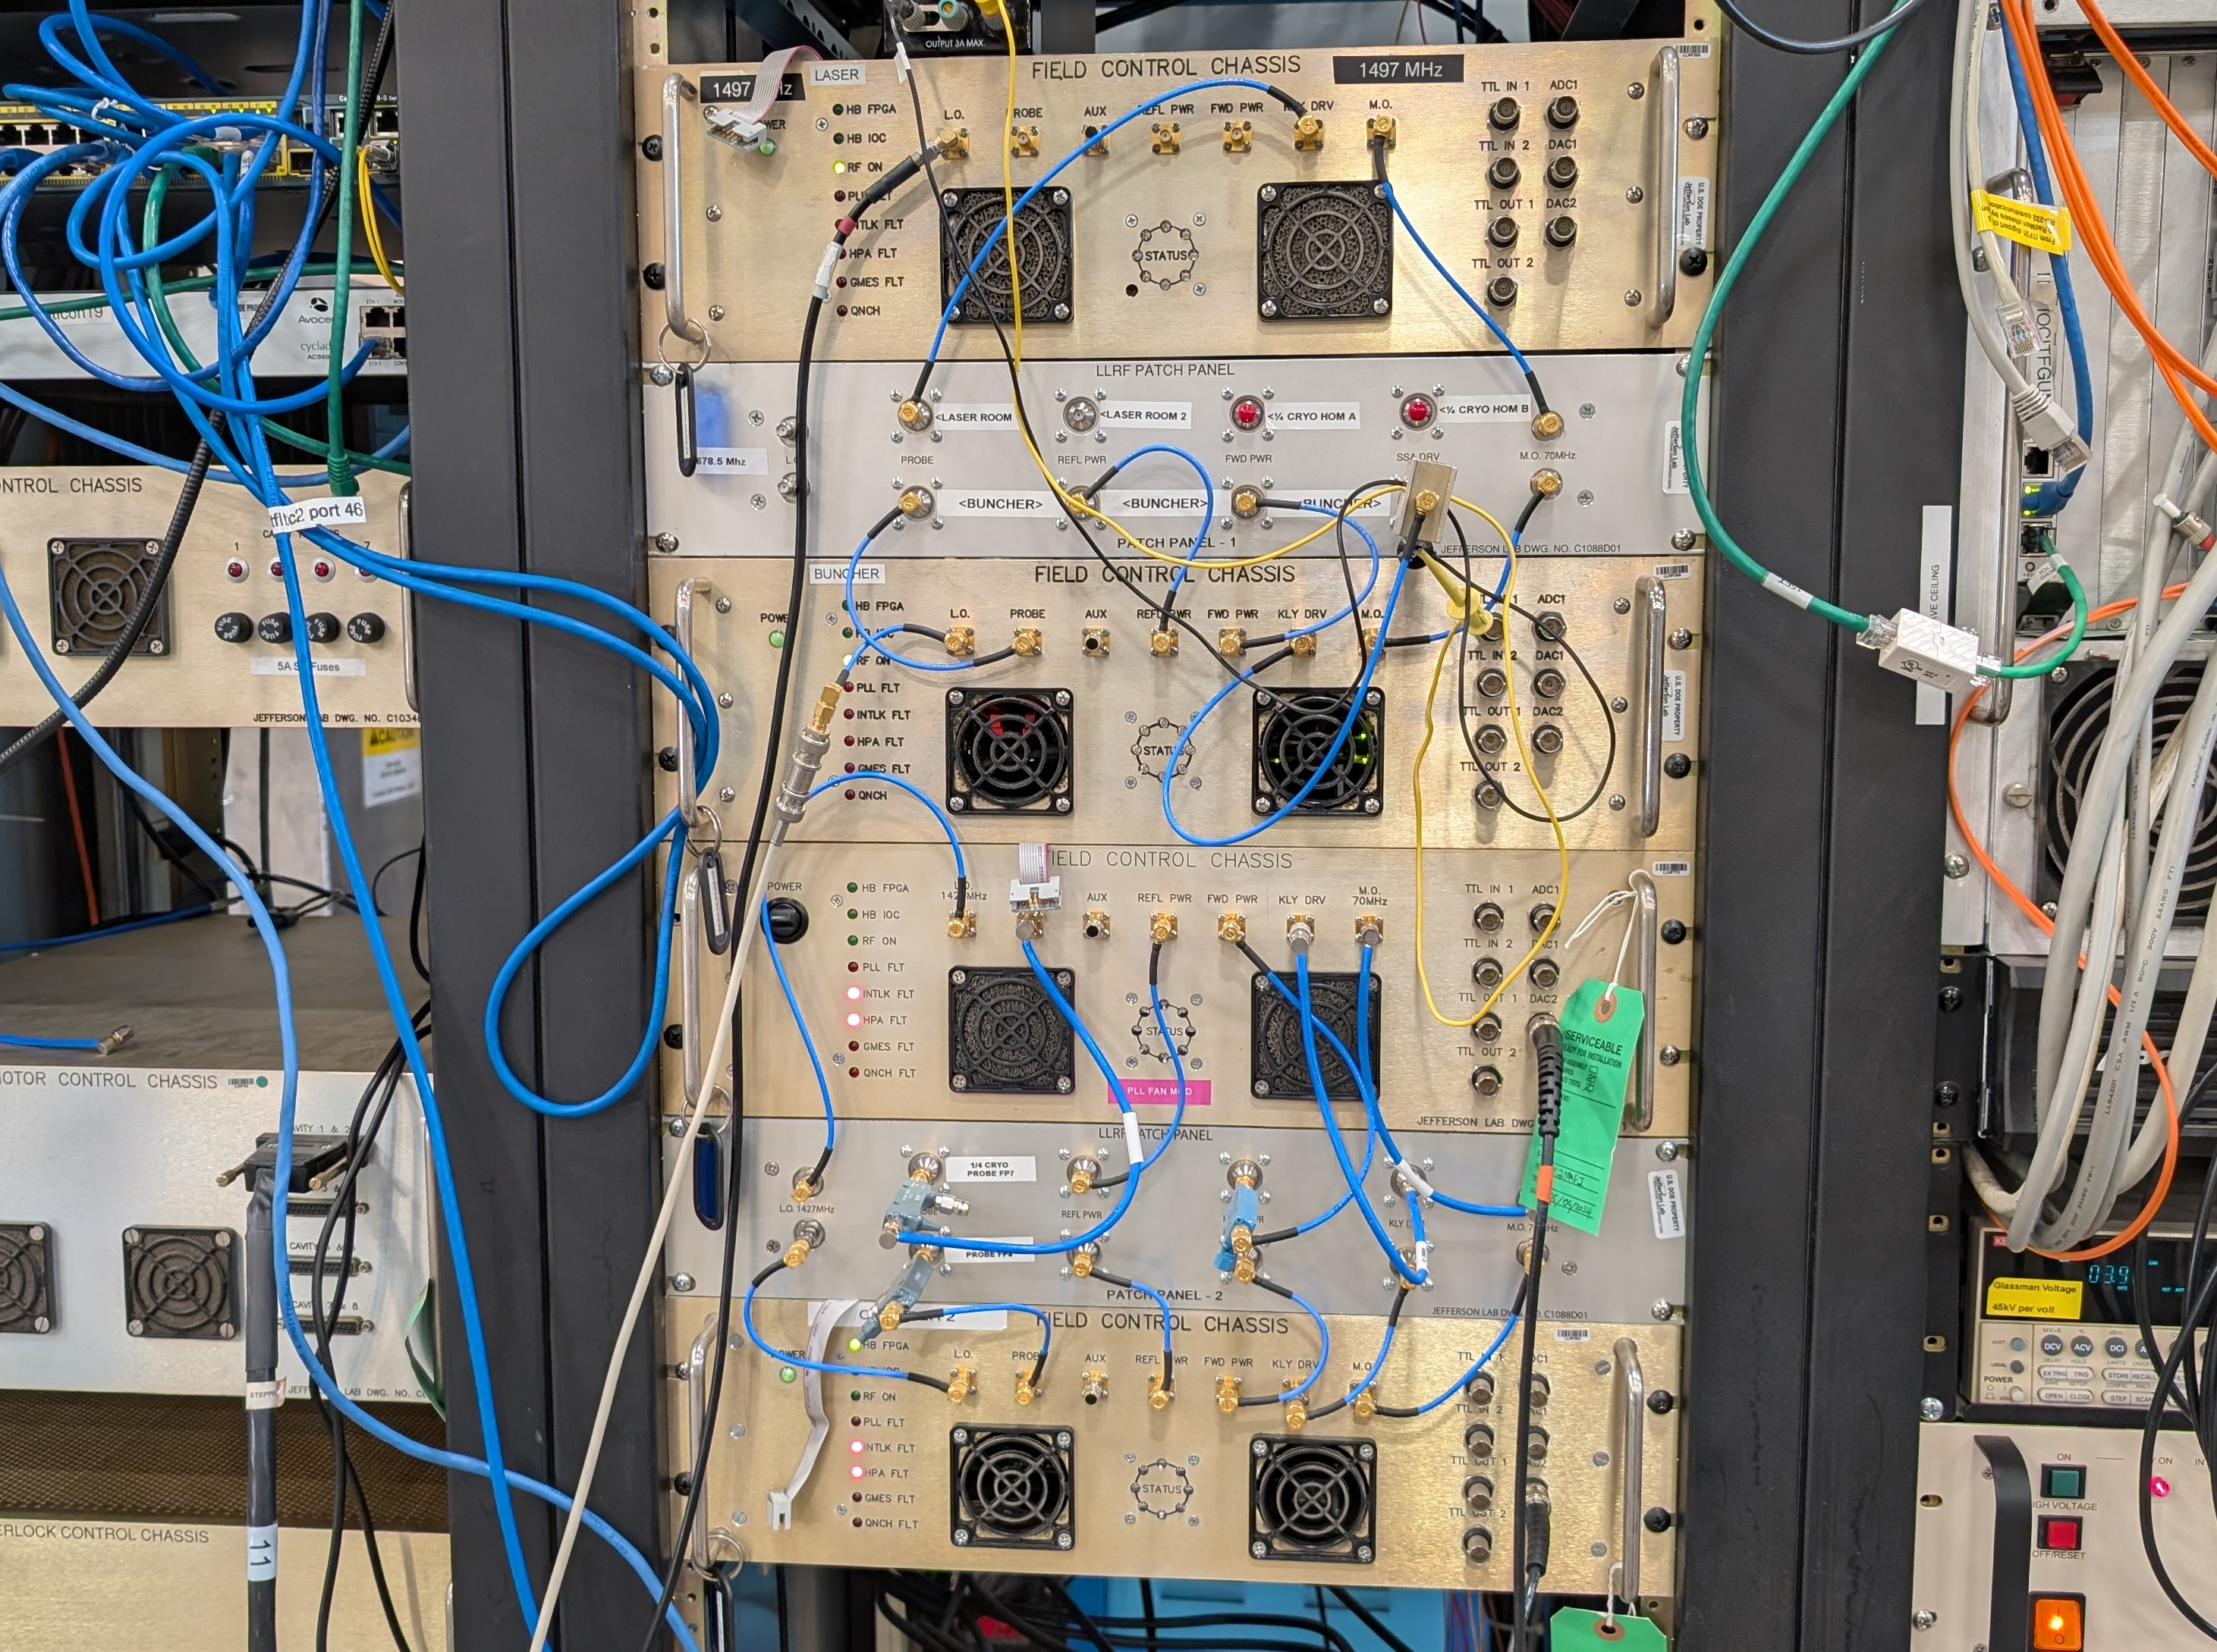
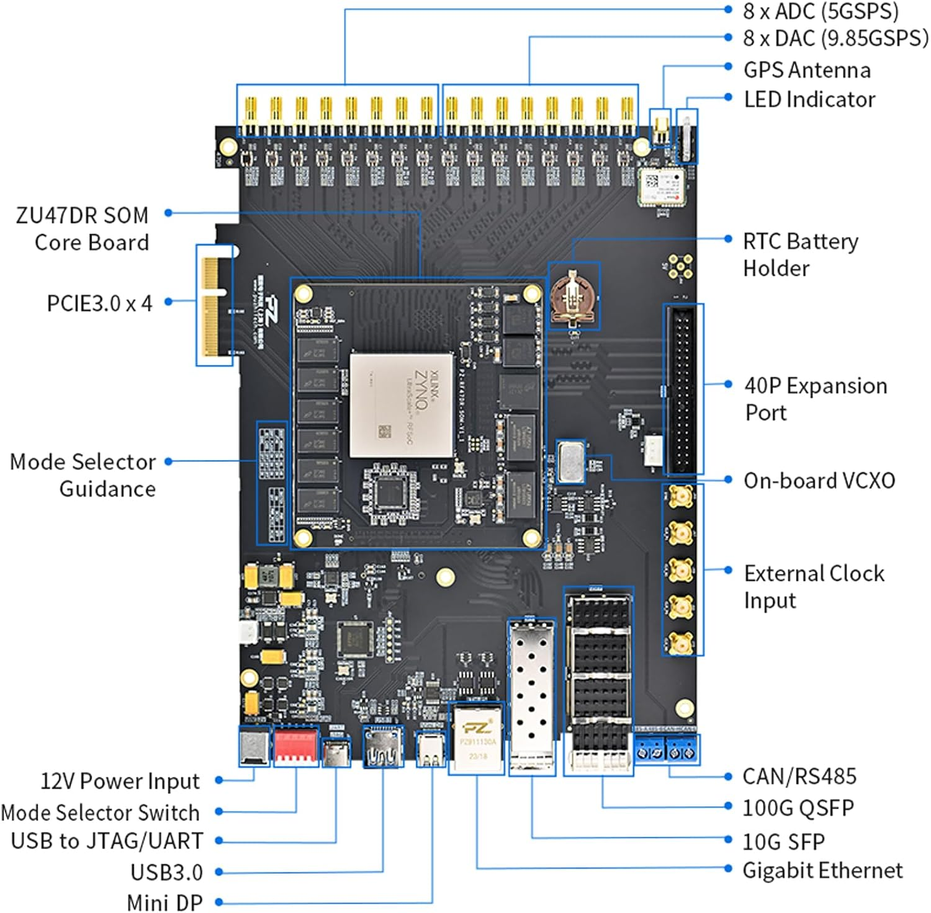
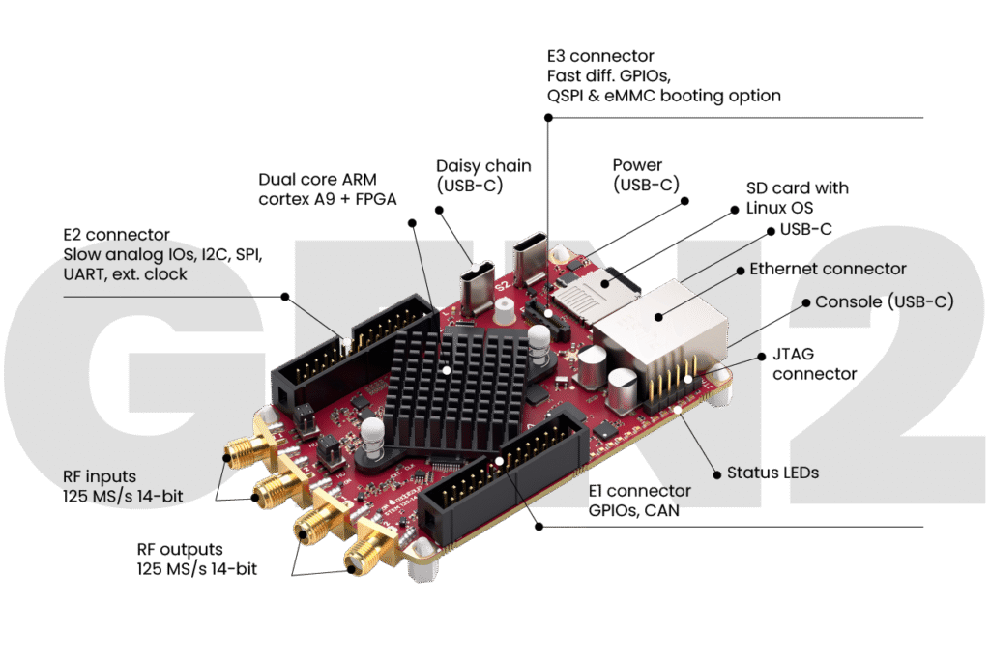
New RF Controllers for SRF
Compact, Conduction-Cooled Accelerator
High-Energy Physics
Quantum Physics
Scalable (100’s of cavities)
Interlocks and MPS
Low noise
Stable operation
Custom system designs
Low cost, low volume
Relaxed requirements for stability
Commercially available
Ultra fast (>5GSps)
Very low noise
Wide bandwidth
More expensive
redpitaya.com
Notes:
Guidelines: 6-8 bullets per slide; Use sentence fragments for bullets
To change the photo: Right-click on photo and select change photo

Slide 5
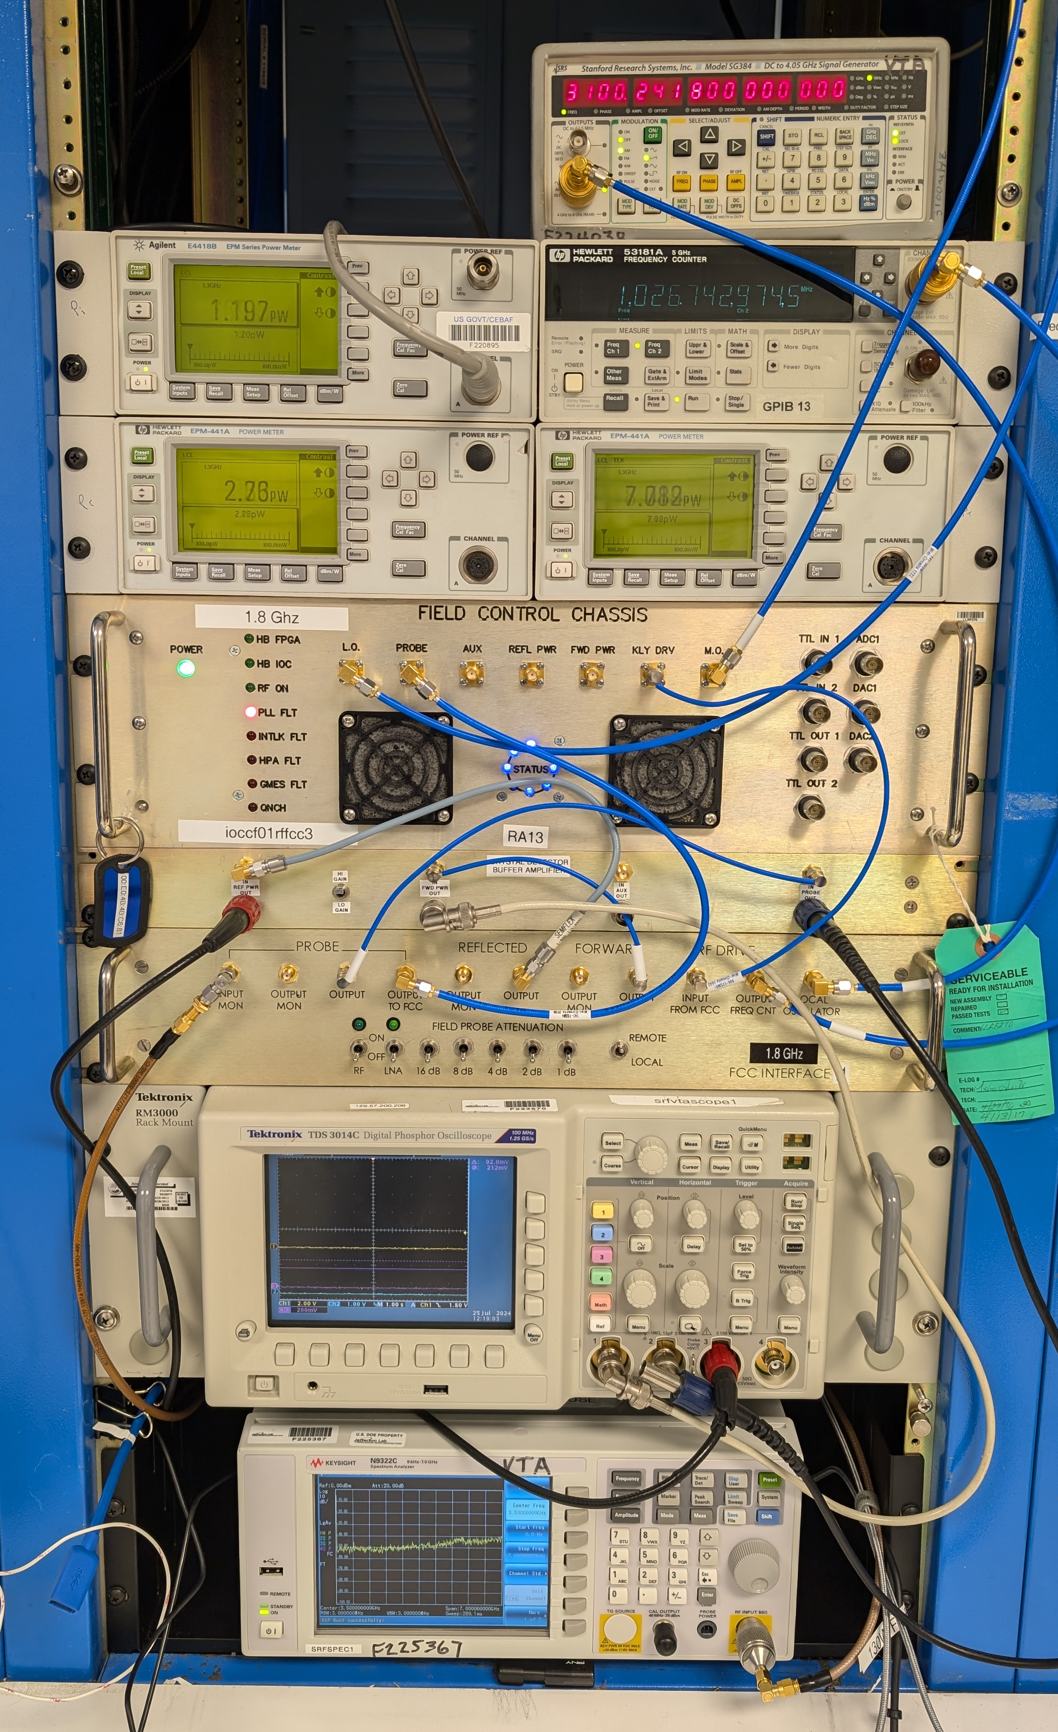
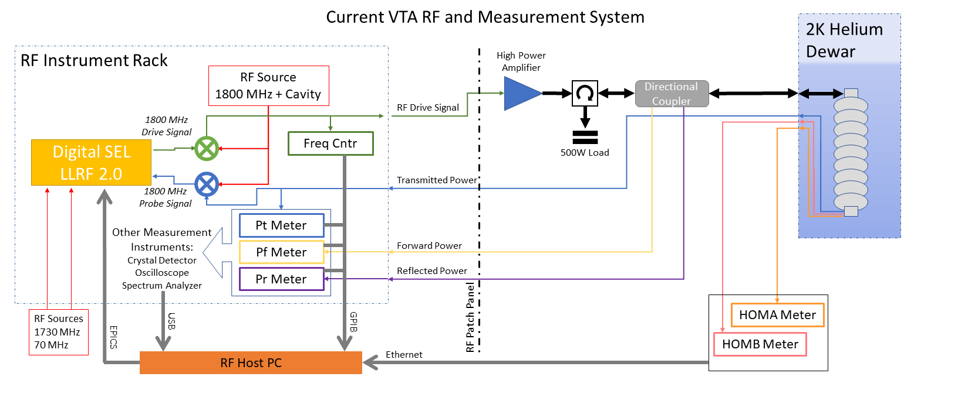
RF Control Systems - VTA
Wide range of cavities and frequencies, 0.2 – 7 GHz
Up to 100W of power, critically coupled cavities
High throughput, up to 400 cavity tests per year
Cavity control (SEL) from CEBAF LLRF2.0 system, adapted through interface chassis
Measurement done with power meters
LLRF control and measurement system in the VTA
Notes:
Guidelines: 6-8 bullets per slide; Use sentence fragments for bullets
To change the photo: Right-click on photo and select change photo

Slide 6
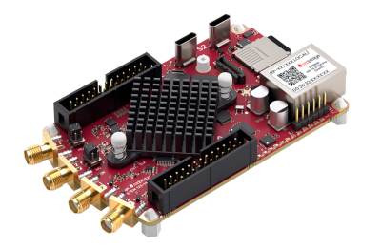
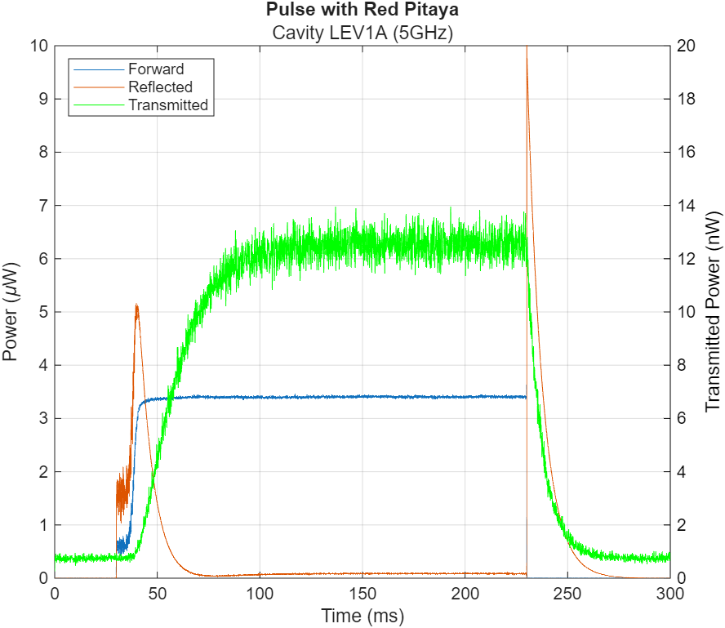
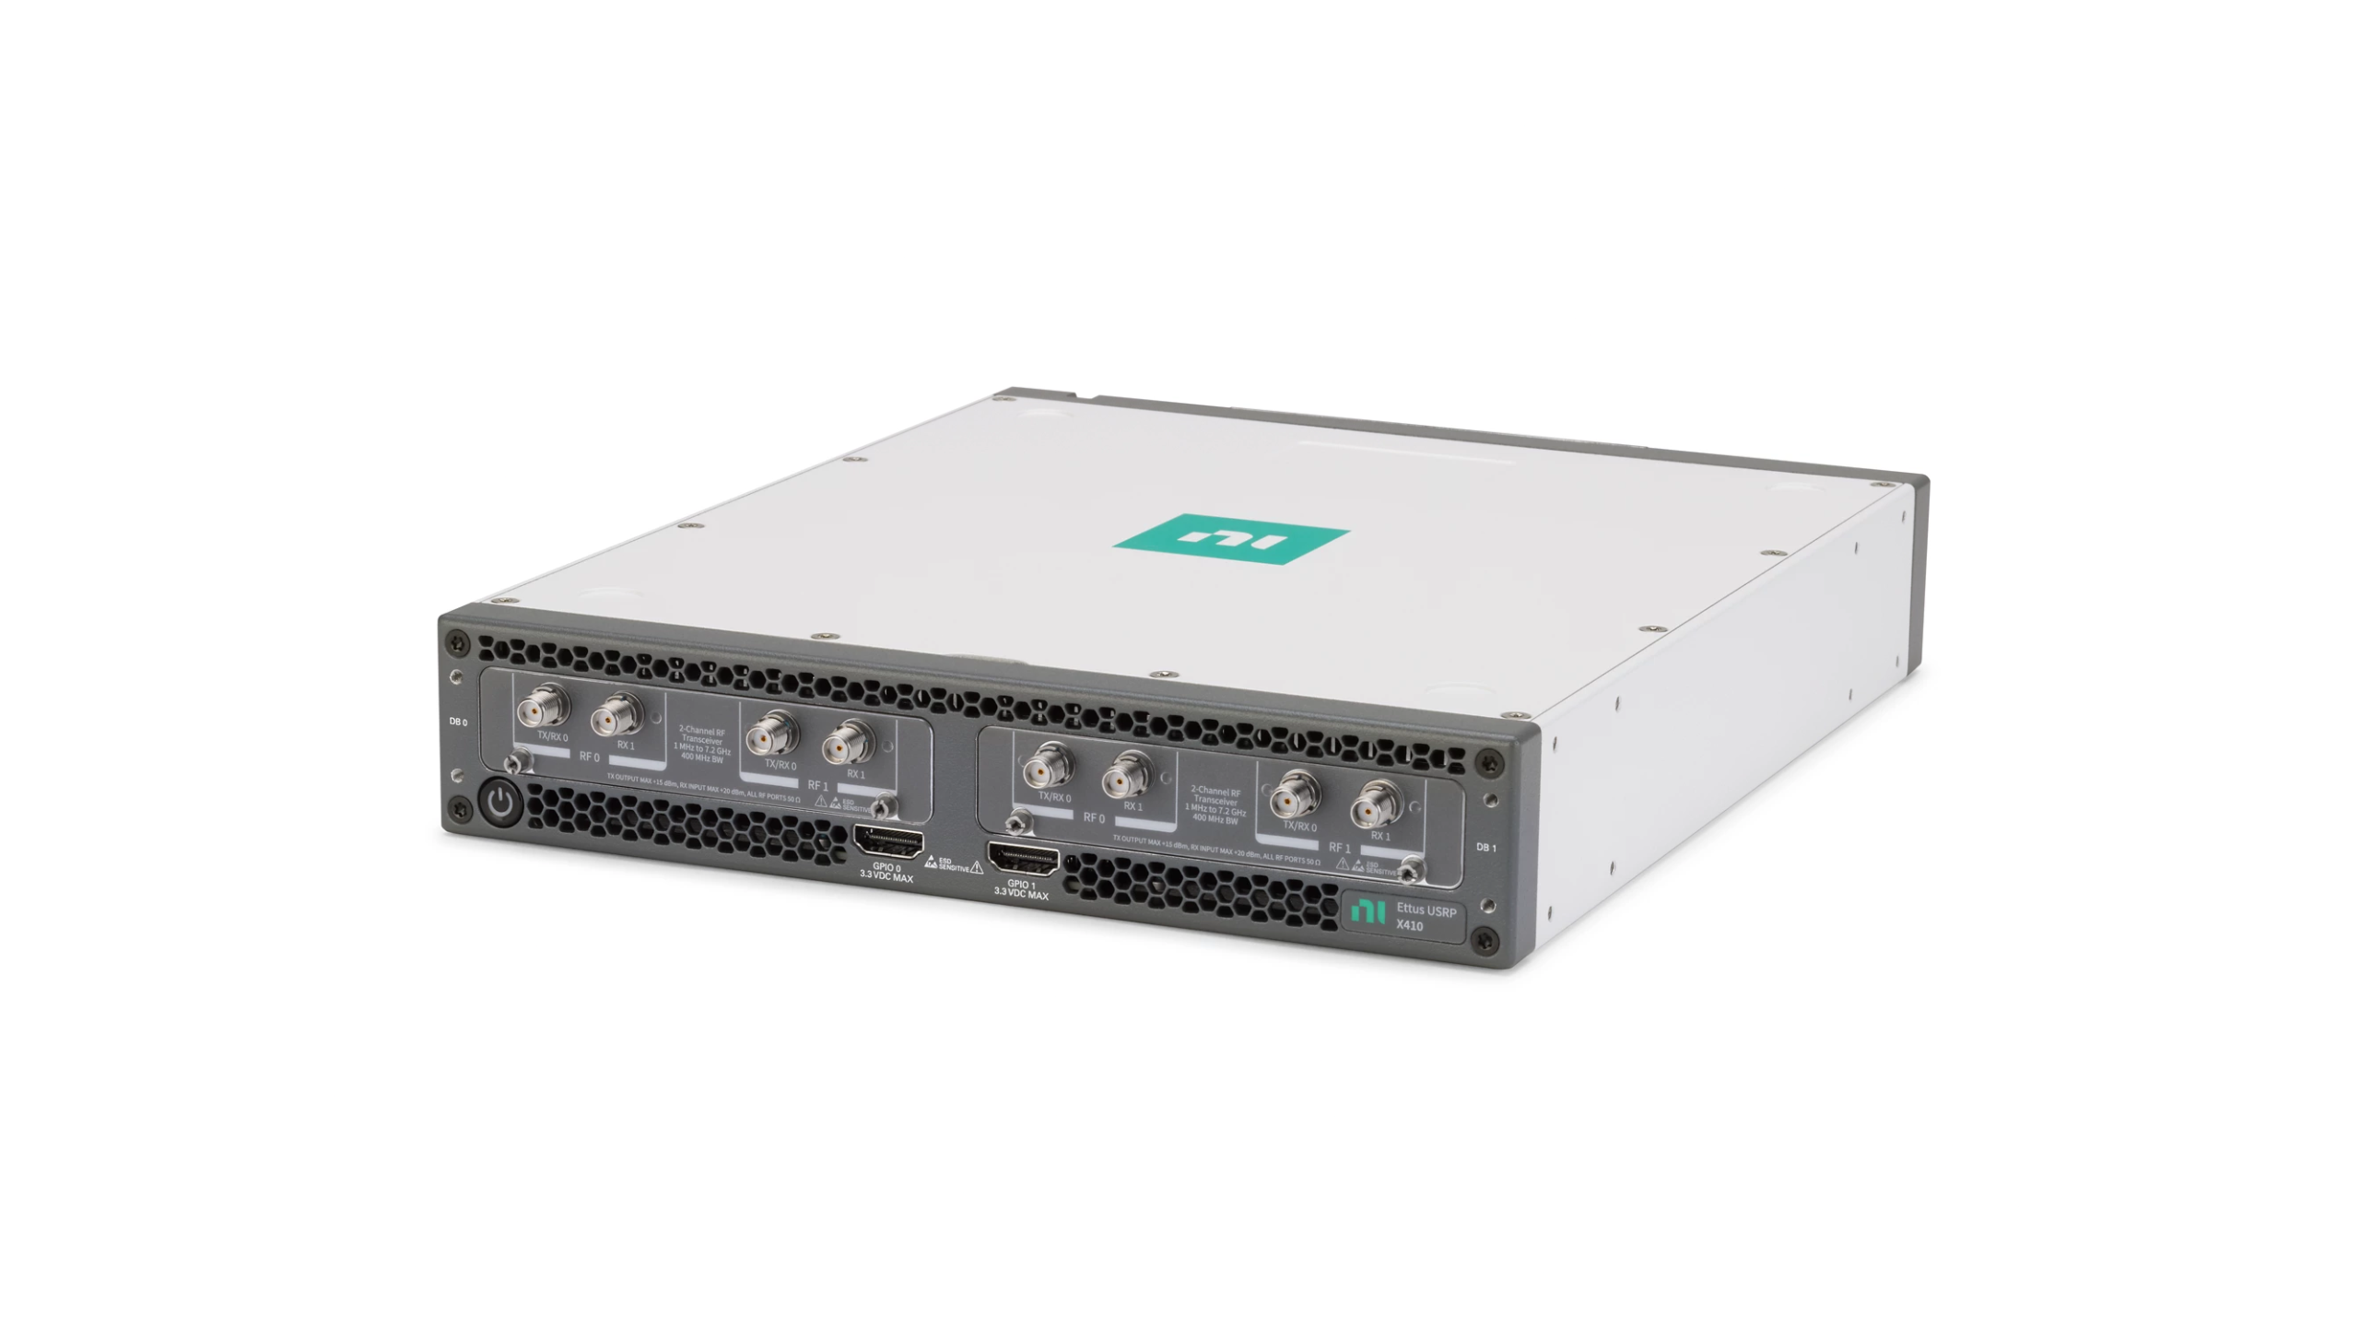
New RF System Design
Red Pitaya FPGA
  2x Rx and Tx channels
  Perform SEL control, easily programmable
NI Software Defined Radio
  Digital acquisition of cavity signals
  Wide frequency range and bandwidth
  FPGA to process signals
  Computer interface, no other external systems needed
All commercially available
  Improve system flexibility at the cost of amplitude and phase stability
  Less than $40k for a very flexible system, 0.1 – 7 GHz
Notes:
Guidelines: 6-8 bullets per slide; Use sentence fragments for bullets
To change the photo: Right-click on photo and select change photo

Slide 7

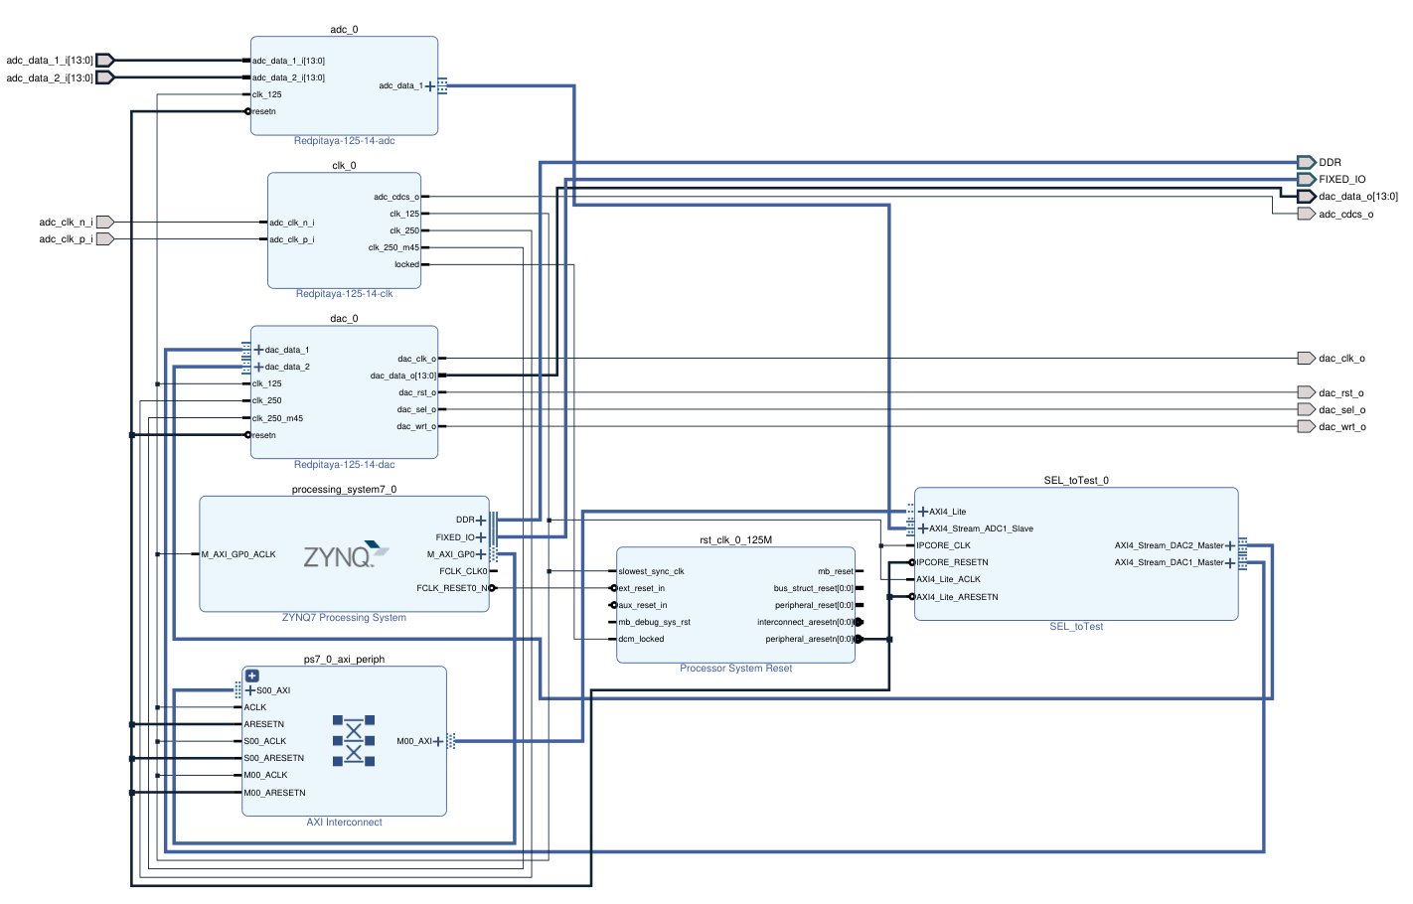
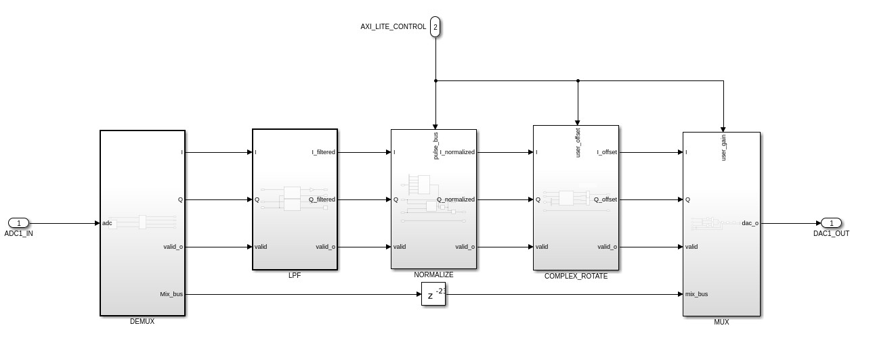
New RF System Design
Control
Jupyter Notebook
Developed a workflow to take Simulink model, compile VHDL in Vivado, and run the code on Red Pitaya
Access to control variables through Jupyter Notebook server
Allows for new control methods to be easily designed and tested in the field
Red Pitaya FPGA
  2x Rx and Tx channels
  Perform SEL control, easily programmable
Design
MathWorks Simulink
Build
AMD Vivado
Execute
Red Pitaya
Notes:
Guidelines: 6-8 bullets per slide; Use sentence fragments for bullets
To change the photo: Right-click on photo and select change photo

Slide 8
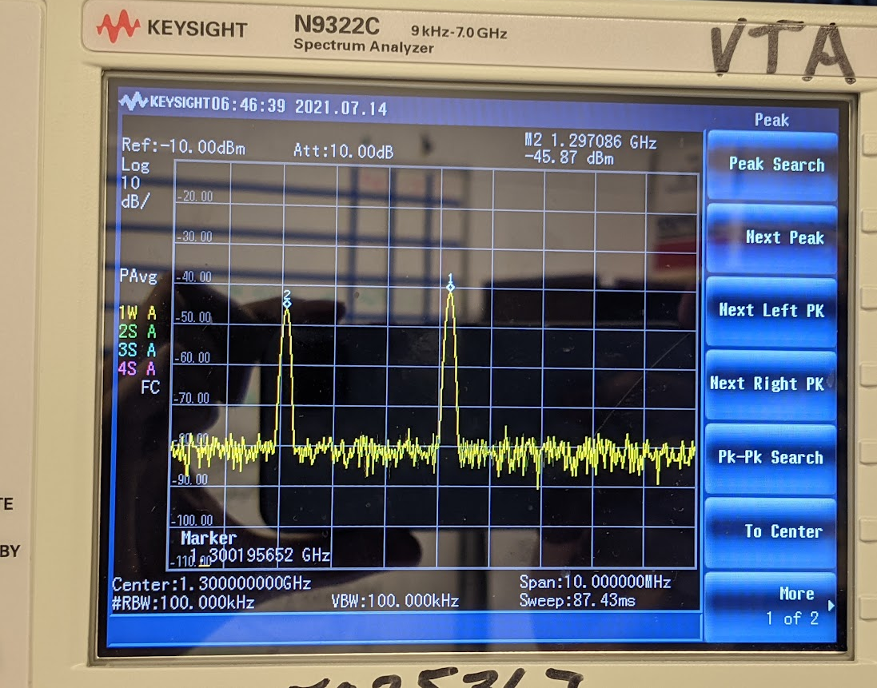
LCLS-II Mode Mixing
Vertical Cavity testing, RF control system exciting the pi mode (1300 MHz)
At high gradients (>18 MV/m) the 7/9 pi mode (1297 MHz) becomes self-excited
Power Meters can only measure the sum of both modes, data points are invalid
New RF Control scheme suppresses 7/9 mode: Setup a second SEL 180 degrees off resonance
~ 1s
Reverse RF phase 180º

Slide 9
Anti-Mode Mixing System (AMMS)
High Power Amplifier
RF Sources
1730 MHz
70 MHz
RF Source
3100 MHz
1800 MHz
Field Control Chassis 1
Directional Coupler
1300 & 1297 MHz Drive
1800 MHz
Probe Signal
Forward Power
Reflected Power
FCC Downconverter
RF Splitters/Combiners
Peter Owen, 2023
1300 MHz Field Probe
1803 MHz
RF Sources
1733 MHz
70 MHz
Measurement instruments:
Power Meters
Frequency Counter
Crystal Detector
Spectrum Analyzer
Field Control Chassis 2
1300 MHz = 3100 – 1800 MHz
Conversion done with RF Mixer in FCC downconverter
Allows easy switching between cavity types and frequencies
1803 MHz
Probe Signal
1297 MHz = 3100 – 1803 MHz
FCC #2 is locked onto 7/9 mode
LLRF control of SRF Cavities– LDRD Meeting 2026

Slide 10
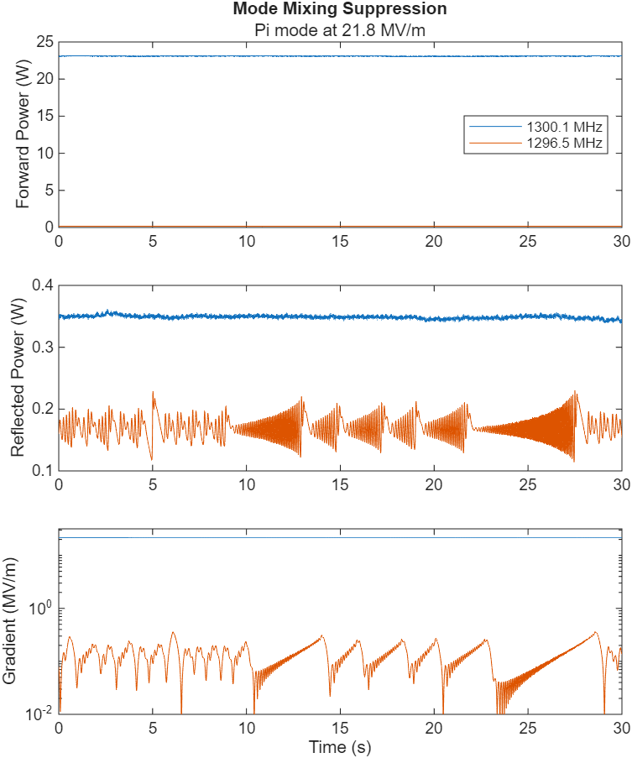
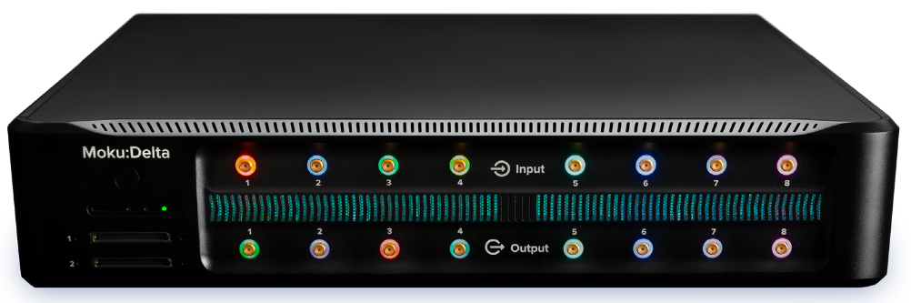
LDRD Anti-Mode Mixing System
High Power Amplifier
Directional Coupler
1300 & 1297 MHz Drive
Forward Power
Reflected Power
FCC Downconverter
Moku Delta
1300 MHz Field Probe
Measurement instruments:
Power Meters
Frequency Counter
Crystal Detector
Spectrum Analyzer
With 180º shift on PLL, second mode is suppressed orders of magnitude below primary mode
Moku Delta:
Commercially available RFSoC
8x input and output
5 GSps sample rate allows direct measurement of SRF cavity signals
Manufacturer’s software allows for rapid testing of RF control and measurement
10

Slide 11

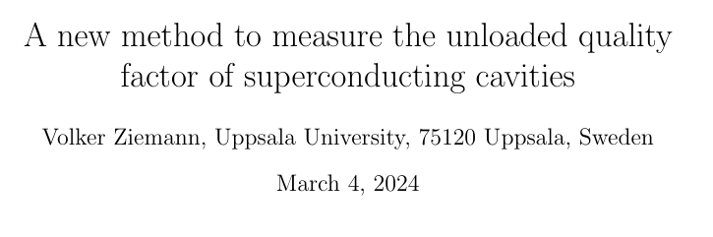
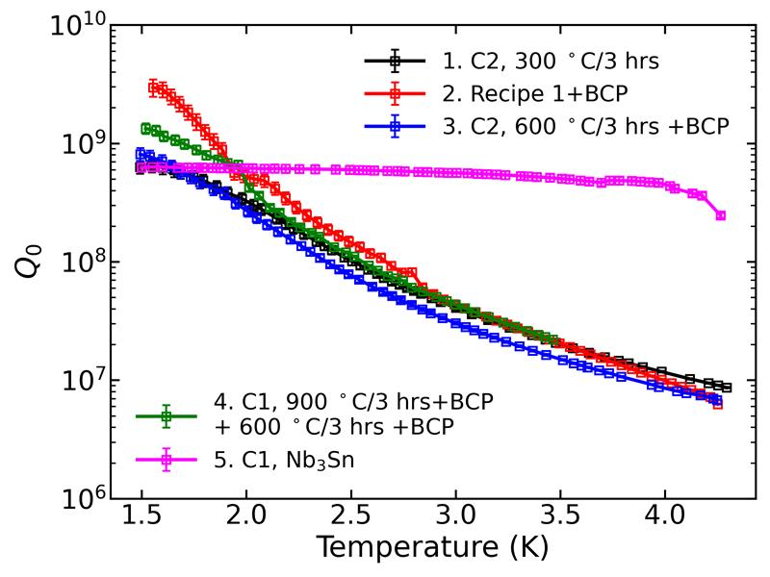
Enabling RF measurements
Attempted in-situ RF measurement of Q0 in a cryomodule
  Complex signals acquired with SDR
  Work is ongoing, disentangling errors from RF crosstalk
  Need to measure signals to less than 0.1% accuracy to determine Q0 in a cryomodule
Measure Q0 of 5 GHz ‘LEV’ cavities for another LDRD project
  Attain high Q0 at low temperatures for magnetic levitation
  Complex signals acquired with SDR
  High frequency signals
  Low temperature for quantum measurements (<1.8K)
  Low power, short pulses
Circulator Reflection
Directional Coupler
Klystron
Overcoupled
Cavity
RF Load
Crosstalk
PRELIMINARY

Slide 12
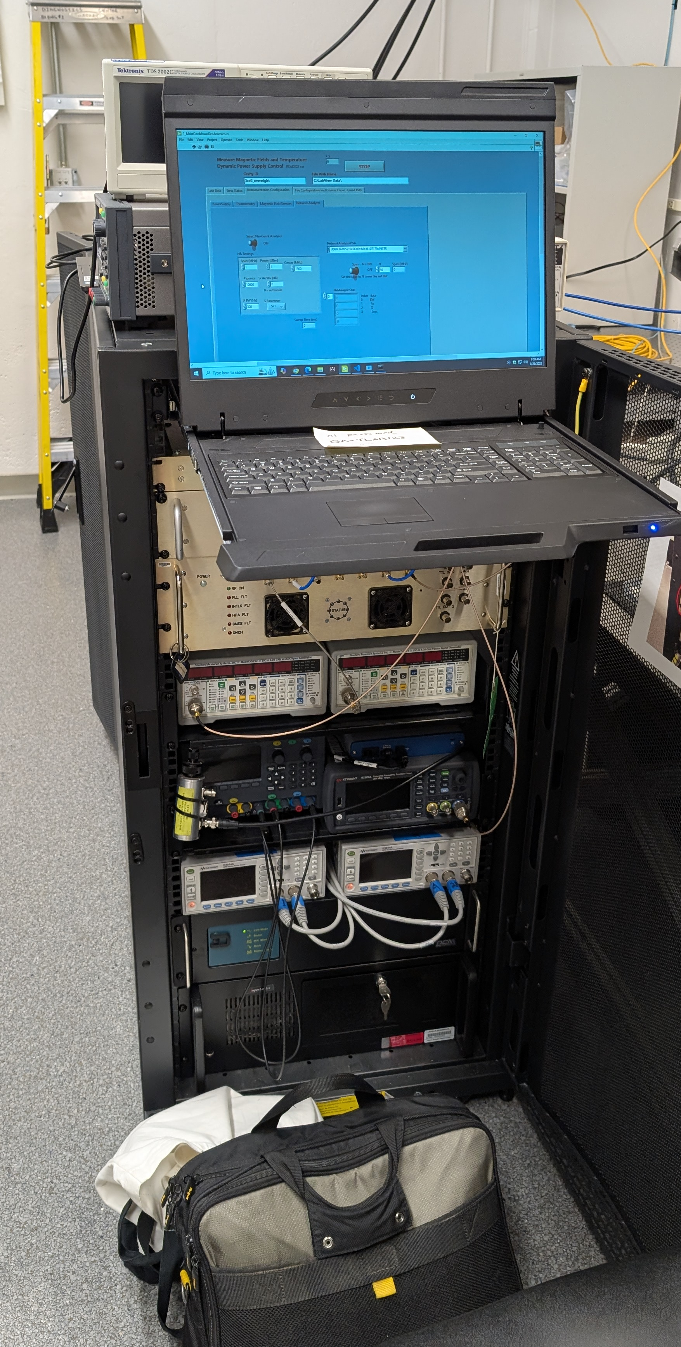
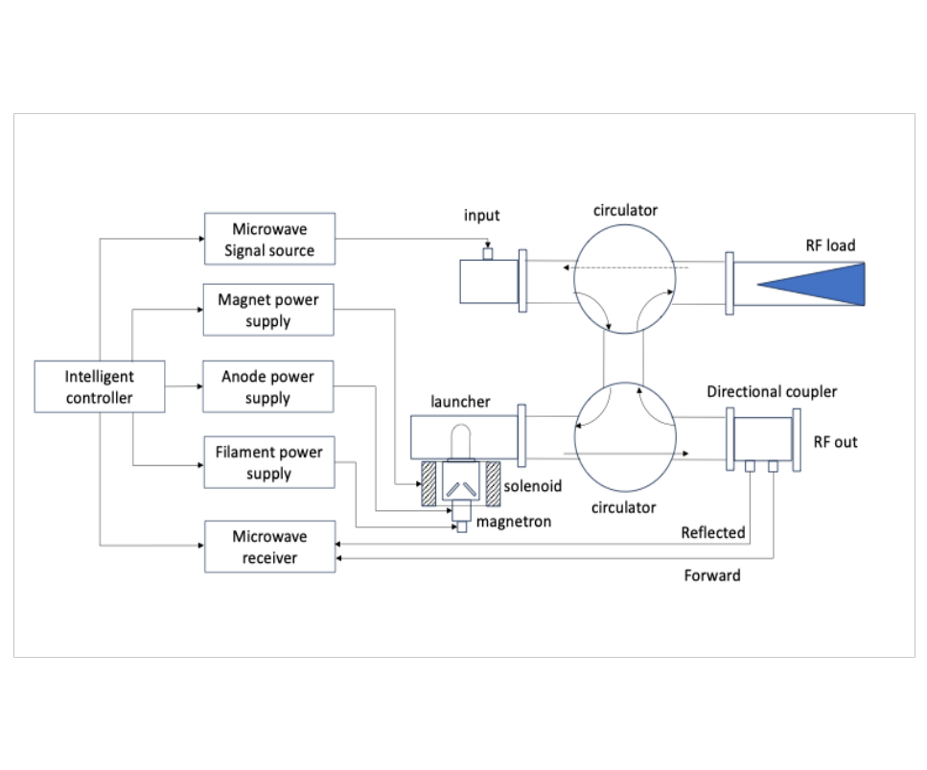
Future Work
Demonstrate SRF Operation at smaller scales (conduction-cooled, compact)
Operation of non-linear amplifiers with complex feedback mechanisms (magnetron)
Integrate commercial LLRF controllers into accelerator RF system
Capturing raw signal data for new measurement methods and AI training for fault detection
Proposed Magnetron Controller layout
- R. Rimmer
LLRF control and measurement system ported from VTA to General Atomics
Notes:
Guidelines: 6-8 bullets per slide; Use sentence fragments for bullets
To change the photo: Right-click on photo and select change photo

Slide 13
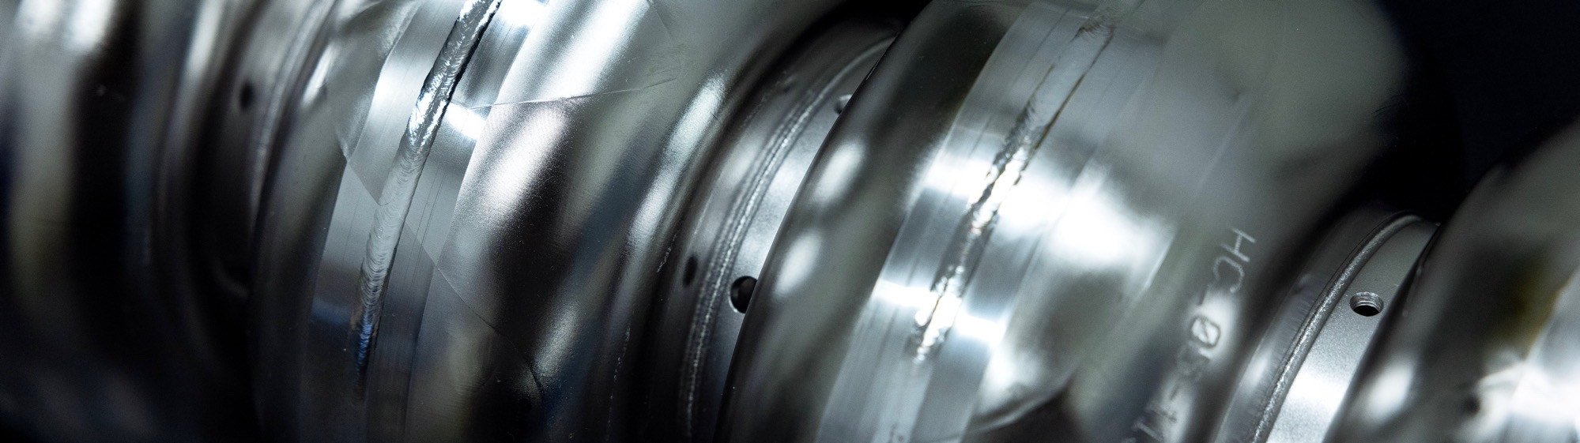
Questions?
This material is based upon work supported by the U.S. Department of Energy,
Office of Science, Office of Nuclear Physics under Contract No. 89243126CSC000213.
Notes:
Guidelines: 6-8 bullets per slide; Use sentence fragments for bullets
To change the photo: Right-click on photo and select change photo

Slide 14

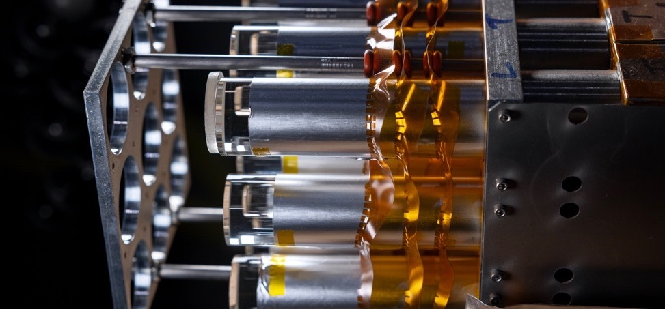
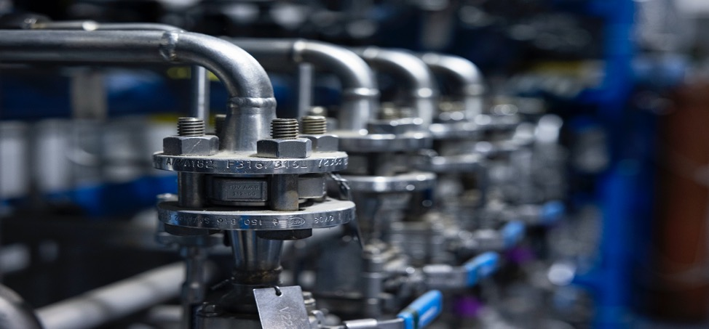
Abstract
As SRF accelerators enter new spaces and face new challenges, the requirements for RF controllers also change. Small compact accelerators consisting of one or two SRF cavities require less precise control than a high-energy accelerator. And magnetron amplifiers require different control and feedback algorithms compared to klystrons or solid-state amplifiers. These changes to RF control require rapid prototype development. At Jefferson Lab, small FPGA boards are being used to demonstrate SRF operation at small scales. New high-performance FPGAs are being used to explore cutting-edge measurement techniques. We are developing FPGA software workflows to quickly take RF control and measurement theories into testing and operation.
Notes:
Guidelines: 6-8 bullets per slide; Use sentence fragments for bullets
To change the photo: Right-click on photo and select change photo

