Slide 1
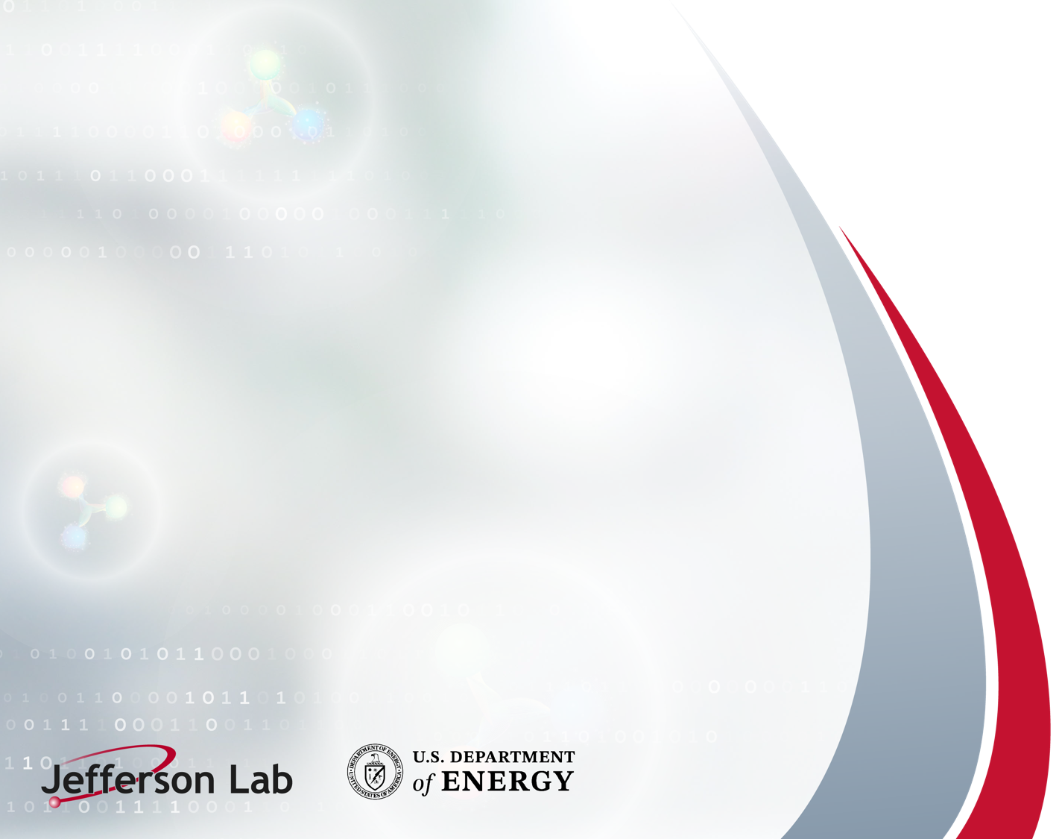
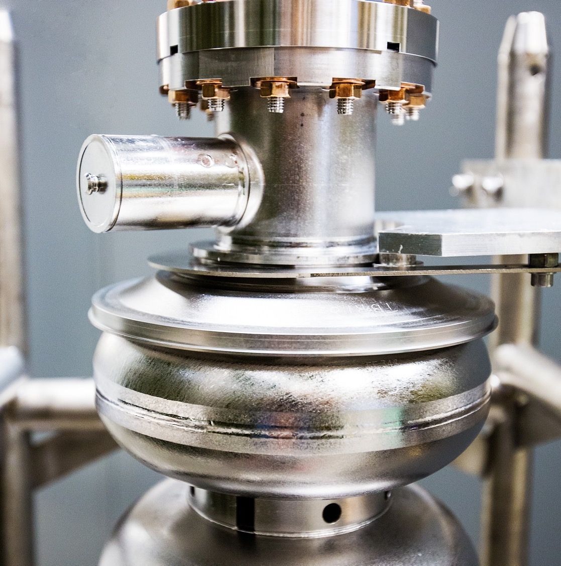
The Inaugural LDRD Strategic Hire
A success story
September 16, 2026
Joe Grames
Department Head, Center for Injectors and Sources
This work was supported by the U.S. Department of Energy, Office of Science, Office of Nuclear Physics under Contract No. 89243126CSC000213. The research was conducted under the Laboratory Directed Research and Development Program at Thomas Jefferson National Accelerator Facility for the U.S. Department of Energy.
Notes:
Tip: Keep titles under 60 characters for readability
To change the photo: Right-click on photo and select change photo

Slide 2
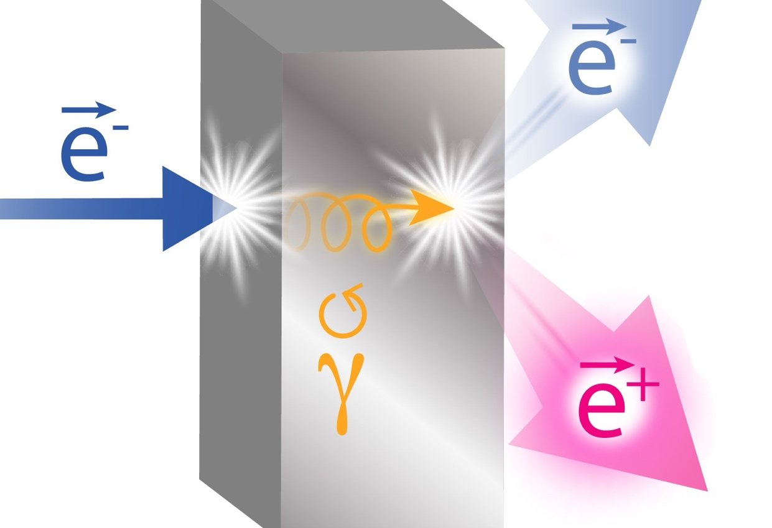
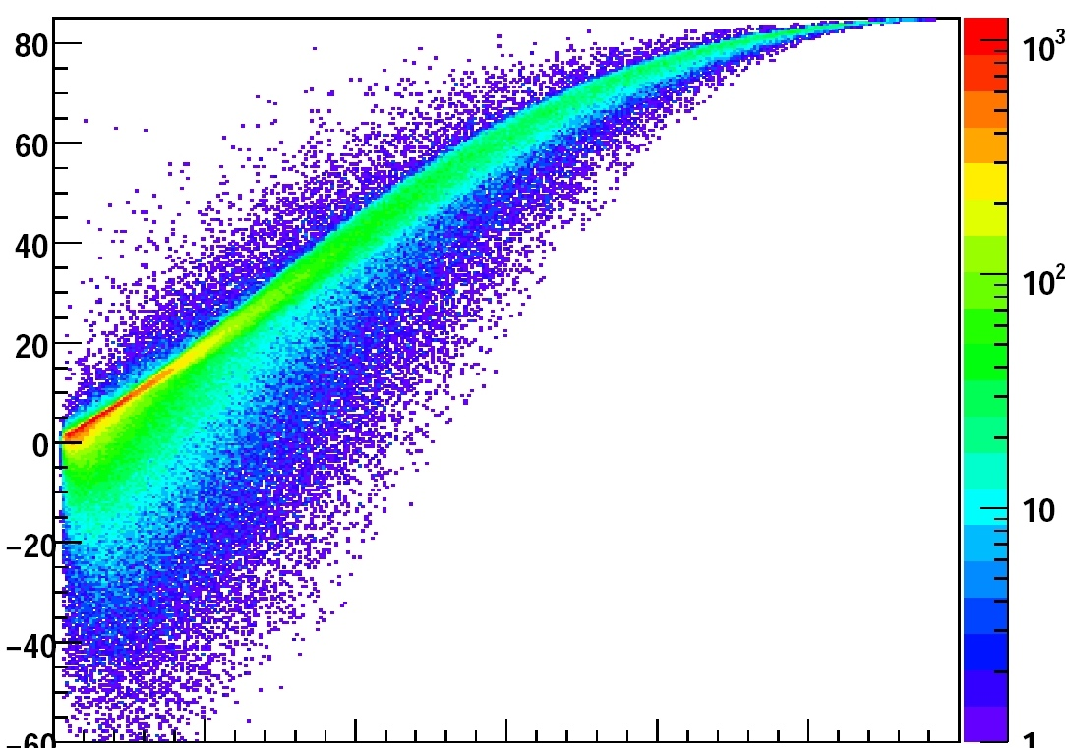
This story begins with something called “PEPPo”
Using the analogy of a prism, which transforms the properties of white light into a useful spectrum, Polarized Electrons for Polarized Positrons (PEPPo), creates a useful spectrum of positron anti-matter
Positron Polarization (%)
0
Positron Energy
Compton scattering, PRL 96 (2006) 114801 => P(e⁺) = 73 ± 15_{stat} ± 19_{syst} %
Helical undulator, PRL 100 (2008) 210801 => P(e⁺) = 80 ± 7_{stat} ± 9_{syst} %
Polarized bremsstrahlung, PRL 116 (2016) 214801 => P(e⁺) = 82 ± 2.7_{stat} ± 1.3_{syst} %
Notes:
Use for: Introducing new topics
To change the photo: Right-click on photo and select change photo

Slide 3
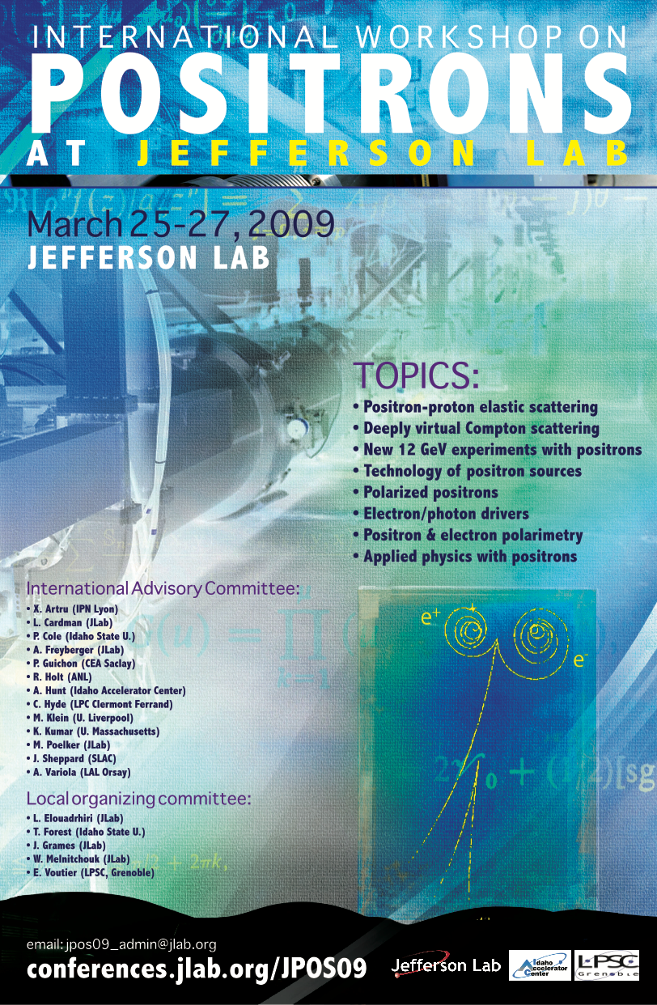
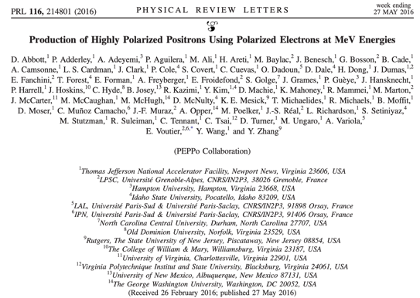
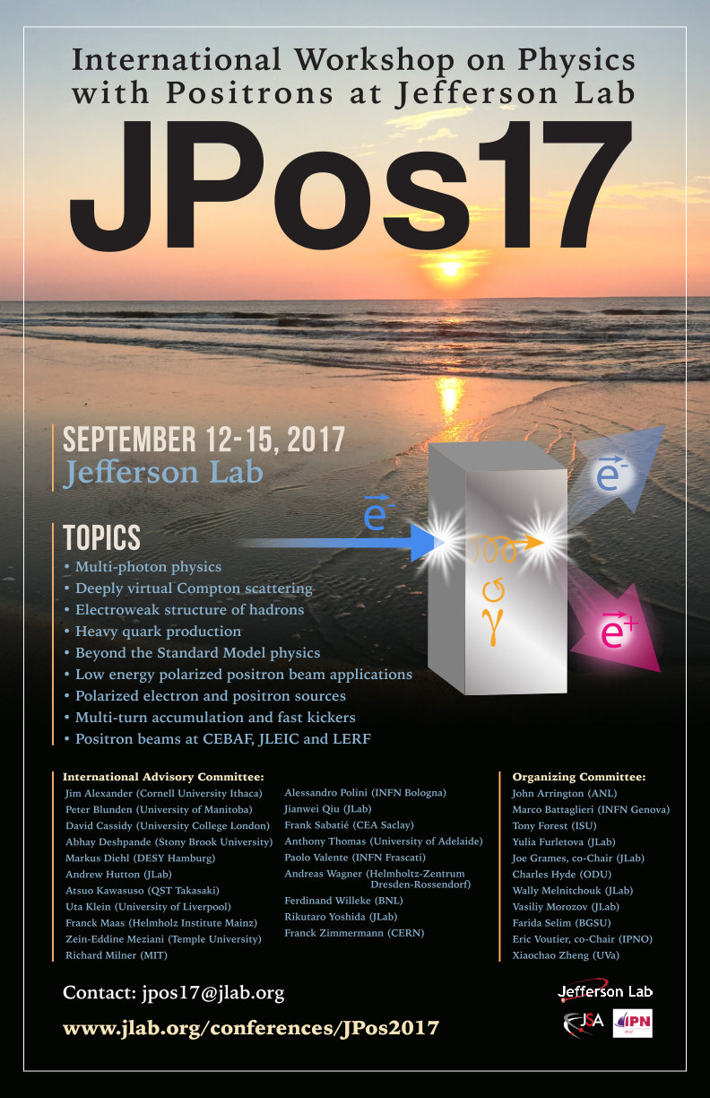
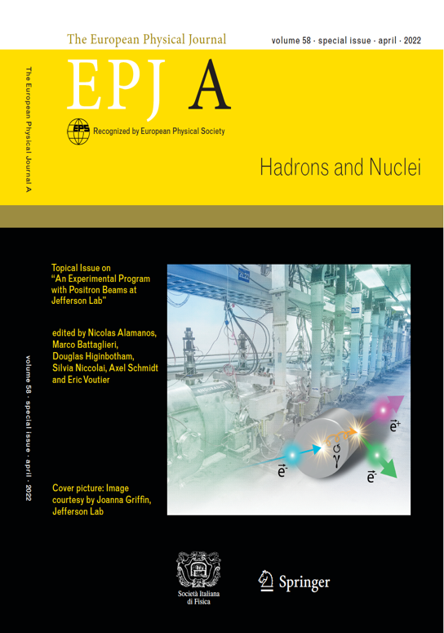
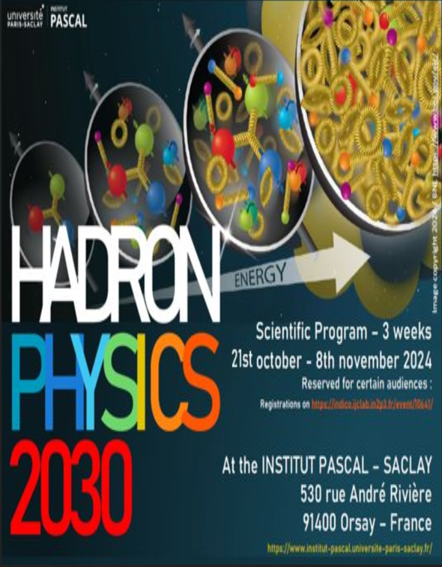
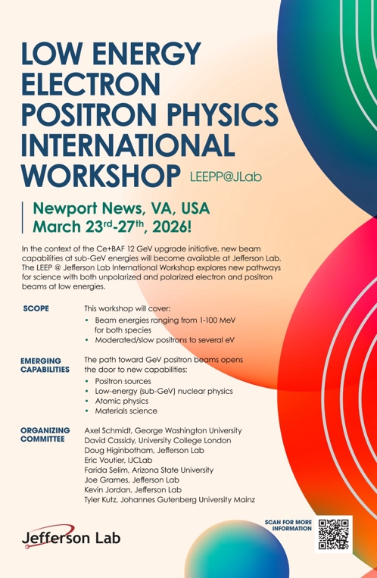
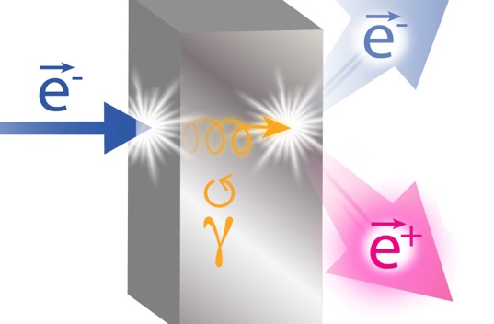
Physics with positron beams
NUMBER | TITLE | PHYSICS THEME | CONTACT PERSON | HALL | DAYS AWARDED | SCIENTIFIC RATING | PAC DECISION
PR12+23-002 | Beam Charge Asymmetries for Deeply Virtual Compton Scattering on the Proton at CLAS12 | GPDs | Eric Voutier | B | 100 | A- | C1
PR12+23-003 | Measurement of Deep Inelastic Scattering from Nuclei with Electron and Positron Beams to Constrain the Impact of Coulomb Corrections in DIS | MPE | Dave Gaskell | C | 9.3 | A- | C1
PR12+23-006 | Deeply Virtual Compton Scattering using a positron beam in Hall C | GPDs | Carlos Muñoz Camacho | C | 137 | A- | C1
PR12+23-008 | A Direct Measurement of Hard Two-Photon Exchange with Electrons and Positrons at CLAS12 | TPE | Axel Schmidt | B | 55 | A | C1
PR12+23-012 | A measurement of two-photon exchange in unpolarized elastic positron–proton and electron–proton scattering | TPE | Michael Nycz | C | 56 | A- | C1
PR12+24-005 | A dark photon search with a JLab positron beam | BSM | Bogdan Wojtsekhowski | B | 55 | A- | C1
PR12+25-006 | Meazsurement of Two-Photon Exchange in Electron-Neutron and Positron-Neutron Elastic Scattering | TPE | Eric Fuchey | C |  |  | C2
PR12+25-011 | Multi-Photon Effects in Inclusive and Semi-Inclusive Deep Inelastic Scattering | MPE | Tyler Hague | C | 58.5 | B+ | C1
The Jefferson Lab Positron Working Group formed in 2018 grew to 250 members from 75 institutions
There are 8 conditionally approved NP experiments representing 471 days of operation
Today, the interest at Jefferson Lab has broadened to include “low energy” materials science and atomic physics
2009
2016
2017
2022
2024
2026
Notes:
Use for: Introducing new topics
To change the photo: Right-click on photo and select change photo

Slide 4
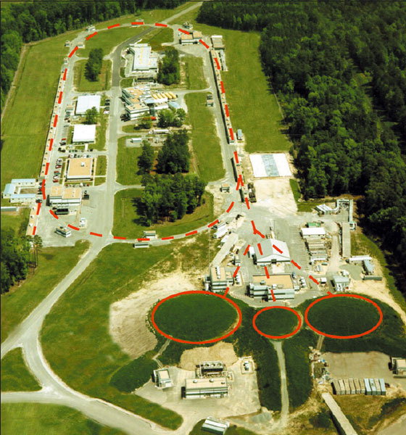
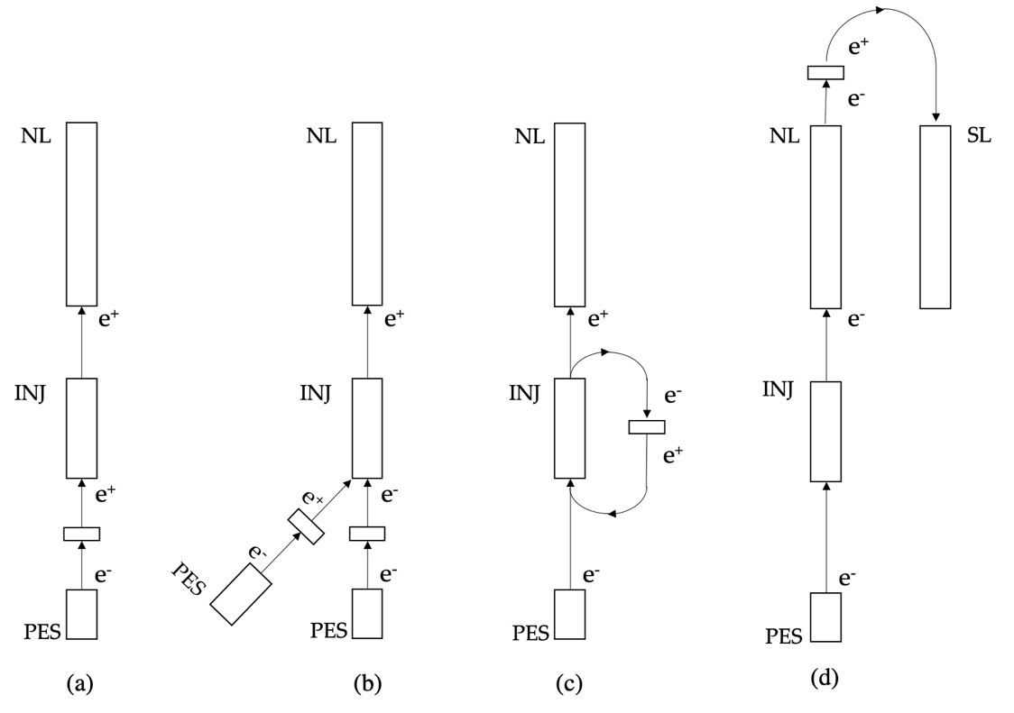
How to add PEPPo to CEBAF?
In FY21 the LDRD “Positrons for Our Future” was funded to answer the question.
We learned that we needed to re-frame the approach & our resources.
7 MeV
123 MeV
1090 MeV
Strategic recommendations by lab leadership:
  Broaden the R&D across the Accelerator and Physics divisions
  Create a multi-year R&D effort
  Develop a proposal for the inaugural LDRD strategic hire at Jefferson Lab
  Evaluate the possibility of using the LERF as a driver for CEBAF e⁺ beams
Notes:
Use for: Introducing new topics
To change the photo: Right-click on photo and select change photo

Slide 5
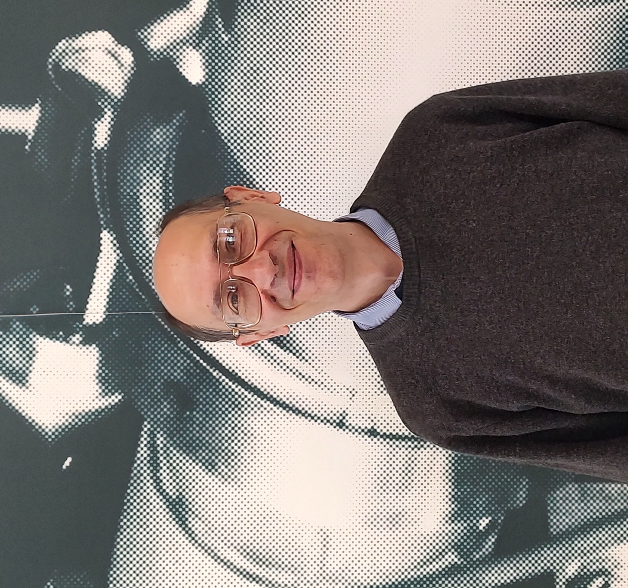
LDRD Strategic Hire to develop the Ce⁺BAF concept
FY 2025 LDRD Proposal
Program: Strategic Hire
Proposal Title: Strategic Staff Hire: Andriy Ushakov as Positron Injector Model Integrator
Principal Investigator, Division: Joe Grames, Accelerator
Two decades of experience in developing polarized and unpolarized positron sources
Simulations of particle interaction with matter using Geant4 and FLUKA
Software development for simulations of positron production, capture and acceleration
Optimization of positron source components such as drive beam, target, capture magnet and RF cavities to get the highest positron yield
Calculations of power deposition, induced radioactivity, dose rates and radiation damage in target area of positron source and beam dump
Experience in thermal-structural analysis (finite element analysis) of target materials under continuous wave or pulsed irradiation and design of radiative cooled and water cooled targets
Conceptual design studies of radiation shielding in target area of positron source and beam dump
Notes:
Use for: Introducing new topics
To change the photo: Right-click on photo and select change photo

Slide 6
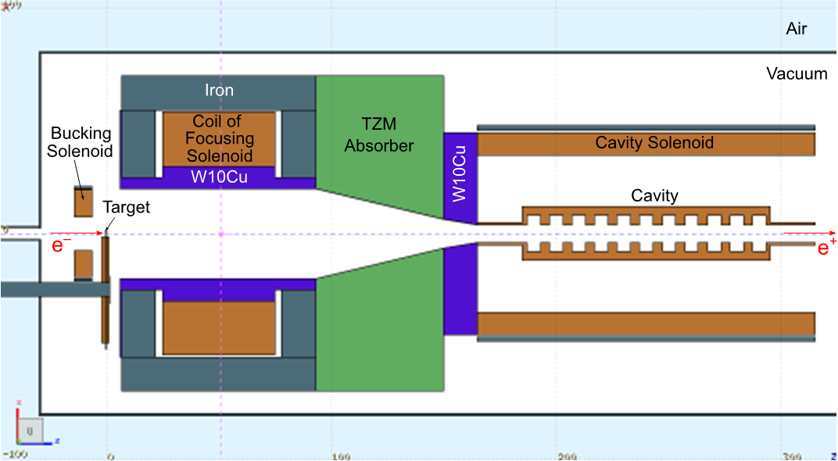
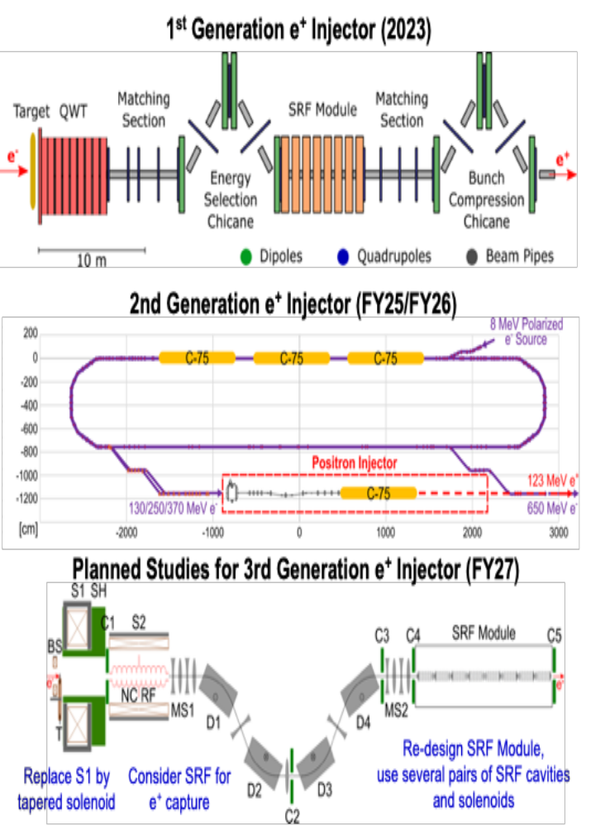
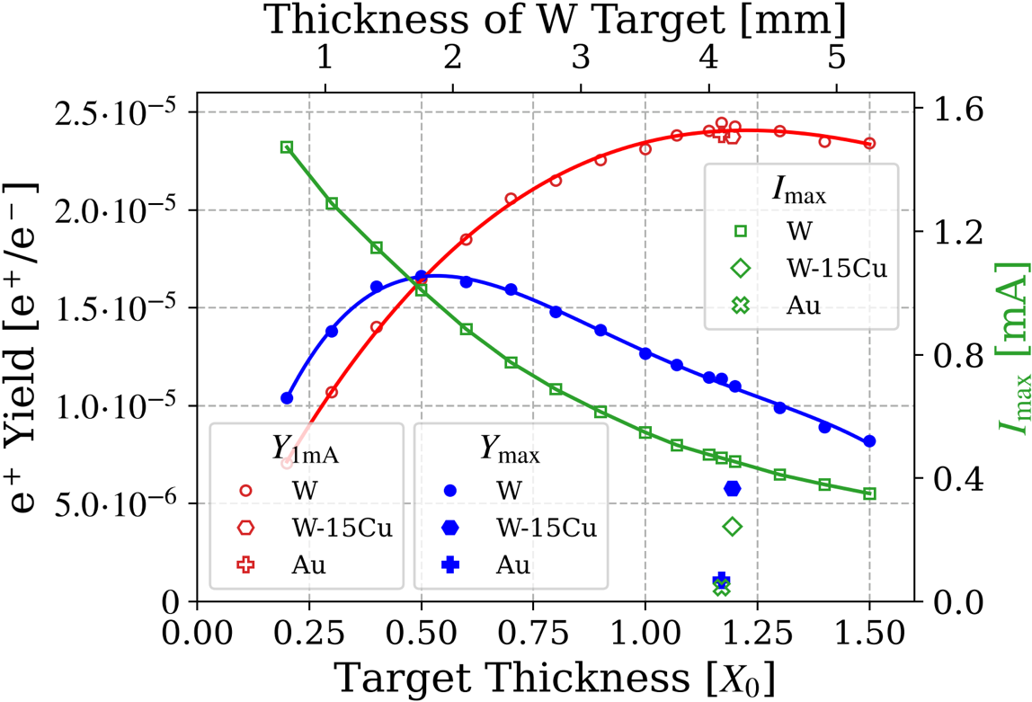
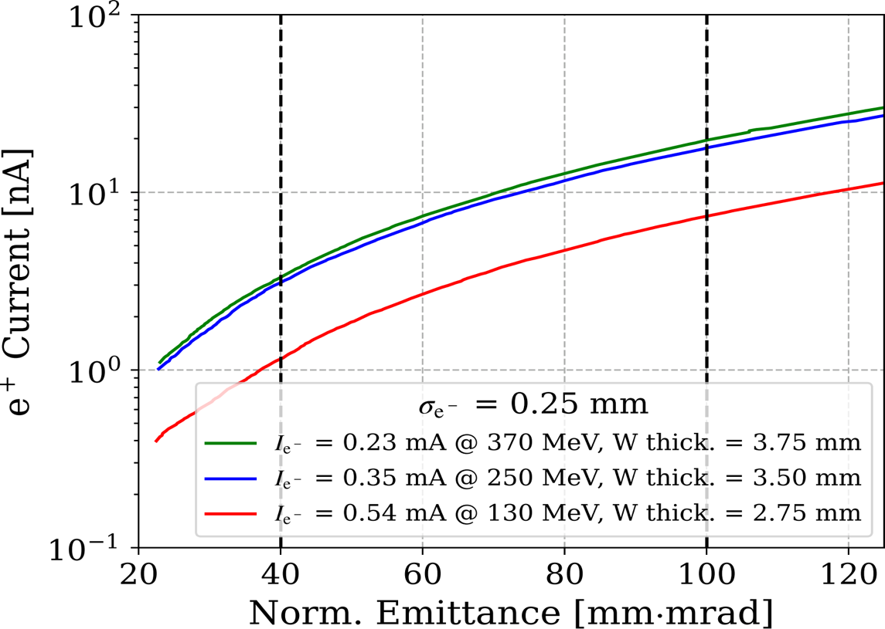
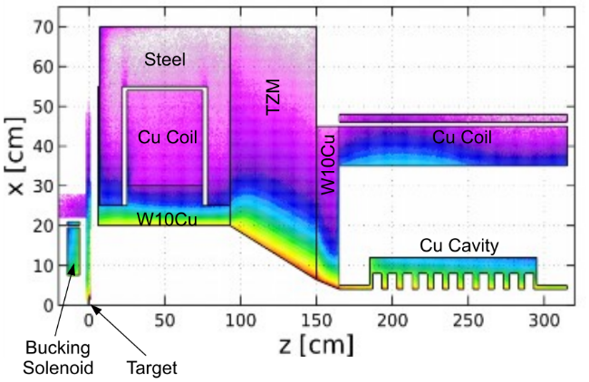
Impactful technical contributions
Optimizing e⁺ yield
Developing absorber geometry
Evolving e+ capture system
370 MeV e⁻, σ = 0.5 mm
Model of Target and e⁺ Capture System
Positron Current vs Norm. Emittance
Distribution of Deposited Power Density
19 nA
~3 nA
7 nA
~1 nA
Notes:
Use for: Introducing new topics
To change the photo: Right-click on photo and select change photo

Slide 7
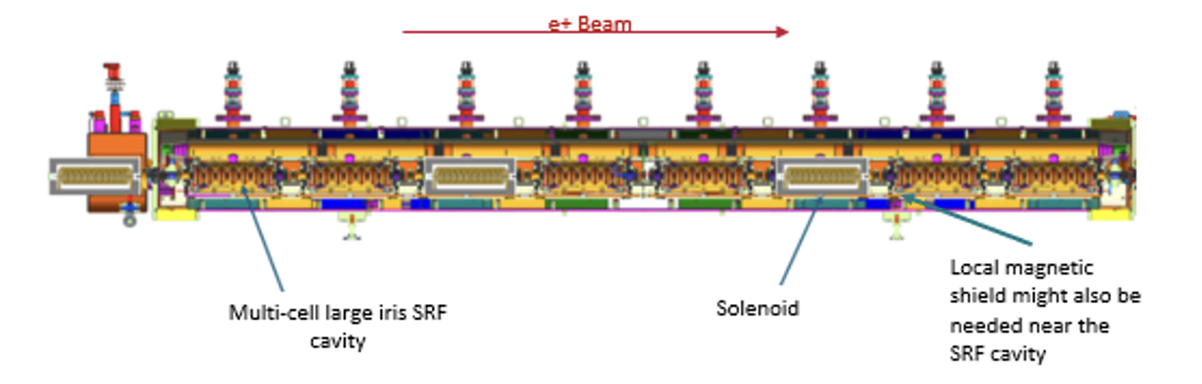

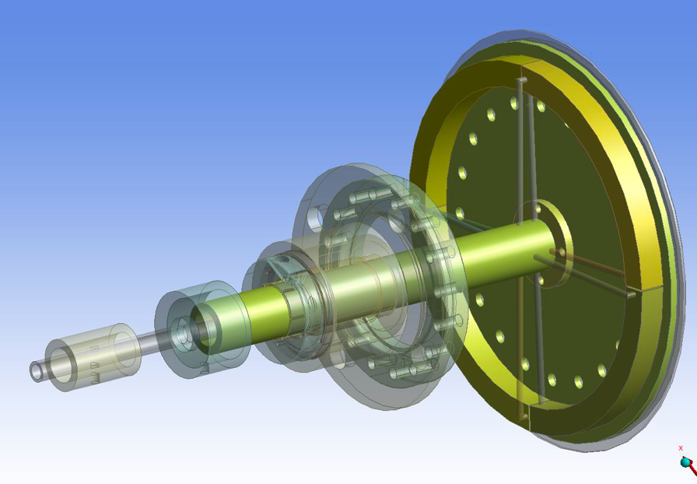
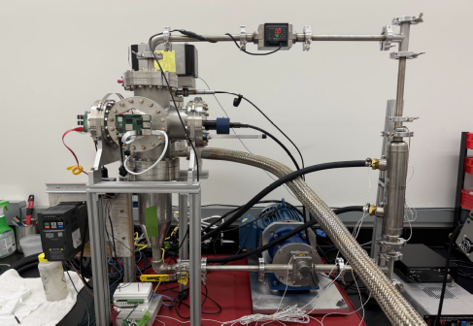
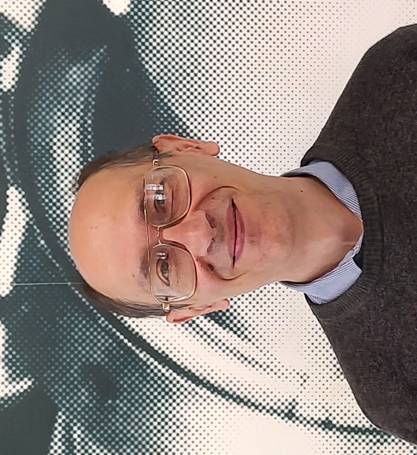
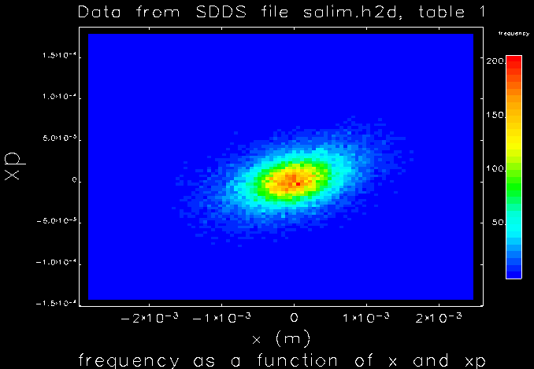
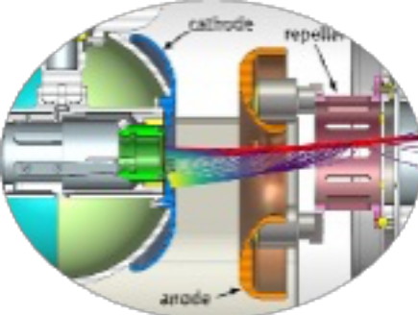
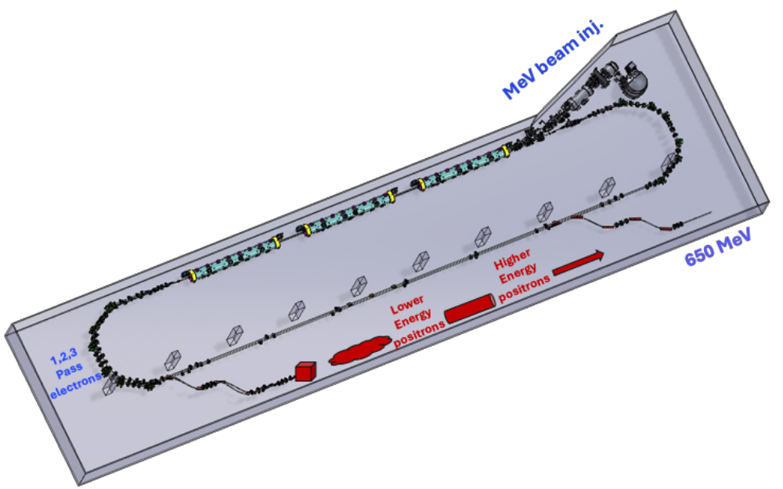
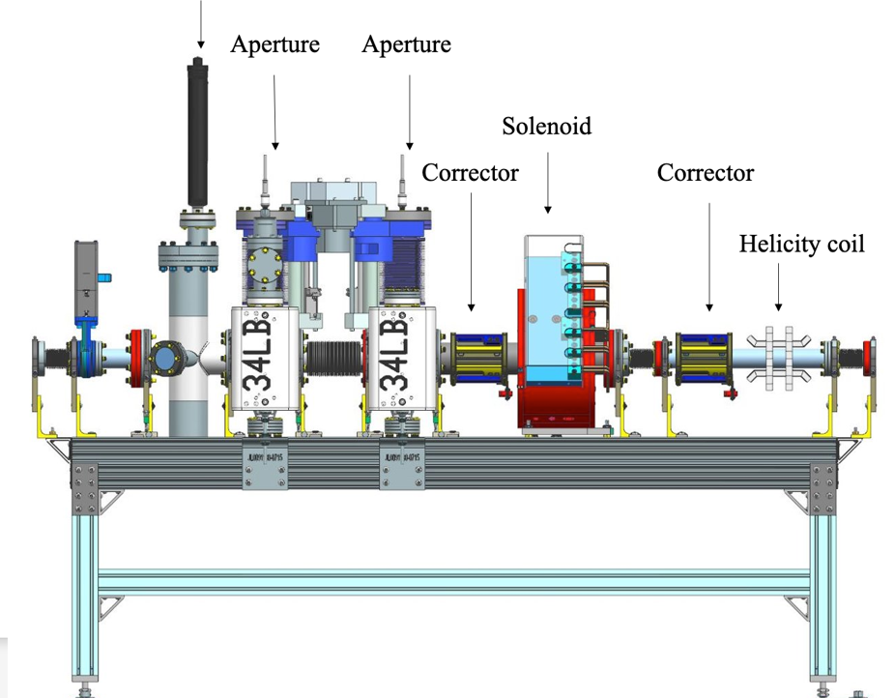
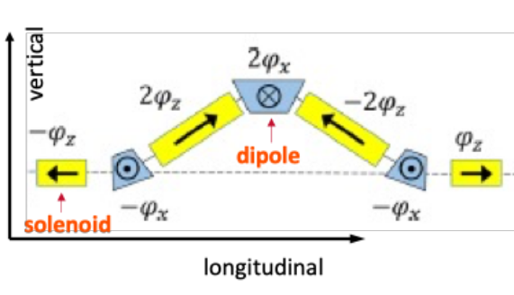
A focal point in the Ce⁺BAF collaboration
Concept for an SRF capture with embedded solenoid focusing
A high-power positron converter based on a recirculated liquid metal in-vacuum target
Computational Fluid Dynamics benchmarking of a high-power rotating solid target
Evaluating large emittance beams at CEBAF
Start-to-End beam dynamics tracking
Milliampere-class spin polarized electron source
Spin rotator concept for Ce⁺BAF
A “universal” CW polarized electron injector
Notes:
Use for: Introducing new topics
To change the photo: Right-click on photo and select change photo

Slide 8
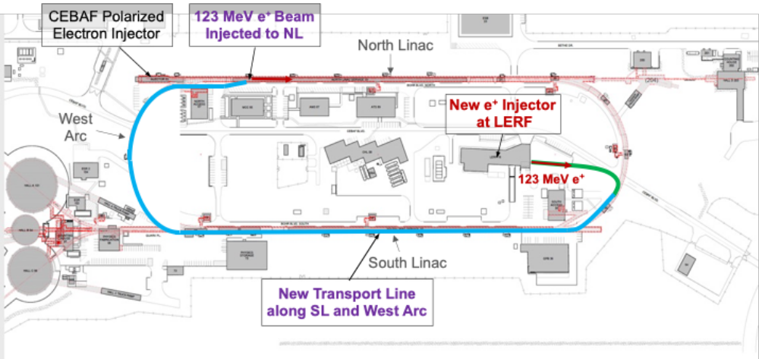










In conclusion
In FY27 Andriy will be leading the team documenting our assessment for adding a CW polarized positron beam capability
The LDRD Strategic Hire and the program in general has been critical to having the the opportunity to support these critical
Notes:
Before sharing your presentation, confirm:
Fonts are consistent
Images meet quality standards
Charts use template colors
Footer information is current
Spell check completed
Links are working
File size is optimized

