Slide 1
Heterogeneous Quantum Systems Initiative
Ben Lawrie, Gilles Buchs

Slide 2


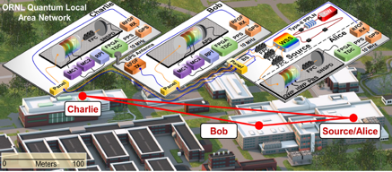


Initiative Overview
Quantum
networking
Quantum
sensing
Enable scalable networks of heterogeneous quantum computing and quantum sensing platforms through coherent transduction of quantum information, enabled by closely coordinated cross-cutting research themes identified by the ORNL quantum roadmap.
Quantum
materials
Quantum
computing
FY 27
Theme 1: Quantum transduction across scalable quantum networks
Theme 2: Quantum sensing, spectroscopy, and imaging
Theme 3: Hybrid workflows
Notes:
Ben to present

Slide 3
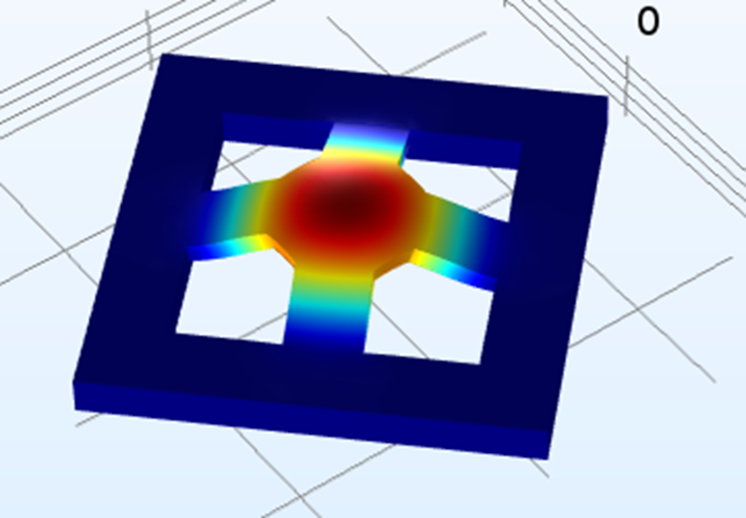
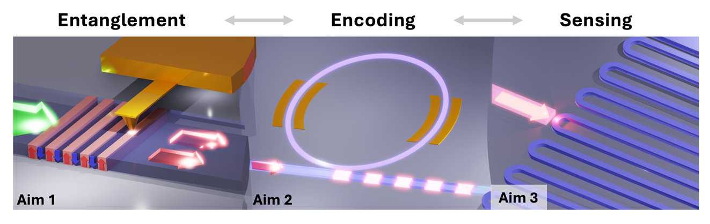
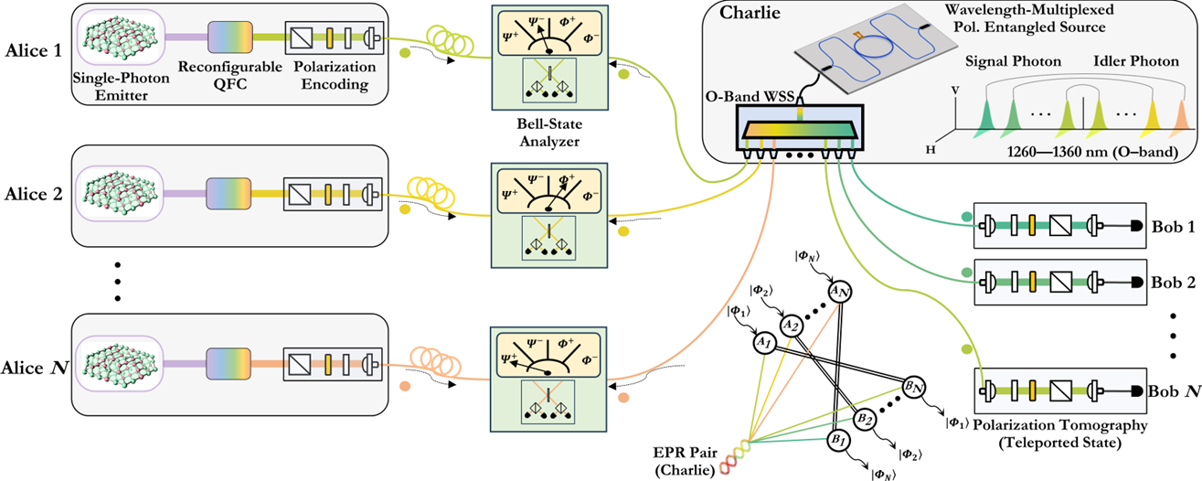
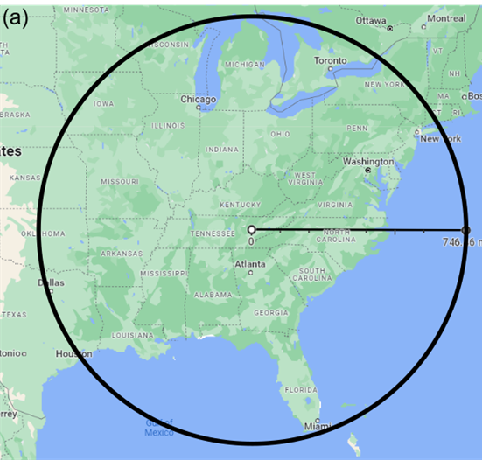
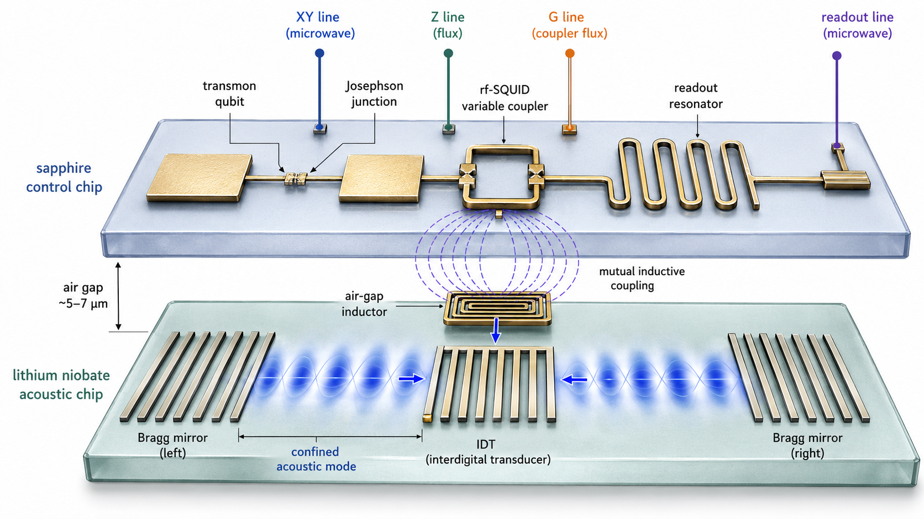
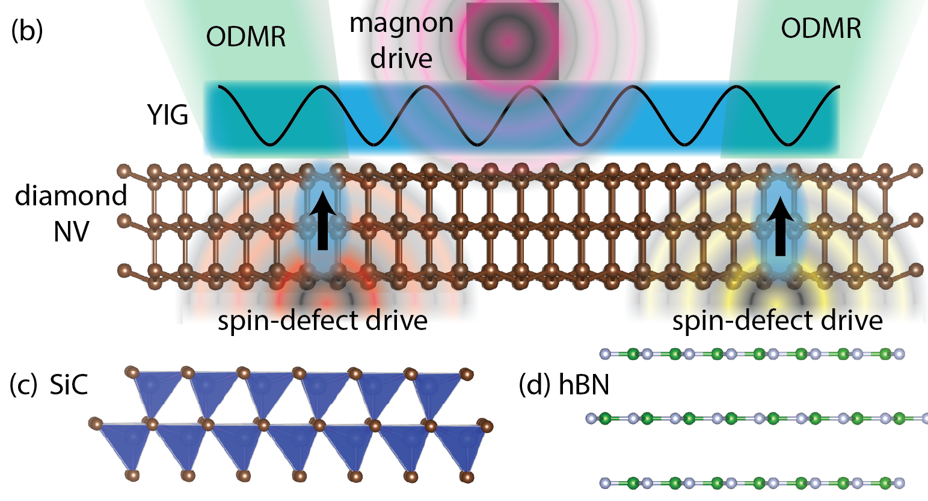
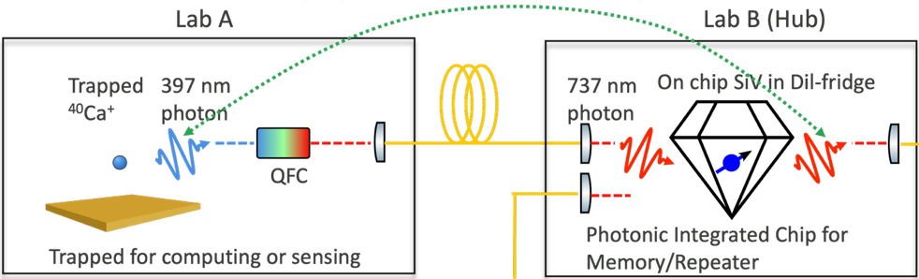
Initiative Integration (hybrid networks)
Optomechanical Devices for Quantum Transduction
(FY26; PI: Claire Marvinney)
Nonlinear Quantum Materials for Lab-to-Fab for Monolithic Integrated Quantum Photonics (FY25; PI: Kyle Kelley)
Reconfigurable Quantum Networking with Wavelength-Multiplexed Single-Photon Emitters (FY25; PI: Jiafeng Cui)
Towards National Scale Quantum Classical Optical Communications (FY25; PI: Joe Chapman)
Superconducting Qubit-Acoustic Resonators for Error correction & Sensing (FY27; PI: Nirjhar Sarkar)
Heterogeneous Quantum Interconnects for Scalable Ion-SiV Networks (FY27; PI: Jiafeng Cui)
Spin–Magnon Transduction at Heterostructured Quantum Interfaces (FY27; PI: Matt Brahlek)

Slide 4
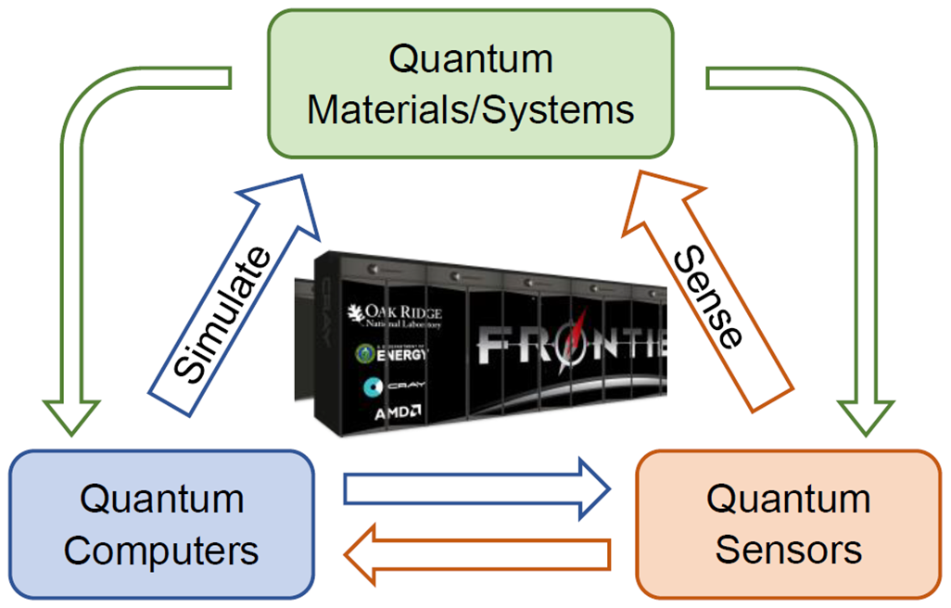
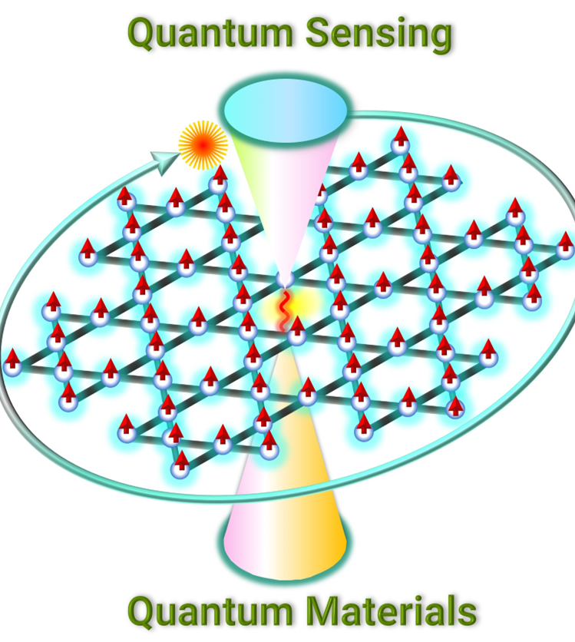
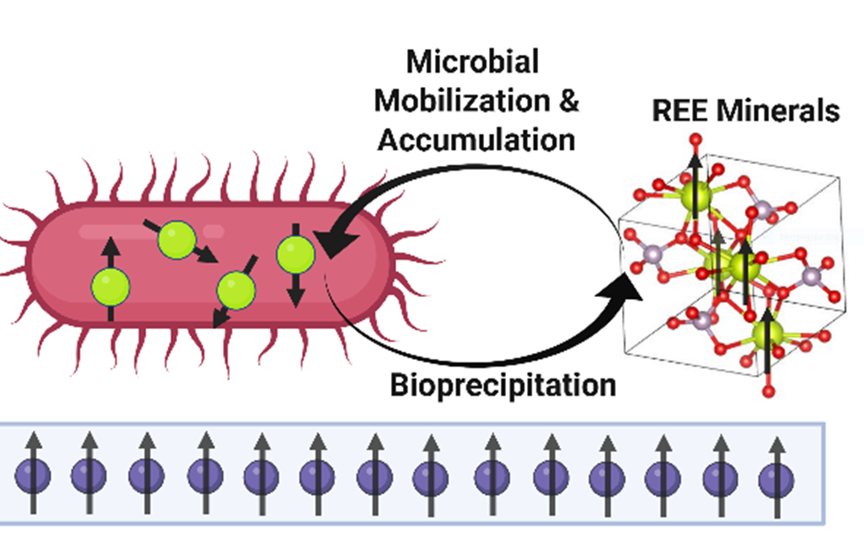
Initiative Integration (sensing)
Codesign of Entanglement-Enhanced Quantum Sensing protocols (FY25; PI: Yan Wang)
Heterogeneous Quantum Interconnects for Scalable Ion-SiV Networks (FY27; PI: Jiafeng Cui)
Spin–Magnon Transduction at Heterostructured Quantum Interfaces (FY27; PI: Matt Brahlek)
Quantum Sensing of Entangled Chiral Excitations
(FY26; PI: Hu Miao)
Interfacing Quantum and Biology: Critical Materials Sensing & Advancing Energy Solutions Through Quantum Sensing
(FY26; PIs: Ivan Vlassiouk and Brian Sanders)

Slide 5
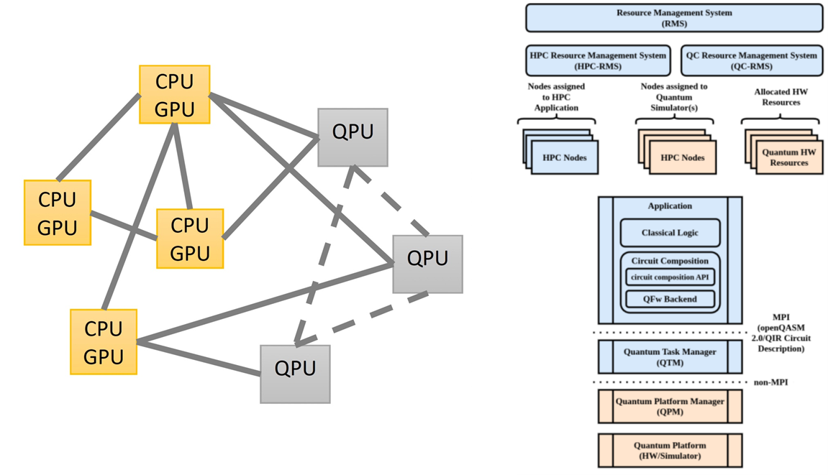
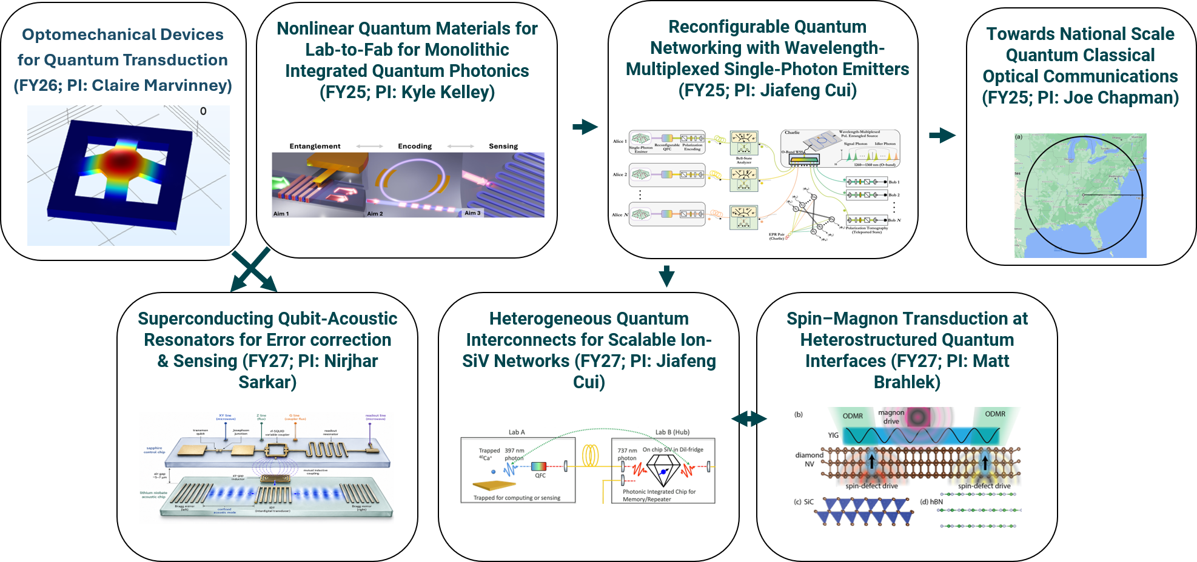
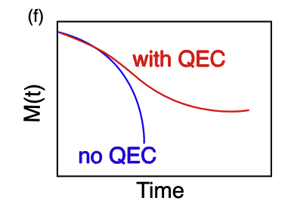
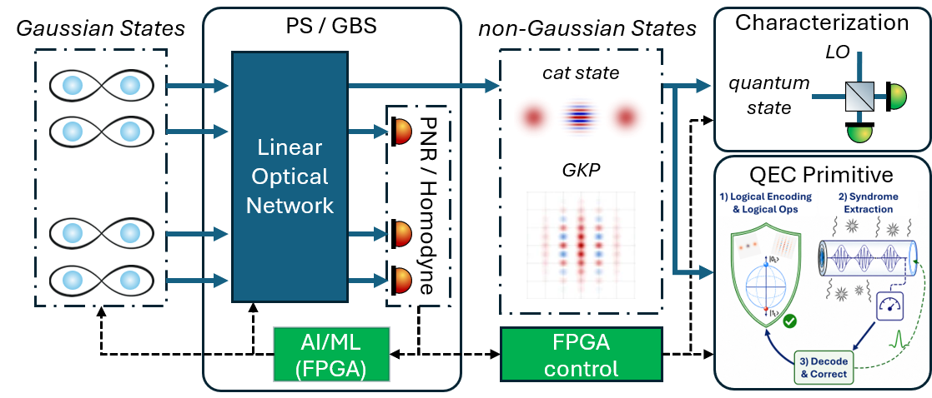

Initiative Integration (Hybrid workflows)
Superconducting Qubit-Acoustic Resonators for Error correction & Sensing (FY27; PI: Nirjhar Sarkar)
Software Framework for Integrated HPC/QC
(FY25; PI: Daniel Claudino)
Efficient Generation of Photonic Quantum Resource States for Quantum Error Correction (FY27; PI: Alberto Marino)
Nonequilibrium Dynamics of the Fermi-Hubbard Model with 100 Logical Qubits(FY27; PI: Phil Lotshaw)

Slide 6
