Slide 1
Big Area Additive Manufacturing – from Concept to Commercialization
September 16, 2026
Yarom Polsky, PhD
Director, Manufacturing Science Division

Slide 2


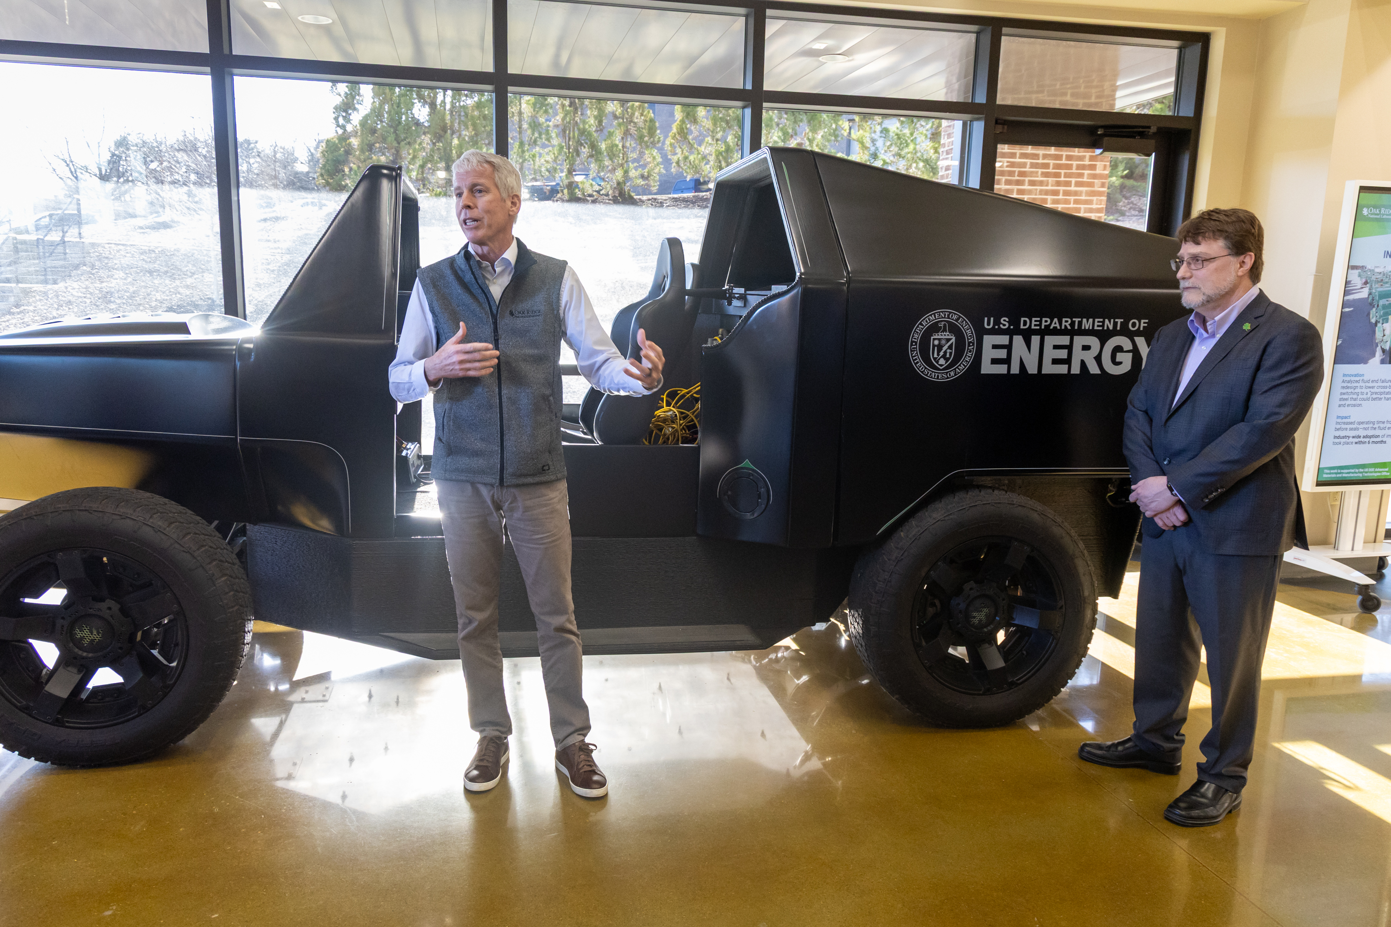
LDRD connected ORNL strengths into the MDF
LDRD enabled ORNL to discover how to use manufacturing platforms in different and novel applications.
3D printing using waste fibers
Commercial partnerships
SM2ART collaboration
Workforce development
30+ technical collaborations
$40M industry savings
Big Area Additive Manufacturing
Nanocellulose Reinforced Polymers
Transformational Challenge Reactor
High Precision Machining
3D-printed car
First AM part in live reactor
300+ end users
Cross-laboratory collaboration
200+ materials developed
Industry partners
Notes:
Big Area Additive Manufacturing
Conventional additive manufacturing techniques were not scalable for large scale polymer deposition. ORNL partnered with different companies to develop new capabilities in additive manufacturing through different deposition methods and control deposition heads.
19 material suppliers, 17 equipment manufacturers and five contract manufacturers and over 300 end users that are now using large scale polymer printing
Over 200 different materials (including carbon fiber, glass fiber and bioderived materials) that have been developed out of the polymer systems
Follow on funding from Advanced Manufacturing Office (~$20M) and private investment (~$600M)
Nanocellulose Reinforced Polymers for Additively Manufactured Structural Composites (6945) (2014-2015)
ORNL research into microfibrils and nanofibrils corresponded with a state of emergency in Maine, as 4 papermills shuttered.
Development of 3D printing of nanocellulose cells lead to a new public-private partnership between ORNL and the University of Maine (The Hub and Spoke Specialized Materials and Manufacturing Alliance for Resilient Technologies (SM2ART)) focused on driving down the cost of manufacturing by using locally sourced materials
SM2ART has forged more than 50 industry partnerships across the country.
Transforming and expanding existing materials supply chain (locally sourced materials)
Workforce development
$65M research budget (AMTO) (approximately half has gone to University of Maine)
Concept Development for a Transformational Challenge Reactor (9562) (2018)
BWXT Technologies presented desire to use additive manufacturing in nuclear applications… Nuclear energy systems remained rooted in outdated concepts (1950s-1960s)
First additive manufactured brackets that went into a live nuclear reactor
Cross laboratory collaboration (FFSED, Materials)
~$98M in research ($72M for the TCR and $26M from present day AMMT)
Industry partners include Kairos and Framatone
High Precision Machining of Additively Manufactured Components (9718) (2019-2021)
AM printing still required machining after the fact, which introduced error into the printed part, in addition to expanding time and resource costs
By developing different molds and processes, ORNL enabled savings to the machine cutting industry and developed ties with commercial partners
MSC (Millamax technology) estimates $750M in savings for their customers
Development of workforce training through the Department of Defense (America’s Cutting Edge), leading to approximately 10,000 American workers gaining new training to remain competitive.
Multidisciplinary strengths of the lab contributed to MDF’s success
20 R&D 100 awards
Photo caption: During a tour of the Manufacturing Demonstration Facility (MDF), U.S. Secretary of Energy Chris Wright pauses to speak in front of a 3D printed car while Laboratory Director Stephen Streiffer looks on. The Secretary was on site during the Oak Ridge segment of his tour of all national labs.
Photo credit: Genevieve Martin

Slide 3
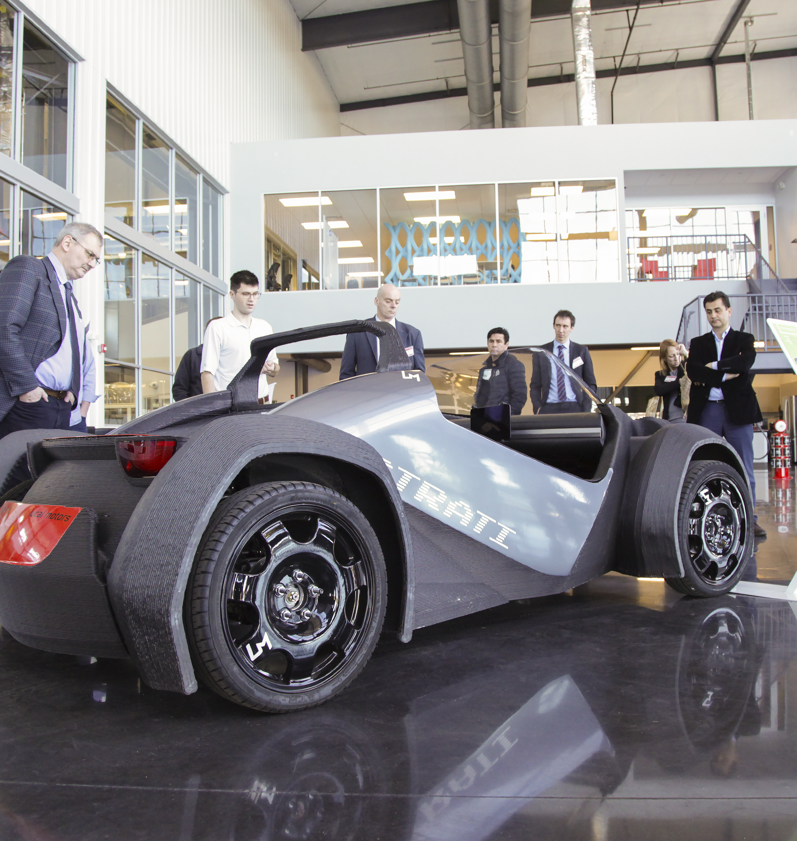
ORNL’s Big Area Additive Manufacturing grew from a lab idea to a national supply chain
2008
2013
2014
Francois Pin proposes “Automated Freeform Construction Technologies and Materials” to LDRD, scaling rapid prototyping into large-scale additive construction concepts.
ORNL pilots polymer additive manufacturing, seeds Big Area Additive Manufacturing (BAAM), partners with Cincinnati; pellet feedstock decision enables commodity material supply chain.
First collaborative agreement with Cincinnati launches BAAM commercialization. IMTS “Strati” car demo proves high-throughput composite deposition, spurring demand for large-format printers and CF-ABS pellets.
Notes:
ORNL began scaling rapid prototyping into construction-scale additive manufacturing in 2008.
By 2013, ORNL and Cincinnati Inc. launched BAAM, crucially deciding to extrude pellets, not filament. This dropped material costs from ~$50–$100/kg to near $1/kg commodity pricing and unlocked immediate access to the existing injection-molding ecosystem.
That choice also enabled fast material iteration, including 20% carbon-fiber ABS, and gave BAAM a ready-made supply chain from day one. CF-ABS is a composite material that combines acrylonitrile butadiene styrene (ABS) plastic with chopped carbon fibers.
The 2014 IMTS “Strati” car demo and 2015 Shelby Cobra proved BAAM’s speed and flexibility while drawing global attention.
These high-visibility projects did more than showcase technology: they created demand signals for new machines, services, and materials, seeding a domestic ecosystem.

Slide 4
ORNL’s Big Area Additive Manufacturing grew from a lab idea to a national supply chain
2008
2013
2013
2014
Francois Pin proposes “Automated Freeform Construction Technologies and Materials” to LDRD, scaling rapid prototyping into large-scale additive construction concepts.
ORNL pilots polymer additive manufacturing, seeds Big Area Additive Manufacturing (BAAM), partners with Cincinnati; pellet feedstock decision enables commodity material supply chain.
First collaborative agreement with Cincinnati launches BAAM commercialization. IMTS “Strati” car demo proves high-throughput composite deposition, spurring demand for large-format printers and CF-ABS pellets.
ORNL pilots polymer additive manufacturing, seeds Big Area Additive Manufacturing (BAAM), partners with Cincinnati; pellet feedstock decision enables commodity material supply chain.
Notes:
ORNL began scaling rapid prototyping into construction-scale additive manufacturing in 2008.
By 2013, ORNL and Cincinnati Inc. launched BAAM, crucially deciding to extrude pellets, not filament. This dropped material costs from ~$50–$100/kg to near $1/kg commodity pricing and unlocked immediate access to the existing injection-molding ecosystem.
That choice also enabled fast material iteration, including 20% carbon-fiber ABS, and gave BAAM a ready-made supply chain from day one. CF-ABS is a composite material that combines acrylonitrile butadiene styrene (ABS) plastic with chopped carbon fibers.
The 2014 IMTS “Strati” car demo and 2015 Shelby Cobra proved BAAM’s speed and flexibility while drawing global attention.
These high-visibility projects did more than showcase technology: they created demand signals for new machines, services, and materials, seeding a domestic ecosystem.

Slide 5
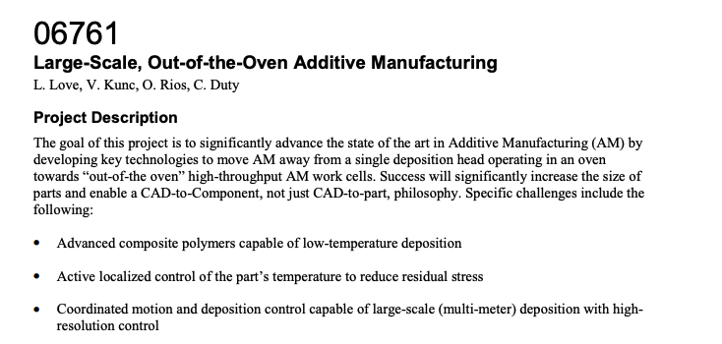
LDRD Investments in BAAM
2013

Slide 6
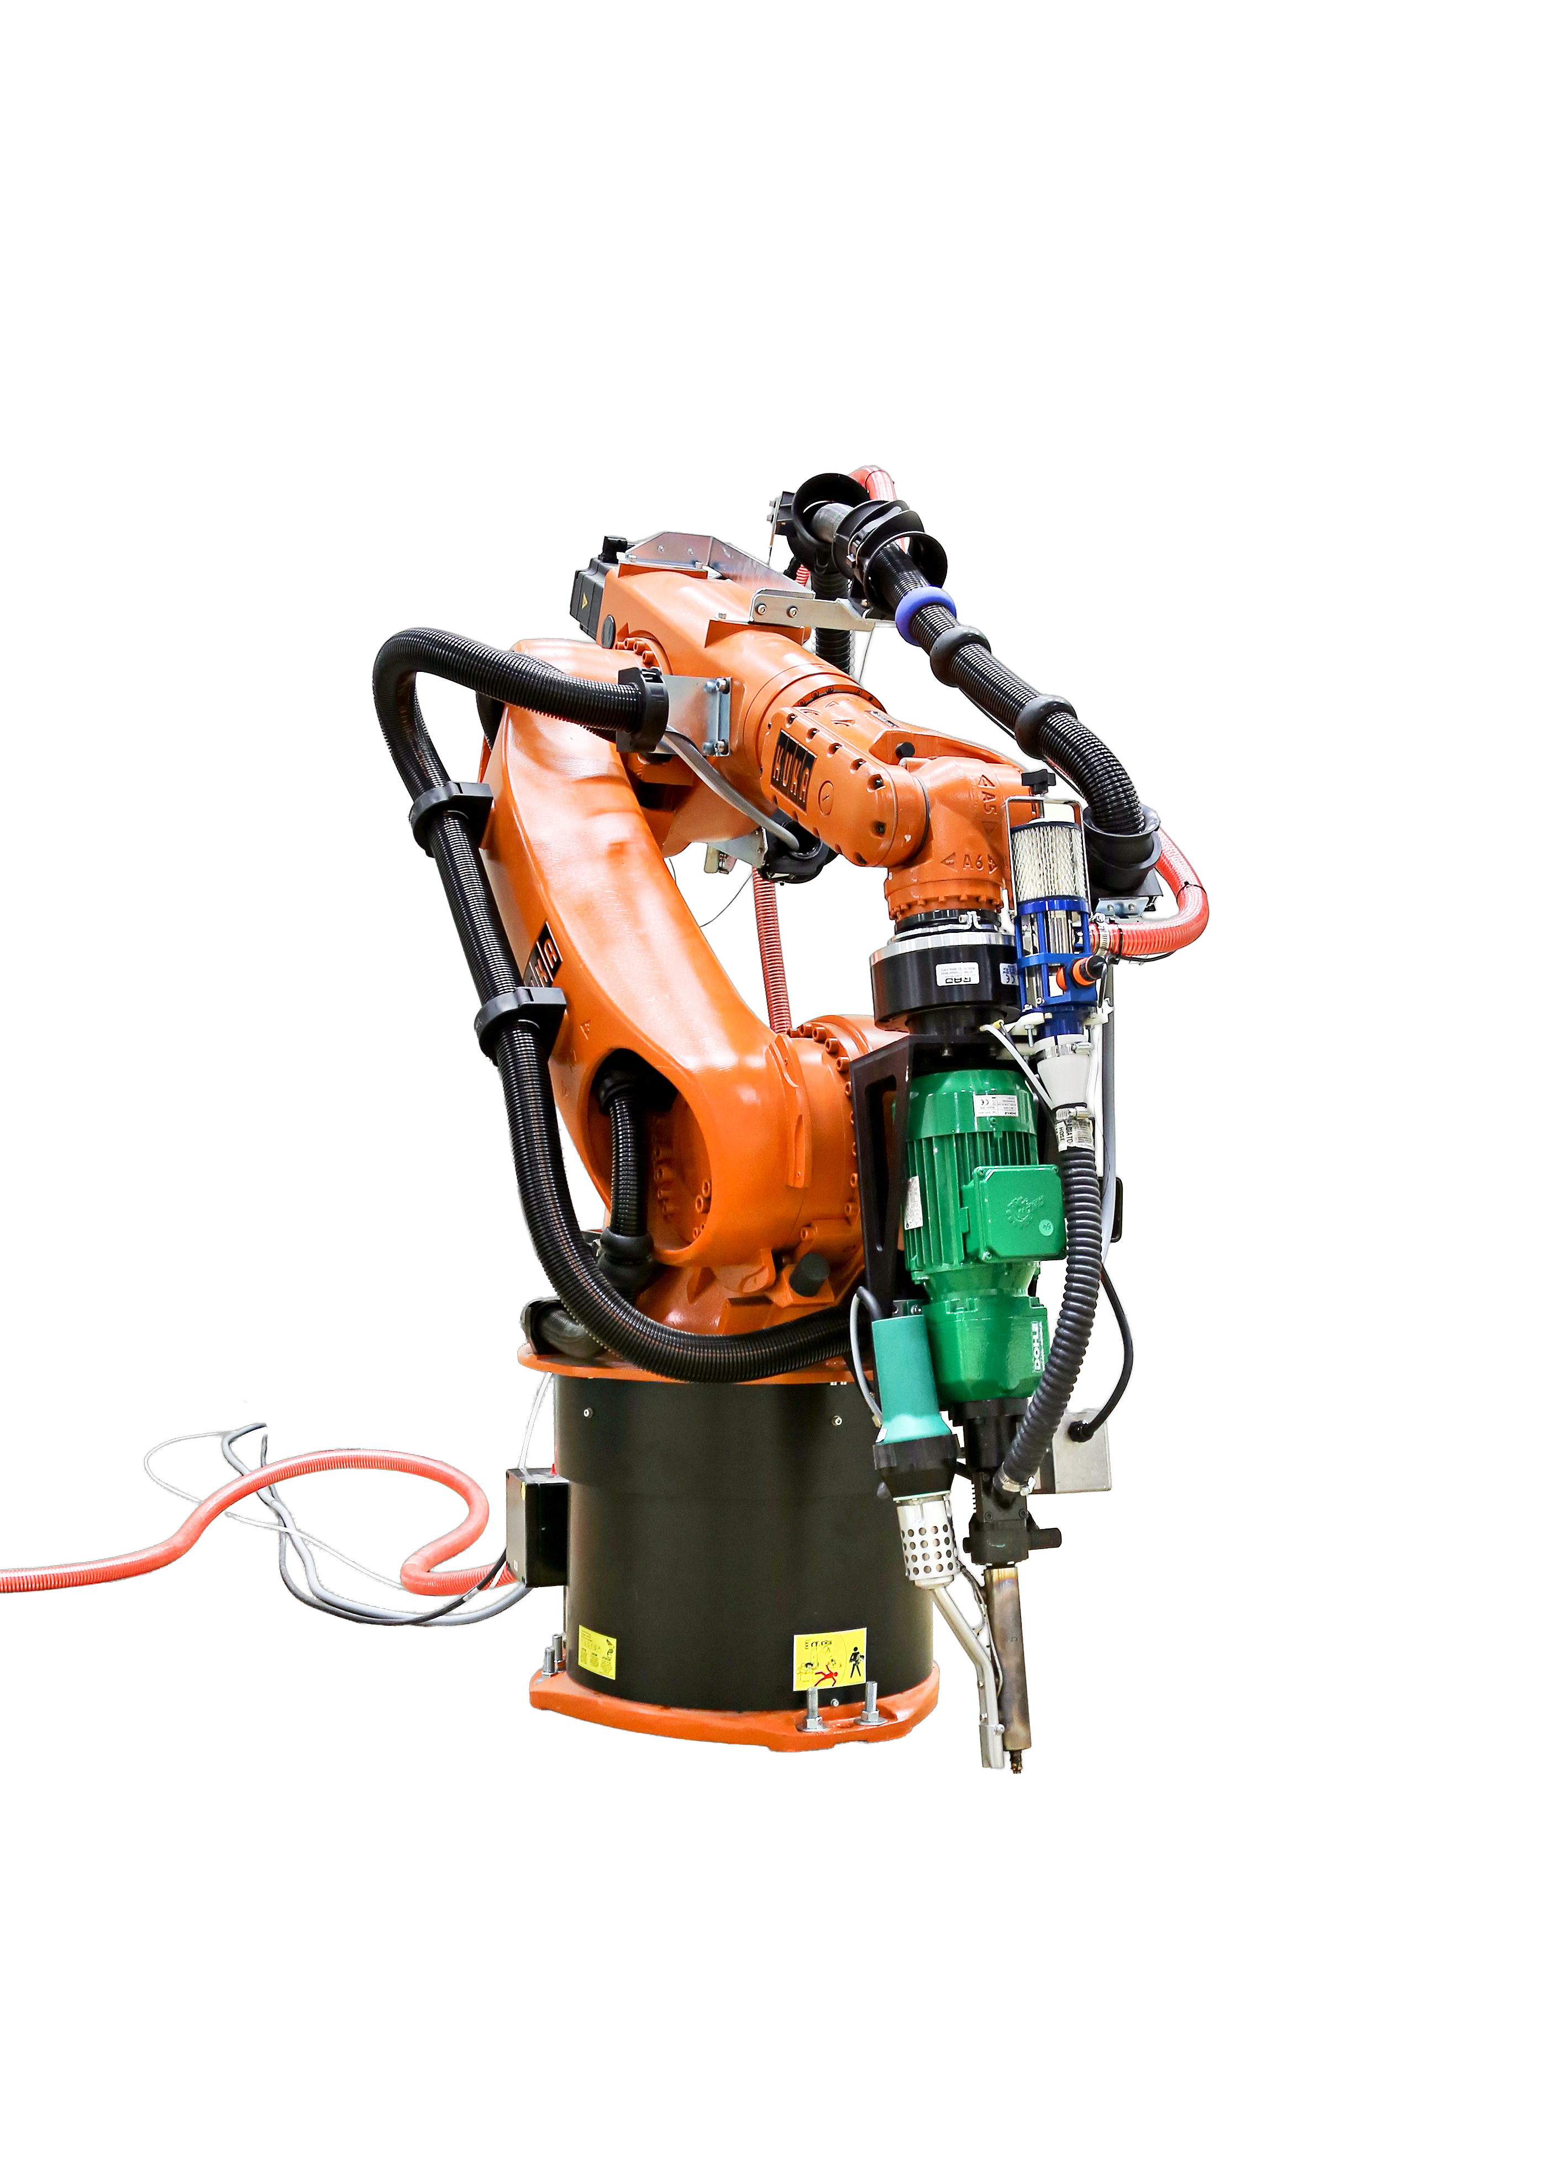
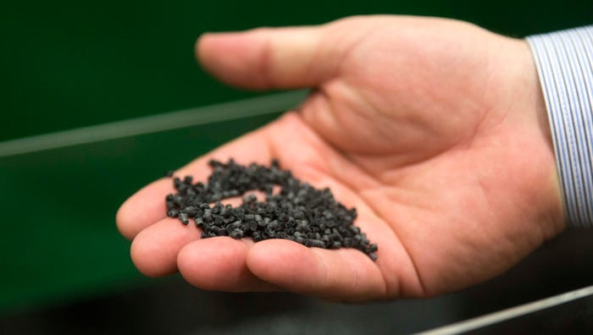
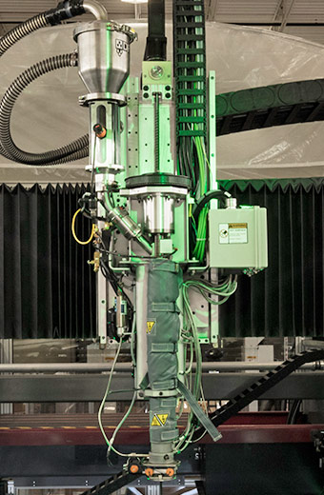
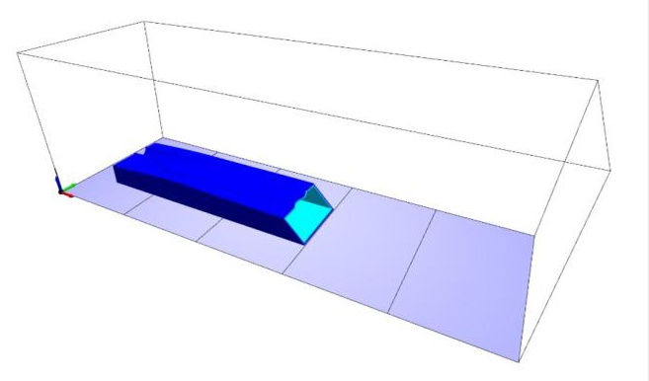
LDRD-supported project enabled key contributions to Large Scale Polymer 3D printing
Material feedstocks with optimized mechanical and rheological properties
Improvements to extruder technology
Slicer software
Notes:
LDRD supported Large Scale, Out of the Oven Additive Manufacturing (2013)
The goal of this project is to significantly advance the state-of-the-art in Additive Manufacturing (AM) by developing key technologies to move AM away from a single deposition head operating in an oven towards “out-of-the oven” high-throughput AM work cells.
September 3, 2025 - A photo of the Big Area Additive Manufacturing (BAAM) machine at rest in the Carbon Fiber Technology Facility in Oak Ridge. Electronic Reference Image – For more images in this

Slide 7
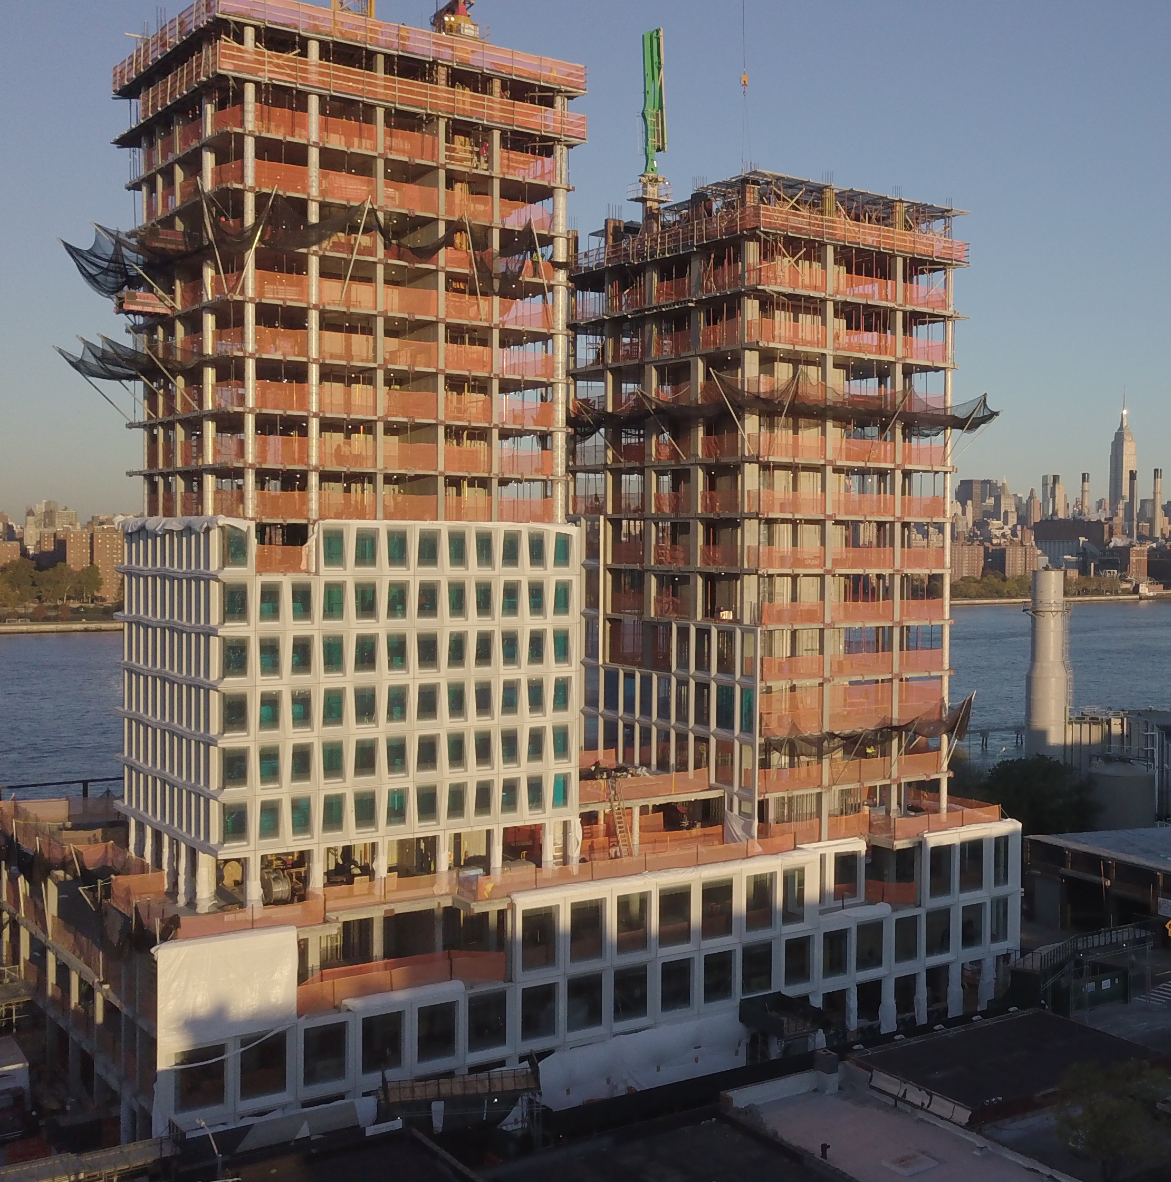
BAAM projects forged supply chains spanning automotive, construction, and nuclear sectors
2015
2016
2018
2025
3D-printed Shelby Cobra debuts, validating CF-ABS and expanding sales and support ecosystems for large-format additive manufacturing (LFAM) technology.
Materials ecosystem grows; CF-ABS tooling standardizes; compounders, recyclates, and multi-material feed systems expand domestic supply chain.
Kairos Power and partners use composite forms for Hermes reactor infrastructure construction, maturing nuclear-grade LFAM supply chain.
ORNL and Gate print molds for Domino Sugar site, the first U.S. building with 3D-printed precast molds. Credit: Gate Precast
Notes:
CI’s BAAM systems, commercialized directly from the CRADA, established a domestic OEM and service base. This move encouraged competitors like LSAM, expanding machine and service diversity.
Materials suppliers plugged in: Techmer PM and SABIC validated carbon-fiber ABS, tested recyclates, and trialed dual-feed extruders, diversifying LFAM’s materials pipeline.
Contract manufacturers like AES filled a critical gap, pairing BAAM with CNC machining and inspection so primes could buy capacity without owning printers. This linked OEMs, suppliers, and end-use industries across aerospace, marine, energy, and defense.
Marquee projects drove sector adoption:
Shelby Cobra raised visibility.
Domino Sugar façade molds proved LFAM in construction supply chains.
Kairos Power tied BAAM into nuclear EPC workflows.
By 2025, LFAM is maturing as a cross-industry supply chain, spanning materials, machines, services, and qualified parts.

Slide 8
Large-scale polymer printing industry impacts

Slide 9

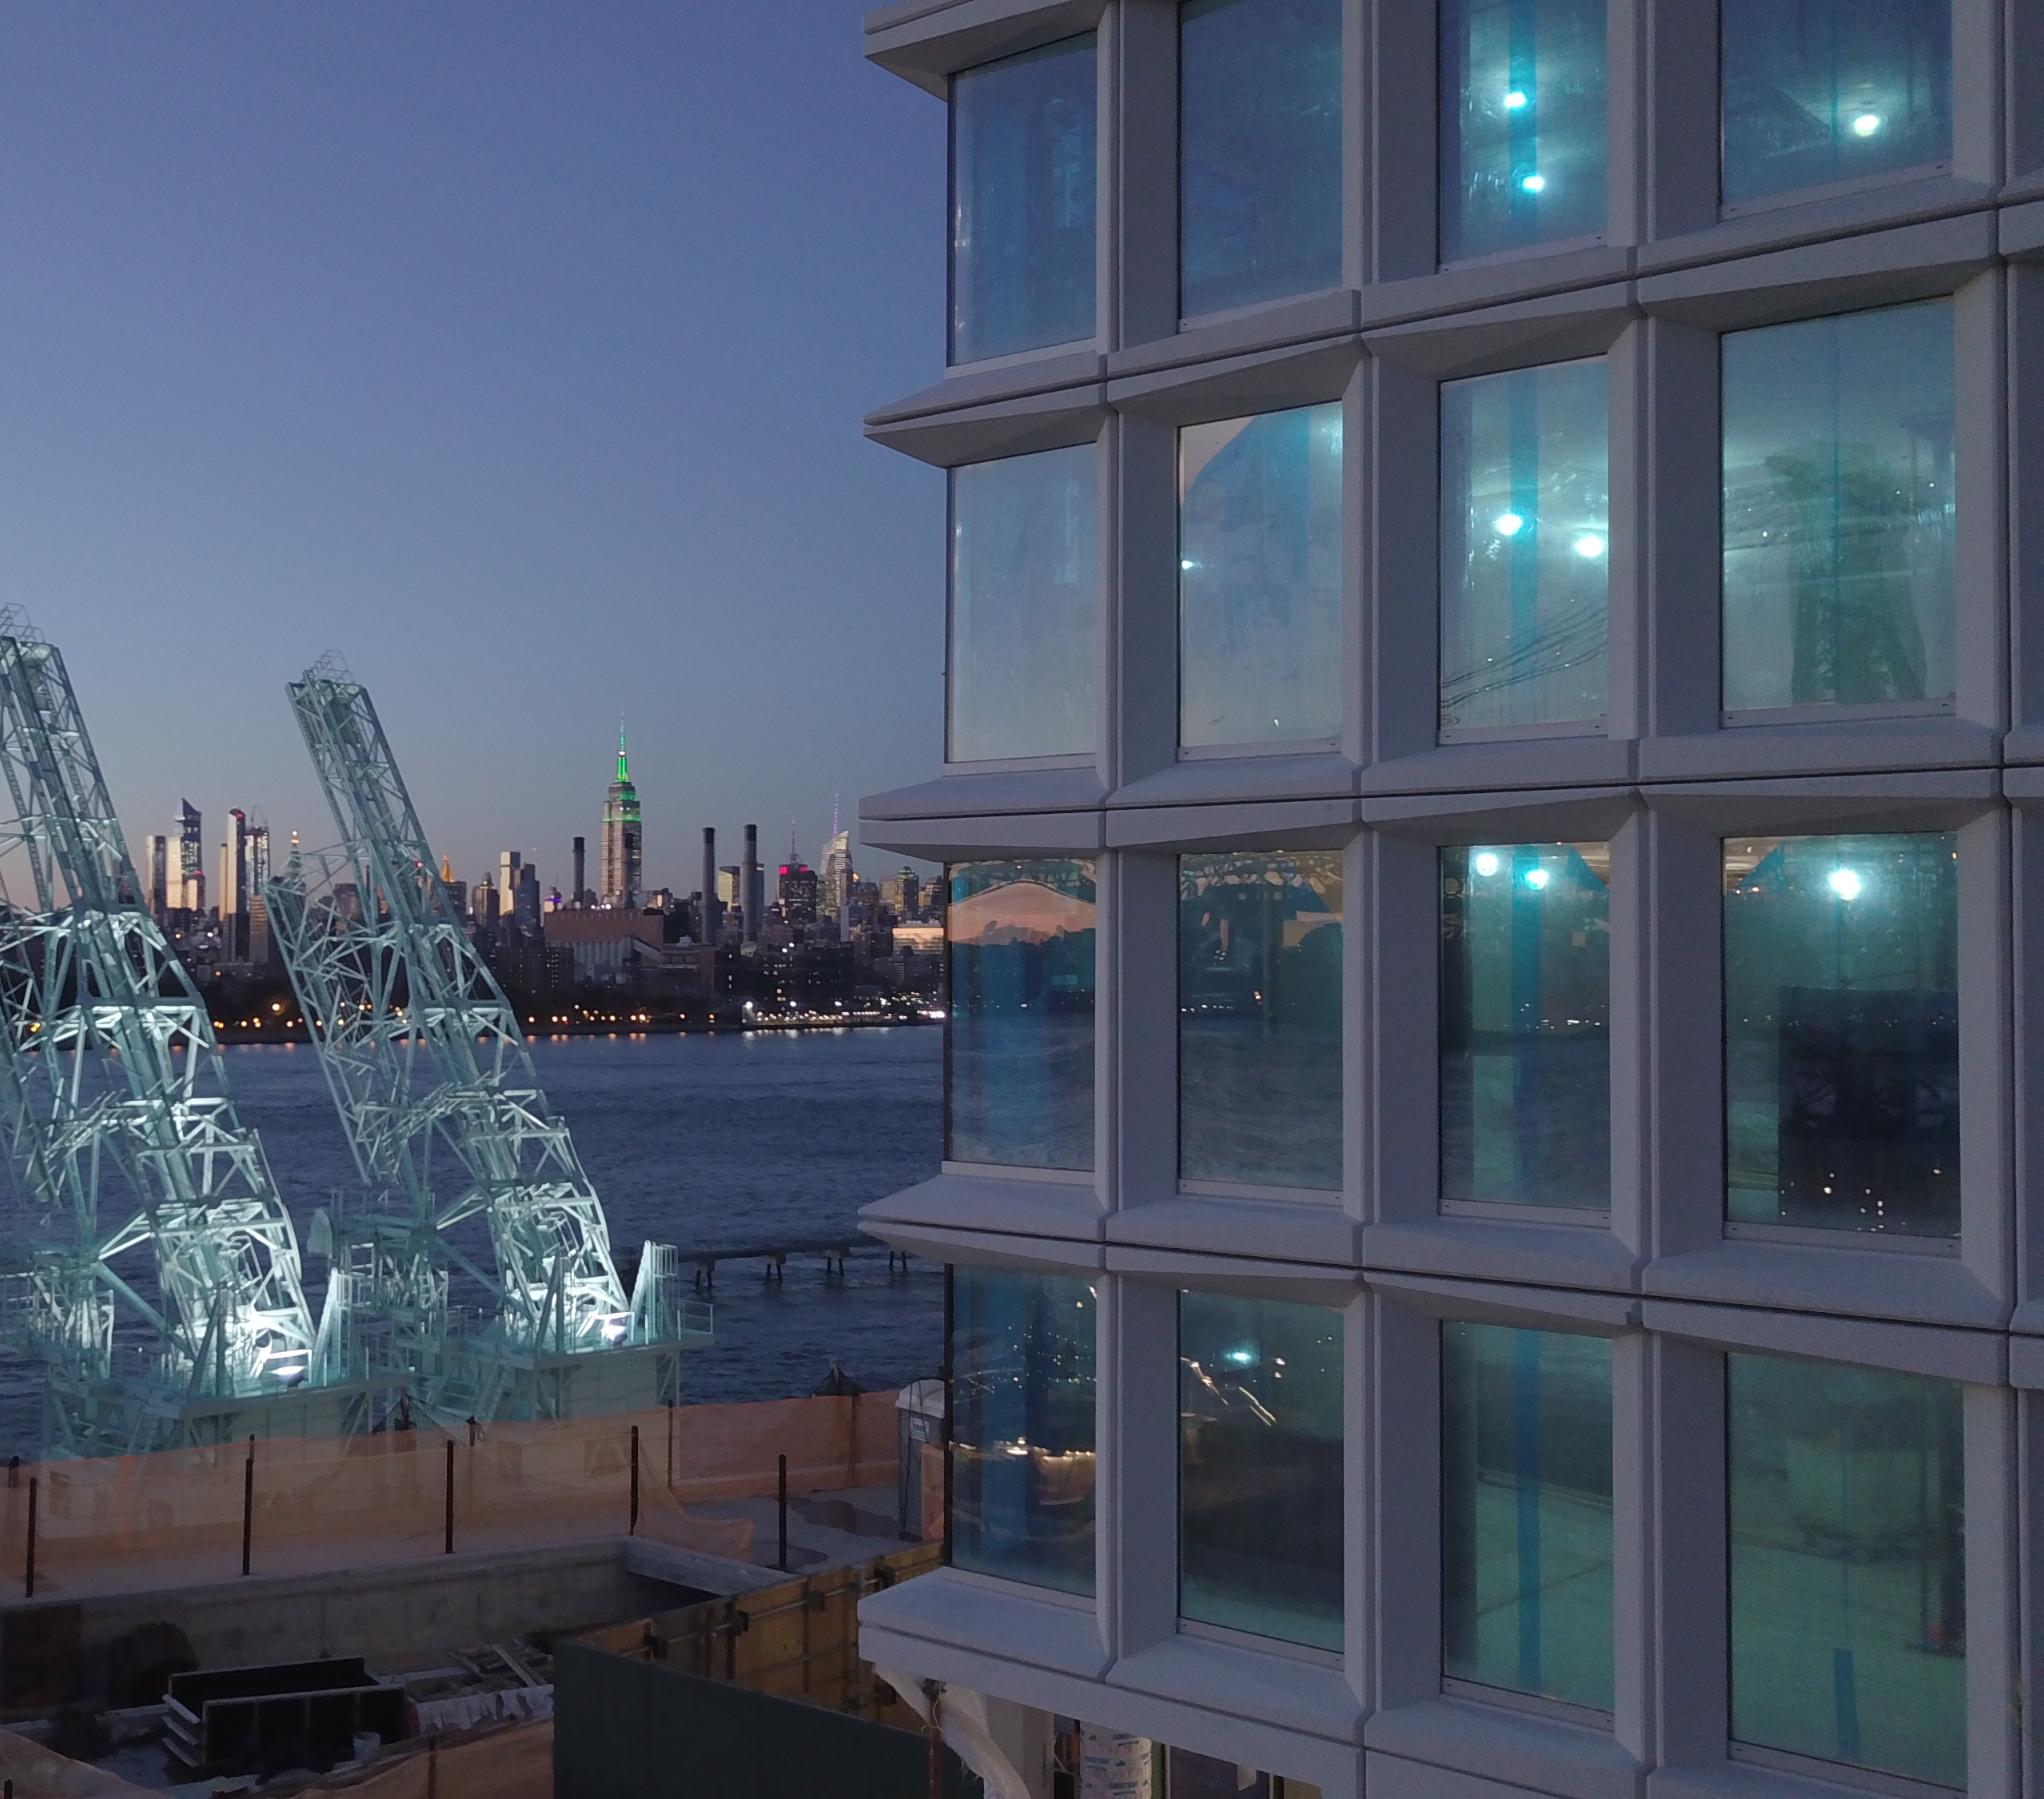
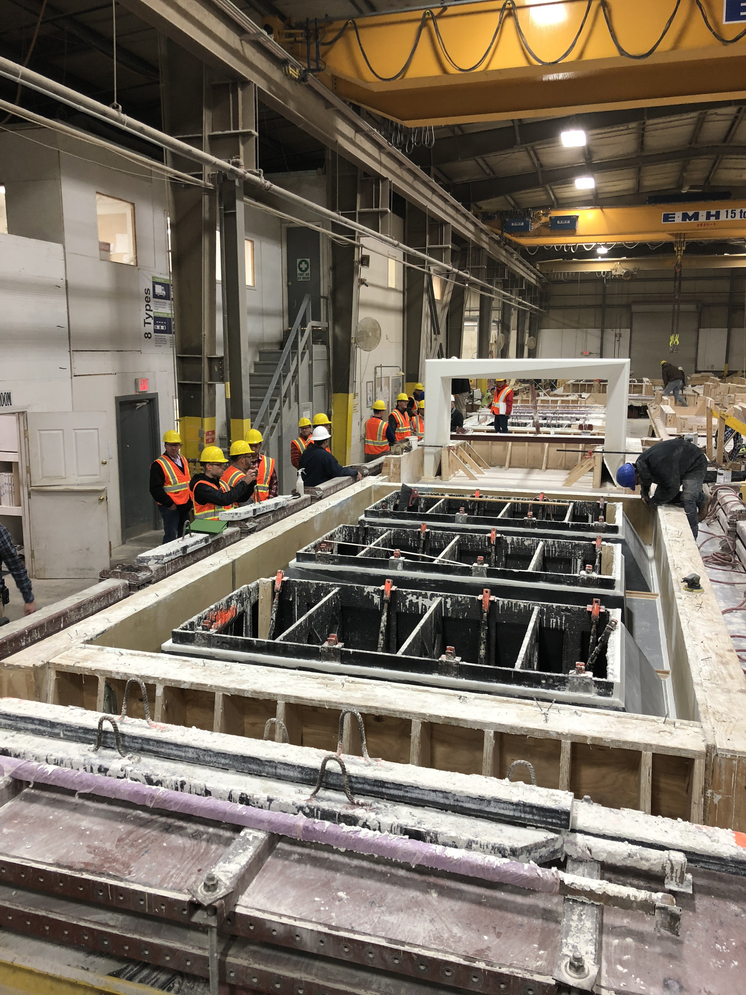
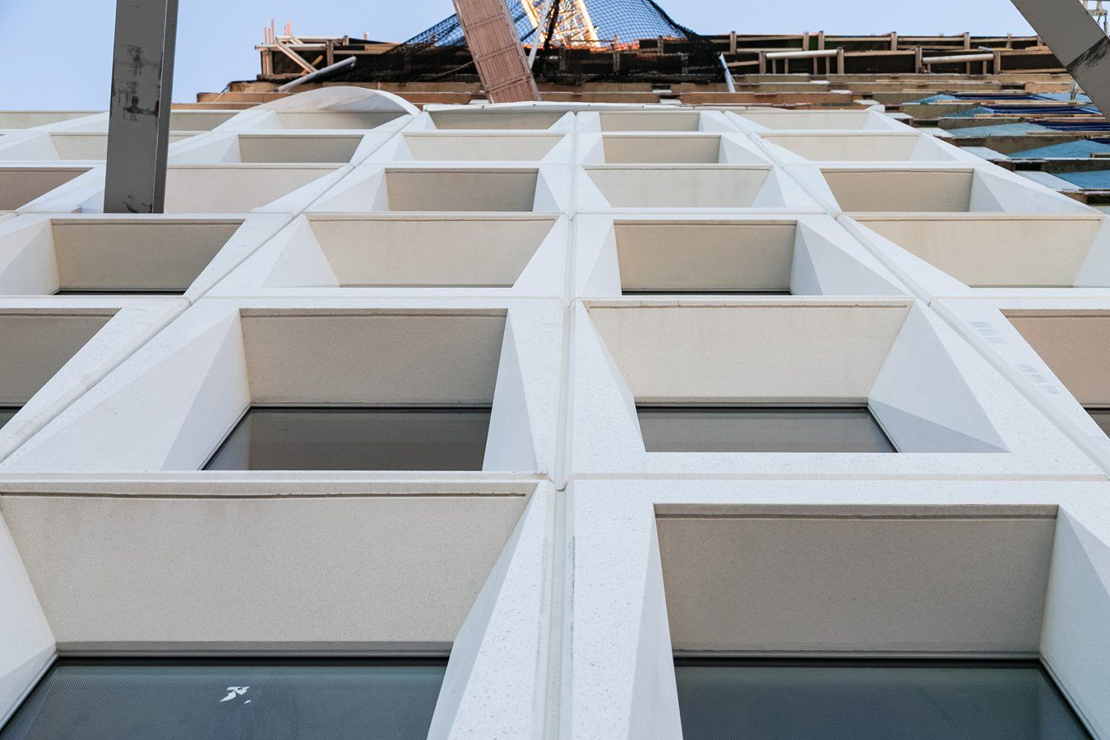


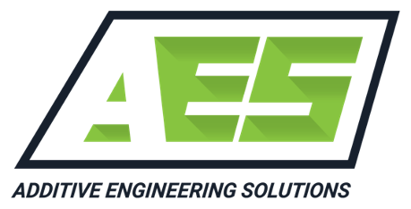

MDF enabled rapid prototyping of complex patterns to make no-waste Al-Ce parts
Reusable 3D-printed molds for pre-cast concrete saves time and costs for construction with complex geometries
v
Used ORNL-developed polymer material, CF-ABS
75% manufacturing cost savings gained per mold
Each mold produced up to 200 castings compared to 3–4 with traditionally manufactured wooden molds

Slide 10

Reusable 3D-printed molds for pre-cast concrete saves time and costs for construction with complex geometries
Used ORNL-developed polymer material, CF-ABS
75% manufacturing cost savings gained per mold
Each mold produced up to 200 castings compared to 3–4 with traditionally manufactured wooden molds
10

Slide 11
MDF enabled rapid prototyping of complex patterns to make no-waste Al-Ce parts
KAIROS
v
Developed and validated large-scale, 3D-printed polymer composite forms for Kairos Power, currently building the Hermes Low-Power Demonstration Reactor
Production timeline is cut down to days, rather than weeks
The molds required mechanical resilience and innovative design and printing strategies, pushing the limits of what additive manufacturing
Possible images:
https://www.ornl.gov/news/3d-printing-reshapes-construction-nuclear-energy
Add Kairos and Barnard Construction logos

Slide 12
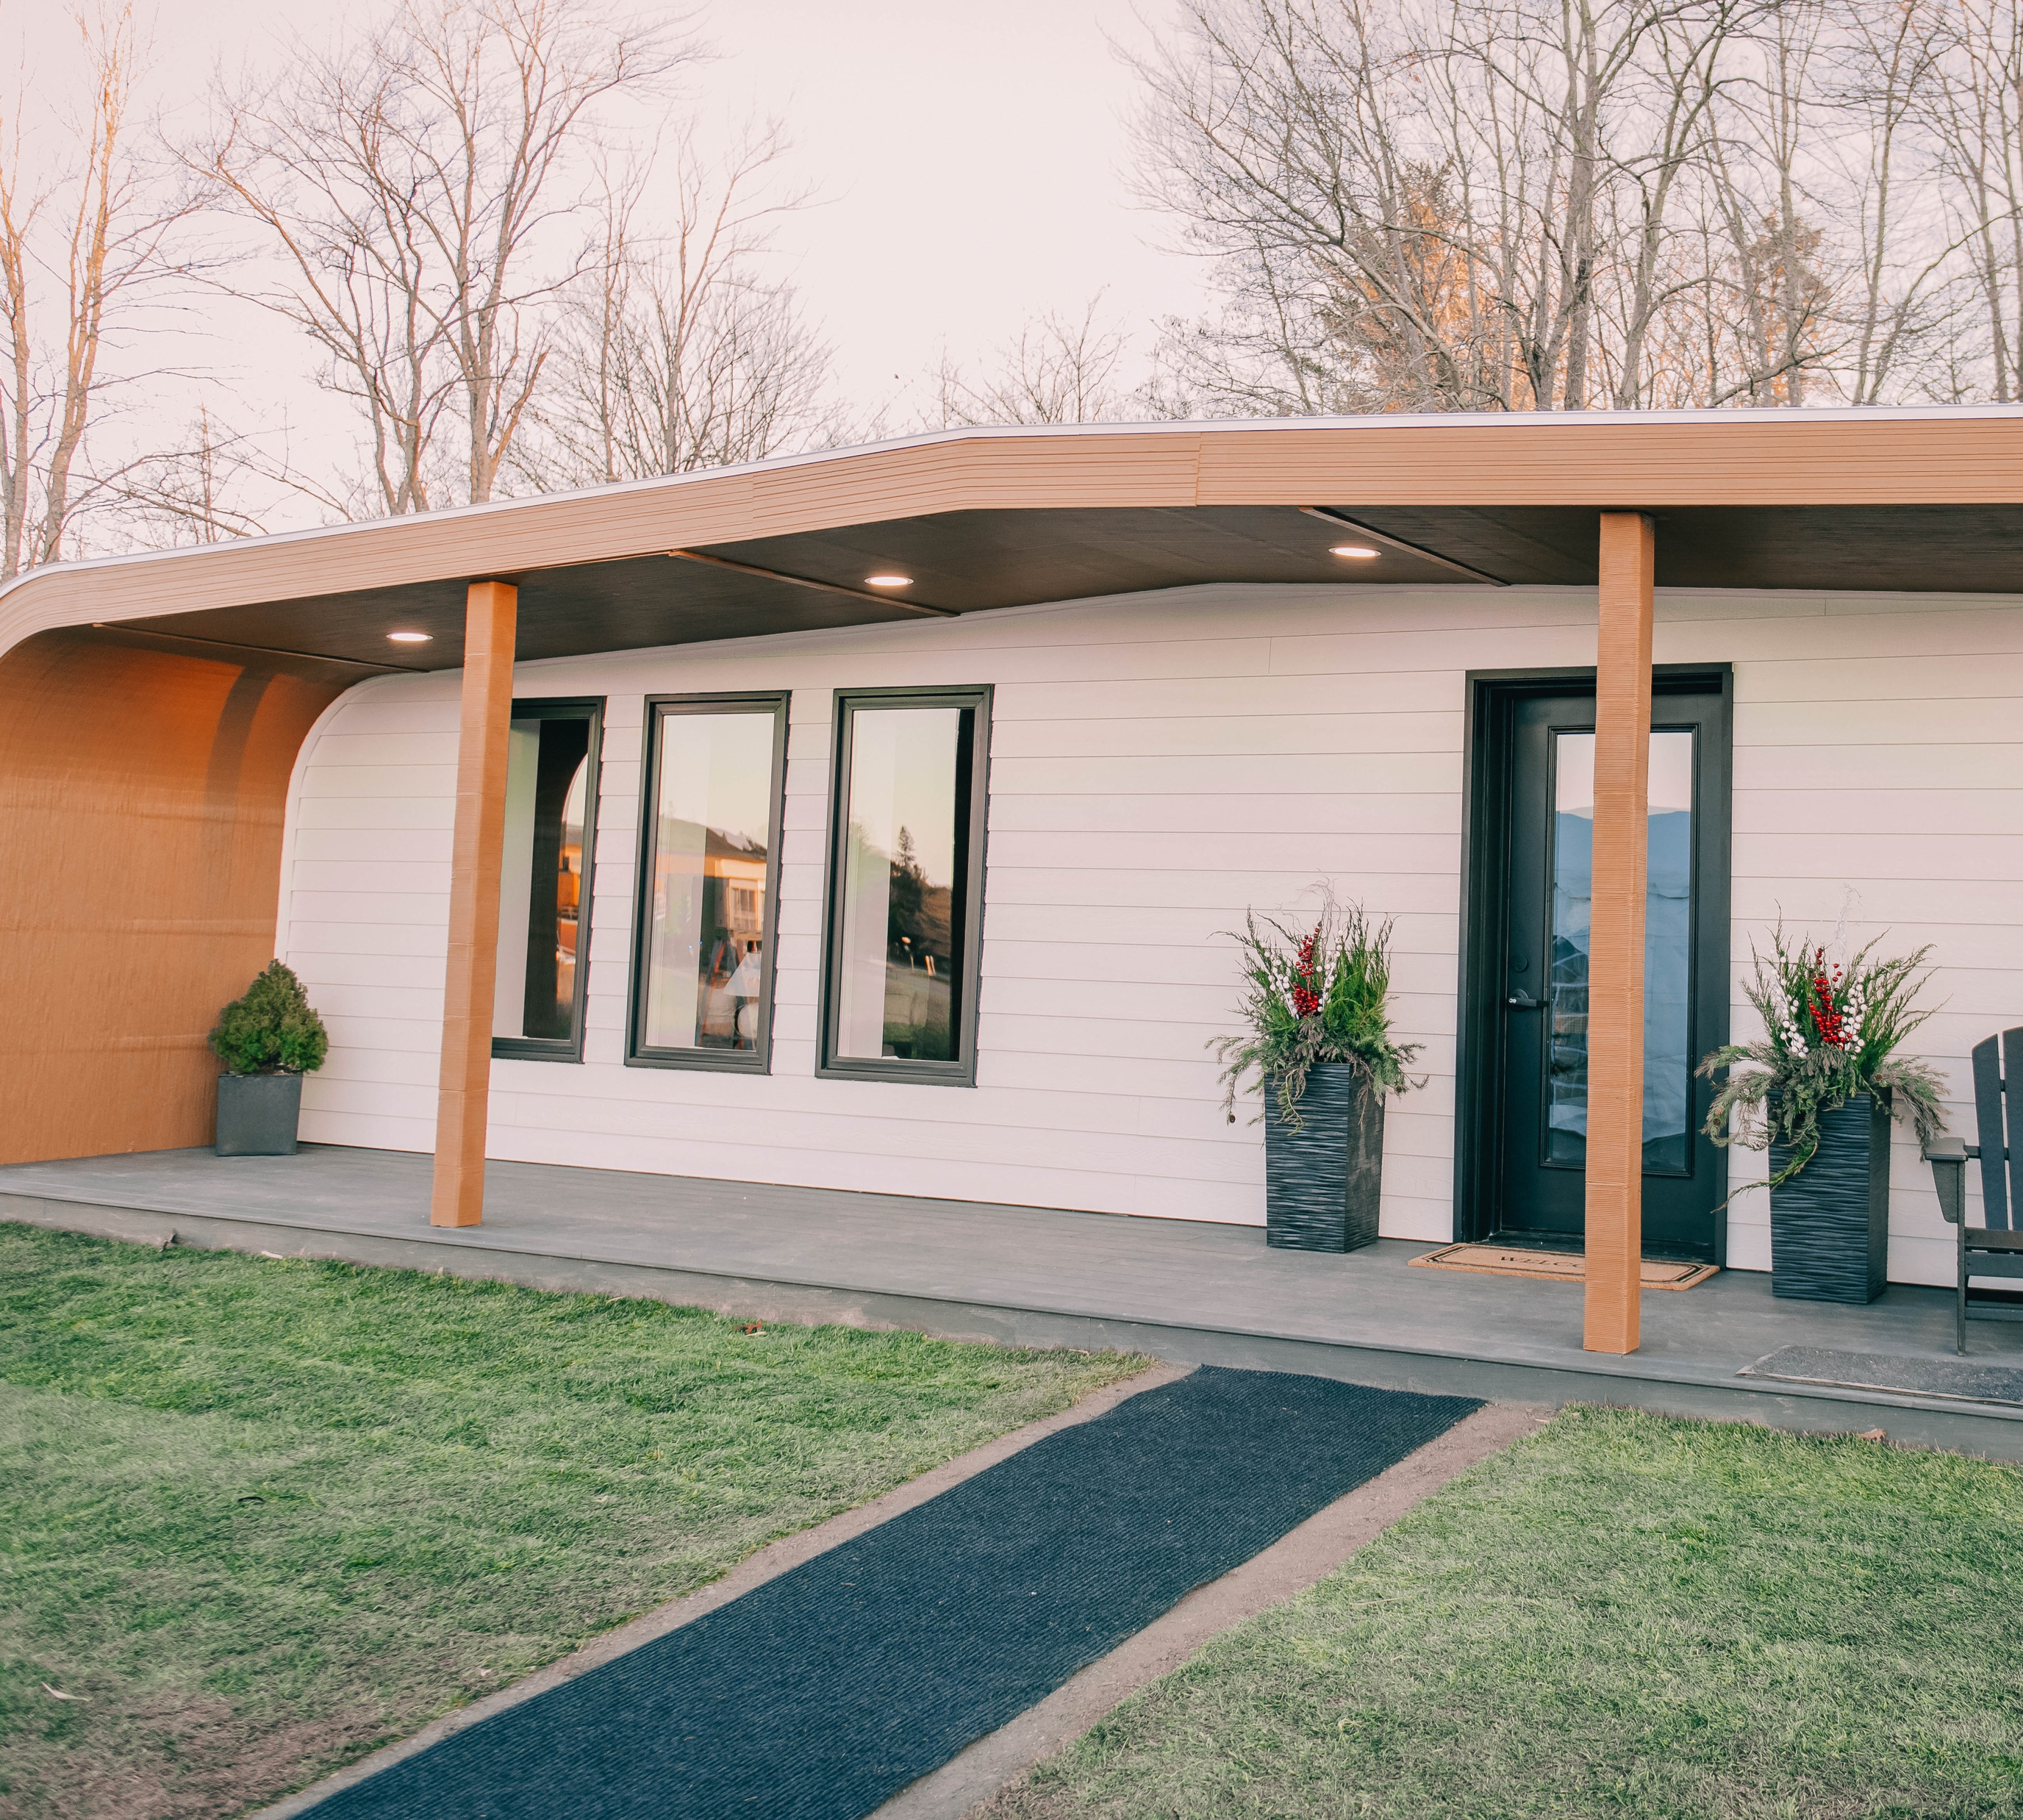

ORNL and UMaine print world’s first 3D-printed, bio-based house through SM2ART program
A single, continuous print path
600 sq-ft finished house
Testbed for the material’s performance over 2 years
Potential for energy efficient, economical housing and net-zero communities

Slide 13
ORNL and UMaine print world’s first 3D-printed, bio-based house through SM2ART program
A single, continuous print path
600 sq-ft finished house
Testbed for the material’s performance over 2 years
Potential for energy efficient, economical housing and net-zero communities
13

Slide 14
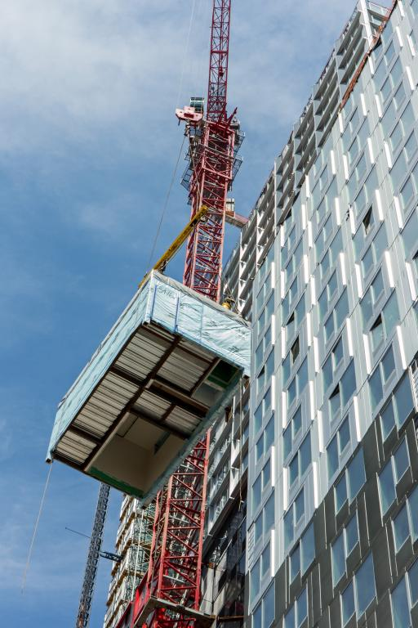
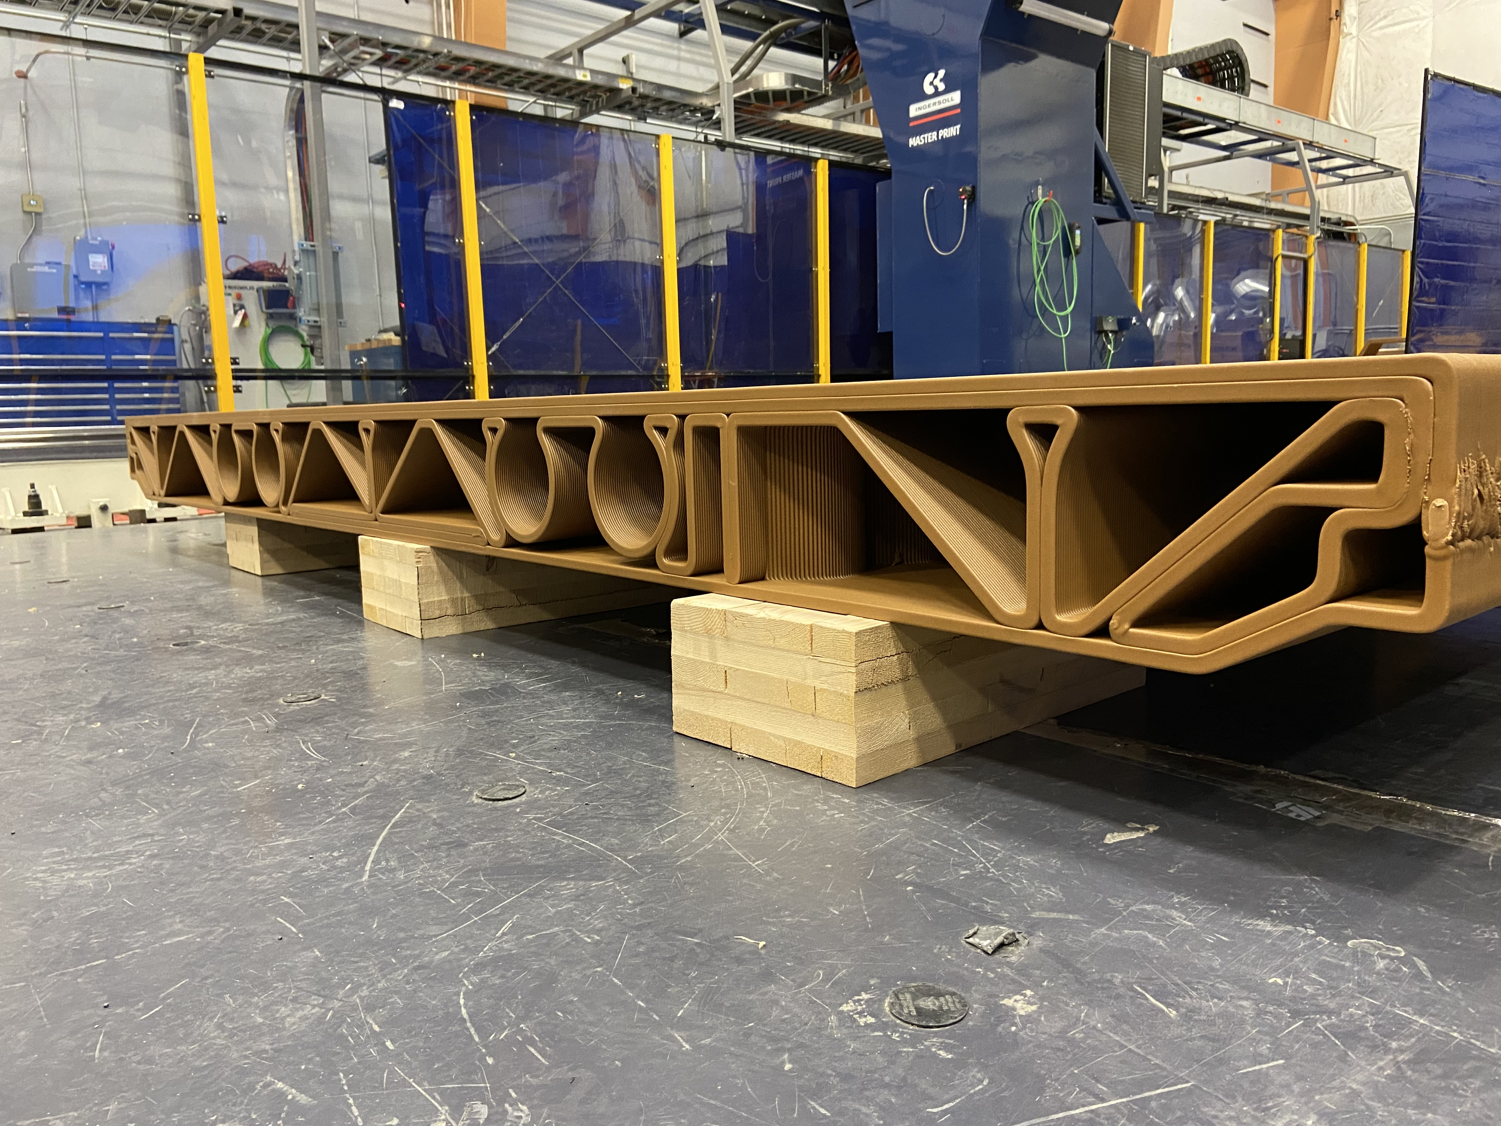
MDF enabled rapid prototyping of complex patterns to make no-waste Al-Ce parts
3D-printed, bioderived multi-story housing cassette reduces materials, waste, and costs
Replaced an assembly made from 31 parts and three materials with a single-material floor panel that is ecologically friendly and has the same strength as traditional steel floor fabrication
Assembly time reduced by 56%. Labor cost reduced by 25%
Removes 53 cubic feet of concrete per floor unit
Reduces part count from 39 parts, 3 materials to 1 part with 1 material

Slide 15
3D-printed, bioderived multi-story housing cassette reduces materials, waste, and costs
Replaced an assembly made from 31 parts and three materials with a single-material floor panel that is ecologically friendly and has the same strength as traditional steel floor fabrication
Assembly time reduced by 56%. Labor cost reduced by 25%
Removes 53 cubic feet of concrete per floor unit
Reduces part count from 39 parts, 3 materials to 1 part with 1 material
15

Slide 16
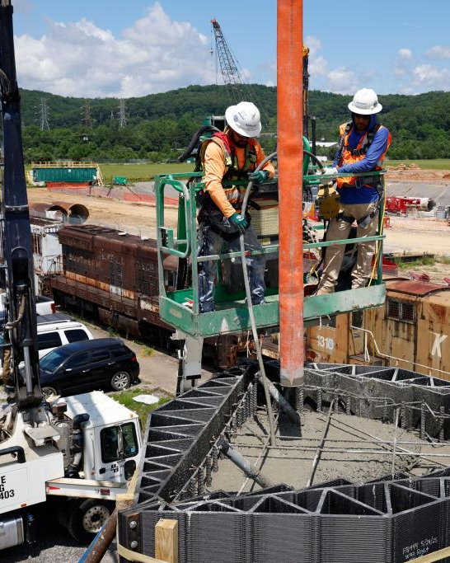
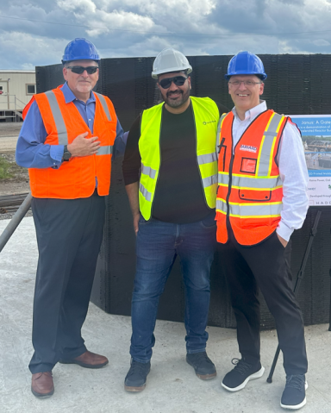
KAIROS
Developed and validated large-scale, 3D-printed polymer composite forms for Kairos Power, currently building the Hermes Low-Power Demonstration Reactor
Production timeline is cut down to days, rather than weeks
The molds required mechanical resilience and innovative design and printing strategies, pushing the limits of additive manufacturing
16
Add Kairos and Barnard Construction logos

