Slide 1
From Weinberg Fellowship to the Reestablishment of U.S. Stable Isotope Enrichment
PhD in Nuclear Engineering & Engineering Physics from University of Wisconsin Madison (2010) with a focus on plasma physics and fusion
BS in Manufacturing Engineering - 2000
Section Head for Plasma Enrichment Science and Engineering at Oak Ridge National Laboratory (ORNL)
DOE Oppenheimer Fellow (2022) and ORNL Weinberg Fellow (2010)
Leading research, development and deployment of Electromagnetic Isotope Separation (EMIS) technology since 2010
September 16, 2026 | Jefferson Lab
Brian Egle, PhD
Oak Ridge National Laboratory

Slide 2
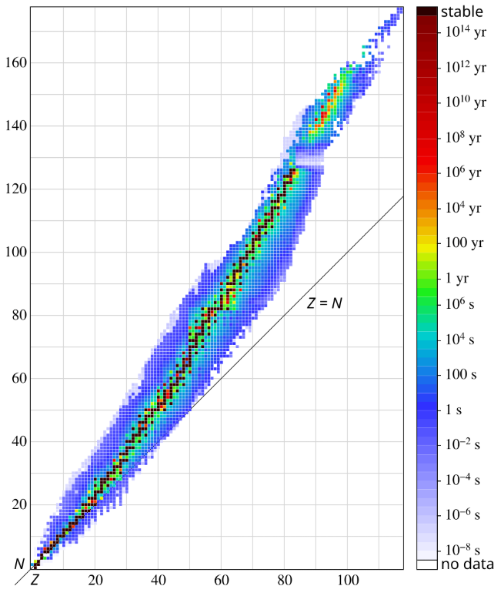
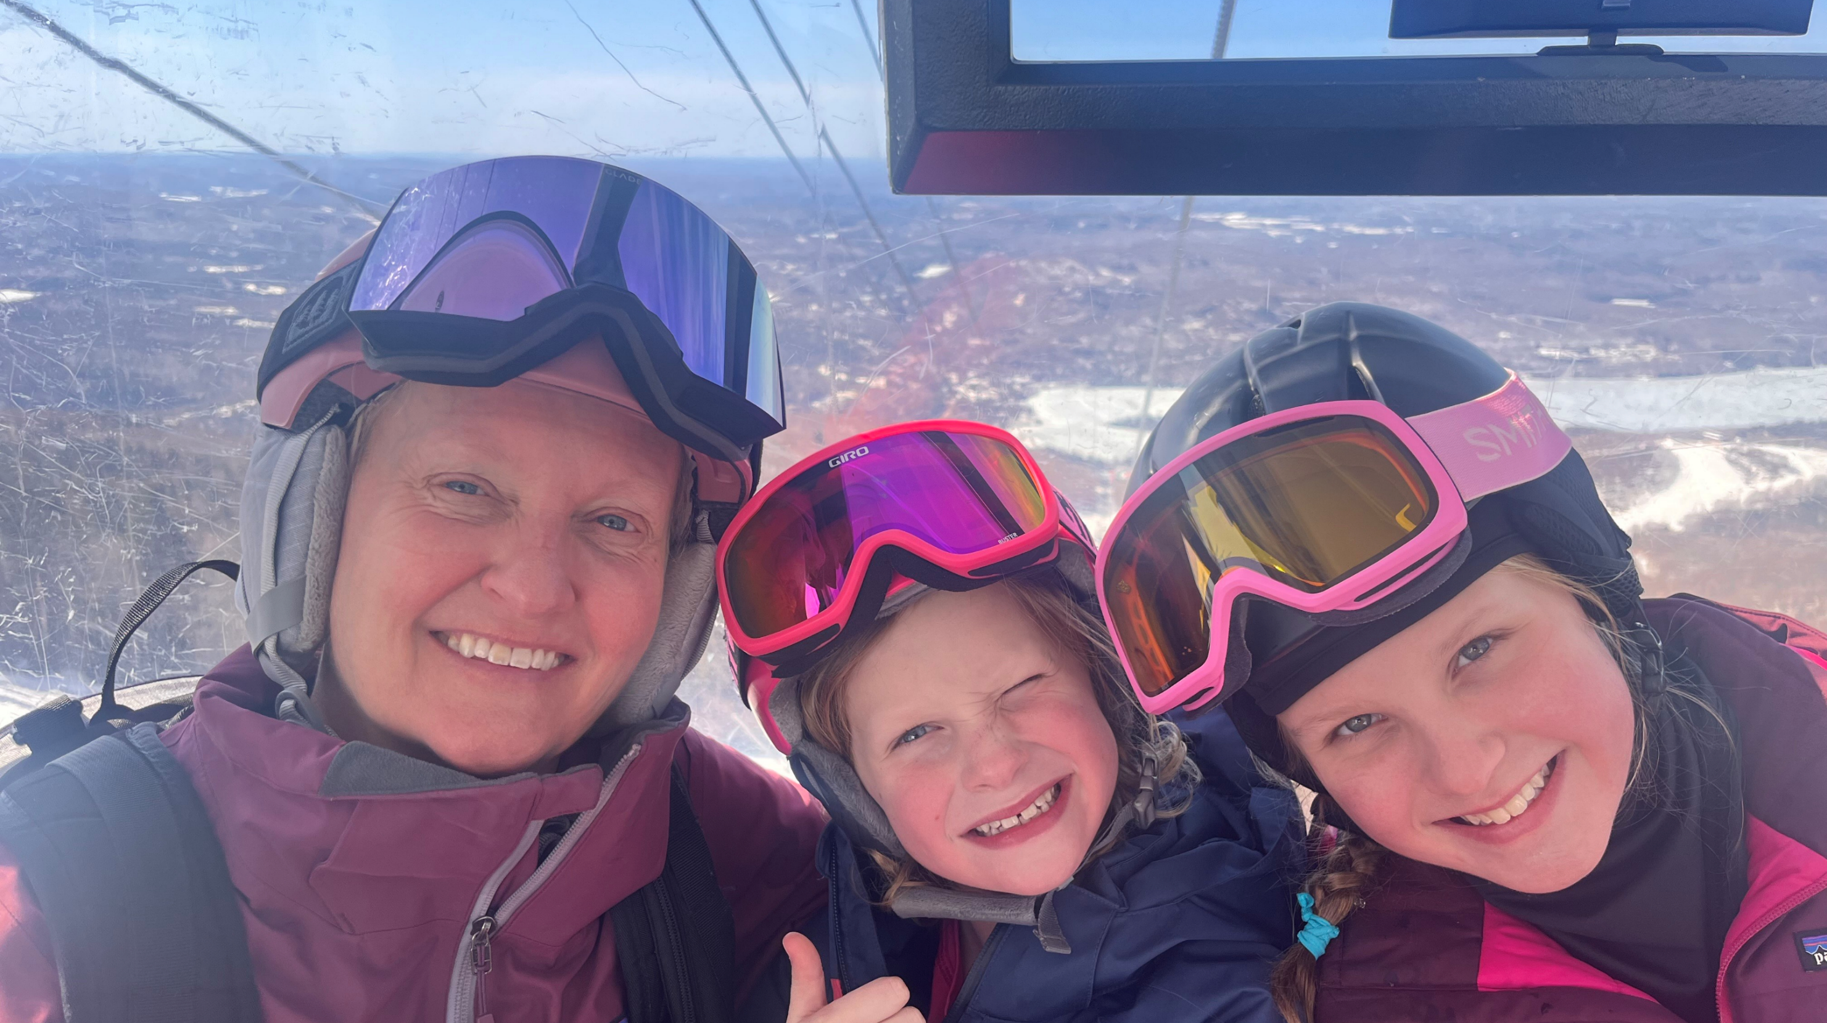
Why are isotopes important?
It’s personal…

Slide 3
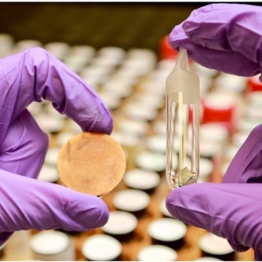
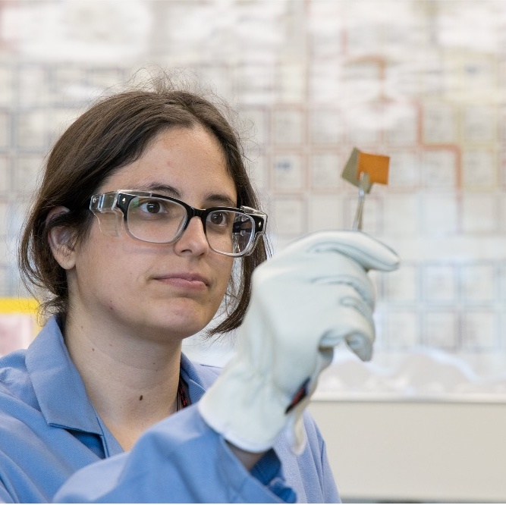
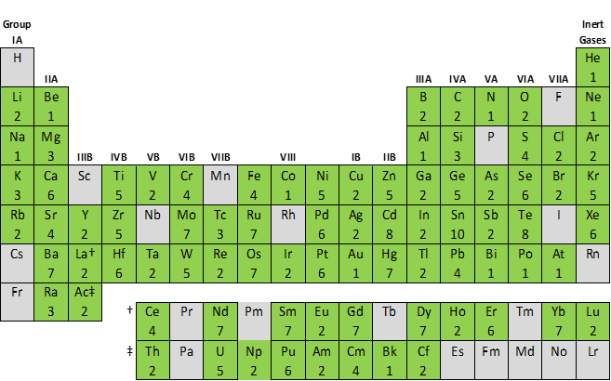
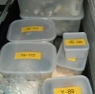
On behalf of the DOE Isotope R&D and Production Program, ORNL serves as the nation’s stable isotope supplier
A milligram of Calcium-48 is several orders of magnitude more valuable than Gold ($0.16/mg)
Our team painstakingly converts mg quantities of high-dollar isotopic materials into unique customer forms.
58
ELEMENTS
We steward an inventory that is an irreplaceable national treasure.
252
ISOTOPES
You can order isotopes at www.isotopes.gov

Slide 4
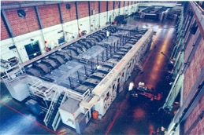
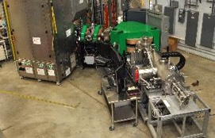
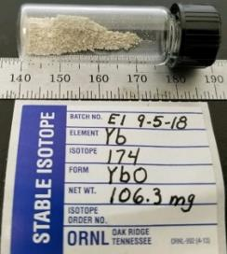
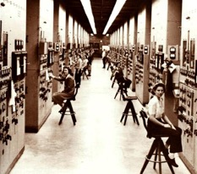
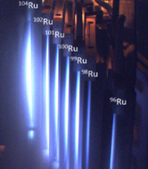
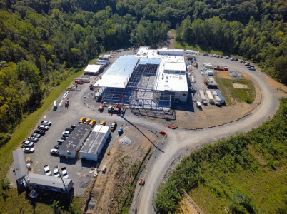
LDRD developed to attract key staff and reestablish core U.S. capabilities
Routine enrichment of 176Yb for commercial production of
cancer-fighting radio-pharmaceutical
Shutdown of calutrons and loss of U.S stable enrichment capability
Weinberg Fellowship (LDRD)
lays foundation of disruptive technology and attracts key staff
1945
1998
2010
2010-2012
2015
2021
2025
PROJECT INSIGHT:
LDRD investments can have major impact by investigating disruptive ideas outside of programs and by developing high-potential staff
1st enrichment of ^{63&65}Cu by the Manhattan Project Calutrons
American Recovery Act project to reestablish stable enrichment technology – prototype EMIS device
$350M investment and full-scale deployment of stable isotope enrichment to reestablish U.S stable isotope program
Notes:
In 2015, the LDRD funds were a great idea, but did not work. However, the post-doc was shown to be a good fit for the Lab and went on to lead the EMIS R&D group.
To dos:
Verify exact amount of 2025 investment to list
Verify 2015 date of LDRD and amount of Weinberg and LDRD funding
Get approval from DOE-IP (via Alan Tatum) for use of E1 picture
Find picture of Yb-176 shipment

Slide 5
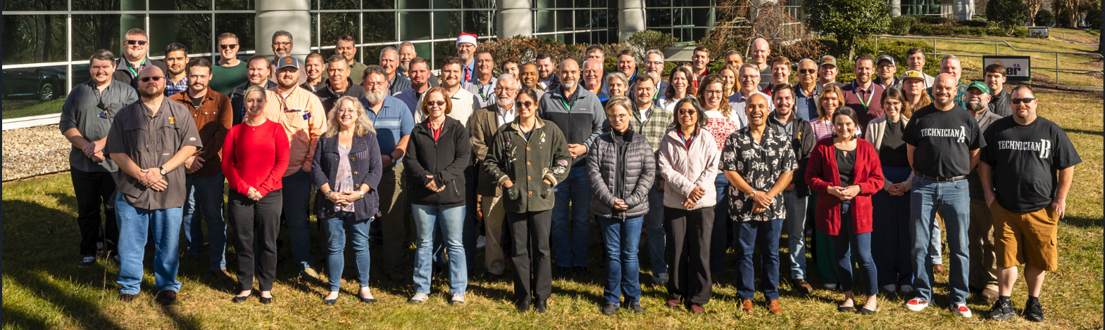
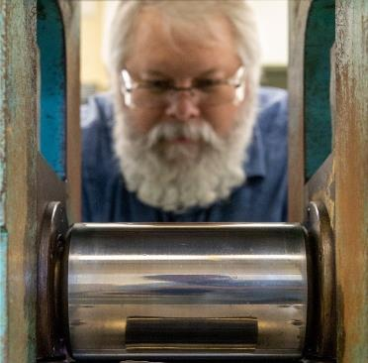
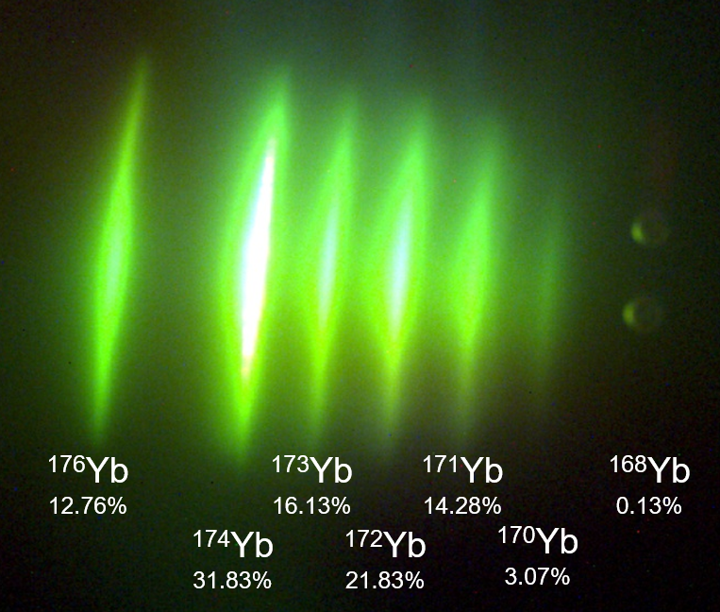
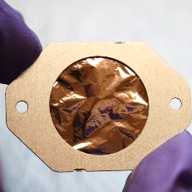
Weinberg Fellowship attracts early career leaders and ensures the programs have a stake in game
In response to declining retention among Wigner Fellows, Weinberg Fellowship hires first cohort in 2009.
Leveraging LDRD funds to develop the world class leadership to complement our world class science
By design, new Fellowship did not provide full funding, ensuring program investment in developing Fellows.
Weinberg hiring committee emphasizes leadership skills.
Successful LDRDs must understand the needs of the program and align with future funding opportunities.
Typically hire early career staff for exceptional technical skills – then promote into project, program, and line management roles.
5
Notes:
The long-established Wiegner Fellowship fully funded fellows for two years and experienced a large number of fellows leaving ORNL at the end of the fellowship.
The first cohort of ORNL Weinberg Fellows was hired in 2009.
By design, this new fellowship did not provide full funding, thus ensuring program investment in developing the Fellow.
LDRD and Program funds cannot mix; however, successful LDRDs must understand the needs of the programs and align with future funding opportunities.
The Weinberg hiring community emphasized leadership skills.
We typically hire early career staff for exceptional technical skills – then promote them into project, program, and line management roles.
Photo: Dr. Stephen Taller from the Nuclear Energy and Fuel Cycle Division mentors Alec Pfundheller, a graduate student intern from Texas A&M University, to perform transmission electron microscopy to investigate radiation damage in additively manufactured type 316 stainless steels. These investigations are routinely performed at ORNL’s Low Activation Materials Development and Analysis (LAMDA) laboratory on irradiated materials. Taller’s current DSF project is entitled: “Improving Nuclear Materials Development Cycle with High Throughput Microscopy and Machine Learning.”

Slide 6
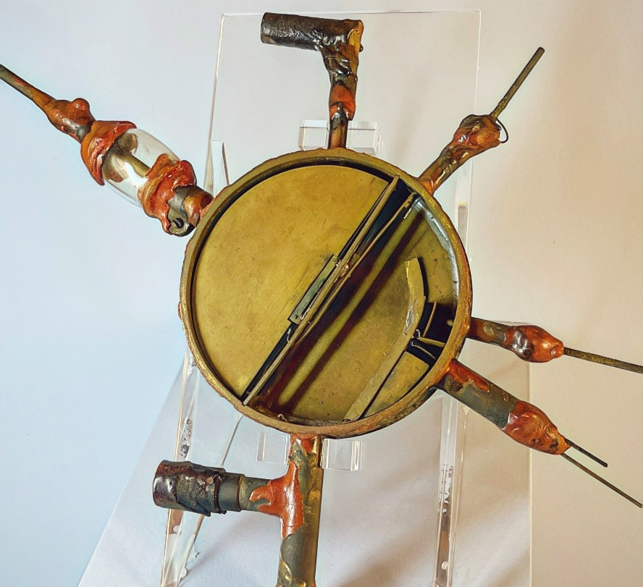
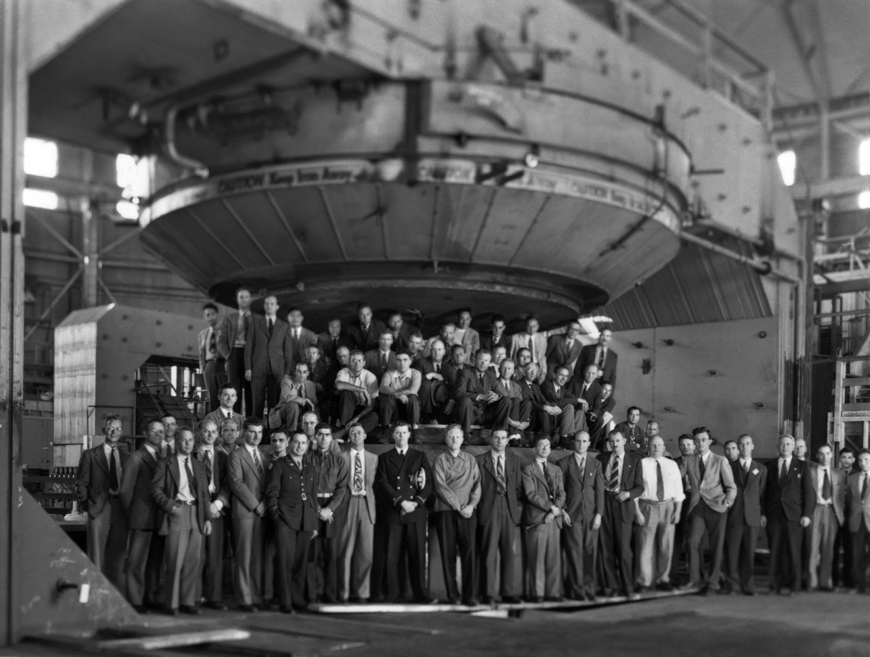
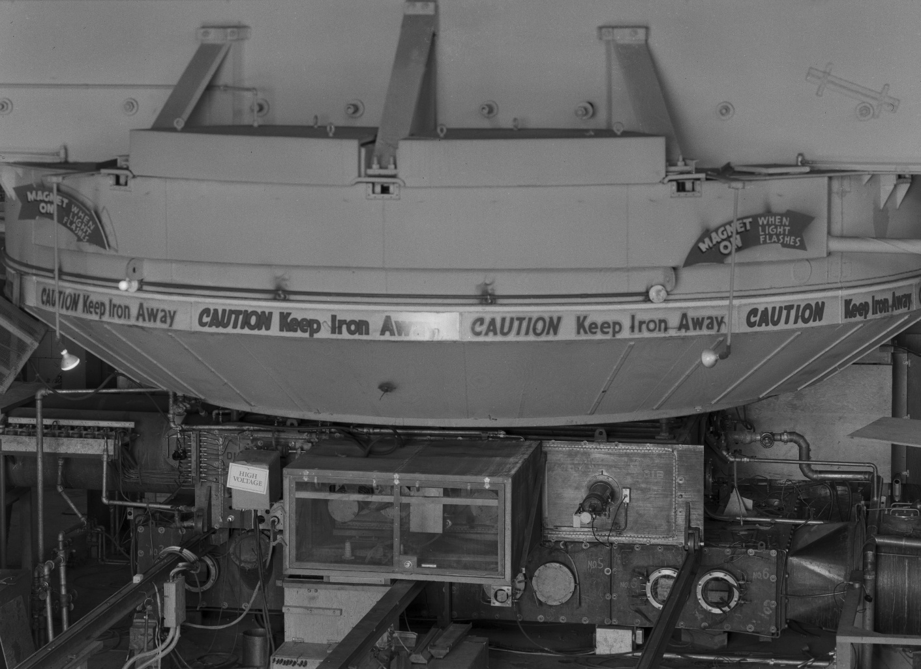
“Good people from diverse fields working together can make major scientific discoveries that are denied geniuses working in isolation”
- Alvin Weinberg, ORNL Lab director from 1955 to 1973
4.5”
January 1931
E.O. Lawerence’s First Cyclotron
Lawerence’s Rad lab team at Berkeley with the 184” cyclotron
4/24/1946
184” cyclotron converted to a calutron for prototype uranium enrichment at the begin of WWI
Berkeley 3/17/1943

