Slide 1
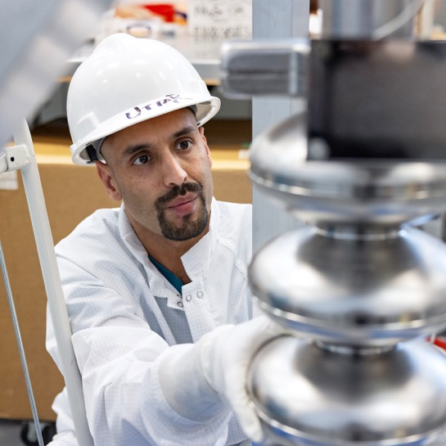


Thomas Jefferson National Accelerator Facility
Fundamental Science in the Age of Data Science
Presented by Eric Brown
Deputy Director for Science and Technology
Chief Research Officer
,

Slide 2
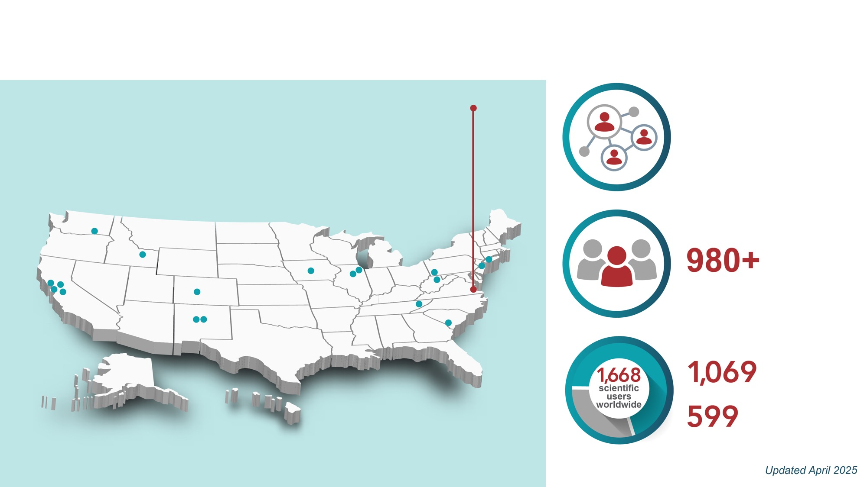






The Nation’s Premier Nuclear Physics Lab and Beyond
Established in 1984
One of 17 Department of Energy National Labs
40 Years and counting
Managed and operated by SURATech
LBNL
BNL
~850
Employees
Future Primary Home of the DOE’s High Performance Data Facility (HPDF)
~1,700
Largest nuclear physics user community in the world with 1/3 of U.S. NP Ph.D.s based on Jefferson Lab research

Slide 3
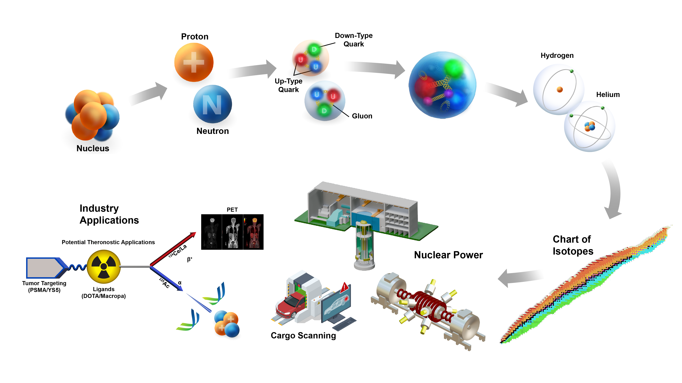

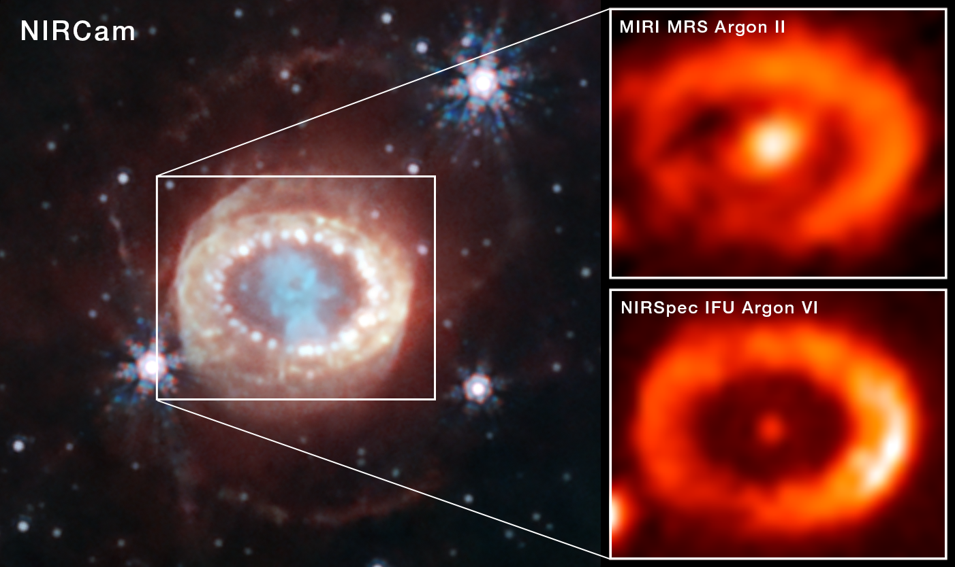
Exploring the Nature of Matter
Developing a predictive theoretical framework from quarks to complex nuclei
Neutron Stars

Slide 4
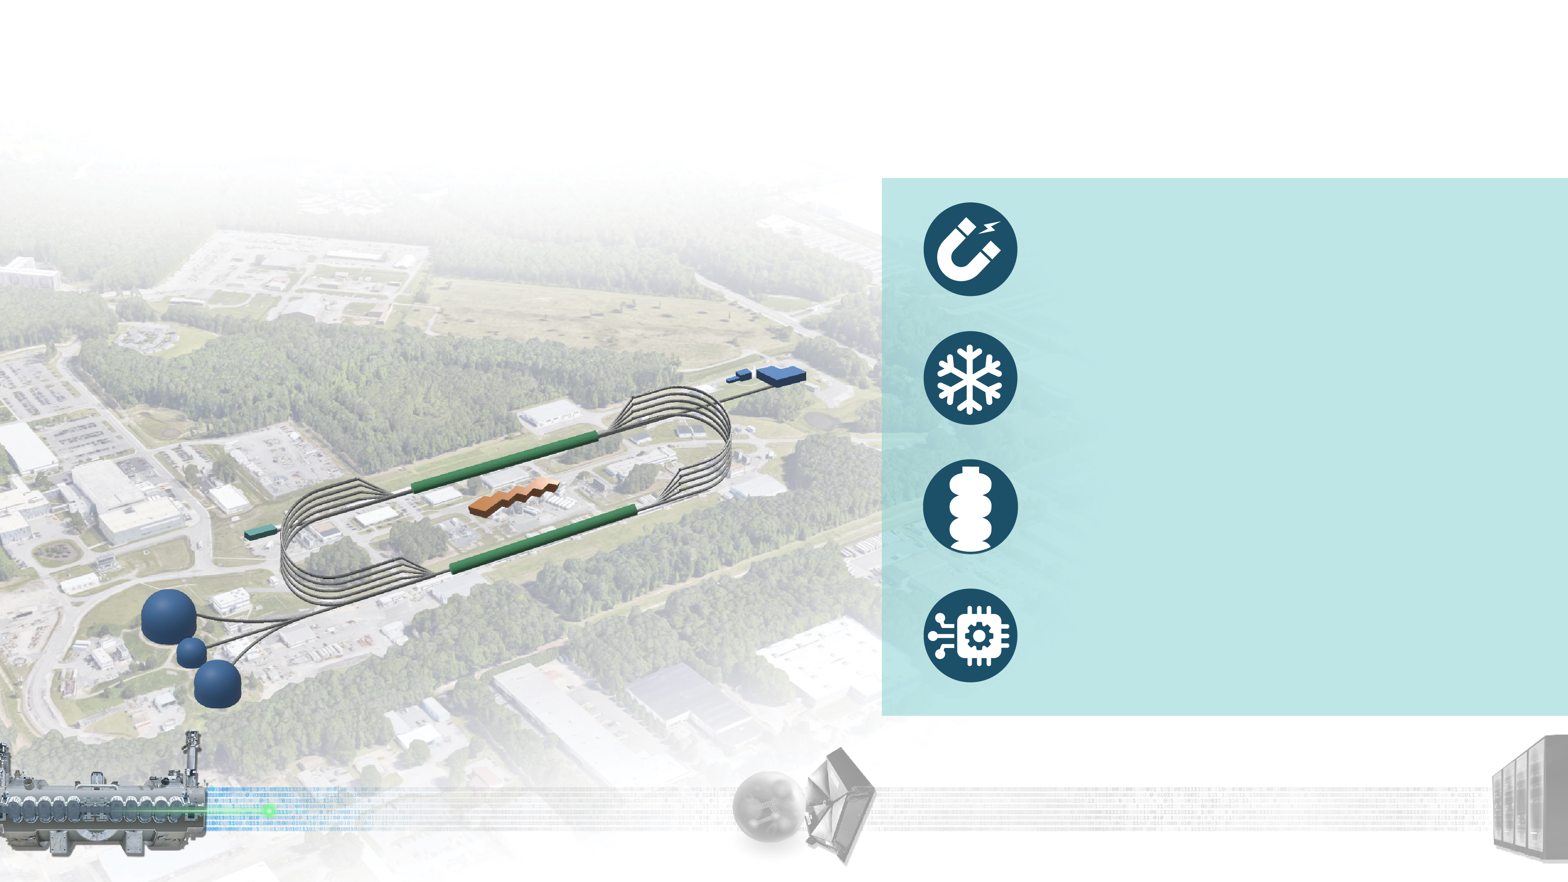





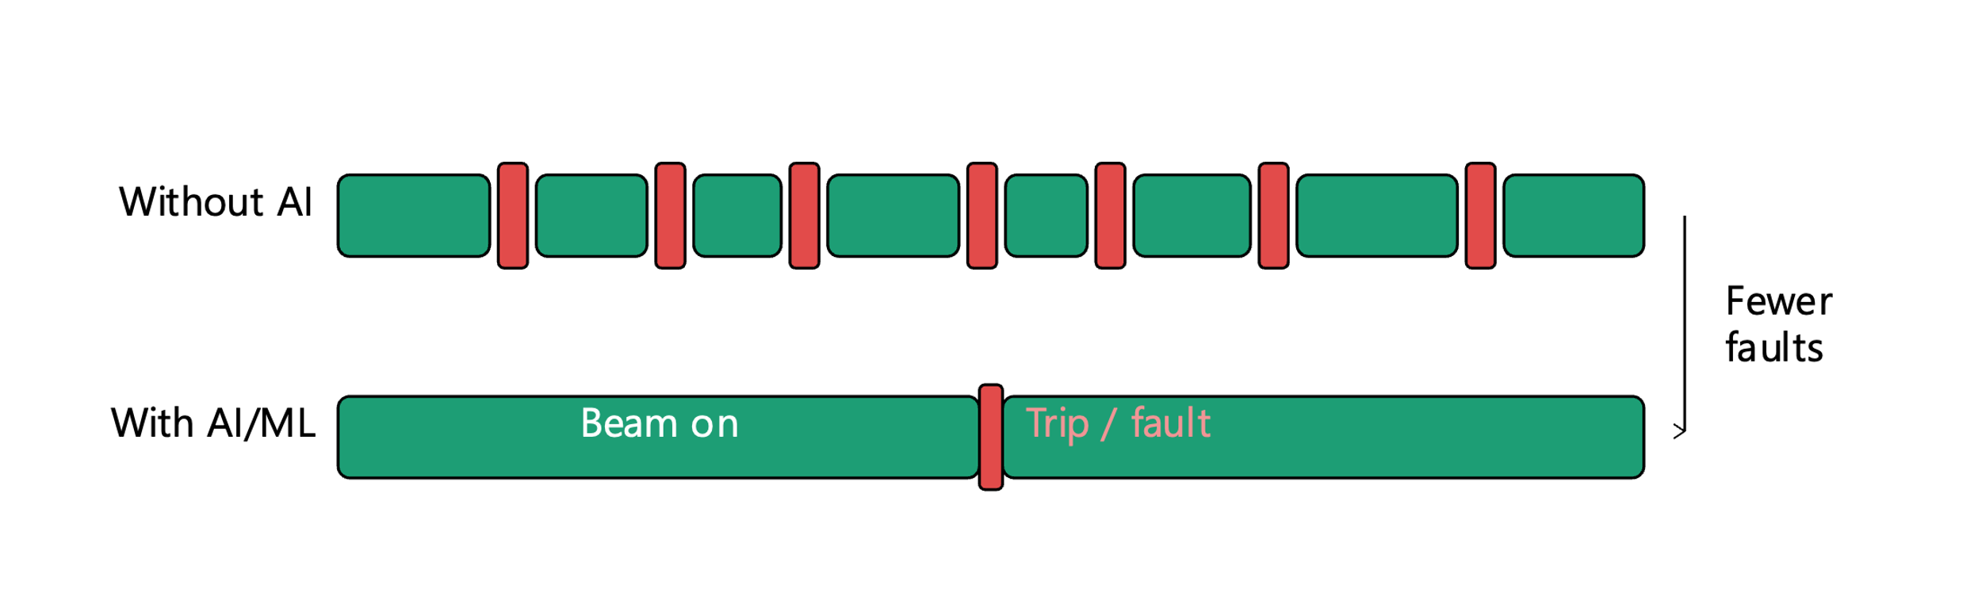
Our Discovery Machine:
Advancing Nuclear Physics Research for the Nation
The Continuous Electron Beam Accelerator Facility is the highest throughput research accelerator in the world.
The Continuous Electron Beam Accelerator Facility (CEBAF) superconducting recirculating design requires only 1/4 the power and 1/10 the length of a conventional accelerator.
Half-million accelerator control points monitored by AI/machine learning systems
Largest pair of 2 Kelvin cryogenics refrigerators in the world: Our AI tools anticipate and prevents cryogenic cavity faults, achieving highest CEBAF beam reliability (2025:87%, 2026 td: 91%) for users.
The highest luminosity continuous electron beam for nuclear physics research, reaching up to about 10³⁹ cm⁻² s⁻¹
x%
Fewer SRF faults w/ AI/ML

Slide 5
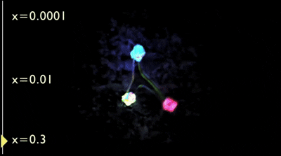

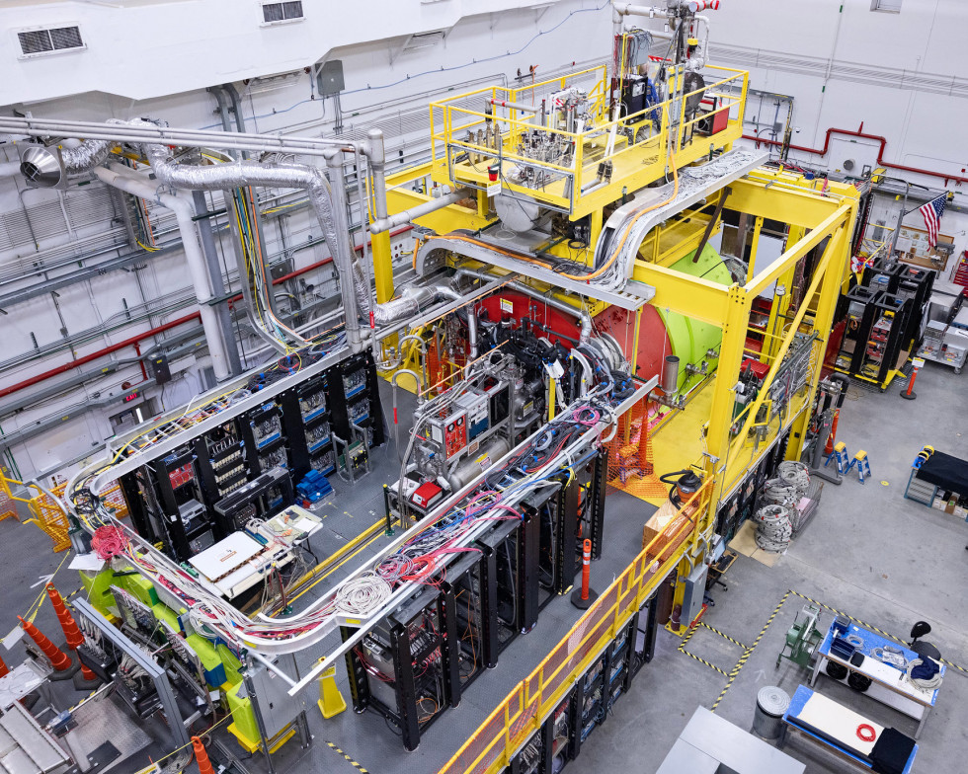
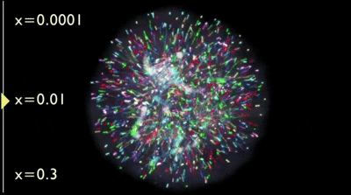
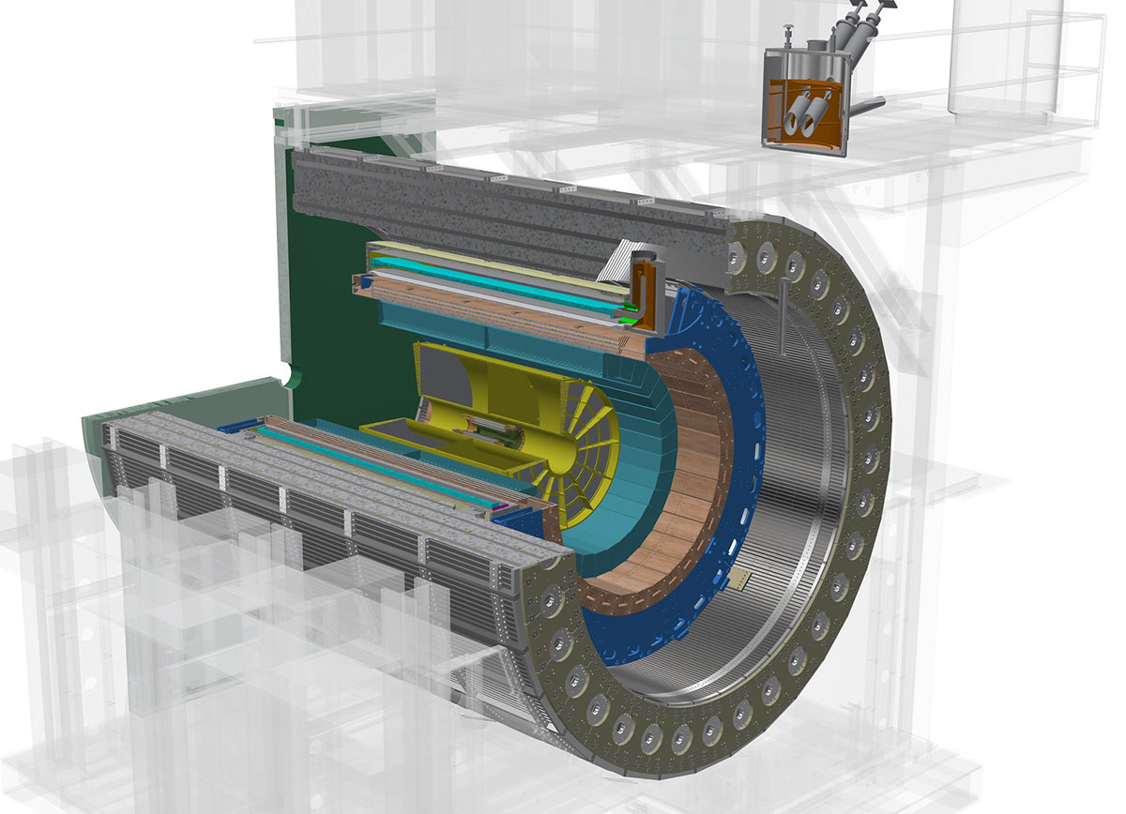

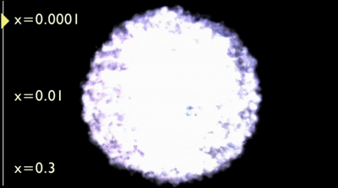
Smarter Particle Accelerators & Nuclear Physics
nucleon visualization at different Bjorken x values
Experimental Nuclear Physics (NP) seeks to understand the internal structure and dynamics of nucleons
Large detectors with high sensor density produce increasingly larger datasets (O(10) PB/yr for a single experiment) which are needed to search for increasingly rare reactions
Workflows that match large datasets with large compute and advanced analysis techniques enable faster, more efficient insight to the science
Accelerator operation with high intensity, precision, and reliability is required to obtain clean signals for next-gen subatomic discovery
https://www.jlab.org/news/releases/pioneering-nuclear-glue-frontier-0
https://www.bnl.gov/rhic/sphenix.php
General Visualizations of a Nucleon

Slide 6

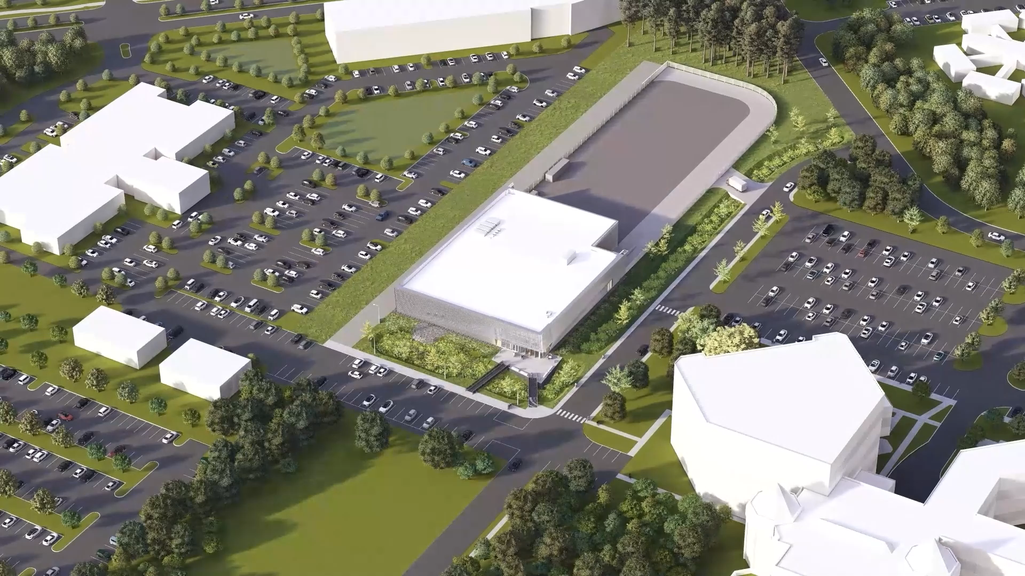

A Future Data Science Facility to Advance DOE Research
HPDF IMPACTS
Steward and facilitator of safe and secure access to AI-ready data/meta-data from and for the Office of Science
Central to advance Genesis Mission and positions DOE as a leader in data and AI-driven science
TIMELINE
2020
CD-0 Mission Need
2026
Rapid Deployment
Early-Early Access System
2028
Hybrid Cloud
On-site Integration
In 2023, DOE selected Jefferson Lab as the site
for the High Performance Data Facility (HPDF),
a scientific user facility, led by Jefferson Lab in partnership with Lawrence Berkeley National Laboratory, specializing in advanced infrastructure for data-intensive science
2023
Site Selection
Today
2027
CD-1 Target
2030
CD-4
Full Operational Scale
Mature Production Environment

Slide 7






Our Scientific Priorities: Three Pillars
Data and Computational Science
Nuclear Physics
Energy and Applied Science
World-leading science breakthroughs · First-class national capabilities State-of-the-art operation of DOE-SC facilities

Slide 8
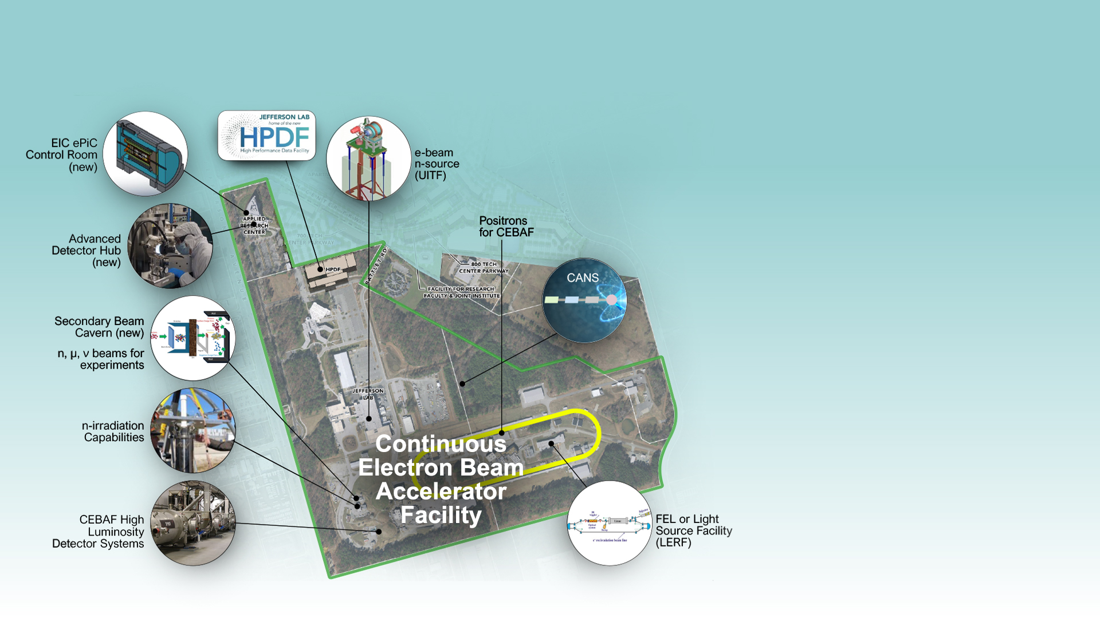



Jefferson Lab: 20-Year Outlook
Continuation of CEBAF Nuclear Physics Program
Growing to a multi-purpose laboratory; leading data-science
Future expansions proposed over the next 20 years supported by:
  working with the scientific user community for buy-in on priorities
  Identifying opportunities with sponsors to support these priorities for the Nation
  Naturally expanding current capabilities and sponsored activities
Compact accelerator-based neutron source
Free-Electron Laser (FEL) or
TeraHz Light Source
Notes:
SURATech’s Vision
Continue CEBAF and expand into high luminosity
Synergistic growth and natural development of the lab campus
Secondary beam capabilities for irradiation
rea
Development of an EIC ePIC Control Center
SRF Institute expansion into novel accelerator concepts
Advanced Detector Hub (light-sources, neutron sources, fixed-target, and collider HEP and NP systems)
Multiple leading DOE User Facilities, including CEBAF, HPDF, a next-generation light source, CANS contract acc. Base neutron source , and other irradiation capabilities

Slide 9

LABORATORY DIRECTED RESEARCH AND DEVELOPMENT
Strategic Research Investments That Build Jefferson Lab’s Future
How LDRD converts high-potential ideas into demonstrated scientific and technical capabilities

Slide 10
Jefferson Lab established its LDRD program in 2013 and has steadily increased its investment
The program has become an important component of laboratory strategic planning
PROGRAM TRAJECTORY
More than 15×
growth from FY14 to the FY26 level shown
$4.5M
FY27 requested program level
The chart shows the historical program series through FY26.
2026 LDRD Annual Meeting
2

Slide 11
Two investment mechanisms serve different capability needs
Both connect laboratory strategy to disciplined review and project execution
DIRECTOR’S R&D FUND
LDRD STRATEGIC HIRE
Two-year capability development
Critical skills in strategic areas
Purpose
Purpose
Address research priorities and develop new science and technology capabilities.
Recruit individuals whose research strengthens priority capabilities and future programs.
Review
Review
Concept, proposal, presentation, execution plan, quarterly progress, and annual report.
Proposal, presentation, execution plan, quarterly progress, and annual project report.
Research Division Directors define priorities together, guided by the Jefferson Lab Plan.
2026 LDRD Annual Meeting
3

Slide 12
JEFFERSON LAB LDRD
Strategy
Highlights
Demonstration
Selected investments and the scientific capabilities they are building
Impact

Slide 13
The FY27 call targets the laboratory’s three research priorities
Strong proposals connect a specific technical advance to a credible path for scientific impact
ADVANCED NUCLEAR PHYSICS R&D
DATA SCIENCE AND AI
ENERGY AND APPLIED SCIENCE
Extend CEBAF and nuclear physics capabilities
Transform discovery through intelligent infrastructure
Apply Jefferson Lab expertise beyond nuclear physics
Advanced detector technologies
Real-time data processing
Secondary beams and scattering
Next-generation accelerator concepts, including positrons
Distributed and scalable data systems
Medical imaging, therapy, and quantum information science
Global analysis across experiment, theory, and computation
AI-enhanced accelerator operation and analysis
Environmental applications and technology transfer
Selection question: will the work create a distinctive capability that matters to Jefferson Lab’s future?
2026 LDRD Annual Meeting
5

Slide 14
JIRIAF distributes one scientific workflow across diverse computing facilities
LDRD LD2304 tested an integrated architecture spanning DOE HPC, research networks, and cloud resources
CONTROL AND ORCHESTRATION
User workflows
JIRIAF Kubernetes Control Plane
NERSC
OLCF
ALCF
FABRIC
Commercial Cloud
Perlmutter
Defiant / Lux
Polaris / Aurora
Research-network slices
Kubernetes extension
HPC INTEGRATION
PREDICTIVE DIGITAL TWIN
Virtual Kubernetes nodes operate in user space while SLURM manages HPC allocations.
Dynamic Bayesian Networks predict workflow resource needs and guide elastic scaling, monitoring, and recovery.
Architecture goal: relocate time-critical workflows between detector readout and geographically remote data centers.
2026 LDRD Annual Meeting
6

Slide 15
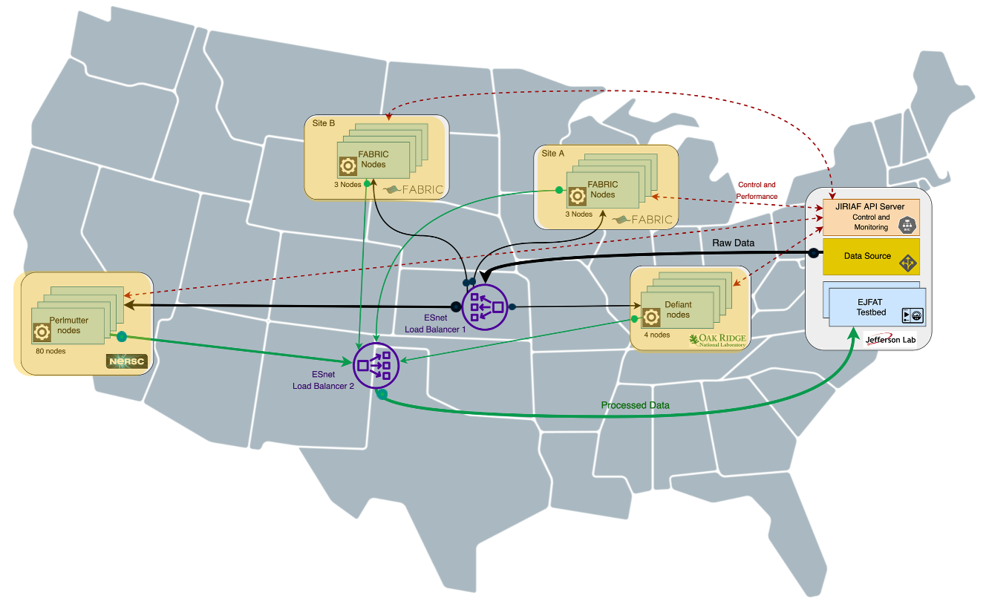
JIRIAF demonstrated one workflow across geographically distributed facilities
LDRD LD2304 connected DOE computing resources into an integrated science infrastructure
DEMONSTRATED RESULT
26,000+
compute cores distributed nationwide processed a single Jefferson Lab data stream.
CLAS12 reconstruction
ERSAP workflows with EJFAT transport
HPC as Kubernetes nodes
User-space integration with SLURM allocations
Autoscaling and recovery
Monitoring, failure recovery, and a predictive digital twin
2026 LDRD Annual Meeting
7

Slide 16
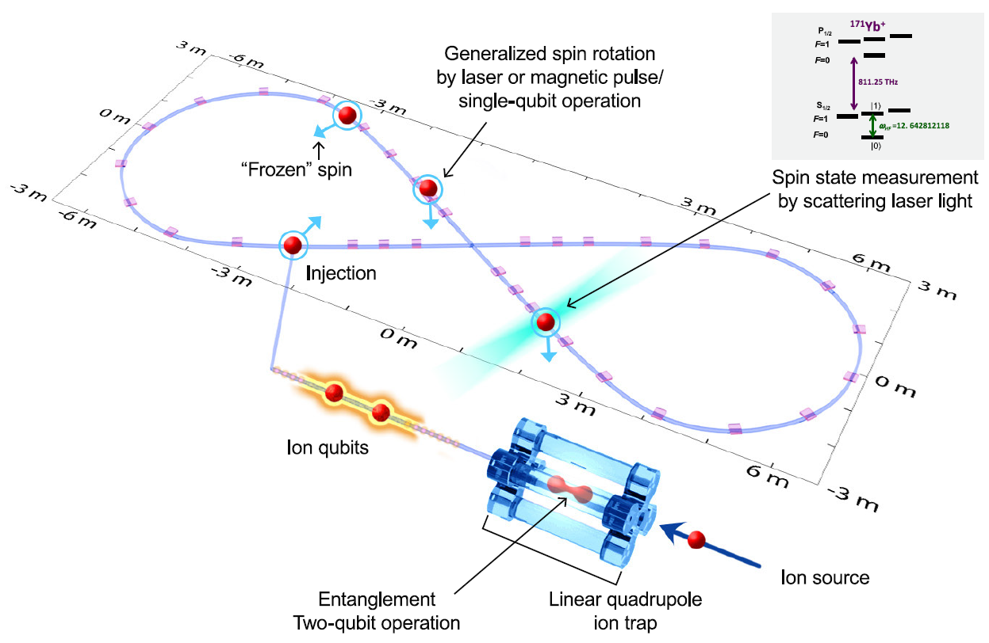
A spin-transparent ring opened a new accelerator path for quantum science
LDRD LD2306 linked Jefferson Lab, Old Dominion University, and Oak Ridge National Laboratory
CAPABILITY HYPOTHESIS
Store and manipulate large numbers of ion qubits with extended coherence time.
Intellectual property
Full U.S. patent application filed; international PCT application pending.
Program growth
Follow-on Atomic-Ion Qubit Injector proposal submitted to DOE QIS.
2026 LDRD Annual Meeting
8

Slide 17
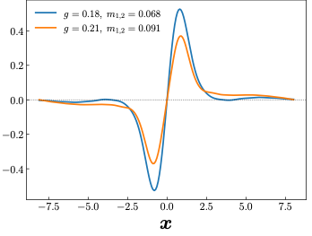
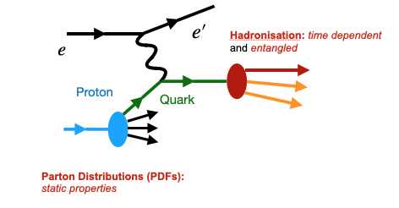
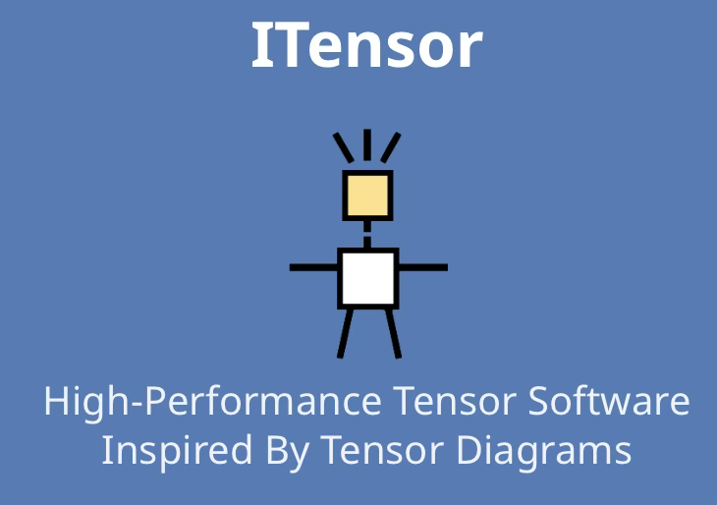
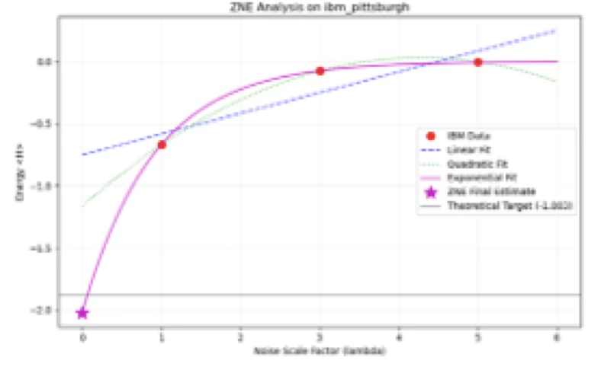
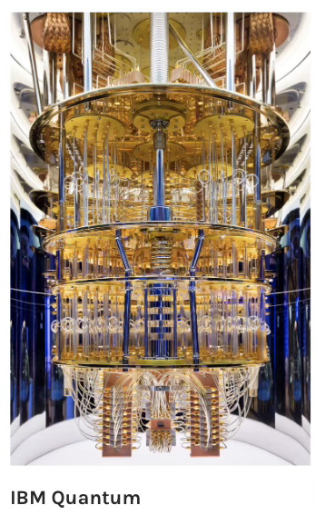
Quantum computing offers a new route to time-dependent hadronization
The 2025–2026 project benchmarks tensor networks and quantum circuits against a QCD model
SCIENTIFIC QUESTION
PDF
How do quarks and gluons form the hadrons observed in detectors?
Progress
Developed tensor-network and quantum-circuit code in a two-flavor model and began fragmentation benchmarks.
Next challenge
Reduce noise and tune calculations efficiently, including possible AI-agent approaches.
2026 LDRD Annual Meeting
Zero-noise extrapolation
9

Slide 18
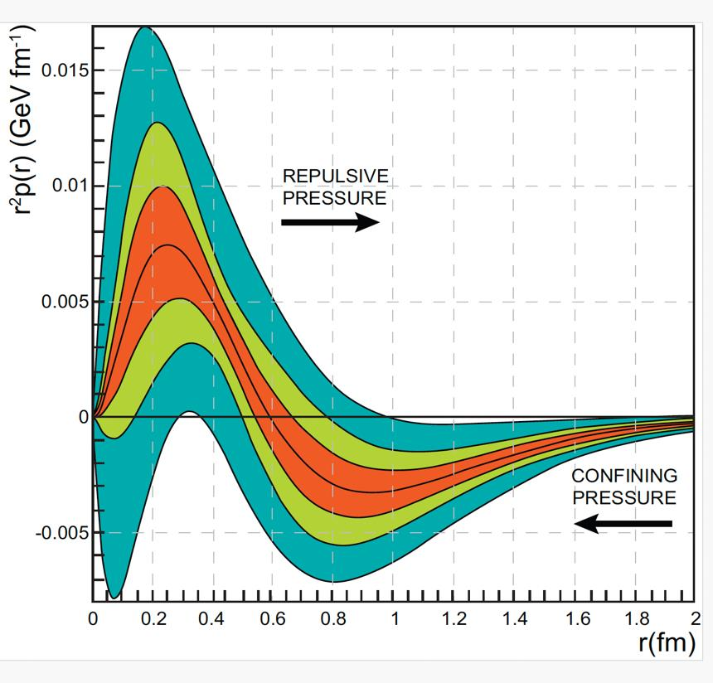
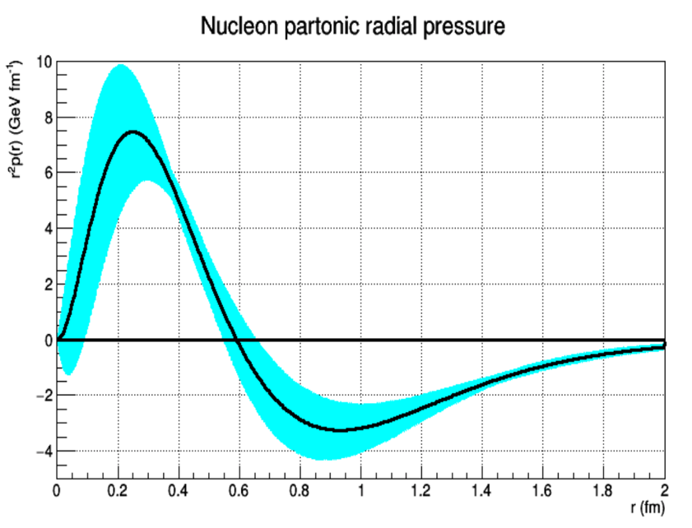
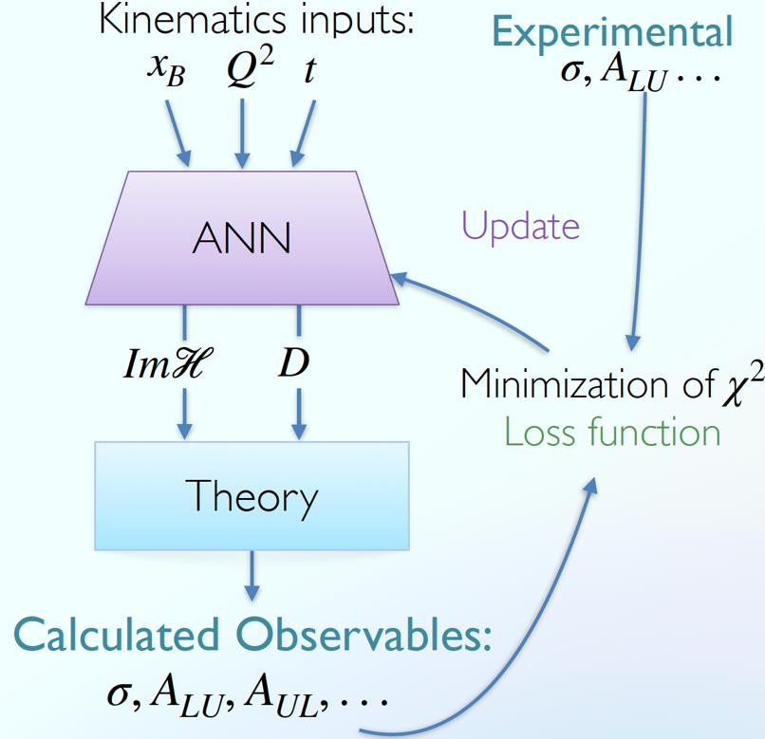
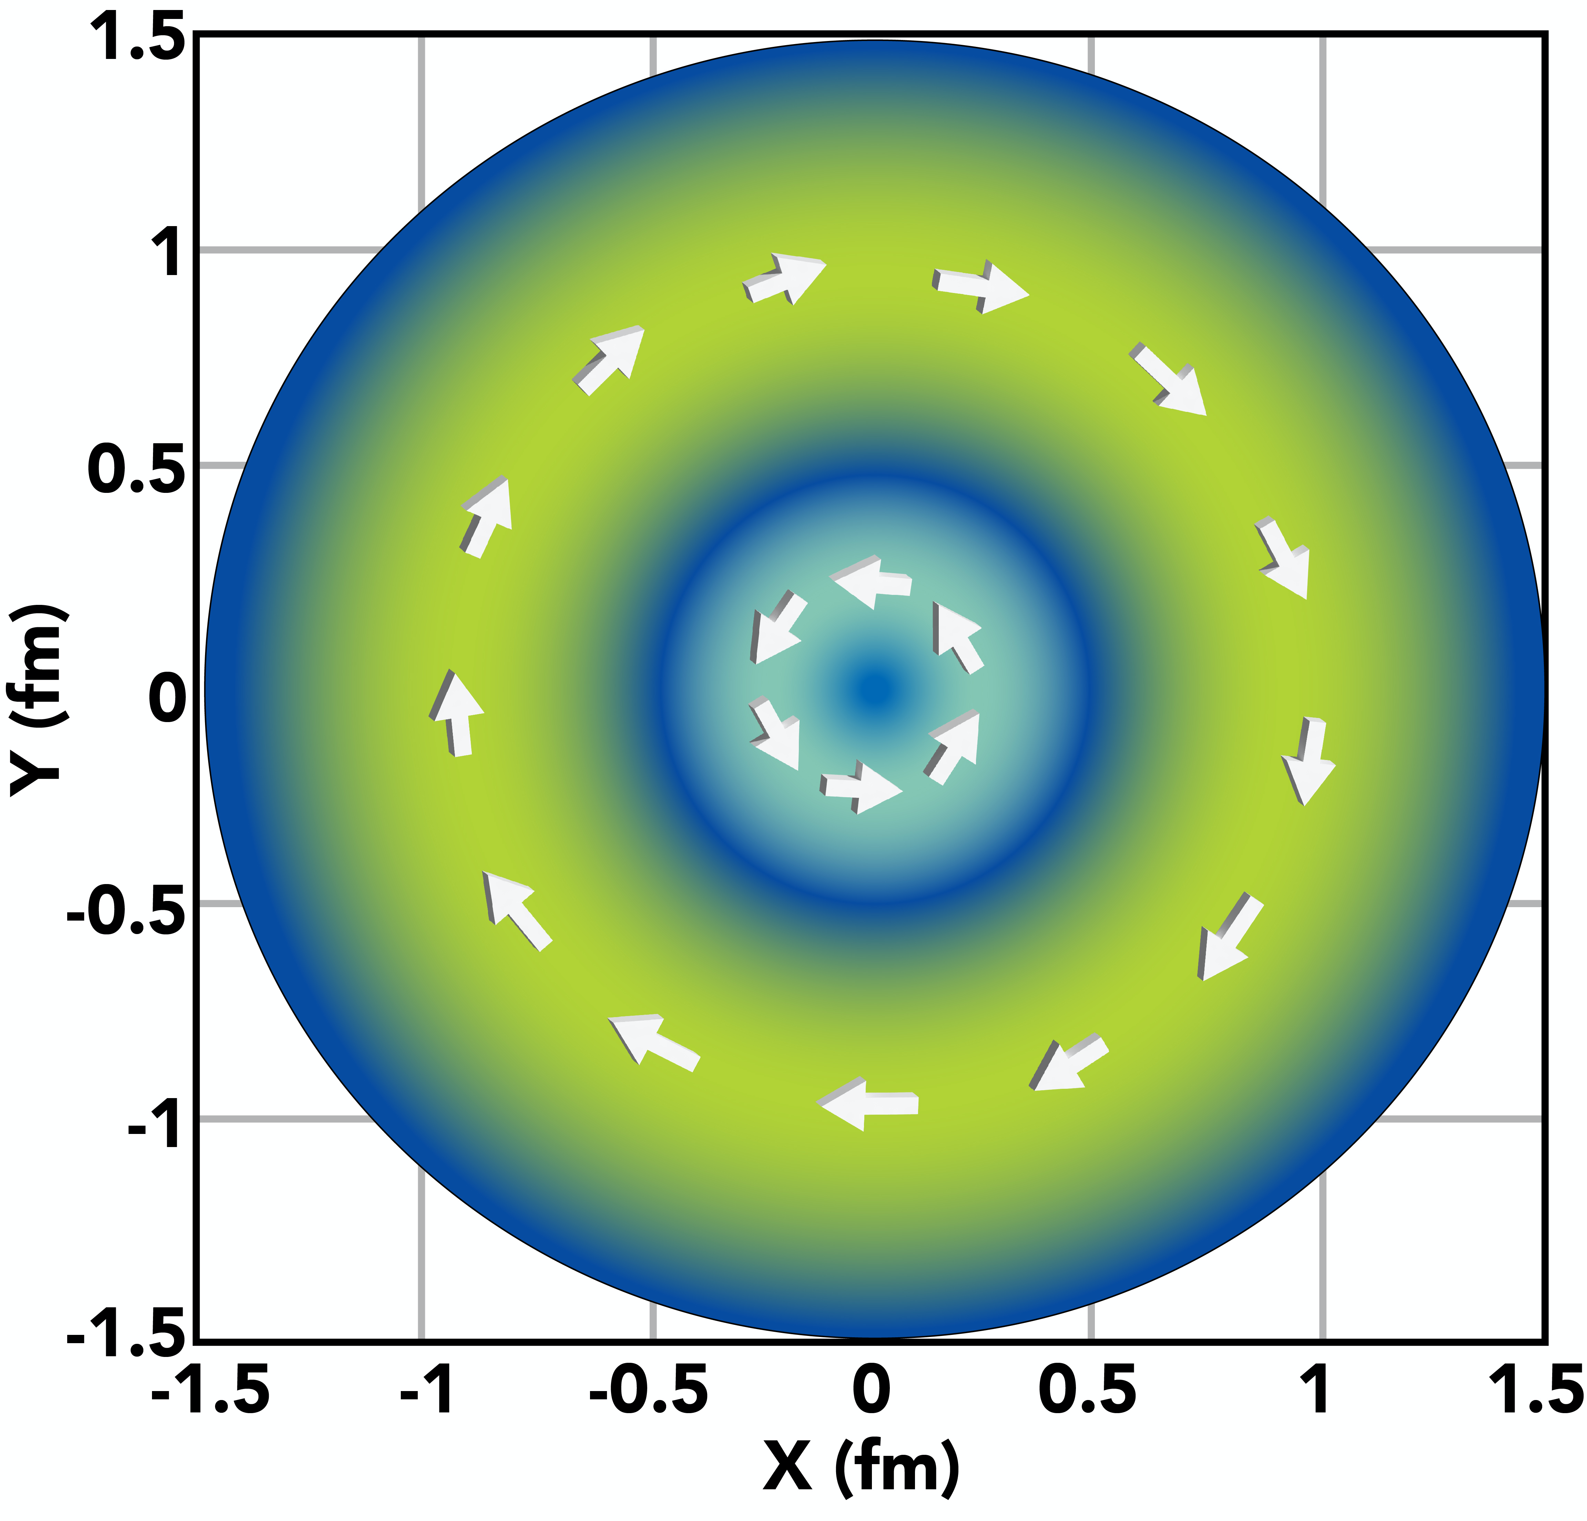
New data and neural networks can sharpen the proton’s pressure map and its gravitational structure
LDRD 26-05 aims to reduce uncertainty and dependence on model assumptions
EVIDENCE BEFORE LDRD
LDRD METHOD
EXPECTED ADVANCE
Nature 557, 396–399 (2018)
V. D. Burkert, L. Elouadrhiri & F. X. Girod
High-statistics Hall A and CLAS12 measurements
Jefferson Lab’s pioneering measurement
opened a new frontier in mapping the
proton’s internal forces.
Flexible CFF fit with propagated uncertainty
A sharper pressure map with greater kinematic reach
LDRD closes the gap between a landmark measurement and a more precise picture of matter.
2026 LDRD Annual Meeting
10

Slide 19
JEFFERSON LAB LDRD
LDRD strengthens Jefferson Lab’s scientific future and national impact
Its value extends beyond the individual projects it funds.
01
Scientific leadership
02
New capabilities
Creates room to pursue high-potential research aligned with the Laboratory Plan and emerging national needs.
Develops technologies, methods, data systems, and infrastructure that strengthen future missions.
03
People and partnerships
04
Future programs
Builds strategic skills and connects divisions, universities, national laboratories, and mission partners.
Reduces technical risk and produces the evidence needed for external funding and sustained programs.
LDRD gives Jefferson Lab the capacity to prepare for opportunities before they become funded programs.

