Slide 1
LDRD Annual Meeting – 16-17 Sep 2026
- NNSA Perspective
Garry Kuhn, Support Service Contractor
NA-114 Office of Advanced Simulation and Computing and Institutional Research & Developments Programs

Slide 2
Presentation Overview
Disclaimer
NNSA Perspective
Guidance that drives the NNSA effort
  DOE Order 413.2D; Roles, Responsibilities and Guidance;
  NA-10 Transformational Objectives
Strategic Outlook for LDRD/SDRD

Slide 3
Disclaimer
  I’ve been supporting the LDRD/SDRD program since Nov 2011
    Military prior to becoming a support service contractor in NNSA
    NA-11: Office of Advanced Simulation and Computing and Institutional Research and Development Programs
  I am a support service contractor here on behalf of Anthony Lewis
    This presentation is for informational purposes and should not be taken as any program direction

Slide 4






NNSA LDRD/SDRD Leadership
Headquarters
Dave Beck
Deputy Administrator for Defense Programs
David LaGraffe
Assist. Dep Administrator for Res, Dev, Test and Eval
Anthony Lewis
LDRD/SDRD
Federal Manager
Field Office Fed Leads
Larry Kwei
Los Alamos
Karin King
Lawrence Livermore
Rick Balthaser
Sandia
Erin Sandoval
Nevada

Slide 5








Lab/Site LDRD/SDRD Leadership
Los Alamos
Livermore
Sandia
Nevada
Lab/Site R&D Leads
Patrick Fitch
Patricia Falcone
Douglas Kothe
Jose Sinibaldi
Lab/Site L/SDRD Leads
Kirsten McCabe
Elizabeth Wheeler
John Feddema
Michael Reed

Slide 6
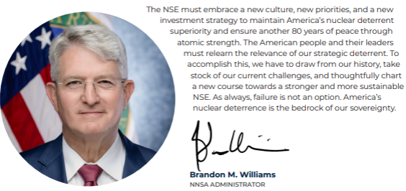
NNSA Mission / Leadership
NNSA is a semi-autonomous agency within DOE (2000 NNSA Act)
  Responsible for enhancing national security
  through the application of atomic science
  Core Missions
    Nuclear Stockpile
    Nonproliferation
    Naval Nuclear Propulsion
    Nuclear Counterterrorism
  Brandon M. Williams
    Undersecretary for Nuclear Security
    NNSA Administrator
Notes:
Returning to our Manhattan Project roots, Deterrence, Urgency, and Production will serve as the hallmarks of our success. Whether that means keeping our nuclear arsenal at the pinnacle of scientific, engineering, and military achievement; denying our adversaries access to nuclear materials and expertise; or supporting the science and production that underpin both.

Slide 7
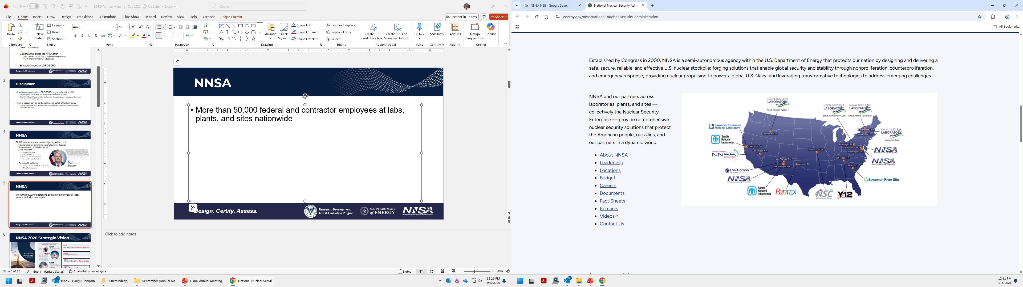
NNSA Locations
More than 64,000 federal
and contractor employees
at labs, plants, and sites
nationwide
HQ and Field Offices
  Forrestal/Germantown (NCR)
  John A. Gordon Albuquerque
  FO at labs/plants/site
    KCNSC, LLNL, LANL, NNSS
    Pantex, SNL, SRS, Y-12

Slide 8
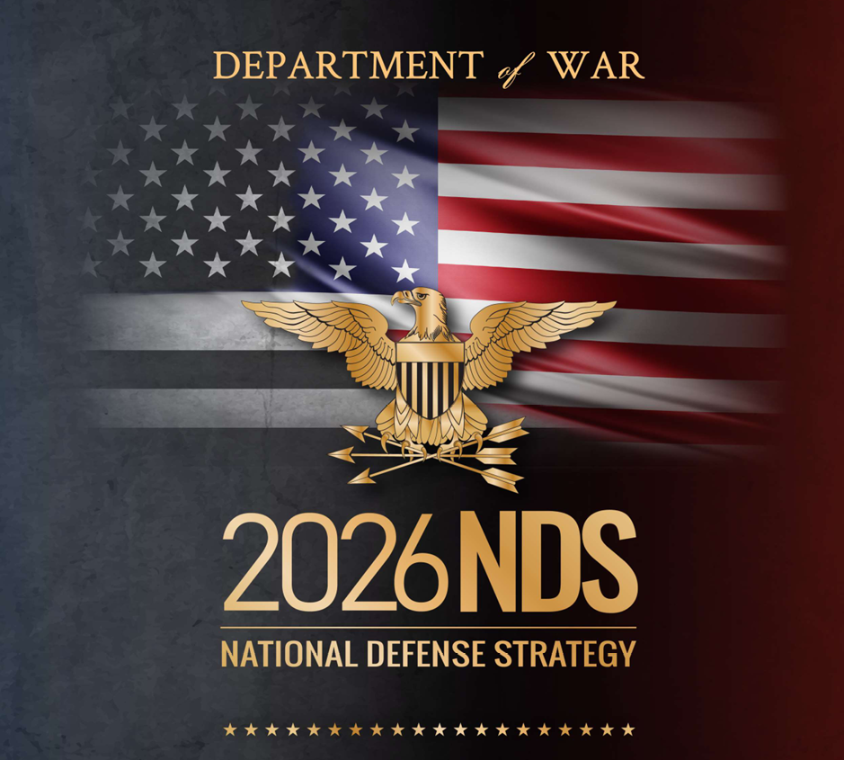
Changing Geopolitical Environment
Rising China
  Nuclear proliferation
  Nuclear Triad
  New silo construction
Russia
  Nuclear peer
  Fielding new systems
  Large number of tactical nuclear weapons
North Korean proliferation
Discontent among non-nuclear states
  Japan and Korea - government discussion

Slide 9

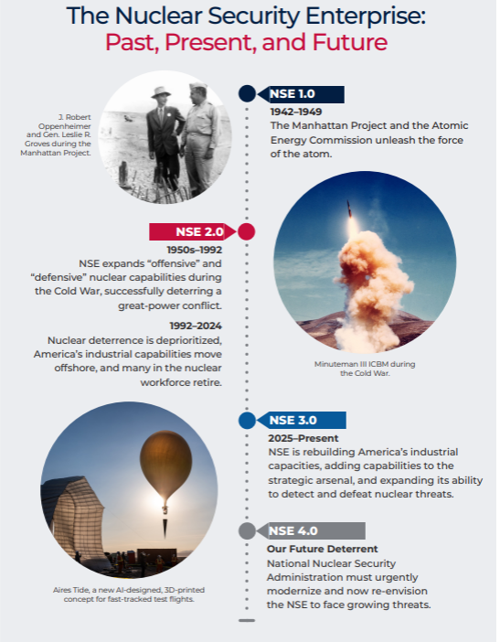
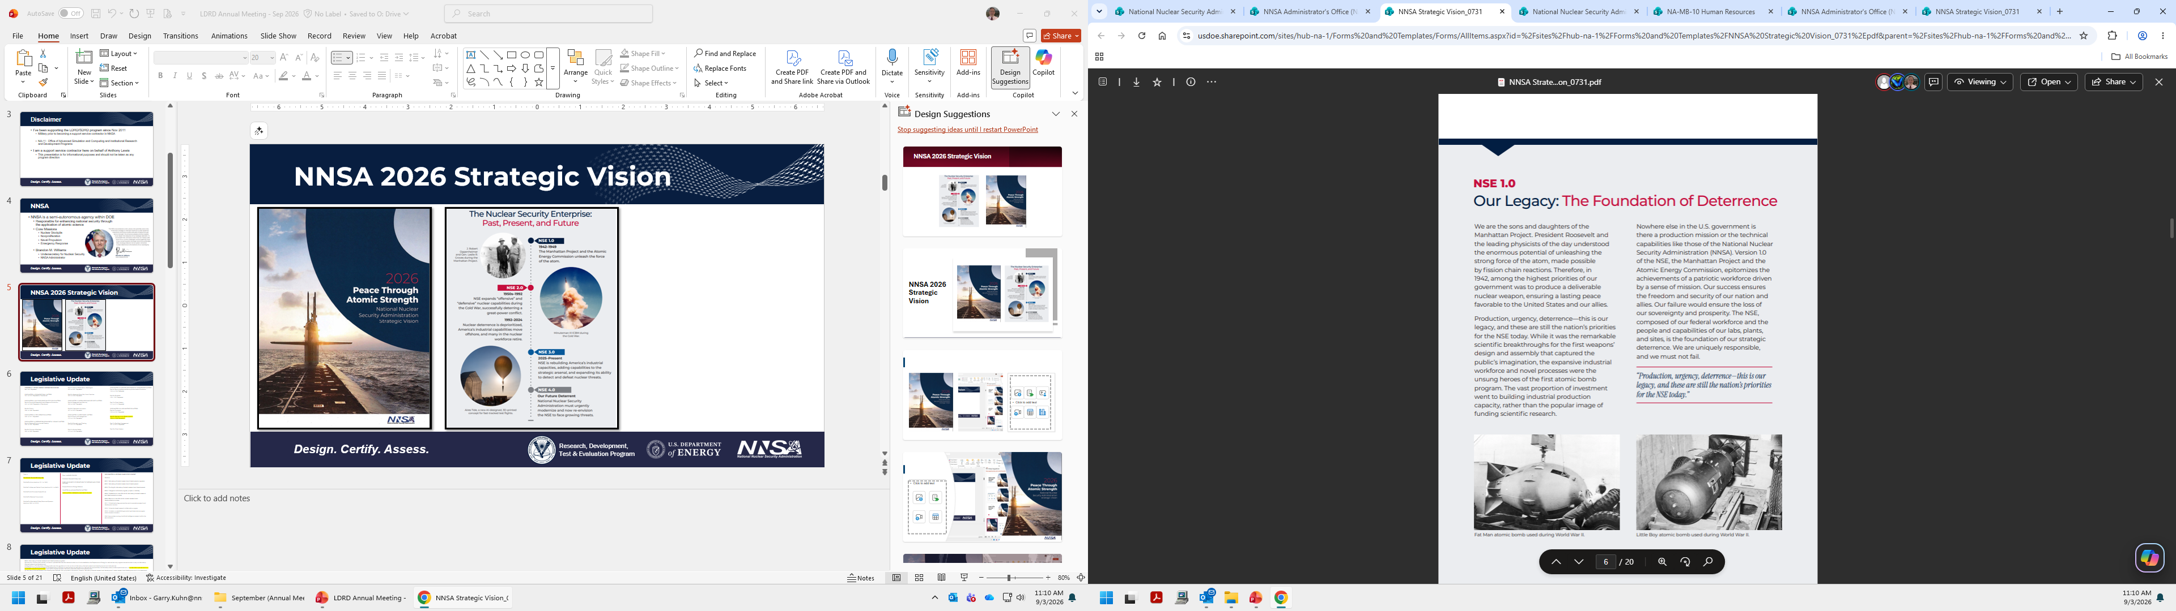
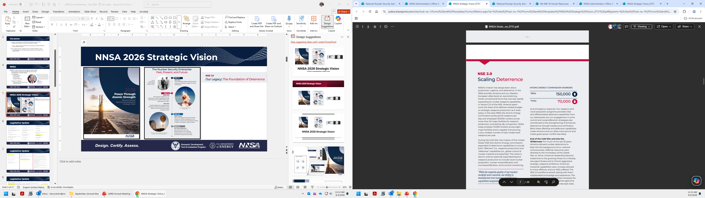
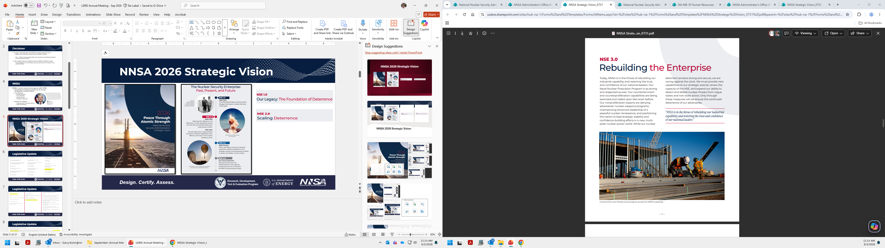
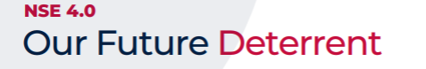
NNSA 2026 Strategic Vision
December 3, 1989: U.S. President George H.W. Bush and Soviet leader Mikhail Gorbachev declared the conflict over at the Malta Summit

Slide 10
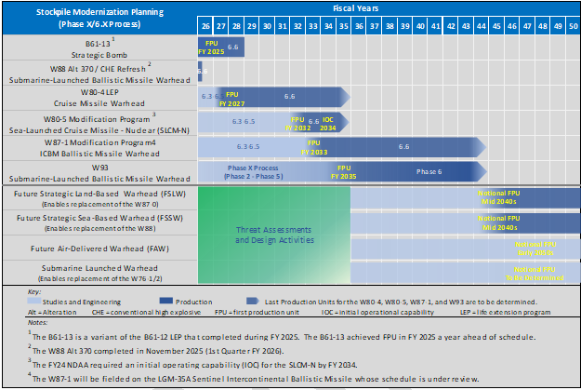
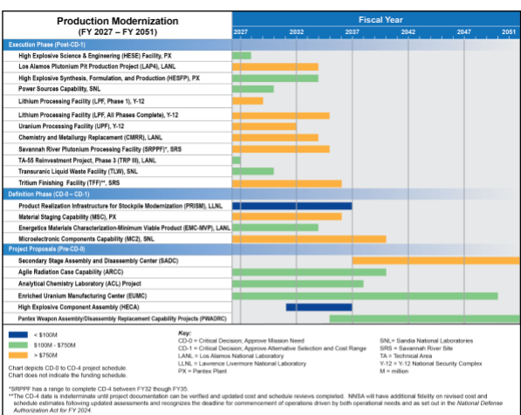
US Future Nuclear Deterrent
Upgraded Triad
  (Air) B-21 Raider
  (Land) LGM-35 Sentinel
  (Sea) Columbia class sub
NNSA
  Multiple Warhead Activities
  Production Modernization

Slide 11
Nuclear Deterrence Rapid Capabilities Team
NDRCT established by NNSA in 2025
  Collaborative effort with Department of War to assess new concepts
Purpose is to provide the US with flexible deterrence options across a wide range of conflict scenarios
Mission is to develop new and advanced capabilities on accelerated timelines
  Compress timelines for weapon system development from 10 years to 3-5 years
  Includes design, prototype, and demonstrate future weapon systems for a modern deterrent
  Pushing the bounds of what is possible
Notes:
To provide the United States with flexible deterrence options across a wide range of conflict scenarios, the nuclear enterprise is developing new and advanced capabilities on accelerated timelines. This undertaking reflects the continual evolution of deterrence. As adversaries adjust their own nuclear postures, the United States continuously adapts its own, ensuring that our nuclear force is sufficient to deter aggression, reassure our allies and partners, and maintain global stability.
To react to changing deterrence requirements on a swifter timeline, NNSA established the Nuclear Deterrence Rapid Capabilities Team in 2025, drawing tools and expertise from across the enterprise. As part of this effort, our scientists and engineers are collaborating with counterparts at the Department of War to assess several new weapon concepts.
This initiative intends to deliver new deterrence options at a faster pace than traditional warhead acquisition programs. The team’s organizing principle is to compress the timeline for fielding new weapons from 10 years to within three to five.
The Rapid Capabilities Team is one of the most groundbreaking initiatives within the nuclear enterprise today, providing the means to design, prototype, and demonstrate future weapon systems for a modern deterrent. The weapon design and engineering work being performed under the program is pushing the bounds of what is possible and is being done much faster than at any rate since the end of the Cold War.
As America's adversaries pursue a variety of exotic delivery vehicles, from long-range underwater drones to hypersonic glide vehicles, our scientists and engineers are working aggressively to ensure the continued preeminence of the U.S. deterrent.

Slide 12
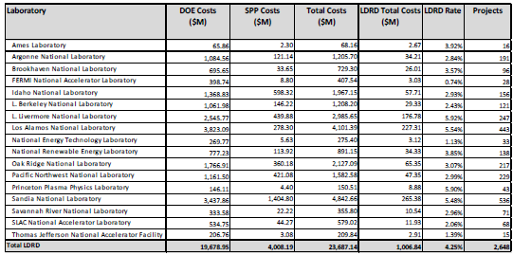
NNSA’s LDRD Program–Critical to Future
- FY2025 Report to Congress

Slide 13
Backup Slides

Slide 14
Recent move to Title 10
NNSA has undergone structural recodification by Congress
  National Defense Authorization Act, FY2026
    Transfer atomic energy defense provisions from Title 50 (War and National Defense) to
    Title 10 (Armed Forces)
    Reason: Streamline military-energy oversight and align defense-related nuclear laws with general military law
Impact: US Code governing LDRD has moved to Title 10
Notes:
The National Nuclear Security Administration (NNSA) has been undergoing a structural recodification by Congress to transfer atomic energy defense provisions from Title 50 (War and National Defense) to Title 10 (Armed Forces) of the U.S. Code to streamline military-energy oversight and align defense-related nuclear laws with general military law.
Reasons for the Recodification
Unified Defense Oversight: Moving provisions to Title 10 places NNSA's defense programs alongside standard Department of Defense (DOD) operational and military codes, making it easier for the congressional defense committees to manage and synchronize nuclear modernization.
Streamlined Statutory Organization: Title 50 primarily houses general war, emergency, and intelligence statutes, whereas Title 10 specifically governs the structure, e.g.,, authorities, and general laws of the U.S. Armed Forces, making it a more logical home for the nation's nuclear deterrent and weapons stockpile maintenance activities.
Reducing Administrative Friction: Consolidating defense-related authorities simplifies cross-agency referencing between the DOD and the semi-autonomous NNSA (housed within the Department of Energy).

Slide 15
Legislative Update
Title 10
Subtitle A—General Military Law
Subtitle B—Army (sections 7011 to 7842)
Subtitle C—Navy and Marine Corps (sections 8011 to 8943)
Subtitle D—Air Force and Space Force
Subtitle E—Reserve Components
Subtitle F—Alternative Military Personnel Systems
(sections 20001 to 20702)
Title 10-ARMED FORCES
Subtitle A-General Military Law
PART VI-ELEMENTS OF DEPARTMENT OF DEFENSE AND OTHER MATTERS
Subpart B-Atomic Energy Defense
CHAPTER 608-ADMINISTRATIVE MATTERS
SUBCHAPTER II-RESEARCH AND DEVELOPMENT
SUBCHAPTER II—R&D
Sections
6331. Laboratory-directed research and development programs.
6332. Laboratory-directed research and development.
6333. Funding for laboratory directed research and development.
6334. Charges to individual program, project, or activity.
6335. Limitations on use of funds for laboratory directed research and development purposes.
6336. Report on use of funds for certain research and development purposes.
6337. Critical technology partnerships and cooperative research and development centers.
6338. University-based research collaboration program.
6339. Limitation on establishing an enduring Bioassurance program within the administration.
6340. Appropriate scoping of artificial intelligence research within the administration.

Slide 16
Legislative Update
§6331. Laboratory-directed research and development programs (formerly 50 USC 2791)
(a) Authority.—Government-owned, contractor-operated laboratories that are funded out of funds available to the Department of Energy for national security programs are authorized to carry out laboratory-directed research and development.
(b) Regulations.—The Secretary of Energy shall prescribe regulations for the conduct of laboratory-directed research and development at such laboratories.
(c) Funding.—Of the funds provided by the Department of Energy to a national security laboratory for national security activities, the Secretary shall provide a specific amount, of not less than 5 percent and not more than 7 percent of such funds, to be used by the laboratory for laboratory-directed research and development.
(d) Laboratory-directed Research and Development Defined.—For purposes of this section, the term "laboratory-directed research and development" means research and development work of a creative and innovative nature which, under the regulations prescribed pursuant to subsection (b), is selected by the director of a laboratory for the purpose of maintaining the vitality of the laboratory in defense-related scientific disciplines.
(Added Pub. L. 119–60, div. C, title XXXI, §3111(a), Dec. 18, 2025, 139 Stat. 1448.)
§6332. Laboratory-directed research and development (formerly 50 USC 2791a)
Of the funds made available by the Department of Energy for activities at government-owned, contractor-operated laboratories funded in this Act ¹ or subsequent Energy and Water Development Appropriations Acts, the Secretary may authorize a specific amount, not to exceed 8 percent of such funds, to be used by such laboratories for laboratory directed research and development: Provided, That the Secretary may also authorize a specific amount not to exceed 4 percent of such funds, to be used by the plant manager of a covered nuclear weapons production plant or the manager of the Nevada Site Office for plant or site directed research and development: Provided further, That notwithstanding Department of Energy order 413.2A, dated January 8, 2001, beginning in fiscal year 2006 and thereafter, all DOE laboratories may be eligible for laboratory directed research and development funding.
(Added Pub. L. 119–60, div. C, title XXXI, §3111(a), Dec. 18, 2025, 139 Stat. 1448.)
§6333. Funding for laboratory directed research and development (formerly 50 USC 2791a)
Notwithstanding section 307 of the Energy and Water Development and Related Agencies Appropriations Act, 2010 (Public Law 111–85; 123 Stat. 2845), of the funds made available by the Department of Energy for activities at Government-owned, contractor-operated laboratories funded in the Energy and Water Development and Related Agencies Appropriations Act, 2014 (div. D of Pub. L. 113–76) or any subsequent Energy and Water Development Appropriations Act for any fiscal year, the Secretary may authorize a specific amount, not to exceed 6 percent of such funds, to be used by such laboratories for laboratory directed research and development.
(Added Pub. L. 119–60, div. C, title XXXI, §3111(a), Dec. 18, 2025, 139 Stat. 1449.)

Slide 17
Legislative Update
§6334. Charges to individual program, project, or activity (formerly 50 USC 2791b)
Of the funds authorized by the Secretary of Energy for laboratory directed research and development, no individual program, project, or activity funded by this or any subsequent Act ¹ making appropriations for Energy and Water Development for any fiscal year may be charged more than the statutory maximum authorized for such activities: Provided, That this section shall take effect not earlier than October 1, 2015.
(Added Pub. L. 119–60, div. C, title XXXI, §3111(a), Dec. 18, 2025, 139 Stat. 1449.)
§6335. Limitations on use of funds for laboratory directed research and development purposes (formerly 50 USC 2792)
(a) Limitation on Use of Weapons Activities Funds.—No funds authorized to be appropriated or otherwise made available to the Department of Energy in any fiscal year after fiscal year 1997 for weapons activities may be obligated or expended for activities under the Department of Energy Laboratory Directed Research and Development Program, or under any Department of Energy technology transfer program or cooperative research and development agreement, unless such activities support the national security mission of the Department of Energy.
(b) Limitation on Use of Certain Other Funds.—No funds authorized to be appropriated or otherwise made available to the Department of Energy in any fiscal year after fiscal year 1997 for defense environmental cleanup may be obligated or expended for activities under the Department of Energy Laboratory Directed Research and Development Program, or under any Department of Energy technology transfer program or cooperative research and development agreement, unless such activities support the defense environmental cleanup mission of the Department of Energy.
(c) Limitation on Use of Funds for Overhead.—A national security laboratory may not use funds made available under section 6331(c) to cover the costs of general and administrative overhead for the laboratory.
(Added Pub. L. 119–60, div. C, title XXXI, §3111(a), Dec. 18, 2025, 139 Stat. 1449.)
§6336. Report on use of funds for certain research and development purposes (formerly 50 USC 2793)
(a) Report Required.—Not later than February 1 each year, the Secretary of Energy shall submit to the congressional defense committees a report on the funds expended during the preceding fiscal year on activities under the Department of Energy Laboratory Directed Research and Development Program. The purpose of the report is to permit an assessment of the extent to which such activities support the national security mission of the Department of Energy.
(b) Plant-directed Research and Development.—(1) The report required by subsection (a) shall include, with respect to plant-directed research and development, the following:
(A) A financial accounting of expenditures for such research and development, disaggregated by nuclear weapons production facility.
(B) A breakdown of the percentage of research and development conducted by each such facility that is plant-directed research and development.
(C) An explanation of how each such facility plans to increase the availability and utilization of funds for plant-directed research and development.
(2) In this subsection, the term "plant-directed research and development" means research and development selected by the director of a nuclear weapons production facility.
(c) Preparation of Report.—Each report shall be prepared by the officials responsible for Federal oversight of the funds expended on activities under the program.
(d) Criteria Used in Preparation of Report.—Each report shall set forth the criteria utilized by the officials preparing the report in determining whether or not the activities reviewed by such officials support the national security mission of the Department.

Slide 18
LDRD Order
Updated objectives (scientific and technical vitality, mission agility, workforce development)
Normally LDRD projects “will” be relatively small and limited to a period of performance of 36 months
  Eliminated: exceptions may be granted by the CSO/Deputy Administrator, NNSA, or his/her authorized designee
LDRD projects will be basic research, applied research, or experimental development as defined by the Office of Management and Budget
  OMB’s current definition, “experimental development” is the systematic search for new knowledge, the application of that knowledge to create new products, processes, or systems, and the testing of those innovations, excluding pre‑production work such as tooling or facility development
LDRD may be used for cooperative research and development agreements or other arrangements for technology transfer
Transition from HQ to SOM/FOM of LDRD review and program authorization
  SOM/FOMs determining how to this will be accomplished
No more federal project approval
  Labs will be held accountable for ensuring all direction is followed
Program plans if significant changes to the review and selection process or 5-years at a minimum
Notes:
Maximize laboratory, plant, and site-directed research & development (LDRD, PDRD, and SDRD) investments and provide process development guidance to focus and support weapons production, sustainment, and certification.
- Develop LDRD/PDRD/SDRD process development guidance; Track and baseline LDRD/PDRD/SDRD expenditures

Slide 19
Contractor Requirements Document
Establish a program that includes:
  A management system to ensure that the LDRD program meets the requirement of 413.2D, including alignment with DOE/NNSA mission focus
  A review and selection process that emphasizes innovative scientific and technological excellence for selection of projects using internal peer and/or technical management review
  A significant number of the projects selected should be independently proposed by individual researchers or small multidisciplinary teams
  Evaluation of the quality of the research and development performed
This program shall be reviewed by the contractor prior to program execution
Submission of Submit an LDRD program plan for approval to the responsible DOE/NNSA site/field office manager
  Only if there is a significant change to the review and selection process or at minimum every 5 years
Notes:
Maximize laboratory, plant, and site-directed research & development (LDRD, PDRD, and SDRD) investments and provide process development guidance to focus and support weapons production, sustainment, and certification.
- Develop LDRD/PDRD/SDRD process development guidance; Track and baseline LDRD/PDRD/SDRD expenditures

Slide 20
LDRD Direction and Guidance
Roles, Responsibilities, and Guidance for LDRD (SC and NNSA) (2019)
  DOE document; modified for NNSA
  Augments DOE Order 413.2D
    Update?
Legislative changes?
  Minimum funding for LDRD at NNSA?
LDRD Working Group
  Monthly meetings via Teams
  In-person meetings (at least twice a year)

Slide 21
Deputy Administrator for Defense Programs Guidance
NA-10 Published Transformational Objectives
  Maximizing laboratory, plant, and site-directed research & development (LDRD, PDRD, and SDRD, collectively XDRD) investments is vital to meeting the Defense Programs mission in a challenging security
  Defense Programs requests that each Field Office promulgate the following guidance and direct, as appropriate, that the LPS incorporate any necessary changes into their internal XDRD programs
    Review processes and selection criteria for XDRD to ensure a sufficient nuclear weapons mission focus, consistent with forthcoming Defense Programs R&D guidance priorities
    Collaborate to enhance formal communication between design and production agencies on high-impact R&D investment areas, including by participating in site-specific Process Development Summits

