Slide 1
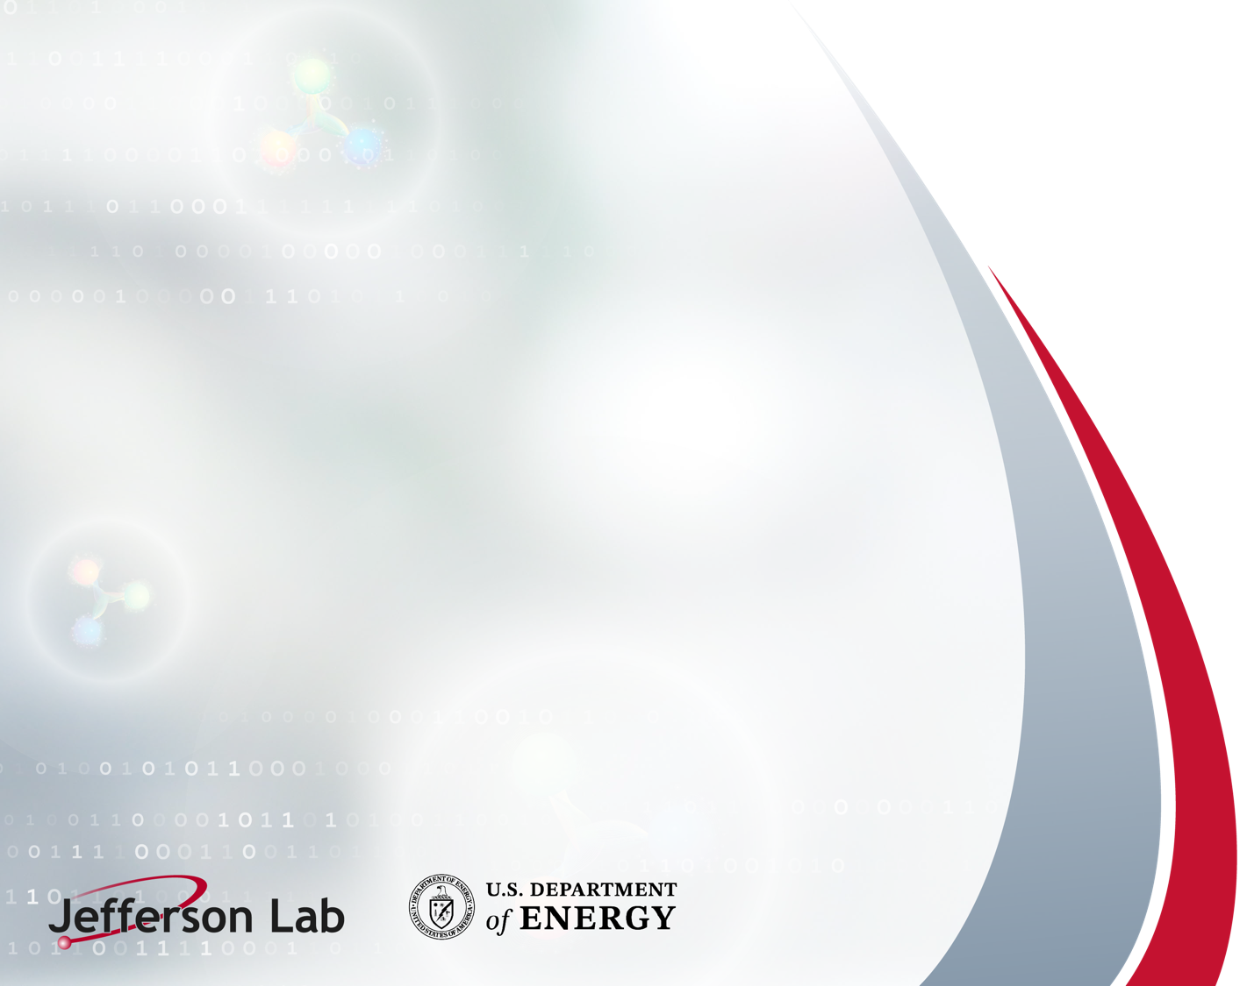
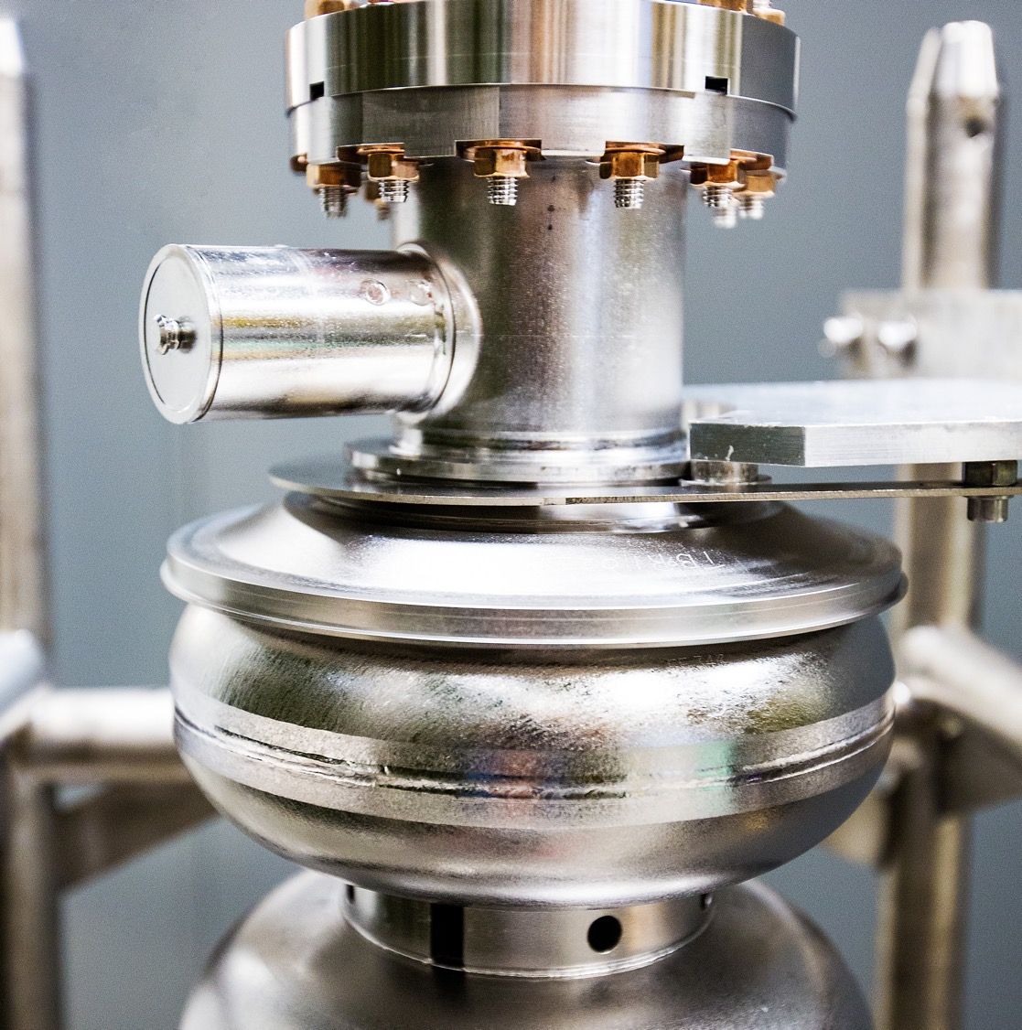
Laboratory Directed Research and
Development (LDRD)
Tour Safety Briefing
September 17, 2026
Nina Ullrich, Tour Coordinator
Notes:
Good morning, everyone and welcome again to Jefferson Lab! My name is Nina Ullrich and as the tour coordinator, it’s my pleasure to take you on a tour of our campus today.
Also helping serve as tour guides are Matt Cahill, Scott Cole, and Dave Chopard.
During today’s tour, we encourage you to get as up close as possible, ask questions, and take pictures. But first, we need to go over a few key safety protocols.
It’s our job to get you safely, and efficiently, to the places where our scientists and engineers are waiting and we want to stay on time so we don’t have to cut the tour short.

Slide 2
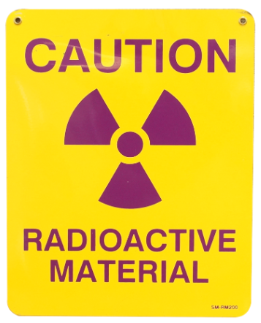
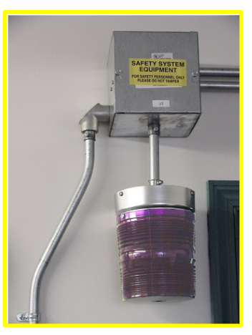
Radiologically Controlled Areas (RCA’s)
Tours with the potential for proximity to radiologically controlled areas require dosimetry.
In these areas:
  Tour escorts carry the SRPD for the group
  The risk for radiation is negligible
  Do not touch equipment or materials unless invited to do so
Notes:
Most of the areas we’ll visit here will not expose you to radiation above normal background levels. However, we’ll be near some Radioactive Material. Because of this:
You’ll notice we are wearing our personal dosimetry
And are carrying a Self-Reading Pocket Dosimeter, SRPD, that will alert us in real time if there is any radiation exposure.
if the SRPD alarm sounds off, follow us to the nearest exit.
The risk for radiation exposure during a tour is minimal to none, but these controls are in place for our safety.

Slide 3
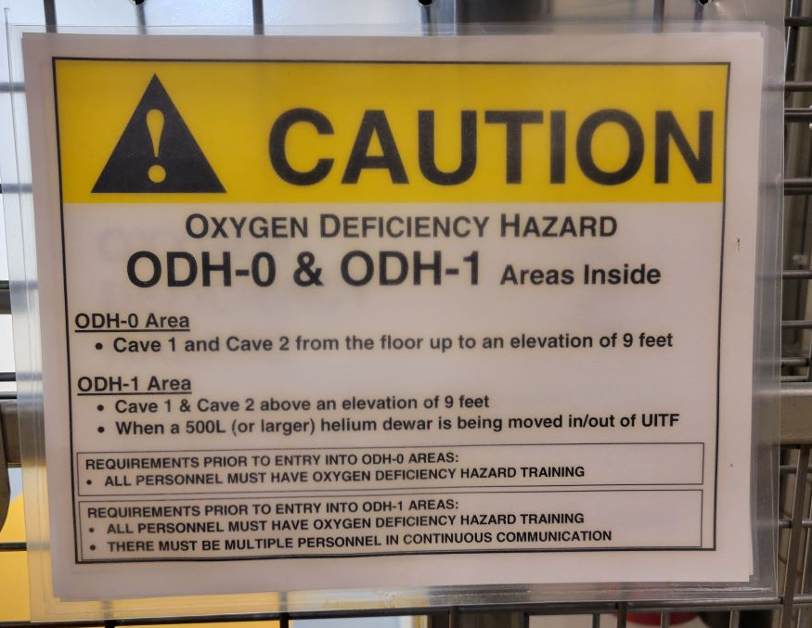
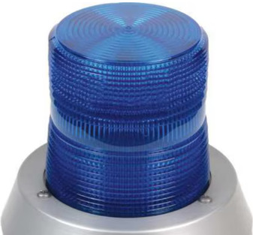
Oxygen Deficiency Hazard (ODH)
ODH areas do exist at Jefferson Lab where cryogens are used to cool superconducting devices.
  If an ODH is detected:
    Alarm will sound (loud klaxon)
    Blue light will flash
    Follow your escort to the exit
    Don’t walk or run through a cloud or fog bank as this indicates the location of the leak
    Do not stop to help others
Notes:
Also, we’ll also be entering areas classified as Oxygen Deficiency Hazard, ODH. If there were to be a cryogen leak:
You’ll see a blue light flashing
Hear a loud buzzing or klaxon alarm
And may see a white plume like fog or a cloud, indicating the leak where the oxygen is displaced. DO NOT walk or run through it, instead follow us to the nearest exit.

Slide 4
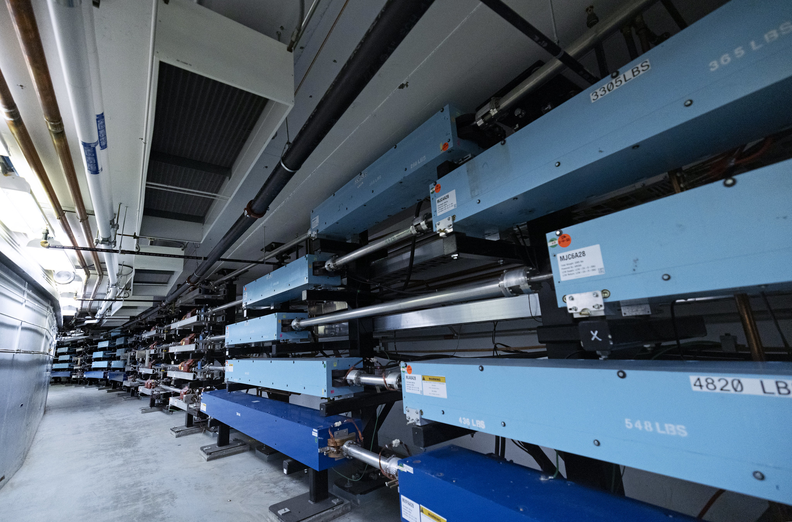
Magnetic Fields / RF Radiation Warning
Notes:
We have a few areas where magnetic fields or RF radiation could interfere with instruments and electronic apparatus, such as cardiac pacemakers. Because of this, we ask you please let us know if you have a medical device such as a pacemaker or defibrillator that may prevent you from safely completing this tour.

Slide 5
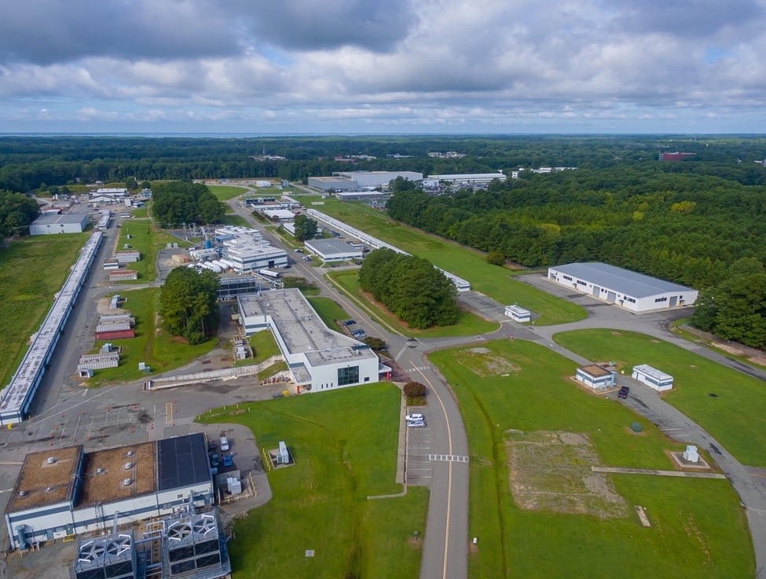
Additional Safety Measures
Please be mindful of the route as we walk
Always stay within 15 ft (~3 m) of your guide
Do not allow equipment items to separate you
You must be able to always see / hear us
Please use the handrails when on the stairs
Closed-toed shoes and long pants are required
Let us know if you don’t feel well, or see someone else not feeling well
Photography is allowed
Notes:
A few other points to note:
Slips, trips and falls are one of the most common cause of injuries and the lab is no exception, so please watch your step.
We will be moving through a working lab where cranes and jacks may be in operation and may be heard to hear at times.
Please stay within 15’ of the speaker or tour escort and try not to allow any large pieces of equipment to come between yourself and the group.
There is no food or drink allowed on the tour, including water, gum or cough drops, and you can leave your drink on the bus if you’d like.
There are no restrooms on the tour so please use the facilities in our lobby before we leave CEBAF Center.
Cell phone reception is very limited and please do not touch anything unless you are invited to do so.
Please let one of us know if at any time you do not feel well for any reason, or if you notice someone else who may not feel well. Should there be a medical emergency, we will call 911 and Lab security at 5822.

Slide 6
GROUP 1
Matt Cahill
Scott Cole
Shana Jensen
Garry Kuhn
Xinchang Li
Liang Luo
Marshall McDonnell
Amy Meacham
Jonathan Menard
Michael Penwarden
Binod Rai
Yihui "Ray" Ren
David Sanches
Lisa Sigler
Justin Simpson
Carole Steward
Vivian Sullivan
Carolyn Urso
Debora Wagner
Yufan Xu
Xiaokun Claire Yang
Group 2
Nina UIlrich
Dave Chopard
Latifa Elouadrhiri
Brian Anderson
Mark Barnes
Stephen Brooks
Damien Culver
Marianne Dietz
Courtney Dornburg
Austin Dorris
Anna Duke
Rachel Dunn
Albert Eiffes
John Feddema
Alex Frank
Natalie Geise
Richard Goffi
Roli Gostelow
Lara Hastings
Peter Heimberg
Tony Huff
Notes:
Because we all need to be accurately covered under our RCA and ODH safety protocols, we will be breaking up into 2 groups, each marked with a color. Those in Group 1, stay with Matt and Scott. Those in Group 2, blue stickers, stay with Dave and I.
Repeating what I said earlier, It’s our job to get you safely, and efficiently, to the places where our scientists and engineers are waiting and we want to stay on time so we don’t have to cut the tour short.
We will be taking one bus so please stay grouped to make it more efficient.
We will all be visiting the Machine Control Center, Test Lab and experiencing the Windshield Tour, but at different times. And the last stop of the day will be together underground in Experimental Hall C, and still breaking up in two groups so we can hear. And then we’ll all come back to CEBAF Center here together. And you are welcome to leave your belongings here.
Taking a look at the names, I’m going to call them out in order and please say here.

Slide 7
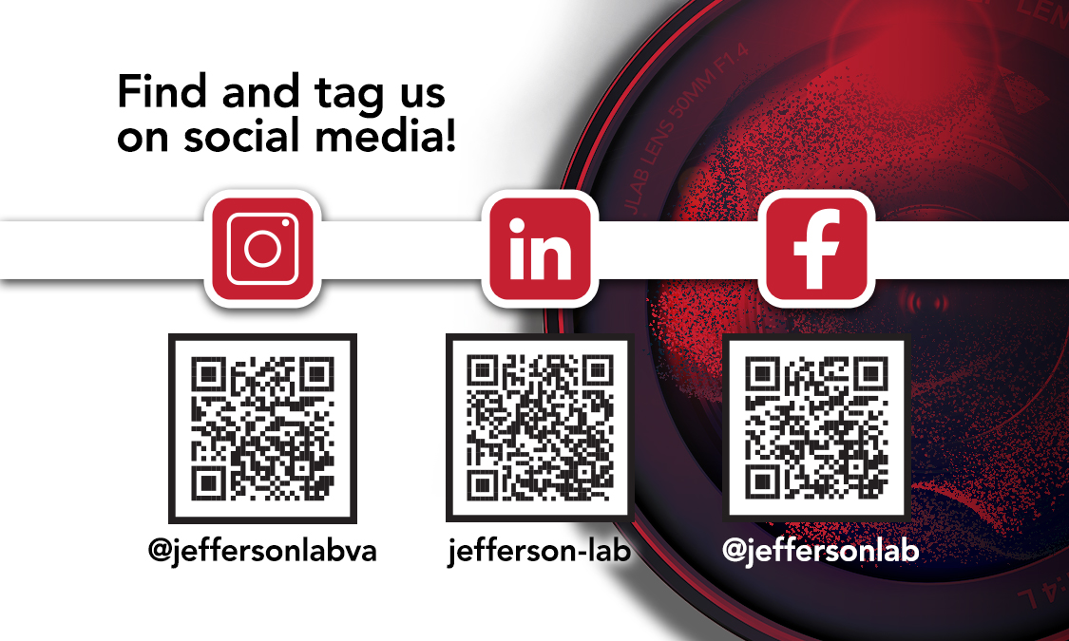
Notes:
And because photography is allowed, we encourage you to take as many photos as you want.
And we’d love to see them! Go ahead and take a photo of these QR codes so you can like our pages and tag us in your photos!

Slide 8
QUESTIONS?
Notes:
For those with a blue sticker, group 2, should board the bus first because Group 1, green, will be getting off first.
Are there any questions?
If not, let’s get started!

