Slide 1
Interlaboratory Collaborations
Origin, Overview, and Impacts
Andy Nelson

Slide 2
Acknowledgements
Legends:
Leigh Cunningham (SNL)
Kathryn Mohror (LLNL)
Jacob Waltz (LANL)
Marie Arrowsmith (SNL)
Kelly Sullivan (retired, PNNL)
Wahid Hermina (retired, SNL)
Doug Rotman (retired, LLNL)
Laura Stonehill (LANL)
Tony Huff (INL)
Mitchell Kerman (INL)
Jacqueline Ramos (formerly, SRNL)
Paul Guss (NNSS)
Katherine Benedict (LANL)
On-going Support from PNNL:
Andy Piatt
Erin Searcy
Kyle Koupus
Erin Brown
Lara Hastings
Communications:
Amy Mosley (LLNL),
Lexi Tyler (LANL),
Amy Treece (SNL)
Past Observers:
Kathleen Barkigia (BNL),
Latifa Elouadrhiri (Jlab),
Darren Ho (LBL)
Roli Gostelow (ORNL)
Katherine Evans (ORNL)
Current IL Collaborators:
Dorean Chaleunphohn (SNL),
Joany Babilonia (LANL),
Kirsten McCabe (LANL),
Elizabeth Wheeler (LLNL),
Cameron Hawkins (NNSS),
Mark Barnes (SRNL),
Liz Hoffman (SRNL),
James Morris (Ames),
Rachel Dunn (PPPL),
Courtney Dornburg (SNL),
John Feddema (SNL)
Garry Kuhn (NNSA contractor)
Anthony Lewis (NNSA)

Slide 3
Interlaboratory LDRD/SDRD Collaborations
Long history of formal and informal collaboration between the DOE National Laboratories and Sites
Combined strengths and capabilities can increase impact for the nation
Began as a Pilot with LANL, LLNL, and SNL in FY24
Key Interlaboratory (IL) LDRD/SDRD characteristics
  Leverage the unique capabilities
  Multiply mission impacts that can be achieved
  Teams will create new collaborations
See: M. Arrowsmith (SNL), K. Mohror (LLNL), & J. Waltz (LANL), NNSA Interlaboratory LDRD Pilot, SAND2024-05220O

Slide 4
FY24 Pilot
Guiding philosophies in initiating the pilot
Interlaboratory LDRD projects will be aligned with each participating laboratory’s strategic goals
The selection of interlaboratory LDRD projects will be competitive
Participating laboratories will retain autonomy in their management of interlaboratory LDRD projects
Intellectual property management will be integrated into the management of interlaboratory LDRD projects
See: M. Arrowsmith (SNL), K. Mohror (LLNL), & J. Waltz (LANL), NNSA Interlaboratory LDRD Pilot, SAND2024-05220O

Slide 5
FY24 PILOT
Pilot Plan
OCT 2022 | Discussions began at LDRD Program Annual Meeting
FEB 2023 | White paper describing goals and proposed procedures
JUL 2023 | NNSA CRO concurrence on pilot parameters
AUG 14, 2023 | Letters of Intent due
SEP 18, 2023 | Full proposals due
OCT 10, 2023 | Proposal down-selects due
OCT 20, 2023 | Oral reviews completed for down-selected proposals
OCT 24, 2023 | Recommendations from review committees due
NOV 10, 2023 | LDRD Office decisions made
NOV 14, 2023 | Notifications of decisions sent to proposers
JAN 8, 2024 | Projects start
SEP 30, 2026 | Projects end
See: M. Arrowsmith (SNL), K. Mohror (LLNL), & J. Waltz (LANL), NNSA Interlaboratory LDRD Pilot, SAND2024-05220O

Slide 6



FY24 Pilot
Selection of Focus Areas, Funding Levels, Management Strategy
Focus areas selected collaboratively
The CRO roles at LANL, LLNL, and SNL determined the total funding level per year
  maximum per-project yearly funding level of $1M,
  approximately 5-6 projects could be funded.
Each laboratory would fund, manage, and be responsible for only the work performed at its laboratory,
No funding transferred between laboratories.
See: M. Arrowsmith (SNL), K. Mohror (LLNL), & J. Waltz (LANL), NNSA Interlaboratory LDRD Pilot, SAND2024-05220O
Notes:
We selected the focus areas collaboratively. The Chief Research Officers (CROs) at LANL, LLNL, and SNL1 discussed several focus areas of mutual interest and ultimately selected four based on alignment with the strategic goals of the participating laboratories. We asked subject matter experts (SMEs) from each of the participating laboratories to generate detailed focus area descriptions for the call for proposals.
The SMEs were asked to identify subtopics for each focus area that were of particular interest to their laboratory. After we received, the subtopics from the laboratories, we merged the subtopics into a single description for each focus area.
The CRO roles at LANL, LLNL, and SNL are held by the Deputy Director for Science, Technology, and Engineering (LANL); the Deputy Director for Science and Technology (LLNL); and the Advanced Science and Technology Associate Laboratory Director (SNL)The CROs determined the total funding level per year that their respective laboratory would commit to this pilot. The total funding levels were approximately equal across the laboratories. Based on the amounts committed, the CROs/DDST agreed on a maximum per-project yearly funding level of $1M, with the idea that approximately 5-6 projects could be funded.
Although the IL LDRD projects are joint projects, we decided that each laboratory would fund, manage, and be responsible for only the work performed at its laboratory, with no funding transferred between laboratories. This decision greatly simplified the process of getting laboratory site office approval of the work to be performed. To facilitate this, we required that proposals clearly specify the work to be performed at each laboratory.
Once these high-level parameters were agreed upon, the CROs gave their concurrence for the NNSA laboratories to start the pilot.

Slide 7
FY24 Pilot
Call, Call Response, and Proposal Management
FOCUS AREA | LOIS RECEIVED | PROPOSALS RECEIVED
HED SCIENCE | 30 | 18
BIOSECURITY | 18 | 12
CLIMATE RESILIENCE | 27 | 15
ADV MATL AND MANUFACTURING | 50 | 34
Total | 125 | 79
Call
  Issued July 2023, closed 14 August 2023
  Letters of Intent (LOIs) required to estimate areas of expertise for review committees
  All proposals unclassified, but classified addendum allowed
Response
  Bigger than anticipated
  No downselect, but email sent to notify about competitiveness
Proposal Management
  Planned to use Sharepoint forms
  Last minute pivot to email list, stored on LLNL OneDrive
  Excel used to track
See: M. Arrowsmith (SNL), K. Mohror (LLNL), & J. Waltz (LANL), NNSA Interlaboratory LDRD Pilot, SAND2024-05220O
Notes:
Call
We developed and agreed on the text for the call for proposals and issued the call soon after receiving concurrence from the CROs. We issued the agreed upon call for proposals using the procedures normally followed for LDRD calls at each laboratory, e.g., via laboratory news article or email list notification.
We required Letters of Intent (LOIs) from proposers by August 14, 2023. The purpose of the LOIs was to enable us to estimate the number of full proposals and to identify areas of expertise needed for the review committees. Full proposals were due September 18, 2023. No late proposals were accepted. No proposals without a corresponding LOI were accepted.
All proposals were required to be unclassified. We did allow for an optional single page classified addendum (up to S//RD) for proposals. We instructed the proposers that the full unclassified proposal should be able to stand on its own and the addendum should only include additional motivation, i.e., the addendum should not contain any project deliverables.
We held an information session on July 17, 2023 open to all interested proposers from all participating laboratories to discuss the call and answer questions.
Proposal Management
We originally planned to use LLNL-hosted Sharepoint forms to manage proposal submissions and set up
forms, etc. for this purpose. However, even though LLNL’s Sharepoint allows remote users to access it,
there were unexpected authentication problems for LANL users. At the last minute, the committee
pivoted to using a standard email list for receiving proposals, stored all shared documents in LLNL
OneDrive, and used Excel spreadsheets for tracking proposal status and review scores and comments.
Call Response
The response to the call was more robust than we expected. We received 125 LOIs and 79 full proposals. We sent an email to all submitters announcing the number of LOIs received in each category and reminded the submitters of the total budget allocated for the pilot. The purpose of this was to let them know that approximately 1-2 projects would be funded in each focus area so that they knew the level of competition they were facing if they decided to submit a full proposal.

Slide 8
FY24 Pilot
Review Committees and Project Selection
FOCUS AREA | PANELISTS | CHAIR AFFILIATION
HED SCIENCE | 12 | LLNL
BIOSECURITY | 9 | LANL
CLIMATE RESILIENCE | 11 | LLNL
ADV MATL AND MANUFACTURING | 15 | SNL
Review Committees
One committee per focus area
One chair per focus area
~Equal representation by labs
Review Process and Project Selection
Scores from reviewers informed
Decision made at LDRD Annual meeting October 2023
Budget, institutions, and scores considered
See: M. Arrowsmith (SNL), K. Mohror (LLNL), & J. Waltz (LANL), NNSA Interlaboratory LDRD Pilot, SAND2024-05220O
Notes:
Review committees
The review committees were selected by management recommendation at each participating laboratory. There were four review committees, one for each focus area in the call for proposals, and the committee size for each focus area was determined by the number of proposals in that focus area.
As much as possible, there was equal representation from the participating laboratories on each focus area committee. A chair was appointed for each focus area committee, again with the goal of having balanced representation from each laboratory for the chairs.
Review Process and Project Selection
The focus area review committees followed the procedures we gave them and returned to us a ranked list of recommended proposals with scores and comments. The NNSA LDRD Offices evaluated the information returned by the committees and inspected them to ensure quality of the reviews, quality of the proposals, and that the highest ranked-proposals met the two critical criteria for IL projects (for creating new collaborations and outcomes that exceed what could be done by a single laboratory).
The LDRD Offices conferred at the LDRD Program Annual Meeting in October 2023 and made an initial selection of the projects to be funded based on ranking by the review committees, distribution across the focus areas, and allocated budget.

Slide 9
FY24 Pilot
Project Initiation and Management
After projects were notified, local procedures followed
  Each laboratory funds, manages, and is responsible for only the work performed at that laboratory.
  Budget information and data sheets collected locally
  Local site office approved the proposed work
Projects started January 8, 2024.
Distributed Intellectual Property (IP) management guidance
Joint appraisal schedule:
  April 2024: Informal check in with project leads to make sure they are starting smoothly
  April 2025: Formal appraisal of project by joint committee
  April 2026: Formal appraisal of project by joint committee
Local reporting requirements
See: M. Arrowsmith (SNL), K. Mohror (LLNL), & J. Waltz (LANL), NNSA Interlaboratory LDRD Pilot, SAND2024-05220O
Notes:
After projects were notified, the LDRD Offices at each participating laboratory followed their internal procedures for initiating LDRD projects. Recall that although IL projects are joint across laboratories, each participating laboratory funds, manages, and is responsible for only the work performed at that laboratory.
Budget information and data sheets were collected locally by each laboratory and each laboratory’s site office approved the proposed work for its respective laboratory. Projects were started January 8, 2024.
We distributed a document describing best practices for Intellectual Property (IP) management to the awarded teams.8 The IP guidance document was written collaboratively by the participating laboratories.
As of this writing, the projects have not yet been appraised as they have only been executing for 2
months. We plan the following appraisal schedule:
• April/May 2024: Informal check in with project leads to make sure they are starting smoothly
• April/May 2025: Formal appraisal of project by joint committee
• April/May 2026: Formal apprasial of project by joint committee
The joint committee will be composed of original proposal reviewers and SMEs.

Slide 10
FY24 PILOT
Projects
IL Identifier | Title | Labs
BIO-4 | Advancing wastewater biomonitoring capabilities toward establishing an actionable national biosurveillance program | LANL, LLNL, SNL
HED-17 | Predictive Ultrafast Low-Rank Simulations via Embedded Tensor Networks | LANL, LLNL, SNL
CLI-12 | Towards a digital twin of Arctic sea ice | LANL, SNL
HED-26 | Quantum Computing for High Energy Density Science | LANL, LLNL, SNL
MM-21 | Discovery of Design Criteria for Polymer Materials in Extreme Environments Using Precisely Engineered Internal Structures Over Multiple Length Scales | LANL, LLNL, SNL
MM-28 | Refractory Additive Manufacturing: Alloys to Z Pulsed Power Facility | LANL, LLNL, SNL
See: M. Arrowsmith (SNL), K. Mohror (LLNL), & J. Waltz (LANL), NNSA Interlaboratory LDRD Pilot, SAND2024-05220O

Slide 11
FY 24 Pilot
Lessons Learned
Observation | Solution
Manual tracking of proposals tedious | Need a proposal management system
Strong interest in call | Need a down-select stage for LOIs
Confusion for the reviewers | Allocate more time and effort for training reviewers
Classified addendum added significant complexity | Remove classified option
Compressed timeline was challenging | Establish focus areas and “ground rules” earlier in the year
Oral presentations challenging to organize | Only have written proposals
See: M. Arrowsmith (SNL), K. Mohror (LLNL), & J. Waltz (LANL), NNSA Interlaboratory LDRD Pilot, SAND2024-05220O
Notes:
Manual tracking of proposals by email, shared directories, and spreadsheets was tedious and potentially error prone. Future iterations of IL LDRD calls should strongly consider a robust proposal management approach.
The response to the first call was robust but we didn’t plan for a down-select stage for LOIs.
Having the first down-select at the full proposal stage resulted in a huge amount of work for proposers and reviewers. Future iterations of IL LDRD calls should strongly consider a down- select stage for “white papers” or LOIs, and should consider standardizing requested information to support an equitable and rigorous down-select process.
For the review process, even though we held training sessions, there was still some confusion for the reviewers based on their previous LDRD reviewing experiences at their respective laboratories. Future iterations should anticipate this confusion and allocate more time and effort for training reviewers for IL LDRD.
Offering a one-page classified addendum added significant complexity to the joint review process. Future iterations should consider removing this option.
The compressed timeline for this pilot was challenging for submitters and reviewers. We recommend that future iterations establish focus areas and “ground rules” between the laboratories earlier in the year to allow more time in the schedule.

Slide 12



FY25
Expand Outside LANL, LLNL, SNL
Year | Focus Area | LOIs | Proposals | Selected
FY25 | Advanced Manufacturing | 35 | 7 | 1
 | Energy Security | 38 | 6 | 2
 | Fundamental AI | 16 | 6 | 2
 | Radiographic Systems | 16 | 6 | 2
Total |  | 105 | 25 | 7

Slide 13
FY25
Projects
IL Identifier | Title | Labs
FY25 #123 | Additively-Manufactured Self-Reporting Neuromorphic Smart Materials for Autonomous Sensing and Computing | LLNL, SNL
FY25 #66 | Rapid, Scalable 3D Ceramic Fabrication via Microwave-Assisted Volumetric Additive Manufacturing | LLNL, INL, SNL
FY25 #56 | Accelerated Qualification of Novel Nuclear Structural Materials: Assessing Irradiation Creep and Irradiation Thermal Fatigue Properties Through In-Situ Testing and Multiphysics Simulations | LANL, INL, SNL
FY25 #113 | Data-Fusion with Physics-Informed Neural Operators for Fast and Robust Prediction of Multiphysics Systems as Design Surrogates | LLNL, PNNL, SNL
FY25 #75 | Multilevel Machine Learning for Performance and Reliability | LANL, LLNL, SNL
FY25 #57 | Fundamental Understandings of Multi-color/Multi-modal Radiography and Methods for Data Assimilation and Design Optimization | LANL, PNNL, SNL
FY25 #114 | Portable High-Resolution MeV Neutron and X-ray Radiography | LANL, NNSS, SNL

Slide 14






FY26
Further Expansion
Participating
Year | Focus Area | LOIs | Proposals | Selected
FY26 | Advanced and Small Modular Reactors | 19 | 7 | 1
 | Fusion Systems | 20 | 9 | 1
 | Quantum Computing | 14 | 8 | 1
 | Energy Infrastructure Resilience | 16 | 6 | 2
Total |  | 69 | 30 | 5
Observing
Mapped to DOE Secretarial Order, “Unleashing the Golden Era of American Energy Dominance”

Slide 15
FY26
Projects
IL Identifier | Title | Labs
FY26 #149 | From Atoms to Systems (FASt Sodium): Uncovering Transport and Interfacial Phenomena in Sodium-Ion Batteries for Resilient and Reliable Energy Infrastructure | LANL, SNL
FY26 #164 | Mapping Interfacial Mechanisms of Impurity-driven Corrosion in Molten Salt Reactor Materials | LLNL, SNL
FY26 #189 | Additive Manufacturing of Liquid Deuterium Wetted Foam Targets for High Yields in Fusion Systems | LLNL, SRNL, SNL
FY26 #213 | Quantum Algorithms for Dynamics and X-ray Absorption Spectroscopy in Rare-Earth Element Separations and Reactions | LANL, PNNL
FY26 #140 | Ensuring Mission Assurance: Resiliency Strategies for Defense Critical Energy Infrastructure Facing Natural and Human Threats | LANL, LLNL

Slide 16

FY27
Currently Underway
Year | Focus Area | LOIs | Proposals | Selected
FY26 | Materials for Extreme Environments | 64
 | Quantum Computing | 11
 | Advanced and Remote Sensing | 37
 | Advanced Manufacturing | 34
Total |  | 146
Mapped to NNSA Appendix A

Slide 17
IL Call and Selection Process
8 Sessions
Identify ~4 Focus Areas for the Call
Networking Sessions
100-150 LOIs
30 Proposals
5-7 projects funded
Develop Focus Areas
Prepare Call and Release Call
Prepare LOIs
Review LOIs
Prepare Full Proposals
Review Proposals
Select Projects
Start Projects
Feb
Mar
Apr
May
Jun
Jul
Aug
Sep
Oct
Nov
Dec
Jan

Slide 18
CURrent IL PRocesses
Participation and Focus Areas
 | FY24 | FY25 | FY26 | FY27
Labs / Sites | LANL, LLNL, SNL | LANL, LLNL, INL NNSS, PNNL, SNL | LANL, LLNL, PNNL, SRNL, SNL | Ames, LANL, LLNL, NNSS, PPPL, SRNL, SNL
Focus Areas | Advanced Materials and Manufacturing​ (2) Biosciences​ Climate Science​ HED Physics​ (2) | Advanced Materials and Manufacturing​ (2) Energy Security​ (1) Fundamental AI​ (2) Radiographic Systems​ (2) | Advanced and SMR​ (1) Grid Resilience (2)​ Fusion Systems (1) ​ Quantum Computing (1) | Advanced Manufacturing Materials for Extreme Environments Advanced and Remote Sensing Quantum Computing
# Funded Projects | 6 | 7 | 5

Slide 19
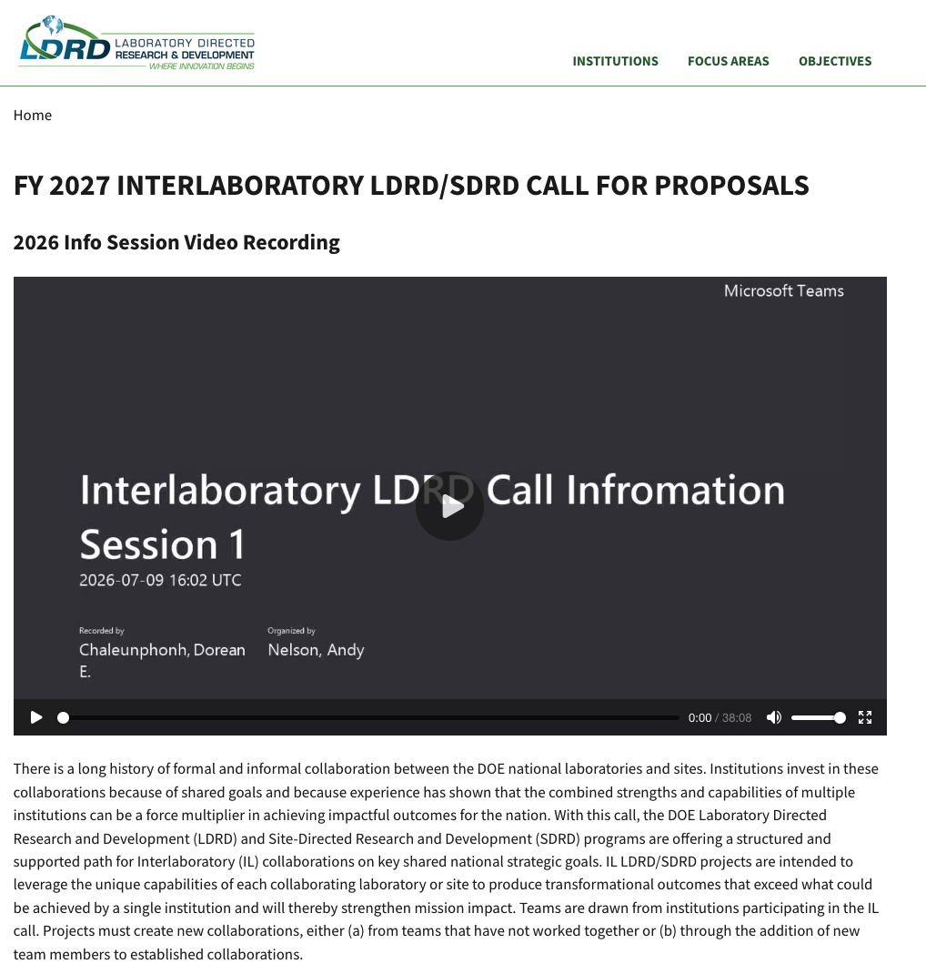
CURrent IL PRocesses
Call
Call released early July
Posted to interlabldrd.pnnl.gov

Slide 20
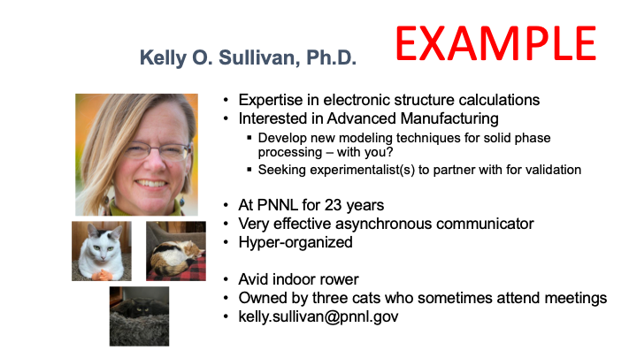
CURrent IL PRocesses
Networking
Started in FY25
90 second bios
2 networking sessions / focus area
Year | Unique Bios Shared | Participants
FY25 | 74 | 249
FY26 | 50 | 165
FY27 | 68 | 95
Total | 192 | 509
Lessons learned

Slide 21
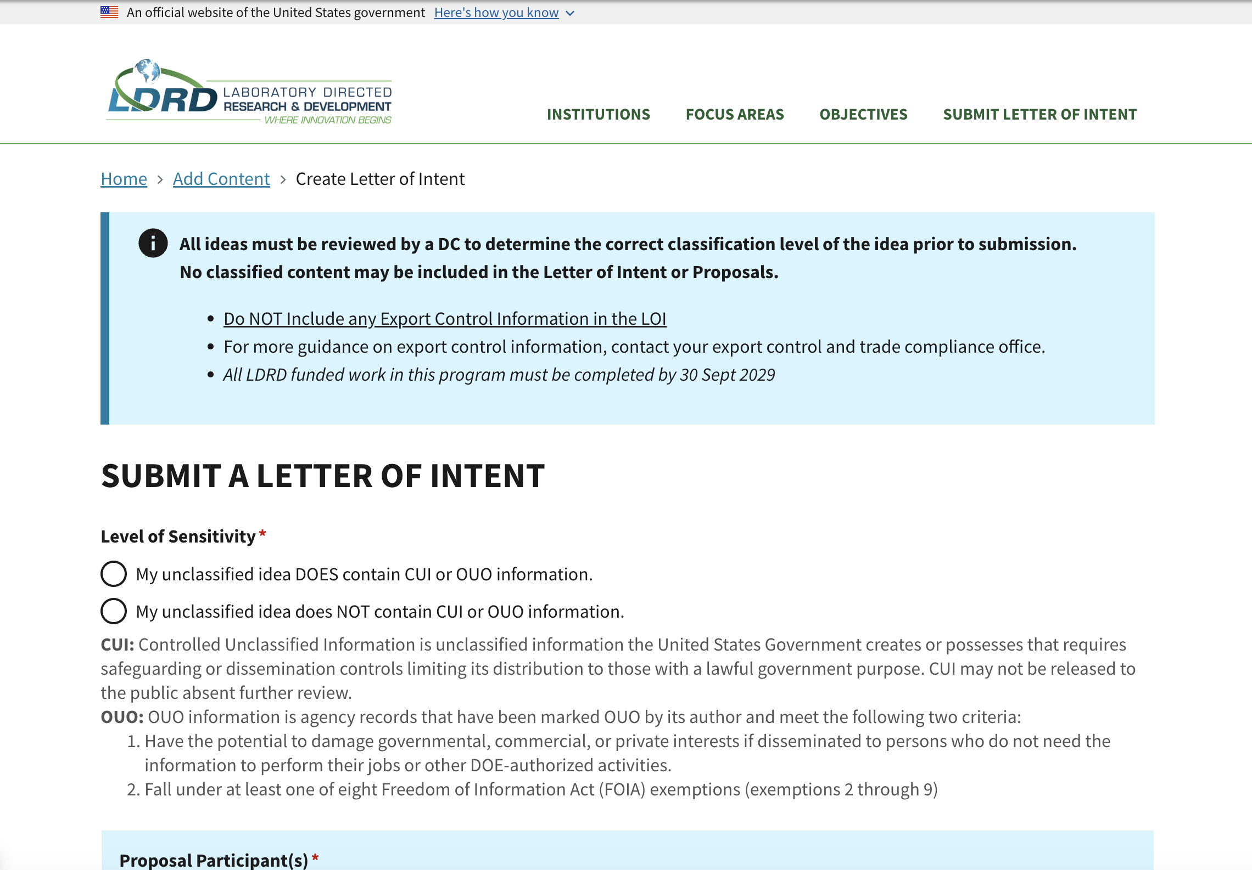
CURrent IL PRocesses
Ideas / LOIs
LOIs
Approximately 2 pages
  Project Description (4000 characters)
  Collaboration Plan (750 characters)
  Tie to Mission (300 characters)
One LOI per team
Minimum 2 labs
No images
No Classified! No CUI//EXPT

Slide 22
CURrent IL PRocesses
LOI Reviews and Downselect
Is the proposed work likely to leverage the unique capabilities of each collaborating Laboratory or Site to produce transformational outcomes that exceed what could be achieved by a single institution?
Is the proposed work likely to create new and/or enhance existing collaborations?
Is the proposed work likely to explore new and original concepts that have the potential to be transformational and impactful?
Is the proposed work likely to advance areas of strategic interest for each participating institution?
Yes/no questions converted to a numerical score using “Yes = 1” and “No = 0”
LOIs must average least 50% "Yes" for the first two questions
Interlab Panel Used to Score

Slide 23
Current IL PRocesses
Full Proposals
 | Section/Header | Word Count / Limit
Data Sheet | Executive Summary; Project Description; FY25 Project Plan; Tie to Mission | 700 words
Proposal | Proposal Narrative | 10 pages maximum; 10-point font minimum; 1” margins
 | Project Summary | about 600 words
 | Background and Significance | about 300 words
 | Research Strategy | about 3500 words
 | Approach | about 3000 words
 | Full Project Plan | about 500 words
 | Deliverables | 300 words suggested
 | Outcomes and Impact | 300 words suggested
 | Strategic Alignment | 250 words suggested
 | Team | 300 words suggested
Additional Info | Staffing List; Budget; References; Biographical Sketches | Does not count against word limit
Invites to ~20-30 teams
Template a word document
Images allowed
No classified
Submissions to a Sharepoint Site
Notes:
Data Sheet
Executive Summary
100 words maximum
Project Description
400 words maximum
FY25 Project Plan
100 words maximum
Tie to Mission
100 words maximum
Staffing List
does not count toward page limit
Budget
does not count toward page limit
References
does not count toward page limit
Biographical Sketches
does not count toward page limit; limited to 2 pages per person

Slide 24
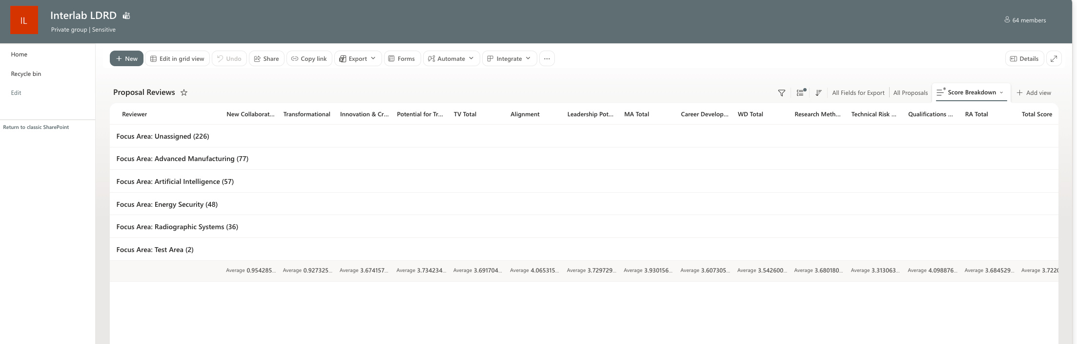
Current IL Processes
Full Proposal Reviews
Interlab Panel
Lead reviewer for each proposal
Scores follow established rubric
Scores submitted through Sharepoint Site

Slide 25
Current IL PRocesses
Scoring Rubric
 | Technical Vitality (40%) |  | Mission Agility (20%) |  | Workforce Development (10%) | Research Approach (30%)
 | * To what extent does the proposed activity explore creative and original concepts? * Does the proposal articulate an intellectual advance or approach to expanding knowledge; or new methods, processes, tools, or devices? * Does the proposed work have the potential to be transformational? * Would the documented outcome of the proposed work be impactful? |  | * Does the proposed work have the potential for disruptive impact within an area of mutual strategic interest between laboratories? * Will the proposed work enhance the capabilities of each collaborating laboratory? * Does the proposed work provide a compelling justification for the necessity of an IL project to solve the technical challenge in question? * Is the proposed work likely to position each collaborating laboratory at the forefront of the field and in a position of leadership vis-a- vis the broader technical community? |  | * Does the proposed work seek to establish multi-disciplinary, multi-laboratory teams and foster critical skills in support of collaborating laboratory objectives? * Does the proposed work create substantive and coordinated opportunities for the creation of new interlaboratory collaborations for team members? | * How well conceived and organized is the proposed activity - including clearly scoped work and milestones for each collaborating laboratory? * Is there a clearly-articulated plan for how the work will be coordinated, executed, and combined into a final integrated result? * Is the project structured so it can effectively undertake high-impact, high-risk R&D? * Do key participants have a record of delivering, quantitatively and qualitatively, as appropriate to their seniority? Is the team strong with respect to their national and international peers? * Are the facilities and resources needed to accomplish the work available, and do they offer a distinct advantage?
Score | Innovation & Creativity (~50%) | Potential for Transformational Impact (~50%) | Alignment (~65%) | Leadership Potential (~35%) | Career Development (100%) | Research Methodology (~40%) | Technical Risk Management (~30%) | Qualifications & Resources (~30%)
5 | The proposal articulates a highly innovative intellectual advance, whether a creative new approach to expanding scientific understanding or new methods, processes, tools or devices that make possible the reduction of scientific and technical advances to practice. Conceptually surprising and very intriguing. | Potential for major impact on a technical field and/or a method/approach. Significantly expands upon the limits of what is currently possible, and/or challenges prevailing paradigms. Likely to lead to development of disruptive technologies or to solve a problem that has historically evaded solution. Strong likelihood of technical reports enabling new mission solutions, significant intellectual property, and/or impactful publications. One expects high-profile publications in leading journals for fundamental work, or external publication to the maximum possible extent. | The scientific discovery or technical breakthroughs produced by success in the project would be highly supportive of one or more strategic objective and mission area of each collaborating laboratory. Proposed applied work would deliver impacts important to mutual Laboratory mission needs. There is a highly compelling rationale for the identified laboratories in order to collaborate to solve the technical challenge in question. | Success in project will place the collaborating laboratories in a position of national or international leadership in the technical field or mission area. | Team members would grow in their technical leadership, with particular emphasis on developing leadership in early career staff. The proposed work would establish a substantive and coordinated multi-disciplinary and multi-laboratory team with outstanding scientific/technical and other career skills. Excellent mentoring would be delivered in the course of the project. | Flawlessly clear and well-designed R&D approach. The scientific methodology of the project is clearly articulated and planned out, and the proposed work is hypothesis-driven when possible. The planned approach is informed by both the theoretical and experimental contexts of the field; if both theoretical and experimental work are proposed, they are highly mutually supportive. The proposal articulates a very appropriate level of planned project management and integration, and the scope of planned work is clearly appropriate to the budget. | Risks are very well-understood and mitigated. The proposal articulates the major challenges of the proposed work and provides thoughtful alternate approaches to the highest risk challenges, with clearly defined go/no-go metrics and decision points as appropriate. | The team formulation is impeccable, with a demonstrated track record of successful innovation in the field. The team represents all expertise needed to pursue the proposed work. Facilities and resources contribute to a unique advantage for collaborating laboratories.
4 | Innovation, whether expansion of scientific understanding or novel reduction to practice, is striking, and the proposed work is clearly differentiated from past work in the field. | Addresses important problems for the technical field that should have high impact. May advance the frontiers of science or engineering. Likely to lead to development of new technologies. Likelihood of an impactful documented outcome, including publishing in leading journals in the field for fundamental work, or, when possible, significant external publications for applied work. | The scientific or technical advances produced by success in the project would be supportive of a strategic objective and mission area of each collaborating laboratory. For proposed applied work, there should be a clear path from the proposed outcomes to mission impact. There is a compelling rational for the identified laboratories to collaborate in order to solve the technical challenge in question. | A successful project will make a clear mark, putting the collaborating laboratories in a leadership position of a limited sector of the technical field and/or mission area or as a competitive player in a major sector. | Team members, particularly early career emerging leaders, are likely to grow in their technical leadership. The proposed work would establish a substantive and coordinated multi-disciplinary and multi-laboratory team with effective scientific/technical and other career skills. Effective mentoring would be delivered in the course of the project. | The R&D methodology is solid, although the formulation of scientific and/or technical questions may show minor gaps. There may be minor weaknesses in awareness of the theoretical and experimental contexts of the field, or in the coordination of theory and experiment within the project. The proposed project management and integration plan is sound. | Risks are well-understood and mitigated, although some details of addressing challenges or alternate approaches may not be as thoroughly outlined as desirable. | The team is very strong, able to stand up to most competitors. Facilities are fully suitable to support the proposed work.
3 | Proposal shows some identifiable signs of innovation, but creative aspects do not stand out. Differentiation from past work in the field may be somewhat unconvincing. | Identifiable but perhaps limited impact on technical field. The expected outcomes may be incremental. Only modest potential for publication, significant reports, and/or intellectual property. | The advances produced by success in the project may be supportive of a strategic objective and mission area of each collaborating laboratory, perhaps in a limited sector. There is a moderately compelling rationale for the identified laboratories to collaborate in order to solve the technical challenge. | Success will place collaborating laboratories as recognizable contributors to the technical field and/or mission area. | The proposed work is likely to deliver identifiable positive impacts on technical leadership skills and development of a coordinated multi-disciplinary and multi-laboratory team. | The formulation of the driving hypotheses may be imperfect. Connection of underlying principles to the proposed work exists but may be incomplete. Connections between theory and experiment, either external to or within the project, may have gaps. The scope of work may be too narrow or too ambitious for the budget. There appears to be some credible level of project management and integration. | Risk may not be thoroughly analyzed, and details of addressing challenges or alternate approaches may be missing. | The team is generally strong, although some aspects of team composition may not be optimal and/or some necessary expertise may be lacking. Facilities are adequate to support the proposed work.
2 | Innovation is minimal. Likely advances are only incremental. | Very limited impact on technical field, with largely incremental outcomes. Minimal potential for publication or intellectual property. | Any advances that may be produced by success of the project are not likely to be supportive of a strategic objective of participating laboratories. The proposed STE products are at best indirectly relevant to collaborating laboratory mission areas. There is a slightly compelling rationale for the identified laboratories to collaborate in order to solve the technical challenge. | Even a successful project is not likely to place the collaborating laboratories amongst the competitive contributors in the technical field and/or mission area. | The proposed work is not likely to positively impact technical leadership skills or development of a multi-disciplinary, multi-laboratory team. | R&D approach is inadequate or contains major flaws. There is little evidence of a research hypothesis or of connection of the proposed work to underlying principles. The scope of work is highly inappropriate, and project management and integration is lacking. | Risk is poorly articulated or not well understood. | The team is not well formulated and does not contain most of the necessary expertise. Facilities are not adequate to support the proposed work.
1 | Proposal is not innovative. | No evidence of impact on technical field. Very little or no potential for publication or intellectual property. | Advances or STE products of the proposed work do not support the strategic objectives or relate to mission areas at any of the collaborating laboratories. There is not a compelling rationale for the identified laboratories to collaborate in order to solve the technical challenge. | There is no evidence of leadership potential. | The proposed work will not have positive impact on technical leadership skills or development of a multi-disciplinary, multi-laboratory team. | Proposal is implausible or fundamentally flawed. | Evidence of any risk management is lacking. | The team is not at all credible to perform the proposed work. Facilities are deficient.
https://interlabldrd.pnnl.gov/sites/default/files/ics/IL_Scoring_Criteria.xlsx

Slide 26
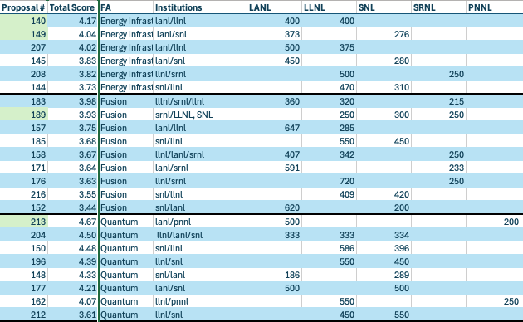
Current IL Processes
Project Selections
Proposals selected by LDRD/SDRD POCs
Scores and funding considered
Attempt to balance portfolio across focus areas

Slide 27
Current IL Processes
Project Initiations and Informal Appraisals
Projects follow local rules
Start in January
Informal Appraisals (Feb-Mar)
  Hear initial progress in project start-up (staffing, equipment, other logistics);
  Ensure PIs are not encountering roadblocks as they get projects started; and
  Inform PIs of the appraisal process for the remainder of the project execution.
Common Roadblocks
Foreign Nationals
Derivative Classification
Data Sharing

Slide 28

Current IL Processes
Formal Appraisals
2nd and 3rd year
  PIs identify 1-2 reviewers per site
  60-minute presentation
  30-minute closed panel deliberation
Common Roadblocks
Challenging to Schedule
Differs from Standard Process
Appraisal Questions
Microsoft Bookings
Has the project met its goals and major deliverables so far, and is it on track to meet them all by project end?
Are changes to the technical approach explained in detail and justified?
Is the project scope still achievable given the proposed staffing, budget, schedule, and long lead items?
Are any remaining high-risk items appropriately addressed with clearly-defined decision points?
Is the project on track to succeed with its exit plan for follow on work or funding?

Slide 29
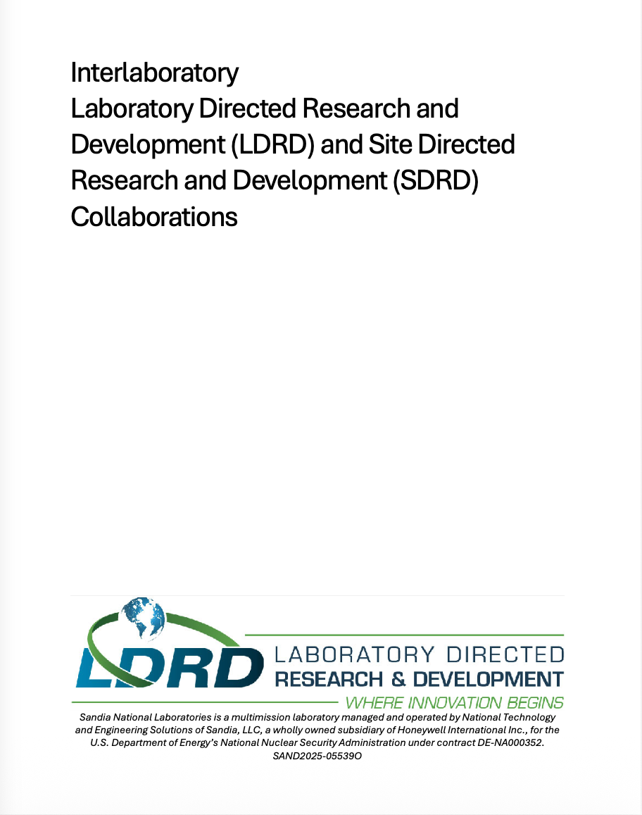
Current IL Processes
Ending Projects and Documentation
Ending Reports
First six projects ending now
Joint ending reports
Documentation
Background
PI Guide
Reviewer Guide
Admin Guide

Slide 30

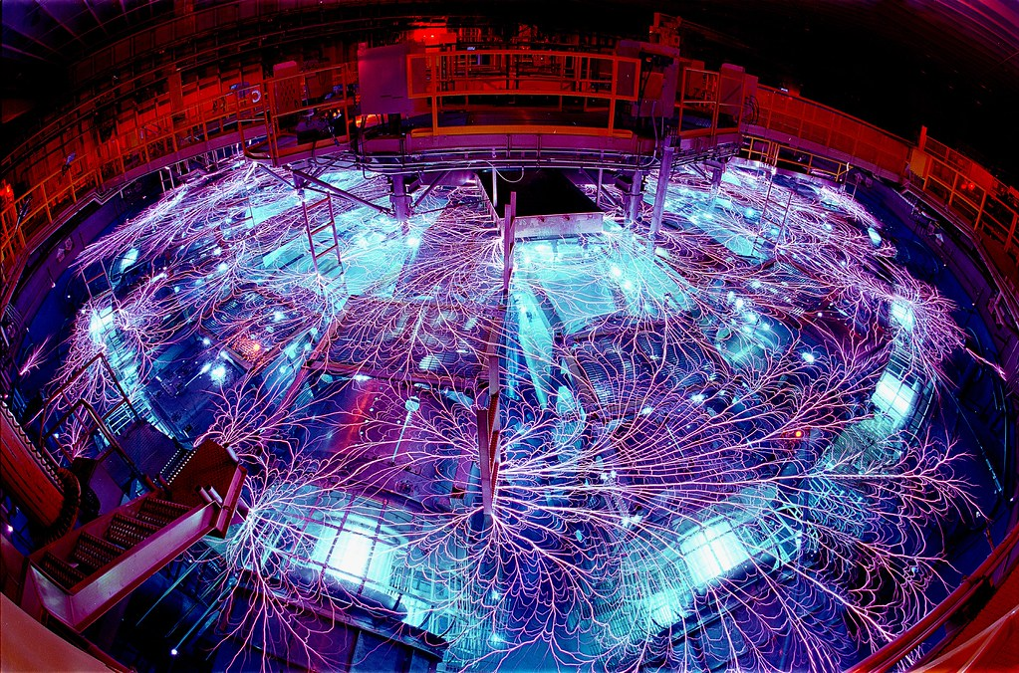
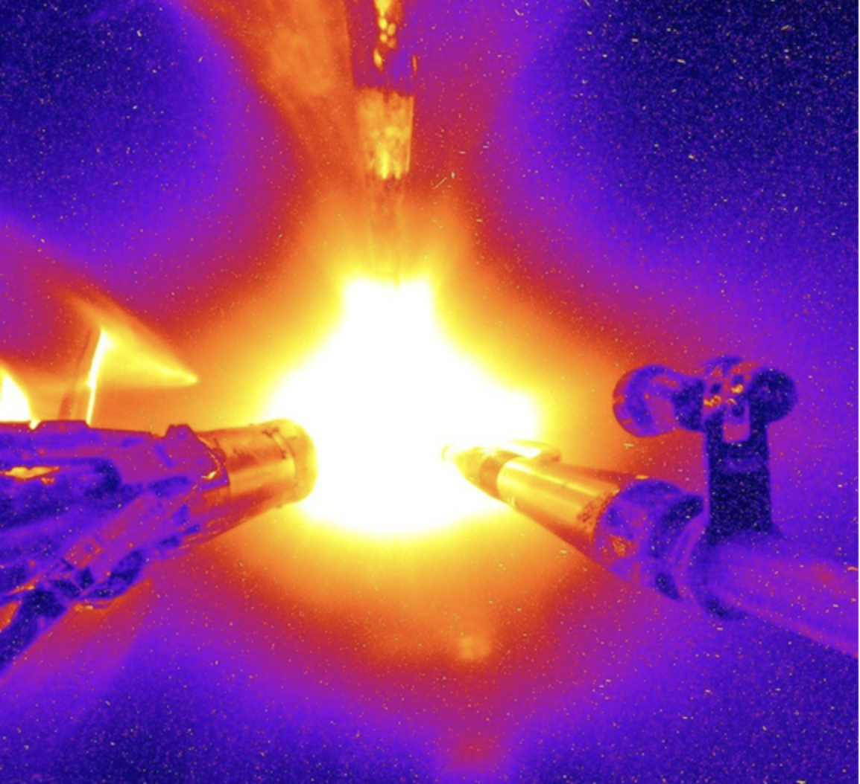

PULSE-TN: Predictive Ultrafast
Low-rank Simulations Enabled by Tensor Networks
R&D Challenge
Approach
Impact & Benefit
Computationally Feasible, High-Fidelity Plasma Physics Simulations — despite the curse of dimensionality.
Combine Advanced Finite Element Discretizations with Emerging Low-Rank Representations
Connections Forged Between Labs in Research, Software, and Capabilities
Better fidelity in plasma physics simulation (avoiding noise of PIC) will enable deeper physics understanding, better engineering design.
Software packages owned by LLNL, LANL, and SNL have seen substantial development
New Open Source releases from LANL and LLNL (SNL’s was already open source)
BoBa and Camellia have gained interoperability
New mathematical insight and practical understanding of application regimes for tensor networks
Collisions results: including more physics will make tensor network approaches more relevant!
Many collaborations formed: more than 20 people participated over 2.5 years!
Open Source software from each lab allows us to continue to build freely on each lab’s work
New capabilities for accelerating plasma simulations provide foundation for future research
Big Foot Target Shot at LLNL’s NIF
SNL’s Z Machine
Notes:
Include SAND #, additional information or other supporting document names into notes as appropriate.

Slide 31
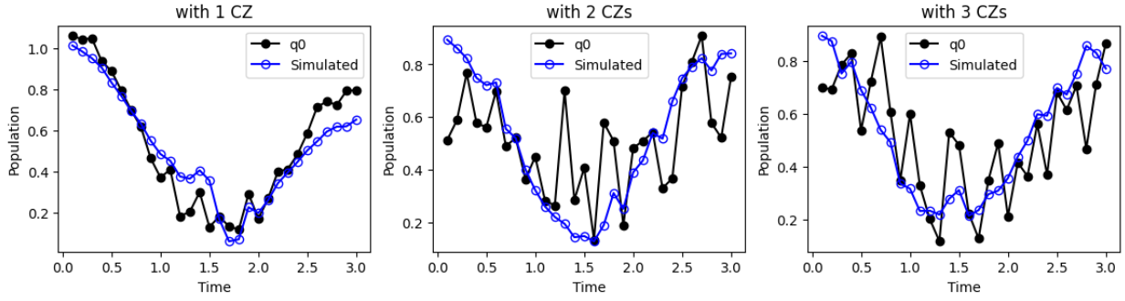
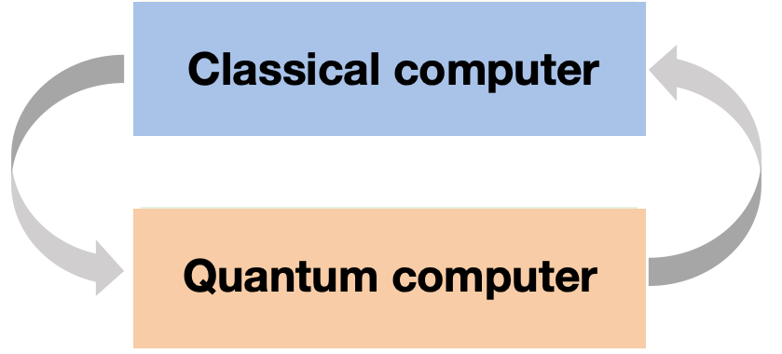

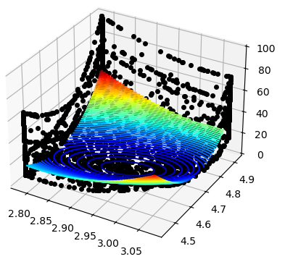
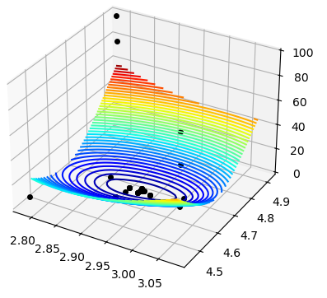
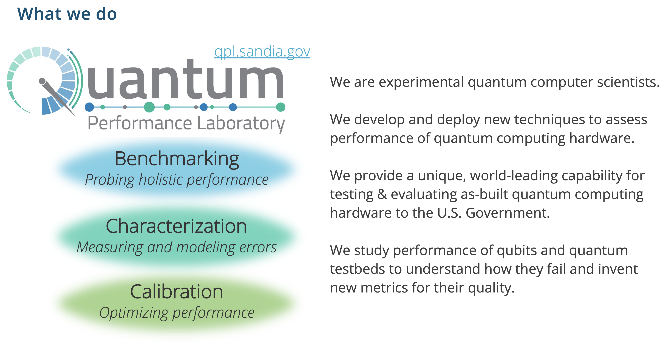
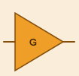

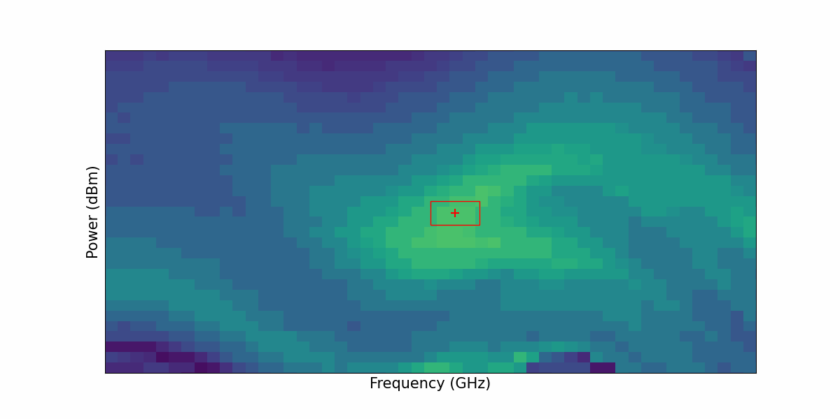
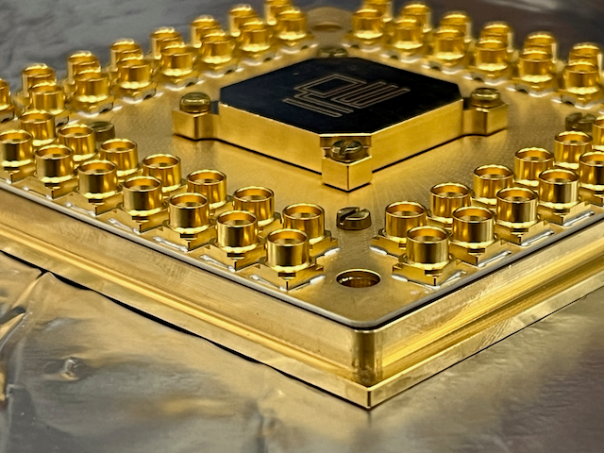
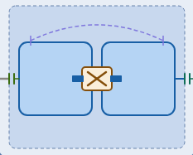
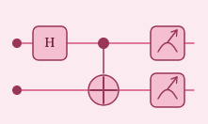
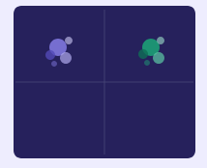
Quantum computing for high energy density science​
R&D Challenge
Approach
Impact & Benefit
Advance quantum computing’s potential to impact high energy density science through a combination of theory, simulation, and superconducting qubit experiments.
Develop quantum computer algorithms and applications in high energy density science
Improve quantum computer capabilities through automated control and calibration
New, tightly integrated Trilab collaboration bridging theory, simulation, experiment
New research outcomes across quantum algorithms & applications as well as autocalibration
Sandia National Labs
Los Alamos National Lab
Design, optimize, and demonstrate hybrid quatum-classical algorithms that leverage quantum computer capabilities for HEDS-relevant applications
Algorithms & Applications
Algorithms & Applications
Theory, method, and algorithm development
Optimization, compilation, machine learning, AI
Calibration workflow
We developed, optimized, and executed small-scale quantum computations for high energy density science (results above show simulation and LLNL hardware demonstration)
Autocalibration
Design, optimize, and demonstrate novel control strategies for improving the performance and scalability of quantum computer tune up and operation
Autocalibration
Real-time stabilization of quantum computer calibration parameter
Our team has automated the quantum computer calibration workflow, resulting in quantitative improvements in device performance and uptime
Lawrence Livermore National Lab
Superconducting qubit experiments
Notes:
Include SAND #, additional information or other supporting document names into notes as appropriate.

Slide 32
Advancing wastewater biomonitoring capabilities toward establishing an actionable national biosurveillance program
CUI//PROPIN
R&D Challenge
Approach
Impact & Benefit
There is a lack of standardization across wastewater surveillance efforts and most programs focus on monitoring known pathogens
We will develop a standardized framework for metagenomic sequencing and create algorithms for early warning of both known and unknown pathogens
This project led to new research connections, new hires, publications, and generation of scientific knowledge
Gaps in a comprehensive and curated database of existing wastewater data
Insufficient understanding of the microbial patterns that define the “normal background” of wastewater data
Lack of effective experimental methods to detect biothreat signatures in complex wastewater backgrounds
Absence of rapid, low-cost detection assays to surveil specific biothreats in wastewater samples
Use archived wastewater samples, active sampling efforts, and publicly available wastewater sequencing data
Process existing wastewater next generation sequencing data and associated metadata
Use machine learning to reveal baseline patterns and relevant biological signatures to build an anomaly detection tool
Examine experimental methods to improve the sensitivity and the cost-effectiveness of genomics-based biosurveillance
Develop targeted, rapid screening assays to complement metagenomic sequencing
Phase III of Sandia-led International Biological Monitoring System will include LANL and include live exercises to demonstrate realistic wastewater and aerosol monitoring scenarios
1 new Sandia hire
~6 publications across all 3 labs
Rapid screening assays that can simultaneously detect both viruses and bacteria (up to 3 targets)
Developed software for detecting gene sharing in wastewater samples; successfully applied to 180 samples, identifying cases of genomic island sharing
CUI//PROPIN

Slide 33
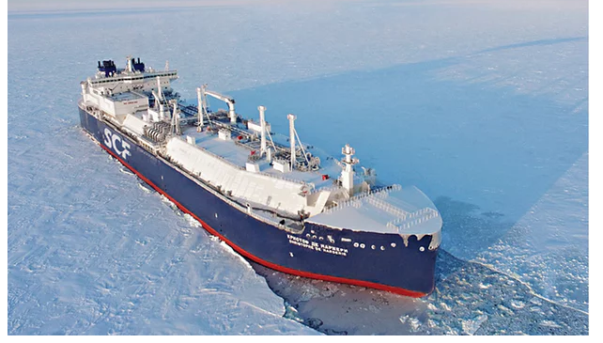
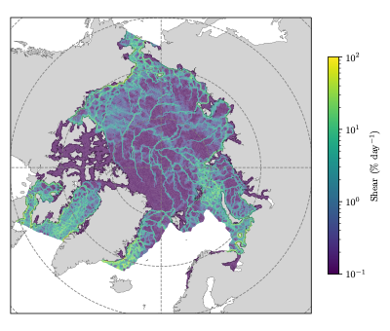
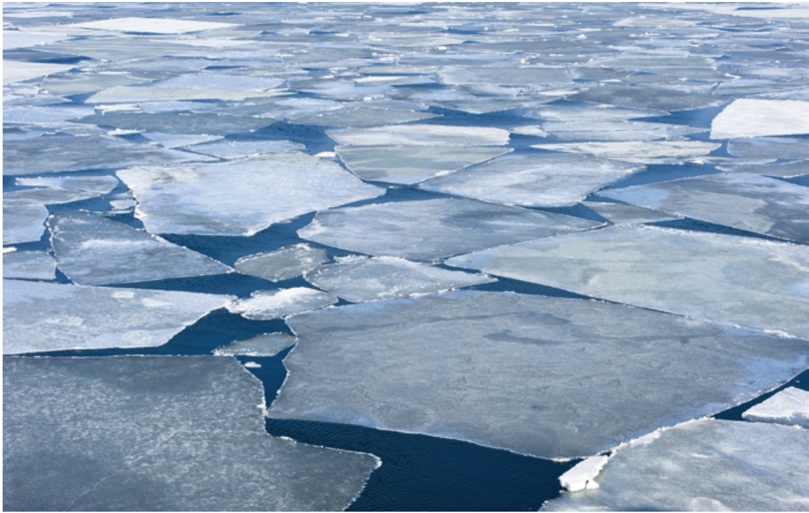
Towards a sea ice digital twin
R&D Challenge
Approach
Impact & Benefit
As interest in the Arctic grows, need accurate sea ice predictive capability for operational requirements and planning.
Enhance discrete element sea ice model physics and combine with high-resolution satellite data to improve forecasts.
Developed new forecasting capability incorporating high-resolution satellite data for initialization and assimilation.
Arctic sea ice is becoming younger, thinner, and more dynamic
Existing forecast models do not capture complex ice mechanics
High-resolution satellite data are not fully exploited in current prediction systems
Advanced DEMSI in partnership w/ LANL
Improved ridging, healing/refreezing, and ice-ocean coupling
Added data assimilation, satellite data fusion, and calibration
Demonstrated regional and basin-scale hindcasts
Foundation for a high-resolution Arctic sea-ice digital twin
Better support for domain awareness, planning, and environmental response
Strengthened SNL-LANL collaboration and positioned team for follow-on investments
Arctic basin simulation with linear kinematic features
Russian tanker sails through Arctic
Granular ice floes
SAR mosaic Canadian Arctic Archipelago
Notes:
Include SAND #, additional information or other supporting document names into notes as appropriate.

Slide 34
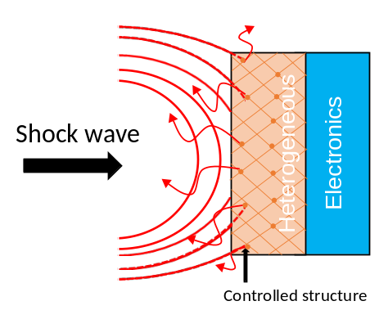
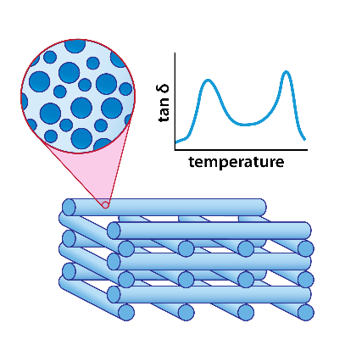
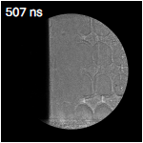
Discovery of Design Criteria for Polymer Materials in Extreme Environments Using Precisely Engineered Internal Structures Over Multiple Length Scales
R&D Challenge
Approach
Impact & Benefit
Polymers with increased resilience to dynamic loading are needed for protective applications
SNL: Polymer chemistry & material design
LLNL: Additive manufacturing & architectural design
LANL: Dynamic characterization
Lightweight materials with improved and tailorable mechanical performance
Materials that mitigate the effects of high rate (> 10³ s⁻¹) deformation environments
Design and study of polymers in these scenarios is extremely challenging
Multi-disciplinary, multi-institution approach required
Extensive study of structure-property relationships in multi-phase epoxies
Hierarchically structured epoxies with independent control at multiple length scales
New approaches to direct ink write of structured epoxies, generalizable to a broad range of different polymers
Improved experimental design and analysis to measure energy absorption under shock
Advanced in situ characterization of hierarchical epoxies during loading
High-throughput, tabletop technique for conventional shock measurements
Results disseminated through a variety of past, current, and future contributed and invited presentations and publications
Follow-on work secured developing materials for specific shock mitigation needs
Additional collaborative proposals under consideration and planned for future
Cartoon schematic of shockwave dissipation via material structure
Diffuse shock front observed in a hierarchical epoxy
Notes:
Include SAND #, additional information or other supporting document names into notes as appropriate.

Slide 35
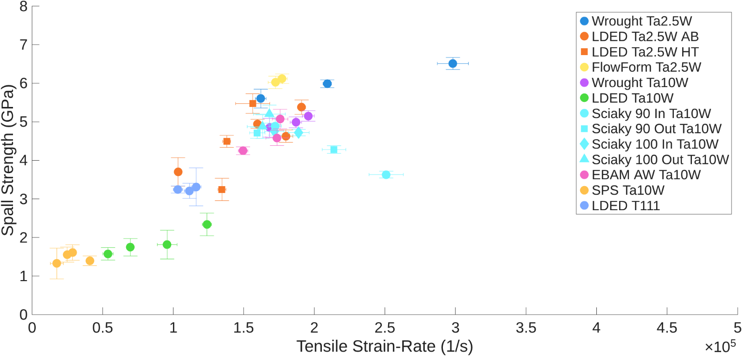
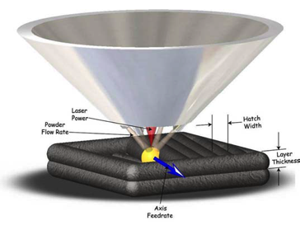
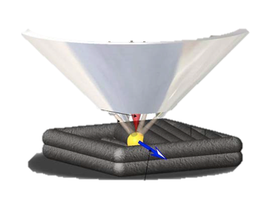
Refractory Additive Manufacturing: Alloys to Z pulsed power facility
R&D Challenge
Approach
Impact & Benefit
Feedstock production for additive manufacturing is a bottleneck for technology advancement within the Nuclear Weapons Complex (NWC), especially for novel refractory alloys.
Process-structure-properties investigation of refractory alloys incorporating both wire- and powder-based AM processes
Ta-W alloys are utilized in NSE and additively manufactured Ta-W alloys were tested in high-strain rate dynamic regimes for first time
Refractory alloys are important for critical ND applications
Discovery and fabrication of novel refractory alloys is expensive as the alloys contain expensive elements; pilot scale heats of feedstock is either impossible or cost-prohibitive
All 3 laboratories improved their additive manufacturing of refractory alloy capabilities
  SNL conducted detailed study of cracking occurring in laser beam directed energy deposition refractory multi-principal elemental alloy
LANL and LLNL contributed printed material for high strain-rate dynamic mechanical testing at SNL’s Z machine and gas gun facilities
Several of the additively manufactured Ta-W alloys have spall strengths comparable to wrought Ta-W
The gas gun results reveal areas for continued improvement in Ta-W alloys (for example, powder-based Ta-10W
Current SOA is in-situ alloying using elemental powders
Summary of spall strengths for the various additively manufactured Ta-W alloys
Notes:
Include SAND #, additional information or other supporting document names into notes as appropriate.

Slide 36
Impacts And Conclusion
Snap shot of impacts
# PIs | 32
# Projects | 18
# LOIs | 445
# Proposals | 134
# Participating Labs/Sites | 9
# Networking Sessions | 24 sessions, 192 bios shared, 509 participants
Number of publications / patents / conferences | metric in progress
# reviewers | 164
follow-on funding | metric in progress
# focus areas | 12
Now in the 4th cycle
Learning from past
Building collaborations now
Making a difference for our future
*not including FY27
Notes:
reviewers: 47 + 43 + 40 + 34 =

Slide 37
Acknowledgements
Legends:
Leigh Cunningham (SNL)
Kathryn Mohror (LLNL)
Jacob Waltz (LANL)
Marie Arrowsmith (SNL)
Kelly Sullivan (retired, PNNL)
Wahid Hermina (retired, SNL)
Doug Rotman (retired, LLNL)
Laura Stonehill (LANL)
Tony Huff (INL)
Mitchell Kerman (INL)
Jacqueline Ramos (formerly, SRNL)
Paul Guss (NNSS)
Katherine Benedict (LANL)
On-going Support from PNNL:
Andy Piatt
Erin Searcy
Kyle Koupus
Erin Brown
Lara Hastings
Communications:
Amy Mosley (LLNL),
Lexi Tyler (LANL),
Amy Treece (SNL)
Past Observers:
Kathleen Barkigia (BNL),
Latifa Elouadrhiri (Jlab),
Darren Ho (LBL)
Roli Gostelow (ORNL)
Katherine Evans (ORNL)
Current IL Collaborators:
Dorean Chaleunphohn (SNL),
Joany Babilonia (LANL),
Kirsten McCabe (LANL),
Elizabeth Wheeler (LLNL),
Cameron Hawkins (NNSS),
Mark Barnes (SRNL),
Liz Hoffman (SRNL),
James Morris (Ames),
Rachel Dunn (PPPL),
Courtney Dornburg (SNL),
John Feddema (SNL)
Garry Kuhn (NNSA contractor)
Anthony Lewis (NNSA)

