Slide 1
ORNL Overview and Discretionary Investment Stewardship
SEPTEMBER 16, 2026 | NEWPORT NEWS, VA
PRESENTED BY:
Brian Anderson
Director, Office of Institutional Strategic Planning

Slide 2


Slide 3
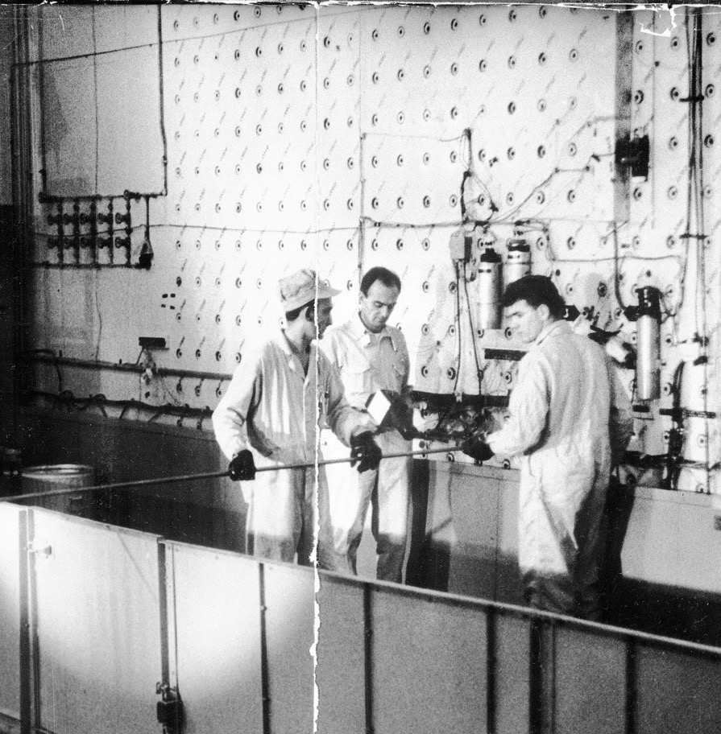
ORNL began in 1943 with the world’s first continuously operating nuclear reactor
MISSION
Demonstrate that gram quantities of plutonium could be chemically separated from irradiated uranium

Slide 4
ORNL’s mission
Deliver scientific discoveries and technical breakthroughs that will accelerate
the deployment of solutions in energy and national security
and, in doing so, create economic opportunity for the nation.

Slide 5
ORNL by the numbers
4
Office of Science user
facilities
Nation’s
most diverse
energy
portfolio
World’s
most intense
neutron
source
5
Applied
research
facilities
$2.7B
FY26 budget
authority
Nation’s
largest
materials
research
portfolio
>2,700
journal articles
published
in FY25
>$1B
modernization
investment
>5,500
research
guests
annually
Critical
isotopes
for medicine, industry, and security
73
patents
issued
in FY25
>7,400
employees
World-class
research
reactor
>260
R&D 100
Awards
Partnerships
to advance
fusion technology and test
facilities
World’s first
exascale
computer
294
invention
disclosures
in FY25

Slide 6
Unite expert teams, transformative technologies, and world-leading facilities to accelerate innovation and advance energy security for a safe, prosperous future
VISION and SCIENTIFIC PRIORITIES
Future of computing
Atoms to applications
Nuclear solutions for national priorities
Secure, resilient systems for abundant energy
NATIONAL SECURITY

Slide 7
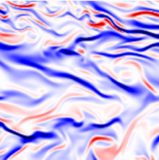
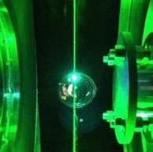
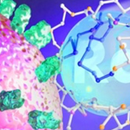
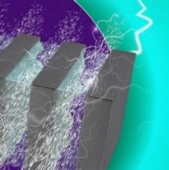
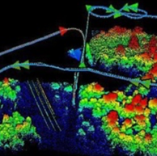
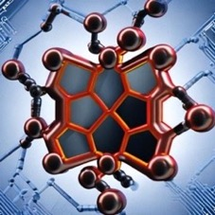

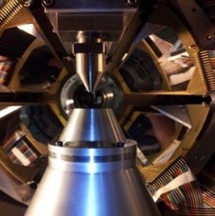

ORNL’s foundational expertise yields solutions to challenging problems with global impact
Biology and
environment
Fusion
and fission
Isotopes
Energy science and technology
National
security
Computing, AI, and
quantum
Neutrons
Materials, chemistry, and nuclear physics
7

Slide 8
ORNL’s unique ecosystem of R&D facilities supports thousands of researchers per year
Office of Science user facilities
Applied research facilities
Center for Nanophase
Materials Sciences
Building Technologies Research and Integration Center
Carbon Fiber
Technology Facility
High Flux Isotope Reactor
Grid Research Innovation and Development Center
Oak Ridge Leadership
Computing Facility
Manufacturing
Demonstration Facility
Spallation Neutron Source
National Transportation
Research Center

Slide 9
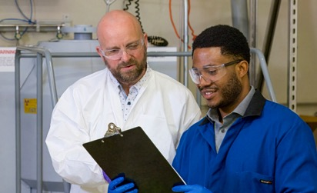
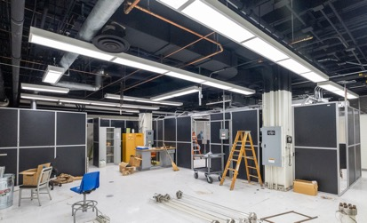
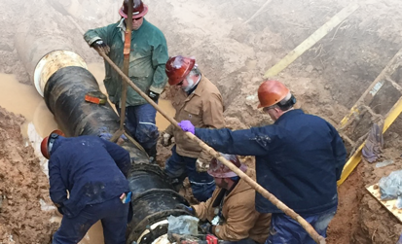
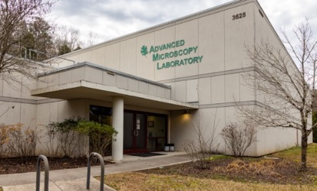
Accelerating innovation and advancing energy security require world-class operations support
Workforce development Expansion of pathways for career growth and retention
Revitalized spaces
Improvements to research and office facilities to support mission needs
Modern infrastructure
Updates to utilities to support next-generation facilities
Expanded capabilities
Investments in cutting-edge scientific tools for
the toughest challenges

Slide 10
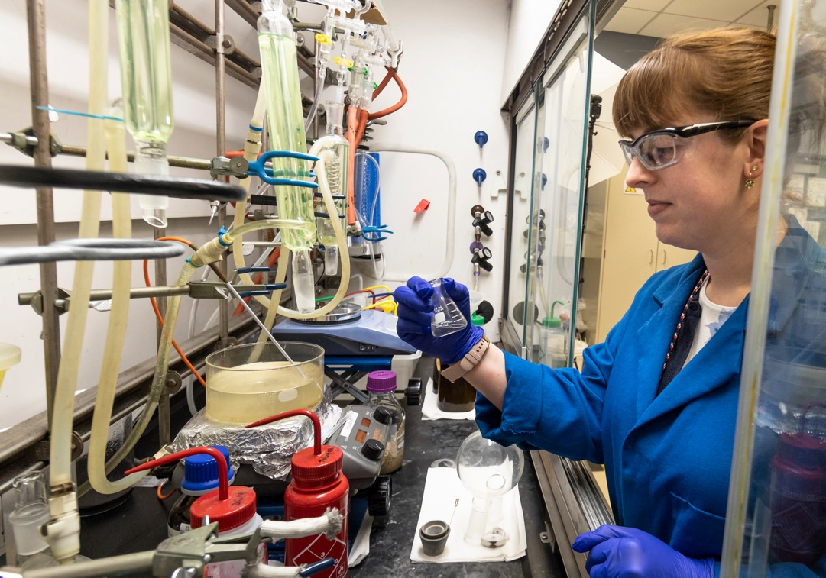
LDRD is a key component of the DOE mission
LABORATORY DIRECTED RESEARCH AND DEVELOPMENT
Internal research portfolio
DOE Order 413.2C
LDRD PROGRAM OBJECTIVES
Mission agility
Scientific and technical vitality
Workforce development
DOE allows up to 6% of business volume
(ORNL actual: ~3.1%)

Slide 11
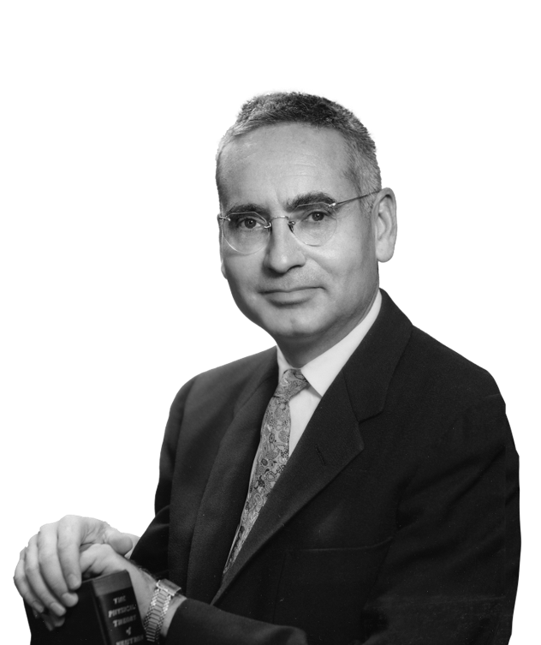
The program had its start in Oak Ridge, Tennessee
Alvin Weinberg had a vision: Molten Salt Reactors would revolutionize energy production, so he sequestered money to develop the technology.
His good intent – albeit questioned at the time – moved the research beyond nuclear and led to Congressional approval for discretionary funds to better innovate and compete.
LDRD was born.

Slide 12
ORNL’s internal investments drive scientific impact for DOE and the nation
+
Goal:
Discretionary investments show maximum return
S
Continuous
improvement
Capital
equipment refresh for maximum
scientific impact
Alignment
with lab strategy
Explanation of resources and stewardship

Slide 13
Program Development funds developed with impact in mind
Special category of org burden to develop new business
~2/3 Allocated to directorates to manage themselves to manage their flavor of org burden
< 10% for LDRD initiative leads (new and planned), workforce development projects (to write the proposal when they arrive)
Director’s discretion for unexpected opportunities, large project planning, multi directorate opportunities

Slide 14
Contractor assurance ensures demonstrated value
Guidelines and Philosophy
Specially designated funds with unique DOE and ORNL rules and guidance for best practice
Funds ideas not yet mature for sponsor support
High-risk/high-reward:
Failure is internal
PI freedom
Recent ORNL Improvements
Balance speed
of science developments with compliance
Q1 FY25 internal assessment found no major findings
Outcome: Update management systems and websites to match needs and provide clarity

Slide 15
ORNL LDRD programs meet three primary goals
Seed Program
Support small, innovative, high-risk/high-reward
ideas to proof-of-principle stage
Distinguished Staff Fellowships
Bring in exceptional early career researchers
LDRD Early Career Competition
Cultivate high-potential early career staff
UT-ORII Fellows
Support ORNL’s commitment to UT-ORII for the next 5 years; hire in areas of joint potential
NEW: Catalyst Leadership Fellowship (pilot)
Strategic Hire Program
Add talent, critical skills in areas aligned with strategic direction
Director’s R&D (DRD)
Develop strategically important capabilities
(S&T initiatives and one-off projects)
Seed
(~10%)
Workforce development focus
(~20%)
DRD
(~70%)

Slide 16
Allocation of DRD program:
Core and crosscutting initiatives
  Multiyear research priorities
  Identification of projects to address
CORE
Typically, 2-year cycle with emphasis on directorate priorities based
on directorate strategic plans
CROSSCUTTING
Typically, longer (4 to 5 years)
Including multiple directorates
and chosen from lab-wide initiative activities
All initiatives rely on initiative
lead engagement and leadership
for success
Initiative plans bring projects together into a cohesive whole
  Strategically-oriented research objectives organized around key thrusts

Slide 17
LDRD is providing resources to execute
Directorate strategies using the core initiatives
Foundational Research for cost-efficient computing
Defining
Leadership in the TRISO Fuel Cycle
Innovative approaches to develop new instruments
Enabling capabilities, methodologies,
and detection techniques for the physical sciences
CCSD
FFESD
NScD
PSD
BESSD
ESTD
ISED
NSSD
Microbiomes, biodesign solutions, and ecosystem impacts
Transformational Heat Energy Research for Multisector Solutions
Continuing Accelerating Radiotherapeutics Through Advanced Molecular Constructs (ARM)
Leverage Autonomous
and Intelligent Systems for Energy Security and National Security

Slide 18
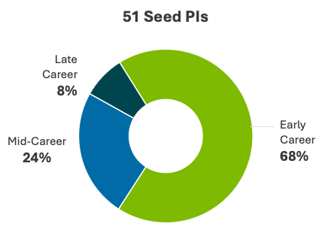
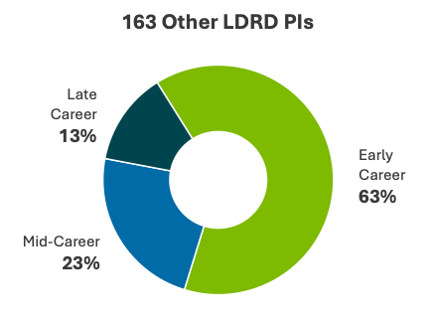
LDRD launches research careers
FY25 PI career stages
ORNL-led Genesis awards recently announced
2 of 9 PIs recent DOE Early Career Research Program awardees
4 of 9 PIs received LDRD support for their research in the last 3 years

Slide 19
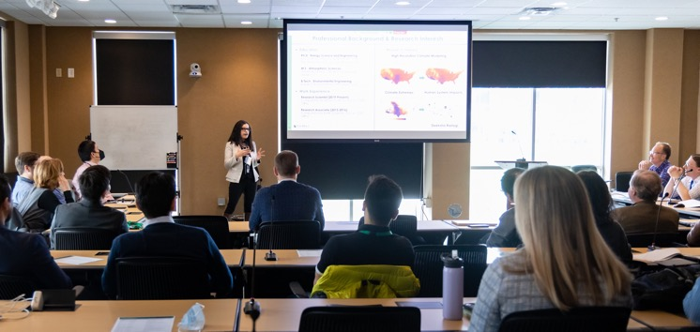
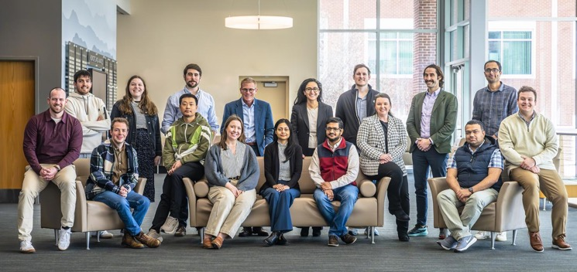

Newest program: Early Career Competition
Address early career scientists of high potential already at ORNL
Third cohort from 2025 will soon complete
  Multiple engagement events with seasoned ORNL leaders
  Training for their development
  Internal network with other early career stars
  Visit each directorate
  Learn DOE 101 to understand DOE system and ORNL

Slide 20
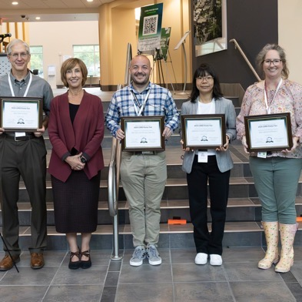


LDRD has lab-wide reach and impact at ORNL
About 900 staff
222 projects
in FY26
138 publications and groundbreaking research in FY26
22 invention disclosures and patents granted in FY26
Every DOE core capability | All directorates | Almost every research division

Slide 21
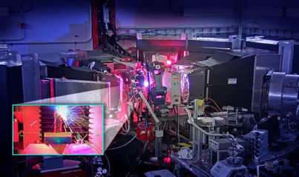
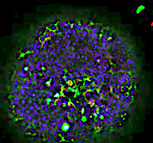

We see continued impact and ROI from FY25 investments
245 PUBLICATIONS
20% in high-impact journals
Nature Communications
Nature Materials
Nature Nanotechnology
ACS Energy Letters
ACM Computing Surveys
FOLLOW-ON SPONSOR INTEREST
Example 1: Nuclear Batteries initiative has received significant support from multiple sponsors
Example 2: AI initiative has already seen significant support from multiple sponsors
11 PATENTS
28 INVENTION DISCLOSURES
2 R&D 100 AWARDS
BIPHASICS: Point-Source CO2 Capture with Biphasic Solvents
Thermal Energy Storage Systems Including Anisotropic Thermal Conductive Carbon Fivers for Enhancing Thermal Efficiency of Phase Change Materials
1 DOE EARLY CAREER AWARD
Chengyun Hua, “Nonequilibrium Spin States Studied by Neutrons” (NEAT Initiative)

Slide 22
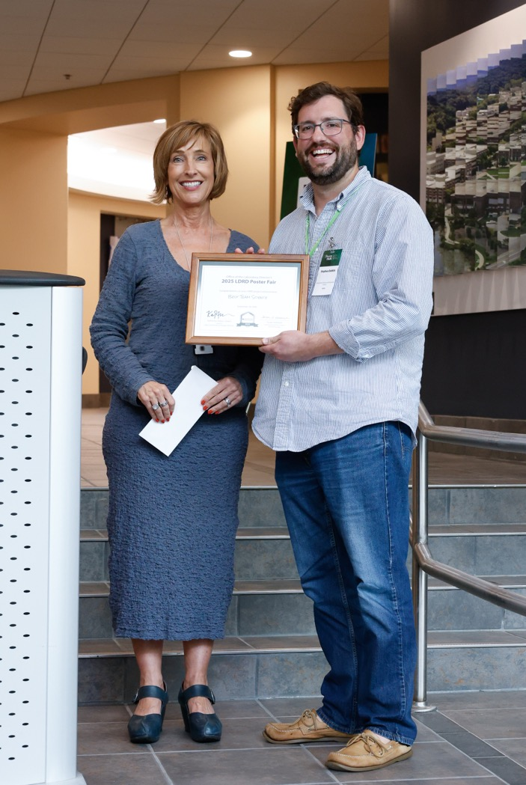
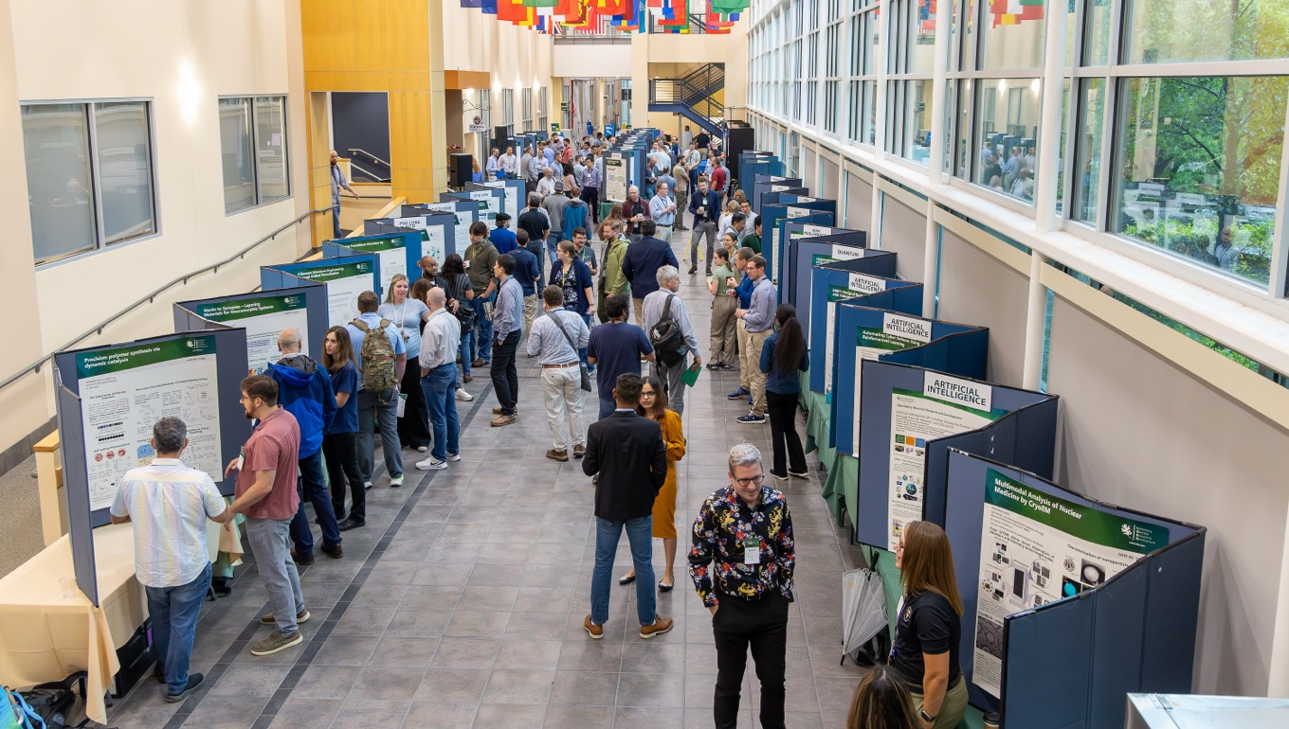
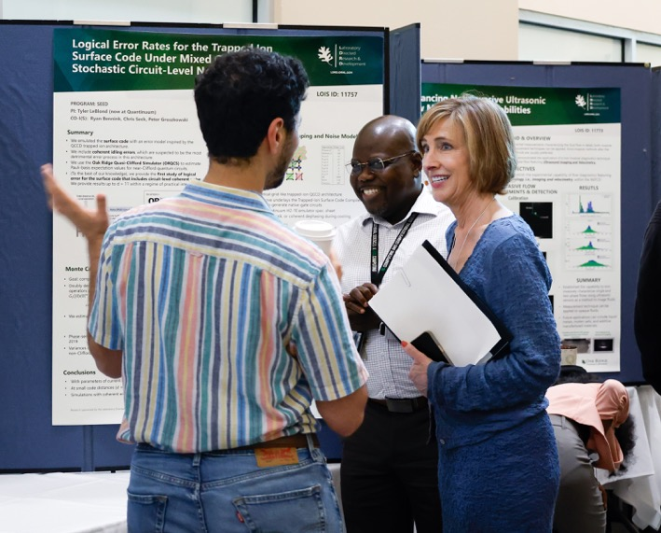
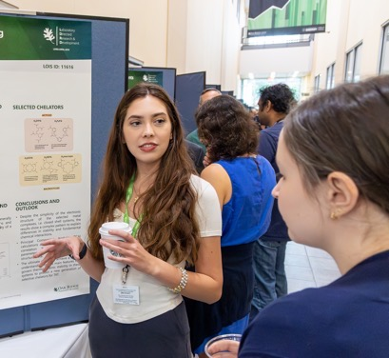
Annual LDRD Poster Fair draws interest and excitement in program’s value

Slide 23
The LDRD program at ORNL continues to evolve
Increase reviewer quantity and quality and awards
to improve reviewer response
Better metrics
to quantify impact
More highlights
and communication of impact
to illustrate value
Increase
Seed Program
limits
Allow postdocs
to lead projects as PIs
Enhance alignment with directorate strategies

Slide 24
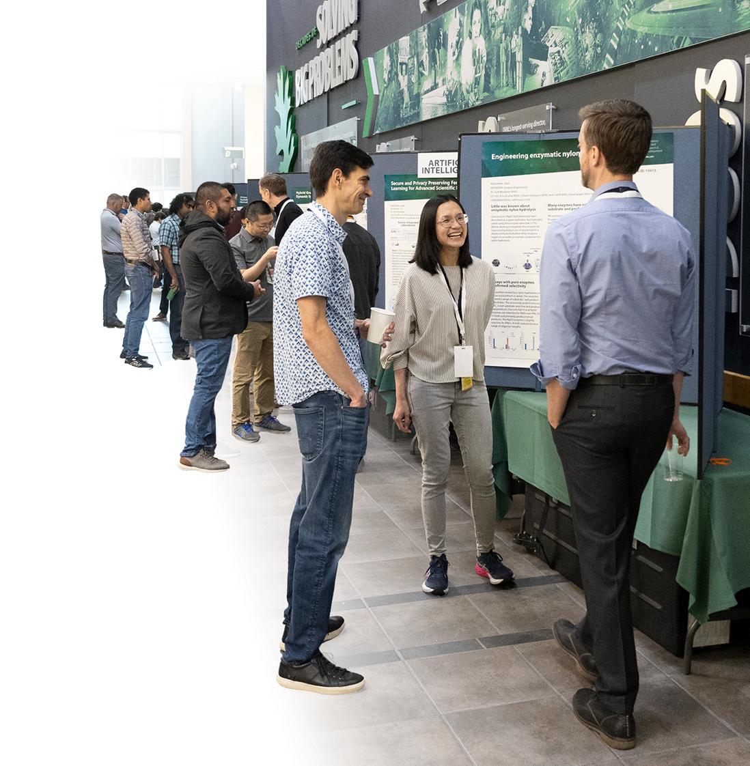
What’s next?
Create more opportunity and desire for collaboration within Lab and with partners, including universities
Better recruit strategic hires
Manage increase in Seed proposal submissions
Continually demonstrate value with more highlights
Connect more intentionally to program development
Help staff create strong proposals and posters, and pursue projects from LDRD outcomes

