Slide 1
2026 LDRD Annual Meeting
Alice Wang
Office of Laboratory Policy | Office of Science
September 2026

Slide 2


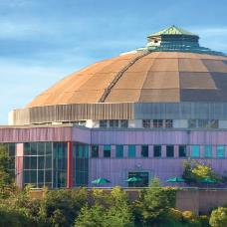
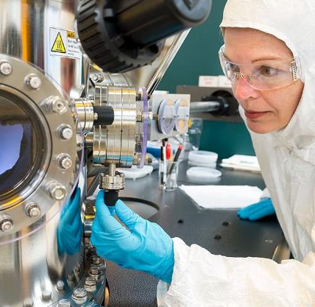


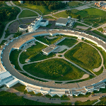
Our Mission:
Deliver scientific discoveries and major scientific tools to transform our understanding of nature and advance the energy, economic, and national security of the United States.
More than 29,400 researchers supported at more than 300 institutions and 16 DOE national laboratories
Steward 10 of the 17 DOE national laboratories
Nearly 40,000 users of 28 Office of Science scientific user facilities
$8.2B
(FY 25 enacted)

Slide 3
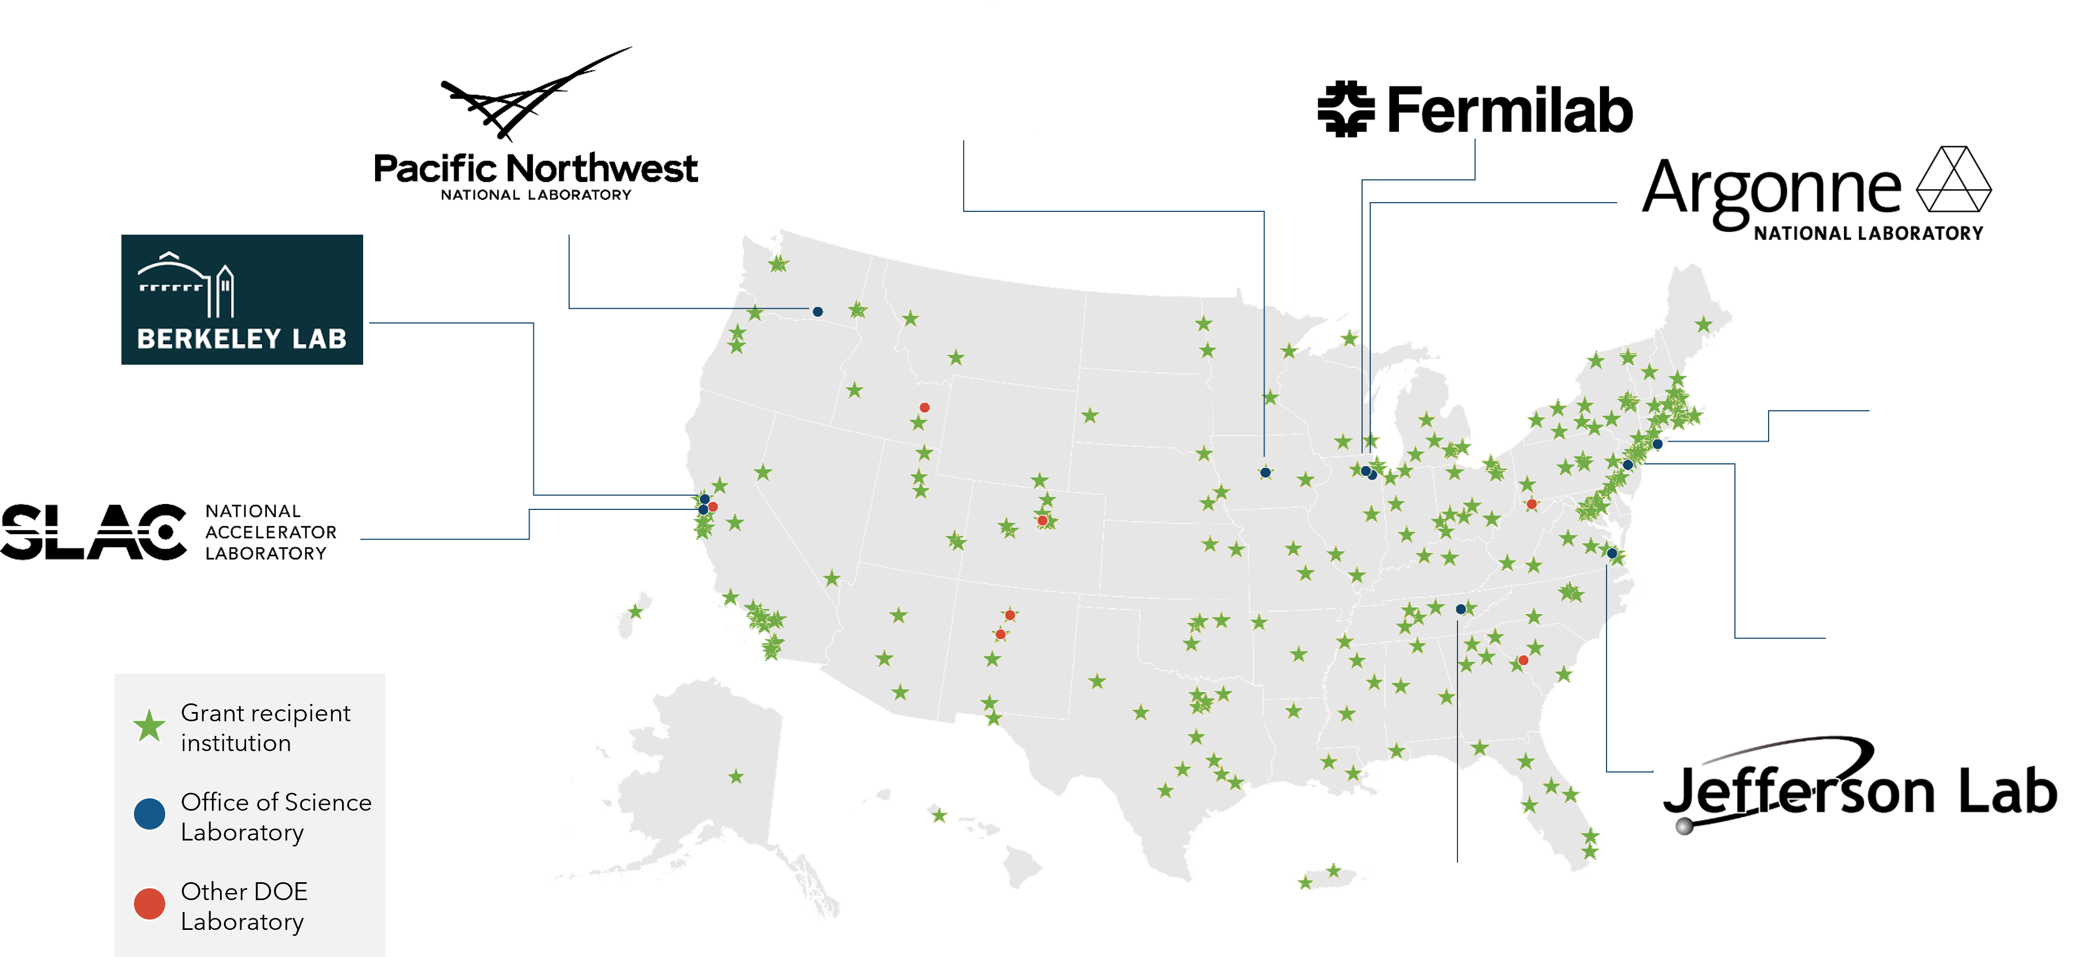

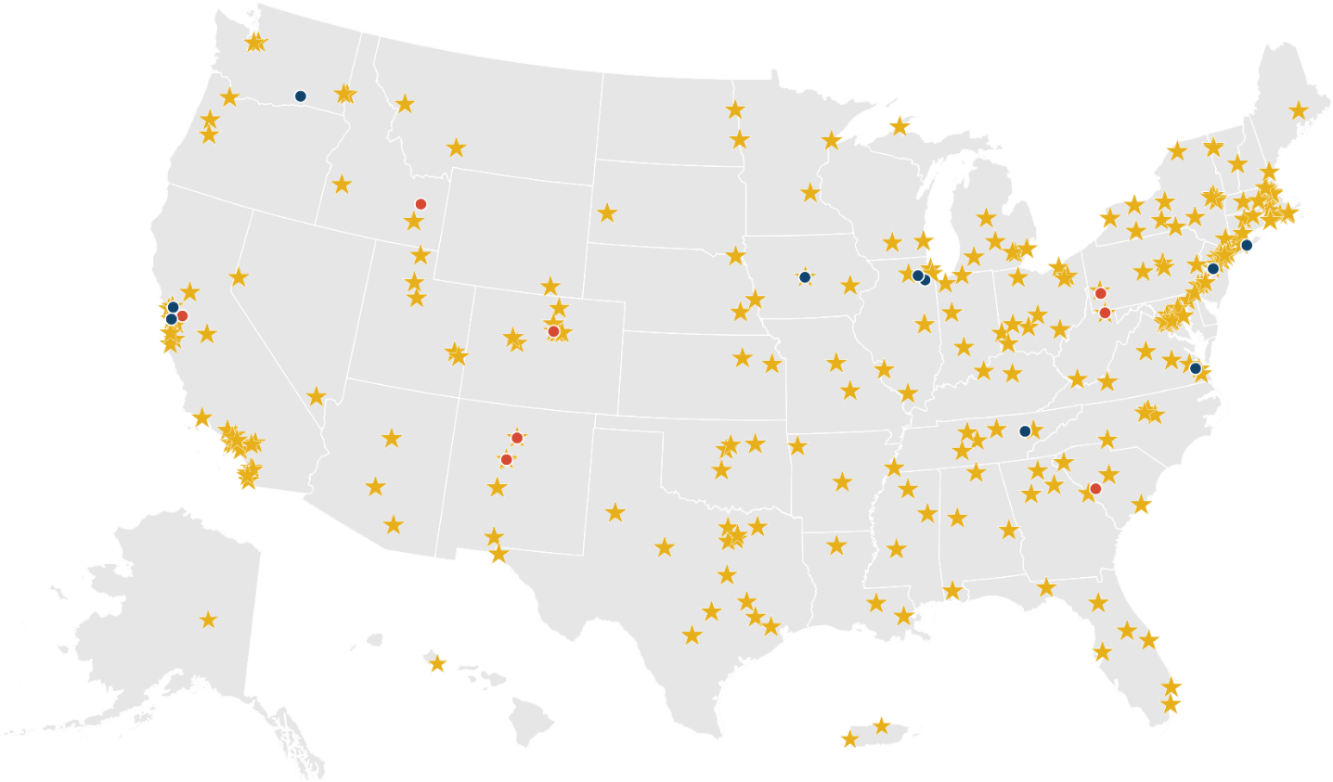



SC National Laboratories

Slide 4
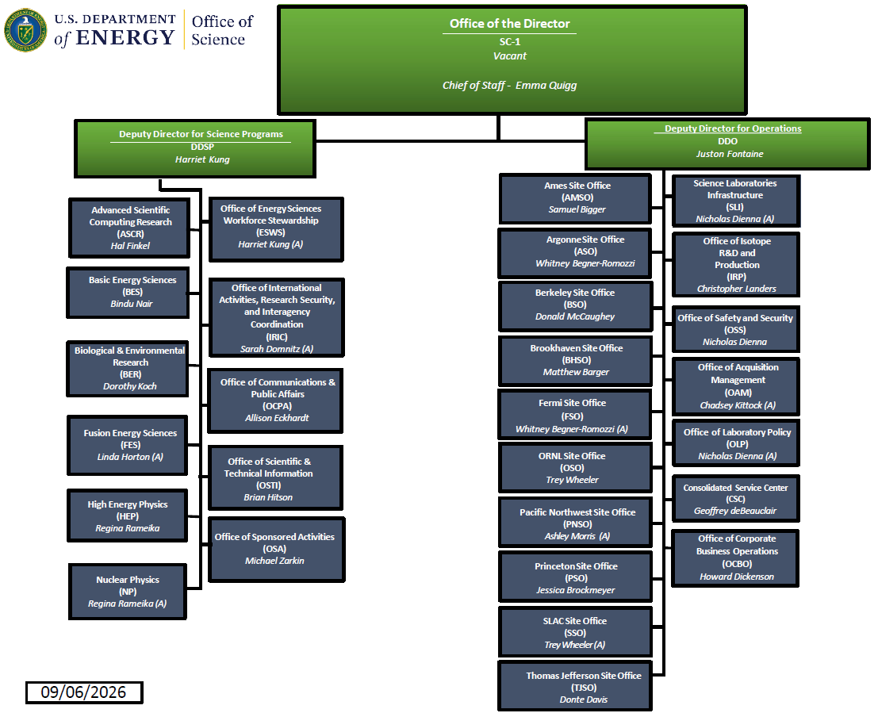

Slide 5
Summary
All DOE GOCO labs are eligible for LDRD funding under the FY 2006 Energy and Water Appropriations Act (P.L. 109-103).
NETL’s LDRD program was signed into law on December 27, 2020, under the Consolidated Appropriations Act 2021 (P.L. 116-260).
All 17 DOE labs have LDRD programs.
The labs spent the following on LDRD in FY 2025:
  $231.67M at SC labs
  $669.47M at NNSA labs
  $57.71M at INL (NE)
  $34.33M at NLR (CMEI)
  $10.54M at SRNL (EM)
  $3.12M at NETL (HGEO)

Slide 6
LDRD Costs by DOE/NNSA Labs, FYs 2016-2025

Slide 7
FY 2025 LDRD Costs as a % of Total Lab Costs

Slide 8
History of LDRD Costs as % of Total Lab Costs

Slide 9
FY 2025 LDRD Average Project Cost ($K)

Slide 10
FY 2025 Number of LDRD Projects

Slide 11
DOE Modernizes Operations
Energy Department Modernizes National Laboratory Operations to Strengthen America’s Scientific, Energy, and National Security Missions – August 13, 2026
DOE effort to modernize National Laboratory operating directives and reduce outdated or duplicative requirements
DOE Order 413.2D now supersedes DOE Order 413.2C Chg. 1
Less transactional oversight
More laboratory discretion
Accountability remains
DOE moves away from annual approvals and individual project concurrence
Labs have greater latitude to select and manage projects within the approved program and the Order’s statutory and policy guardrails
Site/Field Offices retain responsibility for program authorization, compliance oversight, and holding the contractor accountable

Slide 12
Major Changes
DOE O 413.2C Chg. 1
Annual HQ approval of LDRD plan and allowable funding level
Site Office Manager recommendation to HQ and formal annual authorization
DOE concurrence on each project and annual continuations
Annual Site Office Manager certification of the LDRD fund accumulation methodology
More prescriptive annual project reporting/review requirements
CRADA/technology transfer use less explicit
DOE O 413.2D
No Order required HQ approval of the plan or lab-specific funding level
Program Plan submitted for approval at least every 5 years or upon significant change
Individual project concurrence expressly not required
Annual certification requirement removed, underlying financial requirements remain
Streamlined reporting, emphasis on management system, performance measures, and accountability
Order expressly permits LDRD in CRADAs or other technology transfer arrangements
Key shift: transaction-level approval program-level, risk-based oversight.

Slide 13

Thank you!

