Slide 1


An Update from the JLab Target Group
Chris Keith
10 March, 2026
Target Group

Slide 2
The JLab Target Group: who we are
Chris Keith
David Meekins
Dep. Group Leader
James Maxwell
Hao Lu
Daniel Akers
Tsuneo Kageya
James Brock
Chris Carlin
Casey Flanagan
David Griffith
Mark Hoegerl
Paul Hood
Stanley Madlock
James Thornton
Donald Williams
Almost 250 years of experience in the TG

Slide 3
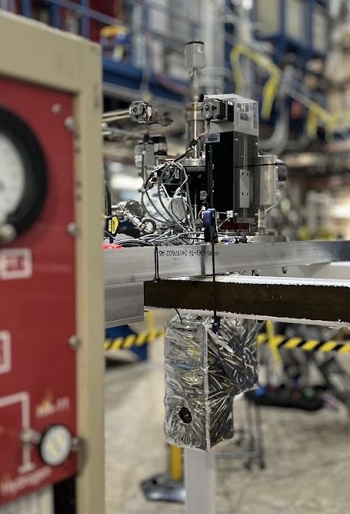
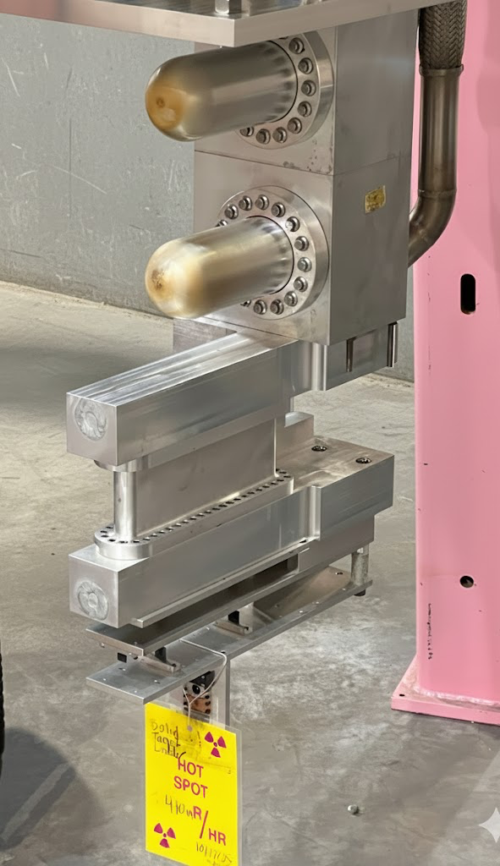
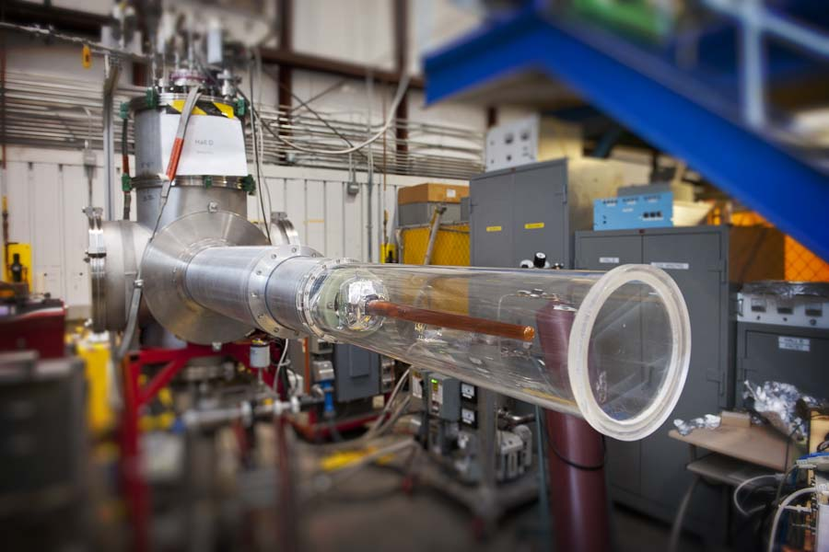
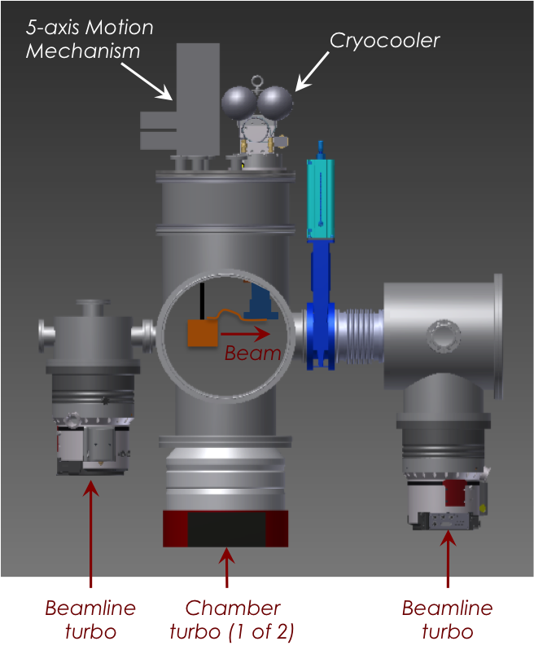
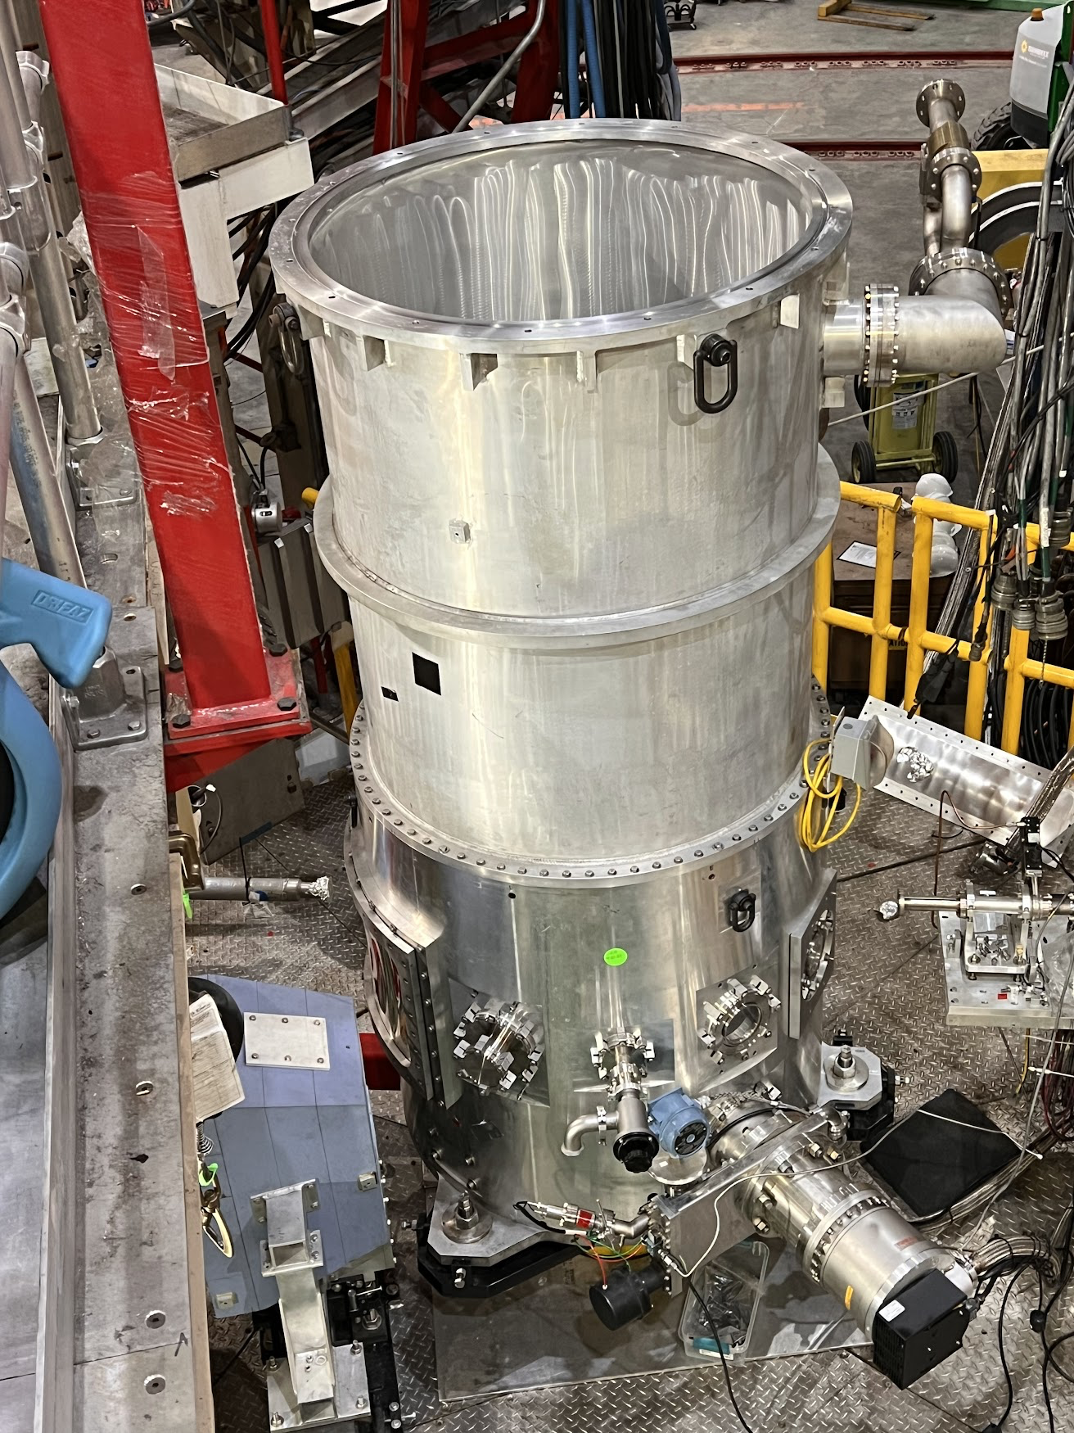
Targets for 2026
Hall B: PRad-II H2 gas target
Hall C: LH2/LD2 cryotarget
Hall D: GlueX LH2/LD2 cryotarget
Thank you, Xiangdong and Phillip!!

Slide 4
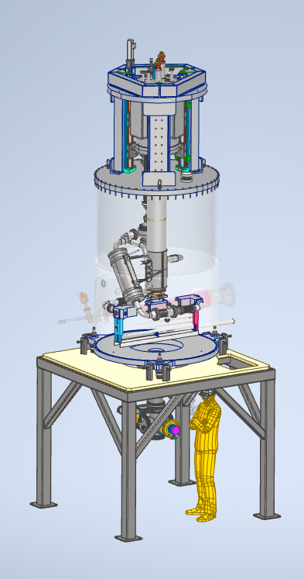
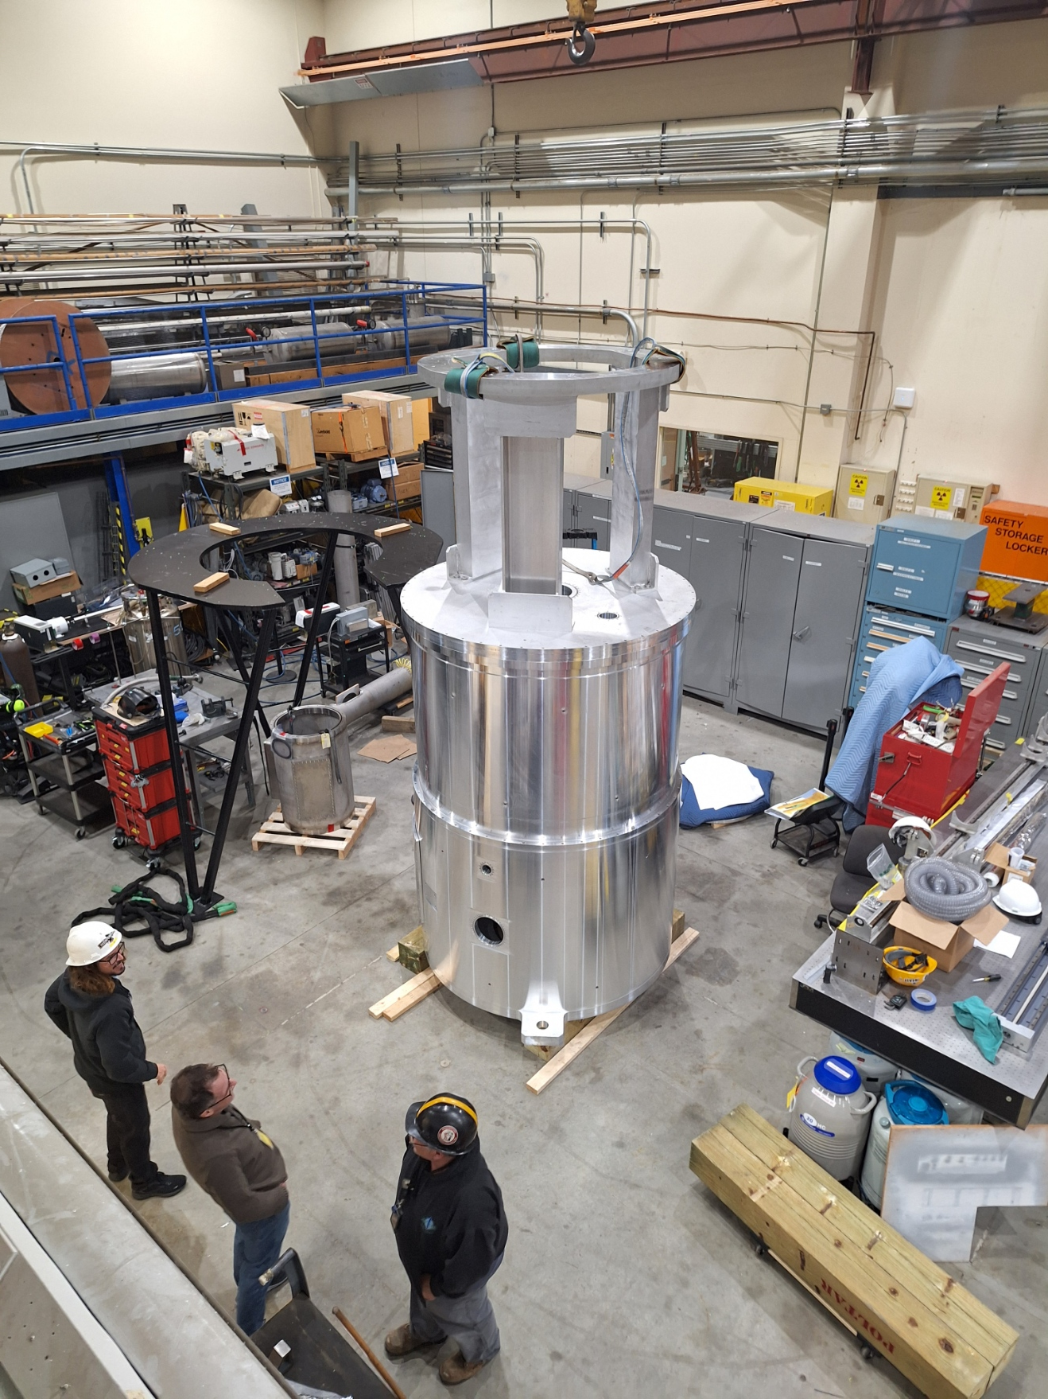
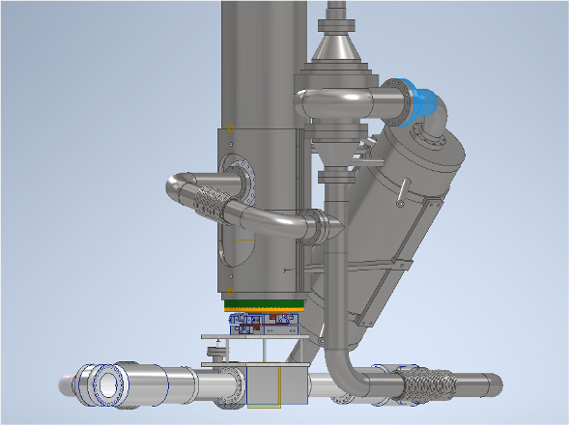
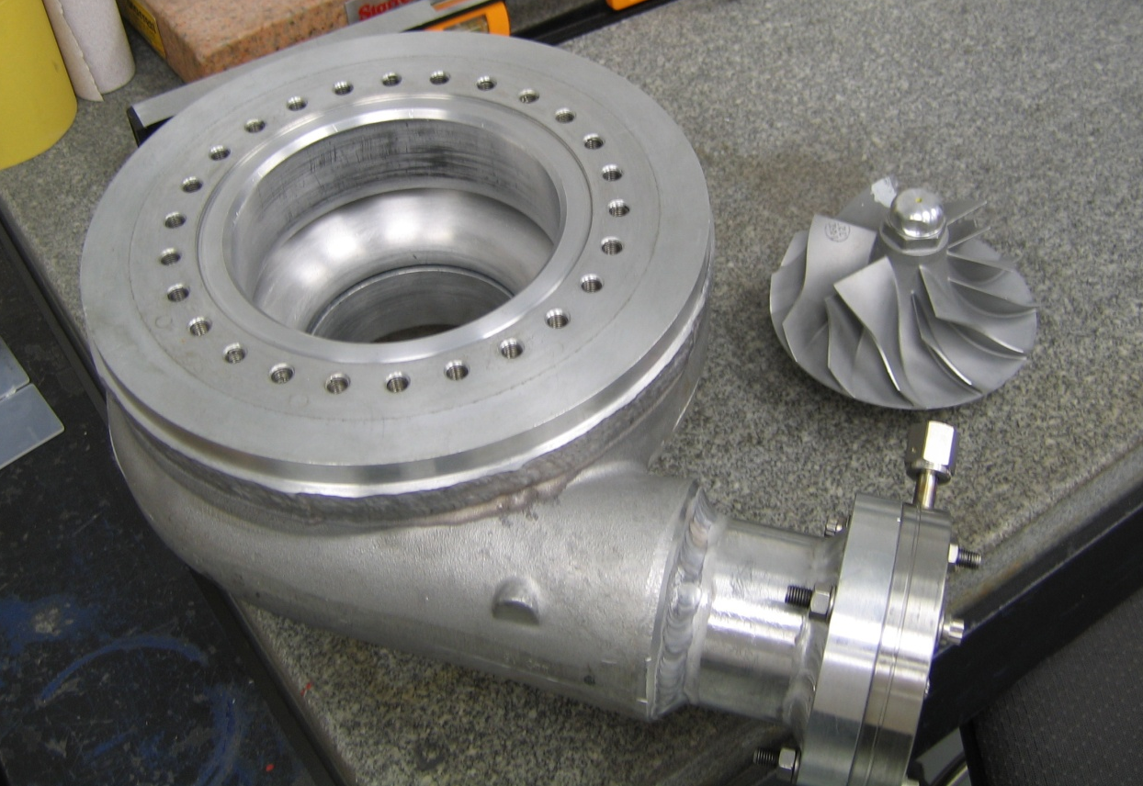
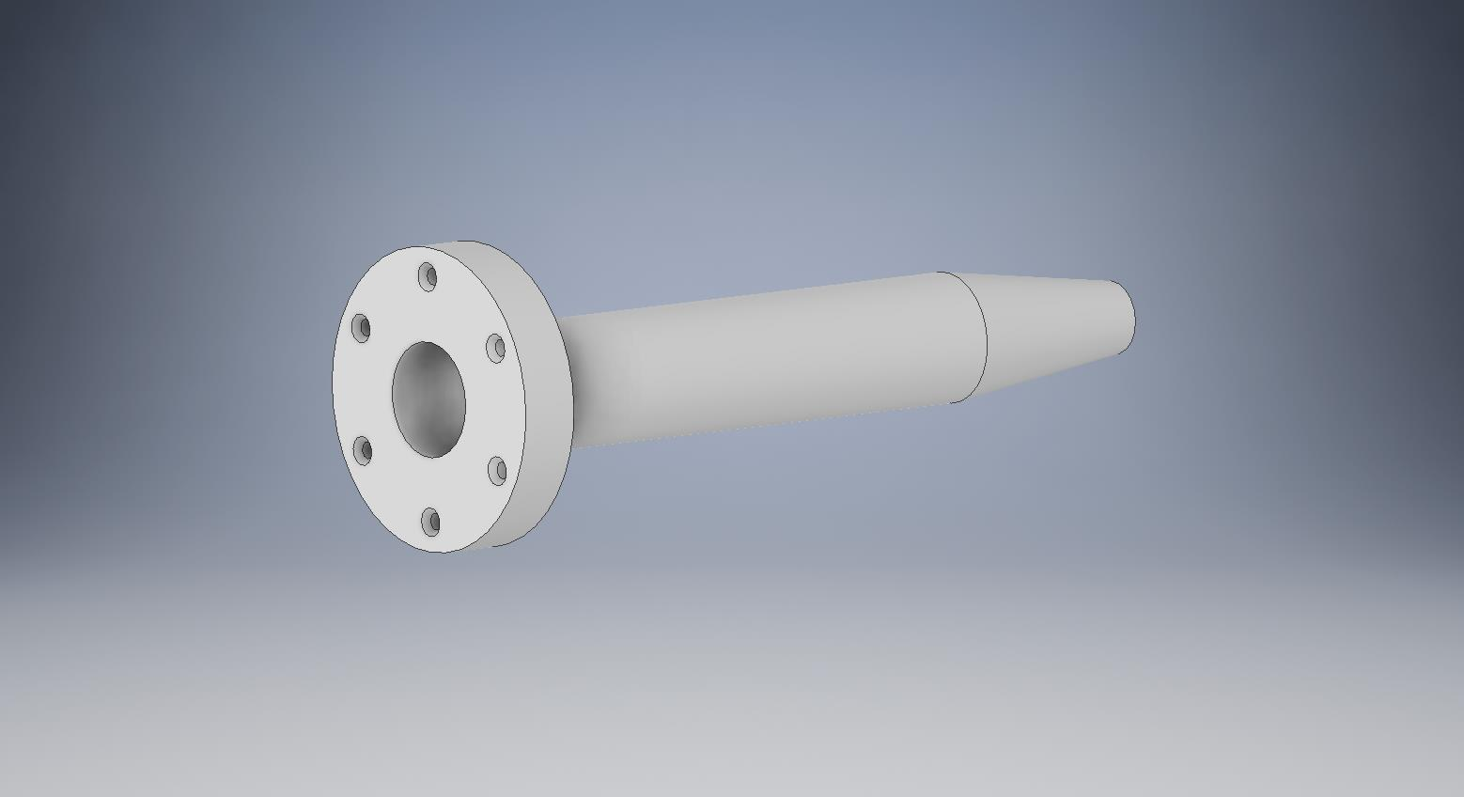
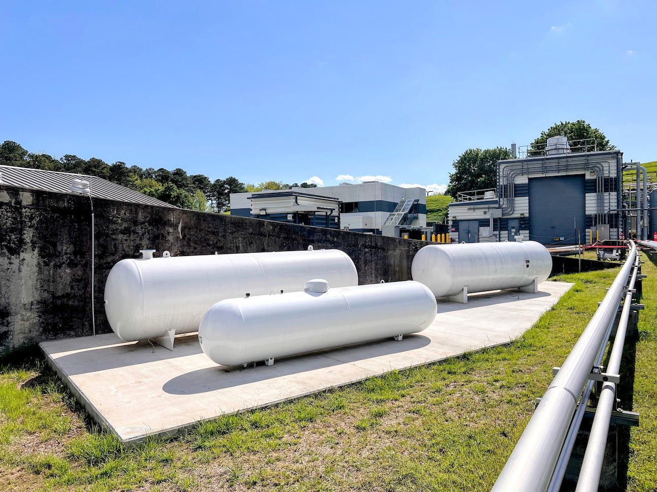
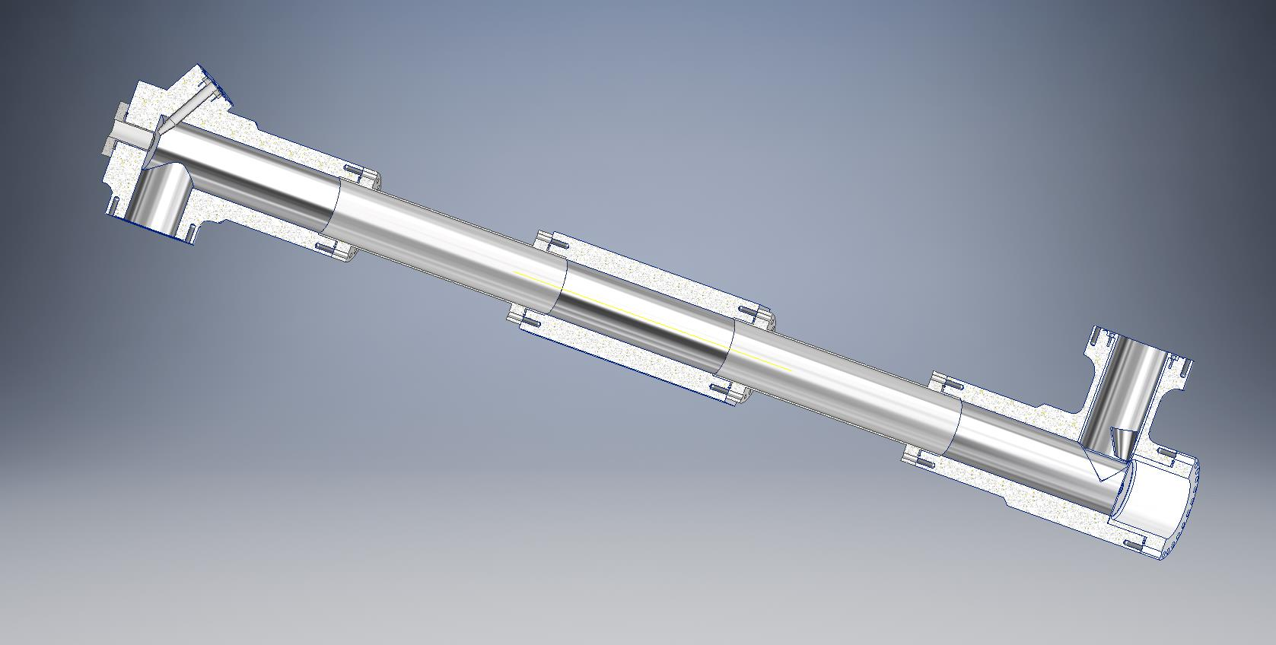
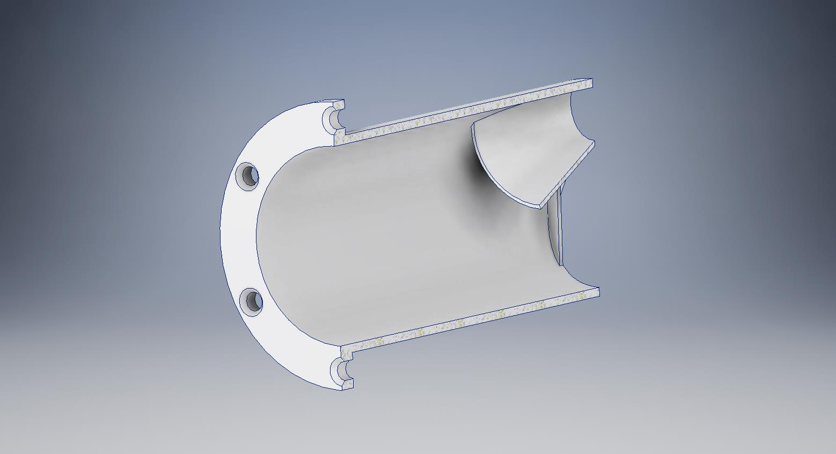
LH2 target for MOLLER
Targets for 2027
65 μA x 125 cm → 3500 W
The most powerful cryotarget ever built
Centrifugal pump for liquid hydrogen
Aluminum scattering chamber
Target cell
flow
diverter
LH2 Flow
flow
diverter
Electron Beam
125 cm
Hydrogen storage tanks

Slide 5
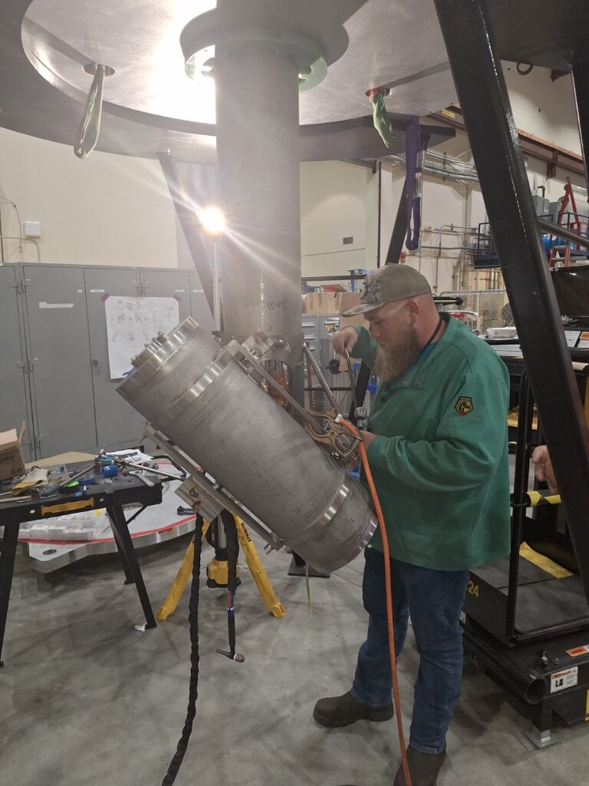
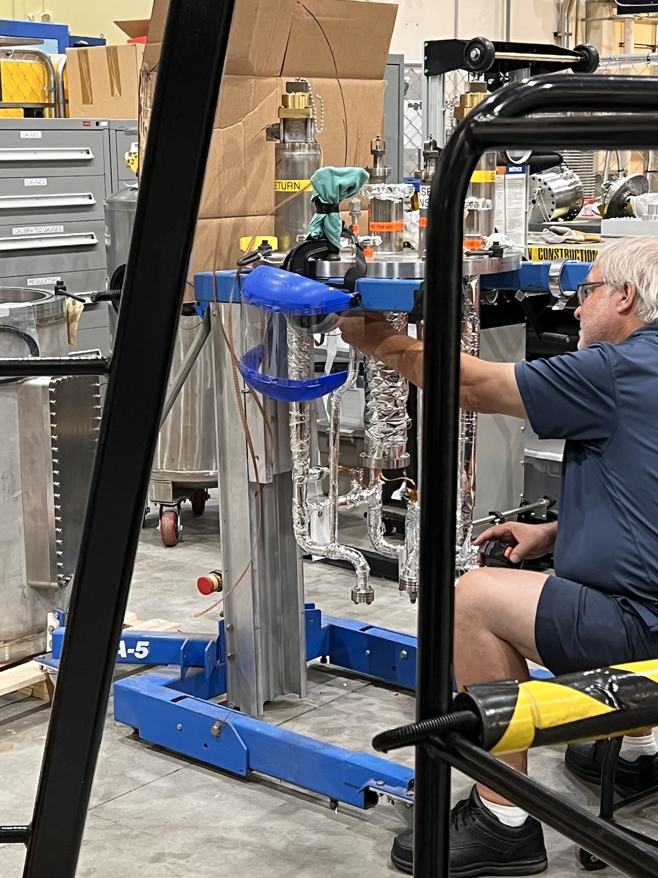
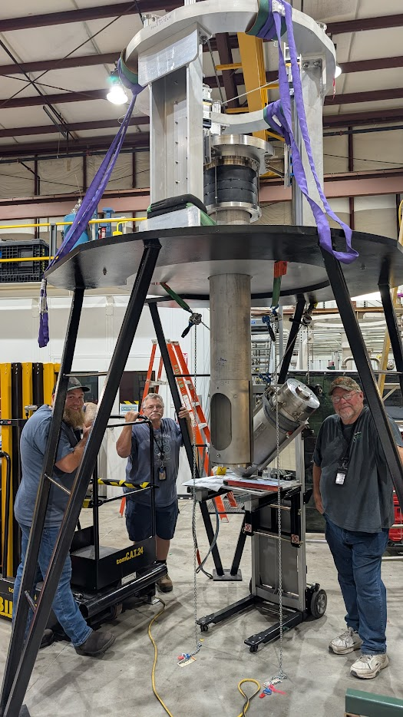
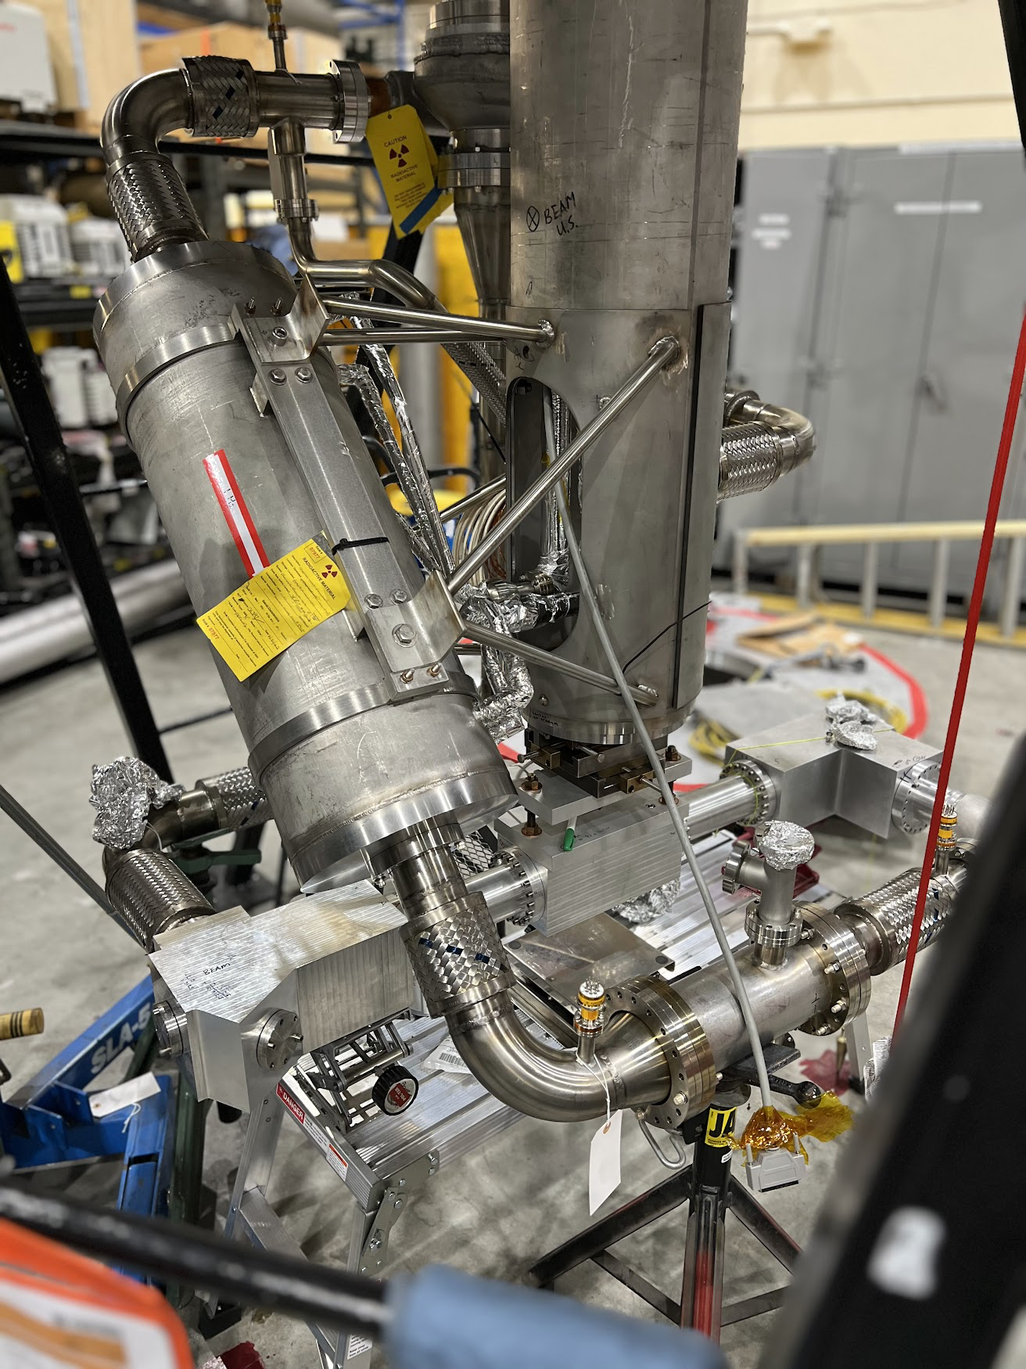
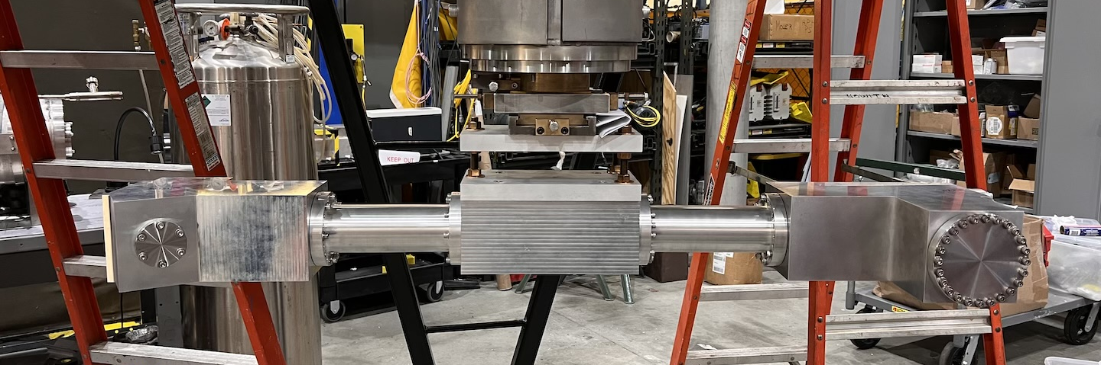
LH2 target for MOLLER
Targets for 2027

Slide 6
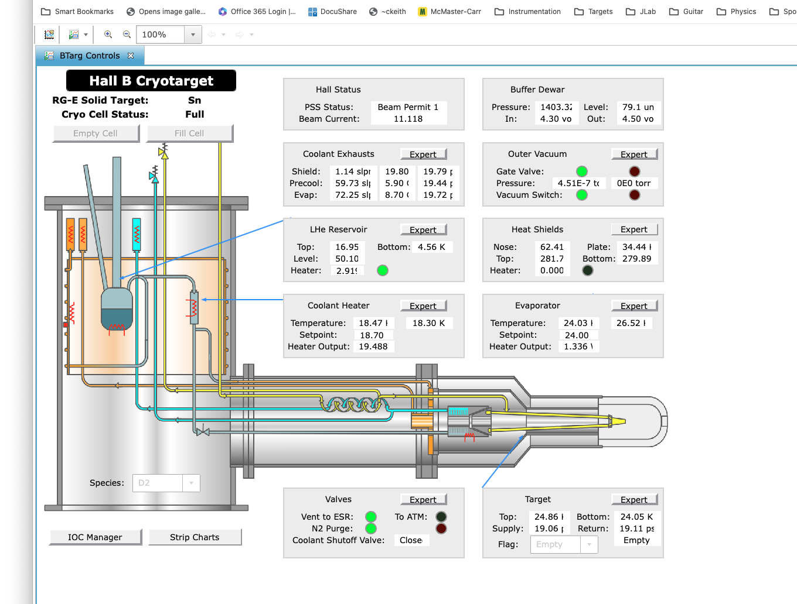
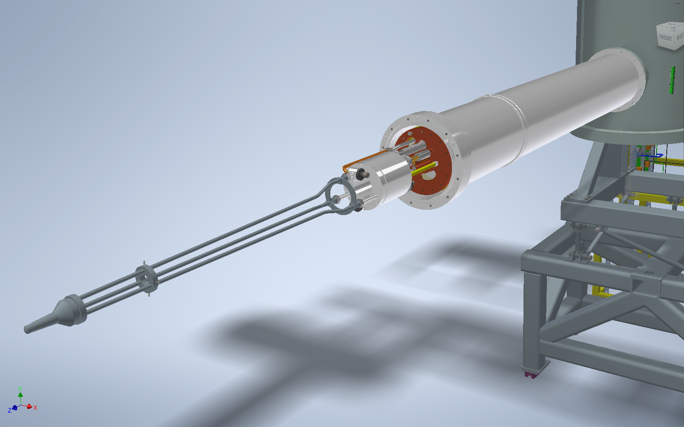
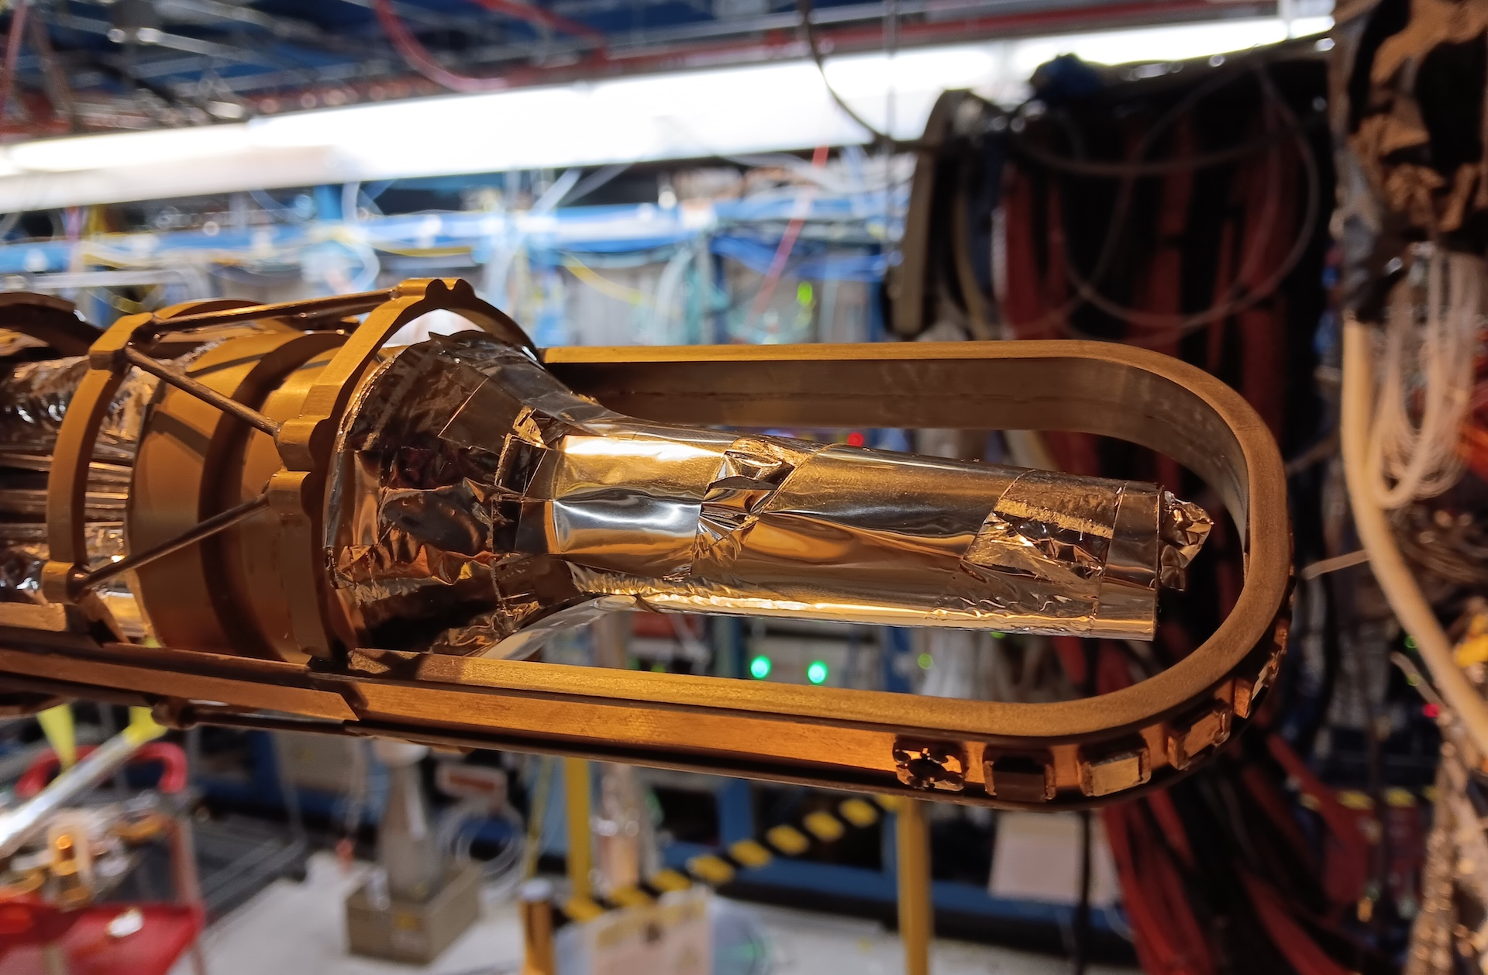
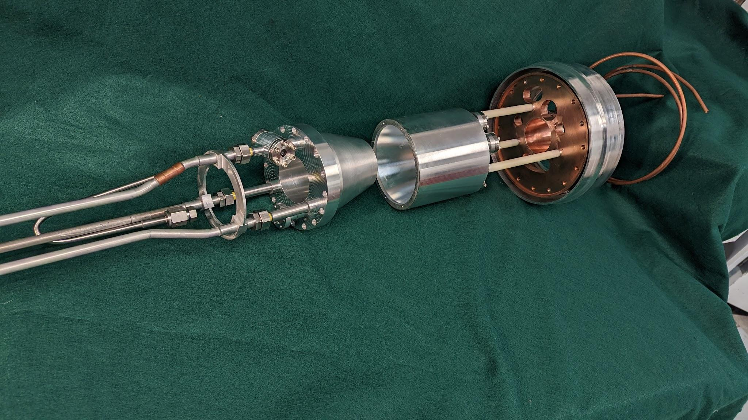
Hall B cryotarget for Run Groups E & K
Targets for 2027

Slide 7
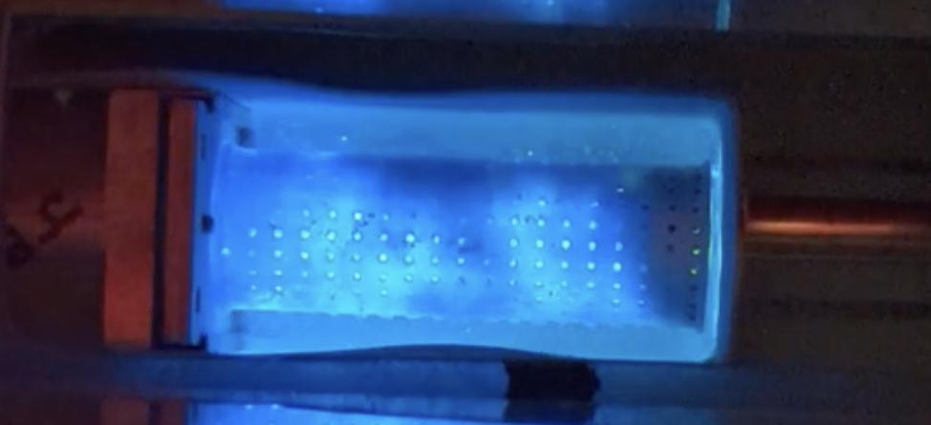
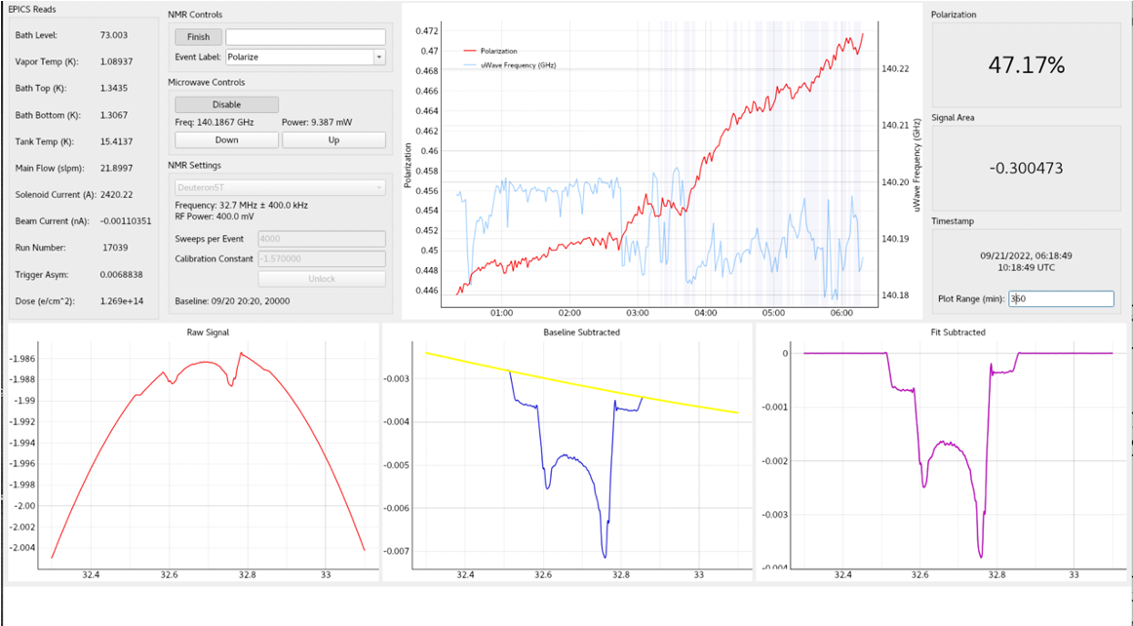
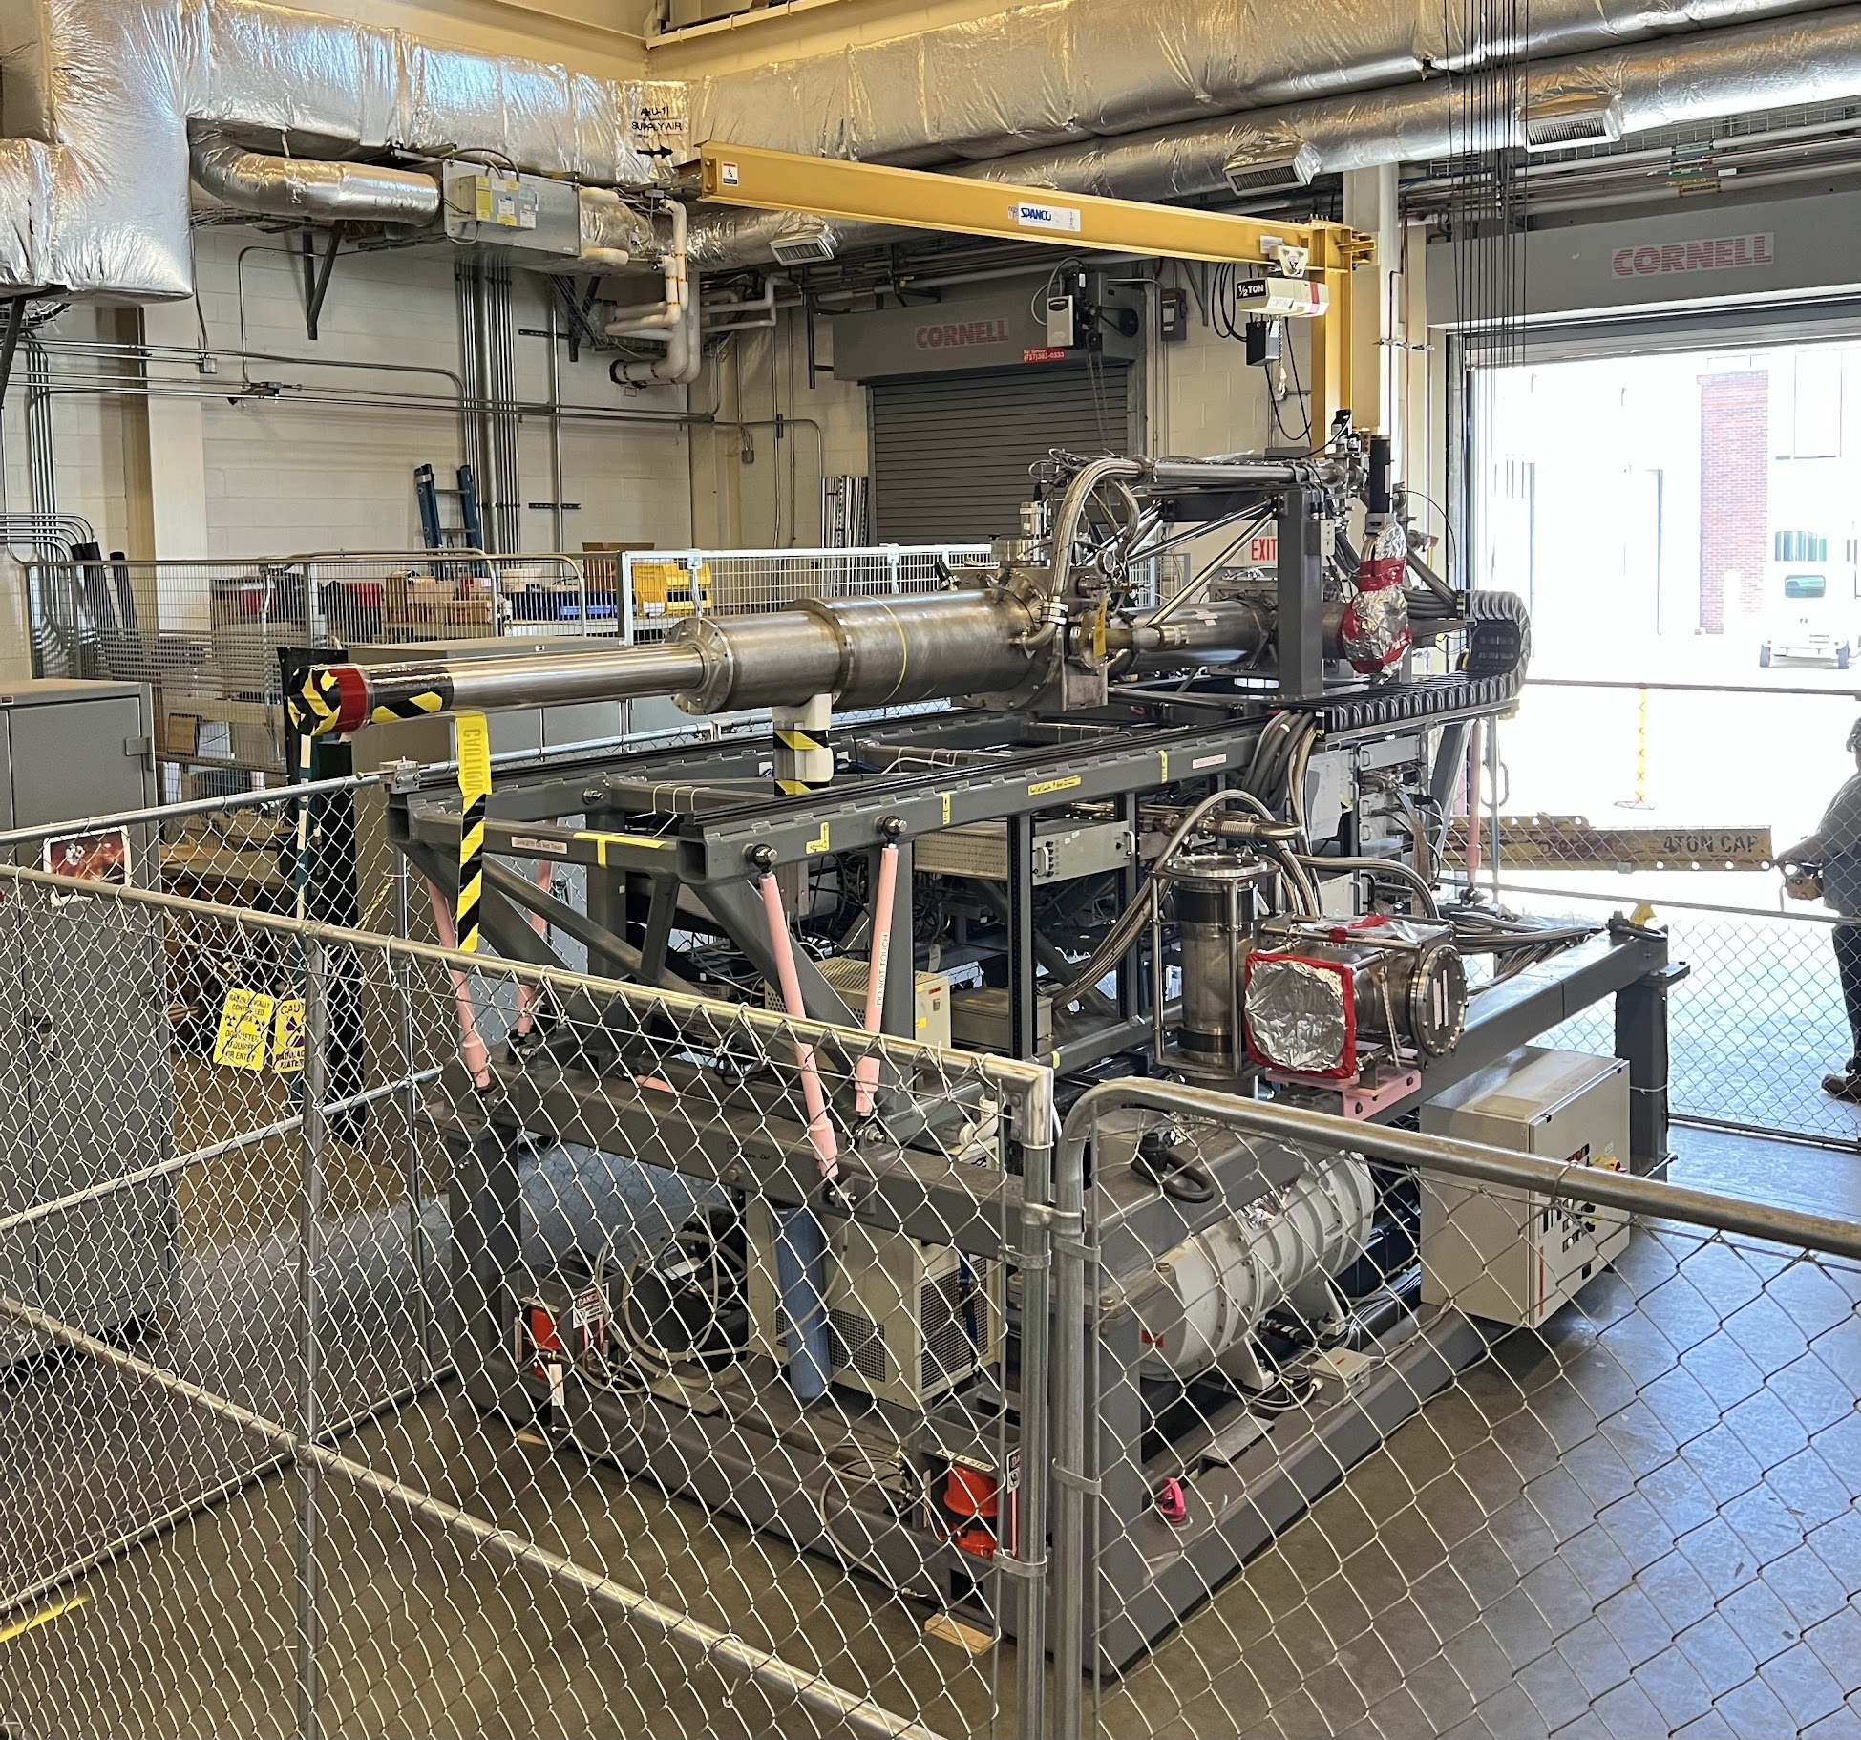
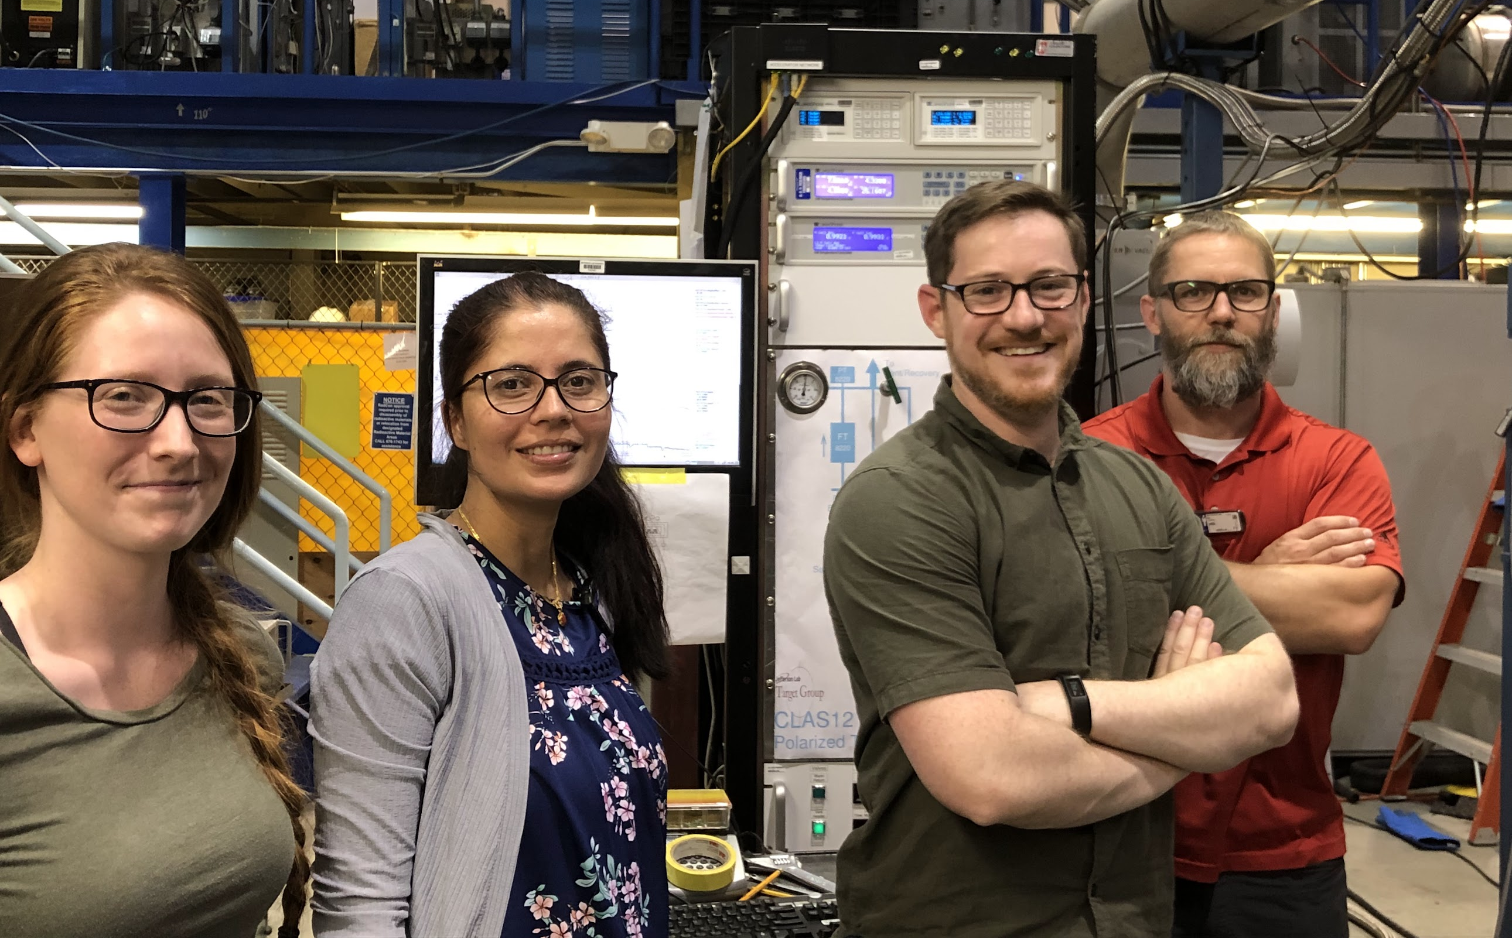
CLAS12 Longitudinally Polarized Target
Targets Beyond 2027

Slide 8
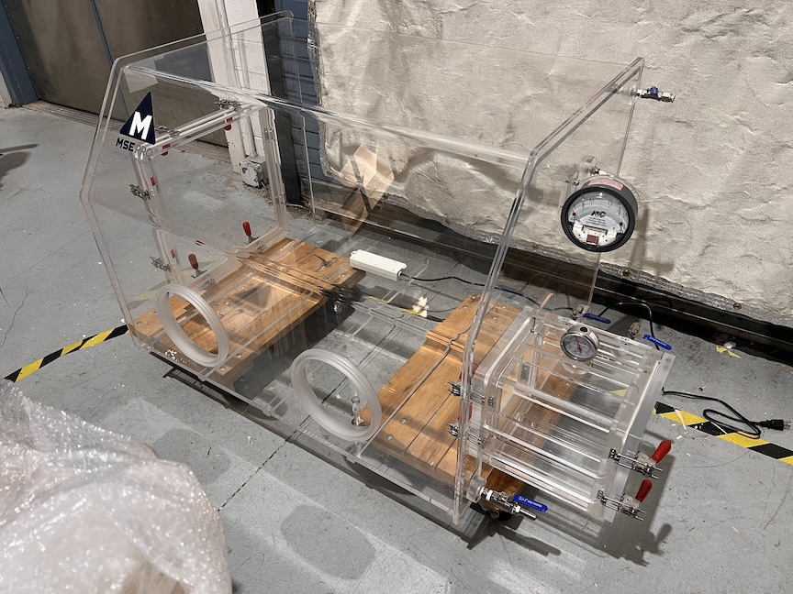
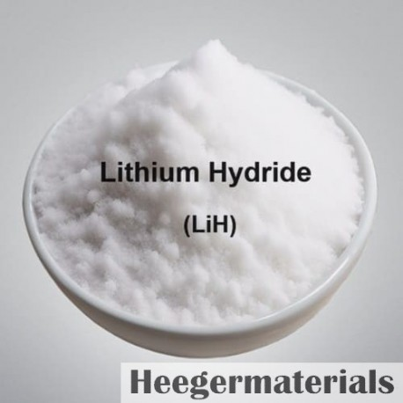



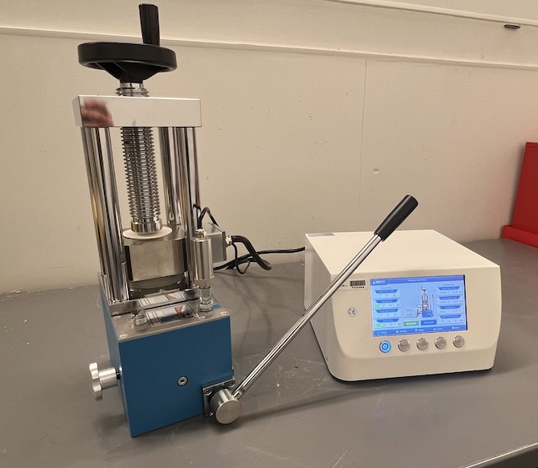

CLAS12 Longitudinally Polarized Target
Targets Beyond 2027
Run Group G
E12-14-001: The EMC Effect in Spin Structure Functions
⁷LiD material procured as micron-sized powder
Must be compressed & sintered into pellets or disks
Irradiate at 185 K to 10¹⁷ e-/cm² for DNP
Deuteride
2
3
2
W

Slide 9
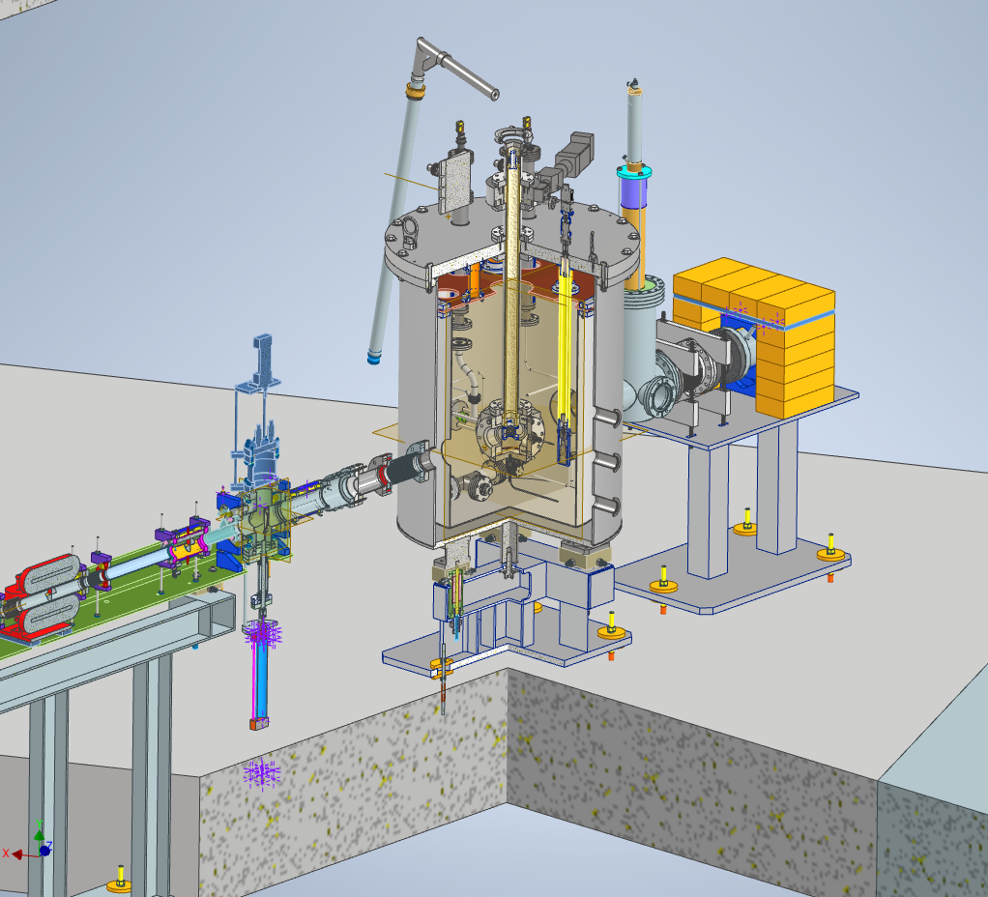
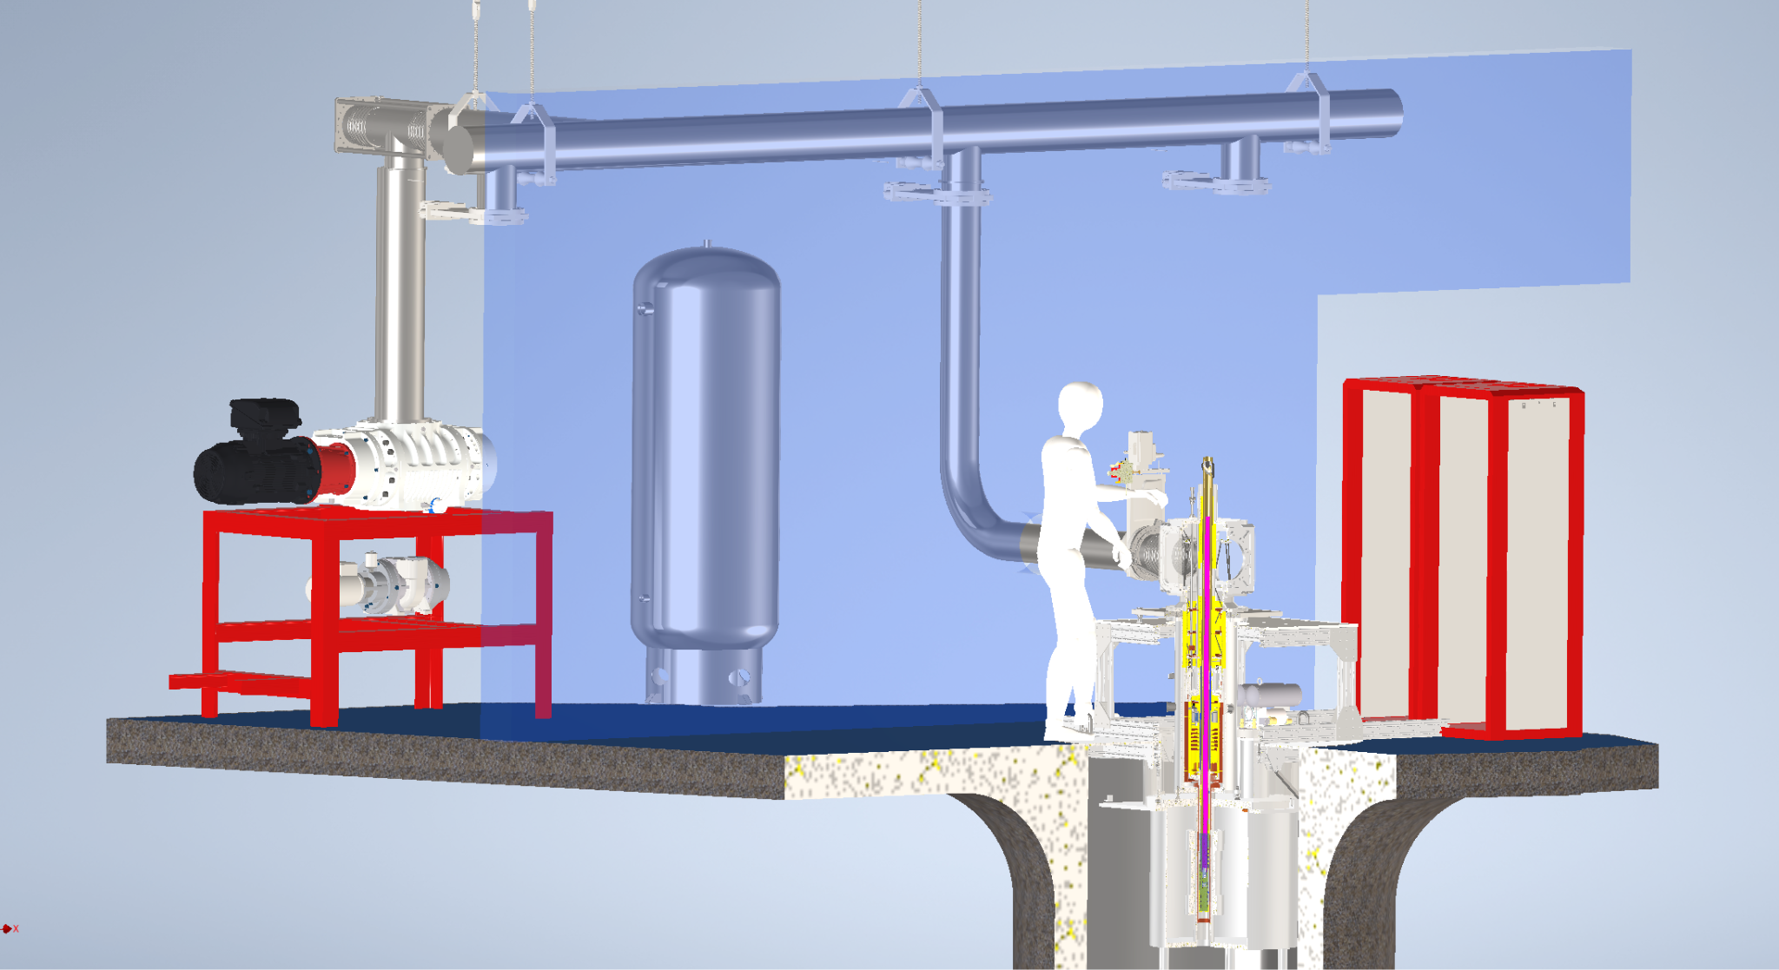
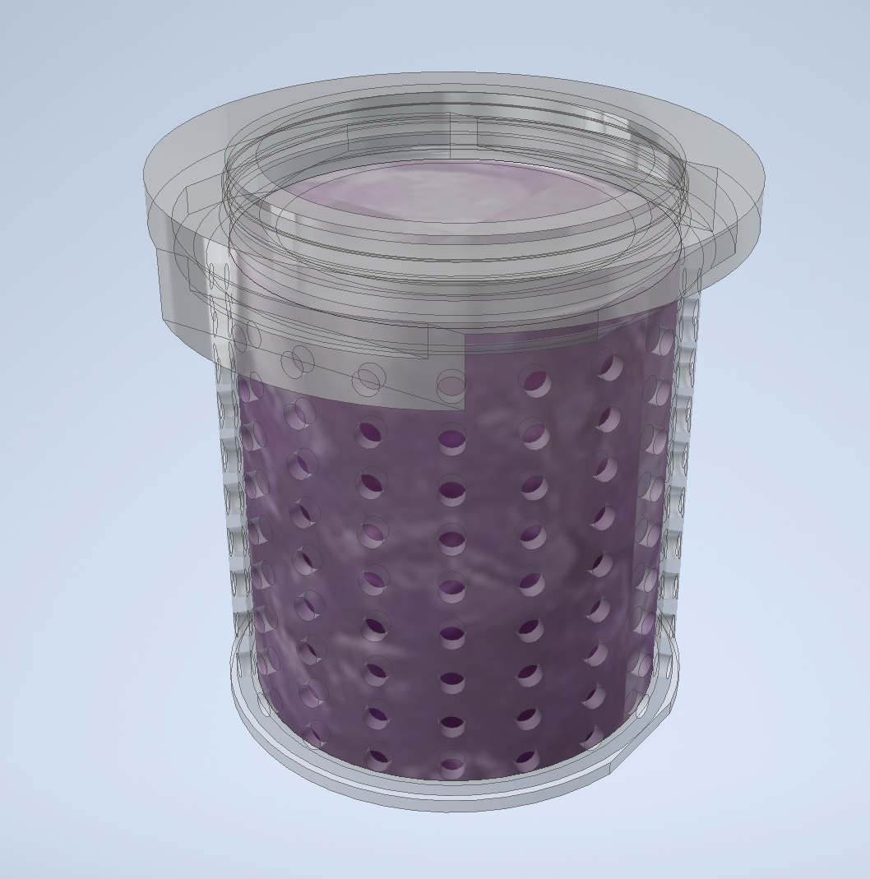
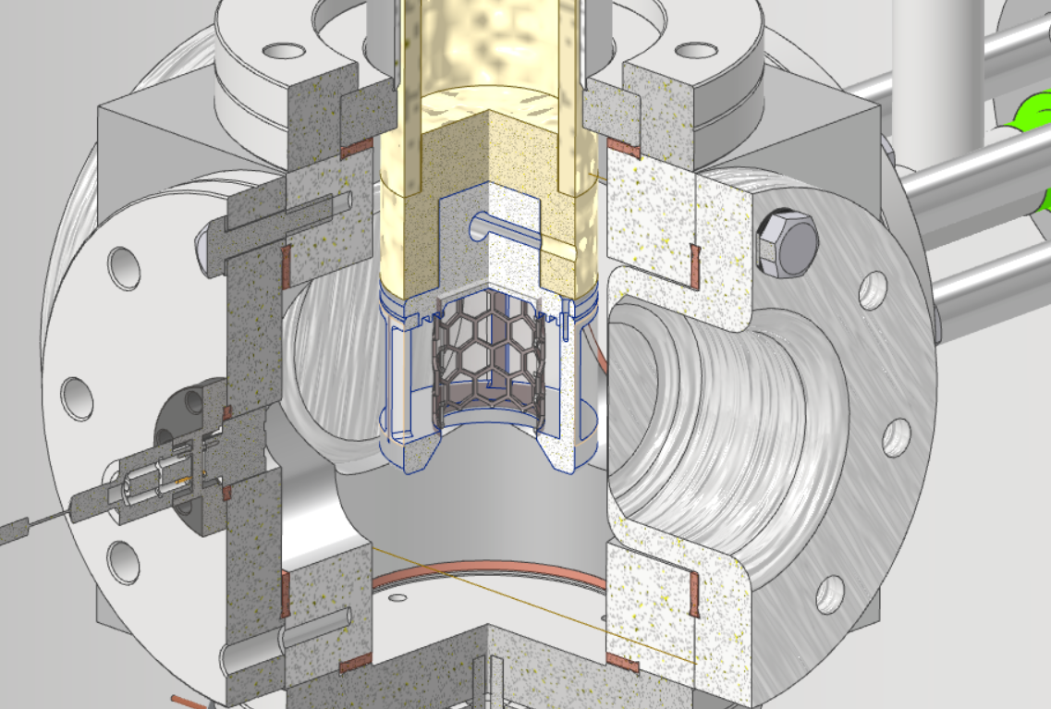
R&D Lab for Polarized Targets
Targets Beyond 2027
Characterize them next door in the Target DevLab
DNP @ 1K / 5T
EPR @ 77K / 0.35 T
Irradiate target materials at the UITF
8 MeV, 1 – 10 uA
2 - 300 K
NH₃, ND₃, ⁷LiD …

Slide 10
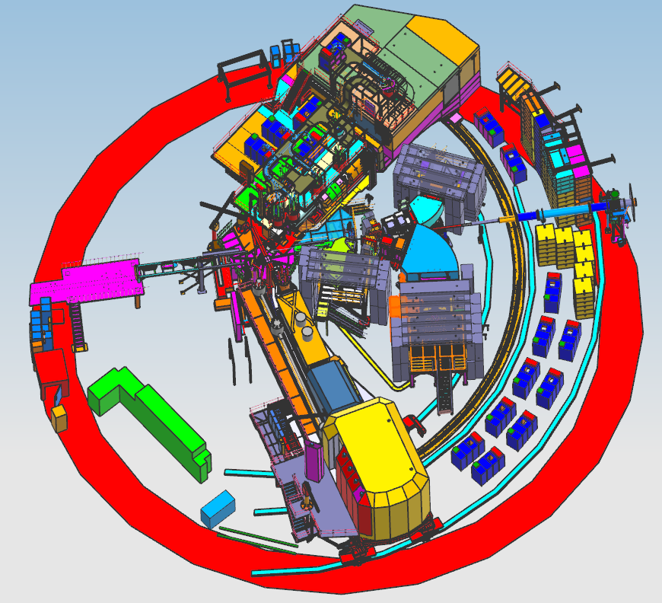
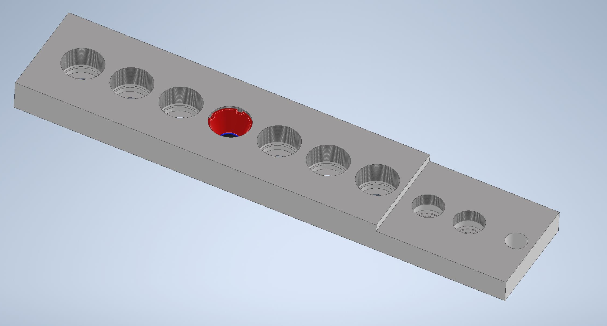
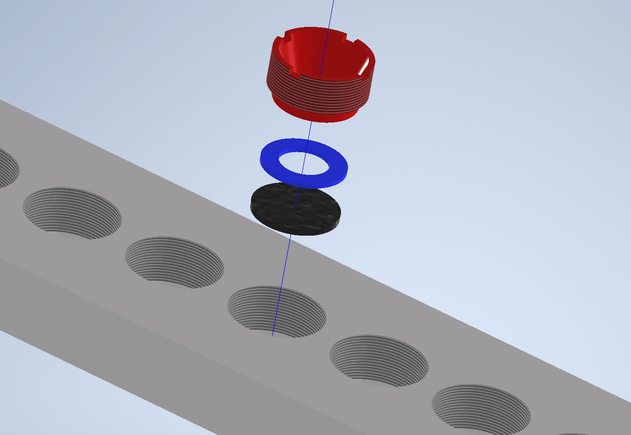
Hypernuclear experiments in Hall C
Targets Beyond 2027
E12-24-003 E12-24-004 E12-24-011
E12-24-013 E12-15-008A
New spectrometers (x3)
New solid target system, cryogenically cooled
SHMS
Target
No. | Material
1 | ⁶LiH
2 | ⁶Li
3 | ⁹Be
4 | ⁹B
5 | ¹²C
6 | ¹²C
7 | ¹²C
8 | ²⁷Al
9 | ⁴⁰Ca
10 | ⁴⁸Ca
11 | ²⁰⁸Pb
12 | ²⁰⁸Pb
13 | α source
14 | CH₂
15 | H₂O
HES
Motion
Actuator
ENGE
Scattering
Chamber
SKS
HMS
Support
Post
Clamp
Clamp ring
Target sample
Courtesy of Dave Meekins

Slide 11
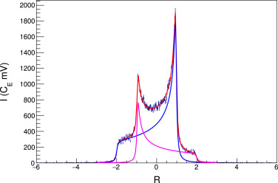
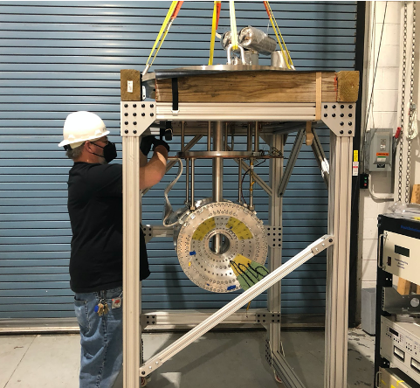
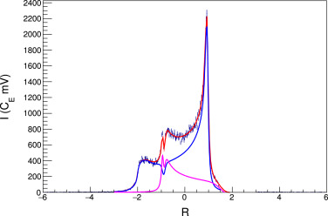





Hall C Tensor Polarized Target
Targets Beyond 2027
Tensor polarization can be increased
(or decreased) using RF saturation
(aka hole-burning)
E12-13-011: The Deuteron Structure Function b₁
E12-15-005: Measurements of the Quasi-Elastic and Elastic Deuteron Tensor Asymmetries
Two polarizations are needed to describe spin populations of spin-1 deuterons
RF
P = 50%
Q = 20%
Vector
Polarization
$$P=N_{+1}−N_{−1}$$
RF
Tensor
Polarization
$$Q=1−3N_{0}$$
“Standard”
DNP
$$Q=2 − \sqrt{4−3P^{2}}$$
New 5 T magnet for Hall C polarized target
Q = 29%
P_{max} ≈ 50%
Q_{max} ≈ 20%
P_{avg} ≈ 30%
Q_{avg} ≈ 7%
D. Keller, D. Crabb, and D. Day., NIM A 981, 164504 (2020)

Slide 12
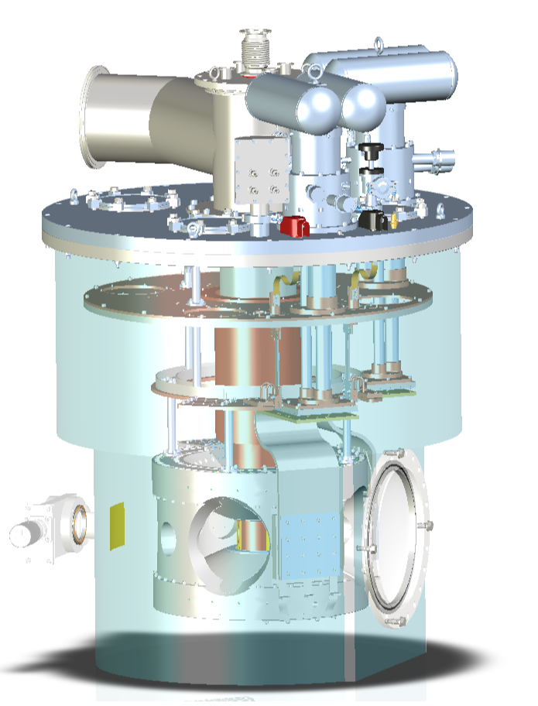
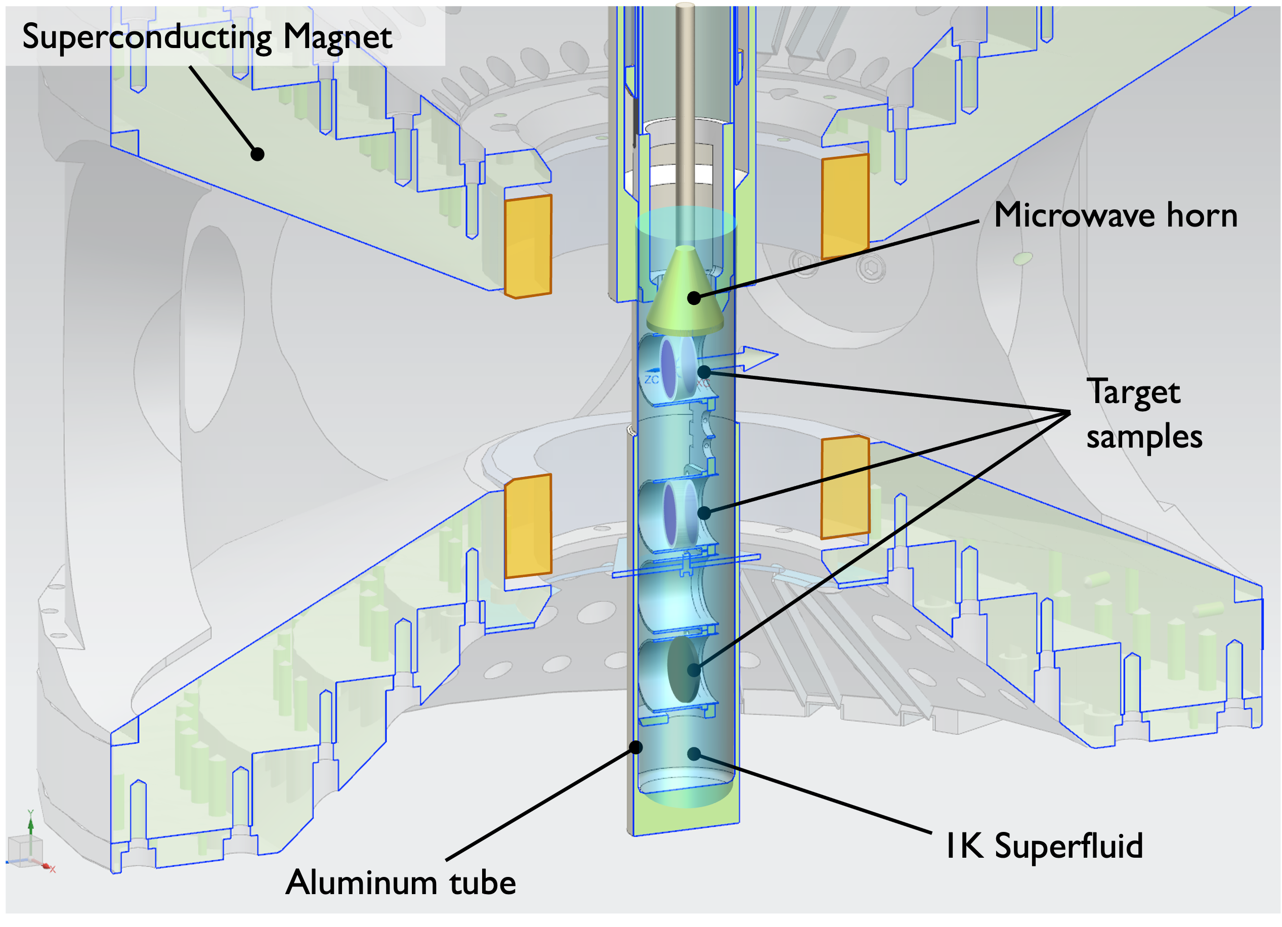
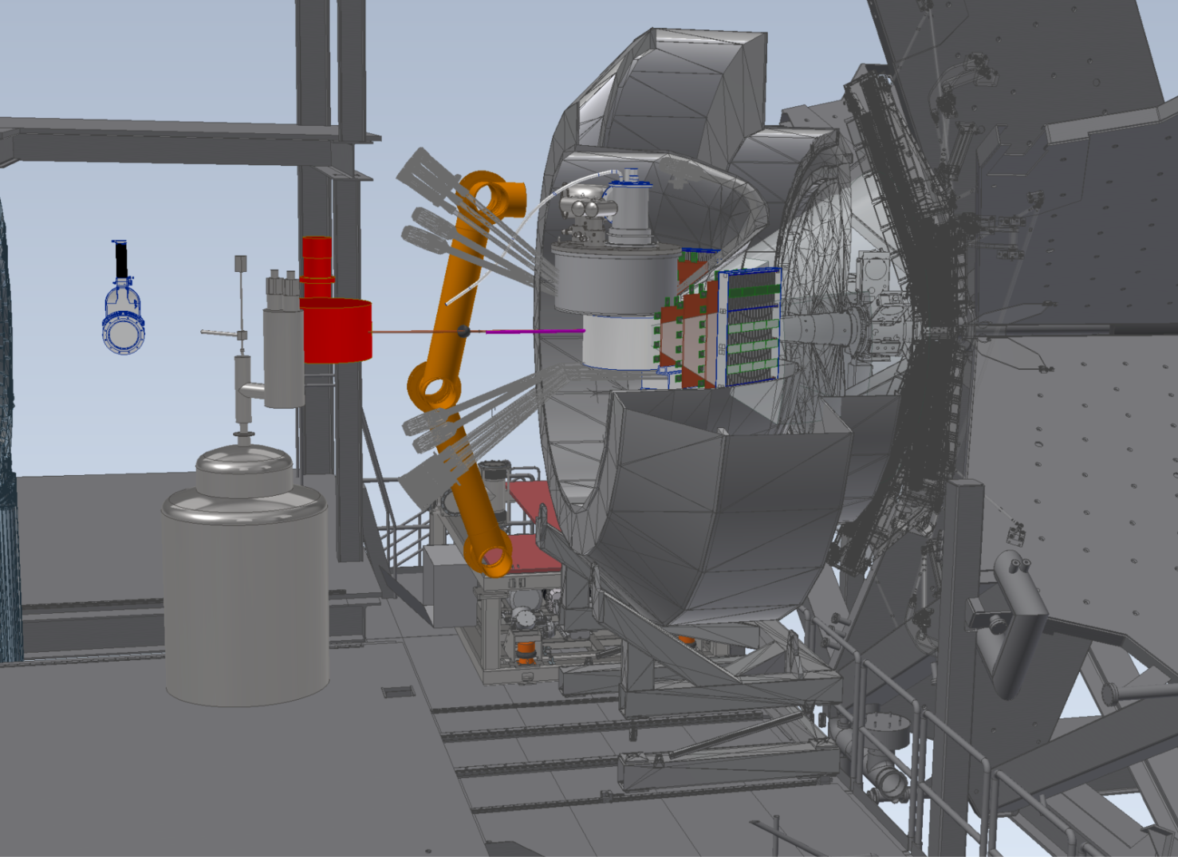
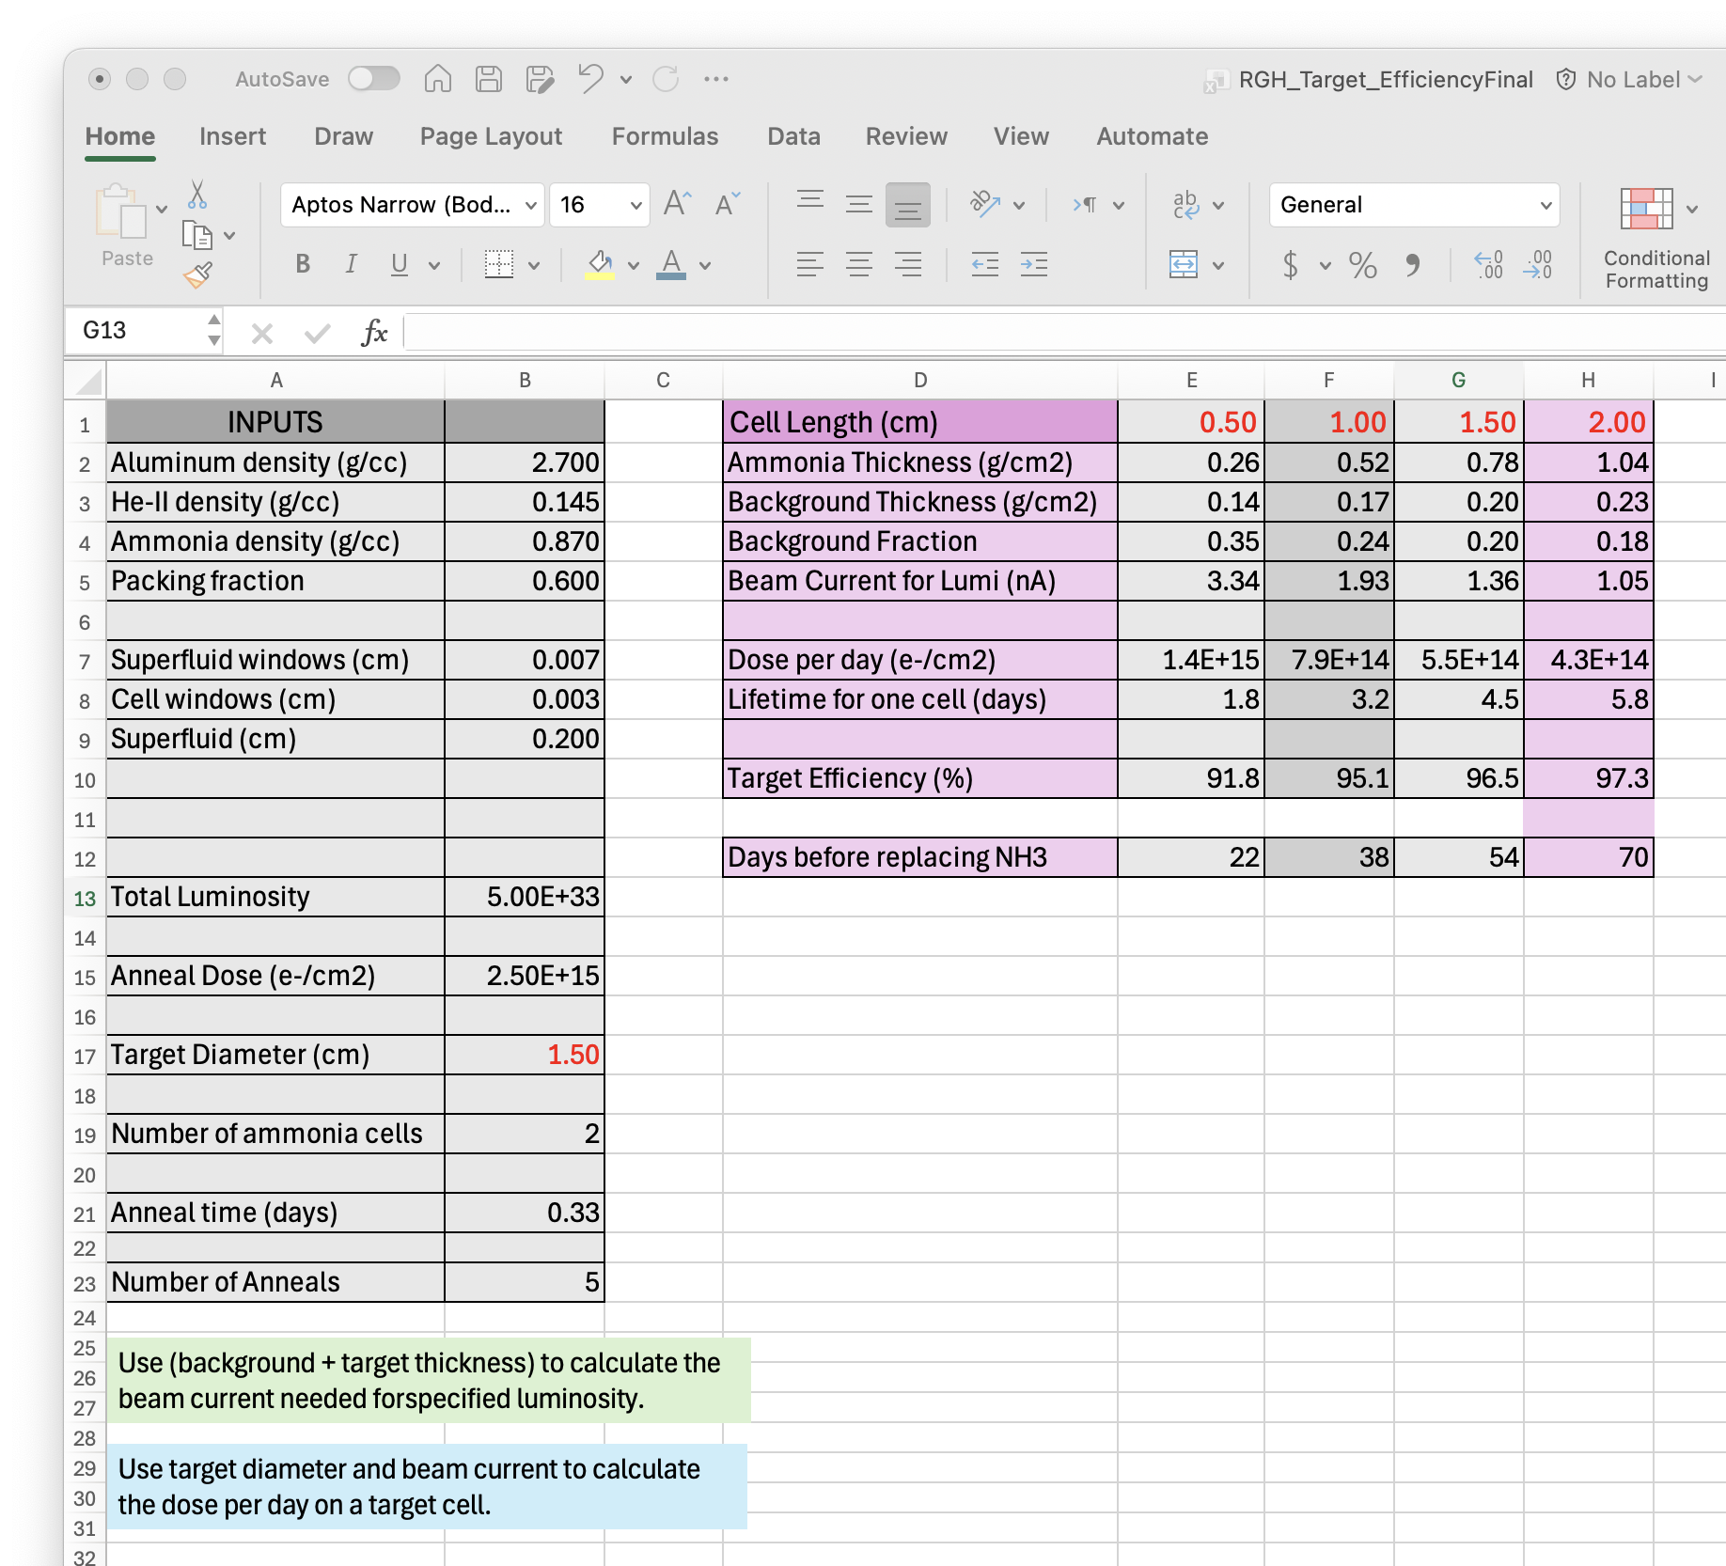
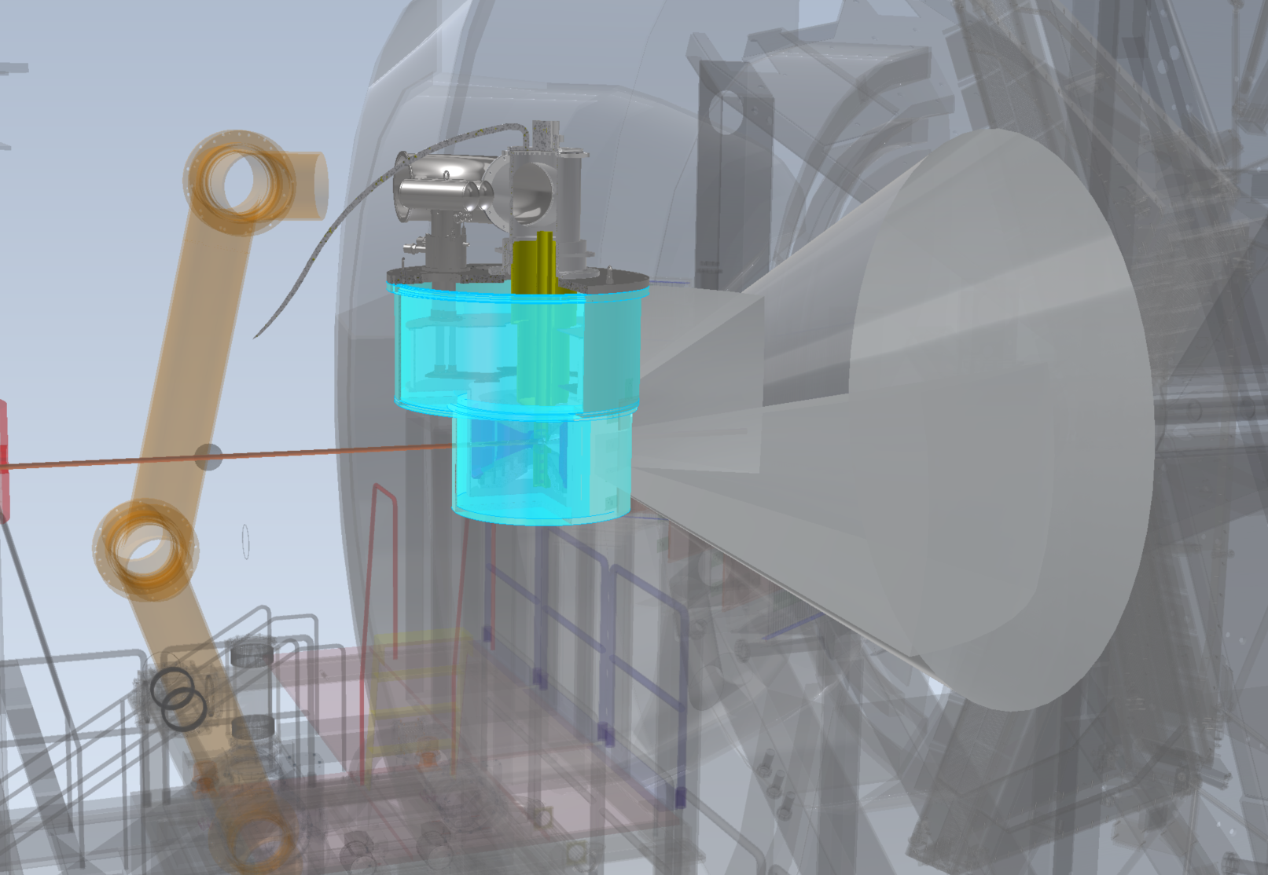
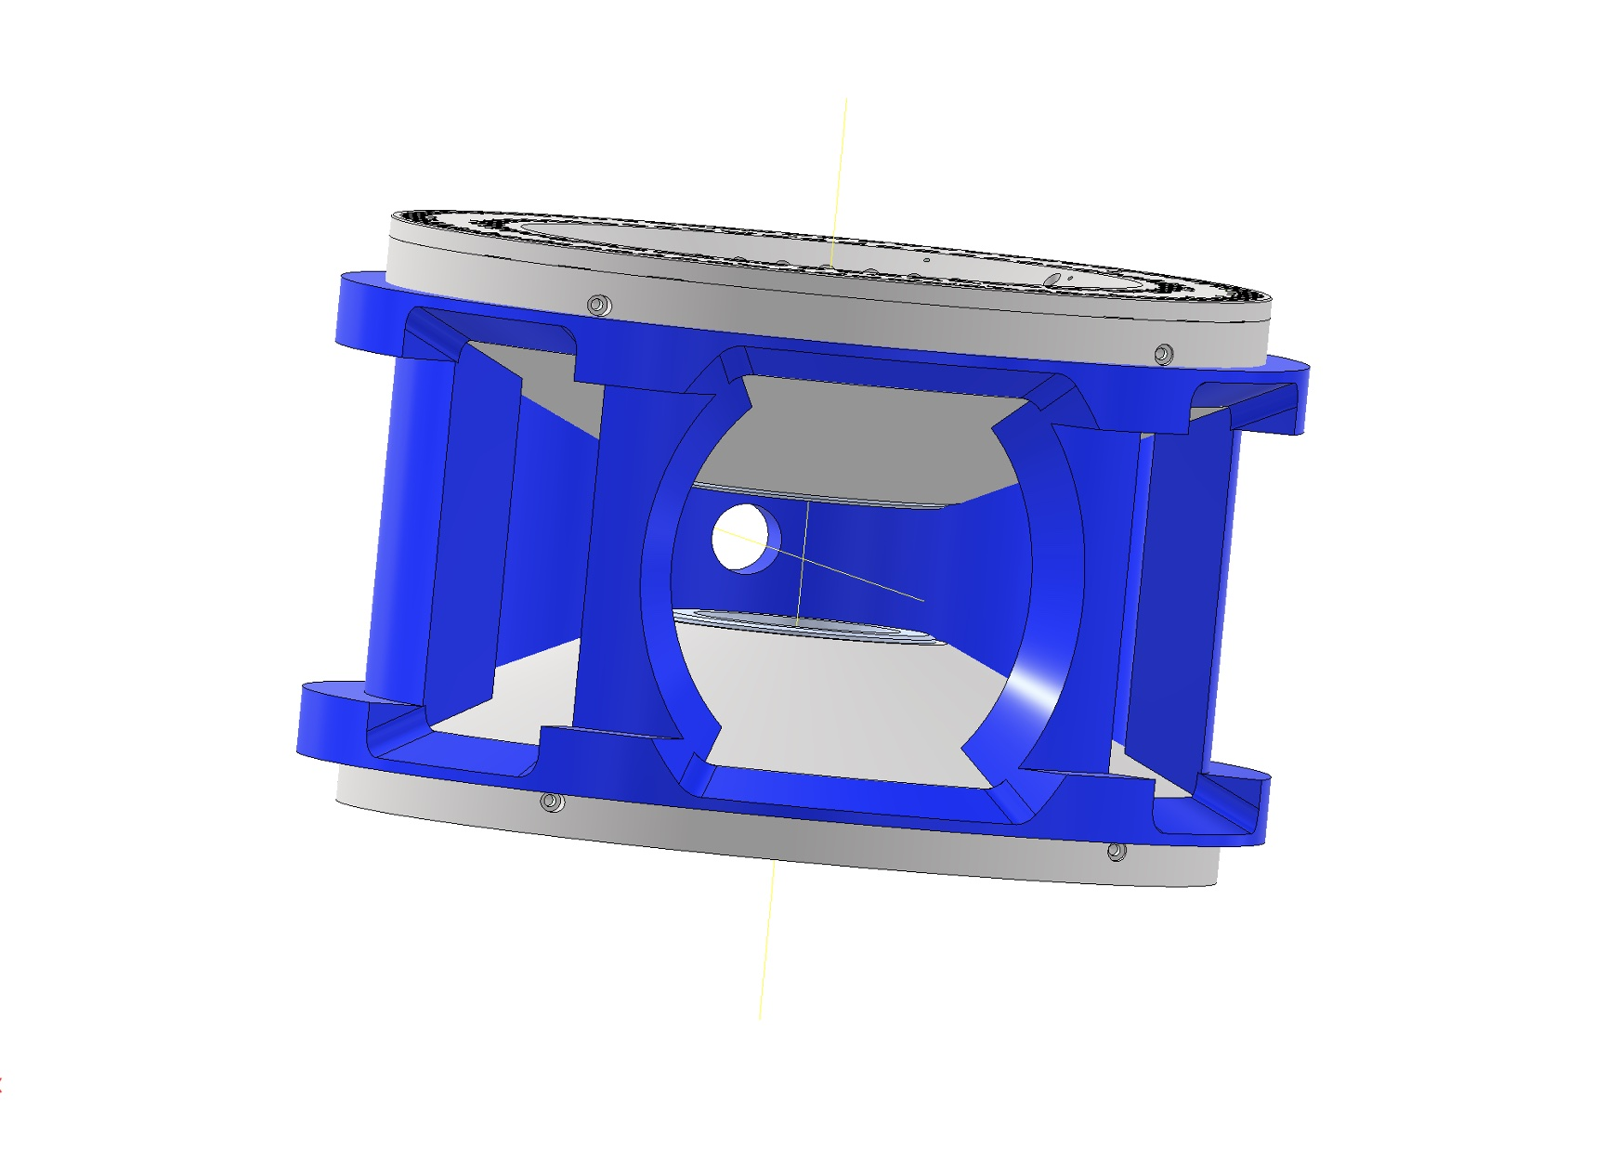
CLAS12 Transversely Polarized Target
Targets Beyond 2027
At 1-2 nA, target ladder should last several weeks before replacement.
New magnet design for RGH

Slide 13
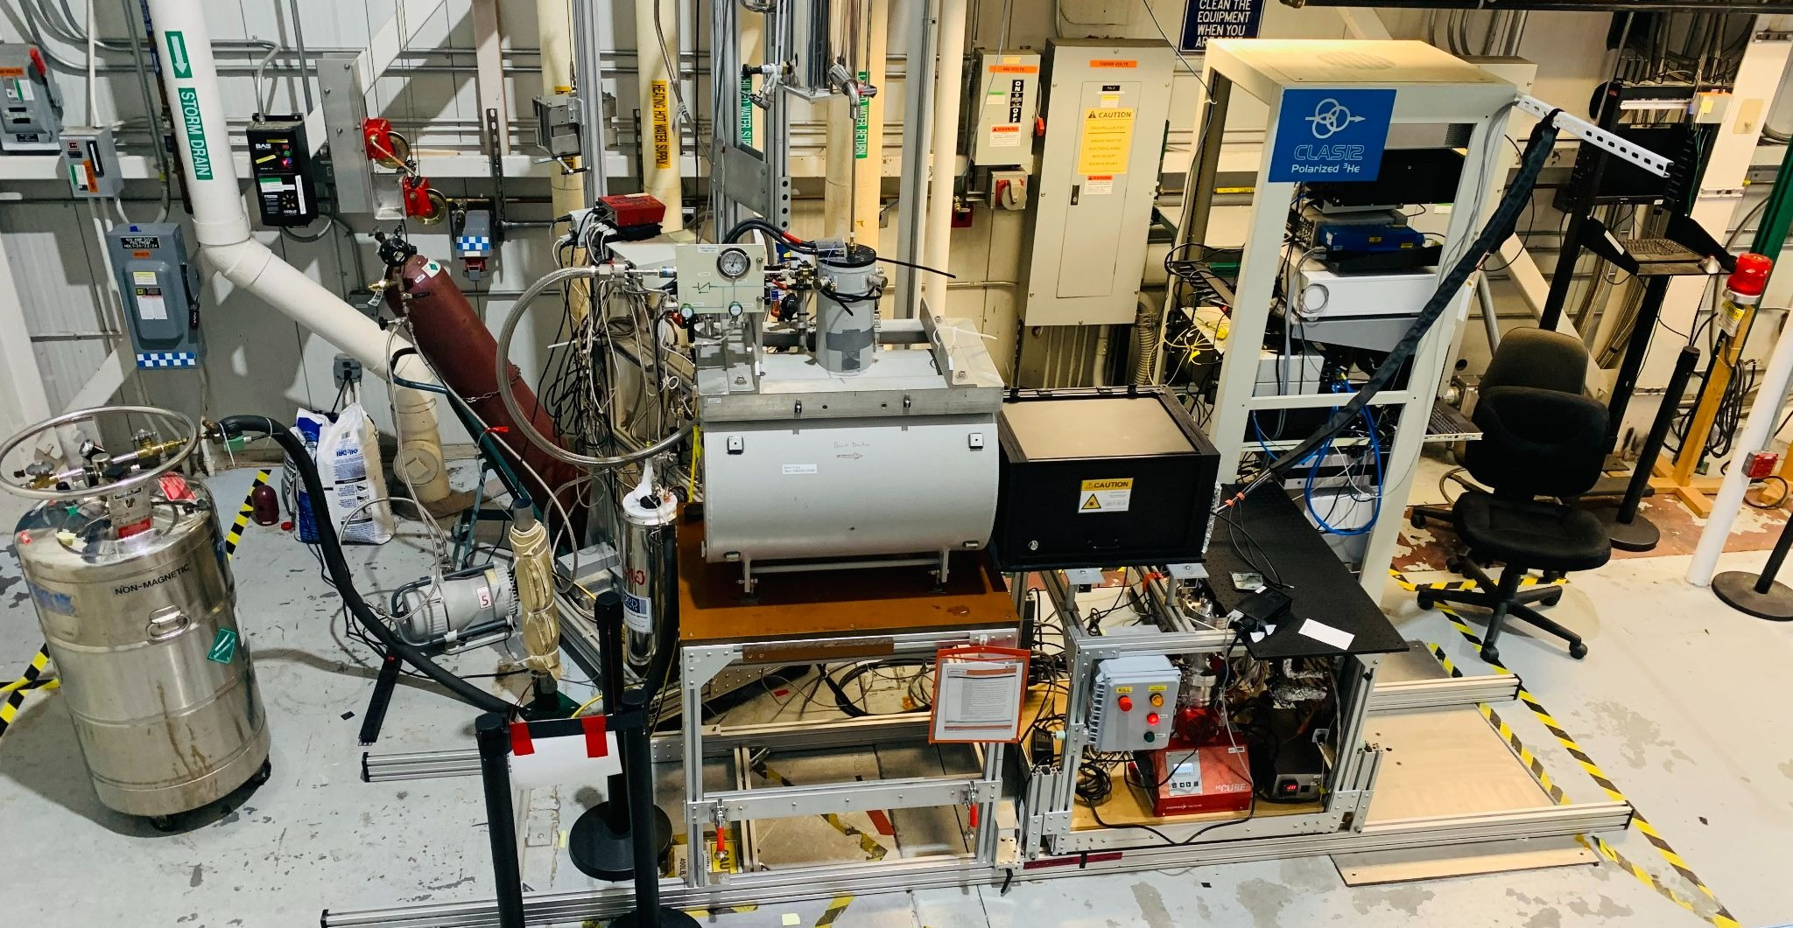
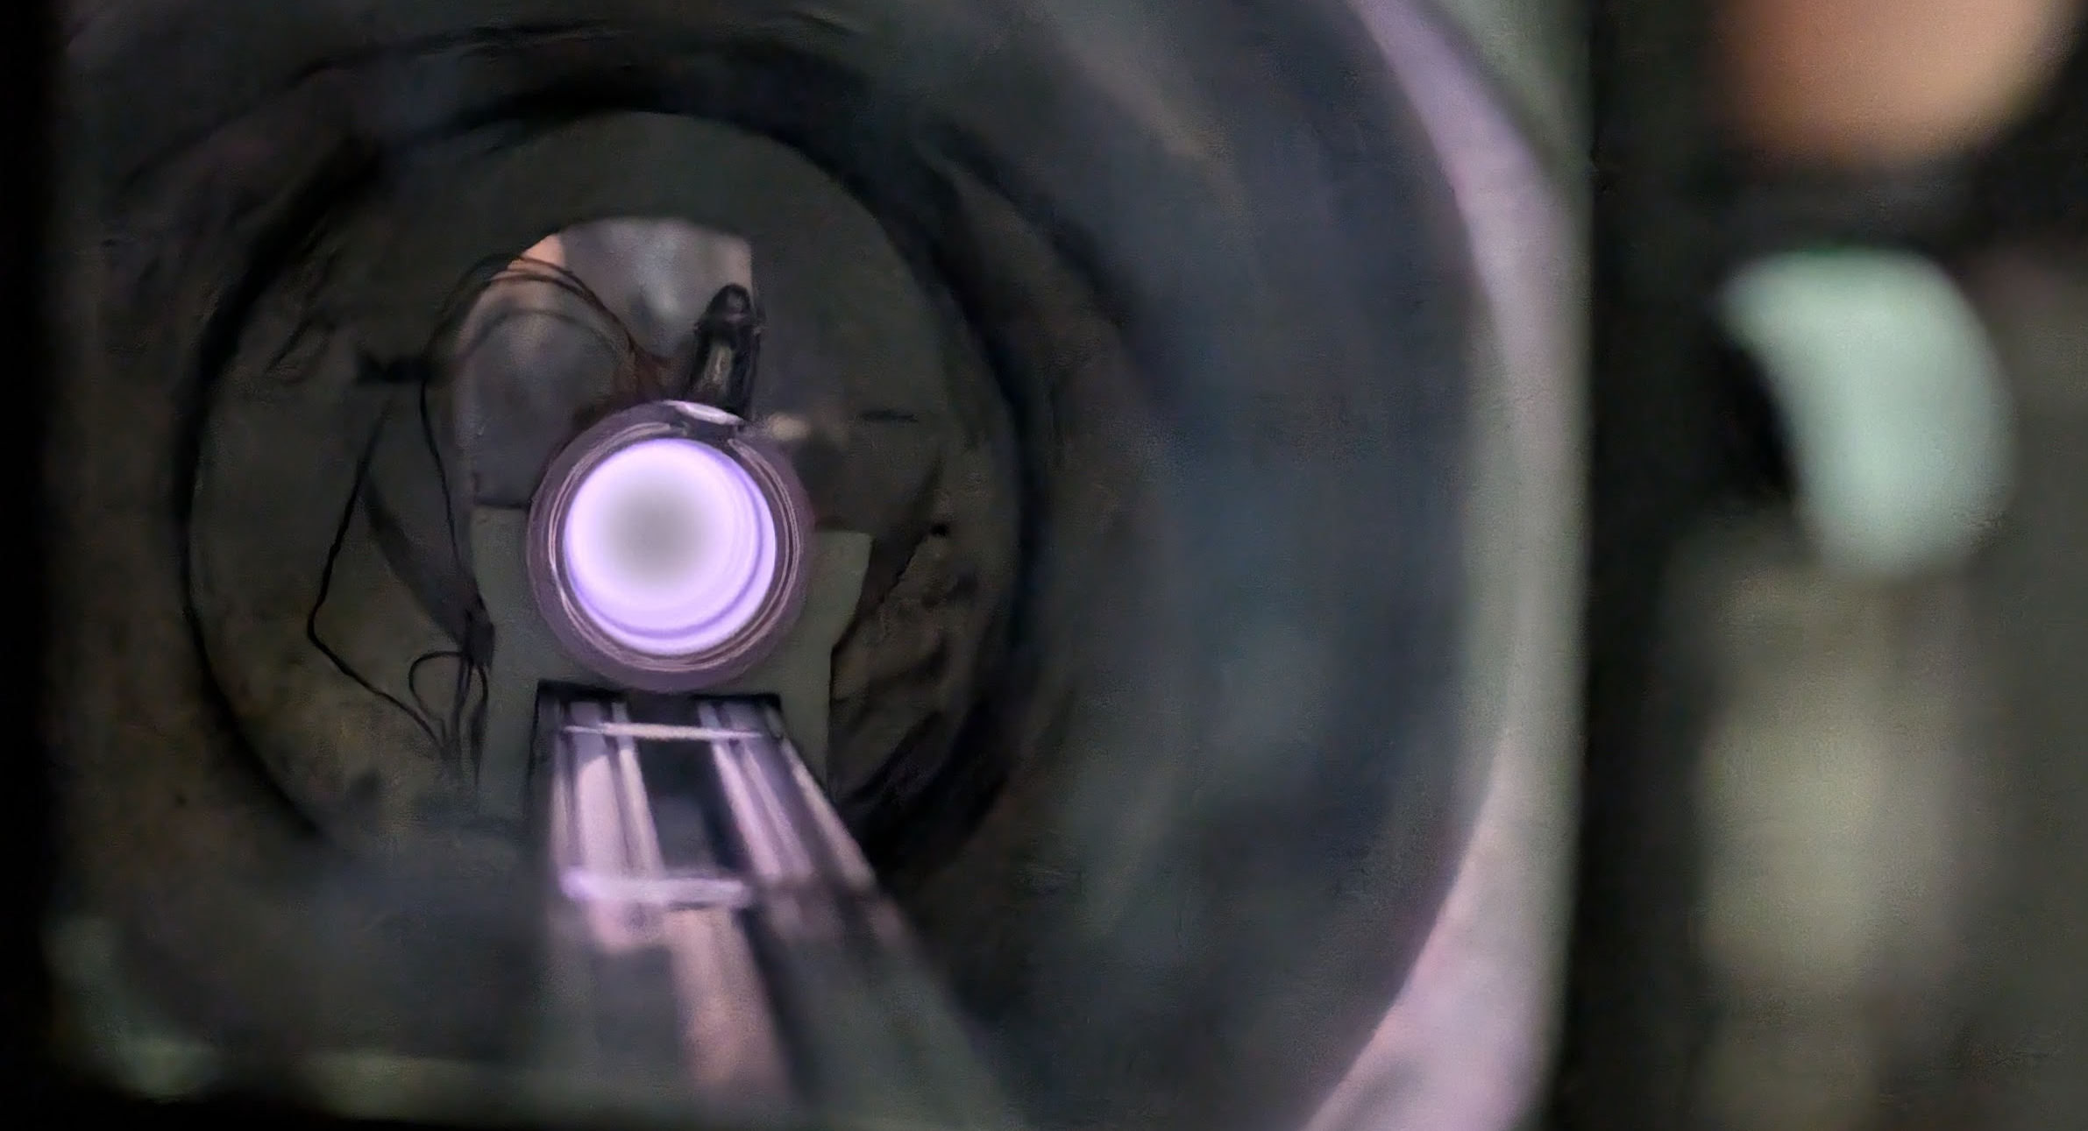
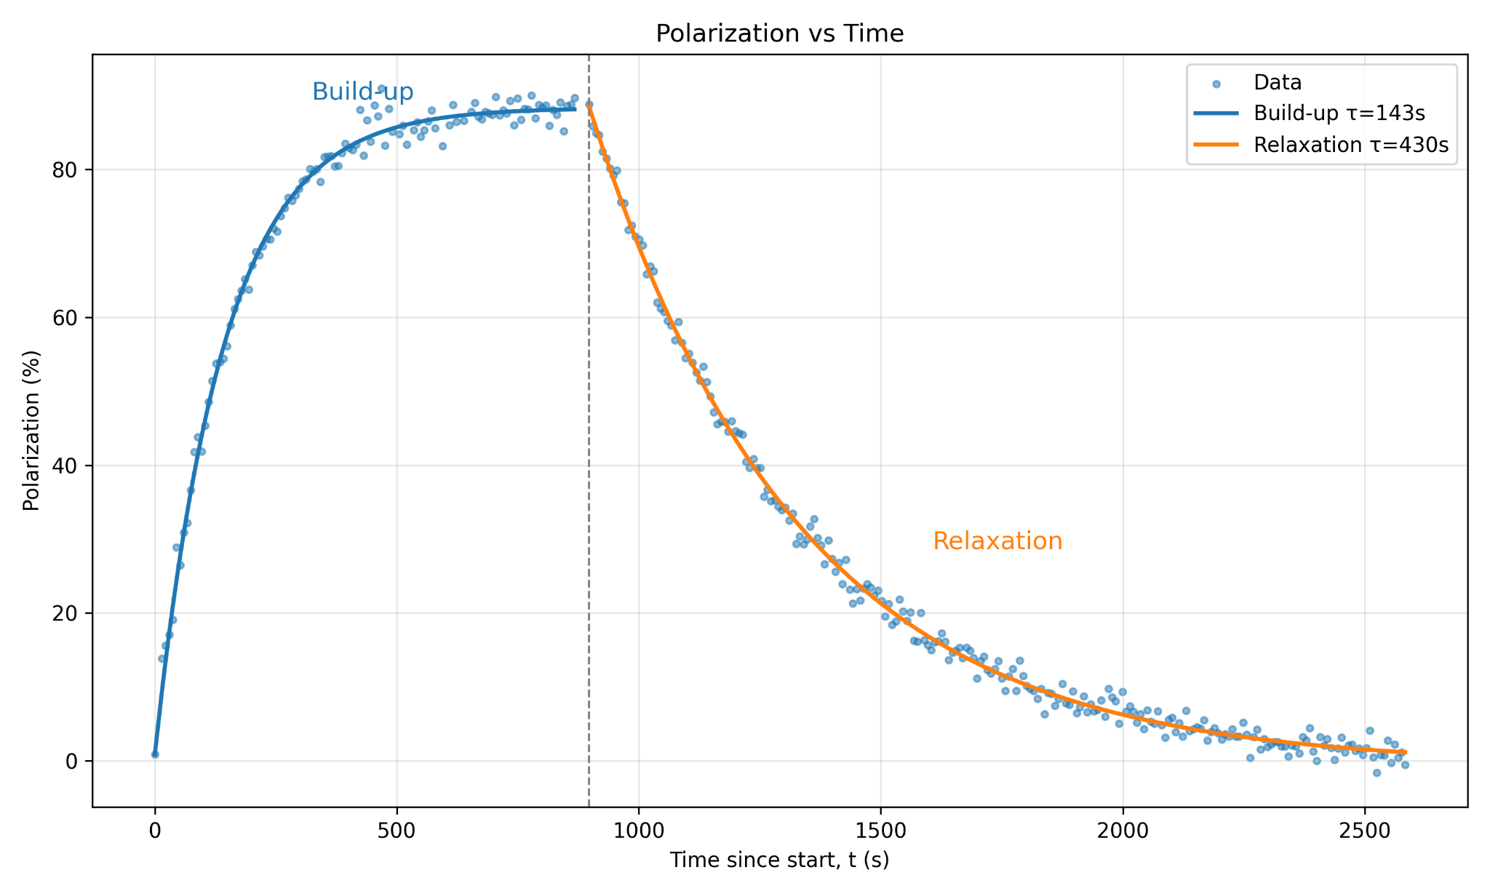


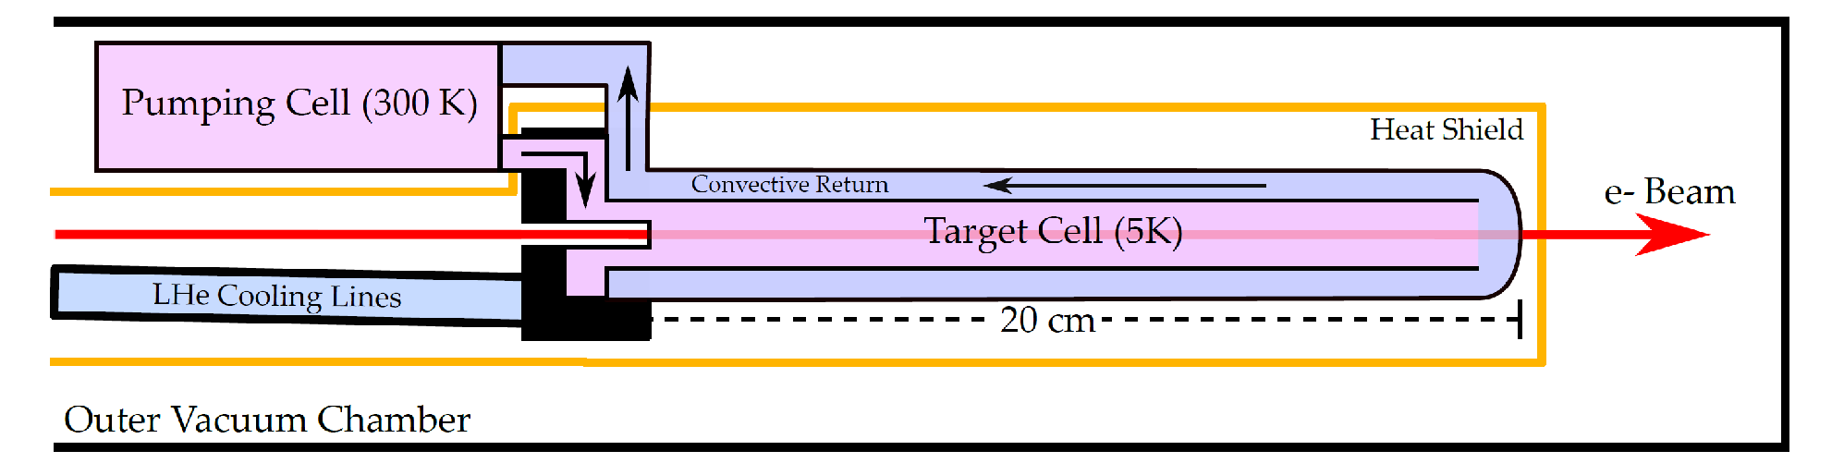

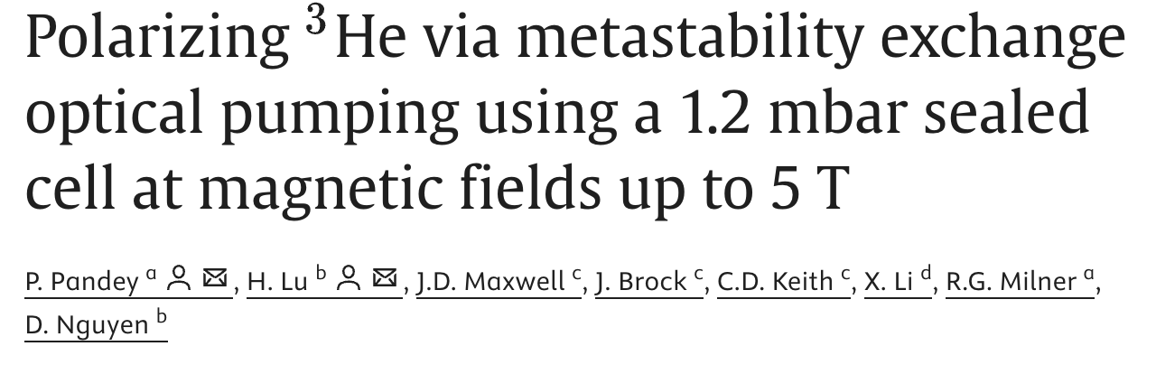

CLAS12 Polarized ³He Target
Targets Beyond 2027
C12-20-002
Spin-dependent electron scattering with polarized ³He target
Target Group
Nucl. Instrum. Methods Phys. Res. A, 1081(2026), 17870, 10.1016/j.nima.2025.170870.

Slide 14
The JLab Target Group
Thank you for your attention.
QUESTIONS?

Slide 15



CLAS12 Tritium Target
Targets Beyond 2027
E12-20-005
Precision measurements of A=3 nuclei in Hall B
C12-21-004
SIDIS measurements of A=3 nuclei
Photos of Hall A tritium targets and infrastructure, c. 2018
Courtesy of Dave Meekins

Slide 16



Hall D Frozen Spin Target
Targets Beyond 2027
E12-20-011: Measurement of the high-energy contribution to the Gerasimov-Drell-Hearn sum rule
E12-25-012: High precision measurement of phi-nucleon cross section using a tensor polarized deuteron target
Dynamic nuclear polarization inside the Hall D solenoid at 2.5 T and 0.3 K.
Frozen spin operation at >50 mK / 2.5 T is also possible.
A test system is under construction
At UT-Knoxville
Target Group

