Slide 1
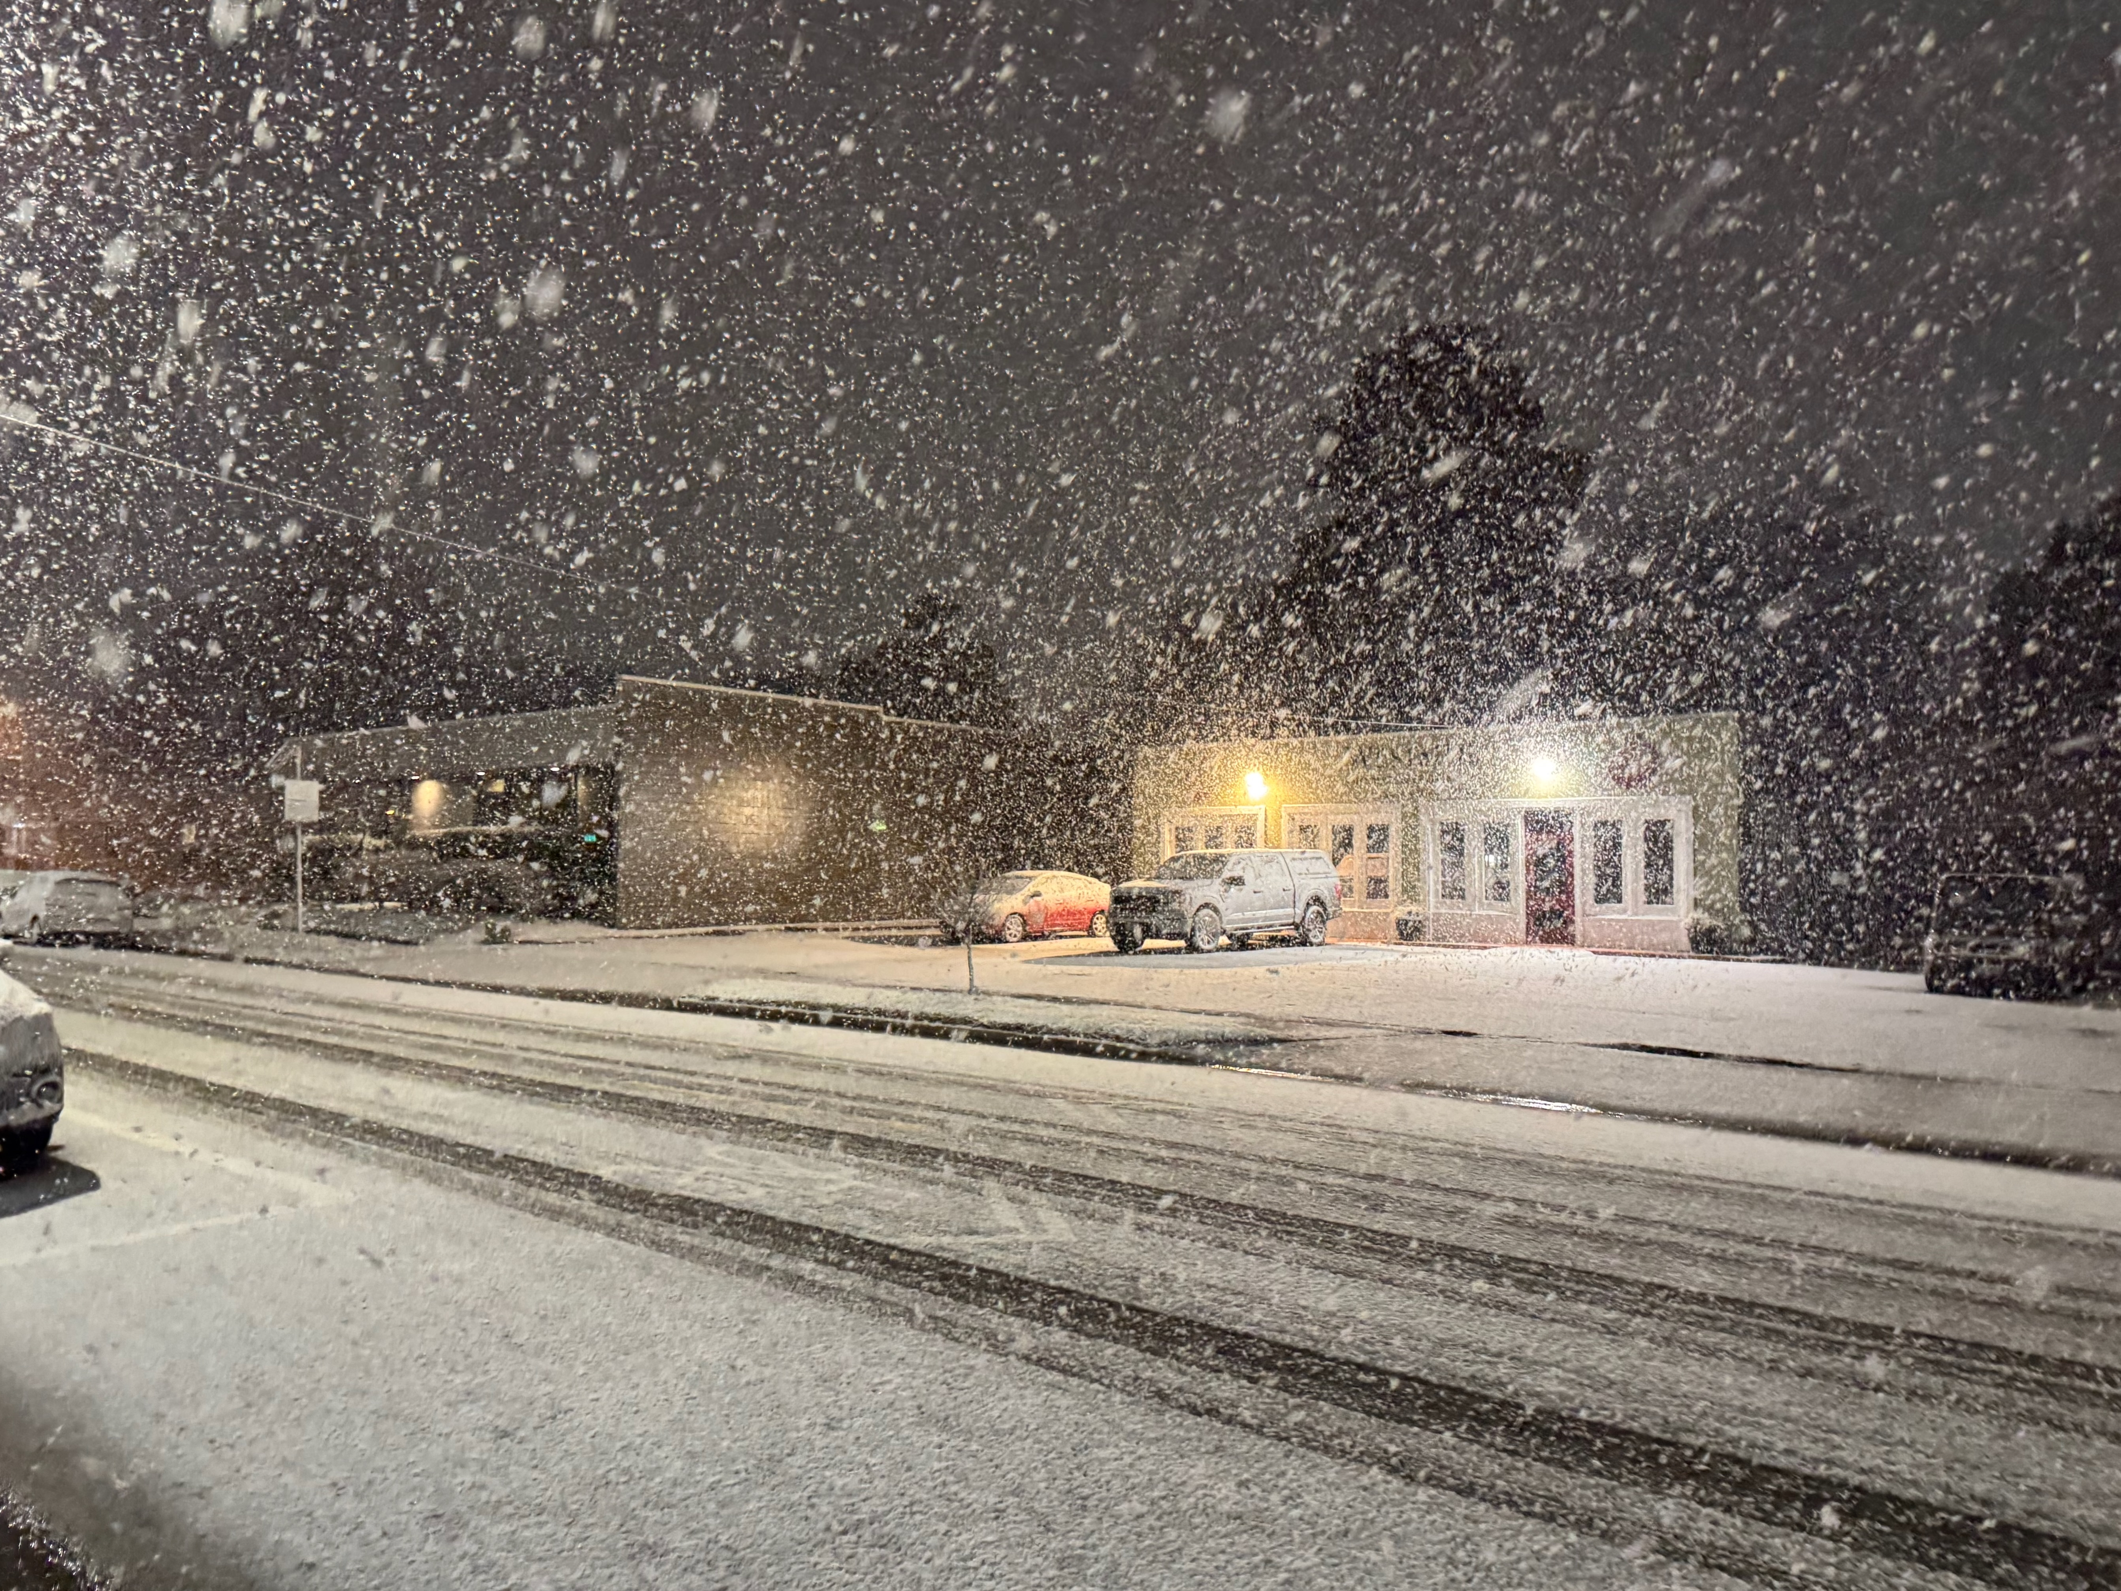

BONuS12 results for F2n/F2p Analysis Review UPDATE CC Meeting March 2026
Sebastian Kuhn
Old Dominion University, Norfolk (VA), USA

Slide 2
Overview
Quick reminder: BONuS12 experiment with CLAS12
Simulation
Preliminary Results from last Meeting
NEW investigations requested by Analysis Review Committee:
RTPC Efficiency
Backgrounds
Conclusions
Notes:
1a) Intrinsic interest: Newest predictions: pQCD, quasi/pseudoPDFS b) high and low Q2, HT, duality 2) a) JAM/CJ, Tevatron/LHC; NSAC 2015LRP, Marathon

Slide 3
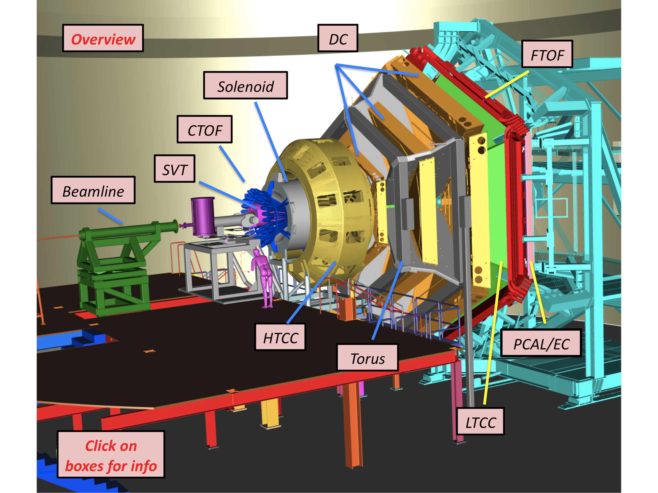
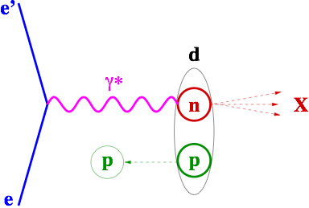
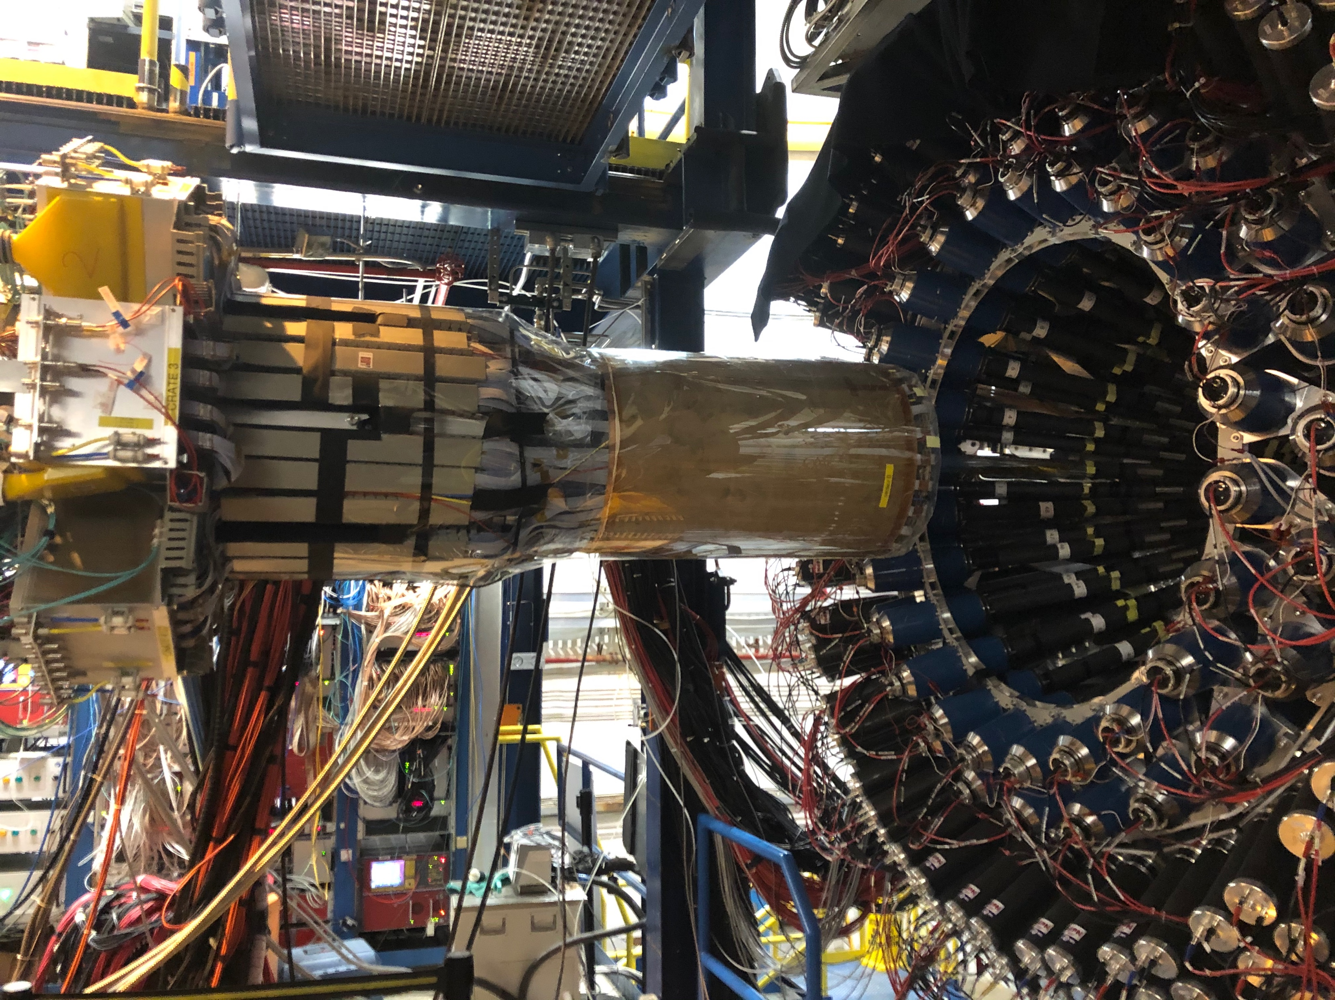
BONuS12 with CLAS12 (Run Group F in 2020)
F_{2n}/F_{2p} through spectator tagging
d(e,e’ps)X
RTPC
spectator
E_{n} = M_{D} – E_{s}
p_{n} = - p_{s}
M*²= E_{n}² – p_{n}²
E_{s}, p_{s}
W²=M² +2Mν – Q²
W*²=M*² +2E_{n}ν – 2p_{n}.q - Q²
Notes:
Explain that through spectator tagging we can a) select events on the neutron (no need to subtract p), b) select events with nearly on-shell neutrons (M* > 0.926 GeV – only 1.3% off mass shell) c) calculate the effect of the initial motion and off-shell-ness of the neutron and correct the electron kinematics to its rest frame.

Slide 4
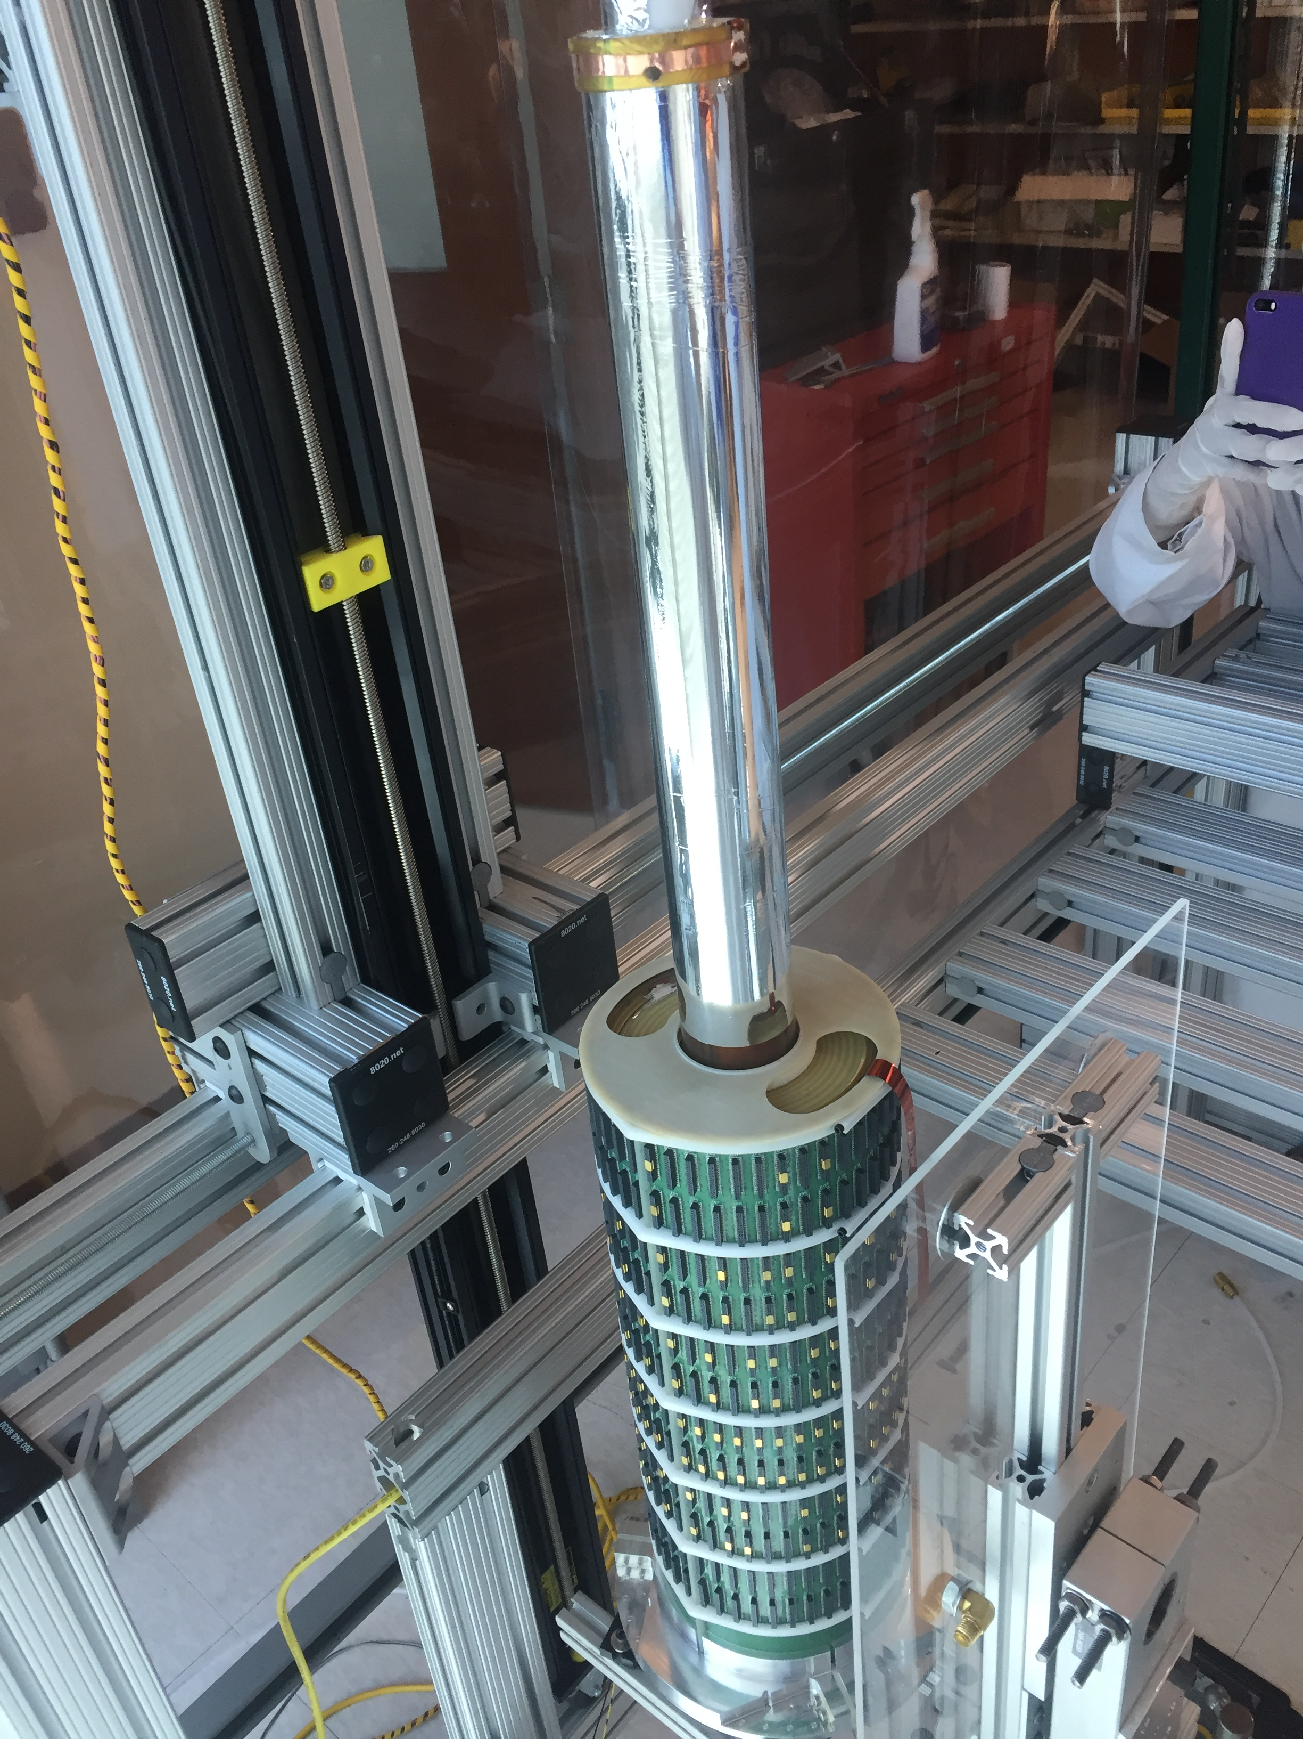
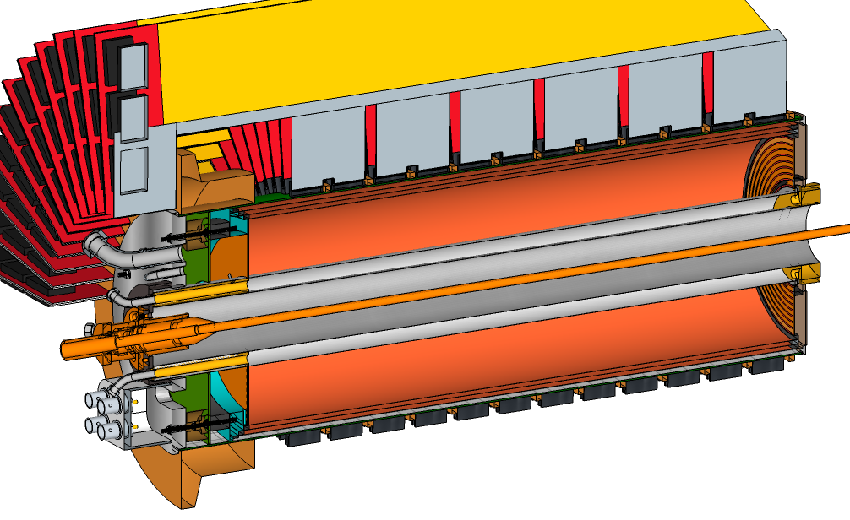
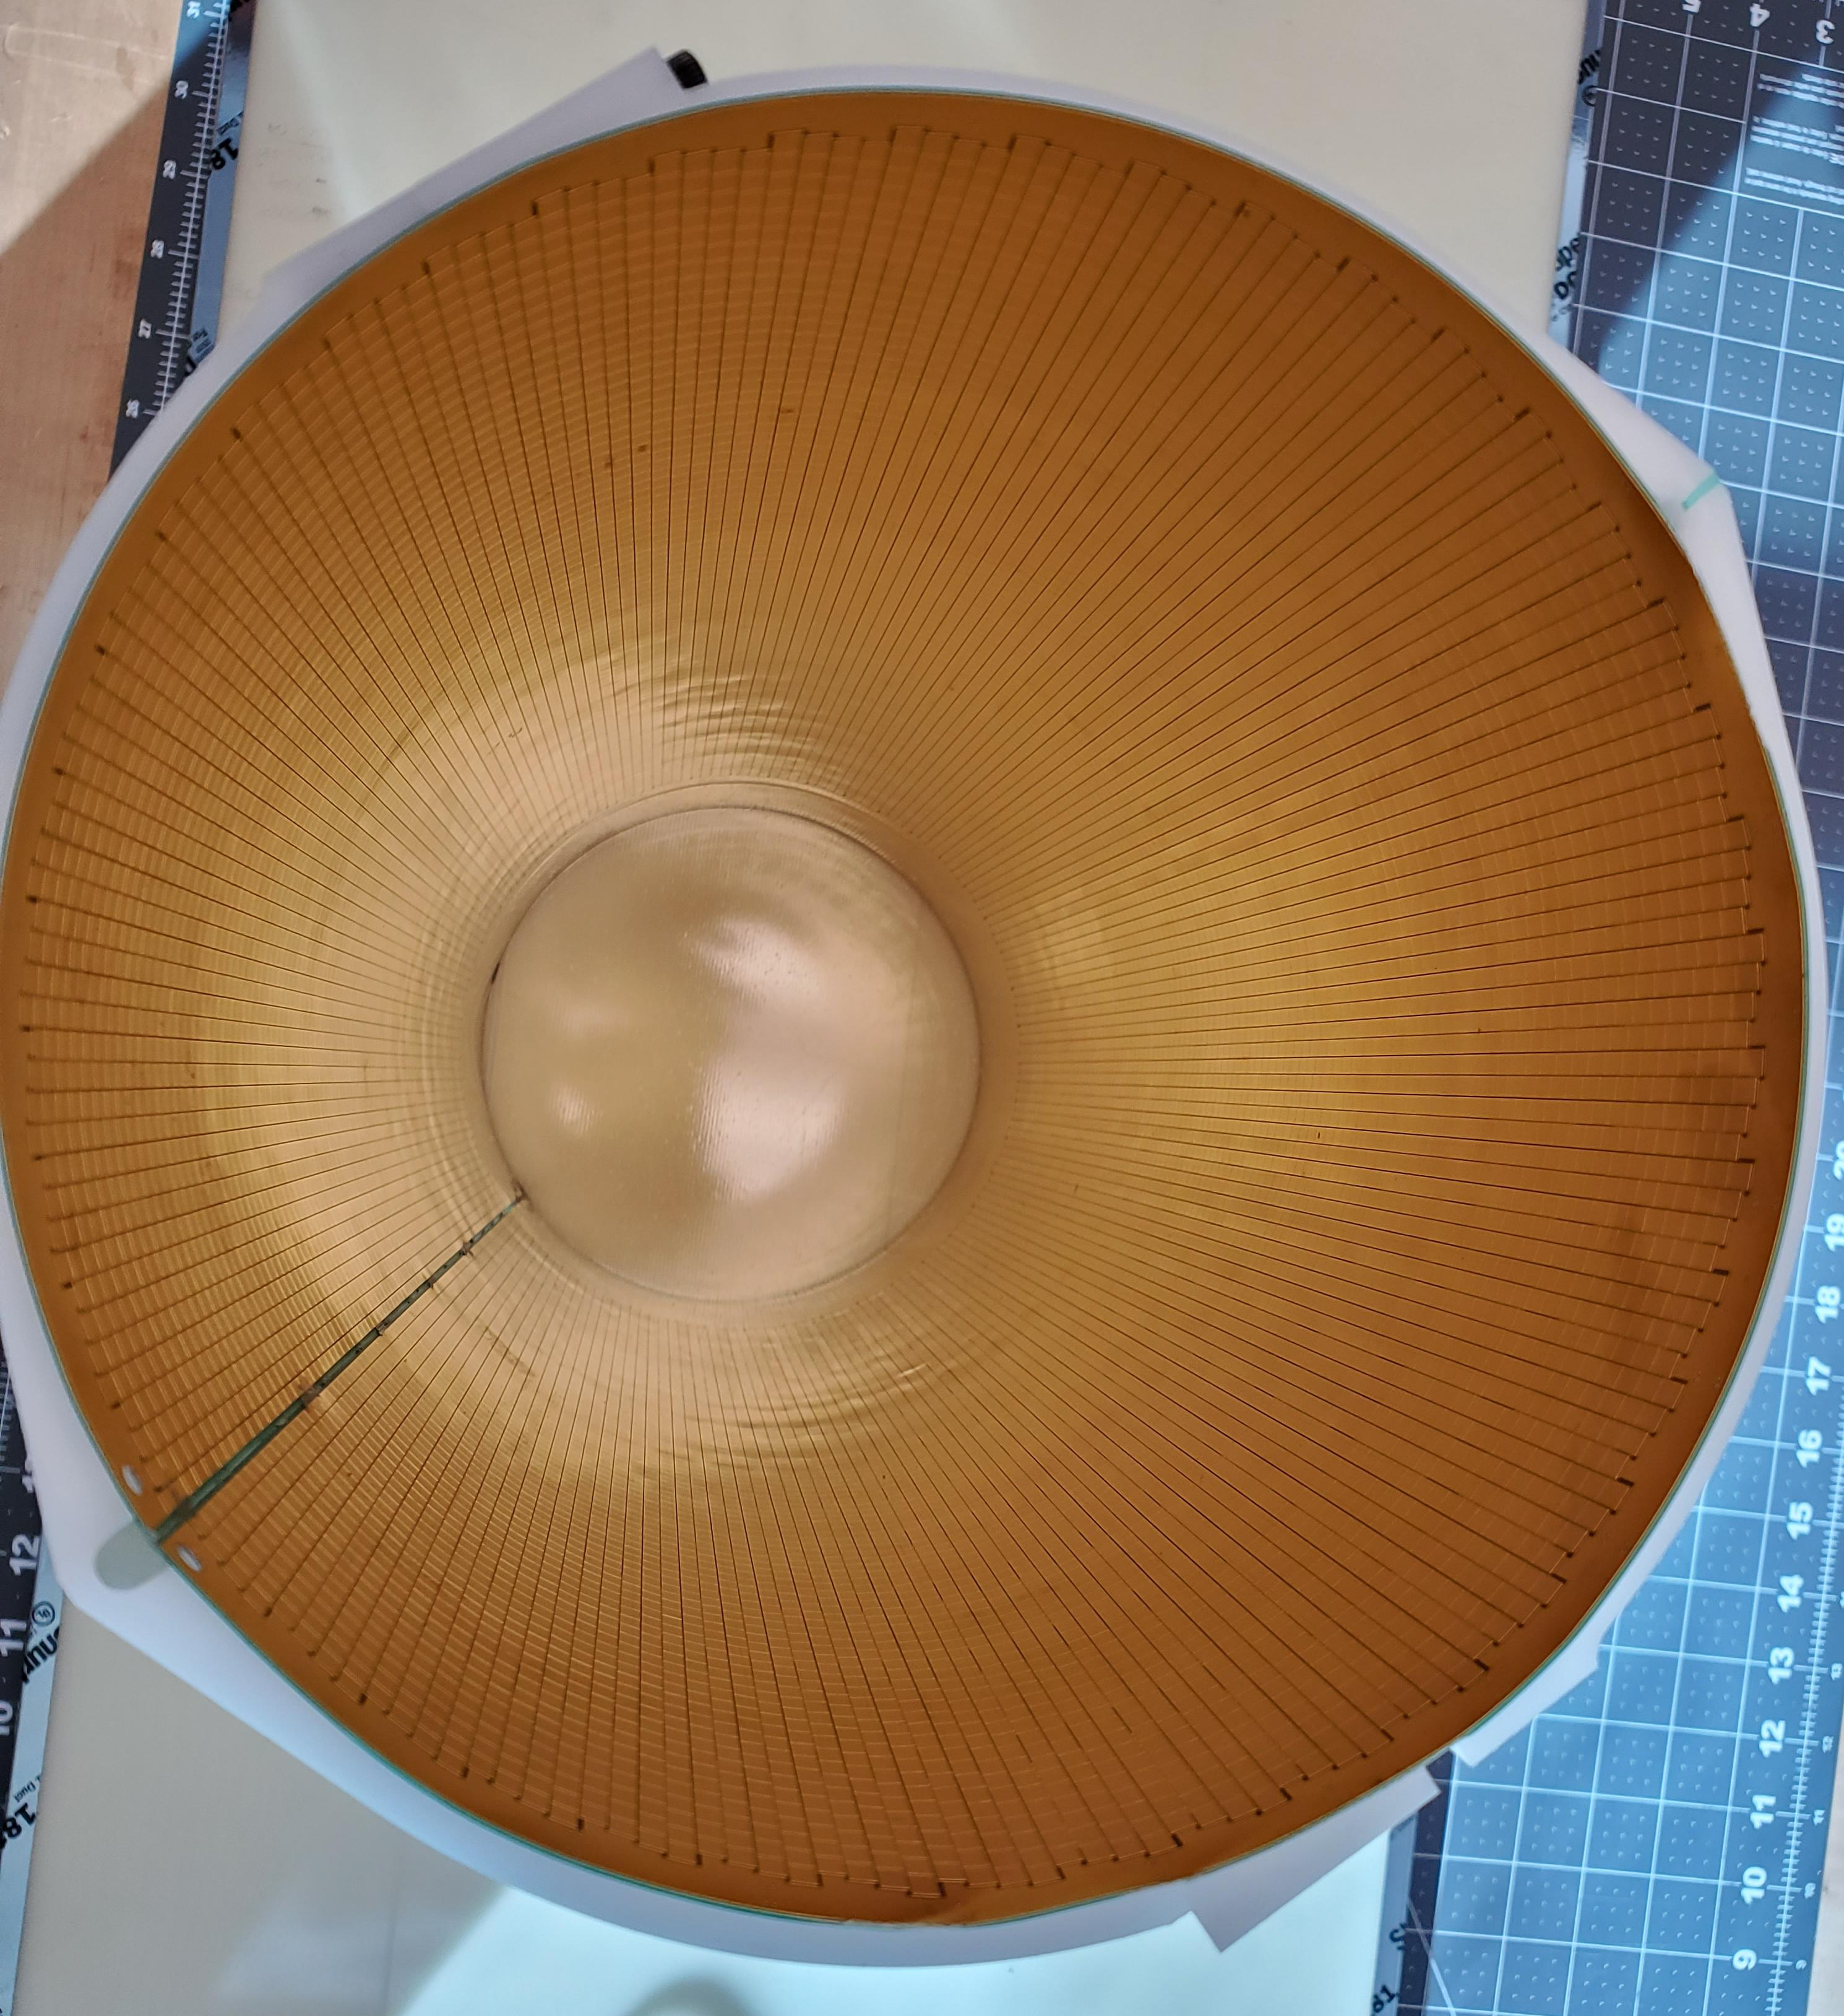
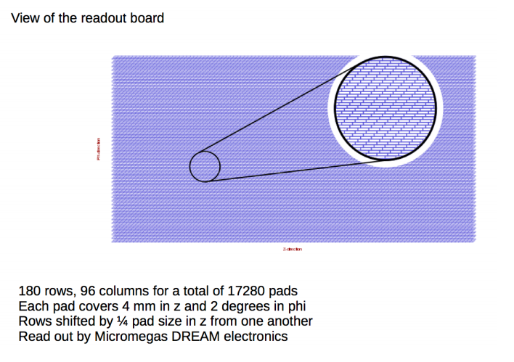
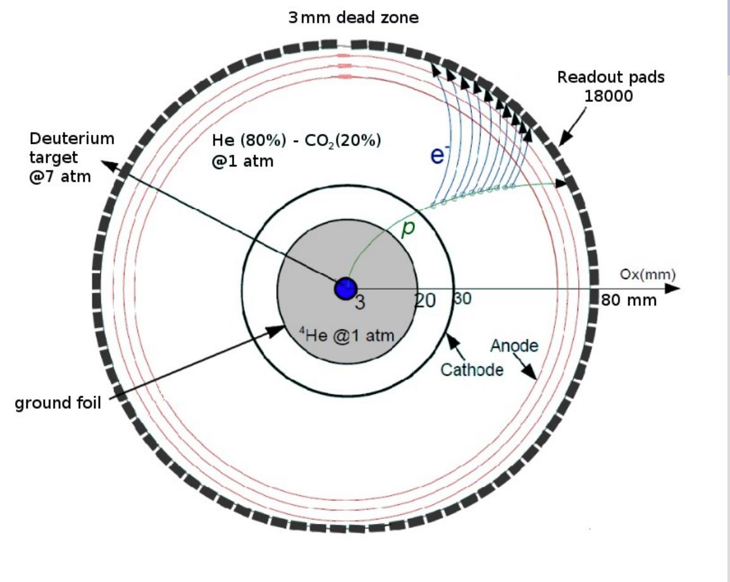
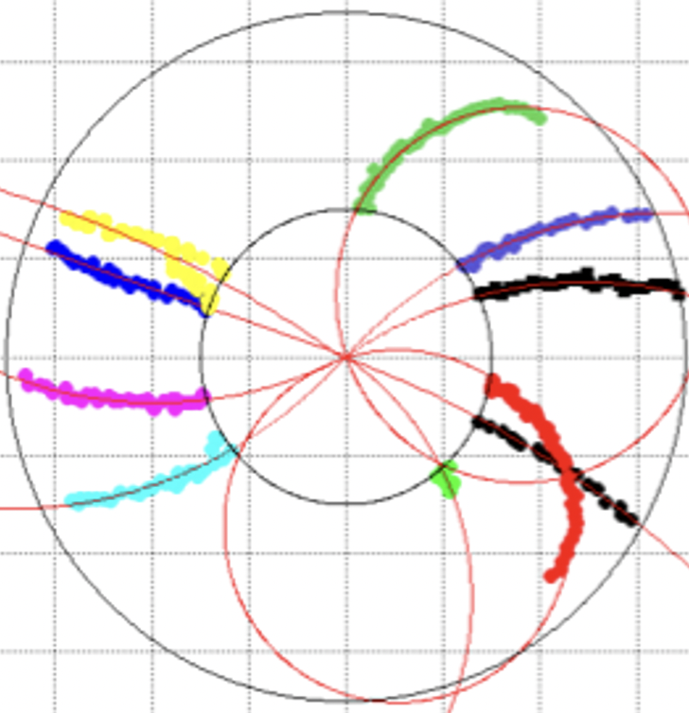
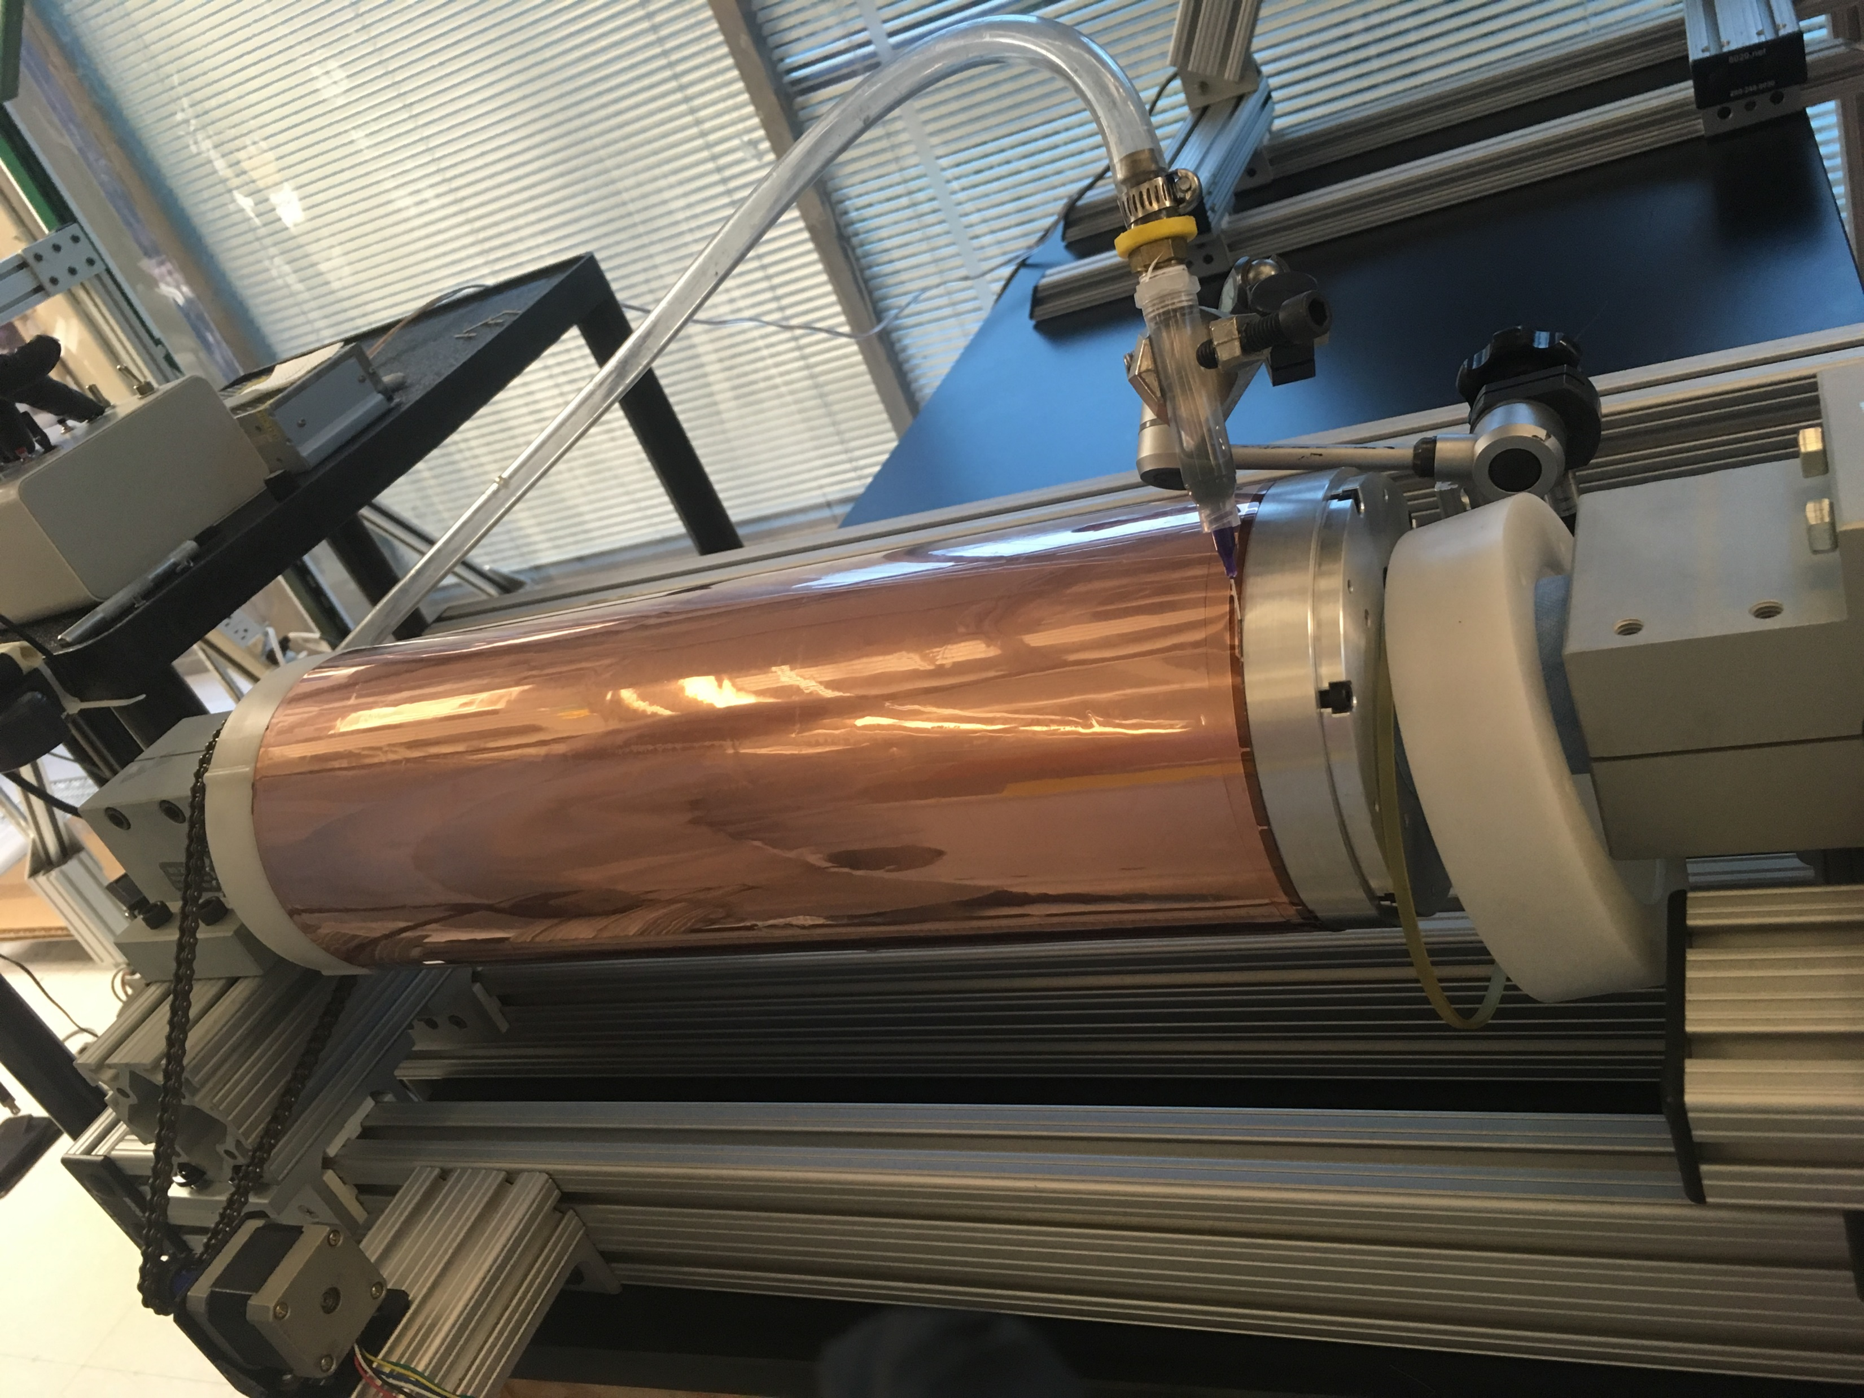
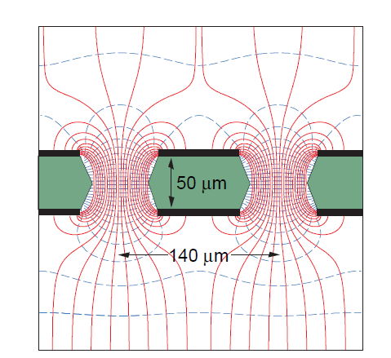
BONuS12 Radial Time Projection Chamber
e’ to CLAS12
Target 5.6 atm D₂
Beam
Spectator p
Installation of Cathode + ground foil assembly
Wrapped Padboard
inner surface
GEM foil wrapping and gluing
Readout Pads
GEM layer
Notes:
40 cm long. HeCO2 gas mixture. Reconstruct 3D track (pad pixel x time), dE/dx (Charge vs. time)

Slide 5
BONuS12 Data
RG-F July 31st - September 21st, 2020
200 nA 10.4 GeV e- on 50 cm 5.6 atm D₂
Collected 0.14 mC 2717 M events (also on H₂, ⁴He, and “empty” target)
Δz Vertex Electron - Proton
dE/dx [arb. units]
x*
Proton momentum
cos(θ_{pq})
W* [GeV]
VIP
Proton momentum
x*
Notes:
Explain VIP. Mention Part I not analyzed.

Slide 6
Data vs. MC : D(e,e’)X and D(e,e’p_{s})X
Full GEMC simulation of both tagged and inclusive spectra with detailed implementation of RTPC
Generator: PWIA spectator model with 2014 Bosted/Christy fit to world data for F_{2n} and F_{2d}, AV14 D wave function, relativistic motion of struck nucleon, and equivalent radiator method for internal rad. effects
Inclusive e⁻ kinematics
-- MC. Data
-- Exp. Data
Tagged nDIS kinematics

Slide 7
Data vs. MC: D(e,e’p_{s})X
Spectator
proton
kinematics

Slide 8
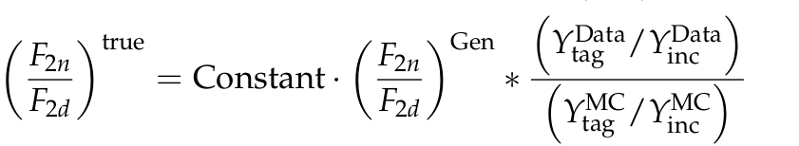

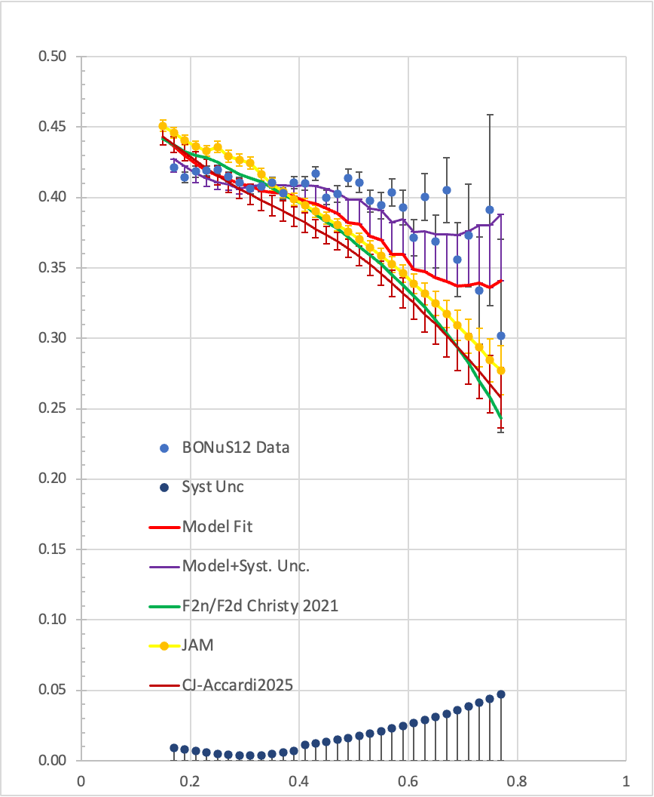
BONuS12 Near-Final Results
D. Biswas et al., arXive hep-ex 2409.15236
Notes:
.

Slide 9
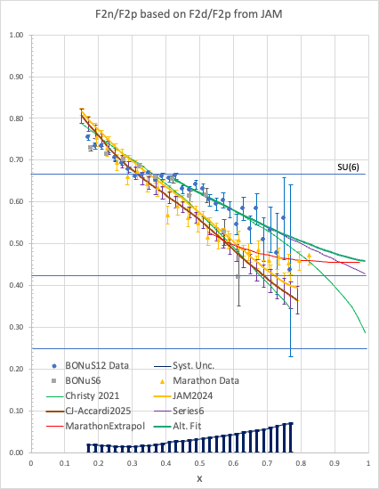
BONuS12 Near-Final Results
Notes:
Explanations – see analysis note. 6q-bags = 0.15%?

Slide 10
RPTC Efficiency
If you observe momentum distribution different from MC expectation it might have at least two possible explanations:
1) your model is wrong, 2) MC efficiency is wrong.
Considering huge variation of the ratio from P=70 MeV to P=240 MeV it looks like the first option dominates. Applying this “efficiency” to the data probably will give wrong cross section.
1.6) section 6.5.3 – phi_p distribution integrated over electron phi_e angle supposed to be flat. Not integrated (or cut by the CLAS acceptance) distribution must have general form: a+B*cos(phi)+C*cos(phi), where phi can be correlated to phi_p. How good is the constant phi_p approximation in
reconstructed distributions?
1.7) in all efficiency studies above the relative efficiency was obtained as a function of various variables. However, the absolute efficiency is never mentioned. When the MC efficiency heavily deviates from the data ones, like in momentum and phi distributions, it seems to be not possible to disentangle relative and absolute (overall) factors. How the absolute efficiency was obtained?
2.20) P94 The correction for efficiency is purely done in one dimensions, that means ignoring any correlation. Better observables could be used as well. For instance one should expect tracks with longer path in the detector to have better efficiency. This is clearly observed for low p, and theta angles far
from 90 degrees. I imagine some of the low efficiency areas can be linked to dead or low gain channels and such.
2.22) P108 Fig 6.40: It is not clear how much of the effect is actually efficiency. The phi behavior is rather strange and could be affected by resolution effects or backgrounds that are not even in the detector
Notes:
Show comparison MC/Data. Explain likely source. Show new plots. Demonstrate it doesn’t matter.
IMPORTANT NOTES: 1) momentum dependence for p is VERY different than for alpha (MUCH higher dE/dx) 2) Absolute efficiency (overall factor) is irrelevant 3) we show that systematics due to efficiency corrections are small

Slide 11
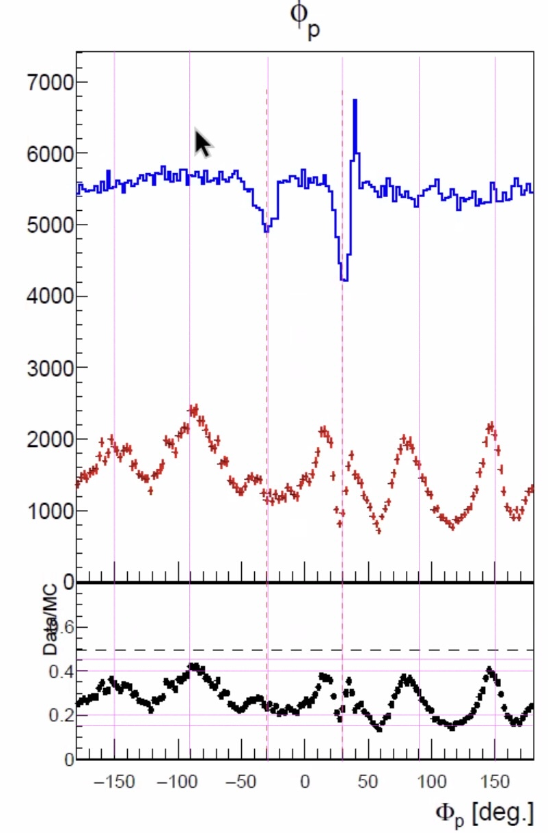
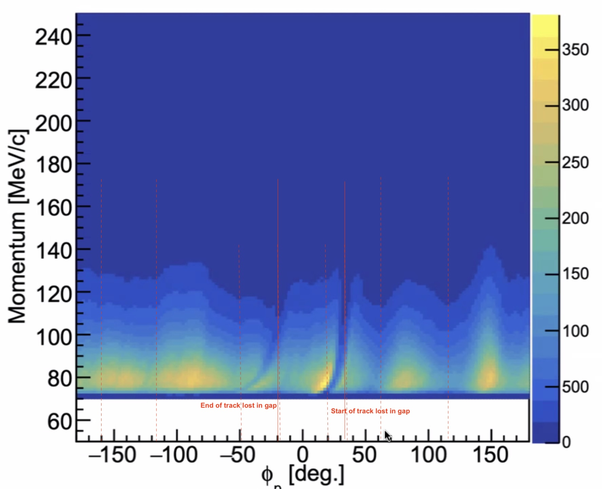
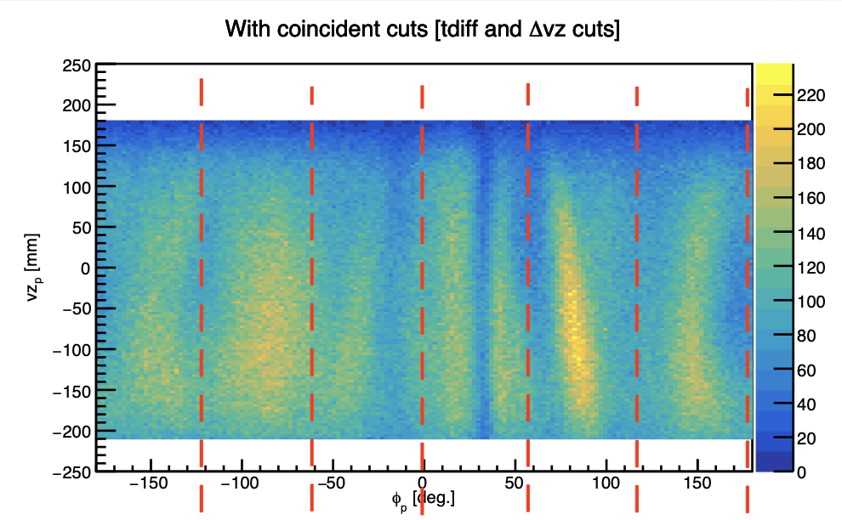
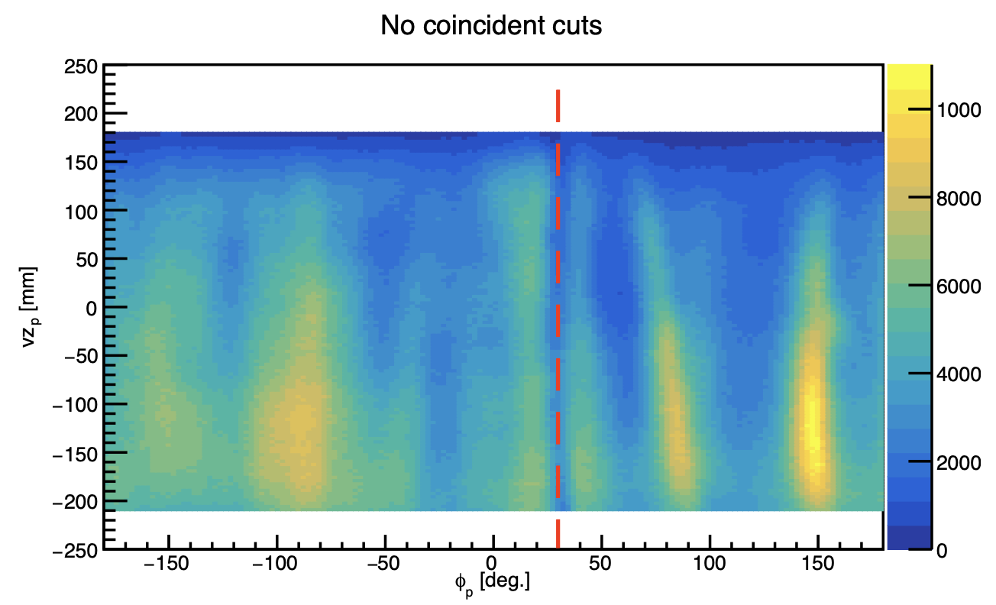
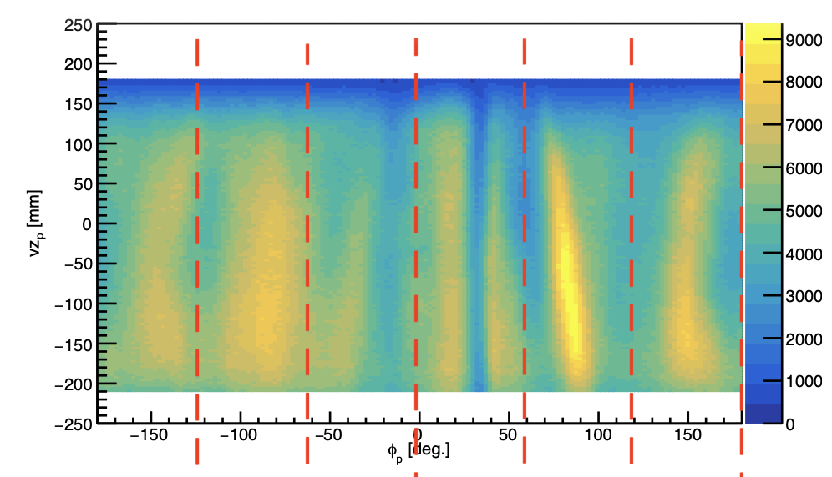
Causes of Inefficiency of RTPC
Dead regions: tracks start or end in a phi-region that is projected on the seam in GEMs/Padout by e- drift
Signal size at hairy edge for higher p_{p}
Inefficient GEM regions, pads, readout electronics… => Should NOT affect φ_{recon}
INDEPENDENT of scattered e⁻ => Distortions of field and foil geometry could affect reconstruction reliability and efficiency
Notes:
Bottom plot: (mostly) accidental protons reconstructed for D2 runs, first AFTER 12600, then BEFORE, then with tight coincidence cuts. Even seen for alphas!

Slide 12
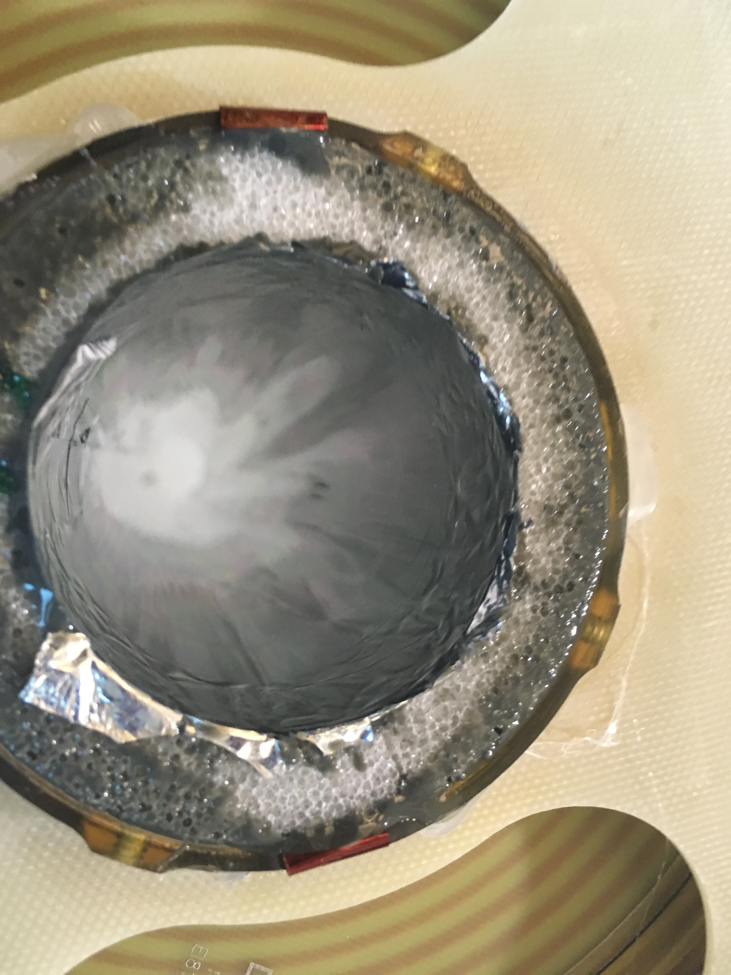
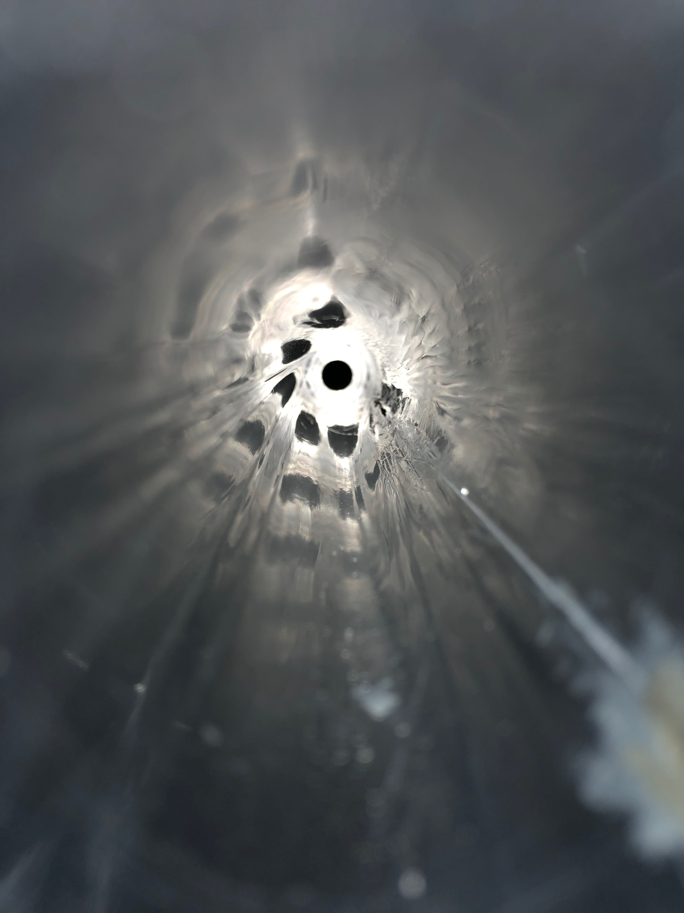
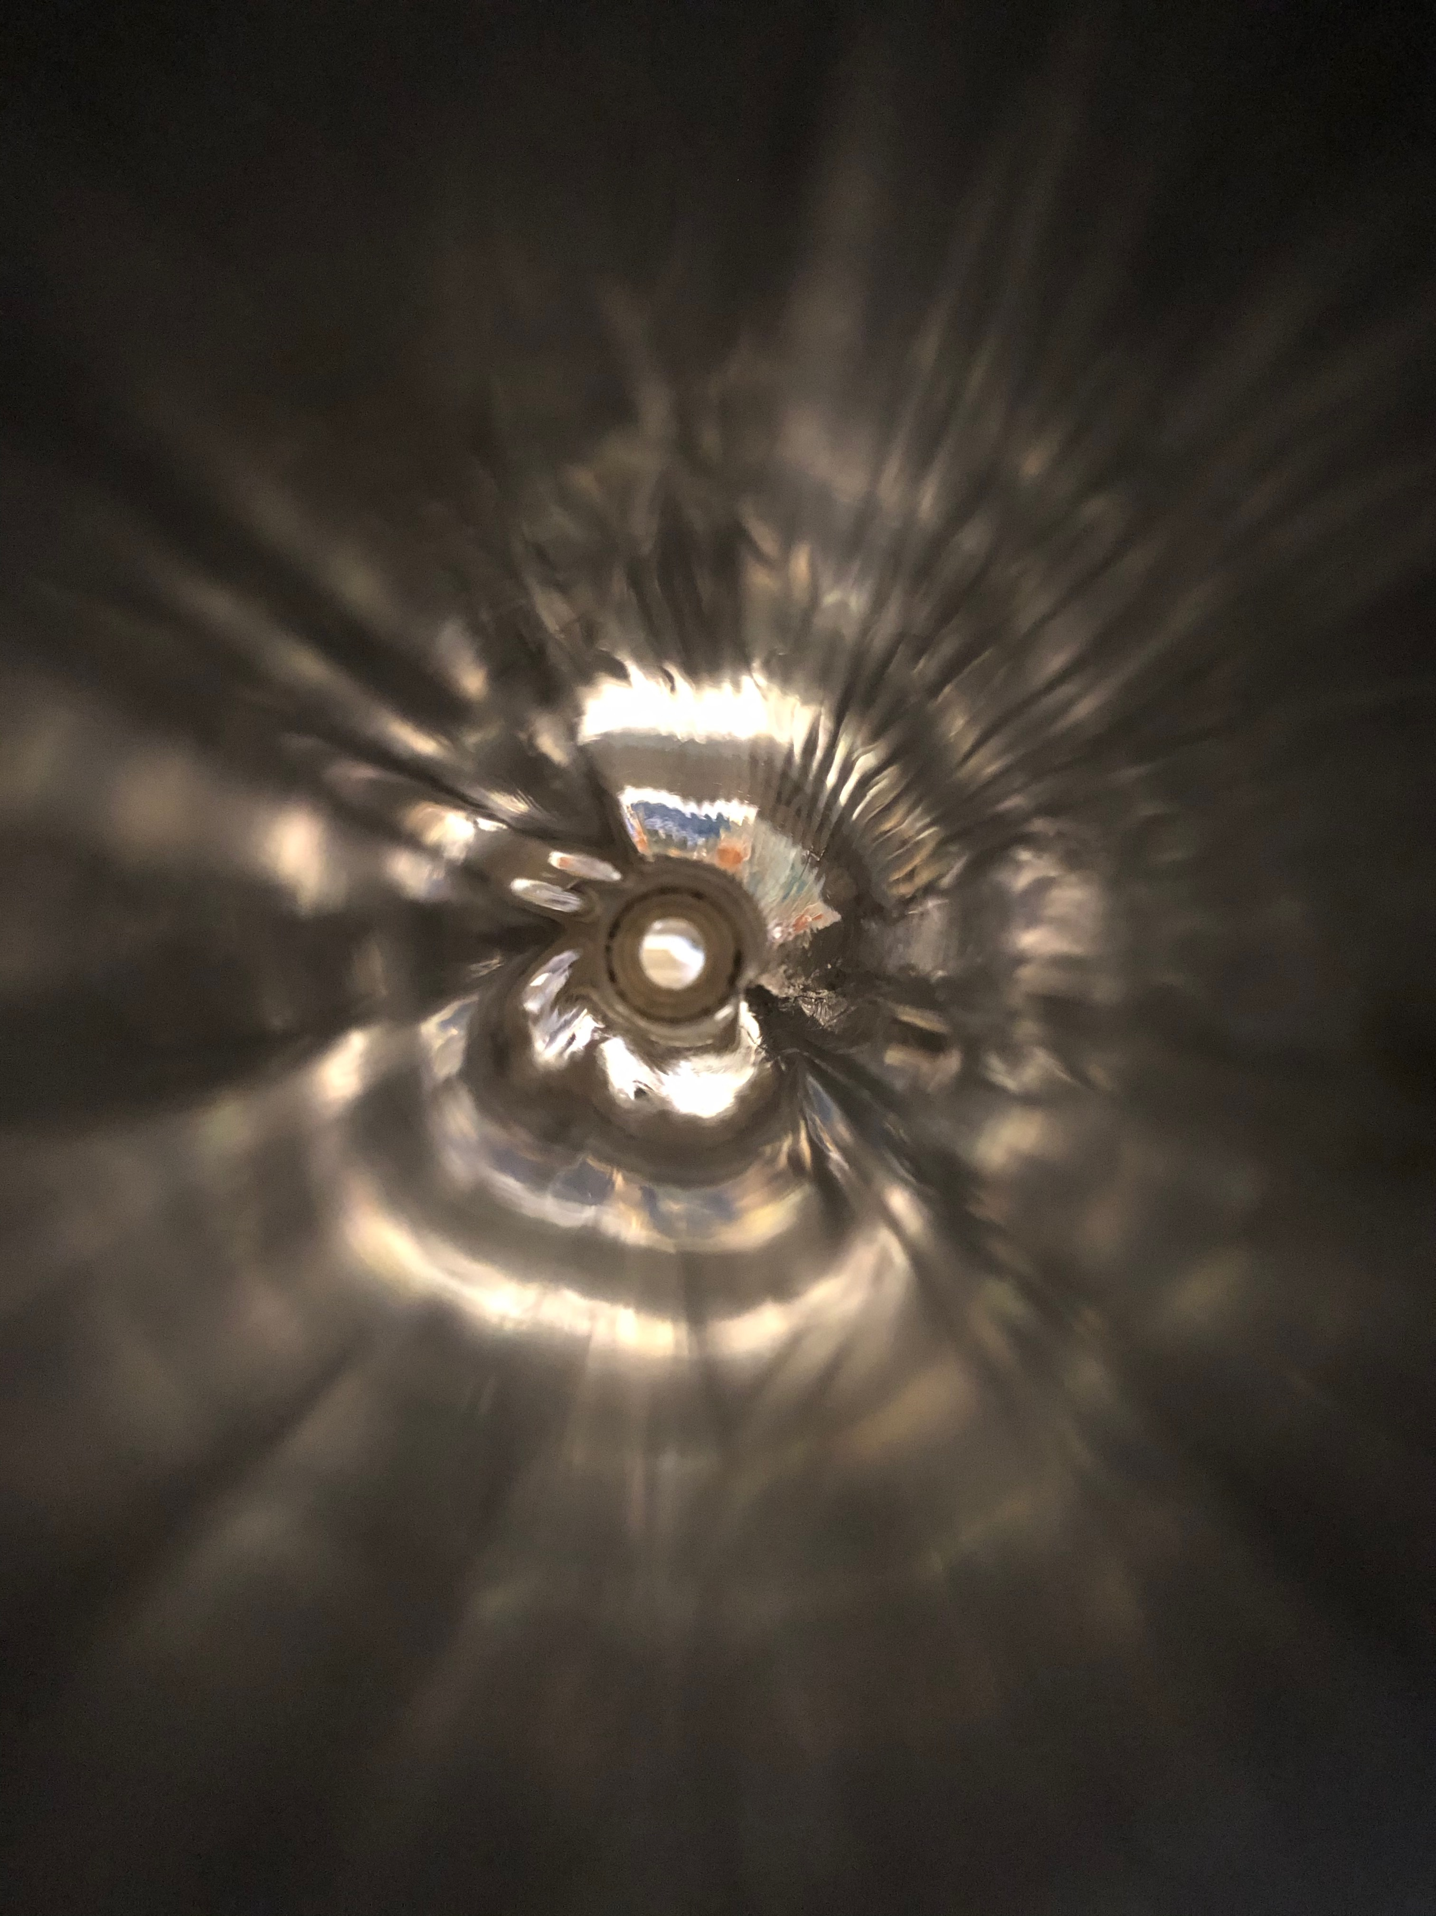
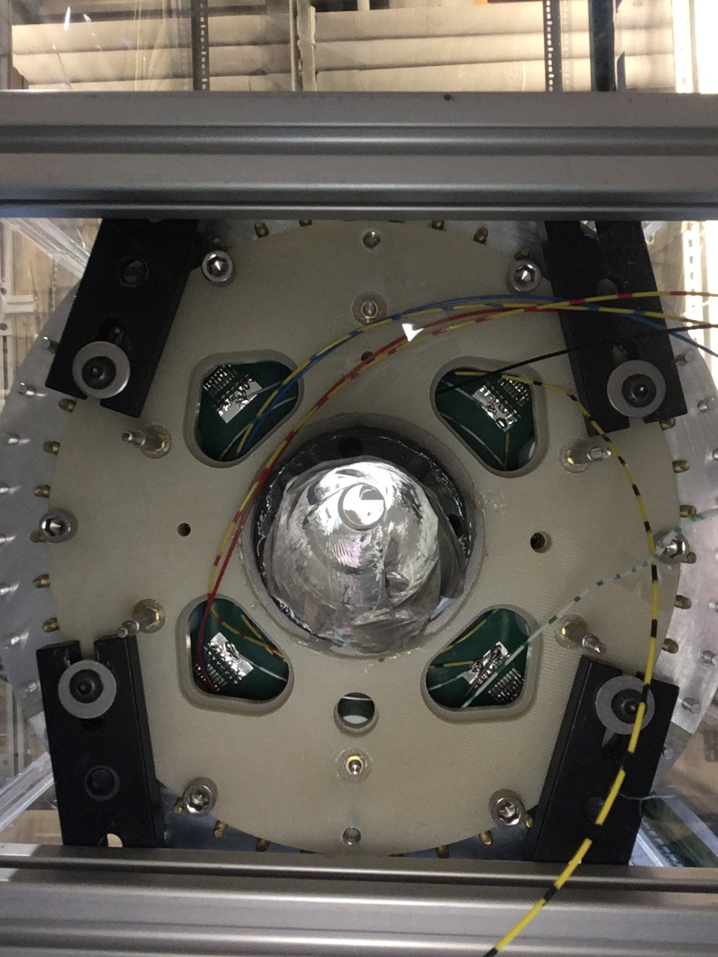
Causes of Inefficiency of RTPC
Dead regions: tracks start or end in a phi-region that is projected on the seam in GEMs/Padout by e- drift
Signal size at hairy edge for higher p_{p}
Inefficient GEM regions, pads, readout electronics… => Should NOT affect φ_{recon}
INDEPENDENT of scattered e⁻ => Distortions of field and foil geometry could affect reconstruction reliability and efficiency
Potential cause: Wrinkles!
Notes:
Bottom plot: (mostly) accidental protons reconstructed for D2 runs, first AFTER 12600, then BEFORE, then with tight coincidence cuts. Even seen for alphas!

Slide 13
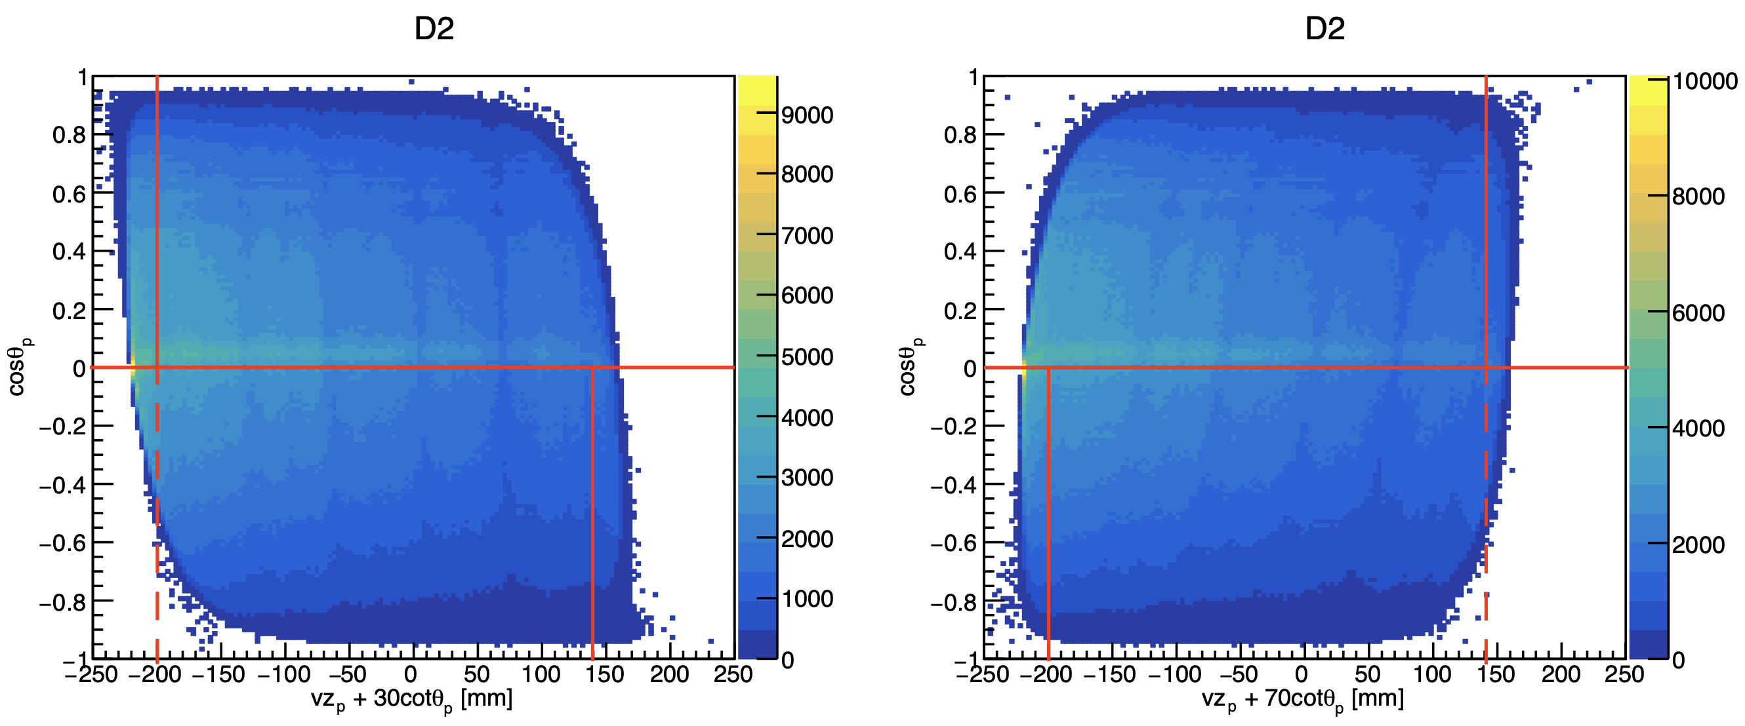
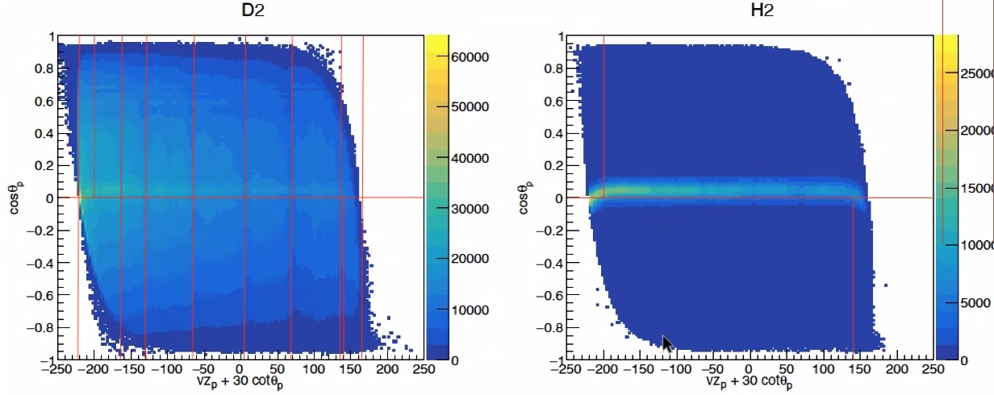
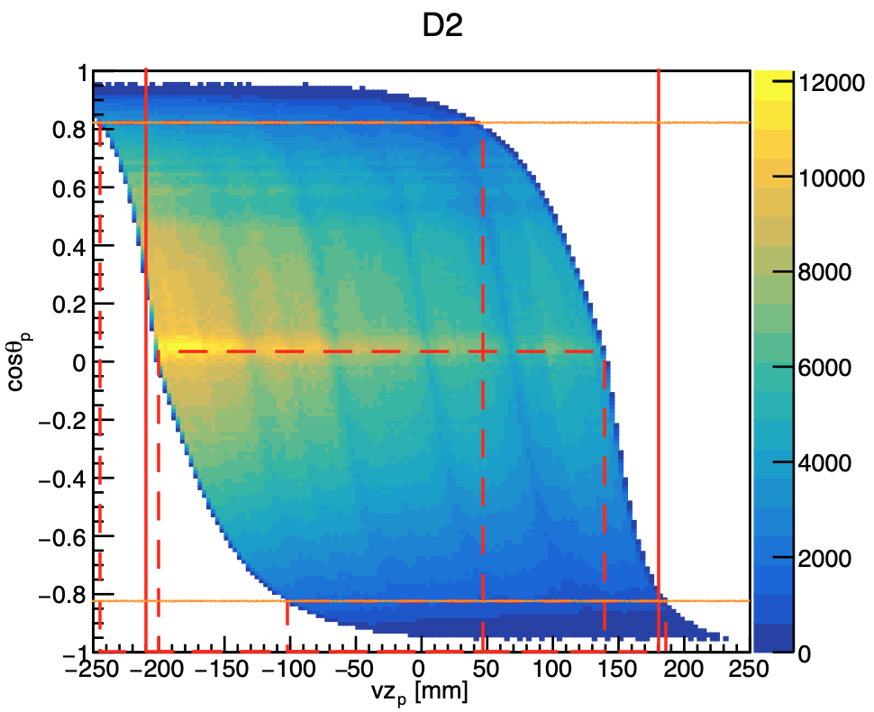
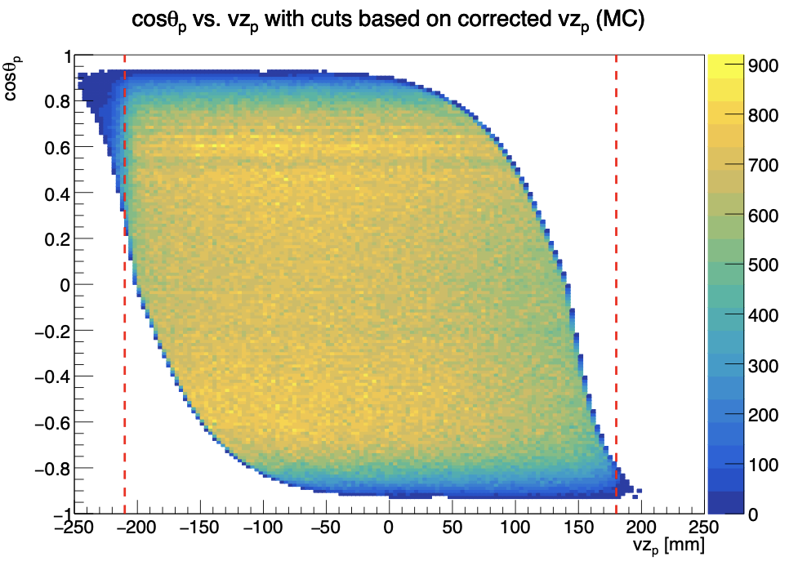
Also: Need Additional Cuts
<= DATA
MC =>
Notes:
Point out distortion, effect of forward / backward going protons outside fiducial geometry

Slide 14
Solution
Apply efficiency correction in 2D “phi_corrected” vs. “z_corrected”
Final analysis underway – stay tuned…

Slide 15
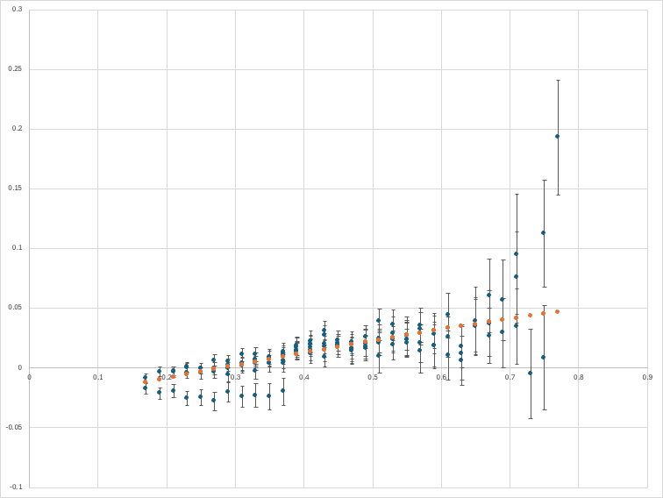
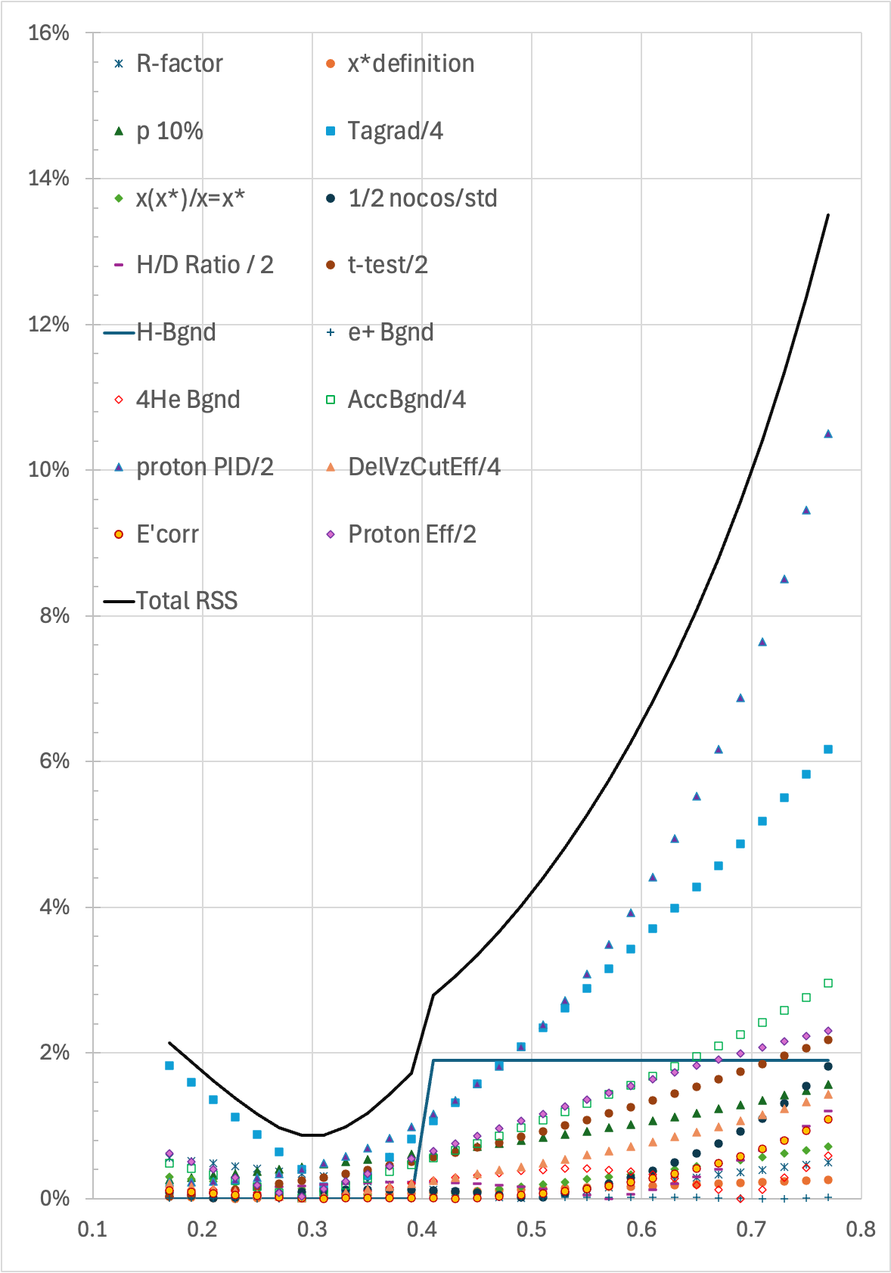
Outlook
… however, results are expected to be quite insensitive to this efficiency correction

Slide 16
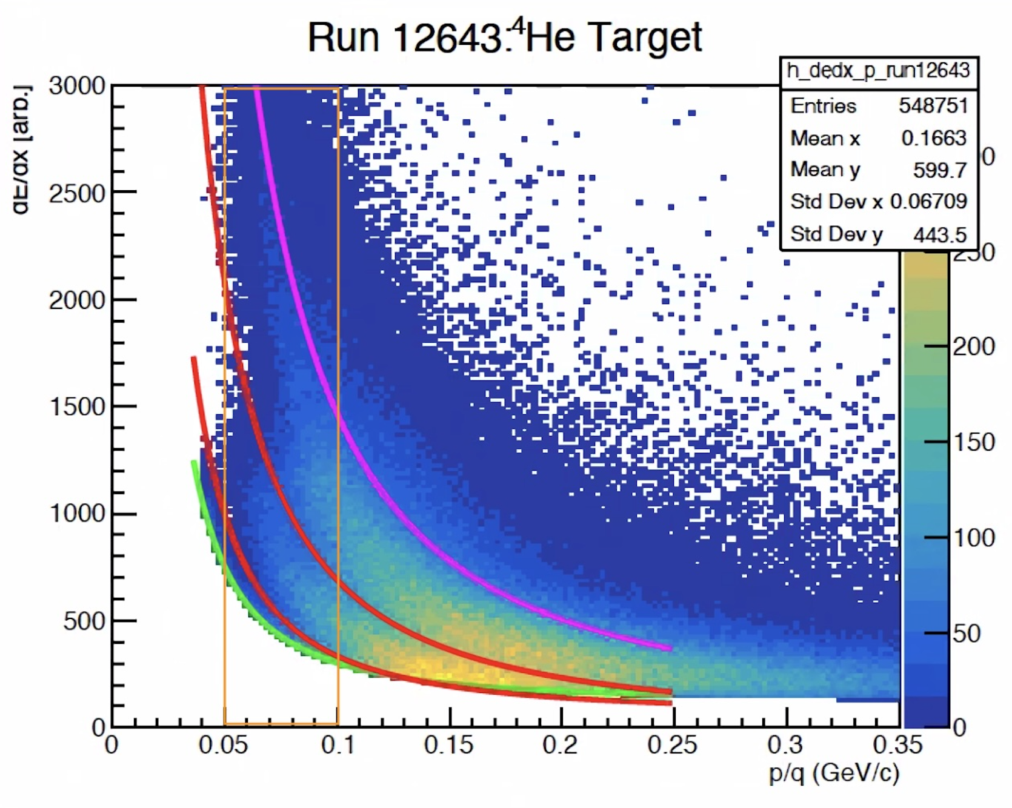
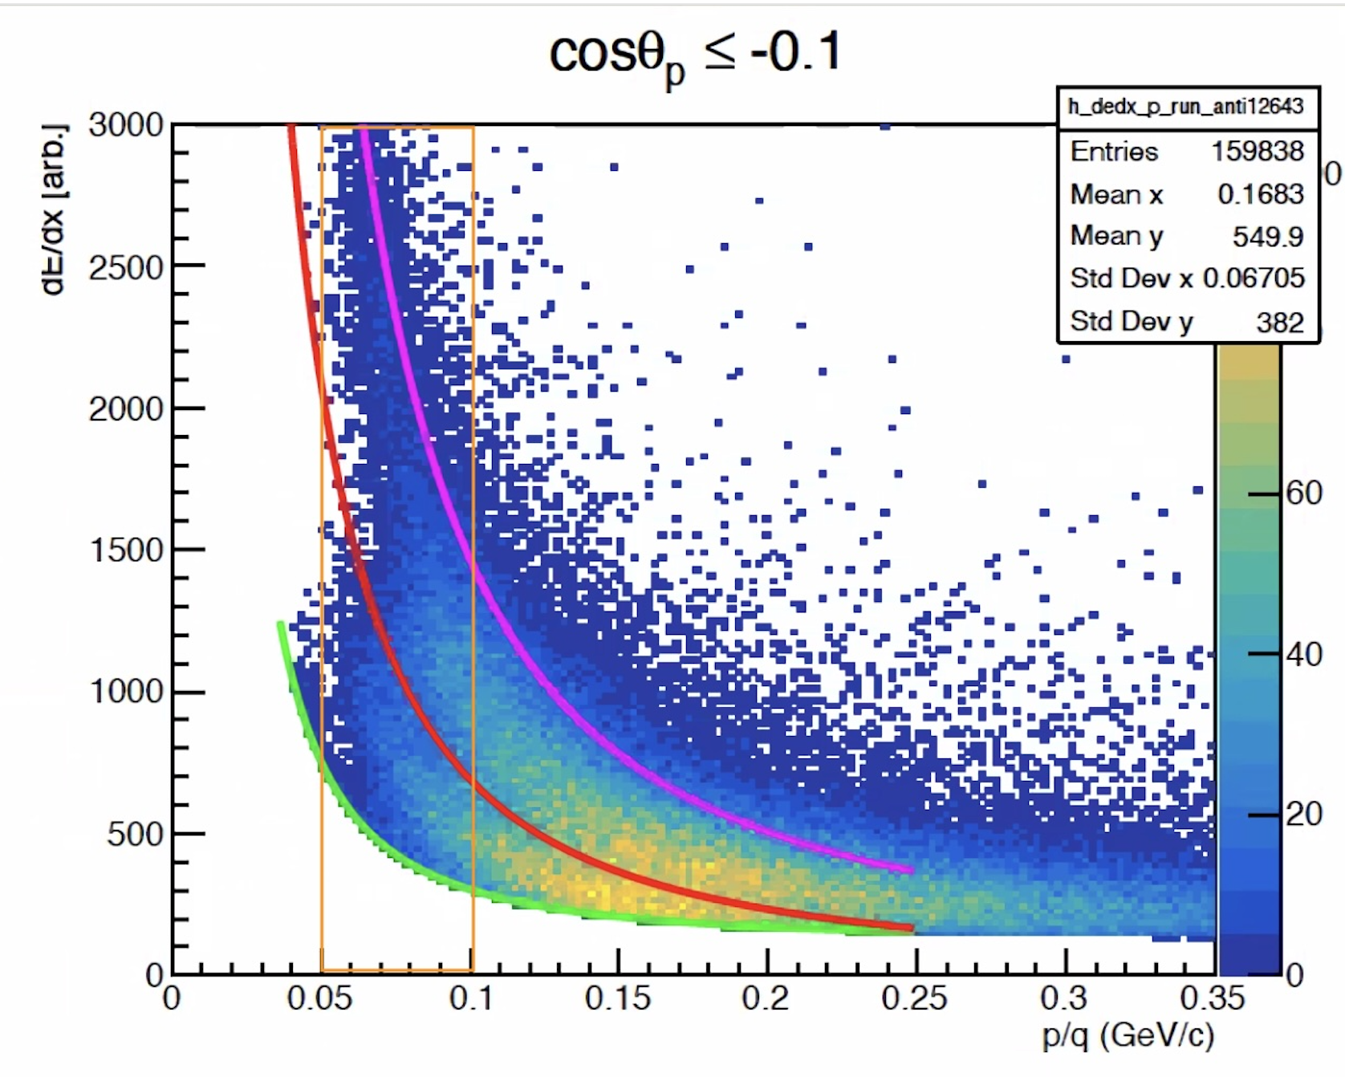
Backgrounds
1.2) section 5.1.2 “Non Deuteron Target Contamination” – not clear why H3/He3 recoils not expected to be produced also from the target walls as suggest the empty target data (radial and maybe axial)? These can be either produced directly by e- or by the generated ions.
1.8) 7.4.2.3 “Helium Contamination Correction” – the contamination of He4 is 7% for tagged an13.5% for inclusive data according to Fig.5.6 (and it is flat in x/x*). Assuming that MC has no He4 contamination, the correction on the super ratio supposed to be Tag/Inc~(1-0.07)/(1-0.135)=1.075.Instead, in this section you state: “analysis has been repeated without this correction, which led to a systematic effect of up to 0.6%.” How is it possible?
2.16) P70 All the discussion on the extra background is rather problematic in my opinion, I countnumber of issues. We would need to see a run number dependency to see if it is correlated with helium contamination.
POTENTIAL SOURCES OF BACKGROUND:
⁴He contamination in all targets (semi-permeable straw wall)
Other gases (AIR!) from backflow while purging
POTENTIALLY: Beam (halo) interacting with target straw walls
NEW: D2 contamination in H2 and ”empty targets” (really 1 atmosphere)
Notes:
Explain possible sources and so-far included sources. Explain “MT”. . New dE/dx. Look at distribution along z. Discuss numbers.

Slide 17
z-dependence of observed backward tracks
Combinatorial Background (random RTPC tracks for each trigger)
Coincident signal, normalized to inclusive rate
NOTES:
Mostly ”flat” vz-dependence (unlikely to come from walls) except possibly alphas from all 5 target types.
³He/³H tracks in non-⁴He targets used as estimate of ⁴He background gas (could be mix from ⁴He, Air and walls).
Most hard to understand: Sizeable backward proton contribution from full H₂ and “empty” (=1atm) H₂ (consistent w/ each other) (CLAIM: It is kinematically IMPOSSIBLE for a particle with mass = target to be released in backward direction in e⁻ scattering)
Can NOT come from ⁴He contamination alone, since a FULL ⁴He target has barely more backward protons than H₂
Significant fraction of D₂ contamination in H₂?
Notes:
Left: Probability (per trigger) to observe a particle of the indicated type from the indicated (nominal) target gas
Right: ratio of tagged events with indicated particle type and nominal target gas to inclusive events

Slide 18
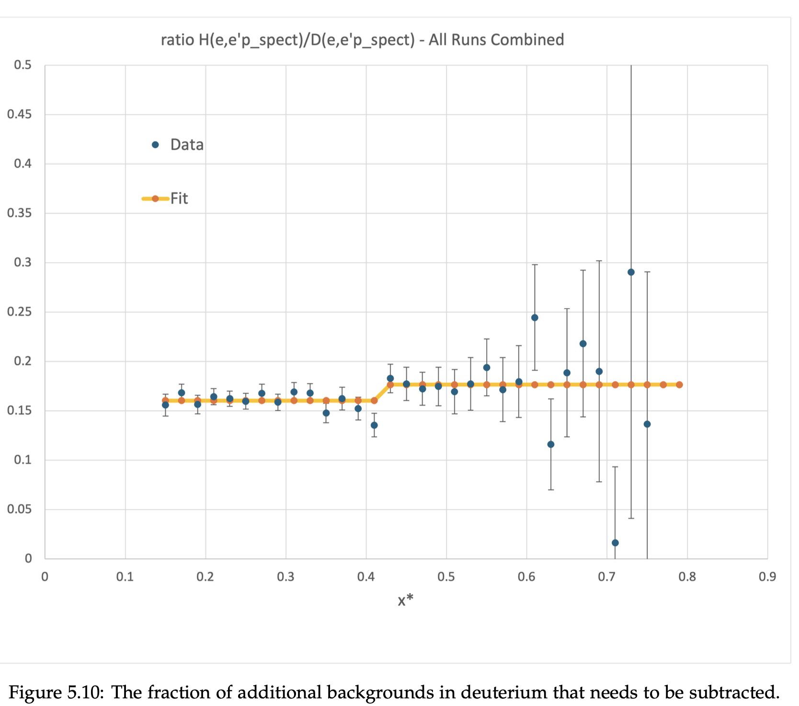
Outlook: Will study further
… however, possible correction already included in systematic error analysis.
NOTE: Since all data (Superratios) are normalized to x* = 0.3, this has zero effect on data below x* = 0.4 and only a 2% reduction of data above x* = 0.4.

Slide 19
Conclusions
A lot of feedback from the committee – we are working on responding.
RTPC efficiency raised many questions, but we believe this is well understood and shouldn’t prove to be a show-stopper
Backgrounds for now still a partial mystery – especially backwards p from H₂ (kinematically forbidden). For now, deal with it through “generous” systematic uncertainty contribution. NOT likely to change results, unless a significant source of background affecting the INCLUSIVE data can be identified.
Hoping to continue towards a publication within a few months.

Slide 20
Backup Slides

Slide 21
Accidental Backgrounds
cosθp < -0.1 && cosθpq < -0.3 | cosθp < -0.3
Counts | Counts | cts/1M e- |  | Normalisation | 4He gas frac | minus 4He | unc | frac from 4He | inferred D2
2.30E+06 | 2.31E+06 | 14665 |  | 1.57E+08 | 16.2% | 14236 | 11 | 3% | 100%
49178 | 49659 | 3130 |  | 1.59E+07 | 10.2% | 2859 | 14 | 9% | 20%
7681 | 7539 | 2650 |  | 2.84E+06 | 100.0% | 0 |  | 100% | 0%
4.21E+02 | 411 | 2031 |  | 2.02E+05 | 1.2% | 2000 | 100 | 2% | 14%
587 | 593 | 455 |  | 1.30E+06 | 6.5% | 283 | 19 | 38% | 2%
11643 | 12448 | 79 |  | 1.57E+08 | 16.2% | 5 | 2 | 94%
617 | 641 | 40 |  | 1.59E+07 | 10.2% | -6 | 2 | 116%
1318 | 1302 | 458 |  | 2.84E+06 | 100.0% | 0 |  | 100%
4 | 4 | 20 |  | 2.02E+05 | 1.2% | 14 | 10 | 27%
23 | 26 | 20 |  | 1.30E+06 | 6.5% | -10 | 4 | 149%
10704 | 10840 | 69 |  | 1.57E+08 | 16.2% | 0 |  | 100%
707 | 690 | 43 |  | 1.59E+07 | 10.2% | 0 |  | 100%
1159 | 1211 | 426 |  | 2.84E+06 | 100.0% | 0 |  | 100%
4 | 1 | 5 |  | 2.02E+05 | 1.2% | 0 |  | 100%
38 | 36 | 28 |  | 1.30E+06 | 6.5% | 0 |  | 100%
631 | 646 | 4 |  | 1.57E+08 | 16.2% | 4 | 0 | 10%
41 | 47 | 3 |  | 1.59E+07 | 10.2% | 3 | 0 | 8%
7 | 7 | 2 |  | 2.84E+06 | 100.0% | 0 |  | 100%
1 | 1 | 5 |  | 2.02E+05 | 1.2% | 5 | 5 | 1%
2 | 1 | 1 |  | 1.30E+06 | 6.5% | 1 | 1 | 21%

Slide 24
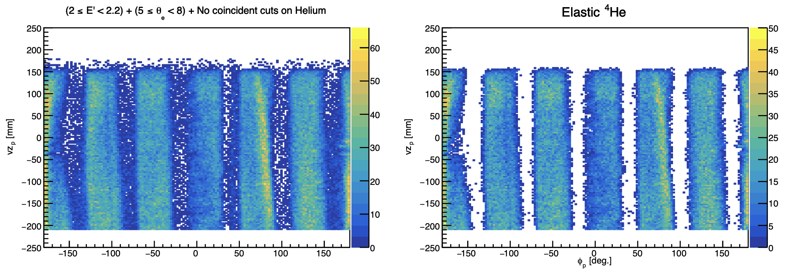
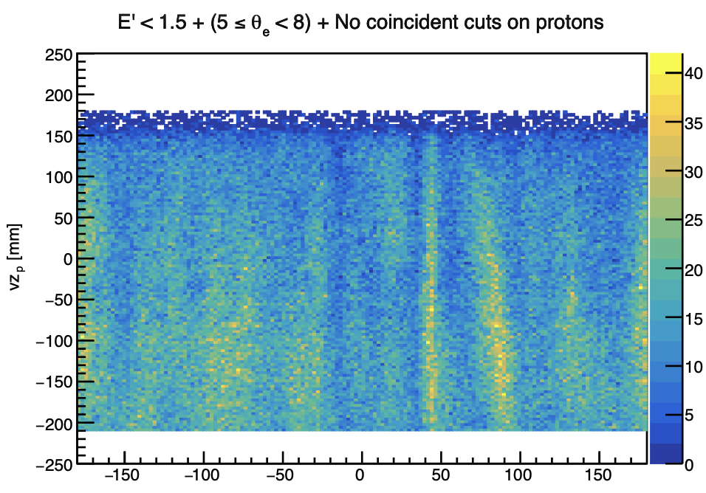
Phi-dep. Efficiency
Elastic alphas
Radiative elastic protons

Slide 25
Systematic Uncertainty Budget
Correction for R = σ_{L}/σ_{T}
Ambiguity in definition of x* / n off-shellness
Momentum misreconstruction
Radiative corrections
Mismatch between inclusive and tagged electron acceptance (different E’, θ if x* = x)
Effect of dropping cos(θ_{pq}) VIP cut
Sanity check: Can we extract F₂p/F_{2D}?
Effect of different RTPC efficiency for 2nd half of run
Background subtraction from tagged events:
“H background” (A > 4 target components)
Pair symmetric background
4He background (A=4 target components)
Accidental background
Difference between low dE/dx and high dE/dx in the proton PID band
Coincidence cut efficiency
E’ correction in data and MC
Efficiency correction for RTPC
TOTAL RELATIVE SYSTEMATIC ERROR (Square root of sum of squares)

Slide 26
BONuS12 Near-Final Results

Slide 27
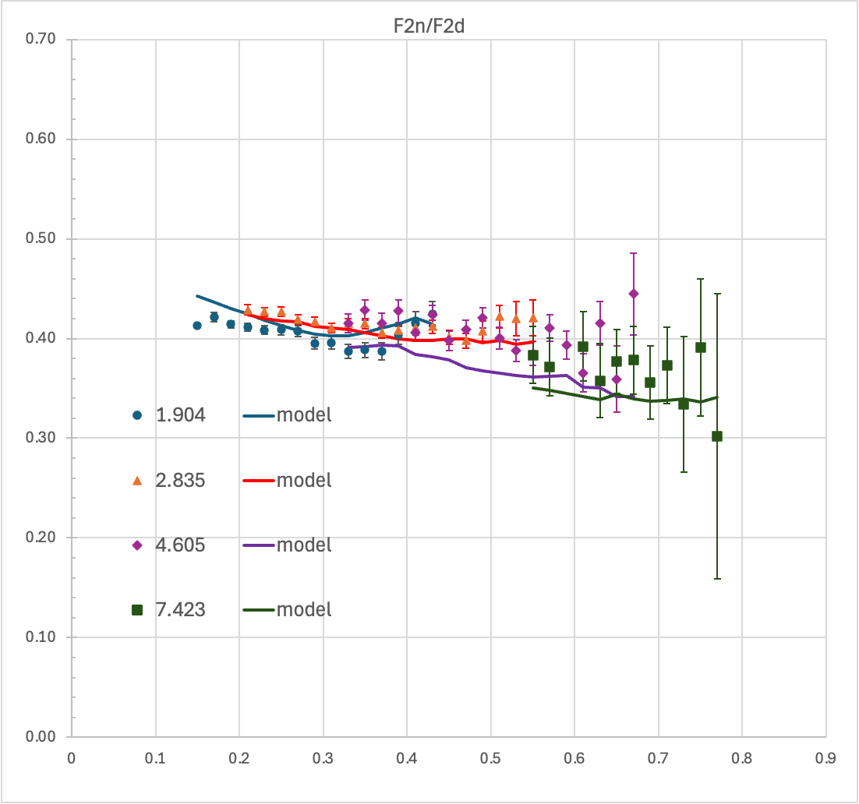
Q2-dependence

Slide 28
Backup Slides

Slide 29
Timing offset vs. file

Slide 30
Gain Calibration

Slide 31
p momentum correction/resolution
Elastic radiative events with 2.2 GeV beam
p vertex, phi and theta resolution

Slide 32
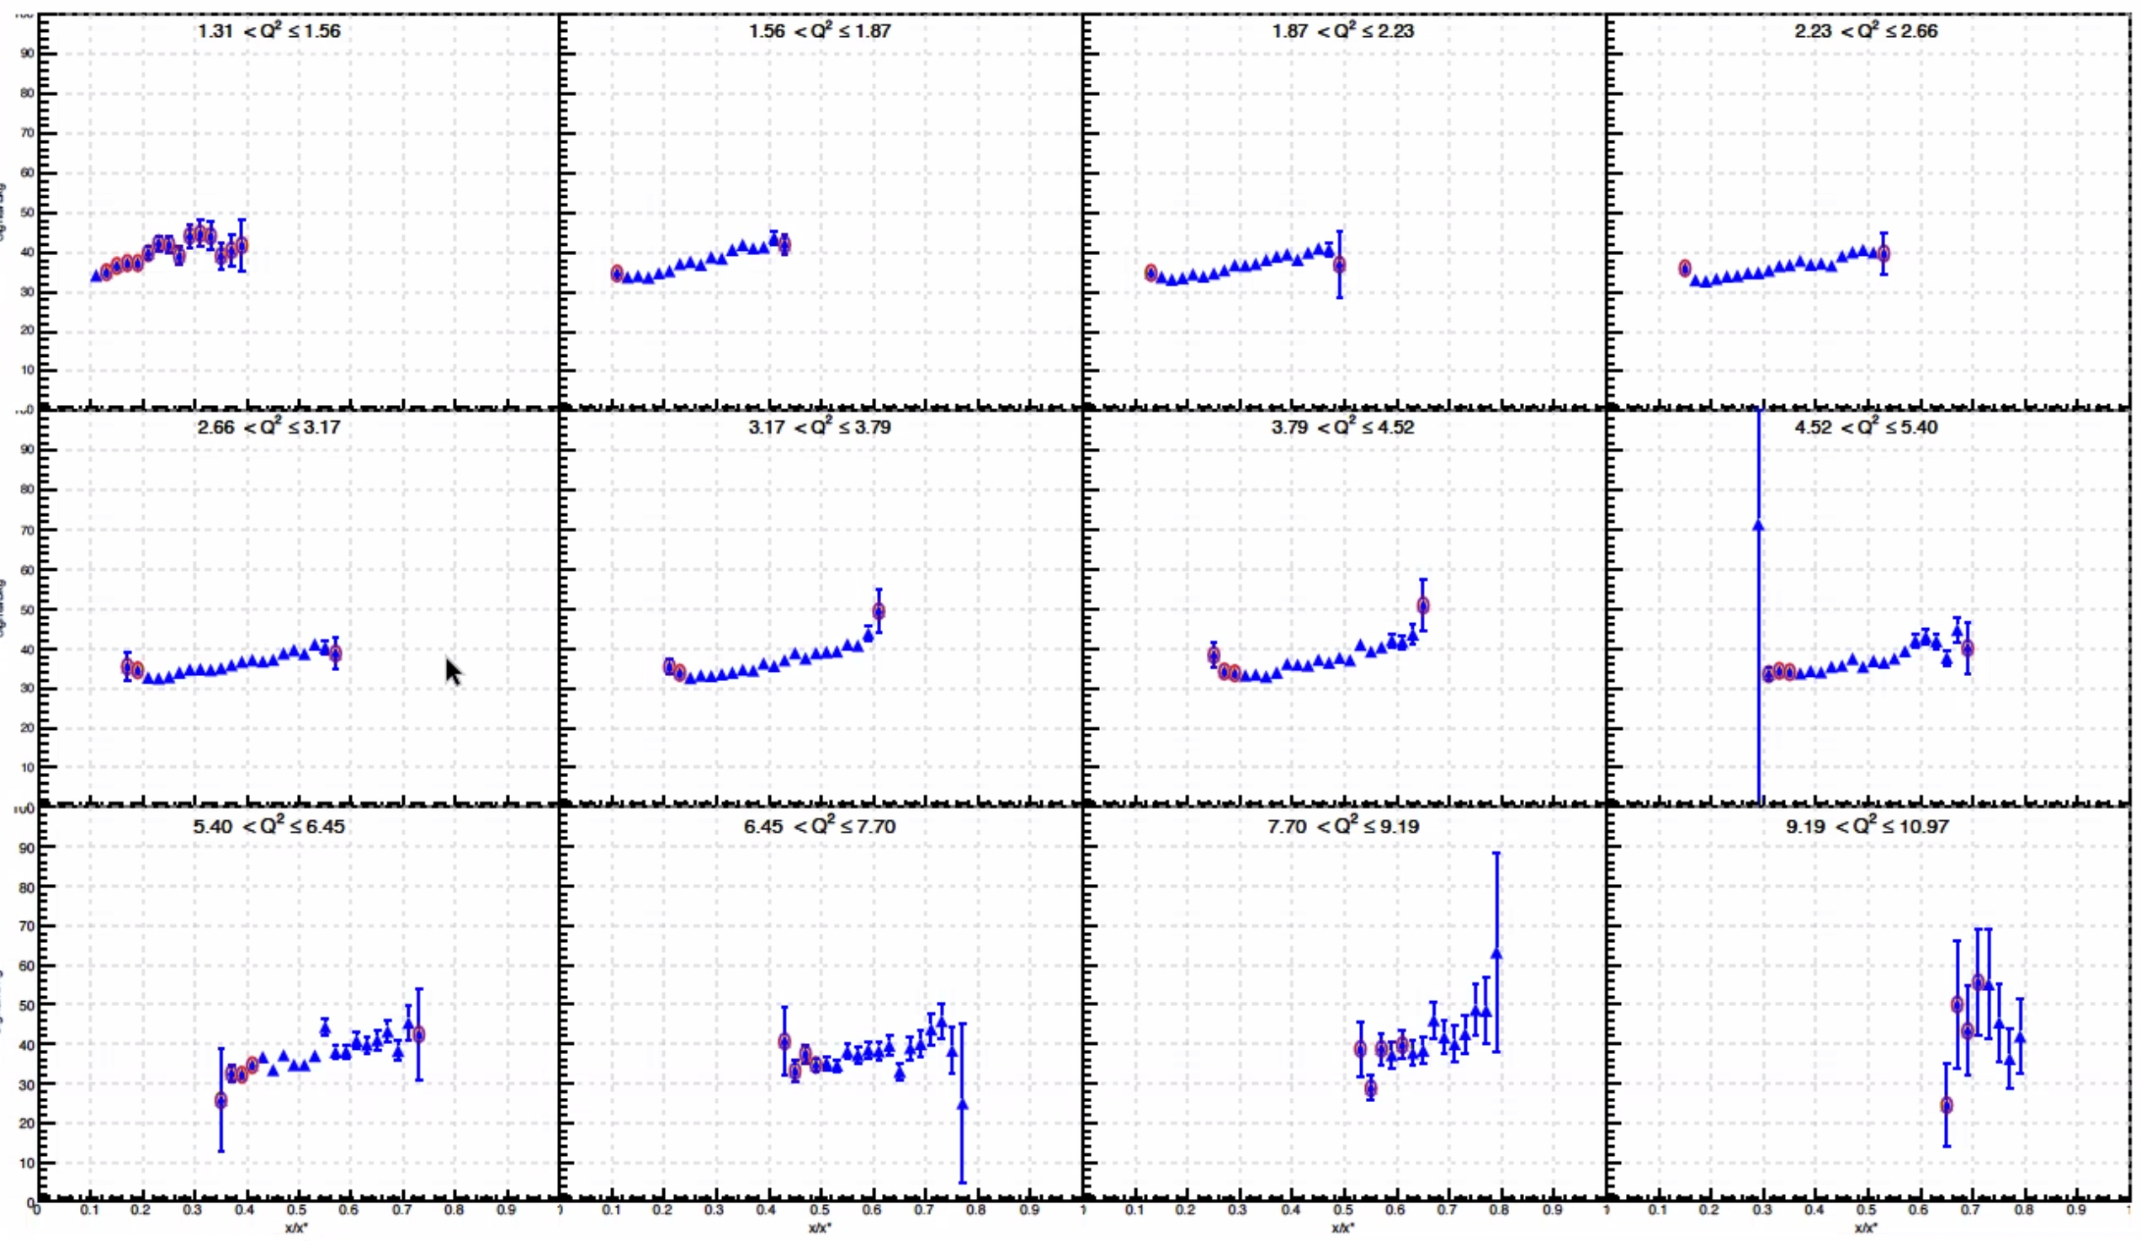
BONuS12 Corrections I: Accidentals
Full distribution of vz(e-) – vz(p) for all in-time events
Mixed events (out-time)
Background/Total in % vs. x* for different Q² bins
x* = 0.1…0.25
x* > 0.55
Overlay
Pure coincidences
Notes:
Explain VIP

Slide 33
BONuS12 Corrections II: ⁴He Contamination
Fraction of ⁴He in target due to permeable target straw – estimated using ³H/³He band in dE/dx vs. p/q plot
VIP fraction coming from ⁴He
Data corrected using polynomial fit
Notes:
Explain VIP. Mention additional “H” contamination

Slide 34
BONuS12 Corrections III: “H Background”
H(e,e’p_{S})/D(e,e’p_{S})
Data correction using step function fit
Notes:
Explain VIP. Mention additional “H” contamination

Slide 35
BONuS12 Corrections IV: Pair-symmetric bgnd
Measured by comparing positrons from outbending torus runs with electrons from inbending torus runs (inclusive, Winter 2020)
and applying a correction for tagged events using positrons from tagged and inclusive events (Summer 2020 only)
Inclusive
Tagged
Event-by-Event correction based on θ and E’ (less than 10% in all kinematics after y < 0.75 cut)
Notes:
Explain VIP

Slide 36
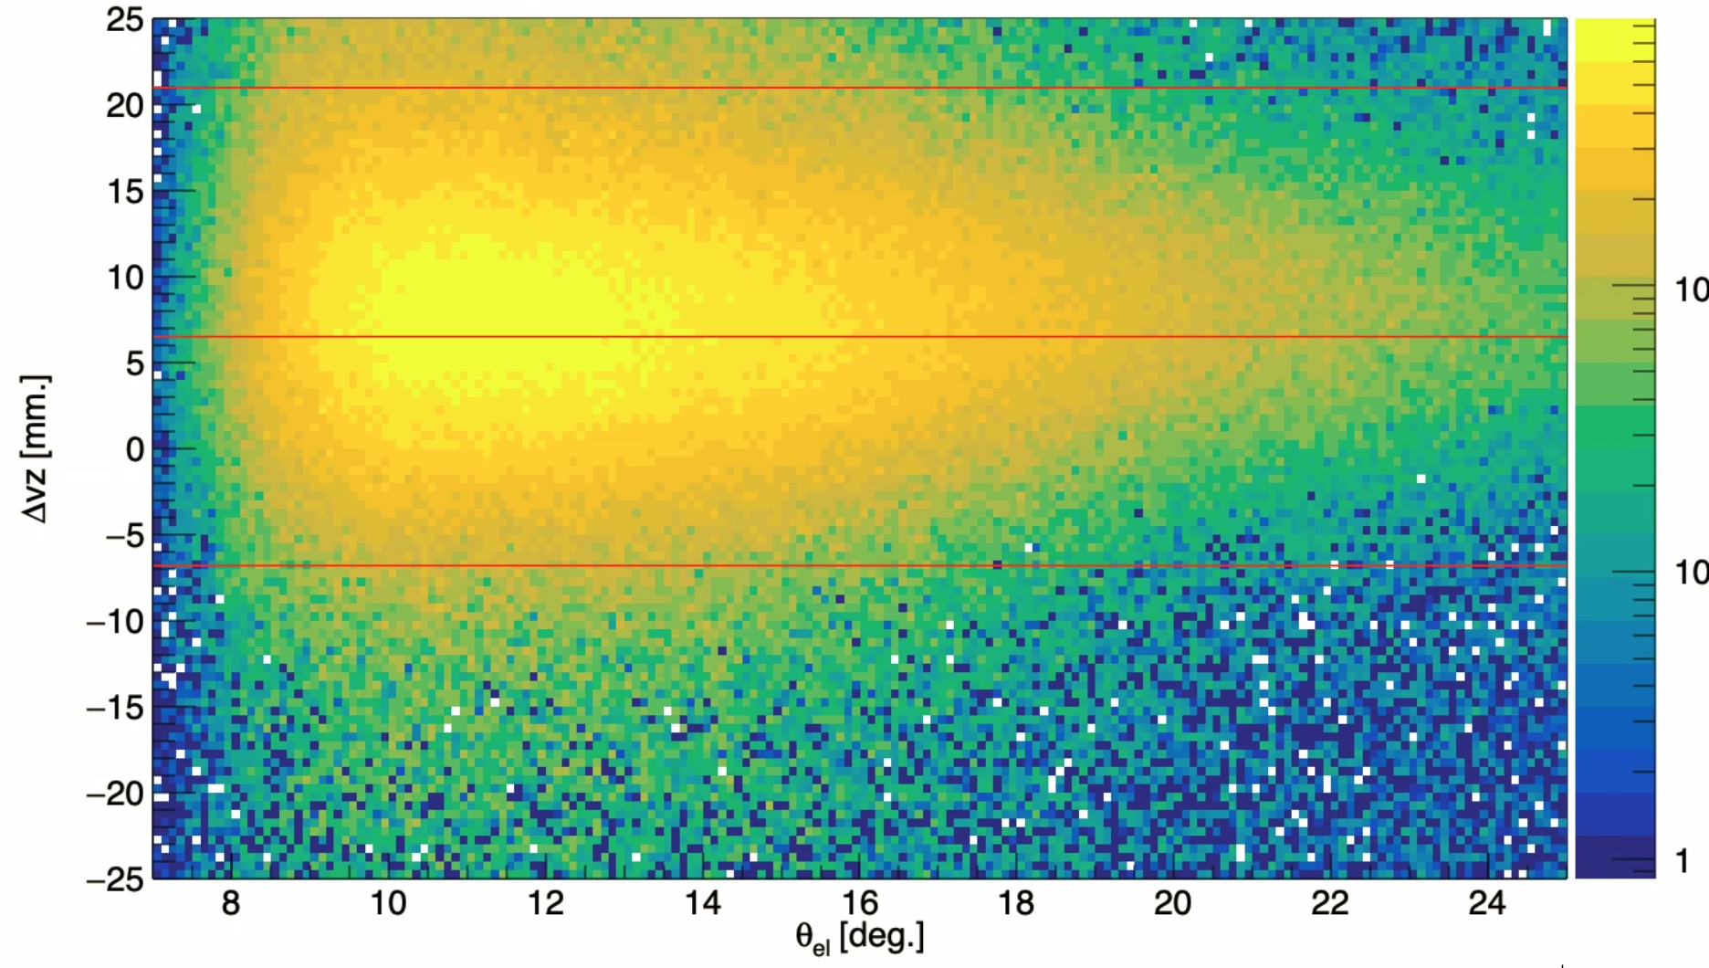
BONuS12 Corrections V: cut efficiencies
Δv_{z} cut for data is 2 times AVERAGE sigma around mean, separately for each sector =>
θ-dependence of mean and sigma leads to θ-dependent inefficiency (Gaussian tails outside the cut)
=> Correct yield for the cut efficiency
For MC, we had to use much wider Δv_{z} cuts (+/- 5 cm ) due to distortion in tracking leading to mis-reconstructed θ and Δv_{z}.
Remaining inefficiency is small (< 0.45%) but also corrected for.
Notes:
Explain VIP

Slide 37
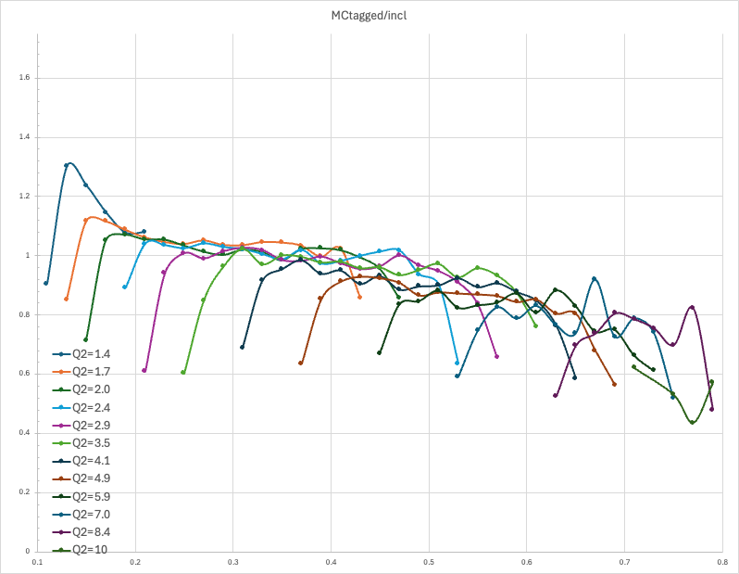
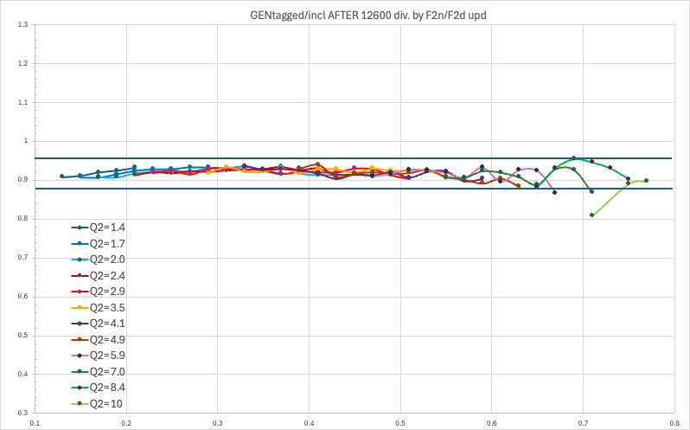
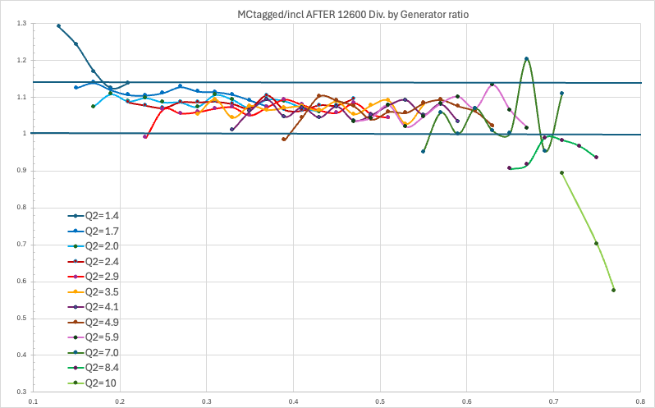
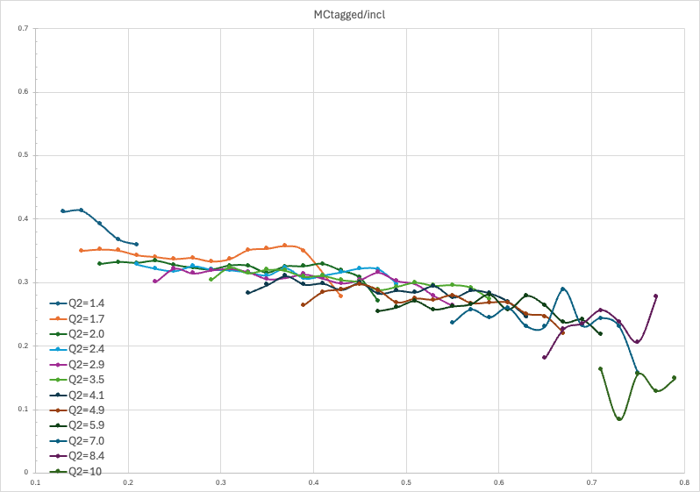
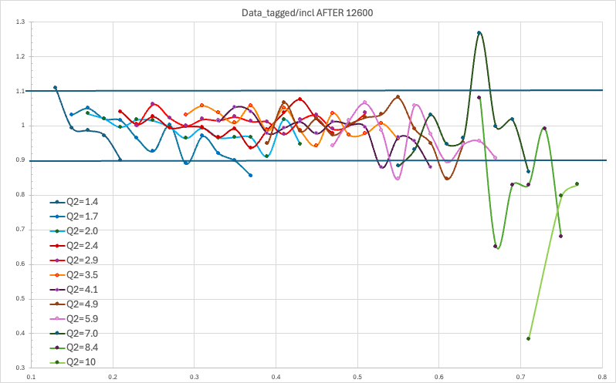
BONuS12 Corrections VI: Culling partially filled bins
Sanity Checks:
Generated / (F_{2n}/F_{2d})
Reconstructed MC / Generated Events
Ratio Tagged/Inclusive from MC show smooth dependence on x and Q2 except for a few bins at the edge of the acceptance (very sensitive to precise simulation of physical boundaries), as well as bins only partially filled due to W* / W cut. These bins have been removed from final results…
…but data show different trend for this ratio (nearly flat with x)
Notes:
Explain VIP

Slide 39
MC generator

Slide 40
MC generator

Slide 41
GEMC Setup
Notes:
Corrections on electrons: additional smearing in E’ and theta, adding 0.25% to E’

Slide 42
RTPC Efficiency Corrections: vs. v_{z}
Electron Acceptance
Correction
Proton
Acceptance
Correction

Slide 43
RTPC Efficiency Corrections: vs. p
BEFORE RUN
12600
AFTER RUN
12600

Slide 44
RTPC Efficiency Corrections: vs. φ

Slide 45
Comparison Data/MC without efficiency correction
Notes:
NOTE: The data here haven’t been corrected for H background

Slide 46
Comparison Data/MC with efficiency correction
VIP <-
VIP <-
Notes:
NOTE: The data here haven’t been corrected for H background

Slide 47
Sanity Checks
Notes:
Consistency check between the 2 halves of the experiment

Slide 48
Sanity Checks
Notes:
Test that, at least for the MC, the ratio of counts faithfully follow the ratio of SFs

Slide 49
Sanity Checks
Notes:
Proof that our superratio method really CAN extract ratios of SFs correctly

Slide 50
Sanity Checks
Notes:
Proof that “flux factors” or any other factors affecting the translation from the struck neutron rest frame to the lab frame don’t have a big effect, and that FSI and target fragmentation don’t seem to play a big role.

Slide 51
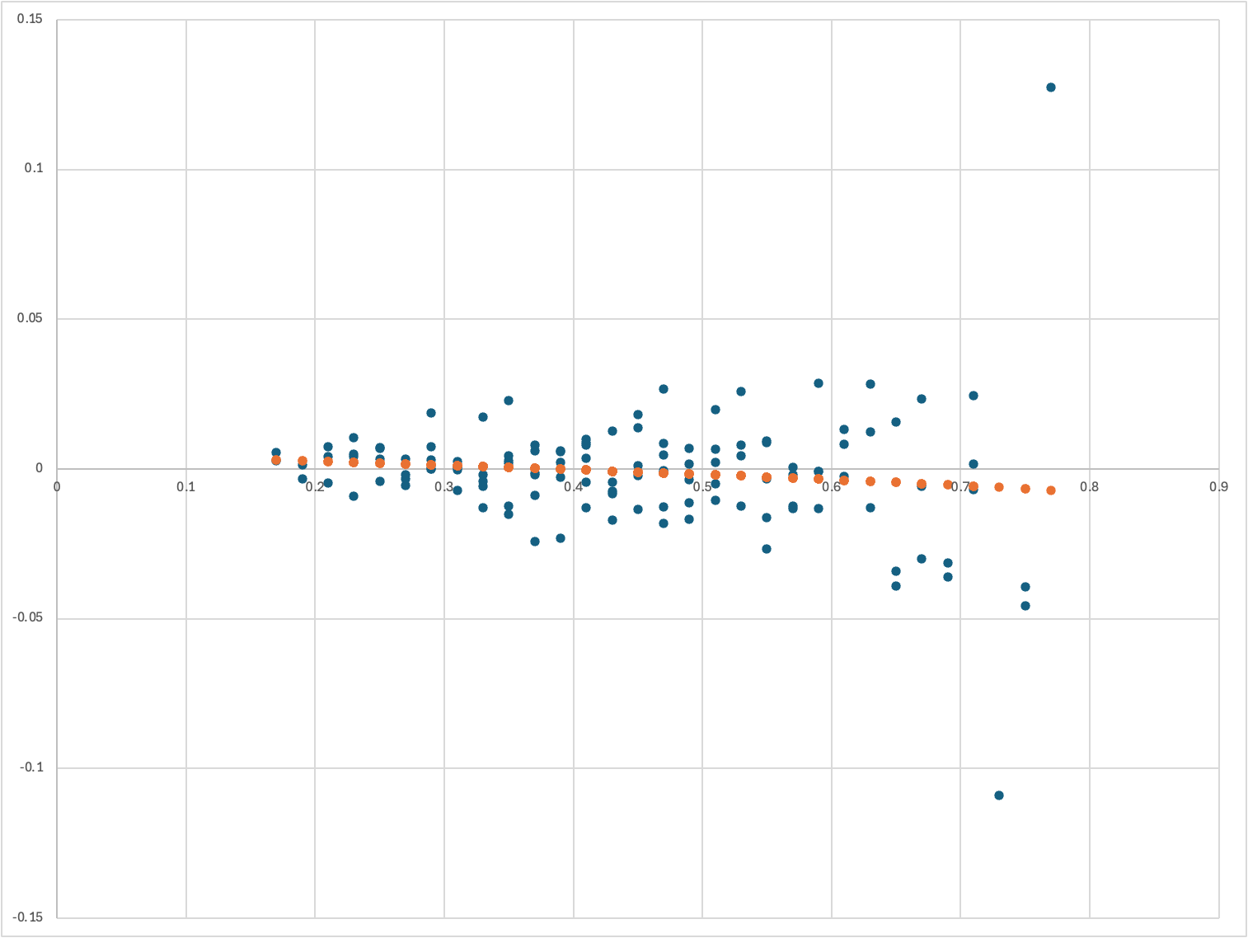
Sanity Checks
Notes:
Deviation between Double ratios using x = x* and x = weighted sum of electron kinematics corresponding to x*. Shows that acceptance ratio seems to be correctly deduced.

Slide 52
Systematic Uncertainty Budget

Slide 54
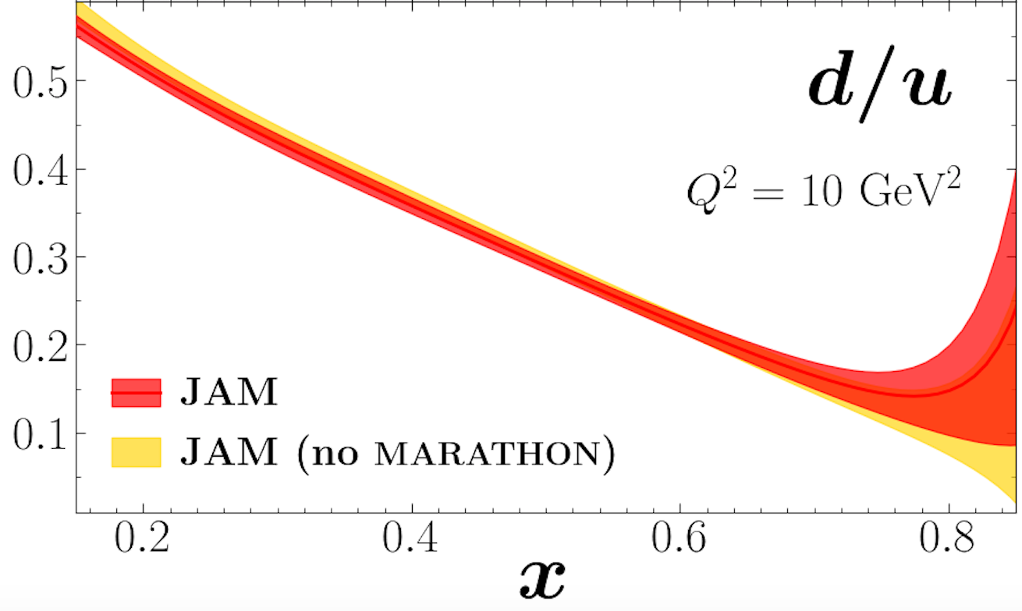
JLab@12 GeV d/u- the full program
NSAC 2015 LRP
Marathon
PhysRevLett.128.132003
BONuS12:
Dark Symbols: W* > 2 GeV (x* up to 0.8, bin centered x* = 0.76)
Open Symbols: “Relaxed cut” W* > 1.8 GeV (x* up to 0.83)
…also: Additional data from ALERT and TDIS
Courtesy Arun Tadepalli
Notes:
Left: LRP expected, right Marathon published, bottom right TDIS

Slide 55
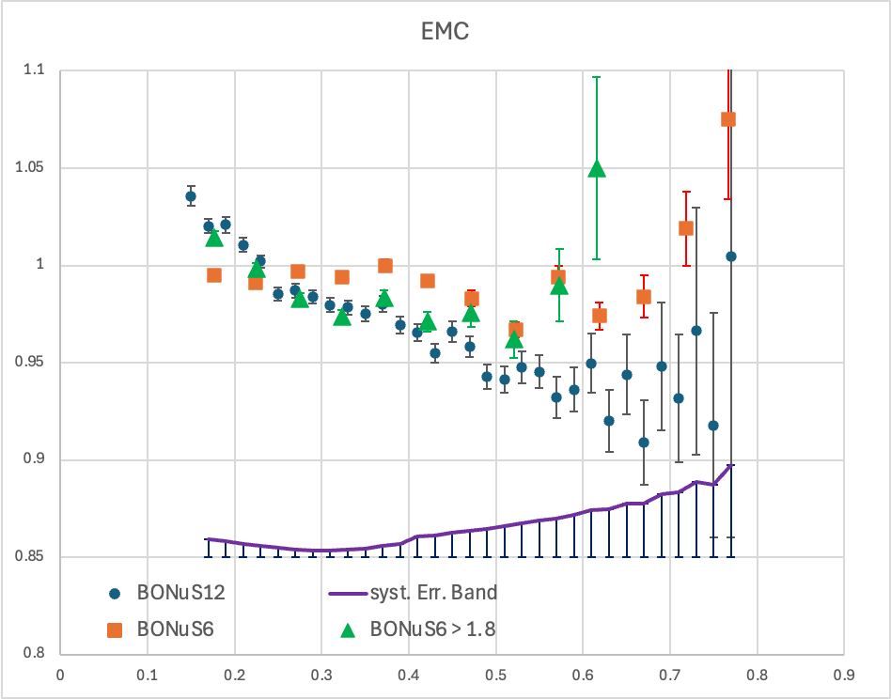
F2n/F2d – EMC effect?

Slide 56
F2n/F2d – EMC effect?

Slide 57
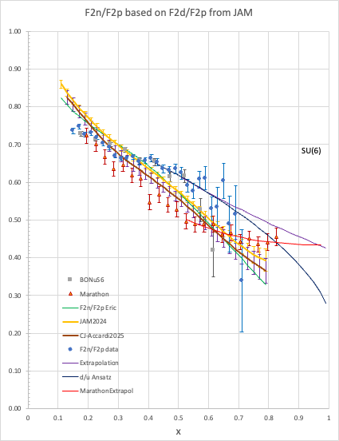
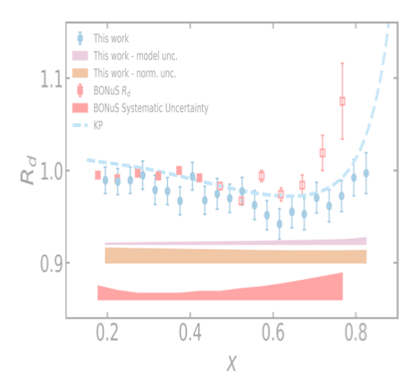
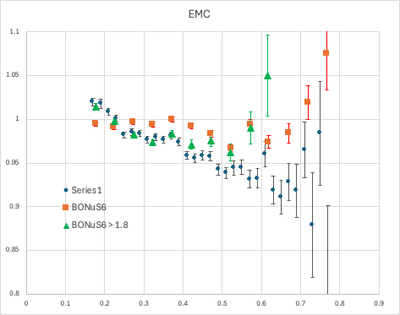
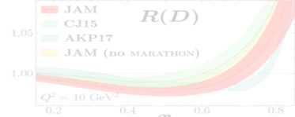
Why the Discrepancy?
Missed backgrounds?
Incorrect assumption about reaction mechanism?
Physics at low W?
D EMC effect???
Strict cut on W>2 GeV

Slide 58
More on Nuclear Corrections
Marathon points have normalization uncertainty up 0.02.
Last Marathon point gets significant contributions from smeared SF in the resonance and even elastic region, as well as much lower x
In general, Marathon data are all Fermi-smeared (Contributions from x* = x/(1±0.15).)
Nuclear Modifications are partially additive; no reason to assume that they affect p and n the same (isospin-dependence).

Slide 59
EMC effect
Fundamental question: How does nuclear binding modify the high-x structure function of the nucleon?
Relevant for the extraction of neutron structure functions from experimental data on d, ³He, ³H
Many models: mean field, Short range correlations (SRC), Light-Front Holography (LFHQCD), …
C. Cocuzza et al.,
Notes:
Note: this is NOT a talk about the EMC effect, but it is clearly relevant for the topic! More tricky than thought: u and d quarks can be affected differently, both depending on whether they are in the proton or the neutron, and whether they are in 3He or 3H

Slide 60
Issues affecting extraction of d/u
Higher twist/target mass correction
Nuclear binding correction
M. Cerruti, A. Accardi et al.
2.7% effect
BONuS12: p_{S} < 0.1 GeV/c =>
Multiplier < 0.027

