Slide 1
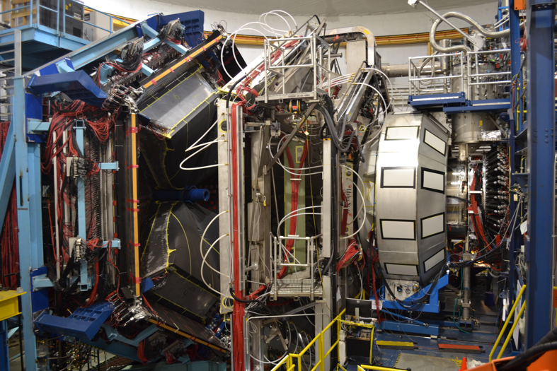

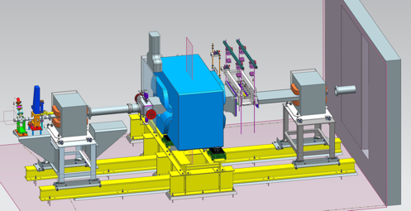

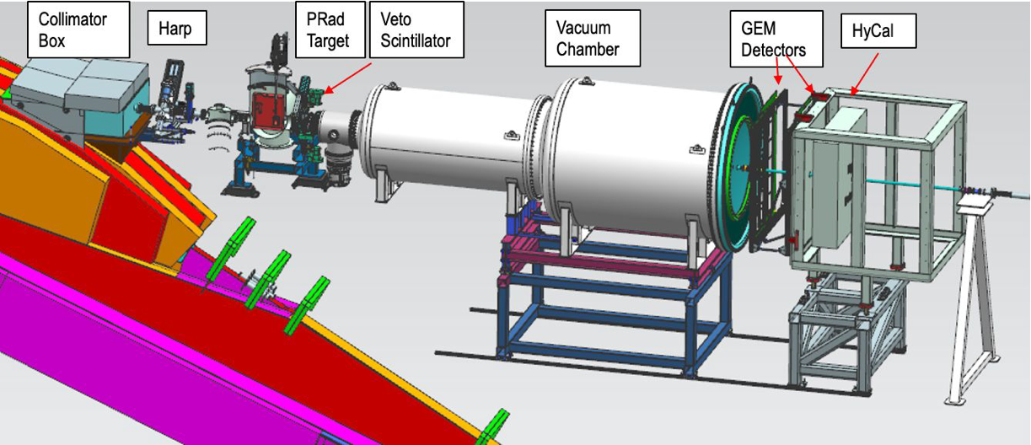
Status of Hall-B
S. Stepanyan (JLAB)
CLAS Collaboration meeting
March 10-13, 2026
Notes:
----- Meeting Notes (9/27/11 07:19) ---
Many thanks to organizers for invitation to participate in the conference and give this talk on GPD program at JLAB.

Slide 2
Outline of the talk:
Activities and goals, CY26
CLAS/CLAS12 publications/presentations
Recent physics results (CLAS/CLAS12/HPS)
Preparations for PRad/X17
R1 μRWELL upgrade
Software/tracking improvements
Computing: JLAB farm and OSG
Tentative run plan for next year or two
Summary

Slide 3
Hall B staffing
We lost two positions to ISP (Lab restructuring) – Dr. Gagik Gavalian and Dr. Victor Mokeev were separated from JLAB in January. I hope, in time, they will return as active users and continue to contribute to our research.
Two additional positions were effectively lost because they were never filled: the position I vacated when I moved to the Hall Leader role after Patrick Achenbach left, and the Hall B postdoctoral associate position after Richard Tyson’s departure. It was a difficult period for hiring at JLab, and unfortunately, these opportunities were eventually lost.
Last week, one of our long-time team members, Calvin Mealer, retired. We thank him for almost 30 years of excellent service to JLab and Hall B.
Many thanks to our colleagues who left the Hall B group. They made an undeniable impact on our progress over the years!

Slide 4
Activities and Goals in CY26
Install, commission, and successfully complete Prad II & X17 experiments. In progress.
Prepare for the FY27 run period, RG-K and RG-E, including initiating and partially completing the BMT upgrade and module replacement. Arrangements have been made with Saclay to fabricate 7 BMT modules and replace the faulty ones before the run. Funding is available, and work has started.
Advance the high-luminosity R1 upgrade by completing tests of the next prototype with a near-final layer design, finalizing the full-size module design, and initiating procurement for Module-0. The next prototype is in the assembly stage at CERN. Expect to be at JLAB in April.
Start preparations for the RG-H run, including completing the field calculation, beginning the beamline design with the accelerator and engineering groups, and initiating procurement of the chicane magnets. In progress
Complete simulations and advance the conceptual design of the μCLAS12 detector. In progress.
Address key Pass-3 objectives, including improvements to calibration suites, acceleration of the calibration workflow, and enhancements to forward and CVT tracking. In progress.
Complete processing of data acquired during the FY24 run period. RG-D is now in the ninth month of running on the JLAB farm. RG-K and RG-E will join soon. Progress is very slow. JLAB computer farm's throughput is a big problem.

Slide 5
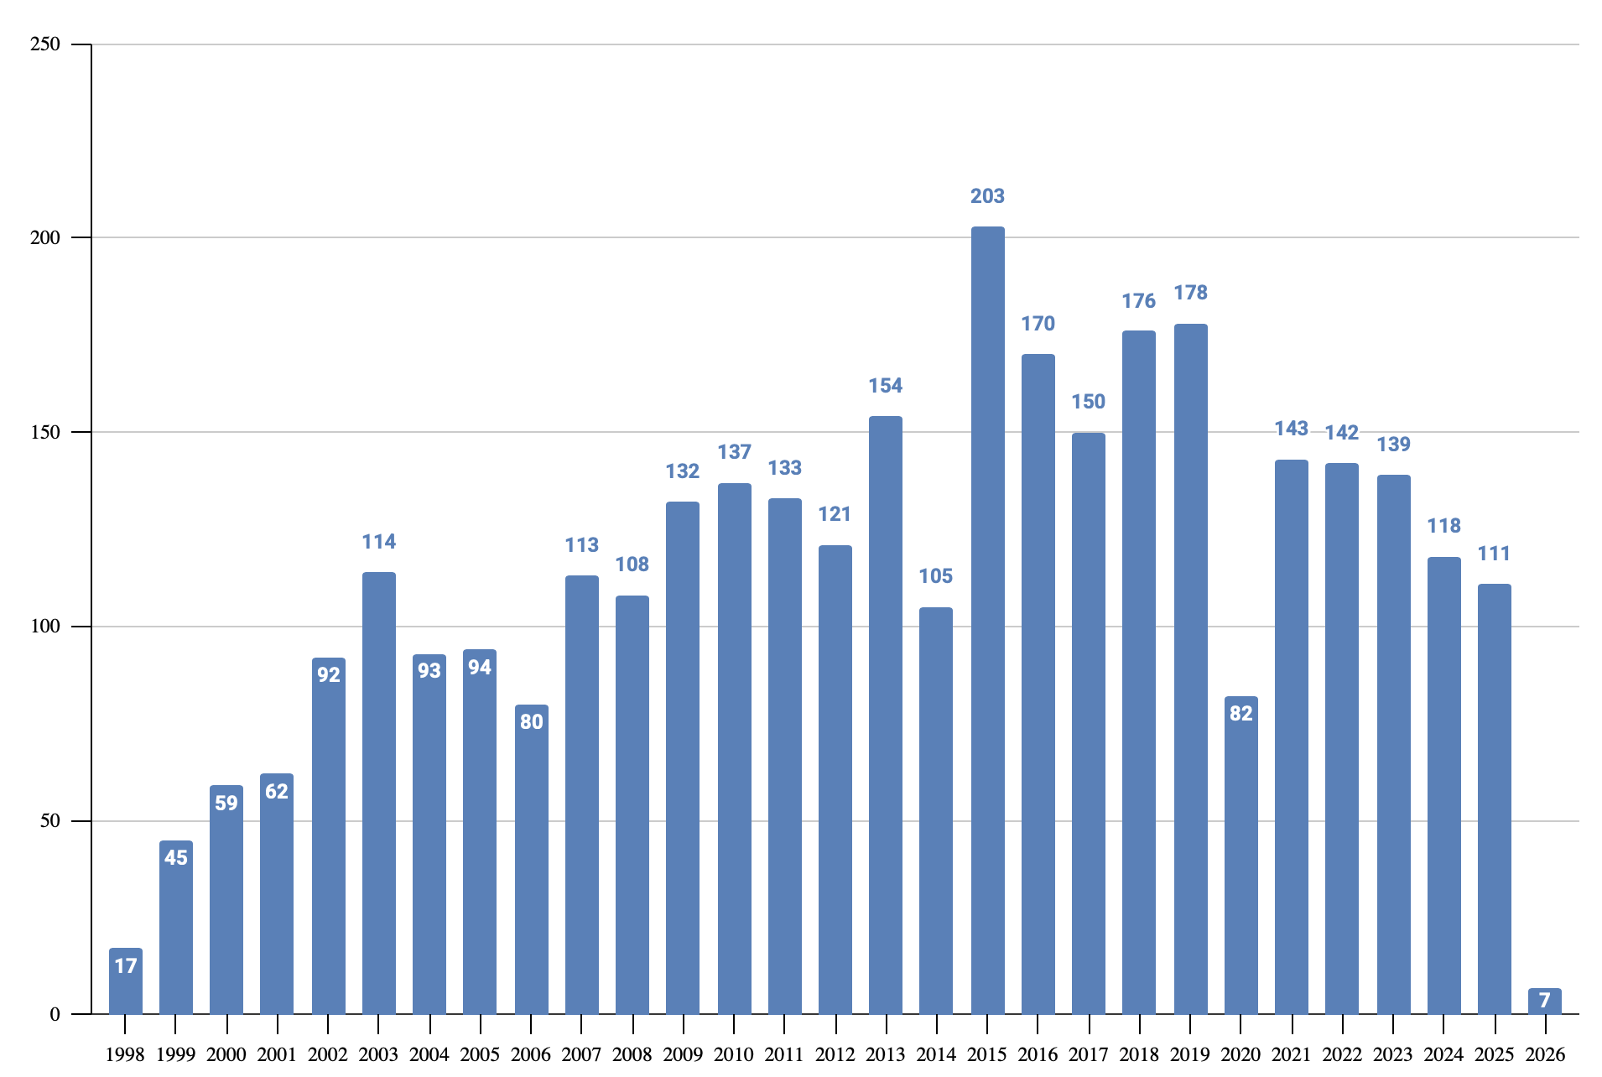
Physics publications and Conference presentations
We continue production of world-class physics results and publications. Since the last collaboration meeting, three papers have been posted on arXiv and submitted to PRL, PRC, and PLB.
Only half of our publications from the last few years are from CLAS12.
If compared to CLAS publications for the same period (8 years from the first experiment), CLAS12 has about x2 fewer publications.
What are the sources of delays: longer data calibration and processing time, and more complex analysis?
Understanding the sources of delay will help to address the issue.
This is not just about the number; lagging on publications affects our students, early-career scientists, and the health of the collaboration overall.
CLAS/CLAS12 related presentations
CSC, N. L. Lanza
Averaging 115 presentations per year
Averaging 9 papers per year

Slide 6
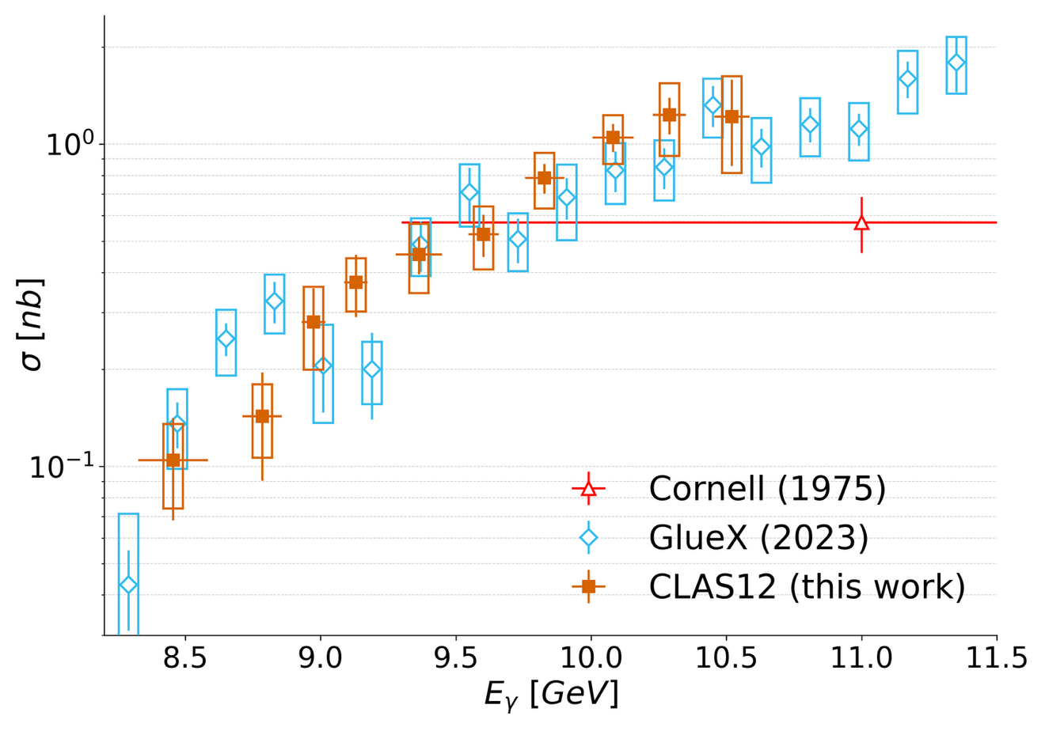
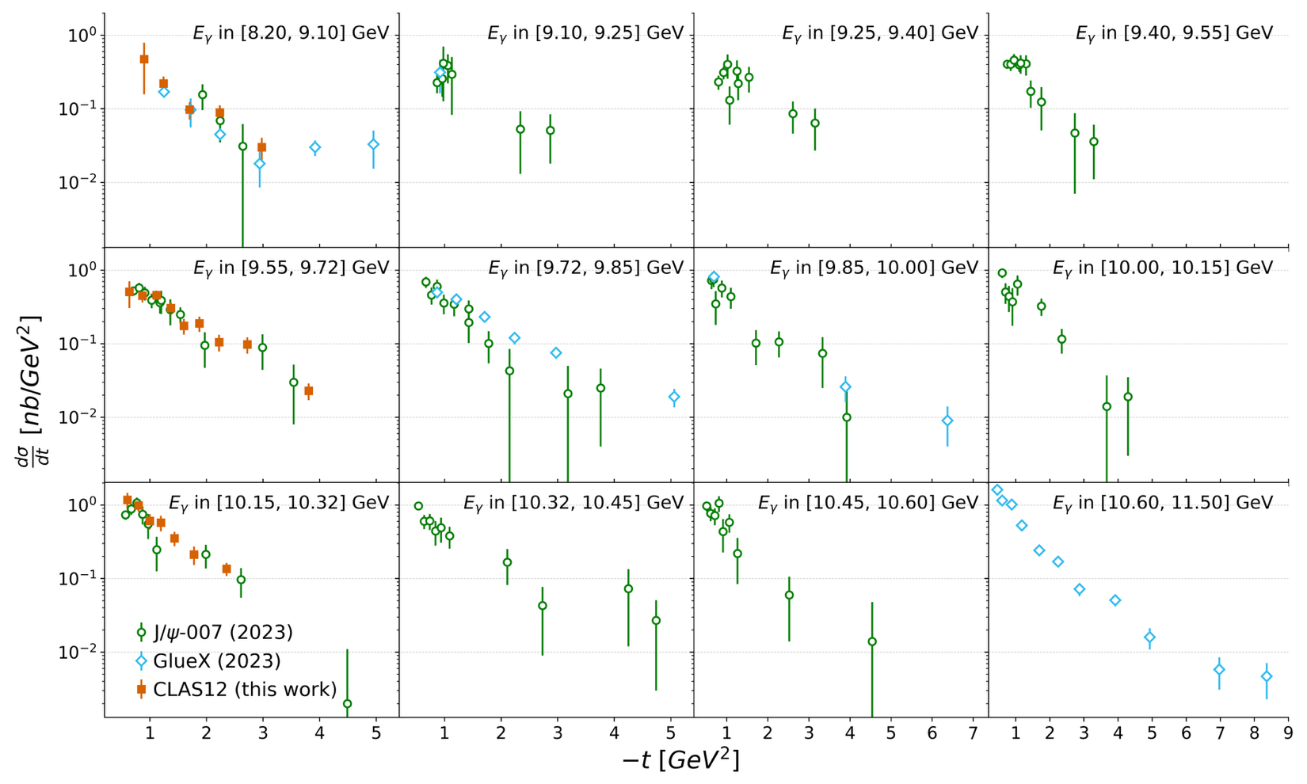
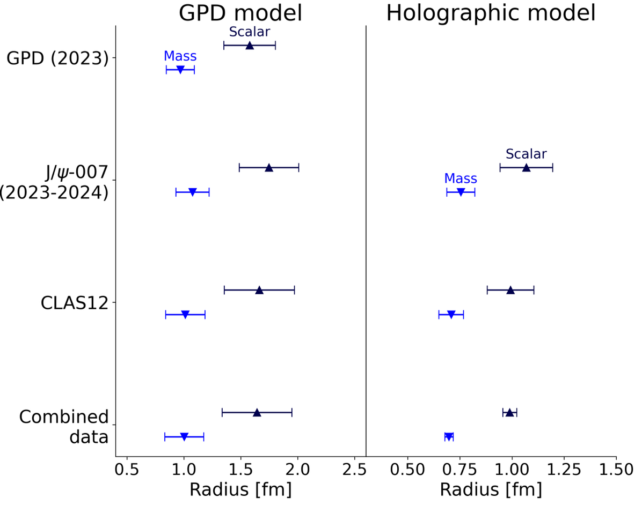
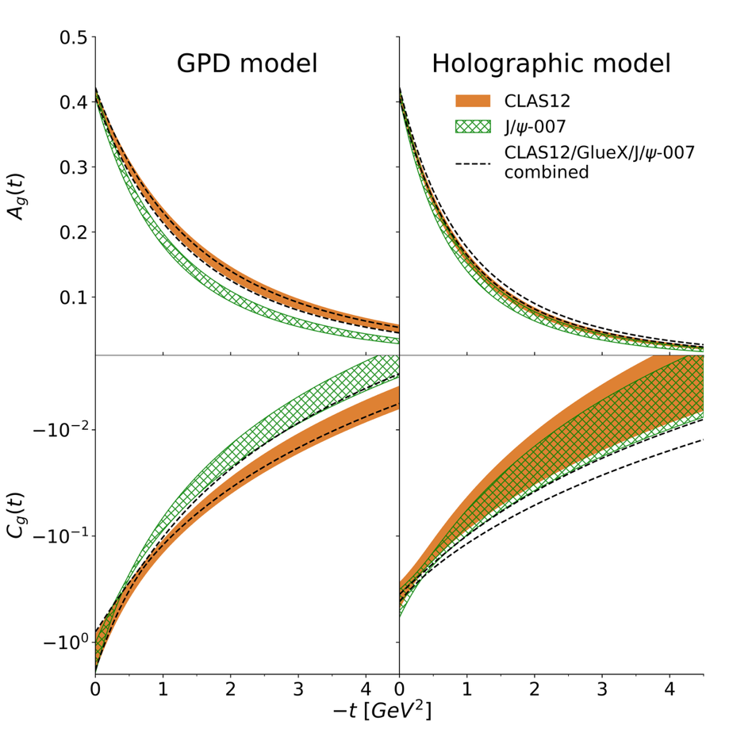
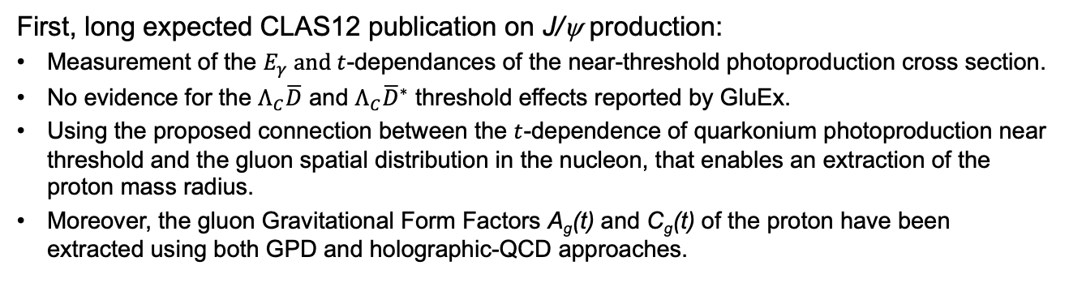


Recent results: CLAS12
P. Chatagnon et al., [the CLAS Collaboration], “Measurement of the near-threshold J/ψ photoproduction cross section with the CLAS12 experiment”, https://arxiv.org/pdf/2602.22128.
First, long expected CLAS12 publication on J/ψ production:
Measurement of the $E_{γ} and t$-dependances of the near-threshold photoproduction cross section.
No evidence for the $Λ_{C}\overline{D}$ and $Λ_{C}{\overline{D}}^{∗}$ threshold effects reported by GluEx.
Using the proposed connection between the $t$-dependence of quarkonium photoproduction near threshold and the gluon spatial distribution in the nucleon, that enables an extraction of the proton mass radius.
Moreover, the gluon Gravitational Form Factors A_{g}(t) and C_{g}(t) of the proton have been extracted using both GPD and holographic-QCD approaches.
$Λ_{C}\overline{D}$
$$Λ_{C}{\overline{D}}^{∗}$$
Extracted mass and scalar radii
A_{g}(t) and C_{g}(t) Gravitational Form Factors for the GPD and holographic models

Slide 7
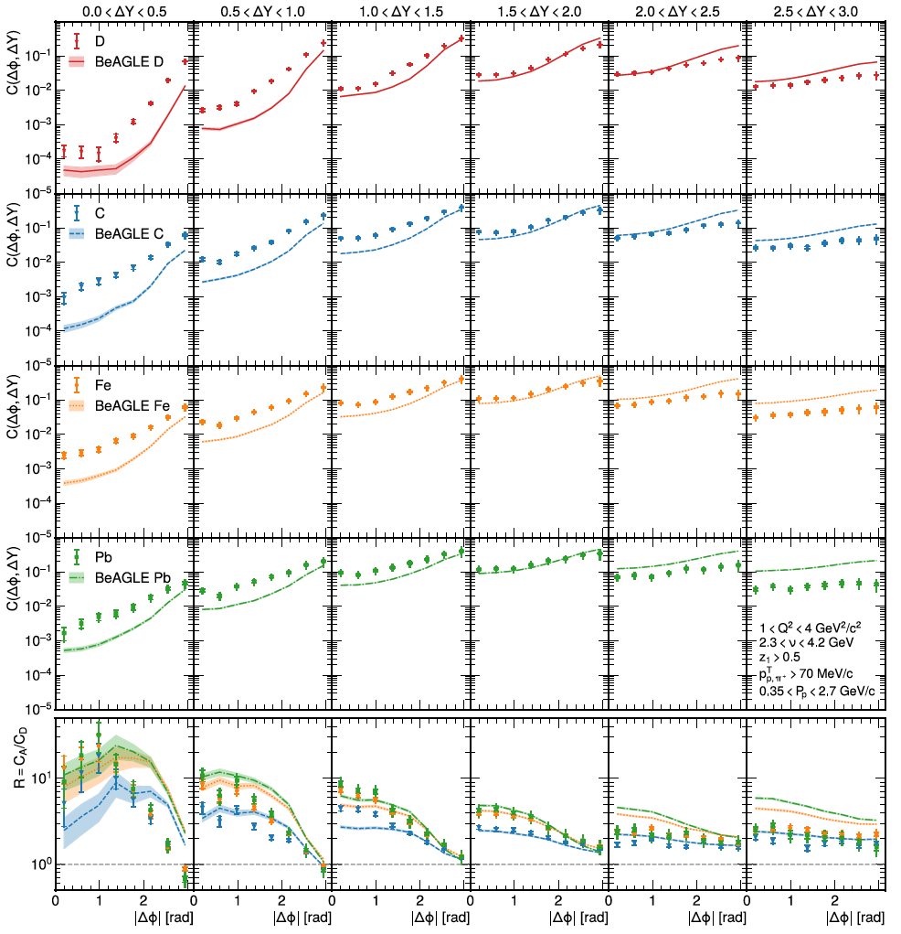
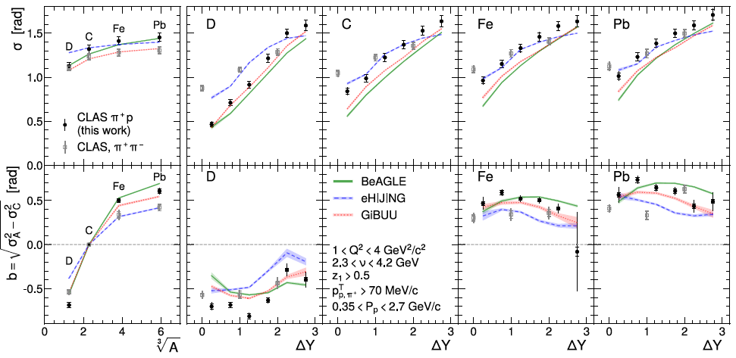
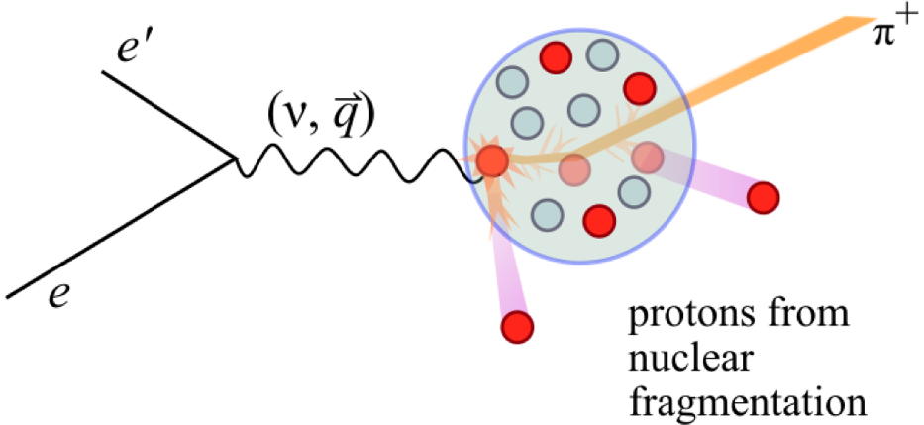


Recent results: CLAS
S. Paul et al., [The CLAS Collaboration], “First study of the nuclear response to fast hadrons via angular correlations between pions and slow protons in electron-nucleus scattering”, Phys. Lett. B 874 (2026) 140250.
The first measurement of angular correlations between high-energy pions and slow protons.
The dependence of the correlation function, $C\left(Δφ,ΔY\right)$, on azimuthal angle (φ) and rapidity difference ($Y$) is studied for various nuclei and is compared with models for the first time.
$$C\left(Δφ,ΔY\right)=C_{0}×\frac{1}{N_{e′π}}\left(\frac{d^{2}N_{e′πp}}{dΔφdΔY}\right)$$
$${ΔY≡Y_{π}−Y_{p}; Y}_{h}=\frac{1}{2}\log{\frac{E_{h}+p_{z,h}}{E_{h}−p_{z,h}}}$$
The general trend are qualitatively reproduced by state-of-the-art 𝑒𝐴 event generators (BeAGLE, eHIJING, and GiBUU).

Slide 8

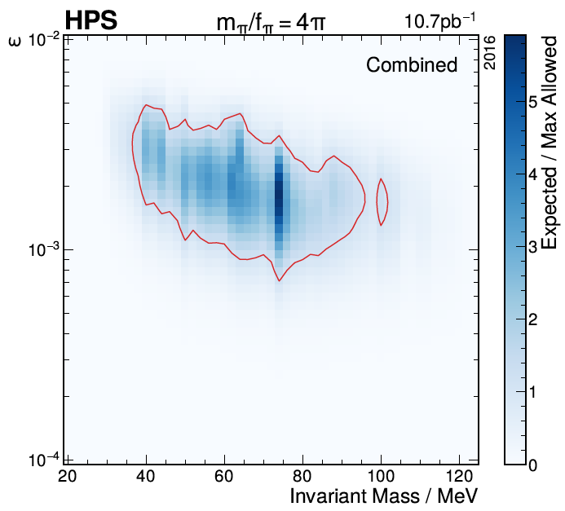
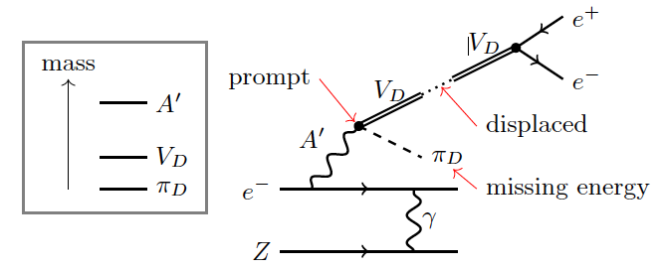
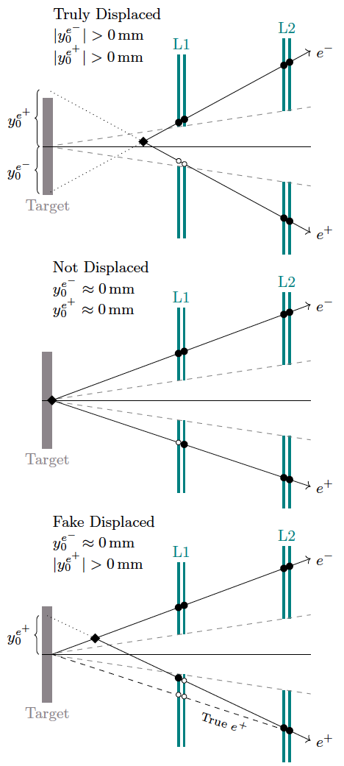
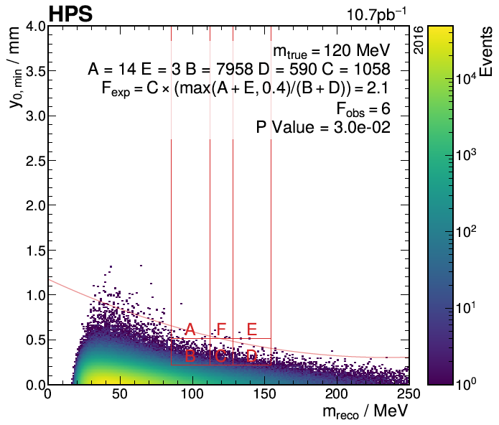
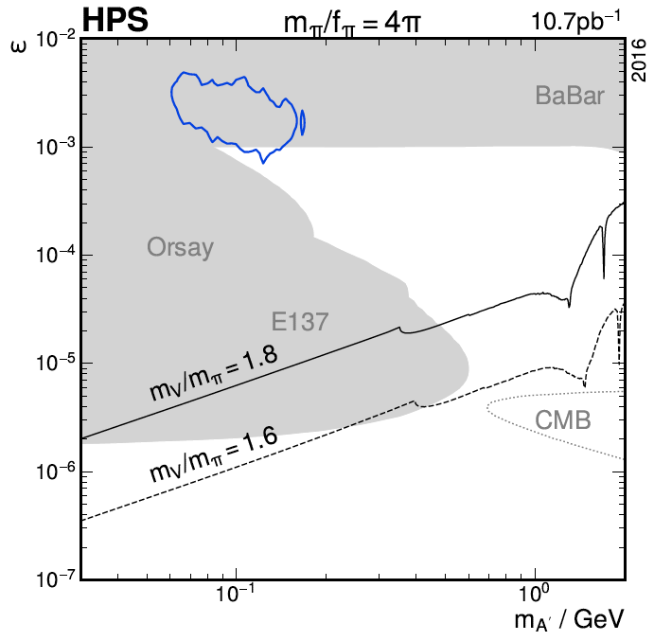
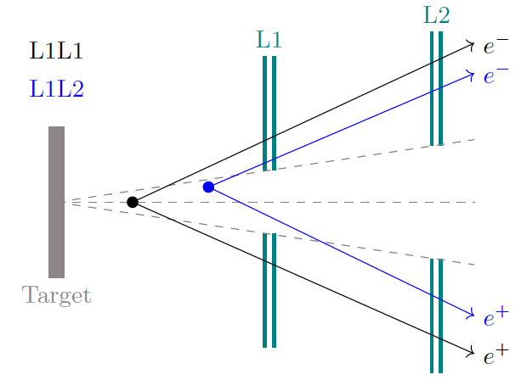
HPS update
Physics goals have been expanded to other long-lived particle searches, e.g., SIMPs.
A new paper has been published on SIMPs search from 2016 data analysis: https://arxiv.org/pdf/2511.02695 and will appear in PRD 113, 032019
Calibration of 2021 data completed, data processing started. Calibration of the 2019 data is progressing.

Slide 9

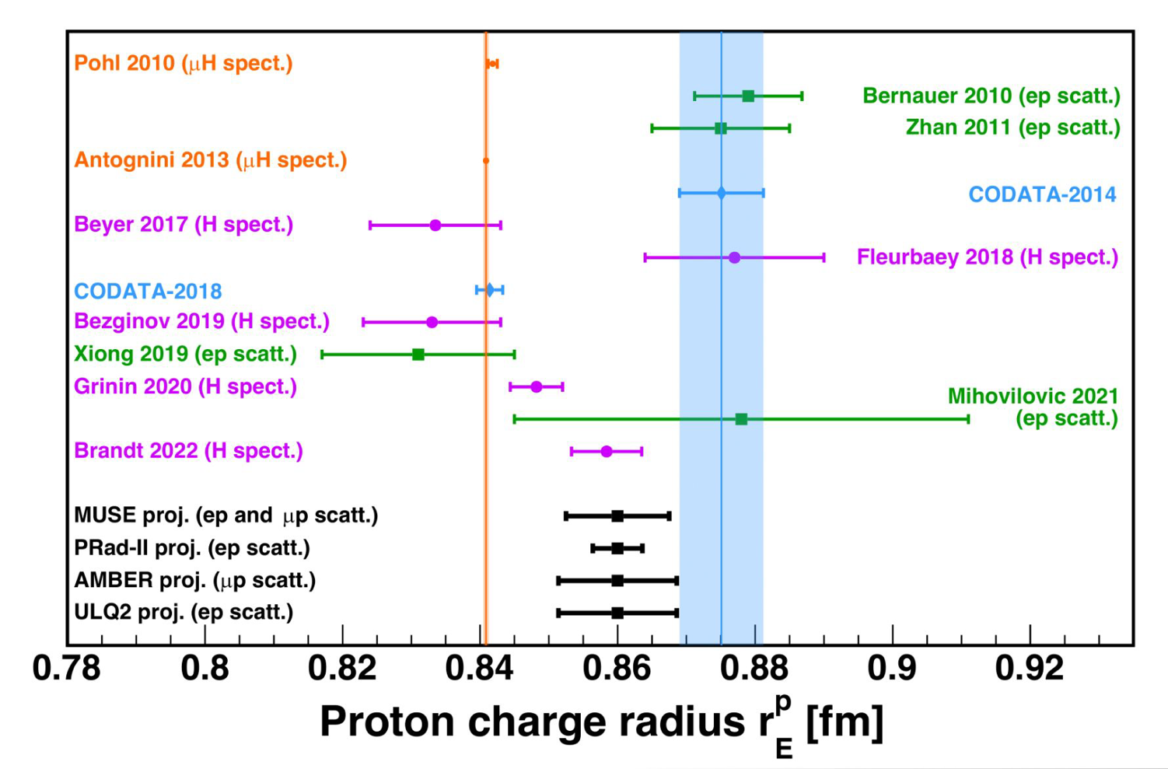

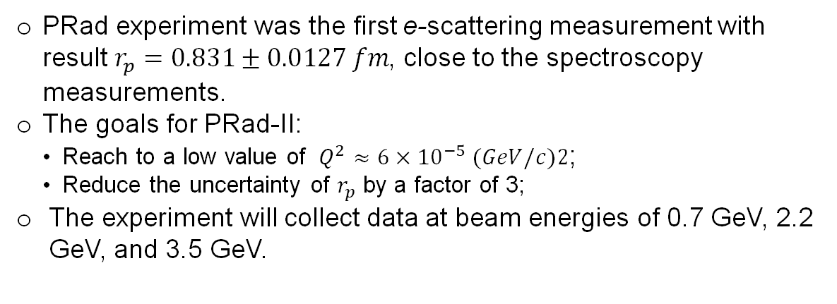
Preparations for Prad-II
PRad experiment was the first e-scattering measurement with result $r_{p}=0.831±0.0127 fm$, close to the spectroscopy measurements.
The goals for PRad-II:
Reach to a low value of $Q^{2}≈6×{10}^{−5} (GeV/c)2$;
Reduce the uncertainty of $r_{p}$ by a factor of 3;
The experiment will collect data at beam energies of 0.7 GeV, 2.2 GeV, and 3.5 GeV.
The main changes to the apparatus:
2 layers of GEM trackers & upgraded DAQ system with MPD/VTP.
New VETO scintillator for separation of e-e and e-p events.
Upgraded HyCal readout electronics (fADCs).

Slide 10
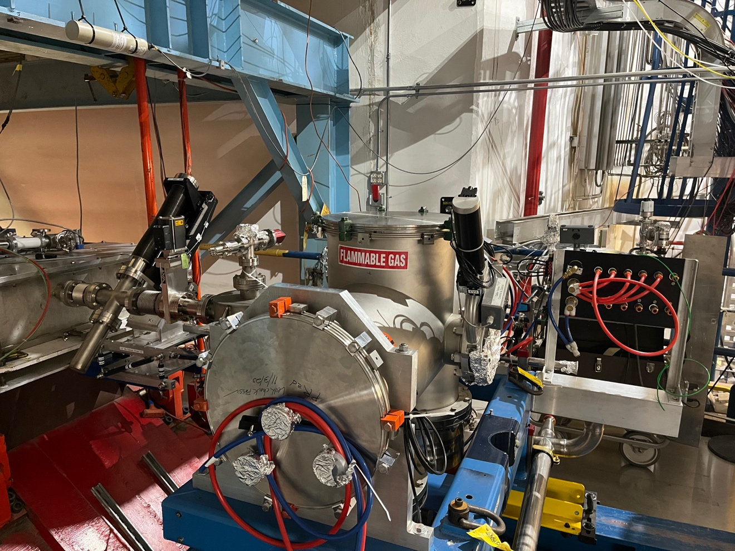
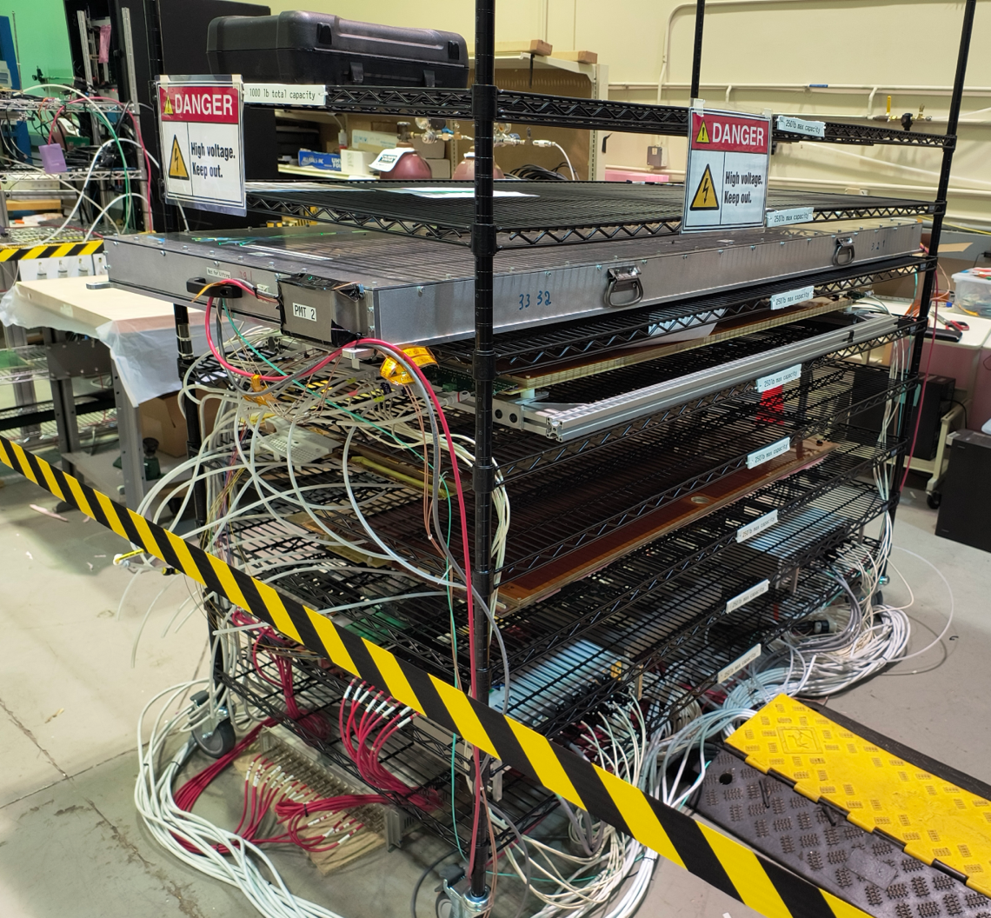
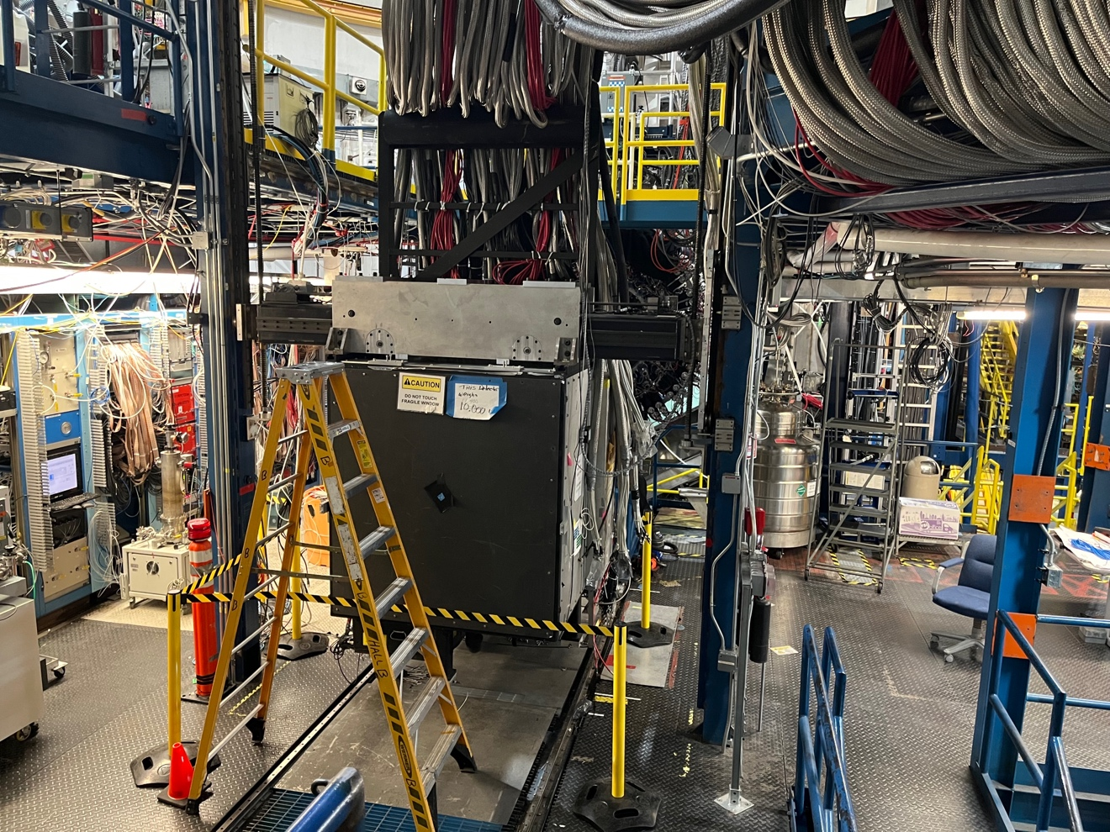
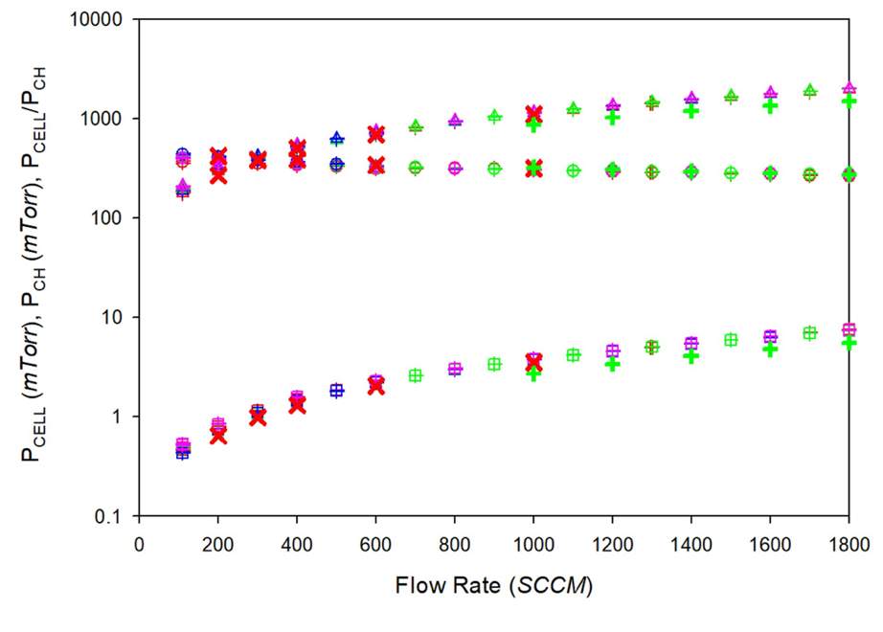
Prad preparations
Gas-jet target vessel on the beamline
GEM cosmic test setup in EEL 125
HyCal tests in the Hall started
Hodo
GEM
GEM
GEM
High-rate test of APV-MPD achieved 22 kHz (limited by the 1 Gbit data rate in EEL).
Eight GEMs are on hand, six new and two old (from Prad I).
Tests are ongoing in EEL. Issues with low efficiency are being worked out.
GEMs will be transported to the Hall when ready.
HyCal is in the Hall, mounted on the transporter.
Cabling, interlocks, and cooling are ready and tested.
Transporter has been commissioned.
Veto counters are ready and will be installed after the target is installed.
The remaining work is expected to be completed before the start of the run on March 27
Achieved a similar target cell pressure ratio PCELL/PCH as in 2016.
The target cell has been surveyed and will be installed after vacuum tests.

Slide 11
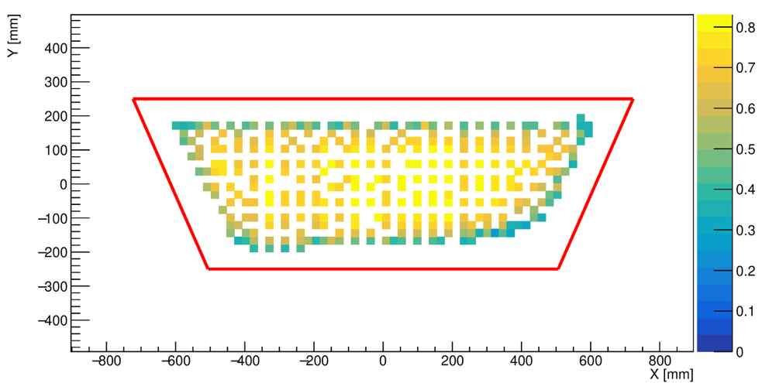
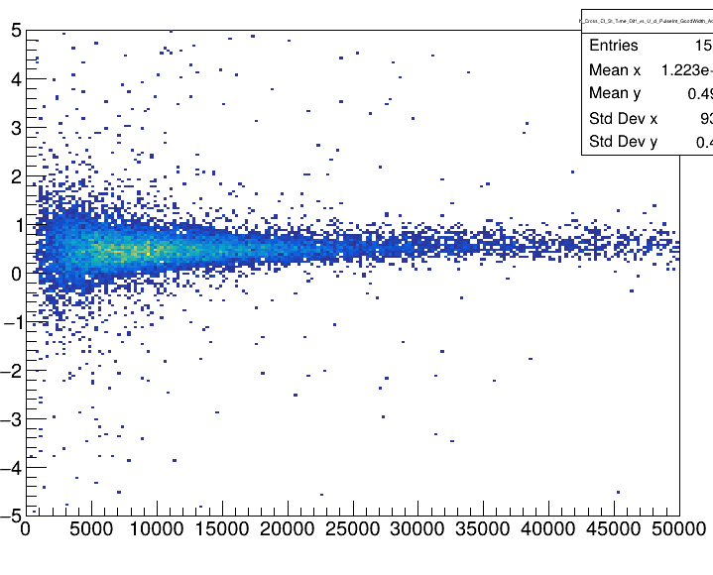
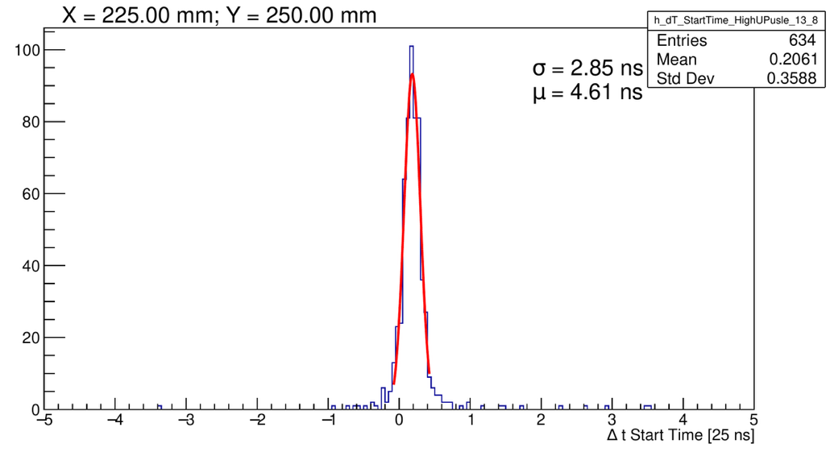
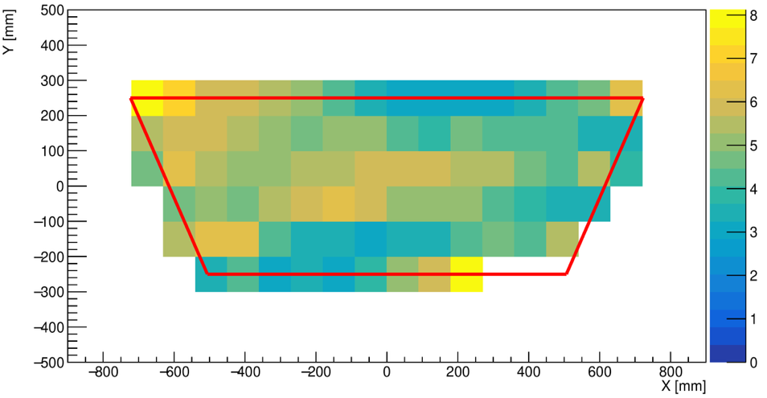
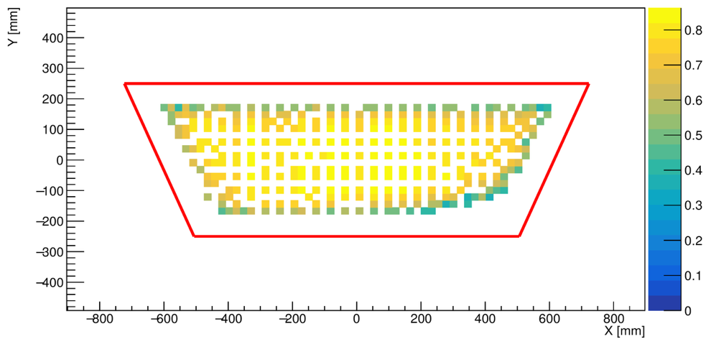
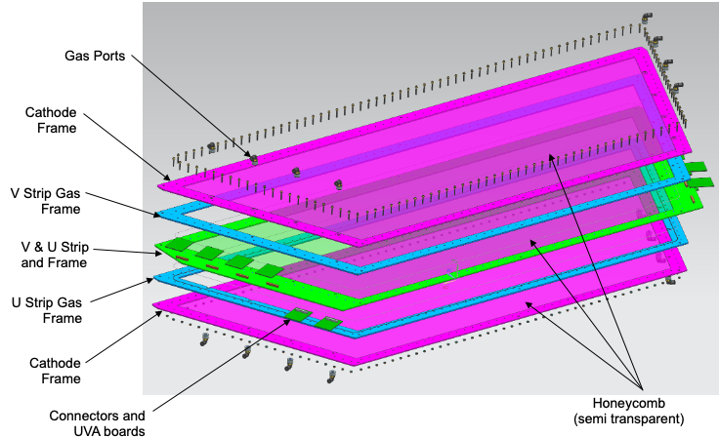
CLAS12 luminosity upgrade – the R1 μRWell project
Continue performance studies of the first prototype:
After almost a year's pause, the detector came up without issues.
The same features: dead sectors, 4 holes in the readout, the same noisy strips, and HV structure.
One of the characteristics under study is the time resolution needed for MC.
Run 2650 (taken 1 year ago)
Pixel (position) dependence of the pulse time resolution
Pixel (6,3)
Run 3051 recent run
Delta t
Large pulse region
Smal pulse
Large pulse
The 2nd 𝛍RWELL prototype (V7) is scheduled for assembly at CERN (starts now).
The detector should be here in April after the initial tests at CERN.
The design of the prototype is close to the arrangement of 𝛍RWELL and the cathode layers of the proposed detector for R1 upgrade.
If the tests prove the concept, we will proceed with fabricating the full-size detector.
Version-7 prototype

Slide 12
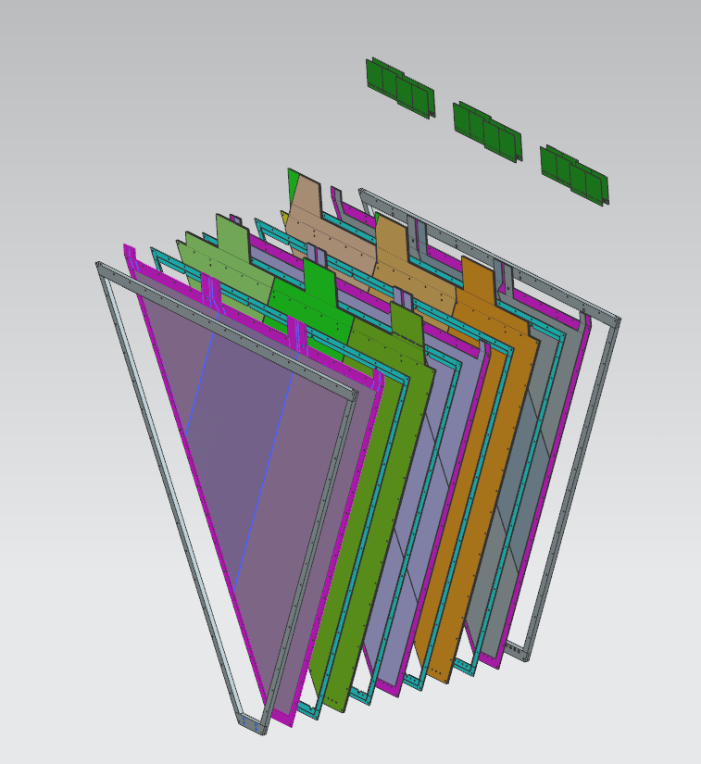
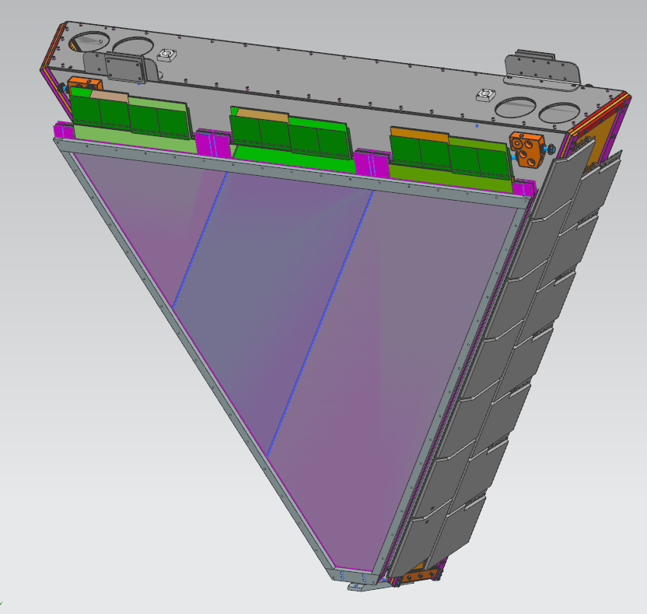
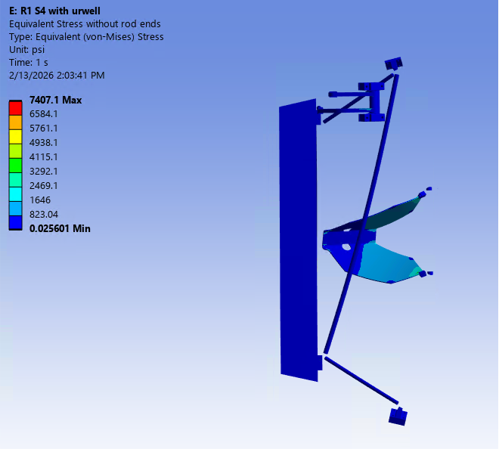
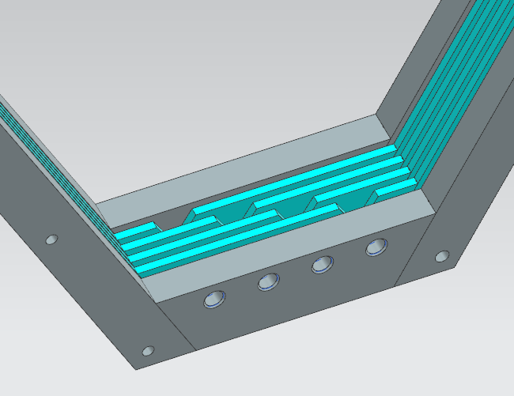
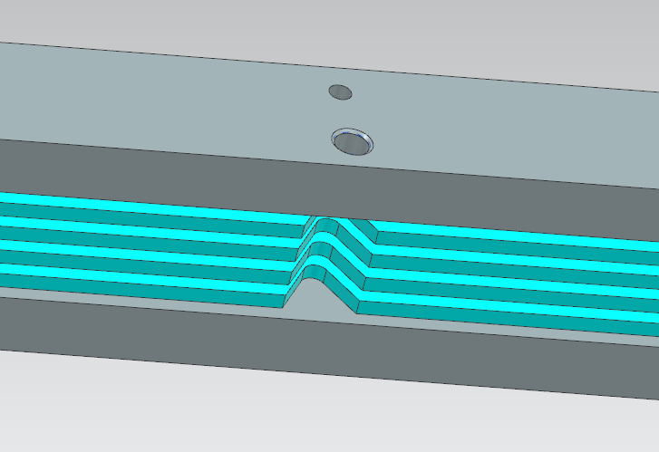
Full-size μRWell detector
Design concept:
Two UV readout planes in one detector.
Four cathode planes on three frames.
Four μRWELL planes mounted on two frames, with U and V layers on opposite sides of the frame.
Strip readout, strips parallel to the sides of the trapezoid, with ±29.5 degrees stereo angle between the U and V strips. The readout pitch size is 1 mm, strip width 0.5 mm.
Readout at the large base of the trapezoid.
The conceptual design is complete, including gas flow through the detector, mounting, and cooling of the front-end electronics.
Started a full design, with FEA analysis of drift chamber links with μRWELLs.
A2

Slide 13
Offline Software update – progress on FD tracking
𝝿
p
d
More work is underway to incorporate μRWELL detectors in the tracking.
Details in T. Cao’s presentation

Slide 14
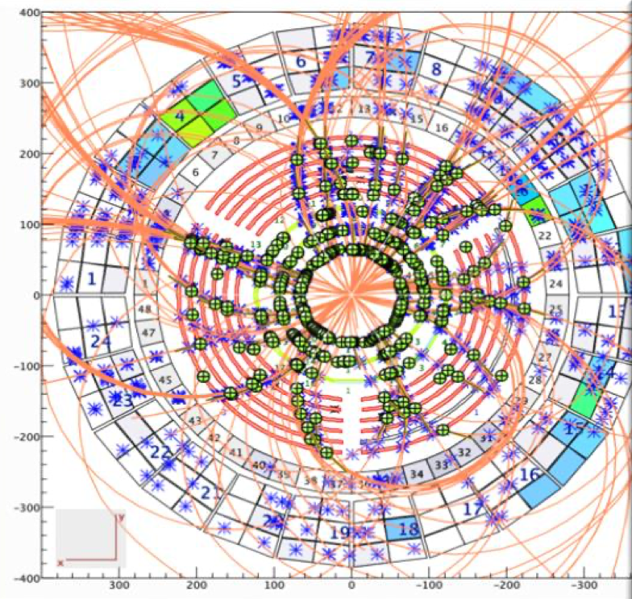
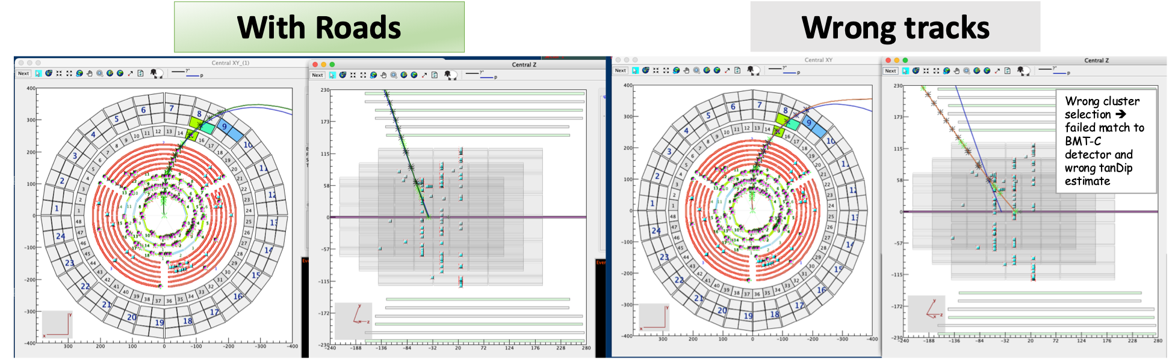
Offline Software update – progress on CVT tracking
RGE
The shortfalls of the existing algorithm: many seeds, difficulty selecting “good” candidates, a large number of “fake” tracks, loss of efficiency, and worsening of track parameter resolution with increasing background.
A new development in seeding the tracks – implement roads, a precomputed, discretized track hypothesis.
The package is ready. It stores simulated tracks in a bit-packed format. Trajectories are binned Q,p,θ,φ,z, and require intersecting the CTOF. Uses UberIndexing to find which roads correspond to the given set of clusters without having to decode every road.
Currently going through validation, code speed-up, and memory footprint evaluation.
Roads are parallel to the ongoing AI denoising effort led by Richard (Pierre, Mathieu R., Noah, Bhawani, Tontong, Veronique).
𝝿
p
d
Check V. Ziegler’s presentation at the round table meeting.

Slide 15
Computing: Data processing on JLAB Farm
We (ENP) are in a challenging situation regarding the availability of computing resources, and the situation is complex:
In 2024, ~10% of ENP computing capacity was taken offline to power non-ENP hardware.
The farm25 nodes were delivered but have not yet been connected, due to infrastructure limitations and issues with the 50A rPDUs.
A block of farm19 nodes (20% of our compute) has been offline since December, waiting for parts to arrive.
The bottom line: ENP/CEBAF computing availability is currently about a factor of two lower than projected just a year ago.
ENP computing projections, provided by the halls as part of the 5-year planning process, have generally been quite accurate. However, although the projected demand is acknowledged, the corresponding resources have not materialized.
Beyond the shortage of resources, we are also facing distribution and utilization challenges:
In early 2025, as planned the prior year, ENP's internal fairshare was redistributed, reducing B and D by one-third each to support an experiment in A. This reduction was expected to be offset by additional hardware, which has not yet been realized.
Shortly after, the scheduling and accounting system was modified to better support single-CPU jobs.
These fair-share redistributions, combined with the new single-CPU reservation policy, have had unintended side effects, including periods of underutilization of the farm.
There is no simple answer to distributing extremely scarce resources, but the current situation is not sustainable – processing only a shift of data (~1% of nominal CLAS12 run) per week is clearly insufficient.

Slide 16
Computing: CLAS12 MC and OSG
OSG remains the main platform for CLAS12 simulations. In 2025, JLab used 108M core-hours (~50% of the JLab farm), with CLAS12 accounting for the majority of usage.
From time to time, we experience congestion in the MC queue. The current backlog – 106+ submissions or an estimated 44 days to run – results from rerunning earlier MC samples generated with GEMC 5.12, which contained a bug affecting ECAL timing. The new release, GEMC 5.13, includes geometry and digitization updates as well as bug fixes.
A similar crunch occurred previously, when run groups (RGs) and working groups (WGs) were asked to coordinate large-scale MC production. In practice, this proved difficult. As a result, the software group has developed and is now implementing a fair-share scheduling mechanism to replace the current first-come, first-served system (details later today).
OSG is/was supported by NSF, which was terminated about 7 months ago. Some stopgap funding was available, which will run out soon. Efforts are ongoing to find funding, but it is complicated.
The collaboration may want to reach out to OSG Council leadership to provide support justification for funding (Brad Sawatzky). I thought we did this, is not it?
If OSG funding ultimately lapses, the computing resources themselves are expected to remain available, so we should be prepared to continue using them under a different support model.

Slide 17
Tentative run plan
Run Group |  |  |  |  |  |  | Scheduled Calendar Days | Remaining PAC Days Before Run | Scheduled PAC Days | Actual PAC Days from ABUs | Remaining PAC Days After Run
 | Setup / Status | Target | Beam Energy | Start Date | End Date | End Date
RG-E |  | liq. D2 & nucl. doublet | 11 |  |  |  | 66 | 33 | 33 |  | 0
 | reconfigure | change |  |  |  |  | 7 |  | 4
RG-K |  | liq. H2 | 8.8 |  |  |  | 120 | 52 | 60 |  | 0
 |  |  |  |  |  |  |  | sum: | 97
FY27
Run Group |  |  |  |  |  |  | Scheduled Calendar Days | Remaining PAC Days Before Run | Scheduled PAC Days | Actual PAC Days from ABUs | Remaining PAC Days After Run
 | Setup / Status | Target | Beam Energy | Start Date | End Date | End Date
RG-C |  | long. pol. NH3/ND3 | 11 |  |  |  | 80 | 40 | 40 |  | 0
RG-G |  | long. pol. 7LiD | 11 |  |  |  | 110 | 55 | 55 |  | 0
 |  |  |  |  |  |  |  | sum: | 95
FY28
Run Group |  |  |  |  |  |  | Scheduled Calendar Days | Remaining PAC Days Before Run | Scheduled PAC Days | Actual PAC Days from ABUs | Remaining PAC Days After Run
 | Setup / Status | Target | Beam Energy | Start Date | End Date | End Date
RG-B |  | liq. D2 | 11 |  |  |  | 90 | 51 | 51 |  | 0
 | reconfigure | change |  |  |  |  | 7 |  | 4
RG-I (HPS) |  | W | 4.4 |  |  |  | 180 | 105 | 50 |  | 0
 |  |  |  |  |  |  |  | sum: | 101
FY29
Run Group |  |  |  |  |  |  | Scheduled Calendar Days | Remaining PAC Days Before Run | Scheduled PAC Days | Actual PAC Days from ABUs | Remaining PAC Days After Run
 | Setup / Status | Target | Beam Energy | Start Date | End Date | End Date
RG-H |  | Transversely pol. NH3 | 11 |  |  |  | 250 | 125 | 90 |  | 0
 |  |  |  |  |  |  |  | sum: | 90
FY30

Slide 18
Summary
Hall B continues to produce world-class physics results, averaging ~9 publications per year.
The share of the CLAS12 publications is increasing, though the pace is slow. This impacts students, early-career scientists, and the overall health of the collaboration.
Preparations are progressing for the next run, PRad-II, scheduled to receive beam on March 27.
Software improvements continue: FD tracking is in good shape, CVT tracking is catching up, and steady progress is being made with RICH. The CalCom and software groups are working to streamline the calibration workflow to accelerate the process.
There is growing use of AI/ML techniques in analysis. Initial steps toward coordination and standardization within the collaboration have begun, though further efforts are needed.
Work continues on the forward-detector luminosity upgrade. Fabrication of the second large-area prototype is nearing completion, and the full-scale detector design is in an advanced stage.
Looking ahead, beyond the currently scheduled running, ~900 PAC-approved beam days (≥C1) with electron beams remain, corresponding to roughly 12 years of running assuming ~22 physics weeks per year. This indicates a strong physics program for the foreseeable future—though an important question remains: will we complete it before the next stage of CEBAF begins?

Slide 19
CLAS12 Run Group A and B Experiments
Proposal | Physics | Exp. Contact | Rating | Days | PAC | Jeop. | Group Days | Equipment | Energy | Group Contact | Target | Complete
E12-06-119(a) | Deeply virtual Compton scattering | M. Defurne | A | 80 | 30 | 48, 52 | 139 | CLAS12; RICH; Forward Tagger | 11 | A L. Elouadrhiri Deep Exclusive Processes | Liquid H₂ | 74d 53%
E12-06-108 | Hard exclusive electro-production of π⁰, η | Stoler | B | 80 | 38 | 48, 52
E12-12-007 | Exclusive φ meson electroproduction | Stoler, Weiss | B+ | 60 | 39 | 48, 52
E12-06-112 | Proton’s quark dynamics in SIDIS pion production | H. Avakian | A | 60 | 38 | 48, 52 |  |  |  | Deep Inclusive and SIDIS
E12-06-112A/ E12-09-008A | Semi-inclusive Λ productiuon in target fragmentation region | M. Mirazita |  |  | 42 | 48, 52
E12-06-112B | Collinear nucleon structure at twist-3 in dihadron SIDIS | M. Mirazita |  |  | 42 | 48, 52
E12-12-001 | Timelike Compton scattering and J/ψ photoproduction | P. Nadel-Turonski | A- | 120 | 39 | 48, 52 |  |  |  | Quasi-Photo-production
E12-12-001A | Near threshold J/𝜓 photoproduction and LHCb pentaquarks | S. Stepanyan |  |  | 45 | 48, 52
E12-09-003 | Excitation of nucleon resonances at high Q² | R. Gothe | B+ | 40 | 34 | 48, 52 |  |  |  | Nucleon Structure
E12-06-108A | Exclusive N* to KY studies with CLAS12 | D. Carman |  |  | 42 | 48, 52
E12-06-108B | Transition form factor of the η’ meson with CLAS12 | S. Schadmand |  |  | 44 | 48, 52
E12-11-005 | Hadron spectroscopy with forward tagger | M. Battaglieri | A- | 119 | 37 | 48, 52 |  |  |  | MesonEx
E12-11-005A | Photoproduction of the very strangest baryon | L. Guo |  |  | 40 | 48, 52 |  |  |  | VeryStrange
E12-07-104 | Neutron magnetic form factor | G. Gilfoyle | A- | 30 | 32 | 48, 52 | 90 | CLAS12; BAND; RICH; Forward Tagger | 11 | B S. Niccolai | Liquid D₂ | 39d 43%
E12-07-104A | Quasi-real photoproduction on deuterium | F. Hauenstein |  |  | 47 | 48, 52
E12-09-007(a) | Study of partonic distributions in kaon SIDIS | W. Armstrong | A- | 110 | 38 | 48, 52
E12-09-008 | Boer-Mulders asymmetry in kaon SIDIS with H and D targets | M. Contalbrigo | A- | 56 | 38 | 48, 52
E12-09-008B | Collinear nucleon structure at twist-3 in dihadron SIDIS | M. Mirazita |  |  | 42 | 48, 52
E12-11-003 | DVCS on the neutron | S. Niccolai | A (HI) | 90 | 38 | 48, 52
E12-11-003A | In medium structure functions, SRC, and the EMC effect | O. Hen |  |  | 43 | 48, 52
E12-11-003B | Study of J/ψ photoproduction from the deuteron | Y. Ilieva |  |  | 46 | 48, 52
Total PAC days for 12 (21) PAC approved experiments or experimental parts, all partially completed in 2018-2020 |  |  |  |  |  |  | 229 |  |  |  |  | 113

Slide 20
CLAS12 Run Groups C, F, K, and M Experiments
Proposal | Physics | Exp. Contact | Rating | Days | PAC | Jeop. | Group Days | Equipment | Energy | Group Contact | Target | Complete
E12-06-109 | Longitudinal spin structure of the nucleon | S. Kuhn | A | 80 | 30 | 48, 52 | 120 | CLAS12; RICH; Forward Tagger | 11 | C S. Kuhn | Long. polarized NH₃ ND₃ | 81d 67%
E12-06-109A | DVCS on the neutron with polarized deuterium target | S. Niccolai |  |  | 44 | 48, 52
E12-06-119(b) | DVCS on longitudinally polarized proton target | M. Defurne | A | 120 | 38 | 48, 52
E12-07-107 | Spin-orbit correlations with longitudinally polarized target | H. Avakian | A- | 103 | 38 | 48, 52
E12-07-107A | Single baryon production in the target fragmentation region | T. Hayward |  |  | 50 | 52
E12-09-007(b) | Study of partonic distributions using SIDIS K production | W. Armstrong | A- | 80 | 38 | 48, 52
E12-09-007A | Dihadron electroproduction in DIS | C. Dilks |  |  | 48 | 52
E12-09-009 | Spin-orbit correlations in K production with polarized targets | H. Avakian | B+ | 103 | 38 | 48, 52
E12-06-113 | Free neutron structure at large x | S. Bueltman | A | 42 | 30 |  | 42 | CLAS12; Radial TPC | 11 | F | Gaseous D₂ | 42d 100%
E12-06-113A | Neutron DVCS measurements with BONuS12 | R. Dupré |  |  | 47
E12-16-010 | A search for hybrid baryons | A. D’Angelo | A- | 100 | 44 | 48 | 100 | CLAS12; Forward Tagger | 6.6, 8.8 | K A. D’Angelo | Liquid H₂ | 49d 49%
E12-16-010A | Nucleon Resonances in exclusive KY electroproduction | D. Carman |  |  | 44 | 48
E12-16-010B | DVCS at 6.6 and 8.8 GeV | L. Elouadrhiri |  |  | 44 | 48
E12-16-010C | Separation of the σ_{L} and σ_{T} contributions to hadron production | H. Avakian |  |  | 51
E12-17-006 | Electrons for neutrinos addressing neutrino-nucleus issues | O. Hen | A | 45 | 46 |  | 45 | CLAS12; No Forward Tagger | 1.1, 2.2, 4.4, 6.6 | M O. Hen | Nuclear | 35d 78%
E12-18-003 | Exclusive studies of short-range correlations in nuclei | O. Hen |  |  | 46
Total PAC days for 9 (16) PAC approved experiments or experimental parts, 14 partially and 2 fully completed in 2018-2024 |  |  |  |  |  |  | 307 |  |  |  |  | 207

Slide 21
CLAS12 Run Group D, E, and L Experiments with existing targets
Proposal | Physics | Exp. Contact | Rating | Days | PAC | Jeop. | Group Days | Equipment | Energy | Group Contact | Target | Complete
E12-06-106 | Color transparency in exclusive vector meson production | L. El Fassi | B+ | 30 | 30 | 48 | 30 | CLAS12 | 11 | D L. El Fassi | Nuclear & liquid D₂ | 40d 100%
E12-06-106A | Nuclear TMDs | R. Dupre |  |  | 48
E12-06-117 | Quark propagation and hadron formation | W. Brooks | A- | 60 | 30 | 48 | 60 | CLAS12 | 11 | E H. Hakobyan | Nuclear & liquid D₂ | 27d 45%
E12-06-117A | Dihadron measurements in electron-nucleus scattering | M. Arratia |  |  | 48
E12-17-012 | Partonic structure of light nuclei | Z. Meziani | A- | 55 | 45 |  | 55 | CLAS12; Forward Tagger; ALERT | 11 | L R. Dupré | Gaseous H, D, ⁴He | 55d 100%
E12-17-012A | Tagged EMC measurements on light nuclei | R. Dupré |  |  | 45
E12-17-012B | Spectator-tagged DVCS on light nuclei | W. Armstrong |  |  | 45
E12-17-012C | Other physics opportunities with ALERT | R. Dupré |  |  | 45
E12-23-013 | Measuring short-range correlations with ALERT | F. Hauenstein | A | 17 | 51 |  | 17 |  | 6.6 | F. Hauenstein (RG-T) |  | 16 d 100%
C12-25-004 | A Measurement of the Coherent J/psi Electroproduction Cross Section off 4He | S. Lee | C2 |  | 53 |  |  |  |  |  | Gaseous ⁴He
Total PAC days for 4 (9) PAC approved experiments, 2 fully and 2 partially completed, 5 scheduled to get completed in 2025 |  |  |  |  |  |  | 162 |  |  |  |  | 57

Slide 22
Experiments ending with A, B or C are run group additions running parallel to the experiments with same experiment number
CLAS12 Run Group H and other non-scheduled CLAS12 experiments with targets under development
Proposal | Physics | Contact | Rating | Days | PAC | Jeop. | Group Days | Equipment | Energy | Group | Target | Complete
E12-14-001 | EMC effect in spin structure functions | W. Brooks | B+ » A- | 55 | 35 | 48, 52 | 55 | CLAS12 | 11 | (RG-G) | Pol. ⁷LiD
E12-11-111 | SIDIS on transverse polarized target | M. Contalbrigo | A»C2»A | 110»125 | 39, 53 | 48, 52 | 125 | CLAS12 | 11 | H M. Contalbrigo | Trans. pol. NH₃
E12-12-009 | Transversity with di-hadron on transverse target | H. Avakian | A»C2»A | 110»125 | 39, 53 | 48, 52
E12-12-010 | DVCS with transverse polarized target | L. Elouadrhriri | A»C2»A | 110»125 | 39, 53 | 48, 52
E12-11-111A | Measurements of Single Spin Asymmetries in exclusive production of hadrons with CLAS transversely polarized target | H. Avakian |  |  | 53
C12-20-002 | Spin-dependent electron scattering with polarized ³He target | R. Milner | C1 (A-) | 30 | 48 |  | 30 | CLAS12 | 11 | (RG-N) | Pol. ³He
E12-20-005 | Precision measurements of A=3 nuclei | H. Szumila-Vance | A- | 60 | 48 |  | 60 | CLAS12 | 2.2, 6.6 | (RG-P) | ³H/³He
C12-21-004 | SIDIS measurement of A=3 Nuclei | L. Weinstein | C2 | 58 | 49, 50 |  | 58 | CLAS12 | 11 |  | D/³H/³He
Total PAC days for 6 (7) PAC approved and conditionally approved experiments |  |  |  |  |  |  | 270
Conditionally approved µCLAS12 Experiments in Hall B
Proposal | Physics | Contact | Rating | Days | PAC | Jeop. | Group Days | Equipment | Energy | Group | Target | Complete
C12-25-001 | Electro- and photo-production of muon pairs with μCLAS12 | S. Stepanyan | C1 (A) | 245 | 53 |  | 245 | µCLAS12 | 11 | RG-S | Liquid H₂
Total PAC days for 1 PAC conditionally approved experiment |  |  |  |  |  |  | 245
CLAS12 – 748 days (includes 245 of muCLAS12)
S. Stepanyan, CLAS Collaboration meeting, March 10-13, 2026, JLAB

Slide 23
Non-CLAS12 Experiments in Hall B
Proposal | Physics | Exp. Contact | Rating | Days | PAC | Jeop. |  | Equipment | Energy | Group | Target | Complete
E12-11-006 | Heavy Photon Search (HPS) | T. Nelson | A | 180 | 37, 39 | 48, 52 |  | HPS setup in alcove | 2.2, 6.6 | (RG-I) | Nuclear | 78d 43.3%
E12-11-106 | High precision measurement of proton charge radius (PRad) | A. Gasparian | A | 15 | 39 |  |  | HyCal setup | 1.1, 2.2 | (RG-J) | H2 gas jet | 15d 100%
E12-20-004 | High precision measurement of proton charge radius (PRad-II) | A. Gasparian | A | 40 | 48 |  |  | HyCal setup | 0.7, 1.4, 3.5 | RG-O PRad-II/X17 | H2 gas jet | 40d scheduled
E12-21-003 | A direct detection search for hidden sector new particles (X17) | A. Gasparian | A | 60 | 50 |  |  | HyCal setup | 2.2 |  | Ta foil | 25d scheduled
E12-22-003 | Precision measurement of neutral pion transition form factor | I. Larin | A- | 67 | 50 |  |  | HyCal setup | 11 | (RG-Q) | Si foil
Total PAC days for 5 PAC approved experiments,1 partially, 1 fully completed in 2016-2021 |  |  |  | 362 |  |  |  |  |  |  |  | 93
Non-CLAS experiments – 252 days (the upcoming run will use ~100 days)
Total Hall B remaining run time – 900 PAC days or 11.7 years of running with electron beams, assuming 22 weeks/year schedule for physics.
Conditionally approved Positron Beam Experiments in Hall B
Proposal | Physics | Contact | Rating | Days | PAC | Jeop. |  | Equipment | Energy | Group | Target | Complete
C12+23-008 | A direct measurement of hard two-photon exchange with e^{+/-} | A. Schmidt | A | 55 | 51 |  |  | CLAS12 | 2.2, 4.4, 6.6 |  | Liquid H₂
C12+23-002 | Beam charge asymmetries for DVCS on the proton | E. Voutier | A- | 100 | 51 |  |  | CLAS12 | 2.2, 11 |  | Liquid H₂
C12+24-005 | A Dark Photon Search with a JLab positron beam | B. Wojtsekhowski | A- | 55 | 52 |  |  | HyCal setup | 2.2,4.4,11 |  | New liquid H₂ target
Total PAC days for 3 PAC conditionally approved positron beam experiments |  |  |  | 210

