Slide 1
Status of KLF Beamline
Hovanes Egiyan
Jefferson Lab

Slide 2
Overview
Beamline Description
Compact Photon Source
Kaon Production Target
Summary and Outlook

Slide 3
KLF Layout
KLF experiment needs to produce high intensity photon beam upstream of KPT.
CPS (Compact Photon Source) with a 20% radiator will be used to produce photons.
CPS will be installed in the Tagger Hall after the GlueX tagger magnet.
K_{L}-beam will be produced in Kaon Production Target (KPT) in the collimator cave.
K_{L}-beam will travel all the way to the cry-target.
Tagger Hall
Hall D
65 m

Slide 4
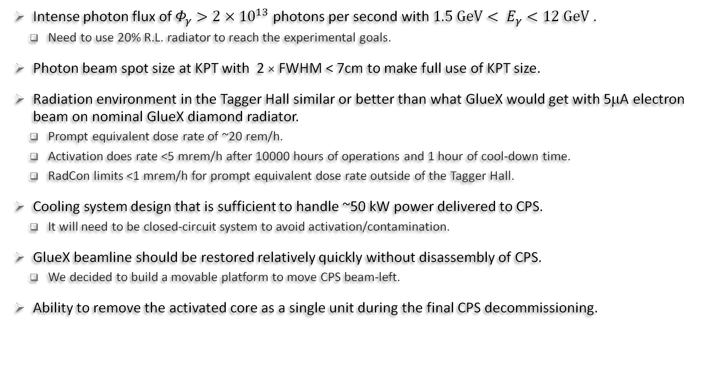
CPS Requirements
Intense photon flux of $Φ_{γ}>{2×10}^{13}$photons per second with ${1.5 GeV< E}_{γ}<12 GeV$ .
  Need to use 20% R.L. radiator to reach the experimental goals.
Photon beam spot size at KPT with 2 × FWHM < 7cm to make full use of KPT size.
Radiation environment in the Tagger Hall similar or better than what GlueX would get with 5μA electron beam on nominal GlueX diamond radiator.
  Prompt equivalent dose rate of ~20 rem/h.
  Activation does rate <5 mrem/h after 10000 hours of operations and 1 hour of cool-down time.
  RadCon limits <1 mrem/h for prompt equivalent dose rate outside of the Tagger Hall.
Cooling system design that is sufficient to handle ~50 kW power delivered to CPS.
  It will need to be closed-circuit system to avoid activation/contamination.
GlueX beamline should be restored relatively quickly without disassembly of CPS.
  We decided to build a movable platform to move CPS beam-left.
Ability to remove the activated core as a single unit during the final CPS decommissioning.

Slide 5
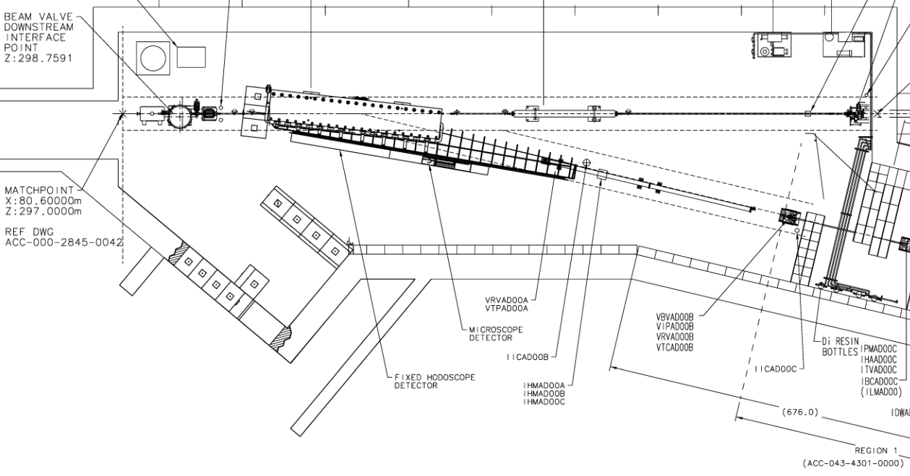
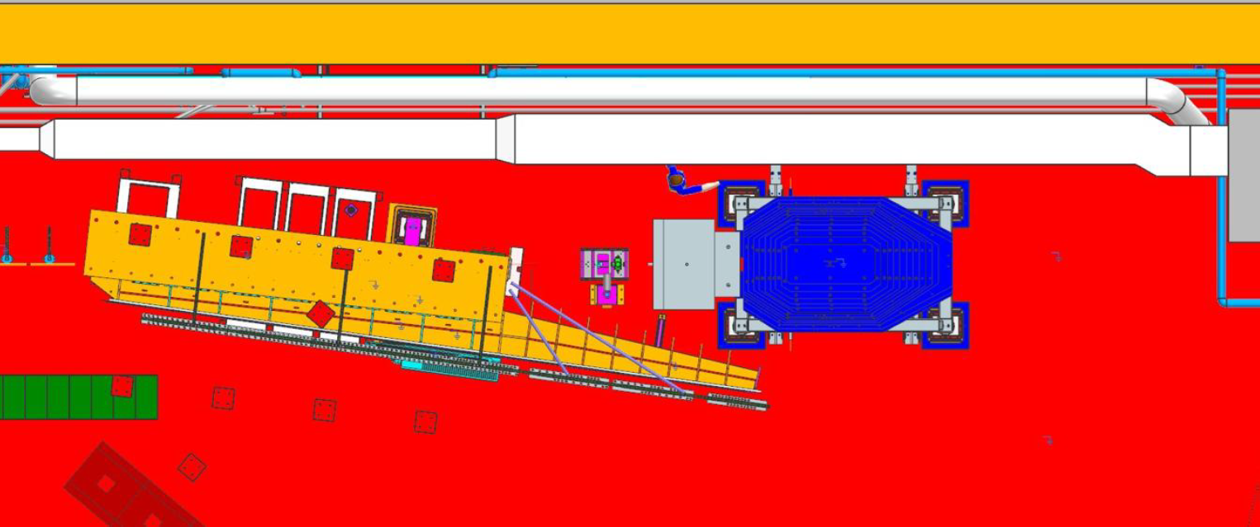
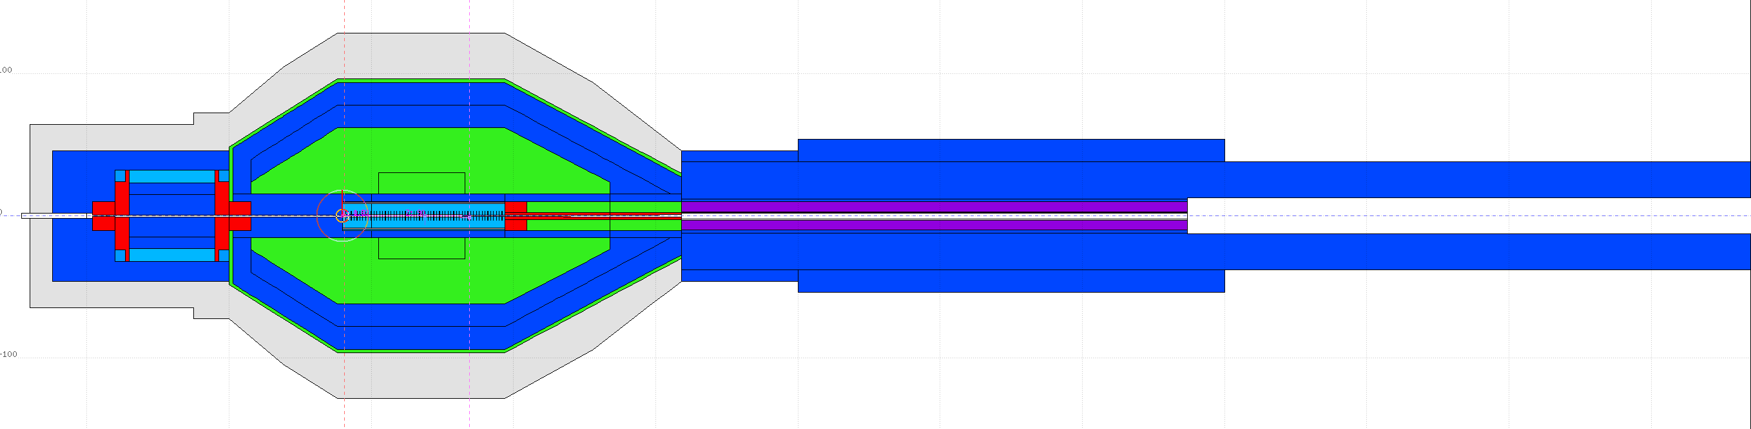
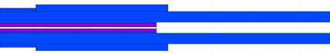
CPS Positioning in the Hall D Tagger
3m space to park CPS
Water skids
Quad
GlueX Tagger magnet
γ
12 GeV, 5 μA e⁻
Goni
CPS
GlueX Tagger focal plane
Tagger detectors will be removed
Door
Truck Ramp
Tagger dump area

Slide 6
Current CPS Model in FLUKA
P. Degtiarenko
Relatively small modifications compared to the design presented in detail in 2023 .
CPS radiator is now 20% R.L.
  We did not see negative impact on CPS after Pavel made small adjustments.
Modifications to incorporate features of the engineering design.
  Detail modeling of the shielding bricks.
CPS magnet located upstream of the absorber bends electron downwards .
  No heat load on the magnet poles and coils from the core.
  Low radiation exposure to the magnet.
Clean-up magnet downstream for charged particles.
  Utilize the existing permanent magnet used in GlueX beamline.
Use lead instead tungsten is used in the CPS shielding to save costs.
  Small amount of a tungsten-copper mix is used for shielding the beam channel and magnet coils.
W80/Cu20
Radiator
W80/Cu20
Borated Poly
Vacuum, photon beam channel
Iron
Concrete
Lead
Concrete
Air or N₂
Lead
Iron
Upstream Magnet
Beam slit after magnet, air or N₂
Borated Poly
Copper Core
GlueX Permanent Magnet

Slide 7
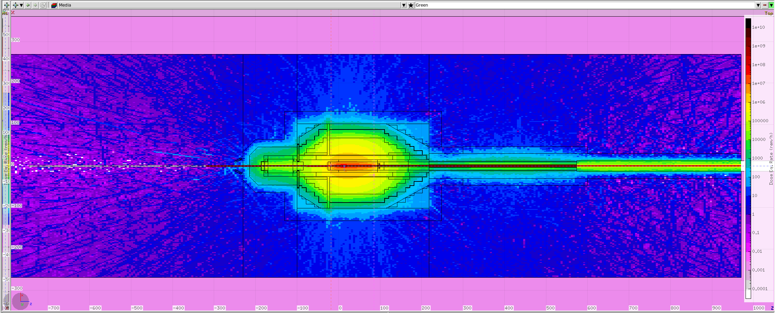
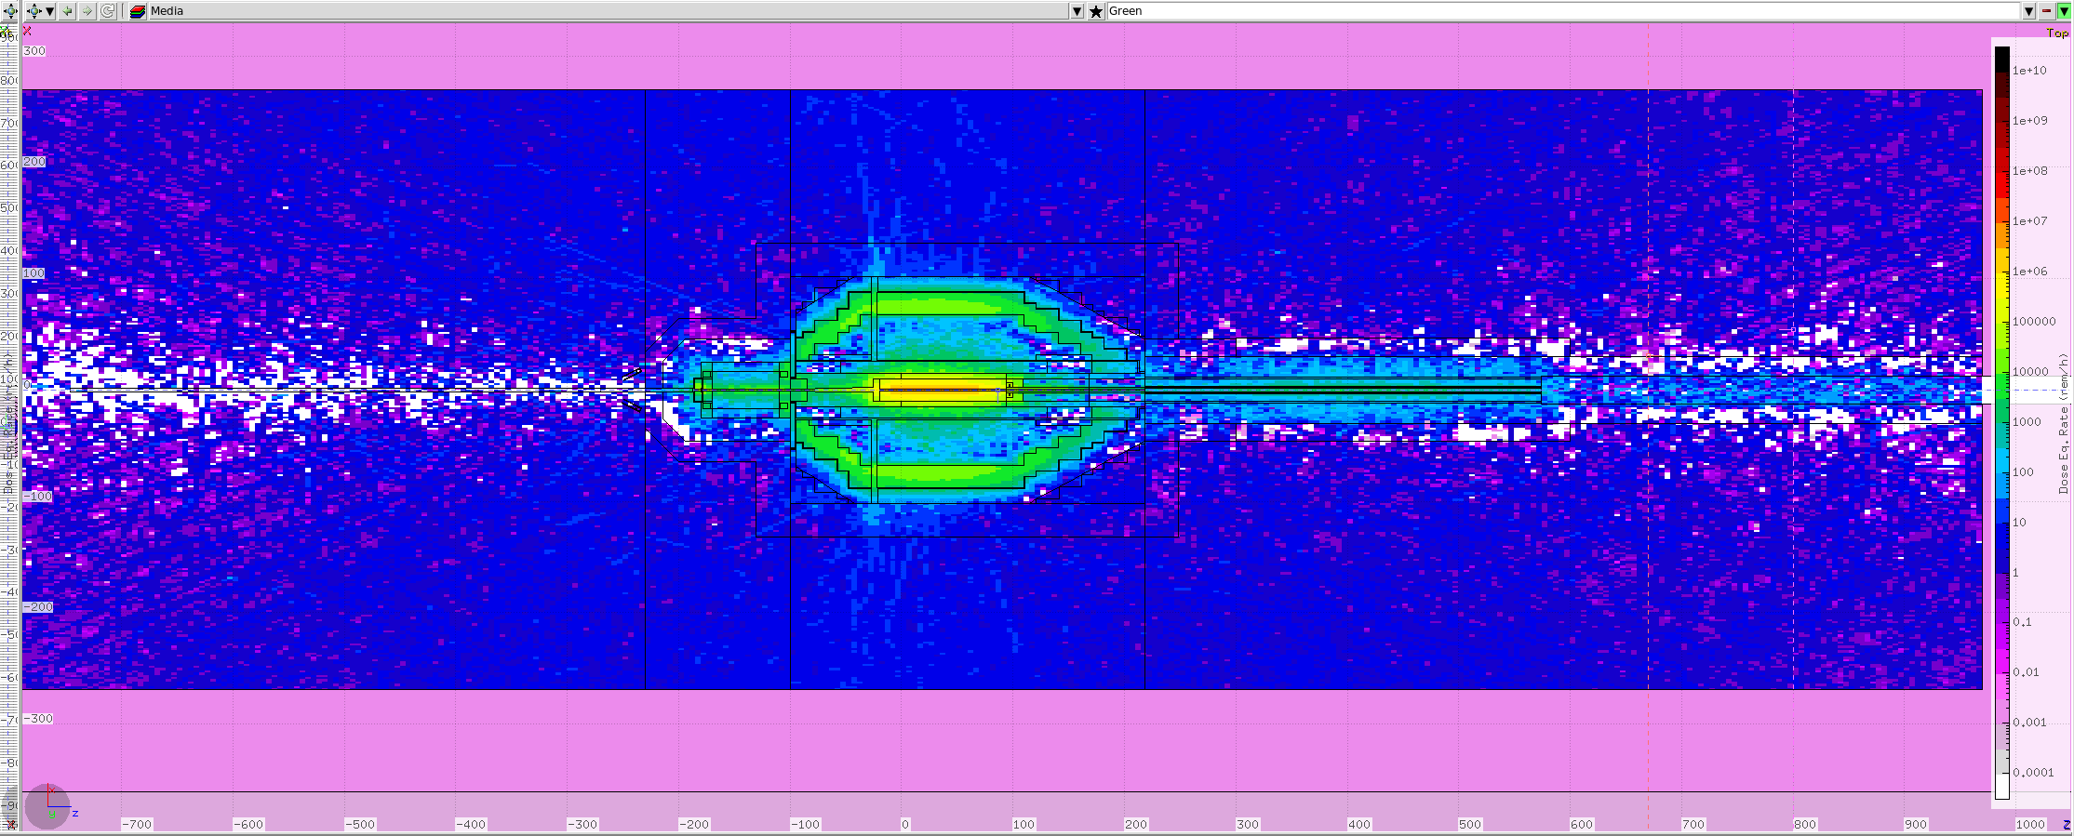
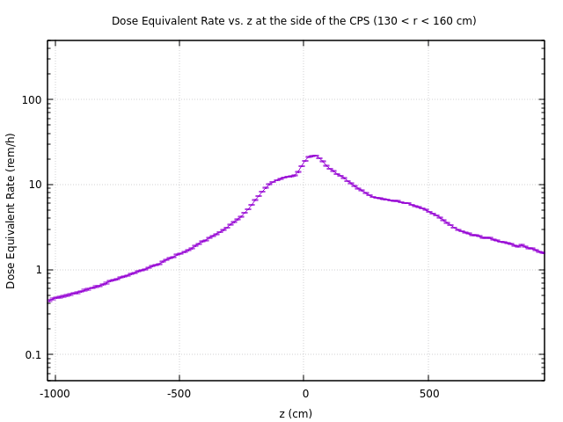
Dose Rates
P. Degtiarenko
Prompt dose equivalent rate, CPS midlpane, view from top
Prompt dose rate inside Tagger Hall around CPS is ~20 rem/h.
  ~30 rem/h right at the CPS surface.
  <10 rem/h far away from CPS
We evaluated residual dose rate after 10000 hours of continuous operations and 1 hour cool-off time.
  The rates outside of CPS are expected to be
  ~1 mrem/h, that is well within JLAB limits.
Tagger Hall
<10 rem/h
30 rem/h
Residual dose rate , CPS midplane, view from top
Prompt rate averaged over r and φ
Tagger Hall
1 mrem/h
1 mrem/h
10 m

Slide 8
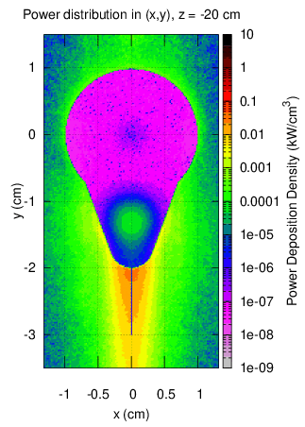
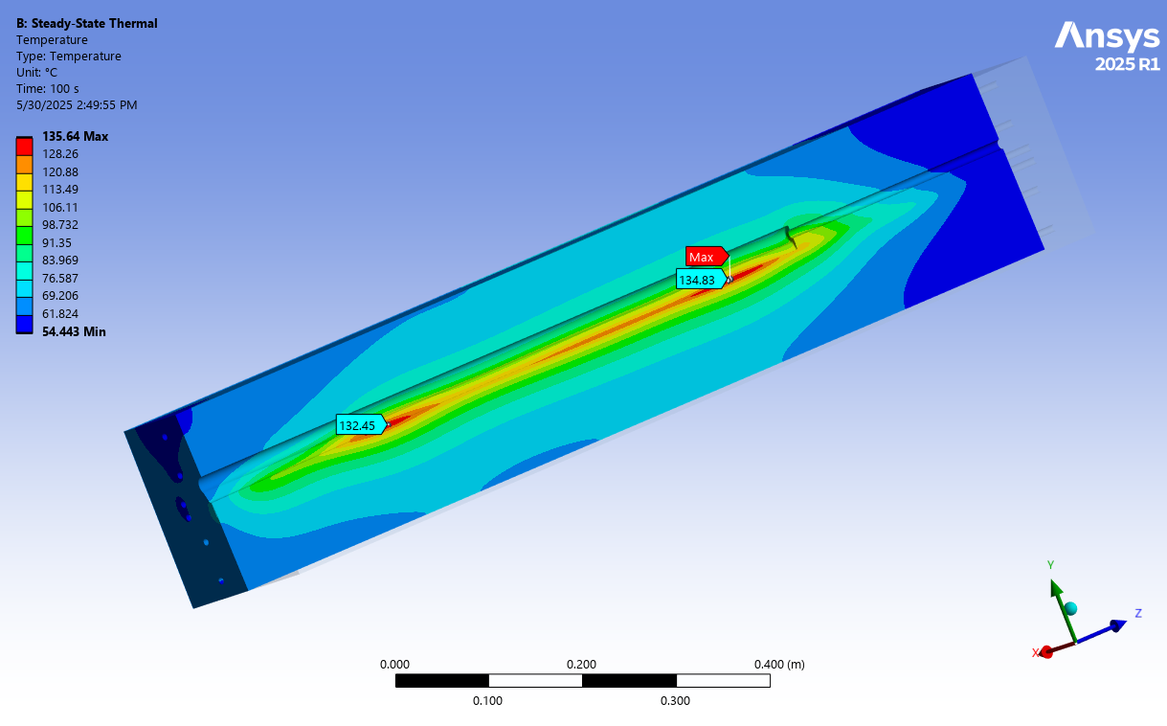
Power Deposition in the Absorber
P. Degtiarenko
Almost all of the electron beam power (~48KW) is deposited into the copper absorber.
  May cause deformation of the photon channel
  CPS absorber needs active cooling.
  Must prevent heat transfer from absorber to the surrounding volumes.
Use FLUKA to estimated power deposition profile in CPS.
T_{max} = 135 ^{O}C
FLUKA provides an output file with power deposition densities in 3D.
  Thermal analysis shows that the hottest spot in the absorber will be ~135 ^{O}C at nominal conditions.
  Radiator will not need active cooling.
ANSYS analysis shows that we should not have problems with deformation with the current design and the assumed beam parameters.
20% radiator with
nominal beam
T. Whitlatch

Slide 9
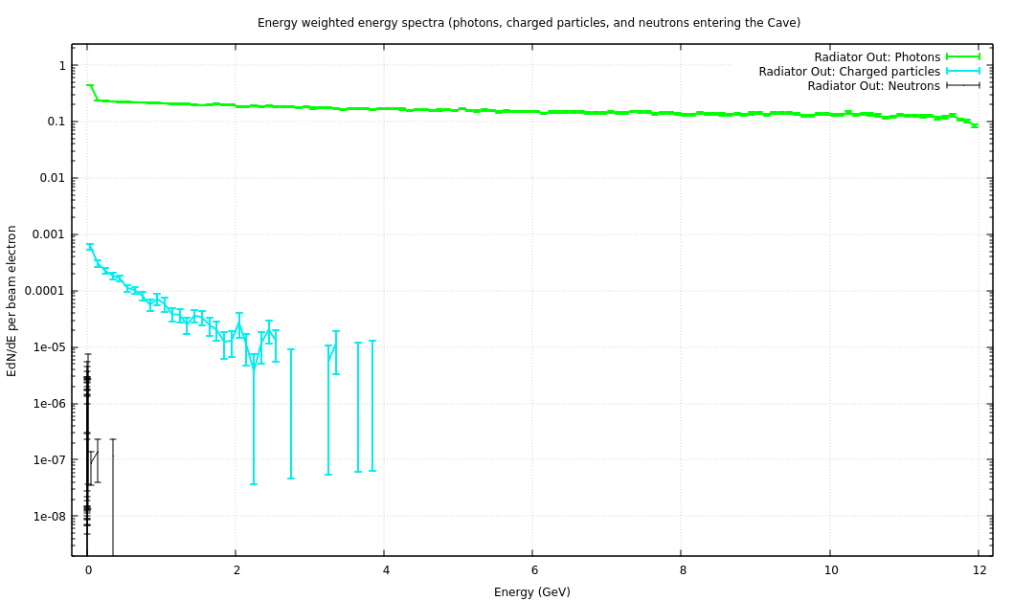
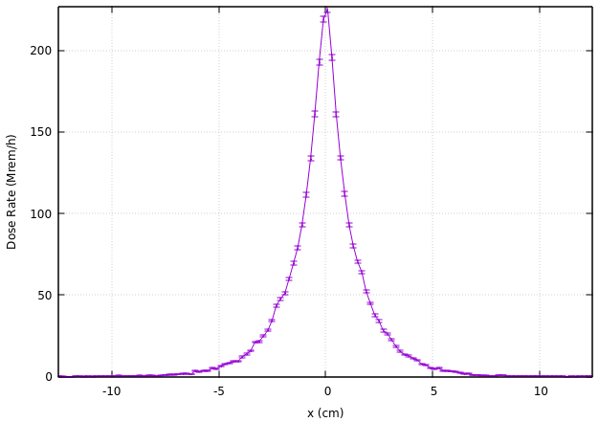
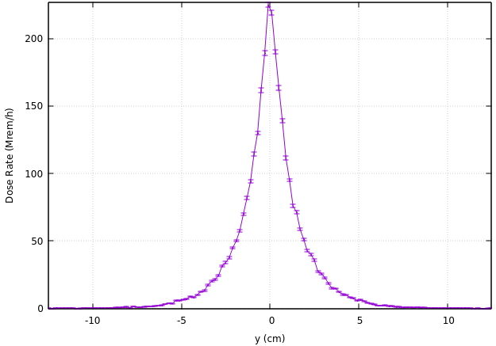
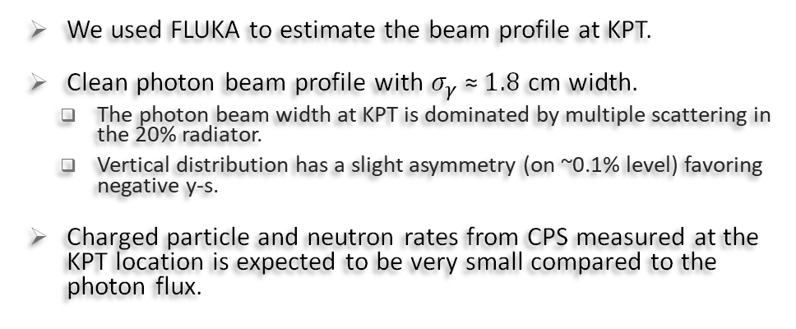
Photon Beam
P. Degtiarenko
γ-s
Energy-weighted spectrum of different types of particles at KPT
We used FLUKA to estimate the beam profile at KPT.
Clean photon beam profile with $σ_{γ} \text{≈} 1.8$ cm width.
  The photon beam width at KPT is dominated by multiple scattering in the 20% radiator.
  Vertical distribution has a slight asymmetry (on ~0.1% level) favoring negative y-s.
Charged particle and neutron rates from CPS measured at the KPT location is expected to be very small compared to the photon flux.
Charged
particles
Neutrons
− 0.2 cm < y < 0.2 cm
− 0.2 cm < x < 0.2 cm
Vertical profile of
photons at KPT
Horizontal profile of
photons at KPT

Slide 10
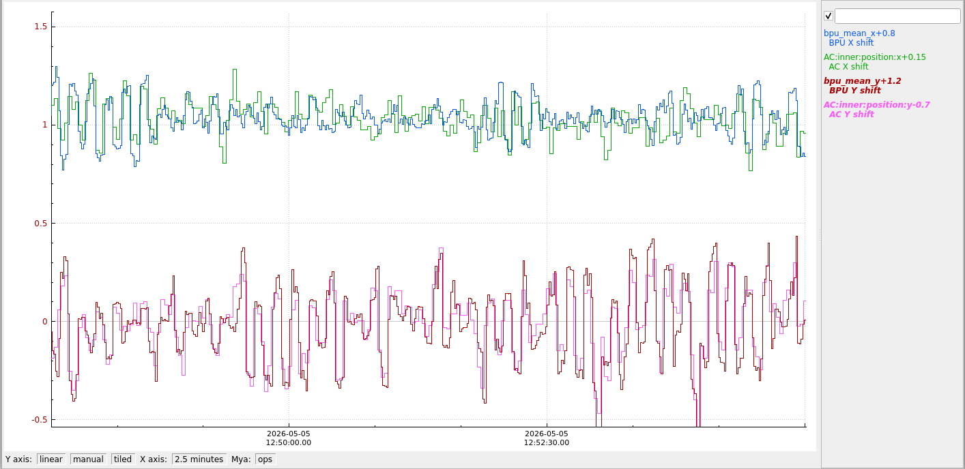
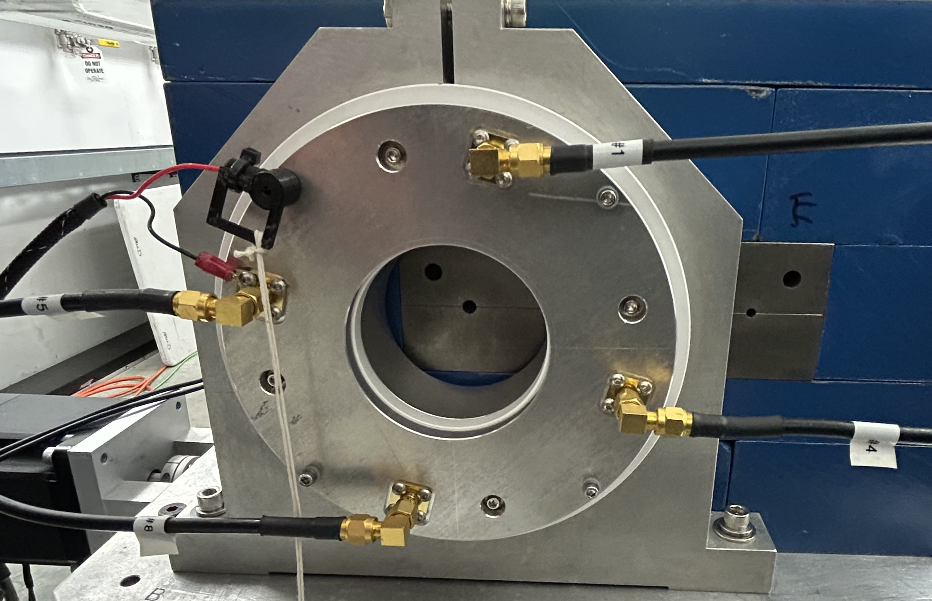
KLF Active Collimator
We will need a device to maintain the high intensity photon beam position on KPT.
Thermal analysis shows that it will need cooling to prevent overheating.
A modified version of the GlueX Active Collimator has been built by University of Connecticut and delivered to JLAB.
The amplifying electronics still needs to be modified to match the AC current and the existing amplifiers.
FSD signals will need to be implemented in the electronics to shut off the CEBAF beam at large beam excursions.
K_{L} Active Collimator is currently installed in the GlueX beamline and is used for the low energy running.
Width σ≈1.8 cm for KLF vs σ≈1.1 cm for GlueX at low energies are closer to each other.
First KLF-specific equipment to be tested with beam at JLAB.
Still being commissioned.
γ-beam motion at GlueX collimator
Beam Profiler vs KLF AC
mm

Slide 11
Electron Beam Requirements
Parameter | @ CPS Radiator | @ KPT
Beam current | 50 nA ≤ I_{B} ≤ 5 μA | N/A
Beam spot size | 0.5 mm ≤ σ ≤ 1.5 mm | σ ≤ 1 cm
Beam stability (@ 1 Hz) | σ ≤ 0.2 mm | σ ≤ 2 mm
FSD tripped levels | |Δx| > 1 mm or |Δy| > 1 mm | |Δx| > 1 cm or |Δy| > 1 cm
Beam halo (halo-to-peak) | < 10⁻⁴ at r > 5σ | N/A
Beam emittances | ε_{x,y} ≤ 5 nm-rad | N/A
It is important to have a good electron beam tune on the radiator.
  Avoid excessive radiation in Tagger Hall.
  Avoid higher temperatures in the CPS absorber.
We found that beam rastering will not be necessary.
  Use wider beam than GlueX does.
  We will need to make sure that beam profile is wide using wire scans at CPS.
  Need to check the beam halo to avoid excessive radiation.
We will install a girder just upstream of CPS for beam diagnostics with:
  BCM to measure the beam current,
  BPM to measure beam positions,
  Wire scanner for beam widths.
FSD trips on
  Large electron beam positions excursions,
    Use a collar and PMT-based counters.
  Electron beam angle excursion,
    Measure photon beam position at KPT using active collimator.
  Magnet current deviations.
    Use power supply ADCs.
    Field sensors or pickup coils inside the magnet
Keep Hall D radiator scanner with ~10⁴ dynamic range for the halo measurement.

Slide 12
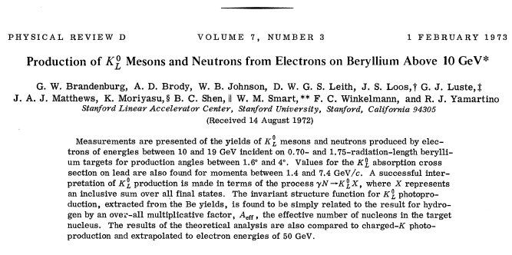
Kaon Production Target
Pb shielding
γ-BEAM
K_{L}-BEAM
Be target
W-plug
Borated poly
shielding
Original Specs
Parameter with original KPT | Value
Electron beam current | 5 μA
CPS Radiator thickness (z) | 0.1 X₀
Be target length (z) | 40 cm
Be target diameter | 6 cm
Tungsten plug length (z) | 10 cm
Tungsten plug width (x&y) | 14.2 cm
Sweeping magnetic field | 0.82 (T•m)
PS magnetic field | 1.65 (T•m)
LH2 target length (z) | ~40cm
LH2 target diameter | 6cm
Total K_{L} rate | 10 KHz
Kaon to neutron ratio R_{K} / R_{n} | <1 at P<2 GeV/c, >10 at P>4 GeV/c
K_{L}-s are created in KPT mostly through φ-photoproduction.
PAC48 proposal had a basic design of KPT.
  Projected ~10 KHz K_{L} rate.
  Passed ERR-1 review in 2023.
  Full engineering design exists for this model.
During summer of 2024, it was found that the flux of low energy photons are very likely to cause serious problems to GlueX detectors.
  Some of the items will be discussed later in this talk.
It was decided in 2024 to suspend all procurements for KPT until these issues have been resolved.

Slide 13
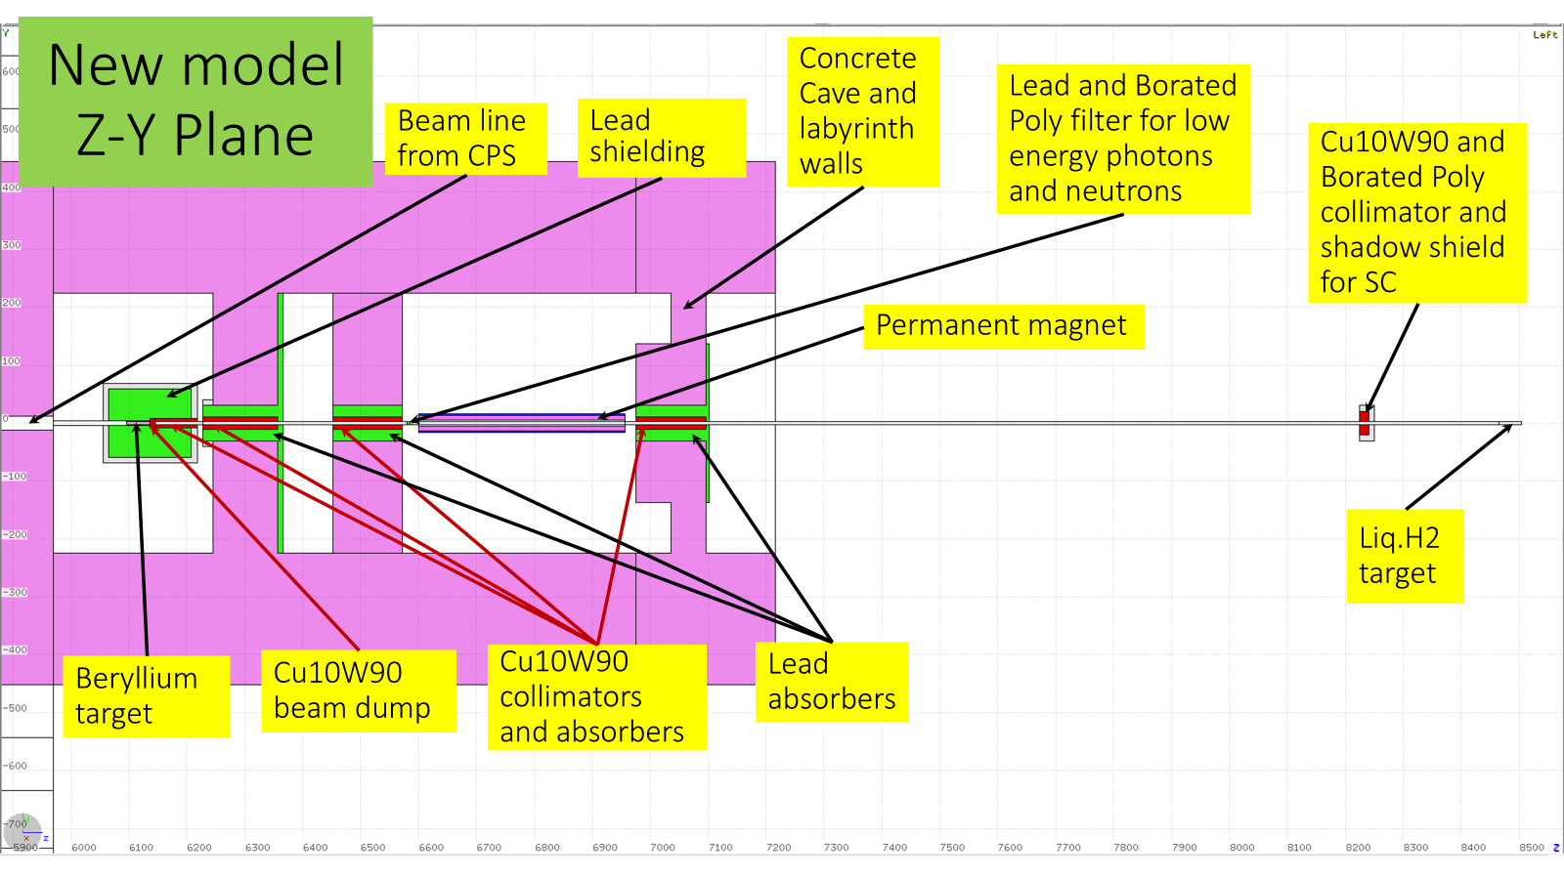
“Recent” KPT Simulations
Richard Jones implemented a KPT model with the downstream beamline into GlueX HDGeant simulation program.
  Significant problems were identified with the detector rates in SC, FDC, TOF, and CDC.
  It was decided to try to find a solution that would reduce the rates to values equal or smaller than the ones seen in HDGeant with GlueX-II conditions.
GEANT4 model
Richard
Pavel Degtyarenko added geometry of KPT and downstream beamline to his FLUKA model for KLF.
  No obvious issues were identified with the radiation environment.
  Pavel suggested improving the shielding by adding steel and CuW collars near the beam at the exit of the KPT assembly and labyrinth walls.
  Pavel noticed that the neutron flux with P>4 GeV/c will be significantly larger than what was in the PAC48 proposal.
  Low energy photon rates in the beam at the target location were higher than expected.
BEAM
FLUKA model
Pavel

Slide 14
Detector Rates using original KPT design
R. Jones
KLF with GlueX SC
L_{W}=10cm
KLF with Cylindrical SC
L_{W}=10cm
GlueX-II with GlueX SC
x10
Start Counter is problematic with 10cm tungsten block.
  Would need a ~17cm W-block to work with GlueX SC
  Need 14cm W-block to work with a cylindrical SC.
FDC cannot be used with 10cm W-block.
  Need 14cm W-block for KLF.
The tungsten plug must be thicker.
FDC rates for KLF
L_{W}=10cm
FDC rates for GlueX-II
x10

Slide 15
Reducing Detector Rates
Attenuation Length
λ = 1.74±0.07cm
CDC rate attenuation with respect to W plug thickness is significantly slower than for SC and FDC rates.
  FDC and SC rates seems to originate mainly from the low energy photons in the beam
The main source of CDC rates is different.
  Making W-block a little thicker will not solve the CDC rate problem.
  Beam pipe shielding is important for CDC rates.
Goal from GlueX-II
Attenuation Lengths
λ₁ = 1.1±0.3 cm,
λ₂ = 8.4±3.7 cm.
Attenuation Lengths
λ₁ = 1.2±0.1 cm,
λ₂ = 4.4±0.6 cm
Goal from GlueX-II
Goal from GlueX
R. Jones

Slide 16
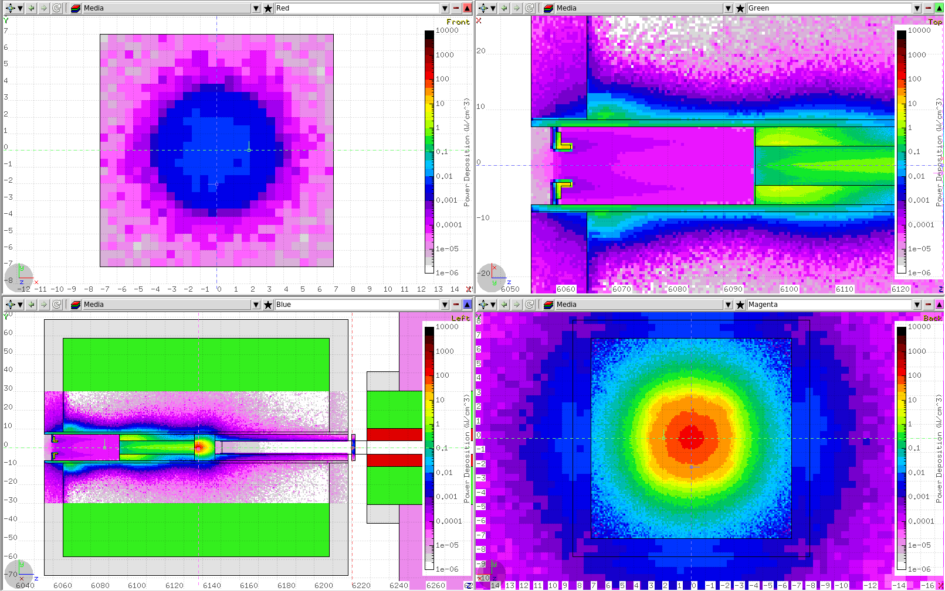
Modifications to KPT
To reduce the background, it was suggested to increase the W-plug thickness to 14 cm.
  Alternatively, one could use 11cm W-plug with variable thickness W or Pb after KPT assembly.
To operate with a 20% R.L. radiator, more modifications are needed to handle more heat load and larger spread of the γ-beam.
  Be-target is surrounded by copper block to absorb the power before reaching W-plug as well as for better cooling.
  The walls of the beam channel upstream of Be-target are water-cooled.
Use very thick beam pipes and a thick shielding wall between PS magnet and the target.
  60cm thick at this time.
It has not been decided if γ-beam to LH₂ target will be needed for calibration purposes.
  Will affect engineering design.
FLUKA model and power deposition by Pavel
11cm W-plug + insertable layers of Pb (6cm)
Power deposition in downstream Pb filter
Copper
Be-target
Pb Filter:
0.4 W
AC
CuW Block (11 cm): 5.9 kW
Be-target
W-plug
Pb filter
Power deposition in W-plug

Slide 17
Radiation Environment with new KPT
FLUKA simulations by Pavel do not indicate high radiation environment in the hall.
The dose rate increase is consistent with roughly x2 increase of the beam energy delivered to the collimator cave.
1 mrem/hr
2 Krem/hr
Evaluations of the dose rates at the ceiling (and other tallies), and the residual dose rates in the cave have not been done with 20% radiator.
  We still need to evaluate the cool off time for accessing the collimator cave.
Pavel is concerned about large muon flux penetrating the hall.
The radiation environment around the hall building will need to be evaluated.
10 mrem/hr
Total Dose Equivalent Rate
FLUKA by Pavel

Slide 18
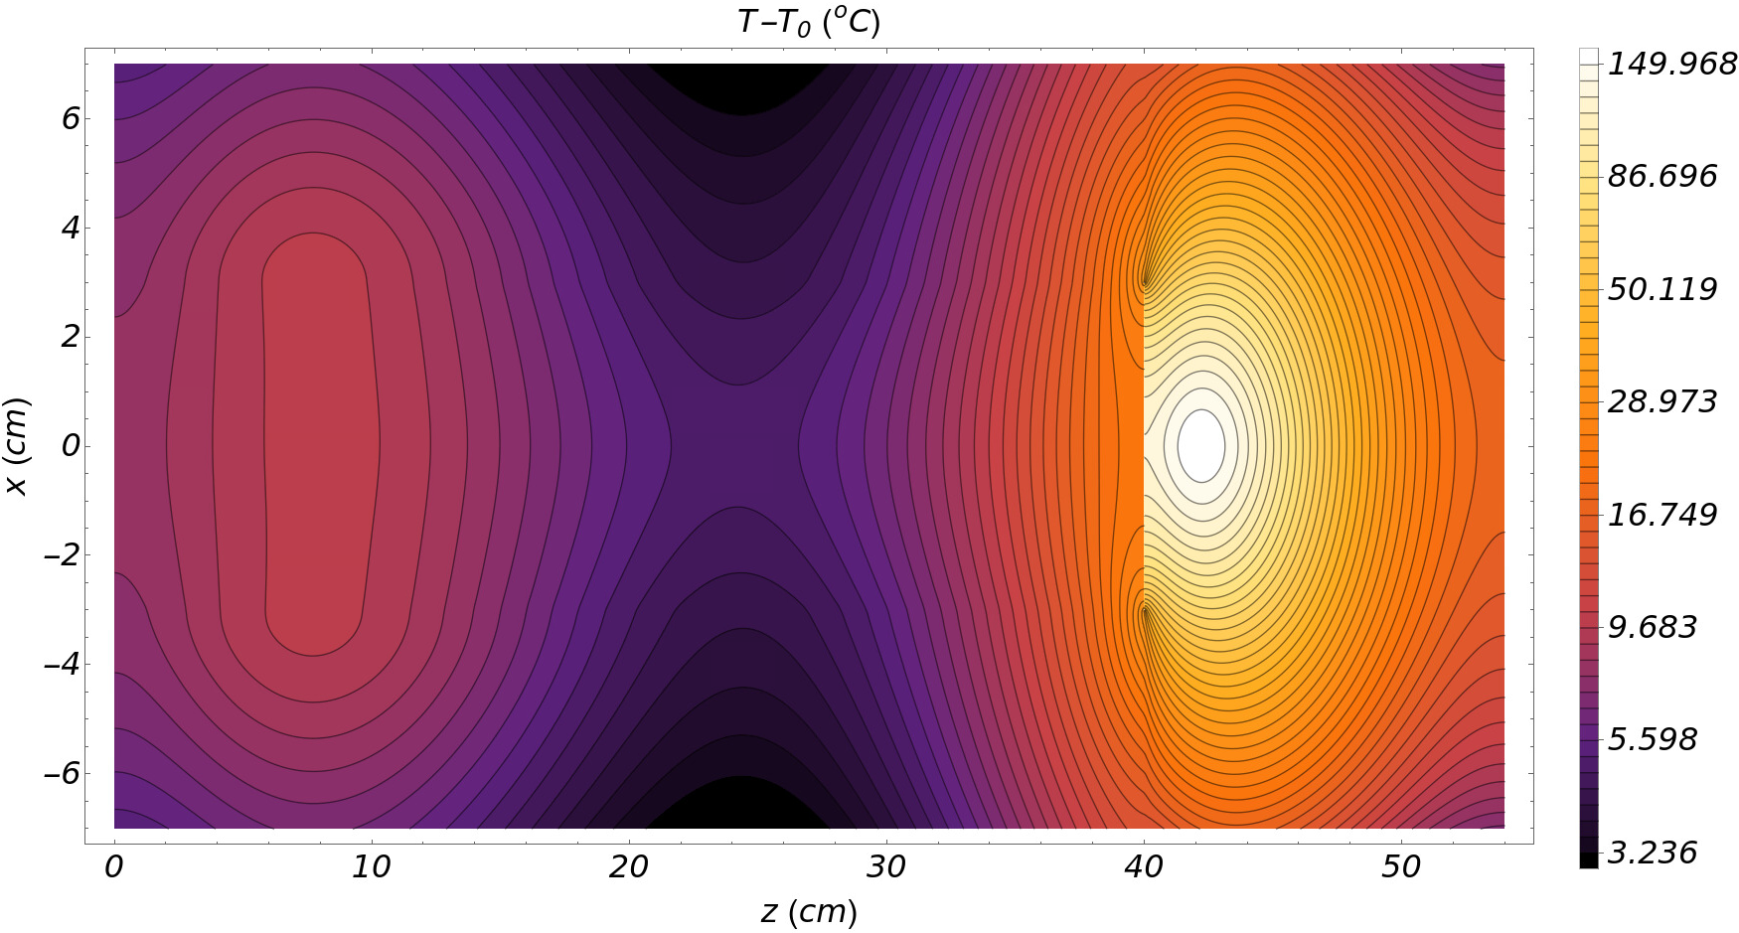
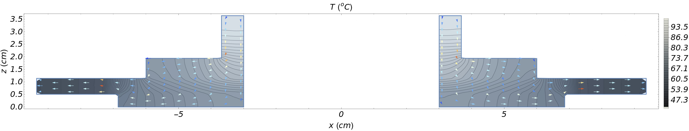
Thermal Analysis for KPT (Mathematica)
Temperature distribution
Power deposition from FLUKA with a fixed 14cm W-plug
D=7cm Be
W-Plug
Cu
Pavel used FLUKA to simulate power deposition in the KPT assembly for nominal beam conditions with a 20% radiator.
Thermal analysis of the plug and Be-target, and the AC plates are done both in Mathematica and ANSYS.
No problems is expected in the nominal beam conditions if the area upstream of the Be target and AC area are water cooled.
  Essentially the same T_{max} as for 10% radiator and 10cm W-plug.
Beam excursion scenarios have not been considered yet.
COLD RING
BN cup base
COLD RING
Tungsten wedges
BEAM
Al backplate
18

Slide 19
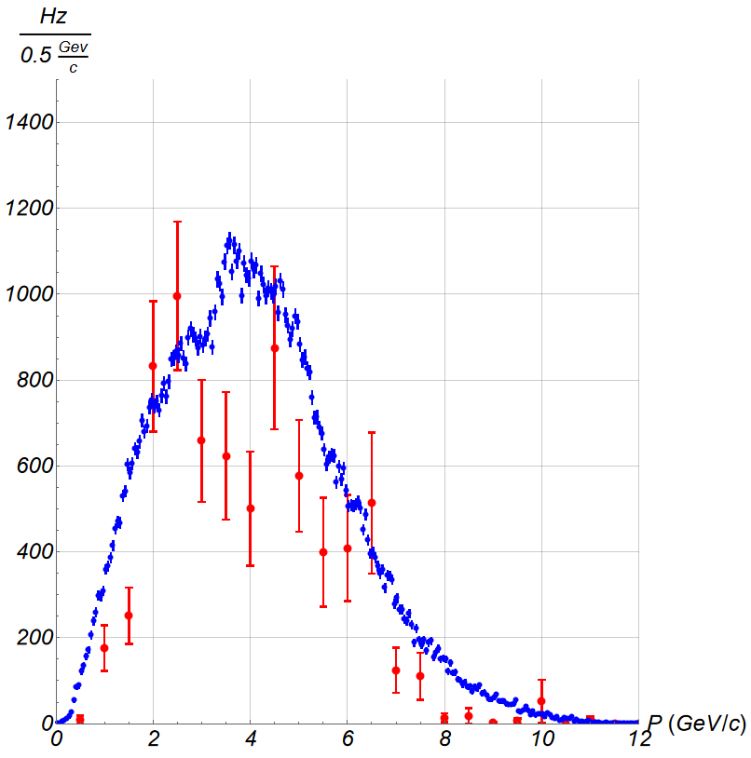
New KPT Parameters
New CPS/KPT Parameters
Parameter | Value
Electron beam current | 5 μA
CPS Radiator thickness (z) | 0.2 X₀
Be target length (z) | 40 cm
Be target diameter | 7 cm
Tungsten plug length (z)* | 14 cm
Tungsten plug width (x&y) | 14.2 cm
Sweeping magnetic field | 0.82 (T•m)
PS magnetic field | 1.65 (T•m)
Beam pipe aperture before LH₂ target ** | 5 cm
LH₂ target length (z) | 40 cm
LH₂ target diameter | 6 cm
PAC48 – 10 KHz
NEW
FLUKA – 7 KHz
NEW
NEW
May change
Aa a result of the KPT design modifications, a new set of key parameters were obtained.
We have multiple estimates for the kaon beam rates for the new design.
K_{L}-to-neutron ratio at higher momenta is expected to be substantially worse than estimated in the PAC48 proposal.
At this point, we need some more input from new detectors to further optimize KPT and beamline.
Analysis | K_{L} Rate (Hz) (10cm W, 10% RL) | K_{L} Rate (Hz) (14cm W, 20% RL) | Effective K_{L} Absorption length used (cm) | Comments
Ilya & Igor | 10000 |  |  | PAC 48
Pavel |  | 8200 | 10.8 | FLUKA
Eugene | 3300 | 1900* | 7.8 | φp production only
Eugene | 8500 | 5000* | 7.8 | PYTHIA, 7KHz - 10KHz range
Richard |  | 1500 | 7.8 | φp production only
Moskov |  | 7600 | 6.4 | Based on SLAC data
Hovanes |  | 3100 | 7.1 | Based on SLAC data

Slide 20
Summary and Outlook
Conceptual design for KLF CPS is complete. We are in the advanced stages of developing the engineering design.
  CPS has been optimized for 20% R.L. radiator.
  Some procurements are already done.
  Development of the engineering design slowed down due to the funding limitations.
Conceptual design of the KPT assembly has changed.
  The tungsten blocker needed to be thicker.
    Different options to achieve this are on the table.
  Cooling and shielding had to be modified to deal with the thicker radiator in CPS.
  The key hardware for the KLF AC is here and is being used in GlueX.
  The engineering design depends on the decision regarding the need of the photon beam in the hall for detector calibration purposes.
The impact of the design changes on the kaon and neutron rates and on the physics FOM needs to be studied.
Presently, the design of the beamline downstream of KPT is not well defined.
  Waiting for inputs from KFM and the Start Counter.
    Geometry and hits from the detectors need to be implemented GlueX GEANT4 simulations.
  Once GEANT4 and FLUKA models are available, we can proceed with optimization of the downstream beamline as well as KPT.
Most of the work on the beamline design are on hold due to two main reasons:
  Further design of KPT and assembly and beamline requires input from KFM and Start Counter.
  There is very little funding available to proceed with procurements and even the design.

