Slide 1
Status of the Bonn-Gatchina PWA
Andrey Sarantsev
KLF meeting 06.05.2026

Slide 2
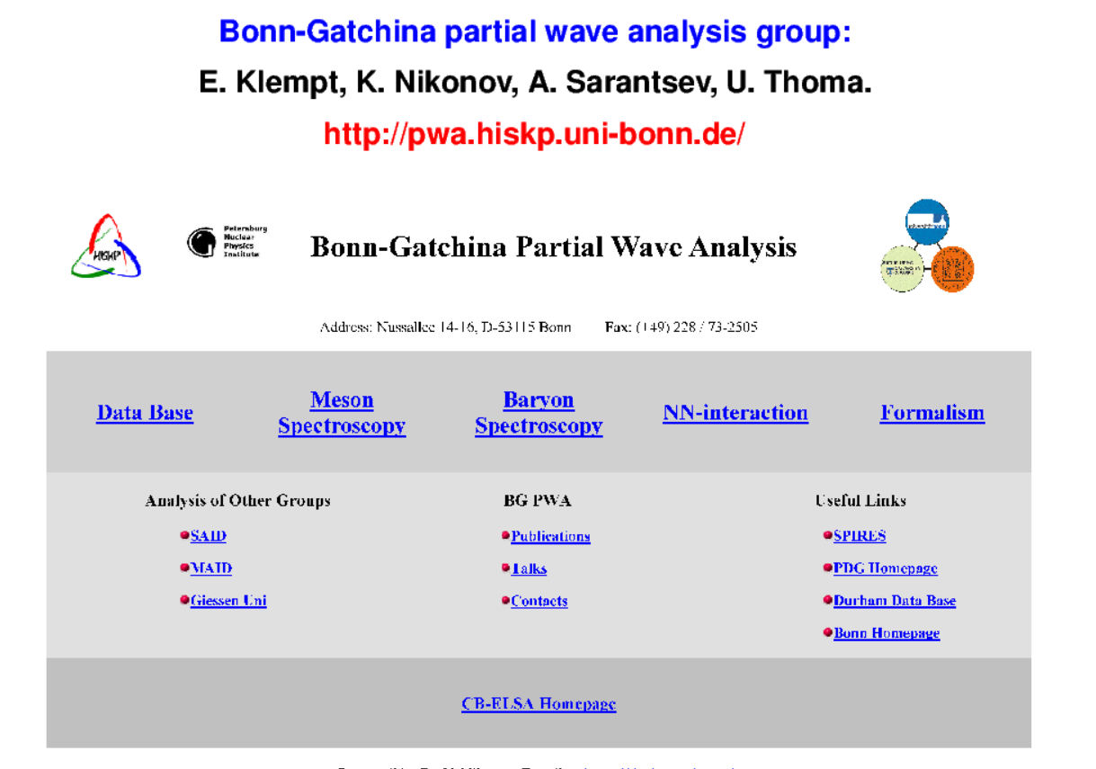

Slide 3
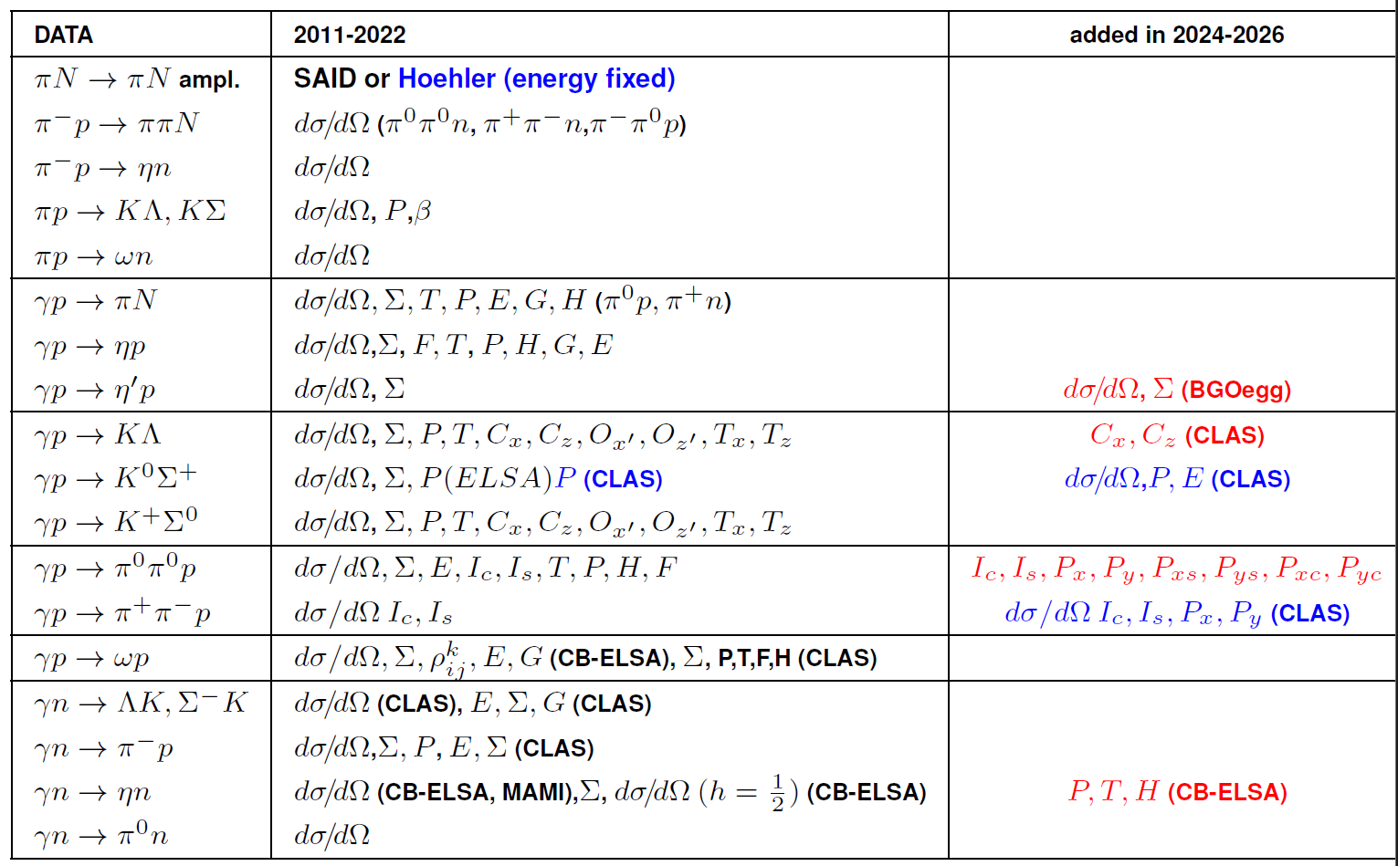
Data Base of the Bonn-Gatchina analysis

Slide 4
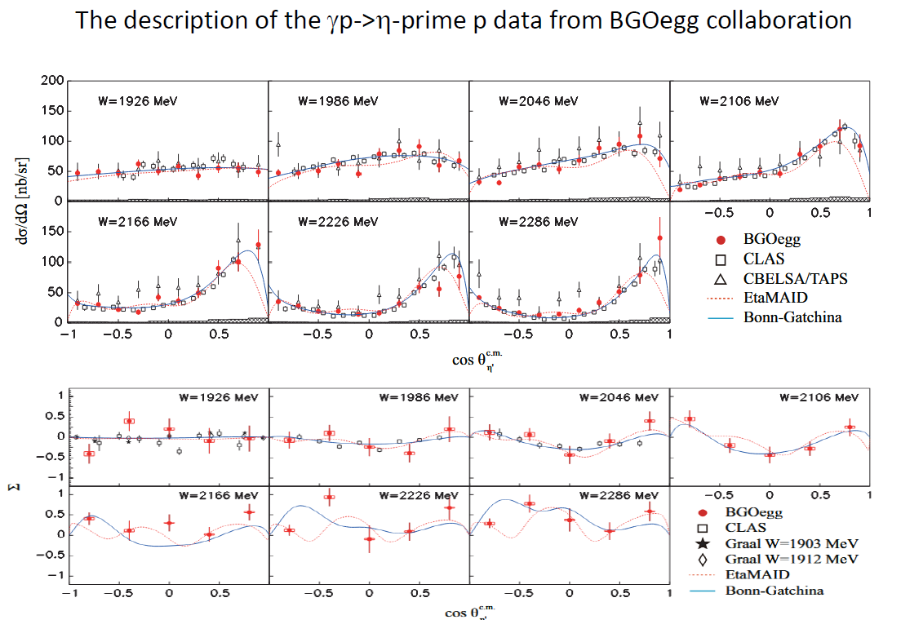

Slide 5
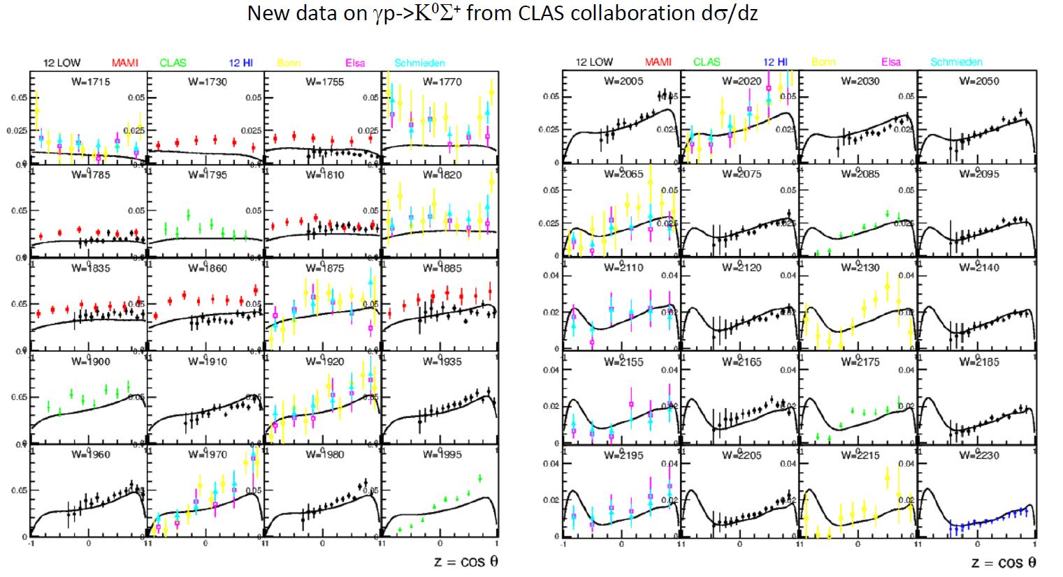
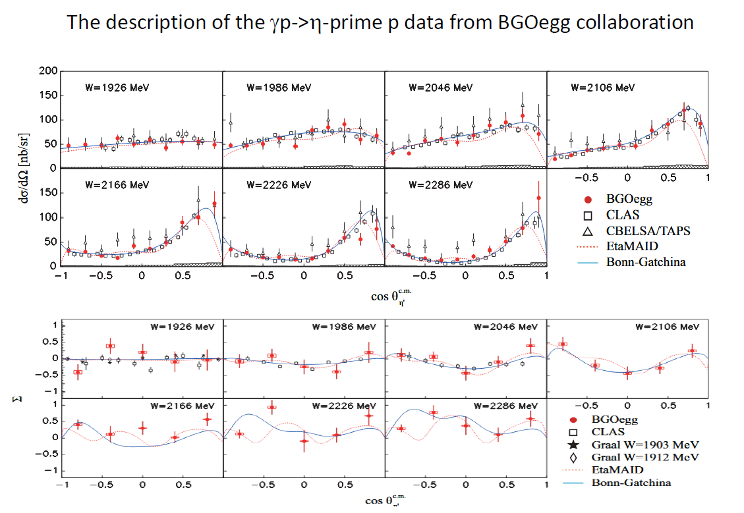

Slide 6
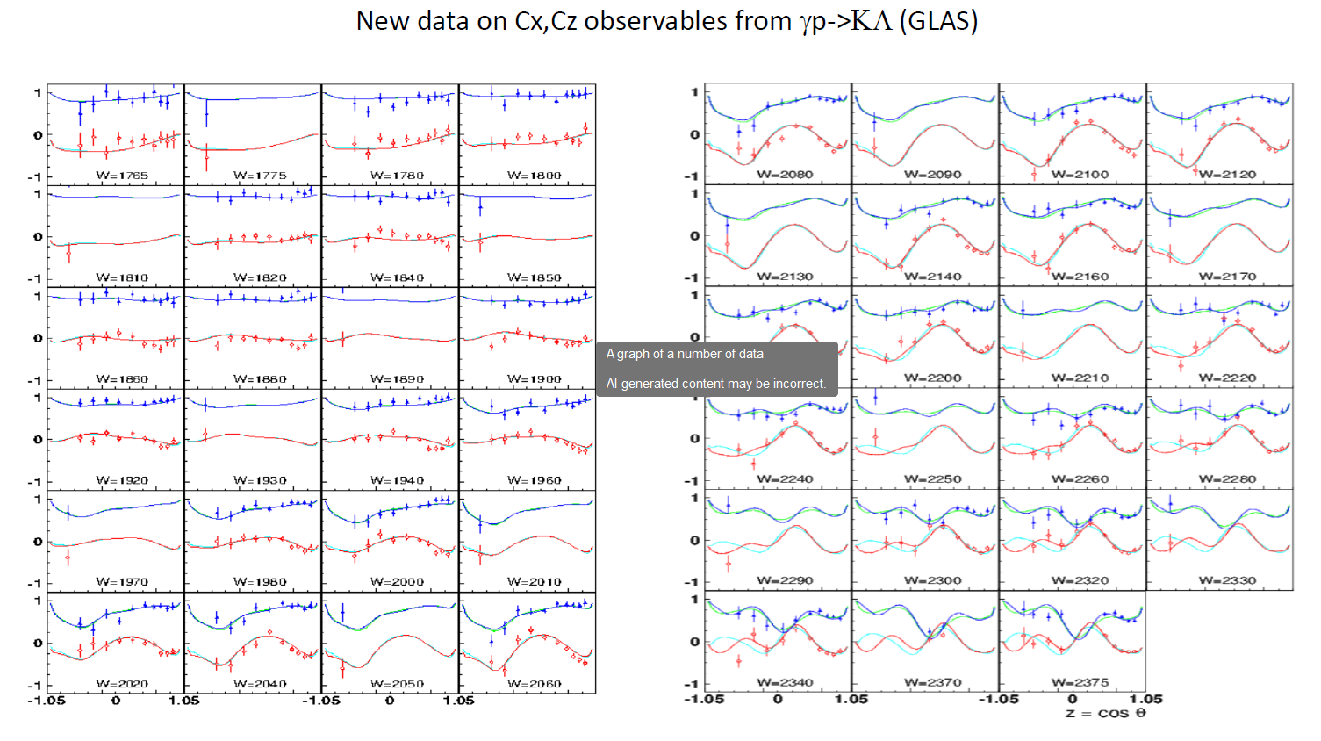

Slide 7
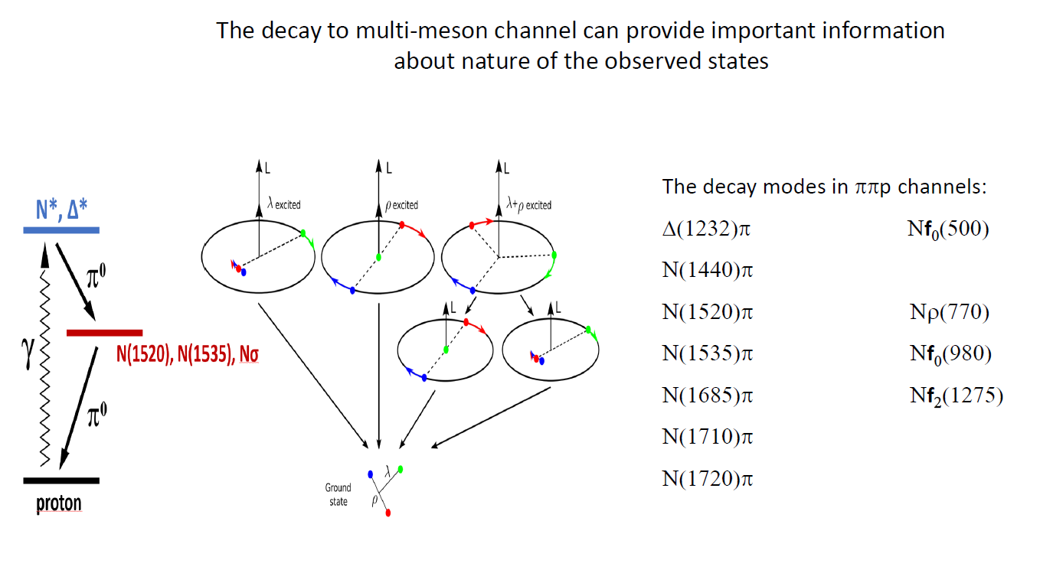

Slide 8
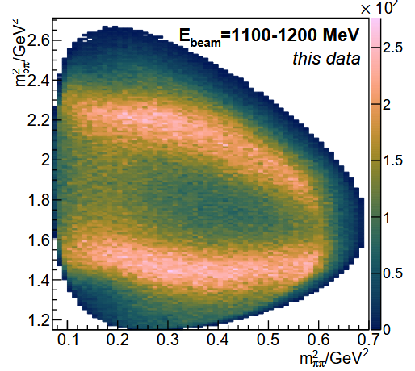
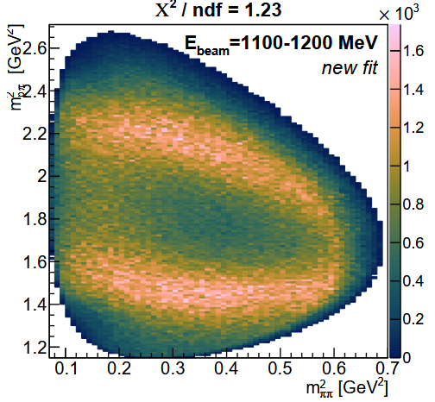
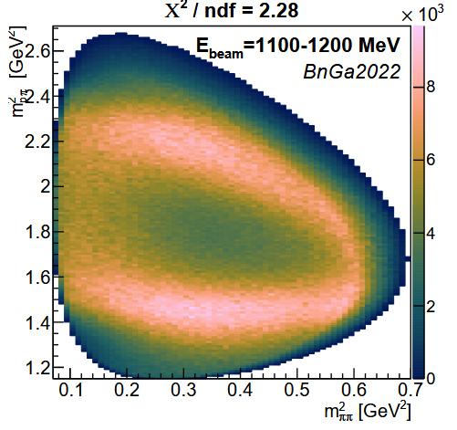
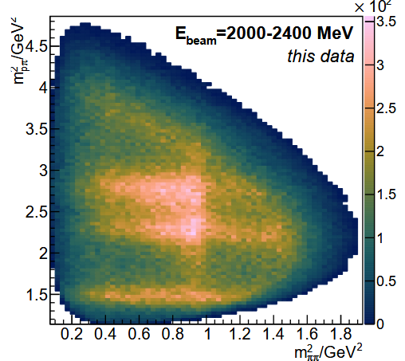
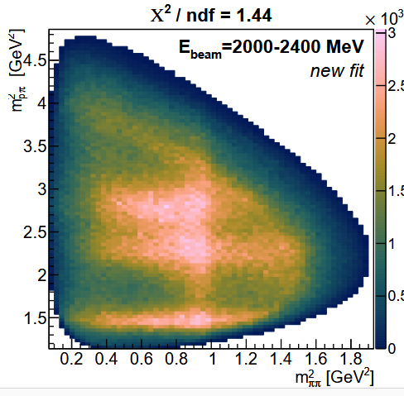
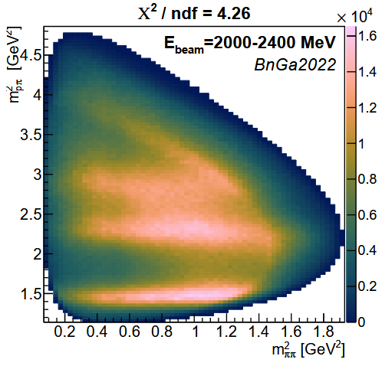
Analysis of the high statistical data on γp -> π⁰π⁰p

Slide 9
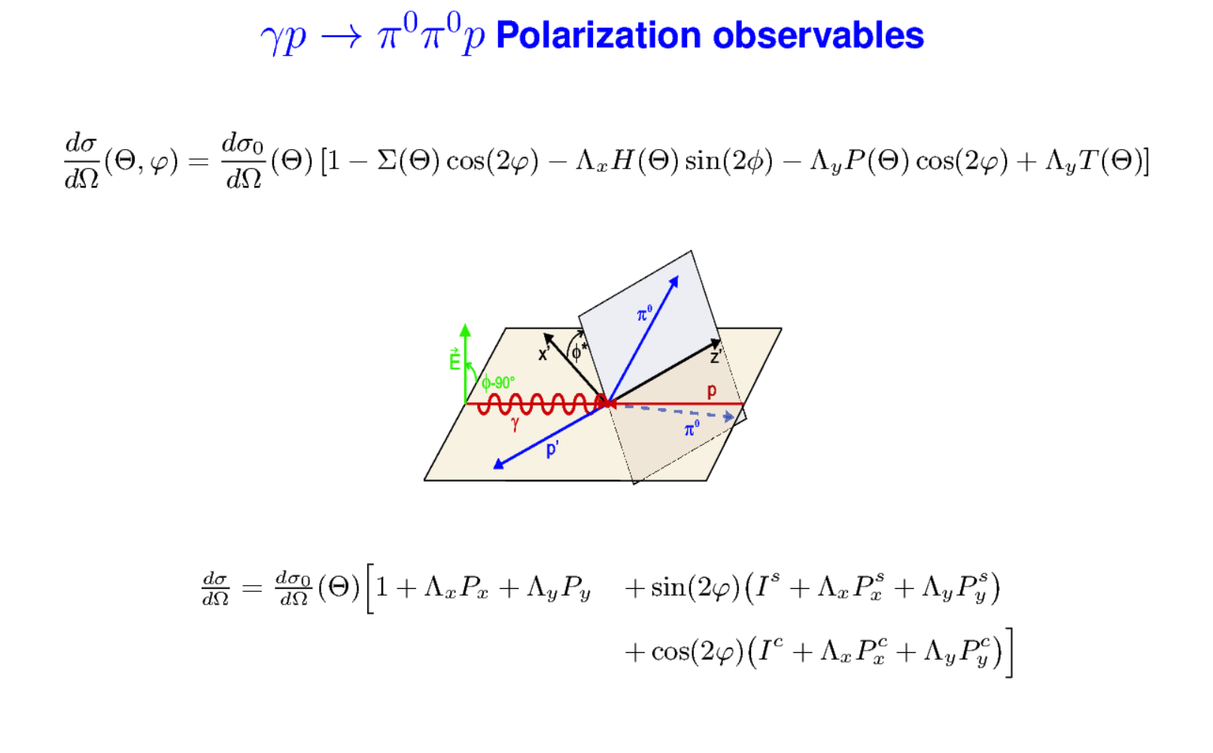
22590 (χ²/Ν=1.3) fitted bins for polarization observables.

Slide 10
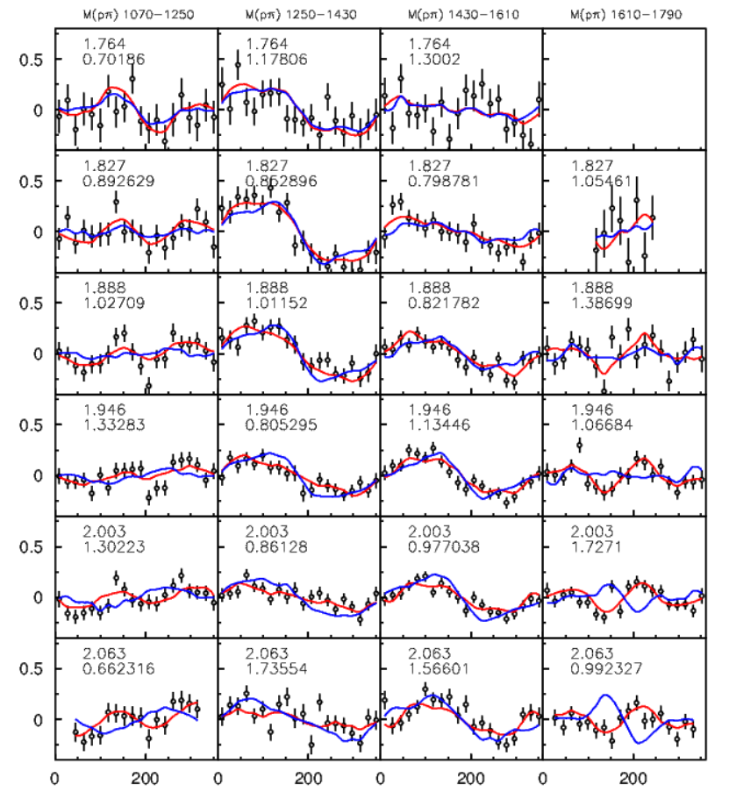
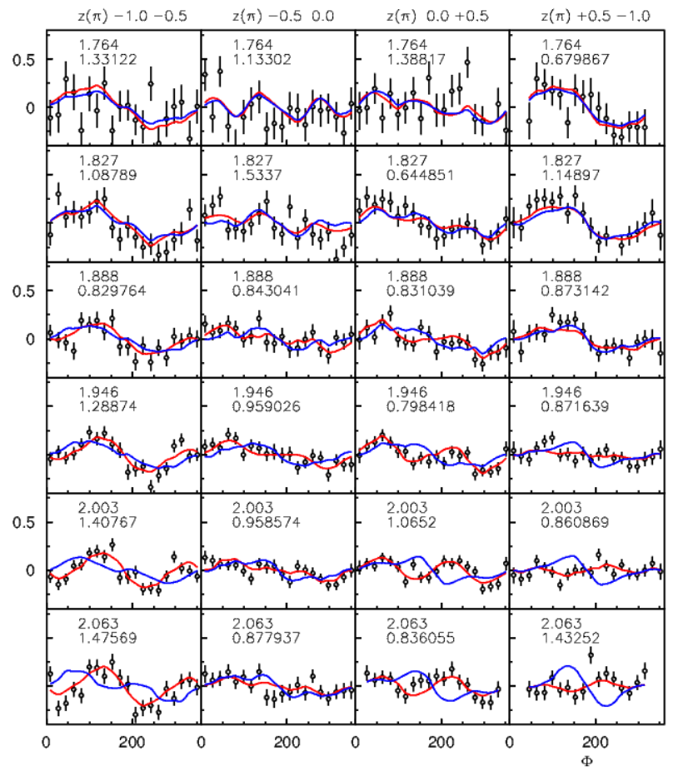
Φ∗ dependence of I_{S} on πp-mass or cosΘ_{π}
BG-2022
BG-2026

Slide 11
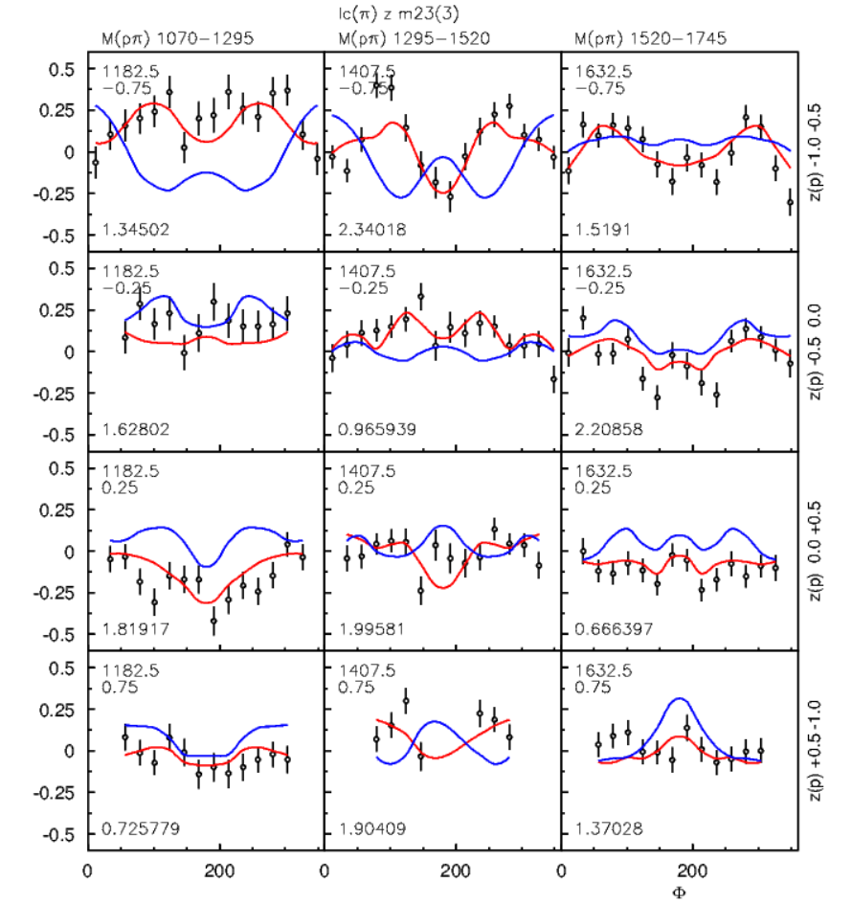
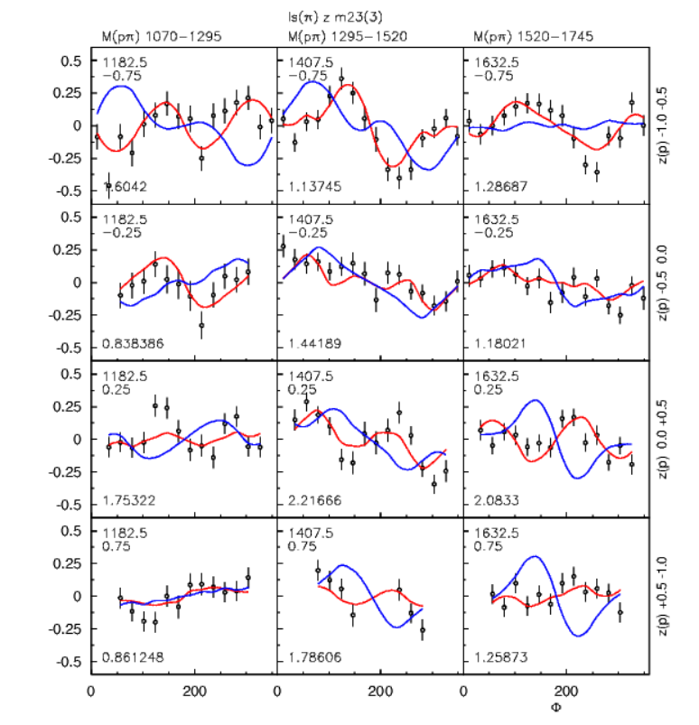
Two-dimension Φ∗ dependencies of I_{S} and I_{c}

Slide 12
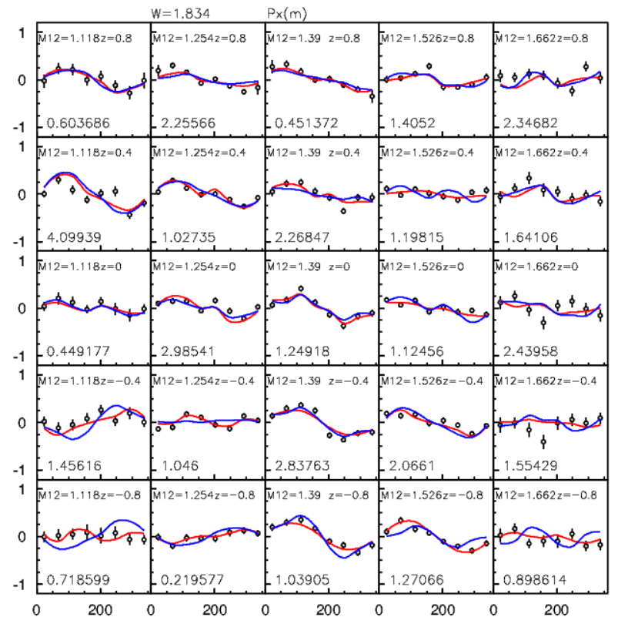
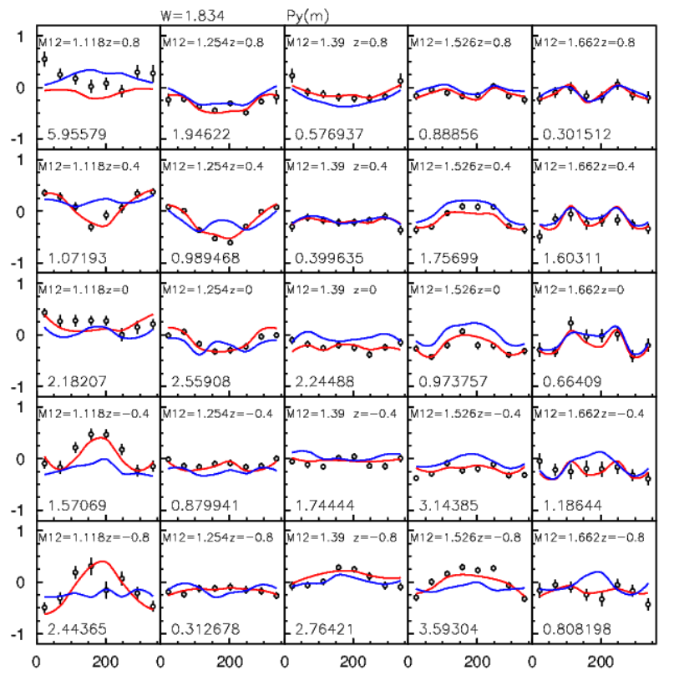
Φ∗ dependence of Px and Py on ππ-mass and cosΘ_{p}

Slide 13
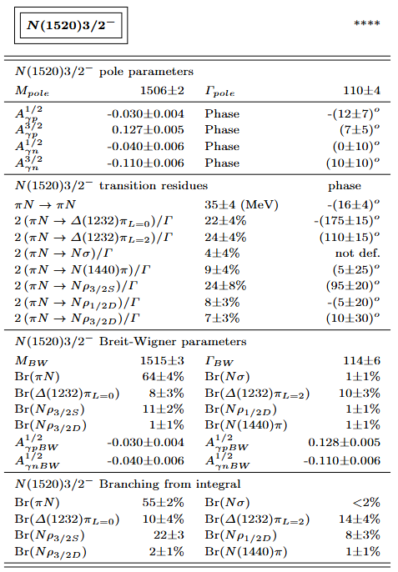
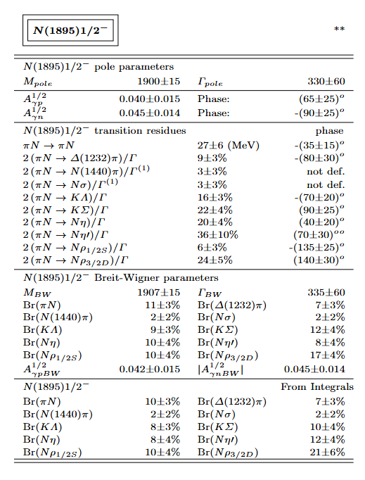
We can define practically all branching ratios and transition amplitudes

Slide 14

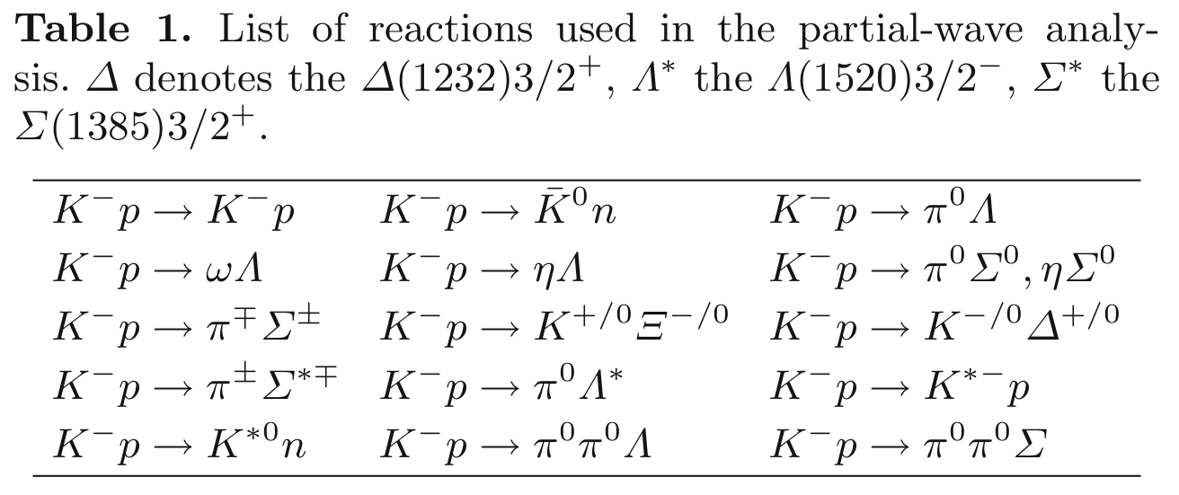
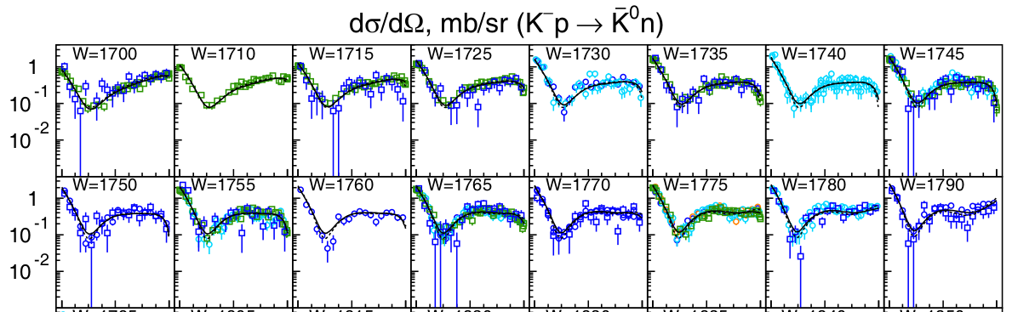

KN – scattering data
Similar reactions (existing data) were fitted by different groups including the Bonn-Gatchina PWA
Bonn-Gatchina PWA
Example for the fit quality
(and data consistency – many different data sets)
Sarantsev et al. EPJ A55 180 (2019)
-1 0 1
-1 0 1
-1 0 1
-1 0 1

Slide 15
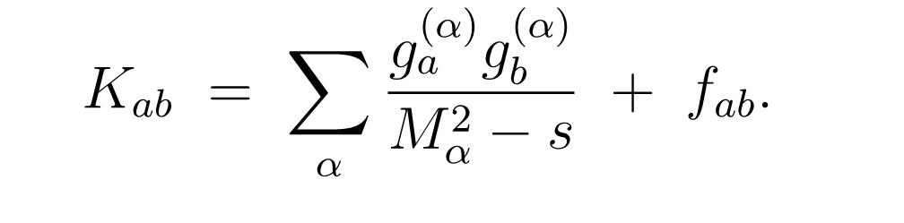
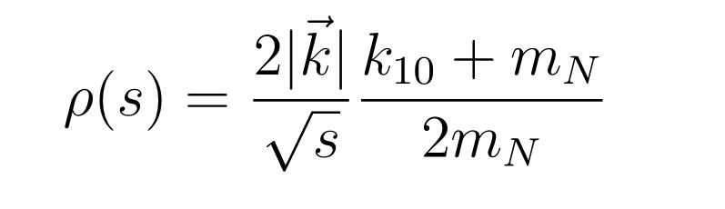
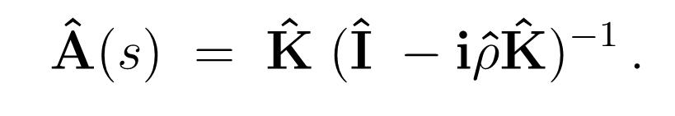
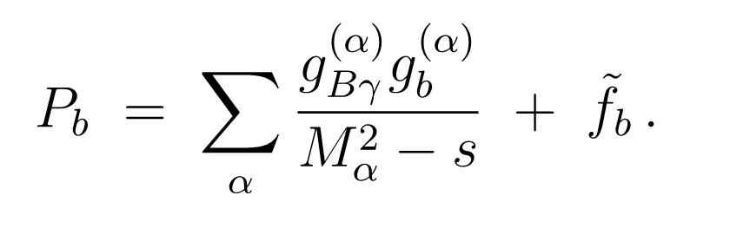
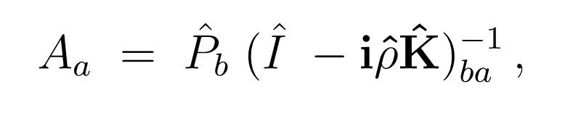
The formalism for the data analysis
The BnGa (Bonn-Gatchina) partial wave analysis method uses a fully covariant operator method and combines the analysis of different reactions, directly imposing unitarity constraint.
a,b = ΚΝ, πΛ, πΣ, ηΛ, ωΛ, BB
The phase space for BB was taken as ππΛ
A multi-channel K-matrix amplitude with the matrix elements defines the transition amplitude from state 'a' to state 'b' where initial and final channels are listed above and a black box which describes the inelasticity (contribution of the channels that are not taken into account explicitly).
The decay reactions can be described in the P-vector formalism:

Slide 16
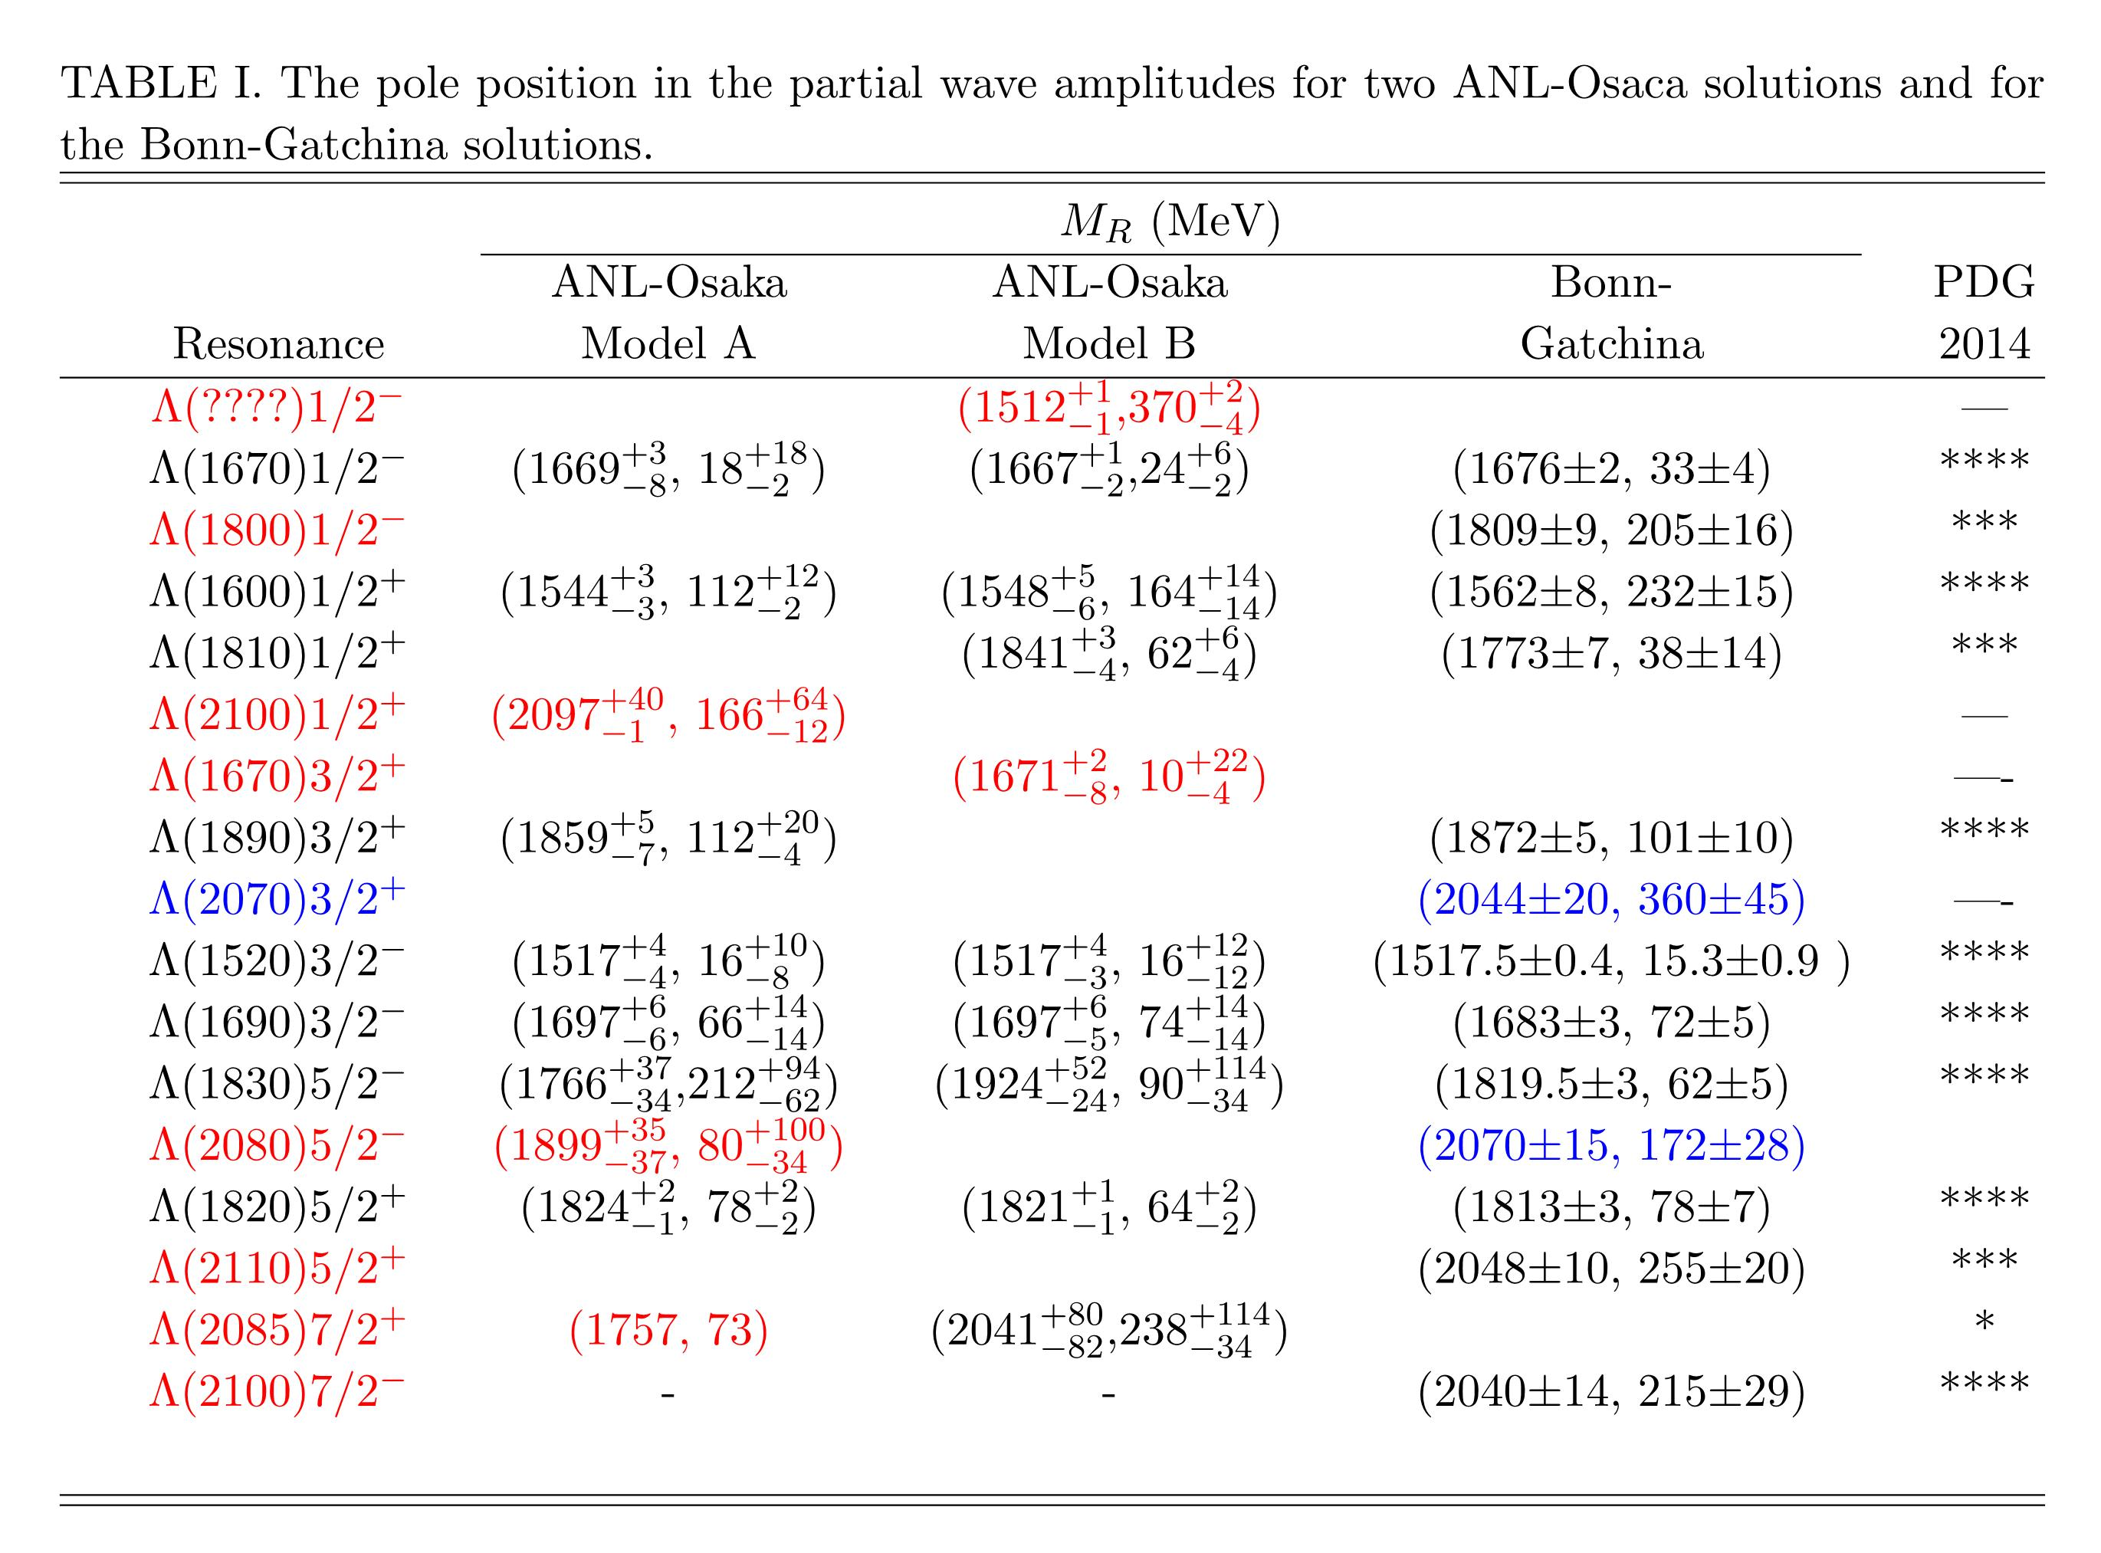
ANL-Osaka: Kamano et al. Phys.Rev. C92 025205 (2015)

Slide 17
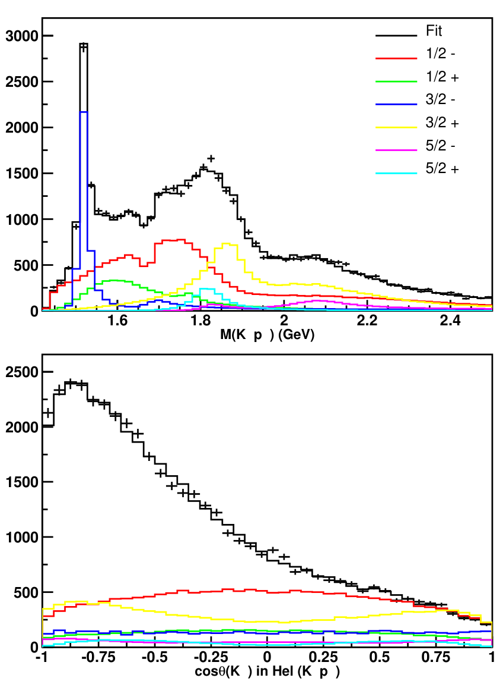
Partial wave analysis of the Λ_{b} →γKp data (LHCb. JHEP06(2024)098)
Fit of the data with resonance parameters obtained from the analysis of data on KN scattering by the Bonn-Gatchina group:
P-vector- K-matrix fit.
The main feature is the interference
Λ(1670) and Λ(1800).
−log L=-26029

Slide 18
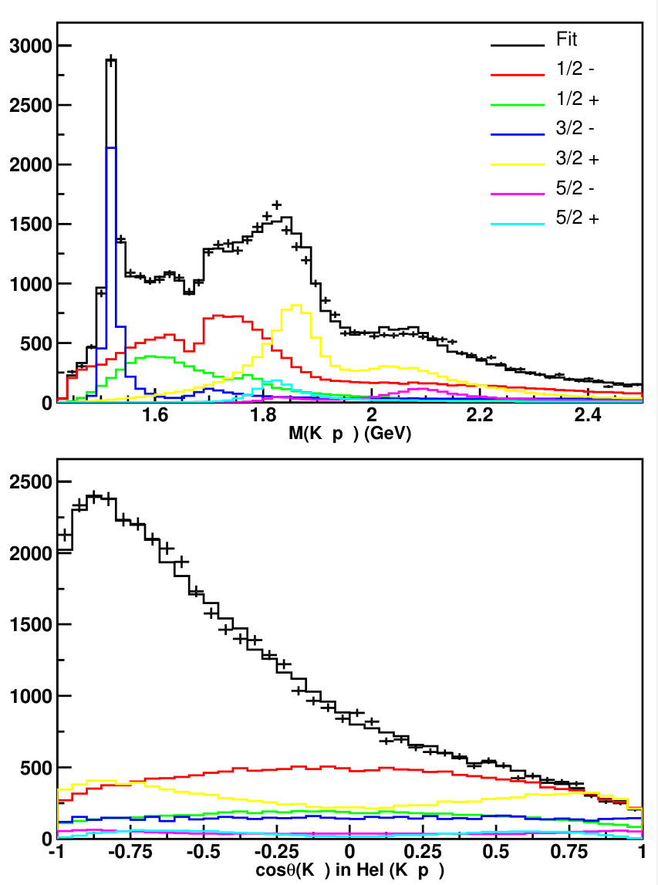
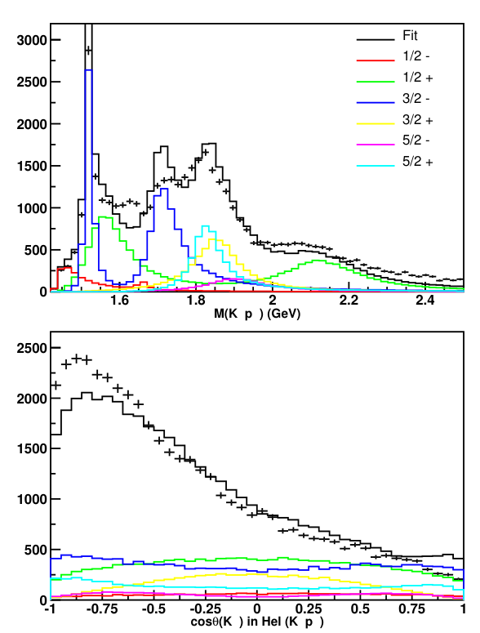
Simplified fit with Breit-Wigner amplitudes corresponding to BG and ANL-Osaka poles
K-matrix BG −log L=-26029
BW-BG -log L=-25730
ANL-Osaka -log L=-22432

Slide 19
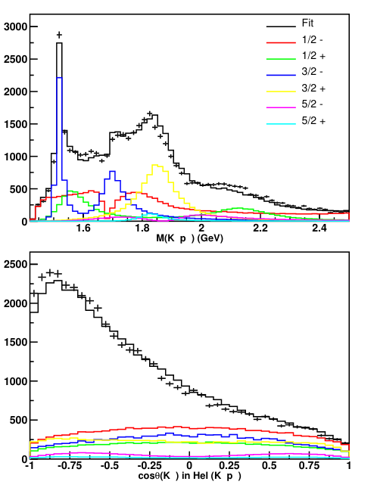
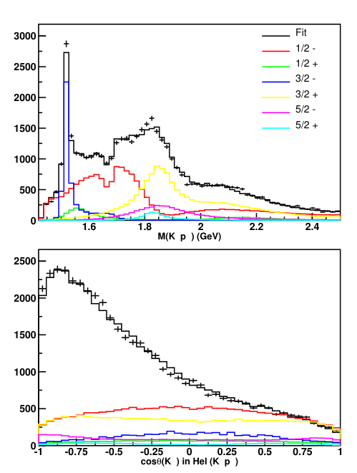
Adding to ANL-Osaka A the states Λ(1800)1/2- and Λ(2070)3/2+
+Λ(1800)1/2- -log L=-24680
+Λ(2070)3/2+ -log L=-25423
BW-BG -log L=-25730

Slide 20
Conclusion
The Bonn-Gatchina solution described very well the new CLAS data on the differential cross section γp −> Κ⁰Σ⁺.
The new polarization data on γp->KΛ are described (and predicted) with a very good accuracy.
The partial wave analysis can describe 12 high statistics Dalitz plots and 22590 polarization measurements from the γp-> π⁰π⁰p reaction with χ²∼1.3.
The transition amplitudes to different 2πΝ channels are extracted at pole residues and branching ratios are calculated with two methods.
Data analysis of the LHCb data showed the full compatibility with the Bonn-Gatchina solution.
One of the most pronounced structures in the LHCb data is the destructive interference of the Λ(1670)1/2- and Λ(1800)1/2- states. Successful data description is in principle impossible in the absence of Λ(1800)1/2-.

