Slide 1

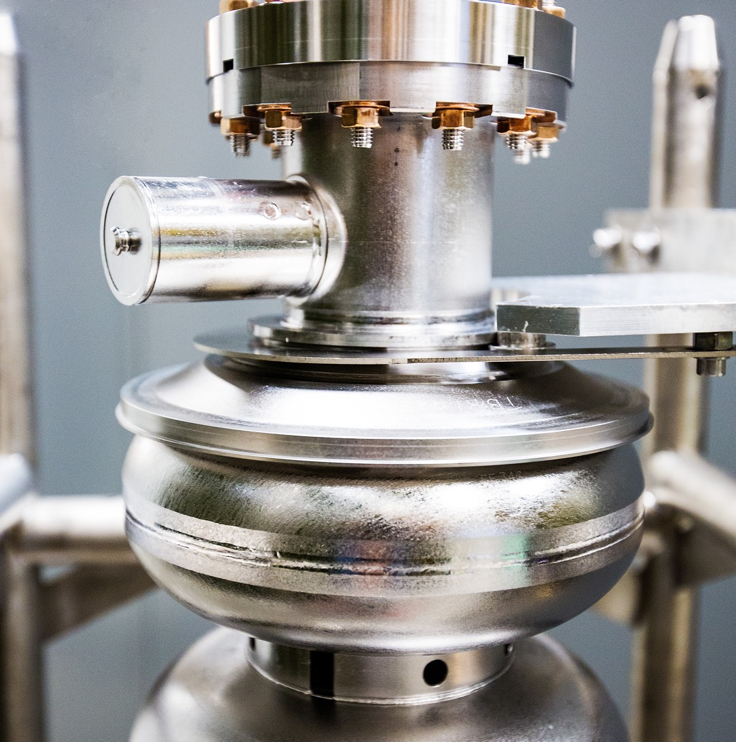

8th KLF Collaboration Meeting
May 6, 2026
Mike Spata, Acting Associate Director Accelerator Operations and R&D
Notes:
Tip: Keep titles under 60 characters for readability
To change the photo: Right-click on photo and select change photo

Slide 2
Outline
CEBAF Performance in FY25 and FY26 to-date
Accelerator Management Plan – Continuous Investments in Reliability, Energy Performance and Technical Systems Improvements
KLF in Hall D Tagger Vault
KLong Drive Laser System Integration
KLong Beam Tests
Summary

Slide 3
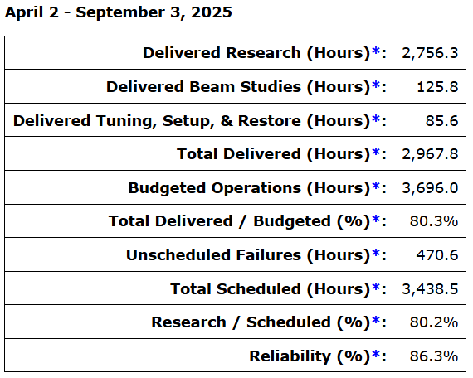
FY25 Run Highlights
Delivered 22 weeks of Physics with beam to Halls A, B, C, D
Linac Energy of 1060 MeV which meets the Moller specification
Run averaged reliability 86.6% - highest since 12 GeV Upgrade!
RF Trip Rate meets Moller specification of < 6%/hour

Slide 4
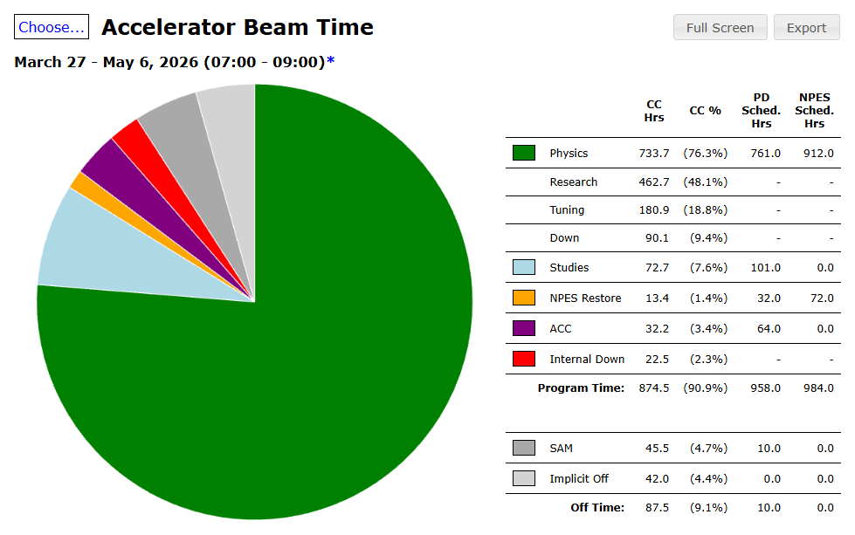
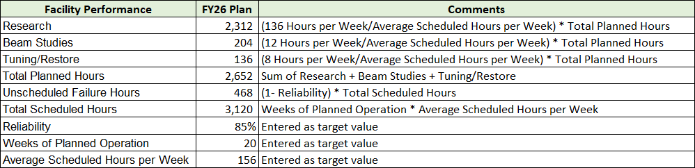
Beam Performance FY26 Run 3/27 through 4/29
The official 14-day restore started on 3/18 and finished on 3/27 (9 days).
The FY26 run plan calls for eight weeks at 345 MeV/linac followed by a two-week period to configure the accelerator for a twelve-week run at 1060 MeV/linac.
Table below reflects the expected performance as agreed to with the NP Program Office.
The chart at right shows the integrated performance including Research, Tuning, Beam Studies and Accelerator Configuration Changes totaling ~82% of delivered vs. planned to date.

Slide 5
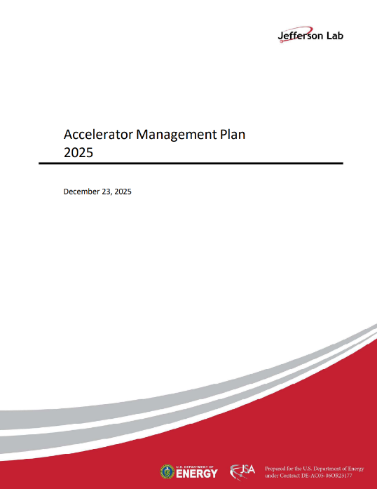
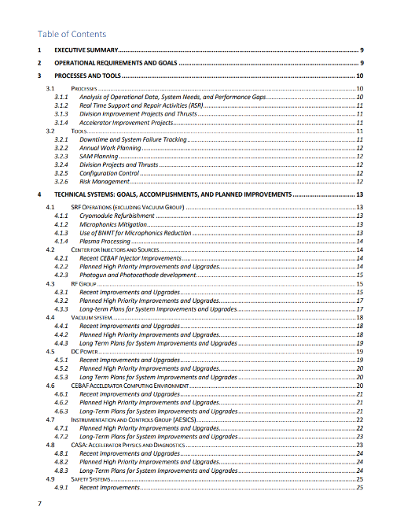
Accelerator Management Plan (AMP)
Provides a framework for managing CEBAF performance, reliability, and future upgrades
Aligns investments with mission needs and future program requirements (e.g., KLF)
Integrates Operations-funded activities:
CEBAF Performance Plan, Accelerator Improvement Projects (AIP), Capital Equipment (CE), Obsolescence Mitigation and Critical Spares Strategy
Provides Risk-informed Prioritization
Reliability and availability
Supply chain and obsolescence issues
Performance margin and capability gaps
Balances near-term operations with long-term capability development

Slide 6
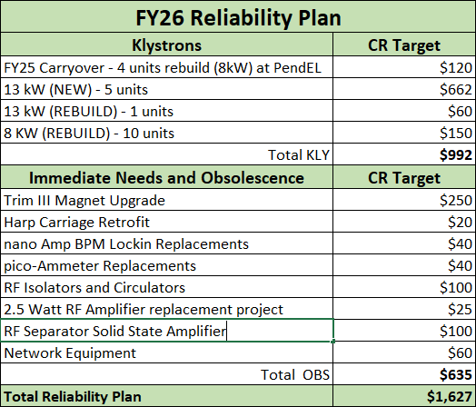
AMP – FY26 Reliability Investments
The reliability program continues to be focused on Klystrons and Obsolescence
Maintaining sufficient inventory of 8 kW and 13 kW Klystrons continues to be a challenge due to the escalating cost of new units.
A campaign to establish a klystron refurbishment programs with two established vendors and an SBIR partner is under development. Also looking into cost benefit analysis of refurbishing in-house.
The Obsolescence program continues to support the multi-year magnet upgrade, I&C upgrades for Harps, nA BPM, and pico-ammeters, RF HV hardware and Separator amplifiers and Network equipment.

Slide 7
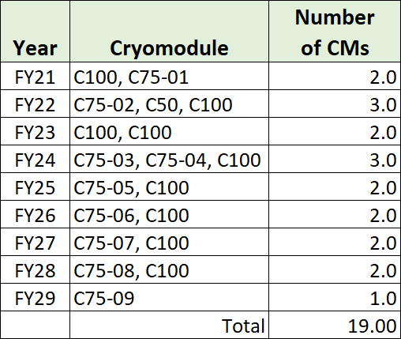
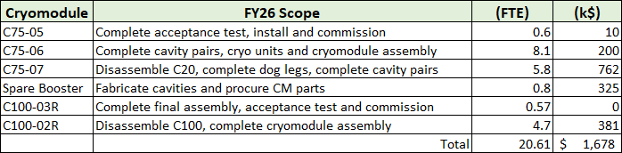
AMP – Linac Energy Performance Investments
The multi-year plan for converting original C20 cryomodules to C75 style and refurbishing C100 cryomodules is shown at right.
Scope of work for FY26 includes:
Delivery of C75-05 and C100-03R into the south linac (done)
Continue the development of C75-06 for installation in FY26/FY27 SAM
Continue the development of C75-07 for installation in FY27
Refurbish C100-02R for installation in FY26/FY27 SAM
Continue multi-year plan to build a Spare Booster Cryounit for the CEABF Injector
Plasma processing continues to be applied during SAMs.
Ozone cleaning continues to be evaluated (Proposal submitted to NP NOFO)
Evaluating optimal approach for FY28 and beyond that may pivot to C60

Slide 8
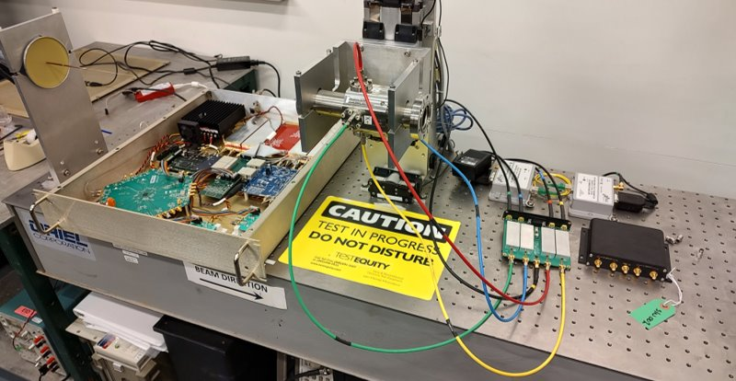
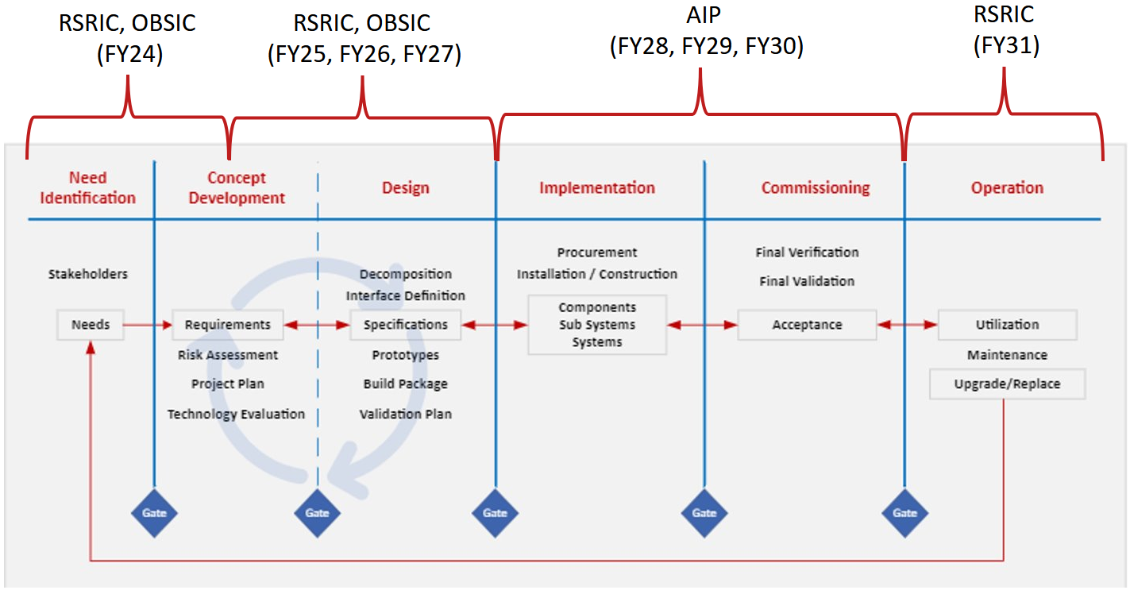
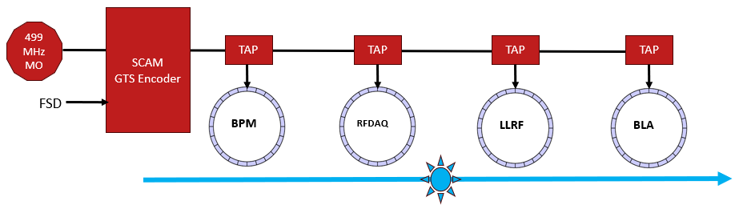
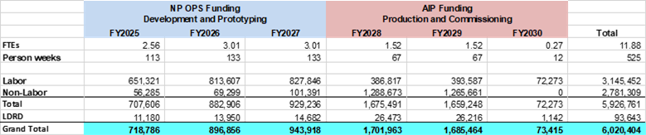
Accelerator Improvement Projects
Next Generation Beam Position Monitor:
New system being developed to replace the existing 4 Channel and SEE BPM systems
Addresses obsolescence and provides enhanced functionality
High bandwidth, synchronized position data collection across the accelerator
AI and ML enabled algorithms for improved beam delivery
Global Timing System:
Site wide synchronization of diagnostic systems
Design of prototype end point underway

Slide 9
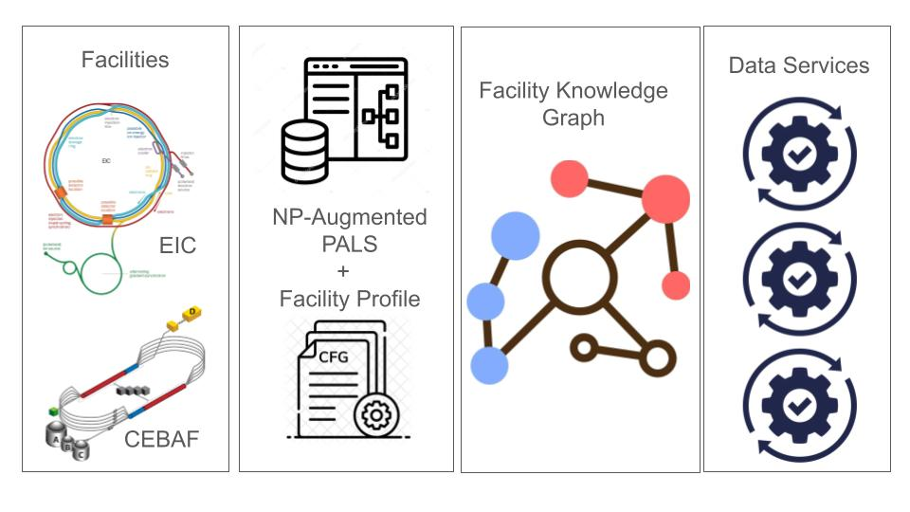
Project Genesis and the Accelerator Division
American Science Cloud (AmSC)
NARAD: Nuclear AI-Ready Accelerator Data
Goal: Develop AI‑ready data standards/pipelines for DOE (NP) accelerator facilities
→ Facility-sharable accelerator design/optimization
JLab PI: Todd Satogata (CASA)
Team
JLab: CASA, CEBAF Operations, Data Science
BNL: C-AD (RHIC/EIC)
LBNL: Advanced Modeling Program (ATAP)
PNNL: Data Science/Graph Analytics
Transformational AI Model Consortium (ModCon)
MOAT: Multi-Office Particle Accelerator Team
Goal: transform how particle accelerators and light sources are operated, optimized and designed by connecting data, expertise and innovation
NP/JLab PI: Chris Tennant (CASA)
Team
JLab: CASA, CEBAF Operations, Controls
along with other Office of Science labs with Scientific User Facilities: ANL, LBNL, BNL, FNAL, ORNL, SLAC
Toward AI-boosted particle accelerator:
Design | Operation
R&D | Workforce
Technology | Theory
Computing | SMEI*
*Safety, Management, Economics, IP

Slide 10
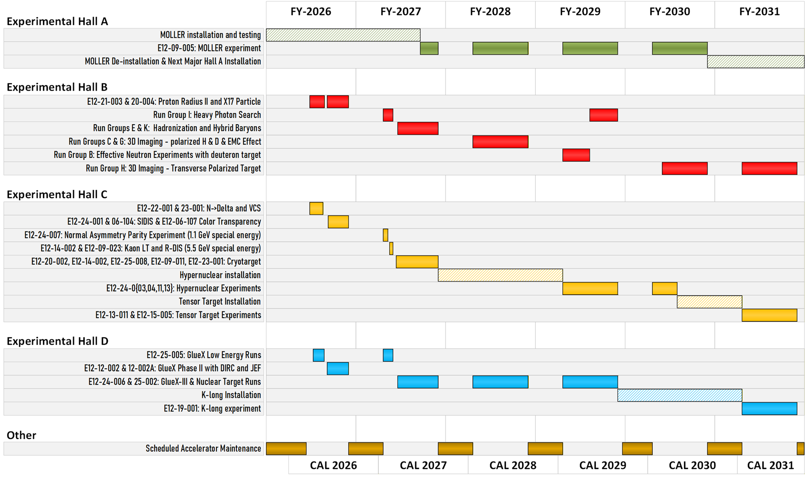
Physics Program through FY 2031

Slide 11
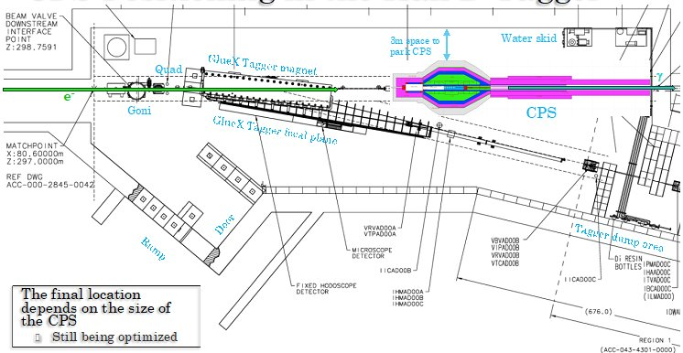
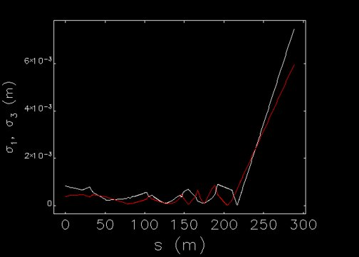
KLF in Hall D Tagger Vault
The Compact Photon Source is located 10.5 M from the Goniometer in our preliminary layout.
The present optics design delivers a beam at the CPS face with 𝛔_{x} = 1.098 mm 𝛔_{y} = 1.072 mm​.
A new NextGen BPM is needed near the CPS. Higher peak currents in KLF will require attenuation to prevent BPM signal saturation.
Additional diagnostics needed: beam current monitor, viewer and wire scanner (harp).
Ion Chambers will be used to protect the CPS and optimize transport with minimal losses.
Current slow-lock method used in GlueX is expected to be sufficient to maintain beam transport.
Need to optimize the procedure for setting the ideal conditions at the Physics target
Transverse Beam Sizes
Credit: Edy Nissen

Slide 12
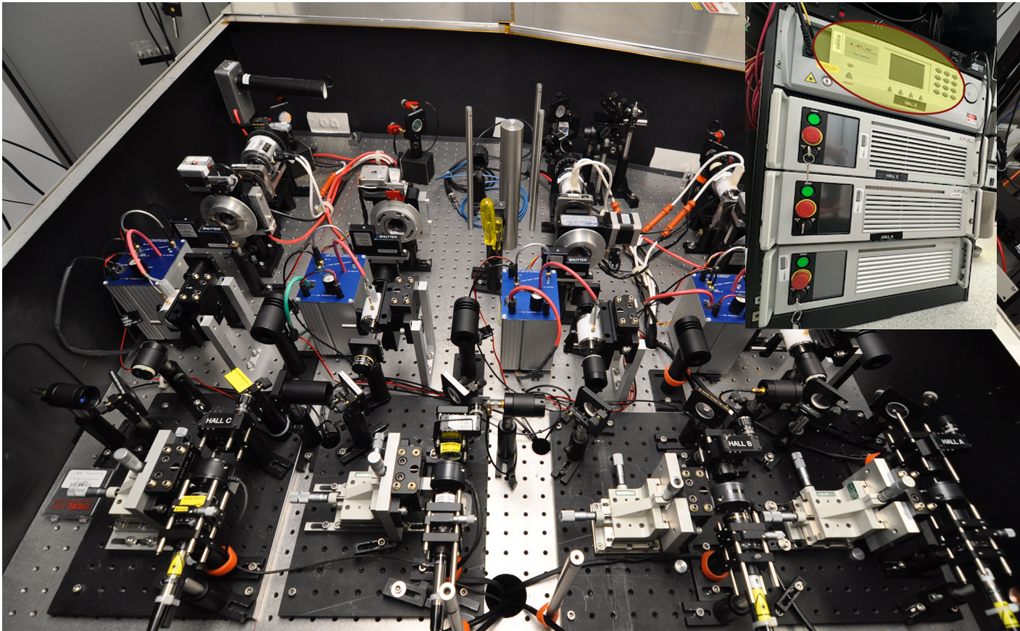
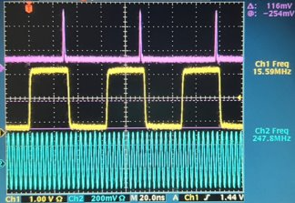
KLong Drive Laser System
Low-repetition-rate beam structure (15.6 / 7.8 MHz) derived from CEBAF RF.
Drive laser system developed: seed laser, RF division, high-power laser amplifier, and Second Harmonic Generation.
Demonstrated strong phase stability (<1° drift over ~8.5 hours).
Achieved sufficient pulse energy and power to support KLong beam production.
Fully integrated into existing CEBAF laser infrastructure with EPICS control.
The design of the LLRF for KLF (15.6/7.8 MHz direct-synthesis driver) is complete and bench tests have confirmed its accuracy.
Current (µA) | Rep Rate (MHz) | Bunch interval (ns) | Sub-harmonic of 499 MHz | Bunch Charge (pC) | Equiv. 249.5 MHz current (µA)
2.5 2.5 5.0 5.0 | 15.59 7.80 15.59 7.80 | 64 128 64 128 | 32nd 64th 32nd 64th | 0.16 0.32 0.32 0.64 | 40 80 80 160
Credit: Shukui Zhang and Tomasz Plawski

Slide 13
KLong Beam Study
Successfully generated KLF bunch structure and charge at 0.32 pC
Measured bunch length ~60 ps, consistent with expectations
Phase space behavior consistent with models (chopper scans, energy dependence)
Beam transmission degrades at higher charge with significant interception in injector apertures
Beam losses observed at both low and high charge
Transmission not yet suitable for sustained operations
Future studies needed after the gun is restored to 200 kV at the end of current run
Gun Current (µA) | Bunch Charge (pC) | A1 interception (µA) | A2 interception (µA) | MS interception (µA) | Beam Transmission (%)
2.8971 | 0.186 | 0.1742 | 0.5242 | 0.00118 | 76.0
4.3704 | 0.280 | 0.0416 | 1.0437 | 0.01218 | 73.0
6.2193 | 0.399 | 0.28521 | 1.6462 | 0.15228 | 66.5
7.8976 | 0.506 | 0.972 | 0.69855 | 0.2016 | 76.3
11.6756 | 0.748 | 3.555 | 0.9894 | 0.4536 | 57.2
17.3721 | 1.114 | 9.244 | 1.1736 | 0.8715 | 35.0
Credit: Sunil Phokharel, Geoff Krafft, Reza Kazimi

Slide 14
Summary
Acceptable CEBAF performance with reliable, high-availability beam delivery across all halls, demonstrating the stability required to support future programs like KLF
Disciplined investment framework through the Accelerator Management Plan aligning operations, AIP, capital equipment, and obsolescence mitigation with mission needs and future program requirements
Key enabling systems for KLF demonstrated, including the low-repetition-rate drive laser, LLRF timing and control, and the Compact Photon Source concept with defined beam transport and diagnostics approach
Injector studies confirm that the required bunch structure and charge for KLF can be produced, with measured beam behavior consistent with expectations and models
Future studies need to focus on:
Improving beam transmission and reducing losses at higher charge to enable reliable, sustained operation under KLF conditions
Finalizing the Compact Photon Source layout, optimizing beam transport modeling, refining the required diagnostics and machine protection solution, and developing operating procedures for efficient and low-loss performance for the experiment

