Slide 1
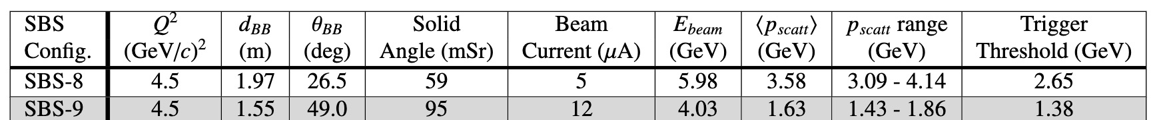
Update on GRINCH NIM – T. Averett 3/4/2026
Title: A Gas Cherenkov Counter for a Large Angular Acceptance
Magnetic Spectrometer in a High Background Environment
Design: high-rate environment - segmented PMT array, large angle side, timing based - VETROC
The online and offline work was largely done by Maria Satnik (Now at LBNL) – Thank you !!
Status: First draft 80% complete
Based on GMn, SBS-9, below pion threshold
Gas: C₄F₈ – 1atm, pion threshold 2.7 GeV

Slide 2
Missing or In-progress Items
Thanks: Lots of information from Eric is mostly in my hands, just not included yet
Abstract, Conclusion – Todd
Clarification of Rates – Todd/Eric
Scalers - not on all runs
Number of events in VETROC per trigger – threshold dependent
Timing background in LE timing
Some geometry information from simulation – Todd, Eric
Clarification of coordinate systems - Todd, Eric
NINO threshold in volts, % of spe – Todd
Additional DAQ details, – Alex
Simulation details – Eric/Andrew

Slide 3
Missing or In-progress Items, con’t
pi/e ratios – Eric
Clarification of clustering algorithm – Andrew
Heat map of event rate at entrance window – Eric
Add simulated track matching plots – Eric
Estimate of false events in cluster, timing window – Todd/Eric/Andrew
Largest Remaining Item: Analysis plots and efficiency calculations need to be redone using updated timing calibration – Andrew, on his (enormous) to-do list

Slide 4
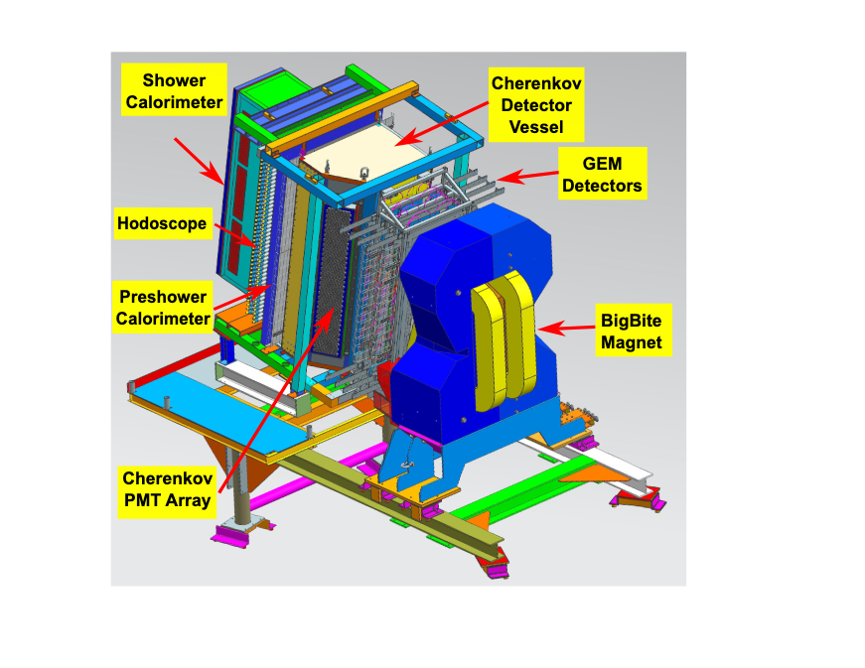
Overview of Sections
Introduction: SBS program – large luminosity, background drives design
510 PMT, 1” diameter” array located on large angle side
“non-focusing” design w/ cylindrical mirrors
Timing-based analysis
BigBite Spectrometer overview
Credit: Anu

Slide 5
Overview of Sections, con’t
Cherenkov Design
Overview/Geometry/Mirrors – non-focusing vertically
PMTs and light catchers
Magnetic shielding
Radiator gas choice and gas panel
DAQ – commissioned VETROC, NINO

Slide 6
Overview of Sections, con’t
Side/rear view with mirrors out
Front view of mirrors

Slide 7
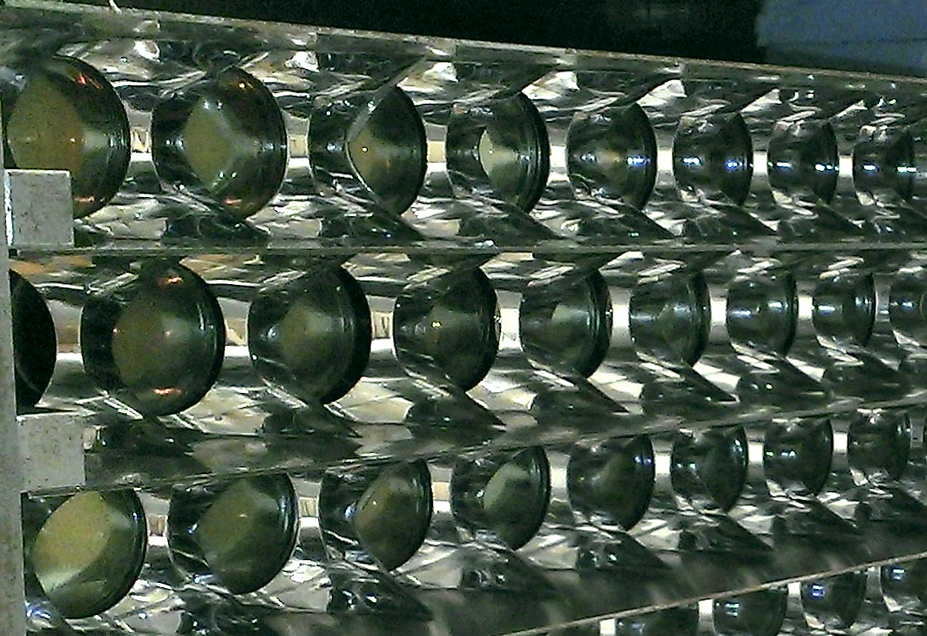
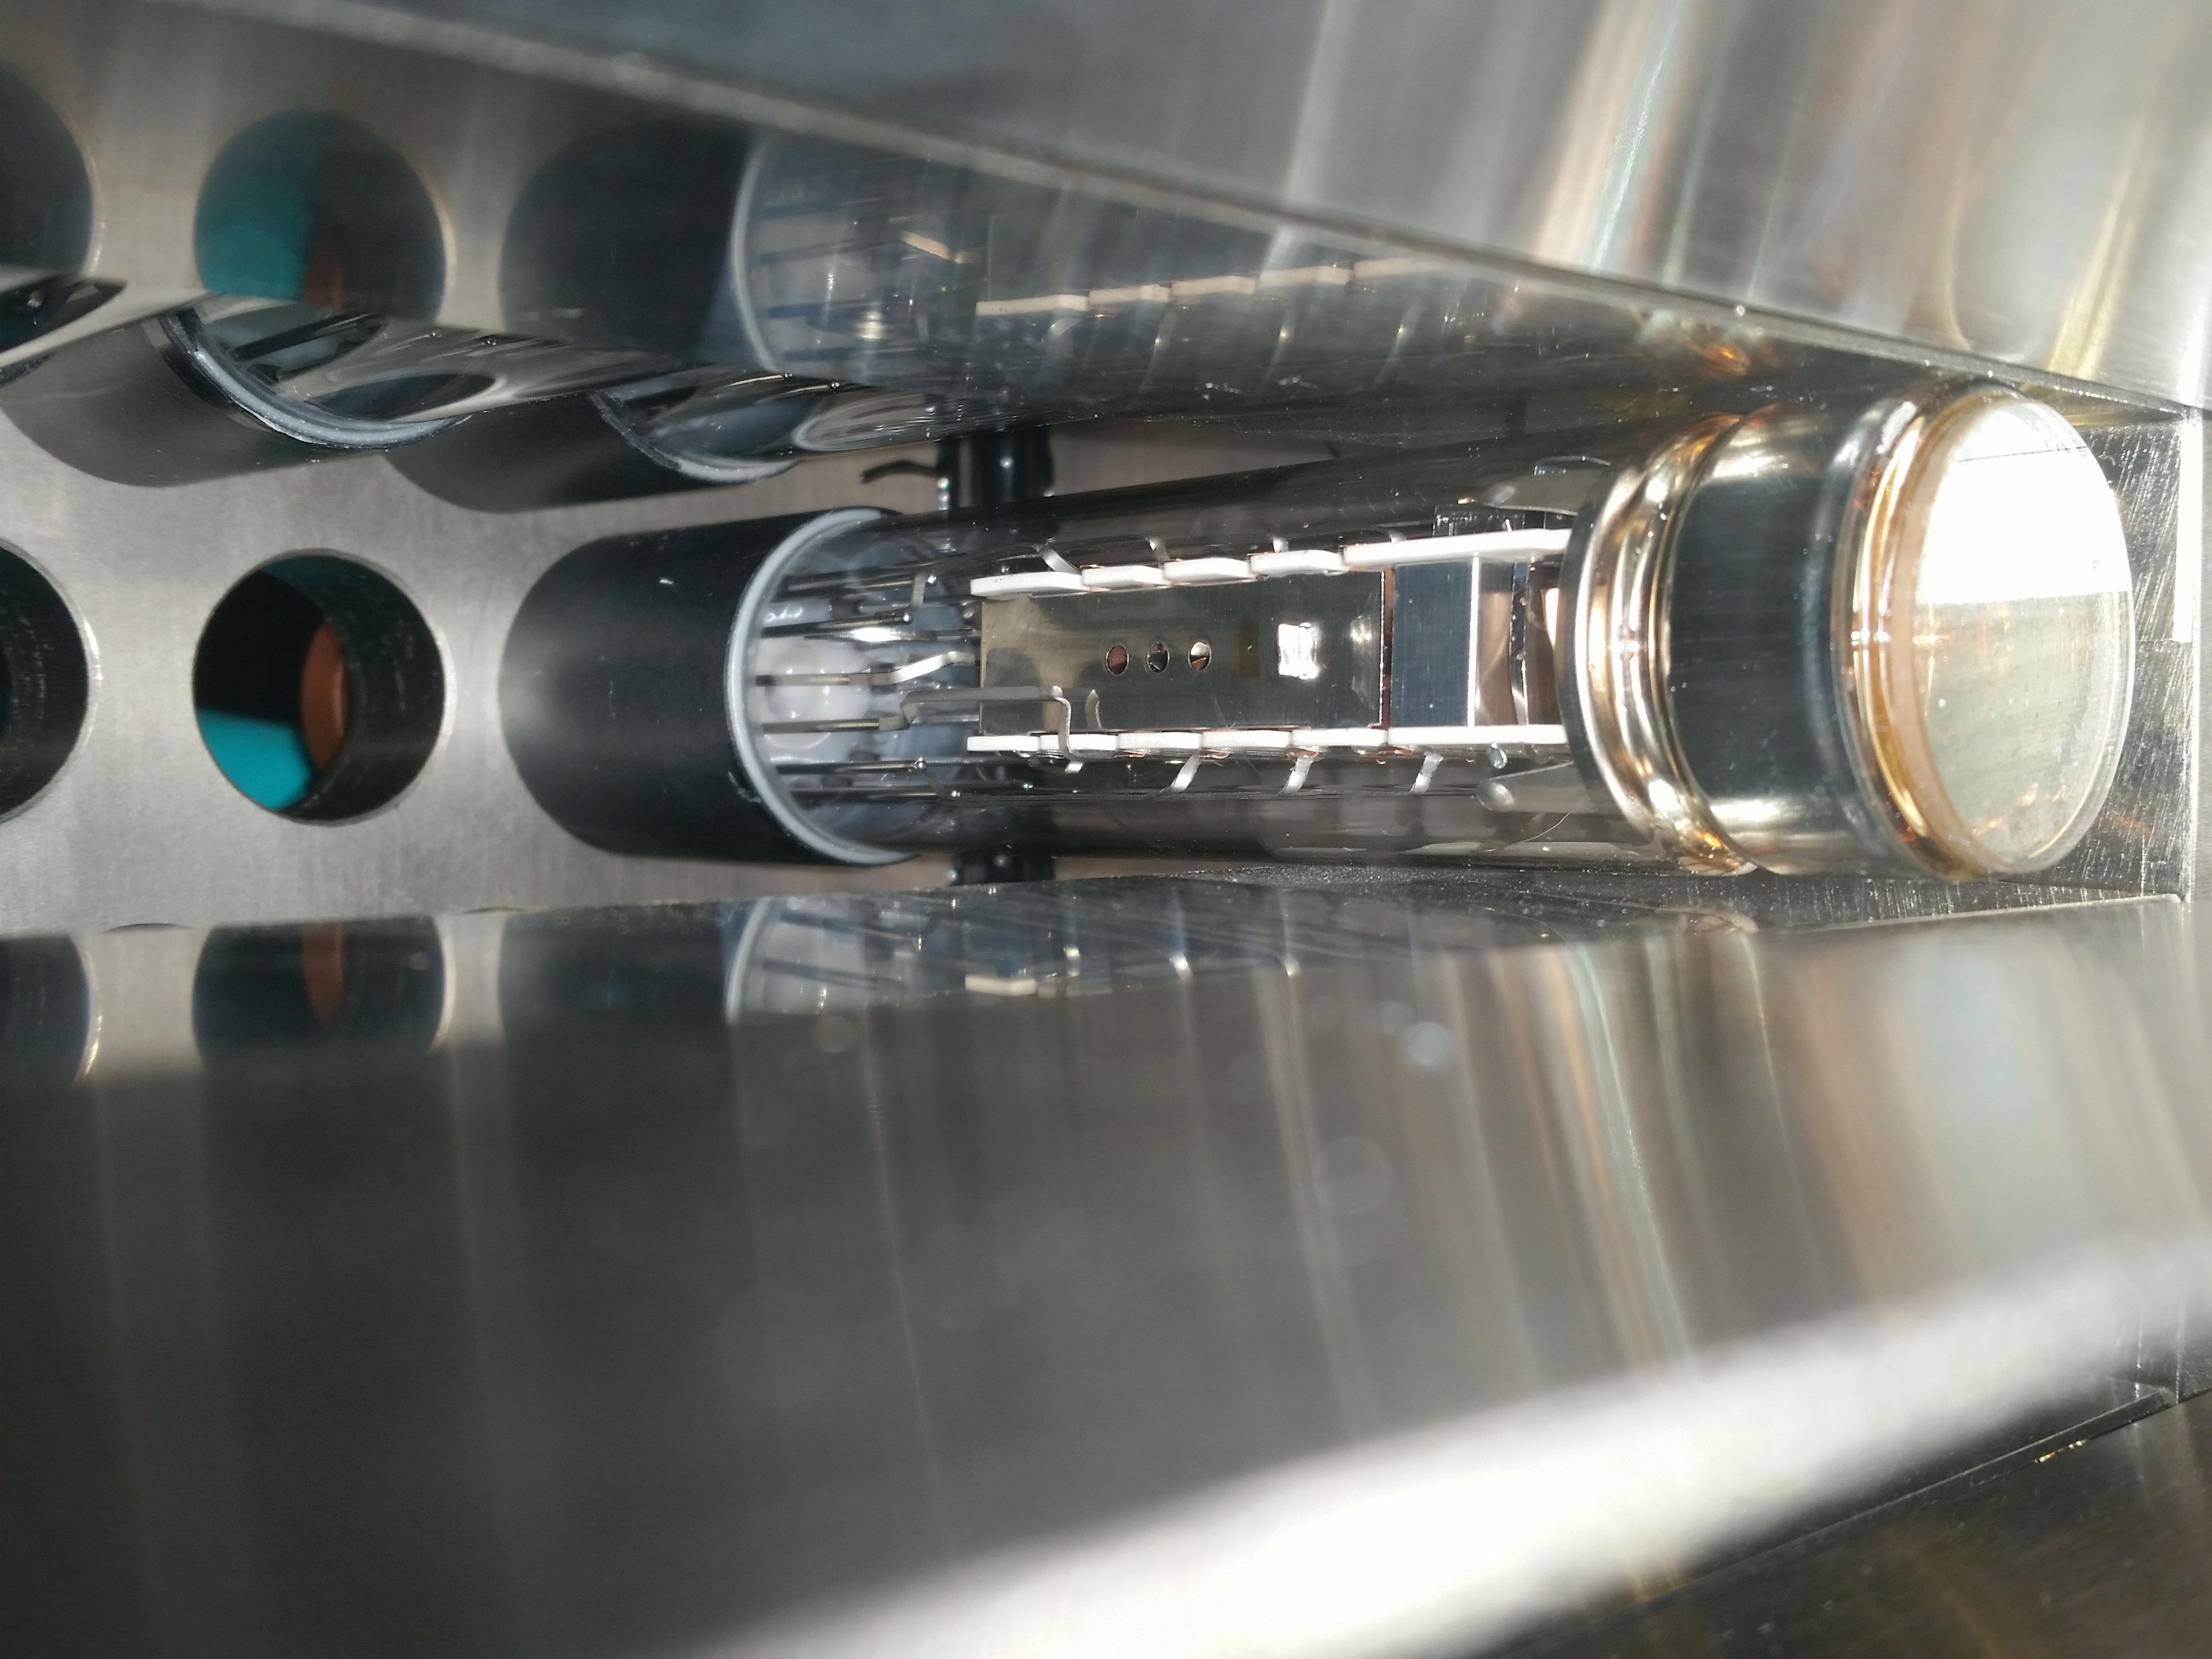
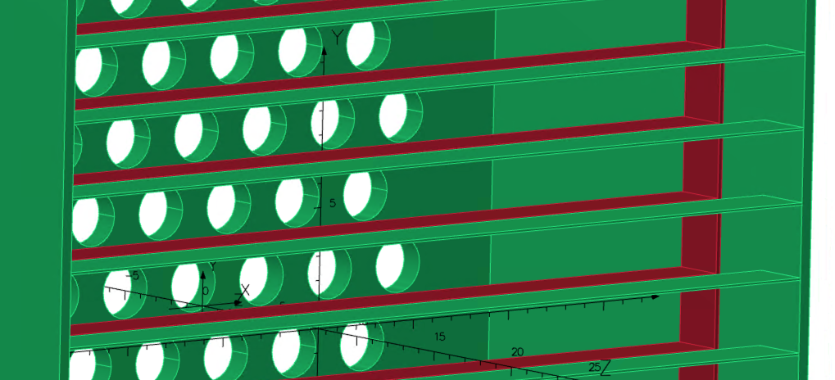
Overview of Sections, con’t
Light catchers
Magnetic
shielding

Slide 8
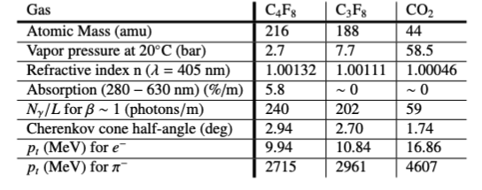
Overview of Sections, con’t
Radiator Gas: C₄F₈ at atmospheric pressure, pion threshold 2.7 GeV
W&M studies of candidate gases – non-toxic, non-flammable, transparent in UV/VIS, large index, affordable
Measured at W&M

Slide 9
Overview of Sections, con’t
DAQ: Commissioned VETROC, NINO
Sparce in some sections

Slide 10
Overview of Sections, con’t
Simulation
Description needed
Pi/e ratio, # pe’s, cluster size multiplicity, track matching, efficiencies
More results?
Clustering algorithm

Slide 11
Performance: Maria’s Analysis
ToT
Track Matching
Cluster size
Note: single tube rate 600 kHz – 1 MHz

Slide 12
Money Plots
Maria’s Analysis:
Design requirements:
Electron > 95% detection
Pion > 90% rejection
>= 3-tube cluster efficiencies:
Electron detection, 97%
Pion rejection, 96%

Slide 13
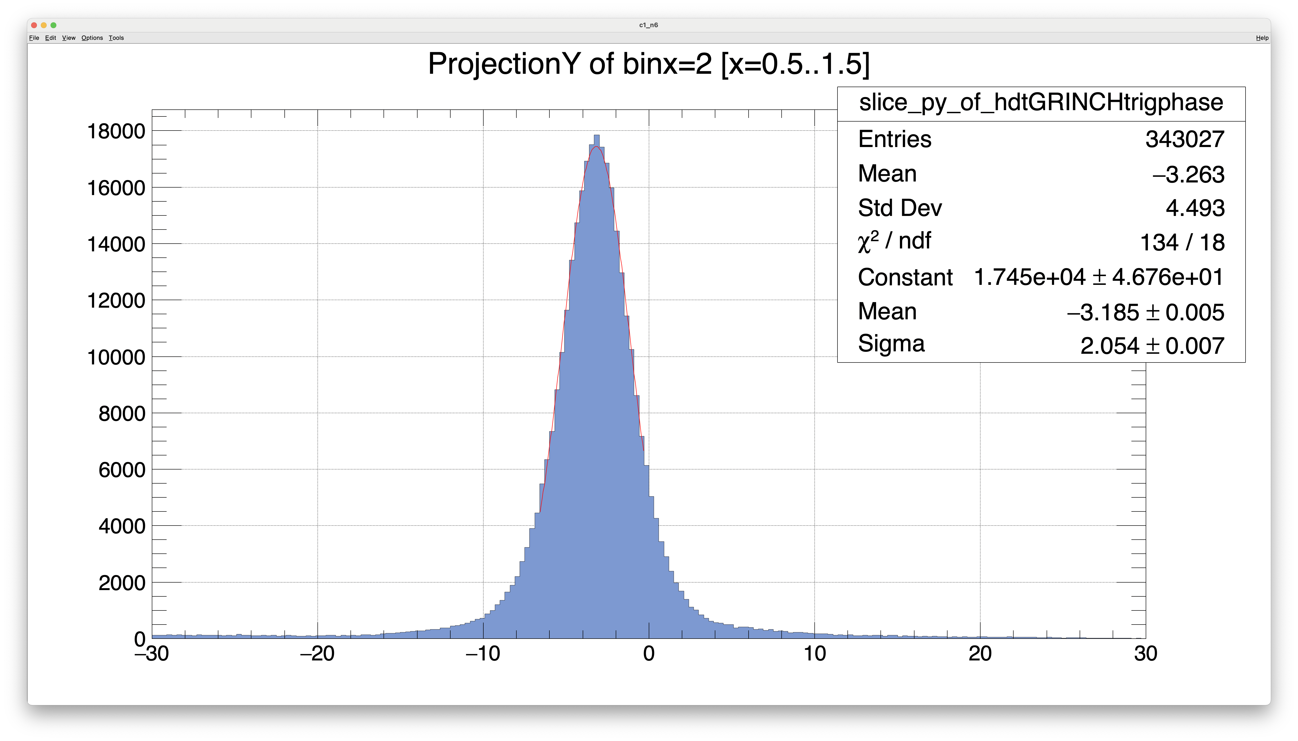
Upcoming improvement
This shows the improved timing resolution from Andrew ~ 4x
Not used by Maria
Need to re-make analysis plots using this information
Efficiency likely unchanged

Slide 14
To Do:
Repeat analysis with improved timing - Andrew
Which parts?
Timing calibration
Number of tubes/per cluster
ToT
Track matching
Efficiencies vs. cluster size, timing window
Maria used +/- 30 ns
Clustering description - Andrew
Background rates - Todd
Scalers – not available for much of kinematics, DAQ threshold?
Out of time rates – From analysis, NINO threshold
VETROC – as a scaler ??

Slide 15
To Do, con’t:
Simulation - Eric/Andrew?
Description
Compare to final analysis plots
N_pe per cluster/tube
N_tubes per cluster
DAQ - Alex
More thorough description – Alex

Slide 16
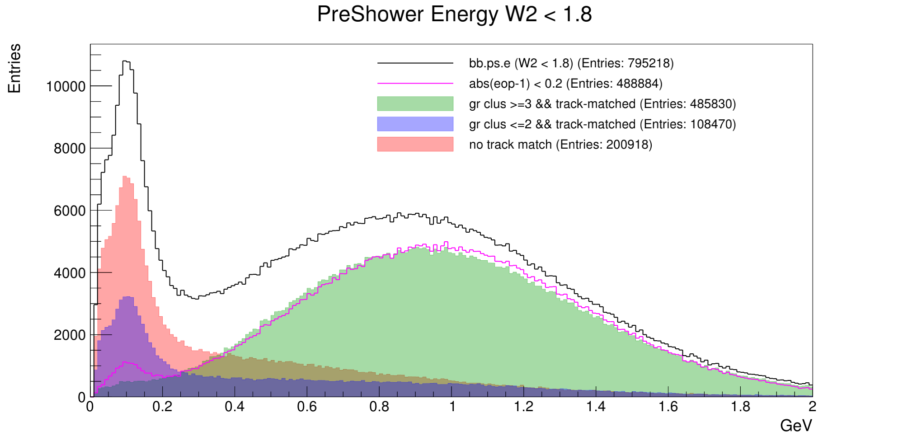
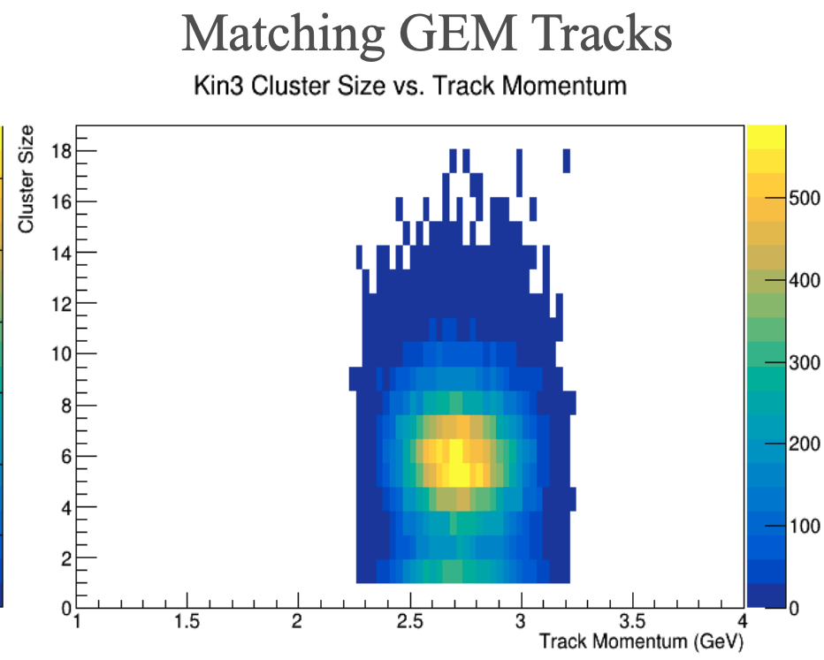
Question
Should we include an analysis from data with events above pion threshold?
GEn Kin 3 where p_{e} = 2.2-3.2 GeV
Results look similar (Jack Jackson’s analysis)
Calculate efficiencies after next pass analysis

Slide 17
Hope to finish this semester/summer
Author List: Let me know if you think you should be included
M. Satnik, A. Ahmidouch, B. Aljawarneh, J. Annand, T. Averett, C. Ayerbe,
A. Camsonne, S. Danagoulian, E. Fuchey, R. Montgomery, G. Nicelescu, A. Puckett
B. Wojtsekhowski, B. Yale, H. Yao

Slide 18
Title

Slide 19
Title

Slide 20
Title

Slide 21
Title

Slide 22
Title

