Slide 1

GEp GEM Readout Electronic Common Mode Sagging
Jacob McMurtry
for SBS Collaboration Meeting
March 4th, 2026

Slide 2
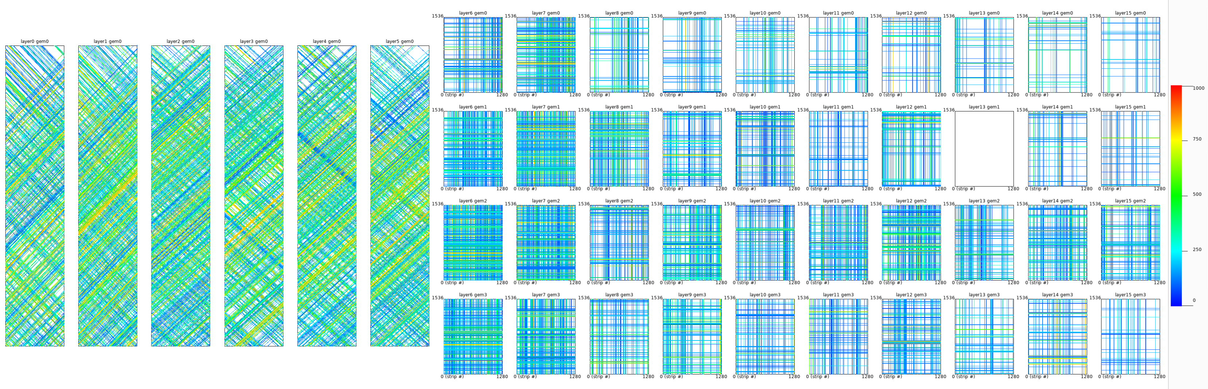
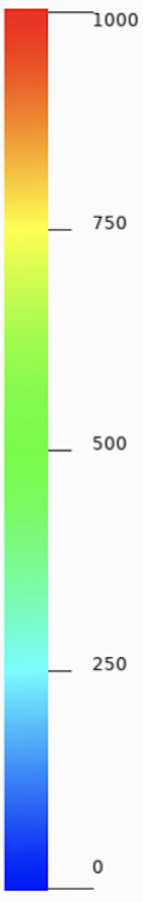
Challenges to Tracking: FT Occupancy
Main challenge by far is GEM tracking under high occupancy (space and time signal pileup) and low signal to background ratios
Large number of combinatorics → high computational times + (fake hits + fake tracks)
1D cluster formation and 2D hit reconstruction is especially affected by high occupancy → lots of fake hit reconstruction
Tracking portion itself is done in field-free regions → straight lines; hence not the most complicated part if the hits fed in are mostly true/real proton hits
Front Tracker raw fired strips in an event color coded in ADC strength.
22 uA on LH2 target; one of the highest background cases in SBS.

Slide 3
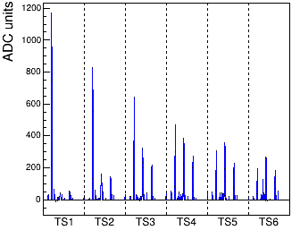
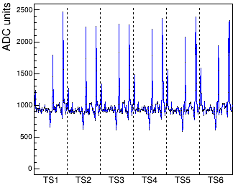
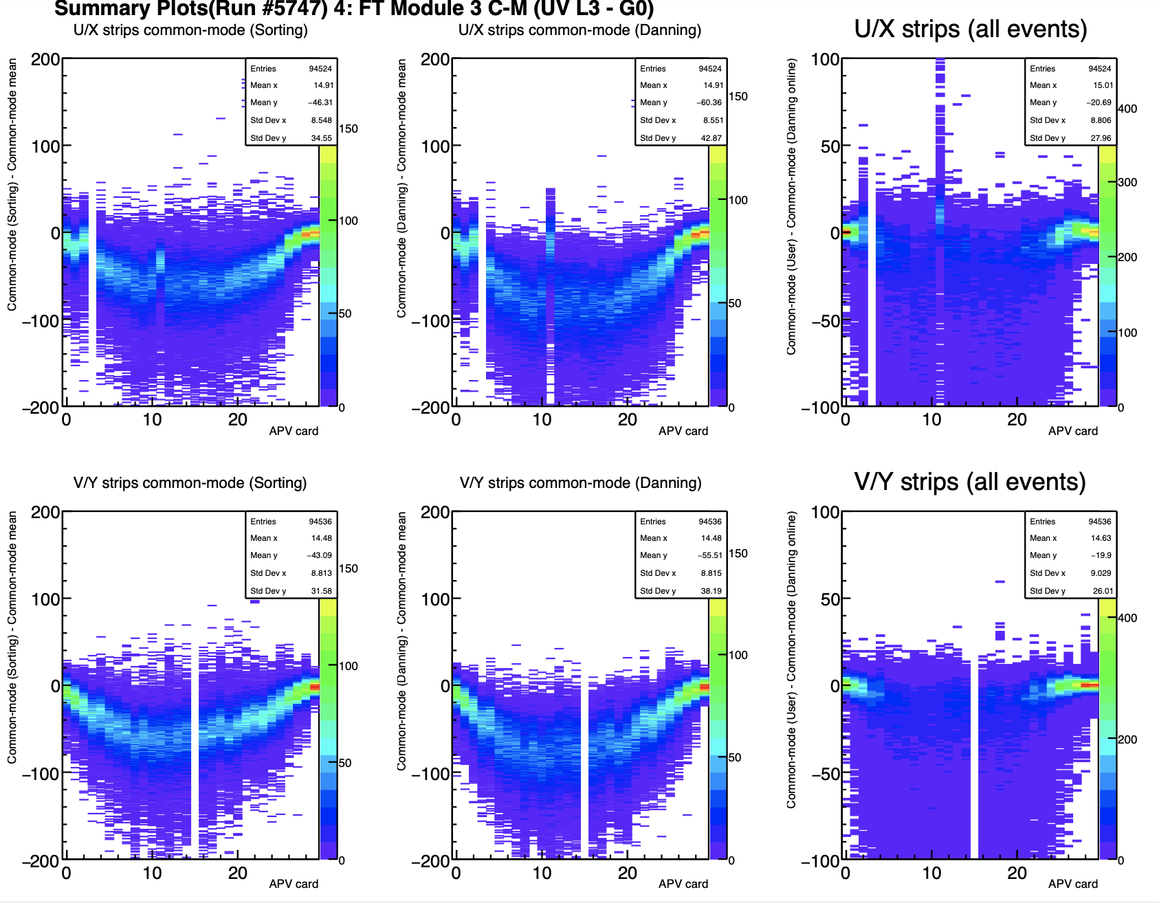
Baseline Sagging
Data undergoes online zero suppression to reduce data rates
Exception is every 1/100 event is saved as full read out for diagnostics
Events that fail the online ZS will be saved as FRO events
Under high rates, the APV25 RC circuit can cause negative pulses which appear to decrease the CM baseline calculated by the online algorithm
So called sagging of the baseline
Figure: Zero Suppressed event
Figure: Negative pulses

Slide 4
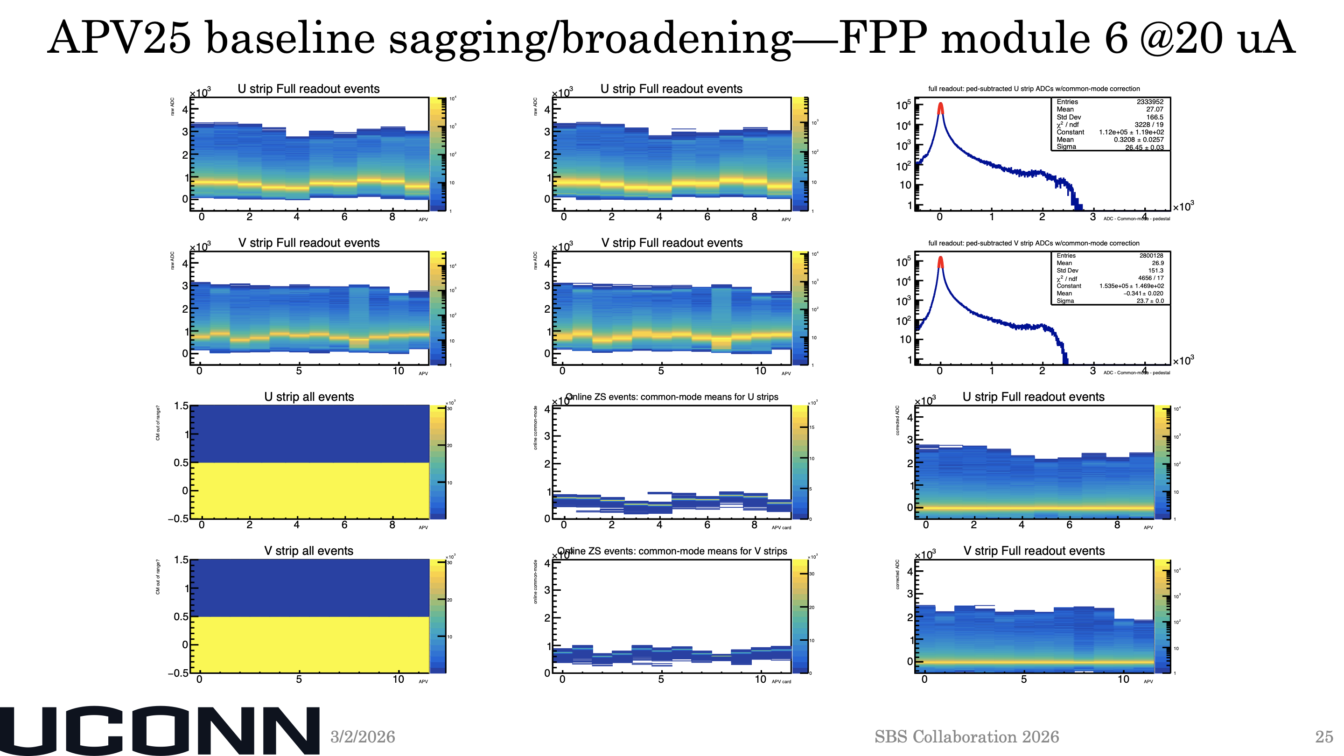

Slide 5
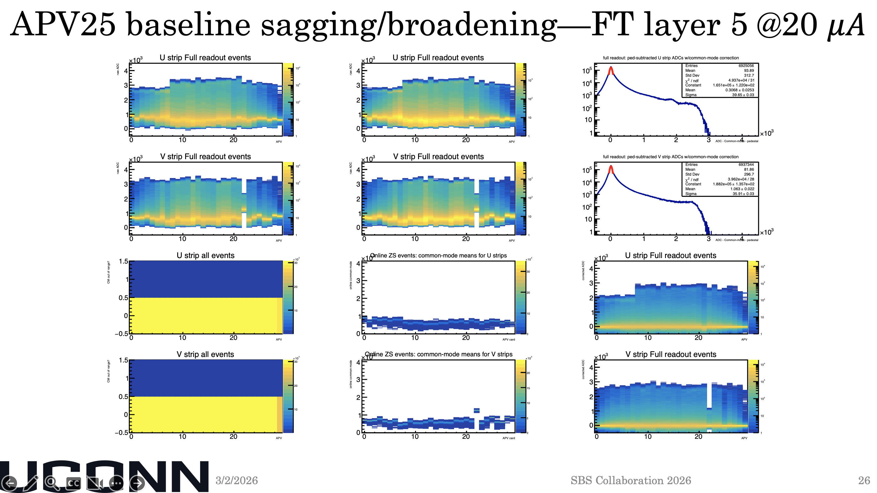

Slide 6
CM Algorithms
Online Danning – Online Algorithm
“Enhanced” Sorting – Offline Algorithm
Sorting
Offline Danning
Histogramming
Potential solution (based off GMn approach)
Using 1/100 FRO events, find an improved CM algorithm that better predicts the actual CM
Using improved CM algorithm, estimate a correction to the online CM calculation → reduction of falsely fired strips
Correction = new corrected offline CM – Online CM
Using FRO events, create a rolling average of “bias”
Bias = corrected CM – true CM
True Common Mode = online CM – correction – bias

Slide 7
“Enhanced” Sorting Algorithm
Sort strips by ADC value in the usual fashion
Rather than cutting off a fixed number of high and low strips and keeping the middle range, instead sweep a range of fixed length “StripsInRange” to find the desired set of strips where the difference between the first and last strip of the range is minimized

Slide 8
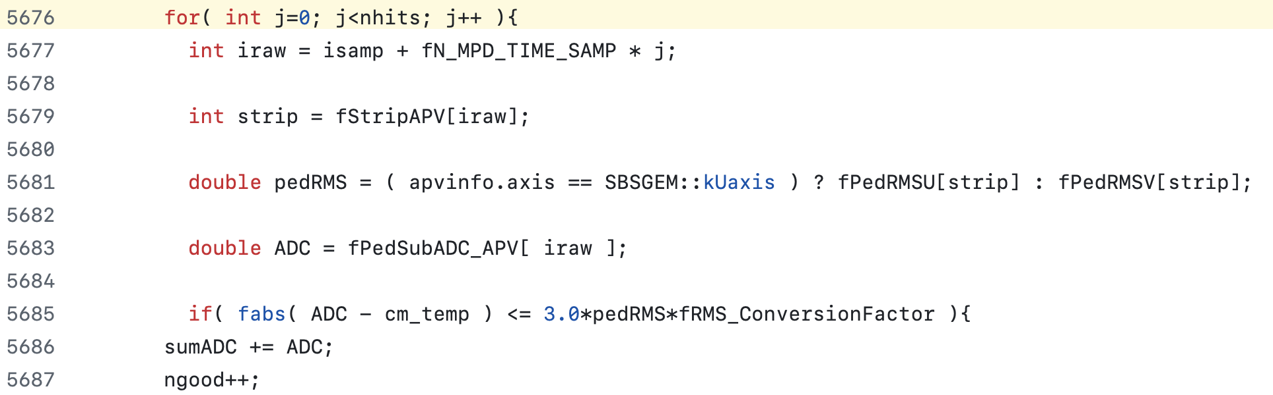
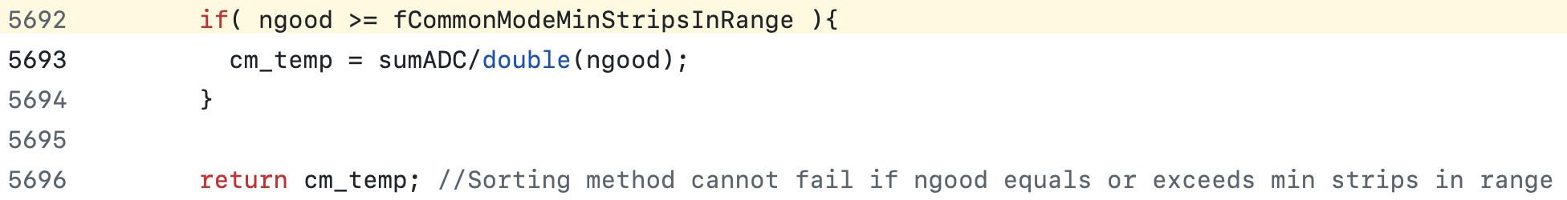
“Enhanced” Sorting Algorithm Cont.
Further improve by taking the average of all strips with +/-3 sigma_ped of previously computed cm_temp
Check there are atleast as many ”ngood” strips in this calculation as the StripsInRange used in the previous step. If so, accept this new cm, if not keep the previous one

Slide 9
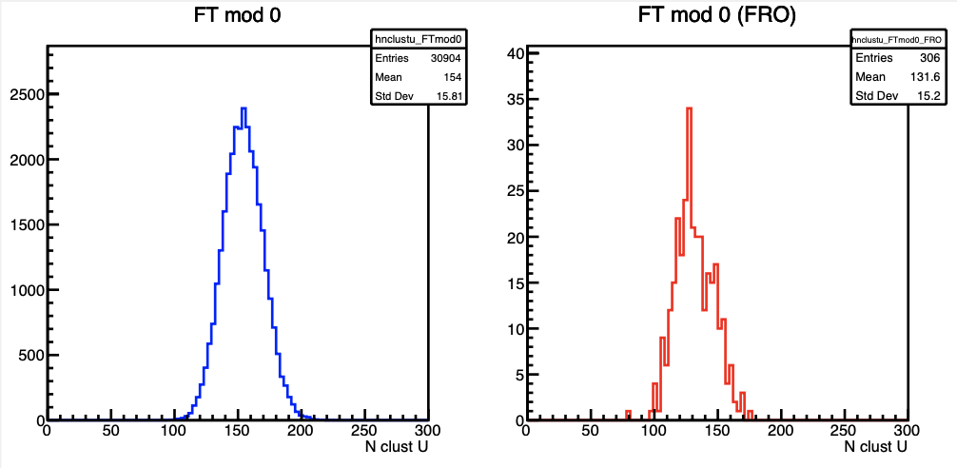
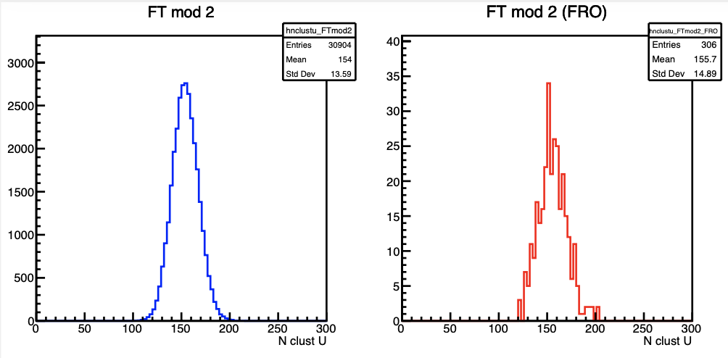
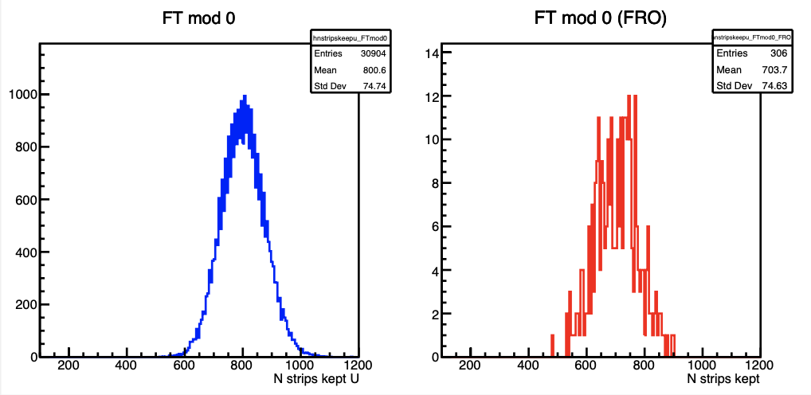
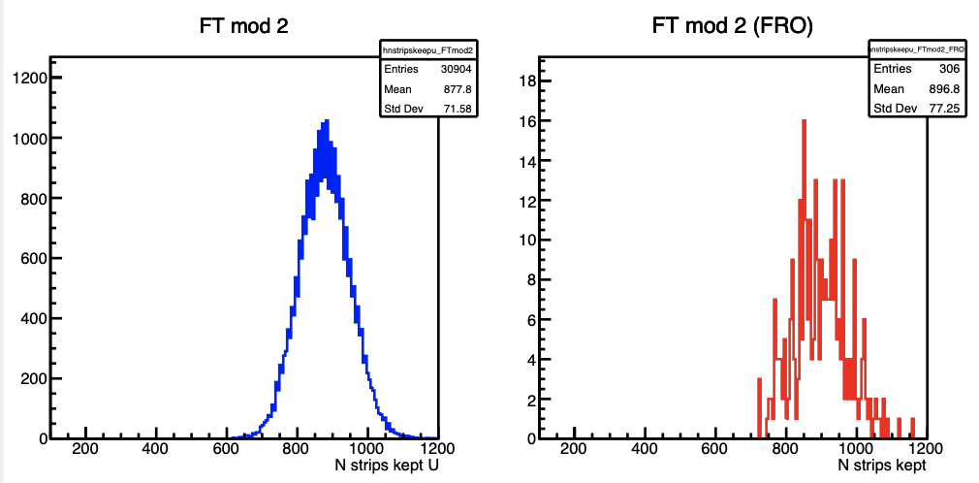
Comparing online ZS and FRO events

Slide 10
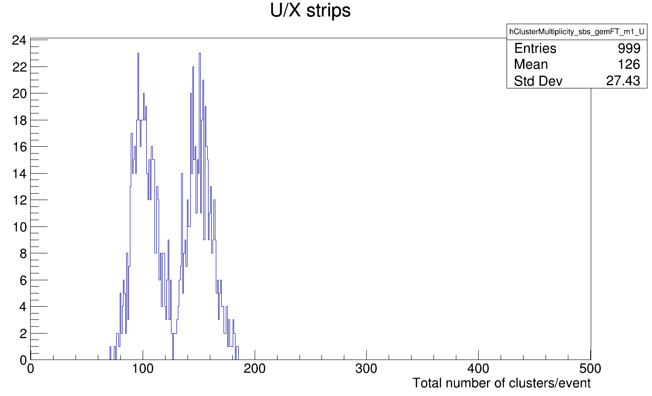
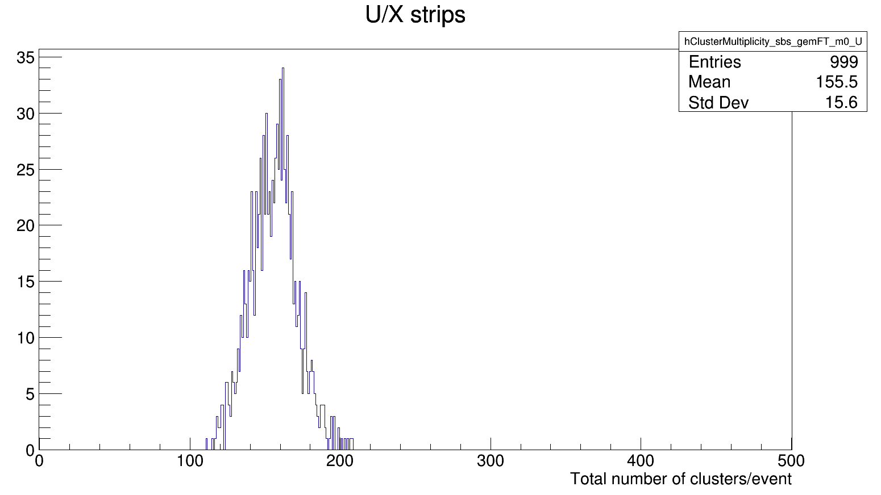
First Issue: Rolling average of Bias
Previously mentioned rolling average of bias is only filled after 10 full readout events (~1000 events)
Bias defaults to 0 otherwise, resulting in over corrected events
Each replay handles ~25-30k events, i.e. something like 4% of data would be impacted
Solution: Don’t do corrections for the first 1000 events!

Slide 11
CM Corrections
For corrections, essentially performing a CM calculation on strips that pass online ZS
We expect low occupancy events should be less likely to need a correction
High occupancy events where a number of strips are clustered around a similar value are events we want to identify
The enhanced sorting algorithm required a minimum of 20 strips. Initial question: How many strips should be required to attempt a correction?

Slide 12
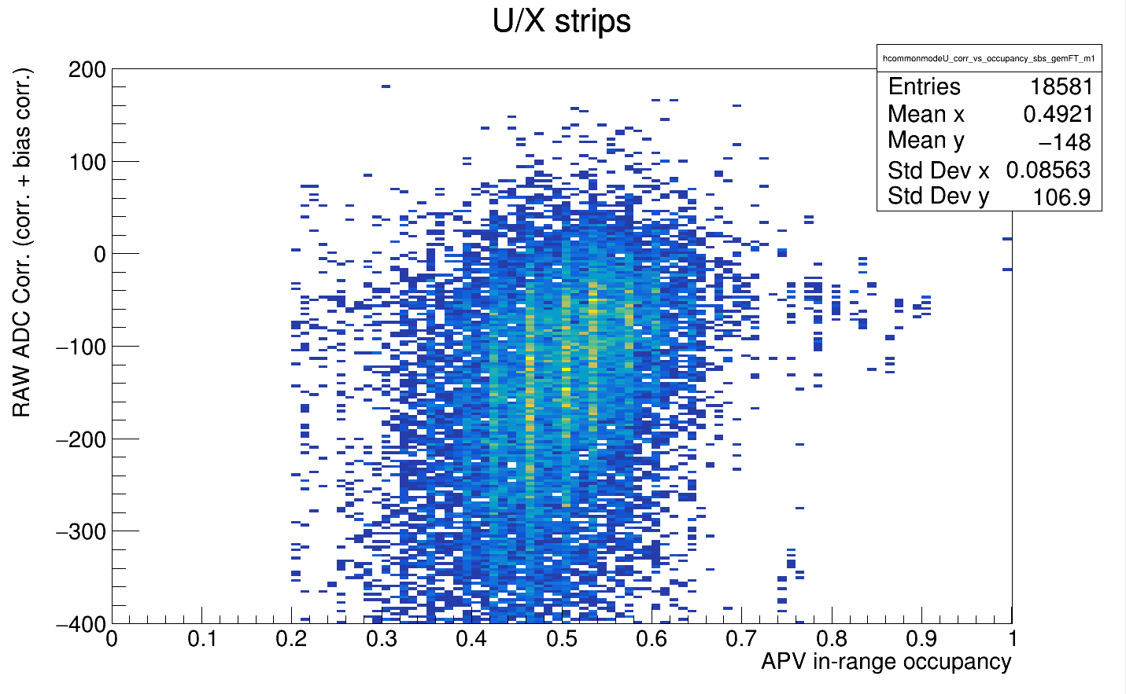
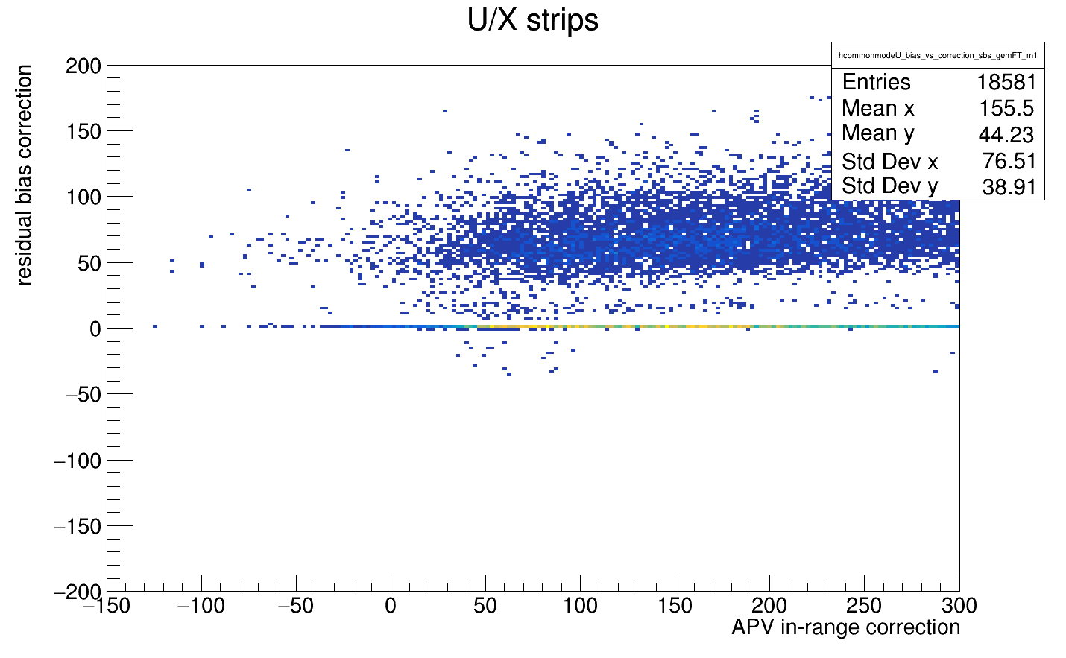
Second Issue: Unexpected Occupancy Behavior
Expect the overall correction to scale with occupancy

Slide 13
Where to go?
What we want: Find events were many strips pass online ZS and are clustered around a common value (The true common mode)
Possible idea to test: In the enhanced algorithm, there is an “improvement” check on strips +/-3 sigma_ped of previously computed cm_temp… what if this is made to be a requirement

