Slide 1
CDet Analysis Status
Benjamin Spaude

Slide 2
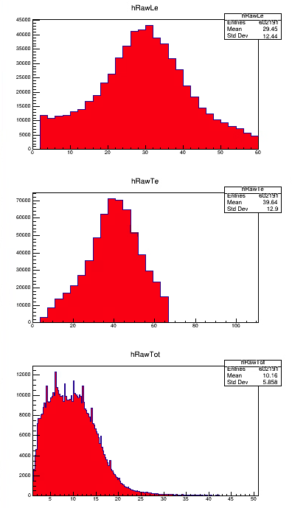
Kin3 Cross Target – Timing Checks
Leading Edge Time (ns)
Trailing Edge Time (ns)
Run 3575 cross target @ 1uA, Ecal singles
~4 hits per event
Raw meaning no cuts
Clear Timing Peak
“Flat” background
Time-over-Threshold (ns)

Slide 3
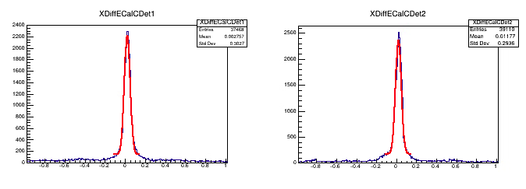
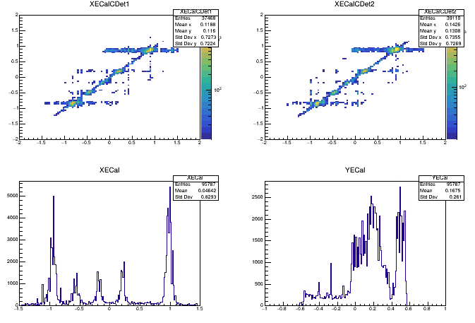
Kin3 Cross Target – CDet & ECal pos check
ECal x
ECal x
CDet x1
CDet x2
Note, peaks on ecal x align with points on XECalCDet
Also, discrepancy on entries – there is a reason!
+/-1m xdiff from Ecal projected to CDet

Slide 4
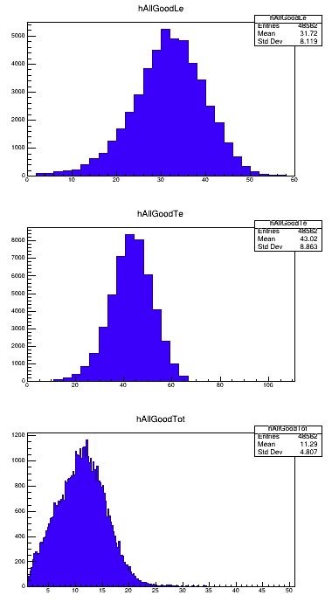
Kin3 Cross Target – Timing Checks w/ Cut
Leading Edge Time (ns)
Trailing Edge Time (ns)
+/-10cm cut on ECal*-Cdet xdiff
“Flat” background goes away
Time-over-Threshold (ns)
*Projected back to cdet

Slide 5
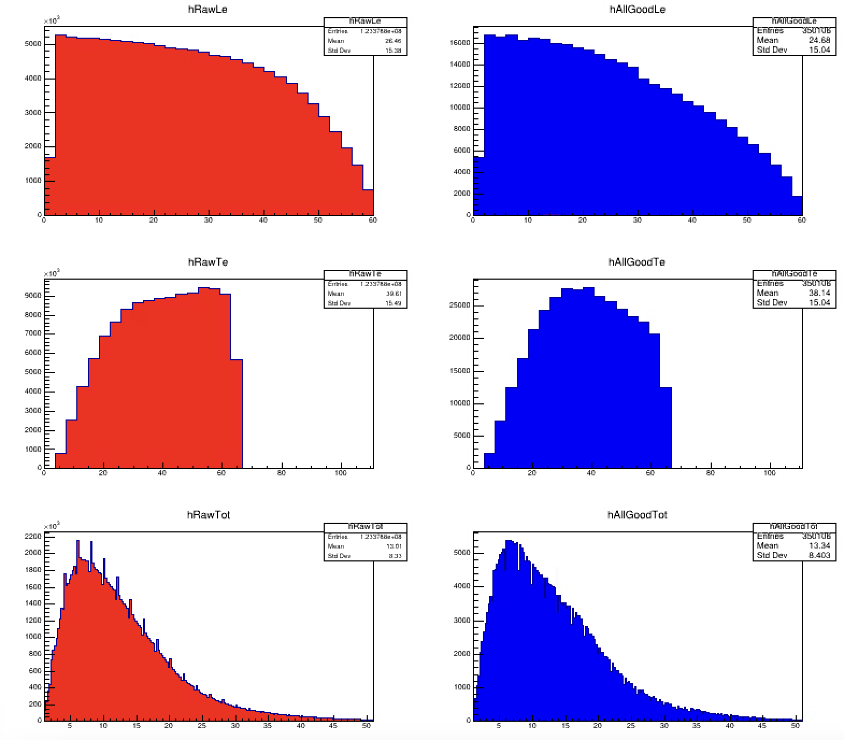
Kin3 LH2 Timing Checks
Leading Edge Time (ns)
Trailing Edge Time (ns)
LH2 @ 22uA, ~600 hits per event
Dominated by background
Background shape is same as cross target
Time-over-Threshold (ns)

Slide 6
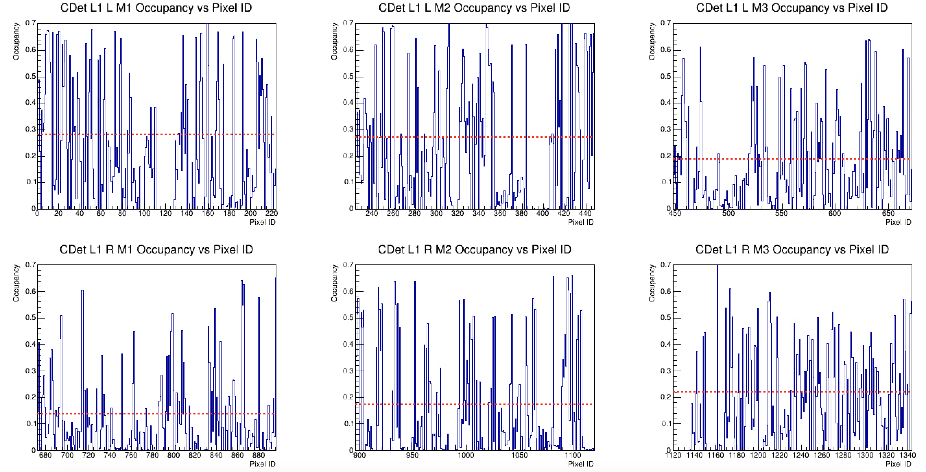
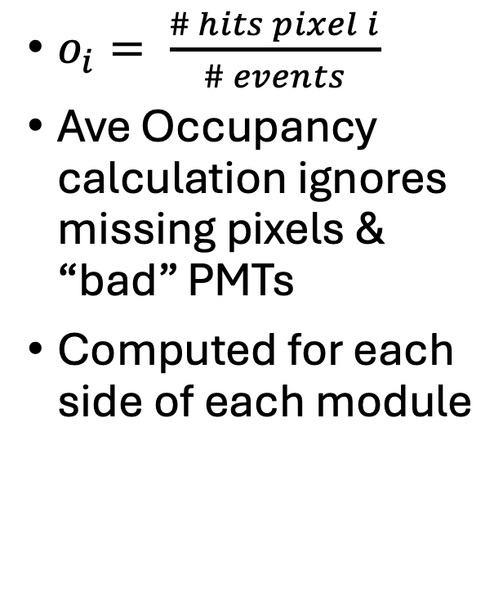
CDet Occupancy from LH2 – Layer 1
$o_{i}= \frac{\# hits pixel i}{\# events}$
Ave Occupancy calculation ignores missing pixels & “bad” PMTs
Computed for each side of each module

Slide 7
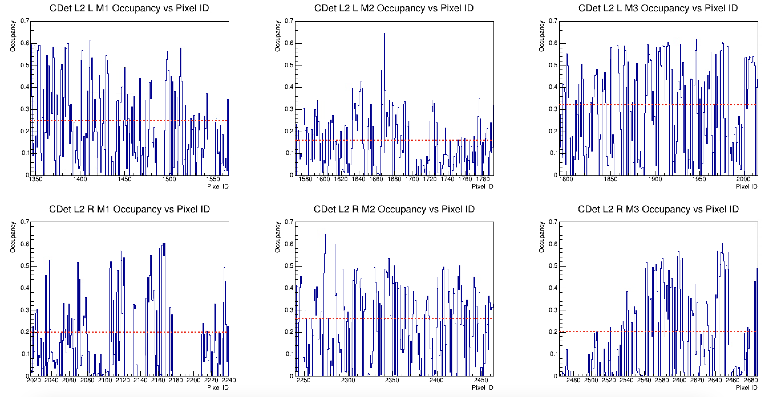
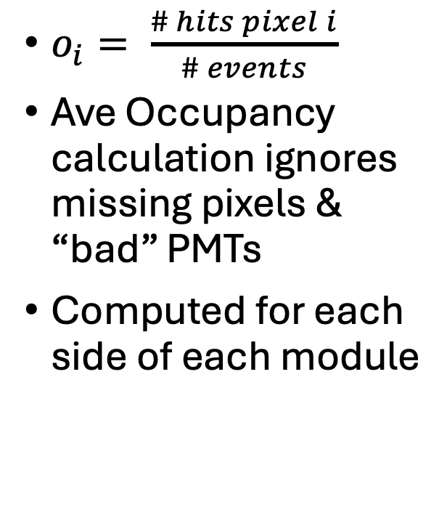
CDet Occupancy from LH2 – Layer 2
$o_{i}= \frac{\# hits pixel i}{\# events}$
Ave Occupancy calculation ignores missing pixels & “bad” PMTs
Computed for each side of each module

Slide 8
Kin3 LH2 Timing Checks w/ ECal x cut
Leading Edge Time (ns)
Trailing Edge Time (ns)
+/- 10cm ecal/cdet xdiff cut
Still background dominated
Need to optimize timing cut
Cross target data should help
Time-over-Threshold (ns)

Slide 9
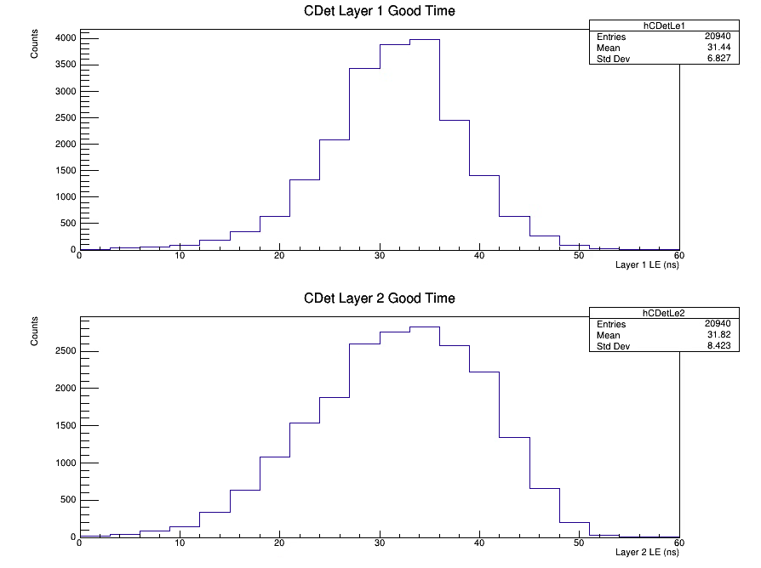
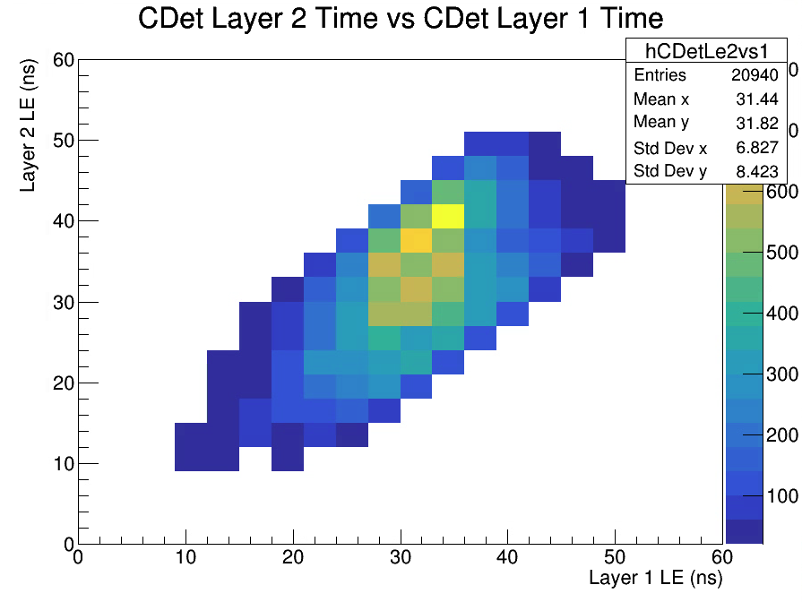
CDet Layer 1 vs 2 Comparisons

Slide 10

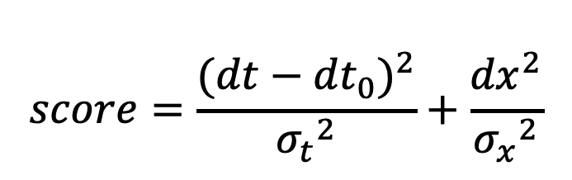
Hit Pairing Strategy
Split hits into layers by using pixel ID
Each hit in layer 1, check all layer 2 hits and compare dt and dx
Store all potential pairs passing accepted dt and dx, sort by best
Only works for events with at least 1 hit in both layers
$$score=\frac{{(dt−dt}_{0})^{2}}{{σ_{t}}^{2}}+\frac{{dx}^{2}}{{σ_{x}}^{2}}$$
$σ_{x}=1$cm
$σ_{t}=$1ns

Slide 11
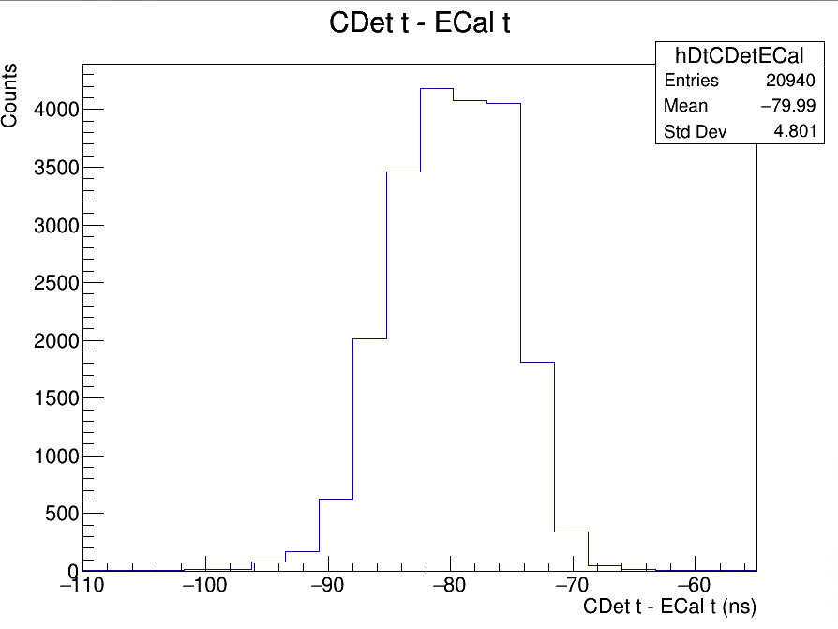
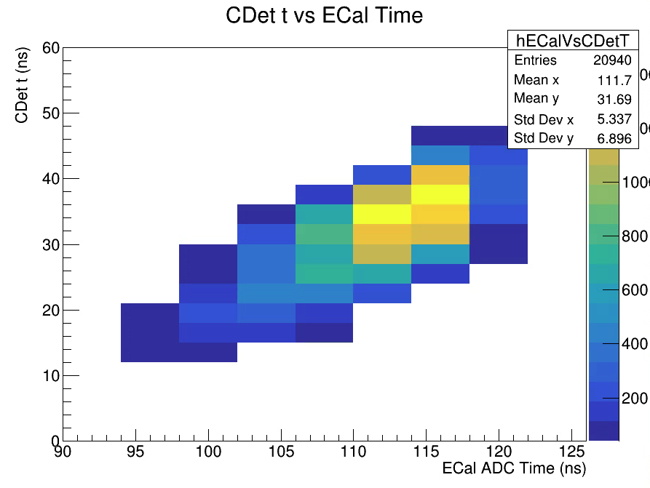
CDet-ECal Comparisons from Cross Target

Slide 12
Conclusion
LH2 suffers from high background rates in CDet
No clear peak with LH2
Significant occupancy variation tube-to-tube
Cross target data has a clean peak and good x correlation
Should be useful in calibrating to extract LH2 peak

Slide 13
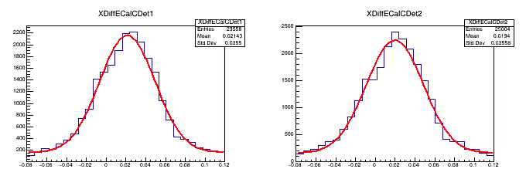
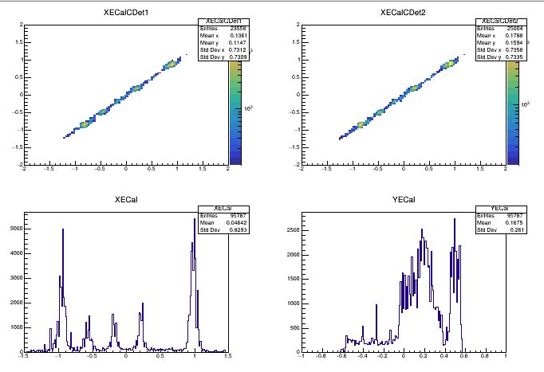
Backup Slides

Slide 14
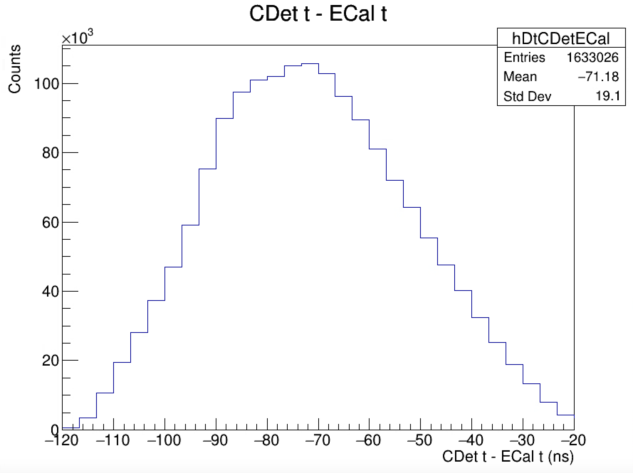
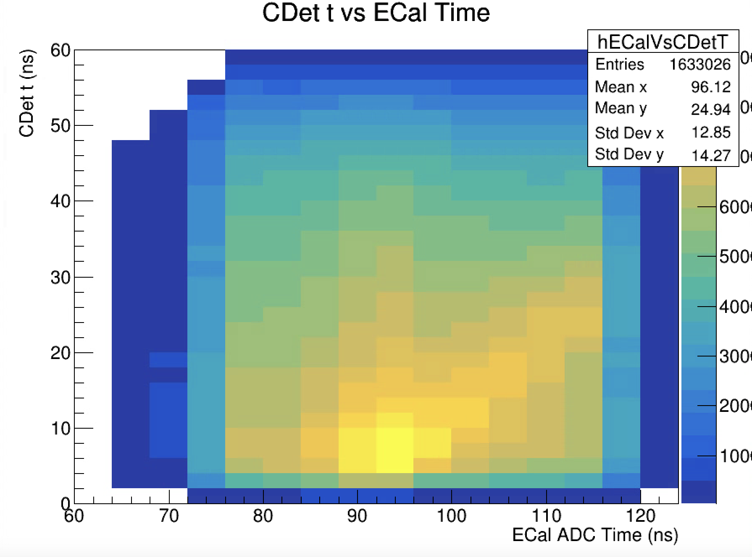
CDet-ECal Comparisons from LH2

Slide 15
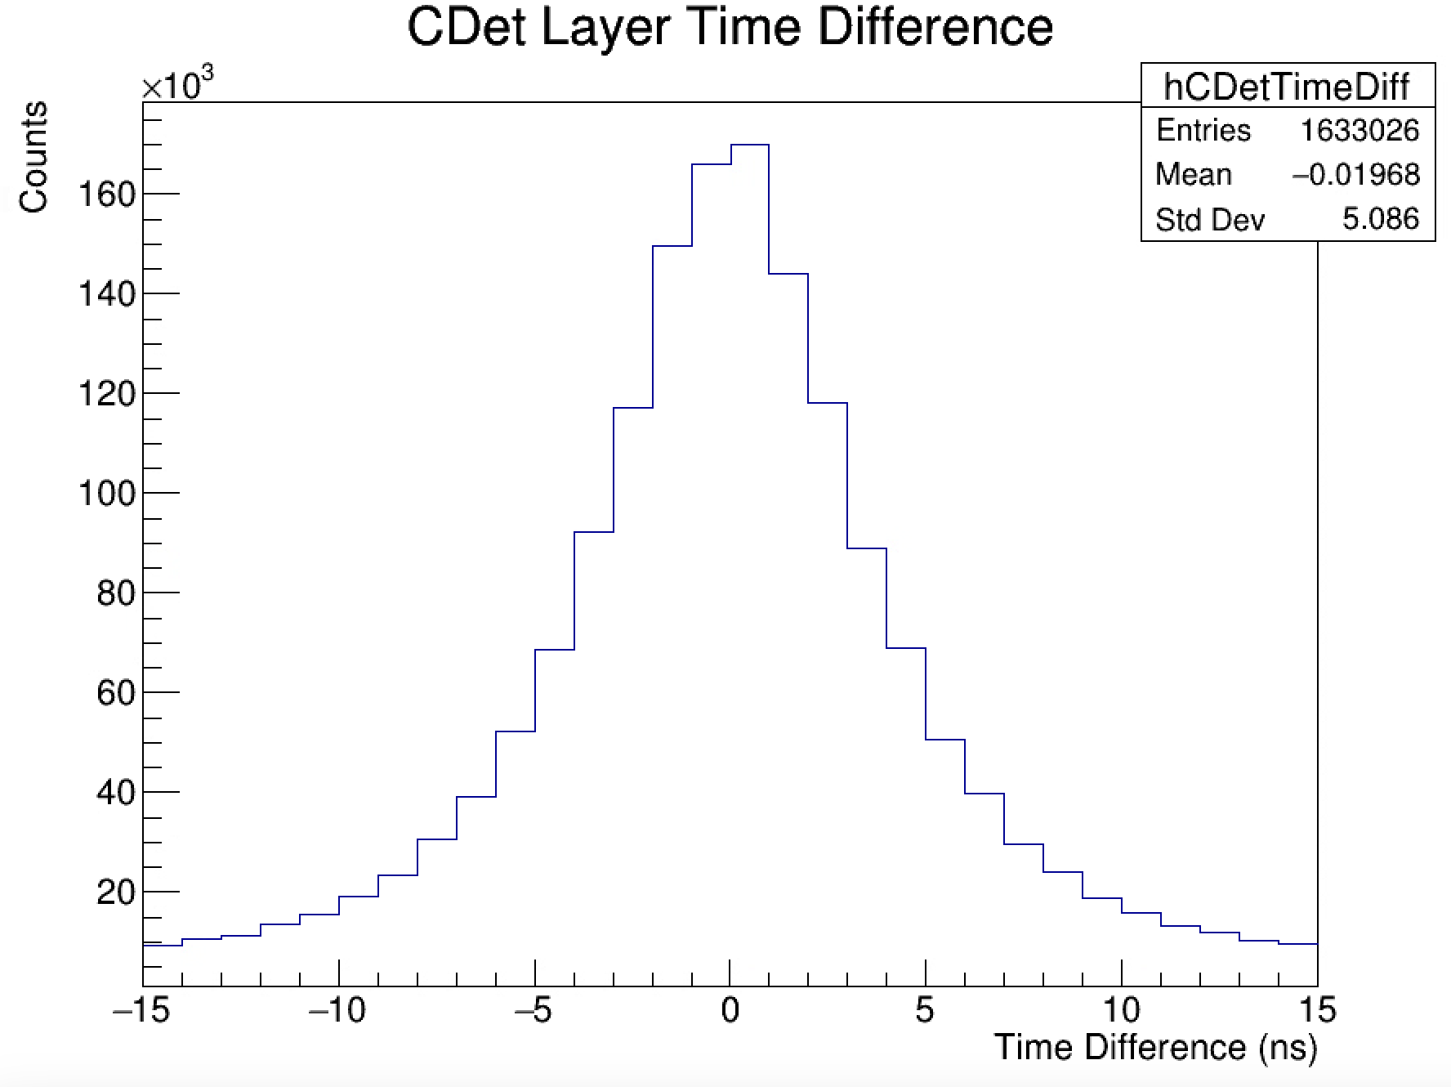
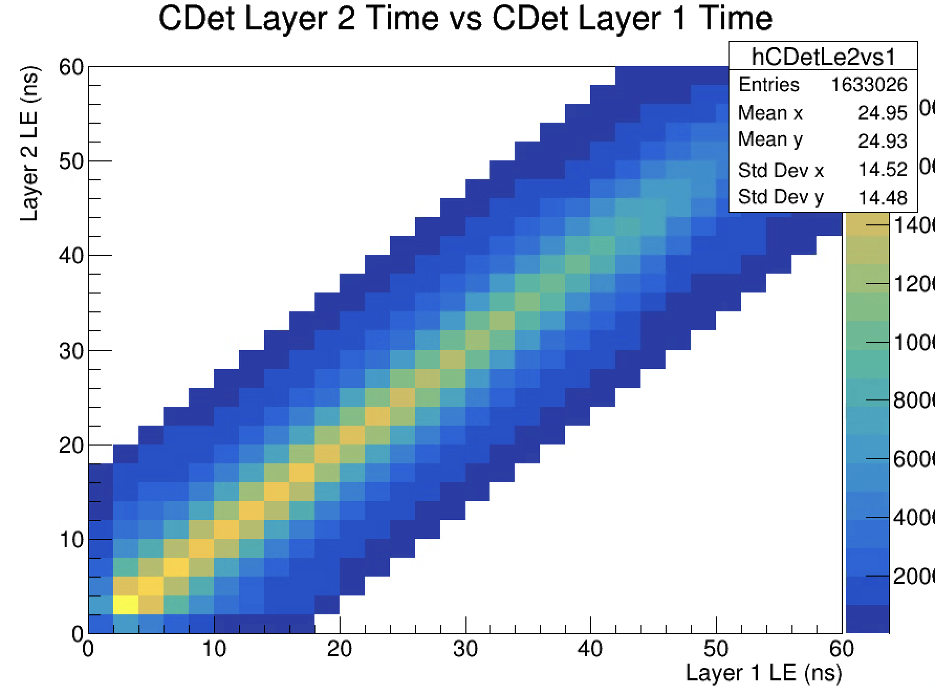
CDet Layer Comparison on LH2

