Slide 1
Analysis Status of the SBS Neutron Two-Photon Exchange Experiment
Ezekiel Wertz
March 2, 2026

Slide 2
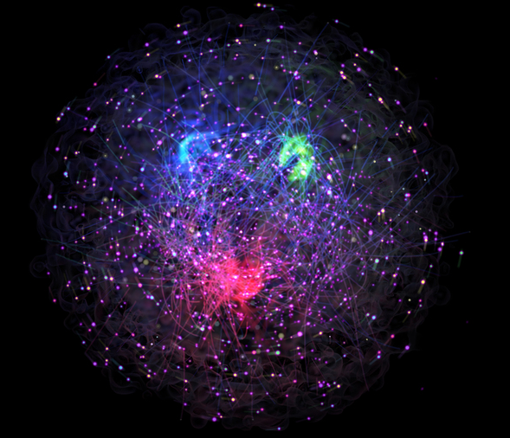
Outline
Nucleon Structure & Electromagnetic Form Factors
SBS nTPE experiment and observable extraction
Overview of Data Analysis Methods
Physics Extraction from Data/MC Comparison
Preliminary neutron Rosenbluth Slope result

Slide 3
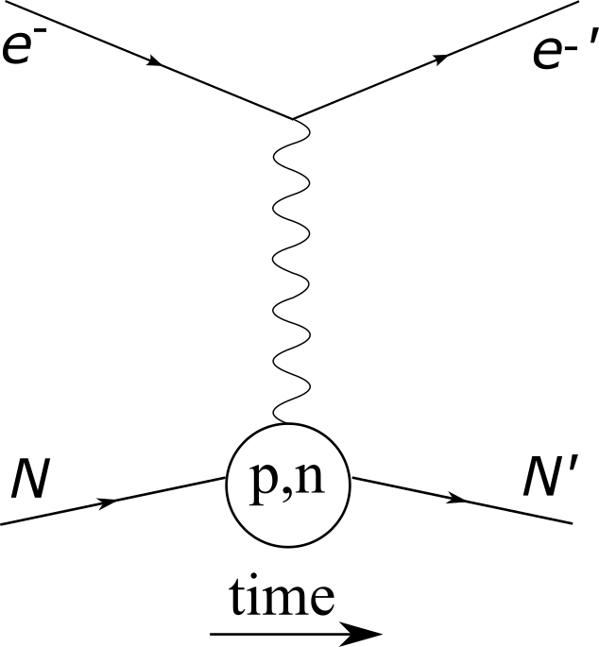

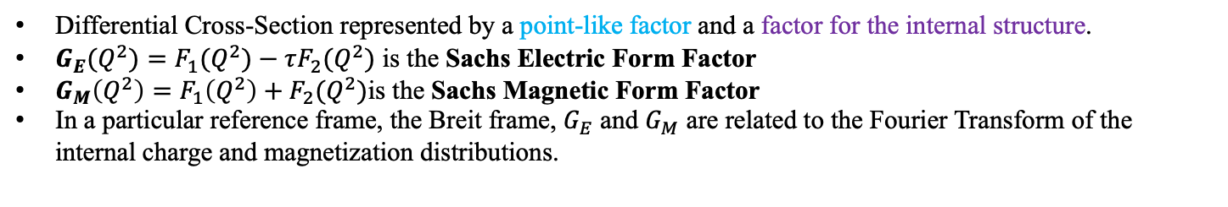
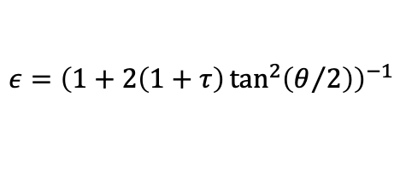
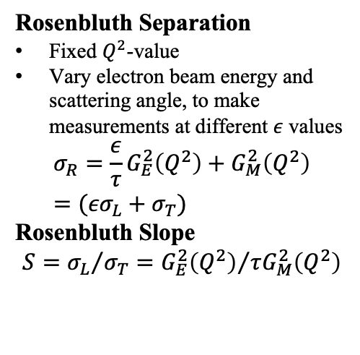
Nucleon Elastic Electromagnetic Form Factors
Differential Cross-Section represented by a point-like factor and a factor for the internal structure.
$G_{E}(Q^{2})=F_{1}(Q^{2})−τF_{2}(Q^{2})$ is the Sachs Electric Form Factor
$G_{M}\left(Q^{2}\right)=F_{1}\left(Q^{2}\right)+F_{2}(Q^{2})$is the Sachs Magnetic Form Factor
In a particular reference frame, the Breit frame, $G_{E}$ and $G_{M}$ are related to the Fourier Transform of the internal charge and magnetization distributions.
Rosenbluth Separation
Fixed $Q^{2}$-value
Vary electron beam energy and scattering angle, to make measurements at different $ε$ values
$$σ_{R}={\frac{ε}{τ}G}_{E}^{2}\left(Q^{2}\right)+G_{M}^{2}\left(Q^{2}\right)=({εσ}_{L}+σ_{T})$$
Rosenbluth Slope
$$S={σ_{L}}/{σ_{T}}={G_{E}^{2}\left(Q^{2}\right)}/{τG_{M}^{2}\left(Q^{2}\right)}$$
$$\frac{dσ}{dΩ}=\frac{{τσ}_{Mott}}{ε(1+τ)}\left({\frac{ε}{τ}G}_{E}^{2}\left(Q^{2}\right)+G_{M}^{2}\left(Q^{2}\right)\right)=\frac{{τσ}_{Mott}}{ε\left(1+τ\right)}({εσ}_{L}+σ_{T})$$
$$ε={\left(1+2\left(1+τ\right)\tan^{2}\left(θ/2\right)\right)}^{−1}$$
Notes:
We know that hadrons (and the nucleon) are not point-like particles. Rather we know the nucleon has a complex internal structure with contributions from valence quarks, gluons, and quark-antiquark pairs
One straightforward experimental technique is electron-nucleon scattering.
By conducting electron-nucleon scattering experiments, we can measure differential cross-sections. The cross-section is a measure of the interaction probability within a given area.
The differential scattering cross-section contains a point-like factor, known as the Mott cross-section
And a factor for internal structure which is composed of two quantities known as the Sachs Electric and Magnetic Form Factors
The electromagnetic form factors are more useful for experimentalists as there are known methods for extracting these electromagnetic form factors.
A classic technique for extracting EMFF is a Rosenbluth Separation or LT Separation which allows for the extraction of EMFFs at a fixed Q^2 and different values of epsilon and exploiting the linearity in epsilon of the reduced cross-section. Which allows for the extraction of a quantity known as the Rosenbluth Slope
Questions
What is the Breit frame?
Something about one of the terms on the slide that is or is not labeled?
Something generic about form factors?
What does form factor represent?
Potentially Refs Thesis chpts 1 or 2 here

Slide 4
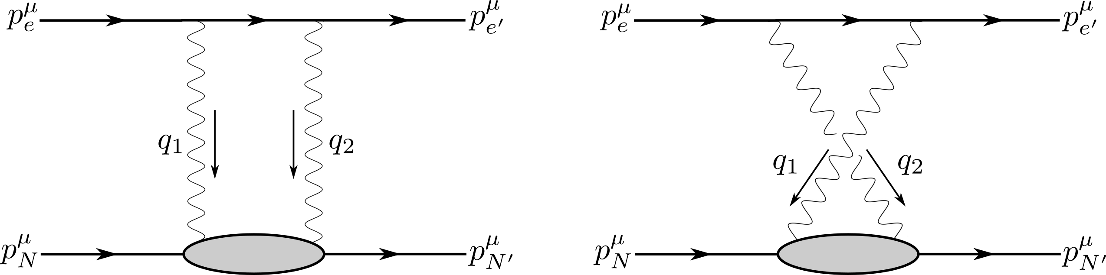
Two-Photon Exchange
Higher order diagrams, Two-Photon Exchange (TPE), contribute to the cross-section
TPE diagrams are difficult to calculate
Studying TPE effects provides insights into nucleon excitation
Notes:
Higher order effects do contribute to the differential scattering cross-section. The magnitude of these contributions is not experimentally well-known
The next-to-leading order diagram from OPE is TPE.
The two Feynman diagrams thought to contribute the most at the TPE level are these box and cross diagrams
The measurement which will be presented in this talk is potentially sensitive to TPE effects
Furthermore studying TPE provides a more complete understanding of nucleon structure. We will revisit this topic in a couple of slides
Questions
Where is QED vs QCD?
Why do these diagrams contribute less?
Are there other second-order diagrams?
At what level do TPE diagrams contribute in alpha?

Slide 5
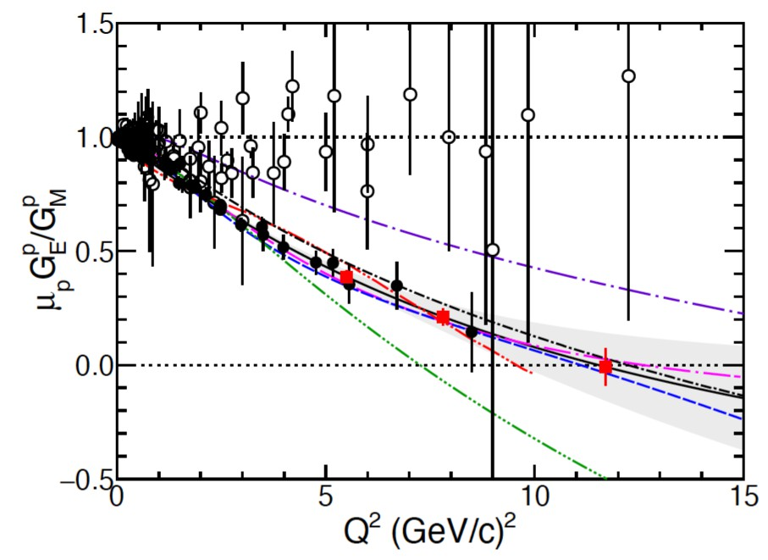
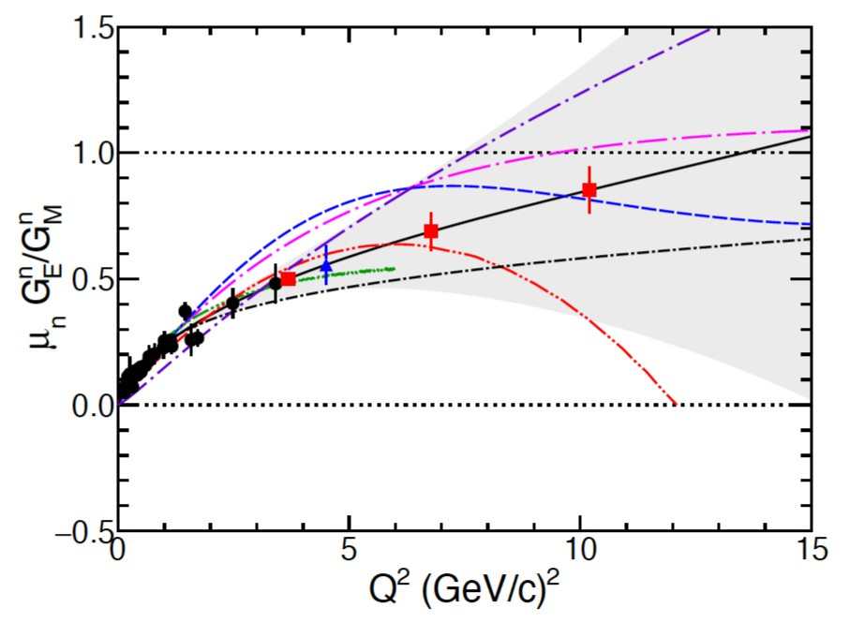
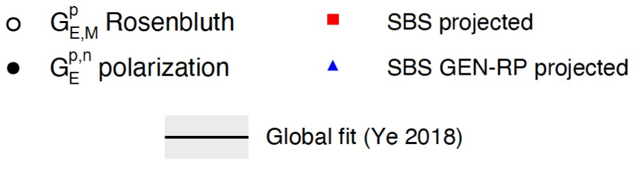
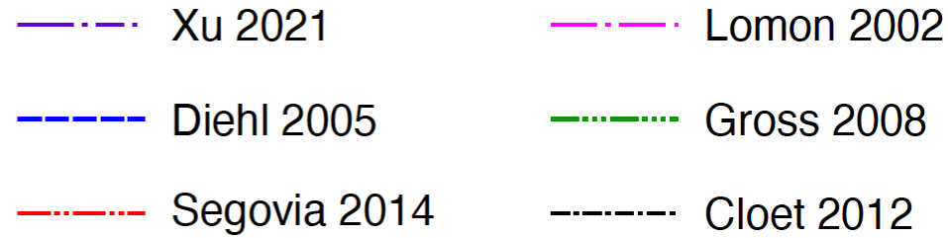
Nucleon Electromagnetic Form Factor World Data
Proton:
Neutron:
Plots: Franz Gross et al., 50 Years of Quantum Chromodynamics
Notes:
Now that we have discussed some of the background related to the nucleon electromagnetic form factors lets look at the existing world data in the which are presented in the form of ratios of electric to magnetic form factor.
If we consider the left plot, which is for the proton. We can see that there exists data from two different types of measurements. One is from Rosenbluth Separation measurements like we just talked about. These are the open circles. The other are black circles which come from measurements of polarization spin observables. If anyone has questions about methods involving polarization observables we can address that during questions. What’s important about this plot is there are two distinct types of methods which both have Q^2 values greater than 10 GeV/c^2
What’s relevant for both plots is that the red and blue data points are projected measurements from experiments in the SBS program. The black line is a parameterization and error band of the fit to the world data. And the various dashed and colored lines are from different theoretical models which predict values of the form factors.
For the right plot, which is for the neutron. We can see that the existing data only comes from measurements of polarization observables.
We will now discuss both of these plots a little bit more to help motivate the neutron TPE experiment and this dissertation.
Questions
Where world data come from?
What are theory curves?
Interpreting the FF plots?
What are PT measurement methods?

Slide 6
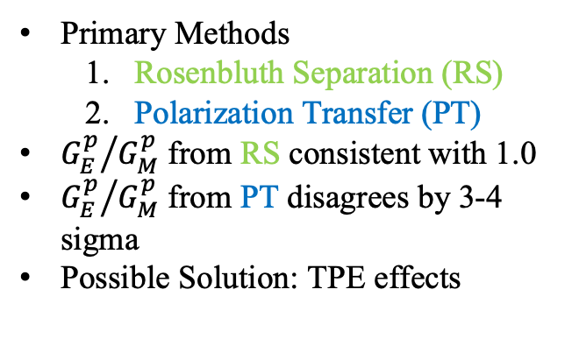
Proton Form Factor Ratio World Data Discrepancy
Proton:
Primary Methods
Rosenbluth Separation (RS)
Polarization Transfer (PT)
${G_{E}^{p}}/{G_{M}^{p}}$ from RS consistent with 1.0
${G_{E}^{p}}/{G_{M}^{p}}$ from PT disagrees by 3-4 sigma
Possible Solution: TPE effects
Plots: Franz Gross et al., 50 Years of Quantum Chromodynamics
Notes:
This is the current available proton Form factor world data and the discrepancy in this data helps motivate study of the EMFF ratio for the neutron
Within their uncertainties the Rosenbluth data points are consistent with a value of 1.0 for the electric to magnetic form factor ratio.
The data point from polarization transfer observables significantly deviate from the RS data points. Particularly at higher values of Q^2 where the deviation is on the order of 3-4 sigma
Naively if one were measuring the same quantity with two different methods, one would expect consistency.
This proton form factor discrepancy is well-known within the community and it is anticipated that a possible solution is contributions from TPE effects.

Slide 7
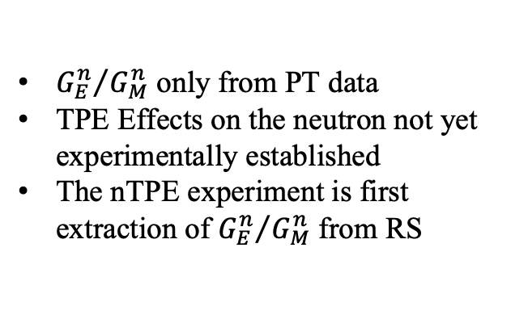
Neutron Form Factor Ratio World Data
Neutron:
${G_{E}^{n}}/{G_{M}^{n}}$ only from PT data
TPE Effects on the neutron not yet experimentally established
The nTPE experiment is first extraction of ${G_{E}^{n}}/{G_{M}^{n}}$ from RS
Plots: Franz Gross et al., 50 Years of Quantum Chromodynamics
Notes:
Now let’s consider the world data for the neutron form factors.
Here there are only measurements from polarization observables, and the existing data is still below 5 GeV/c ^2. We do not yet have any measurements from a Rosenbluth technique
Which means there is no experimentally established picture of TPE on the neutron
The focus of this talk, as well as the SBS nTPE experiment, is a first measurement of the neutron electromagnetic form factor ratio from a RS technique.

Slide 8
Neutron Rosenbluth Slope Measurement Checklist
High intensity electron beam.
Source of protons and neutrons.
Simultaneous detection of scattered electron and scattered nucleon.
Two separate neutron-to-proton cross-section ratio measurements at the same Q² with different values of epsilon.

Slide 9

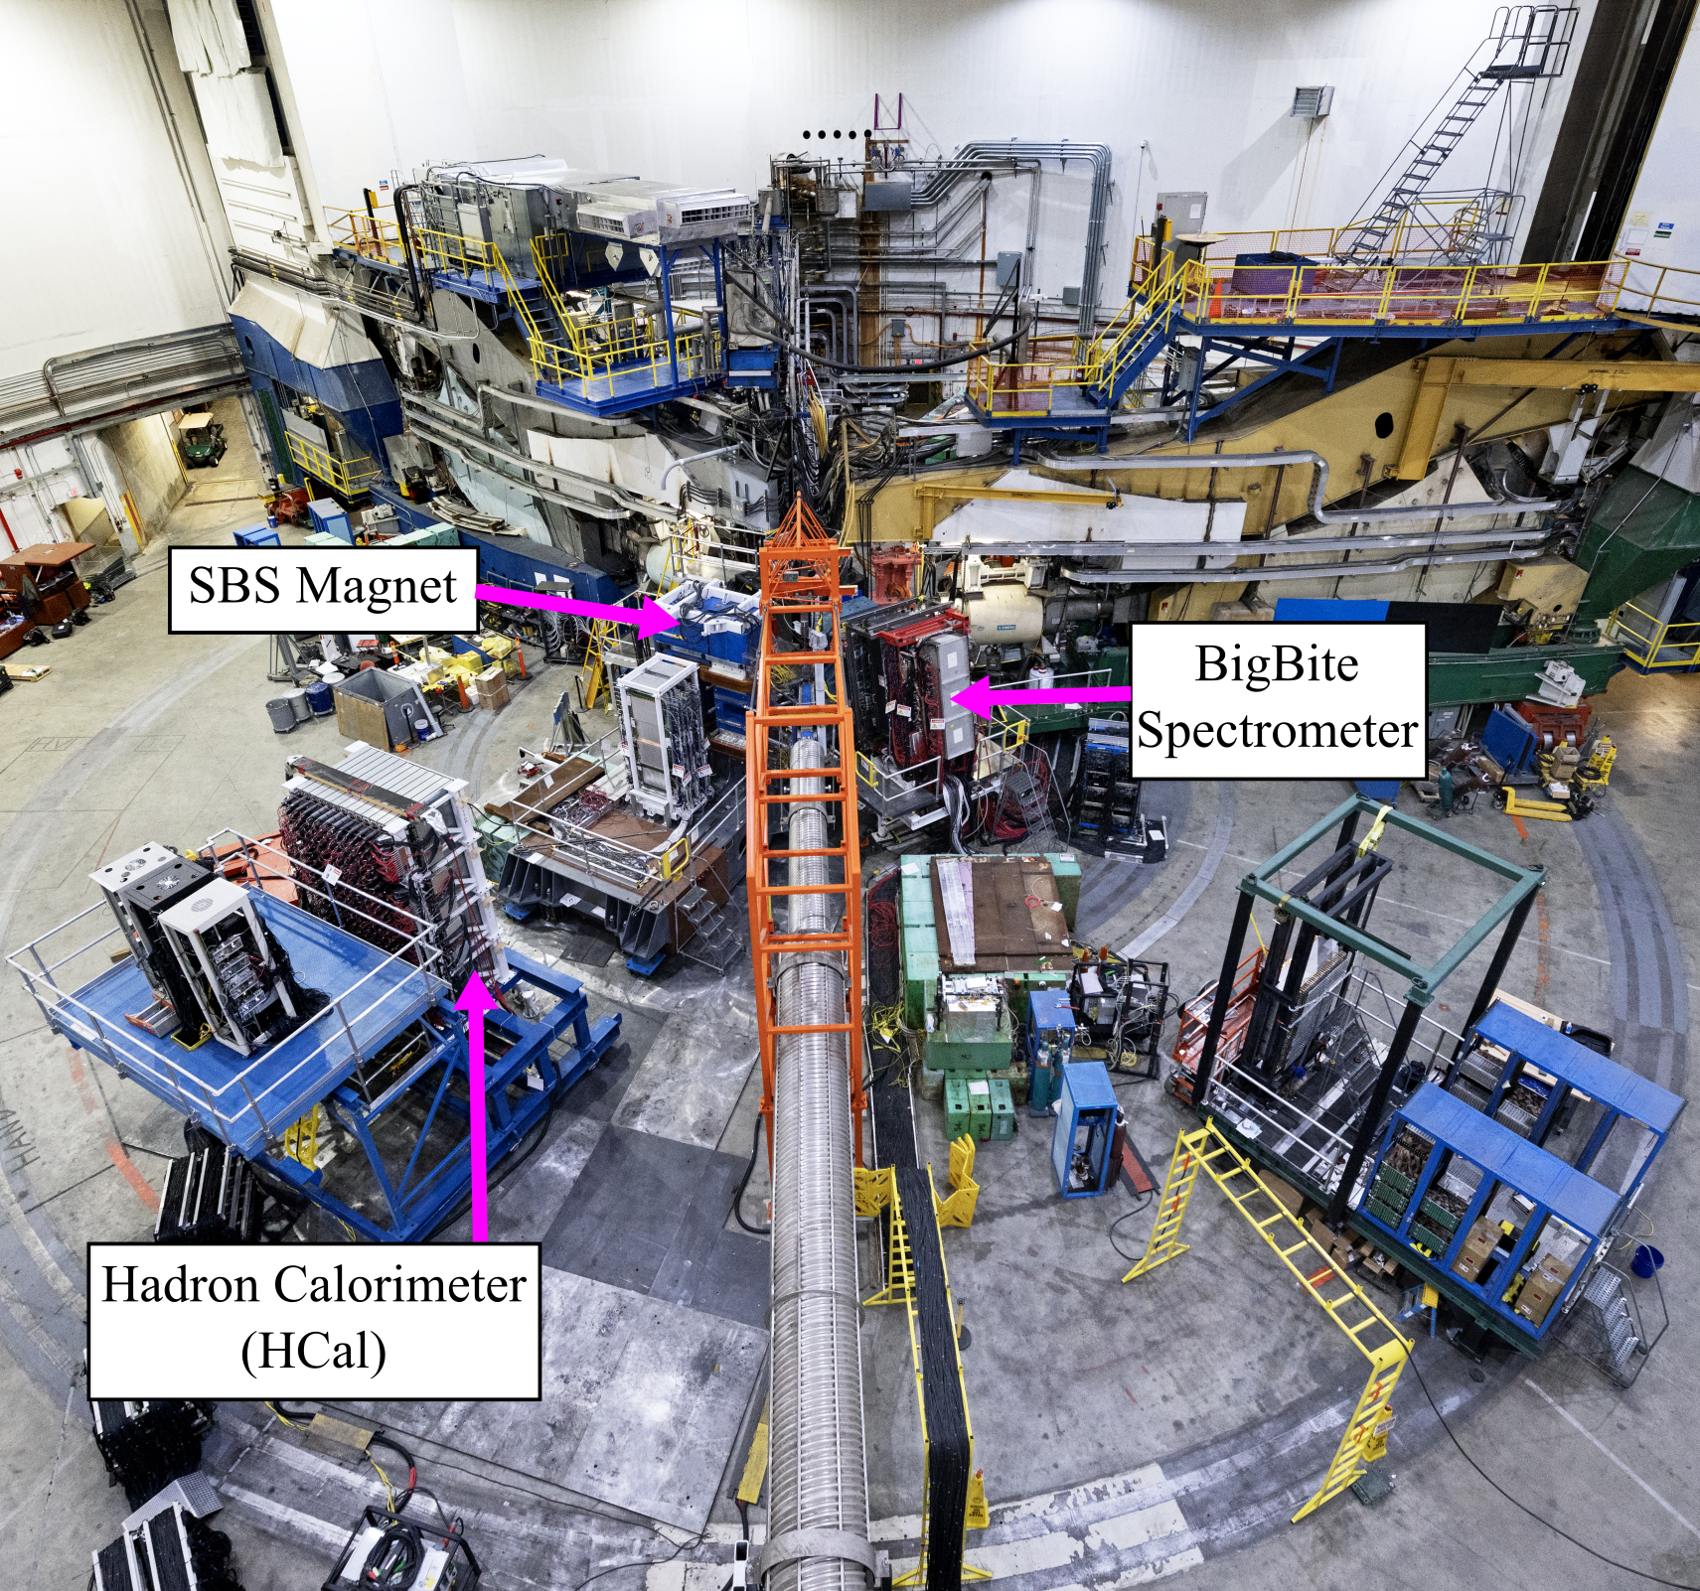
Super BigBite Spectrometer (SBS) Apparatus in Hall A
Liquid Deuterium target - source for protons and neutrons
BigBite Spectrometer – electron arm
SBS Magnet + HCal – hadron arm
Notes:
The Super BigBite Spectrometer in Hall A was used to conduct the nTPE experiment
The experimental program related to the SBS apparatus are precision measurements of all nucleon electromagnetic form factors in a higher Q^2 regime.
We will use a liquid deuterium target. Which provides a stable source of both protons and neutrons
This accomplishes point 2 of the list
The main components of the SBS apparatus were the BigBite and Super BigBite Spectrometers
The BigBite Spectrometer was the electron arm. Providing all relevant information about the scattered electrons
The Super BigBite Spectrometer was the hadron arm and it measures information about the scattered nucleons
This handles point 3 of the list
Questions about the individual detectors or the target. Might have to reference thesis

Slide 10
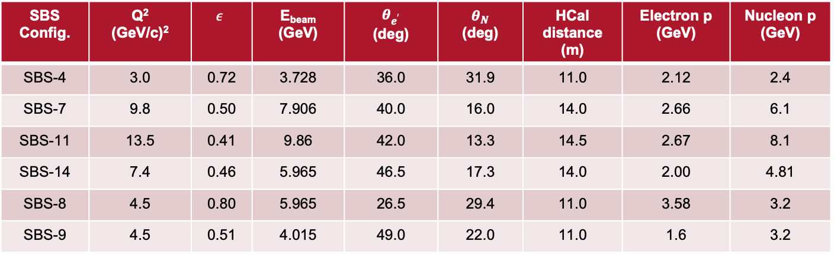
SBS nTPE and GMn experiments
neutron Two-Photon Exchange (nTPE) Goal: First measurement of the neutron Rosenbluth slope, extract the neutron electromagnetic form factor ratio. Seeks to quantify TPE effects.
GMn Goal: Precision measurement of neutron magnetic form factor at high Q².
GMn and nTPE took data from October 2021 to February 2022.
SBS-8 and SBS-9 are kinematics for nTPE.
SBS Config. | Q² (GeV/c)² | $$ε$$ | E_{beam} (GeV) | $$θ_{e^{′}}$$ (deg) | $$θ_{N}$$ (deg) | HCal distance (m) | Electron p (GeV) | Nucleon p (GeV)
SBS-4 | 3.0 | 0.72 | 3.728 | 36.0 | 31.9 | 11.0 | 2.12 | 2.4
SBS-7 | 9.8 | 0.50 | 7.906 | 40.0 | 16.0 | 14.0 | 2.66 | 6.1
SBS-11 | 13.5 | 0.41 | 9.86 | 42.0 | 13.3 | 14.5 | 2.67 | 8.1
SBS-14 | 7.4 | 0.46 | 5.965 | 46.5 | 17.3 | 14.0 | 2.00 | 4.81
SBS-8 | 4.5 | 0.80 | 5.965 | 26.5 | 29.4 | 11.0 | 3.58 | 3.2
SBS-9 | 4.5 | 0.51 | 4.015 | 49.0 | 22.0 | 11.0 | 1.6 | 3.2
Notes:
The goal of the SBS neutron TPE experiment is to provide a first measurement of the Rosenbluth Slope for the neutron. Extract the neutron electromagnetic form factor ratio. And potentially seek to experimentally assess TPE effects on the neutron. The extraction and analysis of the data for this experiment is the central topic of this talk.
The SBS GMn and nTPE experiments collected data during the same run period from October 2021 to February of 2022.
The table presents the nominal kinematic configurations. This talk is going to focus on the SBS-8 and SBS-9 configurations which correspond to the data for the nTPE experiment.
Questions
Maybe clarifying questions about kinematic parameters

Slide 11
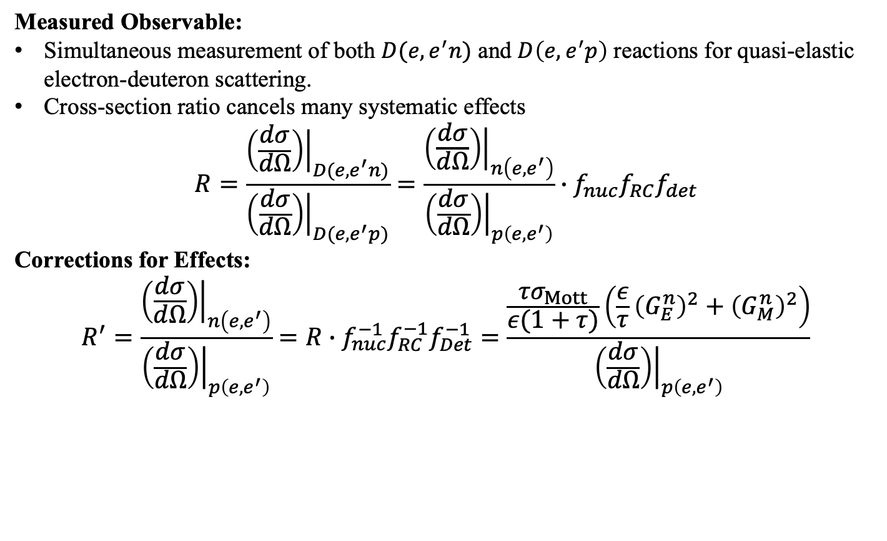
The Ratio Method
Measured Observable:
Simultaneous measurement of both $D(e,e^{′}n)$ and $D\left(e,e^{′}p\right)$ reactions for quasi-elastic electron-deuteron scattering.
Cross-section ratio cancels many systematic effects
$$R=\frac{{\left.\left(\frac{dσ}{dΩ}\right)\right|}_{D(e,e^{′}n)}}{{\left.\left(\frac{dσ}{dΩ}\right)\right|}_{D(e,e^{′}p)}}=\frac{{\left.\left(\frac{dσ}{dΩ}\right)\right|}_{n\left(e,e^{′}\right)}}{{\left.\left(\frac{dσ}{dΩ}\right)\right|}_{p\left(e,e^{′}\right)}}∙f_{nuc}f_{RC}f_{det}$$
Corrections for Effects:
$$R^{′}=\frac{{\left.\left(\frac{dσ}{dΩ}\right)\right|}_{n\left(e,e^{′}\right)}}{{\left.\left(\frac{dσ}{dΩ}\right)\right|}_{p\left(e,e^{′}\right)}}=R∙f_{nuc}^{−1}f_{RC}^{−1}f_{Det}^{−1}=\frac{\frac{{τσ}_{Mott}}{ε(1+τ)}\left({\frac{ε}{τ}\left(G_{E}^{n}\right)}^{2}+{\left(G_{M}^{n}\right)}^{2}\right)}{{\left.\left(\frac{dσ}{dΩ}\right)\right|}_{p\left(e,e^{′}\right)}}$$
Notes:
I want to start by describing the extraction method which is known as the Ratio Method. This method is also important for the extraction of the nTPE experiment and we will discuss that extraction shortly.
In this technique we simultaneously measure the D(e,e’n) and D(e,e’p) reactions for quasi-elastic electron deuteron scattering.
Using this technique we have access to the ratio of neutron-to-proton quasi-elastic cross-sections. Which we will call R
The main advantage of this technique is that main systematic effects cancel in the cross-section ratio. These includes effects associated with the apparatus, the beam profile, and the target properties. In absolute cross-section measurements, these types of systematic effects are typically present.
In our case we can relate the ratio of quasi-elastic cross-sections to the ratio of neutron-to-proton elastic scattering cross-section ratio by applying correction factors for systematic effects which will not exactly cancel in the ratio.
It is expected that these correction factors correspond to known nuclear effects (mainly Fermi-smearing and Final-State Interactions), radiative corrections, and nucleon detection efficiencies
We are ultimately measuring R. But we can relate R to the ratio of neutron-to-proton elastic scattering cross-sections, which we shall call R’. R’ is directly related to the neutron electromagnetic form factors we are interested in studying. And the proton elastic cross-section
Questions
Sort of expected questions about details of this formalism. Just be ready to either reference chpt 3 or chpt 6 of thesis

Slide 12
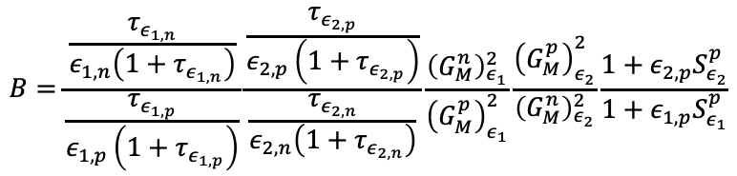
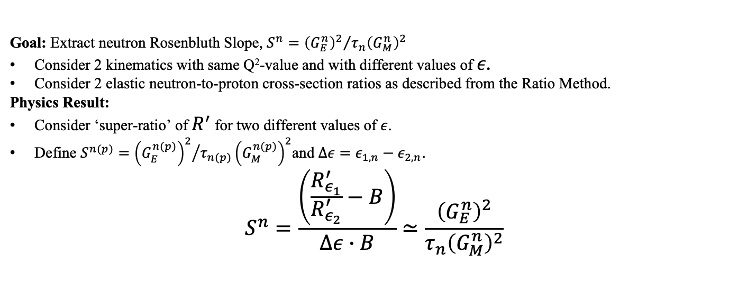
Neutron Rosenbluth Slope Technique
Goal: Extract neutron Rosenbluth Slope, $S^{n}={{\left(G_{E}^{n}\right)}^{2}}/{τ_{n}{\left(G_{M}^{n}\right)}^{2}}$
Consider 2 kinematics with same Q²-value and with different values of $ε$.
Consider 2 elastic neutron-to-proton cross-section ratios as described from the Ratio Method.
Physics Result:
Consider ‘super-ratio’ of $R^{′}$ for two different values of $ε$.
Define $S^{n(p)}={{\left(G_{E}^{n(p)}\right)}^{2}}/{τ_{n(p)}}{\left(G_{M}^{n(p)}\right)}^{2}$and $Δε=ε_{1,n}−ε_{2,n}$.
$$S^{n}=\frac{\left(\frac{R_{ε_{1}}^{′}}{R_{ε_{2}}^{′}}−B\right)}{Δε∙B}≃\frac{{\left(G_{E}^{n}\right)}^{2}}{τ_{n}{\left(G_{M}^{n}\right)}^{2}}$$
From Data Extraction
Physics Result!
From Kinematic Information
$$B=\frac{\frac{τ_{ε_{1,n}}}{ε_{1,n}\left(1+τ_{ε_{1,n}}\right)}}{\frac{τ_{ε_{1,p}}}{ε_{1,p}\left(1+τ_{ε_{1,p}}\right)}}\frac{\frac{τ_{ε_{2,p}}}{ε_{2,p}\left(1+τ_{ε_{2,p}}\right)}}{\frac{τ_{ε_{2,n}}}{ε_{2,n}\left(1+τ_{ε_{2,n}}\right)}}\frac{{\left(G_{M}^{n}\right)}_{ε_{1}}^{2}}{{\left(G_{M}^{p}\right)}_{ε_{1}}^{2}}\frac{{\left(G_{M}^{p}\right)}_{ε_{2}}^{2}}{{\left(G_{M}^{n}\right)}_{ε_{2}}^{2}}\frac{1+ε_{2,p}S_{ε_{2}}^{p}}{1+ε_{1,p}S_{ε_{1}}^{p}}$$
From Global Form Factor Analysis.
Notes:
We can extract S^n with the following relation. Where again the super-ratio A comes from elastic neutron-to-proton cross-sections from this data analysis. The delta epsilon quantity is calculated from kinematic information. And the components of the quantity B are taken from either kinematic information or parameterizations to the nucleon electromagnetic form factor world data.
Now that we have explained the techniques we will use for extracting both GMn and the neutron Rosenbluth Slope. We will move to an overview of the data analysis and how we extract values of R’

Slide 13
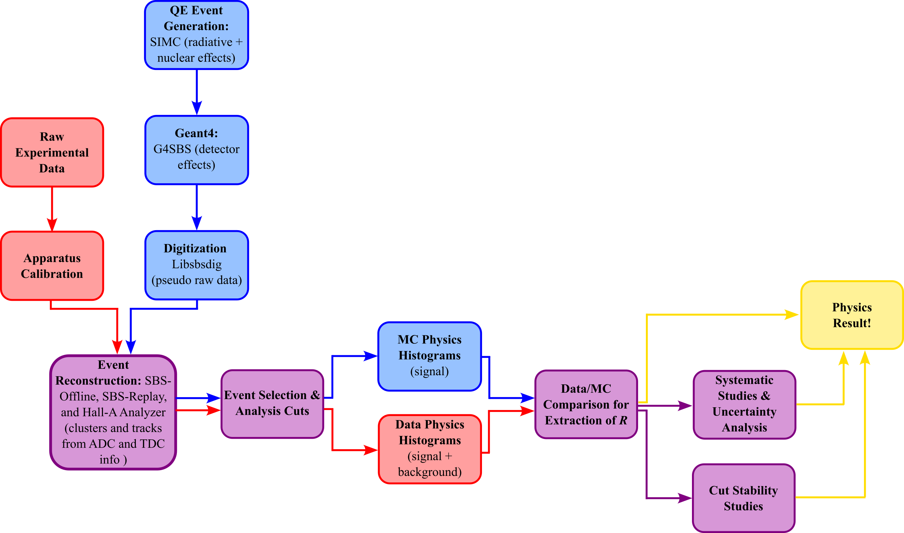
Analysis Overview
Monte Carlo (MC) Event generator SIMC applies nuclear effects and radiative corrections.
Geant4 MC Simulation G4SBS
MC transports particles through SBS geometry
Accounts for detector layout and material properties
Simulated events are digitized and processed with the same software as the experimental data.
Experimental observables are extracted by comparing simulation to data.
Notes:
This diagram overviews the big picture analysis components that goes from either the raw experimental data or the simulated events and the processes that happen to reach the physics results we just discussed.
Extracting our experimental observable R’ will depend on comparing distributions from both the real data and simulated events.
Much of the remainder of this talk will be to discuss key components of this data analysis, studies of systematic effects, and present physics results
Questions
Could be questions about features of the analysis framework. Likely the MC

Slide 14
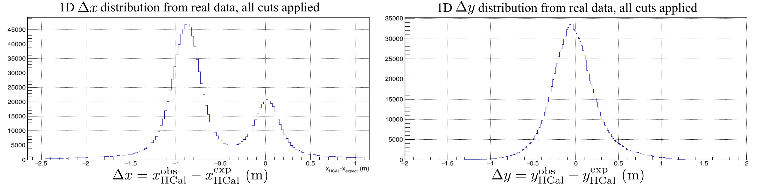
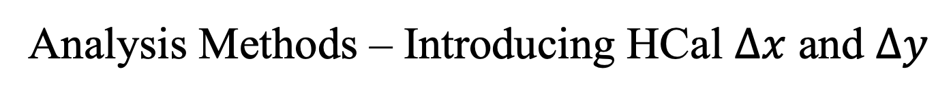
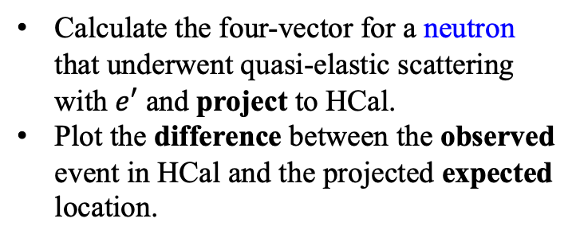
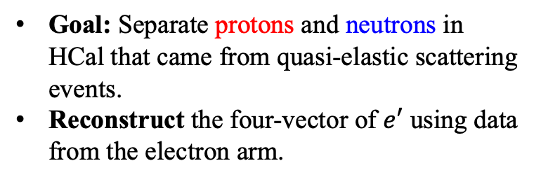
Analysis Methods – Introducing HCal $Δx$ and $Δy$
Proton Peak
Neutron Peak
Q² = 4.5 (GeV/c)²
Calculate the four-vector for a neutron that underwent quasi-elastic scattering with $e′$ and project to HCal.
Plot the difference between the observed event in HCal and the projected expected location.
Goal: Separate protons and neutrons in HCal that came from quasi-elastic scattering events.
Reconstruct the four-vector of $e′$ using data from the electron arm.
Notes:
As I just mentioned the goal is to separate protons and neutrons that are detected in Hcal that originate from quasi-elastic scattering events
We reconstruct the scattered electron track using data from the electron arm
We then calculate the four vector for a neutron that underwent quasi-elastic scattering and project the expected postion to Hcal
Here we plot the difference between the observed event in Hcal and the expected location as determined by the electron arm information
Here we have two 1D distributions of both delta x and Delta y, after all cuts have been applied.
For Delta x we see two distinct distributions. The one which is centered at 0 corresponds to neutrons. The one centered at a negative value of delta x corresponds to protons and arises from the deflection introduced by the SBS magnet.
These distributions are key tools in our data analysis and experimental extraction.

Slide 15
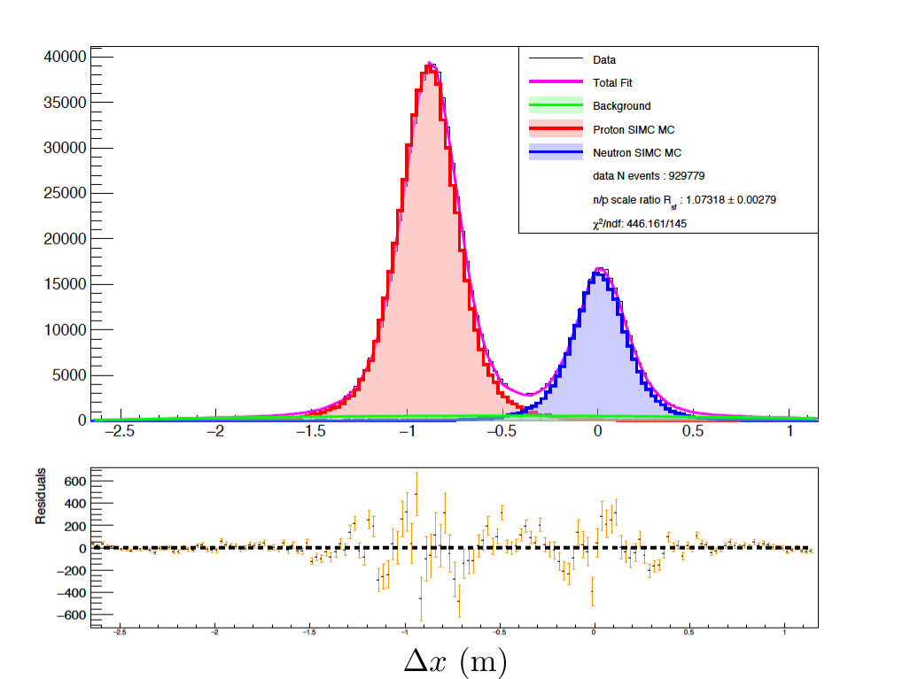
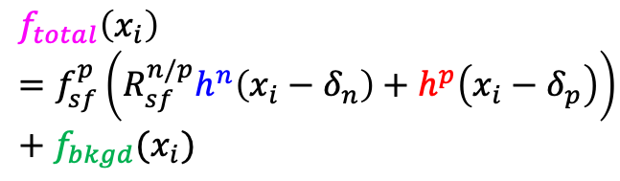

Data-Monte Carlo Comparison
Q² = 4.5 (GeV/c)²
Fit Equation:
Fit Parameters:
$f_{sf}^{p}$- proton scale factor
$R_{sf}^{n/p}$- ratio of neutron to proton scale factors
$δ_{n(p)}$- neutron (proton) centroid shift parameters
$f_{bkgd}$- parameters associated with the background
$$f_{total}\left(x_{i}\right)=f_{sf}^{p}\left(R_{sf}^{n/p}h^{n}\left(x_{i}−δ_{n}\right)+h^{p}\left(x_{i}−δ_{p}\right)\right)+f_{bkgd}(x_{i})$$
Notes:
Now I want to return to Data MC comparisons of Delta x. Which is how the experimental observable Rsf np is extracted.
Rsf np is extracted as a fit parameter from the total fit functional form that we described earlier and is present on this slide

Slide 16
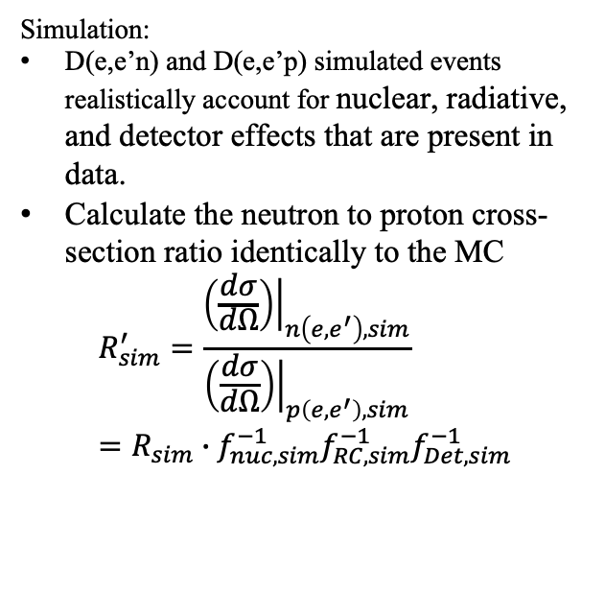
Data-Monte Carlo Comparison
Q² = 4.5 (GeV/c)²
Simulation:
D(e,e’n) and D(e,e’p) simulated events realistically account for nuclear, radiative, and detector effects that are present in data.
Calculate the neutron to proton cross-section ratio identically to the MC
$$R_{sim}^{′}=\frac{{\left.\left(\frac{dσ}{dΩ}\right)\right|}_{n\left(e,e^{′}\right),sim}}{{\left.\left(\frac{dσ}{dΩ}\right)\right|}_{p\left(e,e^{′}\right),sim}}=R_{sim}∙f_{nuc,sim}^{−1}f_{RC,sim}^{−1}f_{Det,sim}^{−1}$$
Notes:
Specifically for the simulated distributions. We claim that the quasi-elastic electron-neutron and electron-proton simulated events realistically account for known nuclear effects, radiative, corrections, and detector efficiency effects that are present in the data. Within a reasonable uncertainty.
Given these conditions we can calculate the neutron to proton elastic cross-section ratios identically to how they are determined in the MC.
Lets call this quantity R’ sim. Additionally we can relate the nucleon cross-section ratio to the nuclear cross-section ratio, called R sim, Via the same extraction prescription as described earlier in the talk which accounts for known dominant effects.

Slide 17
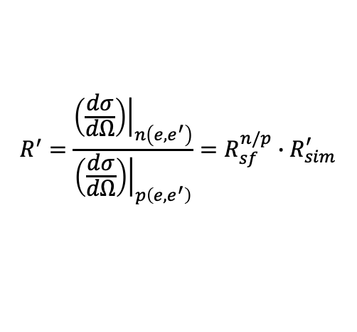
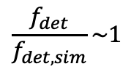
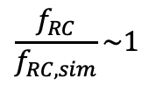
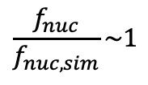
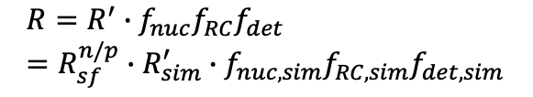
Data-Monte Carlo Comparison
Q² = 4.5 (GeV/c)²
Extraction:
Claim:
Simulation consistently replicates nuclear, radiative, and detector effects that are present in the experimental data.
Implication:
$$R=R^{′}∙f_{nuc}f_{RC}f_{det}=R_{sf}^{n/p}∙R_{sim}^{′}∙f_{nuc,sim}f_{RC, sim}f_{det,sim}$$
$$\frac{f_{nuc}}{f_{nuc,sim}}\sim 1$$
$$\frac{f_{RC}}{f_{RC, sim}}\sim 1$$
$$\frac{f_{det}}{f_{det,sim}}\sim 1$$
$$R^{′}=\frac{{\left.\left(\frac{dσ}{dΩ}\right)\right|}_{n\left(e,e^{′}\right)}}{{\left.\left(\frac{dσ}{dΩ}\right)\right|}_{p\left(e,e^{′}\right)}}=R_{sf}^{n/p}∙R_{sim}^{′}$$
Notes:
What is critical is we can use our fit parameter Rsf np to relate the experimental observed quasi-elastic cross-section ratio to the quasi-elastic cross-section ratio modeled in the simulation generators. This relation is at the top of this slide.
Again it is sufficiently motivated that the simulation consistently replicates nuclear effects, radiative corrections, and nucleon detection efficiency effects. Such that the individual correction factors between the real data and the simulation will approximately cancel to 1.
We are then presented with a simplified relation for the experimentally observed R’ which is equal to Rsf np multiplied by R’ sim. And from this extraction technique we can determine experimental R’ value which we can use to extract preliminary physics results.
Questions
There could be questions about the extraction or the assumptions. As well as the structure of each correction factor.

Slide 18
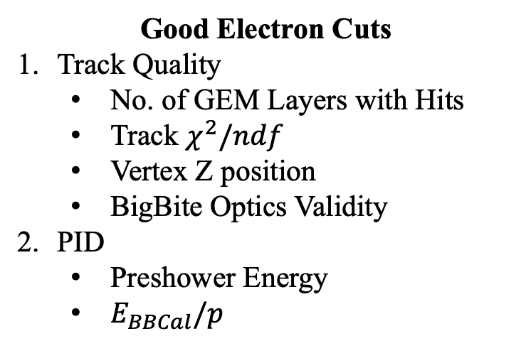
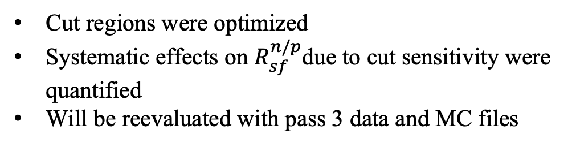
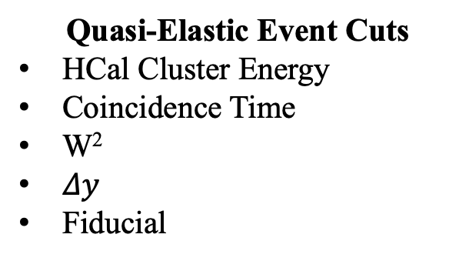
Event Selection Criteria
Good Electron Cuts
Track Quality
No. of GEM Layers with Hits
Track $χ^{2}/ndf$
Vertex Z position
BigBite Optics Validity
PID
Preshower Energy
$E_{BBCal}/p$
Quasi-Elastic Event Cuts
HCal Cluster Energy
Coincidence Time
W²
$Δy$
Fiducial
Cut regions were optimized
Systematic effects on $R_{sf}^{n/p}$due to cut sensitivity were quantified
Will be reevaluated with pass 3 data and MC files
Notes:
Broadly we have two categories of cuts we can implement. The first are cuts which select good electron candidates and rely on information only from the electron arm. The second are quasi-elastic cuts which ensure that the event corresponds to a quasi-elastically scattered nucleon.
It is also important to note that separate studies were conducted to optimize the choice of cut regions. As well studies to address systematic effects on Rsf np due to cut sensitivity. If anyone is interested in the details of the studies. We can address that during questions.
Now let’s look at some examples of some of the cuts
Questions
Pertaining to individual cuts
Overall cut regions
Information about cut region optimization
Information about quantifying systematic effect due to cut choice

Slide 19
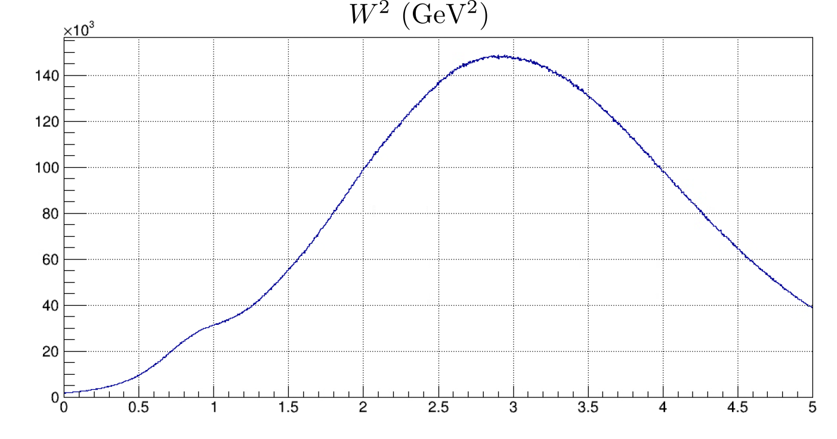
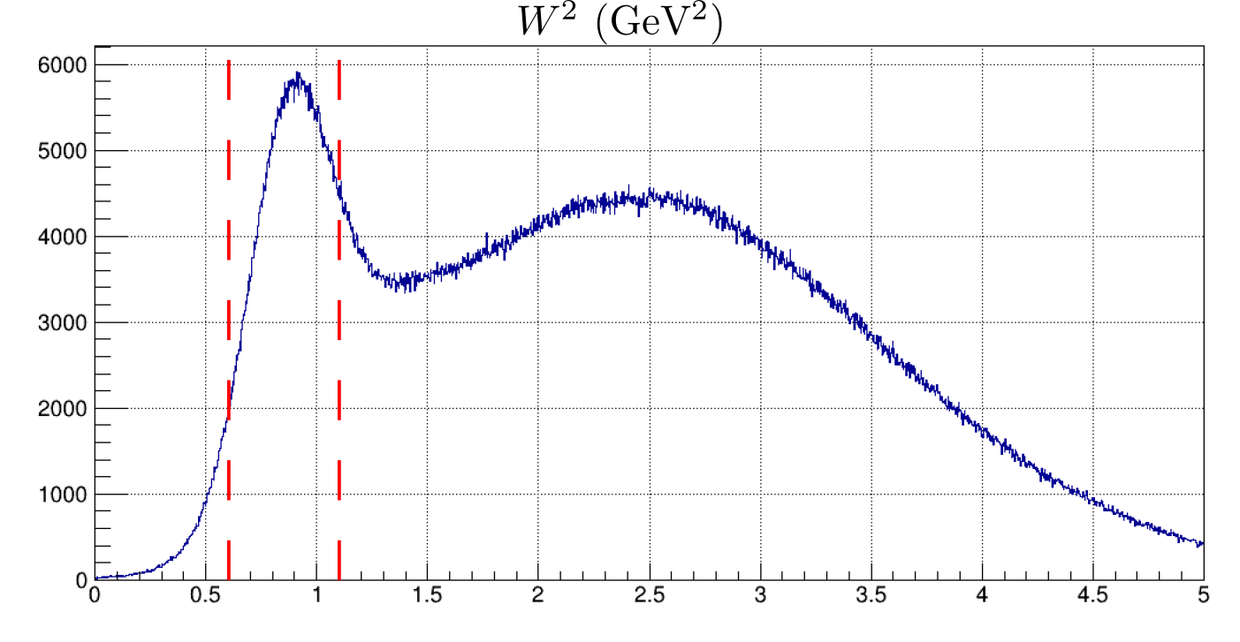
Invariant Mass Squared (W²)
Q² = 4.5 (GeV/c)²
No Cuts Applied
All Other Cuts Applied
Notes:
One of the most important cuts in the entire analysis is a cut on the invariant mass squared of the system, W^2. It allows us to select events that most likely correspond to quasi-elastic electron nucleon scattering.
In the plot on the left we have a W^2 distribution with no cuts applied and we can clearly see that distribution is dominated by other processes. Mostly inelastic processes which in our case are a background. It should be noted that the quasi-elastic peak is extremely difficult to resolve.
In the plot on the right we have a W^2 distribution with all other cuts applied and we can clearly see the quasi-elastic peak and we can better select those events. However, its evident that inelastic processes still are not fully removed by the other event selection criteria and enforcing a W^2 cut removes a significant portion of background events.

Slide 20
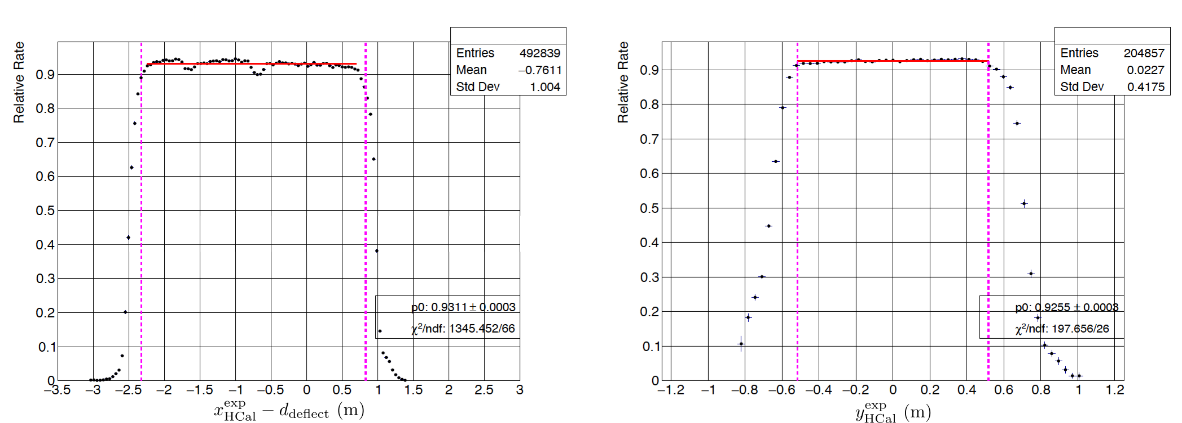
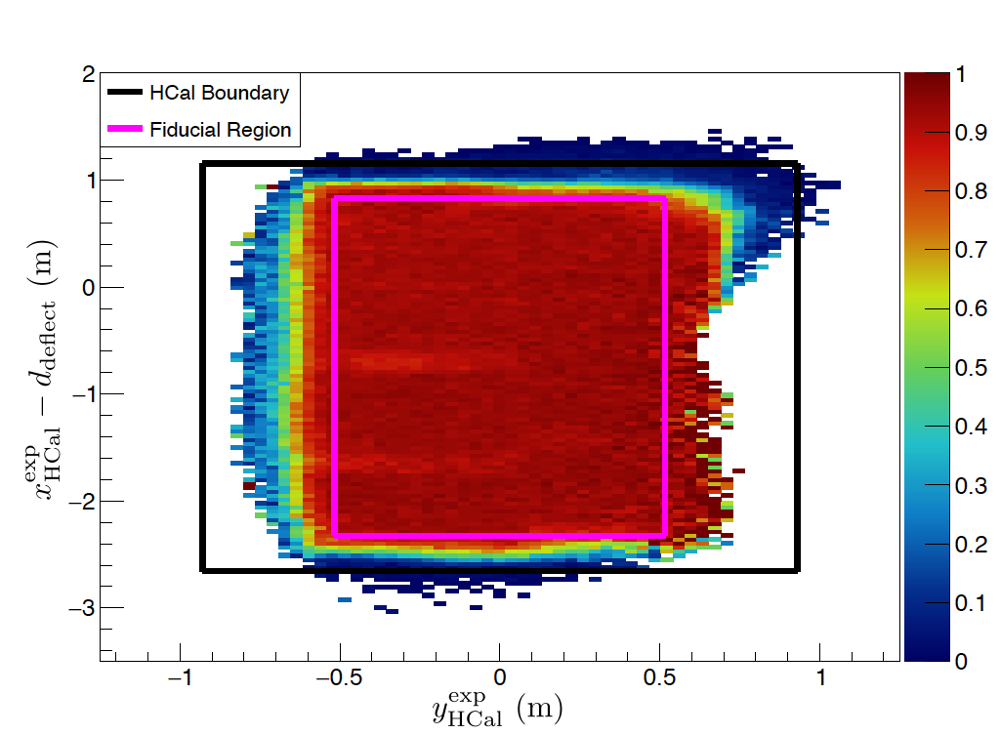
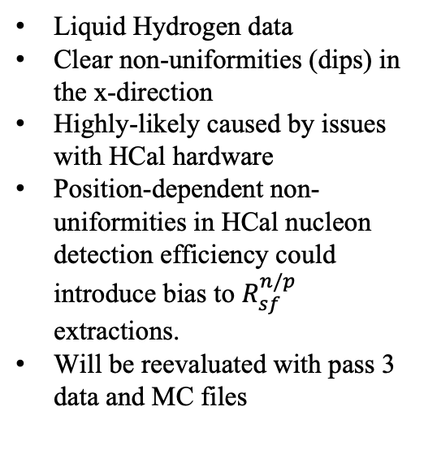
HCal Non-Uniformity in Real Data
Liquid Hydrogen data
Clear non-uniformities (dips) in the x-direction
Highly-likely caused by issues with HCal hardware
Position-dependent non-uniformities in HCal nucleon detection efficiency could introduce bias to $R_{sf}^{n/p}$ extractions.
Will be reevaluated with pass 3 data and MC files
SBS-8, Q² = 4.5 (GeV/c)²
Notes:
1. As a reminder one of the dominant systematic effects is the nucleon detection efficiency. For the observable extraction to work we need to have similar detection efficiency between both neutrons and protons. As well as modeling nucleon detection efficiency in MC as similar as possible to efficiency observed in real data.
By implementing a cut based analysis we can study the proton relative rate from LH2 data, over the HCal Acceptance. We observe regions of non-uniform behavior in HCal. These non-uniformities could bias individual proton and neutron detection efficiencies in real data.
From the 1D plot in the top left and the 2D plot on the bottom we clearly see non-uniformities or dips at xexp – the deflection at about –0.6 and -1.7 m
These non-uniformities are highly-likely to be caused by issues with Hcal hardware
These position-dependent non-uniformities in Hcal nucleon detection efficiency could introduce bias to our extraction of the observable Rsf np.
Questions
I would expect questions about either how we account for the proton deflection. I would just reference the thesis for that if need be
Probably questions on how any of these plots get generated.
Maybe something about how systematic effects are quantified

Slide 21
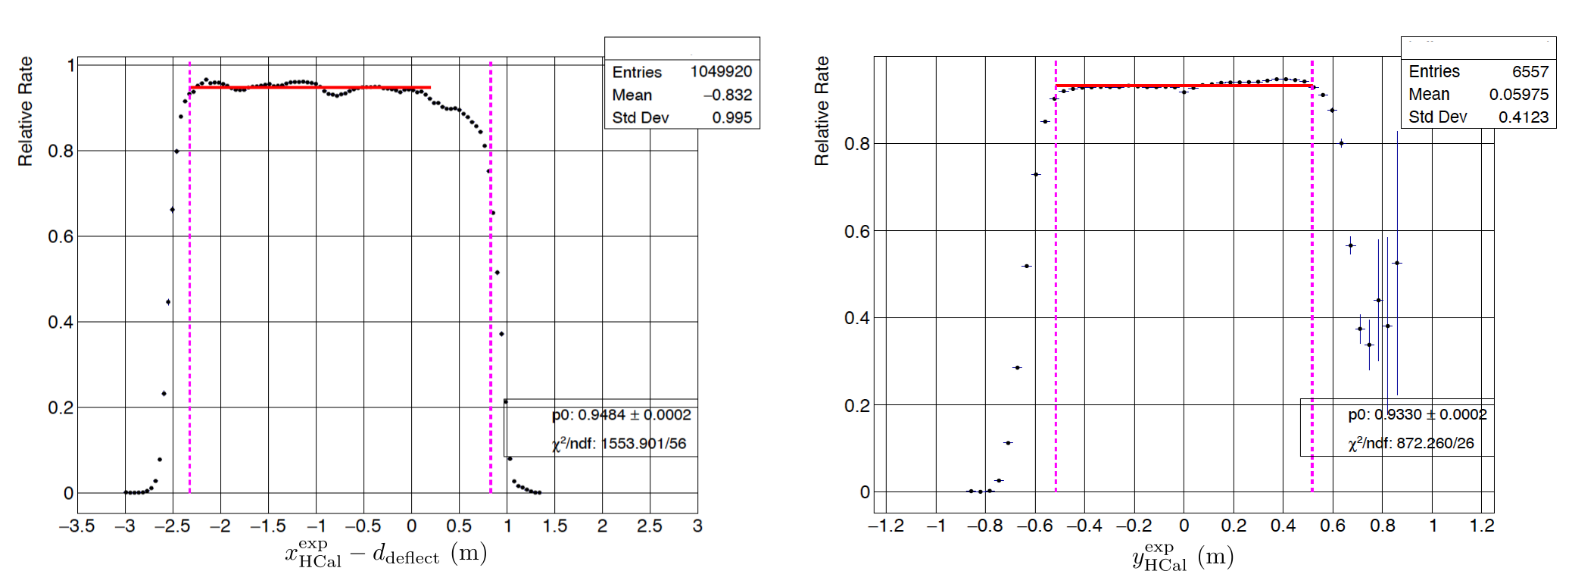
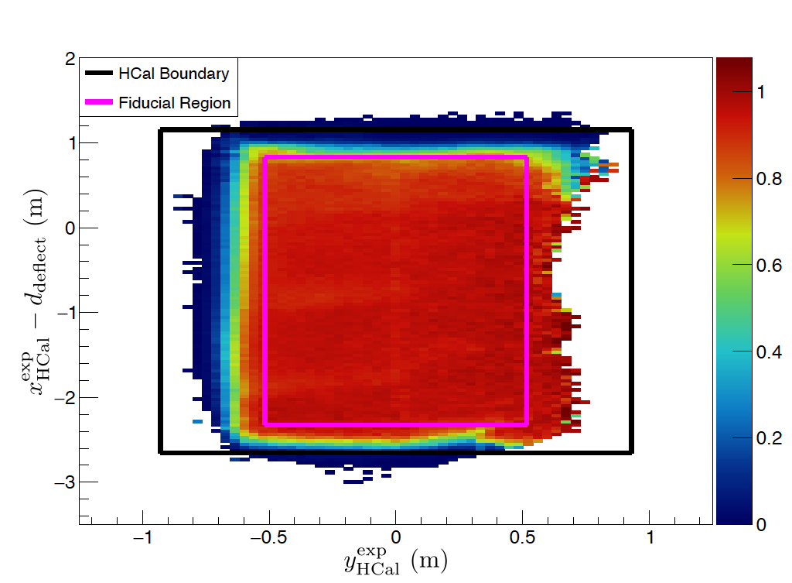
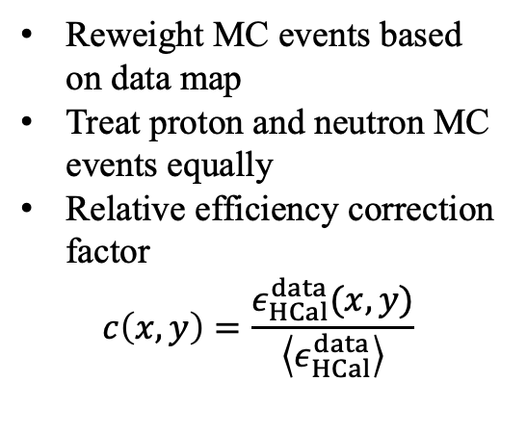
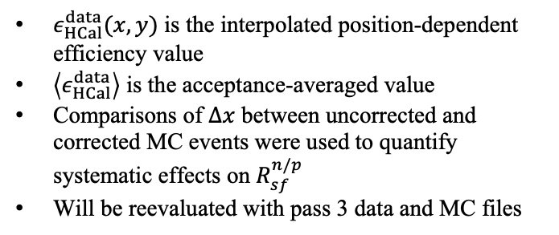
Position-Dependent Efficiency Correction to MC
Reweight MC events based on data map
Treat proton and neutron MC events equally
Relative efficiency correction factor
$$c\left(x,y\right)=\frac{ε_{HCal}^{data}(x,y)}{\left\langle ε_{HCal}^{data}\right\rangle }$$
$ε_{HCal}^{data}(x,y)$ is the interpolated position-dependent efficiency value
$\left\langle ε_{HCal}^{data}\right\rangle$ is the acceptance-averaged value
Comparisons of $Δx$ between uncorrected and corrected MC events were used to quantify systematic effects on $R_{sf}^{n/p}$
Will be reevaluated with pass 3 data and MC files
SBS-8, Q² = 4.5 (GeV/c)²
Notes:
One method, which was implemented in this analysis, was a position dependent efficiency correction to MC events.
The goal is to reproduce the non-uniformities present in the real data by introducing position-dependent weights on MC events.
This method has two assumptions, one that detection efficiency variations are only due to position and that protons and neutrons can be treated equally.
Essentially we reweight the MC events based a real data map that covers the entire HCal acceptance.
For a given nucleon position, MC events will be reduced or enhanced respectively relative to the acceptance-averaged value of the detection efficiency
What we see from both the 1D and 2D relative rate distributions is that the non-uniform regions are similarly reproduced for the MC events.

Slide 22
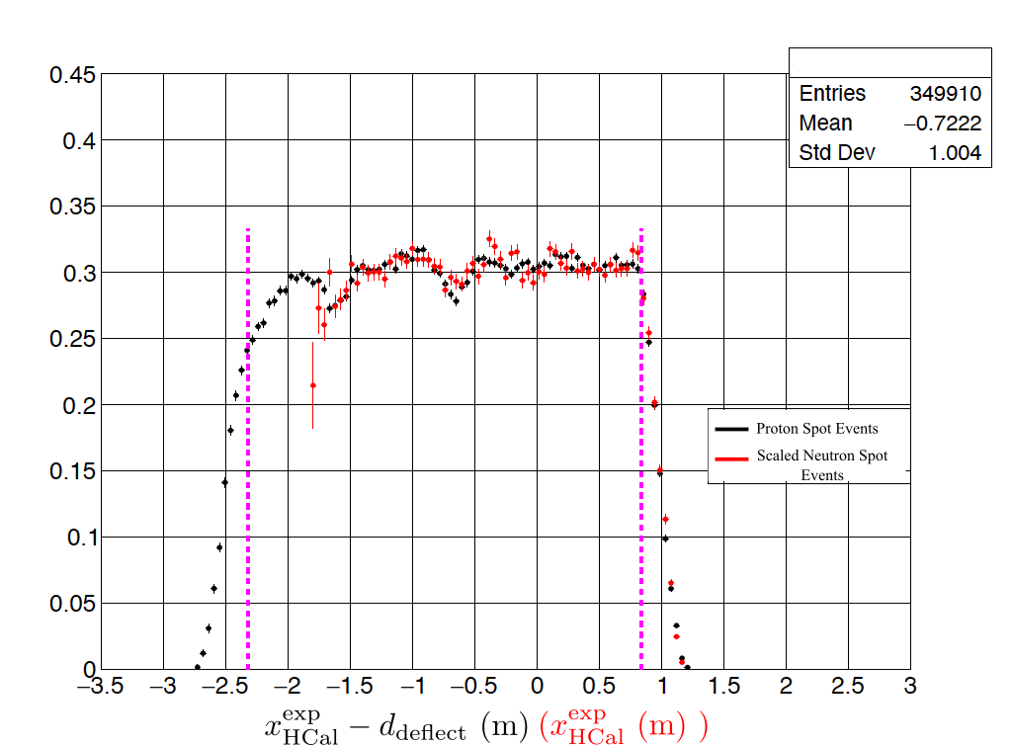
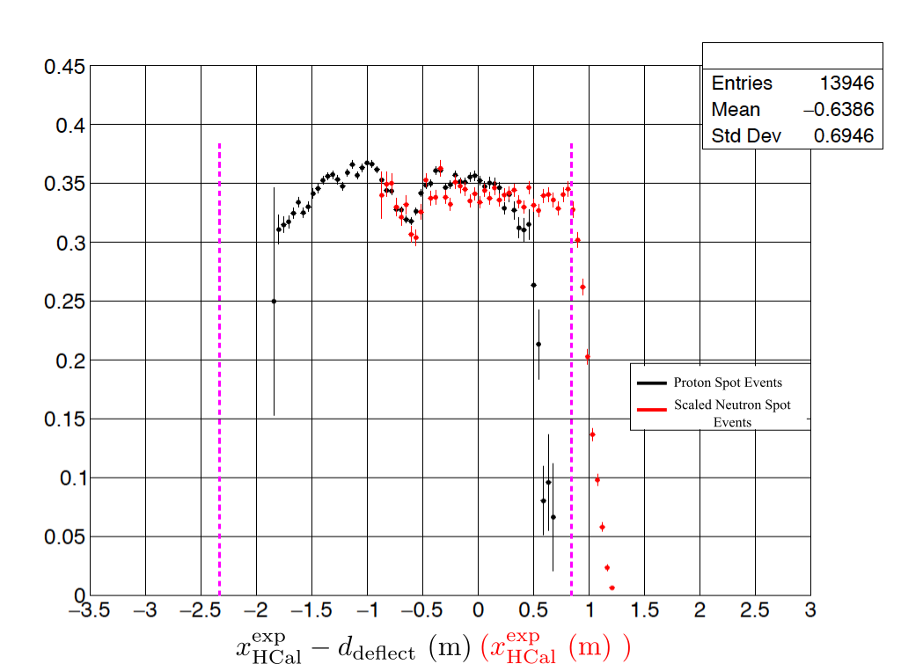
Proton and Neutron Relative-Rate Comparisons
SBS-8
SBS-9
Proton Spot Events Neutron Spot Events
Notes:
To validate the claim that protons and neutrons can be treated equally in this framework for studying HCal detection efficiency non-uniformity. We studied proton spot selected and neutron spot selected events from liquid deuterium real data.
Distributions for protons are shown as black data points, whereas red data points are for neutrons
By implementing narrow spot cuts we can select events that likely correspond to either protons or neutrons. And we can get a qualitative understanding of how they behave in the non-uniform regions.
These plots show the proton selected and neutrons selected events, where the neutron distributions are scaled to the protons. For two kinematic configurations of interest for this analysis.
What we see is that in the overlapping regions of the acceptance the non-uniform regions similarly impact proton and neutrons
Questions
Something about how the protons and neutrons are selected
Comparing SBS8 and SBS9

Slide 23
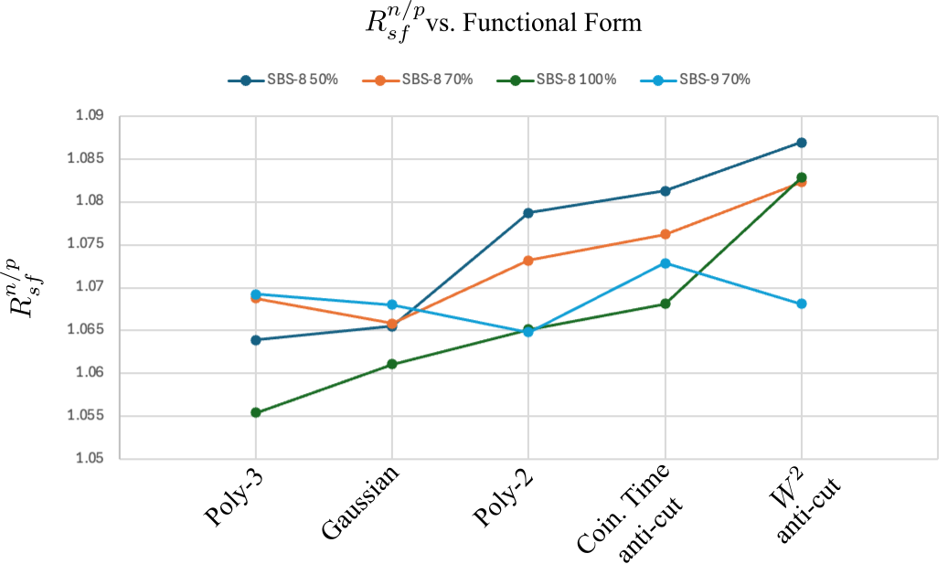
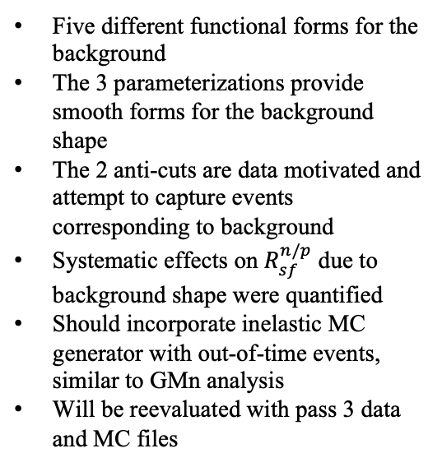
Inelastic Background
Five different functional forms for the background
The 3 parameterizations provide smooth forms for the background shape
The 2 anti-cuts are data motivated and attempt to capture events corresponding to background
Systematic effects on $R_{sf}^{n/p}$ due to background shape were quantified
Should incorporate inelastic MC generator with out-of-time events, similar to GMn analysis
Will be reevaluated with pass 3 data and MC files
Notes:
As described earlier in this presentation we have many event selection cuts that significantly reduce the presence of events corresponding to inelastic background
However, even after all of the cuts are implemented. Parts of the Delta x distribution will still contain events which correspond to background processes
As such we estimated the background shape and quantified systematic effects on Rsf np
Overall we used 5 different functional forms for the background
Three of these shapes are smooth parameterizations. They are a Gaussian, poly-2, and poly-3 fit. These three functions provide reasonable forms for the background without overfitting. But are the least-physically motivated.
The 2 remaining shapes are data-motivated anti-cut distributions, which attempt to capture events likely to correspond to a background process
To quantify the systematic effect we conduct a data MC comparison and vary the shape of the background and extract a value of Rsf np.
From the graph we can see how Rsf np varies with respect to the functional
form for each relevant kinematic configuration. Within the SBS8 kinematic there is a clear correlation.
Questions
I would sort of expect questions about choice of functional form
How systematic effects are quantified

Slide 24
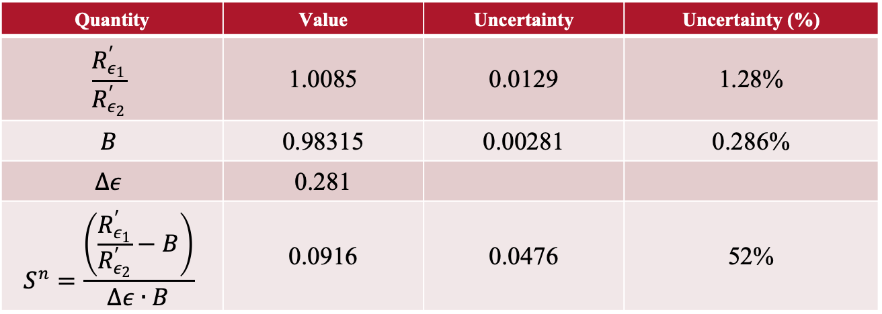
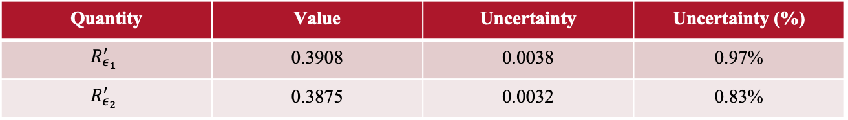

Neutron Rosenbluth Slope Preliminary Result
$R_{ε_{1}}^{′}$is SBS-8 (Weighted Mean), $R_{ε_{2}}^{′}$is SBS-9
For $Q^{2}=4.48$ (GeV/c)²
Quantity | Value | Uncertainty | Uncertainty (%)
$$R_{ε_{1}}^{′}$$ | 0.3908 | 0.0038 | 0.97%
$$R_{ε_{2}}^{′}$$ | 0.3875 | 0.0032 | 0.83%
Quantity | Value | Uncertainty | Uncertainty (%)
$$\frac{R_{ε_{1}}^{′}}{R_{ε_{2}}^{′}}$$ | 1.0085 | 0.0129 | 1.28%
$$B$$ | 0.98315 | 0.00281 | 0.286%
$$Δε$$ | 0.281
$$S^{n}=\frac{\left(\frac{R_{ε_{1}}^{′}}{R_{ε_{2}}^{′}}−B\right)}{Δε∙B}$$ | 0.0916 | 0.0476 | 52%
Notes:
Here we have a preliminary result for the neutron Rosenbluth Slope
We have a breakdown of the value determination for the key components. A which comes from the experimental observables presented in this analysis. B which comes from parameterization of the nucleon form factor world data. And Delta epsilon which is calculate from kinematic quantities.
We find the neutron Rosenbluth Slope Sn to be equal to 0.0916 +/- 0.0476 which presents a 52% total uncertainty on the slope
Questions
Here I imagine questions about uncertainty propagation
Clarifications of the Sn value and uncertainty
Determination of B and uncertainty propagation
If there are any questions about how we handled the correlated errors for B just reference the thesis

Slide 25




Neutron Form Factor Ratio Preliminary Result
For $Q^{2}=4.48$ (GeV/c)²
$$μ_{n}\frac{G_{E}^{n}}{G_{M}^{n}}≃μ_{n}\sqrt{S^{n}τ_{n}}=0.652±0.160$$
Does not account for TPE effects
Conclusions:
$S^{n}$ result is consistent with the extrapolation of the global parameterization.
$S^{n}$ result suggests an absence of large TPE corrections for the neutron
$S^{n}$ result is not precise enough to experimentally expose neutron TPE effects
Notes:
1. Now since this measurement of the neutron Rosenbluth slope is determined from measurements of cross-sections it likely contains contributions to higher-order effects. Most notably TPE.
2. If instead we currently neglect TPE corrections and extract the neutron electromagnetic form factor ratio from our neutron Rosenbluth slope. We find a value of the neutron form factor ratio to be 0.652 +/- 0.16. Which is about a 25% uncertainty on the ratio.
3. What’s interesting about this extracted value for the neutron electromagnetic form factor ratio is that within the uncertainty it is consistent with the extrapolated value of the fit to the world data.

Slide 26
Outlook
Summary
Remaining Tasks
Potentially improve Radiative Correction models in MC
Quantifying systematic effects due to Radiative Corrections for nTPE results: (Implemented for GMn Analysis by P. Datta)
Updated (Pass-3) data and MC files with improved detector calibrations are available or available soon
Study effects due to final-state interactions
Quantify effects due to absolute HCal nucleon detection efficiency
Reevaluate Inelastic Background systematic uncertainty with improved method (MC Inelastic and Out-Of-Time): (Implemented for GMn Analysis by P. Datta)
Reevaluate systematic uncertainty associated with Event Selection Cuts
Nucleon Structure & Electromagnetic Form Factors
SBS nTPE experiment and observable extraction
Overview of Data Analysis Methods
Physics Extraction from Data/MC Comparison
Preliminary neutron Rosenbluth Slope result
Notes:
Still analysis tasks, to reach both GMn and neutron Rosenbluth Slope final values
Particularly quantifying systematic effects for radiative corrections, Final State interactions, and absolute HCal nucleon detection efficiency
Ideally efforts could be made to try and reduce the uncertainty on the neutron Rosenbluth Slope
There is a proposed future TPE experiment for the neutron. It would be a measurement of the TPE contribution in elastic positron neutron and elastic electron neutron scattering at three different values of Q^2.
Ultimately this measurement involves extraction the neutron TPE effects by considering ratios of positron-neutron over positron-proton scattering cross-sections and electron-neutron over electron-proton measurements. It also depends on the proton TPE measurement with CLAS12 which is also proposed.

Slide 27


Thank You!
Special thanks:
PhD advisor: David Armstrong. SBS graduate students John Boyd, Provakar Datta, Anu Rathnayake, Sebastian Seeds, Maria Satnik, Ralph Marinaro, Nathaniel Lashley, Sean Jeffas, Hunter Presley. Hall A/C Staff Arun Tadepalli, Bogdan Wojtsekhowski, Jack Segal, Mark Jones, Jessie Butler, Dave Mack. W&M Folks: Todd Averett, Kate Evans, Jack Jackson, Eric Fuchey. GEM Folks: Nilanga Liyanage, Kondo Gnanvo, Holly Szumila-Vance, Evaristo Cisbani, Roberto Perrino. Andrew Puckett. GMn/nTPE Analysis Working Groups. The SBS Collaboration. NSF for supporting this work.
GEM Folks, February 2022. Left to right: Holly Szumila-Vance, Anu Rathnayake, Zeke Wertz, Kondo Gnanvo, Thir Gautam , Sean Jeffas, John Boyd.
DNP Hawaii, November 2023. Left to right: John Boyd, Vimukthi Gamage, Eric Fuchey, Provakar Datta, Zeke Wertz, Sean Jeffas, Hunter Presley, Anu Rathnayake, Sebastian Seeds, Maria Satnik, Andrew Puckett.
Notes:
Thanks folks here. Wrap up. Ready for questions.

Slide 28

Backup

Slide 29




Super-Ratio A
$$A≡\frac{R_{ε_{1}}^{′}}{R_{ε_{2}}^{′}}$$
Notes:
Update with plots from thesis

Slide 30

B term
Transverse cross-section term is based on Ye et al. 2018 article
Proton Rosenbluth Slope term is based on Christ et al. 2022 article
Z. Ye, J. Arrington, R. J. Hill, and G. Lee, Proton and neutron electromagnetic formfactors and uncertainties, Physics Letters B 777, 8 (2018).
M. E. Christy et al., Form Factors and Two-Photon Exchange in High-Energy Elastic Electron-Proton Scattering, Phys. Rev. Lett. 128, 102002 (2022).

Slide 31



Determination Proton Rosenbluth Slope for B
$S_{{ ε}_{1}/{ ε}_{2}}^{p}$is determined from Christy et al. (2022) article and supplemental material, which provides most recent parameterization for RS from only e-p cross-section data.
$RS=1+c_{1}τ+c_{2}τ^{2}$, where $c_{1}=−0.456299±0.124409$, $c_{2}=0.121065±0.10032$, and $τ={Q^{2}}/{4M_{p}^{2}}$
$$∆RS= \sqrt{{\left(\frac{∂RS}{∂c_{1}}∆c_{1}\right)}^{2}+{\left(\frac{∂RS}{∂c_{2}}∆c_{2}\right)}^{2}+2\frac{∂RS}{∂c_{1}}\frac{∂RS}{∂c_{2}}cov(c_{1},c_{2})}$$
$\frac{∂RS}{∂c_{1}}=τ$, $\frac{∂RS}{∂c_{2}}=τ^{2}$, $cov\left(c_{1},c_{2}\right)=−0.778∆c_{1}∆c_{2}$
 | Value | Uncertainty | Uncertainty (%)
$${RS}_{{ ε}_{1}}=\frac{{\left(μ_{p}G_{E}^{p}\right)}^{2}}{{\left(G_{M}^{p}\right)}^{2}}$$ | 0.6151 | 0.10722 | 17.4%
$$S_{{ ε}_{1}}^{p}=\frac{{\left(G_{E}^{p}\right)}^{2}}{τ_{p, ε_{1}}{\left(G_{M}^{p}\right)}^{2}}$$ | 0.06186 | 0.01078 | 17.4%
 | Value | Uncertainty | Uncertainty (%)
$${RS}_{{ ε}_{2}}=\frac{{\left(μ_{p}G_{E}^{p}\right)}^{2}}{{\left(G_{M}^{p}\right)}^{2}}$$ | 0.6156 | 0.10674 | 17.3%
$$S_{{ ε}_{2}}^{p}=\frac{{\left(G_{E}^{p}\right)}^{2}}{τ_{p, ε_{1}}{\left(G_{M}^{p}\right)}^{2}}$$ | 0.06191 | 0.01074 | 17.3%

Slide 32

Neutron Rosenbluth Slope Uncertainty
$$S^{n}=\frac{\left(A−B\right)}{BΔε_{n}}$$
$$∆S^{n}=\sqrt{{\left(\frac{∂S^{n}}{∂A}∆A\right)}^{2}+{\left(\frac{∂S^{n}}{∂B}∆B\right)}^{2}}$$
$$∆S^{n}=\sqrt{{\left(\frac{1}{BΔε_{n}}∆A\right)}^{2}+{\left(\frac{−A}{B^{2}Δε_{n}}∆B\right)}^{2}}$$

Slide 33


Neutron Rosenbluth Slope Preliminary Result
Notes:
Update with plots from thesis

Slide 34

Neutron TPE from Theory
Calculates TPE contributions to the unpolarized cross-section by computing scattering amplitude for TPE diagrams.
For Q² = 4.5 (GeV/c)², TPE correcting a Rosenbluth measurement could increase the neutron form factor ratio by 30%
Ref: P. Blunden et al, Two-photon exchange in elastic electron nucleon scattering
Notes:
One theoretical calculation is available for TPE contributions on the unpolarized electron-neutron elastic scattering cross-section on from Blunden et al’s 2005 article Two-photon exchange in elastic electron nucleon scattering.
In this article TPE contributions are compute from scattering amplitude for TPE box and cross-box diagrams. Similar to what has been introduced earlier in this talk.
The primary result from this article, which pertains to the neutron, is the plot shown here. Which is the neutron electromagnetic form factor ratio against Q^2. The open blue circles represent TPE uncorrected values from world data parameterization of the form factors which was available at the time of publication. These uncorrected TPE values are described as being from LT separations. The green and red data points respectively are TPE corrected values with particular ranges for the epsilon values.
The key takaway from this plot is that the Blunden et al theory calculation suggests that a LT separated measurement, if corrected for TPE at a Q^2 value of 4.5 GeV/c ^2, and in the epsilon range for our measurement would result in an increased value of the neutron form factor ratio by approximately 30%. The sign of the effect is attributed to the negative anomalous magnetic moment of the neutron.

Slide 35



Neutron Form Factor Ratio Preliminary Result
For $Q^{2}=4.48$ (GeV/c)²
Approximately TPE corrected based on Blunden et. al.
$$μ_{n}\frac{G_{E}^{n}}{G_{M}^{n}}+TPE≃0.867±0.160$$
Notes:
If we apply this approximate TPE correction as described by Blunden et al, to the value for this measurement. This would increase the central value by about 30% and would keep the uncertainty the same.
We have plotted the approximately TPE corrected preliminary value for the neutron electromagnetic form factor along side the world data.
What is interesting is that the approximately TPE corrected central value is about 2 sigma away from the extrapolated value of the recent world data parameterization.

Slide 36





Neutron TPE from Theory Expanded
TPE modification to the CS. Here $M_{0}$ and $M_{2γ}$ are OPE and TPE amplitudes
Here $N_{box}$, $N_{x−box}$, $D_{box}$, $D_{x−box}$ are matrix elements and propagators, respectively. For TPE diagrams on slide 7
The TPE amplitude contains finite and IR divergent terms, as well as FFs at the $γNN$ vertices
The finite terms can be computed analytically
There are no IR divergent terms for the neutron
Ref: P. Blunden et al, Two-photon exchange in elastic electron nucleon scattering

Slide 37






Neutron TPE from Theory Expanded
FF functional form taken from older world data parameterization available when article published
Normalization condition
Ref: P. Blunden et al, Two-photon exchange in elastic electron nucleon scattering

Slide 38


Neutron TPE from Theory Expanded
TPE contribution to the unpolarized electron-neutron elastic scattering cross-section
The dot-dashed curve for $Q^{2}=6$ GeV² comes from a particular older world data parameterization
The other curves come from a different older world data parameterization
Magnitude of TPE contribution is approx. 3 times smaller than proton
Sign change is due to negative neutron anomalous magnetic moment
Ref: P. Blunden et al, Two-photon exchange in elastic electron nucleon scattering

Slide 39

Neutron TPE from Theory Expanded
Accounting for the $ε$ dependence, the correction is applied to the cross-section, reduced cross-section, and then the FF ratio.
For Q² = 4.5 (GeV/c)², TPE correcting a Rosenbluth measurement could increase the neutron form factor ratio by 30%
Ref: P. Blunden et al, Two-photon exchange in elastic electron nucleon scattering

Slide 40

Improved Inelastic Background Systematic
Determination of Inelastic Background
From MC W² distributions of signal and MC inelastic generator events. Select events outside quasi-elastic peak
Select out-of-time events
Fit delta x distribution of selected background events
Use background shape in Systematic uncertainty evaluation
Analysis Credit and Ref: P. Datta APS 2025 Talk
Notes:
Update with plots from thesis

Slide 41

Systematic: Radiative Corrections
Analysis Credit and Ref: P. Datta
Notes:
Update with plots from thesis

Slide 42



Future TPE Experiments
Ref: E. Fuchey et al, Measurement of the Two-Photon Exchange Contribution in the Electron-Neutron and Positron-Neutron Elastic Scattering
Ref: J. Bernaeur et al, Determination of two-photon exchange via $e^{+}p/e^{−}p$ Scattering with CLAS12
Notes:
Update with plots from thesis

Slide 43

Nucleon Structure
Hadrons (including protons and neutrons) have an internal structure!
Not structureless point-like.
Complex internal structure of valence quarks, gluons, and quark-antiquark pairs.
Important Questions:
How are the charge and magnetization distributed inside a nucleon?
How do emergent properties of the nucleon arise?
How does the internal nucleon structure behave at different momentum transfer scales (non-perturbative vs. perturbative regimes)?
How do the gluon and quark-antiquark pairs contribute?
Notes:
Hadrons (including protons and neutrons) have internal structure
We know they are not structureless point-like particles
Protons and Neutrons are the most stable hadrons and serve as the building blocks of atomic nuclei.
It is expected that the complex internal structure of the nucleon has contributions from valence quarks, gluons, and quark-antiquark pairs
There are many major questions to be studied about the nucleon structure which could lead to better understandings of QCD and the SM.
Questions:
Elaborating more on why its difficult to understand nucleons in non-perturbative regime.
Evidence for nucleon structure.
Potentially questions about sea quarks

Slide 44


BigBite Spectrometer (Electron Arm)
BigBite Dipole Magnet:
1.2 T $∙$m
53 msr, 1.6 m from target
Tracking:
Gas Electron Multiplier
Cherenkov Detector:
GRINCH
Scintillator Array:
Timing Hodoscope
Electron Calorimeter:
BigBite Calorimeter (Preshower + Shower)
Notes:
1. The BigBite Spectrometer is composed of a dipole magnet and a detector package of 4 different types of individual detectors. Each which provides different information about the scattered electron.
2. If anyone is interested the details of the detectors can be discussed at questions

Slide 45


Hadron Calorimeter (HCal)
1.8 m
SBS magnet is a large dipole magnet
One module consists of 40 layers of iron absorber and 40 layers scintillator.
Hadronic showers are created in the iron absorbers and the energy is sampled by scintillators and guided to the PMTs
3-4 cm spatial resolution
30% energy resolution
3.6 m
Interior of an HCal module
A side view of HCal in Hall A
Notes:
Hcal is composed of many individual modules.
One module consists of 40 layers of alternating iron absorber and scintillator
The iron absorber causes hadronic showers from the incoming particles and the energy is sampled by the scintillators and is then guided to the PMTS
Here we can see just the size and shape of the Hcal in Hall A

Slide 46


Quasi-Elastic Scattering
SBS nucleon physics program focuses on quasi-elastic scattering.
$M_{T}$ is mass of the target (deuterium)
$M_{N}$ is mass of the nucleon
Notes:
There are multiple different scattering processes when scattering from deurerium. These include elastic, quasi-elastic, and inelastic scattering.
We need quasi-elastic scattering because we need simultaneous access to both protons and neutrons. These one or two slides might make more sense later.
Also there are no free neutron targets. So deuterium is what we use to access neutron for measurements of cross-sections that are not using polarization transfer techniques.
Questions
I sort of expect conceptual questions about quasi-elastic scattering verses other scattering processes.

Slide 47

Quasi-Elastic Scattering
GMn, Q² = 3.0 – 13.5 (GeV/c)²
nTPE, Q² = 4.5 (GeV/c)²
Need many statistics and strong cuts on the electron arm to resolve the quasi-elastic peak above the inelastic background.
Diagram: Xiaochao Zheng, Precision Measurement of Neutron Spin Asymmetry A1n at Large x_{Bj} Using CEBAF at 5.7 GeV
Notes:
Maybe
Here we have the scattering cross-section as a three-dimensional distribution of Q^2 and invariant mass W.
We can see that as we go to larger Q^2 the elastic and quasi-elastic scattering regimes are dominated by inelastic processes and it is quite difficult to resolve the quasi-elastic peak.

Slide 48



Analysis Methods – Introducing HCal $Δx$ and $Δy$
Definition of $Δx$ ($Δy$): The difference between the observed and the expected nucleon (assuming neutron) position on HCal in the dispersive (non-dispersive) direction.
Used to separate neutrons and protons
Conceptual diagram introducing HCal $Δx$ and $Δy$ variables.
Notes:
Delta x and Delta y are analysis quantities which we define as the difference between the observed and expected nucleon position on HCal in the dispersive and (non-dispersive) directions.
The observed nucleon position is from signal detected in the Hcal
The expected nucleon position involves projecting the reconstructed electron track to Hcal using quasi-elastic electron-nucleon kinematics
The tools are introduced to straightforwardly separate neutrons and protons
Questions. E
On this slide or the next I would not be surprised if there were questions about how Delta x or Delta y were defined. Either go to backup slide or chpt 6 of the thesis. We have to assume elastic scattering processes

Slide 49

Data-Monte Carlo Comparison
Q² = 4.5 (GeV/c)²
Fit Equation:
Fit Parameters:
$f_{sf}^{p}$- proton scale factor
$R_{sf}^{n/p}$- ratio of neutron to proton scale factors
$δ_{n(p)}$- neutron (proton) centroid shift parameters
$f_{bkgd}$- parameters associated with the background
Interpretation: $R_{sf}^{n/p}$ quantifies the relative scaling of the neutron to proton quasi-elastic scattering cross-section as modeled by the simulation and as observed in data.
$$f_{total}\left(x_{i}\right)=f_{sf}^{p}\left(R_{sf}^{n/p}h^{n}\left(x_{i}−δ_{n}\right)+h^{p}\left(x_{i}−δ_{p}\right)\right)+f_{bkgd}(x_{i})$$
Notes:
1. Lets start with the plot on the left. The top plot contains a Delta x distribution from real data, which is the histogram in black. This is somewhat difficult to see. But it is fit with a total fit function in magenta. The individual MC proton and neutron delta x distributions are present in red and blue respective. And the shape of the background is presented in green.
By comparing distributions of Delta x from the real data and the MC information with this fit equation, we can extract our experimental observable.
Particularly, our experimental observable is the fit parameter Rsf n/p.
Questions
Potential questions about the diagram
Potential questions about any of the information in the fit.
Clarifications about Rsf np

Slide 50





Data-Monte Carlo Comparison
Q² = 4.5 (GeV/c)²
Simulation:
$$R_{sim}^{′}=\frac{{\left.\left(\frac{dσ}{dΩ}\right)\right|}_{n\left(e,e^{′}\right),sim}}{{\left.\left(\frac{dσ}{dΩ}\right)\right|}_{p\left(e,e^{′}\right),sim}}=R_{sim}∙f_{nuc,sim}^{−1}f_{RC,sim}^{−1}f_{Det,sim}^{−1}$$
Extraction:
Claim:
Simulation consistently replicates nuclear, radiative, and detector effects that are present in the experimental data.
Implication:
$$R=R^{′}∙f_{nuc}f_{RC}f_{det}=R_{sf}^{n/p}∙R_{sim}^{′}∙f_{nuc,sim}f_{RC, sim}f_{det,sim}$$
$$\frac{f_{nuc}}{f_{nuc,sim}}\sim 1$$
$$\frac{f_{RC}}{f_{RC, sim}}\sim 1$$
$$\frac{f_{det}}{f_{det,sim}}\sim 1$$
$$R^{′}=\frac{{\left.\left(\frac{dσ}{dΩ}\right)\right|}_{n\left(e,e^{′}\right)}}{{\left.\left(\frac{dσ}{dΩ}\right)\right|}_{p\left(e,e^{′}\right)}}=R_{sf}^{n/p}∙R_{sim}^{′}$$
Sources of Systematic Uncertainty:
Cut Stability
HCal Nucleon Detection Efficiency
Inelastic Background
Notes:
What is critical is we can use our fit parameter Rsf np to relate the experimental observed quasi-elastic cross-section ratio to the quasi-elastic cross-section ratio modeled in the simulation generators. This relation is at the top of this slide.
Again it is sufficiently motivated that the simulation consistently replicates nuclear effects, radiative corrections, and nucleon detection efficiency effects. Such that the individual correction factors between the real data and the simulation will approximately cancel to 1.
We are then presented with a simplified relation for the experimentally observed R’ which is equal to Rsf np multiplied by R’ sim. And from this extraction technique we can determine experimental R’ value which we can use to extract preliminary physics results.
Questions
There could be questions about the extraction or the assumptions. As well as the structure of each correction factor.

Slide 51

Neutron Rosenbluth Slope Technique
Goal: Extract neutron Rosenbluth Slope, $S^{n}={{\left(G_{E}^{n}\right)}^{2}}/{τ_{n}{\left(G_{M}^{n}\right)}^{2}}$
Consider 2 kinematics with same Q²-value and with different values of $ε$.
Consider 2 elastic neutron-to-proton cross-section ratios.
Combine the Ratio Method with a Rosenbluth Technique.
$$R_{ε_{1}}^{′}=R_{ε_{1}}∙f_{nuc,ε_{1}}^{−1}f_{RC,ε_{1}}^{−1}f_{Det,ε_{1}}^{−1}=\frac{\frac{{τ_{ε_{1,n}}σ}_{Mott}}{ε_{1,n}\left(1+τ_{ε_{1,n}}\right)}\left(ε_{1,n}σ_{L,ε_{1}}^{n}+σ_{T,ε_{1}}^{n}\right)}{\frac{{τ_{ε_{1,p}}σ}_{Mott}}{ε_{1,p}\left(1+τ_{ε_{1,p}}\right)}\left(ε_{1,p}σ_{L,ε_{1}}^{p}+σ_{T,ε_{1}}^{p}\right)}$$
$$R_{ε_{2}}^{′}=R_{ε_{2}}∙f_{nuc,ε_{2}}^{−1}f_{RC,ε_{2}}^{−1}f_{Det,ε_{2}}^{−1}=\frac{\frac{{τ_{ε_{2,n}}σ}_{Mott}}{ε_{2,n}\left(1+τ_{ε_{2,n}}\right)}\left(ε_{2,n}σ_{L,ε_{2}}^{n}+σ_{T,ε_{2}}^{n}\right)}{\frac{{τ_{ε_{2,p}}σ}_{Mott}}{ε_{2,p}\left(1+τ_{ε_{2,p}}\right)}\left(ε_{2,p}σ_{L,ε_{2}}^{p}+σ_{T,ε_{2}}^{p}\right)}$$
Notes:
As a reminder the goal of this dissertation and the nTPE experiment is to extract the neutron Rosenbluth Slope. Which S^n and in the OPE consideration is equal to GEn^2 over tau_n GMn^2
We will now overview the extraction technique which combines the Ratio Method we just talked about and a Rosenbluth Separation
We want to consider two kinematic configurations which are at the same value of Q^2 and two different values of epsilon.
We want to start with 2 elastic neutron-to proton cross-section ratios.
We will represent the two elastic cross-section ratios under these conditions as R’ epsilon 1 and R’ epsilon 2. And they have the following relations.
Questions
If there are questions about this formalism reference chapter 3 or 6 of thesis

Slide 52

Neutron Rosenbluth Slope Technique
Physics Result:
Consider ‘super-ratio’ of $R^{′}$ for two different values of $ε$.
Define $S^{n(p)}={{\left(G_{E}^{n(p)}\right)}^{2}}/{τ_{n(p)}}{\left(G_{M}^{n(p)}\right)}^{2}$and $Δε=ε_{1,n}−ε_{2,n}$.
$$\frac{R_{ε_{1}}^{′}}{R_{ε_{2}}^{′}}=B∙\frac{1+ε_{1,n}S_{ε_{1}}^{n}}{1+ε_{2,n}S_{ε_{2}}^{n}}$$
Super-Ratio
From Kinematic Information
$$B=\frac{\frac{τ_{ε_{1,n}}}{ε_{1,n}\left(1+τ_{ε_{1,n}}\right)}}{\frac{τ_{ε_{1,p}}}{ε_{1,p}\left(1+τ_{ε_{1,p}}\right)}}\frac{\frac{τ_{ε_{2,p}}}{ε_{2,p}\left(1+τ_{ε_{2,p}}\right)}}{\frac{τ_{ε_{2,n}}}{ε_{2,n}\left(1+τ_{ε_{2,n}}\right)}}\frac{{\left(G_{M}^{n}\right)}_{ε_{1}}^{2}}{{\left(G_{M}^{p}\right)}_{ε_{1}}^{2}}\frac{{\left(G_{M}^{p}\right)}_{ε_{2}}^{2}}{{\left(G_{M}^{n}\right)}_{ε_{2}}^{2}}\frac{1+ε_{2,p}S_{ε_{2}}^{p}}{1+ε_{1,p}S_{ε_{1}}^{p}}$$
From Global Form Factor Analysis.
Notes:
Now we want to consider the super-ratio quantity, which we call A, of elastic neutron to proton cross-section ratios
This super-ratio is defined as R’ epsilon 1 over R’ epsilon 2.
After a good amount of algebraic manipulation we can relate our super-ratio A to a quantity which we shall call B and ratio involving S^n at each kinematic configuration
This quantity B is related to ratio of kinematic quantities, transverse cross-section components and proton electromagnetic form factor ratios. The kinematic information will be included in the calculation but is expected to cancel. The transverse cross-section components and the proton electromagnetic form factor ratios will be taken from parameterizations of the world data.
Moving forward since S^n is only dependent on Q^2 and we are considering the same Q^2 value we will solve this equation for the neutron Rosenbluth Slope S^n

Slide 53

Neutron Rosenbluth Slope Technique
Physics Result:
Consider ‘super-ratio’ of $R^{′}$ for two different values of $ε$.
Define $S^{n(p)}={{\left(G_{E}^{n(p)}\right)}^{2}}/{τ_{n(p)}}{\left(G_{M}^{n(p)}\right)}^{2}$and $Δε=ε_{1,n}−ε_{2,n}$.
$$S^{n}=\frac{\left(\frac{R_{ε_{1}}^{′}}{R_{ε_{2}}^{′}}−B\right)}{Δε∙B}≃\frac{{\left(G_{E}^{n}\right)}^{2}}{τ_{n}{\left(G_{M}^{n}\right)}^{2}}$$
From Data Extraction
Physics Result!
From Kinematic Information
$$B=\frac{\frac{τ_{ε_{1,n}}}{ε_{1,n}\left(1+τ_{ε_{1,n}}\right)}}{\frac{τ_{ε_{1,p}}}{ε_{1,p}\left(1+τ_{ε_{1,p}}\right)}}\frac{\frac{τ_{ε_{2,p}}}{ε_{2,p}\left(1+τ_{ε_{2,p}}\right)}}{\frac{τ_{ε_{2,n}}}{ε_{2,n}\left(1+τ_{ε_{2,n}}\right)}}\frac{{\left(G_{M}^{n}\right)}_{ε_{1}}^{2}}{{\left(G_{M}^{p}\right)}_{ε_{1}}^{2}}\frac{{\left(G_{M}^{p}\right)}_{ε_{2}}^{2}}{{\left(G_{M}^{n}\right)}_{ε_{2}}^{2}}\frac{1+ε_{2,p}S_{ε_{2}}^{p}}{1+ε_{1,p}S_{ε_{1}}^{p}}$$
From Global Form Factor Analysis.

Slide 54



Event Selection Criteria
Good Electron Cuts
Track Quality
No. of GEM Layers with Hits
Track $χ^{2}/ndf$
Vertex Z position
BigBite Optics Validity
PID
Preshower Energy
$E_{BBCal}/p$
Quasi-Elastic Event Cuts
HCal Cluster Energy
Coincidence Time
W²
$Δy$
Fiducial
Cut regions were optimized
Systematic effects on $R_{sf}^{n/p}$due to cut sensitivity were quantified
Notes:
Broadly we have two categories of cuts we can implement. The first are cuts which select good electron candidates and rely on information only from the electron arm. The second are quasi-elastic cuts which ensure that the event corresponds to a quasi-elastically scattered nucleon.
It is also important to note that separate studies were conducted to optimize the choice of cut regions. As well studies to address systematic effects on Rsf np due to cut sensitivity. If anyone is interested in the details of the studies. We can address that during questions.
Now let’s look at some examples of some of the cuts
Questions
Pertaining to individual cuts
Overall cut regions
Information about cut region optimization
Information about quantifying systematic effect due to cut choice

Slide 55

Preshower Energy (PID cut)
Q² = 4.5 (GeV/c)²
Notes:
This is a plot of pre-shower cluster energy from SBS-8, which is one of our Q^2=4.5 GeV/c^2 configurations. Here all other cuts have been applied except pre-shower energy. A typical cut location is indicated by the dashed red line.
We can clearly see two distinct distributions. The distribution centered around 0.1 GeV corresponds to particle which behave like minimum ionizing particles. These typically are pions. The broader distribution centered around about 0.75 GeV correspond to high-energy scattered electrons.
Enforcing this cut typically removes background events

Slide 56




Extracted $R_{sf}^{n/p}$ Values
Notes:
Now we are going to start by showing extracted values of the experimental observable Rsf np.
We present the value of Rsf np, the total uncertainty, and a breakdown of the statistical and systematic uncertainties
Whats important to notice is that the SBS-8 Rsf np values all agree within 1 standard deviation of the total uncertainties.
Moreover a weighted mean analysis of the SBS8 Rsf np values was conducted. This is presented towards the bottom of the slide. To conduct this weighted mean analysis we designated uncertainties into two categories as either uncorrelated or correlated. The only correlated uncertainty, that we have evidence for, is the inelastic background. All other uncertainties are treated as uncorrelated. By combining uncertainties in this way, the weighted mean has a small total uncertainty compared to the high statistics data set, SBS-8 70% .
For extractions of preliminary results we will use the SBS-8 weighted mean value and the SBS-9 70% Rsf np values
Questions
Would not be surprised if there was questions about the Weighted Mean Analysis

Slide 57



Extracted $R^{′}$ Values
Notes:
Here we present the individual configuration and SBS-8 weighted mean values and uncertainties for the neutron to proton elastic scattering cross-section ratios.
They exhibit many of the same properties of the Rsf np values
For extractions of preliminary results we will use the SBS-8 weighted mean value and the SBS-9 70% R’ values

Slide 58




Rosenbluth Separation Technique
Fixed $Q^{2}$-value
Vary electron beam energy and scattering angle, to make measurements at different $ε$ values
Reduced cross-section linear dependence in $ε$
$$σ_{R}=\frac{ε\left(1+τ\right)}{τ}\frac{E}{E′}{\frac{dσ}{dΩ}}/{σ_{Mott}}={\frac{ε}{τ}G}_{E}^{2}\left(Q^{2}\right)+G_{M}^{2}\left(Q^{2}\right)=({εσ}_{L}+σ_{T})$$
$$ε={\left(1+2\left(1+τ\right)\tan^{2}\left(θ/2\right)\right)}^{−1}$$
Rosenbluth Slope
$$S={σ_{L}}/{σ_{T}}={G_{E}^{2}\left(Q^{2}\right)}/{τG_{M}^{2}\left(Q^{2}\right)}$$
Notes:
One experimental method for extracting the nucleon form factors is called a Rosenbluth Separation
It assumes that the measurement is conducted at a particular value of Q^2 and at least two different values of epsilon
For a fixed Q^2, multiple different values of epsilon can be achieved by varying the beam energy and the scattering angle of the incoming electron
In a Rosenbluth Separation one measures the reduced cross-section, which is directly related the nucleon electromagnetic form factors.
More importantly there is a linear dependence in the reduced cross-section with respect to epsilon
Need to reference figure here
Thus if multiple measurements of the reduced cross-section are made, at the same Q^2, for different values of epsilon. The electric formfactor can be extracted from the slope of the linear fit.. While the magnetic form factor can be extracted from the intercept of the linear fit.
More about how this measurement employes a Rosenbluth Technique will be described in the coming slides
Here is probably the best time to introduce the Rosenbluth Slope
Questions
Probably just method clarifications

Slide 59



Rosenbluth Separation Technique
$$σ_{R}=\frac{ε\left(1+τ\right)}{τ}\frac{E}{E′}{\frac{dσ}{dΩ}}/{σ_{Mott}}={\frac{ε}{τ}G}_{E}^{2}\left(Q^{2}\right)+G_{M}^{2}\left(Q^{2}\right)=({εσ}_{L}+σ_{T})$$
Rosenbluth Slope
$$S={σ_{L}}/{σ_{T}}={G_{E}^{2}\left(Q^{2}\right)}/{τG_{M}^{2}\left(Q^{2}\right)}$$
Notes:
One experimental method for extracting the nucleon form factors is called a Rosenbluth Separation
It assumes that the measurement is conducted at a particular value of Q^2 and at least two different values of epsilon
For a fixed Q^2, multiple different values of epsilon can be achieved by varying the beam energy and the scattering angle of the incoming electron
In a Rosenbluth Separation one measures the reduced cross-section, which is directly related the nucleon electromagnetic form factors.
More importantly there is a linear dependence in the reduced cross-section with respect to epsilon
Need to reference figure here
Thus if multiple measurements of the reduced cross-section are made, at the same Q^2, for different values of epsilon. The electric formfactor can be extracted from the slope of the linear fit.. While the magnetic form factor can be extracted from the intercept of the linear fit.
More about how this measurement employes a Rosenbluth Technique will be described in the coming slides
Here is probably the best time to introduce the Rosenbluth Slope
Questions
Probably just method clarifications

Slide 60


Targets
Cryogenic Targets:
Liquid Hydrogen
19 Kelvin
Proton Source
Used for apparatus calibrations
Liquid Deuterium
22 Kelvin
Proton and Neutron Source
Used for production data
Solid Targets:
Used for calibrations, systematics, and optics studies
Include dummy, carbon hole, and optics foil targets
Target ladder with cryotarget cells.
Target ladder showing solid foil targets.

Slide 61





Gas Electron Multiplier (GEM)
Electric Field in the region of the holes of a GEM electrode
Diagram of a typical GEM electrode
Diagram of a single GEM detector with Cartesian readout
Type of gaseous ionization detector, reliant on electron avalanche and a subclass of detectors known as Micro-Pattern Gas Detectors (MPGDs).
Used as tracking detectors, preamplification, drift chambers, time projection chambers, radio imaging.
Triple GEM detector effective gains typically are 10⁴ or 10⁵ .
~100 $μm$ spatial resolution and 100-500 kHz/cm² particle rate.
Diagram of a triple GEM detector

Slide 62







GEM Detectors for SBS Program
4 INFN GEM layers prepared for SBS program
4 UVA UV-GEM layers prepared for SBS program
11 UVA XY-GEM layers prepared for SBS program
2 INFN GEM layers operated during $G_{M}^{n}$
2 UVA UV-GEM layers operated during $G_{M}^{n}$
2 more UVA UV-GEM layers moved to BigBite during $G_{M}^{n}$
INFN XY-GEM Layer schematic and picture with RF shielding
UVA UV-GEM Layer schematic and picture with RF shielding
UVA XY-GEM Layer schematic and picture without RF shielding

Slide 63




GEM DAQ Electronics
INFN Analog Pipeline Voltage (APV25) Card
VXS Trigger Processor (VTP)
Long Fiber OpticCables
10 or 20 m
HDMI Cables
Multi Purpose Digitizer (MPD)
CODA3 Platform
UVA APV25 Card

Slide 64


Gas RINg CHerenkov (GRINCH)
PID for electrons and pions
510 one-inch PMTs in a honeycomb array
4 highly reflective cylindrical mirrors
Filled with heavy gas: C₄F₈
Pion Threshold of 2.7 GeV
NINO front-end cards instrumented for data collection in high-background environment
GRINCH in the BigBite Spectrometer in Hall A
Cylindrical Mirrors Inside GRINCH

Slide 65


Timing Hodoscope
High precision timing reference
90 plastic scintillators with light guides and PMTs on each end
Alternated straight and curved light guides
Located between Preshower and Shower
~60 ps timing resolution
~5 cm spatial resolution
Diagram: Ralph Marinaro, Performance and Commissioning of the BigBite Timing Hodoscope for Nucleon Form Factor Measurements at Jefferson Lab.
Zoom-in of Timing Hodoscope in BigBite Spectrometer
Top-View of Scintillator Bar Types

Slide 66



BigBite Calorimeter (BBCal)
Preshower and Shower together sample the total energy and position of the scattered electron.
Electron induces electromagnetic shower in the lead-glass blocks. Light is collected with PMTs.
Preshower
52 lead-glass blocks perpendicular to $e′$ track
Pions leave a lower energy signal, ~200 MeV/c²
Shower
189 lead-glass blocks parallel to $e′$ track
Electrons deposit remaining energy
Provides single-arm trigger.
Allows for energy measurement, constraints on track search region, and pion rejection.
BBCal in BigBite Spectrometer, composed of Preshower and Shower.

Slide 67



Super BigBite Magnet
Dipole magnet
Deflects positively charged particles, differentiating between scattered protons and neutrons.
100 tons
1.3 T $∙$m
2.1 kA excitation current
35 msr, 2.25 m from target
Side View of SBS Magnet
Downstream View of SBS Magnet

Slide 68


Theta Scattered Electron Distributions (after all cuts)
For Extraction Theta Scattered Electron values SBS-8: 0.4619 , SBS-9: 0.8506
SBS-8 70%
SBS-9 70%

Slide 69



$Q^{2}$ Distributions (after all cuts)
For Extraction $Q^{2}$ values SBS-8: 4.48, SBS-9: 4.476
SBS-8 70%
SBS-9 70%

Slide 70


Scattered Nucleon Momentum Distributions (after all cuts)
For Extraction Scattered Nucleon Momentum values SBS-8: 3.19 , SBS-9: 3.19
SBS-8 70%
SBS-9 70%

Slide 71



$ε$ Distributions (after all cuts)
For Extraction $ε$ values (neutrons) SBS-8: 0.79925 , SBS-9: 0.51802
SBS-8 70%
SBS-9 70%

Slide 72








Analysis Methods – Introducing HCal $Δx$ and $Δy$

Slide 73



Analysis Methods – Introducing HCal $Δx$ and $Δy$
Definition of $Δx$: The difference between the observed ($x_{HCAL}^{obs}$) and the expected ($x_{HCAL}^{exp}$) nucleon position on HCal in the vertical (dispersive) direction.
Definition of $Δy$: The difference between the observed ($y_{HCAL}^{obs}$) and the expected ($y_{HCAL}^{exp}$) nucleon position on HCal in the horizontal (non-dispersive) direction.
Conceptual diagram introducing HCal $Δx$ and $Δy$ variables.

Slide 74

Q² = 4.5 (GeV/c)²

Slide 75

Q² = 4.5 (GeV/c)²

Slide 76

Optics Validity Cuts
Q² = 4.5 (GeV/c)²

Slide 77

Q² = 4.5 (GeV/c)²

Slide 78

Q² = 4.5 (GeV/c)²

Slide 79


Q² = 4.5 (GeV/c)²
No Cuts Applied
All Other Cuts Applied

Slide 80

Q² = 4.5 (GeV/c)²

Slide 81

Q² = 4.5 (GeV/c)²

Slide 82

Fiducial Cut
Q² = 4.5 (GeV/c)²
For a given electron event, the Fiducial Cut ensures the event is in the acceptance for both a scattered neutron and proton.
Notes:
Conceptually the fiducial region is defined for a particular set of electron kinematics or rather expected nucleon positions for each neutron detected in the HCal active area the corresponding proton would also need to be detected.
If either the expected neutron or proton would be outside the Hcal acceptance the event would fail the fiducial cut.
The diagram on this plot visualizes the fiducial regions for both neutron and proton envelopes and we can see how that compares to the physical HCal boundary.
The fiducial region also incorporates exclusion of outermost border of HCal blocks and introduces safety margins to attempt to mitigate Fermi Smearing effects

Slide 83


Slide 84

Correlated Cut Variables Pt 1

Slide 85

Correlated Cut Variables Pt 2

Slide 86

Cut Region Optimization

Slide 87

Cut Region Optimization

Slide 88


Slide 89

Cut Systematic One Boundary

Slide 90

Cut Systematic Two Separate Boundary

Slide 91

Cut Systematic Two Boundary Symmetric

Slide 92


Proton Relative Rate Information
Data
MC

Slide 93

Proton Relative Rate Information
Data Combined

Slide 94


HCal Non-uniformity Systematic

Slide 95


SBS-9 Proton Relative Rate

Slide 96


Spot Cuts for HCal Non-uniformity
SBS-8
SBS-9

Slide 97


SBS-8 and SBS-9 Comparison
neutron
proton

Slide 98

Detection Efficiency (MC)
Method:
Simulate, digitize, replay protons and neutrons separately, with momentum 1-9 GeV. Throw flat and populate 1000 events/channel.
Get energy spectra vs nucleon momentum. Fit each peak to determine mean E for p bin.
Total: Populate energy per p bin regardless.
Pass: Separately populate energy per p bin > E_{mean}/4.
By looping over p bins, evaluate the integral of energy histograms so Efficiency = Pass / Total.
Notes:
Make consistent with thesis. Maybe put method as a backup slide

Slide 99
Detection Efficiency (MC)
 | Proton Efficiency | Neutron Efficiency
SBS4 | 96.6% | 95.6%
SBS8 | 97.8% | 96.7%
SBS9 | 97.8% | 96.7%
SBS14 | 97.9% | 96.9%
SBS7 | 96.7% | 96.5%
SBS11 | 94.9% | 96.0%
Preliminary

Slide 100

Coincidence Time Anti-cut

Slide 101


$W^{2}$ anti-cut

Slide 102

Inelastic Background Systematic

Slide 103

Weighted Mean SBS-8
Weighted Mean Formula: ${\overline{R}}_{sf,w}=\frac{\sum_{i=1}^{3}{R_{sf,i}w_{i}}}{\sum_{i=1}^{3}{w_{i}}}$ , where $w_{i}=\frac{1}{σ_{uncorr,i}^{2}}$
Uncertainty on the weighted mean, for uncorrelated uncertainties: $σ_{mean, uncorr}^{2}=1/{\sum_{i=1}^{3}{w_{i}}}$
Uncertainty on the weighted mean, for correlated uncertainties, procedure:
Add the correlated error, $σ_{corr,i}$, for a given data set to the scale factor, $R_{sf,i}$: $R_{sf,i}^{+1}=R_{sf,i}+σ_{corr,i}$
Apply step 1 for every data set
Calculate a new weighed mean from the above formula with all $R_{sf,i}^{+1}$s, call it ${\overline{R}}_{sf,w}^{+1}$
The correlated uncertainty on the weighted mean is the absolute value between ${\overline{R}}_{sf,w}^{+1}$ and ${\overline{R}}_{sf,w}$:
$σ_{mean, corr}=\left|{\overline{R}}_{sf,w}^{+1}−{\overline{R}}_{sf,w}\right|$
Repeat Steps 1 through 5 but considering $R_{sf,i}^{−1}=R_{sf,i}−σ_{corr,i}$. This should obtain the same value for $σ_{mean, corr}$
Total Uncertainty on the weighted mean is $σ_{mean, total}=\sqrt{σ_{mean, uncorr}^{2}+σ_{mean,corr}^{2}}$
Values for SBS8
${\overline{R}}_{sf,w}=$1.07113
$σ_{mean, total}=0.01036$, or 0.97% $σ_{mean, uncorr}=0.00538$ $σ_{mean, corr}=0.00886$

