Slide 1
GEP Analysis Status
Andrew Puckett
University of Connecticut
SBS Collaboration Meeting
March 2, 2026

Slide 2
Outline
Introduction
Recoil Polarization Technique
SBS GEP layout
Statistics—what we “should” have versus what we can already more-or-less project that we have
Event Reconstruction in GEP
Efficiency challenges and plans to overcome
First look at FPP asymmetries
Summary and Conclusions

Slide 3
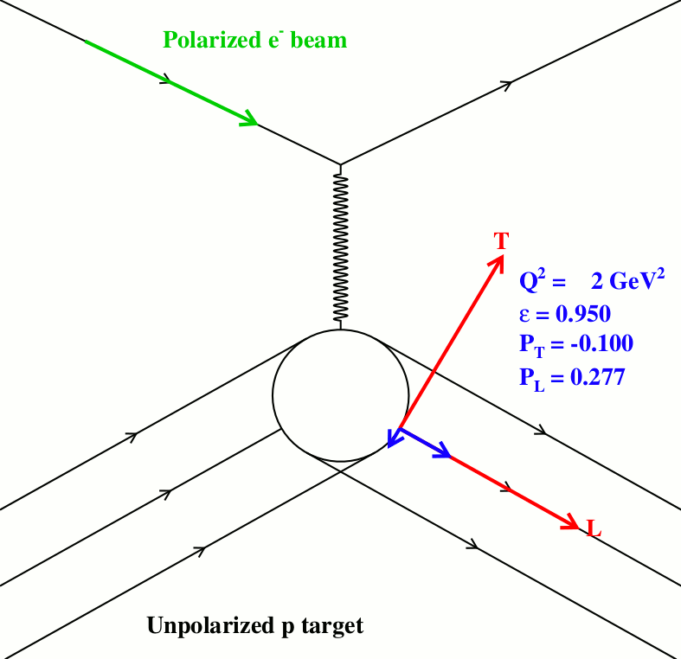
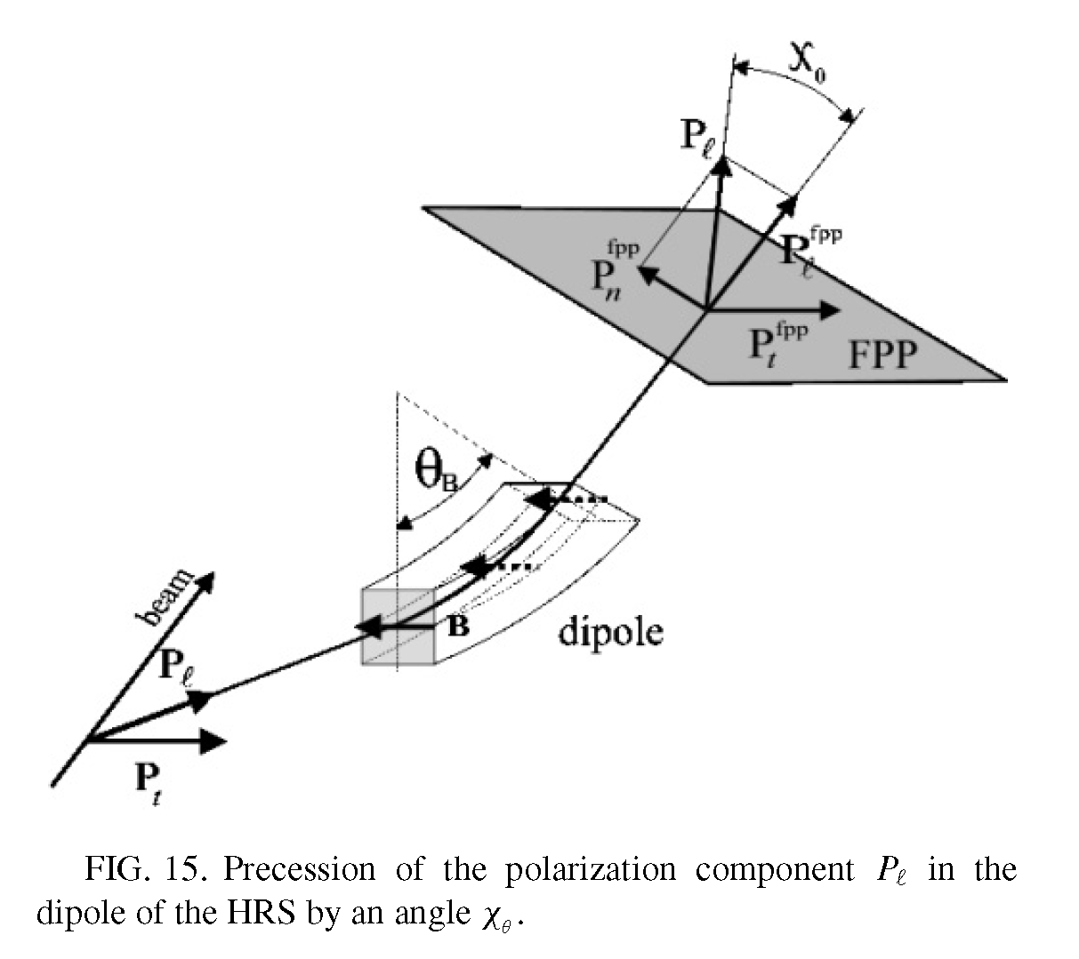
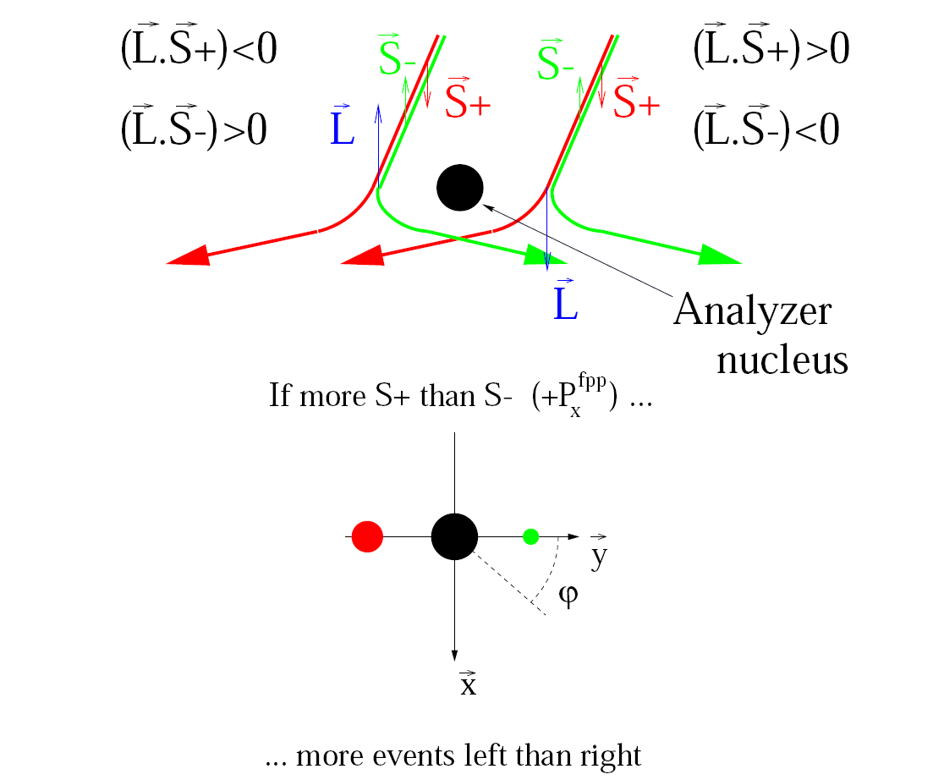
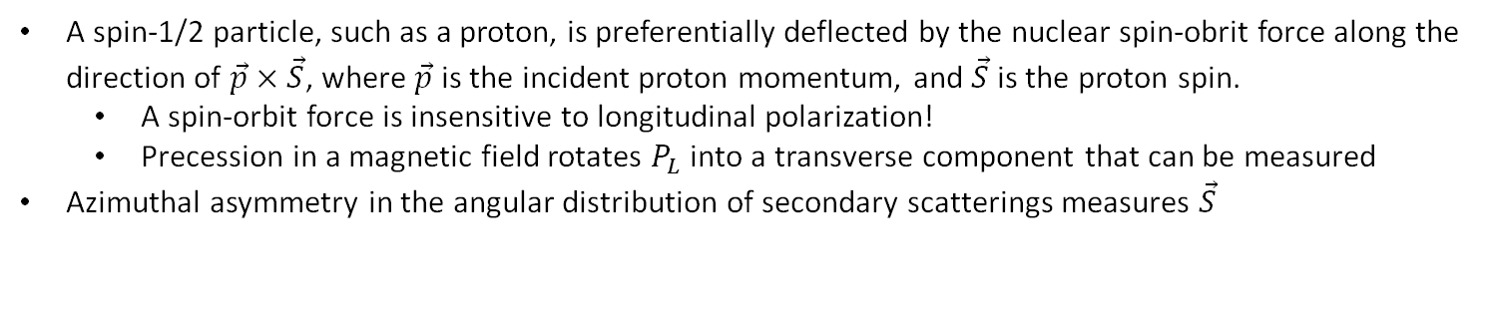
Polarization Transfer Method
Based on spin-orbit coupling in proton-nucleus scattering
A spin-1/2 particle, such as a proton, is preferentially deflected by the nuclear spin-obrit force along the direction of $\vec{p}×\vec{S}$, where $\vec{p}$ is the incident proton momentum, and $\vec{S}$ is the proton spin.
A spin-orbit force is insensitive to longitudinal polarization!
Precession in a magnetic field rotates $P_{L}$ into a transverse component that can be measured
Azimuthal asymmetry in the angular distribution of secondary scatterings measures $\vec{S}$

Slide 4
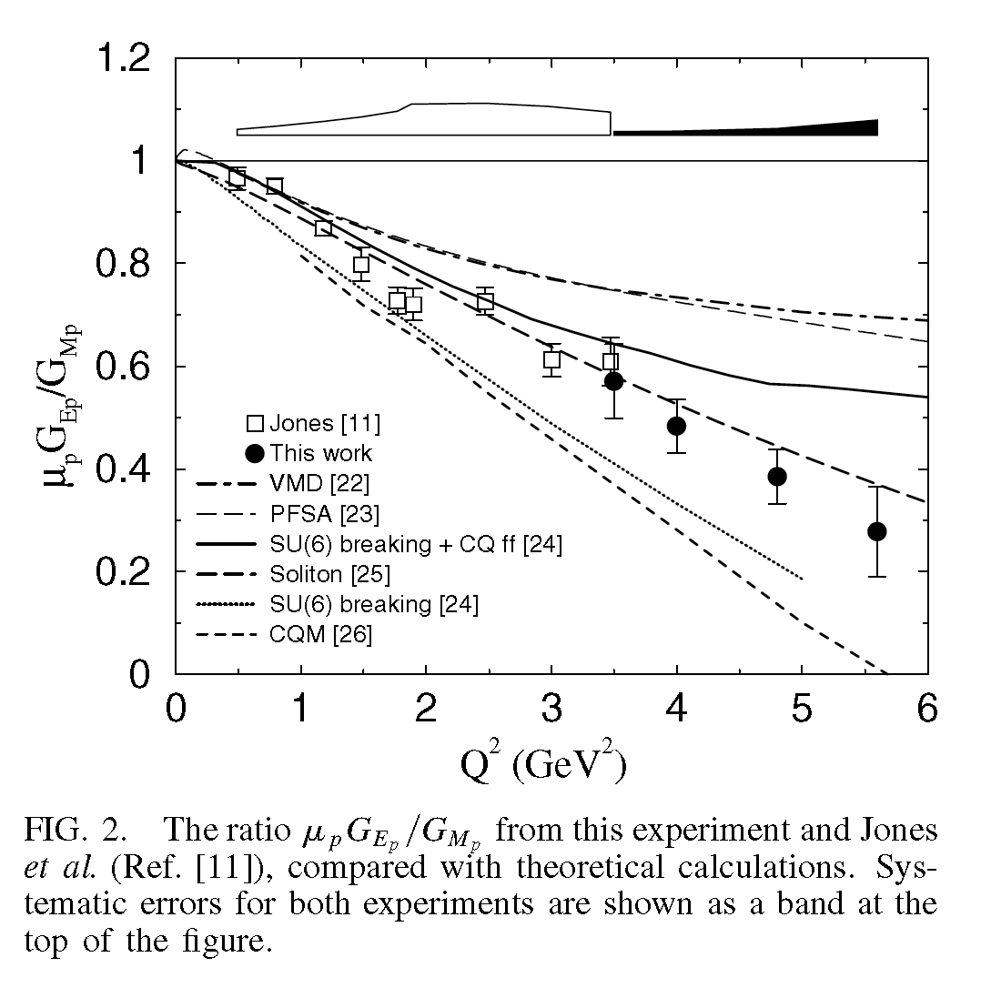
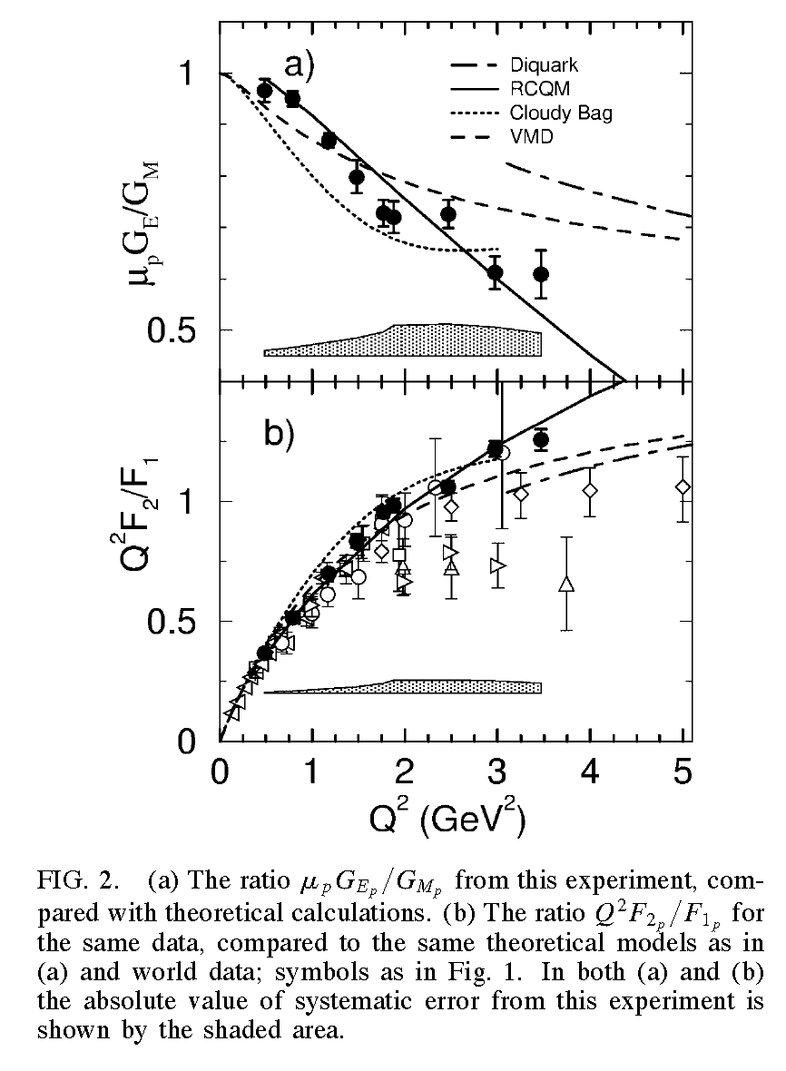
Polarization transfer and the ratio $μ_{p}G_{E}^{p}/G_{M}^{p}$: 6 GeV era Hall A/C results
Gayou et al., PRL 88, 092301 (2002) (“GEp-II”)
Figures at right are from Punjabi et al., PRC 71, 055202 (2005)
Jones et al., PRL 84, 1398 (2000) (“GEp-I”)
Puckett et al., PRL 104, 242301 (2010)

Slide 5
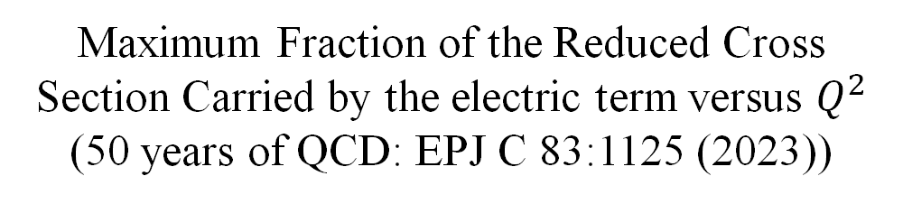
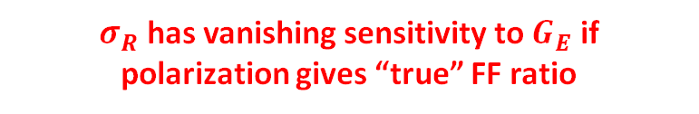
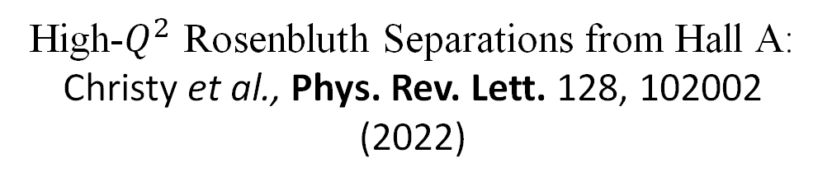
The Problem with Rosenbluth Separations
$σ_{R}$ has vanishing sensitivity to $G_{E}$ if polarization gives “true” FF ratio
High-$Q^{2}$ Rosenbluth Separations from Hall A: Christy et al., Phys. Rev. Lett. 128, 102002 (2022)
Maximum Fraction of the Reduced Cross Section Carried by the electric term versus $Q^{2}$
(50 years of QCD: EPJ C 83:1125 (2023))

Slide 6
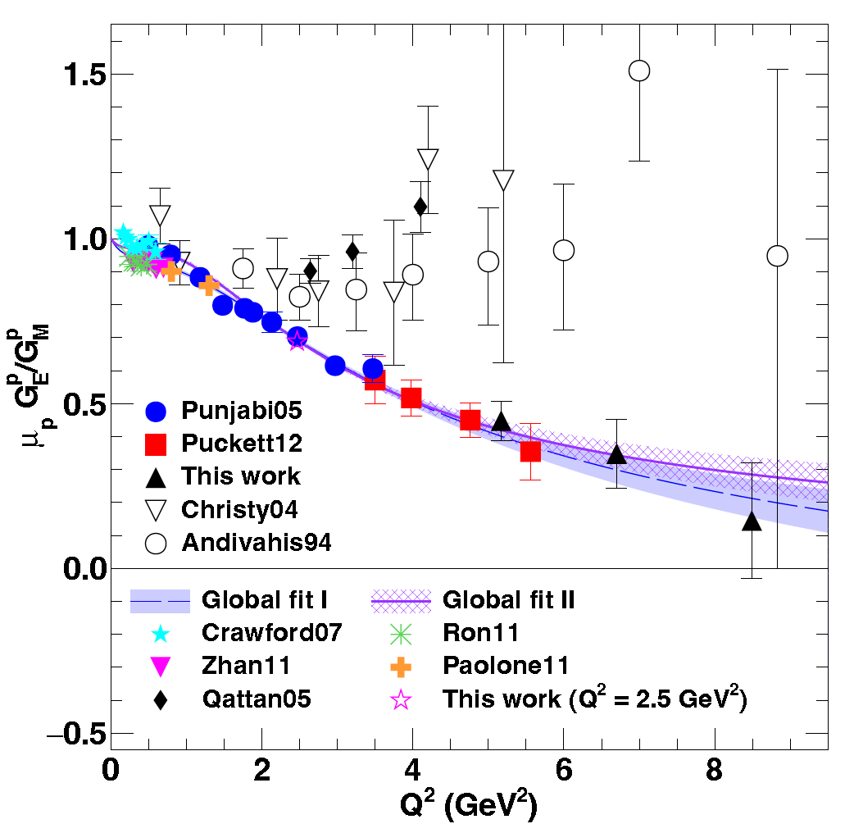
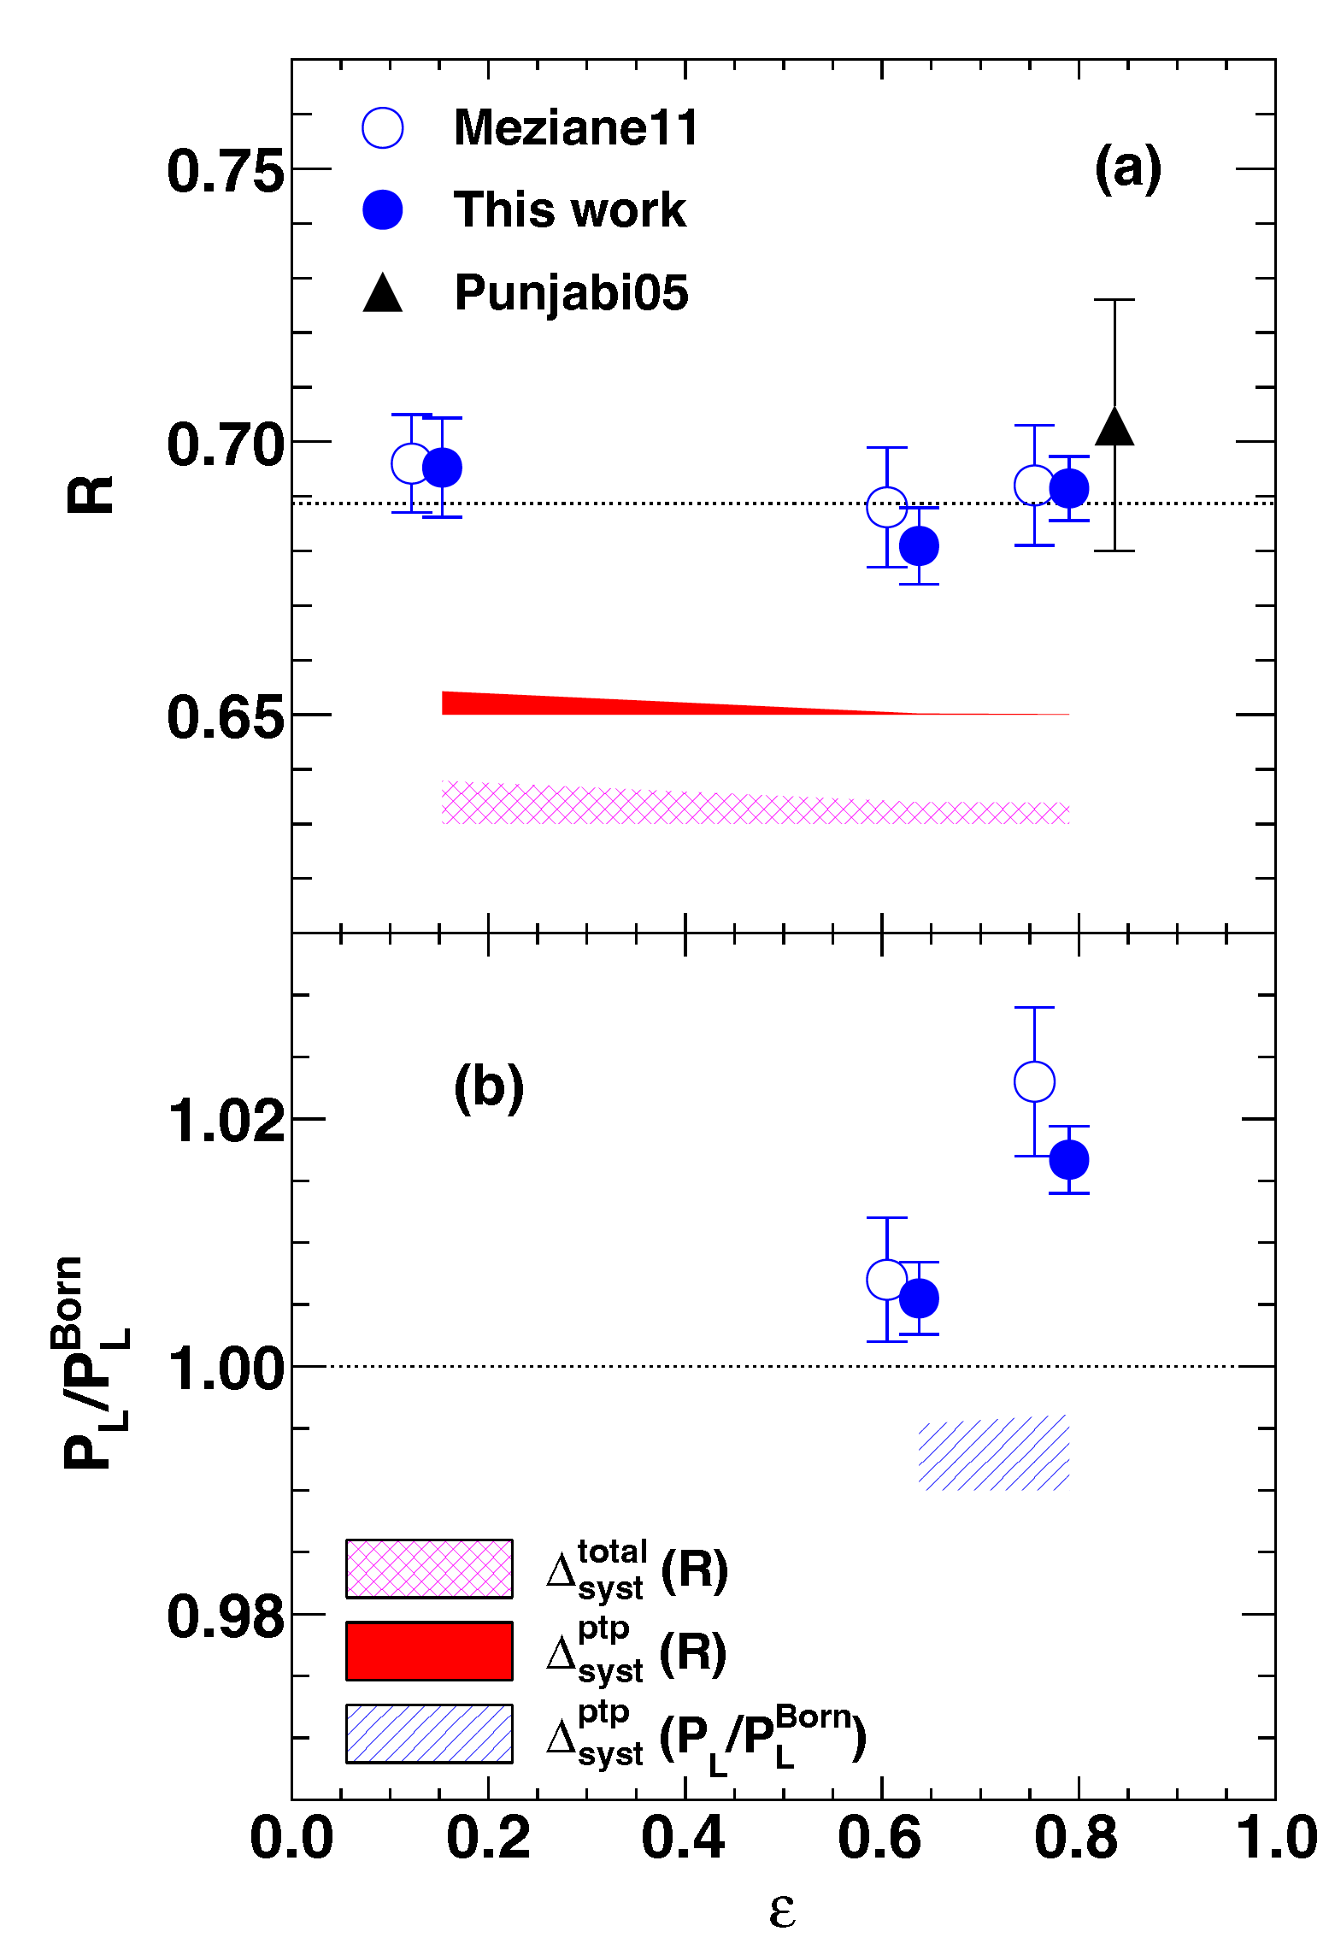
The APS Bonner Prize in Nuclear Physics, 2017
Puckett et al., PRC 96, 055203 (2017)

Slide 7
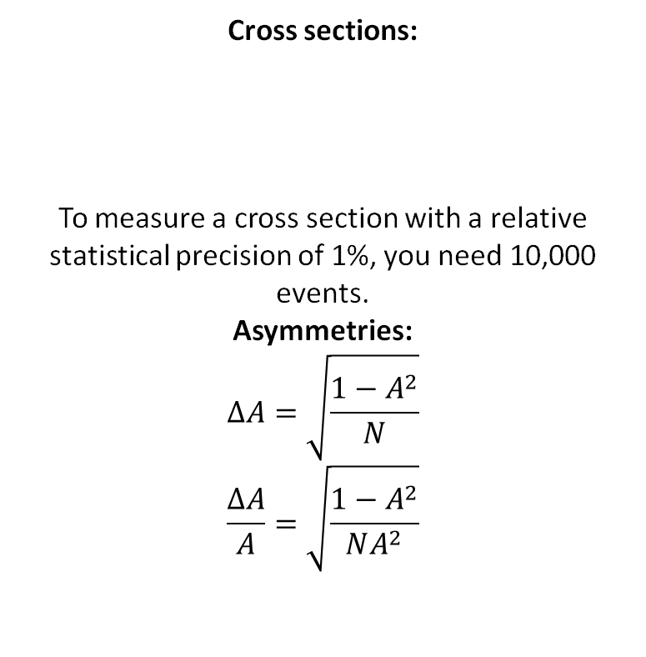
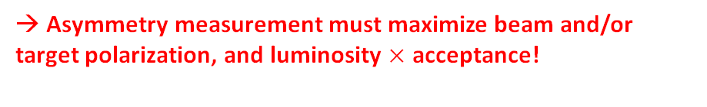
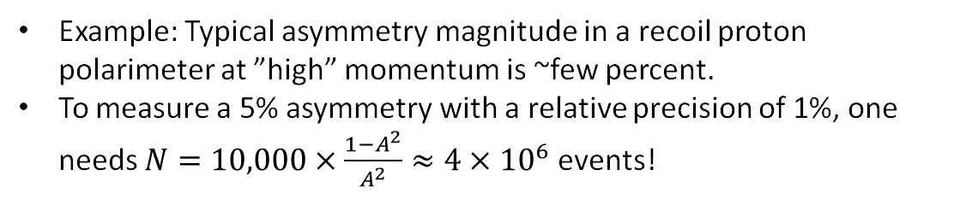
Statistics requirements: asymmetries vs. cross section measurements
Cross sections:
To measure a cross section with a relative statistical precision of 1%, you need 10,000 events.
Asymmetries:
$$ΔA=\sqrt{\frac{1−A^{2}}{N}}$$
$$\frac{ΔA}{A}=\sqrt{\frac{1−A^{2}}{NA^{2}}}$$
Example: Typical asymmetry magnitude in a recoil proton polarimeter at ”high” momentum is ~few percent.
To measure a 5% asymmetry with a relative precision of 1%, one needs $N=10,000×\frac{1−A^{2}}{A^{2}}≈4×{10}^{6}$ events!
→ Asymmetry measurement must maximize beam and/or target polarization, and luminosity $×$ acceptance!

Slide 8
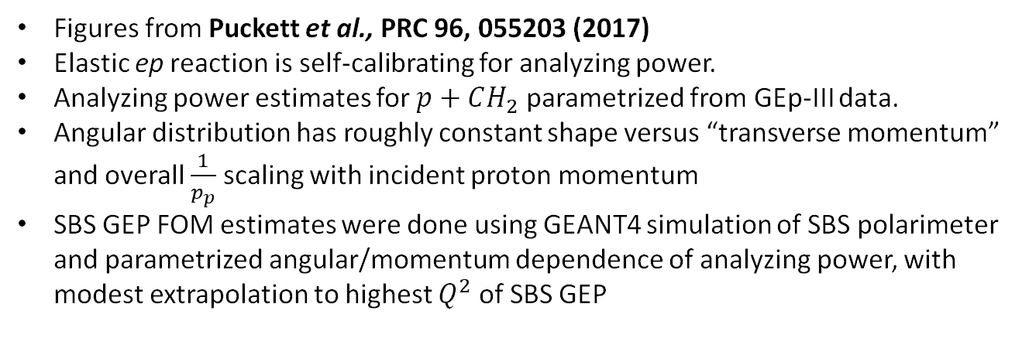
Proton Polarimetry Figure-of-Merit Ingredients
Figures from Puckett et al., PRC 96, 055203 (2017)
Elastic ep reaction is self-calibrating for analyzing power.
Analyzing power estimates for $p+CH_{2}$ parametrized from GEp-III data.
Angular distribution has roughly constant shape versus “transverse momentum” and overall $\frac{1}{p_{p}}$ scaling with incident proton momentum
SBS GEP FOM estimates were done using GEANT4 simulation of SBS polarimeter and parametrized angular/momentum dependence of analyzing power, with modest extrapolation to highest $Q^{2}$ of SBS GEP

Slide 9
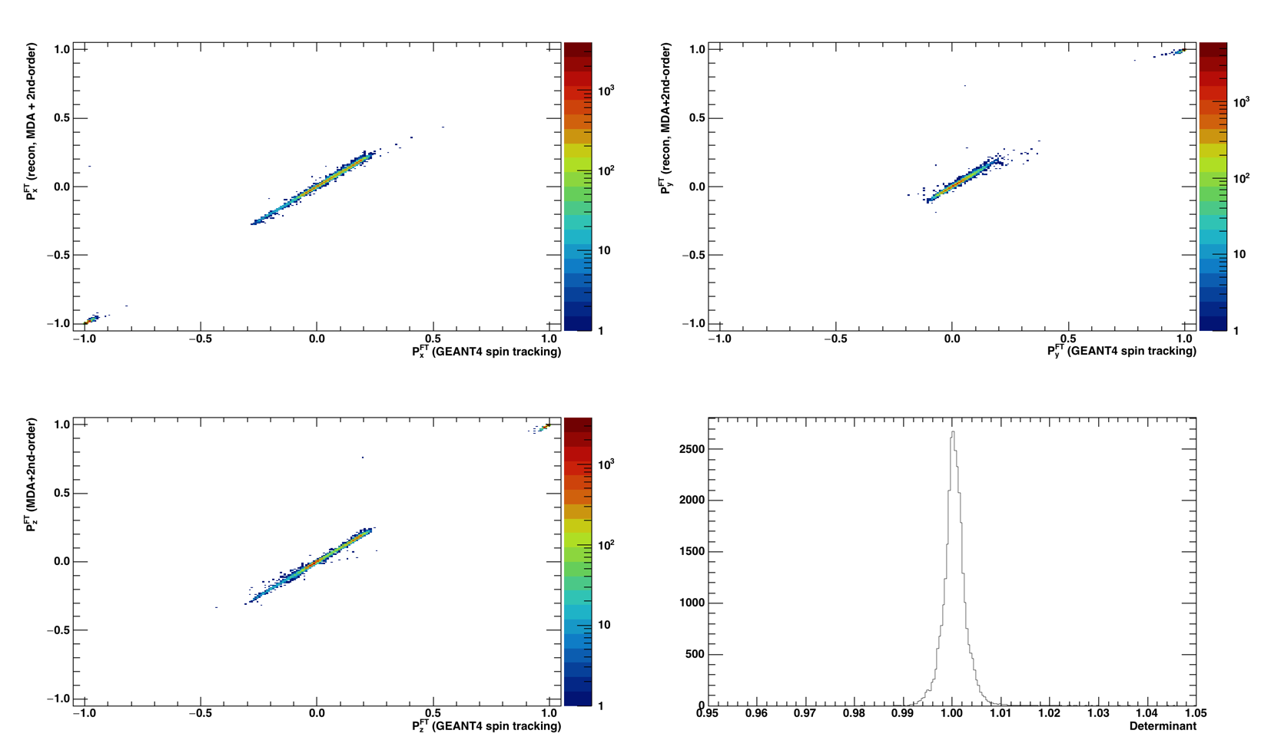

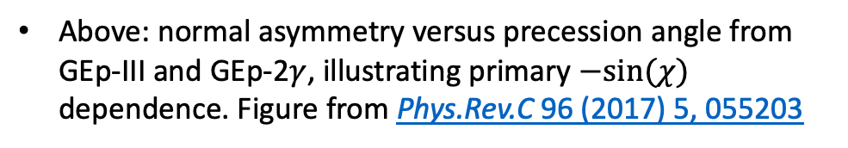
Spin Precession
Above: Correlations between fitted and “true” proton polarization components at the ”focal plane” using GEANT4 spin tracking and determinant of resulting 3x3 rotation matrix.
SBS highest $Q^{2}$ sits roughly here
Above: normal asymmetry versus precession angle from GEp-III and GEp-2$γ$, illustrating primary $−sin⁡(χ)$ dependence. Figure from Phys.Rev.C 96 (2017) 5, 055203

Slide 10
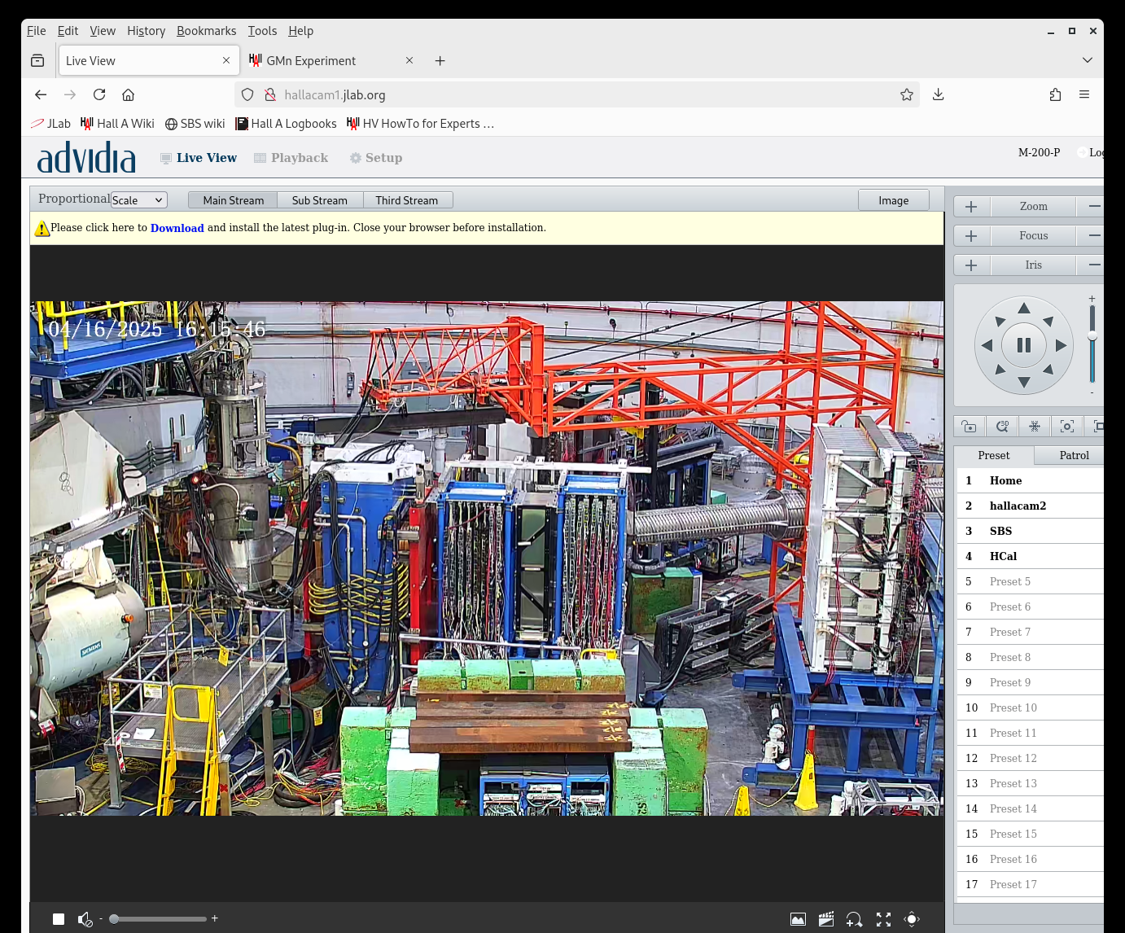
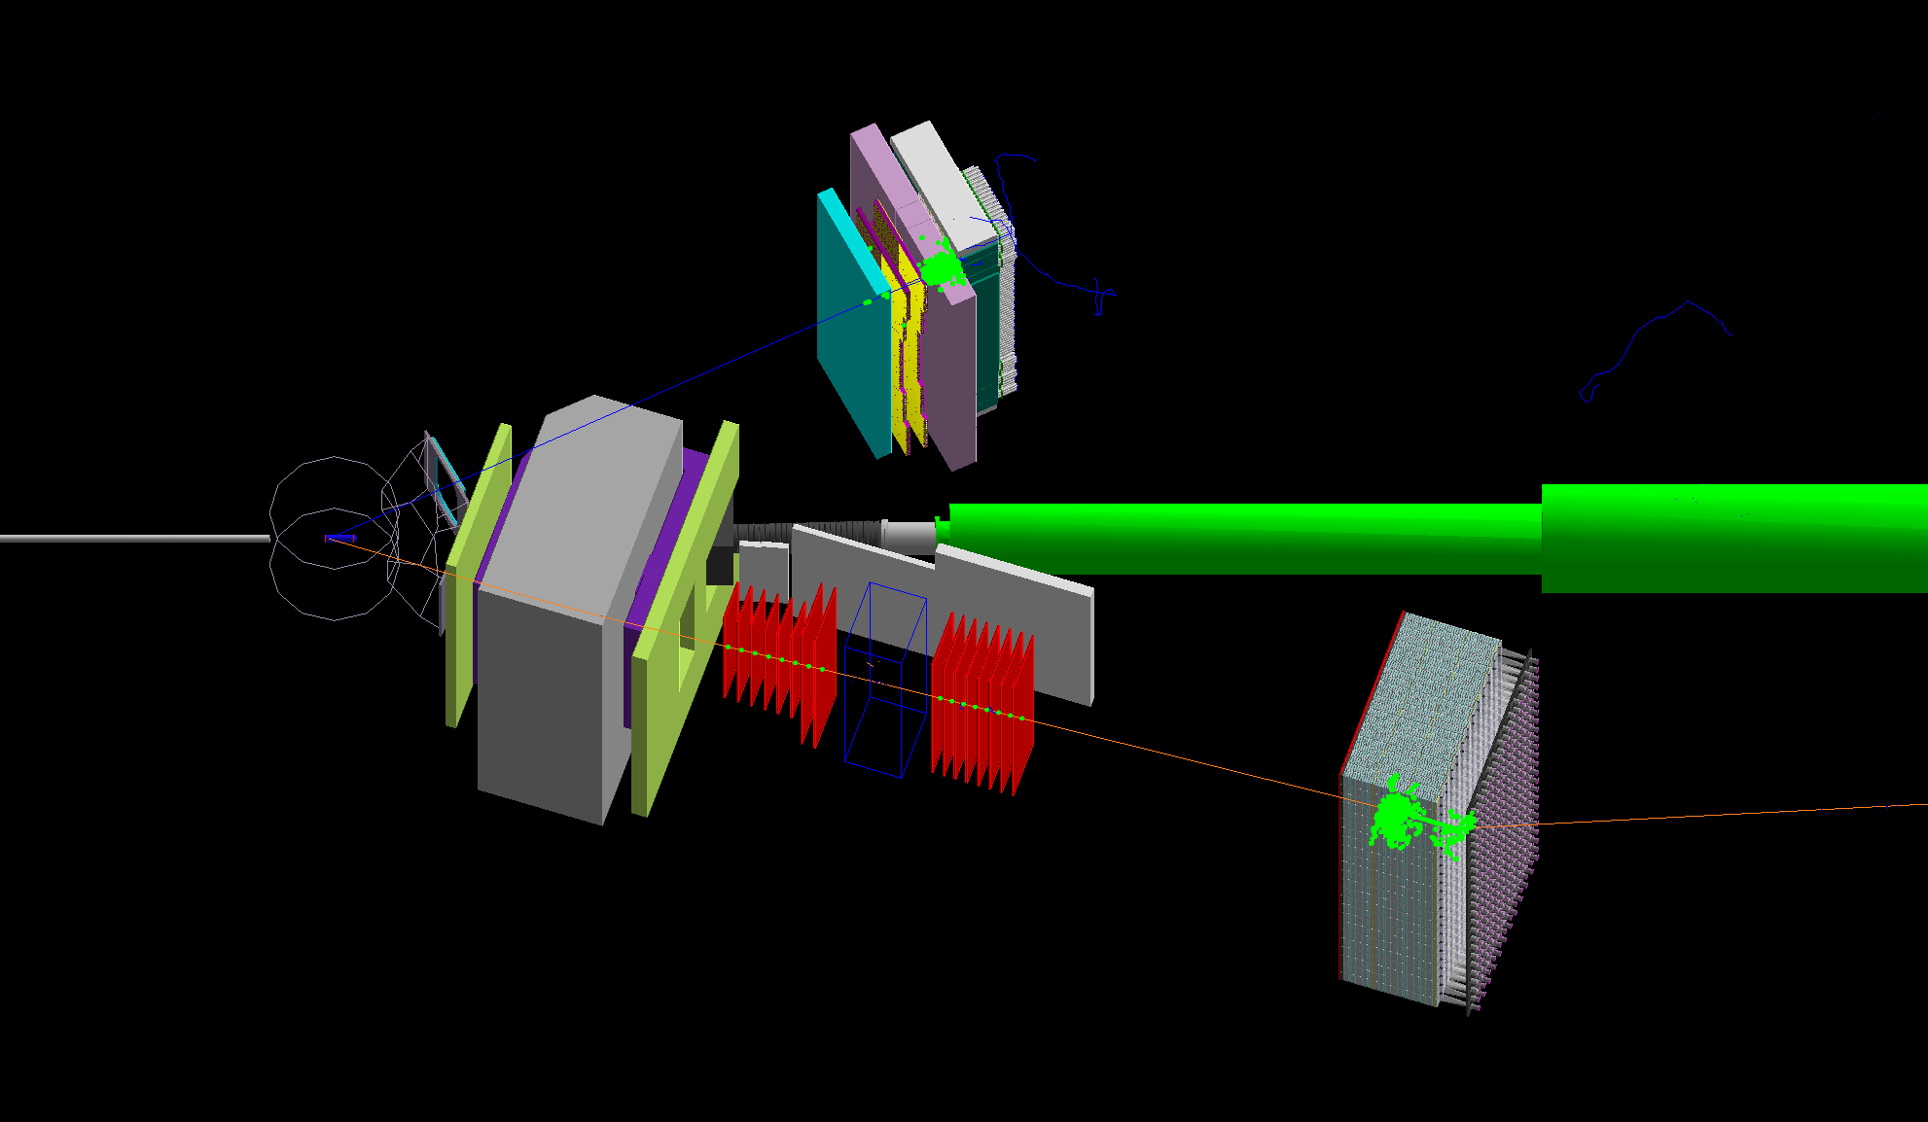
SBS GEP Layout
30-cm LH₂ + ~20 uA beam, ~87% polarized, up to 10.7 GeV
Electron arm—ECAL+ CDET
Proton arm—FT+CH₂+FPP+HCAL
Left: Hall Camera During GEP
Right: A simulated elastic ep event in g4sbs

Slide 11
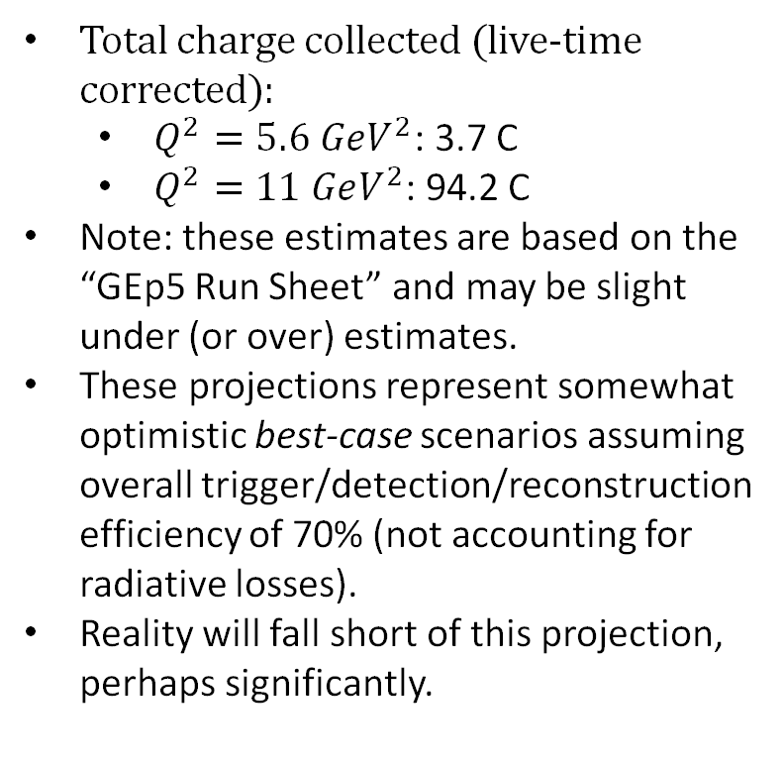
Summary of data collected and best-case scenario for physics result
Total charge collected (live-time corrected):
$Q^{2}=5.6 GeV^{2}$: 3.7 C
$Q^{2}=11 GeV^{2}$: 94.2 C
Note: these estimates are based on the “GEp5 Run Sheet” and may be slight under (or over) estimates.
These projections represent somewhat optimistic best-case scenarios assuming overall trigger/detection/reconstruction efficiency of 70% (not accounting for radiative losses).
Reality will fall short of this projection, perhaps significantly.

Slide 12
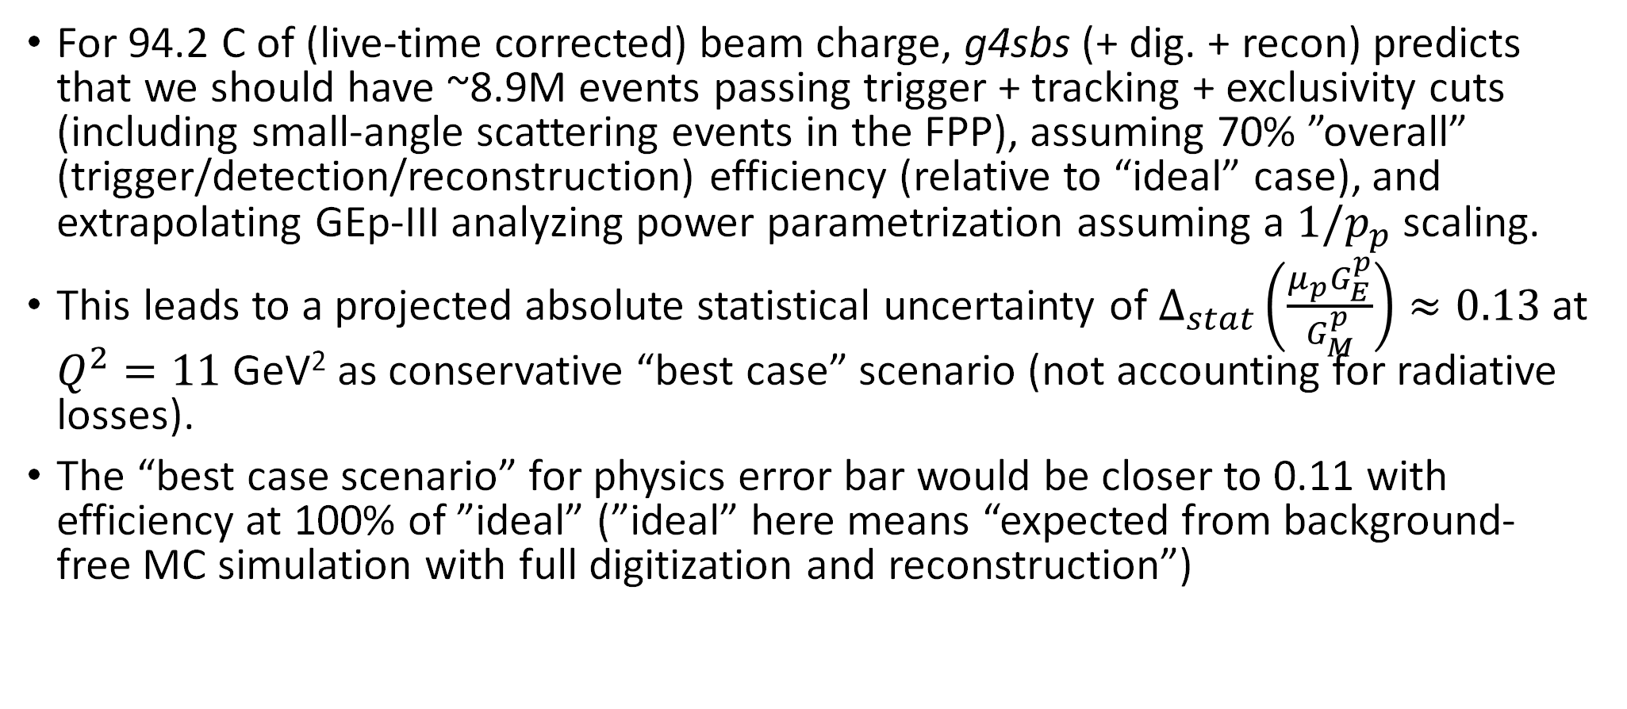
GEP statistics—what we “should” have at 11 GeV²
For 94.2 C of (live-time corrected) beam charge, g4sbs (+ dig. + recon) predicts that we should have ~8.9M events passing trigger + tracking + exclusivity cuts (including small-angle scattering events in the FPP), assuming 70% ”overall” (trigger/detection/reconstruction) efficiency (relative to “ideal” case), and extrapolating GEp-III analyzing power parametrization assuming a $1/p_{p}$ scaling.
This leads to a projected absolute statistical uncertainty of $Δ_{stat}\left(\frac{μ_{p}G_{E}^{p}}{G_{M}^{p}}\right)≈0.13$ at $Q^{2}=11$ GeV² as conservative “best case” scenario (not accounting for radiative losses).
The “best case scenario” for physics error bar would be closer to 0.11 with efficiency at 100% of ”ideal” (”ideal” here means “expected from background-free MC simulation with full digitization and reconstruction”)

Slide 13
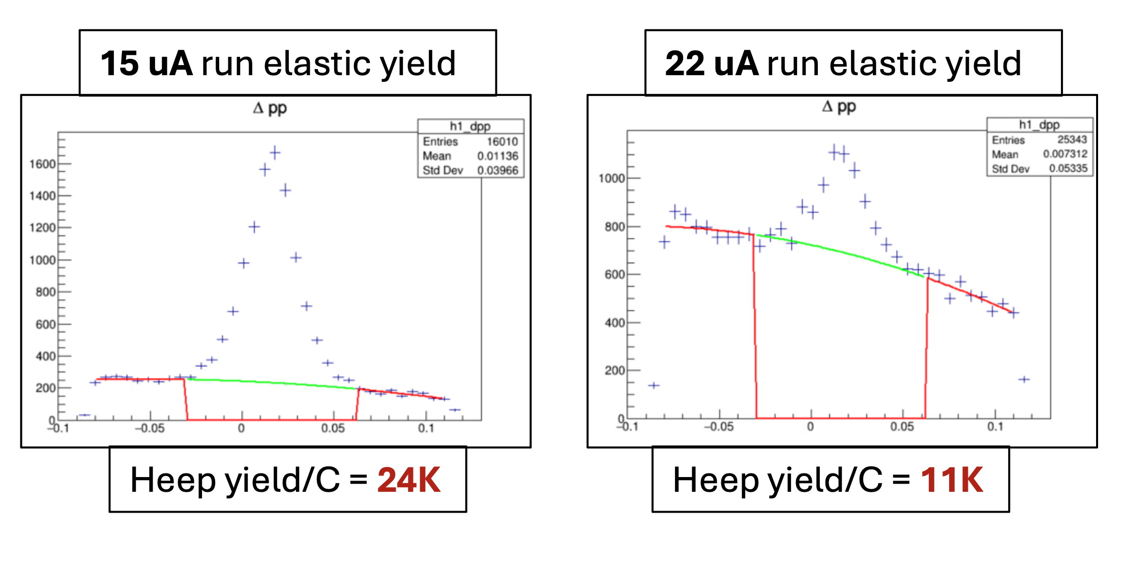
GEP Statistics—What about “worst case” scenarios?
I attempted a very rough estimate of our “worst case” elastic ep statistics for 11 GeV² (without benefit of a full cooking pass) based on what we have already demonstrated we can reconstruct.
From the GEp ”Run Sheet”, I calculated a rough, charge-weighted average beam current during Kin. 3 running, obtaining a result of 18.8 uA.
Interpolating between 15 uA and 22 uA yields reconstructed by Anu (representative examples), I estimated an ”average” elastic yield of 17K/C (~18% overall “efficiency” relative to “ideal”)
In the “worst case” scenario, then, we should have ~1.6M “good” events passing our typical elastic ep cuts requiring both front and back tracks (including small-angle scatterings in the CH₂)
Yield extractions by Anuruddha Rathnayake (Uconn)
NOTE: “ideal” expected elastic yield from g4sbs+dig+recon with zero background (w/o radiative corrections) and “typical” event selection cuts is approximately 94K/C

Slide 14
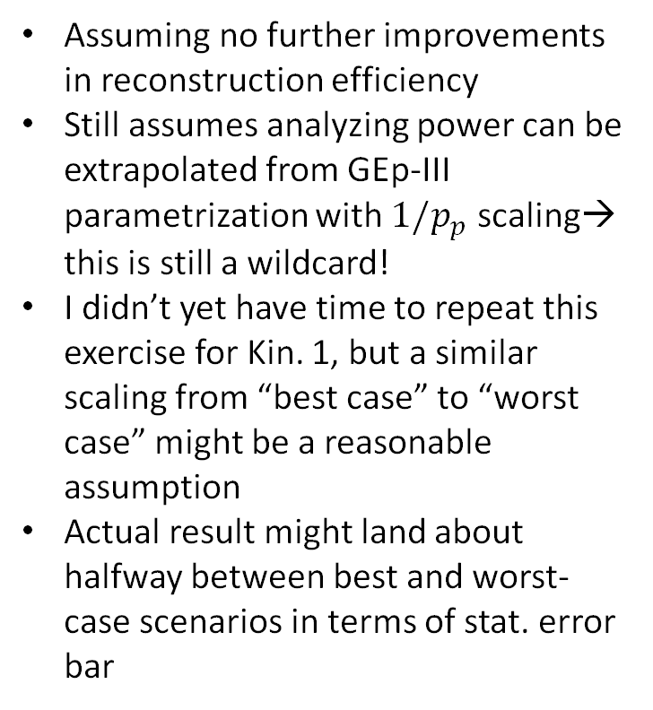
Approximate “Worst Case” Projection for 11 GeV²
Assuming no further improvements in reconstruction efficiency
Still assumes analyzing power can be extrapolated from GEp-III parametrization with $1/p_{p}$ scaling→ this is still a wildcard!
I didn’t yet have time to repeat this exercise for Kin. 1, but a similar scaling from “best case” to “worst case” might be a reasonable assumption
Actual result might land about halfway between best and worst-case scenarios in terms of stat. error bar

Slide 15
SBS GEP Event Reconstruction Strategy

Slide 16
Initial, ”perfect” alignment of all 46 SBS GEMs
From ”straight-through” data at the beginning of Kin. 1, before CH₂ install, on single C foil target with magnet OFF. This was a “golden” alignment (internal+global+front-to-back), which we sadly couldn’t actually use ☹!

Slide 17
How to calibrate GEP reconstruction?
No sieve slit in GEP (we couldn’t really use one if we had it due to no PID capability and punch-through of high-energy hadrons)
No “traditional” straight-through data
We have single C foil and multi-foil optics targets, with full-field and zero-field data obtained at low current
We also have H(e,e’p) scattering; however, it is all but impossible in the current formalism to calibrate SBS optics using this channel due to overconstrained kinematics, correlations, and “overfitting” issues.
Also, how well do we know ECAL geometry?
→Optics models are generated from simulation using randomized proton trajectories in angles, vertex, and momentum.
SBS GEMs are globally aligned wrt magnet and Hall using zero-field data on thin foil targets→ significant fringe field effect on SBS track curvature seen (see Vidura’s talk tomorrow)

Slide 18
Logic of Electron Arm Reconstruction and Front Tracking Constraint
At right, we show the correlation of the “true” vertex z position (x axis) and the difference between the “true” proton track parameters in the SBS front tracker and the “predicted” ones from ECAL+CDET for the point-target assumption.
From top left to bottom right: (x,y,dx/dz,dy/dz), where x (y) is dispersive-plane (non-dispersive plane) coordinate

Slide 19
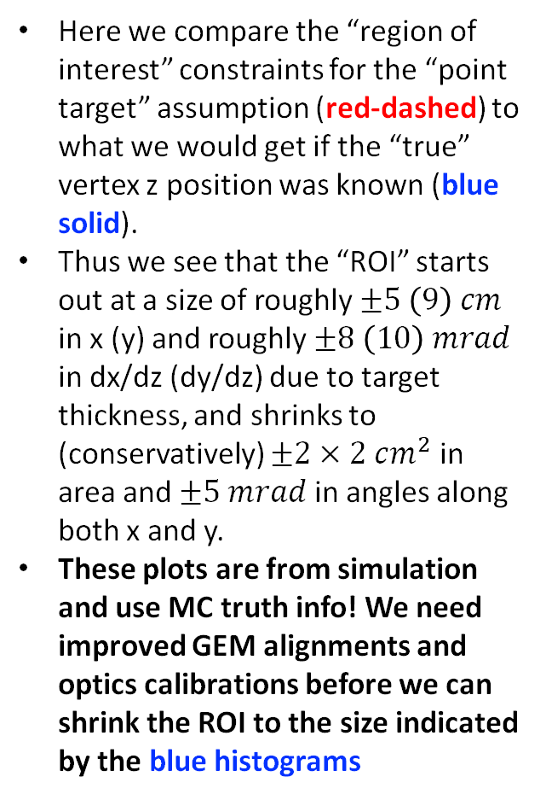
Logic of Electron Arm Reconstruction and Front Tracking Constraint
Here we compare the “region of interest” constraints for the “point target” assumption (red-dashed) to what we would get if the “true” vertex z position was known (blue solid).
Thus we see that the “ROI” starts out at a size of roughly $±5 \left(9\right) cm$ in x (y) and roughly $±8 \left(10\right) mrad$ in dx/dz (dy/dz) due to target thickness, and shrinks to (conservatively) $±2×2 cm^{2}$ in area and $±5 mrad$ in angles along both x and y.
These plots are from simulation and use MC truth info! We need improved GEM alignments and optics calibrations before we can shrink the ROI to the size indicated by the blue histograms

Slide 20
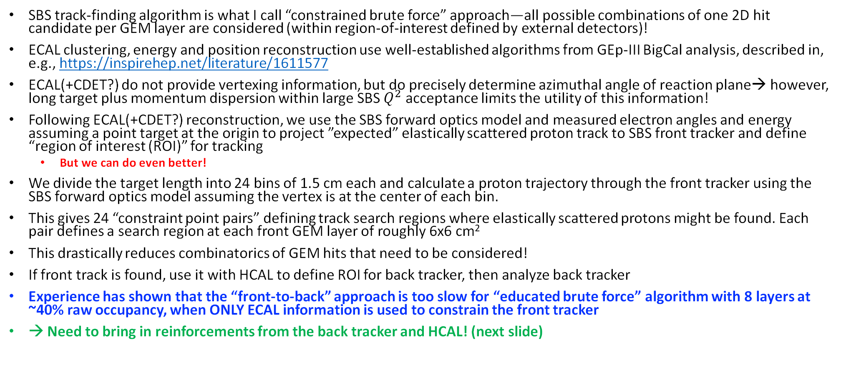
GEP reconstruction: “front to back” approach
SBS track-finding algorithm is what I call “constrained brute force” approach—all possible combinations of one 2D hit candidate per GEM layer are considered (within region-of-interest defined by external detectors)!
ECAL clustering, energy and position reconstruction use well-established algorithms from GEp-III BigCal analysis, described in, e.g., https://inspirehep.net/literature/1611577
ECAL(+CDET?) do not provide vertexing information, but do precisely determine azimuthal angle of reaction plane→ however, long target plus momentum dispersion within large SBS $Q^{2}$ acceptance limits the utility of this information!
Following ECAL(+CDET?) reconstruction, we use the SBS forward optics model and measured electron angles and energy assuming a point target at the origin to project ”expected” elastically scattered proton track to SBS front tracker and define “region of interest (ROI)” for tracking
But we can do even better!
We divide the target length into 24 bins of 1.5 cm each and calculate a proton trajectory through the front tracker using the SBS forward optics model assuming the vertex is at the center of each bin.
This gives 24 “constraint point pairs” defining track search regions where elastically scattered protons might be found. Each pair defines a search region at each front GEM layer of roughly 6x6 cm²
This drastically reduces combinatorics of GEM hits that need to be considered!
If front track is found, use it with HCAL to define ROI for back tracker, then analyze back tracker
Experience has shown that the “front-to-back” approach is too slow for “educated brute force” algorithm with 8 layers at ~40% raw occupancy, when ONLY ECAL information is used to constrain the front tracker
→ Need to bring in reinforcements from the back tracker and HCAL! (next slide)

Slide 21
GEP reconstruction: “back to front” approach
Exploits the fact that the back tracker (”FPP”) has much lower occupancy, and we are only really interested in events where we have a good FPP track anyway.
We use ECAL(+CDET?) and HCAL to define ROI for back tracker.
As in “front-to-back” algorithm, we define 24 constraint point pairs, only this time the ”front” constraint point is the projection of the expected proton trajectory to the midpoint of the CH₂ analyzer for a given vertex assumption, and the “back” constraint point is the position of the highest-energy cluster in HCAL
ROI widths are informed by simulation.
Back tracker occupancy is manageable even using 24 constraint point pairs
Back tracker results are used to choose ONE ”constraint point pair” for the front tracker analysis… typically based on distance and point of closest approach and angle between actual FPP track and expected FT track.
Using the back tracker results to further shrink/constrain the front tracker ROI makes the FT analysis computationally manageable (barely)

Slide 22
GEP GEM Front Tracker (raw) occupancy at 15 uA on 30-cm LH₂

Slide 23
A few lessons from the SBS FF program for future intensity-frontier experiments (e.g., SOLID)
More commissioning/calibration time with new/custom equipment operating in extreme high-rate/high-background regimes
High-rate GEM tracking is more challenged for MIP-like particles (e.g., 7-GeV protons) than for ultra-relativistic electrons (signal/noise ratio!)
APV25 front-end seems inadequate for the most extreme conditions (e.g., GEP)—need faster pulse shaping, better stability of baseline/gain/etc
APV25 would have worked significantly better in SBS with 9 time samples instead of 6
Pay VERY close attention to trigger threshold calibrations and efficiencies for both electron and hadron calorimeters—need clear plans to validate trigger efficiencies and TIME to collect the data—even (especially) for asymmetry measurements

Slide 24
Front tracker occupancies and elastic yields vs beam current
Slide credit: Anuruddha Rathnayake @Fall 2025 DNP Chicago

Slide 25
APV25 baseline sagging/broadening—FPP module 6 @20 uA

Slide 26
APV25 baseline sagging/broadening—FT layer 5 @20 $μA$

Slide 27
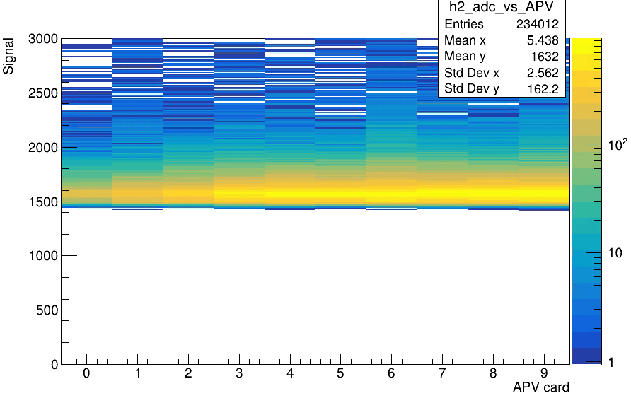
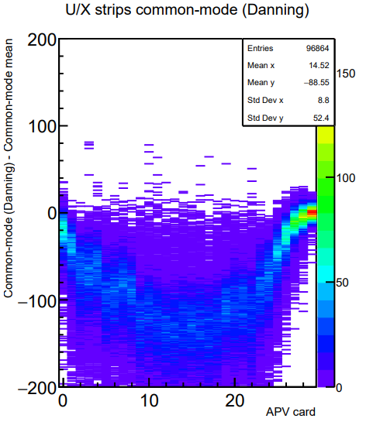
Producing MC data to train ML models for GEM tracking
An attempt to enhance the reconstruction speed and efficiency through ML.
Both hit finding (1D clustering and 2D hit formation) and track reconstruction under the overwhelming GEM occupancy/background is very challenging.
After some discussions with experts, we decided to go in the route of using MC data to train a ML model to help with this.
However, our existing MC GEM data is much less noisy and have an unrealistically better signal/noise ratio that REAL GEP data. Some of the missing features in MC:
GEM pulses seems to be shorter in time.
APV25 (front-end r/o) have baseline fluctuations (common-mode, CM) in real data which is not simulated in MC data.
In real data taking we did online CM correction and ZS. This will introduce some error into the GEM signal strengths.
“Sagging” of the CM under high-rate will also cause
More realistic MC GEM data is better for ML training and to benchmark any new algorithmic developments.
Current MC – signals added to a const. CM of 1500.
Data – CM sagged and broadened at the mid-acceptance.

Slide 28
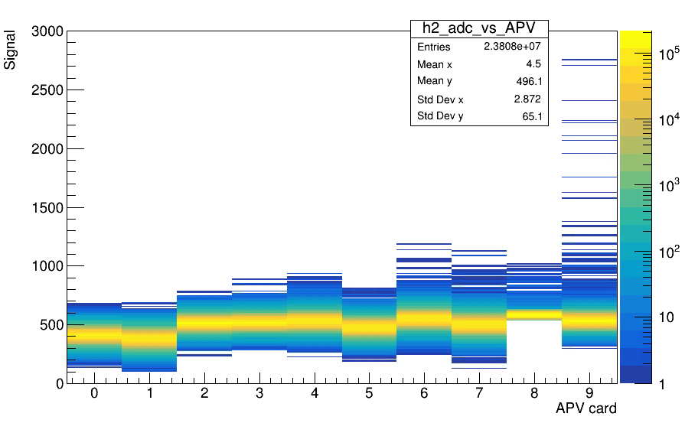
Improvements/additions to the GEM digitization
Now we add CM random fluctuations to simulation ‘APVs’.
Now
Previous
Also, now “online” Danning CM calculation and ZS is implemented in digitization.
CM sagging effect yet to be implemented. But now the machinery is setup for that.
Replay of MC data with new CM/pedestal effects works to an extent but still not 100% figured out. On progress…
Added the “adc_good” branch to the GEM digitization output that tells you what number of ADCs are from the “mother particle” avalanche. This will be used as our ‘MC truth info help train a ML model. Eric. F working on getting this integrated to SBS_OFFLINE.

Slide 29
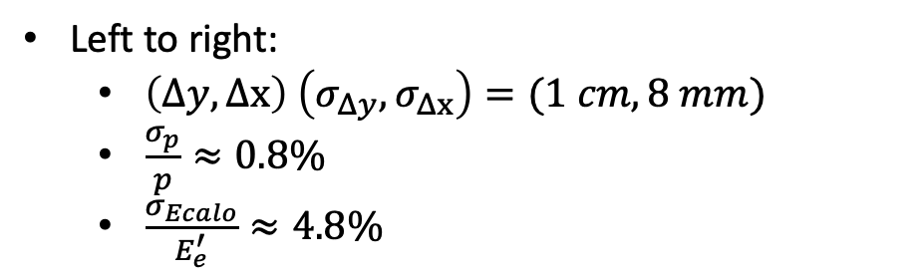
Elastic Event Selection (ideal)
Left to right:
$\left(Δy,Δx\right) \left(σ_{Δy},σ_{Δx}\right)=(1 cm, 8 mm)$
$\frac{σ_{p}}{p}≈0.8\%$
$\frac{σ_{Ecalo}}{E_{e}^{′}}≈4.8\%$
Expected elastic event selection performance in the “ideal” scenario from MC: no background, no alignment uncertainty, no magnetic field and/or optics modeling uncertainty

Slide 30
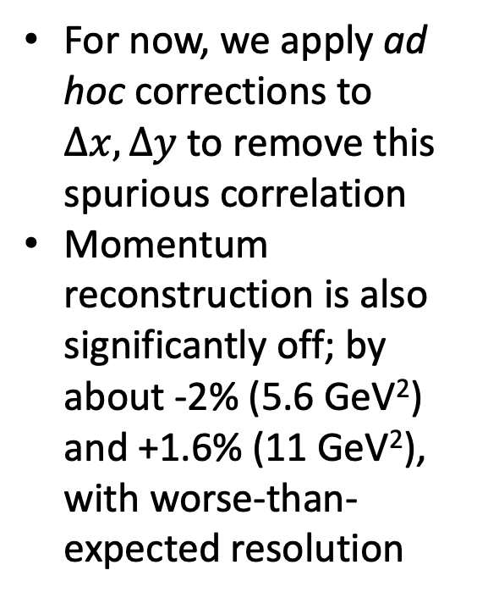
Elastic Event Selection (real), I: Spurious Correlations
For now, we apply ad hoc corrections to $Δx, Δy$ to remove this spurious correlation
Momentum reconstruction is also significantly off; by about -2% (5.6 GeV²) and +1.6% (11 GeV²), with worse-than-expected resolution
Significant spurious correlation seen between $Δy, Δx$ and vertical position at ECAL
Cause not fully understood: ECAL geometry description, GEM alignment, SBS optics modeling, all of the above?

Slide 31
Elastic Event Selection (real), II (w/ad hoc corrections on $Δx, Δy$)

Slide 32
Polarimeter Reconstruction (ideal)
Left to right: polar scattering angle, distance-of-closest-approach, z coordinate of closest approach, correlation between $θ,z_{close}$

Slide 33
Polarimeter Reconstruction, real

Slide 34
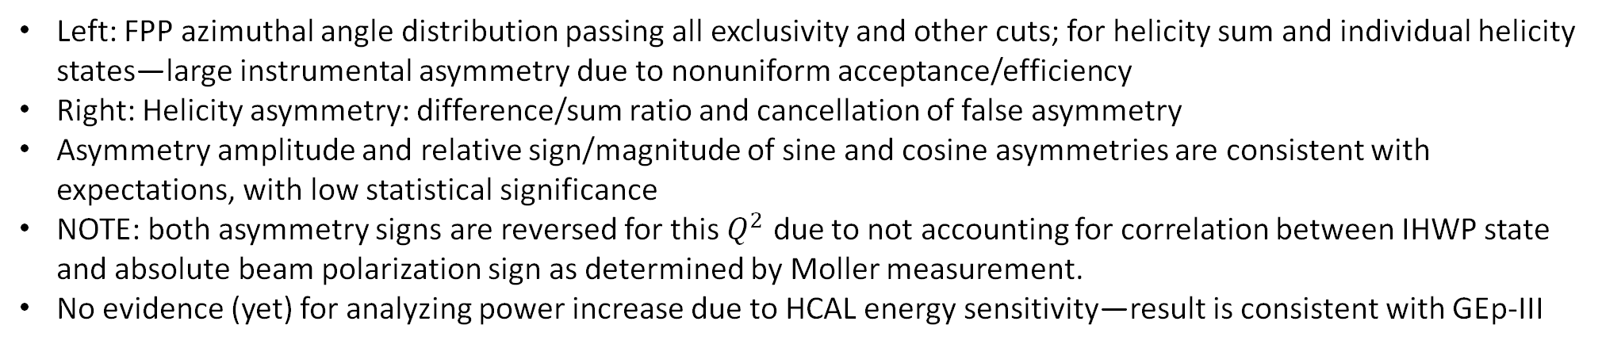
FPP Kin. 1 azimuthal distribution and asymmetry
Left: FPP azimuthal angle distribution passing all exclusivity and other cuts; for helicity sum and individual helicity states—large instrumental asymmetry due to nonuniform acceptance/efficiency
Right: Helicity asymmetry: difference/sum ratio and cancellation of false asymmetry
Asymmetry amplitude and relative sign/magnitude of sine and cosine asymmetries are consistent with expectations, with low statistical significance
NOTE: both asymmetry signs are reversed for this $Q^{2}$ due to not accounting for correlation between IHWP state and absolute beam polarization sign as determined by Moller measurement.
No evidence (yet) for analyzing power increase due to HCAL energy sensitivity—result is consistent with GEp-III

Slide 35
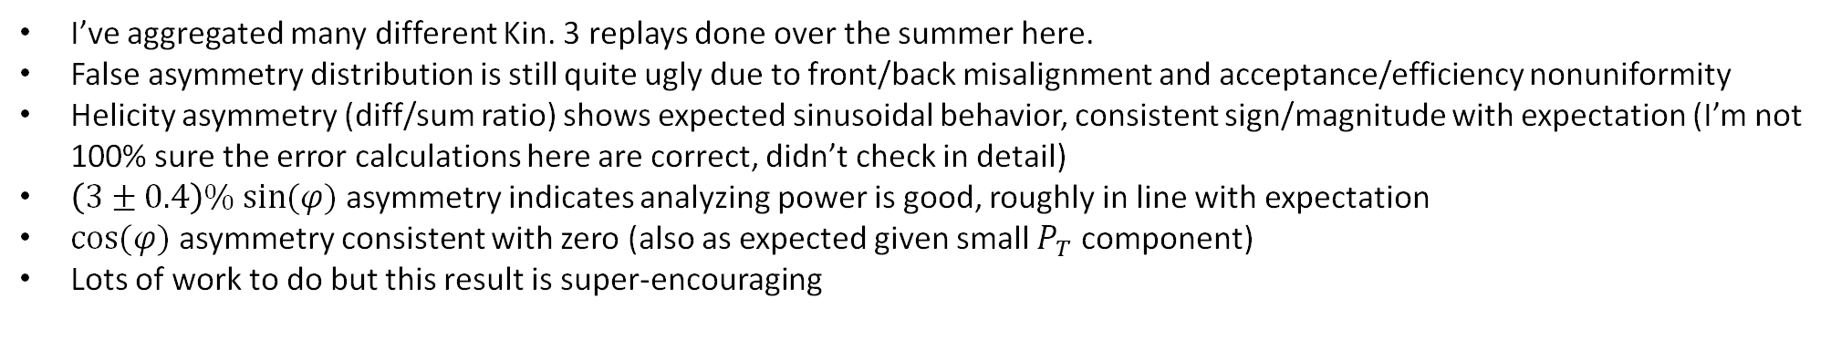
FPP Kin. 3 azimuthal distribution and asymmetry
I’ve aggregated many different Kin. 3 replays done over the summer here.
False asymmetry distribution is still quite ugly due to front/back misalignment and acceptance/efficiency nonuniformity
Helicity asymmetry (diff/sum ratio) shows expected sinusoidal behavior, consistent sign/magnitude with expectation (I’m not 100% sure the error calculations here are correct, didn’t check in detail)
$\left(3±0.4\right)\% sin⁡(φ)$ asymmetry indicates analyzing power is good, roughly in line with expectation
$cos⁡(φ)$ asymmetry consistent with zero (also as expected given small $P_{T}$ component)
Lots of work to do but this result is super-encouraging

Slide 36
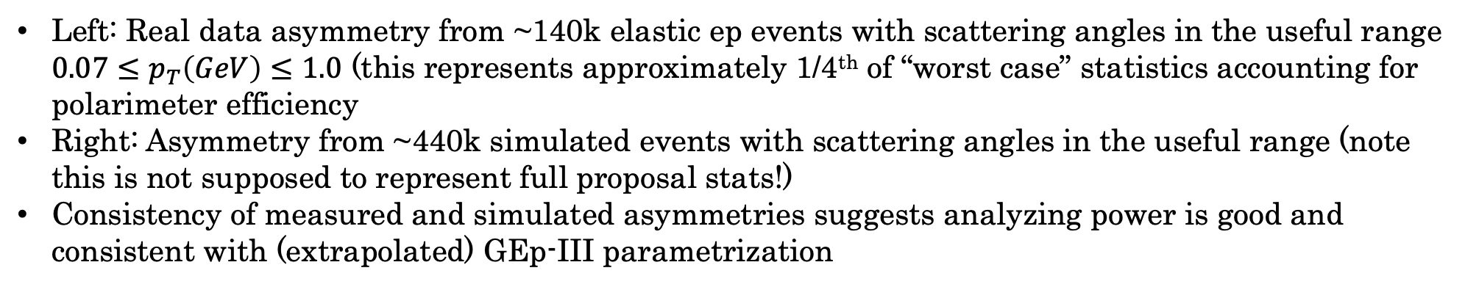
Kin. 3 asymmetry: measured vs. projected
Left: Real data asymmetry from ~140k elastic ep events with scattering angles in the useful range $0.07≤p_{T}\left(GeV\right)≤1.0$ (this represents approximately 1/4th of “worst case” statistics accounting for polarimeter efficiency
Right: Asymmetry from ~440k simulated events with scattering angles in the useful range (note this is not supposed to represent full proposal stats!)
Consistency of measured and simulated asymmetries suggests analyzing power is good and consistent with (extrapolated) GEp-III parametrization

Slide 37
For more details, see student talks tomorrow:

Slide 38
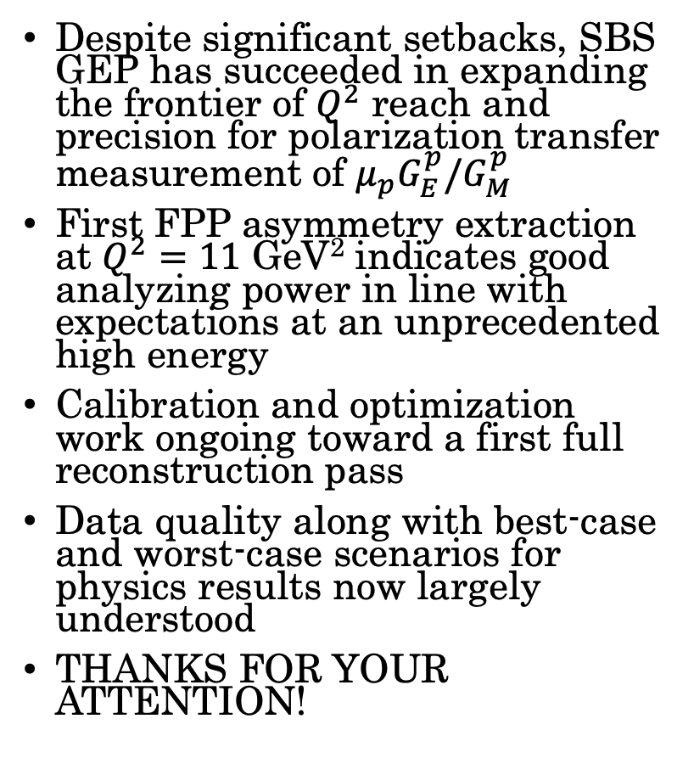
Summary and Conclusions
Despite significant setbacks, SBS GEP has succeeded in expanding the frontier of $Q^{2}$ reach and precision for polarization transfer measurement of $μ_{p}G_{E}^{p}/G_{M}^{p}$
First FPP asymmetry extraction at $Q^{2}=11$ GeV² indicates good analyzing power in line with expectations at an unprecedented high energy
Calibration and optimization work ongoing toward a first full reconstruction pass
Data quality along with best-case and worst-case scenarios for physics results now largely understood
THANKS FOR YOUR ATTENTION!

Slide 39
Backups

Slide 40
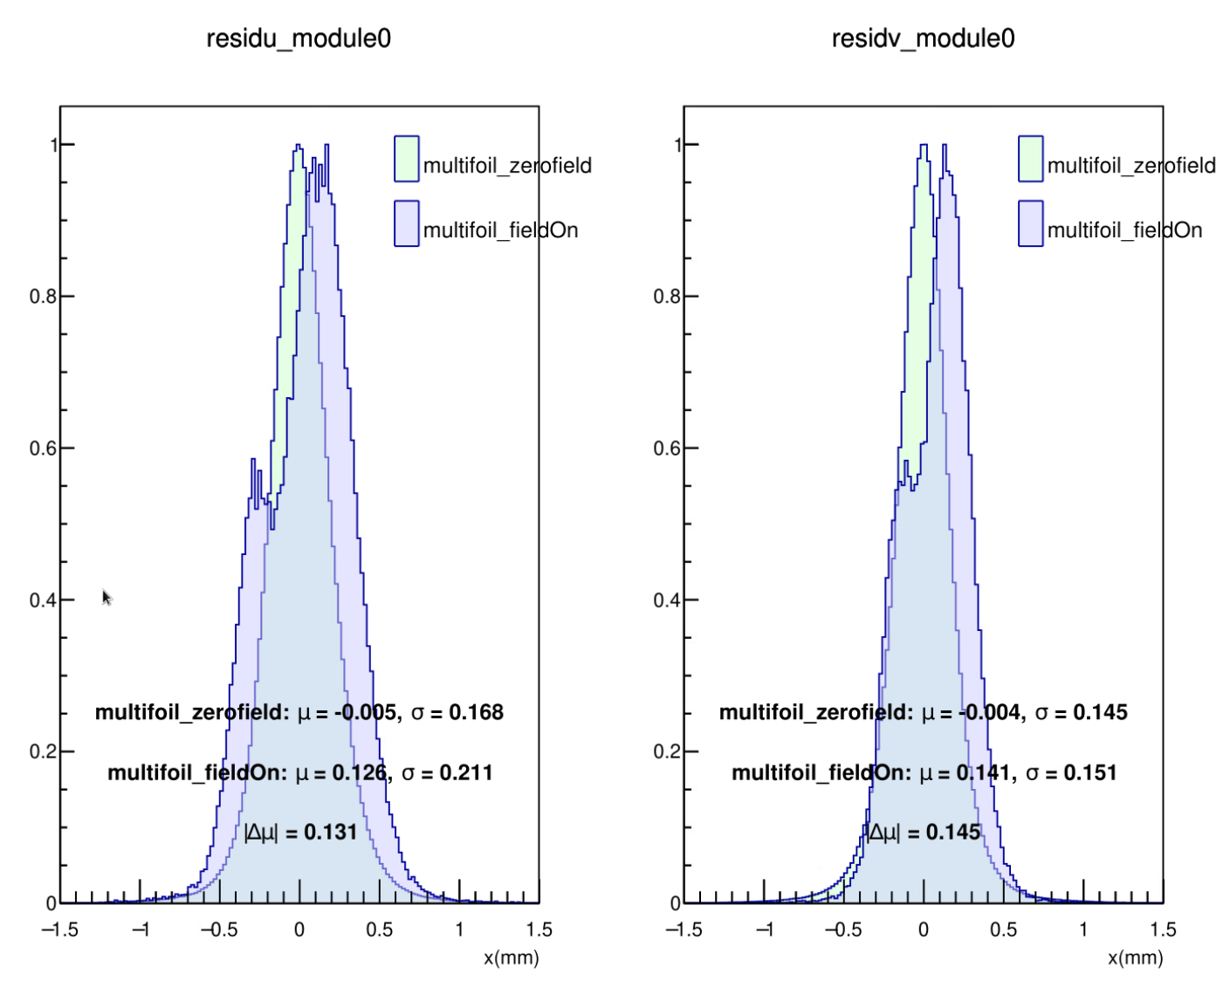

Progress on Internal GEM Alignment
Performed a study to assess the differences in GEM tracking residuals between field-on and field-off data, in a common alignment obtained from field-off dataset.
The study showed shifts in the mean of the residual distributions on the order of the intrinsic GEM resolution for field-on residuals.
Conclusion: We will strictly use field-on data to improve the internal GEM alignment.
Based on the repair work performed by the GEM team during the Kin1 and Kin3 run periods, Kin1 requires only a single internal GEM alignment for both the FT and FPP. The FT in Kin3 also requires one internal alignment, while the FPP requires two separate alignments due to the sliding out of layers for APV replacement during the May 21, 2025 repair work.
Work on improving the internal GEM alignment is currently underway, with more details to be presented in Vidura’s talk.
Once the internal GEM alignment is done, the focus should shift toward improving the GEM back-to-front alignment and the overall global alignment.

Slide 41
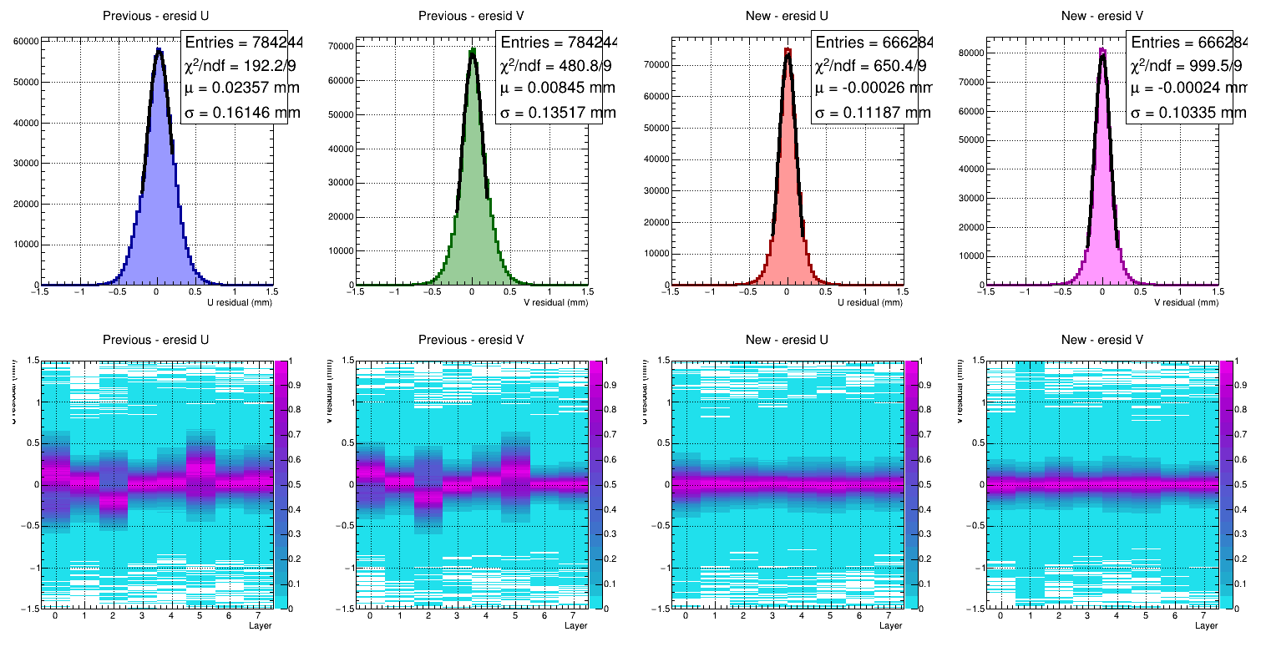
Internal GEM Alignment – Kin3 FT
Internal alignment of the FT for Kin3 before and after, performed using field-on optics data. We can observe residual shifts due to the effects of the SBS fringe field on the previous alignment.

Slide 42
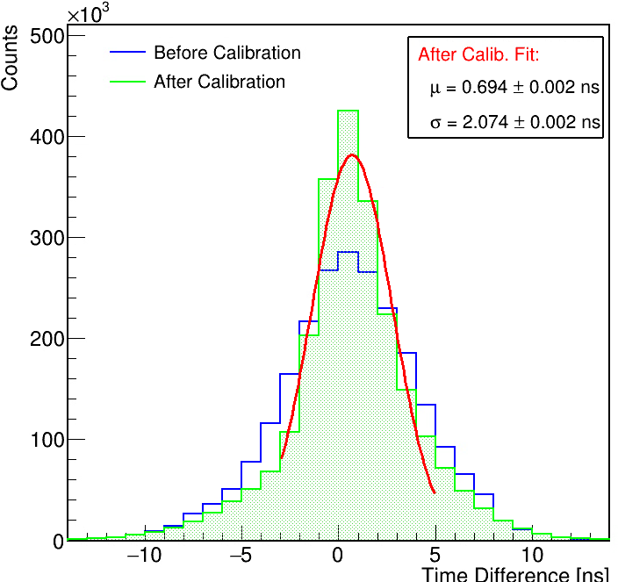
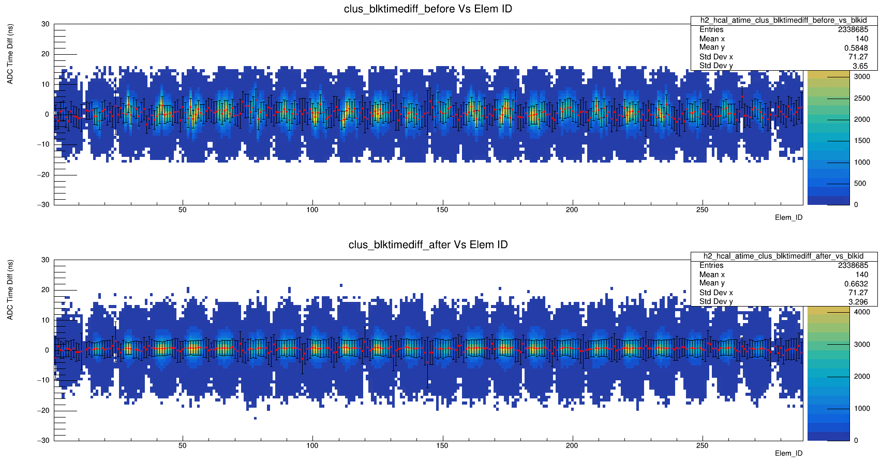
HCal Cluster Timing Difference
HCal cluster timing difference vs block ID:
Broader timing response before calibration
More zero-centered timing response and improved alignment
Before
After
Post calibration resolution improved to ~2.1 ns.
Further improvements are anticipated as calibration progresses.
HCal Internal Timing Alignment for SBS GEp V Kin. 3

