Slide 1


A Semantic Retrieval Framework for the CEBAF Logbook
Chris Tennant
February 6, 2026
Notes:
Tip: Keep titles under 60 characters for readability
To change the photo: Right-click on photo and select change photo

Slide 2
Project Description
Jefferson Lab's CEBAF electronic logbook (ELOG) contains over 165,000 entries annually and serves as a critical knowledge repository for accelerator operations. However, the system currently suffers from limited accessibility due to its reliance on exact-match keyword search. The terse, acronym-laden, and often inconsistent terminology used in entries creates significant barriers for knowledge discovery. This proposal aims to transform a subset of CEBAF logs into an intelligent, semantically aware knowledge system through the development of a hybrid semantic retrieval framework. The proposed solution leverages locally deployed embedding models and a dual-index architecture to support both semantic and keyword-based retrieval with high efficiency and precision. The two-year project is structured around three specific aims: (1) converting and embedding a selected subset of logbook entries into a vector database, (2) developing a hybrid retrieval engine combining semantic and keyword search, and (3) evaluating usability and operational impact through control room deployments and user studies. The result will be a high-performance proof-of-concept search platform, demonstrated on a subset of entries, that improves knowledge transfer, reduces troubleshooting time, and preserves institutional expertise.
Notes:
Guidelines: 6-8 bullets per slide; Use sentence fragments for bullets

Slide 3
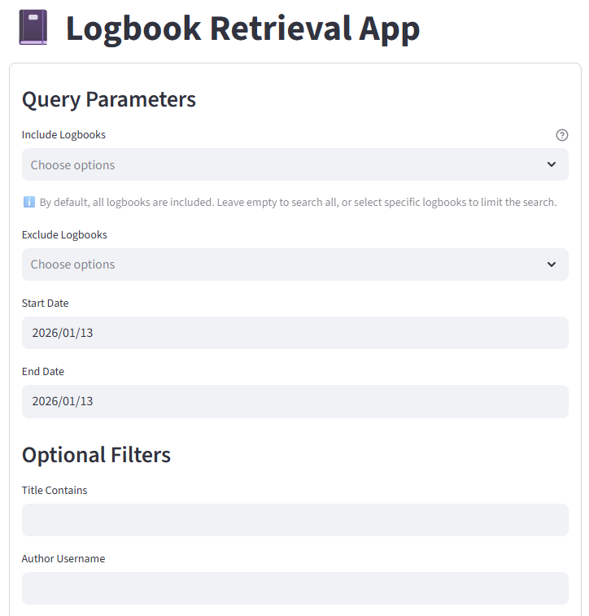
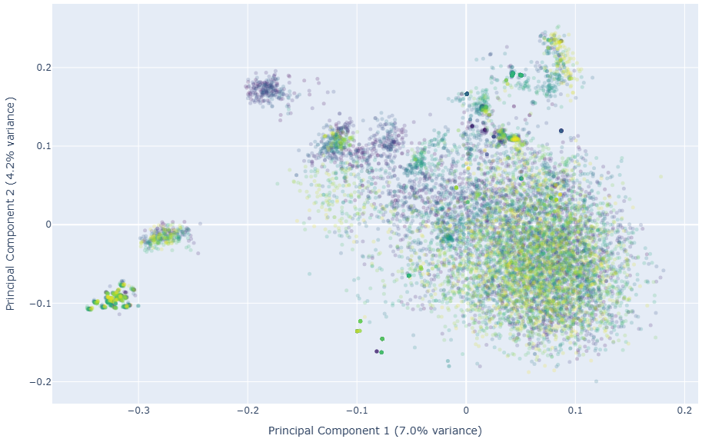
Progress Report
Created web app to download CEBAF log entries and convert to plain text
Created web apps to curate a controlled vocabulary of CEBAF acronyms and shorthand
  engaged with Operation group for their help
  v1.0 of the controlled vocabulary generated (188 acronyms, 90 shorthand)
A framework was created to evaluate embedding models and tested on a subset of the 2025 logbook data
  initial metrics show that e5_base model works best
Q2 Objectives
Create test retrieval benchmarks
Collect performance metrics from Operators
PCA plot showing e5_base embeddings of a random sampling of 11,647 logbook entries from 2025
Notes:
Guidelines: 6-8 bullets per slide; Use sentence fragments for bullets

Slide 4
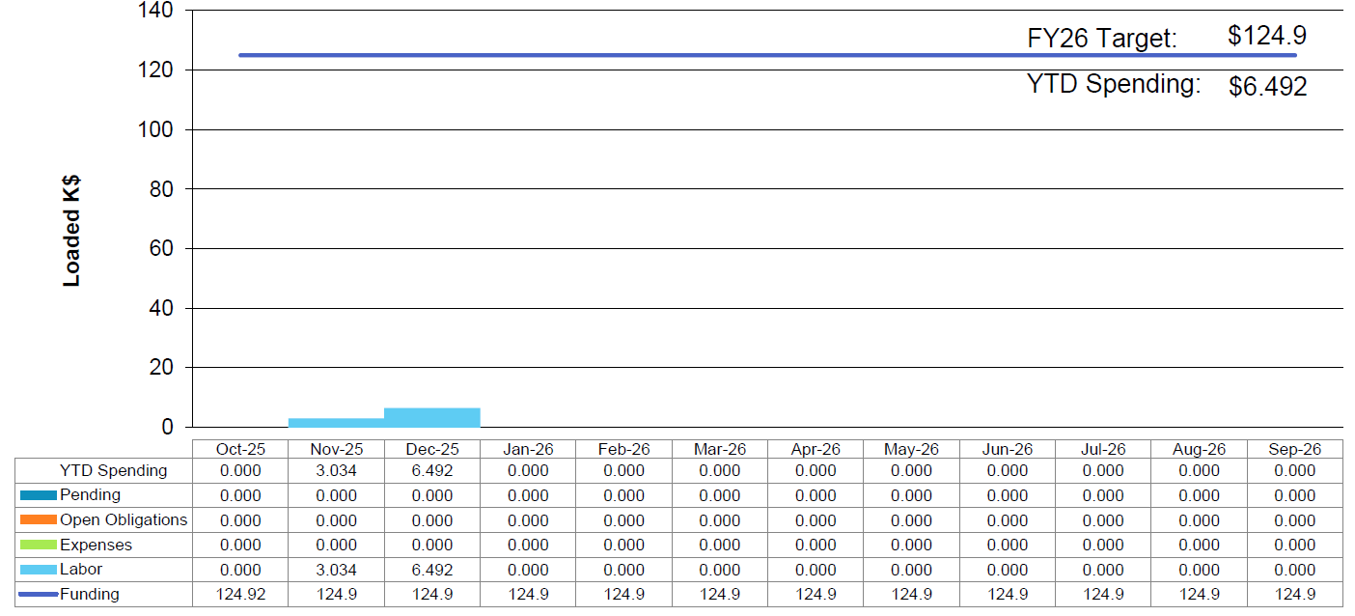
Financial Report
through January 11, 2026
spending expected to ramp up in CY26
$10.5
Notes:
Guidelines: 6-8 bullets per slide; Use sentence fragments for bullets

