Slide 1


A Semantic Retrieval Framework for the CEBAF Logbook
Chris Tennant
January 21, 2026
Notes:
Tip: Keep titles under 60 characters for readability
To change the photo: Right-click on photo and select change photo

Slide 2
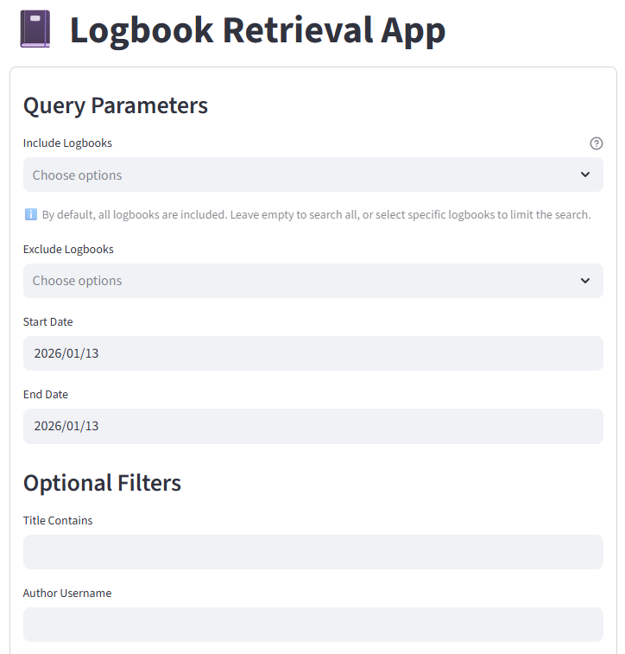
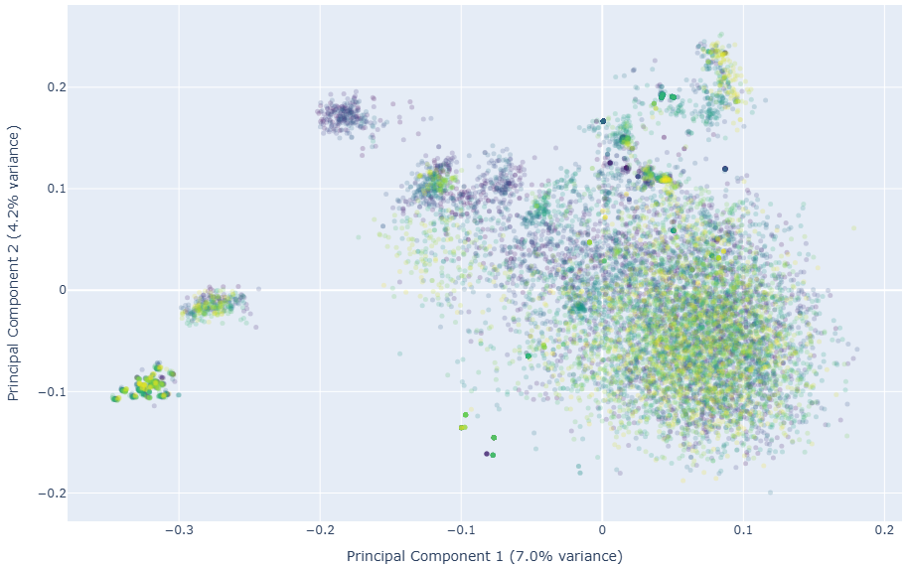
Progress Report
Created web app to download CEBAF log entries and convert to plain text
Created web apps to curate a controlled vocabulary of CEBAF acronyms and shorthand
  engaged with Operation group for their help
  v1.0 of the controlled vocabulary generated (188 acronyms, 90 shorthand)
A framework was created to evaluate embedding models and tested on a subset of the 2025 logbook data
  initial metrics show that e5_base model works best
PCA plot showing e5_base embeddings of a random sampling of 11,647 logbook entries from 2025
Notes:
Guidelines: 6-8 bullets per slide; Use sentence fragments for bullets

Slide 3
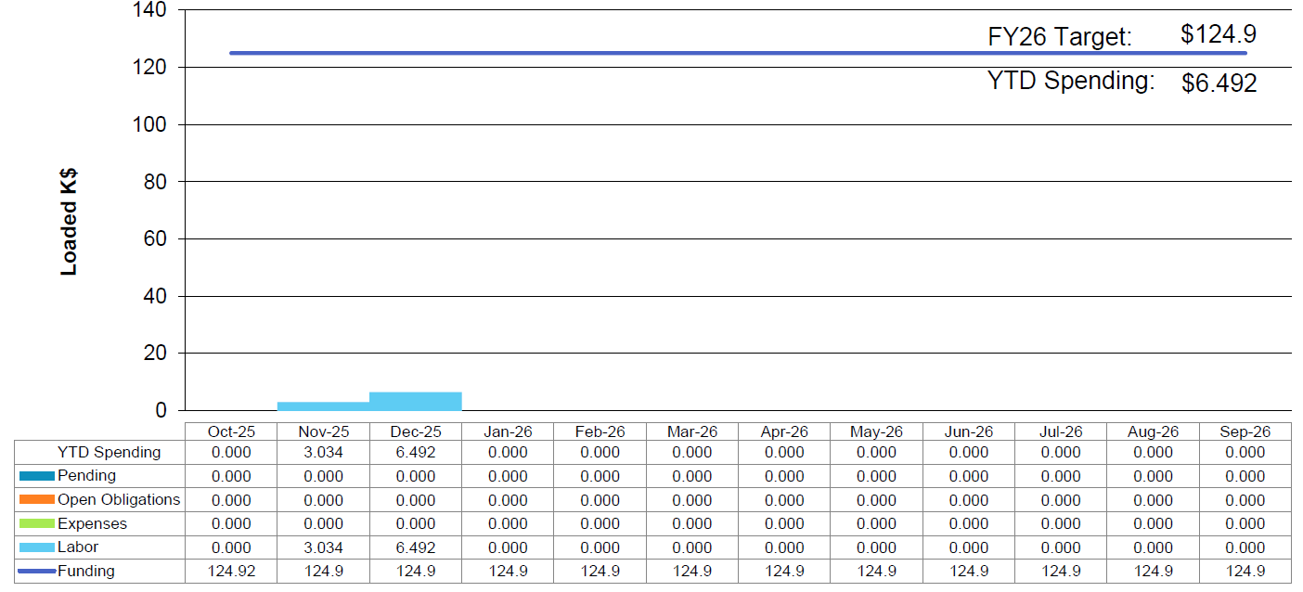
Financial Report
through January 11, 2026
spending expected to ramp up in CY26
$10.5
Notes:
Guidelines: 6-8 bullets per slide; Use sentence fragments for bullets

