Slide 1

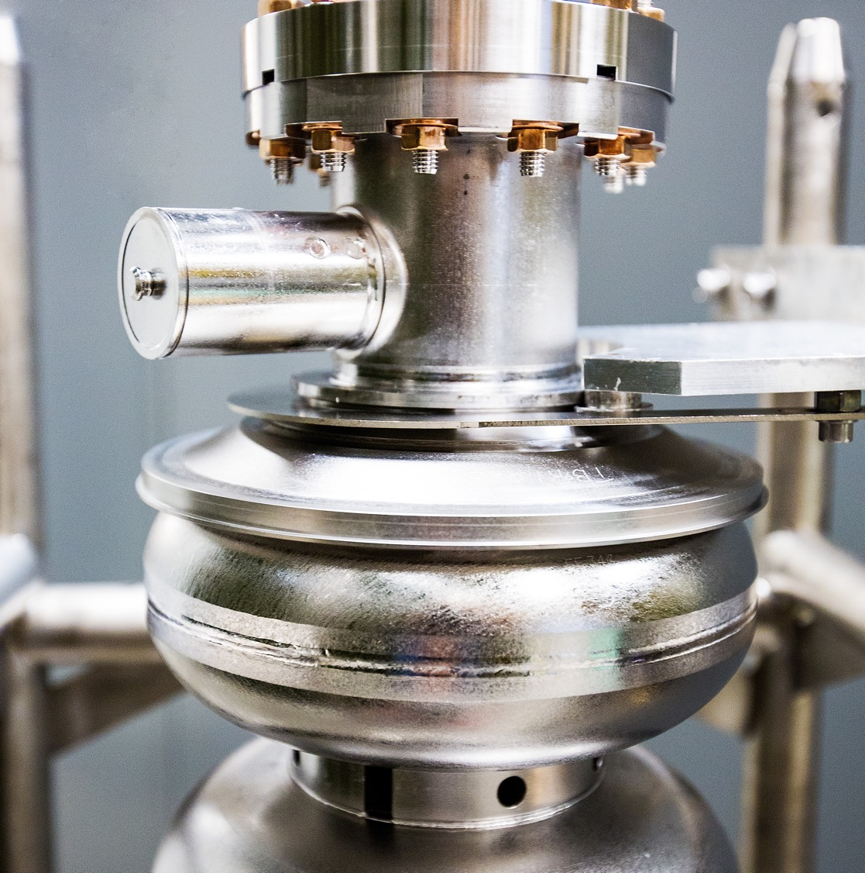
LDRD project:
CEBAF Reliability Enhancement with Smart Fast Tuners for Microphonics Compensation
Progress Report_Q1
Sergey Kuzikov
SRF S&T
Notes:
Tip: Keep titles under 60 characters for readability
To change the photo: Right-click on photo and select change photo

Slide 2
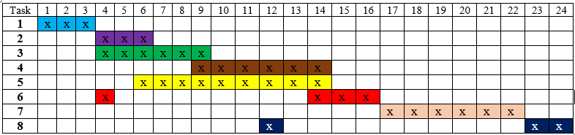
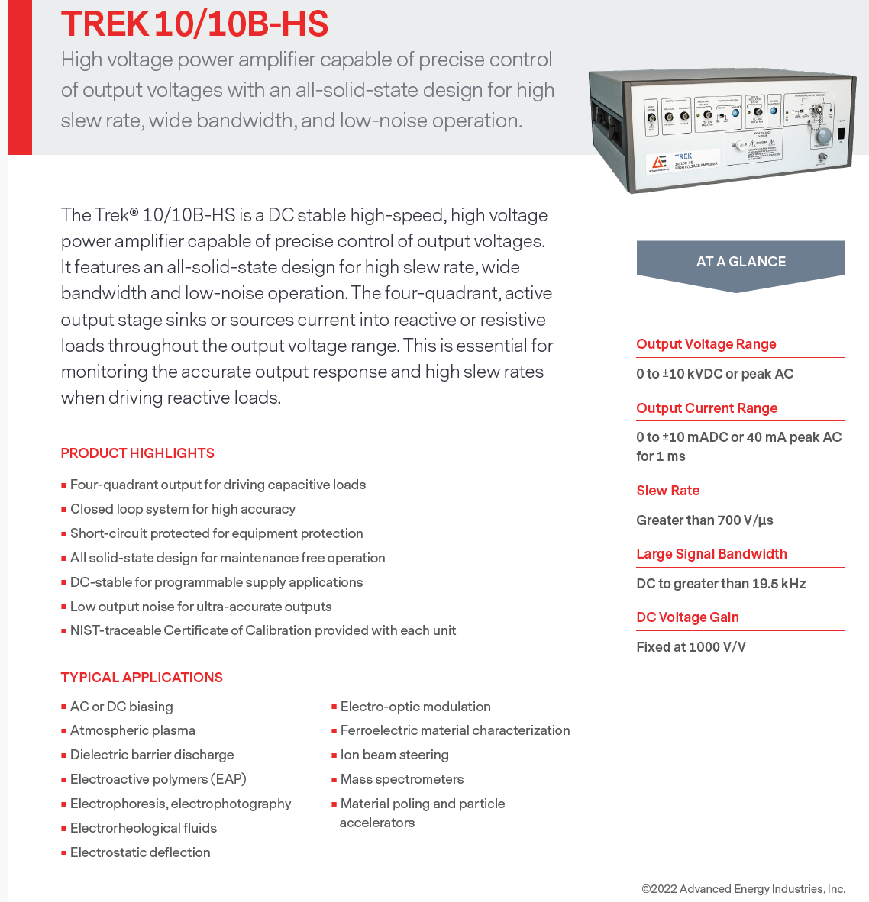
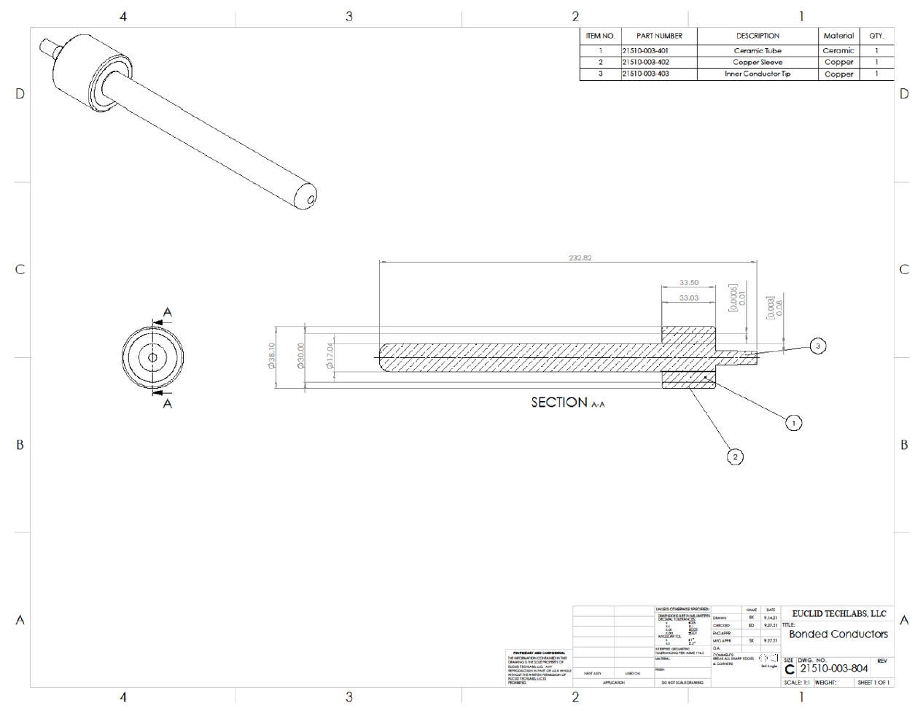
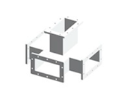
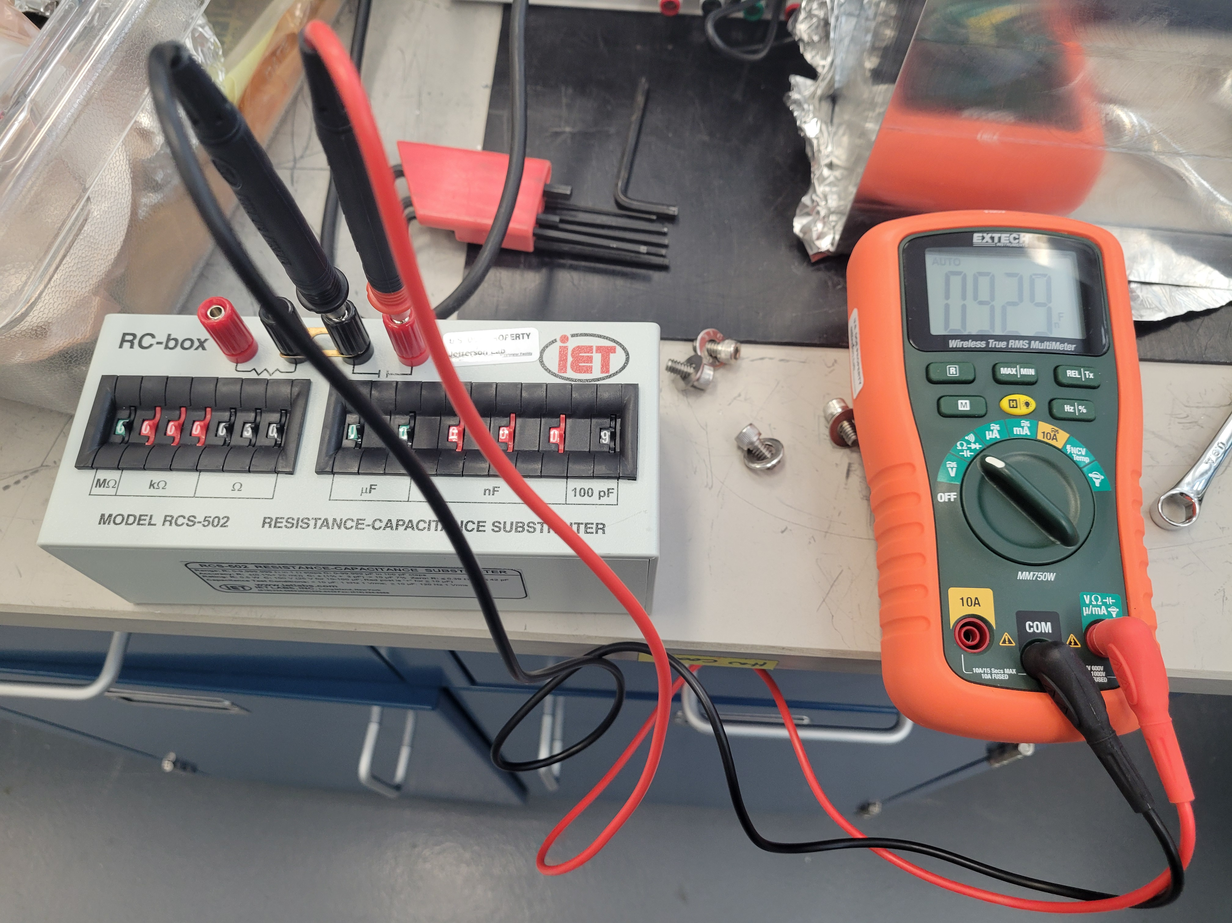
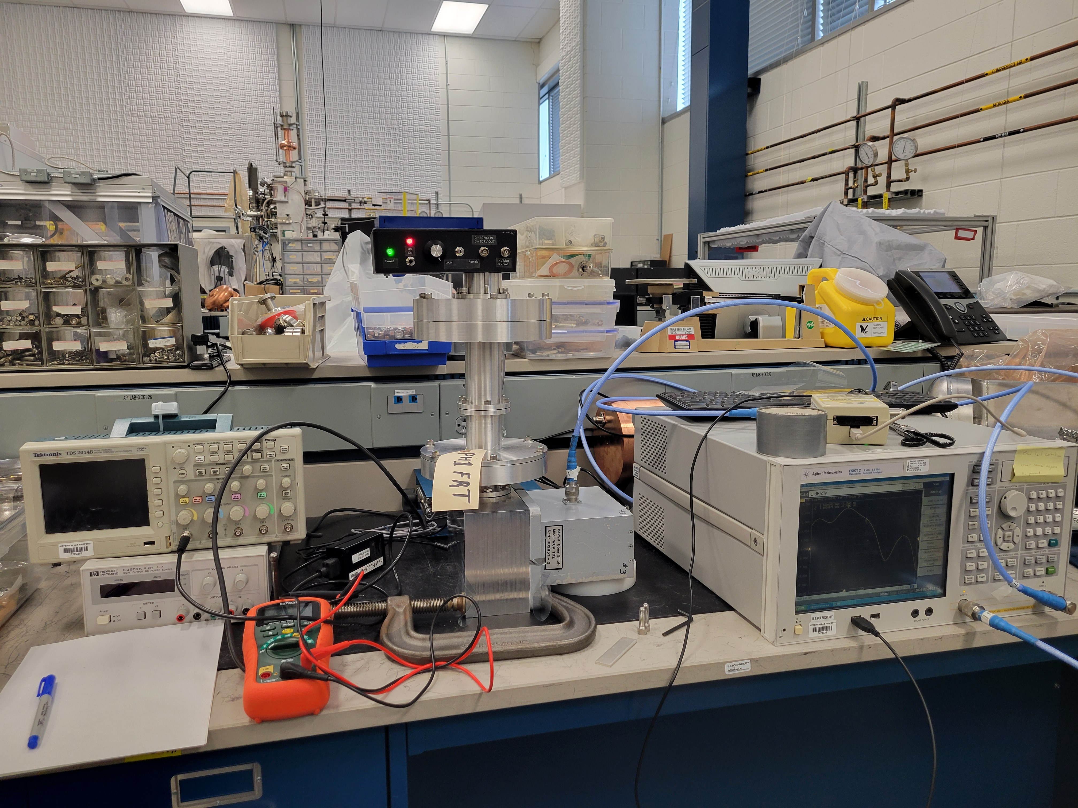
1. Progress Report
Work completed:
High voltage test. Discharge threshold measured.
Selected fast high-voltage amplifier. Purchase order submitted.
Ordered Magic Tee and ferroelectric assembly to be used at future experiments.
Low-power RF test of the FRT prototype. Tuning range and sensitivity of the ferroelectric sample to bias voltage measured.
Started design and optimization of the FRT to be used at high power level.
High-voltage test of the prototype
Low-power test of the prototype including:
a) S11 phase measurement;
b) S-parameters measurement of the tuner attached to magic Tee.
3. To order FE samples for the prototype from Euclid, LLC;
5. Design and optimization of the FRT to be used at high power level;
4. Design of a fast bias voltage supply (10 kV, <100 ms)
Notes:
Guidelines: 6-8 bullets per slide; Use sentence fragments for bullets
To change the photo: Right-click on photo and select change photo

Slide 3
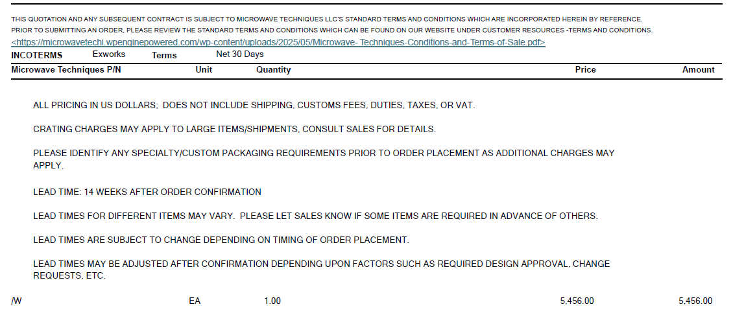
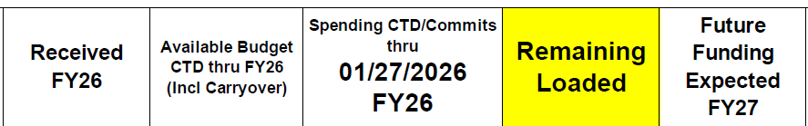
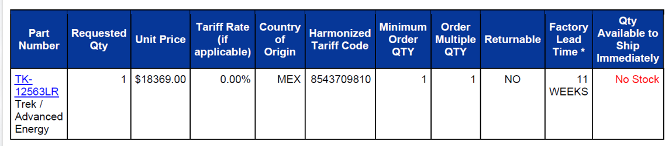
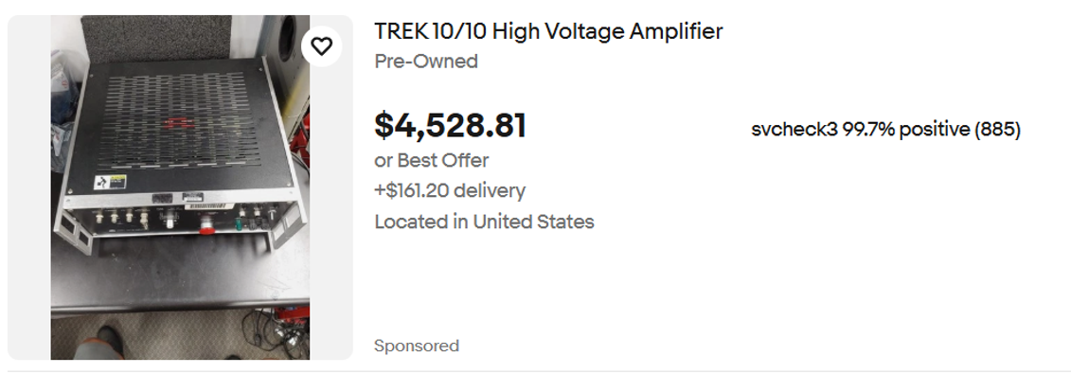
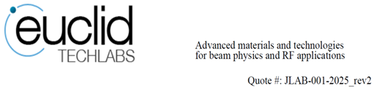
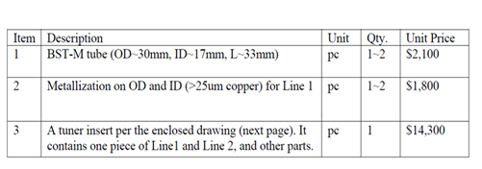
2. Financial Report
Notes:
Equipment:
Ferroelectric sample assembly – $14,300 (need one more)
Magic Tee - $5,456
TREK amplifier - $18,369.
Notes:
Guidelines: 6-8 bullets per slide; Use sentence fragments for bullets
To change the photo: Right-click on photo and select change photo

