Slide 1
Streaming Readout PET
LDRD Q1 Report – January 21, 2026
Cameron Clarke, BRIC Staff Scientist
Radiation Detector & Imaging (RD&I) Group
Standard Phototube
Standard Phototube
Standard Phototube
Standard Phototube
Position sensitive phototube
Position sensitive phototube
Position sensitive phototube
Position sensitive phototube
SiPM array
SiPM array
SiPM array
SiPM array

Slide 2
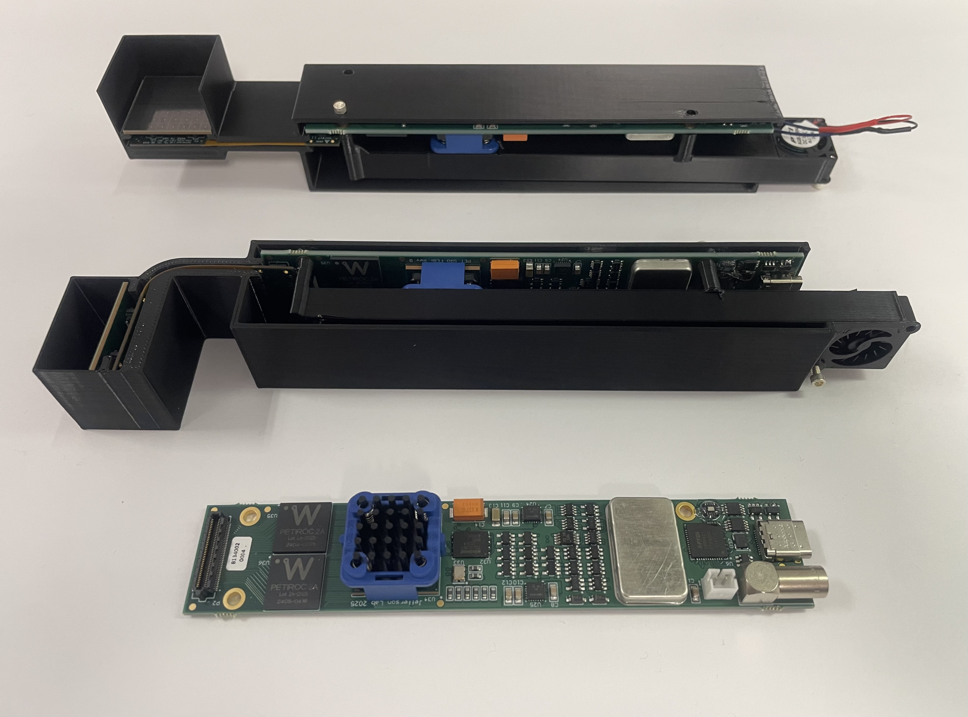
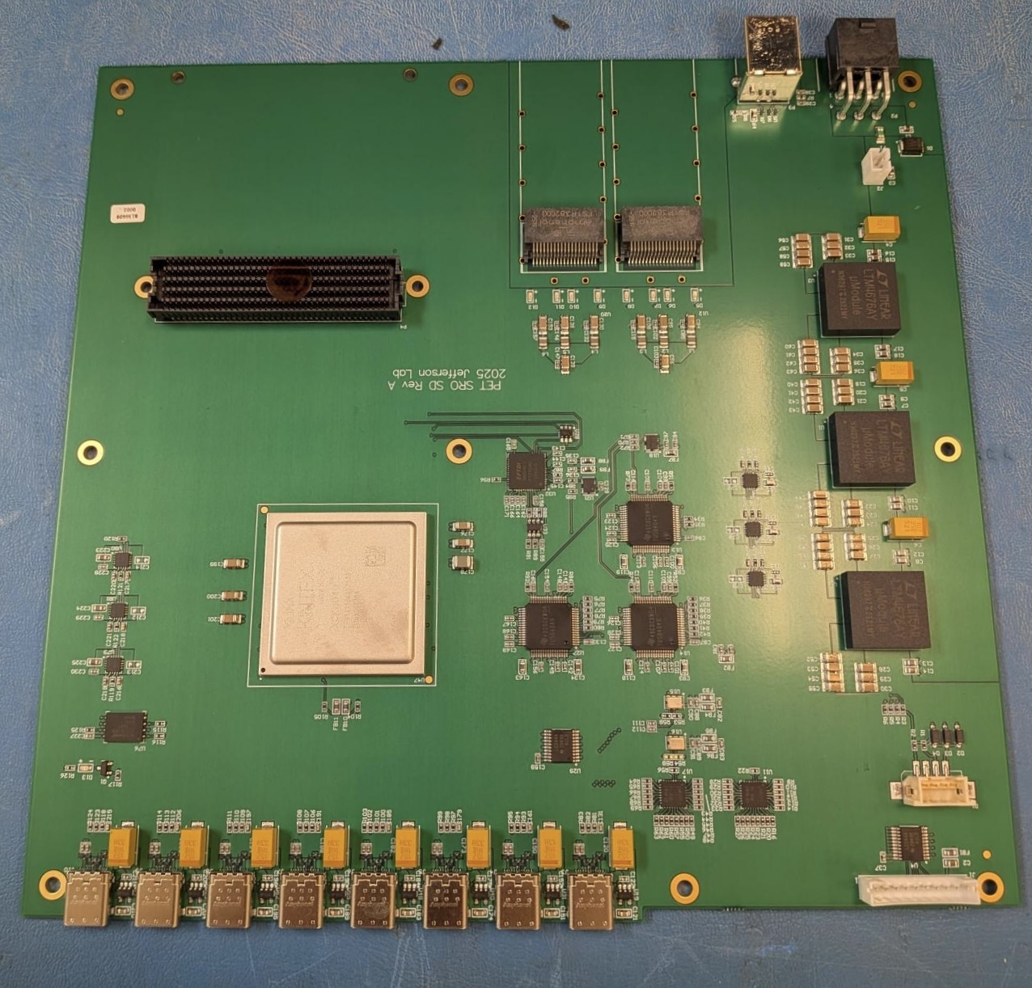
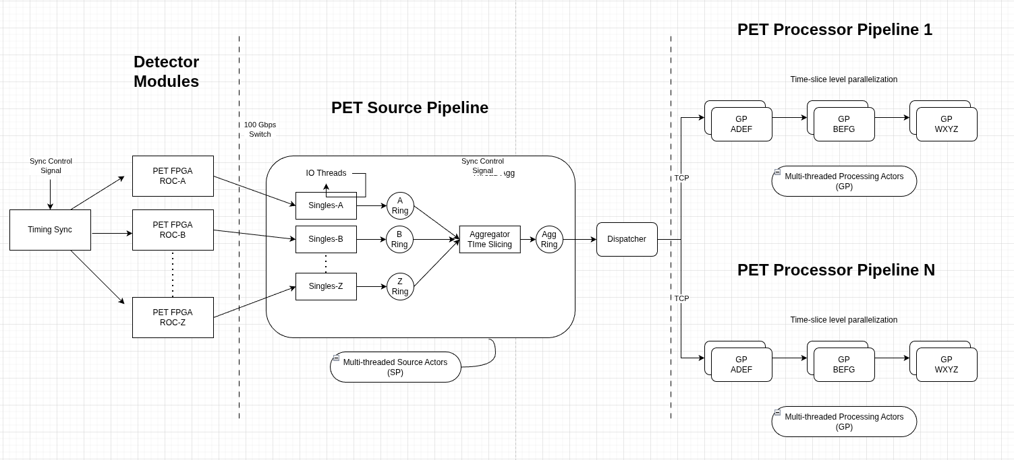
Q1 Accomplished Goals
A) Detector prototype development
Front end boards in hand and scalers tested
3D printed housings, cooling, and assembly
Synch distribution board received, in progress
B) SRO data processing system development
Successfully factorized analysis into ERSAP
Multi-node horizontal parallelization added
Delayed synch distribution board procurement has delayed Q1 SRO system integration step
C) Broader scope project work
2nd provisional patent filed, IEEE RT Abstract
Contract P.R. placed with UMAB PET facility
Trained to use NERSC Spin and Perlmutter
ISP Challenge: EPSCI's Mike Goodrich Solution: NERSC support and re-allocate FTE as AmSC settles
FY 2025 Starting Points
Front-end boards in-hand and testing underway
FY 26 Q1 Implementation Progress
SD Board in-hand and firmware on-track
Updated streaming architecture for multi-node horizontal scaling
2

Slide 3
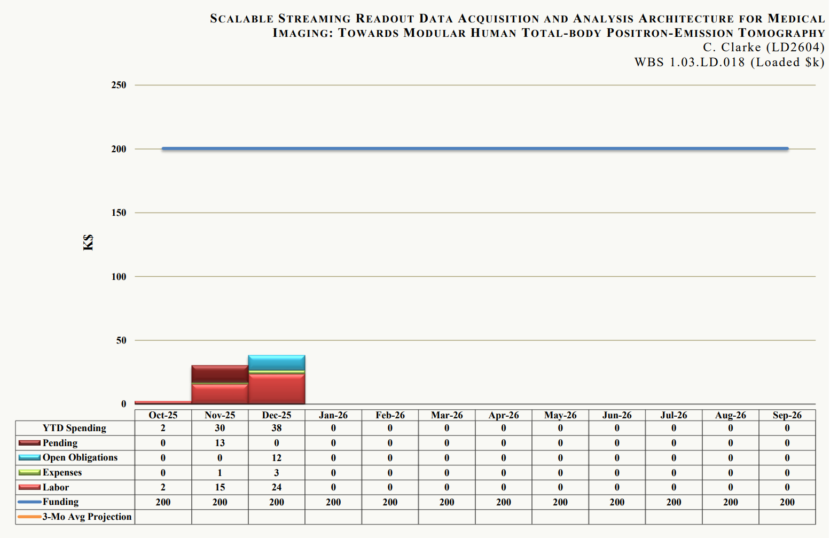
Spending
Spending is generally on target – electronics finalized, software on track, UMAB contract P.R. placed
Labor: Spent ~$24k on labor
Equipment: Spent ~$12k on signal/synchronization distribution board procurement delayed from last year
Travel: Cancelled IEEE meeting attendance, retracted 2 papers, due to government shutdown chaos
3

Slide 4
Backups
4

Slide 5
Deliverables
Deliverables – milestones and timeline:
Three primary aims
Implement ERSAP to existing SRO PET detectors, DAQ, and analysis system in FY 25
Design and build improved version of modular PETIROC ASIC PET detectors in FY 25
Deploy detector array, perform imaging and parallelized scaling tests with distributed computing in FY 26
Year 1 |  |  | Year 2
1) | Implement ERSAP in FY 25: (✔) Implement FPGA based PETIROC signal digitization (✔) Factorize analysis components into ERSAP microservices (✔) Reproduce old system performance with ERSAP system (✔) Vertical multi-threaded, horizontal multi-node scaling | FY 2025: Month 3 Month 6 Month 9 Month 12 | 3) | Deploy detector array, imaging and parallelized scaling tests in FY 26: (✔) Procure and test new detector front-ends (O ) Integrate modular 8-detector array with new SRO system Verify detector and imaging performance for new system Deploy the system and perform phantom imaging tests at UMAB NERSC streaming with JIRIAF control plane Finalize reports on local and farm streaming scalability tests | FY 2026: Month 3 Month 3 Month 6 Month 6 Month 9 Month 12
2) | Design and build modular PETIROC ASIC PET detectors in FY 25: (✔) Optimize FPGA multi-detector readout firmware (✔) Optimize detector power supply and readout cabling (✔) Design and order new PETIROC modular detector PCBs (✔) Get electronics parts, build, and test 8 new detectors | FY 2025: Month 3 Month 3 Month 6 Month 12
5

Slide 6
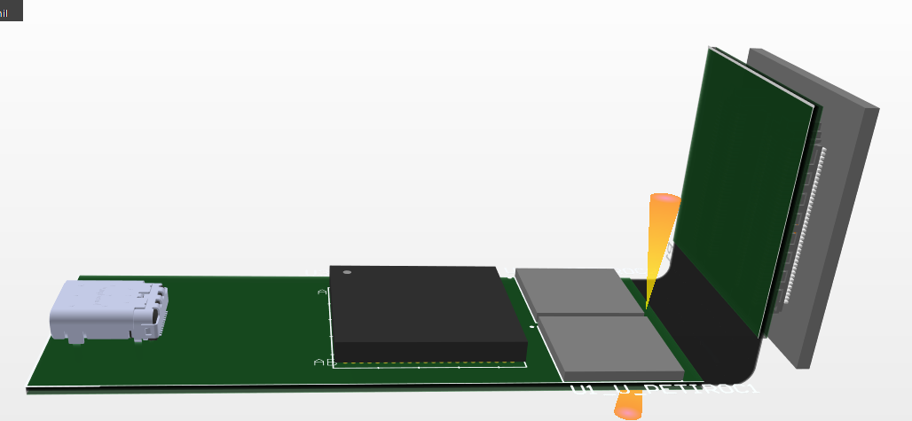
Detector Prototype Development
Designed concept for v2.0 front end layout
Modular detector design
Aiming for 4-side buttable
SiPM and scintillator separated
Flex cable permits multiple orientations
& permits thermal and optical isolation
USB-C connector simplifies connections
Communication board (not shown) synchronizes and powers all detectors
~25.8mm
USB-C
(power & communication)
~25.8mm
>75mm
<125mm
Artix Ultrascale+
AU15P FPGA
2x PETIROC ASICs
(64 channels)
6

Slide 7
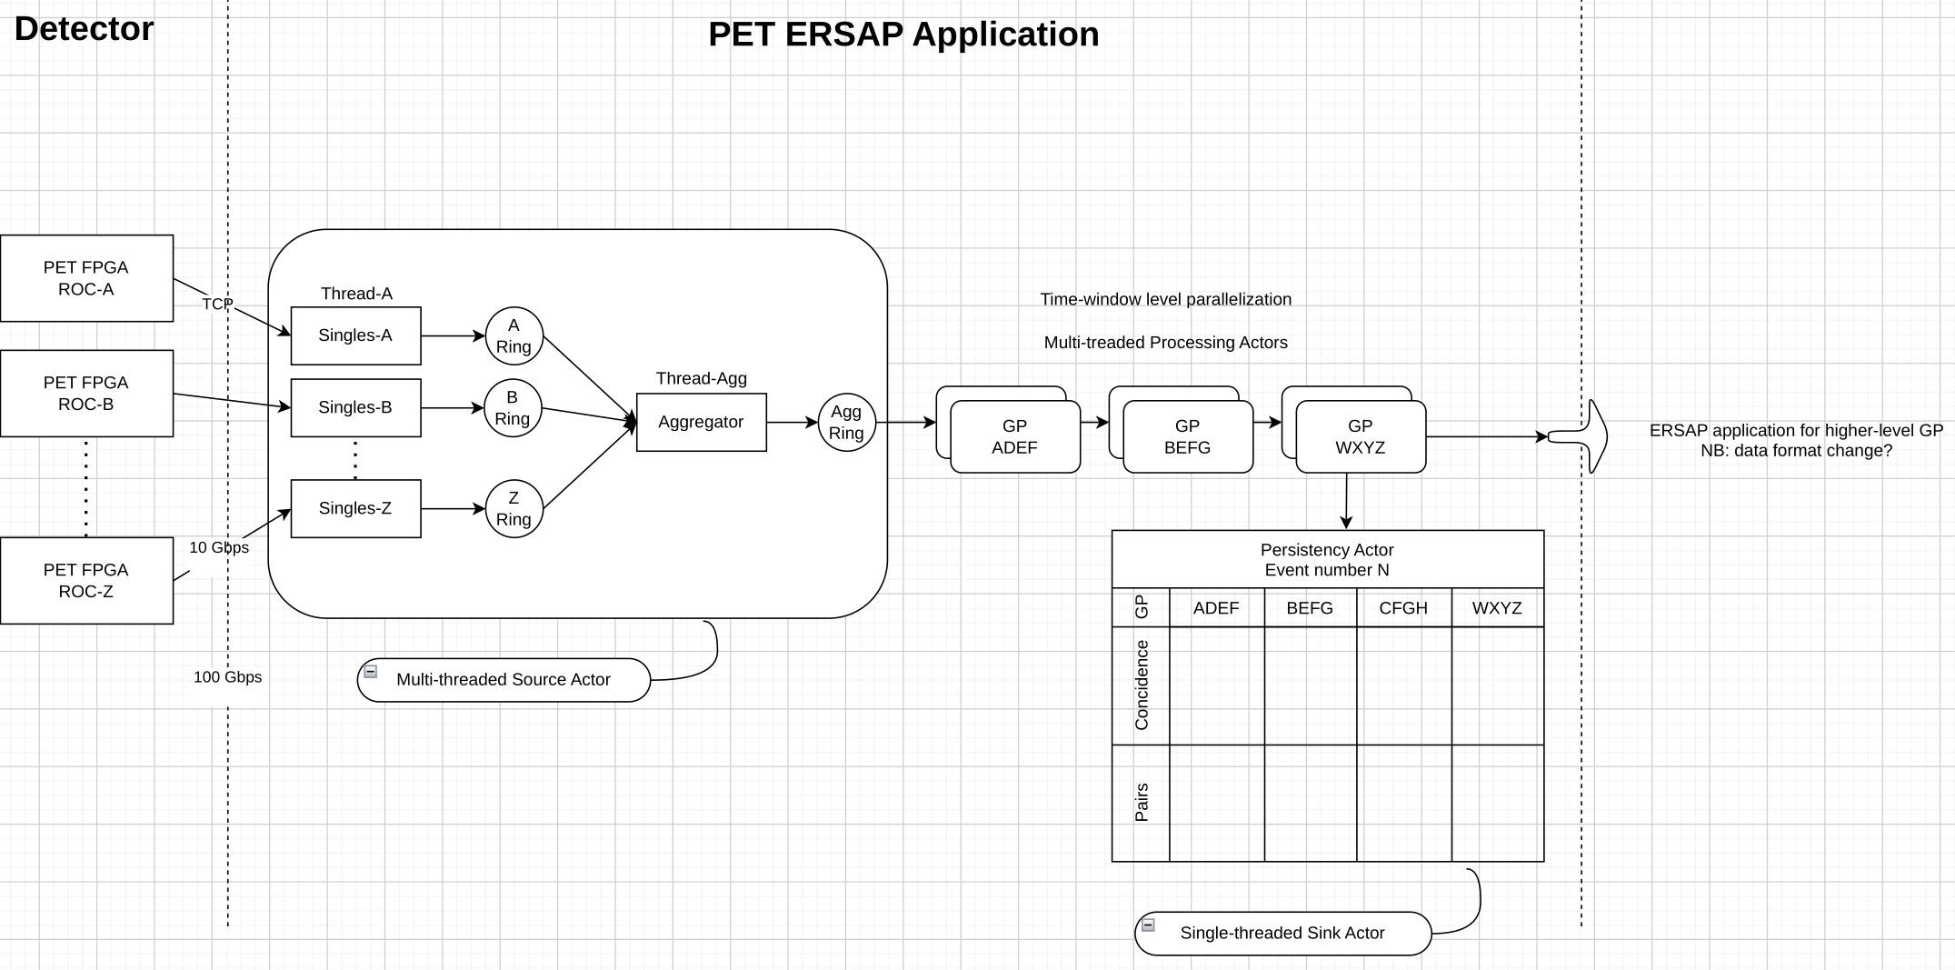
SRO Platform Development
Explored SRO analysis architecture options
Event-based processing from FPGA
Time-windowing at singles or geometry processor
Potential for time- windowing in the FPGA
Updated diagram for one potential architecture
All time-interleaving in a single actor option
Finalized ERSAP-based software development
Completed GitLab CD/CI implementation
Finished converting KMax singles and geometry processors into ERSAP actors
7

Slide 8
Summary
We are on track to meeting deliverable goals
SRO platform development is proven, under iterative refinement
Detector front-end design work is underway, finishing up the details now
Sub-contracted imaging studies are on track for FY26
Talks at conferences are being planed
8

