Slide 1
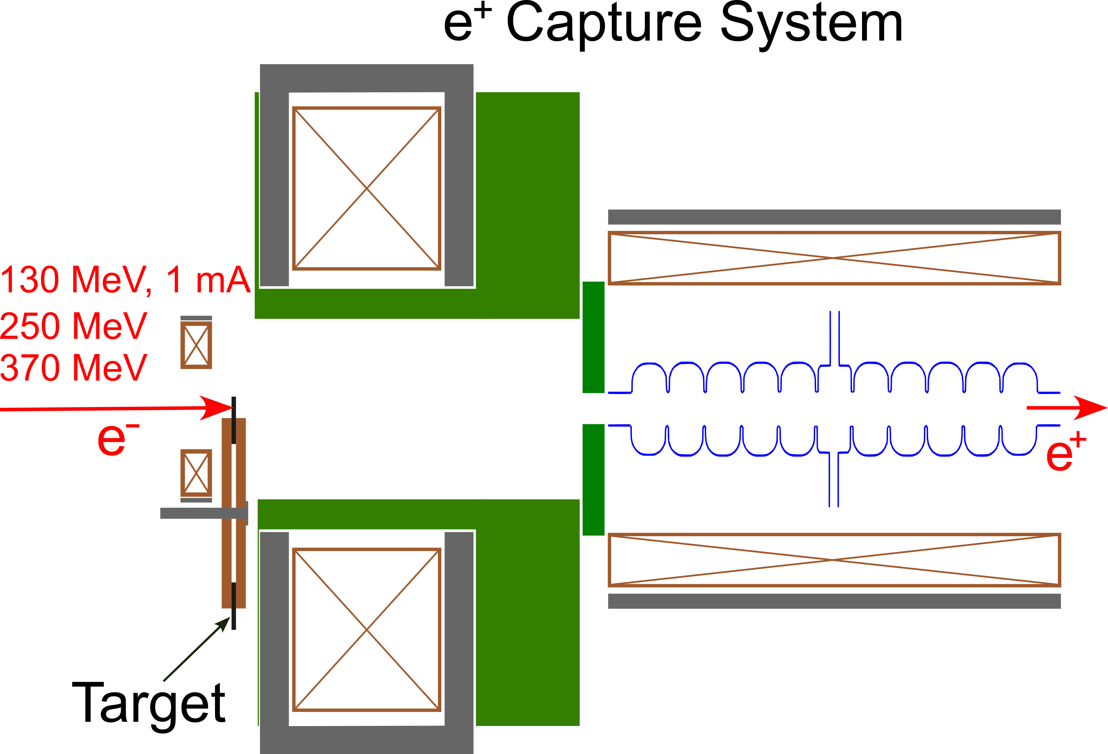
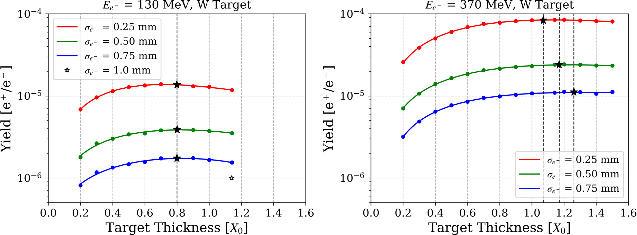
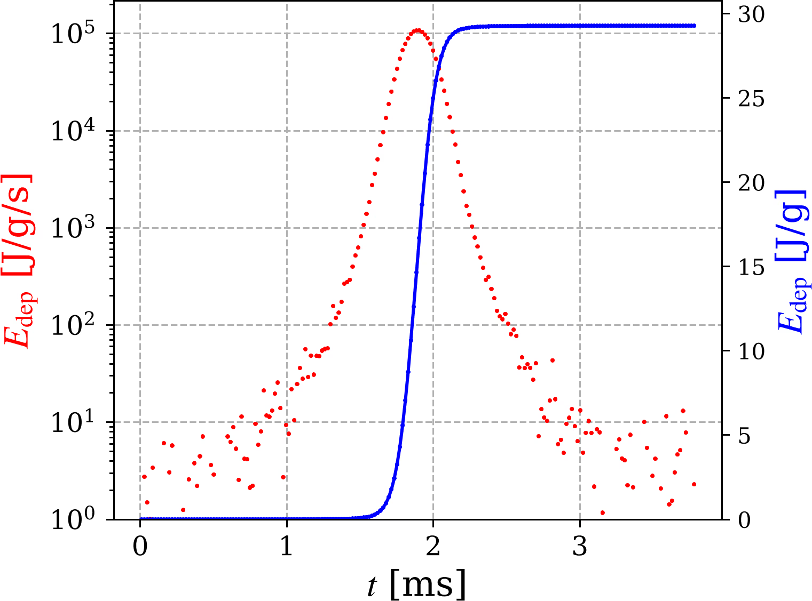
LD2602 Q1: Strategic Staff Hire - A. Ushakov as Positron Injector Model Integrator (Year 2)
1 mA @ 130 MeV e-, 0.8 X₀ W Target
σ_{e-} = 0.5 mm
D_{tgt} = 45 cm
f_{rot} = 4 Hz
FY26 Q1 Results
Calculated yield of positrons with norm. emittance of 100 mm·m rad, estimated radiation damage of target, determined optimal target thickness for the highest e⁺ yield and e⁻ beam energies of 130/250/370 MeV, 0.25/0.5/0.75 mm transverse rms sizes of e⁻ beam for 100%W, 85%W+15%Cu and 100%Au targets. Simulation results were presented partly at LCWS, Valencia, Spain, Oct 22, 2025.
Distributions of heat in W, W-alloy and gold targets generated by
e⁻ beams with three energies and three transverse sizes (listed above) were provided to Silviu Covrig for the thermal CFD analysis.
Analyzed/reviewed published results on essential material properties at elevated temperatures for three candidate materials. Estimated peak energy deposition densities (PEDD) required in the analytic model of thermal stress and compared with PEDD and peak mechanical stress of SLAC (SLC) 75%W+25%Re positron target.
Shared information about e⁺ injector beam line with mechanical modeler (Joe Gubeli) helping create a 3D model of the e⁺ injector in the LERF.
In collaboration with SLAC colleagues I contributed to writing US-Japan proposal with a focus on applying AI/ML for optimizing targets.
Q2 Objectives
Complete optimization of e⁻ beam parameters (energy, beam size, angles and emittance) and target parameters (material and thickness) to define max. currents and min. allowed beam sizes.
Benchmark results of simplified analytic approach with CFD thermal analysis performed by Silviu Covrig.
Update e⁺ injector design using optimal e⁻ beam and target.
Publish 2 tech notes: 1) temperature dependent properties of target materials; 2) PEDD and peak thermal stress in positron targets.

Slide 2
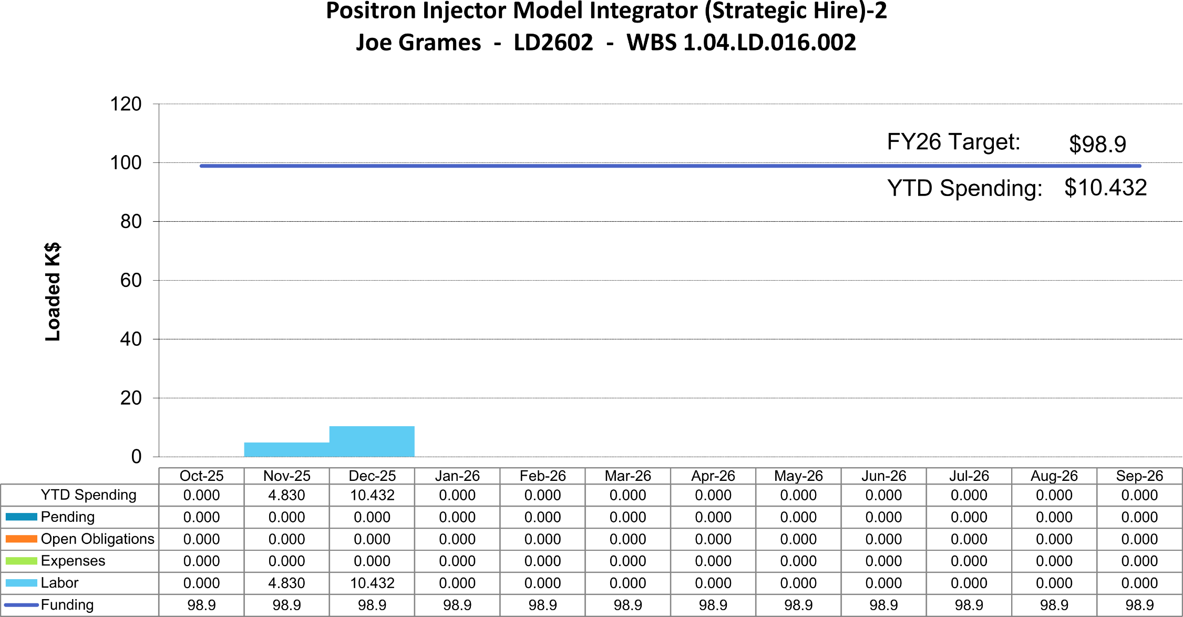
LD2602 FY26 Q1: Strategic Staff Hire - A. Ushakov as Positron Injector Model Integrator
FY26 (Year 2): 50% LD2602 + 50% ARD-Polarized Positrons
Submitted Proposal "US-Japan Collaboration: Applying ML for software optimization of positron beams“, PI: Joe Grames, FY26: 0.25 Person-Months

