Slide 1
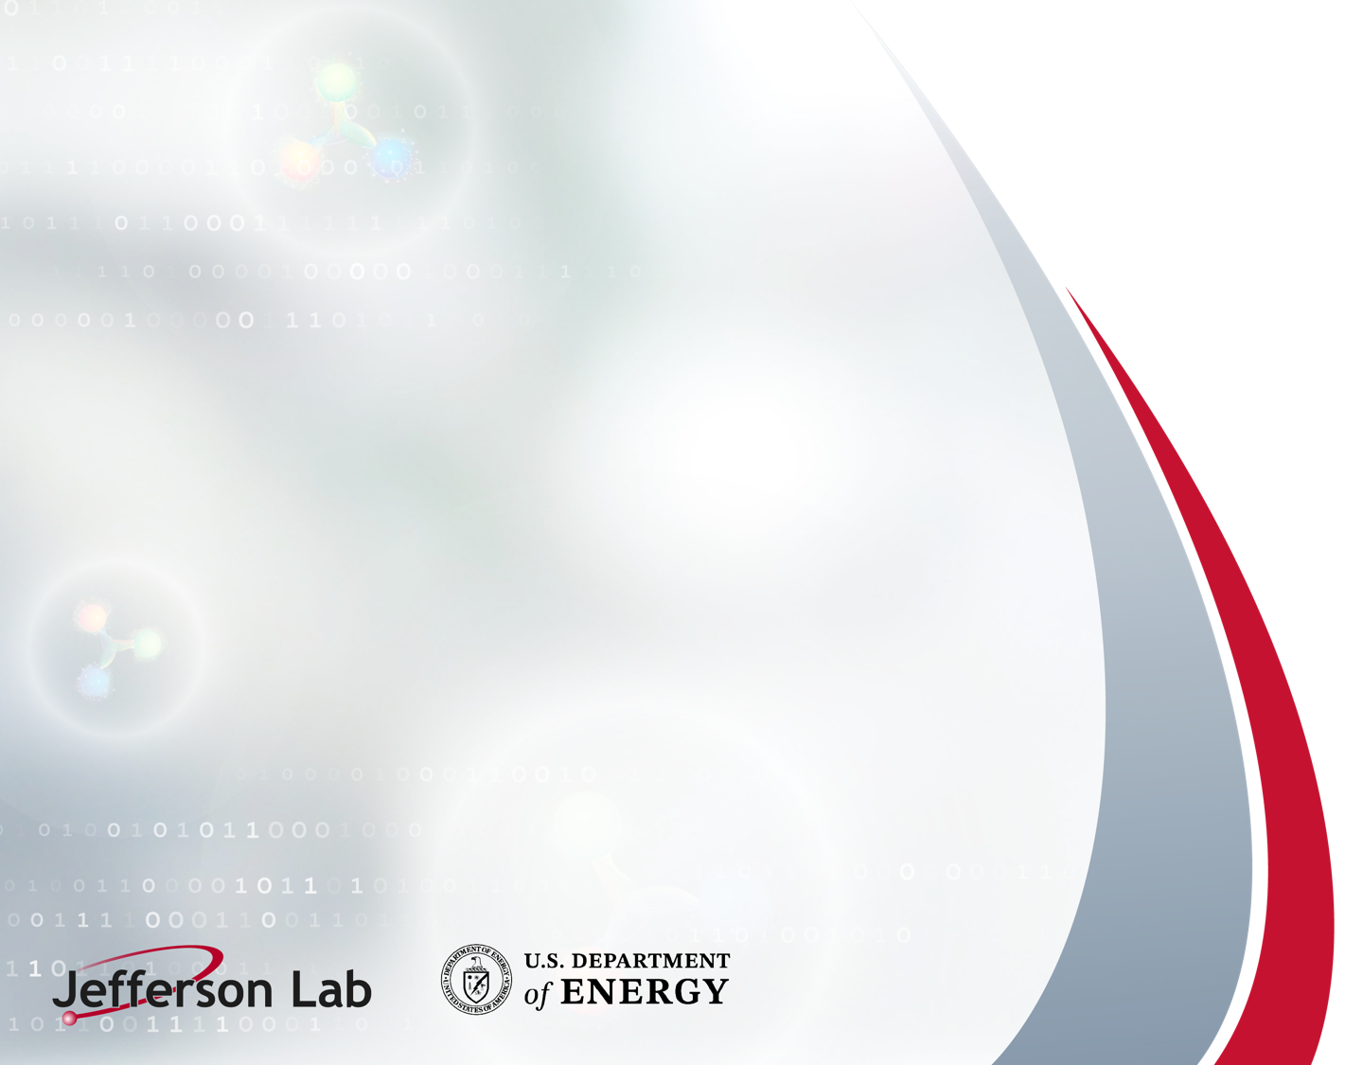

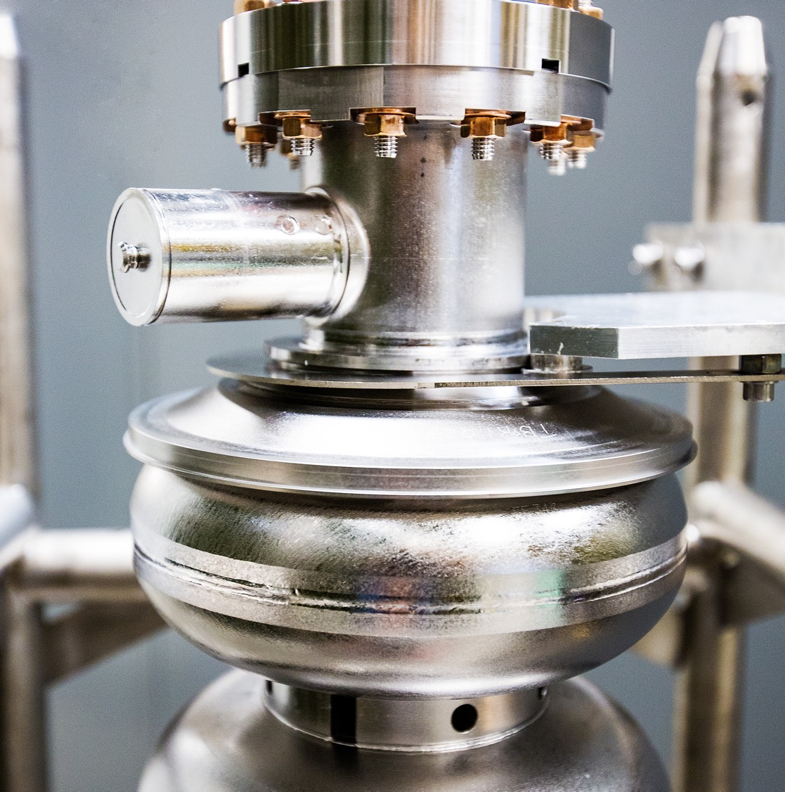
SoLID as a Self-Driving Detector
SoLID Collaboration Meeting
February 19th, 2026
K. Dehmelt (TJNAF)
On behalf of the SoLID Collaboration
Notes:
Tip: Keep titles under 60 characters for readability
To change the photo: Right-click on photo and select change photo

Slide 2
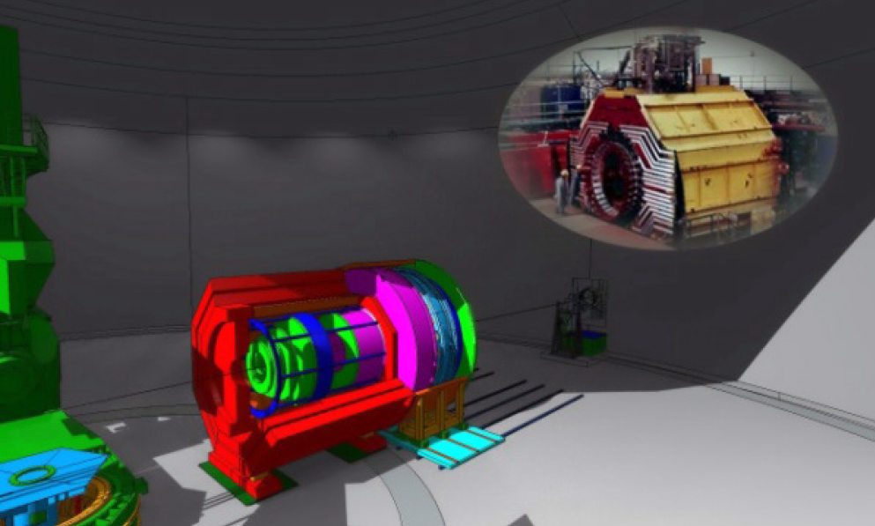
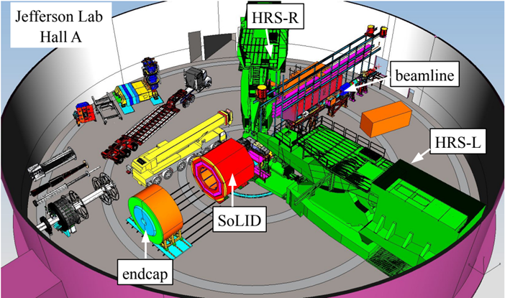
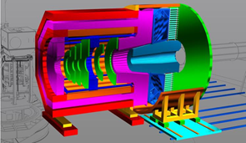
Proposed Apparatus in Hall A – Around CLEO-II Magnet
Notes:
Guidelines: 6-8 bullets per slide; Use sentence fragments for bullets

Slide 3
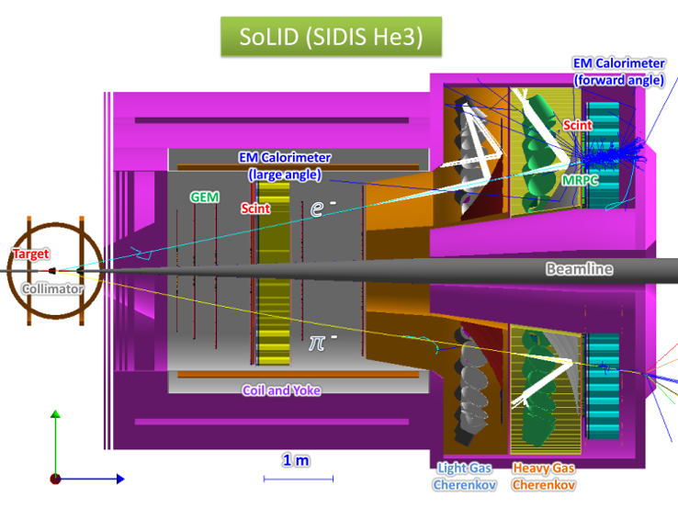
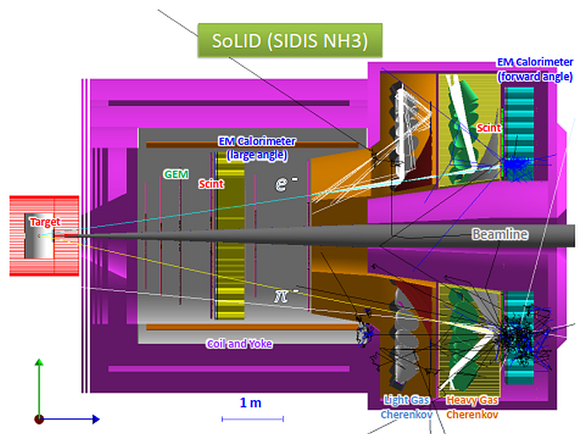
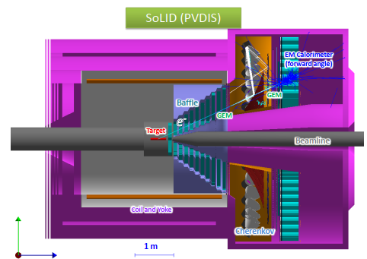
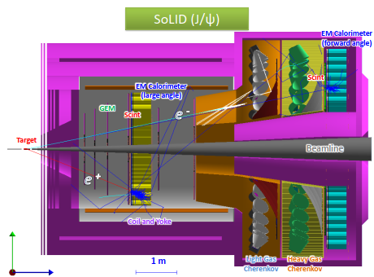
SoLID – The Apparatus
Notes:
Guidelines: 6-8 bullets per slide; Use sentence fragments for bullets

Slide 4
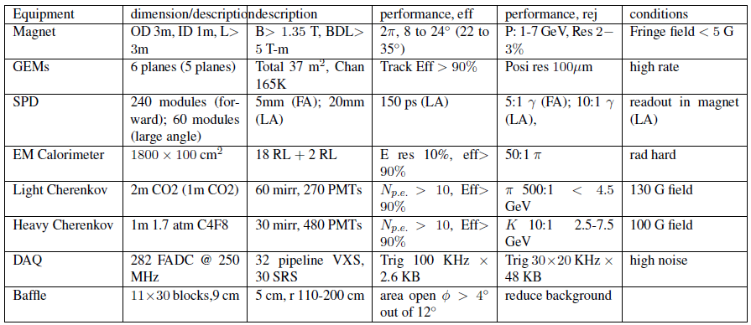
SoLID – The Apparatus
Notes:
Guidelines: 6-8 bullets per slide; Use sentence fragments for bullets

Slide 5
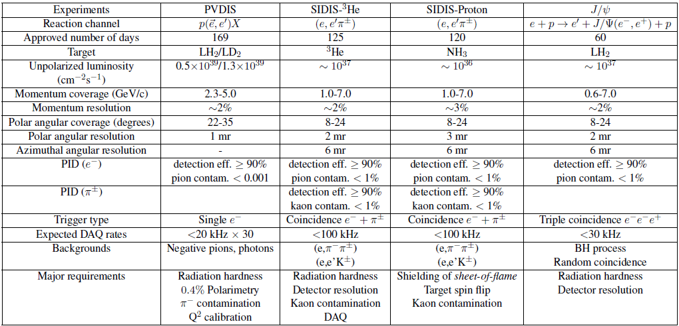
SoLID – The Experiments
Notes:
Guidelines: 6-8 bullets per slide; Use sentence fragments for bullets

Slide 6
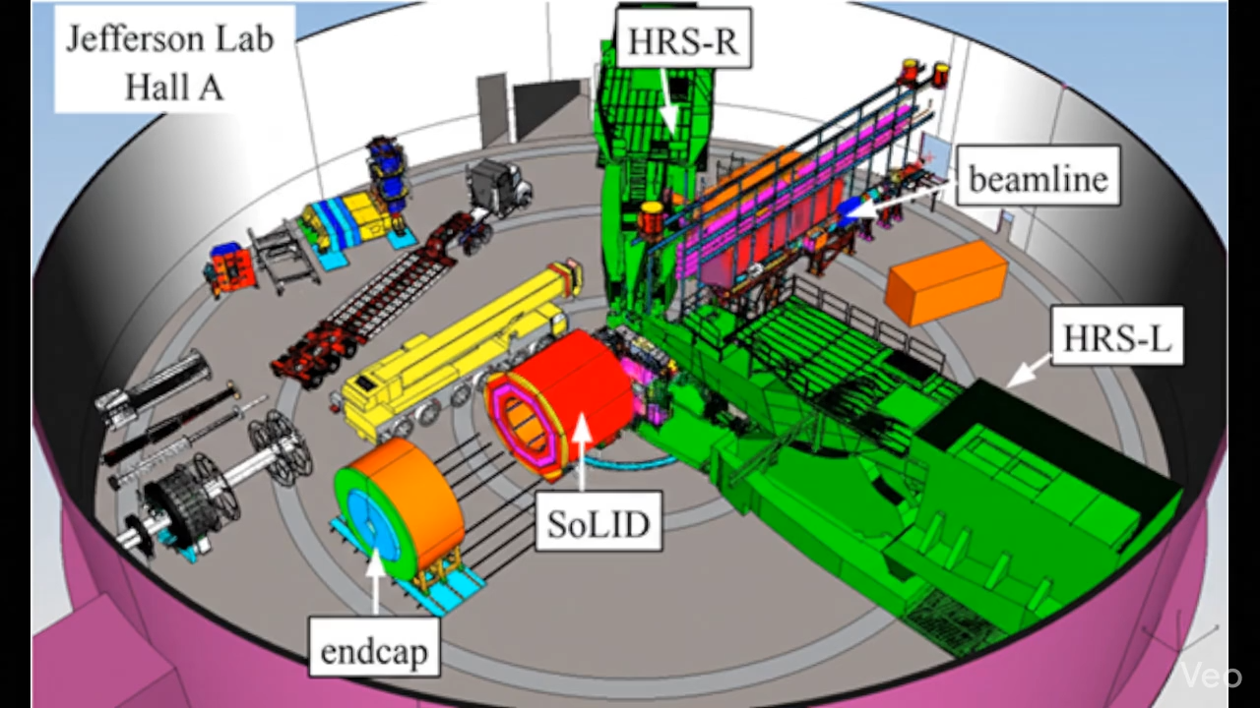
What is a Self-Driving Detector?
What if your particle detector… could drive itself? Introducing the world’s first self-driving detector.
By day, it’s SoLID — a powerful scientific instrument inside Jefferson Lab’s Hall A.
  But after hours? It transforms.
  SoLID and endcap deploy autonomous mobility mode.
  No steering wheel. No driver. Just pure detector intelligence.
  Equipped with advanced navigation, precision alignment, and absolutely zero regard for lab traffic laws.
  Watch as they cruise effortlessly around the hall…
  Avoiding beamlines. Respecting spectrometers. Parallel parking like pros.
  Then — mission complete.
  They return to their original coordinates.
  Reassemble.
  And resume discovering the secrets of the universe.
Because why just detect particles … when you can drive yourself to them?
Self-Driving Detector™. Science. But make it autonomous.
Notes:
Guidelines: 6-8 bullets per slide; Use sentence fragments for bullets

Slide 7
What is a Self-Driving Detector?
Vision: A detector that continuously adapts and optimizes itself
  Closed-loop intelligence: data acquisition, processing, and control form a self-correcting feedback loop
  ML-driven decisions at every scale: from nanosecond trigger logic to multi-day calibration cycles
Seven automation tiers with increasing latency and intelligence
  Tier 1 (μs): FPGA-based trigger primitives
  …
  Tier 7 (days): global model retraining and physics-quality feedback
Inspired by autonomous vehicles - applied to nuclear physics detectors
  Human oversight retained at all critical decision points
  Builds on JLab AI/ML foundation: Hall B/C track reconstruction, waveform ML, GNN-based PID
Notes:
Guidelines: 6-8 bullets per slide; Use sentence fragments for bullets

Slide 8
SoLID Physics Program
Six PAC-approved “A”-rated experiments in Hall A at Jefferson Lab
  3 SIDIS experiments: 3D nucleon structure via TMDs and Collins/Sivers functions
  1 PVDIS experiment: parity-violating DIS probing electroweak physics and BSM
  1 J/Ψ threshold production: gluonic gravitational form factors
  1 Beam-Normal asymmetry A_{n} (test beyond parton model)
  Plus 2 conditional approval Plus 6 run-group experiments (3-D and spin structure) Plus 1 Endorsed
High luminosity frontier: L ~ 10³⁷ cm⁻² s⁻¹ with large acceptance at 1 - 7 GeV/c
  Multi-track environment at up to 100 kHz DAQ rate
  ~50 TB/day raw data volume requiring intelligent online reduction
SoLID’s complexity makes it an ideal testbed for AI-driven detector control
  High occupancy, large data rates, multi-subsystem correlations demand automation

Slide 9
The 7-Tier Latency Architecture
Seven tiers map AI/ML roles to time scales of detector operation
  Tier 1 (μs): FPGA-based ML trigger primitives — calorimeter clustering, GEM hit patterns
  Tier 2 (ms): GPU online tracking with GNNs, real-time PID, fast calibration
  Tier 3 (seconds): Data quality monitoring, anomaly detection, prescale optimization
  Tier 4 (minutes): Adaptive trigger menus, occupancy-based rate control
  Tier 5 (hours): Calibration updates — HV, alignment, gain corrections via ML
  Tier 6 (days): Full calibration campaigns, systematic uncertainty estimation
  Tier 7 (weeks/months): Foundation model retraining on accumulated physics data
Human oversight required at each tier boundary; all AI actions are logged and auditable

Slide 10
ML Models for SoLID Subsystems
Tracking — Graph Neural Networks (GNNs) for multi-track reconstruction
  GEM tracker with multi-track events/beam crossing at design luminosity
  GNN processes hit graphs; expected 20-40% improvement in tracking efficiency
Calorimeter — Convolutional Neural Networks (CNN) - based cluster reconstruction and particle identification
  ECal/SPD: CNNs suppress hadronic punch-through, improve e/π separation
  2-5× background rejection improvement over classical algorithms
Cherenkov Detectors — Waveform ML for RICH/MRPC signals
  RICH and MRPC: DNN waveform classifiers for pion/kaon/proton separation
Anomaly Detection — Autoencoders for unsupervised data quality monitoring
  Latent-space anomaly scoring flags subsystem failures without labeled training data

Slide 11
Expected Performance Gains
Trigger efficiency: +10–50% for physics signals vs. classical Level-1 triggers
  GNN-based online track seeding reduces ghost tracks and improves L1 accept rate
  Adaptive prescale algorithms maintain physics throughput as luminosity fluctuates
Background rejection: 2–5× improvement in signal-to-background ratios
  ECal CNN cuts hadronic contamination in SIDIS pion sample by factor ~3
  PVDIS: Improved π/e separation critical for 10⁻⁴ asymmetry precision
Detector livetime: +15–25% via predictive maintenance and adaptive HV control
  Autoencoder anomaly detection flags failing channels minutes faster than human shifts
Calibration cadence: 3–10× faster constants updates vs. offline-only workflows
  Online gain corrections reduce systematic uncertainties in SIDIS cross-sections

Slide 12
Data and Training Strategy
Training corpora built from three complementary sources
  GEANT4 Monte Carlo simulations of full SoLID geometry with realistic beam conditions
  Real detector data with validated reconstruction (iterative bootstrapping)
  Transfer learning from existing JLab Hall B/C AI models and CLAS12 datasets
Domain adaptation techniques bridge simulation-to-real gaps
  Adversarial domain adaptation and CycleGAN-style sim-to-data transfer
  Continuous model validation against blinded physics benchmark datasets
Active learning and continual learning pipelines
  Uncertainty quantification (Bayesian NNs, MC Dropout) guides new data labeling
  Incremental model updates avoid catastrophic forgetting as detector conditions evolve

Slide 13
Pilot Projects
Four near-term pilots to validate the self-driving concept before full deployment
Pilot 1: Calorimeter Clustering CNN
  Train on GEANT4 SoLID ECal sim; benchmark vs. sliding-window algorithm; target: >95% cluster efficiency
Pilot 2: GNN-Based Online Tracker
  Implement edge-classification GNN on GPU farm; test on GEM strip hits; target: 30% track efficiency gain
Pilot 3: Autoencoder Anomaly Detector
  Train on nominal detector data; inject synthetic faults; target: <2-minute fault detection latency
Pilot 4: Adaptive Trigger Prescaler
  RL agent controlling prescale factors; reward = physics throughput; target: +15% rare trigger livetime

Slide 14
Engineering Infrastructure
FPGA trigger boards with on-chip ML inference capability
  Xilinx Alveo U250 or equivalent; hls4ml toolchain for model deployment on FPGAs
  10 Gbps optical links from detector readout to online computing farm
GPU computing cluster for real-time online reconstruction
  ~100 NVIDIA A100/H100 GPUs for Tiers 1–3 processing at 10 MHz event rate
  Integration with JLab’s CODA (CEBAF Online Data Acquisition) framework
MLOps pipeline for model versioning, deployment, and monitoring
  MLflow + Kubeflow for experiment tracking; automated rollback on performance regression
Human-in-the-loop interfaces at critical decision boundaries
  Shift monitoring dashboards with explainability overlays (SHAP, GradCAM)
  Model changes above threshold require shift crew approval before deployment

Slide 15
Summary & Outlook
SoLID as a Self-Driving Detector is a transformative vision
  7-tier latency architecture from μs FPGAs to multi-week foundation model retraining
  GNNs, CNNs, autoencoders, and RL agents deployed across all subsystems
Expected physics impact is significant
  10–50% trigger efficiency gain; 2–5× background rejection; 3–10× faster calibration
  Directly benefits SIDIS TMD, PVDIS electroweak, and J/Ψ gluonic form factor programs
Near-term roadmap: four pilot projects in 2025–2026
  ECal CNN, GNN tracker, autoencoder anomaly detector, adaptive prescaler
  Collaborate with JLab AI task force; leverage existing Hall B/C ML investments
SoLID SDD: a model for intelligent detectors at the EIC and beyond
Notes:
Guidelines: 6-8 bullets per slide; Use sentence fragments for bullets

