Slide 1
Development of μRGroove detectors
UTSC-MPGD Group
If there are questions, please contact :
Yi Zhou, zhouyi@cern.ch
20-02-2026

Slide 2
Outline
Introduction
Large area μRGroove
50cm×50cm detector
100cm×50cm detector
Beam test of Cylindrical μRGroove @ 1Tesla
Summary & Outlook

Slide 3
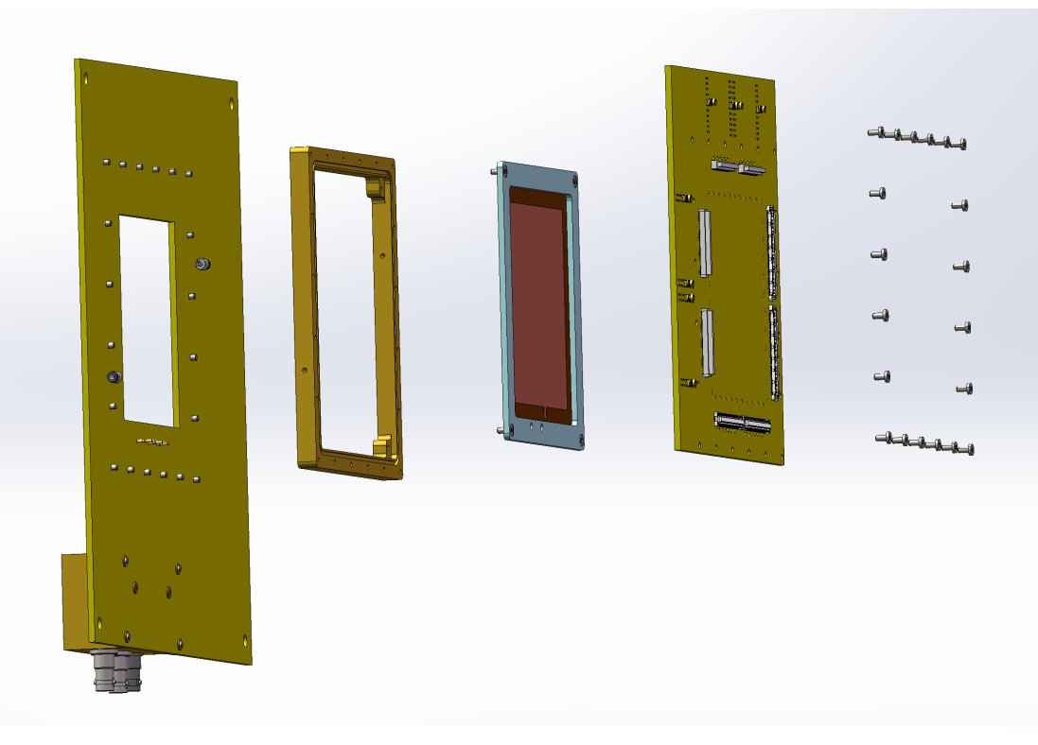
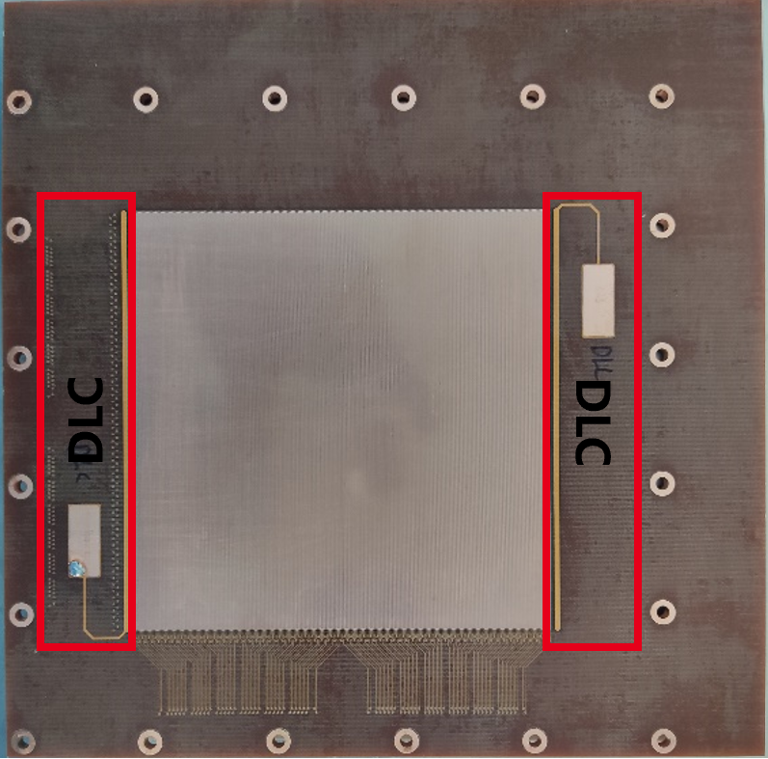
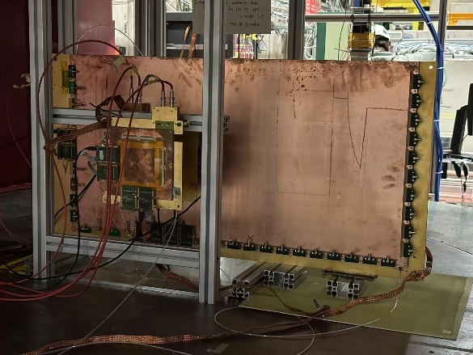
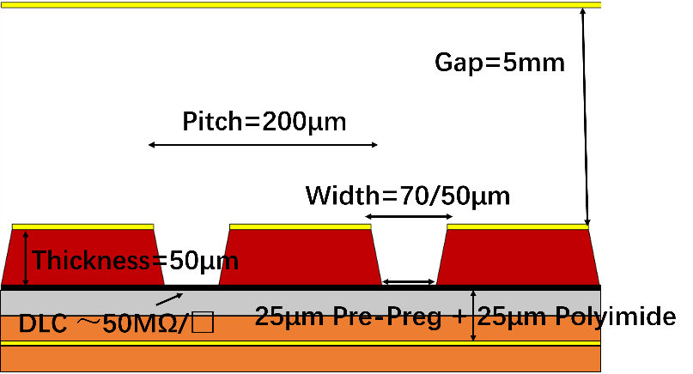
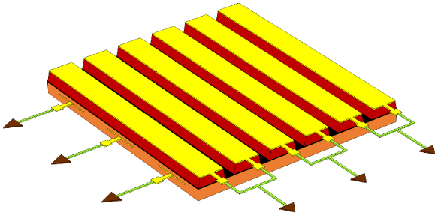
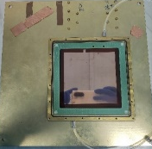
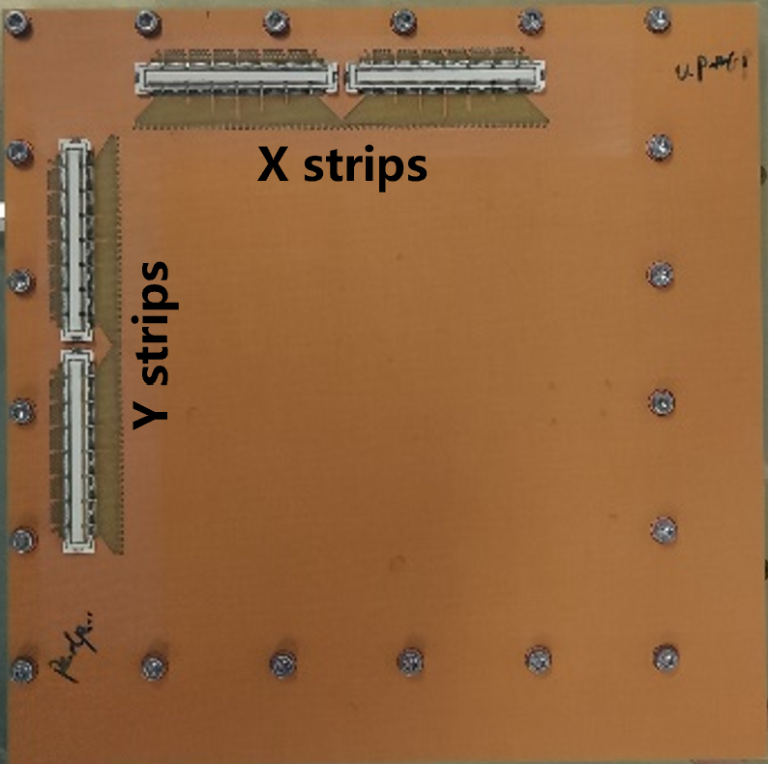
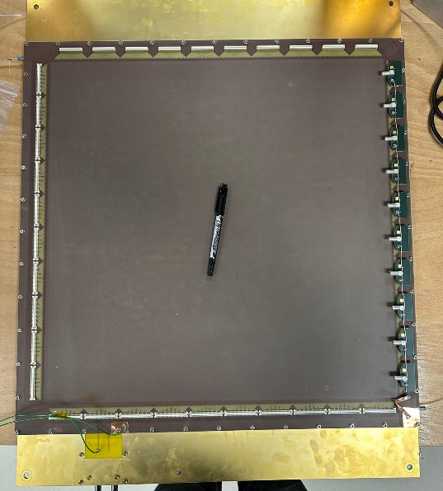
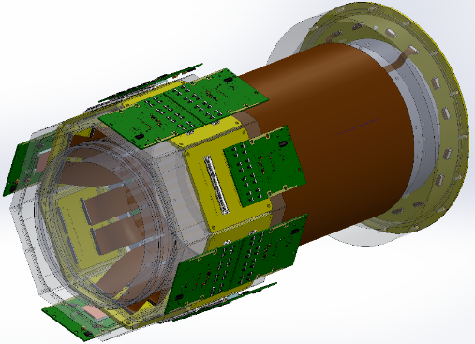
micro-Resistive Groove
Drift
μRGroove
μRGroove
Small prototype
Large area
DLC HV
Decoupled X&Y readout strips, avoided induced charge sharing effect, increased signal amplitude
Easier to process due to its open geometry
Easy clean, important for the end user.
Lower material budget
Drift HV
V readout
U readout
Cylindrical μRGroove
Suitable for cylindrical geometry and large-area tracking application.

Slide 4
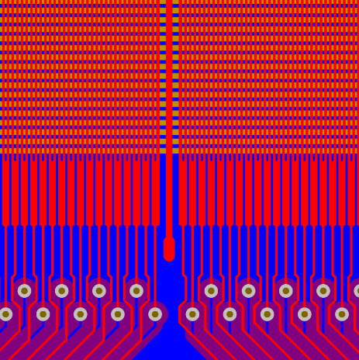
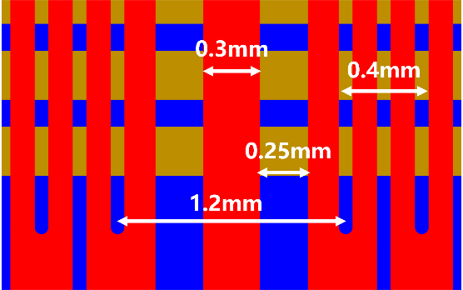
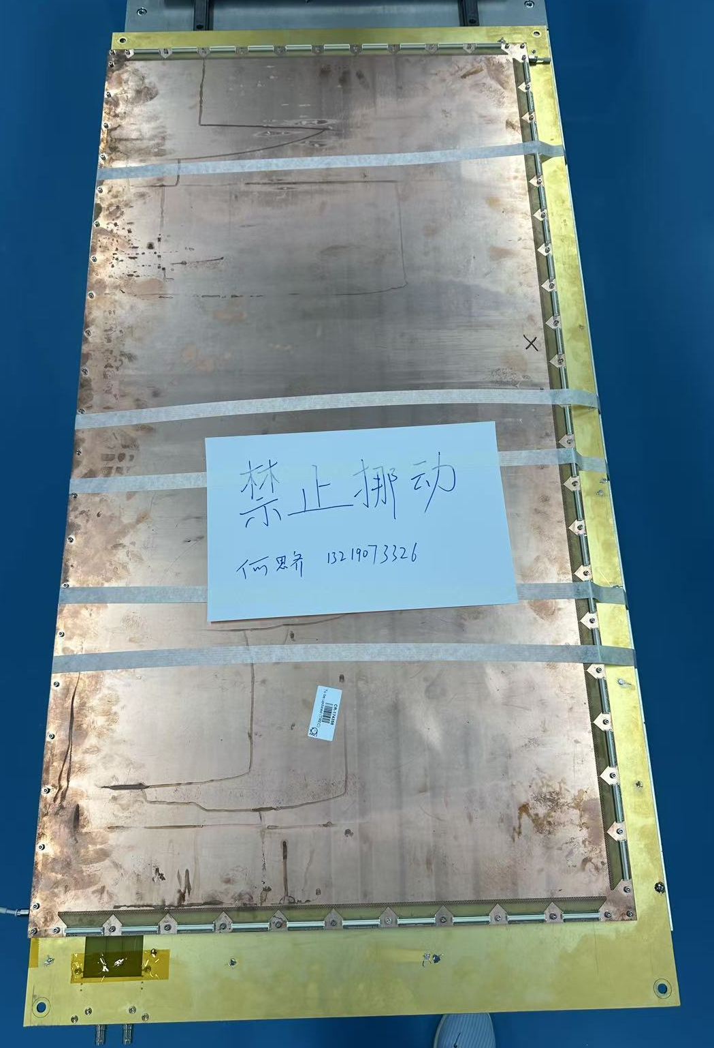
The Large-area μRGroove
A4 paper
2 readout strips are replaced by a PEP GND line in each 128 readout strips;
Active area:
50 cm × 50 cm
100 cm × 50 cm
PEP fast grounding line, divided into 10/20 sub-regions of 5 × 10 cm each
Dead Area (TOP): 2/128 = 1.5625%
Simple structure, easy installation

Slide 5
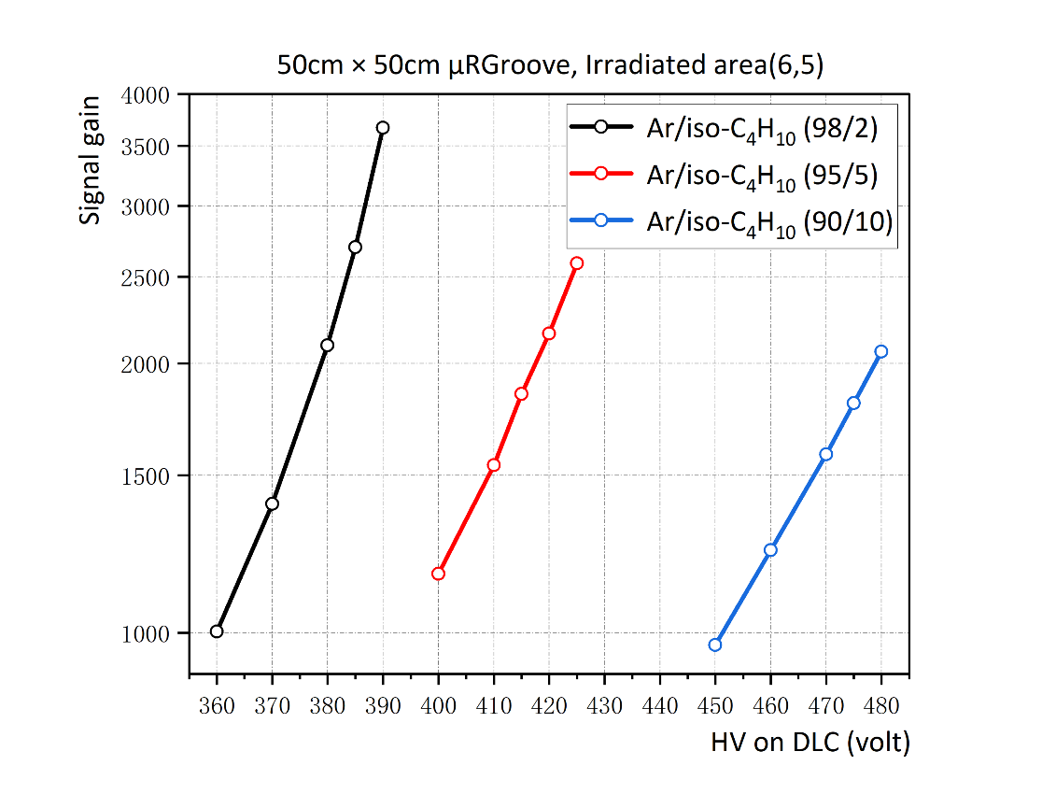
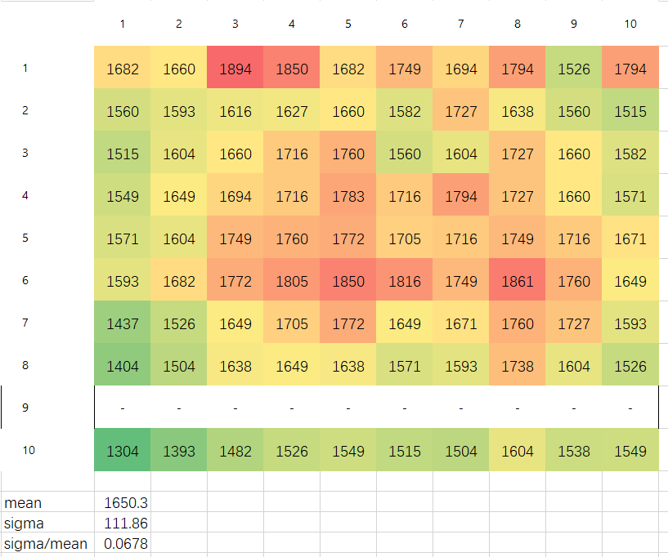
50cm × 50cm: Signal gain and uniformity
Ar/iso-C₄H₁₀ (95/5), DLC: 415V, Drift -500V
The signal gain is relatively low (<3000) due to insufficient matching capacitance of ORTEC.
The Gas gain is similar with that in small μRGroove
Pretty uniformity, approximately 7%.

Slide 6
50cm × 50cm: Rate capability
Read out the current from the top electrode and calculate the “current gain” to obtain the G/G₀ curve.
Scan different irradiation spot diameters.
For an 8 mm irradiation diameter with 8.1 keV X-rays, the counting rate capability (at 90%) is approximately 300 kHz/cm².
By converting the energy deposition to that of a MIP, the corresponding counting rate capability is about 2.4 MHz/cm².
Irradiated area: (6,5)

Slide 7
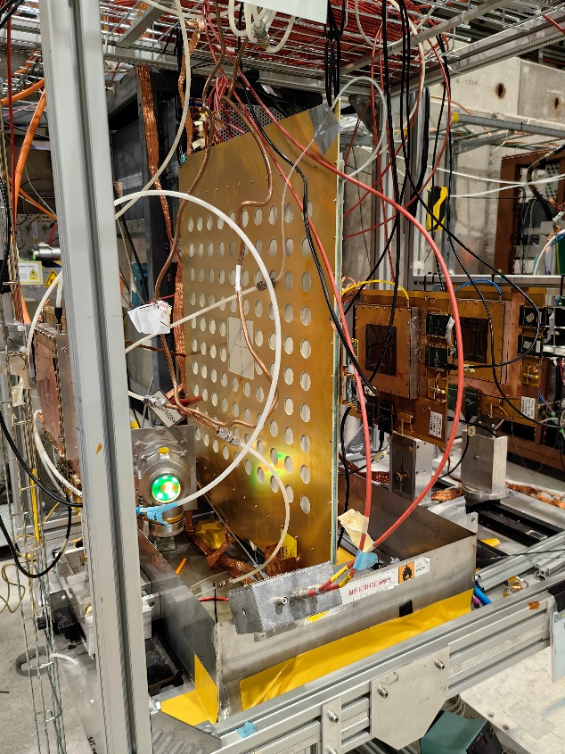
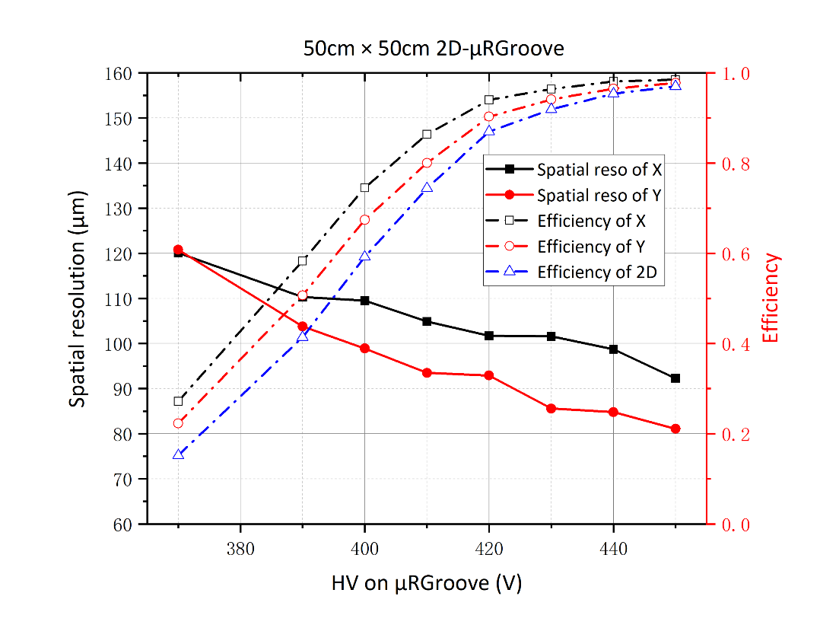
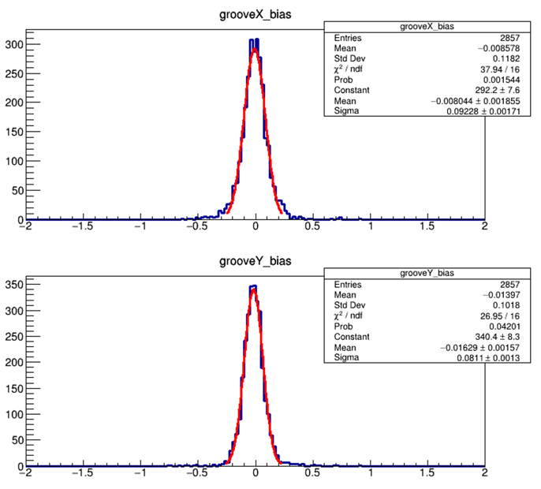
50cm × 50cm: spatial reso & efficency
2024.04
Work gas: Ar/iC₄H₁₀(90/10)
The combined efficiency is >96%
Spatial resolution is ~93μm for X readout and ~81μm for Y readout
CERN SPS-H4
150GeV/c muon
APV25 + SRS + mmDAQ

Slide 8
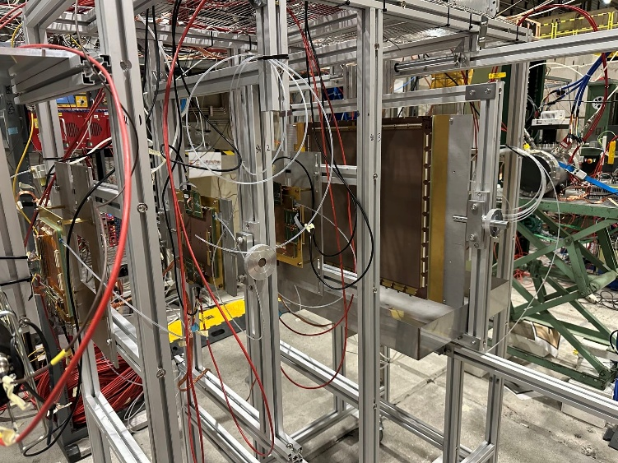
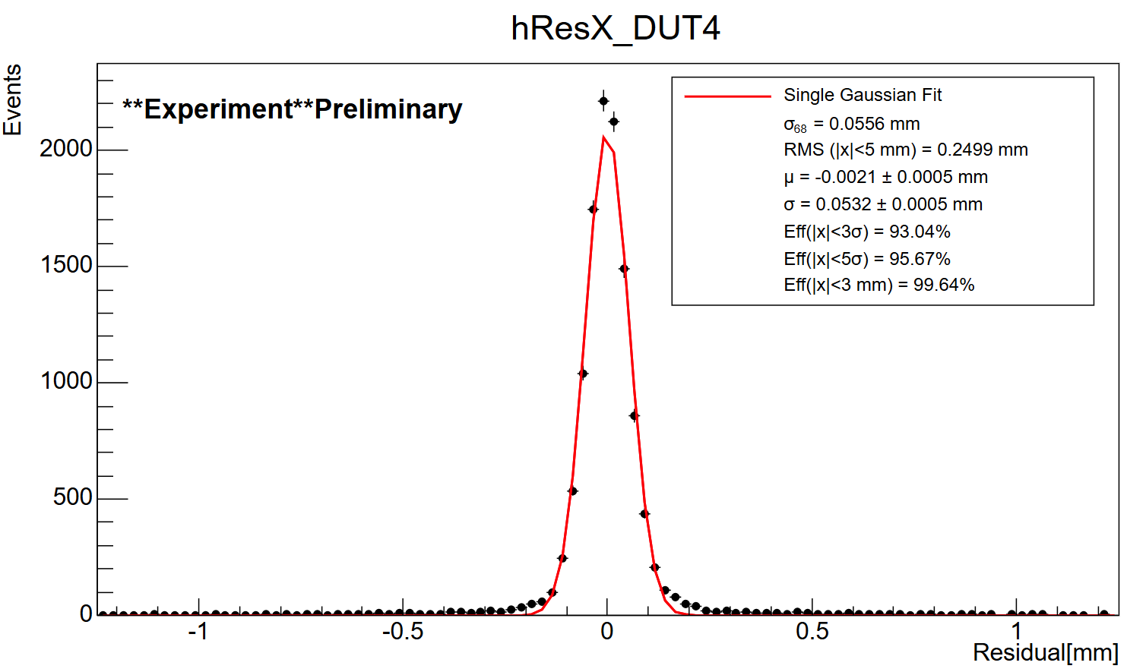
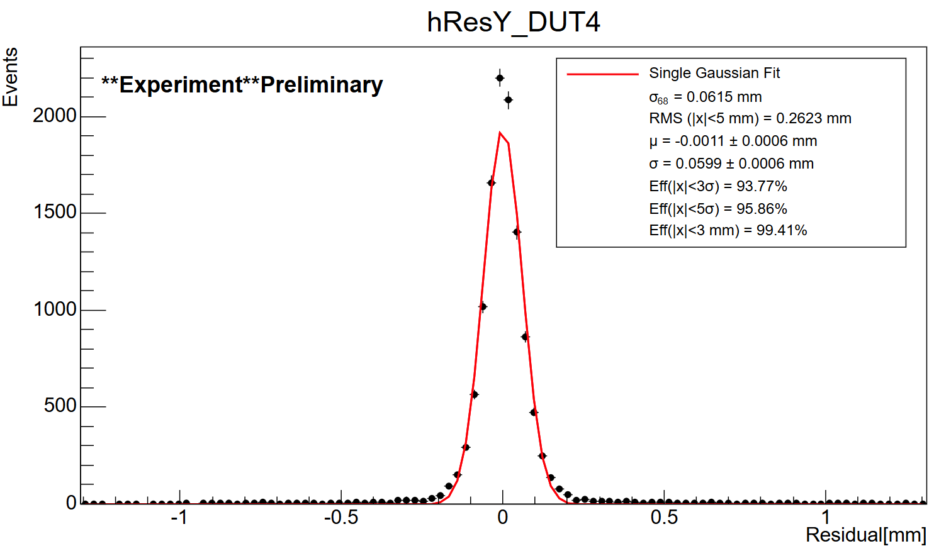
50cm × 50cm: New beam test
2025.11
Work gas: Ar:CF₄:CO₂/45:40:15. Better gas parameters but smaller gain
The efficiency is >95%
Spatial resolution is ~56μm for X readout and ~62μm for Y readout
CERN SPS-H4
150GeV/c muon
APV25 + SRS + mmDAQ
Rotatable around the X-axis
Better resolution is related to gas parameters such as smaller gas diffusion.
More μTPC-related analyses are underway.

Slide 9

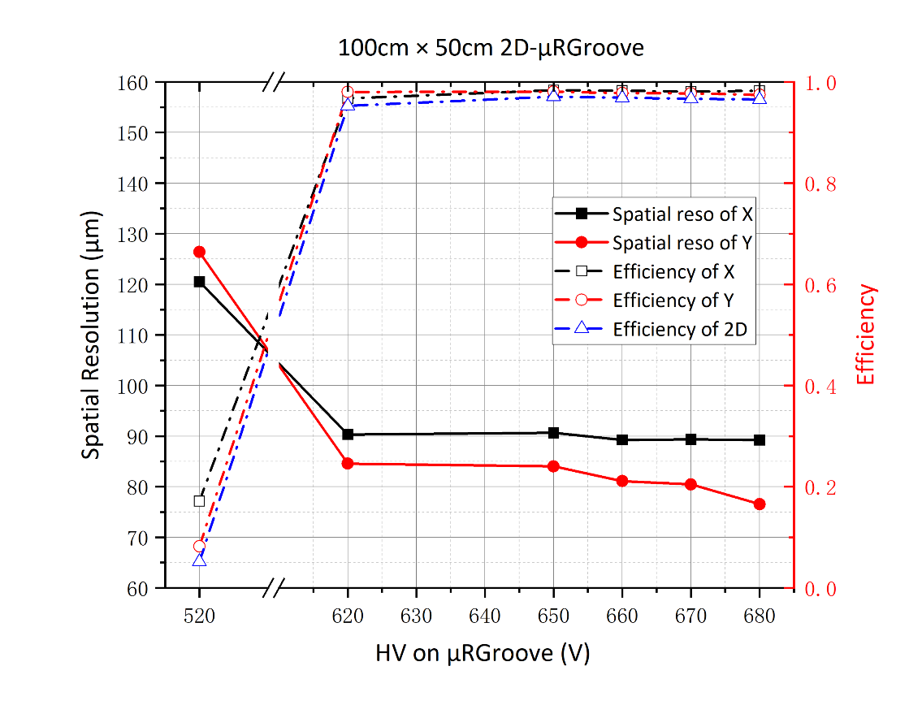
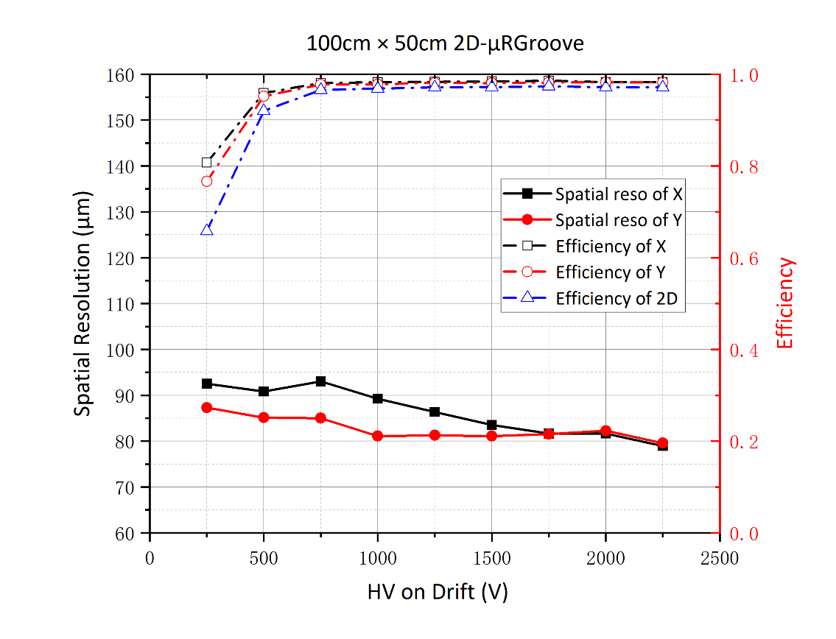
100cm × 50cm: spatial reso & efficency
2025.07
Work gas: Ar:CF₄:CO₂/45:40:15.
The efficiency is >96%
Spatial resolution is ~90μm for X readout and ~80μm for Y readout
CERN SPS-H4
150GeV/c muon
APV25 + SRS + mmDAQ
More detailed tests about uniformity and rate capability are ongoing

Slide 10
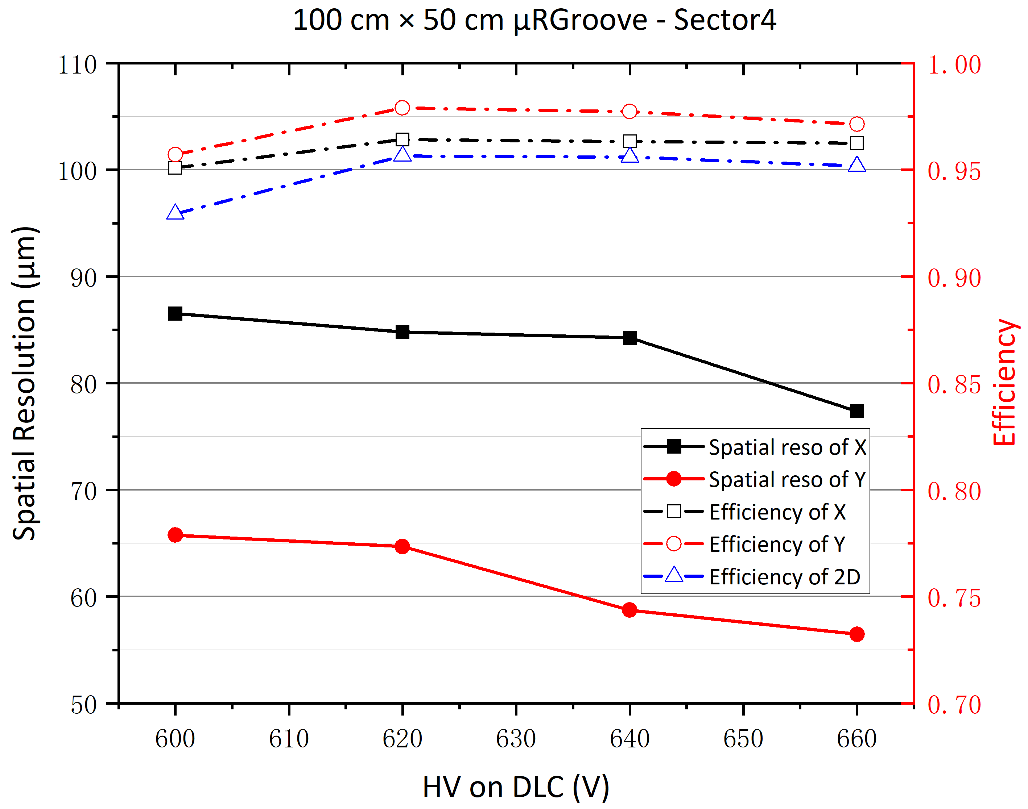
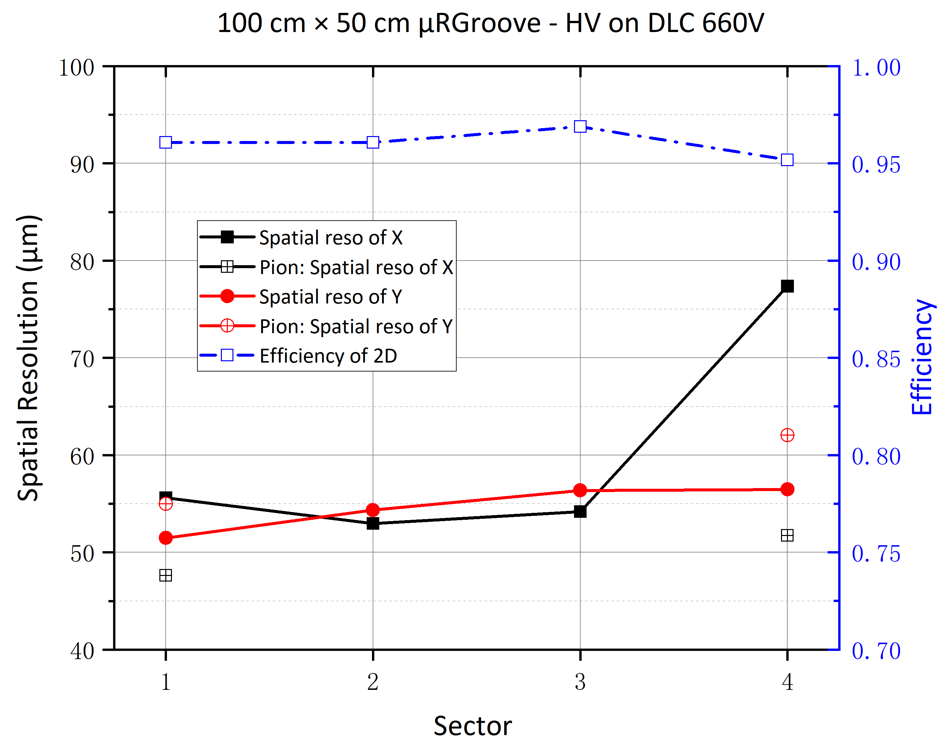
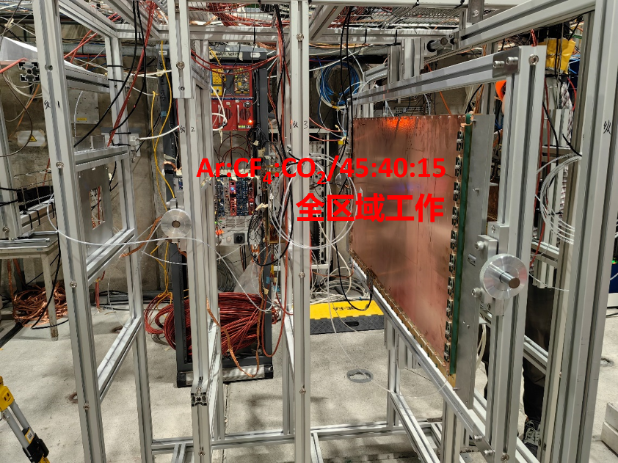
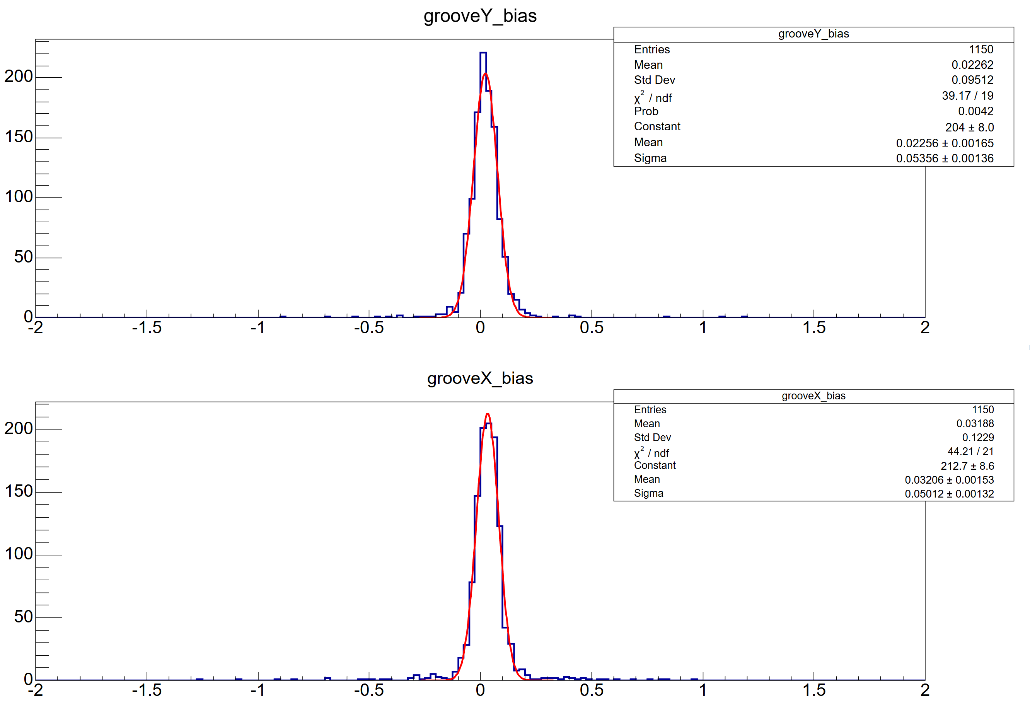
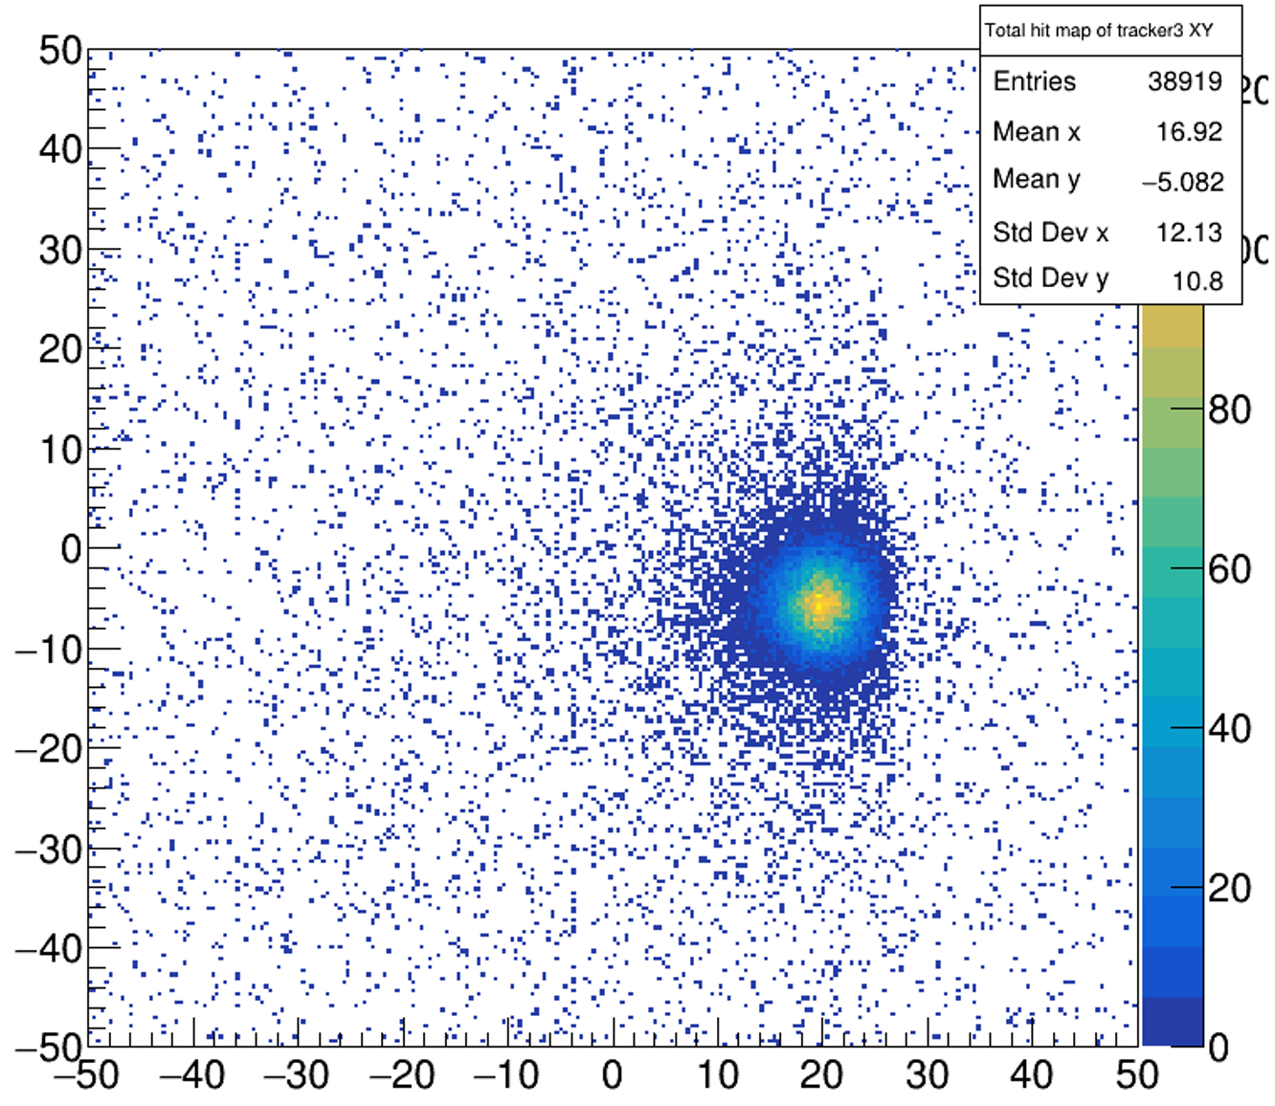
100cm × 50cm: New beam test
Muon
Muon
2025.11
Pion
Pion
Muon
∼53μm
Spatial Resolution： ∼52μm to ∼78μm
(small bending on sector4)
Detection Efficiency：≥95%
Pion
∼50μm
Pion (Ultra High Rate: ~1.73MHz/cm²)
Spatial Resolution： ∼50μm to ∼53μm
Detection Efficiency： ∼96%
Work gas: Ar:CF₄:CO₂/45:40:15
APV25 + SRS + mmDAQ

Slide 11
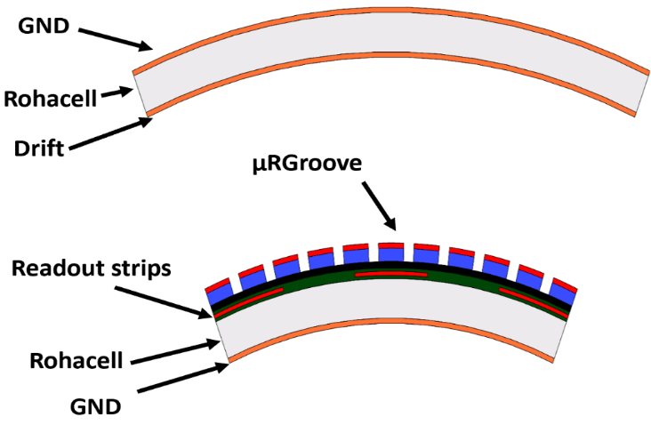
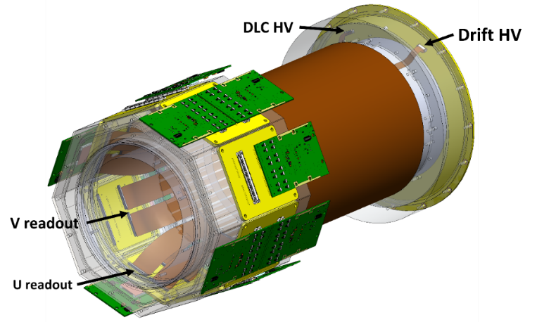
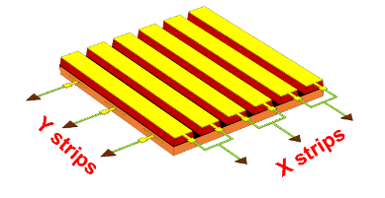
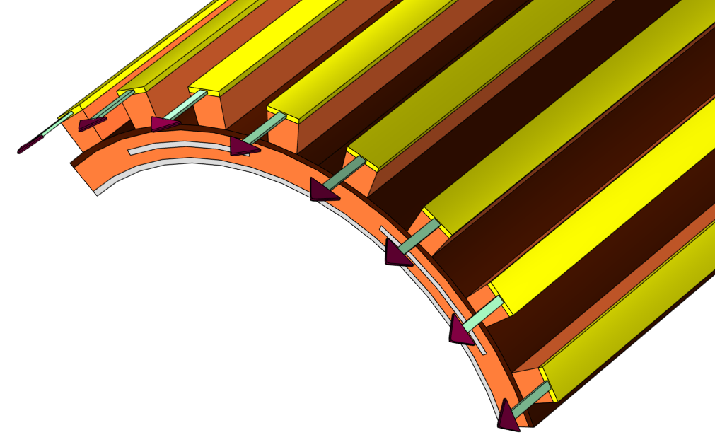
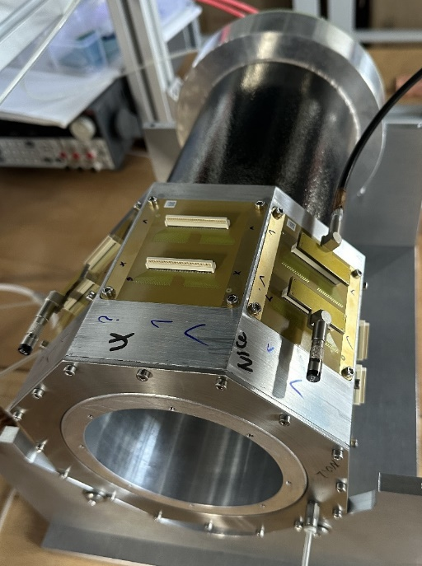
The low-mass Cylindrical μRGroove
1st C-μRGroove prototype:
Size of active area: D=131.0mm, L=100.0mm;
Material budget of active area: ~0.23% X₀
Out cylinder is drift and inner is μRGroove-PCB
Detachable mechanical design
Prototype
2021.09 - 2024.05: design and production
2024.07：Beam test
2024.11: 1st beam test under magnetic field
One of the options for STCF inner tracker

Slide 12
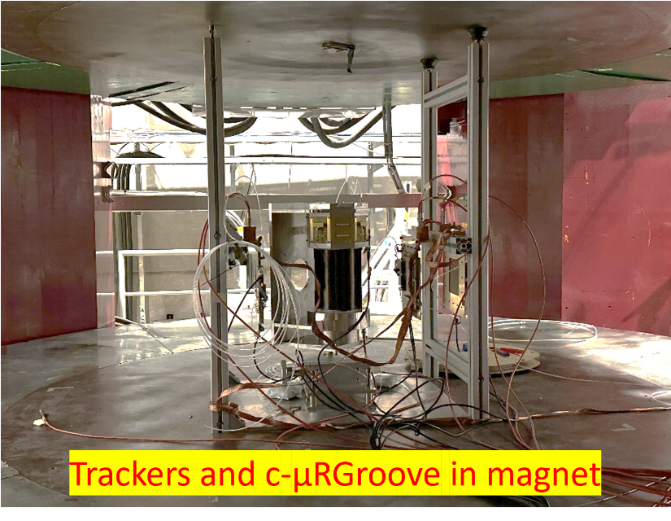
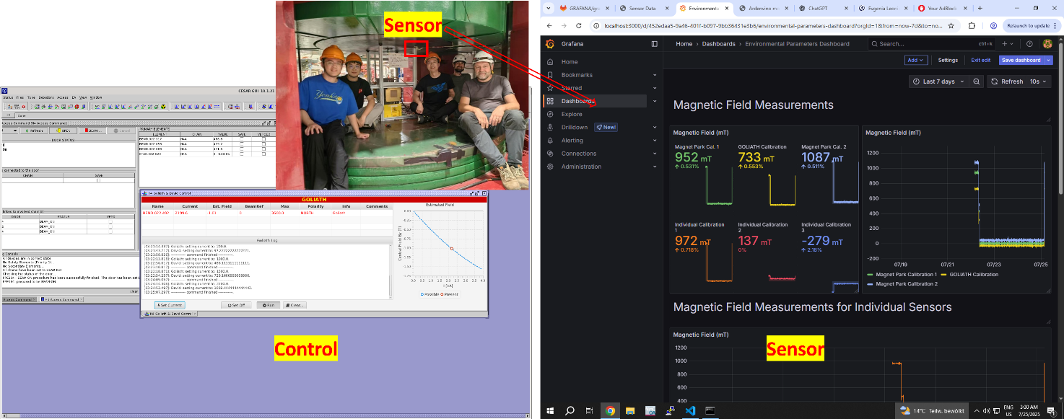
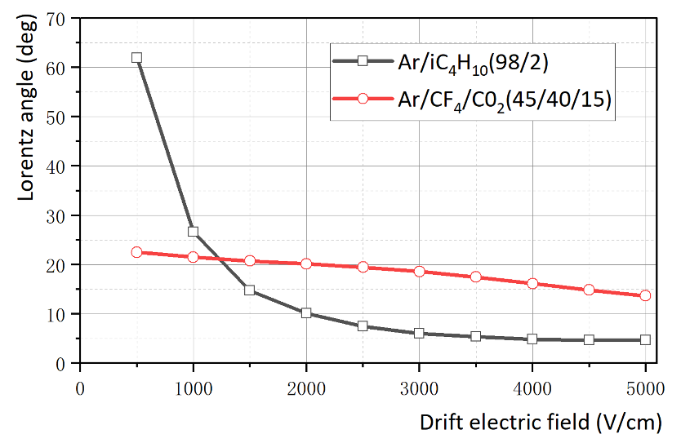
Beam test in magnet
2025. 07
B = 1T
Goliath magnet at SPS-H4, B = 1T
Trackers: μRGroove, Ar/iC₄H₁₀(98/2), 3kV/cm drift field, Lorentz angle: ~6°
c-μRGroove: Ar/CF₄/CO₂(45/40/15), 0.5kV/cm drift field, Lorentz angle: ~22°
APV25 + SRS + mmDAQ
Slimulatoin@B=1T

Slide 13
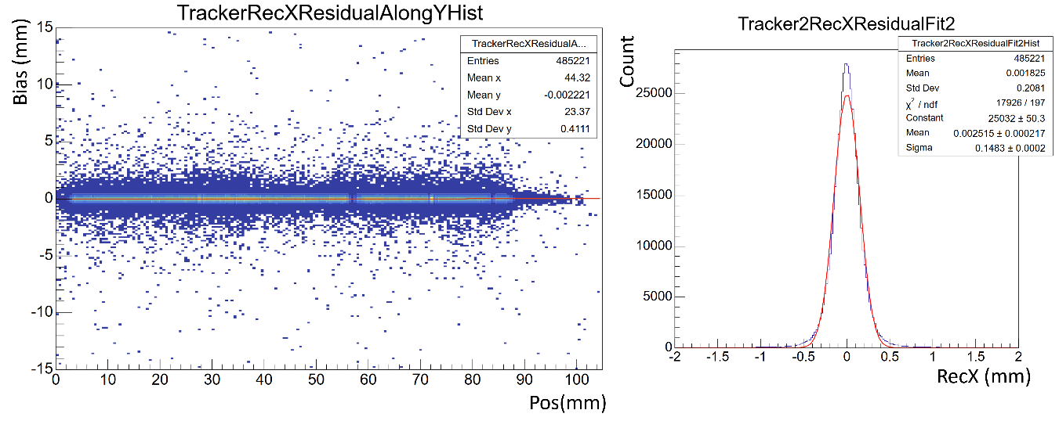
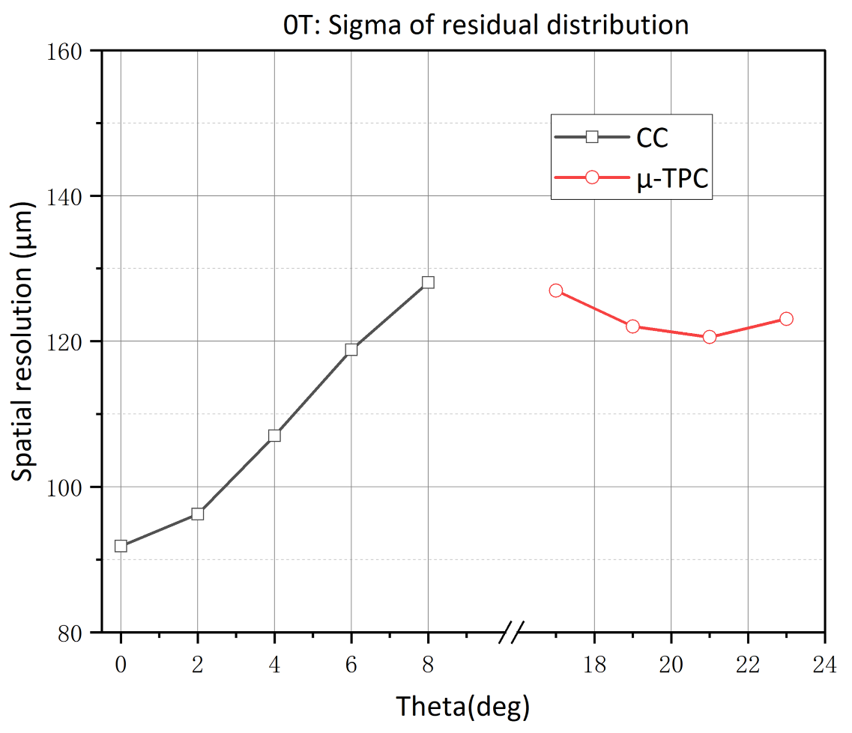
Spatial resolution @B = 0T
B = 0T
Reconstruction Methods for c-μRGroove:
Charge centroid (CC) for tracks at small angles
Micro-Time projection chamber (μTPC) for tracks at big angles
Alignment of trackers
Tracker:
the sigma of Tracker2 is ~148μm, So that its resolution is ~115μm
Track error is ~66μm
c-μRGroove：
Sigma: μTPC (23°) ~120μm, CC (0°) ~92μm
Resolution without track error: μTPC (23°) ~100μm, CC (0°) 64μm

Slide 14
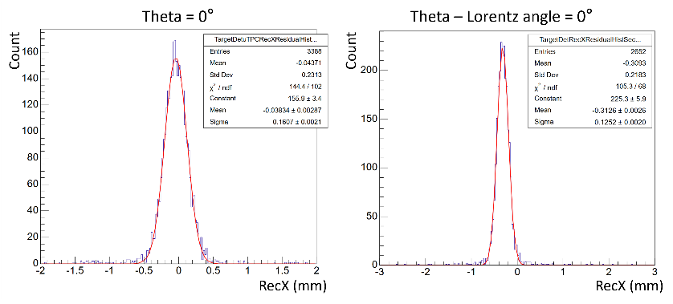
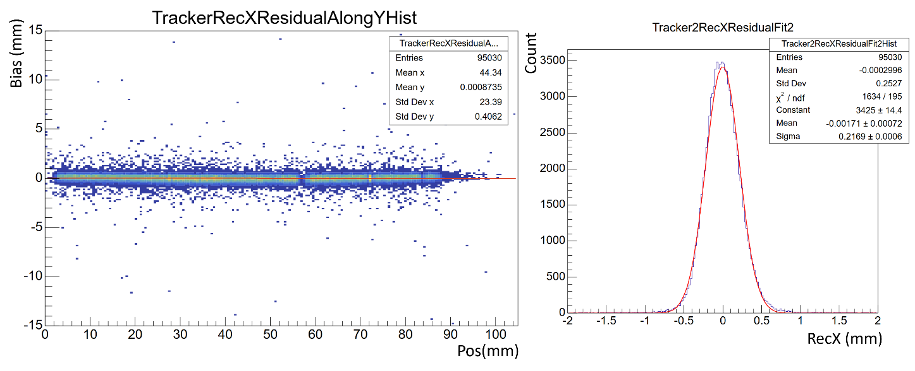
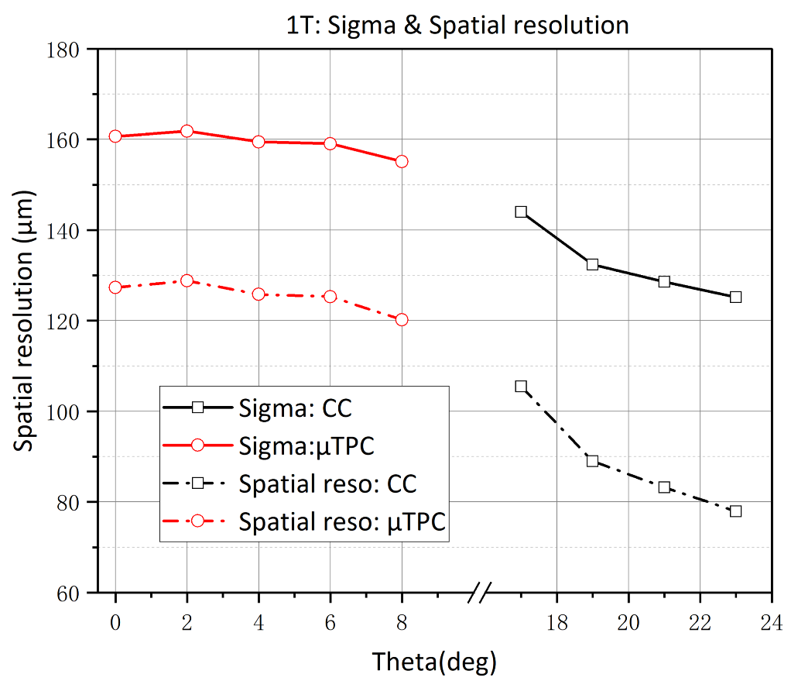
Spatial resolution @B = 1T
B = 1T
Alignment of trackers
Tracker:
the sigma of Tracker2 is ~217μm, So that its resolution is ~169μm
Track error is ~98μm
c-μRGroove：
Lorentz angle ~23°
Sigma: μTPC (0°) ~160μm, CC (Theta – Lorentz angle = 0°) ~125μm
Resolution without track error: μTPC ~127μm, CC ~78μm

Slide 15
Summary
50cm×50cm planar μRGroove
Pretty gain uniformity: better than 7%.
Rate capability: 300kHz/cm²@8mm diameter@8.1keV X-ray.
New beam test: Spatial resolution is ~60μm.
100cm×50cm planar μRGroove
Efficiency is > 96%.
Spatial resolution is better than 60μm(except the bending area).
Cylindrical μRGroove
Lorentz angle is ~ 23° @1T @Ar/CF4/CO2(45/40/15), 0.5kV/cm drift field.
Spatial resolution @0T: μTPC (23°) ~100μm, CC (0°) ~64μm (track error deducted).
Spatial resolution @1T: μTPC (0°) ~127μm, CC (Theta – Lorentz angle = 0°) ~78μm (track error deducted).

Slide 16
Outlook
Detailed test of 100cm×50cm μRGroove
Develop μTPC algorithm based on several beam tests
Analyze new beam data of large area μRGrooves
Optimize the detector structure, such as groove structure and readout, etc.

Slide 17
Backup

Slide 18
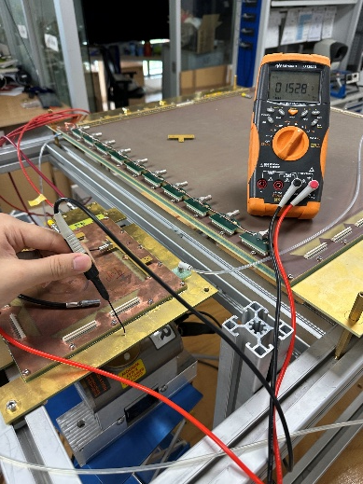
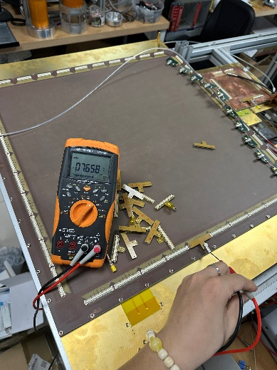
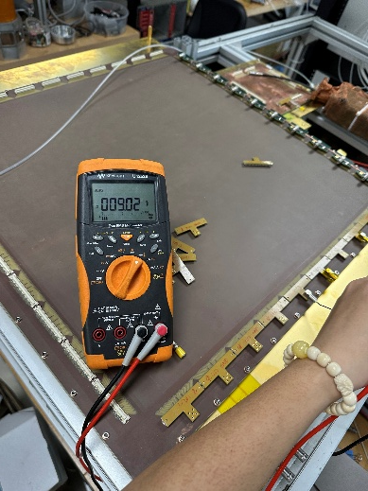
Influence of capacitance
Irradiated area: (6,5)，DLC: 415 V; Drift: -500 V
Test setups | Signal gain
Full size connected； Bottom is readout | 1749
Central 10cm×10cm area connected Bottom is readout | 1872
Central 10cm×10cm area connected Top is readout | 1905
Small μRGroove
5×5cm connected
45×50cm connected
.
It is necessary to determine the effect of capacitance by comparing with a small-area μRGroove.
By reducing the connected area, the signal gain only increased by 7%.
Under the same setups, the top and bottom maintain similar amplitudes.
Capacitance measurement:
small μRGroove, 5 × 5 cm connected: 1.53 nF
Large μRGroove, 5 × 5 cm connected : 7.66 nF
Large μRGroove, 45 × 50 cm connected : 9.02 nF

Slide 19
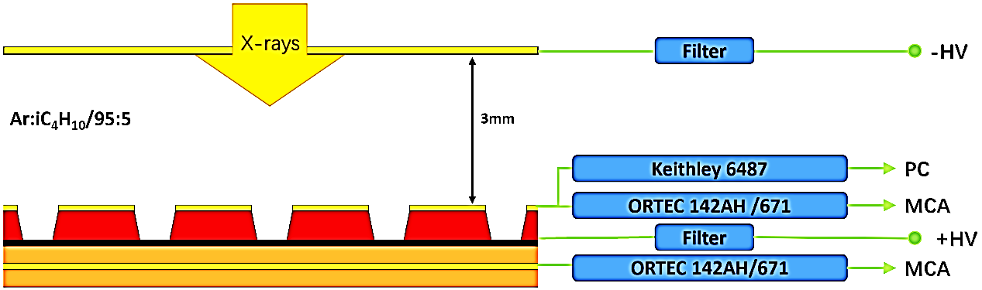
Further check between large and small detectors
5mm
Test setups | “Current gain” | Signal gain | G_{sig}/G_{cur}
Large μRGroove 5×5cm (6,5) connected； Top readout | 7573 | 2139 | 3.54
Small μRGroove 5×5cm connected Top readout | 8914 | 5079 | 1.76
The difference in current gain between the large and small detectors is relatively minor, where the difference in signal gain is substantial.
This suggests that the electron multiplication is likely similar, but the reduced signal result from insufficient matching capacitance in the ORTEC preamplifier.
“Current gain” refers to the “gain” based on the current read out from the top electrode.
Although it’s not the total current on the DLC, it is still suitable for comparative analysis.

Slide 20
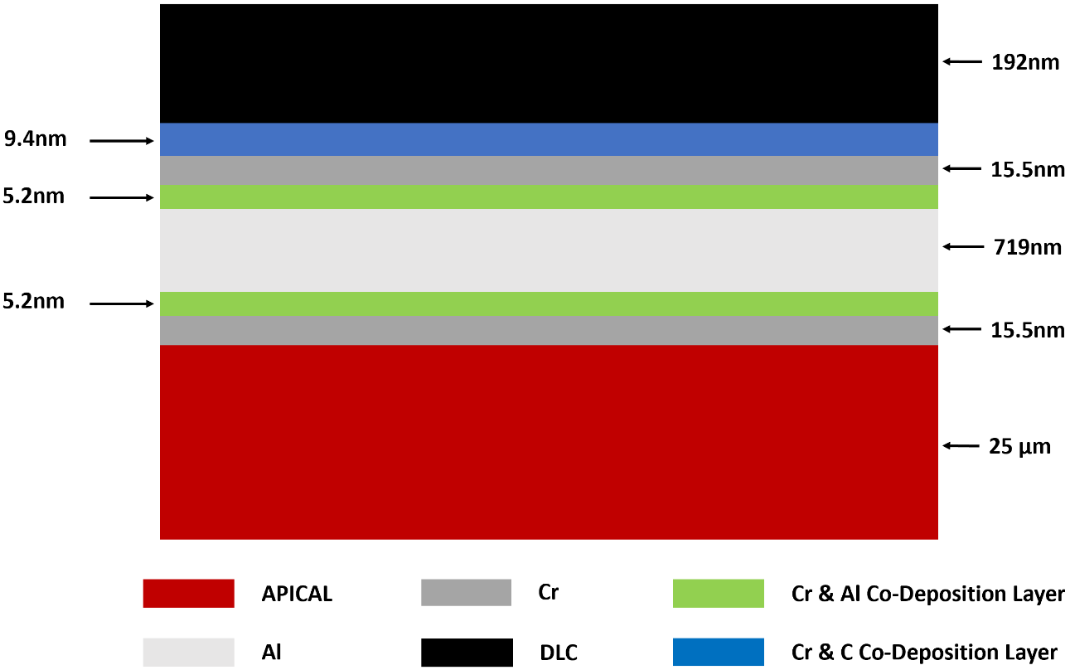
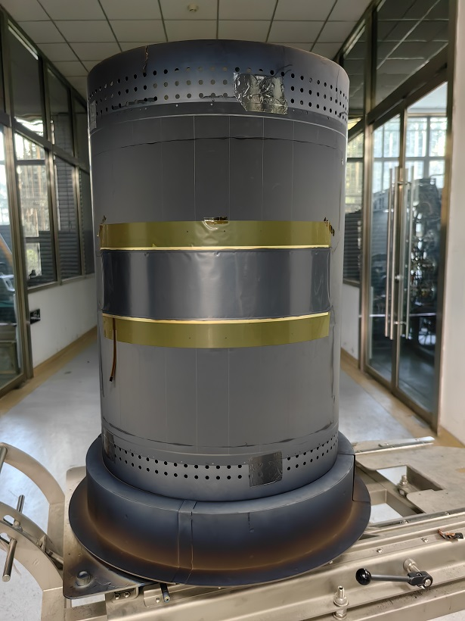
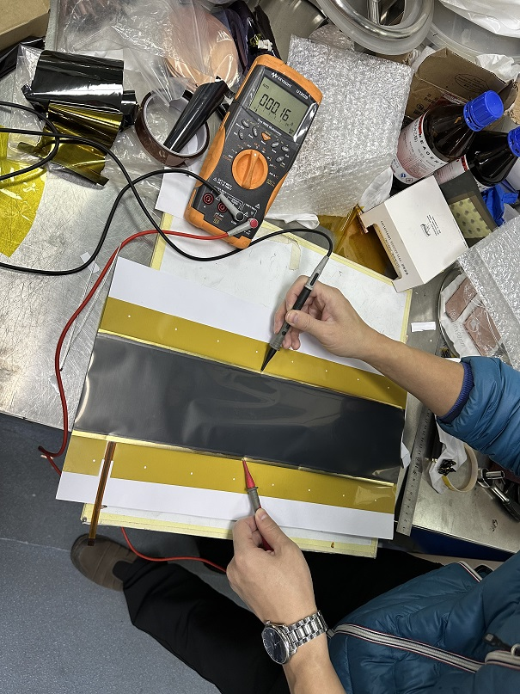
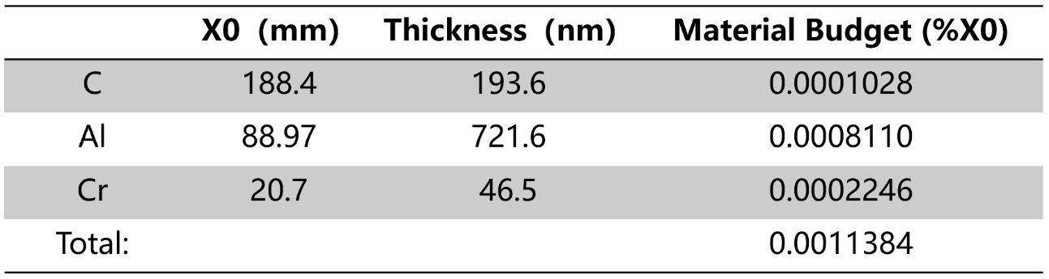
C-μRGroove: Low-Mass Electrode
LM Drift & GND are both made
Zhou Lin, RD51 Collaboration Meeting, 21/06/2023
DLC: Diamond Like Carbon

Slide 21
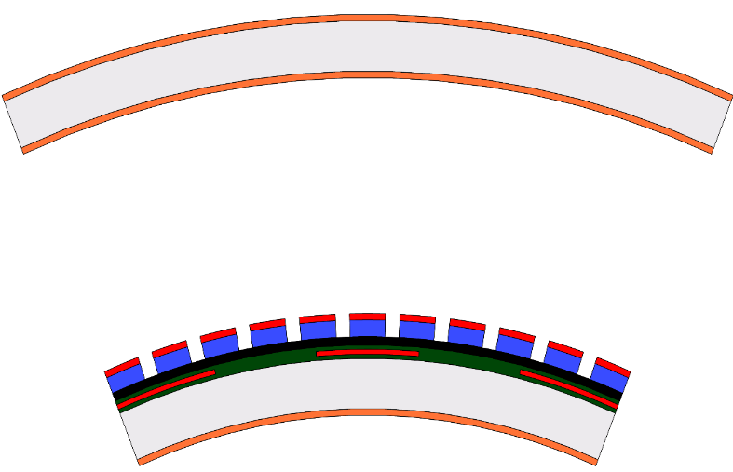
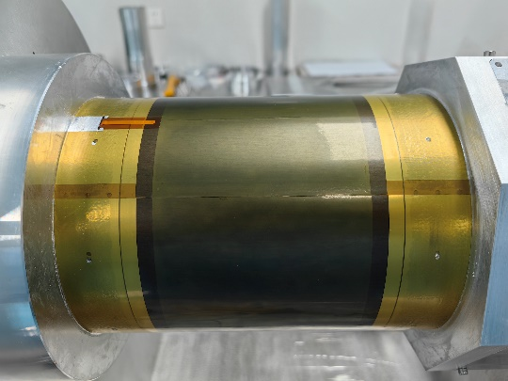






C-μRGroove: Manufacture
Drift electrode
Rohacell foam
Kapton/GND
Kapton/GND
Rohacell foam
V strip film
Det.&U-strip film
Total material budget: ~0.23%X₀

Slide 22




C-μRGroove: Electrodes design
Layer stack of μRGroove
μRGroove/U Strips
V Strips
Layer stack of V readout
U/V 2D strip-readout, pitch of U strips is 0.4mm, Pitch of V strips is 0.8mm, angel between UV is 15°

Slide 23


Slide 24




Gain and energy spectrum measurement
Setup：
Gas: Ar:iC₄H₁₀/95:5
Source: ⁵⁵Fe
Readout from X strips (cathode)
V strips are grounded
Ortec142AH/671 + MCA
Gain measured by signal amplitude spectrum
~1h@gain : 5100
Energy resolution: ∼26%;
Effective gain: 4000~10000;
Similar signal amplitude on X&V readout strips;
Good stability if the humidity can keep low enough;
3 sectors not work (8 sectors in total);
Bad gain uniformity, caused by the gas(flow);

