Slide 1
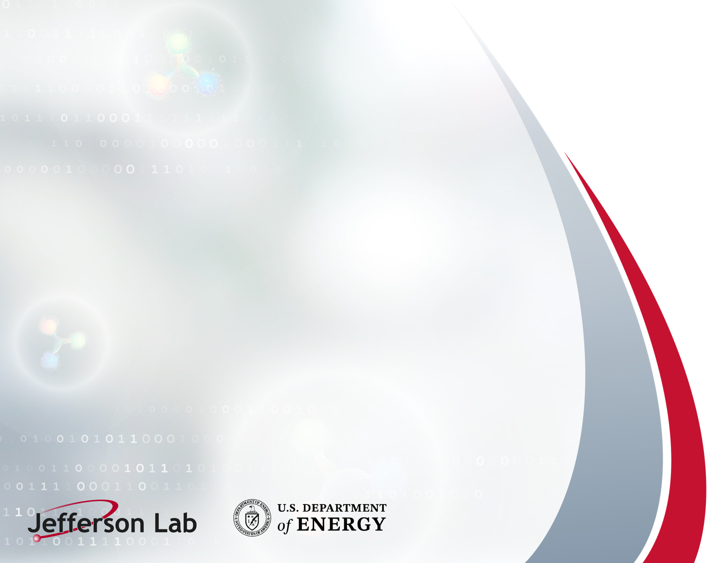
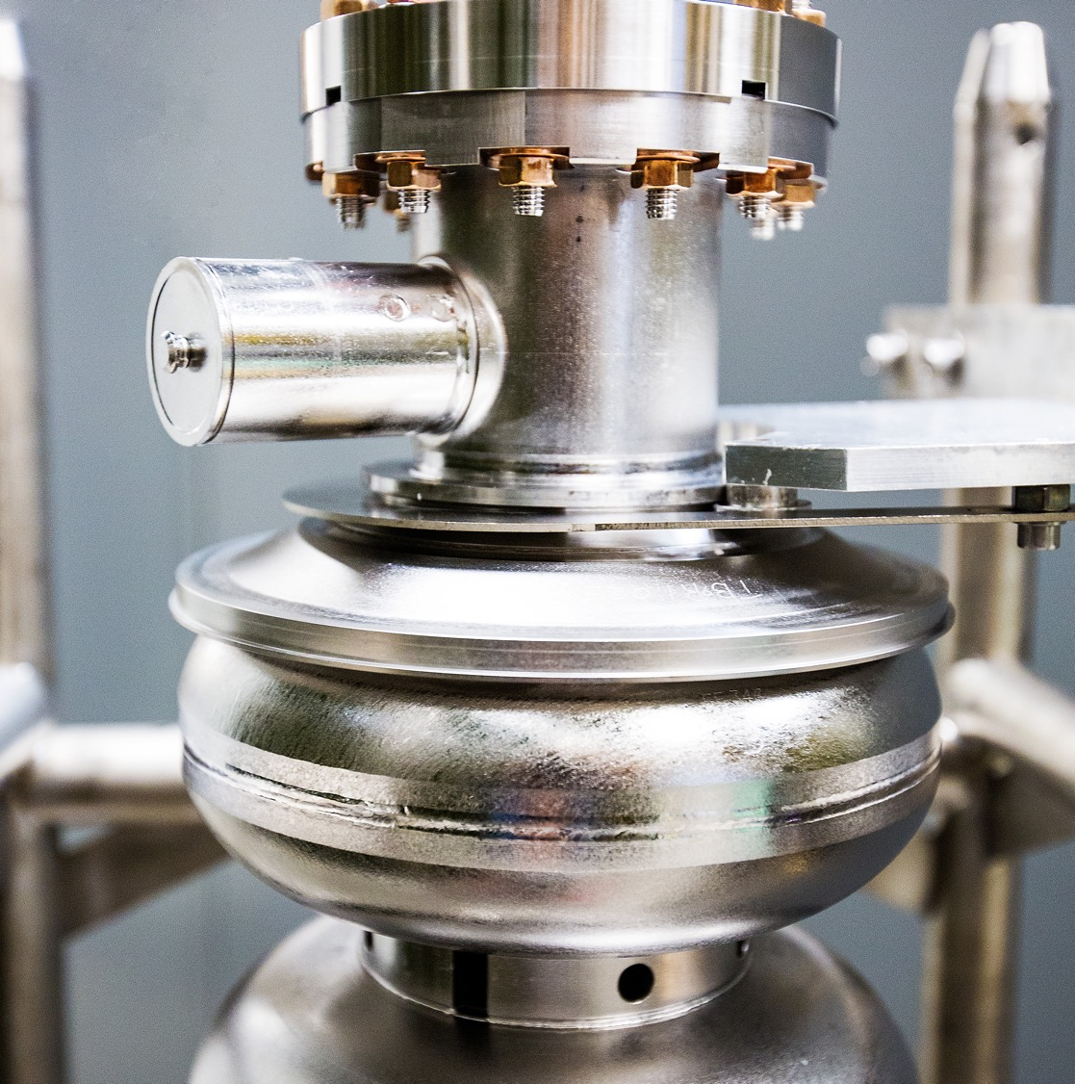
AI/ML Activities at Jefferson Lab:
An Overview
Kishan Rajput
Staff Scientist
Data and Computational Science
Jefferson Lab

Slide 2
AI for Science and Technology
Jefferson Lab is a recognized leader at the intersection of AI and Nuclear Physics.
Current State
Jefferson Lab is an innovative adapter of specific AI technologies relevant to our mission.
AI/ML Activities at Jefferson Lab | JLUO Meeting 2026

Slide 3
Outline
Overview of AI/ML Capabilities (Data and Computational Science)
  Uncertainty quantification for ML
  Reinforcement Learning based optimization and Control
  Collaborators and Sponsors
AI/ML Activities in Experimental Halls
  AI assisted tracking and FPGA
  AI optimized Polarization, Coupling Experiments to Accelerator Controls, and SMOCS
  Inverse Problem Solvers and HAIDIS
  Many other activities
AI/ML Activities at CEBAF
  AI ready data and Agentic AI to help operations
Conclusion
  References, and point of contacts
AI/ML Activities at Jefferson Lab | JLUO Meeting 2026

Slide 4
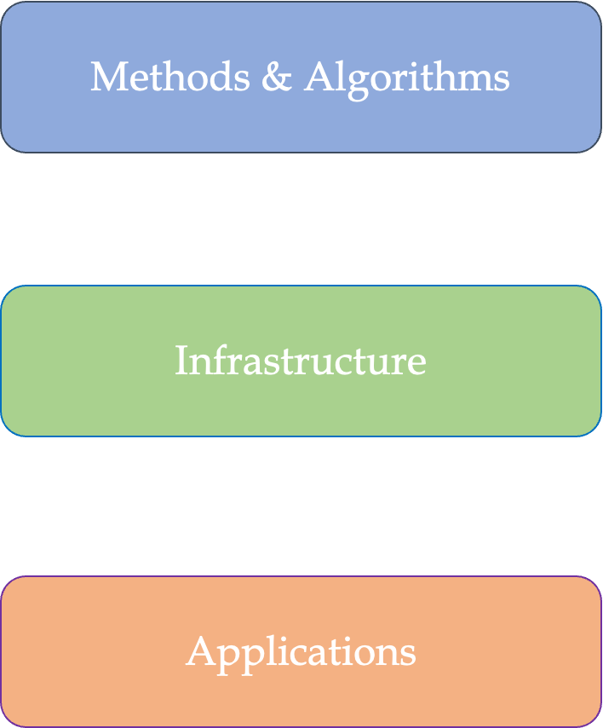

Data Science Research Pillars
Focused Methods & Algorithms
Scalable Machine Learning
Optimization and Controls
Uncertainty Quantification for Machine Learning
Continual and Online Learning
Graph Neural Networks
Infrastructure Efforts
Scientific Optimization and Control Toolkit (SOCT)
Scalable Asynchronous Inverse Problem Solver (SAGIPS)
Streaming Monitoring Optimization and Controls System (SMOCS)
Applications
Experimental and Theoretical Nuclear Physics
Particle Accelerators (NP, HEP, BES)
Fusion (DIII-D)
Health and Climate
AI/ML Activities at Jefferson Lab | JLUO Meeting 2026

Slide 5
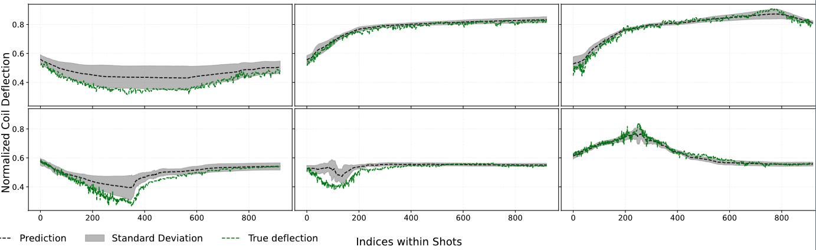
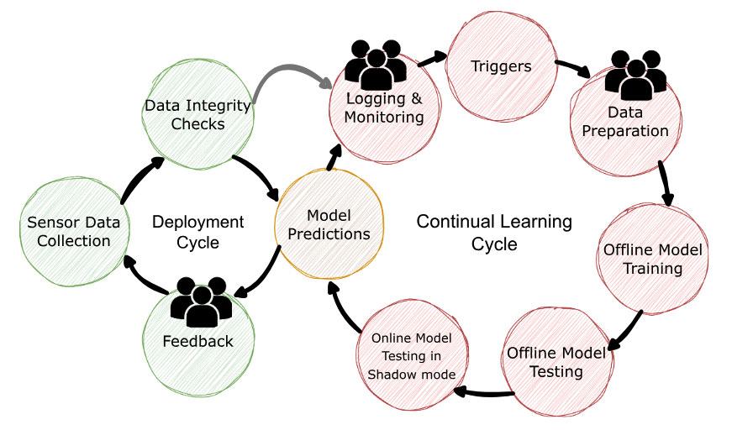
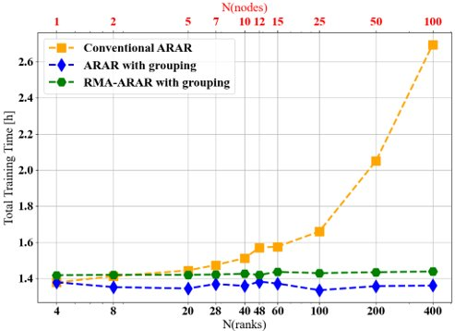
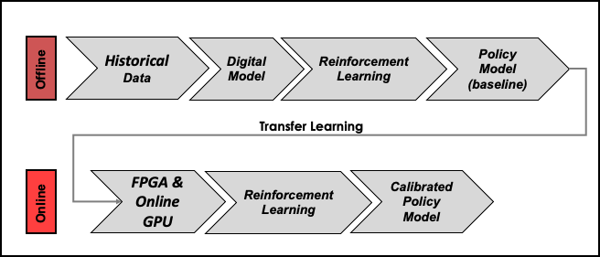
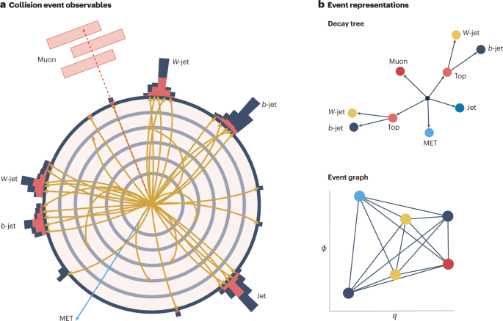
Core ML Capabilities
Uncertainty Quantification for ML
Continual Learning for drifting data streams
Scalable Machine Learning
Reinforcement Learning based Optimization and Controls
Graph Neural Networks
AI/ML Activities at Jefferson Lab | JLUO Meeting 2026

Slide 6















DS Projects (with Collaborators)
AI for Science and Technology:
AI for improved accelerator operation: Jlab, SNS
Uncertainty Aware Online Learning for Fusion: Jlab, DIII-D
Hardware Aware AI for accelerator operations: SLAC, FNAL, ANL, PNNL
Towards Self-driving Scientific User Facilities: Jlab, SLAC, ANL, FRIB
AI based Digital Twin for BNL Hadron Accelerator: Jlab, BNL, Cornell, SLAC, FNAL
AI based controls for compact accelerators: Jlab, FNAL, FSU
QuantOm: Jlab, ANL, ODU, Vtech
American Science Cloud: Jlab, BNL
Genesis Model Consortium: Jlab, PNNL
AI Optimized Polarization: Jlab
Coupling Experiments to Accelerator Controls: Jlab, W&M, FSU, UVA, CMU
AI Assisted charged particle tracking: JLab
AI for health and Climate
AI for Healthcare: Jlab, ODU (EVMS)
AI for regional Flood modeling and mitigation: Jlab, ODU, UVA
POC: Kishan Rajput (Kishan@jlab.org) & Daniel Lersch (dlersch@jlab.org)
AI/ML Activities at Jefferson Lab | JLUO Meeting 2026

Slide 7
Outline
Overview of AI/ML Capabilities (Data and Computational Science)
  Uncertainty quantification for ML
  Reinforcement Learning based optimization and Control
  Collaborators and Sponsors
AI/ML Activities in Experimental Halls
  AI assisted tracking and FPGA
  AI optimized Polarization, Coupling Experiments to Accelerator Controls, and SMOCS
  Inverse Problem Solvers and HAIDIS
  Many other activities
AI/ML Activities at CEBAF
  AI ready data and Agentic AI to help operations
Conclusion
  References, and point of contacts
AI/ML Activities at Jefferson Lab | JLUO Meeting 2026

Slide 8
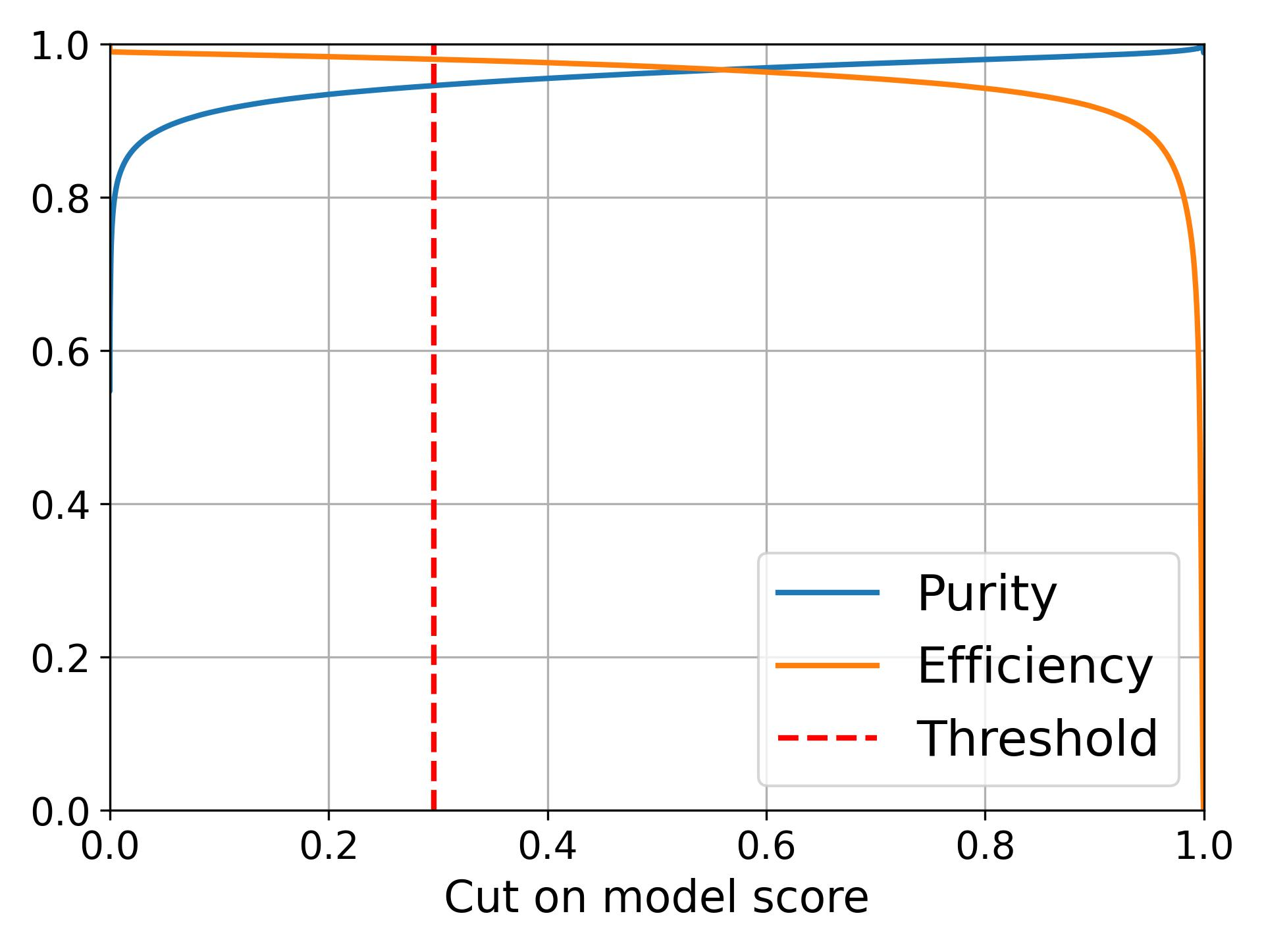
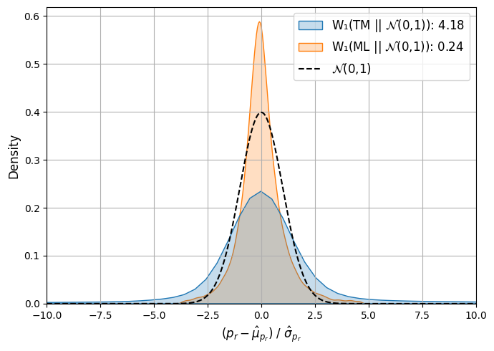
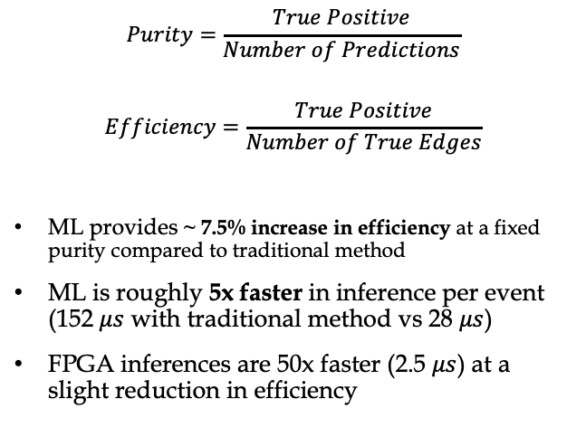
AI Assisted Tracking for FDC -- GlueX
$$Purity=\frac{True Positive}{Number of Predictions}$$
$$Efficiency=\frac{True Positive}{Number of True Edges}$$
ML provides ~ 7.5% increase in efficiency at a fixed purity compared to traditional method
ML is roughly 5x faster in inference per event (152 $μs$ with traditional method vs 28 $μs$)
FPGA inferences are 50x faster (2.5 $μs$) at a slight reduction in efficiency
POC: Ahmed Mohammed (ahmedm@jlab.org) &
Kishan Rajput (Kishan@jlab.org)
AI/ML Activities at Jefferson Lab | JLUO Meeting 2026

Slide 9
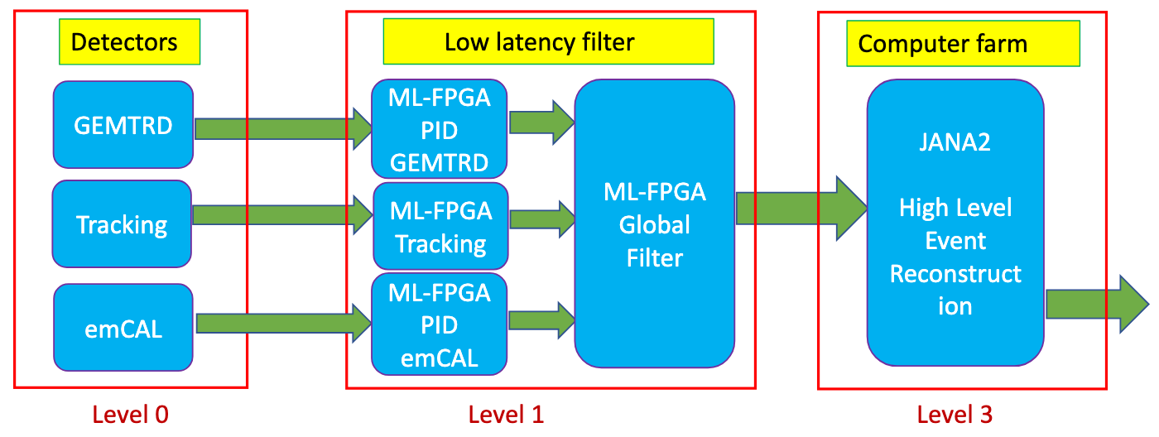
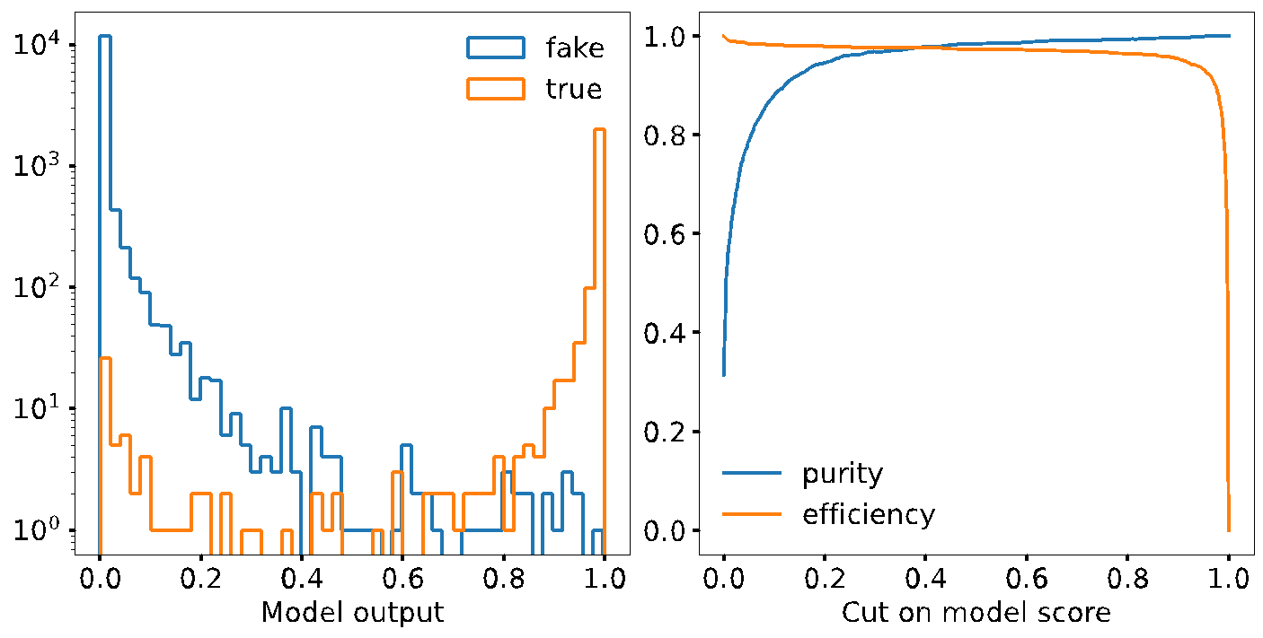
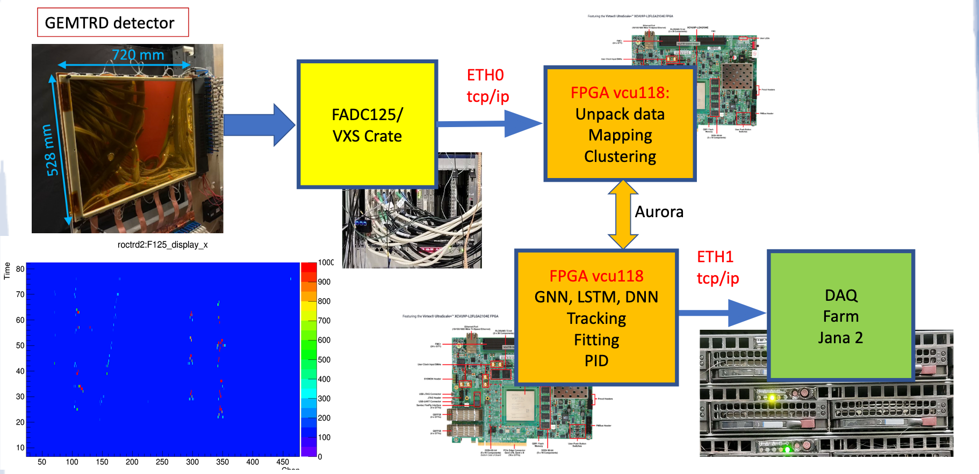
AI Assisted Tracking on FPGA
Graph Neural Network for track finding
  In this case we have a straight track segments, with a quite narrow angular distribution ~15 degree.
  FPGA takes about 3 microseconds per event
Recurrent Neural Networks/LSTM for track fitting
PID based on measuring ionization along the track
POC: Sergey Furletov (furletov@jlab.org)
AI/ML Activities at Jefferson Lab | JLUO Meeting 2026

Slide 10
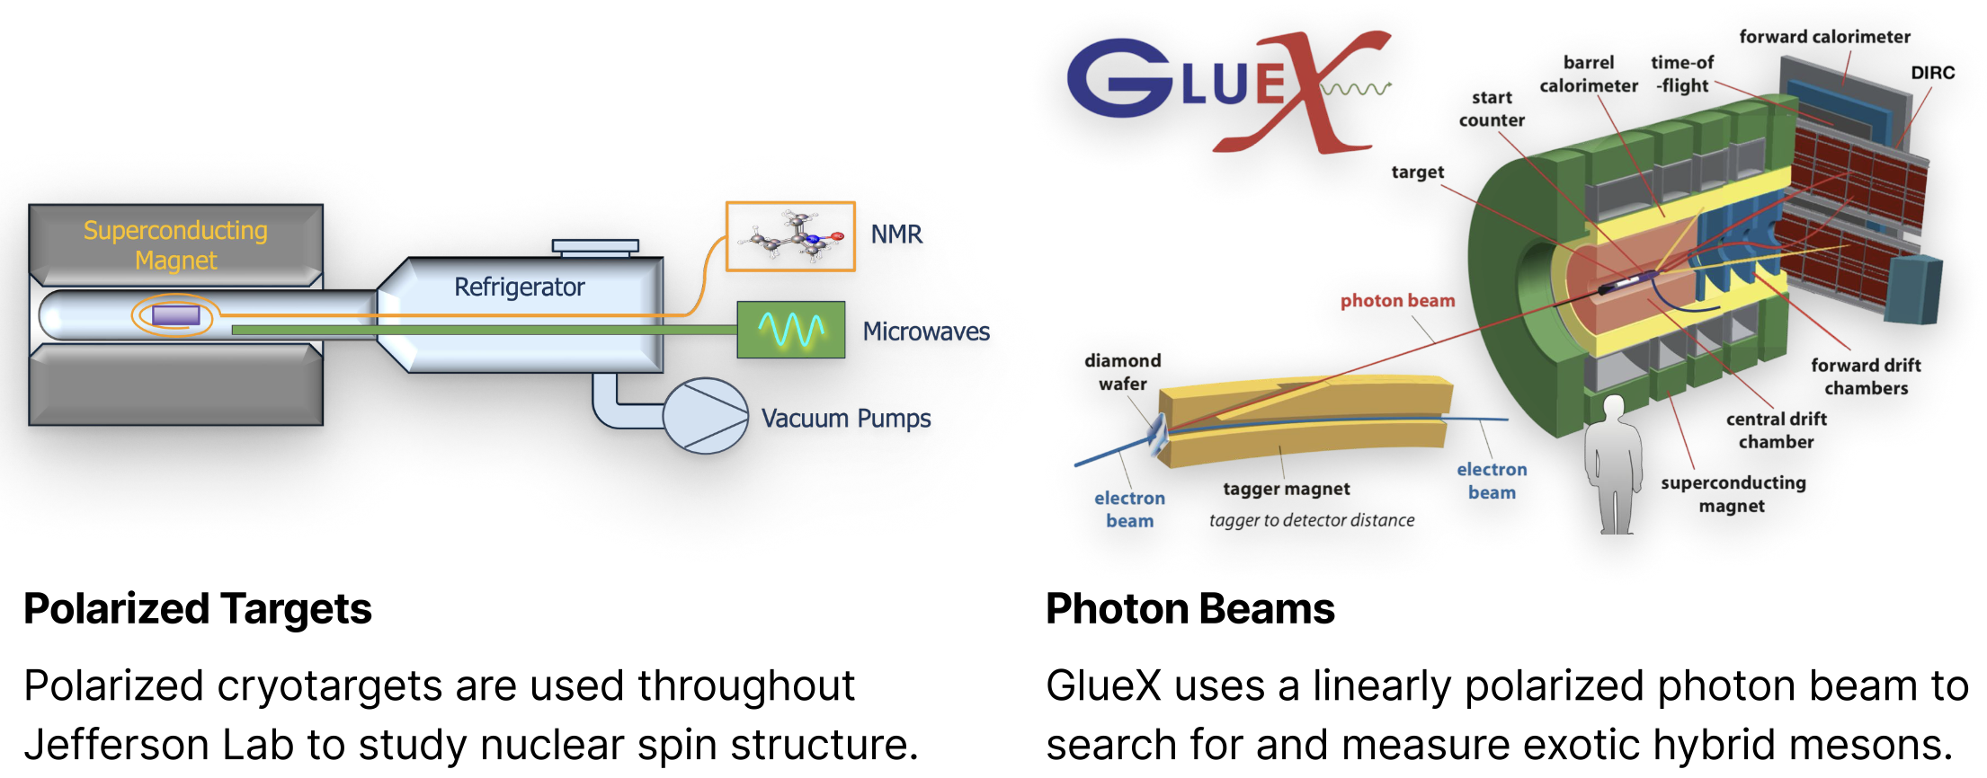
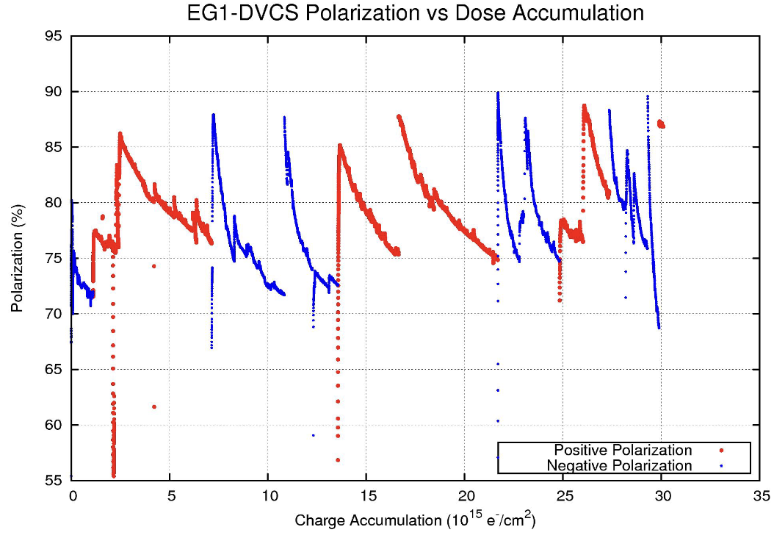
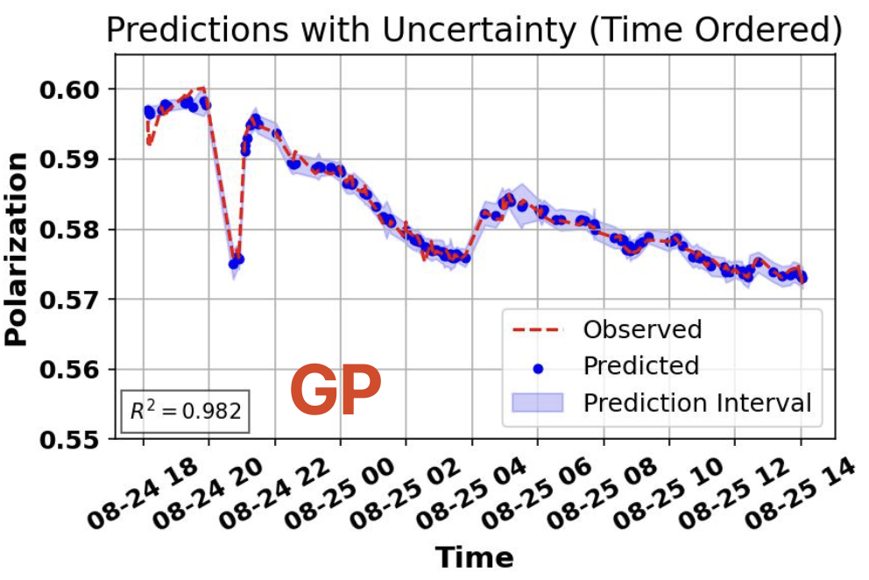
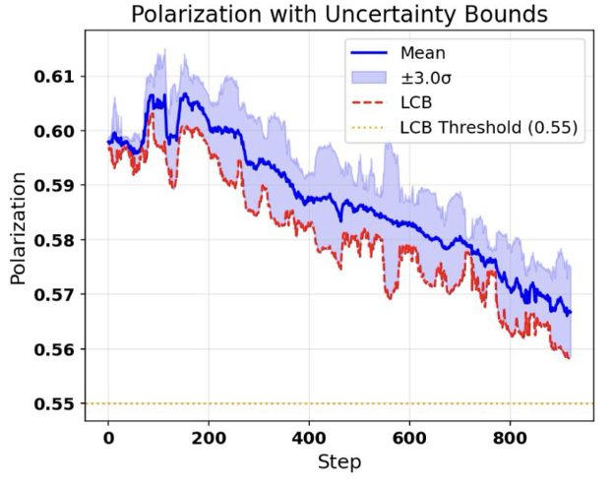
AI Optimized Polarization
The optimal polarization decreases due to the electron beam from CEBAF creating additional radicals, requiring adjustments from the shift crew.
Shift crews are responsible for maximizing polarization, by continuously adjusting the microwave frequency
With a surrogate model trained on
a single sample (P07), the RL agent
is able to closely reproduce human
operation.
AI/ML Activities at Jefferson Lab | JLUO Meeting 2026

Slide 11
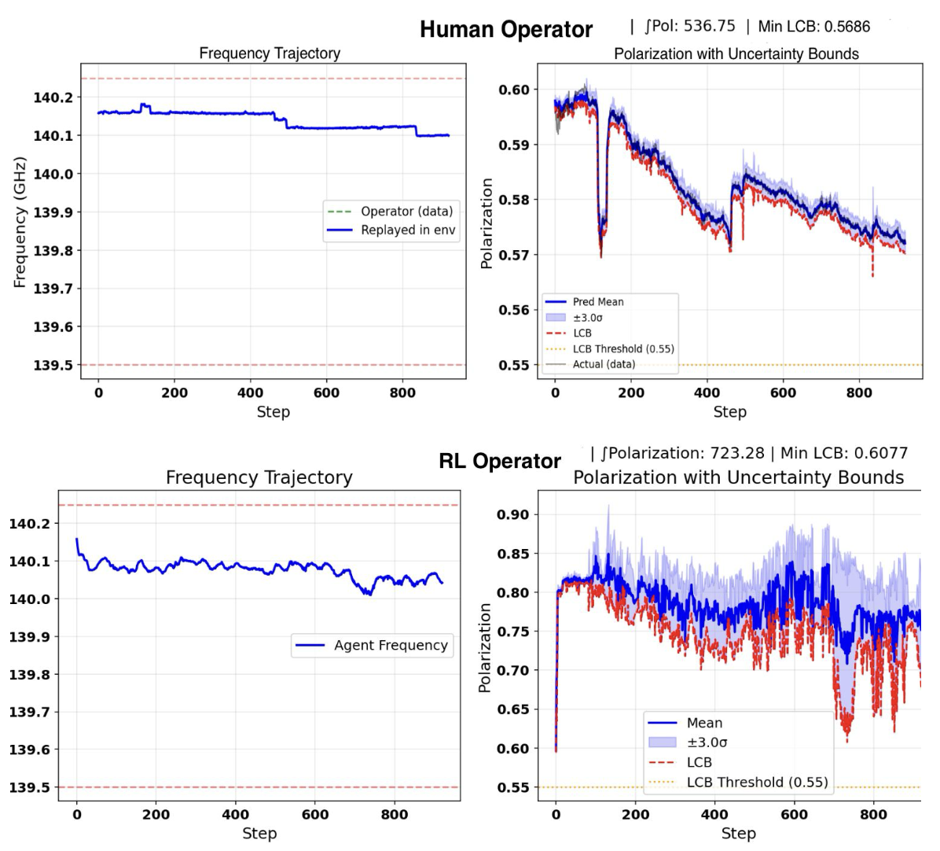
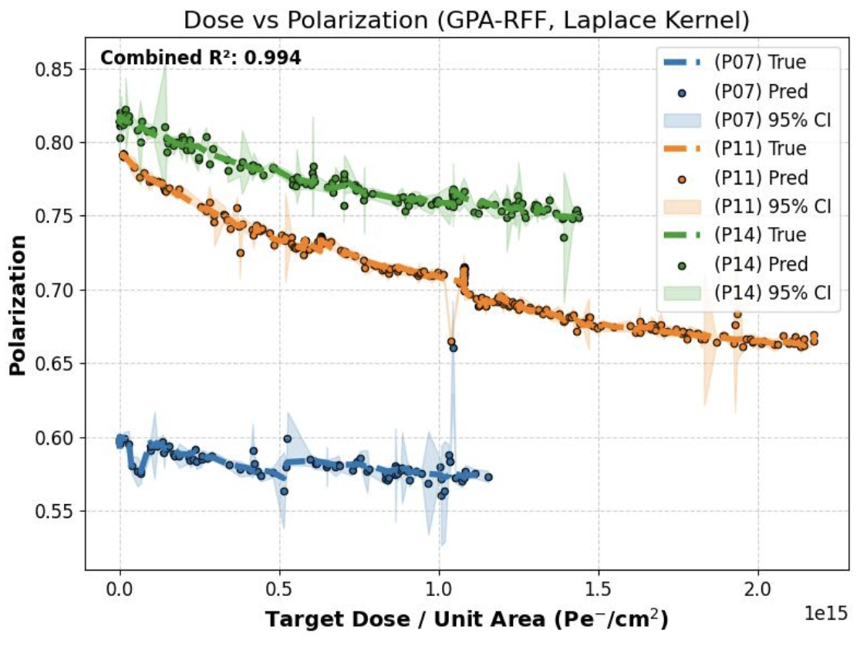
AI Optimized Polarization
With a surrogate model trained on​​
multiple samples, the RL agent​​
is able to out-perform human​​
operation.​
POC: Torri Jeske (roark@jlab.org)
AI/ML Activities at Jefferson Lab | JLUO Meeting 2026

Slide 12
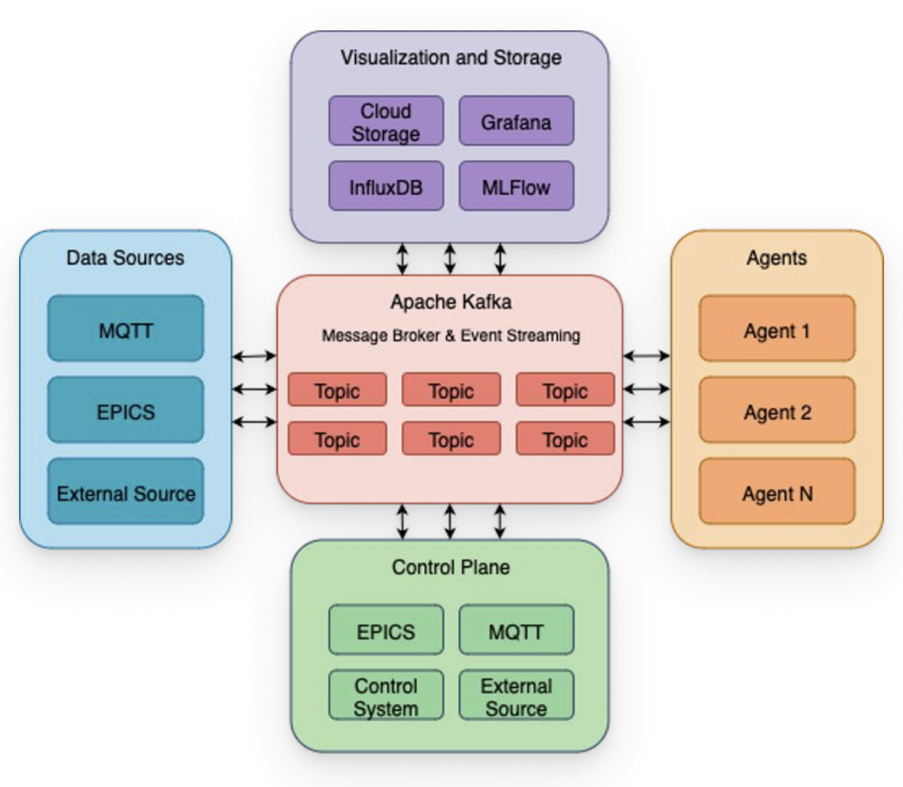
SMOCS
Kafka-based distributed data streaming platform designed for real time data streaming, processing, ML model training/inference, and controls, originally designed for accelerator and industrial applications
Your complex System
POC: Armen Kasparian (armenk@jlab.org) & Kishan Rajput (Kishan@jlab.org)
Documentation: https://pages.jlab.org/datascience/smocs_docs/
AI/ML Activities at Jefferson Lab | JLUO Meeting 2026

Slide 13
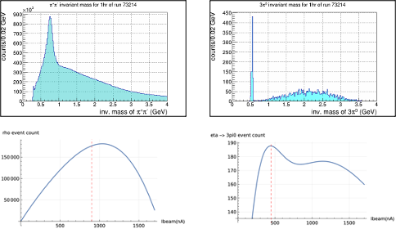
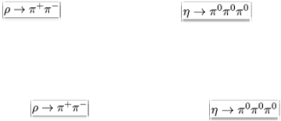


CEAC: Coupling Experiments to Accelerator Controls
Couple real-time calibration, reconstruction, and physics analysis to accelerator and detector controls so that the experiment automatically minimizes its measurement uncertainty during data taking.
Two experiments are targeted:
Cross-section measurements with GlueX
  Large detector, modest beam parameters
Asymmetry measurements with MOLLER
  Simpler detector, larger number of beam parameters
POC: David Lawrence (davidl@jlab.org)
AI/ML Activities at Jefferson Lab | JLUO Meeting 2026
Notes:
The plots here on the right are a little hard to read, but they show:
UPPER LEFT: the two pion invariant mass for an hour of data taking. The bump in the histogram sits at the rho mass region.
LOWER LEFT: Rho meson event count as a function of electron beam current from CEBAF.
UPPER RIGHT: three pion invariant mass for an hour of data taking. The bump in the histogram sits at the eta mass region.
LOWER RIGHT: the number of eta's decaying to 3 neutral pions as a function of electron beam current from CEBAF.
Since we want the most statistics for measuring a cross section, the beam current selection matters. This is what kind of informs the multi-objective nature of this problem – if we change our minds and want to measure rho as opposed to eta, we would need to modify the beam current to account for running at 500 nA, we'd see a lot less rho mesons. Hopefully that makes sense.

Slide 14
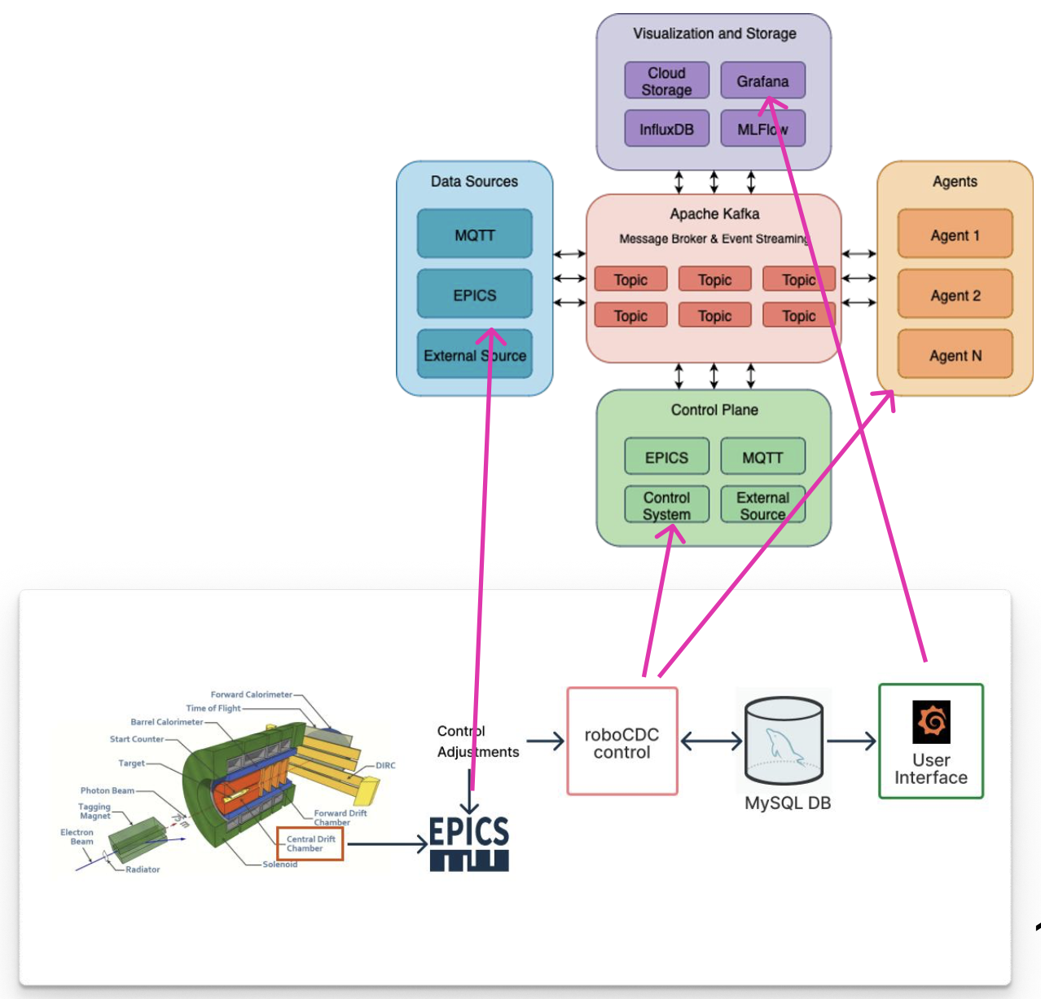
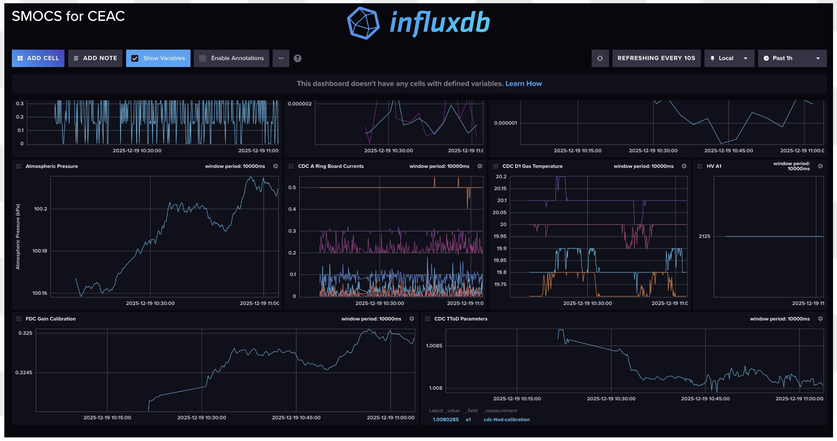
CEAC: Coupling Experiments to Accelerator Controls
SMOCS as Infrastructure for Online Calibrations
Calibrations are currently done on a run-by-run basis for each detector subsystem.
The CEAC project requires fast, more frequent online calibrations for many of the GlueX detector components.
For the drift chambers, we can use linear and Gaussian process regression to calibrate the gain drifts associated wit h changes in the atmospheric pressure.
AI/ML Activities at Jefferson Lab | JLUO Meeting 2026

Slide 15
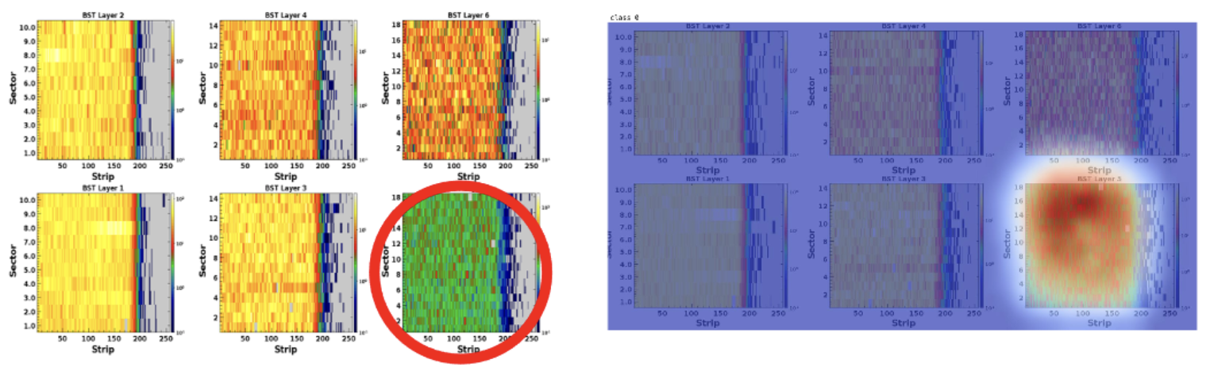
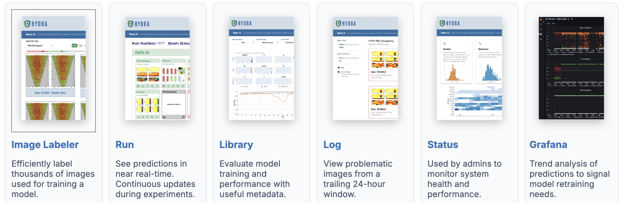
Hydra
Framework for organizing, training, and deploying models on image-based data​
  Computer vision for online data quality monitoring​
  Unsupervised techniques for automated labeling, clustering, and anomaly detection​
DB-RAG: Talk to Your Database in Plain English
A RAG-powered interface that converts natural language questions into SQL queries using database schema context.
Workflow:
  Ask in plain English
  SQL generated automatically
  Preview results
  Export CSV
From question to CSV — no SQL required.
POC: Thomas Britton (tbritton@jlab.org)
AI/ML Activities at Jefferson Lab | JLUO Meeting 2026

Slide 16
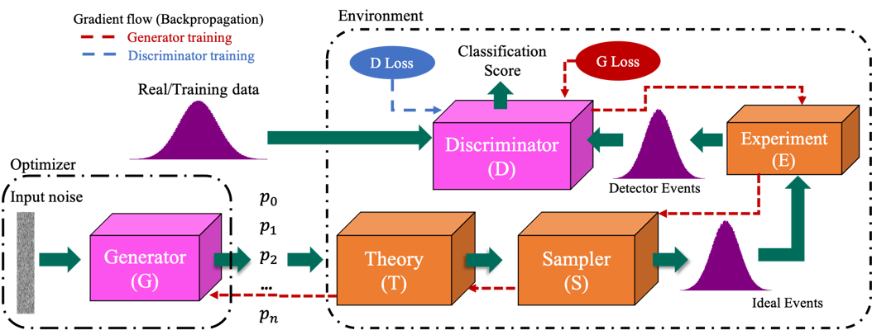
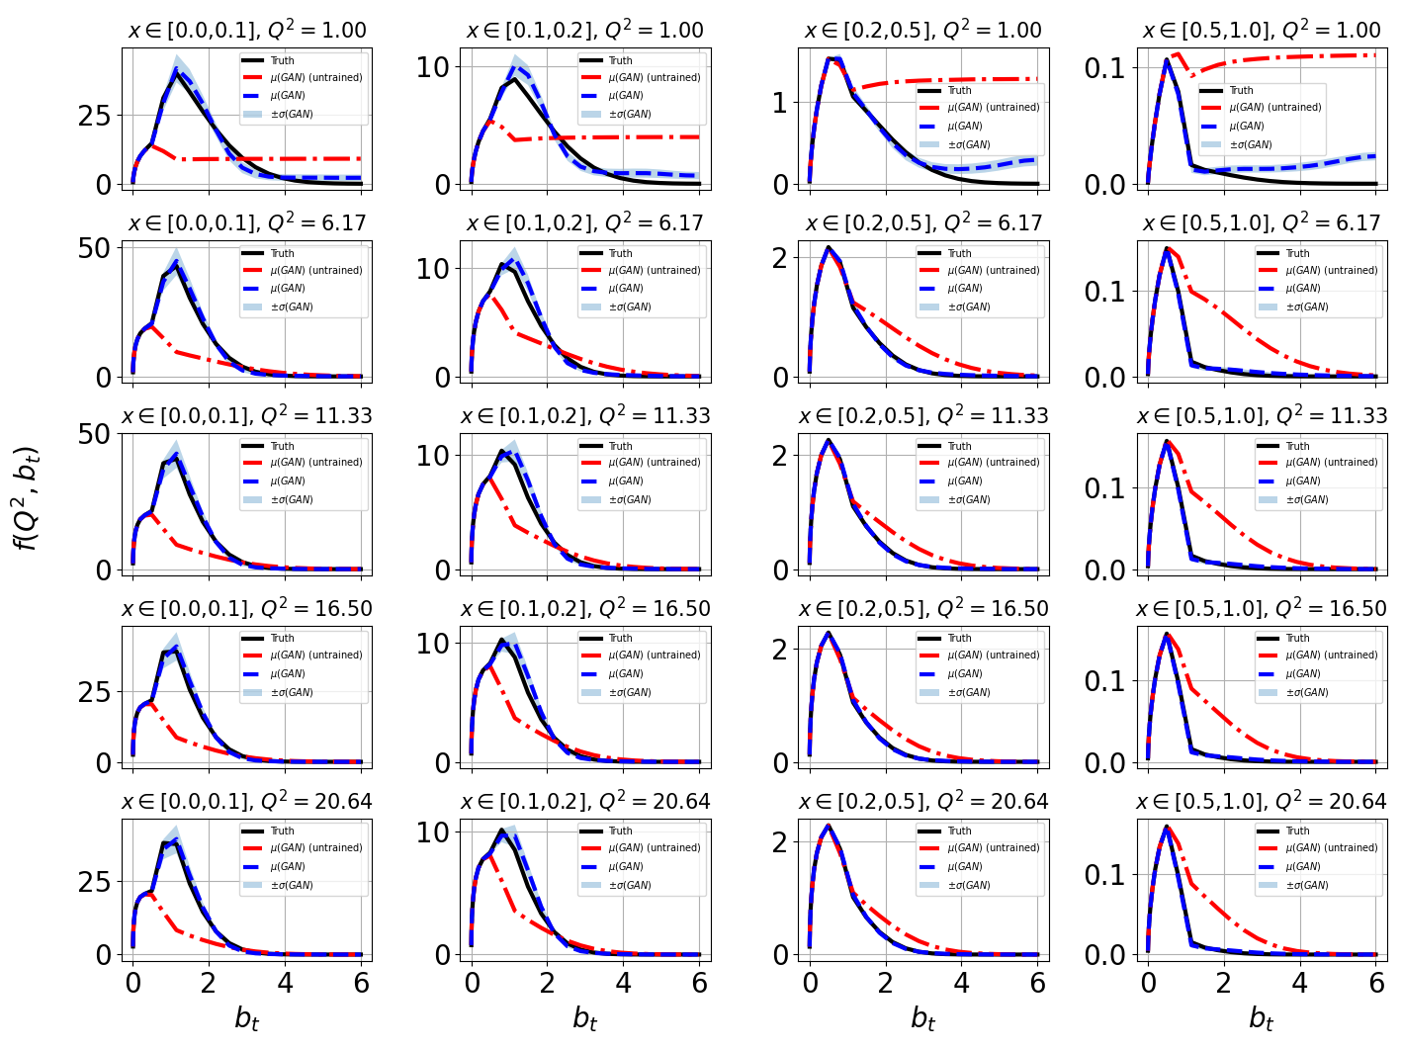
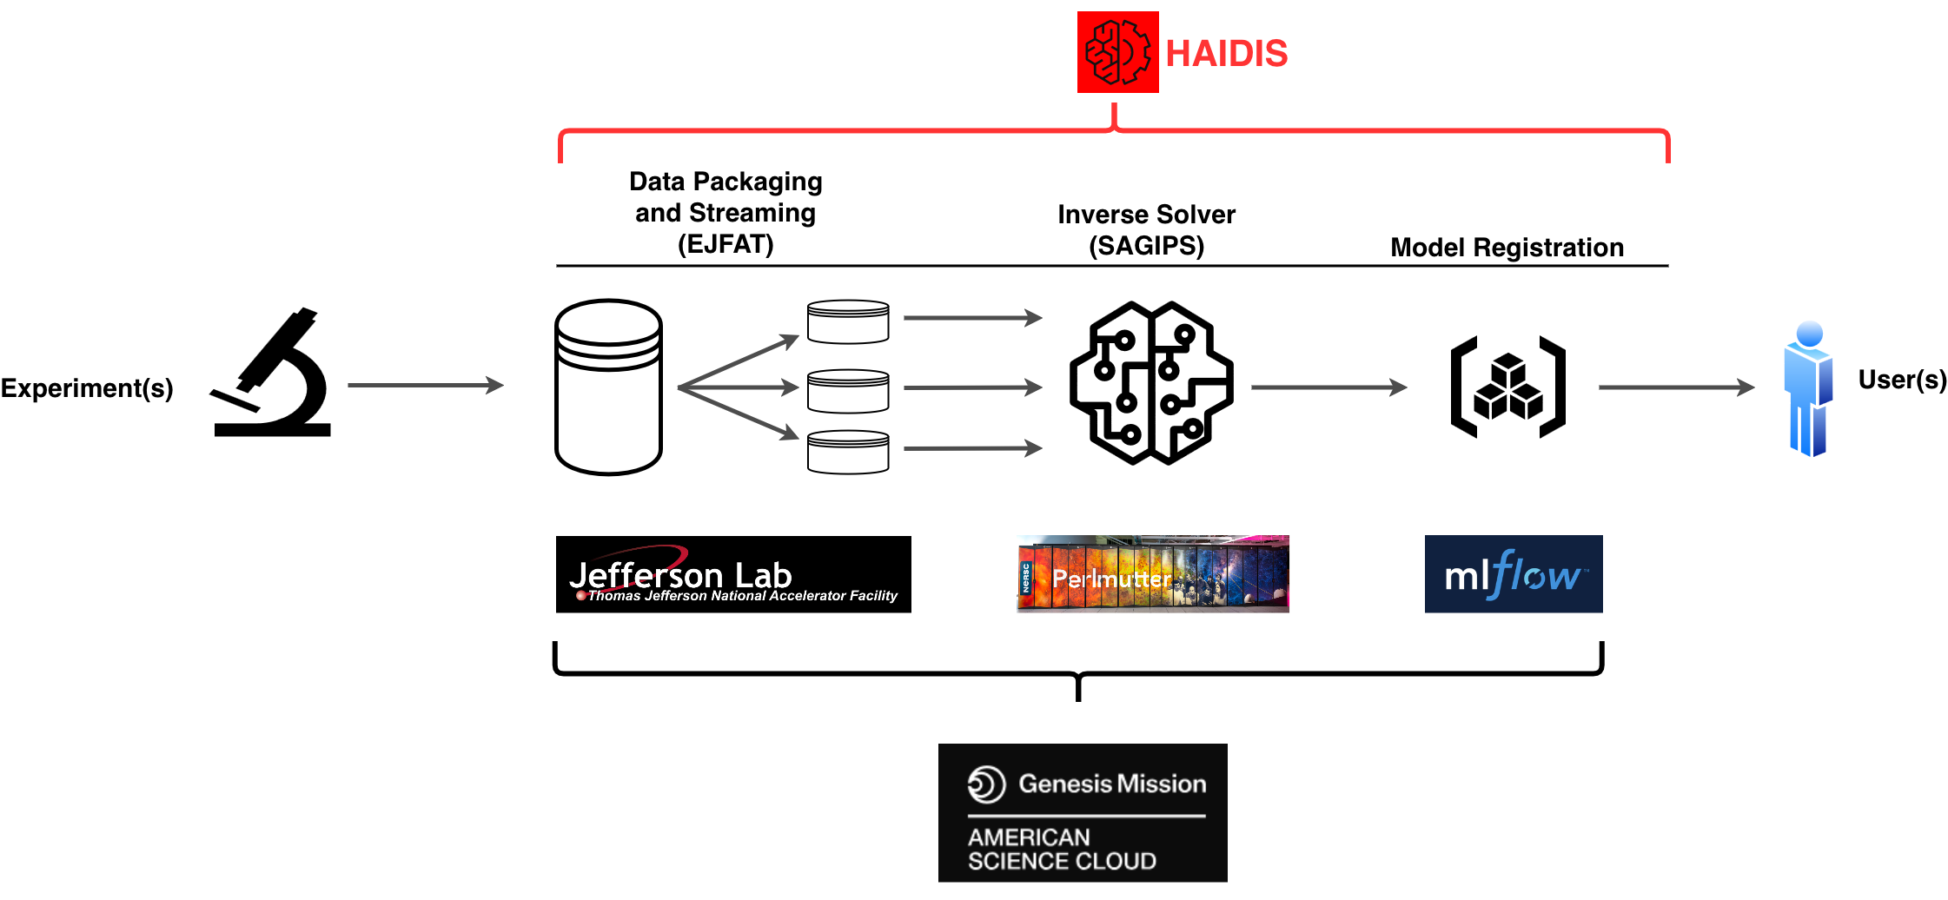
SAGIPS: Scalable Asynchronous Generative Inverse Problem Solver
QuantOm: Nuclear Tomography --> Extract 3D image of the proton from nuclear scattering data
Analysis of synthesized scattering data on Aurora
SAGIPS successfully recovered input distributions, utilizing multiple Aurora GPU nodes.
POC: Daniel Lersch (dlersch@jlab.org)
AI/ML Activities at Jefferson Lab | JLUO Meeting 2026

Slide 17
AI/ML for Nuclear Theory
Simulation based inference (SBI) for femtoscale imaging
Combines theory and experimental simulations to reconstruct PDFs, TMDs and GPDs at event level data reconstruction of PDFs, TMDs
Supported by SciDAC-5
Norm Flows for QCD global analysis
Gen AI approach for Bayesian inference with classical non-differentiable global analysis toolkits
Supported by LDRD 25
Norm Flows for pixel based GPD reconstruction
NF based Bayesian inference of GPD reconstruction
Supported by LDRD 24-25
SBI4EIC
Conditional flow matching diffusion large scale model for EIC physics inference
Supported under NESAP program
Quantum state representation via ANN
ANN representation of quantum field theory wave functional built on hamiltonian formalism.
Supported by theory.
Science Apps with AI agents
AmSC funded project of science apps (QCD global analysis, SBI4EIC, LQCD) with AI agents
Supported by AmSC FemtoMind project.
AI/ML Activities at Jefferson Lab | JLUO Meeting 2026

Slide 18
Other AI/ML Activities
CLAS 12 AI working group: https://clasweb.jlab.org/wiki/index.php/CLAS12_AI_Group#tab=CLAS12_AI_2FML_Group
2026-present: ALHADIN Genisis Proposal, LLMs for hadronic data mining and preservation (M. Battaglieri)
2026-present: MLPs for ALERT track finding (M. Ouillon)
2026-present: ALERT particle identification with MLPs (U. Weerasinghe)
2026: Kaon contamination reduction with Random Forest decision trees (C. Pecar)
2026: RICH particle identification with GNNs (R. Milton)
2026-present: µCLAS12 absorber energy loss estimation based on MLPs (T. Cao) · 2026: Fast CLAS12 electromagnetic showers with generative models (C. Fanelli)
2025-present: AiDAPT, AI for Data Analysis and Preservation with GANs (M. Battaglieri)
2025: CLAS12 central neutron/photon identification with MLPs and BDTs (N. Pilleux)
2025: GNNs for hyperon extraction and vertexing (M. McEneaney)
2025: Neural networks for DVCS form factor extraction (Y. Wang)
2025: RGM Neural Network-based neutron identification in the CLAS12 central detector (N. Wright)
2025-present: GNNs for CLAS12 central hit denoising (R. Tyson)
2025-present: CLAS12 and µCLAS12 forward track finding based on Multi-Layer Perceptron networks (T. Cao)
2025-present: CLAS12 and µCLAS12 forward, hit-based track fitting based on Transformer networks (T. Cao)
2025: Object condensation for CLAS12 forward calorimeter clustering (G. Matousek)
2024-present: CLAS12 lepton identification with TMVA (M. Tenorio-Pita)
2024: Dilepton background modeling with Boosted Decision Trees (P. Chatagnon)
2024: CLAS12 forward photon classification with gradient BDTs (G. Matousek)
2024: Converting sWeights to Probabilities with Density Ratios (D. Glazier)
2024: Detector pulse compression using AI/ML (F. Rossi)
2022-present: Hydra online data quality monitoring (T. Jeske)
2022-present: macparticles: fast simulations with neural networks and decision trees (D. Glazier)
2021-present: CLAS12 forward hit denoising based on Convolutional Auto-Encoders (R. Tyson)
AI/ML Activities at Jefferson Lab | JLUO Meeting 2026

Slide 19
Outline
Overview of AI/ML Capabilities (Data and Computational Science)
  Uncertainty quantification for ML
  Reinforcement Learning based optimization and Control
  Collaborators and Sponsors
AI/ML Activities in Experimental Halls
  AI assisted tracking and FPGA
  AI optimized Polarization, Coupling Experiments to Accelerator Controls, and SMOCS
  Inverse Problem Solvers and HAIDIS
  Many other activities
AI/ML Activities at CEBAF
  AI ready data and Agentic AI to help operations
Conclusion
  References, and point of contacts
AI/ML Activities at Jefferson Lab | JLUO Meeting 2026

Slide 20
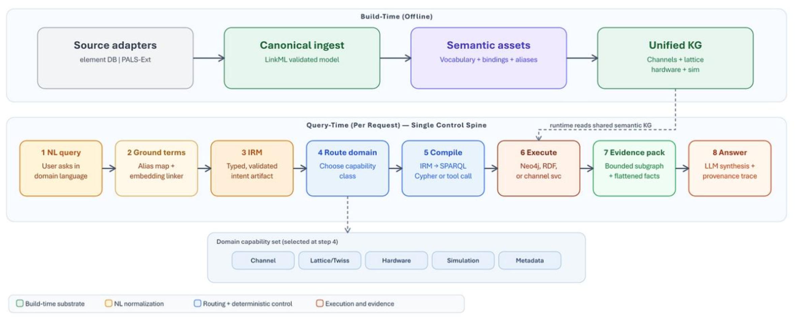
AI Ready Data for CEBAF / UITF
POC: Todd Satogata (satogata@jlab.org)
AI/ML Activities at Jefferson Lab | JLUO Meeting 2026

Slide 21

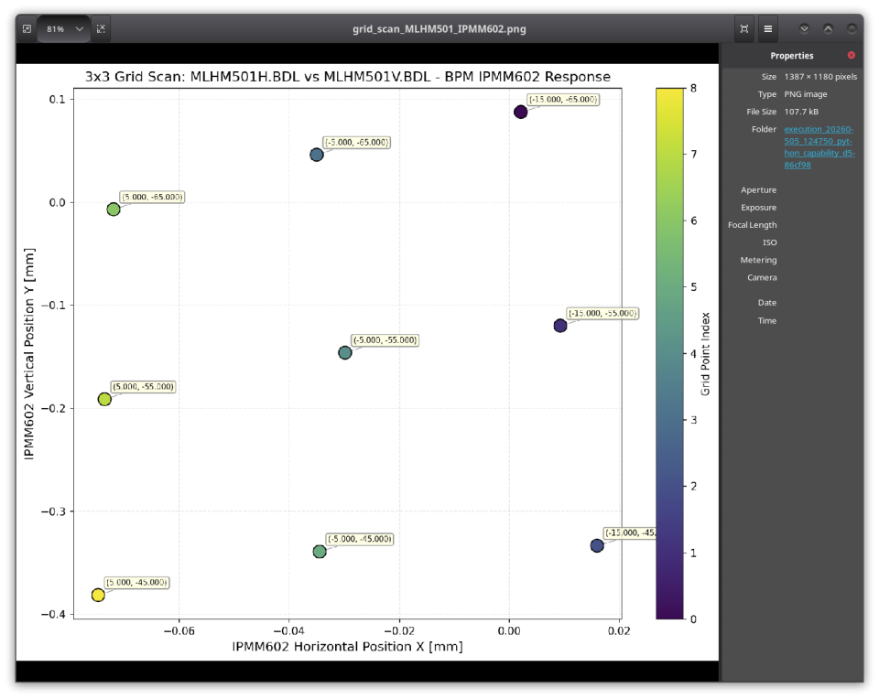

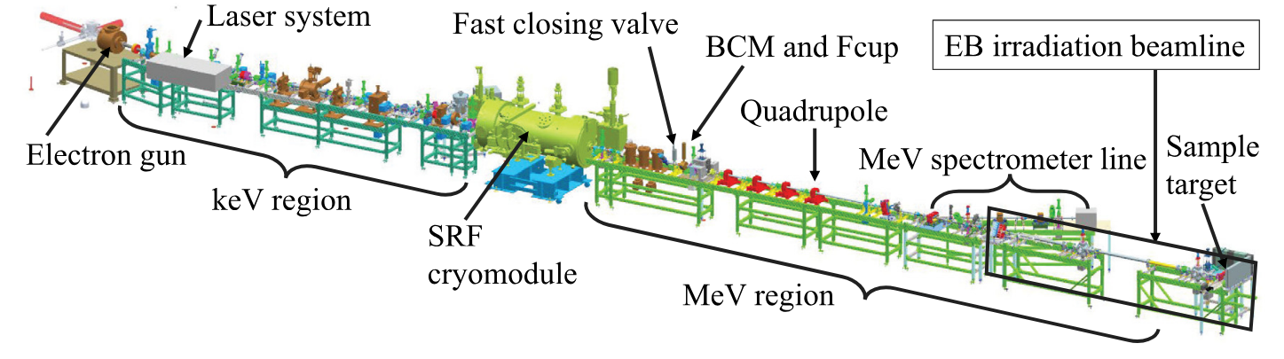
Agentic AI for Accelerators
PROMPT: “Vary the integrated field of MLHM501H.BDL and MLHM501V.BDL in a 3 by 3 grid scan from their baseline values in steps of 10, e.g. for each setpoint of MLHM501H.BDL, scan three steps of MLHM501V.BDL. Before each setpoint, ask for verification. Wait 7 seconds for signals to settle and record the measured horizontal and vertical beam positions from BPM IPMM505. Return corrector values to their baseline values. Plot X vs Y for all 9 points.
POC: Chris Tennant (tennant@jlab.org)
AI/ML Activities at Jefferson Lab | JLUO Meeting 2026

Slide 22
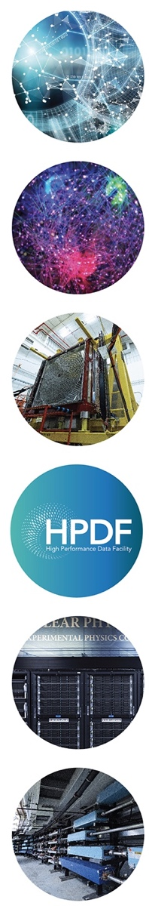
Conclusion | Strategic Areas of AI at Jefferson Lab
Data as a Catalyst for AI Innovation: Connecting AI with the discovery potential of data through FAIR data integration, governance, and stewardship for broader impact and innovation.
Femtoscale Imaging: Advancing nuclear physics through AI-driven femtoscale imaging, bridging complex data analysis with nuclear theory to image quarks, gluons, and their interactions.
Integrated Compute-Detector Systems for Streaming Data: Integrating large-scale detector systems, AI, and computing for seamless data processing—from detector readout to nuclear physics analysis—enabling rapid insights and next-generation experimentation
HPDF: Multiscale Data Management Orchestration: Using AI to create user-centered and optimized tools for distributed workflows and data management.
Reconfigurable Optimization and Design: Adapt and optimize computing hardware resources based on user-specific needs.
Autonomous Accelerator Operations: Boosting facility efficiency and reliability through AI-driven optimization and control, enabling adaptive, autonomous operations for next-generation accelerator performance.
AI/ML Activities at Jefferson Lab | JLUO Meeting 2026

Slide 23
Backup

Slide 24
Backup | Genesis Mission
Models
Model Consortium
BASE-SAFE
Infrastructure
American Science Cloud
Data
Nuclear Physics AI Ready Data (NARAD)
Jefferson Lab submitted or partnered on around 60 proposals for recent Genesis RFA call
AI/ML Activities at Jefferson Lab | JLUO Meeting 2026

Slide 25
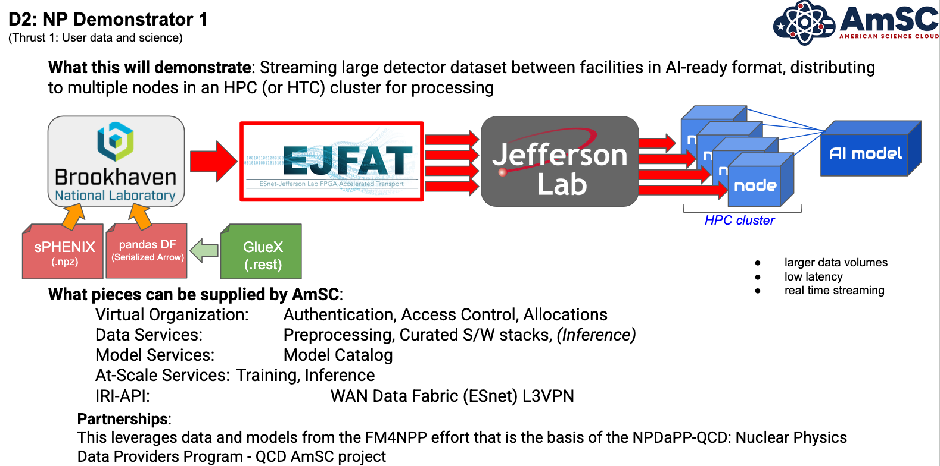
Backup | NP Demonstrator
AI/ML Activities at Jefferson Lab | JLUO Meeting 2026

Slide 26
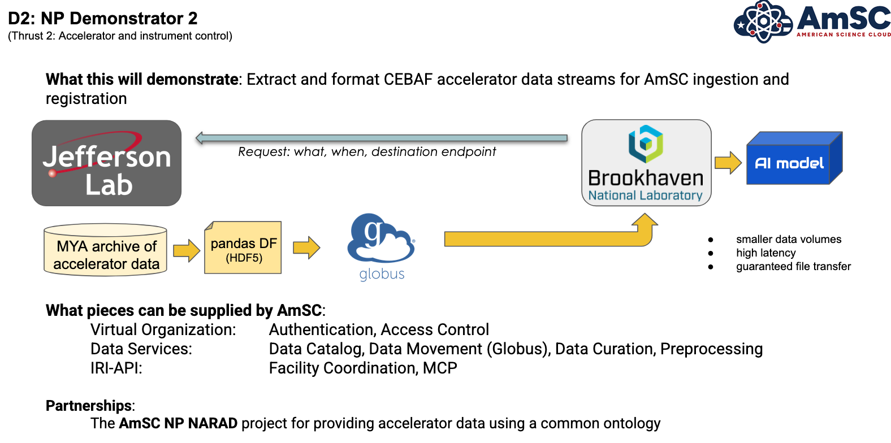
Backup | NP Demonstrator
AI/ML Activities at Jefferson Lab | JLUO Meeting 2026

