Slide 1


Data Management and Stewardship
JLab User Organization Annual Meeting
June 23, 2026
Laura Biven
Chief Data Officer, JLAB
Notes:
https://www.jlab.org/jluo2026
https://indico.jlab.org/event/1000/
1:45: -- 25 mins
Data management and stewardship
Speaker: Laura Biven

Slide 2
Introduction to the Chief Data Office at JLab
Motivating factors
FAIR for Data, FAIR4RS, and AI-Ready Data
Layers of Data Management
Gaps and Future Work

Slide 3
Chief Data Office at JLab

Slide 4


JLAB Chief Data Office https://www.jlab.org/about/leadership/cdo_office
Laura Biven
Chief Data Officer
orcid.org/0000-0002-5755-8449
My interests:
Enhancing innovation and integrity in science through the data lens
Building data infrastructure for creative, inquisitive research
Diana McSpadden
Data Scientist – Data Steward
https://orcid.org/0000-0002-8520-1631
My interests:
Data stewardship for scientific data
ML and uncertainty quantification for coastal flood management

Slide 5


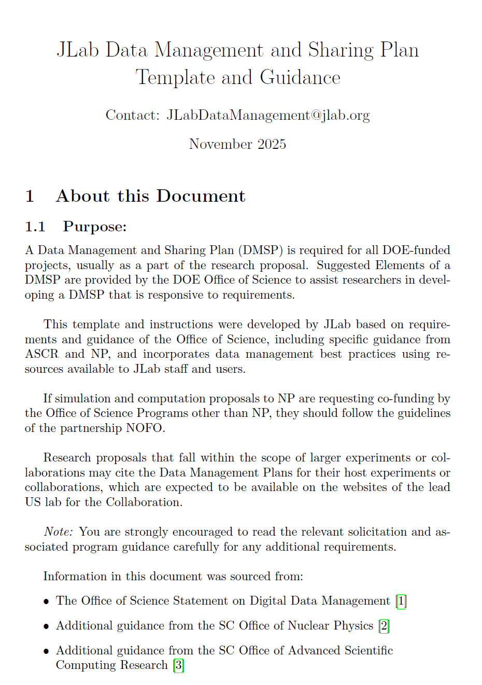
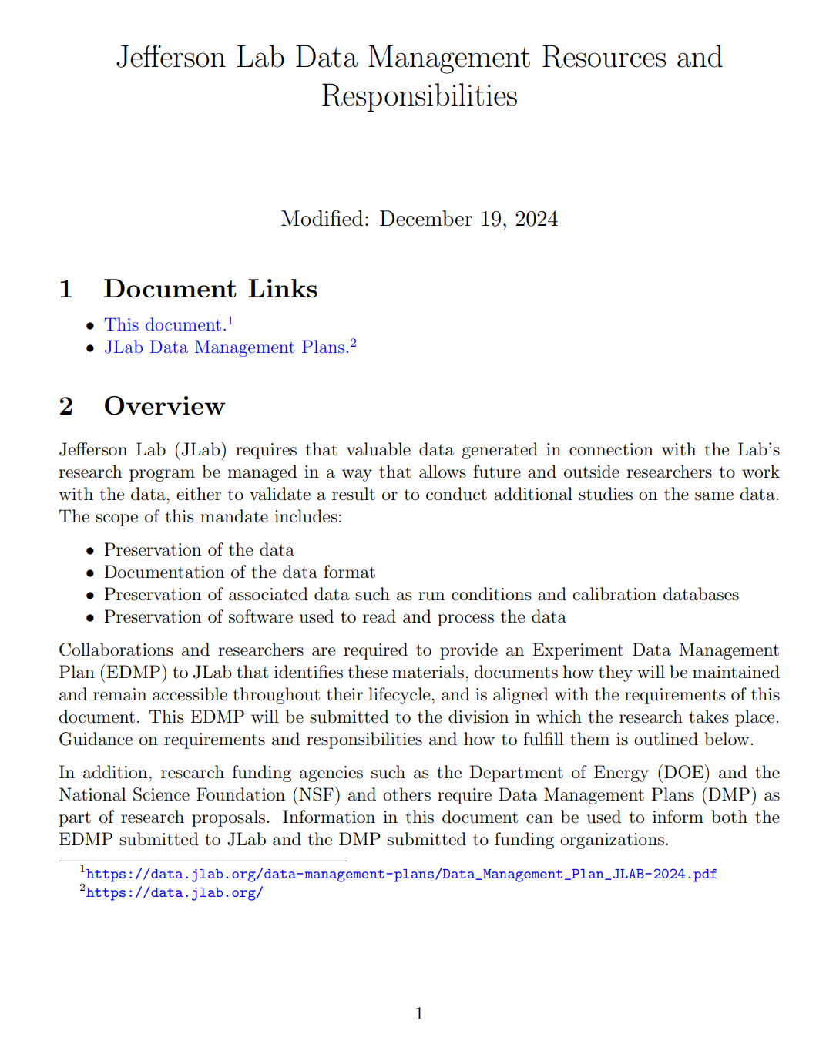
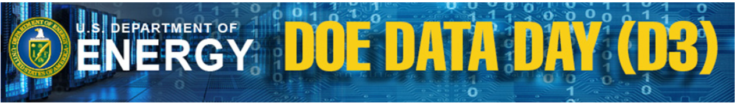

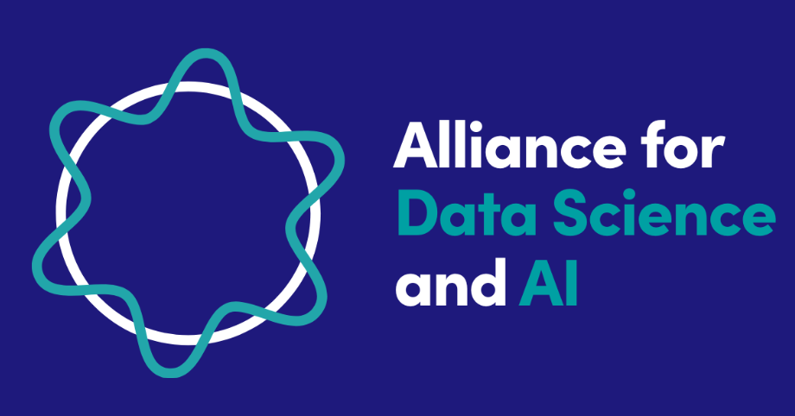
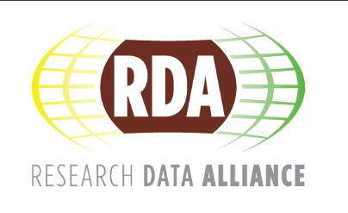
What we do (so far)
Cross-Lab, Data-focused Initiatives
JLab Guidance and Processes
DOE Data Curation Working Group
Data Stewardship
Community
Leadership roles in Genesis Mission for Data
Collaborators on active research projects
Governance support to research activities

Slide 6
Motivating Factors
Requirements, Initiatives, Your Science!

Slide 7
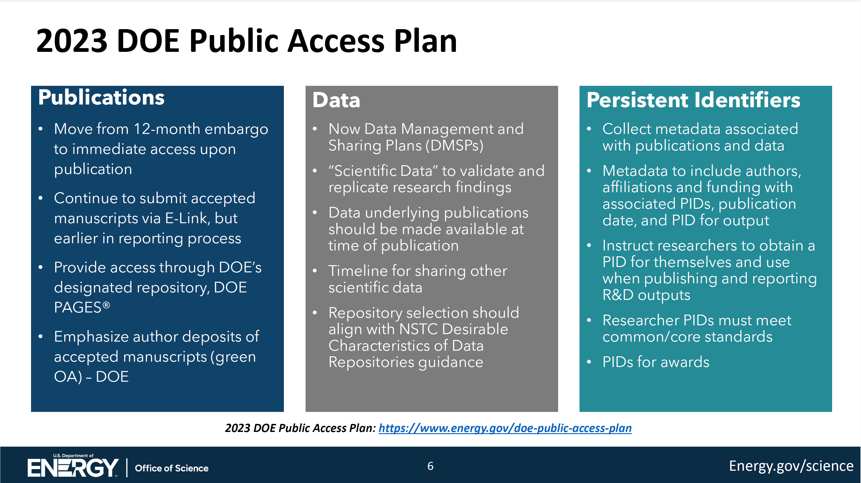
2023: DOE O241.C New Requirements
?
Notes:
https://www.osti.gov/stip/about/supporting-documentation/2411C

Slide 8
Gap
Each community needs to establish norms for “data underlying a publication” and revisit these as technologies and expectations change.
Each community needs to establish norms for data sharing timelines and revisit these as technologies and expectations change.

Slide 9
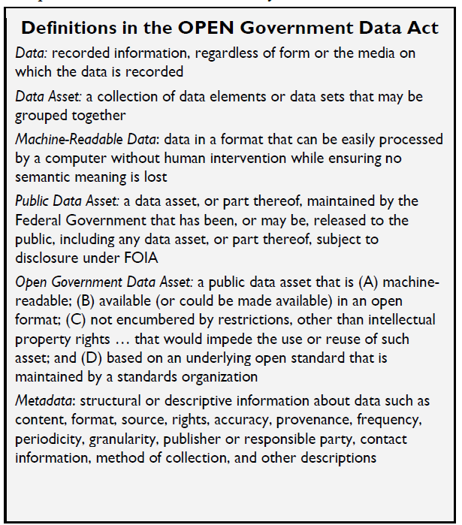
Some Terminology
Data Sharing
Data sharing means making data available to people other than those who have generated them. Examples of data sharing range from bilateral communications with colleagues, to providing free, unrestricted access to the public through, for example, a web-based platform.
Appropriate Sharing
The term “appropriate” is used to signal that public access to Federally-funded research results and data should be maximized in a manner that protects confidentiality, privacy, business confidential information, and security, avoids negative impact on intellectual property rights, innovation, program and operational improvements, and U.S. competitiveness, and preserves the balance between the relative value of long-term preservation and access and the associated cost and administrative burden.
(https://www.energy.gov/datamanagement/glossary)
Open Data
Open data is data that can be freely used, re-used and redistributed by anyone - subject only, at most, to the requirement to attribute and sharealike. (https://opendatahandbook.org/guide/en/what-is-open-data/)

Slide 10
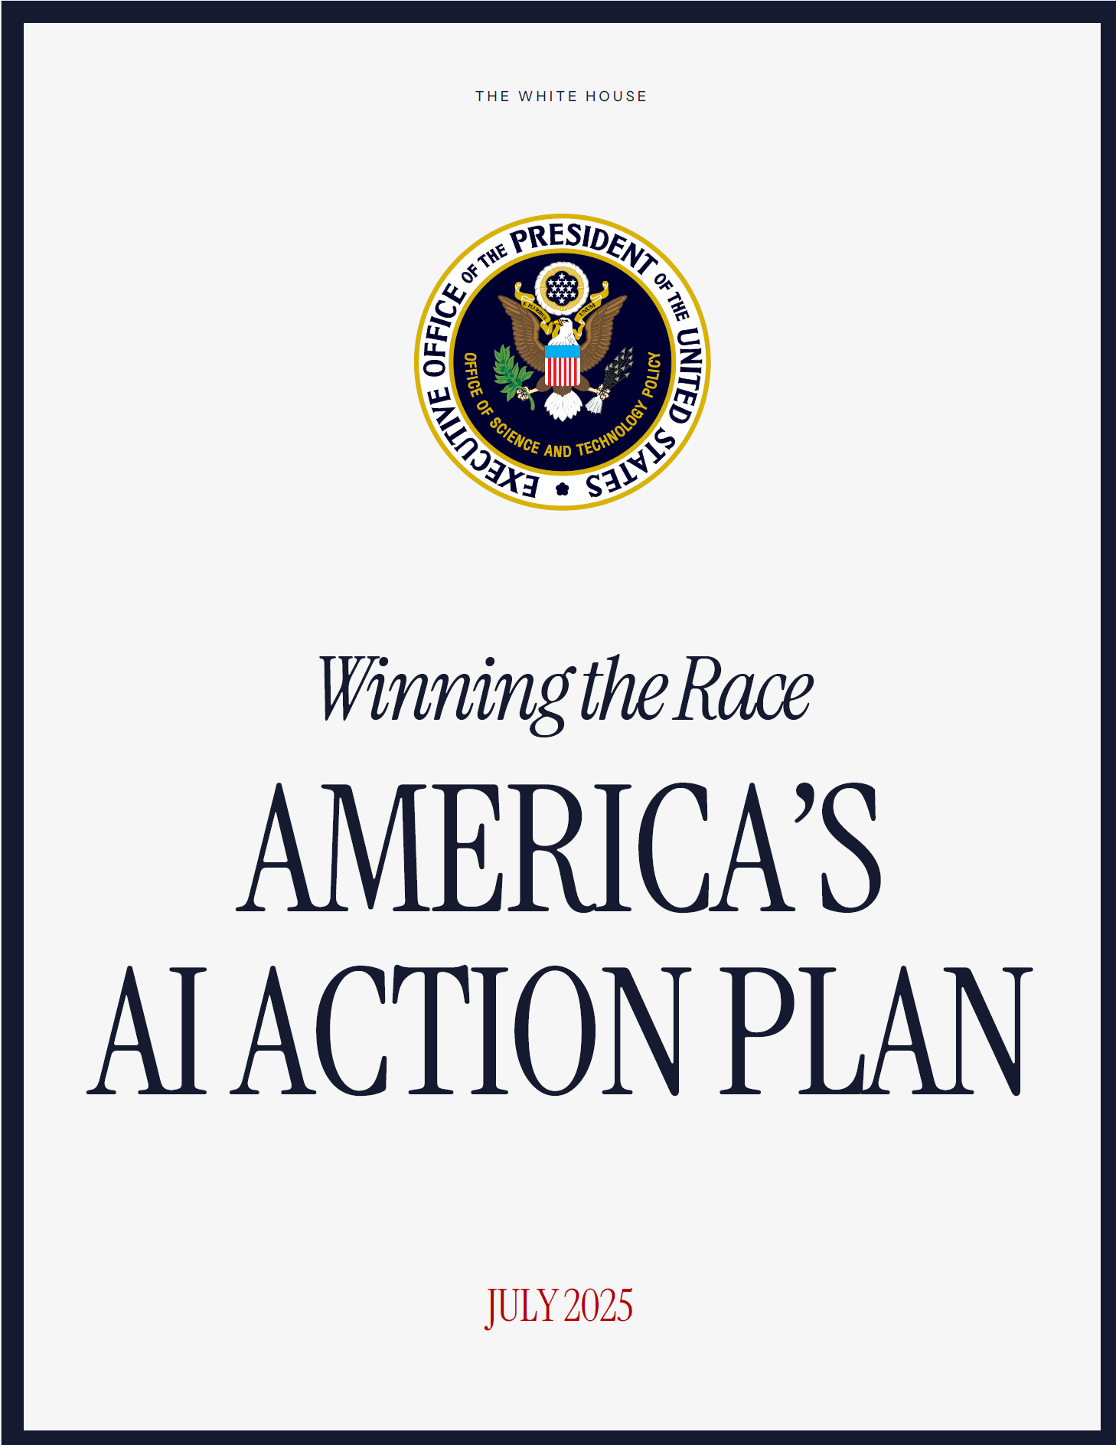
July 2025: AI Action Plan
Build World-Class Scientific Datasets
High-quality data has become a national strategic asset as governments pursue AI innovation goals and capitalize on the technology’s economic benefits. Other countries, including our adversaries, have raced ahead of us in amassing vast troves of scientific data. The United States must lead the creation of the world’s largest and highest quality AI-ready scientific datasets, while maintaining respect for individual rights and ensuring civil liberties, privacy, and confidentiality protections.
Recommended Policy Actions
Direct the National Science and Technology Council (NSTC) Machine Learning and AI Subcommittee to make recommendations on minimum data quality standards for the use of biological, materials science, chemical, physical, and other scientific data modalities in AI model training.”

Slide 11
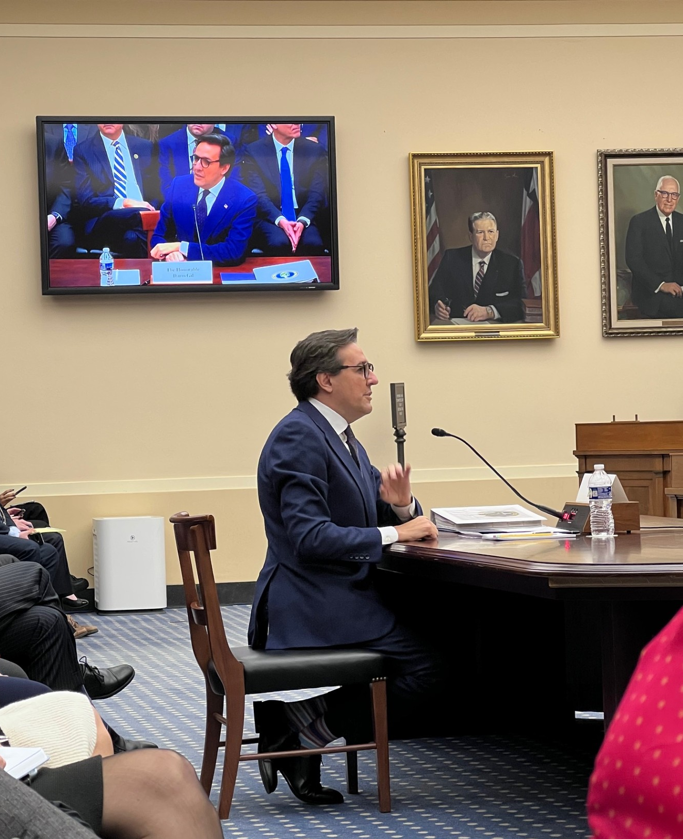
The Genesis Mission:
Prioritizing American Science and Technology Leadership
“The Genesis Mission will mobilize the Department of Energy’s 17 National Laboratories, industry, and academia to build an integrated discovery platform—The Genesis Science and Security Platform. The platform will connect the world’s fastest supercomputers, AI systems, and next-generation quantum computers with the most exquisite scientific instruments and data in the Nation…
This mission embodies our ambition to dramatically accelerate scientific discovery and to significantly increase the productivity and impact of R&D in the United States, which we aim to double within a decade.”
Under Secretary for Science, Darío Gil (December 10, 2025)
From testimony before the House Committee on Science, Space, and Technology
The Genesis Mission will produce "the world’s largest and highest-quality scientific data sets to train the next generation of AI systems".
Under Secretary for Science, Darío Gil
https://www.energy.gov/science/articles/under-secretary-gils-letter-community

Slide 12
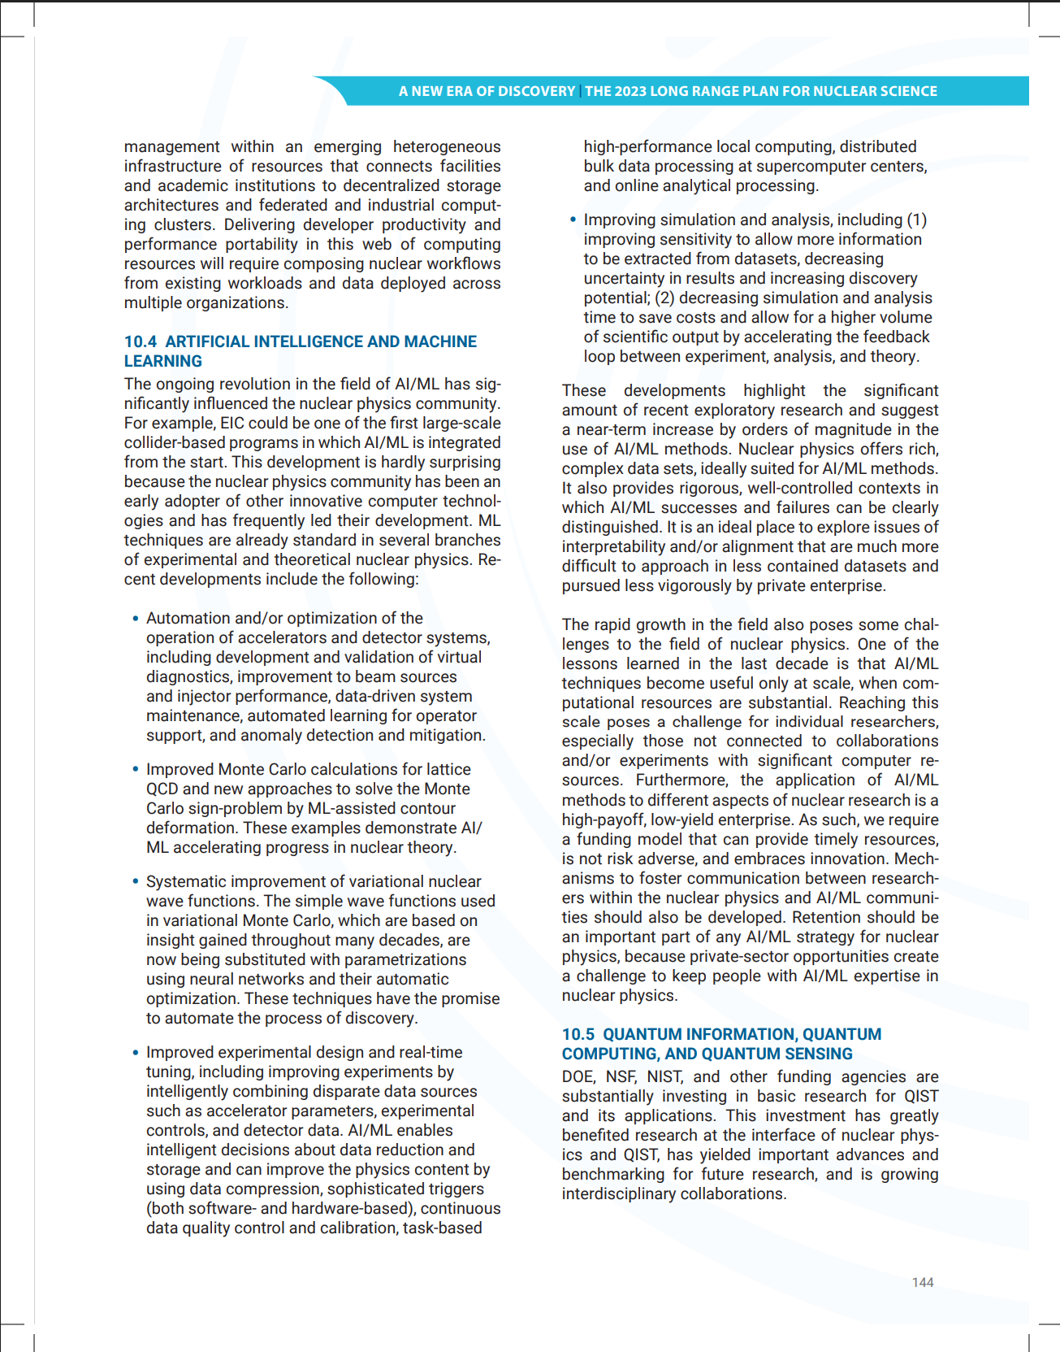
Nuclear Physics Long Range Plan 2023
Artificial Intelligence and Machine Learning—
The ongoing revolution in the field of AI/ML has already affected several aspects of nuclear physics, from nuclear theory to accelerator operation. To capitalize on this promise, a fast and effective funding model must be developed to bring the hardware and software resources as well as workforce training to individual researchers.
DOI # https://doi.org/10.2172/2280968
Notes:
https://nuclearsciencefuture.org/wp-content/uploads/2024/03/23-G06476-2024-LRP-8.5x11-pcg-v1.5-3.14.24.pdf

Slide 13
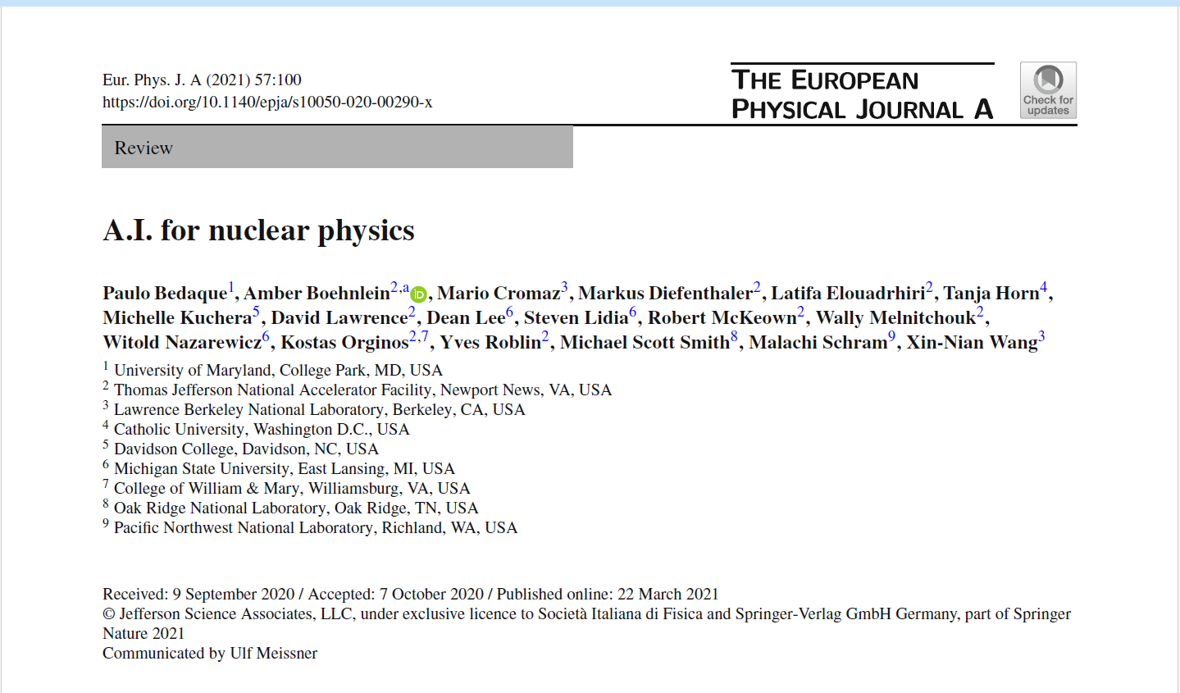

AI for Nuclear Physics Workshop
Need for comprehensive data management:
AI techniques are reliant on large volumes of data for training and the subsequent evaluation of models. For this reason, applications of AI are dependent on effective data management. Such data could be sourced from theoretical calculation, simulation, or experiment. Providing accessibility of the data to the wider NP community and increasing uniformity in data representation would create a connectivity across experiments that could increase collaboration and accelerate the development of AI techniques and tools. Such AI techniques could also facilitate near real time calibration and analysis. To maximize the usefulness of the data, it will be important to have standards on the processing of data, the application of theoretical assumptions, and the treatment of systematic uncertainties that will be used as training samples or as part of combined analysis. This meta-data will be encoded in the datasets.
https://doi.org/10.1140/epja/s10050-020-00290-x
https://www.jlab.org/conference/AI2020
Notes:
https://nuclearsciencefuture.org/wp-content/uploads/2024/03/23-G06476-2024-LRP-8.5x11-pcg-v1.5-3.14.24.pdf

Slide 14
Where is this going? (Laura’s predictions)
Increasing expectations for {data, code, documentation…} sharing
  More data, more immediate sharing, more context,
  Publications, data, code, and AI models are fully integrated, FAIR and AI-ready.
  Data governance at all stages of the lifecycle is explicit and computable.
Tensions between protecting data and openness
Emergence of global frameworks and standards for data and metadata
Where does “intelligence” live? Data, code, models…
Enhanced interplay between humans and AI
  Machines become better at understanding theory, not just data.
  Increasing need for validation and resiliency for AI in the scientific process
Emergence and Importance of a “Web of Science”

Slide 15
FAIR and AI-Ready Data

Slide 16
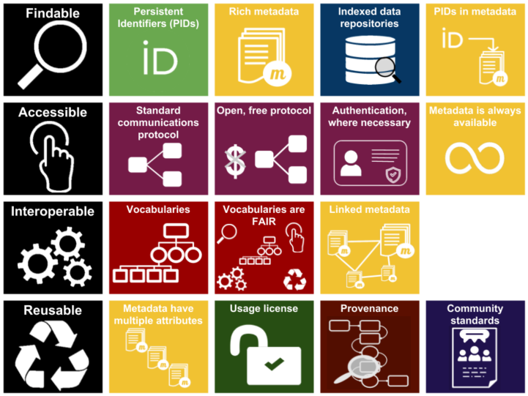

FAIR Principles for Data
https://www.gofair.foundation/interpretation
FAIR data infographic (CC-BY except F.A.I.R logos CC-BY-SA by Sangya Pundir)

Slide 17
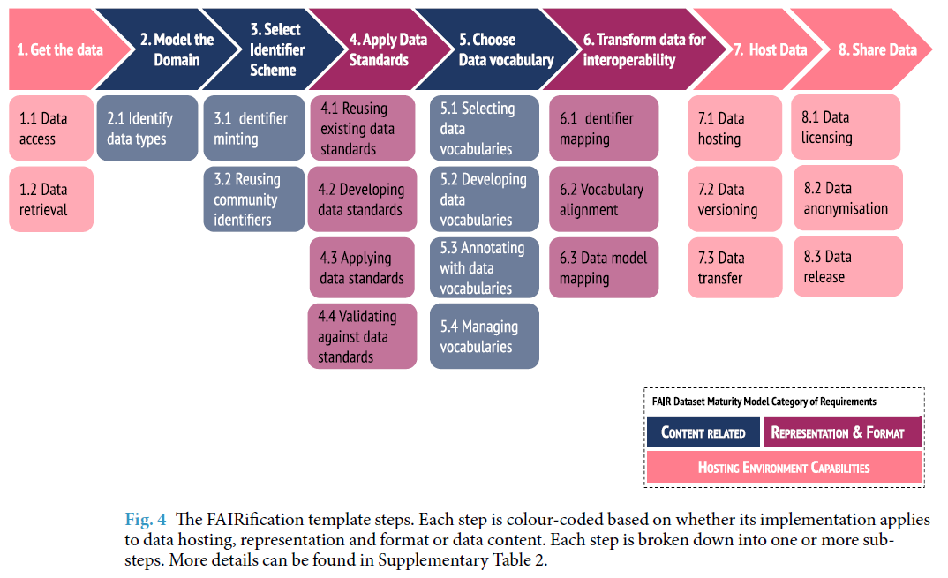
FAIRification
Welter, D., Juty, N., Rocca-Serra, P. et al. FAIR in action - a flexible framework to guide FAIRification. Sci Data 10, 291 (2023). https://doi.org/10.1038/s41597-023-02167-2

Slide 18
FAIR4…
FAIR4Workflows: https://workflows.community/groups/fair/
FAIR4HEP: https://fair4hep.github.io/ , https://fairos-hep.org/
FAIR4RS: https://www.researchsoft.org/blog/2024-03/
FAIR4AI: https://doi.org/10.1038/s41597-023-02298-6
FAIR4HPC: https://hpc-fair.github.io/ , https://doi.org/10.1145/3708035.3736097
FAIR training Materials https://doi.org/10.1371/journal.pcbi.1007854
FAIRDO – Digital Objects https://fairdo.org/
FAIR Principles for Research Hardware https://www.rd-alliance.org/groups/fair-principles-research-hardware
Desirable Characteristics for Repositories https://www.whitehouse.gov/wp-content/uploads/2022/05/05-2022-Desirable-Characteristics-of-Data-Repositories.pdf

Slide 19
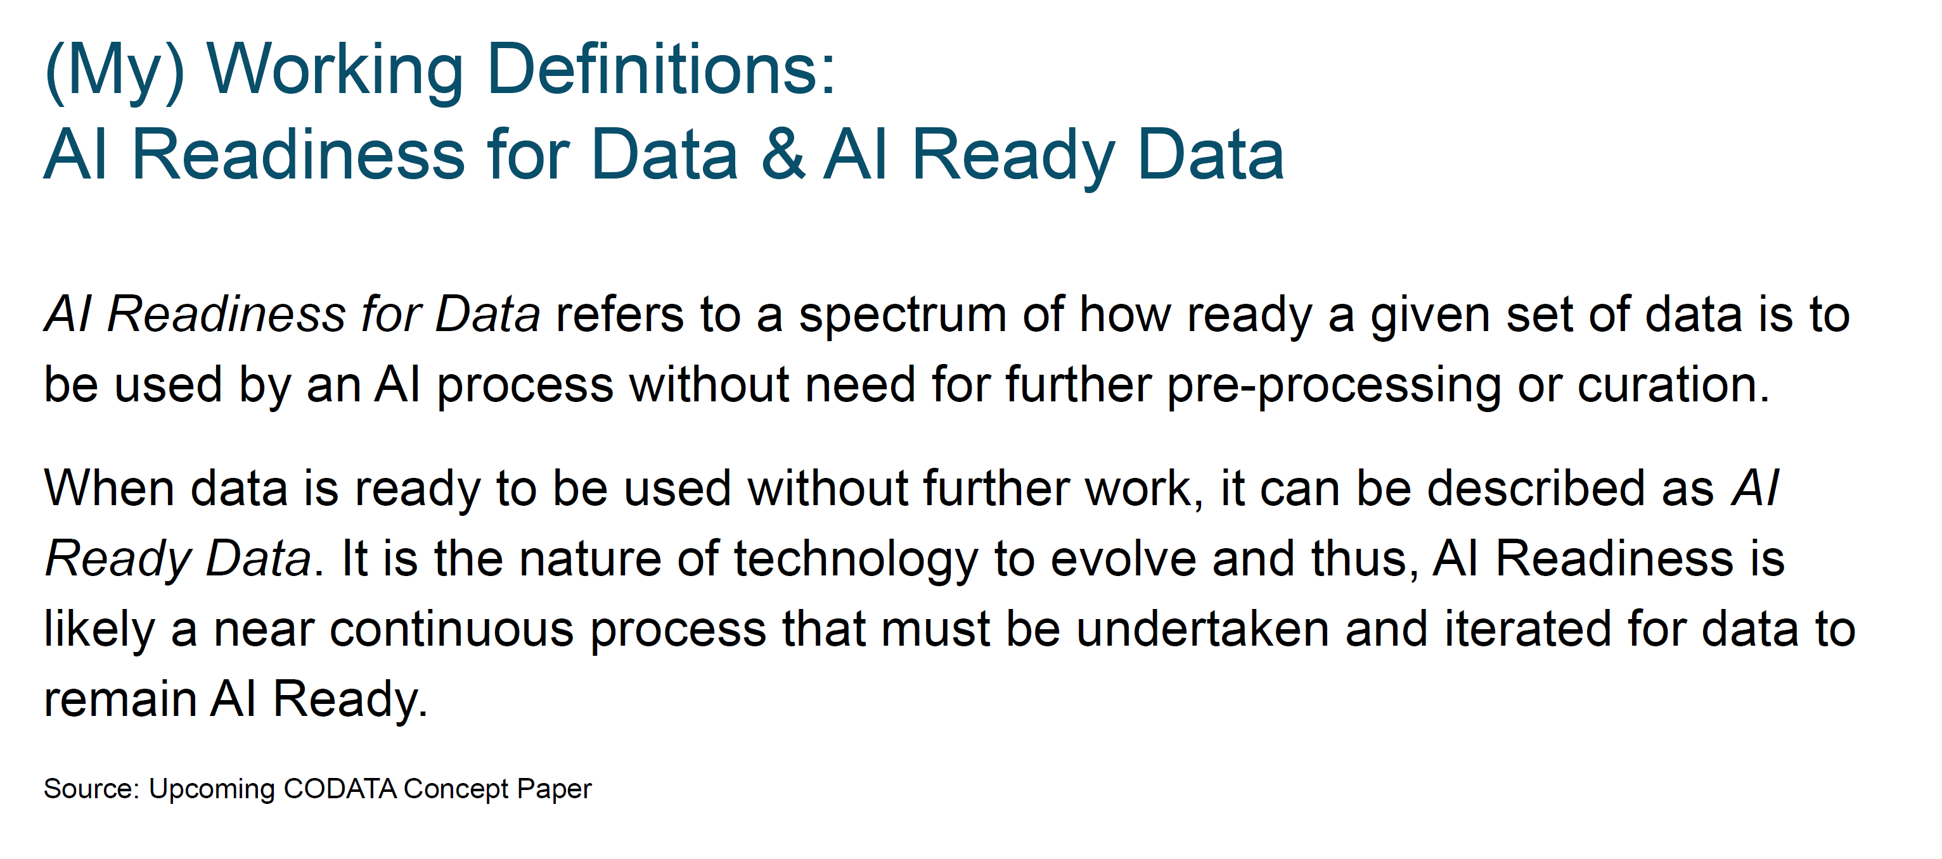
AI-Ready Data
Element level:
Data format
Metadata completeness, accuracy
Access…
Dataset level:
Balance or representativeness (bias)
Findability
Ability to generate more data…
Data for Model Training
Data for Inference
MA Data for Agents
Christine’s
Courtesy of Christine Kirkpatrick, “El Dorado or Troy? Demystifying FAIR and AI Ready Data” Data Readiness for AI Workshop (DRAI) at ICPP’25

Slide 20
FAIR for Research Software (FAIR4RS)
Making scientific software findable, reusable, and trustworthy

Slide 21
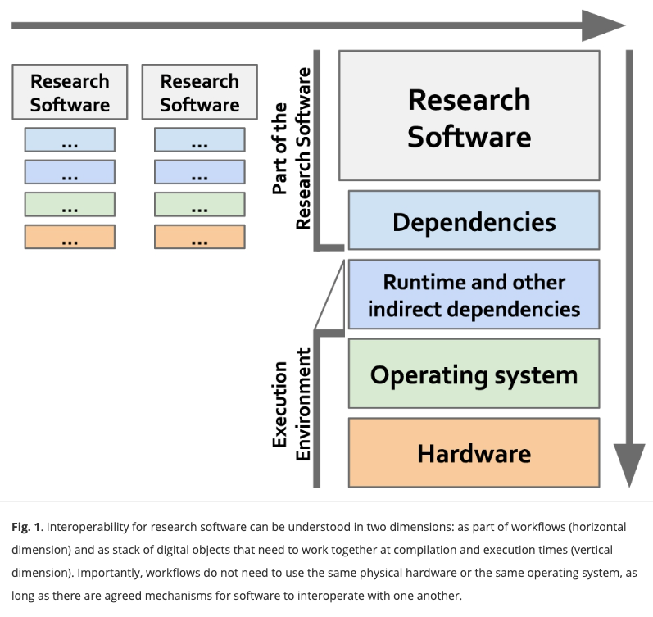
FAIR vs. FAIR4RS
[1] Lamprecht, A. L., Garcia, L., Kuzak, M., Martinez, C., Arcila, R., Martin Del Pico, E., ... & Capella-Gutierrez, S. (2020). Towards FAIR principles for research software. Data Science, 3(1), 37-59. https://doi.org/10.3233/DS-190026.
[2] Allen, R., & Hartland, D. (2018). FAIR in practice-Jisc report on the findable accessible interoperable and reuseable data principles. https://doi.org/10.5281/zenodo.1245567.
“interoperability has been found to be ‘the most challenging of the four FAIR principles. This, in part, is due to interoperability not being well understood’ [2]. In contrast to the rather static nature of data, research software are live digital objects that interact at different levels with other objects, e.g., other software, managed data, execution environments; and either directly and/or indirectly, as scripts or as part of a workflow (see Fig. 1). The interoperability principles are therefore even more challenging to apply to software, some are not directly applicable, others need to be rephrased and even new principles need to be defined to appropriately address the dynamic nature of software.” [1]

Slide 22
FAIR for Research Software
Git Repos are not enough
Missing Metadata
  Git = code storage
  FAIR = metadata-driven
Missing Relationships
  Git does not encode:
    “this model depends on that dataset”
    “this workflow produces that output”
No Preservation Guarantee
  GitHub ≠ archive
  FAIR requires long-term stewardship
Execution ≠ Reproducibility
  “Code runs on my machine” problem
From code to FAIR ecosystem
Git (baseline)
  Code + version control
Metadata
  CITATION.cff, codemeta.json, DOI (Zendodo/Software Heritage)
Reproducibility
  Containers, environments, MLFlow experiment tracking
Interoperability
  Schemas, APIs, shared data models, e.g., LinkML, JSON Schemas
Standardized APIs
Relationships
  Registry patterns + IDs
  Graph/ontology layer (e.g., RDF/PROV-O)

Slide 23
Layers of Data Management

Slide 24
Layers of data management
Data Management Planning
Persistent Identifiers
Metadata
Data Documentation
Governance
Data Sharing
Provenance and Analysis Preservation
Reuse

Slide 25
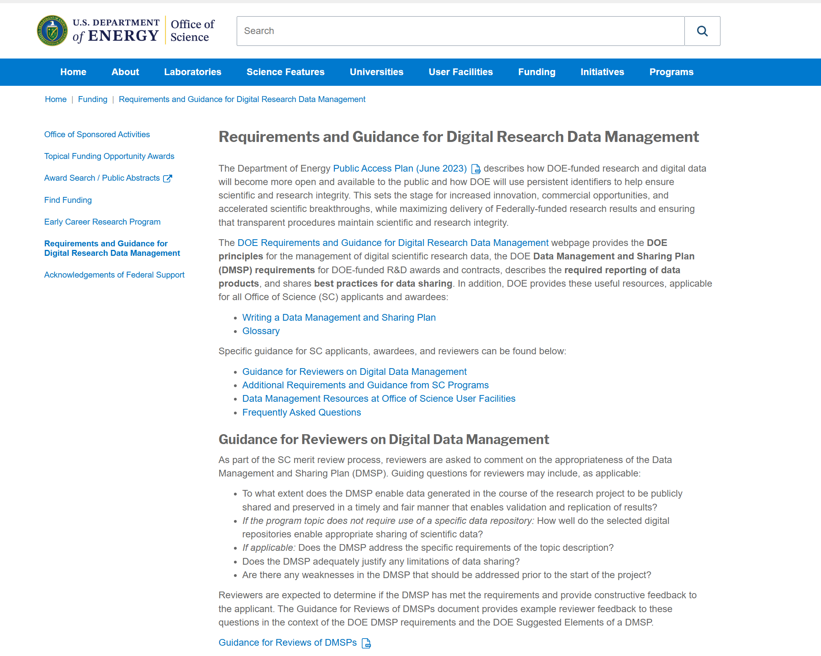
Data Management Planning
As part of research planning
DOE and other federal funding agencies require Data Management and Sharing Plans as part of research proposals.
JLab has developed a template DMSP to help you meet the DMSP requirements.
https://sci-software.jlab.org/
https://science.osti.gov/Funding-Opportunities/Digital-Data-Management

Slide 26
Data Management Planning
As part of experiment planning
JLab requires users to submit an Experiment Data Management Plan (EDMP) to help us provision resources and because JLab has a stewardship responsibility for data produced at the lab.
JLab has developed guidance to support the development of EDMPs and DMSPs.
https://sci-software.jlab.org/

Slide 27
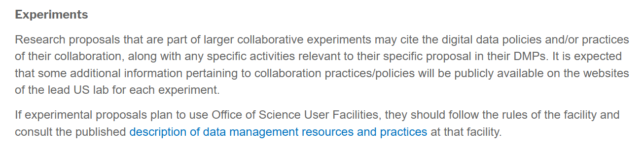
Data Management Planning
As part of collaboration planning
https://science.osti.gov/np/Funding-Opportunities/Digital-Data-Management

Slide 28
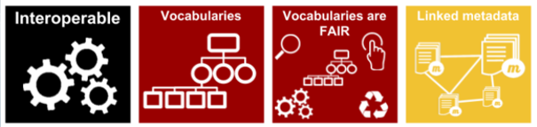
Persistent, Unique Identifiers
Digital persistent identifier (DPI or digital PID) – A digital identifier that is globally unique, persistent, machine resolvable and processable, and has an associated metadata schema*.
Satisfies DOE Requirement
ORCID(s) for individual researchers
ROR ID(s) for research organizations
Grant ID(s) for funding sources
DOI(s) for Dataset(s)
DOI(s) for Datasheet(s)
DOIs / citations for software and code
DOI(s) for manuscripts
Allows for distinct authors, research orgs, resources, funding sources, etc for each atom of the scientific record.
Allows for linking the elements of the scientific record.
* DOE Public Access Plan 2023 https://doi.org/10.11578/2023DOEPublicAccessPlan

Slide 29
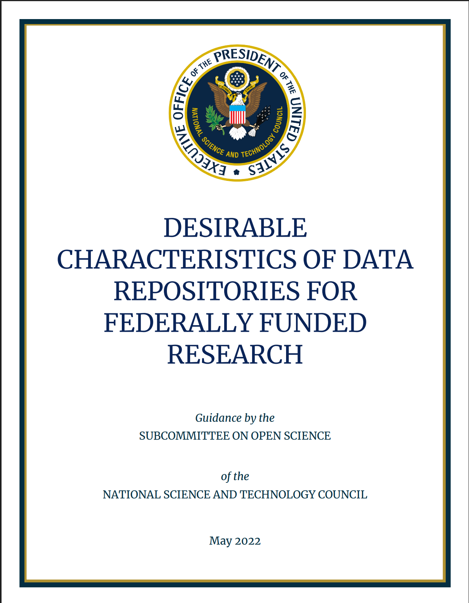
Metadata and Repositories
Repositories should have requirements for metadata.
Domain-specific repositories will have more specific requirements and curation support.
Metadata are absolutely essential and typically insufficient for reuse and interoperability
Notes:
Submitting to a community repository is best practice.
Generalist repositories are acceptable.
Posting to a website is NOT best practice.
Metadata: The repository ensures datasets are accompanied by metadata to enable discovery, reuse, and citation of datasets, using schema that are appropriate to, and ideally widely used across, the communities that the repository serves.
https://bidenwhitehouse.archives.gov/wp-content/uploads/2022/05/05-2022-Desirable-Characteristics-of-Data-Repositories.pdf

Slide 30
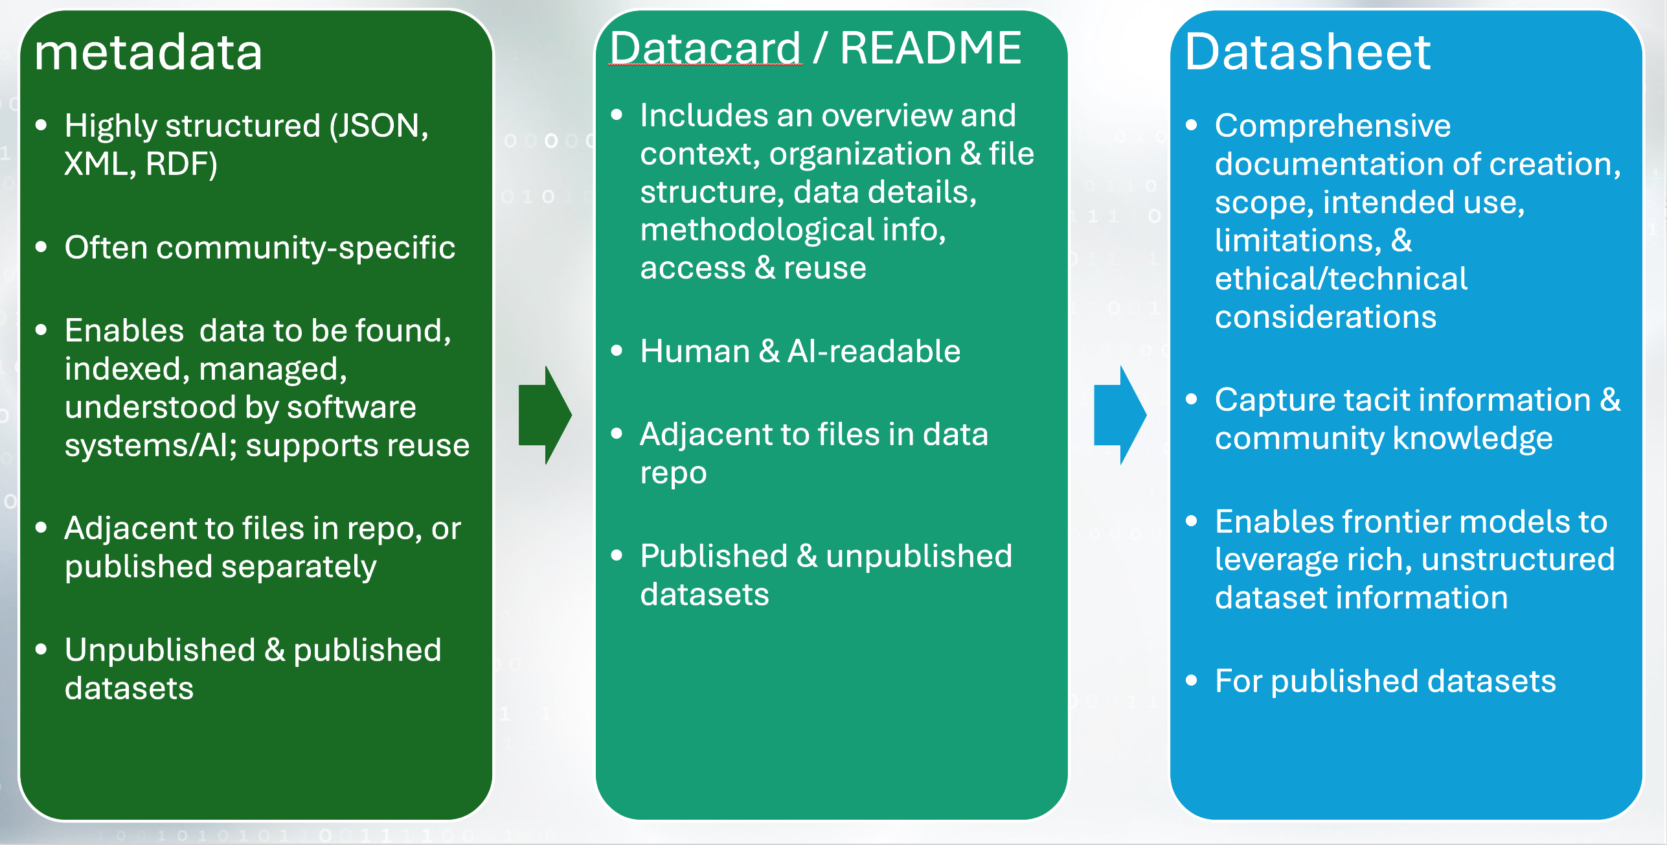
Metadata and Documentation

Slide 31
Machine Actionable Data with Data Cards
Challenge
Critical know‑how remains human‑held
Rate-limiters: Finding & assessing
fit-for-purpose data
AI and humans need explicit context:
  What data are?
  What do they mean?
  Reuse rules
Solution
Rich and unambiguous context
Machine-actionable data context
  at scale
Data cards: structured metadata + computable natural language
Machine-actionable Genesis Mission data for humans and agents:
Datacard template
Today: post-hoc card generation of Genesis Mission datacards
Autonomous generation of data, model, agent (xCards)
Lifecycle generation
What this enables:
Provenance-aware linkages: PID (asset) + xCard + relationship: “Web of Science”
Reusable workflows ➝ Gen AI capabilities
Data plane for data, infrastructure, & scientific instruments
Enable facilities, like HPDF, to accelerate discovery
Data Card Template coming soon…

Slide 32
Data Sharing and Reuse
Instead of one-off data sharing with colleagues, consider publishing data to an open repository.
  JLAB is developing the JRDB with links to OSTI’s DOI service.
For highly-reuseable data, consider developing a datasheet or data publication.
Do cite data in your publications.

Slide 33
Data Analysis and Preservation; and Provenance
Build software into containers and share those versioned containers in GitLab
  Documentation on GitLab usage at Jefferson Lab: https://pages.jlab.org/scicomp/software/code-gitlab-docs/
  Documentation on Container usage at Jefferson Lab: https://pages.jlab.org/scicomp/software/jlab-container-docs/
Take the time to tag the analysis with metadata for analysis discovery.

Slide 34
Gaps and Future Work
Community norms for data sharing
Governance
  We are working on data governance and release processes for JLab, with a couple collaborations and projects, and for Genesis
Provenance and Analysis Preservation
  Encourage best practices
  Continue to develop tools and services that reduce burden.

Slide 35



Kudos
Casey Morean
Physics AI/ML Data Scientist
orcid.org/0000-0001-5588-4841
My interests:
Software supporting metadata capture and automation in science
Physics: EMC effect, SRCs, GPDs
Anil Panta
Physics Data Scientist
orcid.org/0000-0001-6385-7712
My interests:
Distributed Data Management
Document Management
Charm physics and CP violation
Nataliia Matsiuk
Scientific Technical and Program Support
orcid.org/0000-0003-0306-5152
My interests:
Software development
AI/ML
Painting and powerlifting

Slide 36
Thank you data.jlab.org
JLabDataManagement@jlab.org

