Slide 1















Study of the Short-Range Nucleon-Nucleon Potentials via Electro-disintegration of the Deuteron at High Four Momentum Transfers
Gema P. Villegas Minyety
JLUO Annual Meeting
25 June 2026

Slide 2

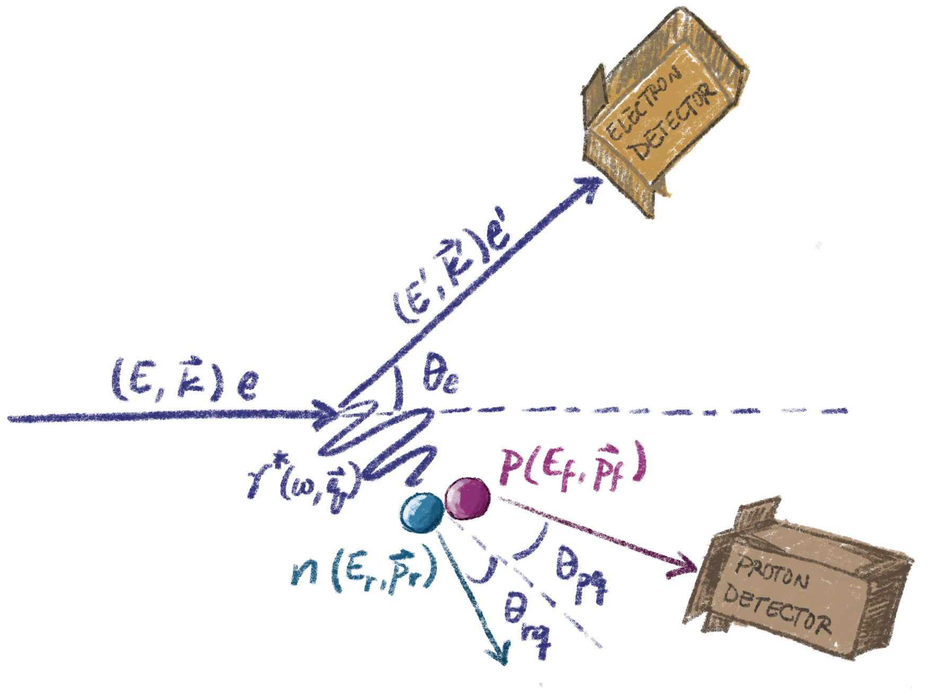
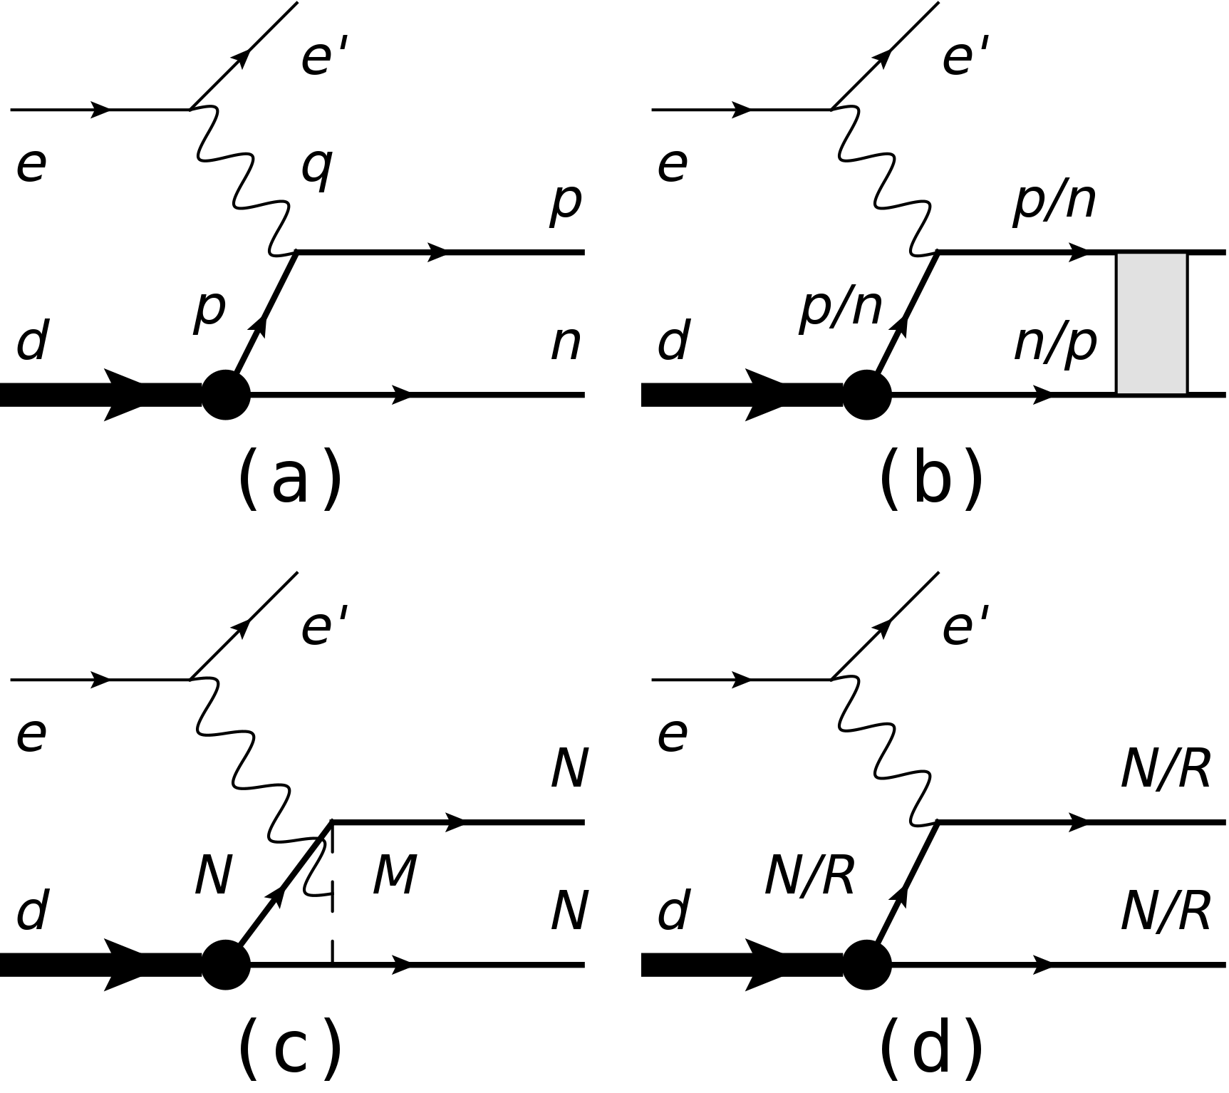

Brief Overview of Deuteron Breakup
Plane Wave Impulse Approx.
Final State Interactions
Meson Exchange Currents
Isobar Configurations
(b), (c), and (d) are suppressed in the kinematic window used
Deuteron Breakup – Gema Villegas – JLUO Annual Meeting – 25 June 2026
Notes:
First I will go over a brief overview of deuteron breakup. In this reaction we have our inccidente electron beam on a deuterium target at high enough momentum transfer that we expect the bond between the proton and neutron to break, and we detect the recoiling electron in coincidence with the proton. Then we reconstruct the missing neutron kinematics from conservation laws.
This ideal reaction I just described in which the electron only interacts with the proton is called the plane wave impulse approximation, and it is best used to extract the initial momentum distribution of the nucleons since we expect the missing kinematics of the unmodified neutron to be equal to its initial state. But there are other processes that can happen, for instance, the recoiling nucleons are more likely to interact with each other after being separated from the nucleus in final state interactions, or the electron can interact with an exchanged meson between the nucleons, or there can be a resonance involved at any stage of the reaction. So we have found a set of kinematic conditions which will minimized these other effects leaving the plane wave as the dominant contribution.

Slide 3
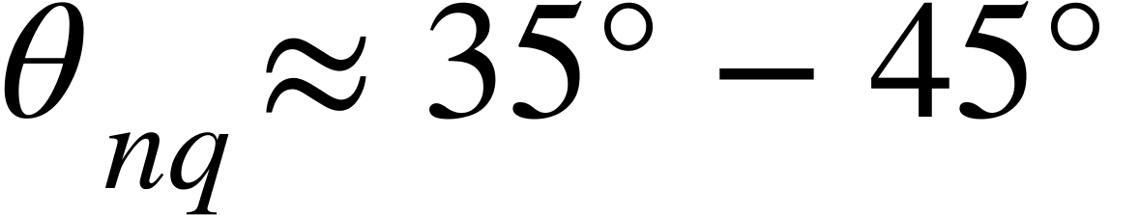
Brief Overview of Deuteron Breakup
Plane Wave Impulse Approx.
Final State Interactions
Suppressed at
Meson Exchange Currents
Isobar Configurations
(b), (c), and (d) are suppressed in the kinematic window used
Deuteron Breakup – Gema Villegas – JLUO Annual Meeting – 25 June 2026
Notes:
First I will go over a brief overview of deuteron breakup. In this reaction we have our inccidente electron beam on a deuterium target at high enough momentum transfer that we expect the bond between the proton and neutron to break, and we detect the recoiling electron in coincidence with the proton. Then we reconstruct the missing neutron kinematics from conservation laws.
This ideal reaction I just described in which the electron only interacts with the proton is called the plane wave impulse approximation, and it is best used to extract the initial momentum distribution of the nucleons since we expect the missing kinematics of the unmodified neutron to be equal to its initial state. But there are other processes that can happen, for instance, the recoiling nucleons are more likely to interact with each other after being separated from the nucleus in final state interactions, or the electron can interact with an exchanged meson between the nucleons, or there can be a resonance involved at any stage of the reaction. So we have found a set of kinematic conditions which will minimized these other effects leaving the plane wave as the dominant contribution.

Slide 4
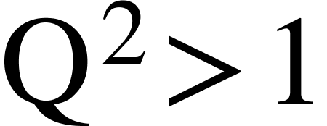
Brief Overview of Deuteron Breakup
Plane Wave Impulse Approx.
Final State Interactions
Suppressed at
Suppressed at
Meson Exchange Currents
Isobar Configurations
(b), (c), and (d) are suppressed in the kinematic window used
Deuteron Breakup – Gema Villegas – JLUO Annual Meeting – 25 June 2026
Notes:
First I will go over a brief overview of deuteron breakup. In this reaction we have our inccidente electron beam on a deuterium target at high enough momentum transfer that we expect the bond between the proton and neutron to break, and we detect the recoiling electron in coincidence with the proton. Then we reconstruct the missing neutron kinematics from conservation laws.
This ideal reaction I just described in which the electron only interacts with the proton is called the plane wave impulse approximation, and it is best used to extract the initial momentum distribution of the nucleons since we expect the missing kinematics of the unmodified neutron to be equal to its initial state. But there are other processes that can happen, for instance, the recoiling nucleons are more likely to interact with each other after being separated from the nucleus in final state interactions, or the electron can interact with an exchanged meson between the nucleons, or there can be a resonance involved at any stage of the reaction. So we have found a set of kinematic conditions which will minimized these other effects leaving the plane wave as the dominant contribution.

Slide 5
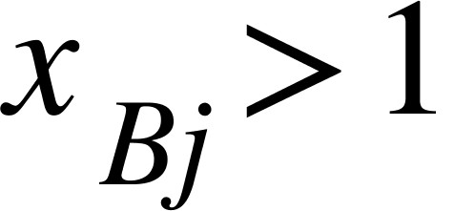
Brief Overview of Deuteron Breakup
Plane Wave Impulse Approx.
Final State Interactions
Suppressed at
Suppressed at
Suppressed at
Meson Exchange Currents
Isobar Configurations
(b), (c), and (d) are suppressed in the kinematic window used
Deuteron Breakup – Gema Villegas – JLUO Annual Meeting – 25 June 2026
Notes:
First I will go over a brief overview of deuteron breakup. In this reaction we have our inccidente electron beam on a deuterium target at high enough momentum transfer that we expect the bond between the proton and neutron to break, and we detect the recoiling electron in coincidence with the proton. Then we reconstruct the missing neutron kinematics from conservation laws.
This ideal reaction I just described in which the electron only interacts with the proton is called the plane wave impulse approximation, and it is best used to extract the initial momentum distribution of the nucleons since we expect the missing kinematics of the unmodified neutron to be equal to its initial state. But there are other processes that can happen, for instance, the recoiling nucleons are more likely to interact with each other after being separated from the nucleus in final state interactions, or the electron can interact with an exchanged meson between the nucleons, or there can be a resonance involved at any stage of the reaction. So we have found a set of kinematic conditions which will minimized these other effects leaving the plane wave as the dominant contribution.

Slide 6
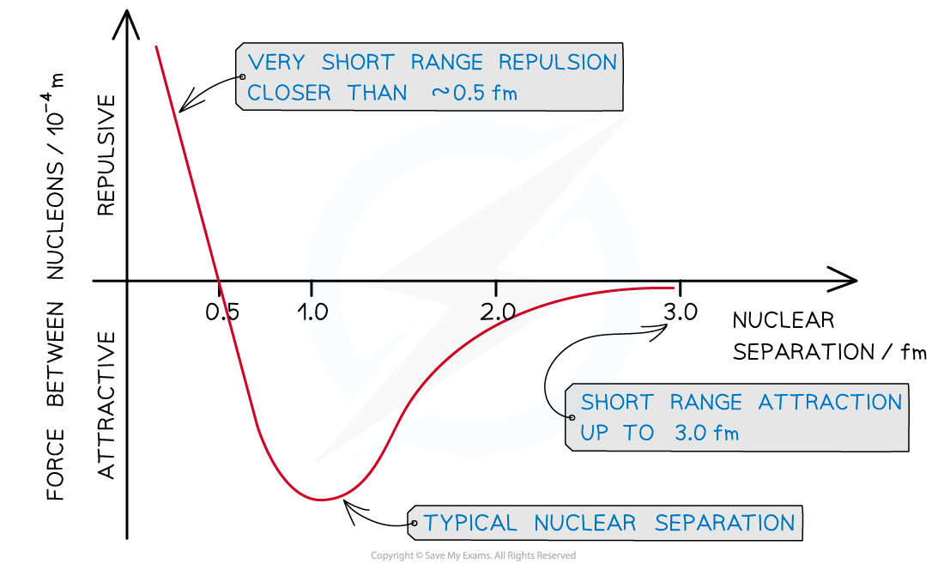






Motivation : Refining our Picture of the Deuteron
π
Higher recoil momenta allow us to see shorter nucleon distances, possibly to quark degrees of freedom
Pion exchange was theorized in 1934, the pion was observed in 1947
The short-range part of the nucleon-nucleon interaction is the least understood and hardest to access experimentally
Deuteron Breakup – Gema Villegas – JLUO Annual Meeting – 25 June 2026
Notes:
why do we want to study the deuteron? the deuteron is the simplest proton-neutron bound system, and despite that, it exhibits the wealth of complicated phenomena that arise from the strong nuclear force. This force that binds nucleons together in atomic nuclei is subdivide into 3 regimes: the long-range, which is dominated by one pion exchange, and thus well decribed by OPEP, the intermediate range, dominated by 2 pion exchange or the exchange of heavier mesons, and finally the short-range where it is expected that the force turns repulsive. This part is the least understood theoretically and hardest to access experimentally.
Studying the short-range part of the potential is also important since it allows us to test up to what point the description of the nucleus in terms of nucleons and mesons is valid and where quark degrees of freedom become more relevant. Deuteron break-up allows us to directly access the short-range part of the potential.

Slide 7
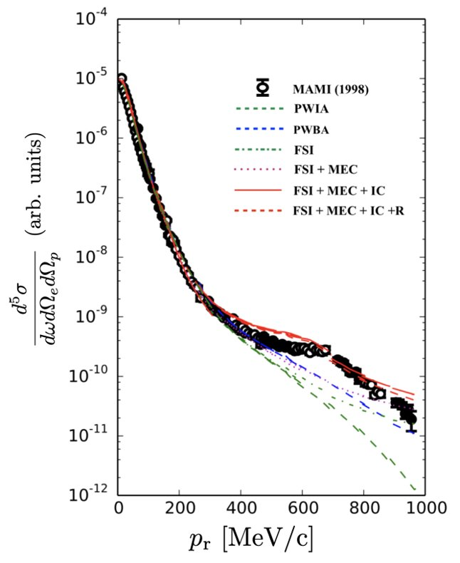
Previous Experiments
Calculations by H. Arenhövel
MAMI (1998). Physics Letters B, 424(1–2), 33–38.
Deuteron Breakup – Gema Villegas – JLUO Annual Meeting – 25 June 2026
Notes:
Here is the first deuteron break-up cross section up to very high recoil momentum, done by the Mainz microtron collaboration and published in 1998. They were able to extract cross section up to very high missing momentum but only extract the PWIA cross section up to ~350 MeV/c after which you have to add all these other effects for the calculation to start taking the shape of the data again. The calculation that agrees the most not only includes FSI, but MEC, IC and relativistic effects.
Here we can also identify the regimes in the NN potential that they were able to access, form long-range at the lowest recoil momenta up to short-range for the highest recoil momenta.

Slide 8
Previous Experiments
r > ~ 2 fm (long-range)
Calculations by H. Arenhövel
MAMI (1998). Physics Letters B, 424(1–2), 33–38.
Deuteron Breakup – Gema Villegas – JLUO Annual Meeting – 25 June 2026
Notes:
Here is the first deuteron break-up cross section up to very high recoil momentum, done by the Mainz microtron collaboration and published in 1998. They were able to extract cross section up to very high missing momentum but only extract the PWIA cross section up to ~350 MeV/c after which you have to add all these other effects for the calculation to start taking the shape of the data again. The calculation that agrees the most not only includes FSI, but MEC, IC and relativistic effects.
Here we can also identify the regimes in the NN potential that they were able to access, form long-range at the lowest recoil momenta up to short-range for the highest recoil momenta.

Slide 9
Previous Experiments
r > ~ 2 fm (long-range)
2 fm > r > 1 fm
(intermediate-range)
Calculations by H. Arenhövel
MAMI (1998). Physics Letters B, 424(1–2), 33–38.
Deuteron Breakup – Gema Villegas – JLUO Annual Meeting – 25 June 2026
Notes:
Here is the first deuteron break-up cross section up to very high recoil momentum, done by the Mainz microtron collaboration and published in 1998. They were able to extract cross section up to very high missing momentum but only extract the PWIA cross section up to ~350 MeV/c after which you have to add all these other effects for the calculation to start taking the shape of the data again. The calculation that agrees the most not only includes FSI, but MEC, IC and relativistic effects.
Here we can also identify the regimes in the NN potential that they were able to access, form long-range at the lowest recoil momenta up to short-range for the highest recoil momenta.

Slide 10
Previous Experiments
r < ~ 1 fm (short-range)
r > ~ 2 fm (long-range)
2 fm > r > 1 fm
(intermediate-range)
Calculations by H. Arenhövel
MAMI (1998). Physics Letters B, 424(1–2), 33–38.
Deuteron Breakup – Gema Villegas – JLUO Annual Meeting – 25 June 2026
Notes:
Here is the first deuteron break-up cross section up to very high recoil momentum, done by the Mainz microtron collaboration and published in 1998. They were able to extract cross section up to very high missing momentum but only extract the PWIA cross section up to ~350 MeV/c after which you have to add all these other effects for the calculation to start taking the shape of the data again. The calculation that agrees the most not only includes FSI, but MEC, IC and relativistic effects.
Here we can also identify the regimes in the NN potential that they were able to access, form long-range at the lowest recoil momenta up to short-range for the highest recoil momenta.

Slide 11
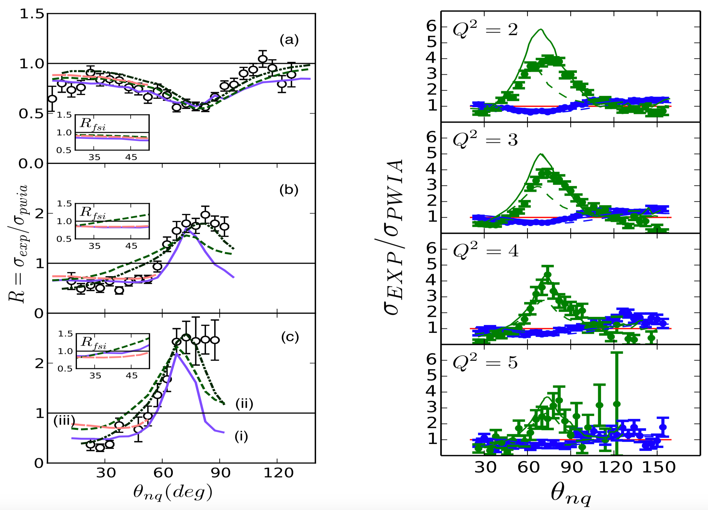
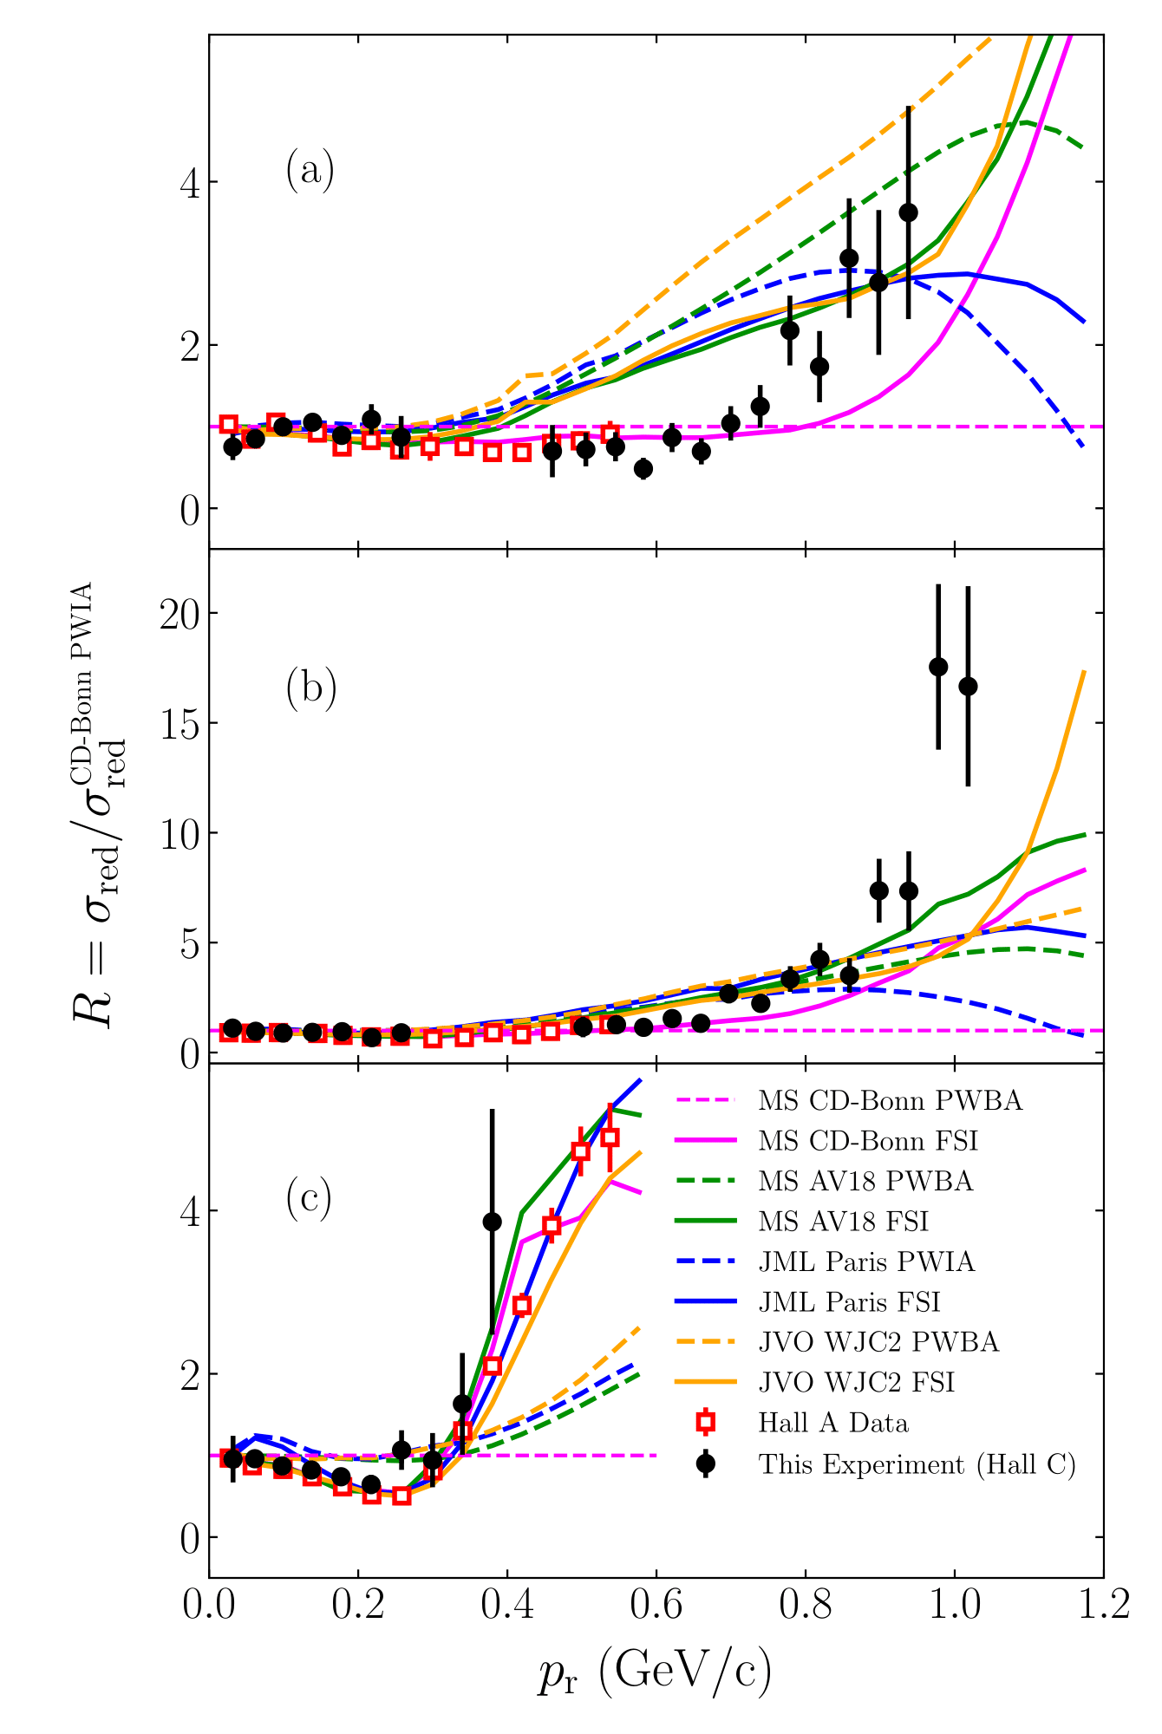
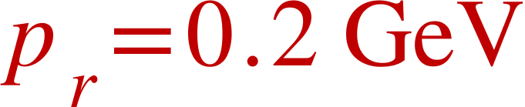
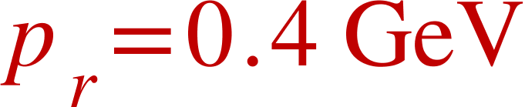
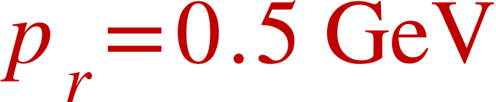
Previous Experiments
Hall B Experiment
(CLAS)
Hall A Experiment
(E01-020)
Hall C Experiment
(E12-10-003)
MS CD-Bonn
200 < p_{r} < 300
JML Paris
JML Paris + MEC + IC
θ_{nq} = 35°
400 < p_{r} < 600
JVO
θ_{nq} = 45°
75°
MS CD-Bonn
JML Paris
K. S. Egiyan et al. (2007) 10.1103/PhysRevLett.98.262502
W. U. Boeglin et al. (2011)
10.1103/PhysRevLett.107.262501
C. Yero et al. (2020) 10.1103/PhysRevLett.125.262501
Deuteron Breakup – Gema Villegas – JLUO Annual Meeting – 25 June 2026
Notes:
Since then other experiments have been done at JLAB from where it was veryfied that FSI have a strong angular dependence at high neutron recoil momenta. The first 2 experiments show a ratio of the experimental cross-section to the PWIA cross-section, a straight line at 1 would signify complete agreement of the data to the PWIA model. This ratio is given versus the neutron recoil angle. In both experiments you can clearly see the FSI peak at 70 degrees that shows for high recoil momenta up to 600 MeV/c, this allows us to identify a range of angles in which FSI are suppressed.
With this knowledge in hand the Hall C experiment was designed. A small version of it was allowed to take data during the commissioning period of the SHMS, and with 3 days worth of data they were able to get this results on the right.

Slide 12
Previous Experiments
Hall B Experiment
(CLAS)
Hall A Experiment
(E01-020)
Hall C Experiment
(E12-10-003)
70°
MS CD-Bonn
70°
200 < p_{r} < 300
JML Paris
JML Paris + MEC + IC
θ_{nq} = 35°
400 < p_{r} < 600
JVO
θ_{nq} = 45°
75°
MS CD-Bonn
JML Paris
K. S. Egiyan et al. (2007) 10.1103/PhysRevLett.98.262502
W. U. Boeglin et al. (2011)
10.1103/PhysRevLett.107.262501
C. Yero et al. (2020) 10.1103/PhysRevLett.125.262501
Deuteron Breakup – Gema Villegas – JLUO Annual Meeting – 25 June 2026
Notes:
Since then other experiments have been done at JLAB from where it was veryfied that FSI have a strong angular dependence at high neutron recoil momenta. The first 2 experiments show a ratio of the experimental cross-section to the PWIA cross-section, a straight line at 1 would signify complete agreement of the data to the PWIA model. This ratio is given versus the neutron recoil angle. In both experiments you can clearly see the FSI peak at 70 degrees that shows for high recoil momenta up to 600 MeV/c, this allows us to identify a range of angles in which FSI are suppressed.
With this knowledge in hand the Hall C experiment was designed. A small version of it was allowed to take data during the commissioning period of the SHMS, and with 3 days worth of data they were able to get this results on the right.

Slide 13
Previous Experiments
Hall B Experiment
(CLAS)
Hall A Experiment
(E01-020)
Hall C Experiment
(E12-10-003)
70°
MS CD-Bonn
70°
200 < p_{r} < 300
JML Paris
JML Paris + MEC + IC
θ_{nq} = 35°
400 < p_{r} < 600
JVO
θ_{nq} = 45°
75°
MS CD-Bonn
JML Paris
K. S. Egiyan et al. (2007) 10.1103/PhysRevLett.98.262502
W. U. Boeglin et al. (2011)
10.1103/PhysRevLett.107.262501
C. Yero et al. (2020) 10.1103/PhysRevLett.125.262501
Deuteron Breakup – Gema Villegas – JLUO Annual Meeting – 25 June 2026
Notes:
Since then other experiments have been done at JLAB from where it was veryfied that FSI have a strong angular dependence at high neutron recoil momenta. The first 2 experiments show a ratio of the experimental cross-section to the PWIA cross-section, a straight line at 1 would signify complete agreement of the data to the PWIA model. This ratio is given versus the neutron recoil angle. In both experiments you can clearly see the FSI peak at 70 degrees that shows for high recoil momenta up to 600 MeV/c, this allows us to identify a range of angles in which FSI are suppressed.
With this knowledge in hand the Hall C experiment was designed. A small version of it was allowed to take data during the commissioning period of the SHMS, and with 3 days worth of data they were able to get this results on the right.

Slide 14
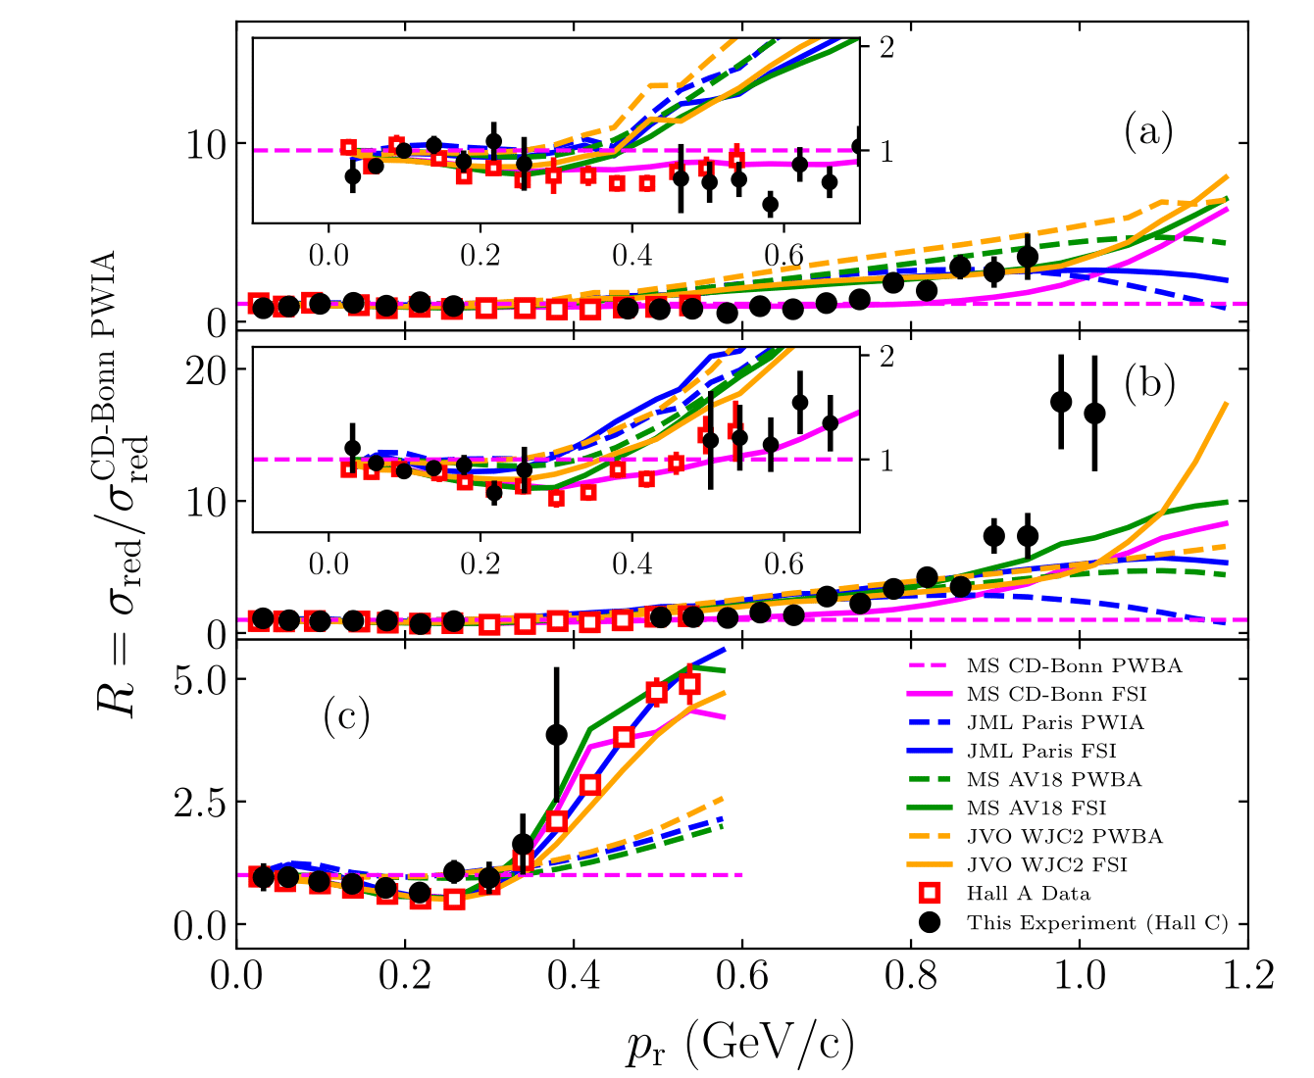
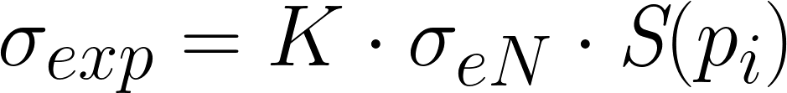

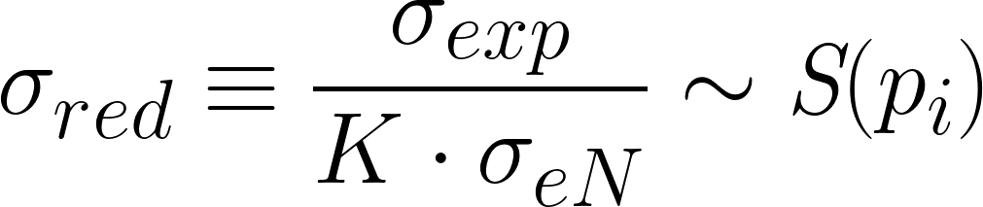
Hall C Experiment (E12-10-003)
C. Yero et al. (2020) 10.1103/PhysRevLett.125.262501
Theoretical Models:
(1) Charge-Dependent (CD) Bonn
(2) Paris
(3) AV18
(4) WJC2
The models differ in the way they use empirical NN scattering data.
CD-Bonn and WJC2 models use an OBE potential approach, while AV18 and Paris are purely phenomenological.
The data agrees well with the CD-Bonn model up to ~ 700 MeV/c
Deuteron Breakup – Gema Villegas – JLUO Annual Meeting – 25 June 2026
Notes:
Here is a better view of those results. This ratio is being compared to Misak Sargsians PWIA model with CD-Bonn potential. This ratio is show for 3 angle bins, 35 and 45 degrees are angles where we expect FSI contributions to be smaller, and 75 degrees is an angle where FSI would be at their highest contribution. Here you can see the data agrees well with not only the previous Hall A experiment but also with the CD-bonn model up to ~ 700 MeV . Of the different models we can see a clear distinction between the CD-Bonn model and the rest of the models which use a Paris, Av18 and WJC2 potentials. The thing that sets the CD-Bonn potential apart from the others is that it predicts a softer short-range repulsion at high recoil momenta.
From Carlos' paper: The CD-Bonn model is based
on the One-Boson-Exchange Potential (OBEP) approach
in which the nucleon-meson-meson couplings are con-
strained to describe the N N scattering phase shifts ex-
tracted from the data. The interaction potential repre-
sents the static limit of this potential. In contrast, the
WJC2 is a OBEP derived within the Covariant Specta-
tor Theory (CST) [24–27] which requires comparatively
few parameters while still producing a high-precision fit
to the N N scattering data.

Slide 15
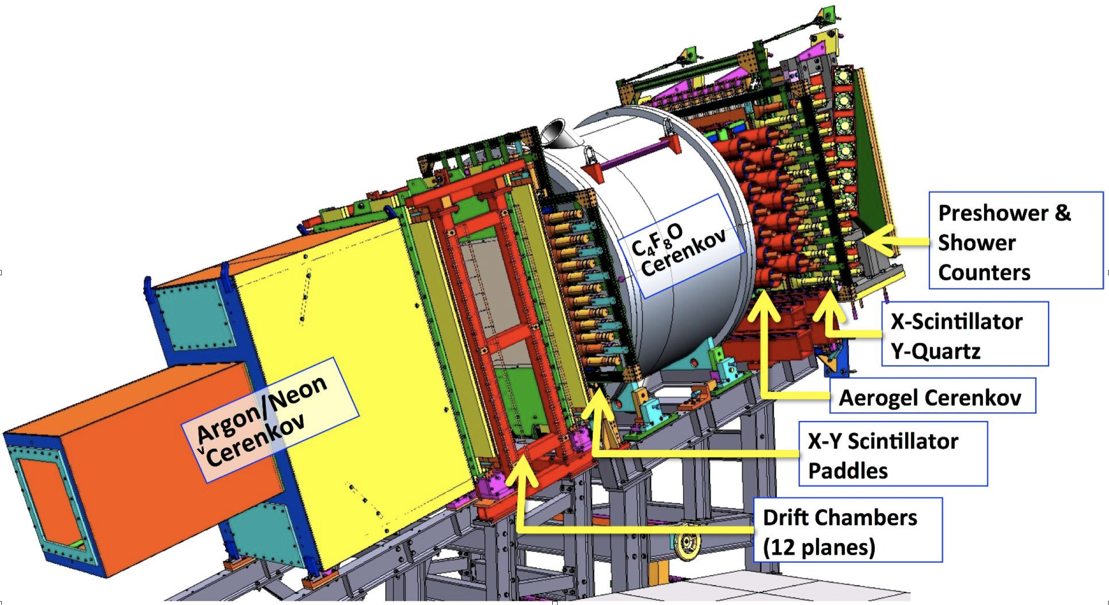
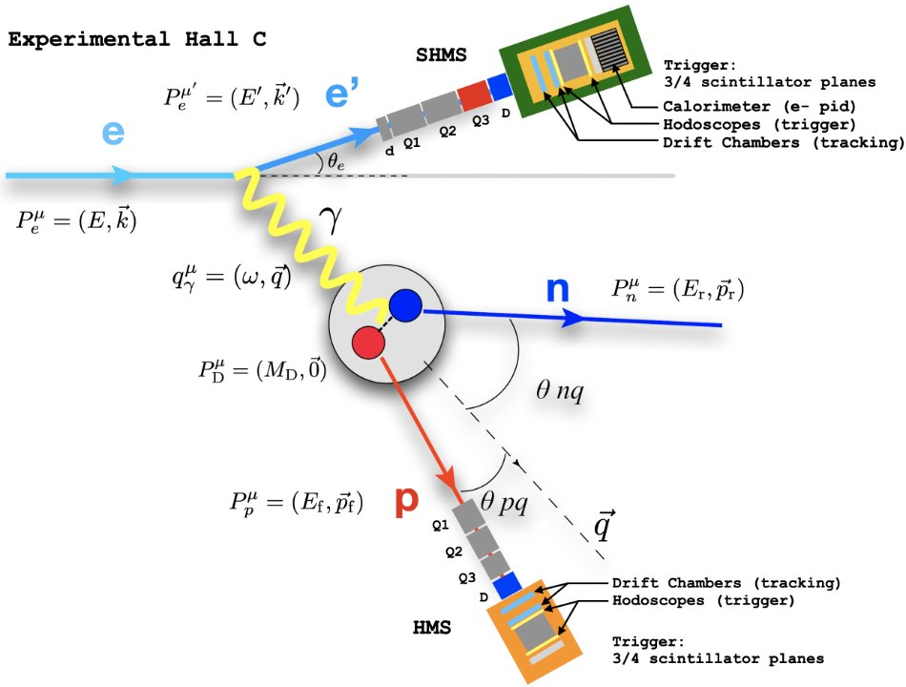
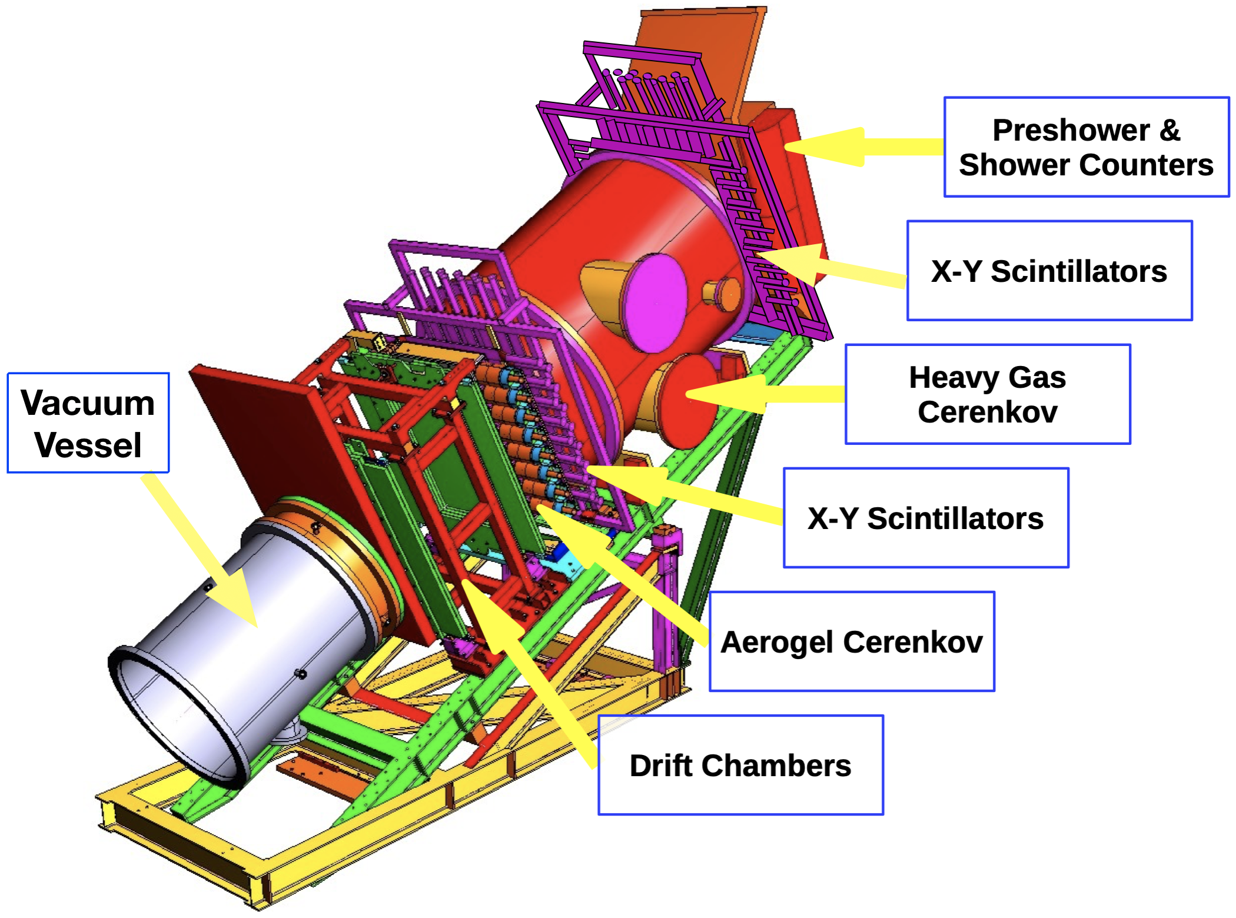
Deuteron Experiment Details
SHMS
HMS
Deuteron Breakup – Gema Villegas – JLUO Annual Meeting – 25 June 2026
Notes:
And now I will be going over some details of the experiment. After the results from the commissioning experiment, the deuteron break-up experiment got approved for 2 weeks of data taking. Again the experiment was don in Hall C, the proton was detected at the HMS and the electron at the SHMS.

Slide 16
Deuteron Experiment Details
Ran from Feb 24th, 2023 until March 20th, 2023
Took hydrogen elastic H(e,e'p) data, in a wide range of delta settings.
D(e,e'p)n production had 4 missing momentum settings chosen to cover much of the area of interest.
Also took luminosity data for target boiling studies.
H(e,e'p) δ scan
δ [%] | SHMS momentum [GeV] | SHMS angle [°] | HMS momentum [GeV] | HMS angle [°]
-8 | -8.55 | 14.15 | 3.499 | 33.34
-4 |  | 12.94 | 3.145 | 35.76
0 |  | 11.71 | 2.703 | 38.55
+4 |  | 10.44 | 2.417 | 41.82
+8 |  | 9.13 | 2.048 | 45.67
+12 |  | 7.70 | 1.664 | 50.50
D(e,e'p)n Production
Missing momentum [MeV] | SHMS momentum [GeV] | SHMS angle [°] | HMS momentum [GeV] | HMS angle [°]
120 | -8.55 | 12.2 | 3.052 | 38.63
580 |  |  | 2.262 | 54.96
800 |  |  | 2.121 | 59.39
900 |  |  | 2.047 | 61.34
Deuteron Breakup – Gema Villegas – JLUO Annual Meeting – 25 June 2026
Notes:
The experiment ran from February to March of 2023. It started by taking a delta scan of the SHMS in which the momentum acceptance of the spectrometer is sampled across different settings. Then, we took 4 production settings: 1 at low neutron recoil momentum and 3 high. We also took luminosity data for target boiling studies.

Slide 17
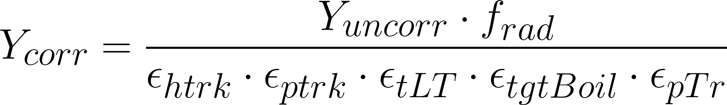
D(e,e'p)n Data Cross Section
How do we extract the data cross section?
The yield is corrected by:
Radiative correction factor (from SIMC)
HMS tracking efficiency
SHMS tracking efficiency
Total EDTM Live Time
Target Boiling factor
Proton Transmission factor
Deuteron Breakup – Gema Villegas – JLUO Annual Meeting – 25 June 2026
Notes:
And now before I show you some preliminary results, I would like to explain how do we get our cross section. First we get our raw yield from the data and we correct it for efficiencies and here we also apply radiative corrections. The efficiencies corrected for are the HMS and SHMS tracking efficiencies, total livetime, target boiling and proton absorption or transmission.

Slide 18
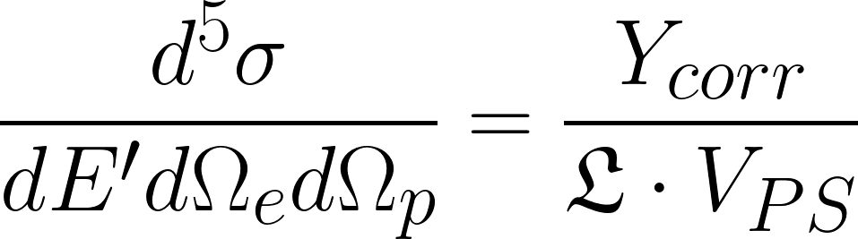
D(e,e'p)n Data Cross Section
How do we extract the data cross section?
The yield is corrected by:
Radiative correction factor (from SIMC)
HMS tracking efficiency
SHMS tracking efficiency
Total EDTM Live Time
Target Boiling factor
Proton Transmission factor
The corrected yield is then divided by:
Luminosity
Phase Space Volume
The phase space is simulated by SIMC
Deuteron Breakup – Gema Villegas – JLUO Annual Meeting – 25 June 2026
Notes:
then we take the corrected yield and divide it by luminosity and phase space to recover or 5-fold differential cross section.

Slide 19
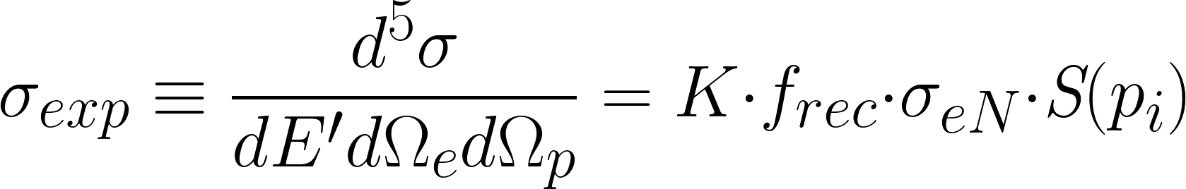
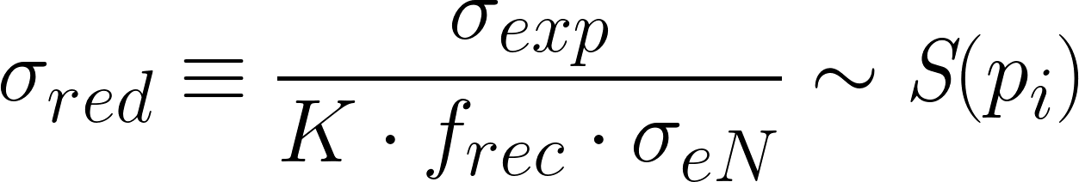
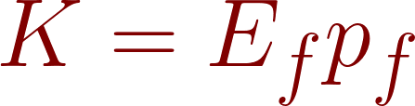
From Cross Sections to Momentum Distributions
Only in the PWIA
This is equivalent to our experimental momentum distributions
In the PWIA the cross section can be factorized into:
Kinematic factor
Binding energy factor
Electron-nucleon cross section for which we use the de Forest off-shell cross section
Spectral Function
Deuteron Breakup – Gema Villegas – JLUO Annual Meeting – 25 June 2026
Notes:
But we don’t focus only on the cross section but on what we call the reduced cross section. In the PWIA we can factorize our differential cross section in to a kinematic factor, the off-shell electron-nucleon cross section and the spectral function which tells you the probability of finding a nucleon of a particular momentum (and energy) in a nucleus. Here you may notice that the spectral function only depends on momentum, this is because for the deuteron the energy correspond to the binding energy and this can be integrated out resulting in this multiplicative factor I called frec. Therefore, after we recover the experimental cross section and divide it as such we can only compare it to the nucleon momentum distributions if we are in kinematics where the PWIA is favored. Now I will show you what the results look like so far for this experiment.

Slide 20
Preliminary Results

Slide 21
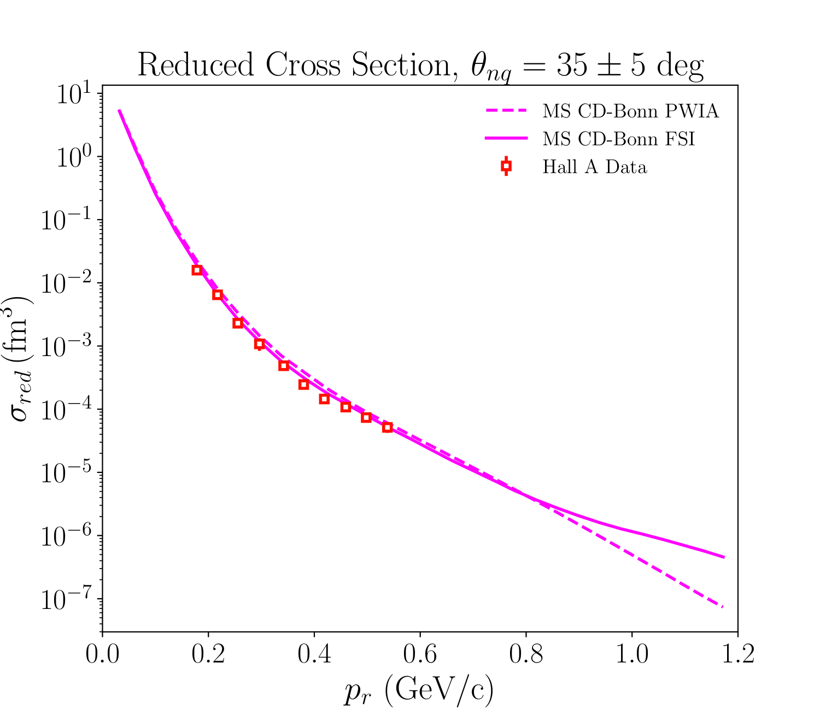
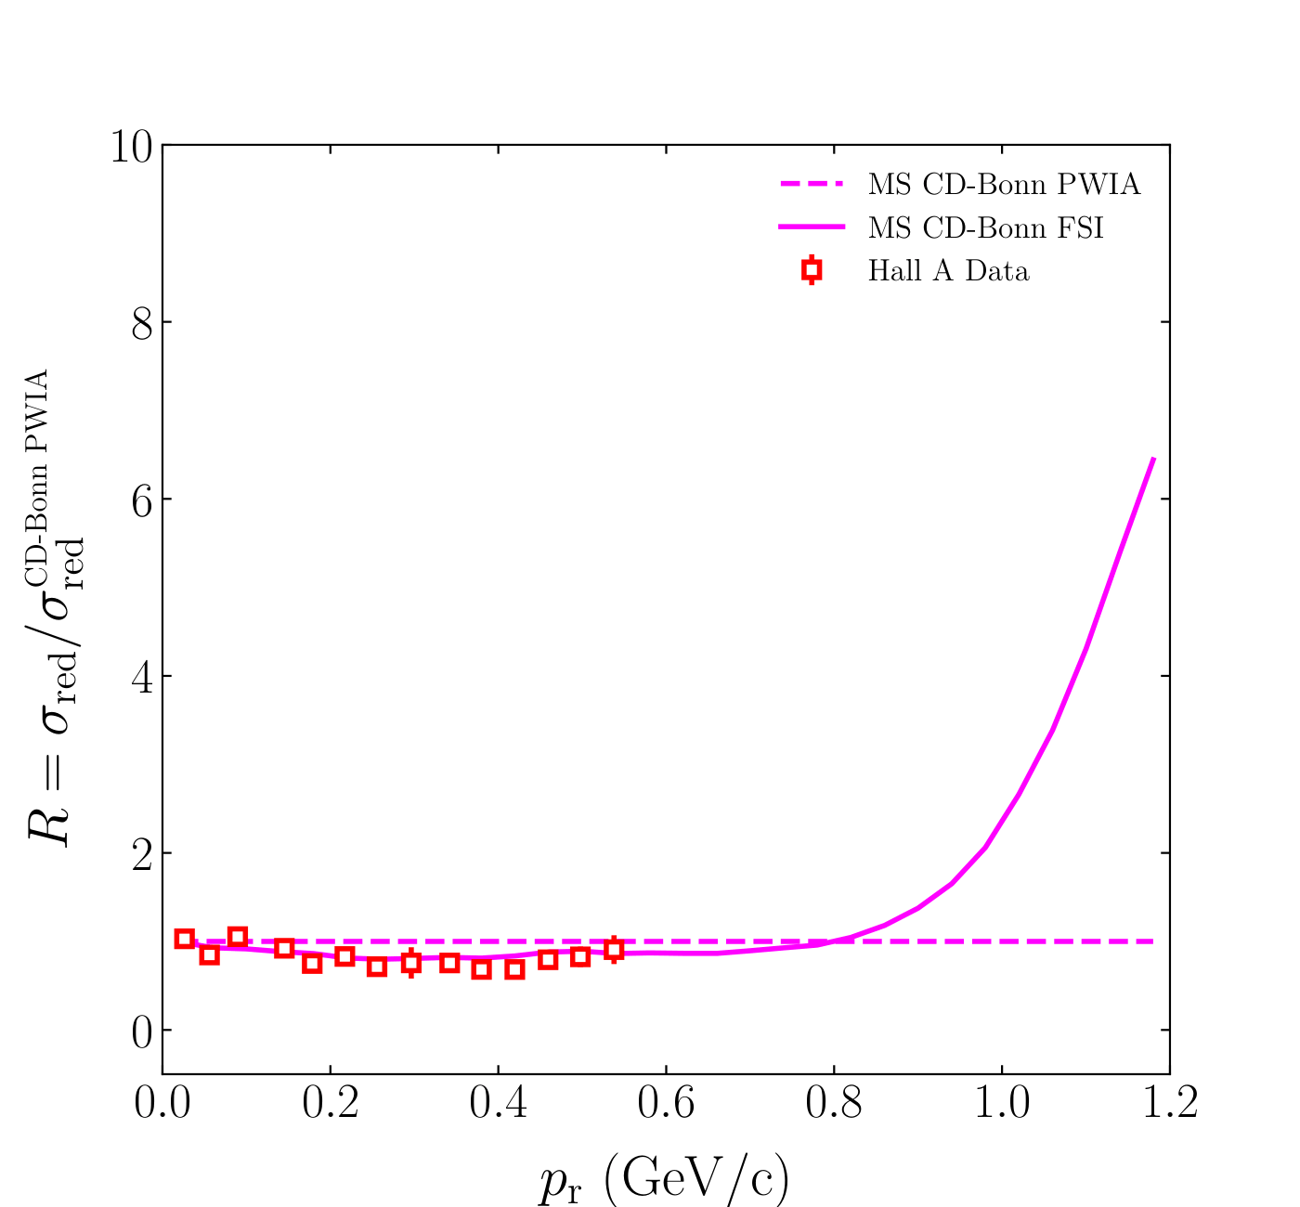
Preliminary D(e,e'p)n Momentum Distributions
Deuteron Breakup – Gema Villegas – JLUO Annual Meeting – 25 June 2026
Notes:
I will show neutron recoil momentum distributions for 3 neutron recoil angle bins 35, 45, and 75. First this is the 35 degree compared only against the CD-Bonn model again, this is the Hall A data

Slide 22
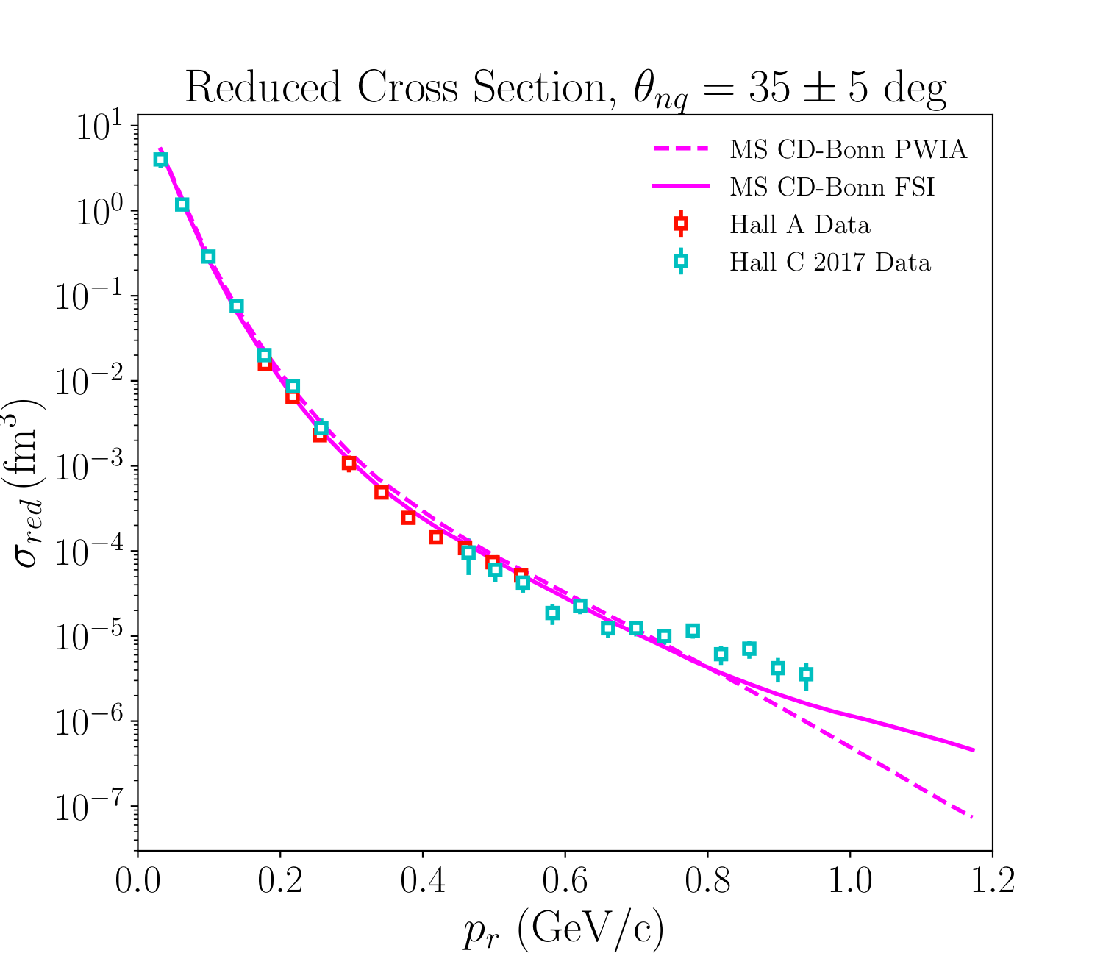
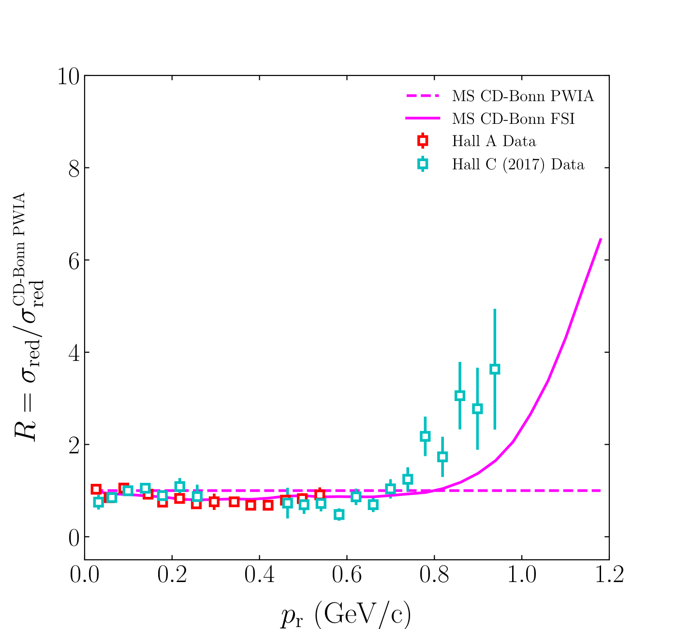
Preliminary D(e,e'p)n Momentum Distributions
Deuteron Breakup – Gema Villegas – JLUO Annual Meeting – 25 June 2026
Notes:
Then the commissioning experiment data

Slide 23
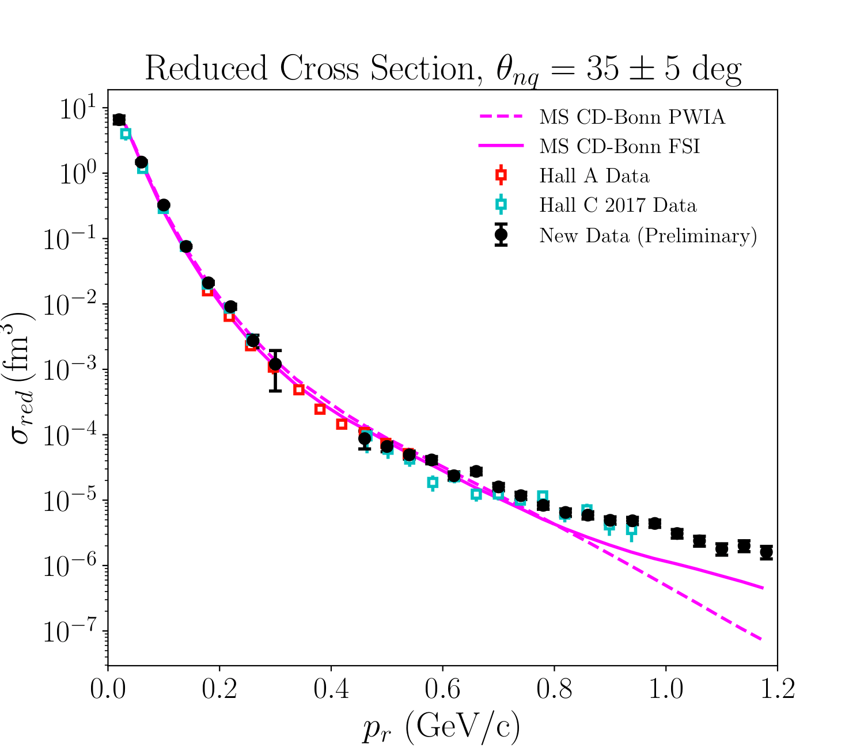
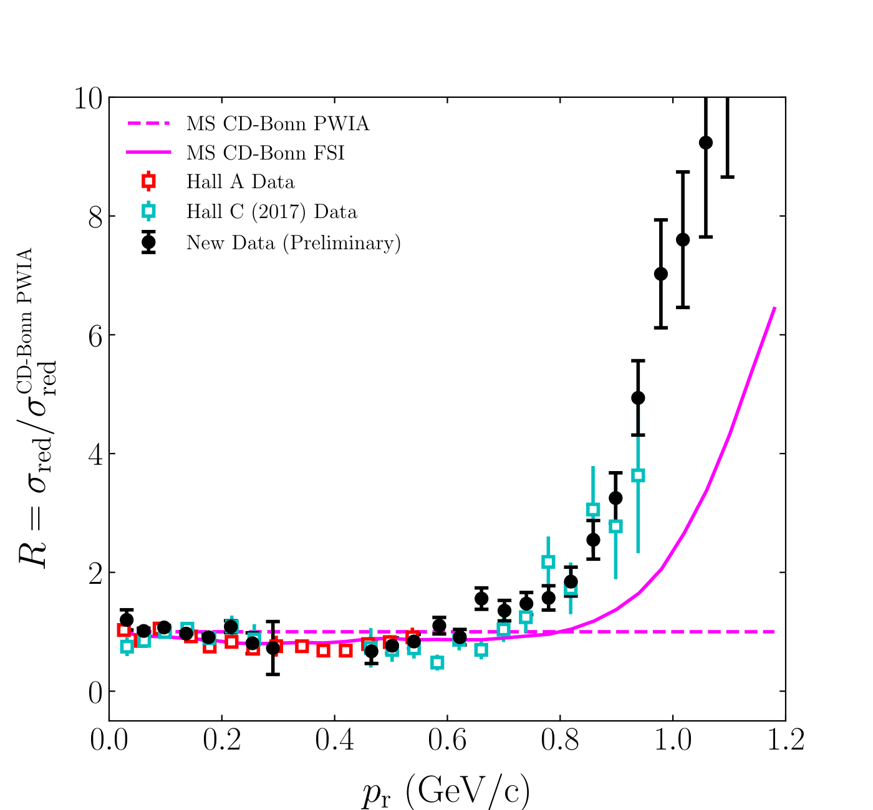
Preliminary D(e,e'p)n Momentum Distributions
Deuteron Breakup – Gema Villegas – JLUO Annual Meeting – 25 June 2026
Notes:
And the new data. As you can see the new data agrees well with both the Hall C and previous Hall C data, and continues on the trend the the previous Hall C data established. There is this significant disagreement above 700 MeV/c, this is only made more obvious when we look at the ratio, this is the same ratio I showed before for the commissioning experiment data. The errors shown here are only statistical.

Slide 24
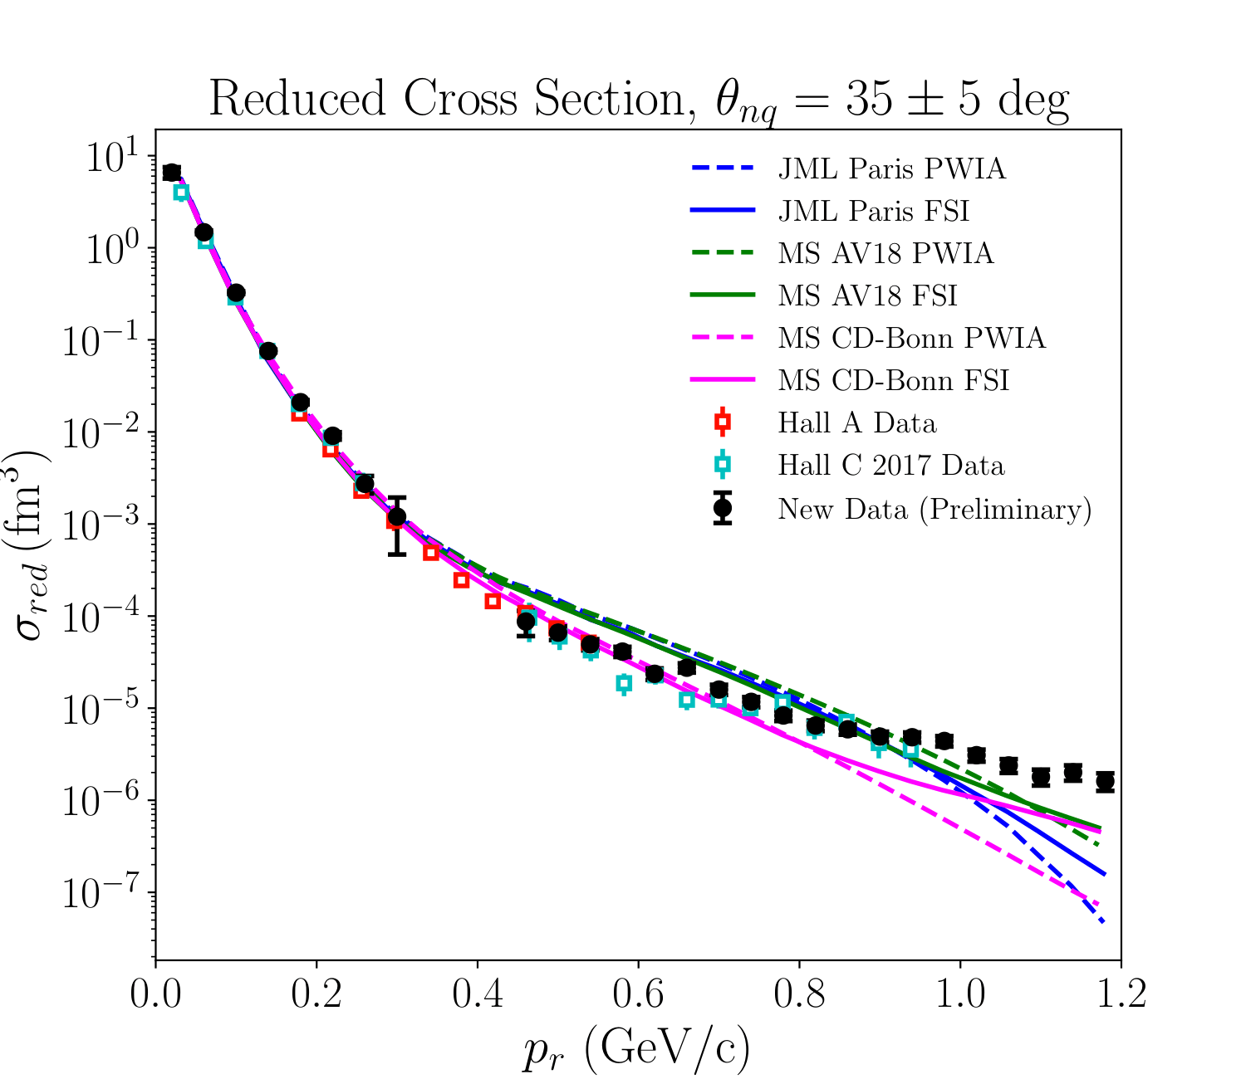
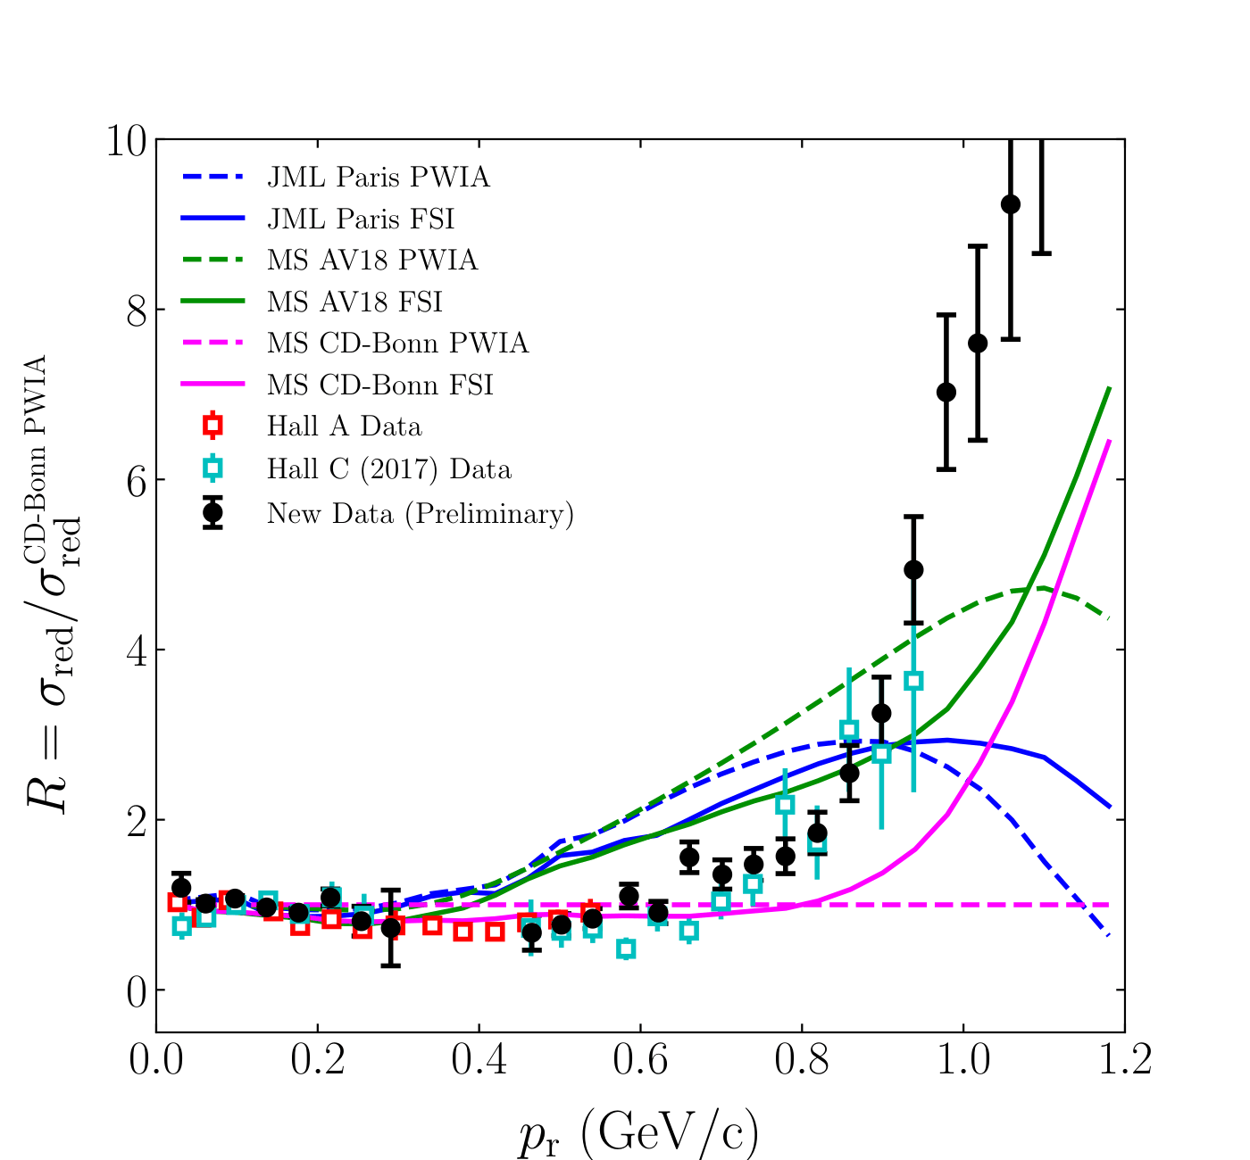
Preliminary D(e,e'p)n Momentum Distributions
Deuteron Breakup – Gema Villegas – JLUO Annual Meeting – 25 June 2026
Notes:
Here are the rest of the models

Slide 25
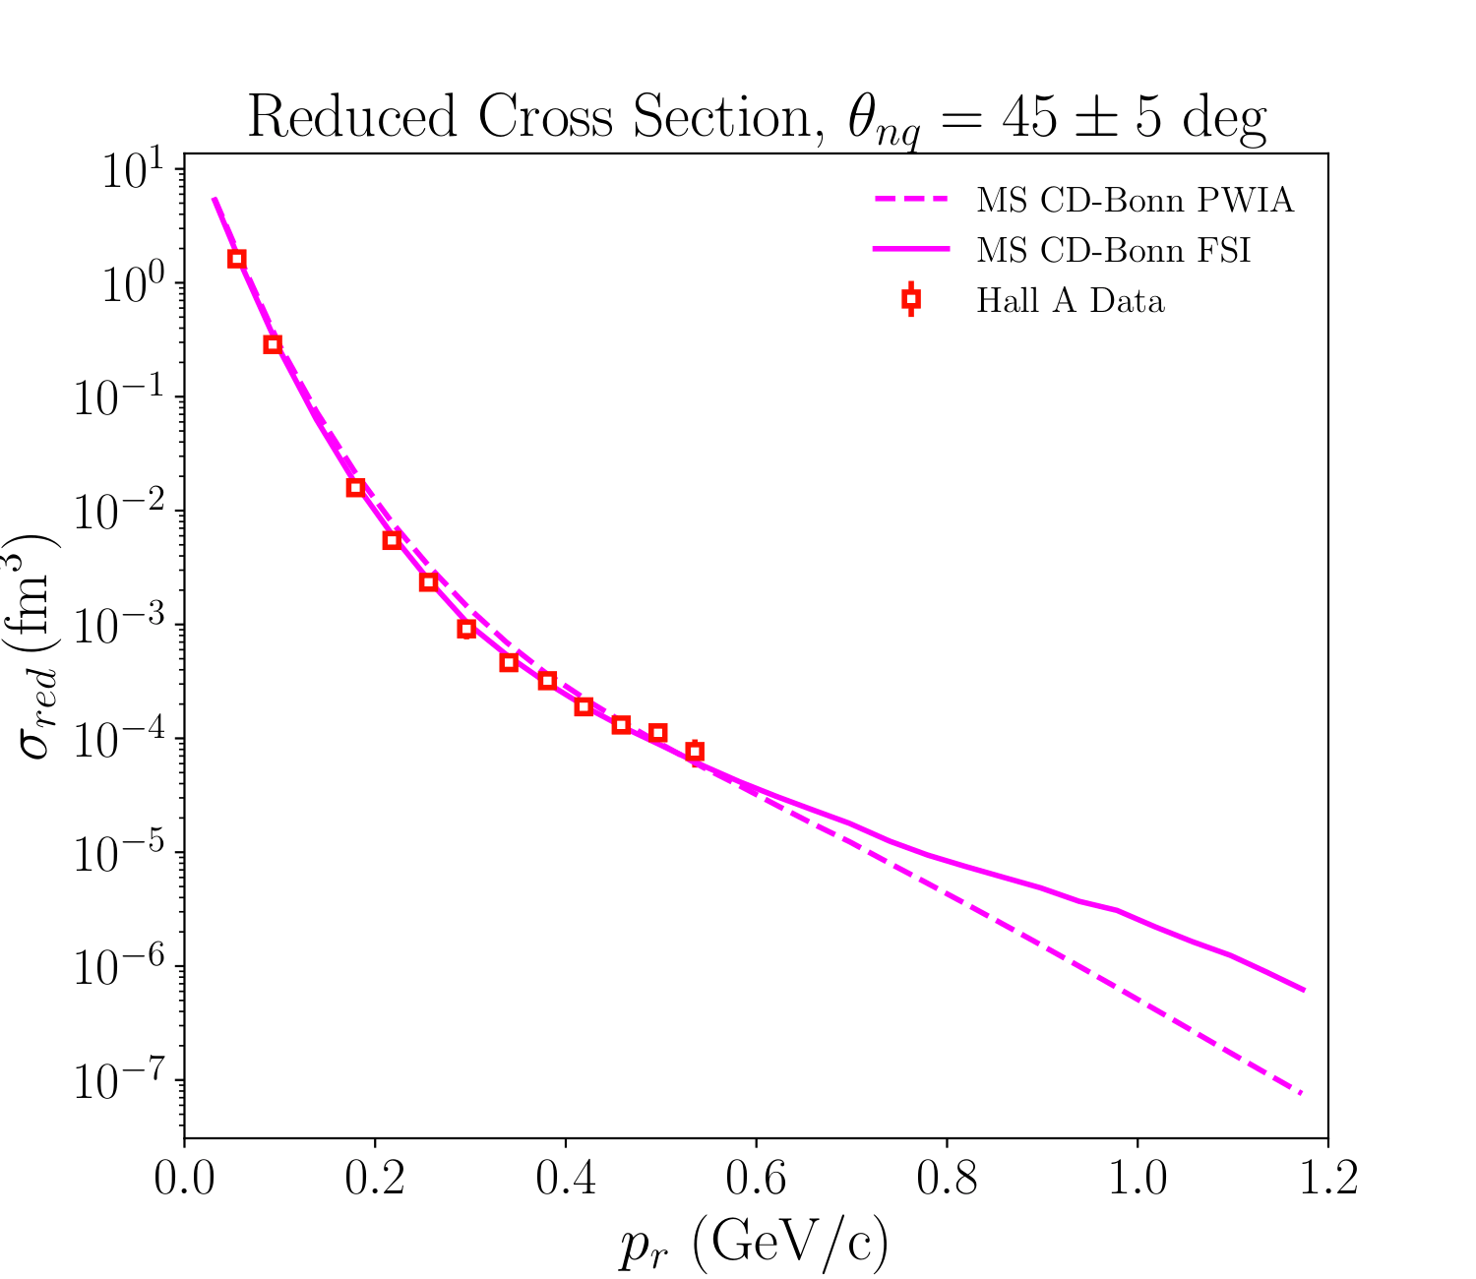
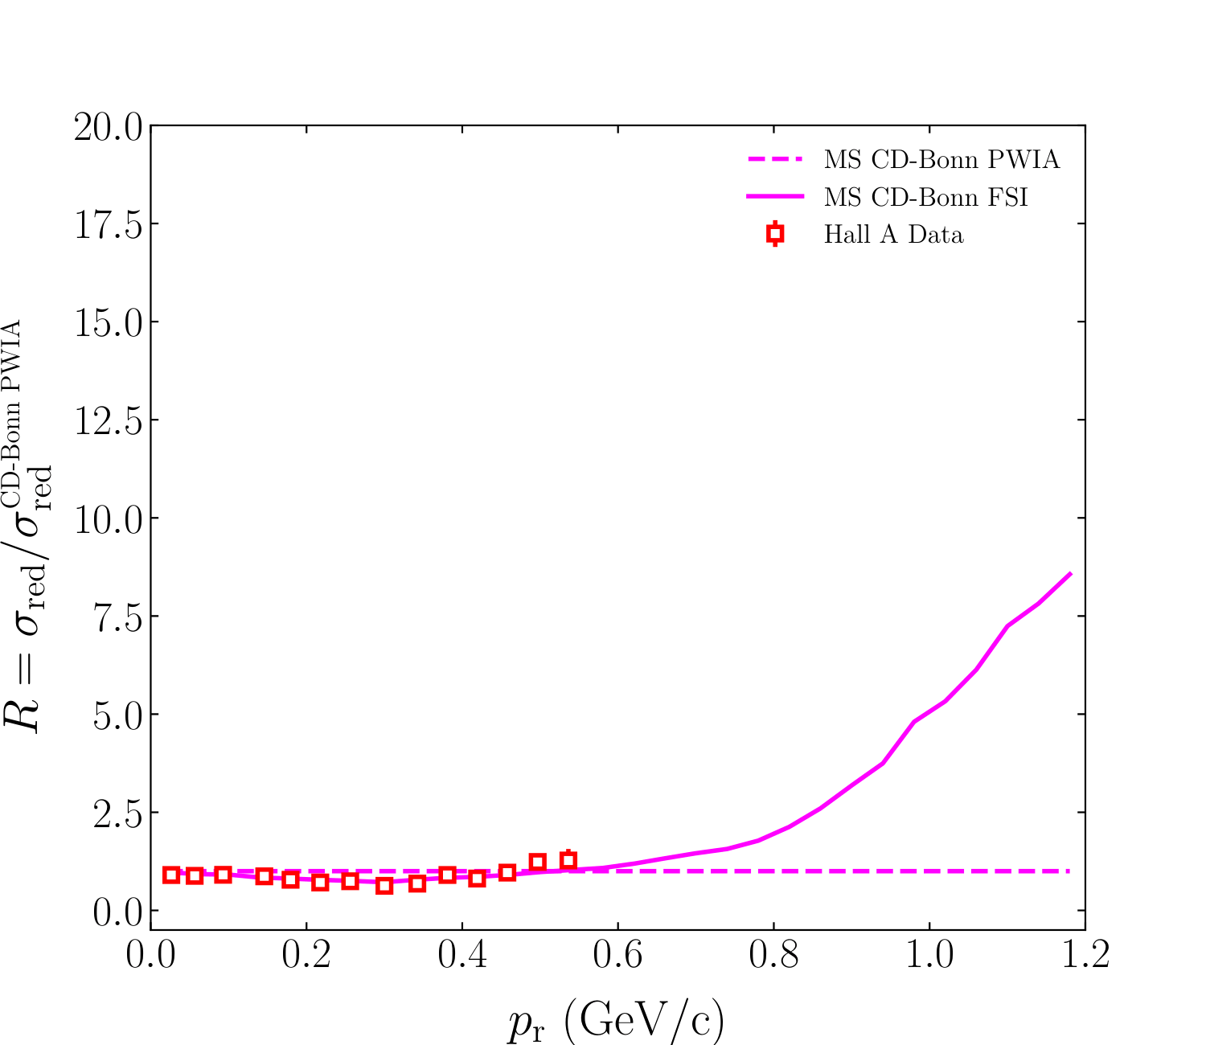
Preliminary D(e,e'p)n Momentum Distributions
Deuteron Breakup – Gema Villegas – JLUO Annual Meeting – 25 June 2026

Slide 26
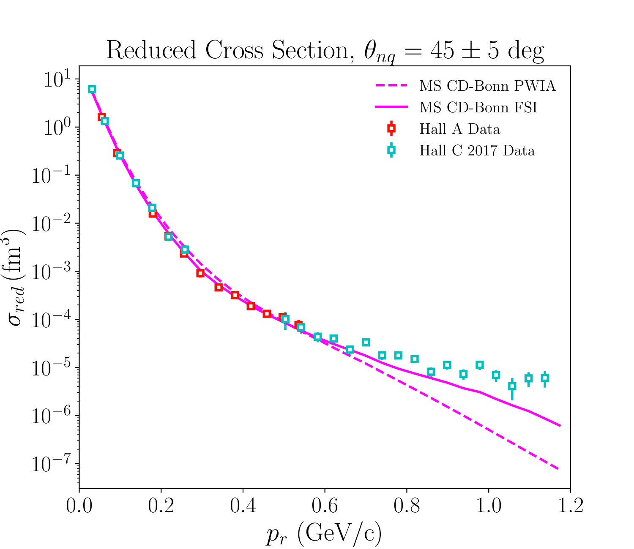
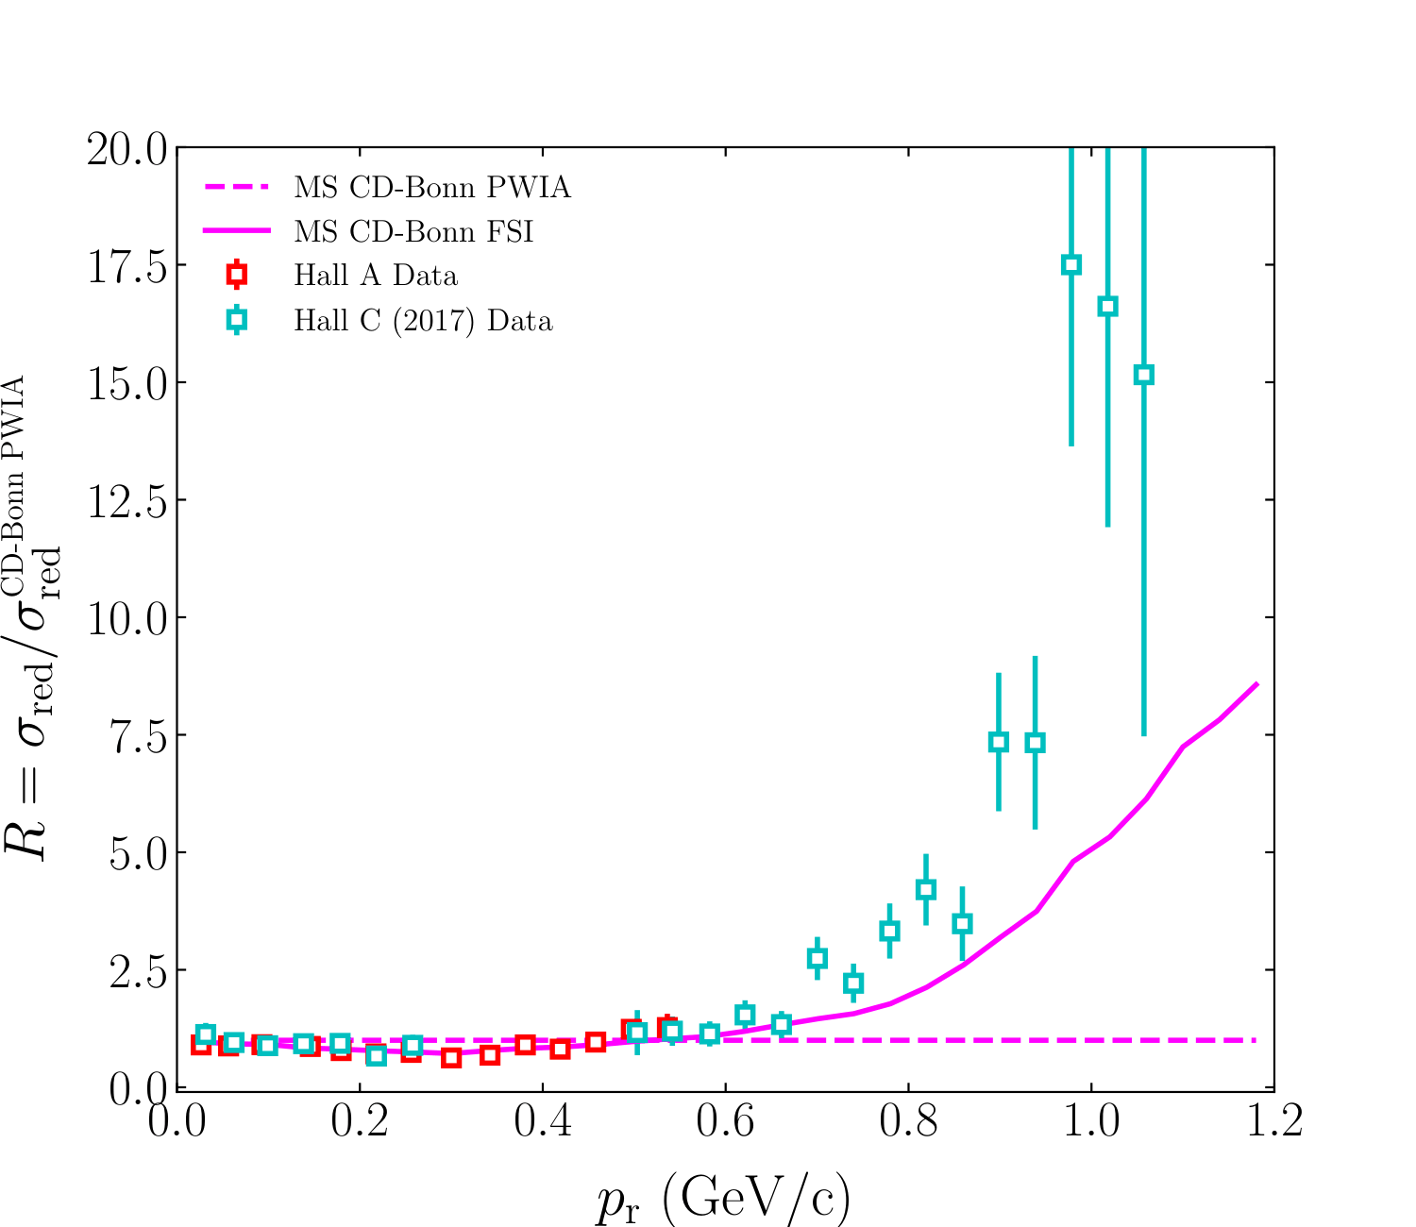
Preliminary D(e,e'p)n Momentum Distributions
Deuteron Breakup – Gema Villegas – JLUO Annual Meeting – 25 June 2026

Slide 27
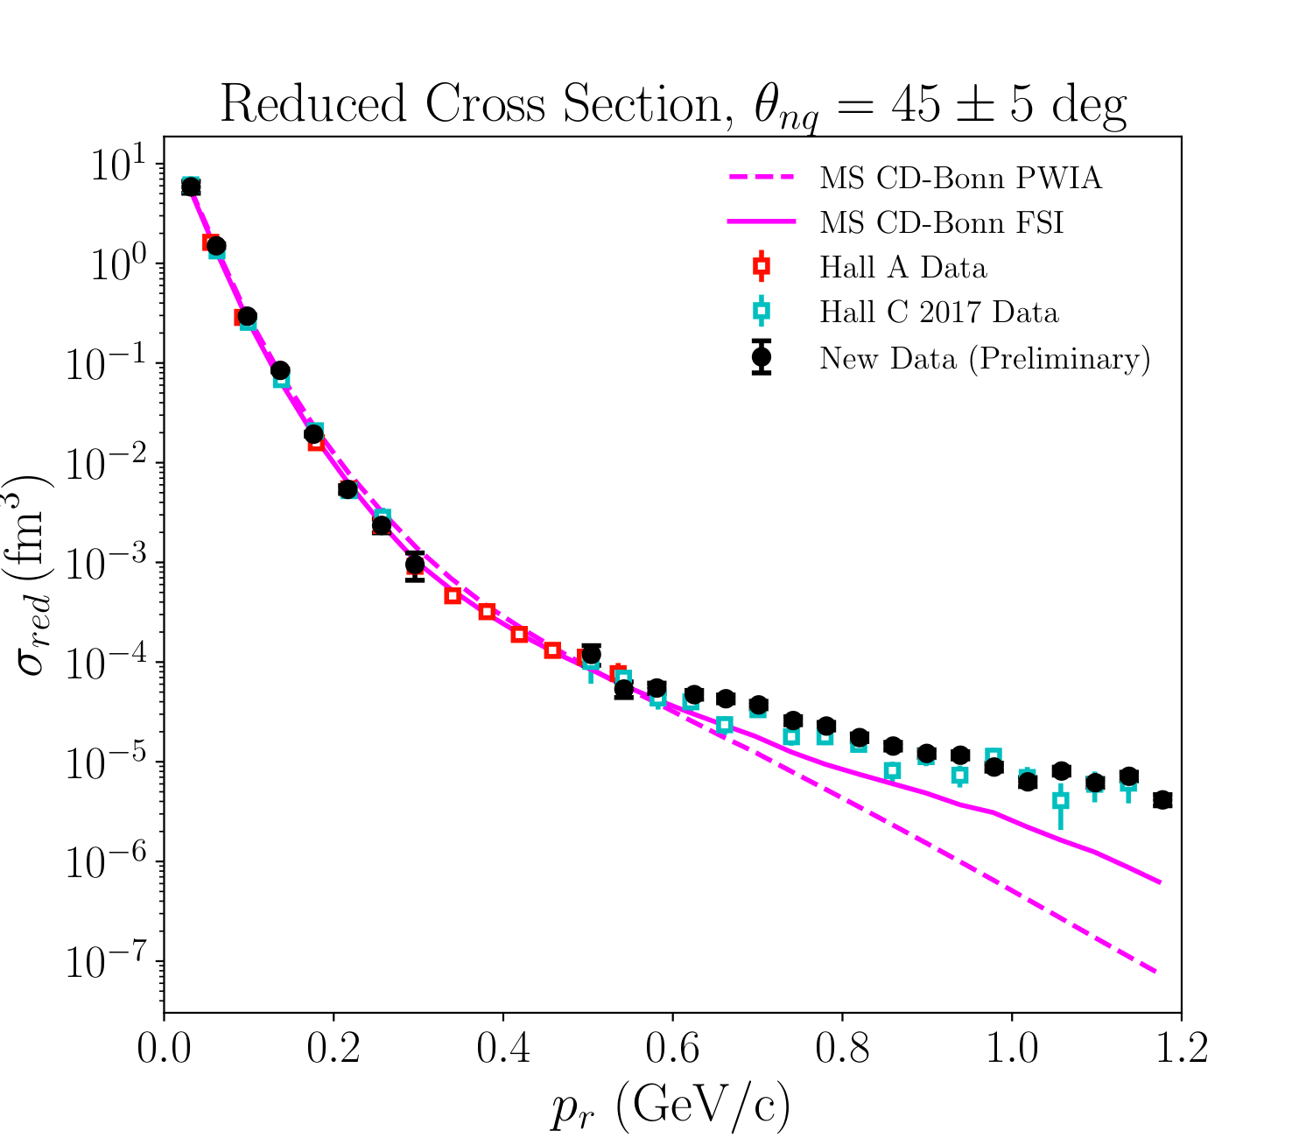
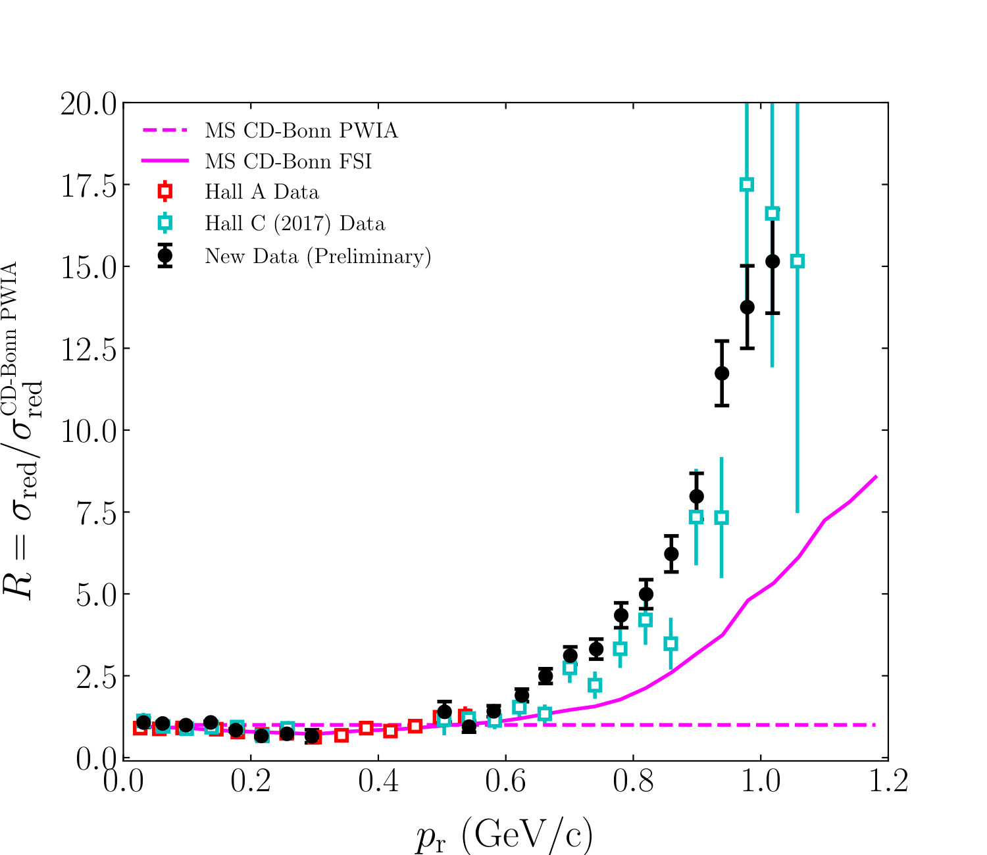
Preliminary D(e,e'p)n Momentum Distributions
Deuteron Breakup – Gema Villegas – JLUO Annual Meeting – 25 June 2026

Slide 28
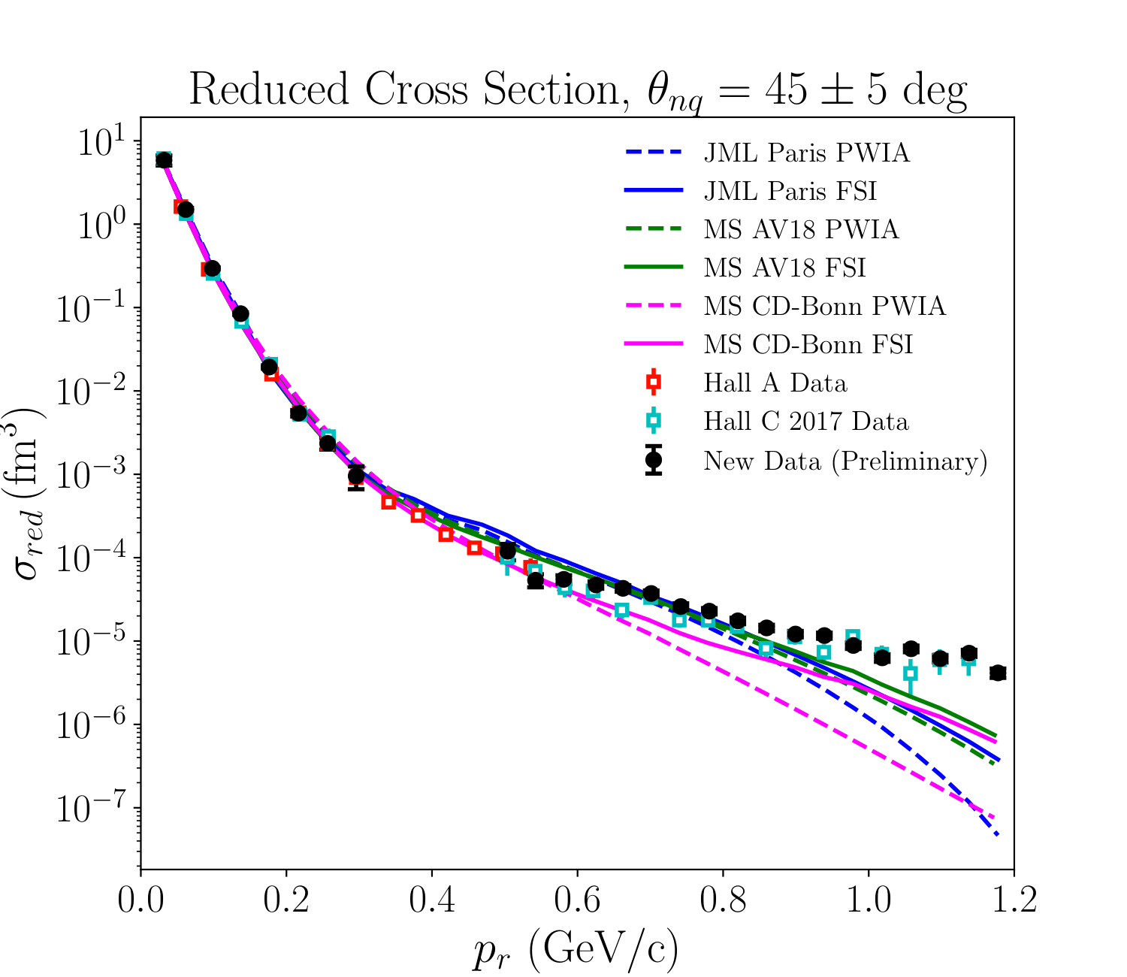
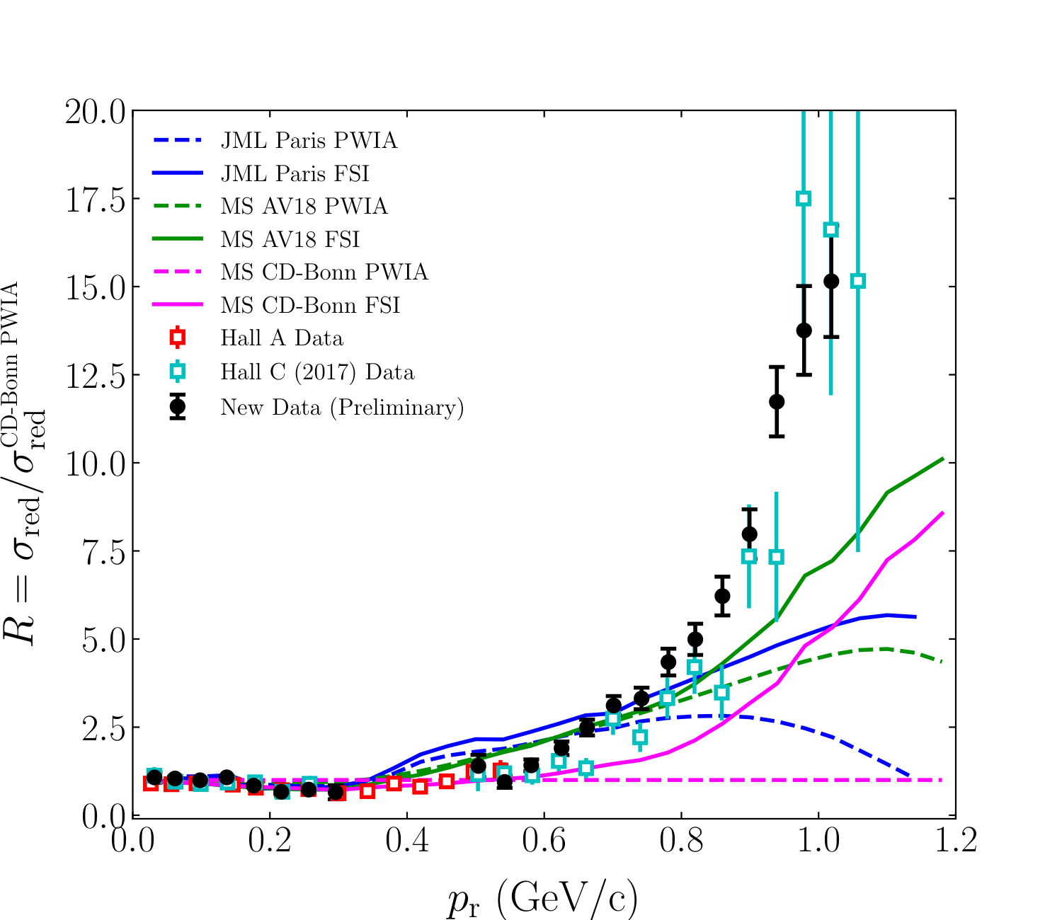
Preliminary D(e,e'p)n Momentum Distributions
Deuteron Breakup – Gema Villegas – JLUO Annual Meeting – 25 June 2026

Slide 29
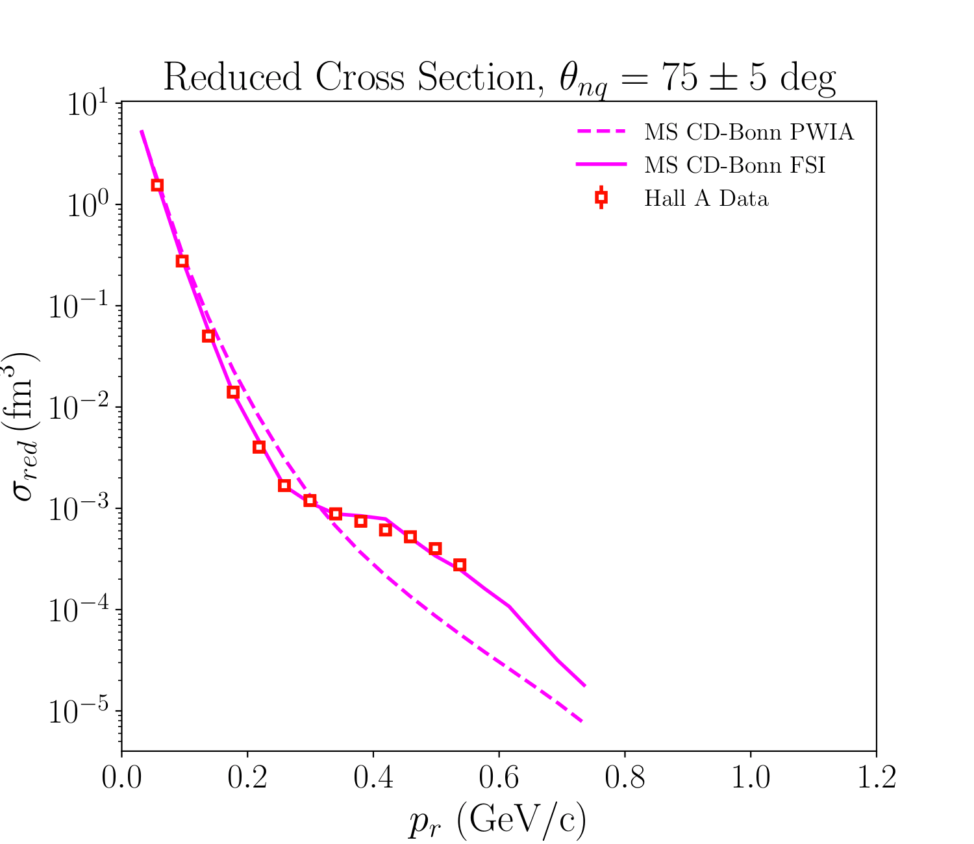
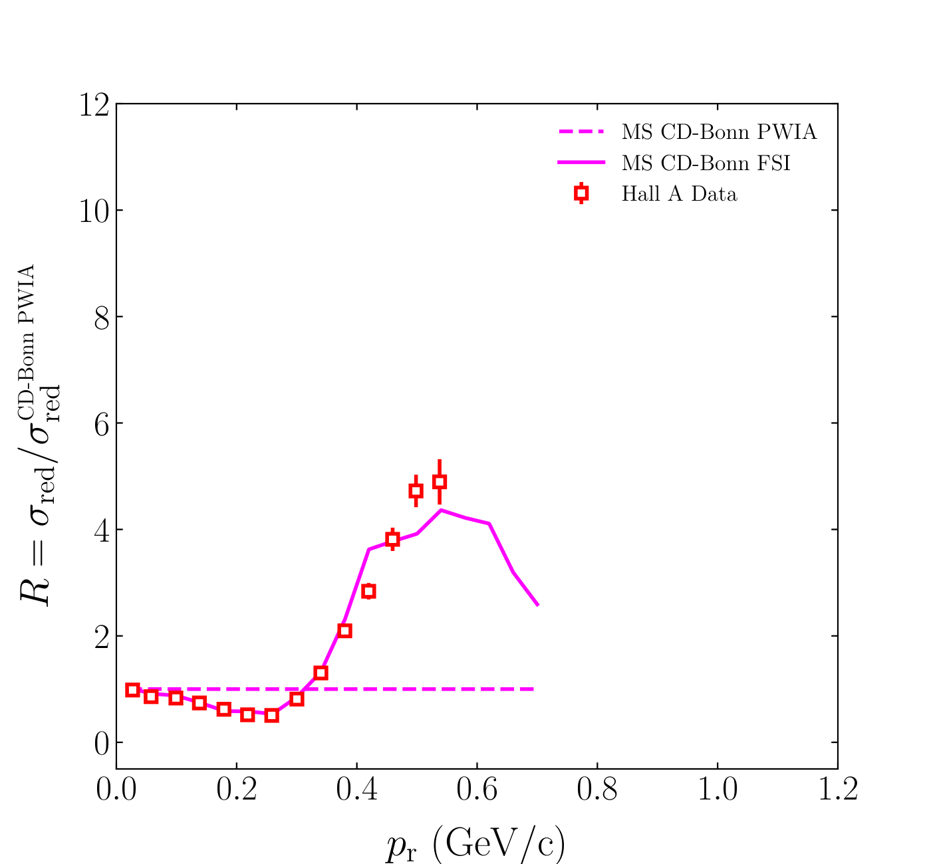
Preliminary D(e,e'p)n Momentum Distributions
Deuteron Breakup – Gema Villegas – JLUO Annual Meeting – 25 June 2026

Slide 30
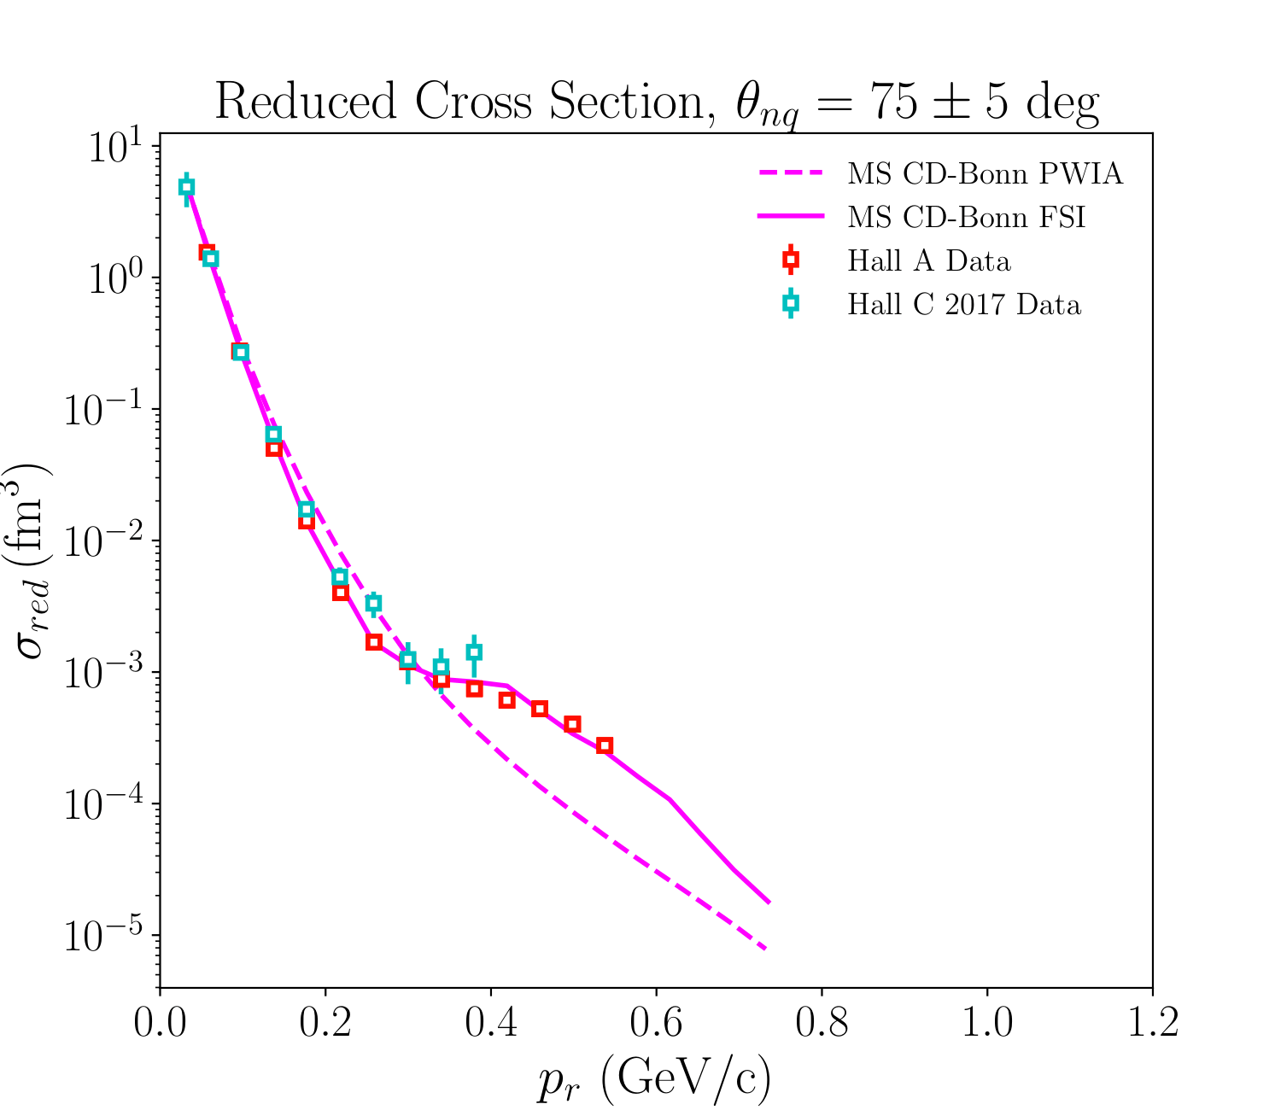
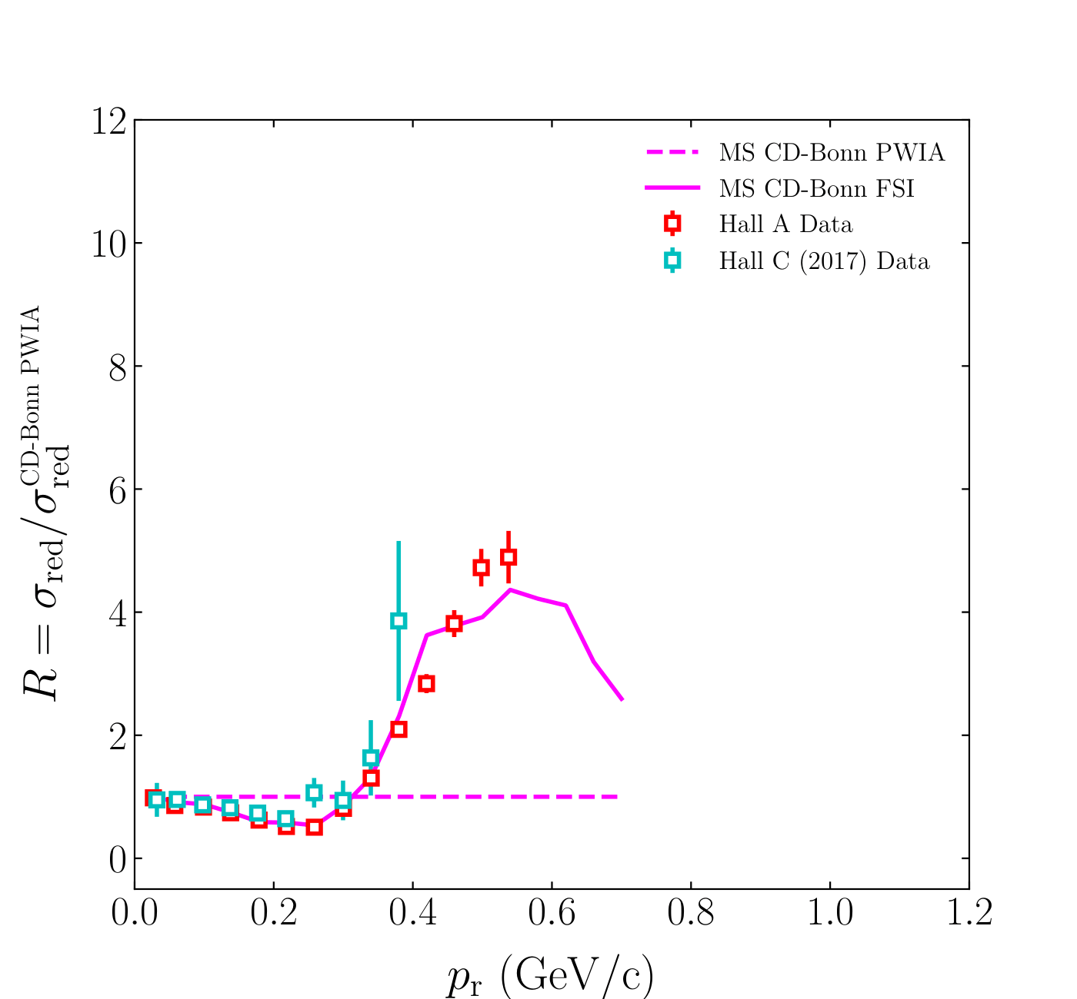
Preliminary D(e,e'p)n Momentum Distributions
Deuteron Breakup – Gema Villegas – JLUO Annual Meeting – 25 June 2026

Slide 31
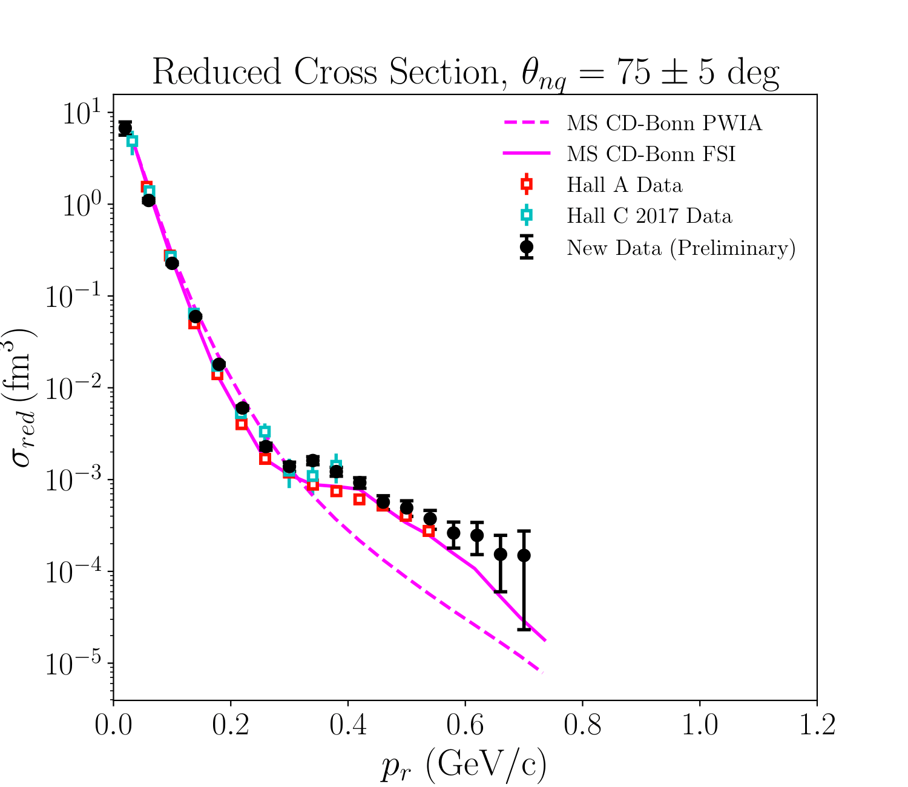
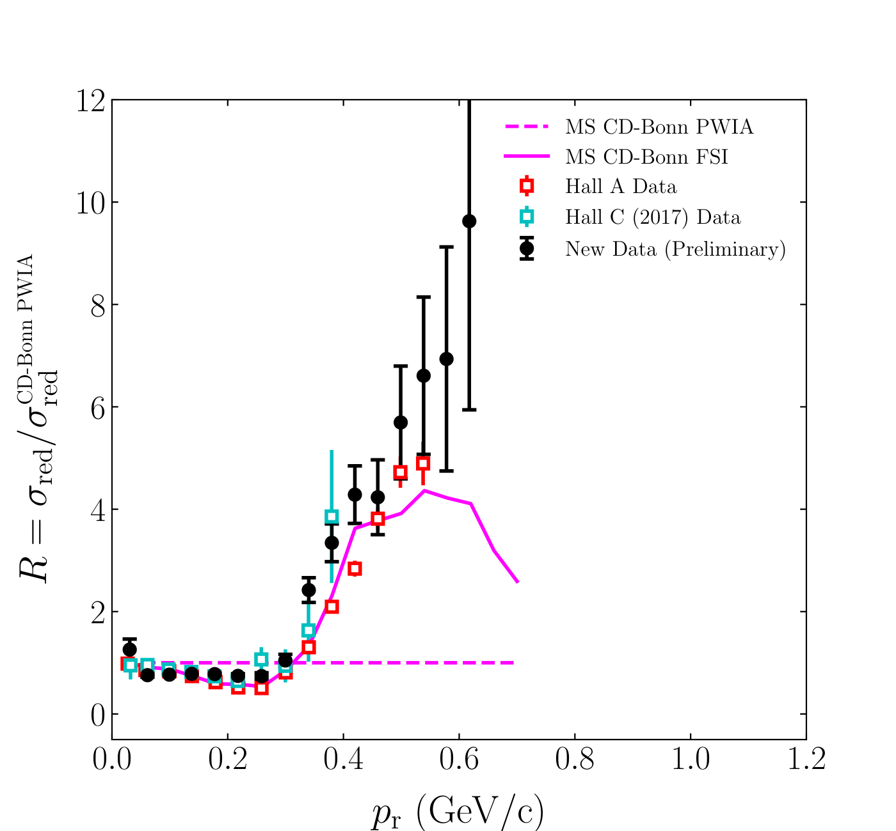
Preliminary D(e,e'p)n Momentum Distributions
Deuteron Breakup – Gema Villegas – JLUO Annual Meeting – 25 June 2026

Slide 32
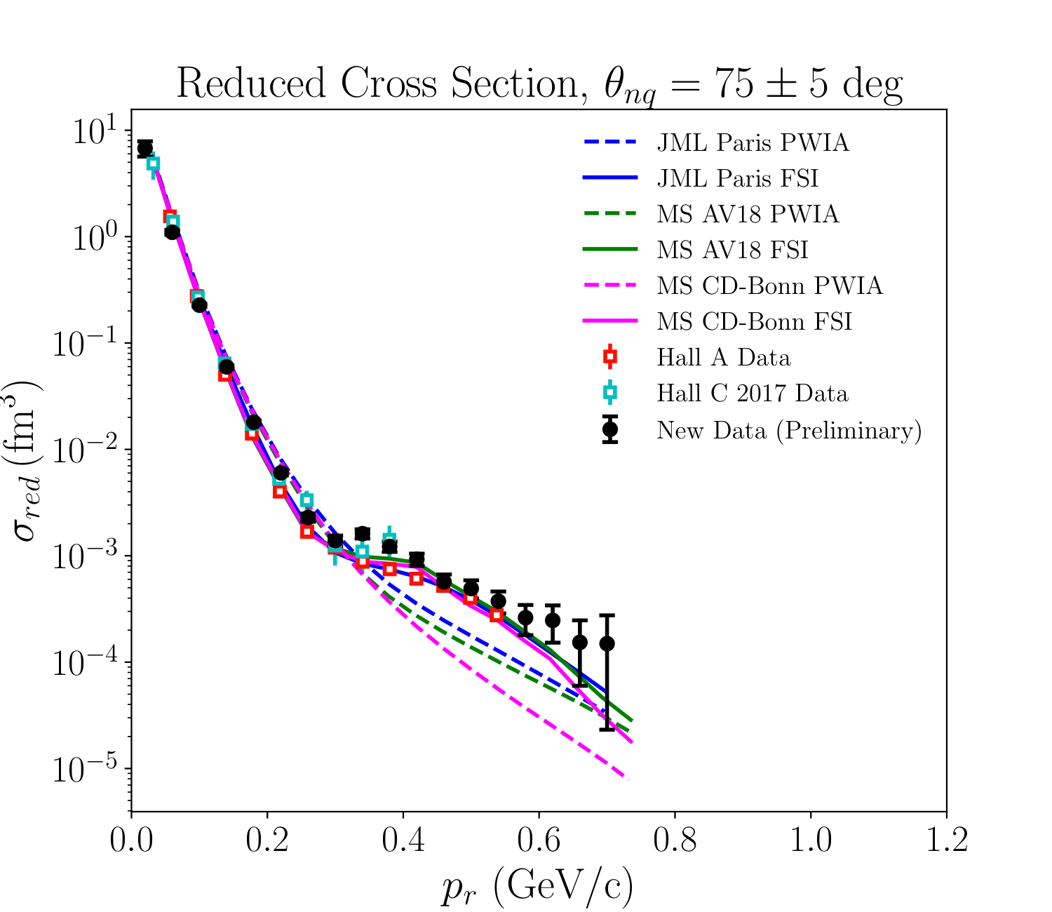
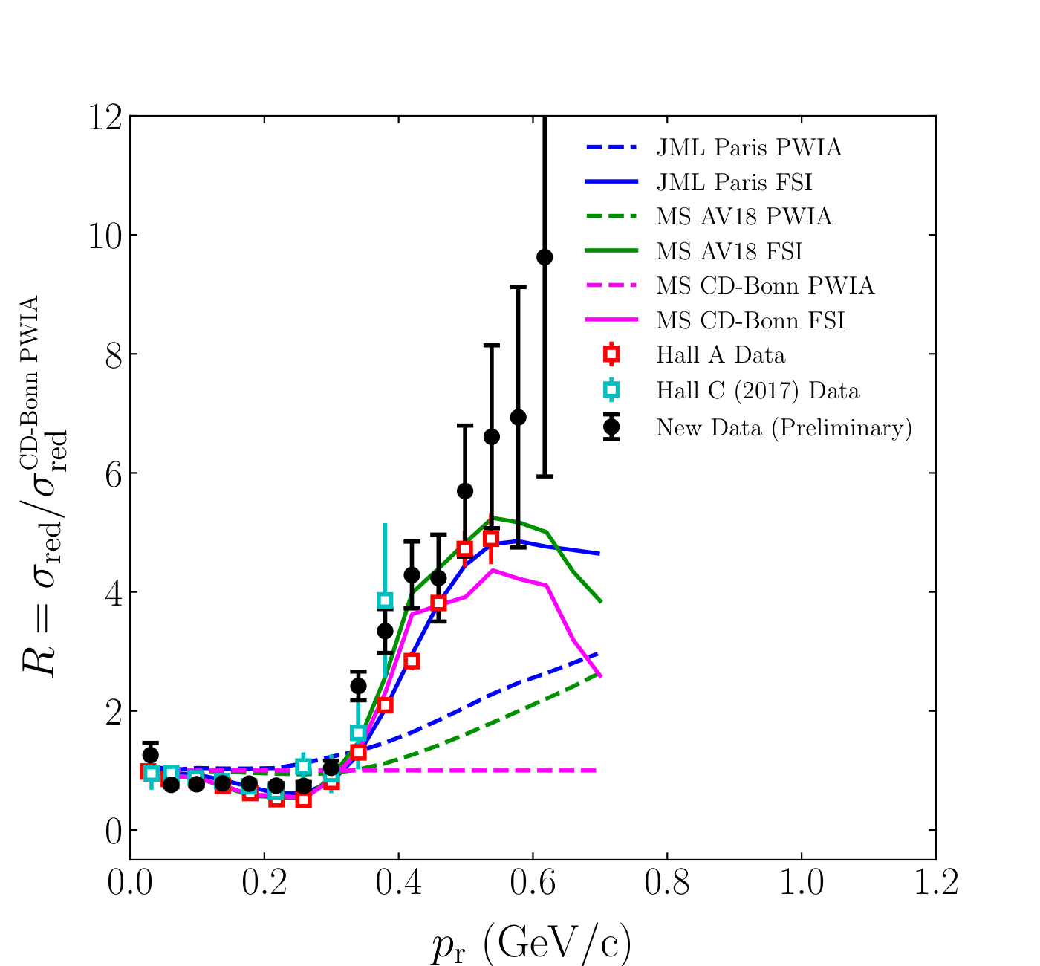
Preliminary D(e,e'p)n Momentum Distributions
Deuteron Breakup – Gema Villegas – JLUO Annual Meeting – 25 June 2026

Slide 33
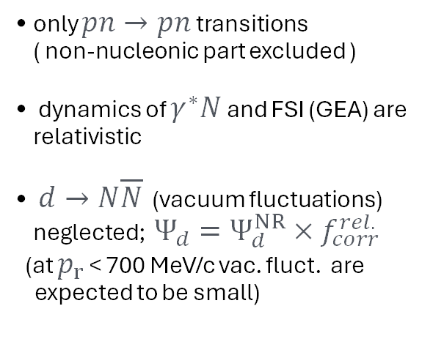

Why the discrepancy? Probing the NN Repulsive Core
Virtual Nucleon Approximation (VNA)
Theoretical Framework (Sargsian 2010)
(1) Inelastic
$$ΔΔ→np$$
expected ~ >800 MeV/c
only $pn→pn$ transitions
( non-nucleonic part excluded )
dynamics of $γ^{∗}N$ and FSI (GEA) are relativistic
$d→N\overline{N}$ (vacuum fluctuations) neglected; $Ψ_{d}=Ψ_{d}^{NR}×f_{corr}^{rel.}$
(at $p_{r}$ < 700 MeV/c vac. fluct. are
expected to be small)
(2) Vacuum fluctuations are not small above 700 MeV/c
(3) What do FSI look like?
M. Sargsian (2009). 10.1103/PhysRevC.82.014612
Deuteron Breakup – Gema Villegas – JLUO Annual Meeting – 25 June 2026

Slide 34
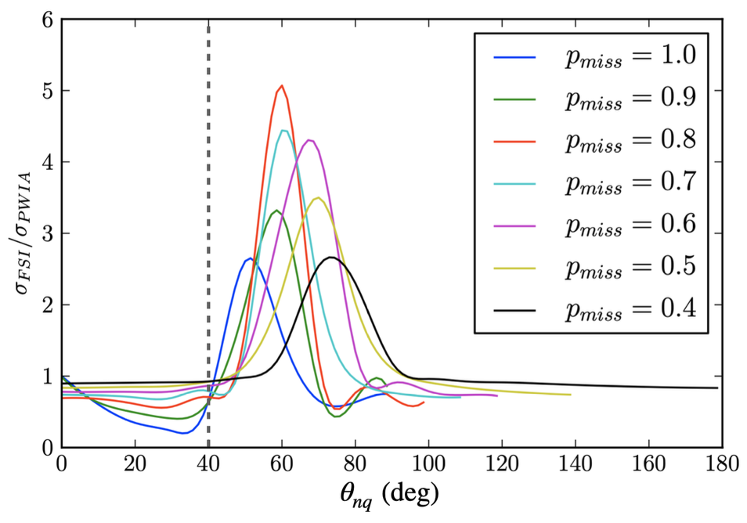
Deuteron FSI Studies (PR12-25-003)
New proposed measurement will address the following:
W. Boeglin & M. Sargsian (2015). 10.1142/S0218301315300039
NO DATA
Check reliability of FSI calculations above neutron recoil momentum of 500 MeV/c
Disentangle FSI + Relativistic + Non Nucleonic effects
Deuteron Breakup – Gema Villegas – JLUO Annual Meeting – 25 June 2026

Slide 35
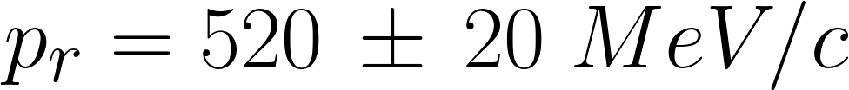





Deuteron FSI Studies (PR12-25-003)
Proposed Measurement
Calculations:
S. Jeschonnek (2008). 10.1103/PhysRevC.78.014007
M. Sargsian (2010). 10.1103/PhysRevC.82.014612
SIMC projections (Paris, JML)
(expected statistical errors)
Yero et al
(Hall C, 2020)
Preliminary
(2023)
CSM (SJ)
CD-Bonn (MS)
AV18 (MS)
Plots courtesy of Carlos Yero
Deuteron Breakup – Gema Villegas – JLUO Annual Meeting – 25 June 2026

Slide 36
Summary
The latest instance of the deuteron break-up experiment ran successfully in 2023
Analysis shows so far that the data agrees well with previous data, still showing the discrepancy between theoretical models around 700 MeV/c
Possible reasons for the discrepancy are:
  Non-nucleonic components not negligible
  Vacuum fluctuations
  FSI not well understood
To address the FSI question a new experiment was proposed (PR12-25-003)
Deuteron Breakup – Gema Villegas – JLUO Annual Meeting – 25 June 2026

Slide 37
Backup Slides

Slide 38
D(e,e'p)n Data Cross Section
How do we extract the data cross section?
Work in 2026:
The HMS and SHMS tracking efficiencies were on average 0.983
The average live time was 0.970
Target Boiling and Proton Transmission/Absorption Studies were done at the beginning 2026
The target boiling for LD2 was 4.85% per 100 muA
The proton absorption studies were done 3 ways: via spreadsheet (6.19%), Geant4 simulation (available on github) (6.029 ± 0.01 %), and data (4.7 ± 1.1 %)
Deuteron Breakup – Gema Villegas – JLUO Annual Meeting – 25 June 2026

Slide 39




Event Selection Cuts
Acceptance cuts:
  HMS momentum acceptance: (-8,8)
  SHMS momentum acceptance: (-7,22)
  HMS collimator cut
SHMS Calorimeter PID
Coincidence time cut
Current Cut
No EDTM Cut
Z-tar difference Cut
Kinematic cuts:
  Missing energy: (-0.05,0.05)
  Q² : (4,5)
Deuteron Breakup – Gema Villegas – JLUO Annual Meeting – 25 June 2026

Slide 40




Event Selection Cuts
Acceptance cuts:
  HMS momentum acceptance: (-8,8)
  SHMS momentum acceptance: (-7,22)
  HMS collimator cut
SHMS Calorimeter PID
Coincidence time cut
Current Cut
No EDTM Cut
Z-tar difference Cut
Kinematic cuts:
  Missing energy: (-0.05,0.05)
  Q² : (4,5)
Deuteron Breakup – Gema Villegas – JLUO Annual Meeting – 25 June 2026

Slide 41


Event Selection Cuts
Acceptance cuts:
  HMS momentum acceptance: (-8,8)
  SHMS momentum acceptance: (-7,22)
  HMS collimator cut
SHMS Calorimeter PID
Coincidence time cut
Current Cut
No EDTM Cut
Z-tar difference Cut
Kinematic cuts:
  Missing energy: (-0.05,0.05)
  Q² : (4,5)
Deuteron Breakup – Gema Villegas – JLUO Annual Meeting – 25 June 2026

