Slide 1


Poster Competition
The organizers: Lorelei Carlson, Christine Ploen and Zeke Wertz
The judges: Latifa Elouadrhiri, Dave Gaskell, Joe Grames, Wally Melnitchouk, Sanghwa Park and Volker Ziemann
The presenters: G.W. Nuwan Chaminda, Gyang Chung, Bianca Gualtieri, Julio Gil Gutierrez, Kei Ishido, Bhishm Joshi, Jacob McMurtry, Ken Nishida, Sharifuzzaman Shakel , and Bella Wilson

Slide 2
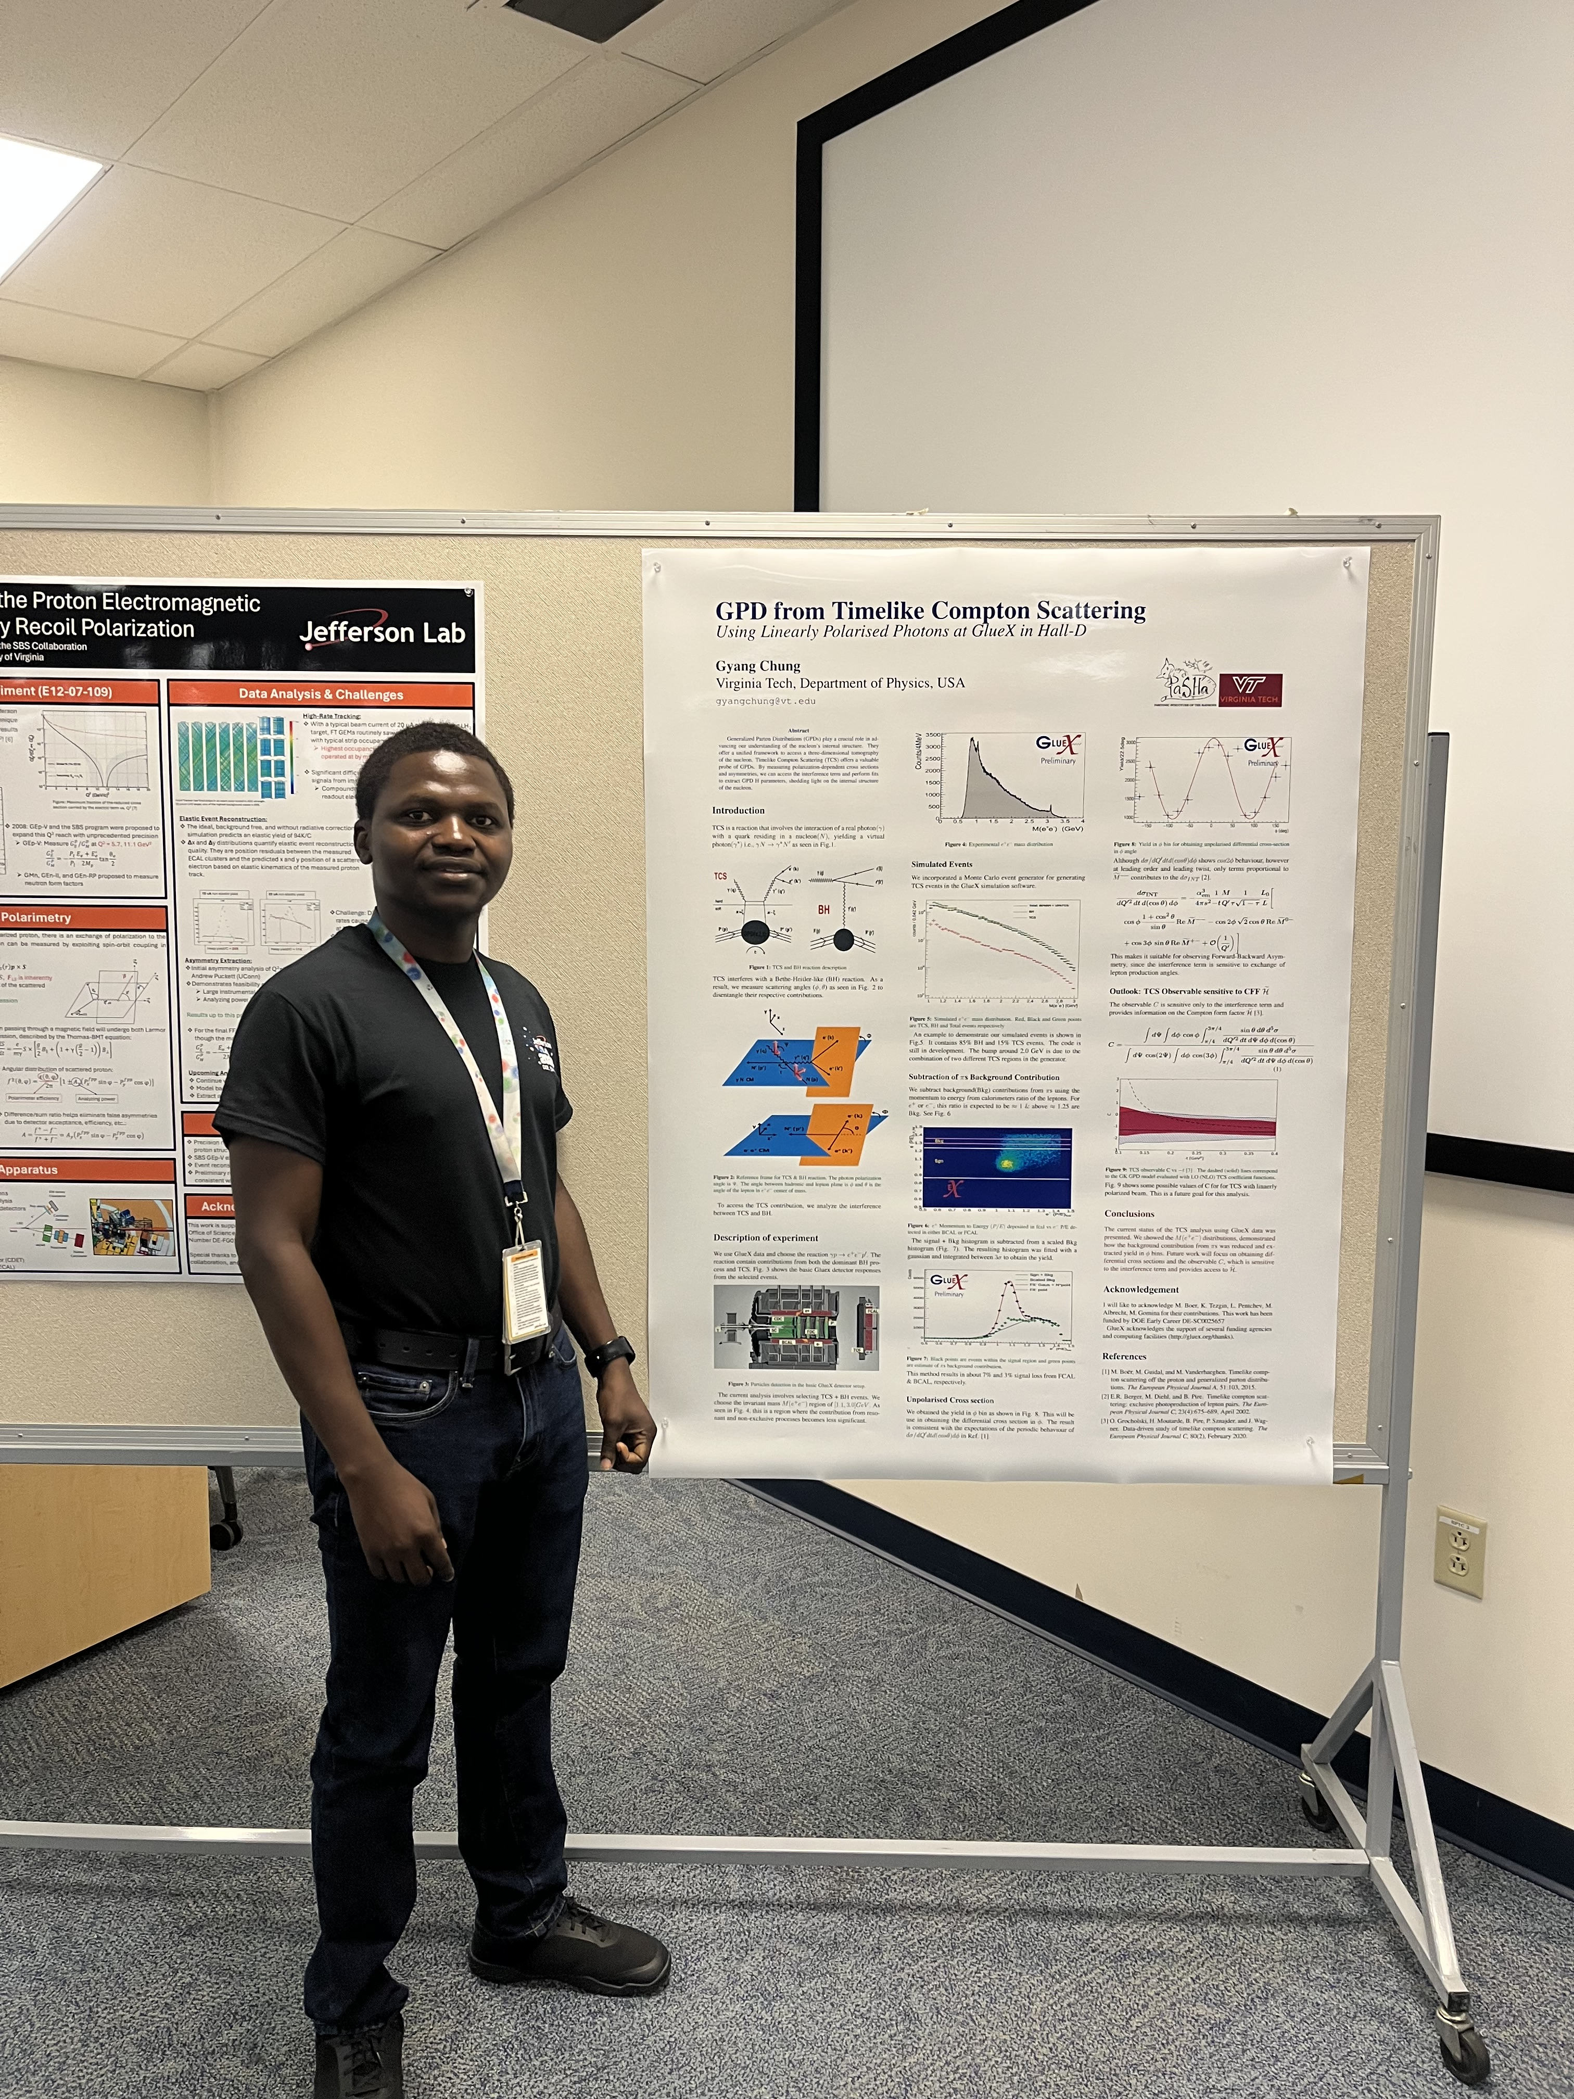
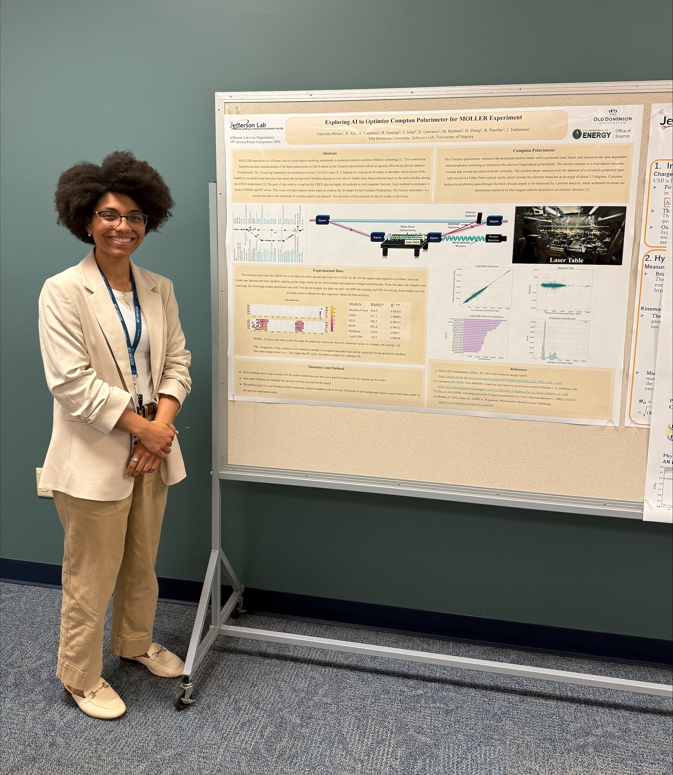
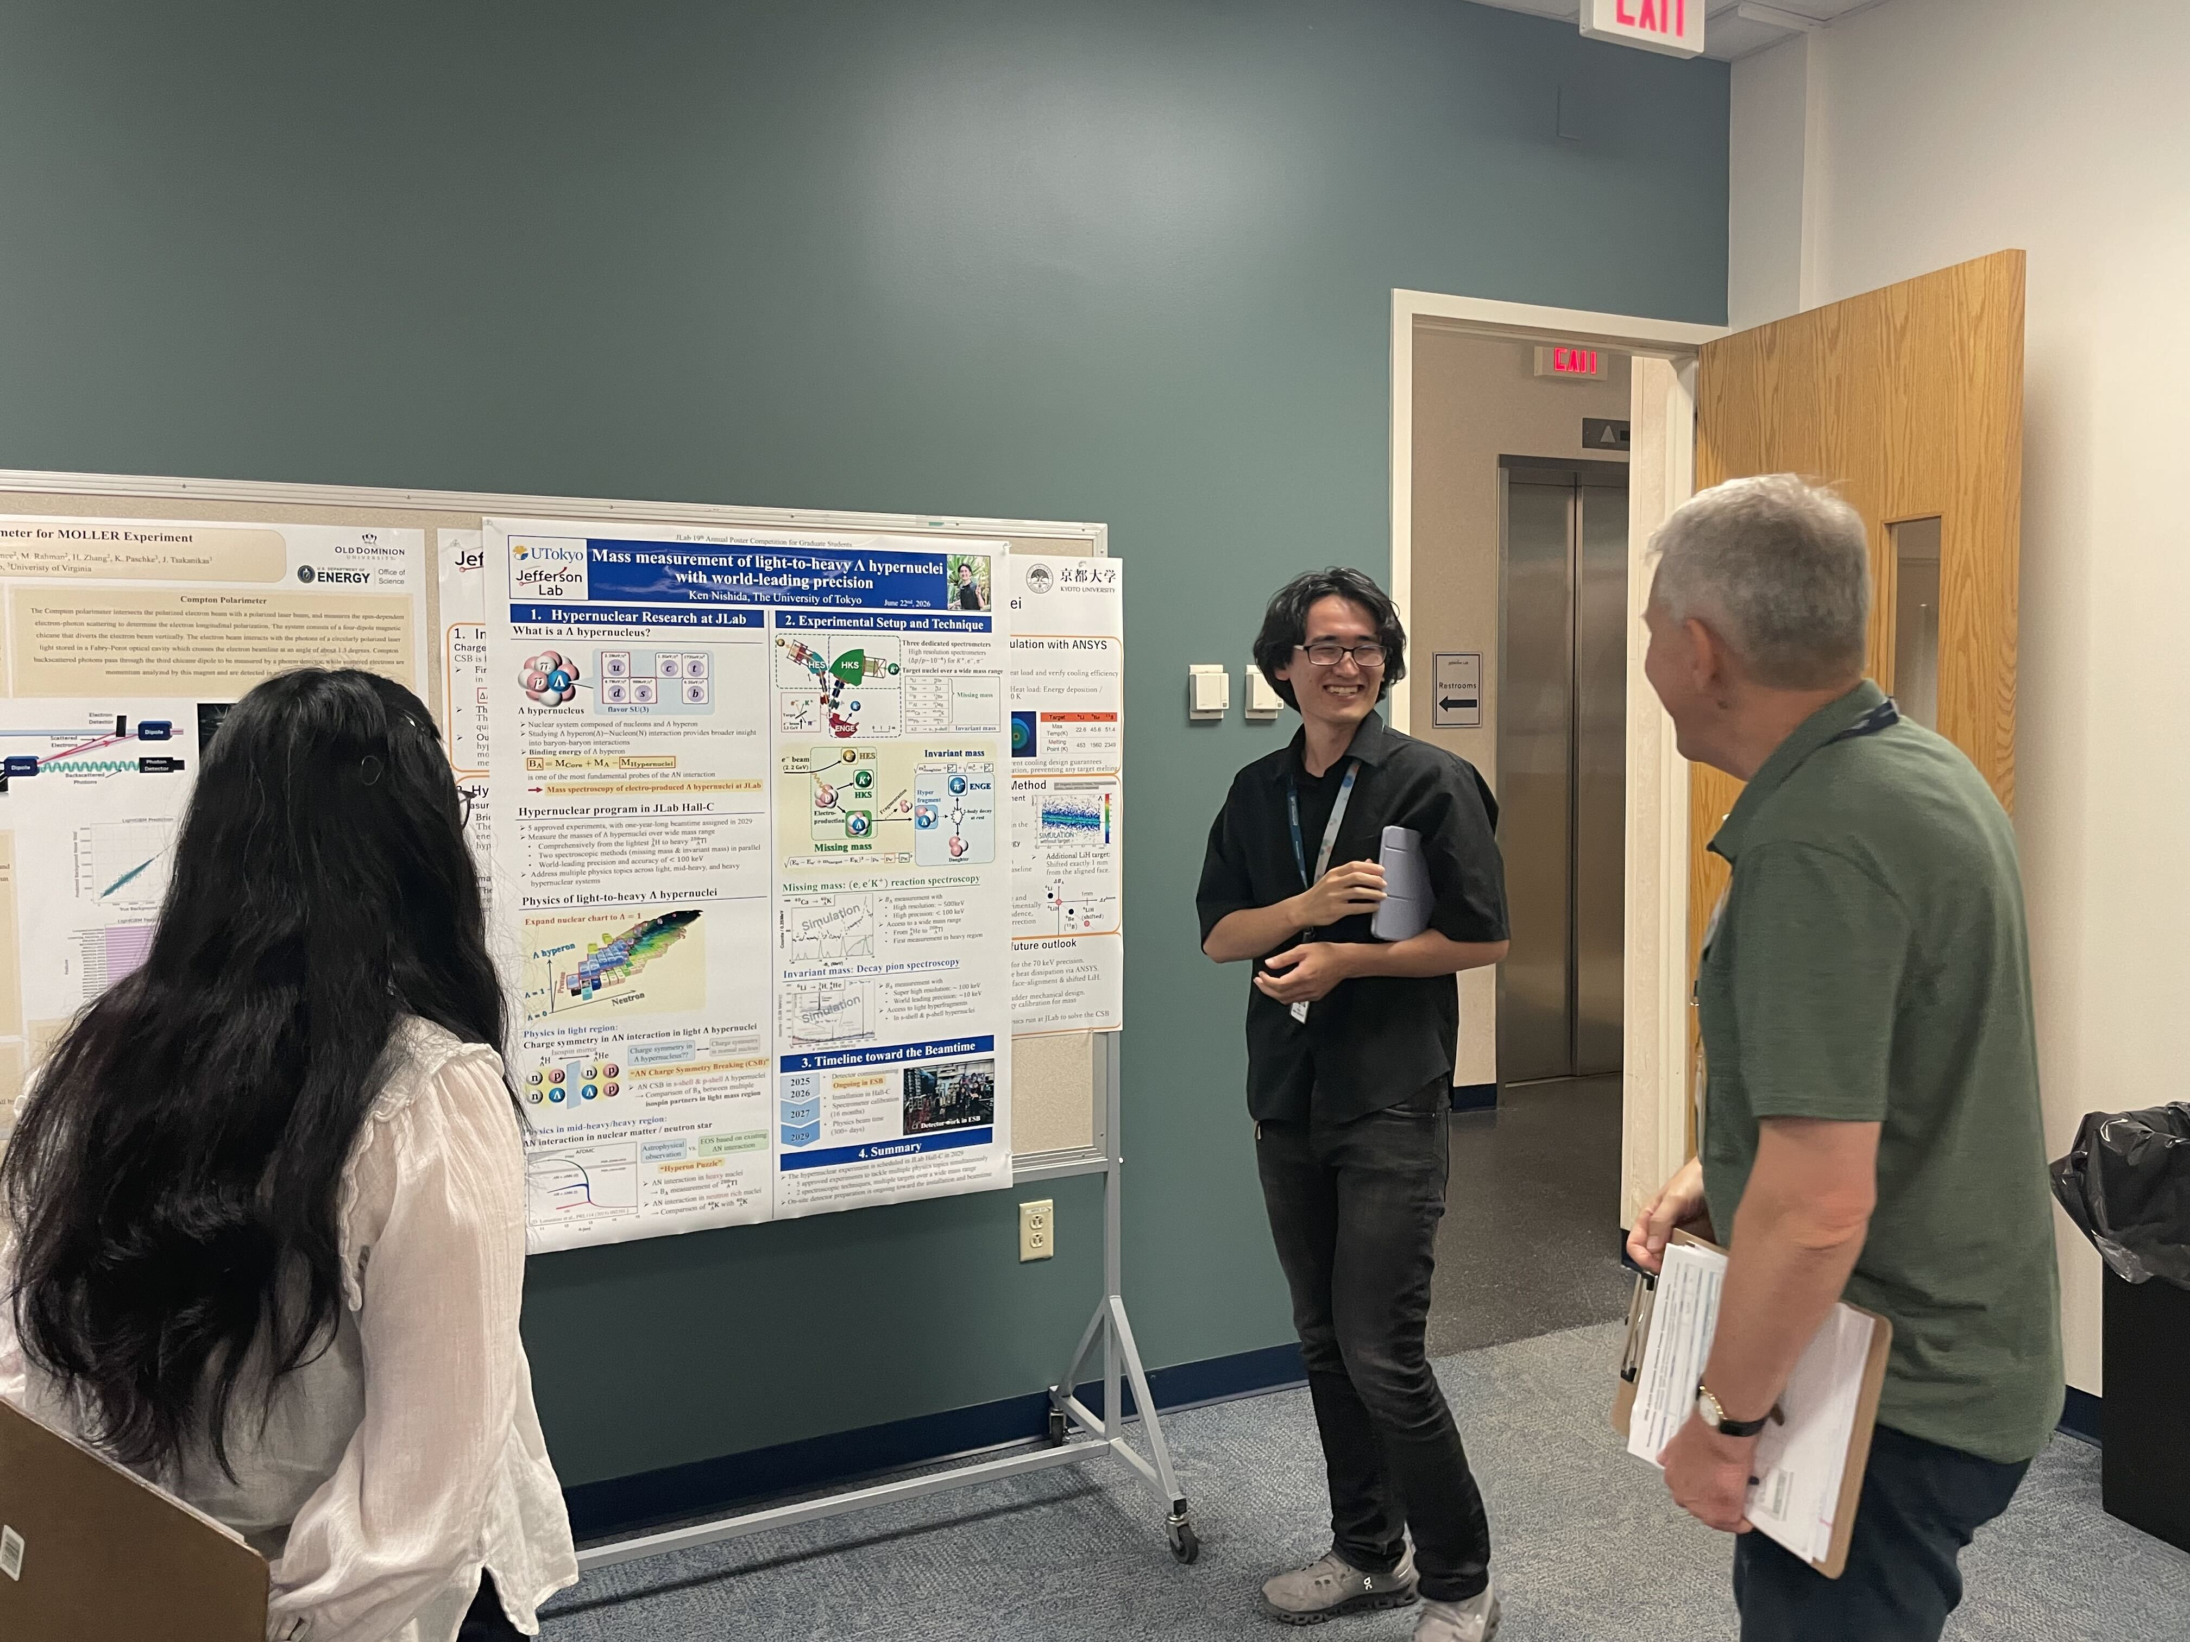
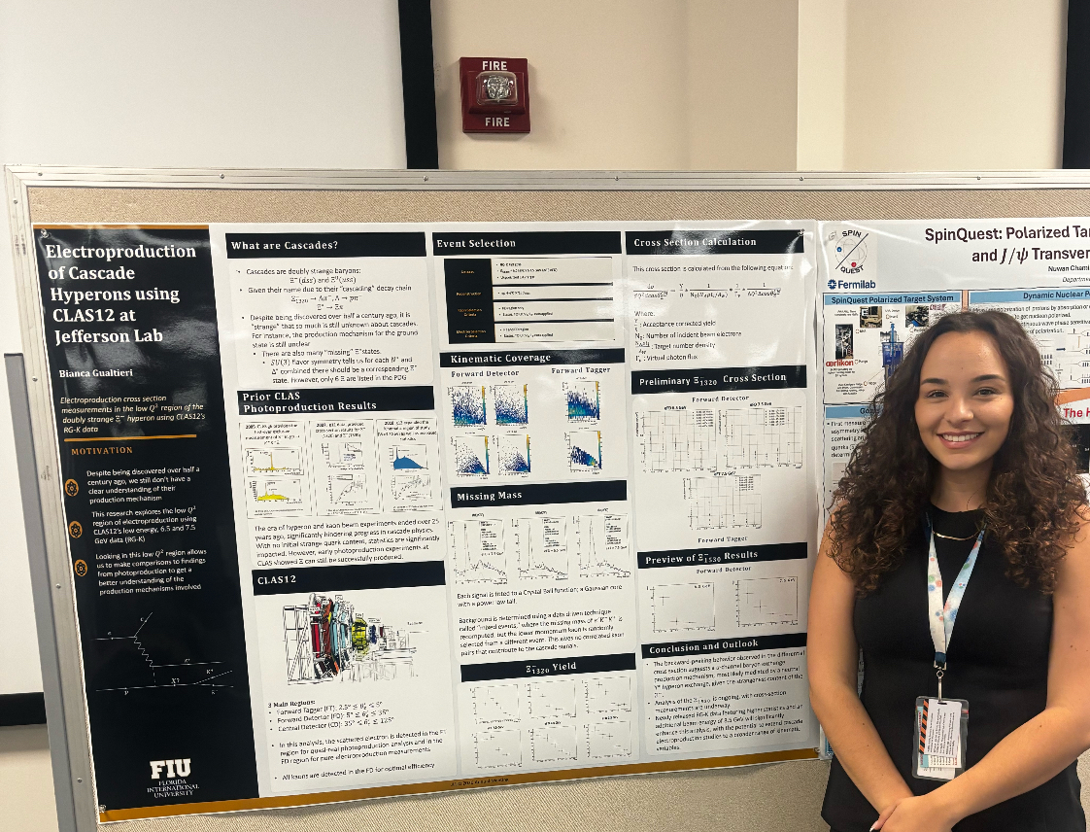

Slide 3
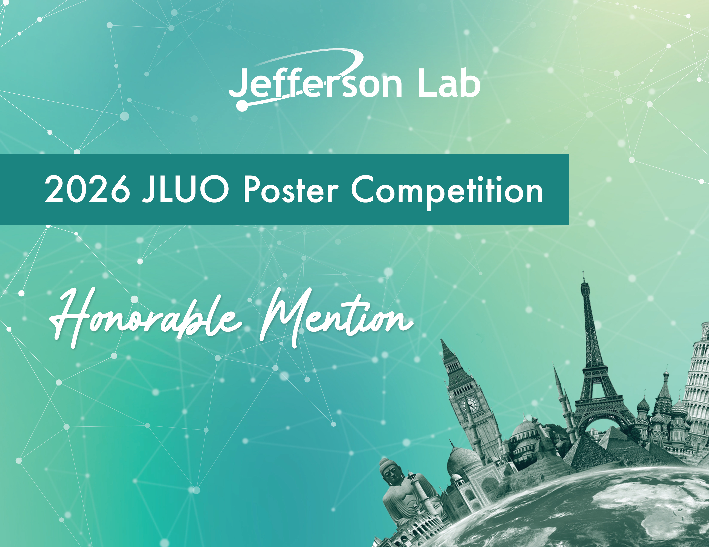
Bella Wilson

Slide 4
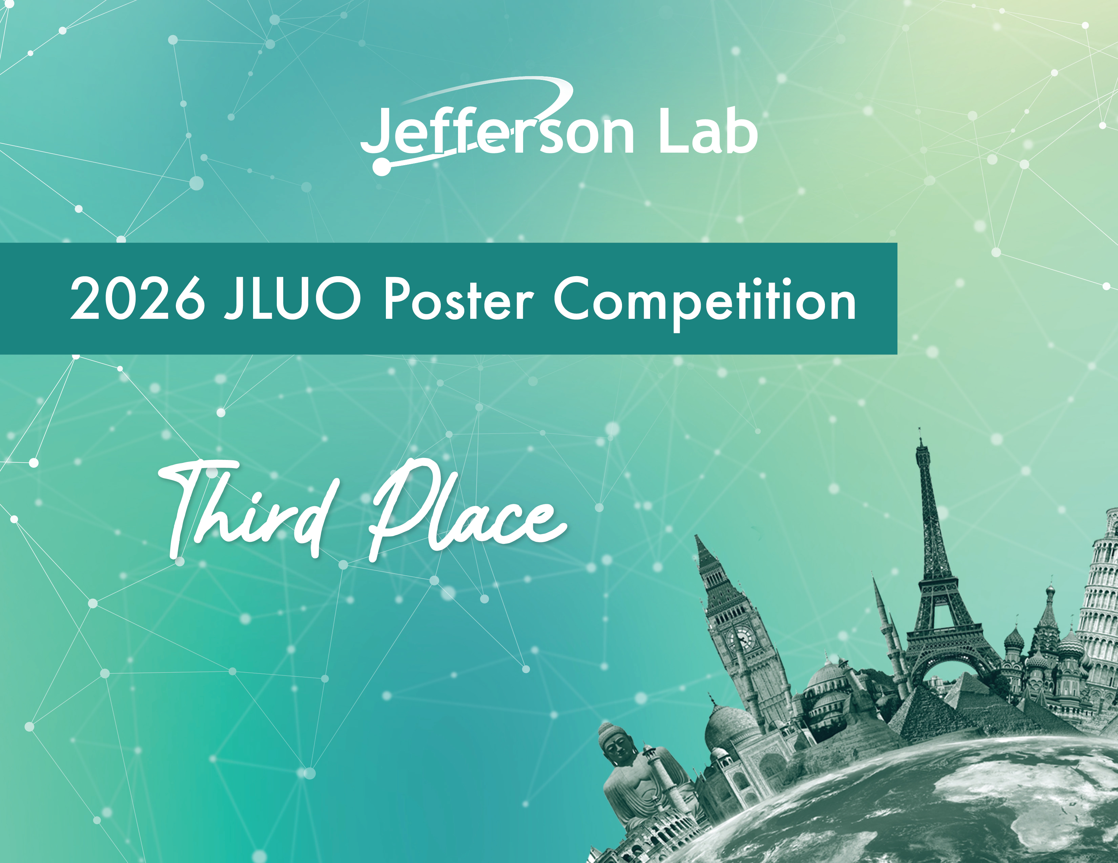
Jacob McMurtry

Slide 5
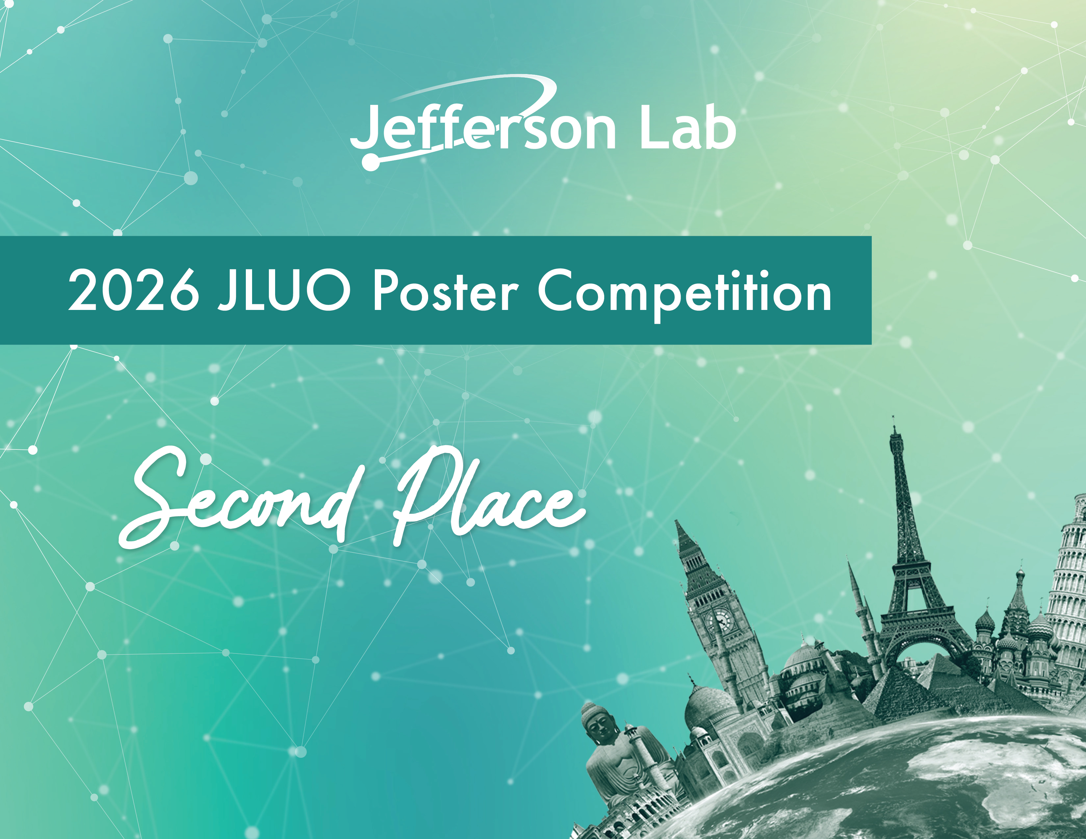
Ken Nishida

Slide 6

Sharifuzzaman Shakel

Slide 7
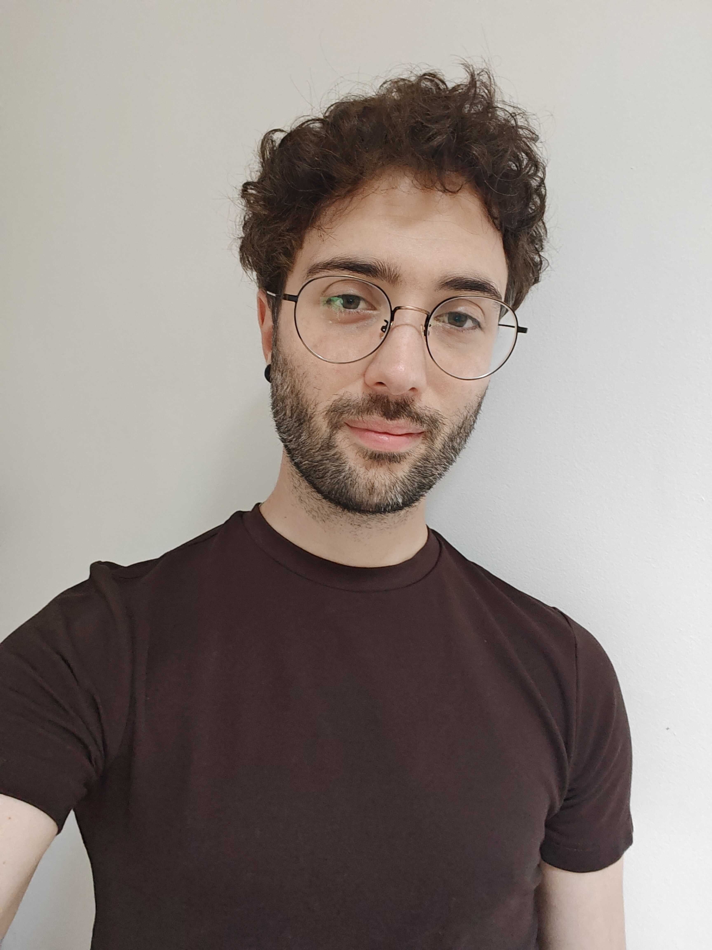
JSA Thesis Prize
Established by SURA in 1999 and continued by JSA through the Initiatives Fund Program
Over two dozen thesis prizes have been awarded to recognize contributions of graduate students
Criteria: General and scientific quality of the writing, Importance of results, Originality of approach, Mastery of the subject
2025 Thesis Prize Winner
Tommaso Rainaldi
PhD, Old Dominion University, 2025
Thesis: Unraveling Nonperturbativ QCD with Transverse Momentum Hadronic Structures
Currently a Postdoc at Stony Brook University
Thank you to the judges!

