Slide 1
Experimental Program: Current & Future
Douglas Weadon Higinbotham, Ph.D.
Acting Director CEBAF Experimental Physics
Presented To:
Jefferson Lab User Group Meeting
23 June 2026

Slide 2
CEBAF at Multiple Energies
One thing that makes the CEBAF accelerator an amazing tool for fixed target experimental nuclear physics is its large range of possible beam energies and and currents it can simultaneously send to each experimental hall.
Typically, that means 2.2, 4.4, 6.6, 8.8 or 11 GeV to Halls A,B,C and 12 GeV to Hall D with currents up to 80 uA with total power of 1.1 MW, but CEBAF can be scaled to even lower energies when the science needs it.
For the current run we spent the first nine weeks at 0.345 MeV/linac ( 0.7, 1.4, 2.1, 2.8 or 3.6 GeV to A,B,C and 4.3 GeV to Hall D.
We have now restored the machine to its nominal 1060 MeV/linac.
  0.11284*(linac energy) + Pass*2*(linac energy) = Beam Energy
  where Pass = {1,2,3,4,5,5.5}
With the two different linac energies, we will take data on TEN different experiments over 22 weeks

Slide 3
CEBAF Experimental Program For FY26 ( 22-week physics run )
Hall B
E12-20-004: PRad-II (Contact: A. Gasparian (NCSU), D. Dutta (MS), H. Gao (Due), N. Liyanage (UVA), E. Pasyuk(JLab), C. Peng (ANL). W. Xiong (Shandong), and DWH (JLab)). [finishing ]
E12-21-003: X17 Boson Search: (Contact: A. Gasparian (NCSU), D. Dutta (MS), H. Gao (Due), T. Hague (JLab), N. Liyanage (UVA), R. Paremuzyan(JLab), C. Peng (ANL). W. Xiong (Shandong)) [starting next week ]
Hall C
E12-22-001: N-> Delta (Contact: N. Sparveris (Temple), H. Atac (Temple), A. Camsonne(JLab), M. Jones(JLab), and M. Paolone (NMS) [ done ]
E12-23-001: VCS (Contact: N. Sparveris (Temple), H. Atac (Temple), A. Camsonne(JLab), M. Jones(JLab) and M Paolone (NMS) [ done ]
E12-24-001: Nuclear-R SIDIS (Contact: D. Gaskell (JLab), P. Bosted(W&M), W. Brooks (Fed. ST. Maria), R. Ent(JLab), E. Kinney(UC), and H. Mkrtchyan (Yerevan)) [ underway ]
E12-06-104: Nucleon R SIDIS (Contact: R. Ent(JLab), P. Bosted(W&M), E.Kinny(UC) and H. Mkrtchyan(Yerevan)) [underway]
E12-06-107: Color Transparency Search (Contact H. Vance(FIU/ODU/JLab), C. Gayoso(W&M), and D. Dutta(MS)) [finale]
Hall D
E12-25-005: GlueX with a 1-4 GeV Photon Beam ( contact: M. Dalton(JLab) & F. Afzal (JLab), V. Crude (FSU), P. Hurck (UB), I. Jeagle (ODU), and A. Thiel (UG) ) [ partially completed, with plan to finish next year ]
E12-12-002: GlueX-II (Contact: C. Meyer (CMU) and M. Shepherd (IU)) [ waiting for magnet repair ]
E12-12-002A: Jefferson Lab Eta Factor (JEF) (Contact: L. Gan (UNCW) & Z. Papandreou, A. Somov(JLab), and S. Tayler(JLab)) [ waiting for magnet repair ]

Slide 4
Plan for FY27 Being Finalized
But again are planning for multiple beam energies
Tentative Physics starting on Jan. 25 and running until August 22nd.
  2 weeks of restoration starting Jan. 11th and then 30 weeks of physics ( optimistic )
500 MeV/c
  normal asymmetry Hall C experiment E12-24-007 ( nice physics & tests parity quality beam )
550 MeV/c ( this is a perturbative change of machine energy )
  LT separation measurements in Hall C & finish low energy GlueX
  During this time Hall B could run HPS, but seem more likely cryo-target.
1060 MeV/c ( this requires again a major change )
  Hall B RG-K & RG-E
  Hall C a series of cryo-target experiments ( Kaon LT, D-Term, U-Channel, R-DIS, and VCS)
  Hall D GlueX-III with the likely addition of the 2nd generation Eta Factory experiment ( JEF-II )
  Building into the schedule Hall A running MOLLER starting July 10th

Slide 5
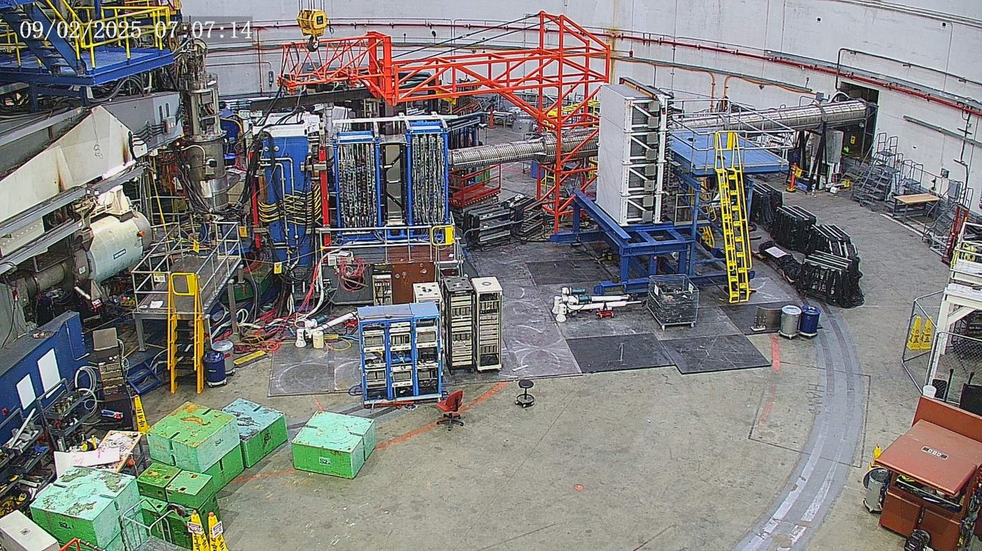
Experimental Hall A Setup for the SBS Experiment 2 Sept. 2025

Slide 6
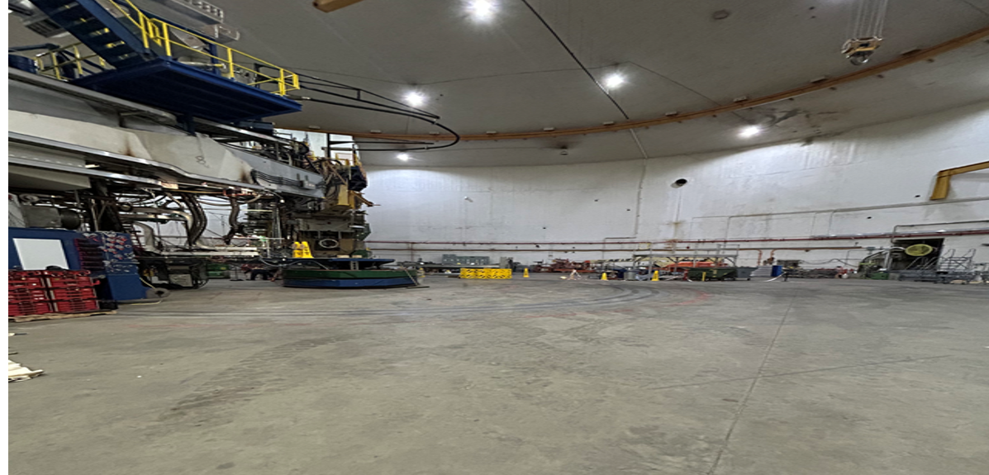
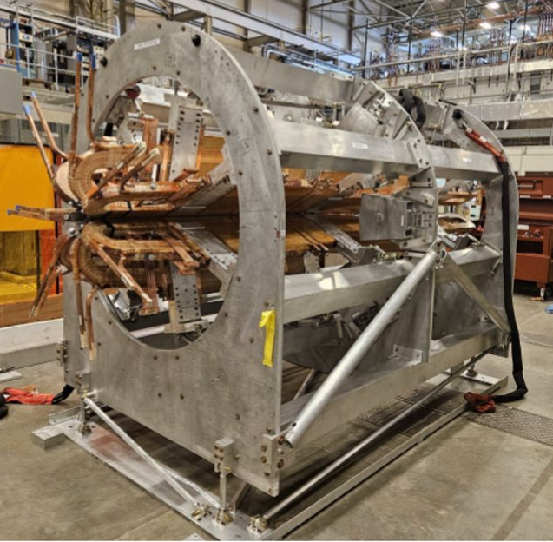
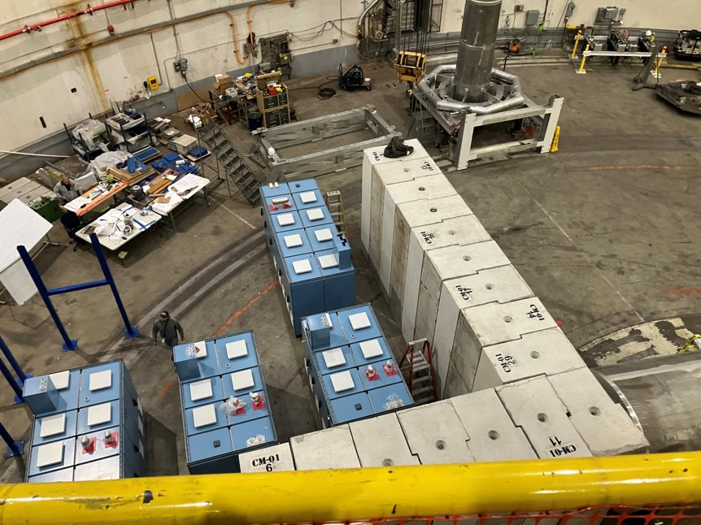
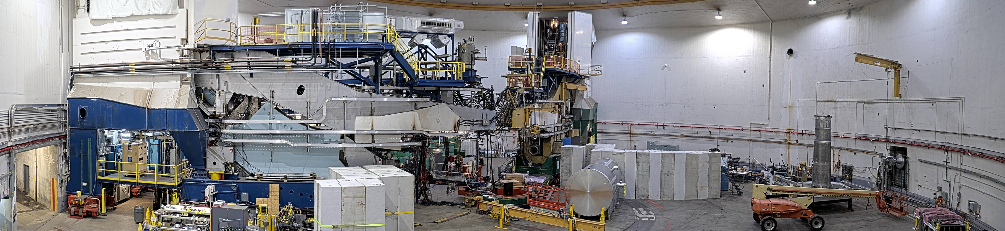
MOLLER Assembly in Hall A Now Well Underway
Hall A After SBS Removal
New Magnet (TM4) In Test Lab
New Power Supplies
Panoramic photo of the Hall A Moller installation take on 15 March 2026.

Slide 7
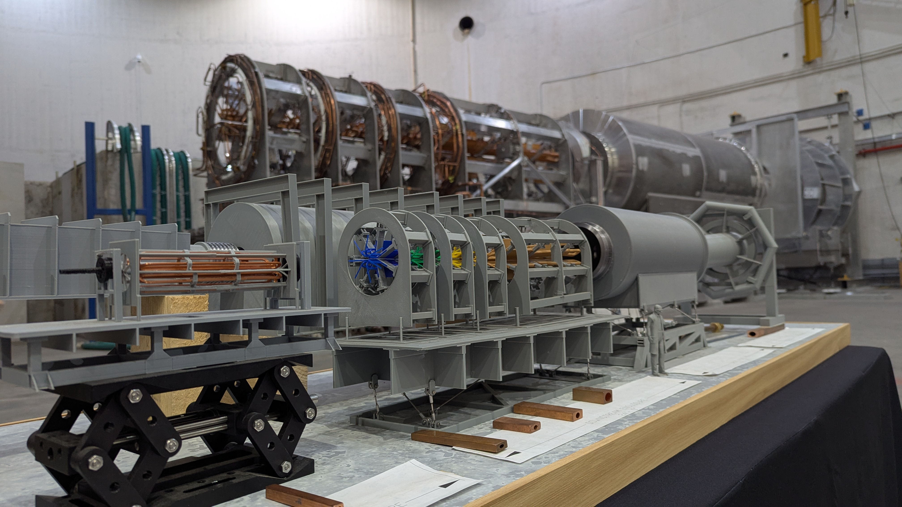

Slide 8
Overview of the Science program of the next 5 years:
Run the Hall A MOLLER Experiment and start the transition to the next large-scale experiment.
Hall B will complete a number of high impact run group experiments (see next slide) and start the running of the transversely polarized target SIDIS program.
Hall C will install and run the Hypernuclear experiments and once that is complete start the Tensor polarized deuteron experiments.
Hall D will run the GlueX-III & the 2nd generation real photon SRC experiments and then install & run the K-Long experiment.

Slide 9
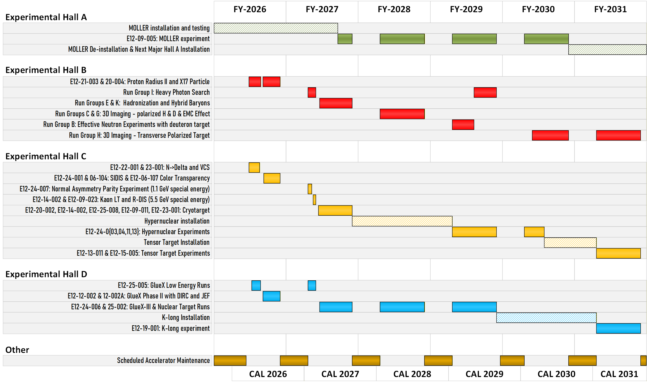
Five year look ahead

Slide 10
CEBAF Summary and outlook
Planning for ~30 week runs starting in FY27; though energy and cryogen costs are making that challenging
We are also striving to make CEBAF more reliable (i.e. instead of pushing energy beyond 1060MeV/linac, we are now focused on reliability).
Looking to go from an average of 50% to 60% efficiency for experiments as we used to have with pre-12GeV CEBAF.
Focused on making sure the support groups have the people and resources they need to carry out the mission.
An area that is bringing renewed attention is our data center where the demands of AI along with the need to store & analyze vast amounts of data is pushing our current limits of power and cooling while at the same time costs are making it challenging to acquire as much new more efficient equipment as we had planned.

Slide 11
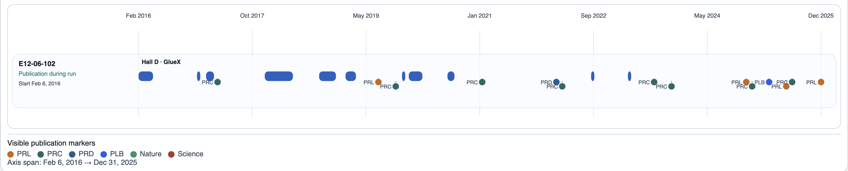
New Continuous Integration (CI) Dashboard In Developement https://pages.jlab.org/physdiv/jrdb/exp-dashboard/
Example from the dashboard showing the Hall D GlueX experiments publications as a function of time.
We will be improving the dashboard this summer including making use of AI tool to help determine when an experiment has met its goals as promised to the PAC.

Slide 12

Discussion

