Slide 1

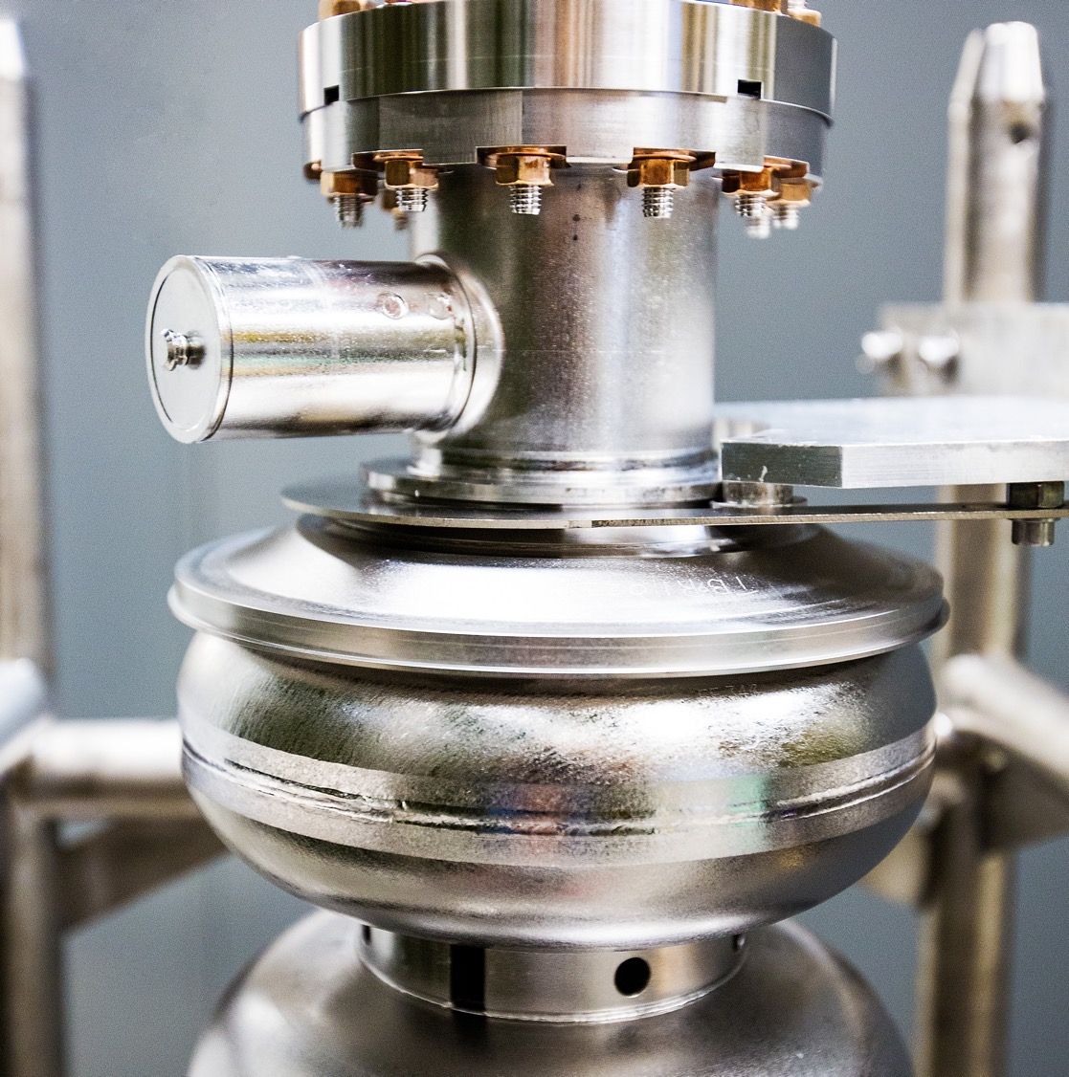
Accelerator Status and Future Plans
JLUO Annual Meeting
June 23-25, 2026
Mike Spata
Division Director CEBAF Accelerator
Notes:
Tip: Keep titles under 60 characters for readability
To change the photo: Right-click on photo and select change photo

Slide 2
Outline
FY26 Run Highlights
  Overview of low energy run at 345 MeV/linac
  Transition to 1060 MeV/linac and initial performance
  MZAAS04 magnet failure
Future Plans
  Accelerator Management Plan
  Reliability and Linac Energy Investments
  Injector Initiatives
  Accelerator Improvement Projects
  Ce+BAF R&D
  22 GeV Upgrade
  MOLLER Preparations
  Hall C Interferometer
  Klong Beam Studies
Summary

Slide 3
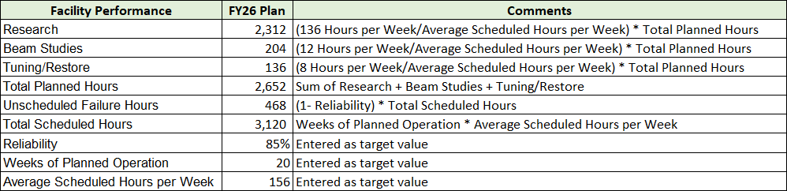
Initial Run Plan for FY26 and Projected Reliability
Plan to deliver 20 weeks of physics with beam to Halls B, C, D at two different linac energies.
Two weeks to restore from SAM at 345 MeV/linac with start of physics on 3/27/26.
  ~13 of 25 cryomodules in each linac will be brought online for this part of the run.
  Low energy requires the removal of in-tunnel magnet shunt resistors for proper system regulation.
  Run eight weeks in support of physics at this energy ending on 5/30/26.
Two weeks to reconfigure the machine to 1060 MeV/linac with start of physics on 6/13/26.
  All available SRF linac systems to be brought online.
  Reinstall all in-tunnel magnet shunt resistors for proper system regulation.
  Run twelve weeks in support of physics at this energy ending on 8/30/26.

Slide 4
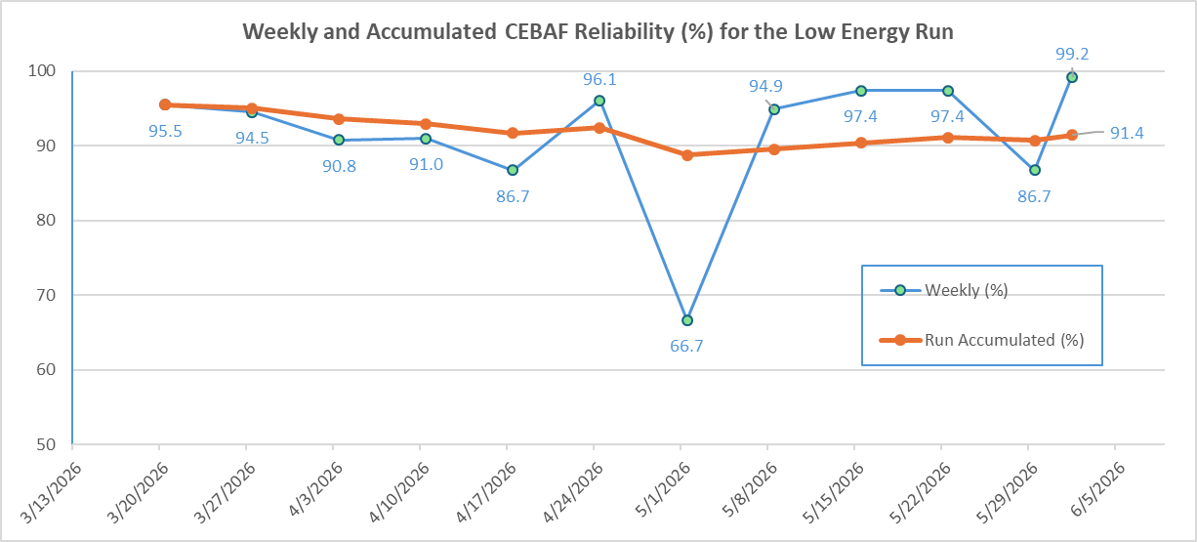
FY26 Low Energy Run Performance
Plot below is over a 12 week period showing the preliminary weekly reliability numbers and the run accumulated average. Any adjustments will be made prior to submitting Q3 data.
Data includes the usage of accumulated accelerator configuration change, tuning, maintenance and beam studies hours to optimize the overall program during periods when unable to deliver Physics.

Slide 5
Transition to 1060 MeV/linac and initial performance
The low energy run concluded on Monday, June 1 at 0800
The hardware transition to 1060 MeV/linac occurred over the period from Monday, June 1 through Tuesday, June 9. Opportunistic beam studies and required maintenance activities were interleaved during the planned Accelerator Configuration Change.
Major activities during the transition included:
  Reinstall Shunt Resistors on large magnet systems in main accelerator and performed hot checkout, including hi-potting for all affected systems
  Turn on 28 linac RF zones that were not in use at the end of the Low Energy run and perform hot checkout along with any necessary repairs to RF systems
  Complete SRF commissioning and Q₀ measurements of RF zone 2L25
  Complete HOM measurements of RF zones 1L22, 2L05 and 2L25
  Add additional vibration dampening hardware to RF zones 1L23 and 2L23
  Installation of IDX radiation monitors in Hall B for improved halo management
  Prepare the injector for high energy running
  Perform beam studies in support of MOLLER and the Beam Degrader system

Slide 6
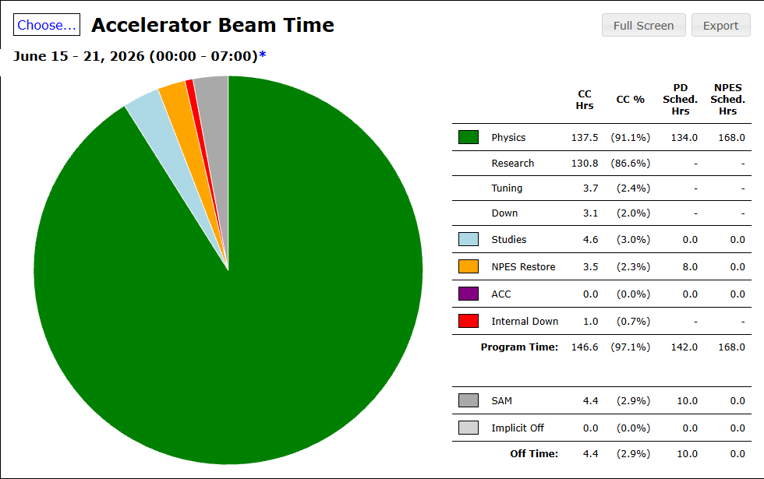
Transition to 1060 MeV/linac and initial performance
Beam restoration in the main accelerator at 1060 MeV/linac was planned over the period from Tuesday, June 9 through Tuesday, June 16 with a staggered start to Hall C on June 15 followed by Hall B and then Hall D.
Optics tuning was going very well through the first three passes and on track to start physics.
A significant failure of MZAAS03 occurred on the owl shift of Saturday, June 13 preventing any beam delivery beyond third pass. Details on the next two slides. The program pivoted to setting up Hall C 3rd pass and B 1st pass while trying to understand the failure and developing a plan for recovery.
The initial early running for Hall C and B over the six-day period had started very smoothly at top energy with all indications that performance is above expectations.

Slide 7
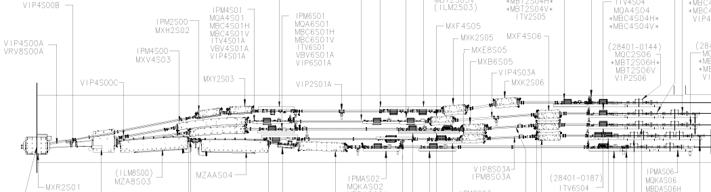
MZAAS04 Magnet Failure
On the evening shift of Friday, June 12 we had completed optics tuning through Arc 7 with very good results throughout.
Initial threading of beam into Arc 8 required some small adjustments to spreader dipoles but beam was ultimately tuned to the end of Arc 8. After cycling the West Arc dipole stack the beam was stuck at the entrance of Arc 8.
West Arc Spreader region indicating the location of the failed magnet that limited the program to three passes.

Slide 8
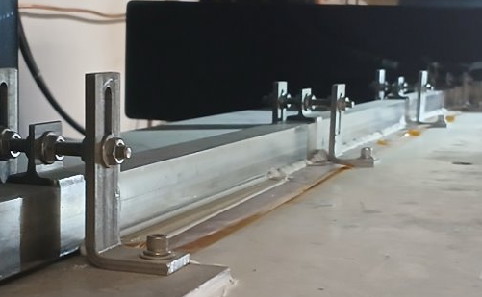
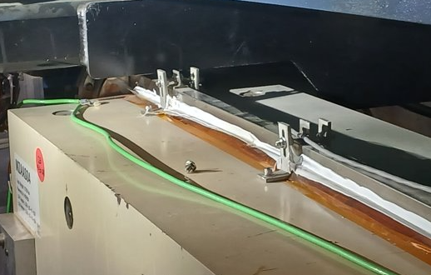
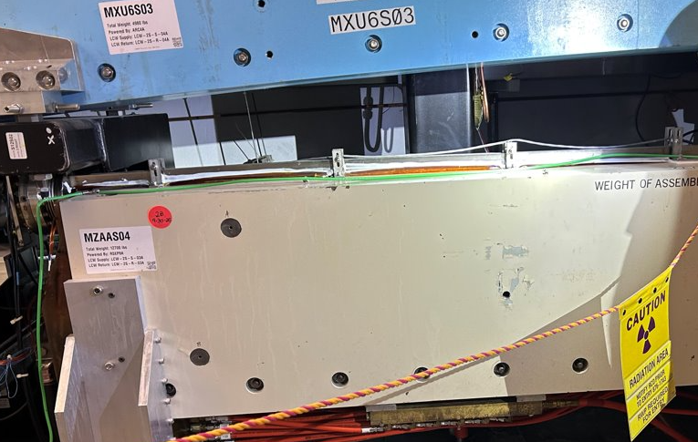
MZAAS04 Magnet Failure
The beam tube and coil assembly within the magnet were found to be bent upward at the entrance of the magnet with enough force to break the retaining hardware and protrude above the magnet steel and prevent further beam delivery.
Options:​
1. Survey as found locations of chamber and attempt to realign in-situ. In the event the beam tube and coils have returned to an acceptable location for transport, the broken hardware would be replaced and return to business as usual (a few days).​
2. Jack Screws with new clamping hardware – in-situ fix with new hardware. Hardware is such that it will press the coil/tube set back into compliant location. Hardware would be left in place upon completion(~1 week). ​
3. Magnet Removal – remove magnet from tunnel and refurbish in magnet shop; drift tube would be reinstalled for time that magnet is absent to allow fourth pass beam delivery (~5 weeks).
Normal configuration with coils within the steel
Close-up of protruding coils and failed hardware
Side view of failed MZAAS04

Slide 9
Outline
FY26 Run Highlights
  Overview of low energy run at 345 MeV/linac
  Transition to 1060 MeV/linac and initial performance
  MZAAS04 magnet failure
Future Plans
  Accelerator Management Plan
  Reliability and Linac Energy Investments
  Injector Initiatives
  Accelerator Improvement Projects
  Ce+BAF R&D
  22 GeV Upgrade
  MOLLER Preparations
  Hall C Interferometer
  Klong Beam Studies
Summary

Slide 10
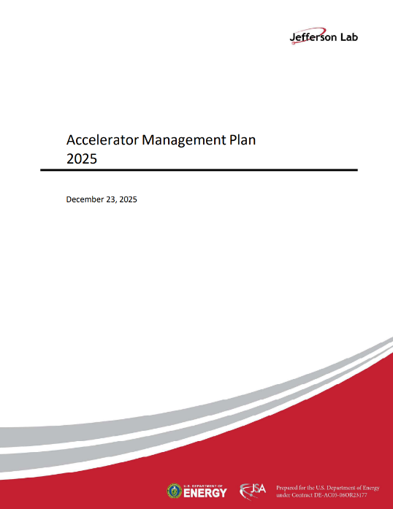
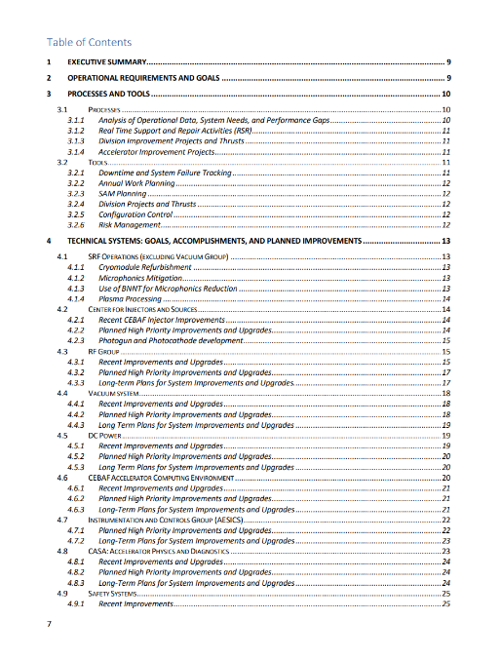
Accelerator Management Plan
Provides a framework for managing CEBAF performance, reliability, and future upgrades
Aligns investments with mission needs and future program requirements
Integrates Operations-funded activities:
  CEBAF Performance Plan, Accelerator Improvement Projects (AIP), Capital Equipment (CE), Obsolescence Mitigation and Critical Spares Strategy
Provides Risk-informed Prioritization
  Reliability and availability
  Supply chain and obsolescence issues
  Performance margin and capability gaps
Balances near-term operations with long-term capability development

Slide 11
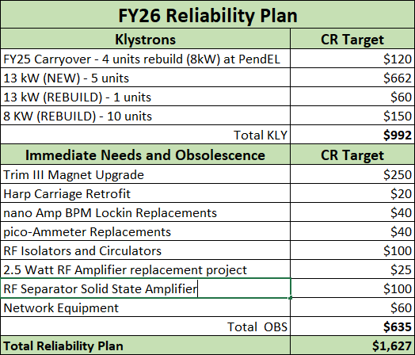
Reliability Investments
The reliability program continues to be focused on Klystrons and Obsolescence
Maintaining sufficient inventory of 8 kW and 13 kW Klystrons continues to be a challenge due to the escalating cost of new units.
A campaign to establish a klystron refurbishment programs is under development. Also looking into cost benefit analysis of refurbishing in-house.
The Obsolescence program continues to support the multi-year Trim Magnet upgrade, I&C upgrades for Harps, nA BPM, and pico-ammeters, Network Upgrades, RF HV hardware and Separator amplifiers, Hall D Tagger Power Supply and ODH updates in Halls.

Slide 12
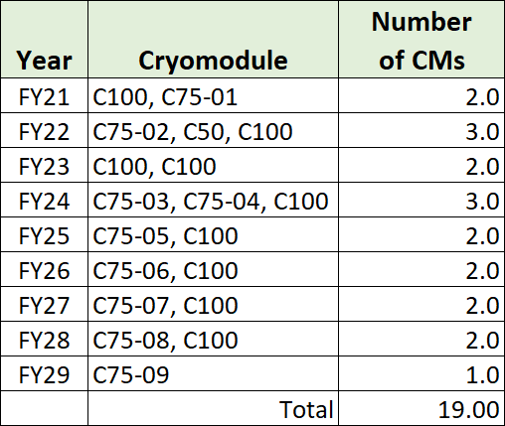
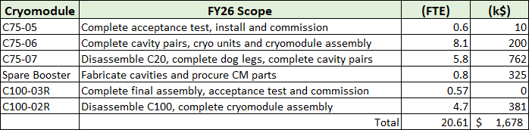
Linac Energy Performance Investments
The multi-year plan for converting original C20 cryomodules to C75 style and refurbishing C100 cryomodules is shown at right.
Scope of work for FY26/27 includes:
  Delivery of C75-05 and C100-03R into the south linac (done)
  Continue the development of C75-06 for installation in FY26 SAM
  Refurbish C100-02R for installation in FY26 SAM
  Continue the development of C75-07 for installation in FY27
  Continue multi-year plan to build a Spare Booster Cryounit for the CEBAF Injector
Plasma processing of SRF cavities continues to be applied during SAMs.
Ozone cleaning is also being pursued as an alternative to Plasma processing
Evaluating optimal approach for FY28 and beyond that may pivot to C60 cryomodules

Slide 13
SAM 2026 Injector Initiatives
Replace HV ceramic and evaluate gun operation up to 200 kV
Fix Wiens to provide spin reversal with no vacuum spikes
Replace harp fork to eliminate charging and beam drift
Install new IA HV driver
Install new helicity magnets controller
Modify A3 and A4 apertures to improve transmission
Laser room improvements: Laser A as reference, steering lens at 5 cm from vacuum window, and new BNC cables and fibers
Laser setup by MOLLER Collaboration:
  New RTP cell
  RTP Cell alignment

Slide 14
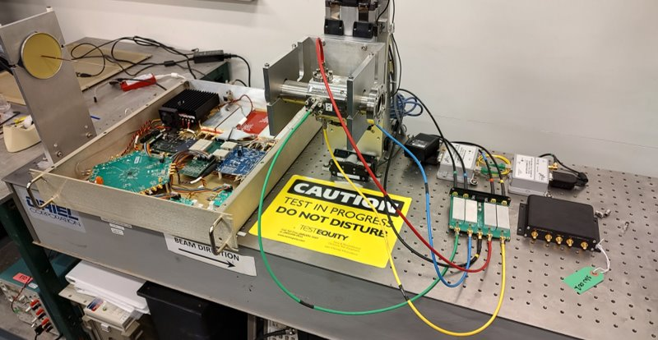
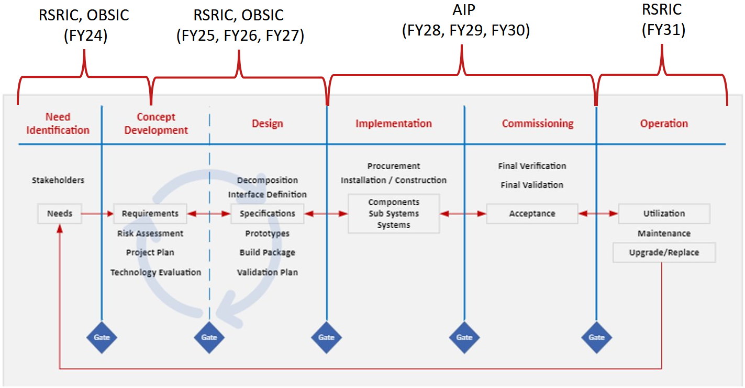
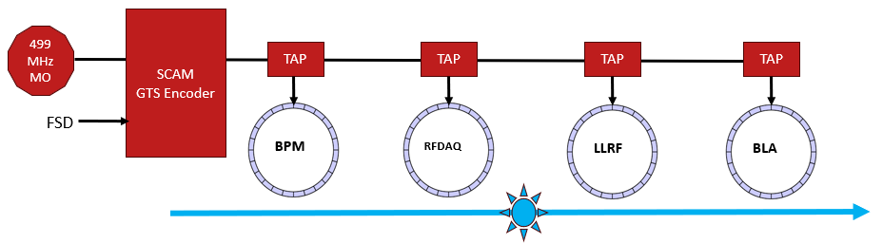
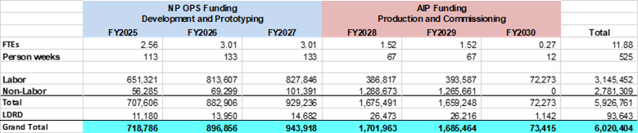
Accelerator Improvement Projects
Next Generation Beam Position Monitor:
New system being developed to replace the existing 4 Channel and SEE BPM systems
Addresses obsolescence and provides enhanced functionality
High bandwidth, synchronized position data collection across the accelerator
AI and ML enabled algorithms for improved beam delivery
Global Timing System:
Site wide synchronization of diagnostic systems
Design of prototype end point underway

Slide 15
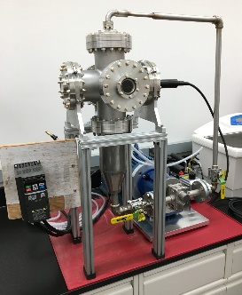
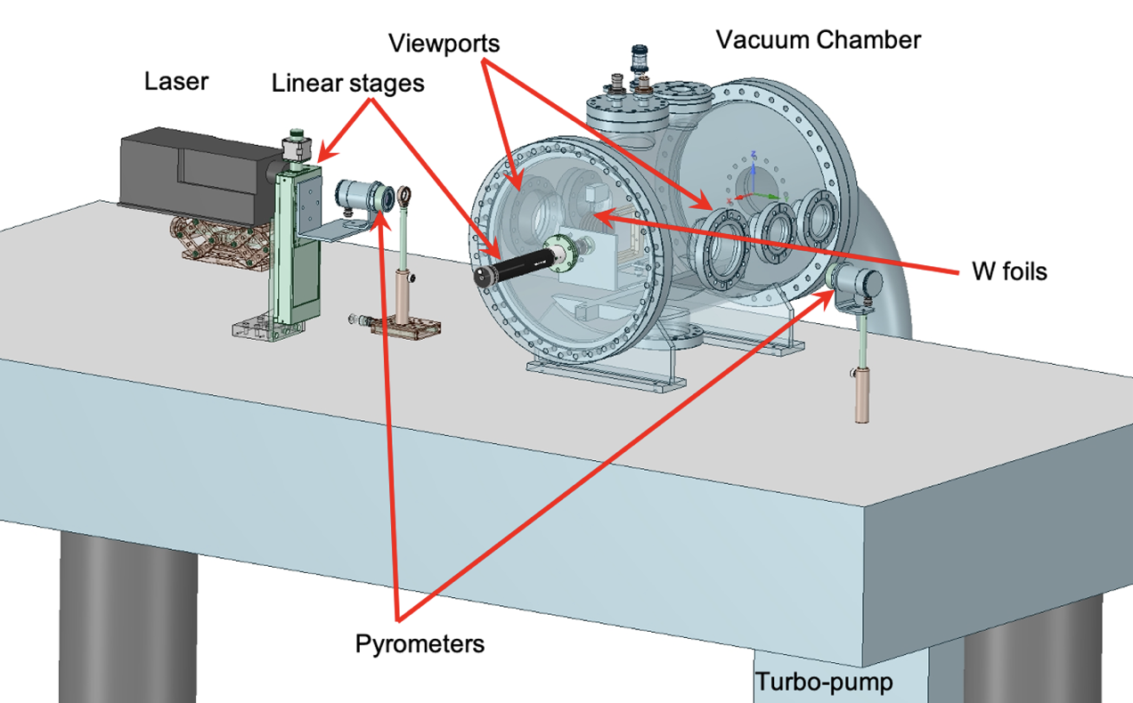
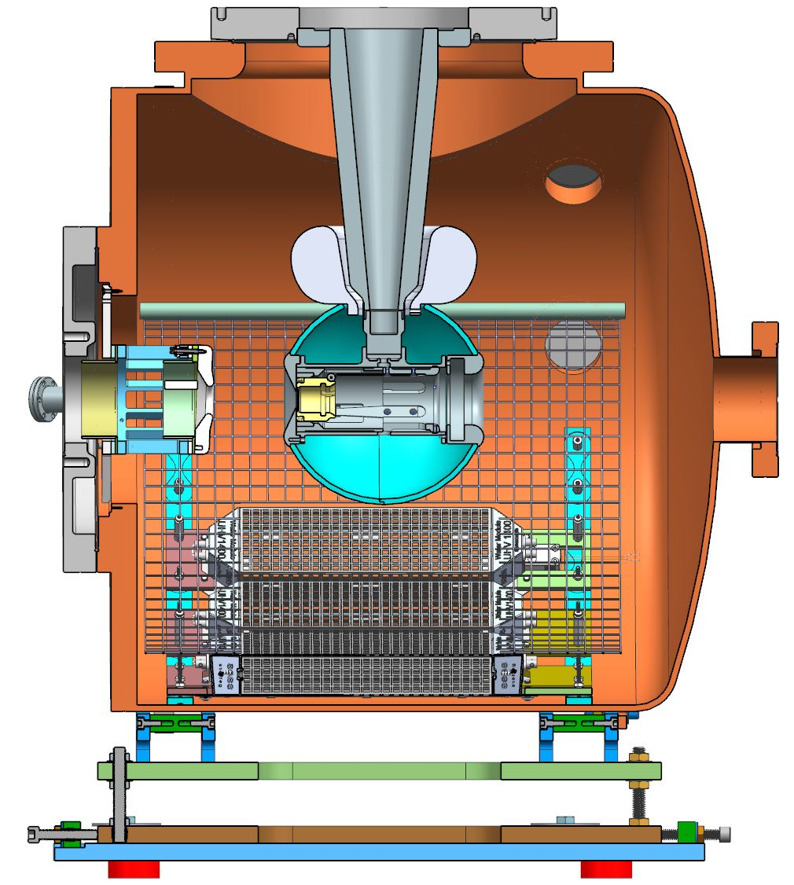
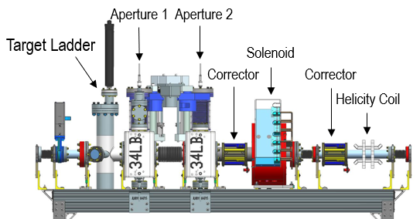
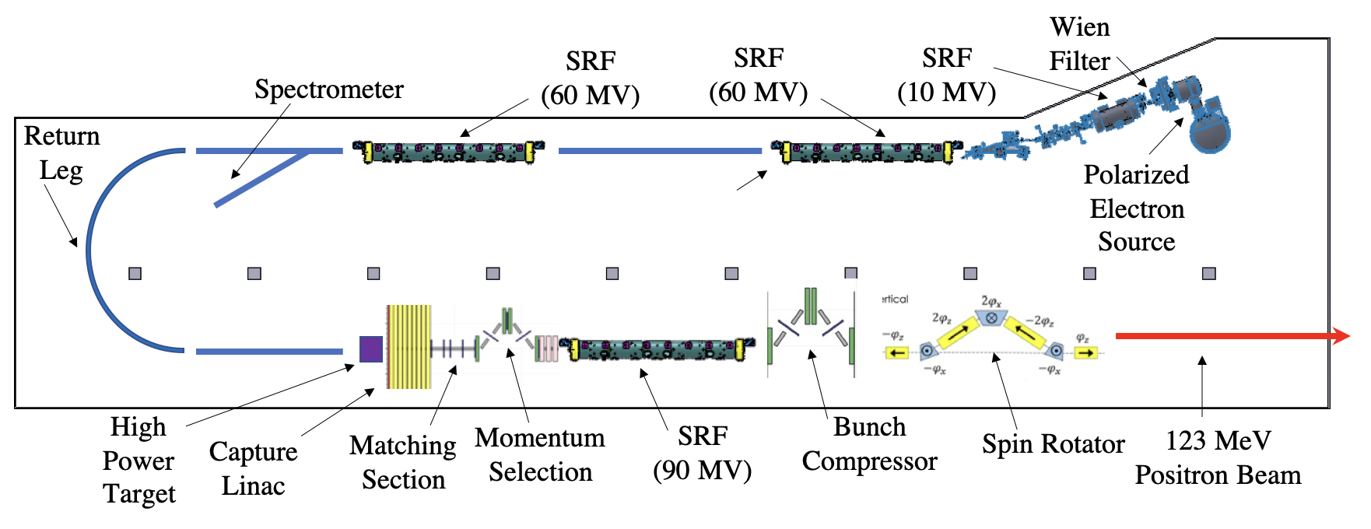
Ce⁺BAF R&D
Design of Ce⁺BAF injector and critical risk areas
Plan to test two prototype targets at LERF
  Rotating solid tungsten (JLab/ODU) and liquid GaInSn (Xelera SBIR Phase 2)
LDRD for high current photogun at GTS & Beam Degrader
  Test highly polarized beams in a gun optimized for high current
  Use degrader to test larger emittance beams through Arc1
Positron generation and capture simulations
  Complete multi-pass "universal e- injector" for e+
  Integrated optimized design to reduce emittance is emerging
Staged approach for LERF Injector
  Install High Current LDRD Photogun
  Install a CEBAF-style polarized laser system
  Upgrade obsolete high power RF controls
  Integrated vacuum design of LGaInSn target
  First, test with 10 mA and low energy
  Later, test with 10 mA and high energy (with QCM)
GaInSn and Tungsten Targets
Polarized e⁻ Source
Beam Degrader

Slide 16
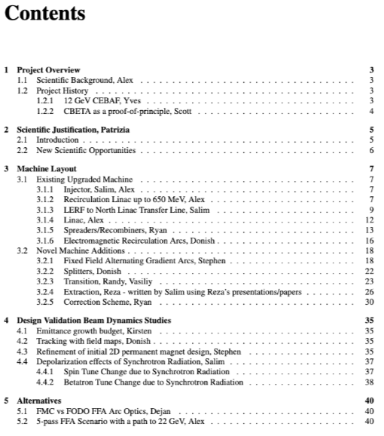
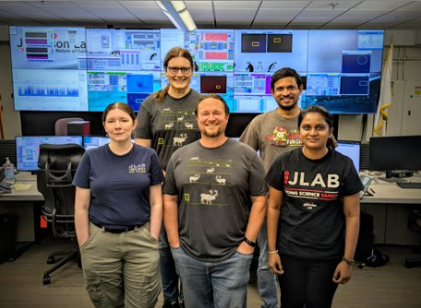
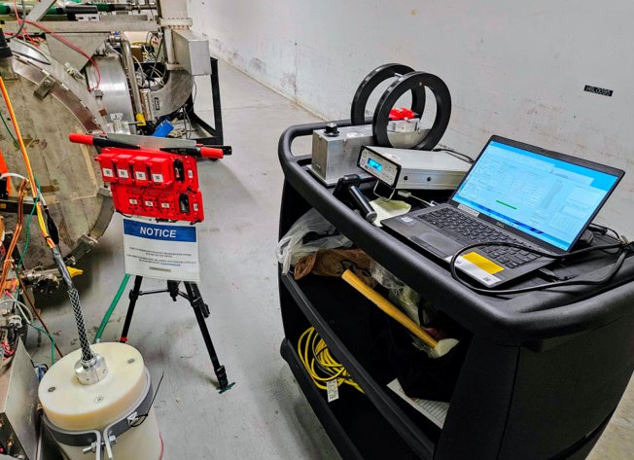
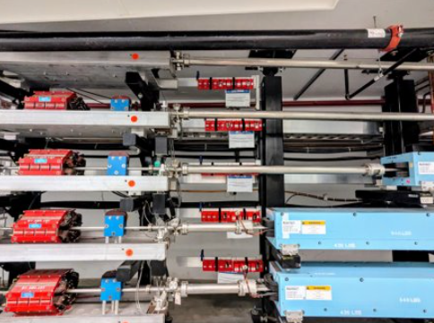
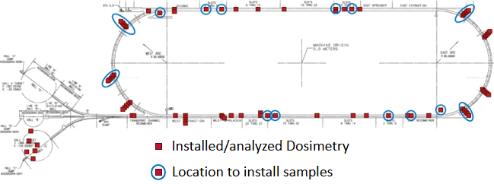
22 GeV Upgrade
A white paper on the 22 GeV Accelerator Physics design is in preparation.
The LDRD to study Permanent Magnet Resiliency in a Real Radiation Environment had been funded for it’s third year. Data analysis for the multi-year program is underway.
The Permanent Magnet LDRD Team
22 GeV Upgrade White Paper TOC
Map of Permanent Magnet R&D Program
Samples Near Cryomodules and Testing Rig
Samples in East Arc

Slide 17
MOLLER Preparations
Present status of the twenty one high-level tasks that are Division’s contribution to MOLLER
Task ID | Topic | Scope | Status | Comment | Completion
1 | Helicity Controller | Helicity board with new settings | Settings are available and tested at 2 kHz and 1 kHz | Perform CEBAF-wide beam study to check readiness | 100%
2 | Helicity Decoder | New boards for delayed helicity reporting and to account for travel times | Built and distributed to users, all DAQs must use | Perform CEBAF-wide beam study to check readiness | 100%
3 | RTP Pockels Cell HV | Build, install a new 8-channel driver, with 10 µs risetime, electrically isolated | Installed in Jan 2026 | Final optimization | 95%
4 | IA HV Driver | Build, install a new 4-channel driver, with 10 µs risetime, electrically isolated | Prototype design is ready | Build, test, and install in 2026 | 60%
5 | Helicity Magnets Controller | Build, install new control system, with 10 µs rise-time, electrically isolated | Prototype circuit is ready, bench testing | Build, test, and install in 2026 | 35%
6 | Polarization Feedback | Provide Wien feedback to keep longitudinal polarization within 0.03° | Beam studies showed viability of using keV Wiens | Possible Phase II SBIR to build MeV Wiens | 90%
7 | Wien Filter Slow Reversal | Study Wiens Flip-Right and Flip-Left setups | Studies showed good reversal, vacuum spikes problem | Implemented water cooling and re-design magnet | 75%
8 | Injector Transmission and PQB | Optimize injector transmission for > 95% | Initial beam studies showed acceptable transmission | Replace ceramic, go to 200 kV after 2026 physics run | 55%
9 | Matching and Adiabatic Damping | Deliver matched beam and adequate adiabatic damping | Measured across Booster, Accelerator will use raytrace | Finish raytrace analysis | 80%
10 | Fast Feedback | Test and maintain existing system | FFB works as designed | Measure current noise affecting vertical position | 90%
11 | Compton Polarimeter Background | Setup beam thru polarimeter with low halo > 100 Hz/µA | Added harp to beamline. No beam to Hall A till 2027 | Working on Compton AI/ML | 50%
12 | Beam Modulation | Hot checkout and maintain system | Beam study showed a working system | Need final results | 100%
13 | Phase Advance | Design Hall A beam optics with sufficient phase advance | Was done before and designed optics with phase advance | Test in 2027 | 100%
14 | Low Beam Current | Deliver low beam current for detectors calibration | New Task, ERR Recommendation | Have requirements – started beam studies | 20%
15 | Control of Charge Asymmetry | Measure and control charge asymmetry of Halls B, C, and D | New IA system was added in Hall D laser | Perform feedback tests for Hall B and D beams | 25%
16 | PQB in Injector and Hall A | Setup PQB in injector and Hall A and perform beam studies | Performed initial beam studies | More beam studies and reduce vertical position noise | 60%
17 | Hallo Monitors in Hall A | Install halo target and detectors and provide FSD and EPICS controls | New halo monitor is being built | Install halo monitor in Hall A beamline | 50%
18 | MOLLER Apparatus Protection | Protect apparatus from beam mis-steering | Comprehensive scheme has been outlined | Implement with Ops and Radiation Control Group | 20%
19 | BPM Receivers | New receivers in Hall A line instead of old SEE electronics | Digital receivers are ready | Implement during MOLLER installation | 60%
20 | BCM Receivers | New BCM receivers in Hall A line to meet linearity and noise requirements | 8 Receivers meet linearity requirement and resolution | Test with MOLLER DAQ in Hall A | 70%
21 | Laser Table Configuration | Configure laser table and injector for MOLLER | A laser will be reference | Common practice – Coordinating with MOLLER Coll | 10%

Slide 18
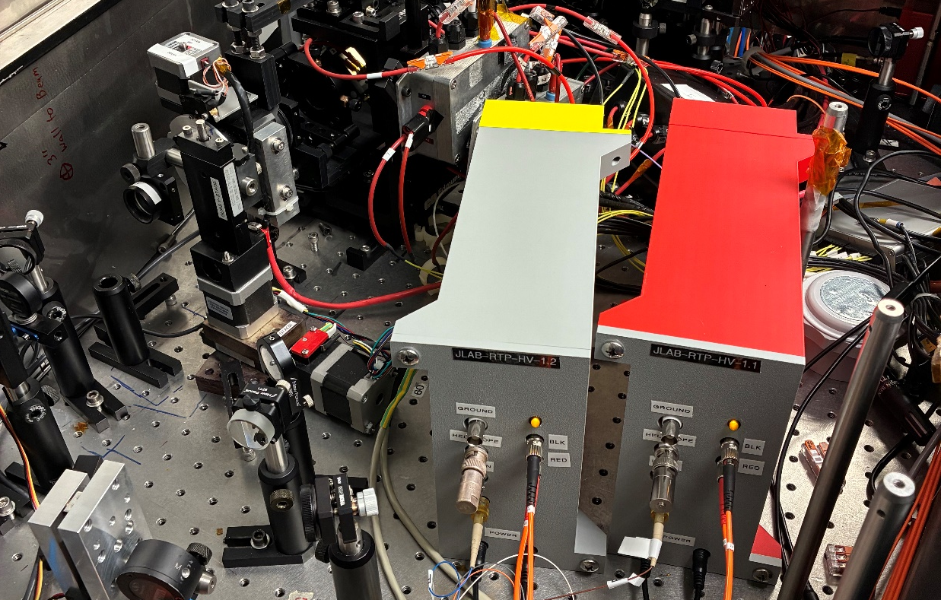
MOLLER Preparations – Hardware
Hardware Installation:
  Completed Helicity Controller Board with 1920 Hz settings
  Completed Helicity Decoder Board to account for electron beam travel time from injector to halls
  Completed new HV driver for RTP Pockels Cell
  Working on new HV driver for laser Intensity Attenuator (IA) system
  Working on new controller for Helicity Magnets
  Identified source of noise and rebuilt digital receivers of beam current monitors to be installed in Hall A
Laser Table Configuration:
  Need to change reference laser from B laser to A laser (A laser is high current and MOLLER laser)
  Need to move steering lens 5 cm in front of vacuum window (now at 61 cm)

Slide 19
MOLLER Preparations – Beam Studies
Parity-Quality Beam Studies in Injector and Hall C:
  Completed initial studies in Injector with encouraging results: small helicity-correlated beam asymmetries with acceptable widths, good transmission, Wiens slow helicity reversal, charge and position feedbacks, and longitudinal beam polarization feedback using Wiens.
  Progress on Hall A beam studies to measure adiabatic damping, beam noise with Fast Feedback on position and energy, and Compton polarimeter background.
  Will continue beam studies this physics run period and use Hall C for MOLLER related studies.
Other MOLLER Required Beam Studies:
  Characterized low currents (5 nA – 100 nA) for MOLLER detectors calibration
  Planning for 1920 Hz helicity reversal dry run:
    Perform CEBAF-wide beam study during this physics run to check readiness to operate at this high rate
    Use Helicity Decoder Board to account for electron beam and helicity signals travel times
Training MOLLER students assigned to beam studies
Graduate Student | University
Jonathon Mott | UMass
Ryan Conaway | Ohio
Andrew Gunsch | VT
Xiang Zhang | UVA
Joachim Tsakanikas | UVA
Nina Niemotka | IU
Patrick Hayden | IU

Slide 20
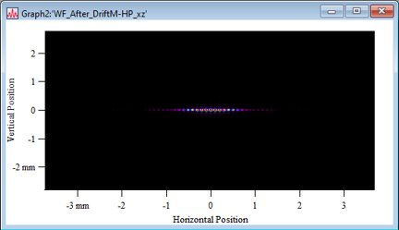
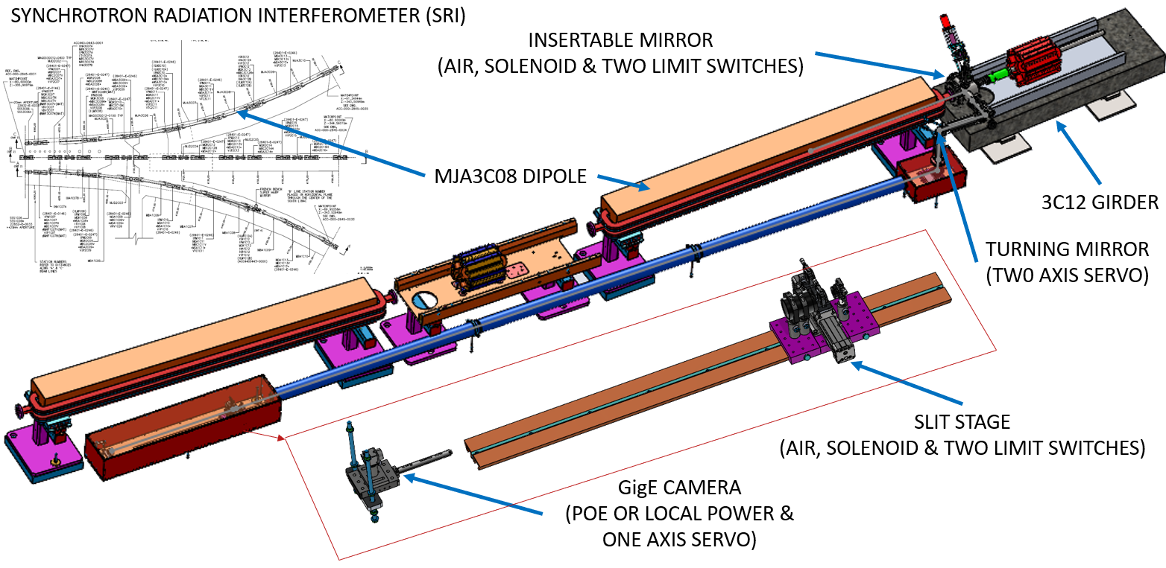
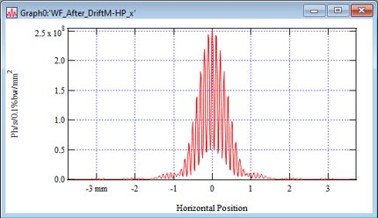
Hall C Interferometer
“Study of charge symmetry breaking in p-shell hypernuclei” (2026) requires < 3x10⁻⁵ (FWHM) energy spread in Hall C.
Developed a synchrotron radiation interferometer to meet the requirements.
Installed and commissioning is now underway.

Slide 21
KLong Beam Studies
Successfully generated KLF bunch structure and charge at 0.32 pC
Measured bunch length ~60 ps, consistent with expectations
Phase space behavior consistent with models (chopper scans, energy dependence)
Beam transmission degrades at higher charge with significant interception in injector apertures
Beam losses observed at both low and high charge
Transmission not yet suitable for sustained operations
Future studies needed after the gun is restored to 200 kV at the end of current run
Gun Current (µA) | Bunch Charge (pC) | A1 interception (µA) | A2 interception (µA) | MS interception (µA) | Beam Transmission (%)
2.8971 | 0.186 | 0.1742 | 0.5242 | 0.00118 | 76.0
4.3704 | 0.280 | 0.0416 | 1.0437 | 0.01218 | 73.0
6.2193 | 0.399 | 0.28521 | 1.6462 | 0.15228 | 66.5
7.8976 | 0.506 | 0.972 | 0.69855 | 0.2016 | 76.3
11.6756 | 0.748 | 3.555 | 0.9894 | 0.4536 | 57.2
17.3721 | 1.114 | 9.244 | 1.1736 | 0.8715 | 35.0

Slide 22
Summary
CEBAF delivered a successful FY26 low-energy run and was positioned for strong high-energy performance prior to the MZAAS04 failure.
Near-term priorities are restoration of full machine capability, continued support of the experimental program, and execution of planned reliability improvements.
Investments in cryomodules, injector performance, diagnostics, controls, and obsolescence mitigation are strengthening CEBAF's long-term operational capability.
Accelerator R&D efforts are advancing future opportunities including polarized positrons, high-current sources, permanent magnet technologies, and a potential 22 GeV upgrade path.
Significant progress continues on preparations for MOLLER, KLong, and other future scientific programs.
CEBAF remains focused on delivering reliable beams while preparing the capabilities needed for tomorrow's science.

