Slide 1
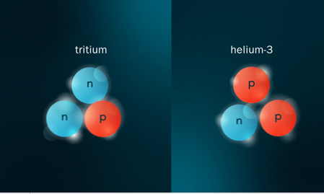
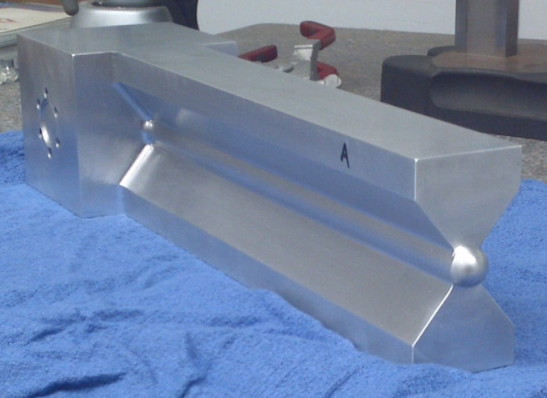
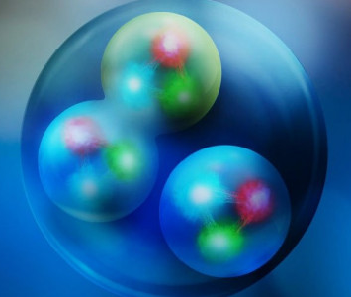
Inclusive studies of 2N- and 3N-SRCs in the mirror nuclei tritium and helium-3
John Arrington and Shujie Li, Lawrence Berkeley National Lab
JLUO Annual Meeting, June 24, 2026

Slide 2
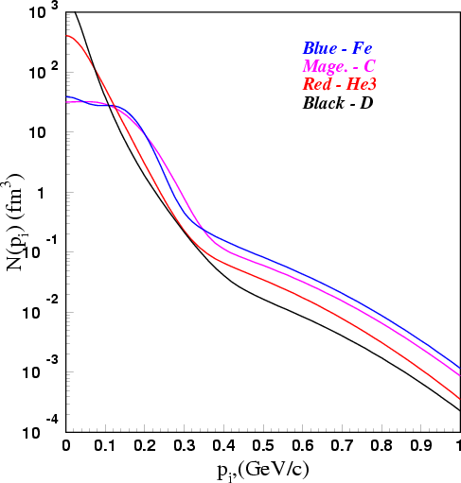
Nucleon momentum distributions: Collective behavior vs. two-body physics
Mean-field region: collective behavior, strongly A-dependent
Cioffi Degli Atti, et al, PRC53, 1689 (1996)
2
Notes:
HOW DO YOU ISOLATE THESE TWO-BODY CONFIGURATION?#

Slide 3
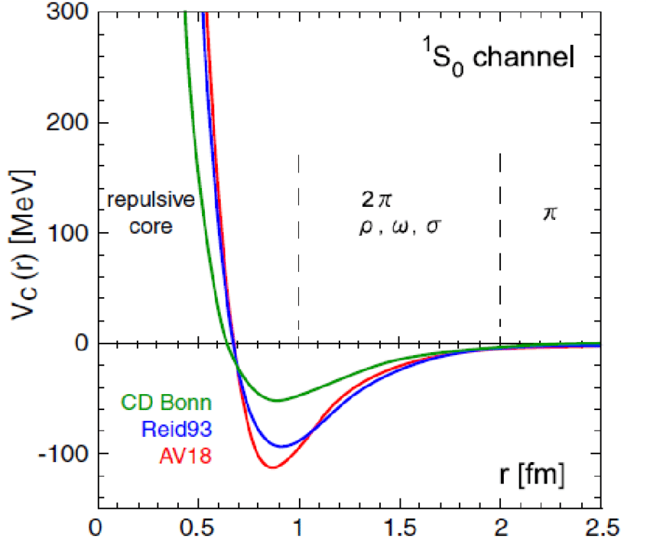
Nucleon momentum distributions: Collective behavior vs. two-body physics
Mean-field region: collective behavior, strongly A-dependent
High-momenta: short-range interactions, 2-body physics, largely A-independent
N-N interaction
Hard interaction at "short" range
Cioffi Degli Atti, et al, PRC53, 1689 (1996)
High-momentum nucleon pairs
3
Notes:
HOW CAN WE STUDY THESE?

Slide 4
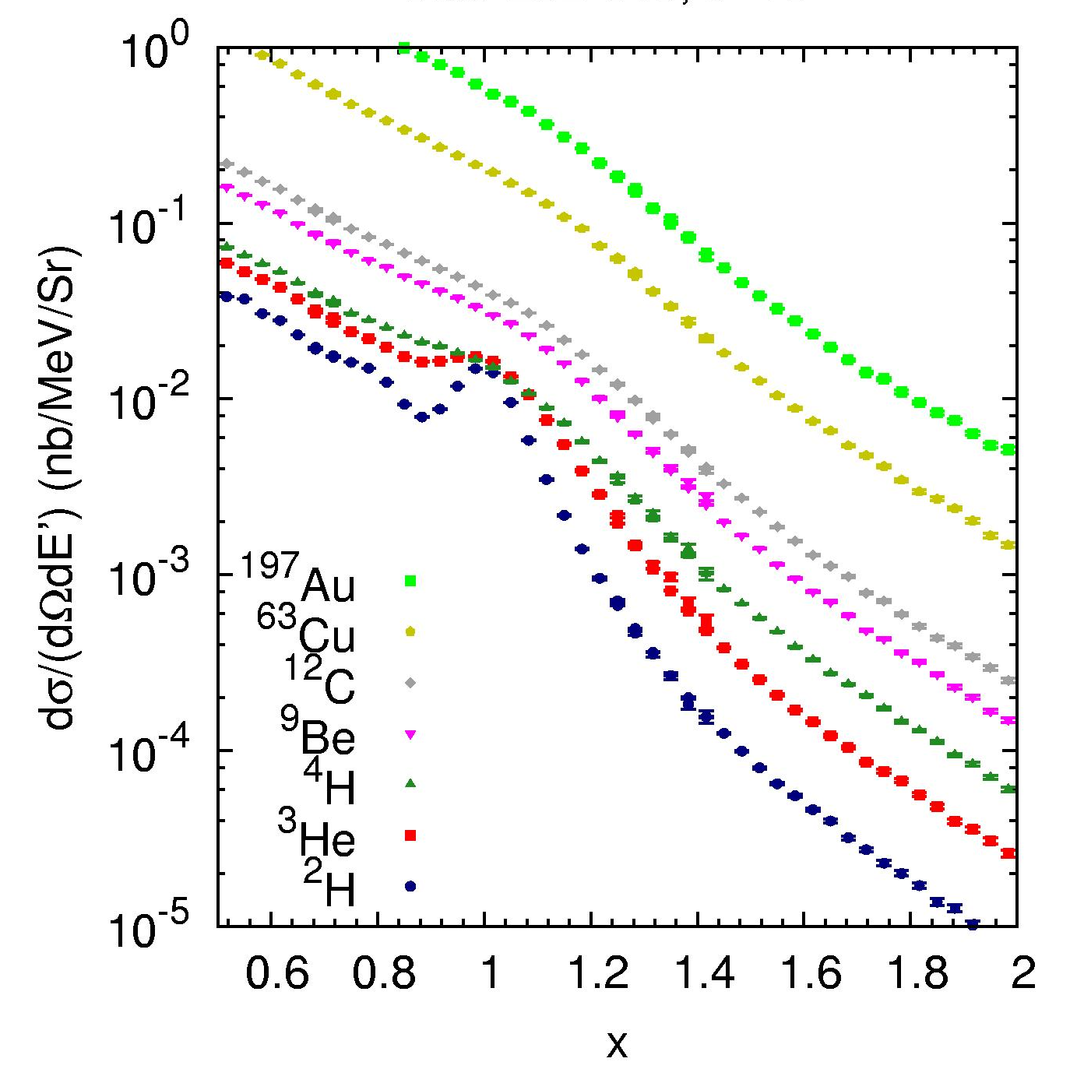
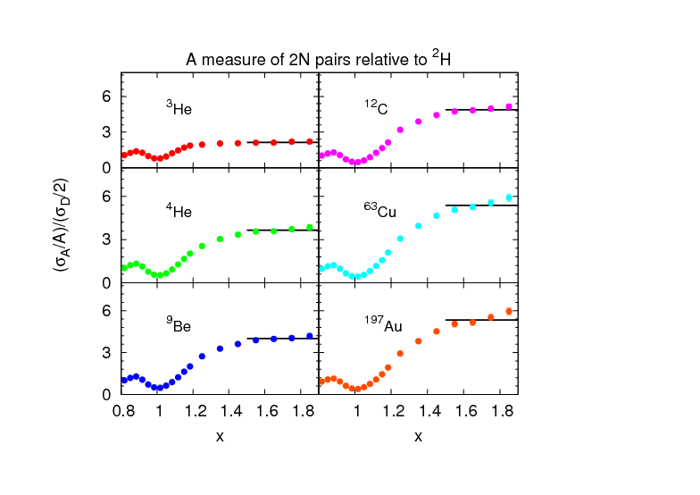
Isolating SRCs in inclusive scattering
QE
a₂(A)
a₂(A)
High momentum tails should yield constant ratio if SRC-dominated (beyond MF region)
Cross section ratio shows plateau at sufficient x, as expected
Inclusive ratios map out relative contribution of 2N-SRCs vs A
Data from N. Fomin, et al., PRL 108 (2012) 092052

Slide 5
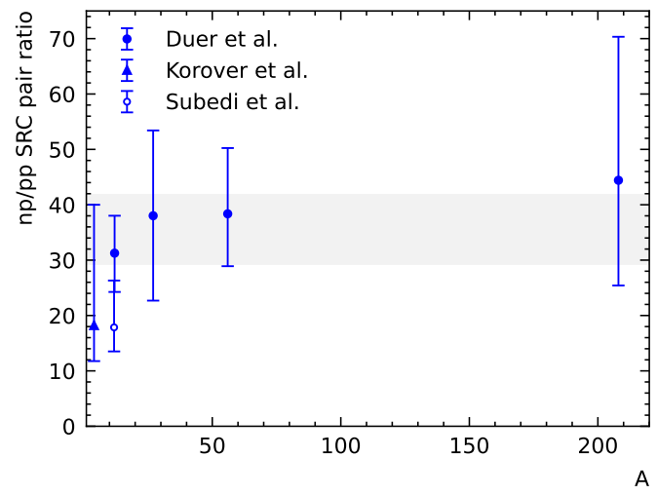
Isolating SRCs in inclusive scattering
a₂(A)
a₂(A)
Cross section ratio shows plateau at sufficient x, as expected
Inclusive ratios map out relative contribution of 2N-SRCs vs A
2-nucleon knockout measurements showed strong dominance of np-SRCs over pp-SRCs

Slide 6
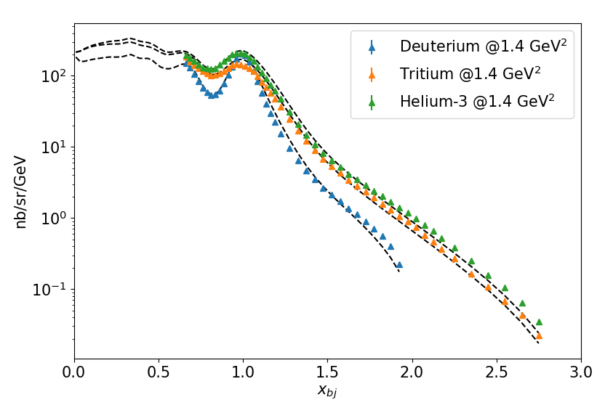
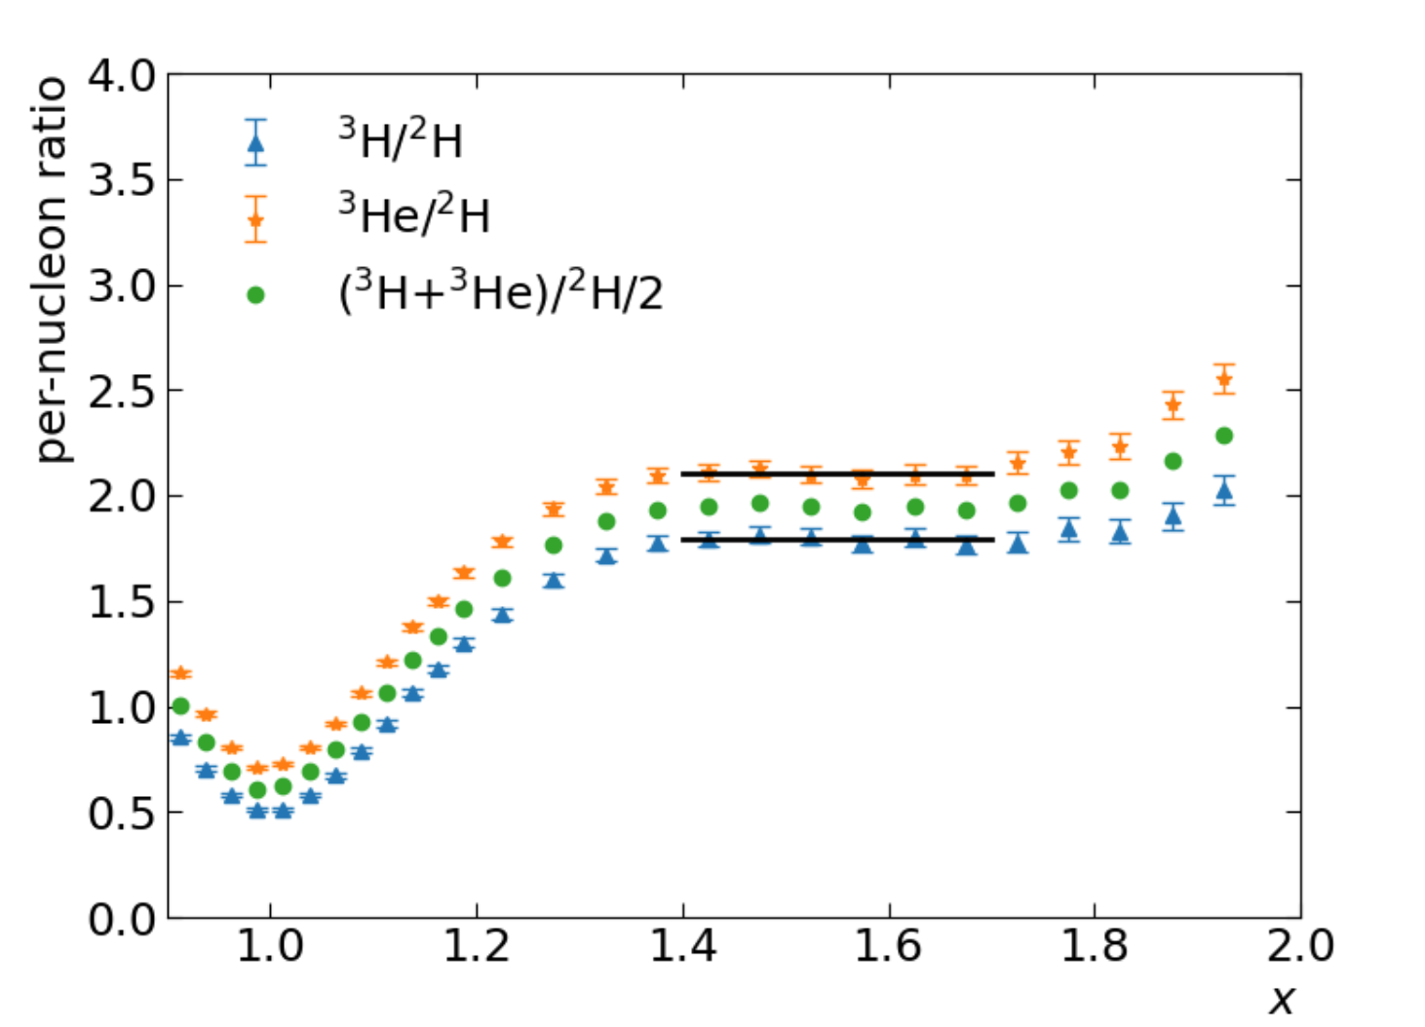
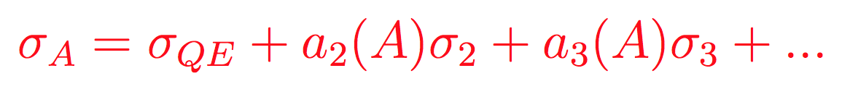
Hall A Tritium: 2N- and 3N-SRCs in A=3
2 np + 1 nn potential pairs
2 np + 1 pp potential pairs
(e,e’) cross section from E12-11-112@Hall A, 2018
Isospin symmetry + np-SRC dominance → expect 3H/3He ratio = 1
2N-SRC dominant
(A=3)/D ratio
0
0
S. Li et al, Nature 609 (2022) 41

Slide 7
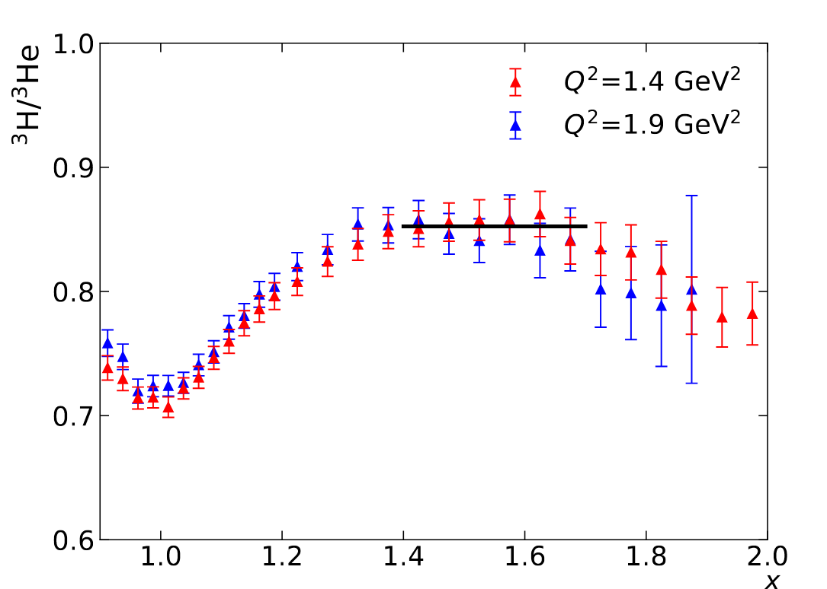
Isospin structure of 2N-SRCs
JLab E12-11-112: JA, D. Day, D. Higinbotham, P. Solvignon, Z. Ye
2 np + 1 nn potential pairs
2 np + 1 pp potential pairs
3H/3He difference allows extraction of pp/np in 3He
  Isospin symmetry + np-SRC dominance → 3H/3He ratio = 1
  Larger cross section from pp-SRCs yields larger 3He cross section, increasing with pp contribution
Measured R(3H/3He)=0.85+/-0.01
R connects to fraction of p vs n scattering
Essentially model-independent, assuming only QE
R=1: equal scattering from proton and neutron
R=0.7: 33% neutron, 67% proton (for 3He)
R=0.85: ~40% neutron, ~60% proton
If scattering from SRCs, this gives fraction of np vs pp
np:pp = 4:1 (80% np, 20% pp) → 40% n, 60% p
Complete np dominance
R=0.85(1)
Isospin independent
S. Li, et al, Nature 609 (2022) 41

Slide 8
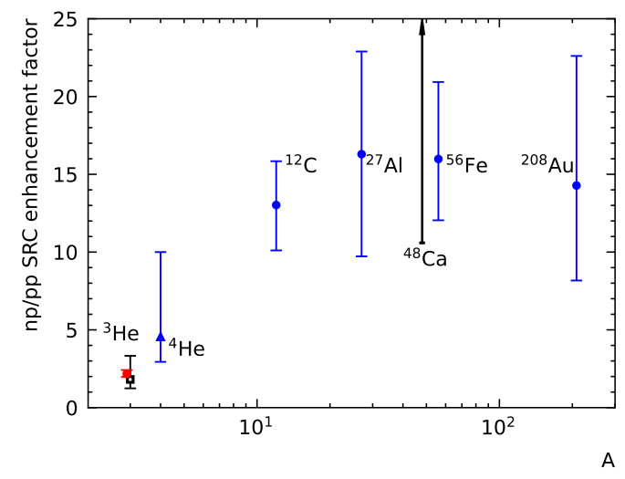
Isospin structure of 2N-SRCs
JLab E12-11-112: JA, D. Day, D. Higinbotham, P. Solvignon, Z. Ye
2 np + 1 nn potential pairs
2 np + 1 pp potential pairs
3H/3He difference allows extraction of pp/np in 3He
  Isospin symmetry + np-SRC dominance → 3H/3He ratio = 1
  Larger cross section from pp-SRCs yields larger 3He cross section, increasing with pp contribution
Measured R(3H/3He)=0.85+/-0.01
np/pp = 4.23+/-0.36 in 3He
  (Corrected for CM motion of SRCs, including the difference between np and pp motion, and difference between 3H and 3He)
Simple pair counting: np/pp = 2
Factor 2.1 np enhancement
S. Li, et al, Nature 609, 41 (2022)
Note: two-nucleon knockout measurements look at somewhat higher SRC momenta, but expectation is that np/pp enhancement is SMALLER at higher-momenta (tensor interaction → central repulsive core)
Ca48(e,e’): D. Nguyen et al, Phys. Rev. C, 102, 064004 (2020)
H3/He3 (e,e’p): R. Cruz-Torres et al, Phys. Lett. B797,134890 (2019)
He4(e,e'pN): I. Korover et al, Phys. Rev. Lett.113,022501 (2014)
A(e'pN) in Solid blue: M.Duer, et al, Phys. Rev. Lett.122, 172502 (2019)
Notes:
Note: 20:1 np/pp for He should be compared to 4:1 from naïve pair counting – still dominate at 90%, but enhancement factor only ~4.

Slide 9
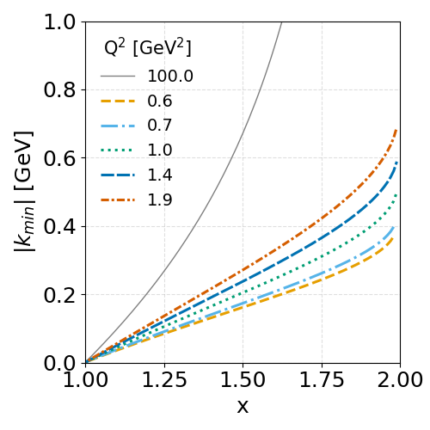
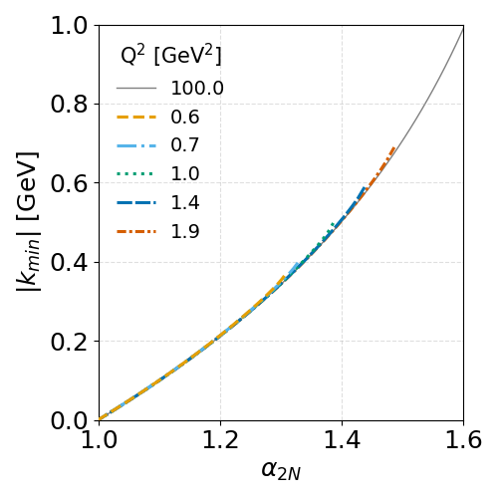
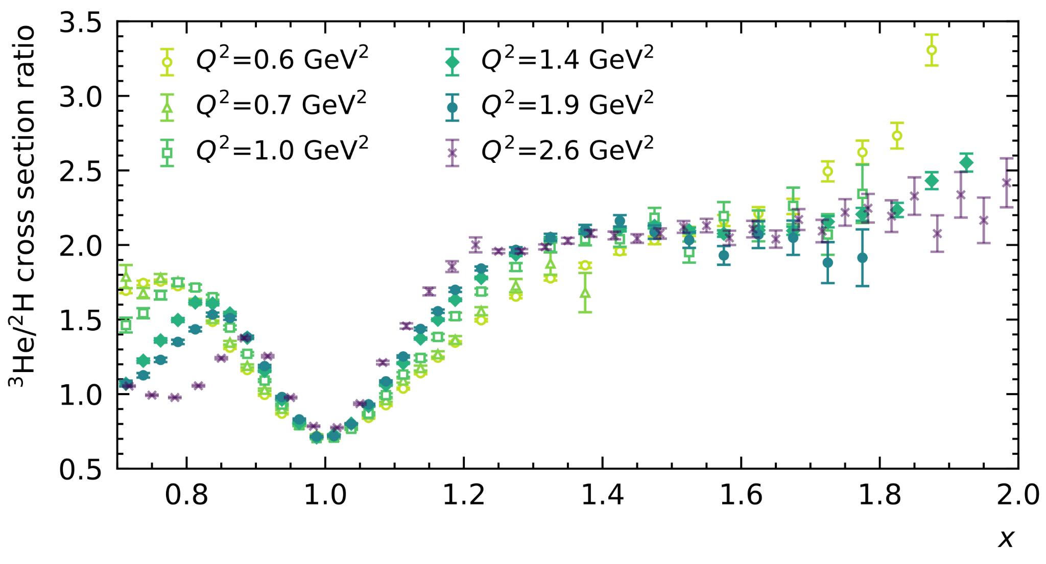
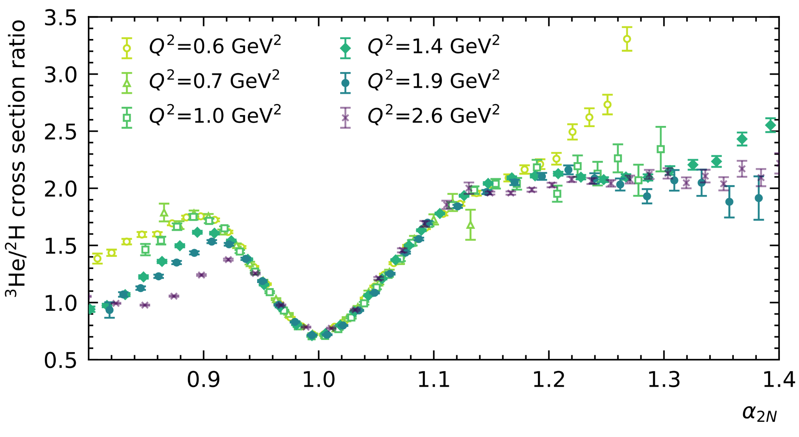
Early onset of 2N SRC scaling in A=3
³He/D
The variable x used as surrogate for struck nucleon momentum
Large Q² dependence in mapping x to k_{init} → Light-cone α
Much better scaling near QE peak
A=3 nuclei have smaller shell-model momenta
2N-SRC scaling onset at a≈1.15 for A=3 (1.3-1.4 for A≥12)
Few body nuclei have smaller scaling violations, e.g. FSI
2N-SRC scaling onset at Q²=1 for A=3 (~1.4 GeV² for A≥12)
2N-SRC scaling seen much earlier in A=3
Can we also expect onset of 3N SRC scaling at lower Q²?
2N- and 3N-SRCs both contribute at all x values.
More about where 2N-SRCs are small than where 3N-SRCs are large
S. Li et al, Physics Letters B, 868, 2025,139734

Slide 10
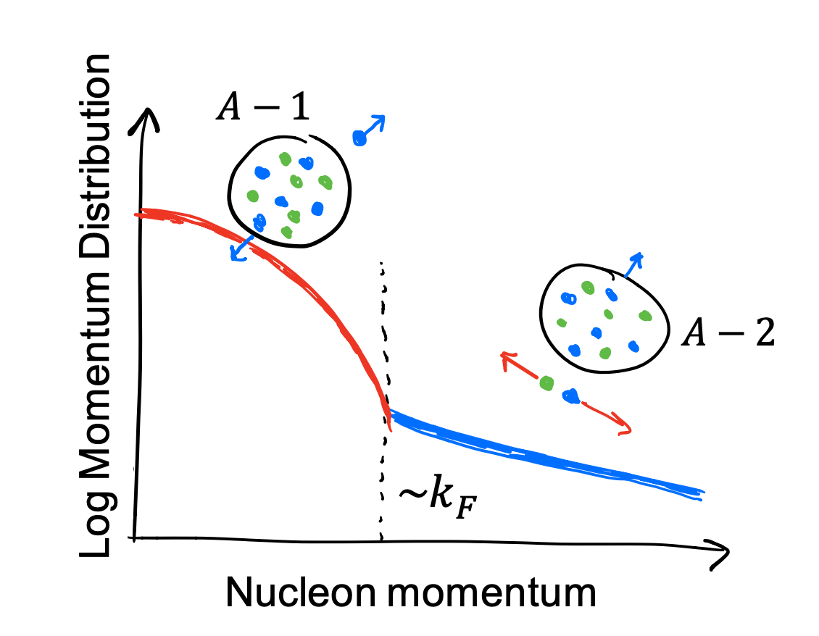
Early onset of 3N SRC scaling in A=3?
Scattering for x≈1: mean-field (MF), 2N-SRCs, 3N-SRCs can contribute…
Taking SRCs to be a set of nucleons with large relative, small total momentum
MF contribution is largest near x=1
Mix of MF and SRCs as we go to larger x
MF distribution drops rapidly above k_{Fermi} → 2N- and 3N-SRCs above α(k_{Fermi})
3N-SRCs assumed to be much smaller contribution, so expect 2N-SRCs to dominate
Larger α probes larger k_{init}; plateau suggests 3N-SRC/2N-SRC ratio stays small
At large enough k_{init} (large enough α), 3N-SRC is lower energy state and 2N-SRCs suppressed – what α value?
Struck Nucleon
300 MeV/c
Spectator 300 MeV/c
2N-SRC: Spectator KE ~ 47 MeV ~ P²/2M
Struck Nucleon
300 MeV/c
2 Spectators 150 MeV/c
3N-SRC: Spectator KE ~ 24 MeV ~ P²/2M

Slide 11
Early onset of 3N SRC scaling in A=3?
Scattering for x≈1: mean-field (MF), 2N-SRCs, 3N-SRCs can contribute…
Taking SRCs to be a set of nucleons with large relative, small total momentum
MF contribution is largest near x=1
Mix of MF and SRCs as we go to larger x
MF distribution drops rapidly above k_{Fermi} → 2N- and 3N-SRCs above α(k_{Fermi})
3N-SRCs assumed to be much smaller contribution, so expect 2N-SRCs to dominate
Larger α probes larger k_{init}; plateau suggests 3N-SRC/2N-SRC ratio stays small
At large enough k_{init} (large enough α), 3N-SRC is lower energy state and 2N-SRCs suppressed – what α value?
Struck Nucleon
300 MeV/c
Spectator 300 MeV/c
2N-SRC: Spectator KE ~ 47 MeV ~ P²/2M
Struck Nucleon
225 MeV/c
Spectator 225 MeV/c
Struck Nucleon
300 MeV/c
2 Spectators 150 MeV/c
150 MeV/c
150 MeV/c
3N-SRC: Spectator KE ~ 24 MeV ~ P²/2M
2N-SRC moving against 3rd nucleon – identical to “3N-SRC”

Slide 12
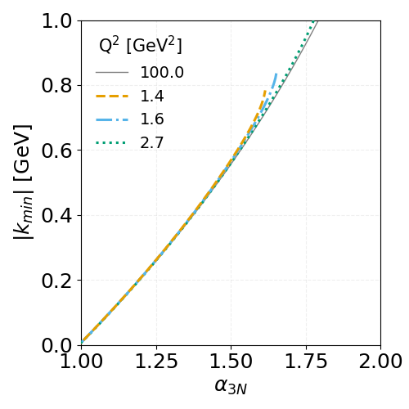
3N-SRC dominance
2N-SRCs dominate at α≈1.15 → k_{init} > 180 MeV/c
Two recoil nucleons with k>180 MeV/c → α > 1.3-1.35
Expect 3N-SRC may start to dominate in this region
Note: lower than predicted α threshold to isolate 3N-SRCs in heavy nuclei → accessible at lower Q², realistic with low-density tritium target.

Slide 13
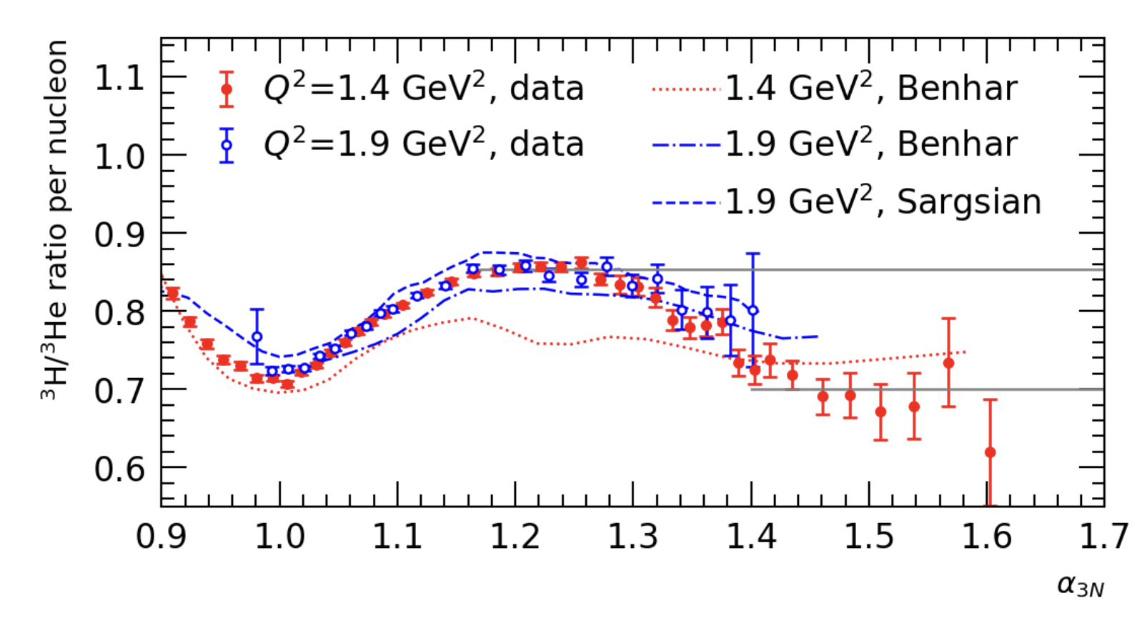
3N-SRC dominance
2N-SRCs dominate at α≈1.15 → k_{init} > 180 MeV/c
Two recoil nucleons with k>180 MeV/c → α > 1.3-1.35
Expect 3N-SRC may start to dominate in this region
S. Li et al, Physics Letters B, 868, 2025,139734
2N SRC
2N-SRC plateau at R=0.84
Possible 3N-SRC plateau above α=1.4
Ratio ≈ 0.7, consitent with 2N-SRC ratio squared (0.84)²
(Predicted if consecutive NN interactions dominate over 3N forces)
Hall A data suggests 3N-SRC dominance: 5-10% level statistical uncertainty, but only one Q² value
3N SRC?

Slide 14
3N-SRC dominance
S. Li et al, Physics Letters B, 868, 2025,139734
Ratio sensitive to relative proton, neutron contribution:
2N region: R=0.84 imples 40/60 for singly/doubly ocurring nucleon – enhanced contribution from singly-ocurring nucleon
3N region: decrease → reduced contribution from singly-occuring nucleon. R=0.7 suggets 1:2 ratio for singly/doubly ocurring nucleon
True whether or not the cross section is dominated by SRCs
2N SRC
3N SRC?
If α>1.4 is dominated by 3N-SRCs, then the highest-momentum nucleon is equally sampled between all nucleons in the nucleus
To claim clear isolation of 3N-SRCs:
Would like better statistics to demonstrate a precise plateau in α
Second Q² value to confirm ‘universal’ 3N-SRC cross section behavior for all α and Q² that isolate 3N-SRCs

Slide 15
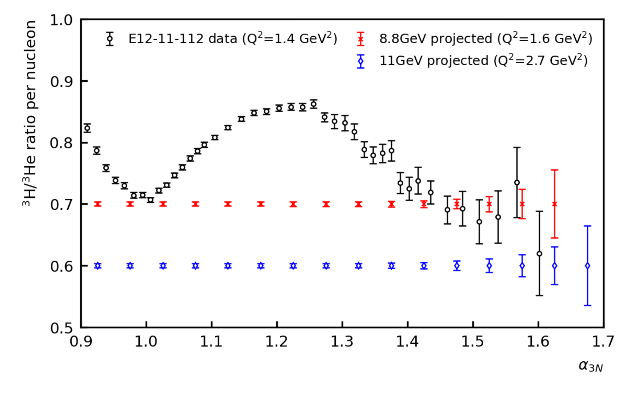
Proposal PR12-26-012 [JA, S. Li]
 | E12-11-112 | This Proposal
Kinematics | L17 | kin1 | kin2
Beam Energy | 4.3 GeV | 11 GeV | 8.8 GeV
Spectrometer | HRS@Hall A | SHMS@Hall C | SHMS@Hall C
Angle | 17.0 | 8.5 | 8.5
Central momentum | 3.54-3.94 GeV | 9.8 GeV | 8.2 GeV
Q² | 1.4 | 2.7 | 1.6
60 PAC days including calibrations
< 3% uncertainties up to alpha≈1.6
2 Q² settings to confirm 3N-SRC plateau, scaling
Search for 3N-SRC dominance
Probe high-momentum structure in A=3
Provide cross sections and ratios to compare to ab initio calculations

Slide 16
Run group proposal: Two main physics topics
E12-26-012: “Probing the isospin and momentum structure of three-nucleon short-range correlations in the ³H/³He mirror system” [S. Li, JA]
Search for expected early onset of 3N-SRC dominance in A=3 nuclei
Study momentum, isospin structure of high-p nucleon distribution
  Direct, model-independent comparison of isospin structure in large-x scattering (high-p nucleons)
  Absolute cross sections and precise ratios for comparison to ab initio calculations at very large x
  If 3N-SRCs dominate, the isospin structure information translates into a statement of 3N-SRC structure
E12-26-011: “Constraining the flavor content of the nucleon and flavor-dependent nuclear effects in the mirror nuclei ³H and ³He” [T.Hague, JA, D. Meekins, S. Li, M. Nycz]
Leading-order: extension of the MARATHON experiment
  Aim for factor 2 improvement in F2n/F2p over full x range (MARATHON + HallC vs just MARATHON)
Higher-order: Dedicated studies to constrain effects limiting extractions of F_{2n}/F_{2p} and d(x)/u(x)
  Isospin dependence of R=σ_{L}/σ_{T} at x=0.3 (impact of flavor-dependent nuclear corrections on normalization)
  Constrain isospin-dependence of Higher Twist corrections at large x (for MARATHON and D/p)

Slide 18
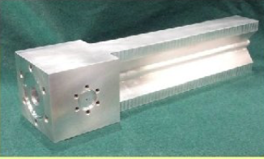
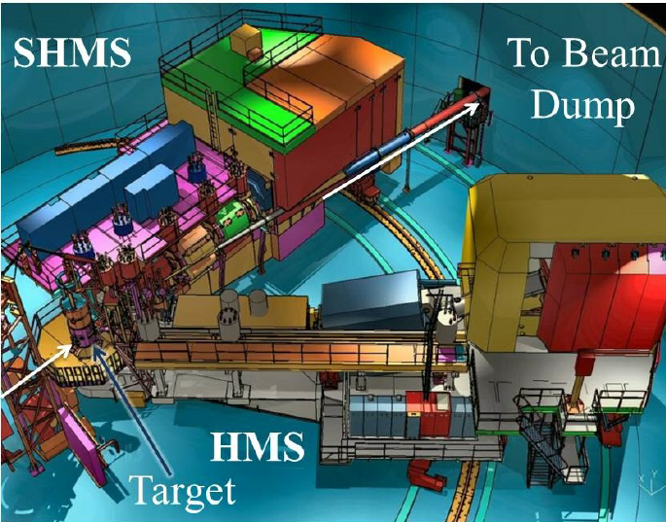
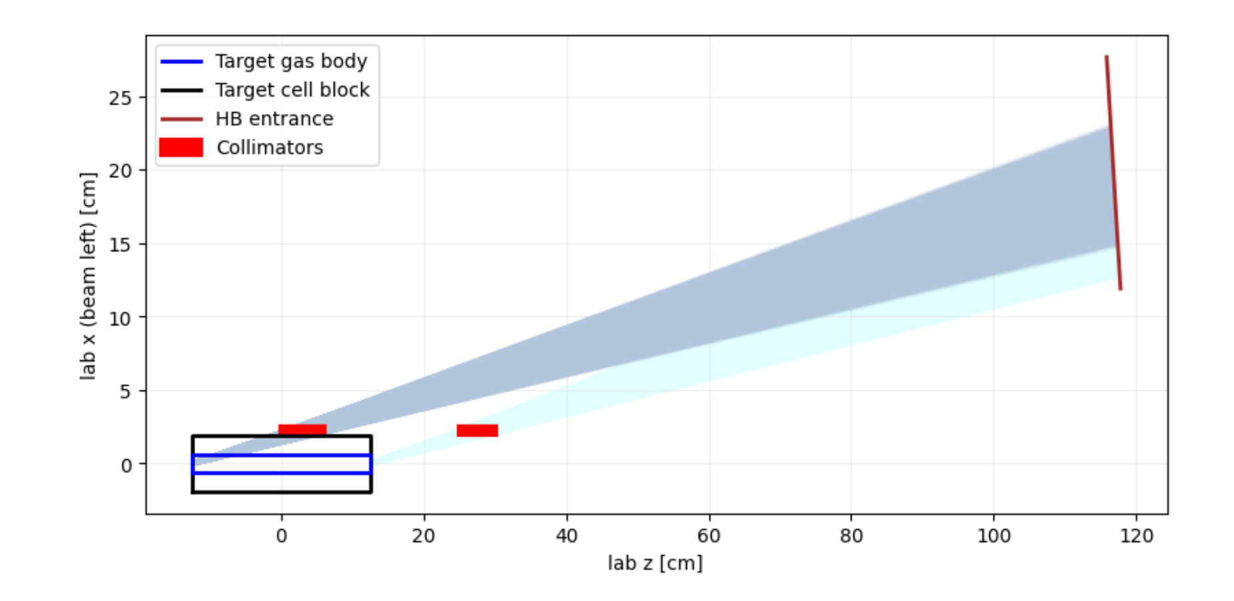
New Proposal: Instrumentation
Same target cell design from the 2018 tritium program:
25cm long sealed Alloy cell, hold 1000 Ci tritium
Well-understood target properties: density fluctuation, decay etc
Beam current < 25uA and other safety measures
SHMS in standard configuration to detect scattered electrons
Good momentum resolution (v.s. Hall B CLAS12)
Higher central momentum range, smaller angle (v.s. Hall A) → higher rates → can afford higher Q²
Large momentum acceptance → one single setting to cover x=1 to 3
Dedicated Collimator (tungsten block) to remove endcap contamination

Slide 19
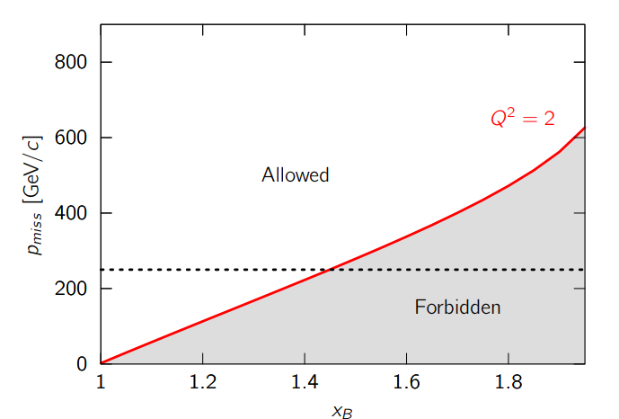
Isolating SRCs in inclusive scattering
QE
Short distance
Mean field
High momentum tails should yield constant ratio if SRC-dominated (beyond MF region)
At large x scattering from mean-field nucleons is excluded, should see universal behavior from 2N-SRCs: Cross section identical in all targets, A/D ratio independent of x and Q² (SRC cross section scaling)
E02-019 data: N. Fomin, et al., PRL 108 (2012) 092052

Slide 20
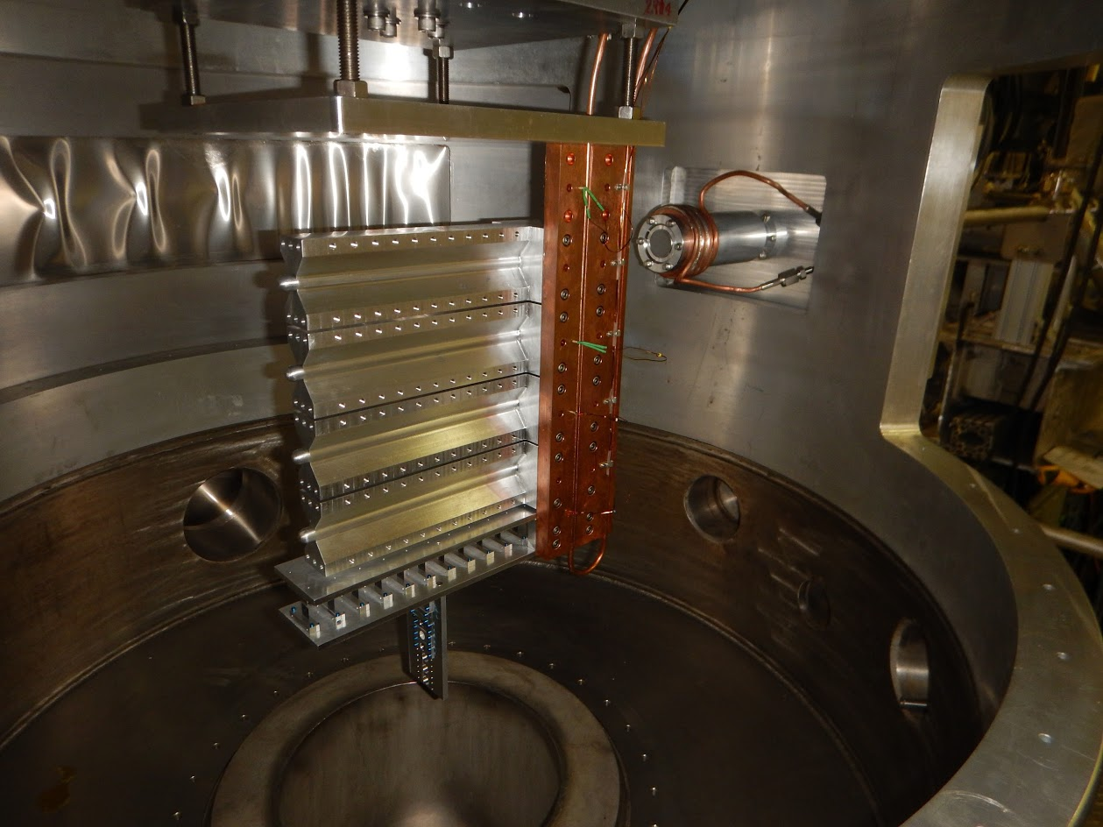
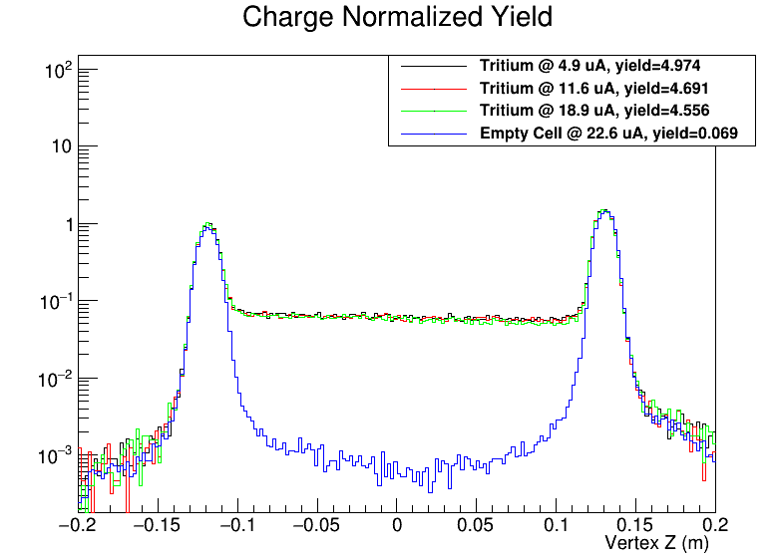
PR12-24-012: target system
Exactly the same target cell design from Hall A:
25cm long sealed Alloy cell, hold 1000 Ci tritium
Well-understood target properties: density fluctuation, decay etc
Beam current < 25uA and other safety measures
Successful cooperation with Savannah River Site
Use collimator (tungsten block) to block endcaps
Remove contamination and reduce rates
Similar to A1n/D2n design
Effective target length -5.5<z<9cm
25 cm
entrance window
exit window

Slide 21
