Slide 1
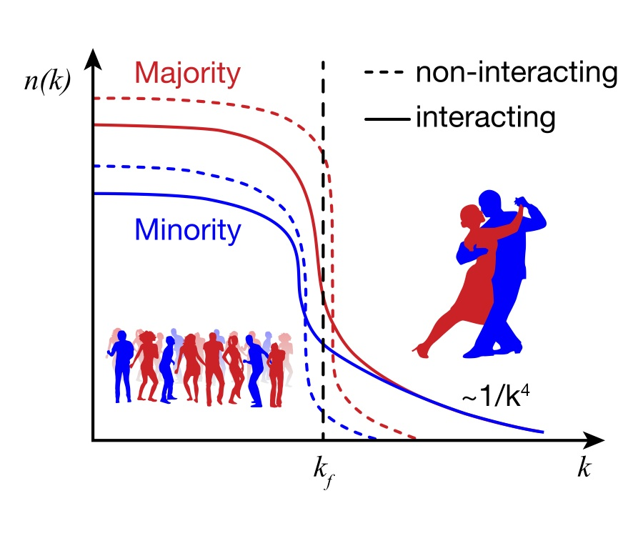
Which Nucleons Pair?
Lawrence Weinstein
Old Dominion University
ODU, MIT, Tel Aviv, JLab, UTK, CUA, GWU …

Slide 2
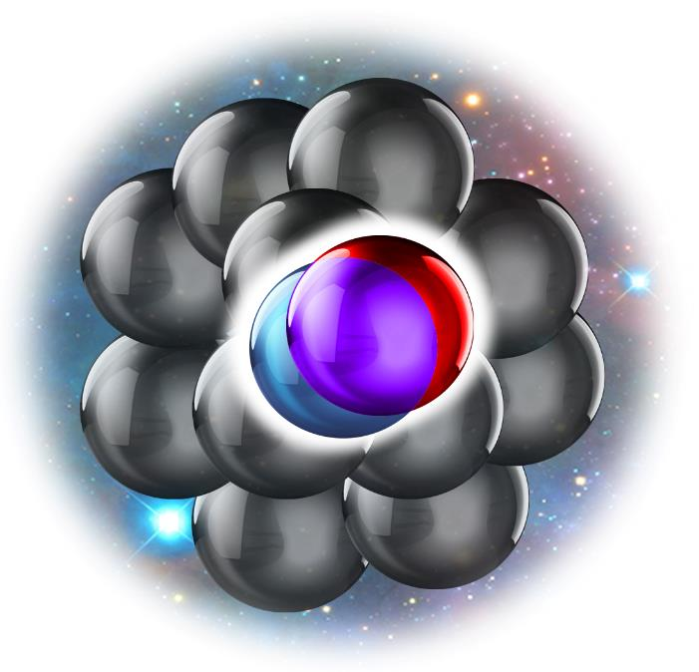
k-space
high relative and lower c.m. momentum compared to k_{F}
Short Range Correlated Pairs
r-space
Close together nucleon pairs

Slide 3
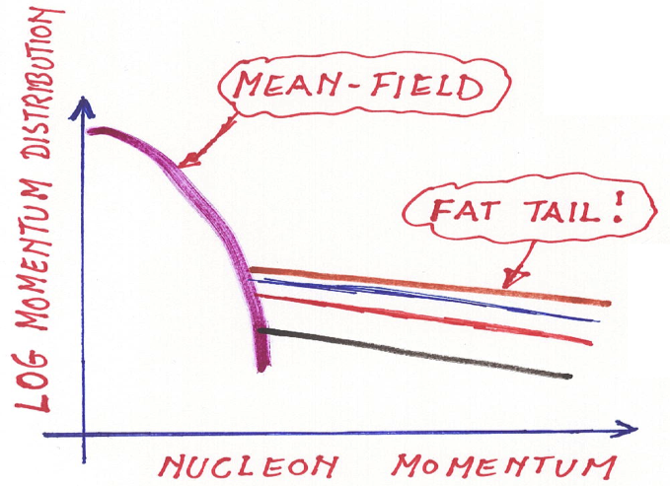
Looking For Correlations
~k_{F}

Slide 4
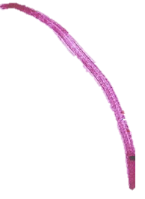
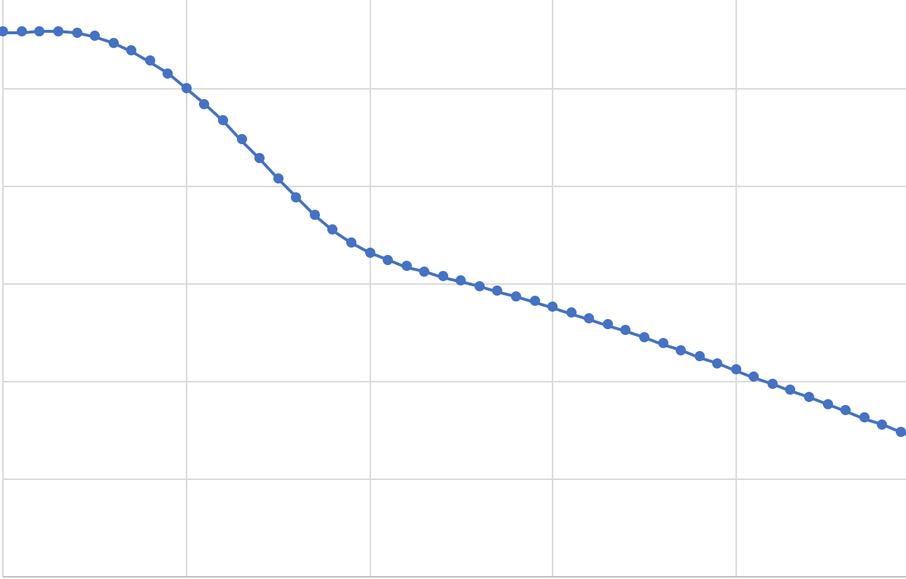
Realistic ¹²C (AV18+UX)
~k_{F}
Wiringa, PRC (2014); Carlson, RMP (2015); …

Slide 5
~k_{F}

Slide 6
Pairs ⬄ Scale Separation
A-2
n
p
R. Cruz-Torres et al., Nature Physics (2021)
R. Weiss et al., Phys. Lett. B 780 (2018)
J.-W. Chen, W. Detmold, J. E. Lynn, A. Schwenk, PRL 119 (2017)
R. Weiss, B. Bazak, N. Barnea, Phys. Rev. C 92 (2015)

Slide 7
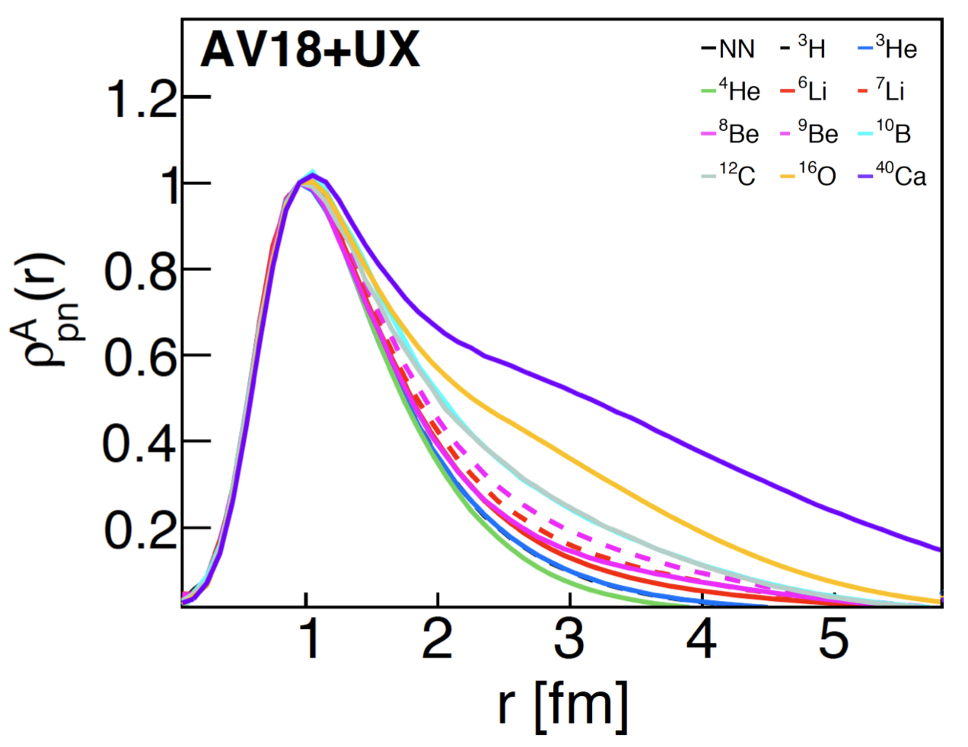
SRCs from Quantum Monte-Carlo (QMC):
Pair Distance Distributions
(normalized at r=1)
One model, many nuclei
Cruz Torres et al., Nature Physics (2020)

Slide 8
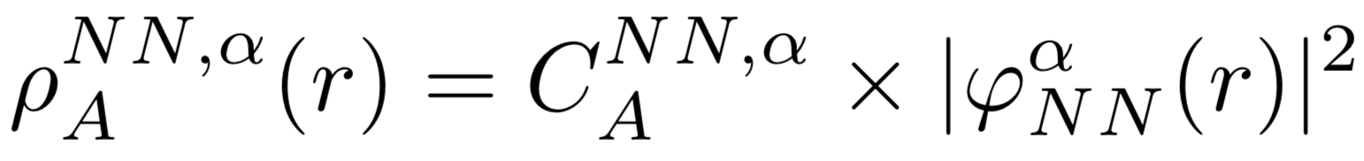
=
Constant x
Two-Body
Many Body
Cruz Torres et al., Nature Physics (2020)

Slide 9
Factorization is model Independent
Many models, many nuclei
Cruz Torres et al., Nature Physics 17 (2021) p306.

Slide 10
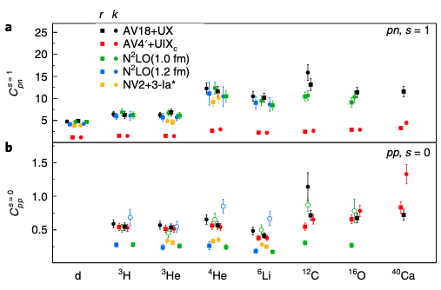
How many pairs are there?
QMC ab-initio calculations
NN potential
pn
AV18, N2LO
NV2
AV4’: no tensor
Per nucleon pair probability
pp
d ³H ³He ⁴He ⁶Li C O ⁴⁰Ca
Number of np pairs independent of NN potential!
→ np pairing is a long-distance phenomenon
Cruz Torres et al., Nature Physics (2021)

Slide 11
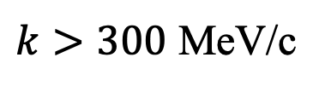
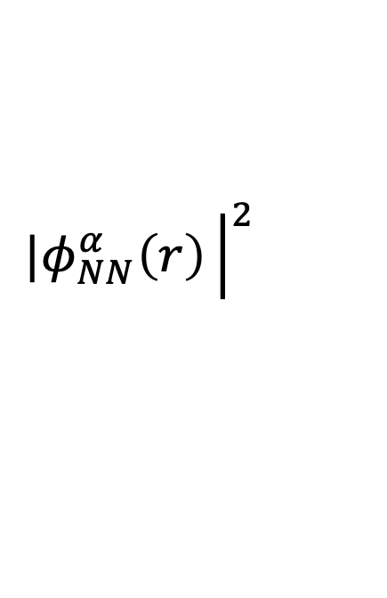
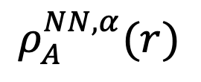

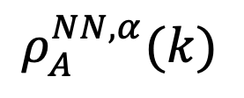
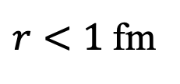
Scale Separation
$${|φ}_{NN}^{α}\left(k\right){\left.​\right|}^{2}$$
$k>300$ MeV/c
$$ρ_{A}^{NN,α}(k)$$
$${|φ}_{NN}^{α}\left(r\right){\left.​\right|}^{2}$$
$r<1$fm
$$ρ_{A}^{NN,α}(r)$$
Total Dist. =
Constant x
(Low-Energy)
Two-body
(High-Energy)
Which nucleons pair? ←→ What determines $C_{A}^{NNα}?$
R. Cruz-Torres et al., Nature Physics (2021)
R. Weiss et al., Phys. Lett. B 780 (2018)
J.-W. Chen, W. Detmold, J. E. Lynn, A. Schwenk, PRL 119 (2017)
R. Weiss, B. Bazak, N. Barnea, Phys. Rev. C 92 (2015)

Slide 12
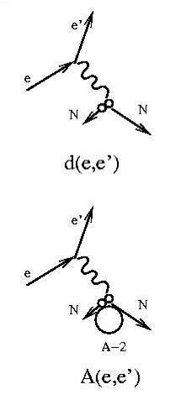
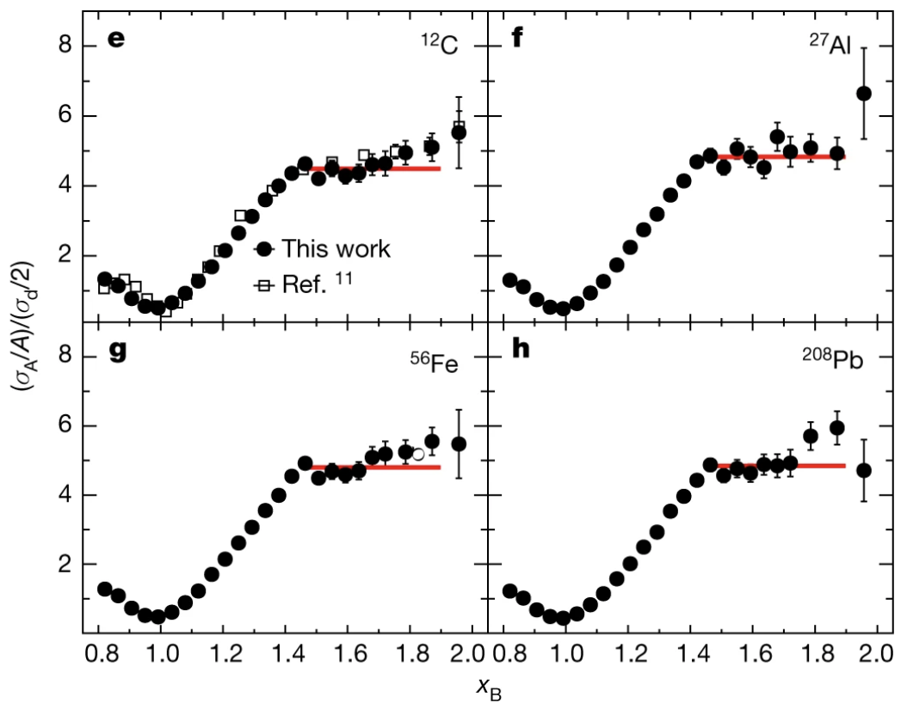

How many pairs are there? A(e,e’) / d(e,e’)
¹²C
²⁷Al
Cross section ratio to deuterium
⁵⁶Fe
$$x_{B}=Q^{2}/2mν$$
α2N ≈20%
Schmookler et al., Nature (2019)

Slide 13

Scale separation
Long range / low momentum region
Nucleus dependent
“Mean Field”
Short distance / high momentum region
Nucleus independent
“Short Range Correlations”
$$x_{B}=Q^{2}/2mν$$

Slide 14
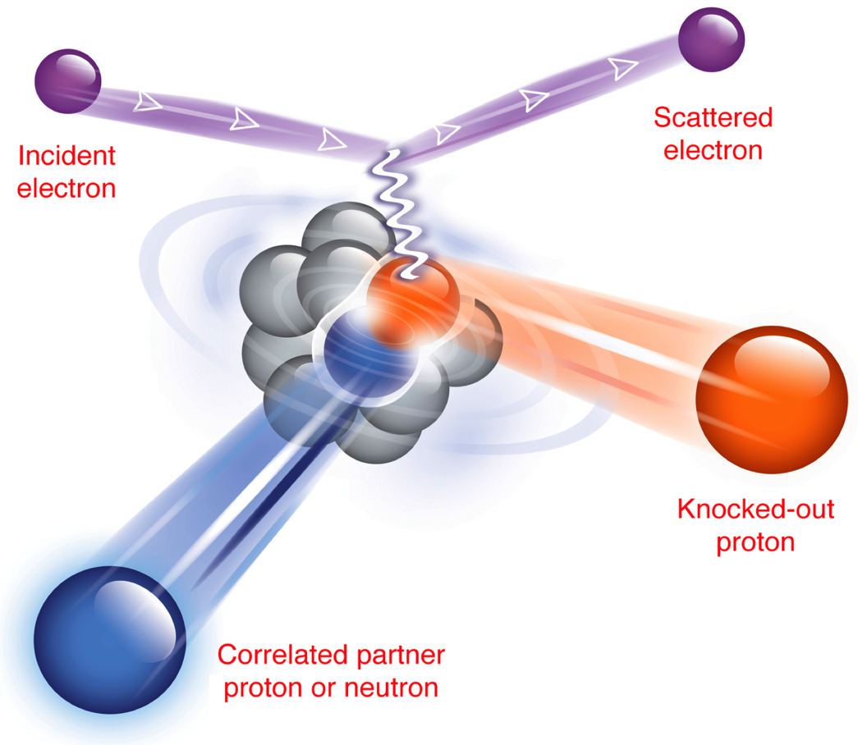
Breakup the pair =>
Detect both nucleons =>
Reconstruct ‘initial’ state

Slide 15
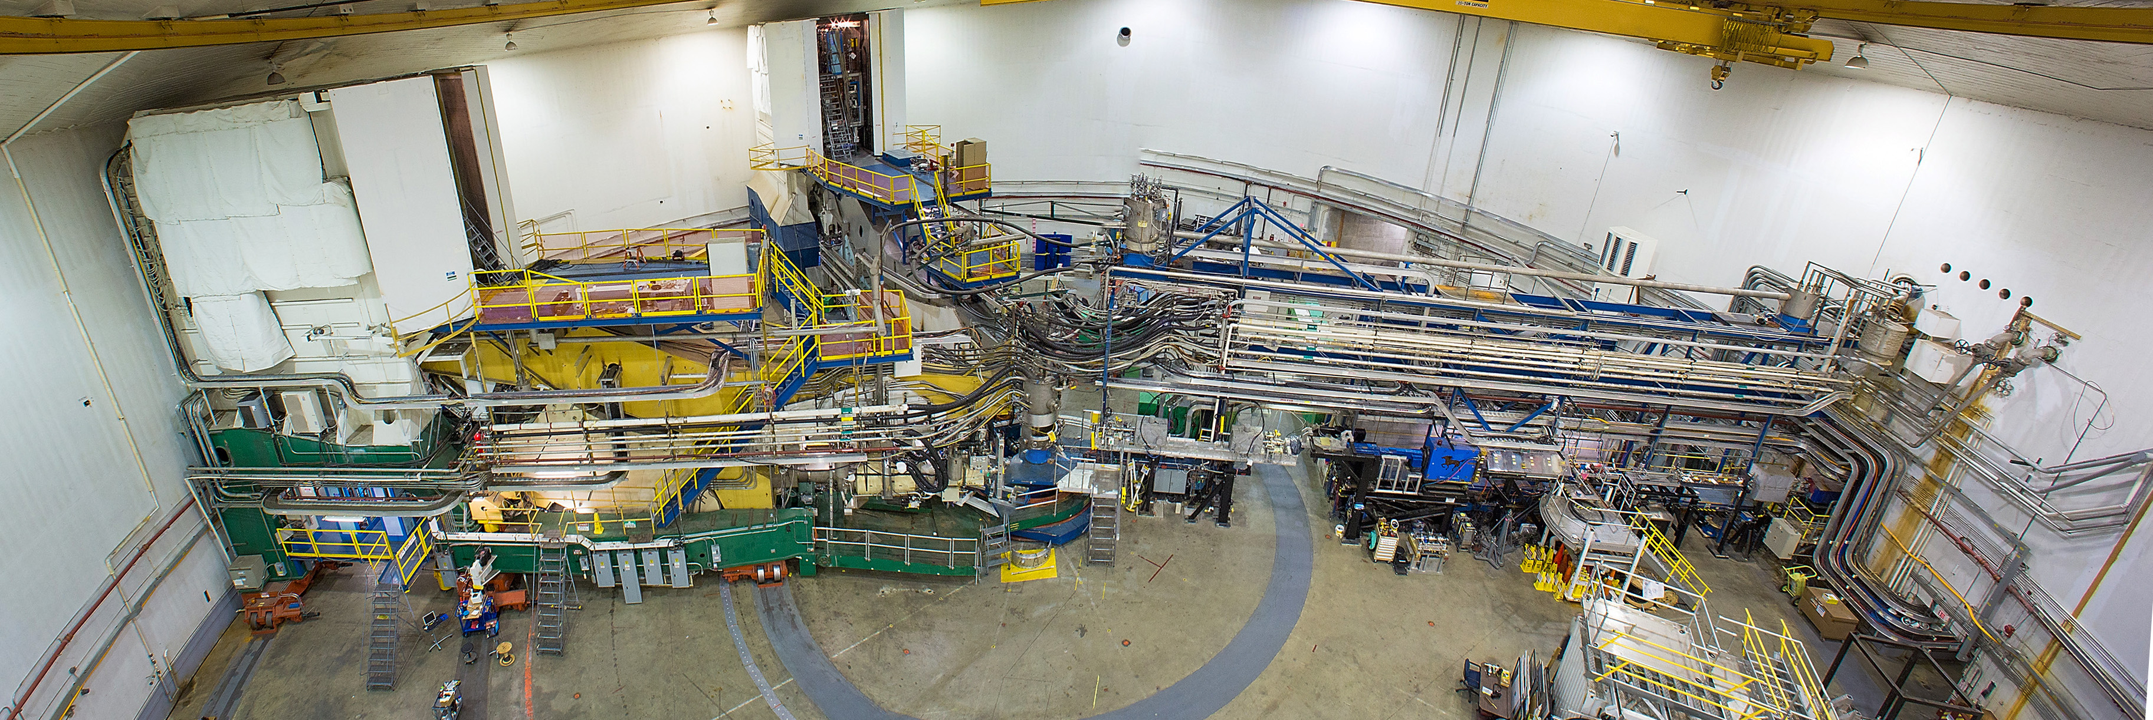
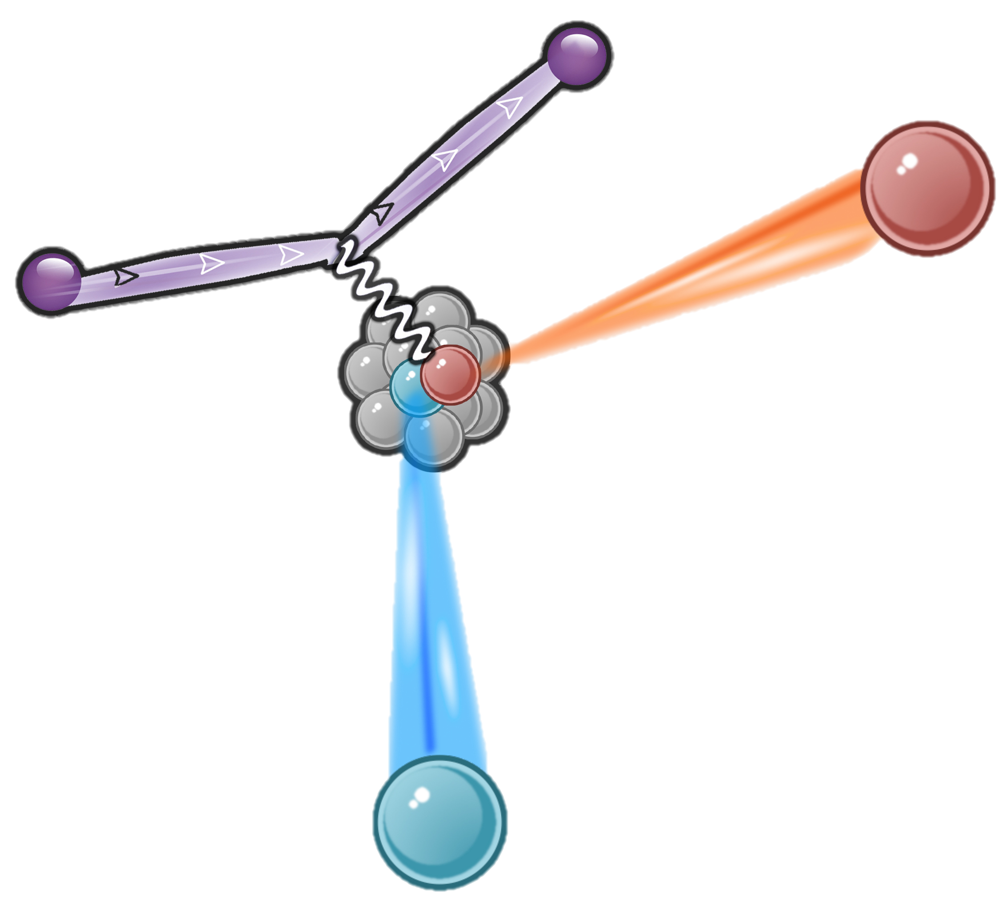
Hall-A: A(e,e’pN)
15

Slide 16
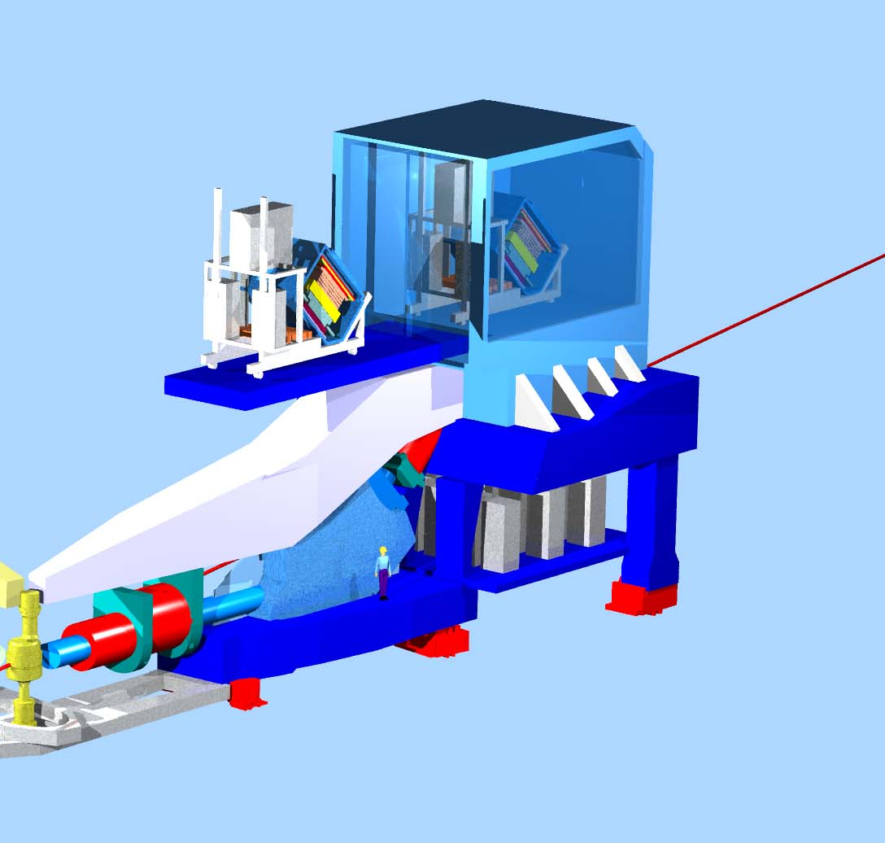
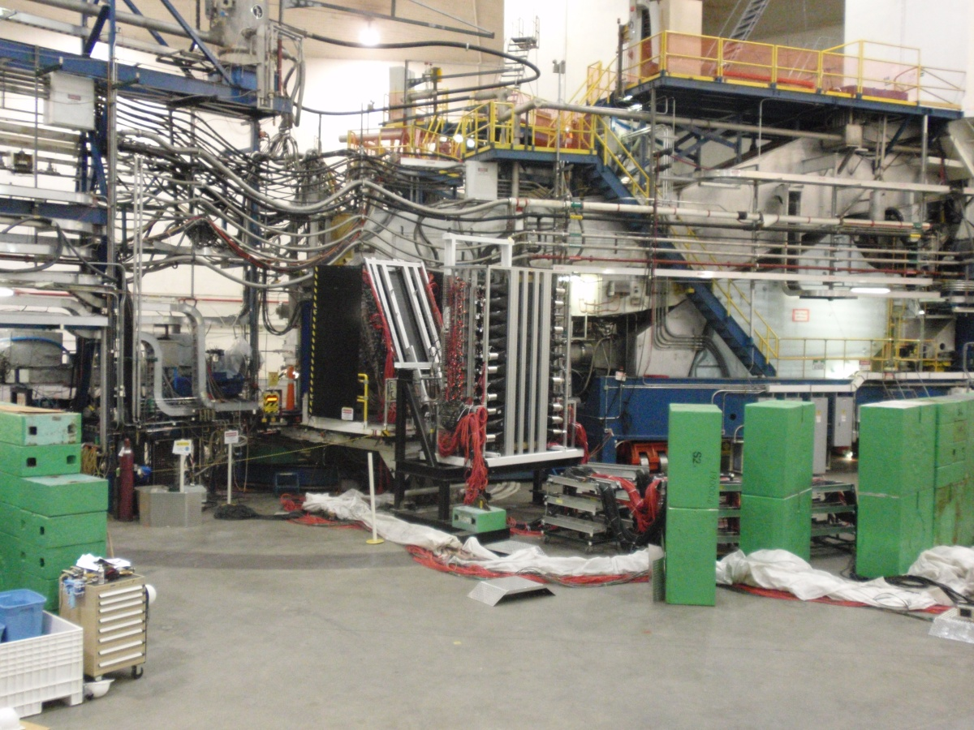
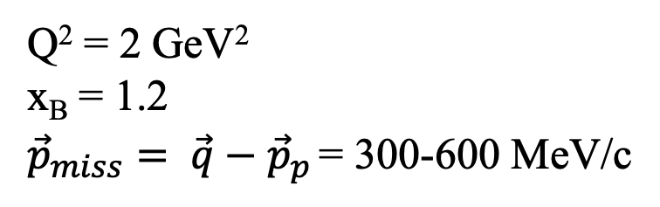
Hall A C(e,e’pN)
Q² = 2 GeV²
x_{B} = 1.2
${\vec{p}}_{miss}= \vec{q}−{\vec{p}}_{p}$ = 300-600 MeV/c
E_{e}’ = 3.7 GeV
e’
E_{e} = 4.6 GeV
e
p
n or p
p_{p} ~ 1.4 GeV/c
p_{miss}
HAND
BigBite
Detect the proton,
look for its partner nucleon

Slide 17
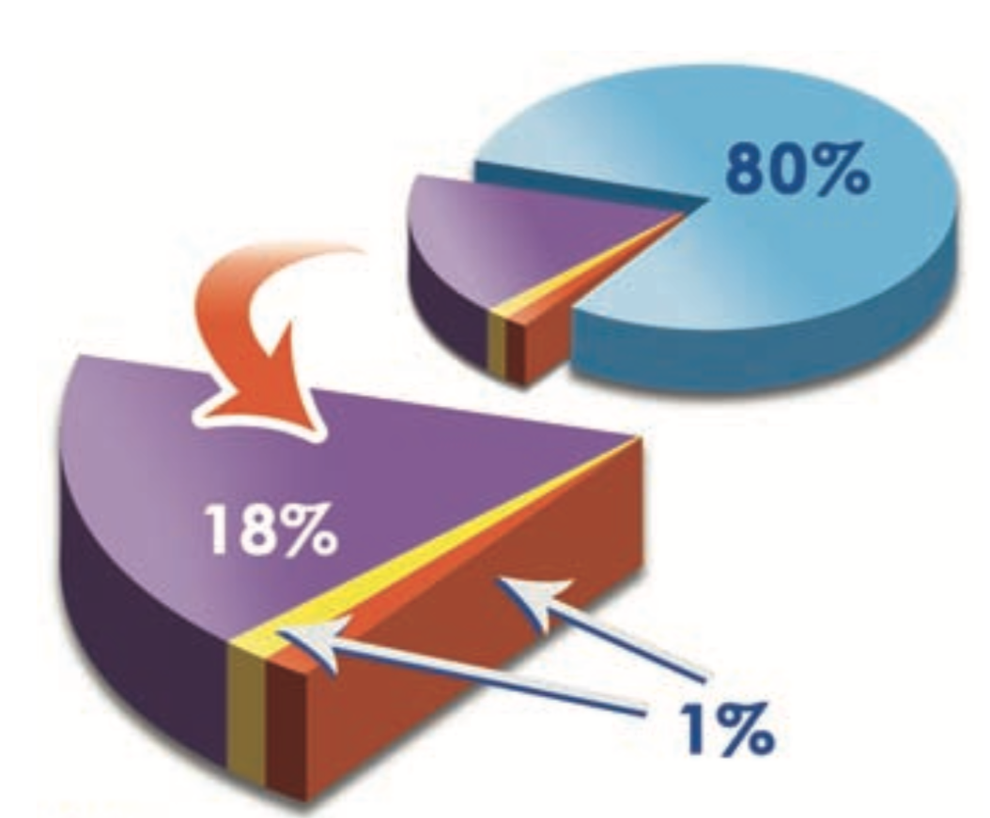
High momentum protons have partners
C(e,e’pN) and C(p,2pn)
Detect the proton
Look for partner nucleons
➔ All high-p protons have partners
➔ np pairs dominate at
np pairs
pp pairs
np
Single n
pp, nn
R. Subedi et al., Science 320, 1476 (2008)

Slide 18
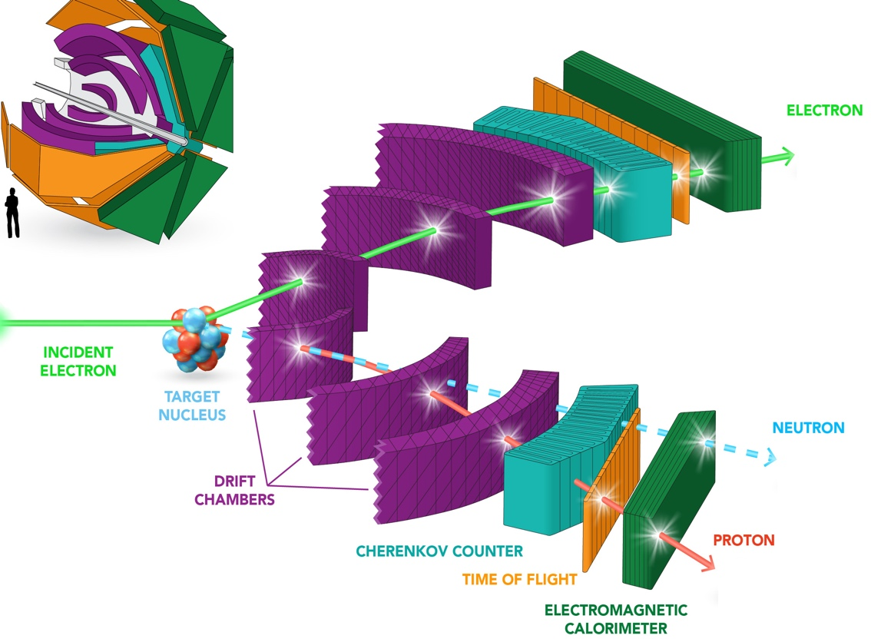
Proton vs. Neutron Knockout
CLAS6

Slide 19
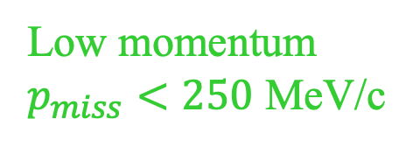
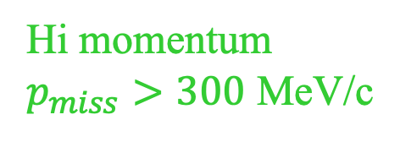
Which nucleons pair?
Low momentum
$p_{miss}<250$ MeV/c
neutrons
protons
Hi momentum
$p_{miss}>300$ MeV/c
Same # of high-momentum protons and neutrons
→ np pair dominance
M. Duer, Nature (2018)

Slide 20
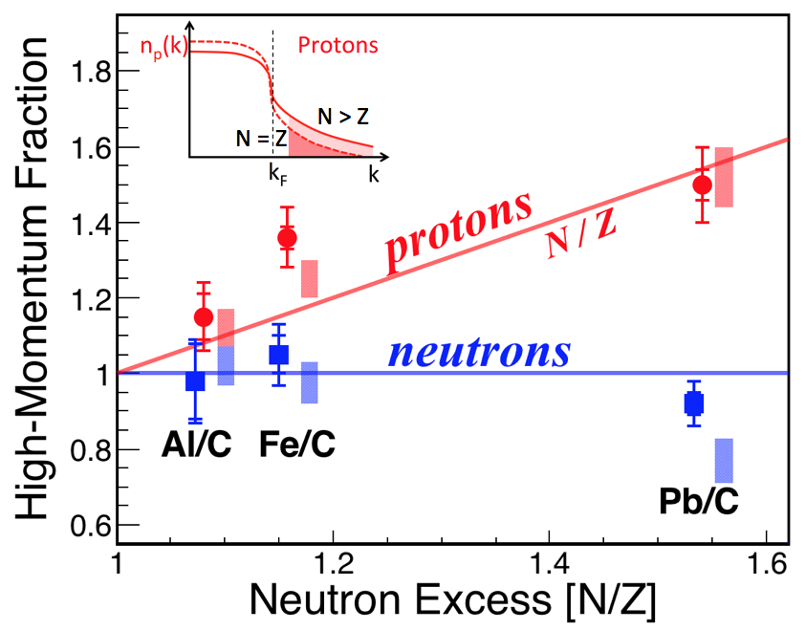
Which nucleons pair?
Hi-mom
Lo-mom
Adding neutrons increases the proton high-momentum fraction!
→ minority nucleons have higher momentum
M. Duer, et al., Nature 560, p617 (2018)

Slide 21
Which nucleons pair?
Hi-mom
Lo-mom
Adding neutrons increases the proton high-momentum fraction!
→ minority nucleons have higher momentum
M. Duer, et al., Nature 560, p617 (2018)

Slide 22
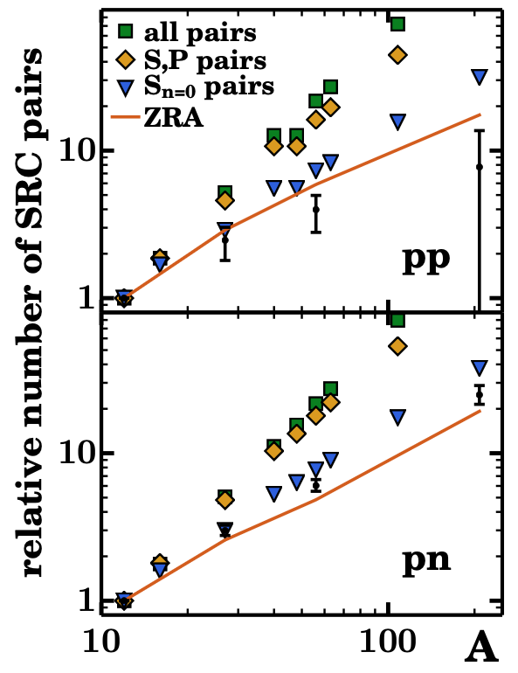
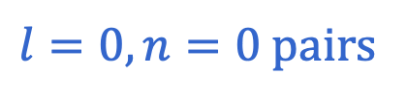
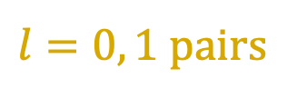
Which nucleons pair?
all pairs
$l=0, 1$ pairs
$l=0, n=0$ pairs
Zero range pairs
data
Colle et al, PRC 92, 024604 (2015)

Slide 23
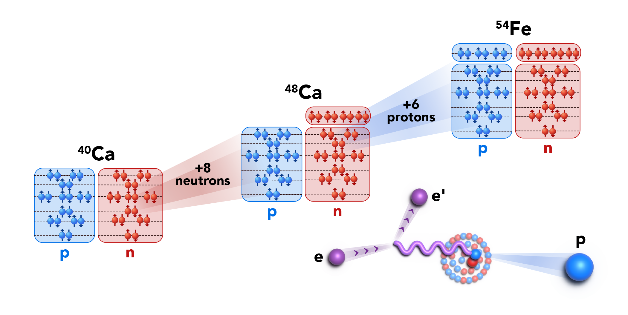
The CaFe experiment: Which nucleons pair?
Separate A and N/Z dependence
PAC44 (2016) deferred
PAC45: B+, 4 days, focus on 40Ca and 48Ca

Slide 24
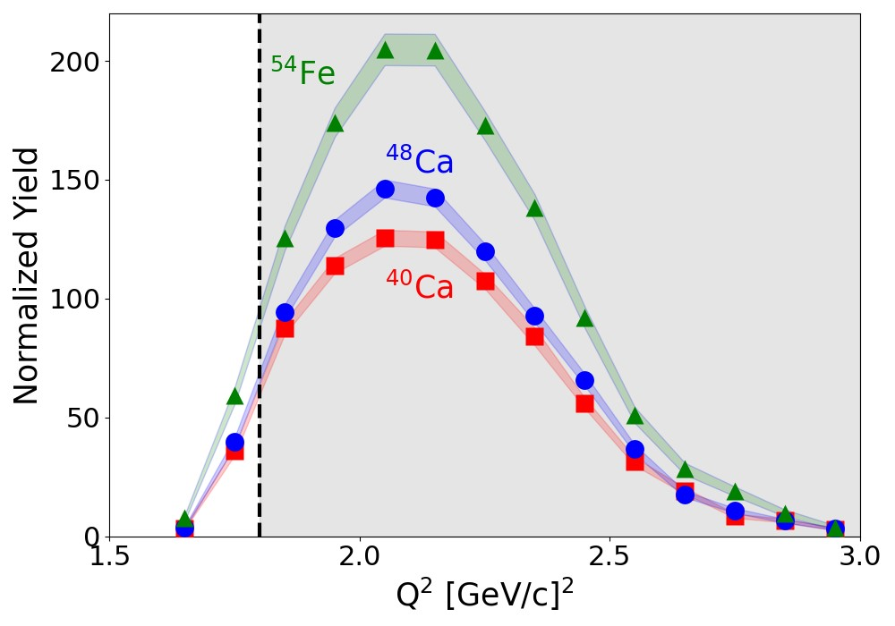
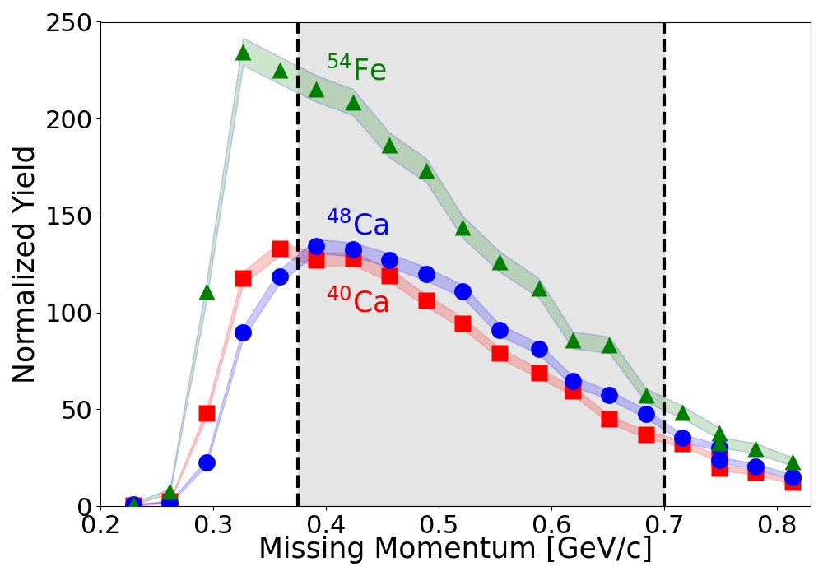
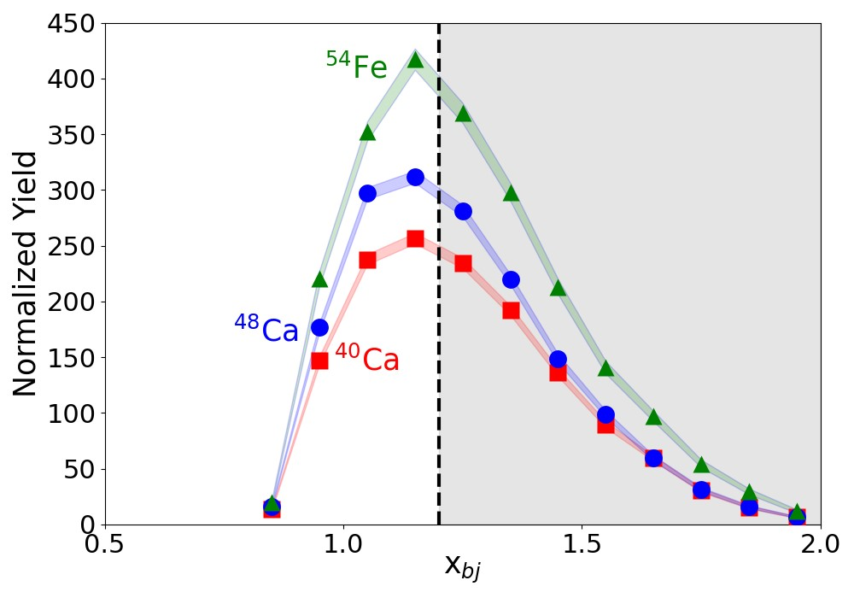
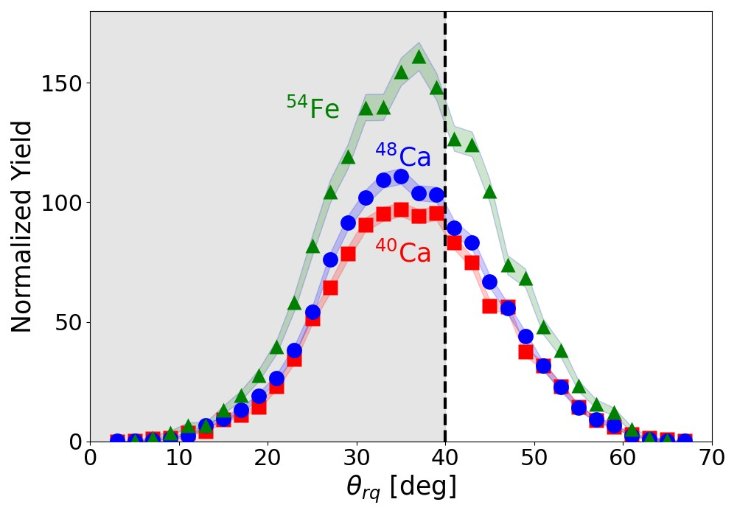


CaFe: A(e,e’p) in Hall C
10.6 GeV Beam
Q² > 1.8 GeV²
$x_{B}=\frac{Q^{2}}{2mν}≥1.2$
$θ_{rq}<{40}^{∘}$
0.$375≤p_{miss}≤0.700$ GeV/c
1.5 Q² (GeV²) 3.0
0.2 p_{miss} (GeV/c) 0.8
0.5 x_{B} 2.0
0 $θ_{rq}$ 70

Slide 25
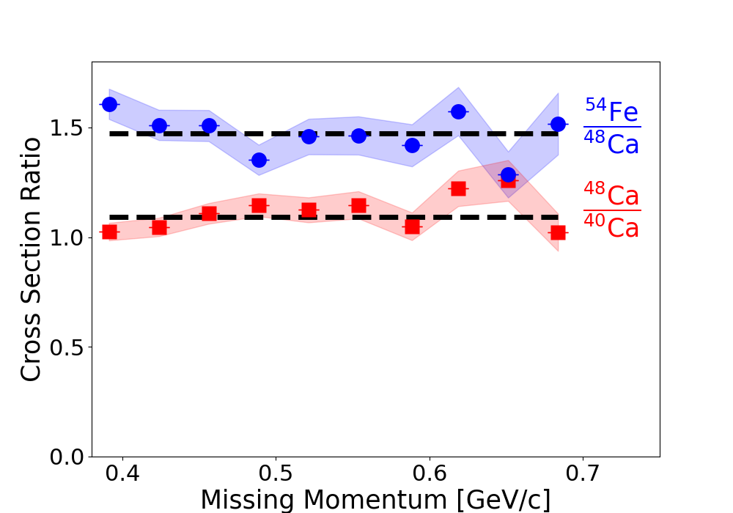
Isolate SRC signal
Flatness → the protons are in SRC pairs

Slide 26
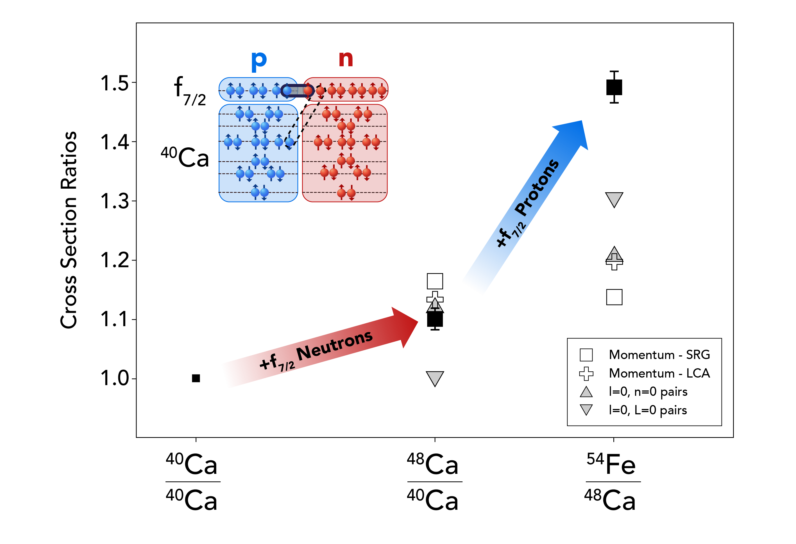
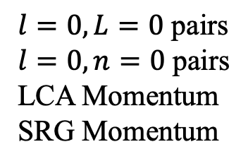
Which nucleons pair?
$$l=0,L=0 \text{pairs}$$
$l=0,n=0$ pairs
LCA Momentum
SRG Momentum
Nguyen, Yero, Szumila-Vance, … Nature 654, 619 (2026)

Slide 27
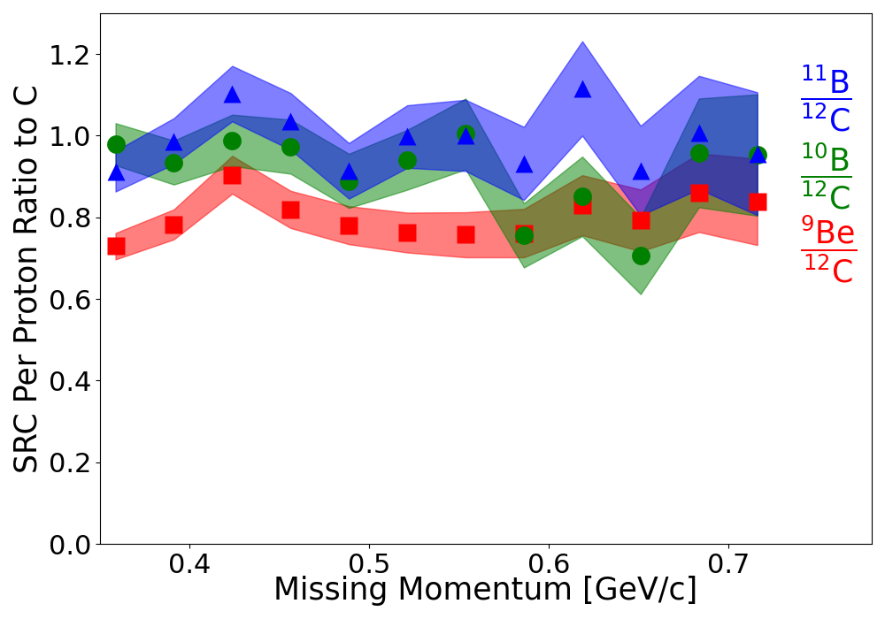
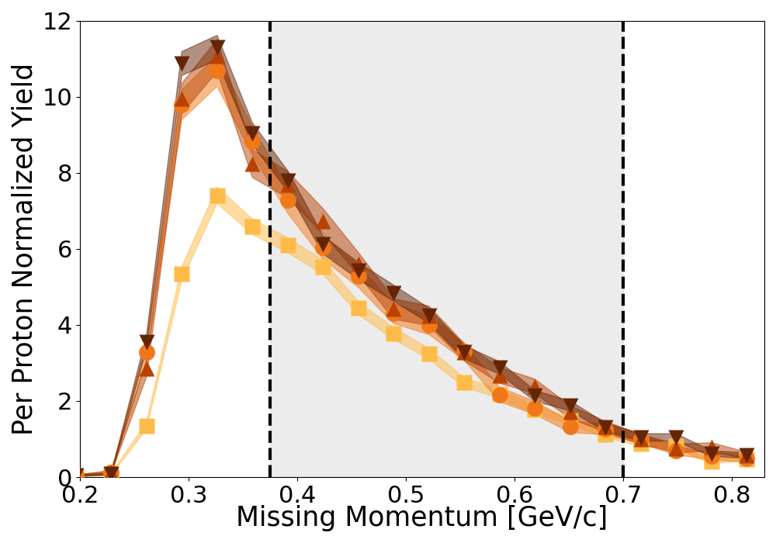
Other nuclei …
Ratios to C
C
Be

Slide 28
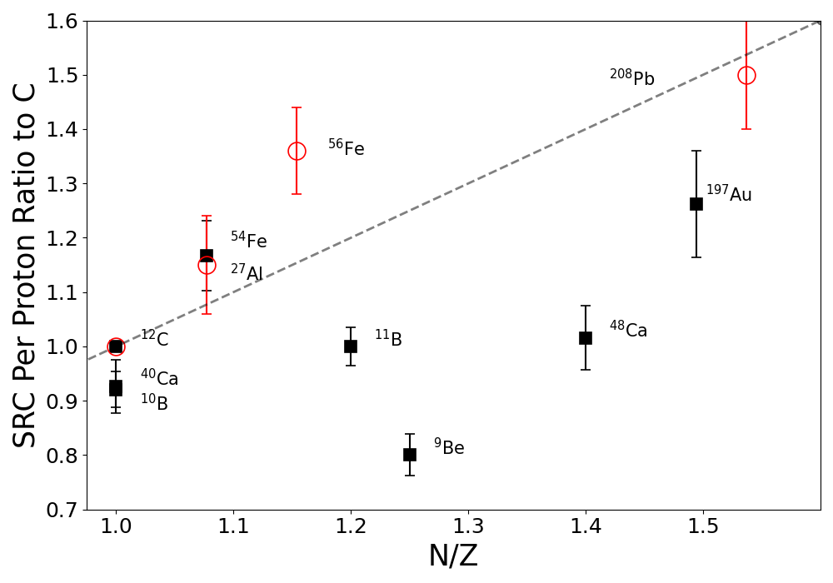
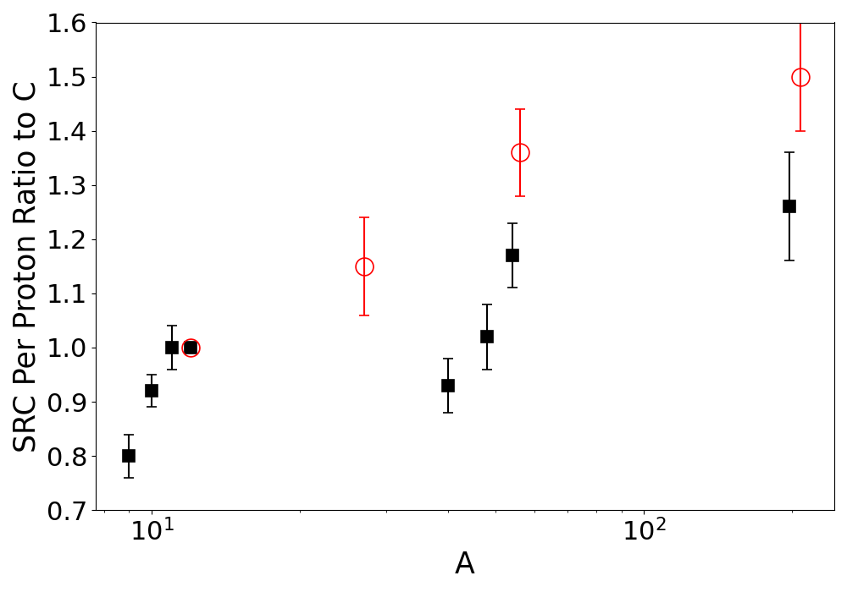
N/Z or A dependence?
Duer et al
SRC relative probability
SRC relative probability
Nguyen, Yero, Szumila-Vance, … submitted to PRL

Slide 29
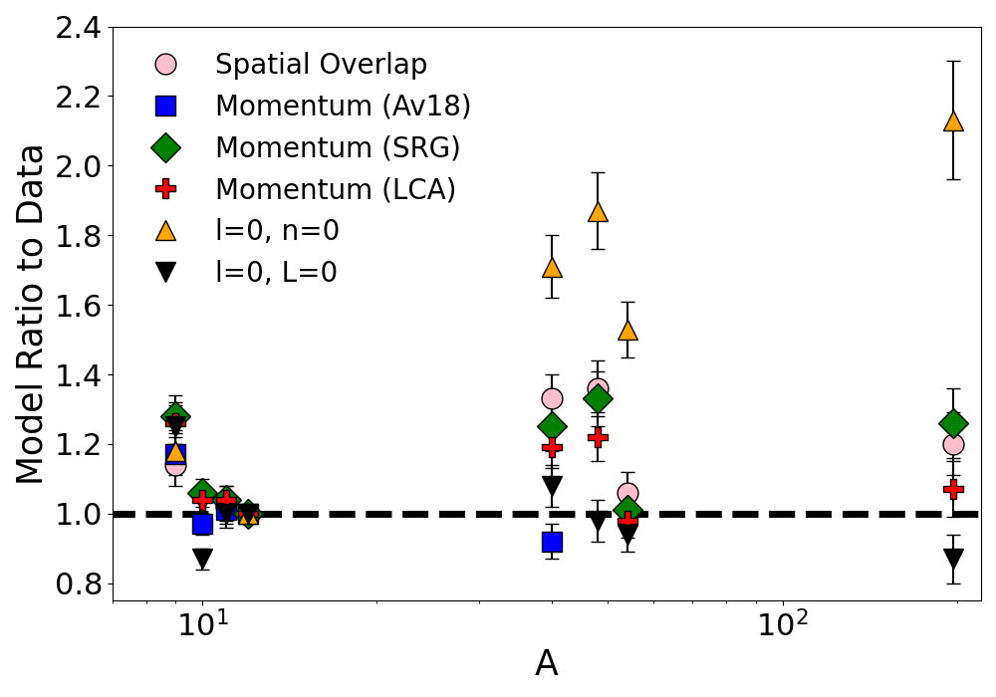
Theory to data ratios

Slide 30
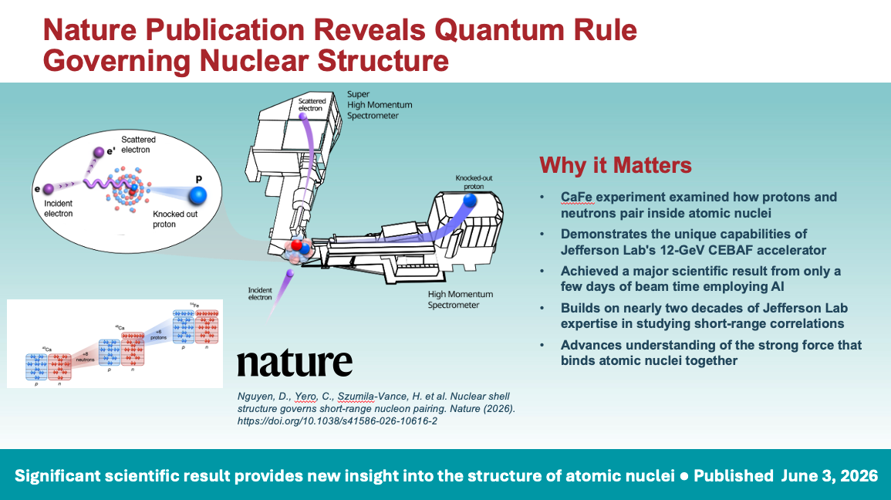
Jens Dilling, JLUO talk 2026

Slide 31
Summary
Formation of Short-Range high-momentum Correlated NN pairs is a long-range low-momentum phenomenon
Strong dependence on shell structure
  f-f pairing stronger than f-core pairing
Weak dependence on A
More data coming from CLAS12 measurements of (e,e’pp) and (e,e’pn)
SRC relative probability

