Slide 1
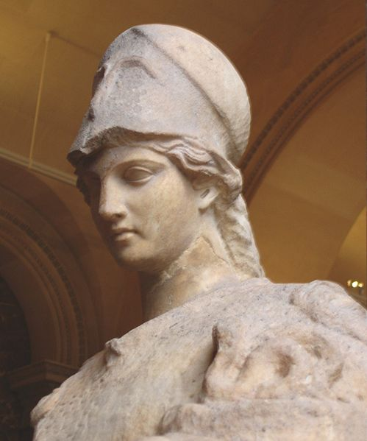
Near Threshold Electroproduction of at 11 GeV
Z.-E. Meziani
on behalf of the spokespeople
Kawtar Hafidi (ANL), Xin Qian (Caltech) , Nikos Sparveris (Temple) and
Zhiwen Zhao (UVa)
for
the ATHENNA Collaboration

Slide 2
ATHENNA Collaboration
J. Arrington, N. Baltzell, A. El Alaoui, D. F. Geesaman, K. Hafidi (Co-spokesperson), R. J. Holt, D. H. Potterveld, P. E. Reimer (Argonne National Laboratory, Argonne, IL)
X. Qian (Co-spokesperson) (California Institute of Technology, Pasadena, CA)
K. Aniol (California State University, Los Angeles, CA)
J. C. Cornejo, W. Deconinck, V. Gray (College of William & Mary, Williamburg, VA)
X. Z. Bai, H. X. He, S. Y. Hu, S. Y. Jian, X. M. Li, C. Shan, H. H. Xia, J. Yuan, J. Zhou, S. Zhou (China Institute of Atomic Energy, Beijing, P. R. China)
P. H. Chu, H. Gao, M. Huang, S. Jawalkar, G. Laskaris, M. Meziane, C. Peng, Q. J. Ye, Y. Zhang, X. F. Yan (Duke University, Durham, NC)
P. Markowitz (Florida International University, Miami, FL)
A. Afanasev (The George Washington University, Washington, DC)
F. J. Jiang, H. J. Lu, X. H. Yan (Huangshan University, Huangshan, P. R. China)
J. B. Liu, W. B. Yan, Y. Zhou, Y. X. Zhao (University of Science and Technology of China, Hefei, P. R. China)
K. Allada, A. Camsonne, J.-P. Chen, E. Chudakov, J. Gomez, M. Jones, J. J. Lerose, B. Michaels, S. Nanda, P. Solvignon, Y. Qiang (Jefferson Lab, Newport News, VA)
M. Mihovilovič, S. Širca (Jožef Stefan Institute of University of Ljubljana, Slovenia)
G. G. Petratos, A. T. Katramatou (Kent State University, Kent, OH)
Y. Cao, B.T. Hu, W. Luo, M. Z. Sun, Y.W. Zhang, Y. Zhang (Lanzhou University, Lanzhou, P. R. China)
T. Holmstrom (Longwood University, Farmville, VA)
J. Huang, X. Jiang (Los Alamos National Laboratory, Los Alamos, NM)
J. Dunne, D. Dutta, A. Narayan, L. Ndukum, M. Shabestari, A. Subedi, L. Ye (Mississippi State University, Mississippi State, MS)
E. Cisbani, A. d. Dotto, S. Frullani, F. Garibaldi (INFN-Roma and gruppo collegato Sanitá and Italian National Institute of Health, Rome, Italy)
M. Capogni (INFN-Roma and gruppo collegato Sanitá and ENEA Casaccia, Rome, Italy)
V. Bellini, A. Giusa, F. Mammoliti, G. Russo, M. L. Sperduto, C. M. Sutera (INFN-Sezione di Catania, Catania, Italy)
D. Y. Chen, X. R. Chen, J. He, R. Wang, H. R. Yang, P. M. Zhang (Institute of Modern Physics, Lanzhou, P. R. China)
C. E. Hyde (Old Dominion University, Hampton, VA)
L. El Fassi, R. Gilman (Rutgers University, Piscataway, NJ)
S. Choi, H. Kang, H. Kang, Y. Oh (Seoul National University, Seoul, Korea)
P. Souder and R. Holmes (Syracuse University, Syracuse, NY)
W. Armstrong, A. Blomberg, D. Flay, E. Fuchey, M. Paolone, N. Sparveris (Co-spokesperson), Z.-E. Meziani (Co-spokesperson/Contact), M. Posik, E. Schulte (Temple University, Philadelphia, PA)
K. Kumar, J. Mammei, S. Riordan (University of Massachusetts, Amherst, MA)
T. Badman, S. K. Phillips, K. Slifer, R. Zielinski (University of New Hampshire, Durham, NH)
H. Badhdasaryan, G. D. Cates, M. Dalton, D. Day, D. Keller, V. V. Nelyubin, K. Paschke, A. Tobias, Z. W. Zhao (Co-spokesperson), X. Zheng (University of Virginia, Charlottesville, VA)
F. R. Wesselmann (Xavier University of Louisiana, New Orleans, LA)

Slide 3
Outline
Physics Motivation
Proposed Measurement
Experimental Setup
Backgrounds and Projected Results
Beam Request

Slide 4
Physics Motivation
This proposal is about exploring and understanding some aspects of the strong regime of QCD
Probes strong gluonic interaction between two color neutral objects and the nucleon
Uses to probe color fields in the nucleon (minimal quark exchange)
Tests the production mechanism of in a nucleon
Probes the conformal anomaly of low energy interaction
A unique opportunity by exploring the threshold region and taking advantage of the high luminosity of CEBAF and the new energy reach namely 11 GeV

Slide 5
Statements from experts in the field!
“Low-energy J/psi-N interaction is a probe of the scalar gluon form factor of the nucleon. This quantity is of fundamental importance since it is related to conformal anomaly of QCD and to the origin of the nucleon's mass”.
Dima Kharzeev (Stony Brook)
“I am very enthusiastic about the physics of J/psi production at JLab” refer to:http://www-public.slac.stanford.edu/sciDoc/docMeta.aspx?slacPubNumber=SLAC-PUB-14985
Stan Brodsky (SLAC, Stanford)

Slide 6
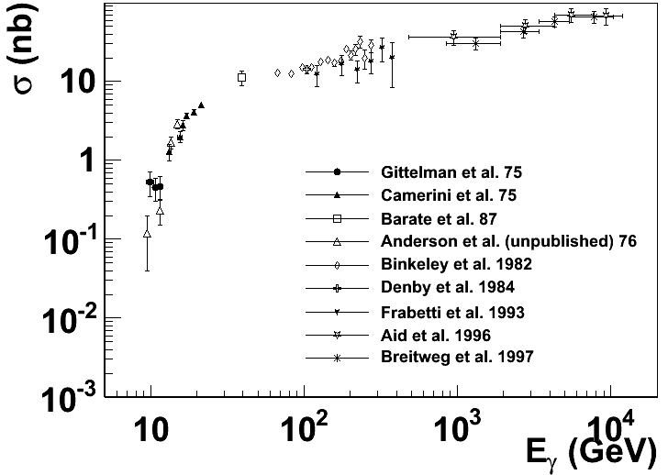
Experimental status
More data exist with inelastic scattering on nuclei, such as A-dependence.
Not included are the most recent results from HERA
H1/ZEUS at large momen-tum transfers and diffractive production with electro-production
SLAC, Cornell, Fermilab, HERA …
The physics focus is this threshold region

Slide 7
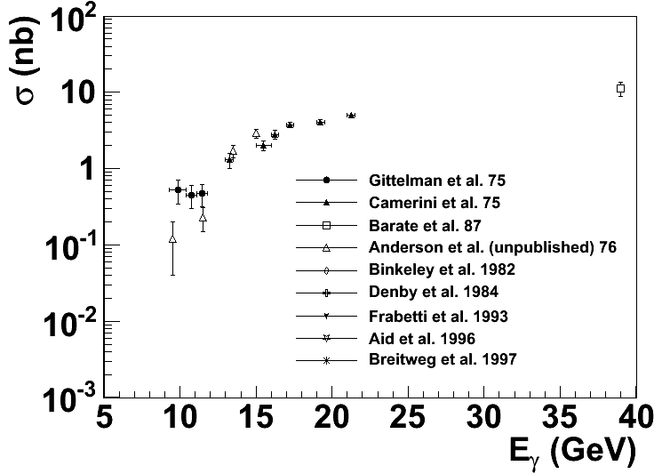
Near Threshold
Enhancement ?
?
Intense experimental effort (SLAC, Cornell … ) shortly after the discovery of J/ψ
But near threshold not much since (36 years till now)

Slide 8
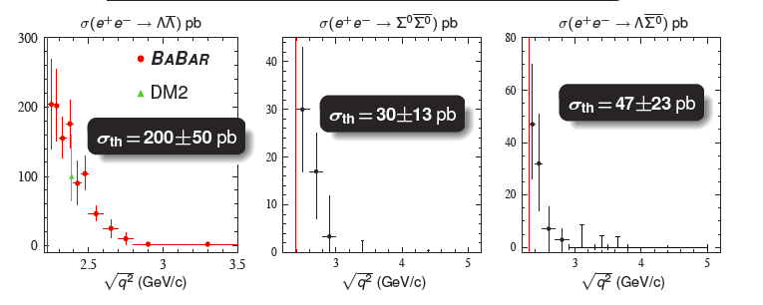
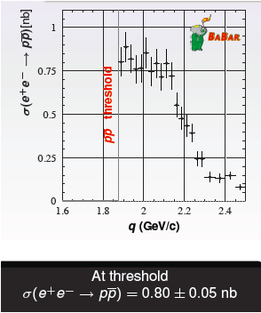
Threshold Enhancement is not rare!
Summary of NPCFiQCD Workshop
http://quarks.temple.edu/~npcfiqcd

Slide 9
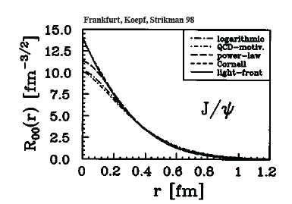
J/ψ as probe of the strong color fields in the nucleon!
J/ψ is a charm-anti-charm system
Little (if not zero) common valence quark between J/ψ and nucleon
Quark exchange interactions are strongly suppressed
Charm quark is heavy
Typical size of J/ψ is 0.2-0.3 fm

Slide 10
Interaction between J/ψ-N
New scale provided by the charm quark mass and size of the J/ψ
OPE, Phenomenology, Lattice QCD …
High Energy region: Pomeron picture …
Medium/Low Energy: 2-gluon exchange
Very low energy: QCD color Van der Waals force
Prediction of J/ψ-Nuclei bound state
Brodsky et al. ….
Experimentally no free J/ψ are available
Challenging to produce close to threshold!
Photo/electro-production of J/ψ at JLab is an opportunity

Slide 11
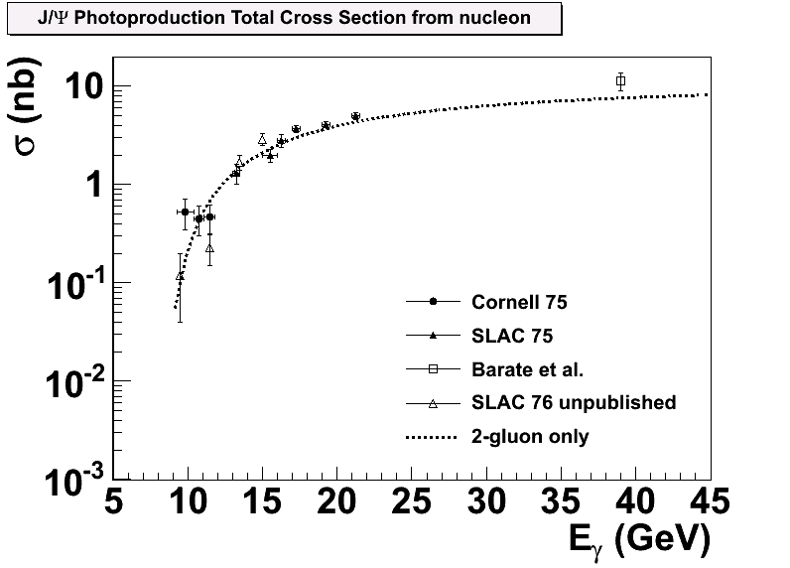
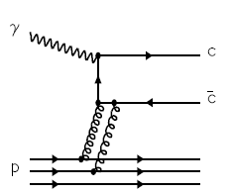
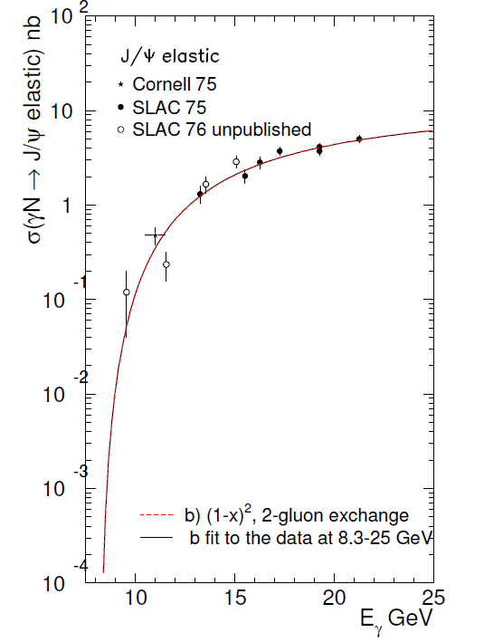
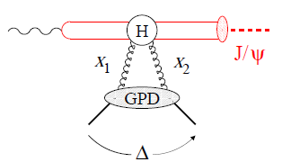
Reaction Mechanism ?
Models-I: Hard scattering mechanism (Brodsky, Chudakov, Hoyer, Laget 2001)
?
Models -II: Partonic soft mechanism (Frankfurt and Strikman, PRD 66, 031502 [2002])
2-gluon Form Factor
Notes:
Slides, Slides, cartoon behavior plots,
Emphasize Luminosity/quality of CEBAF + capability of SoLID
F. F. form factor (see like)

Slide 12
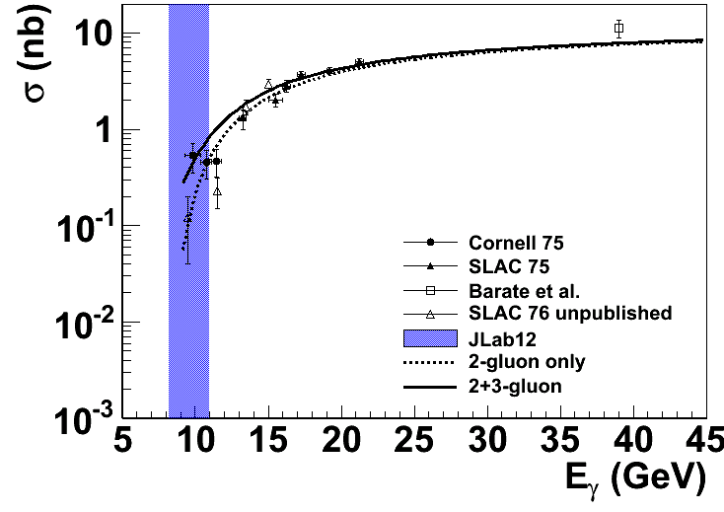
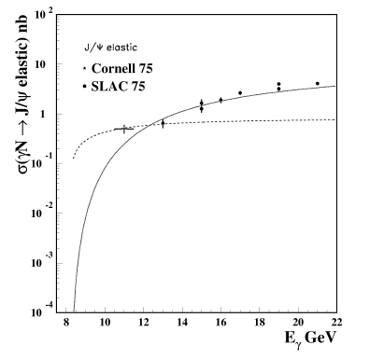
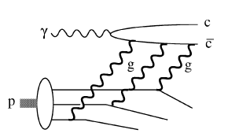
Reaction Mechanism
Models (I): Hard scattering
(Brodsky, Chudakov, Hoyer, Laget 2001)
Add in 3-gluon scattering
?

Slide 13
Conformal (Trace) Anomaly
Trace of energy momentum tensor
“Beta” function energy evolution of strong
interaction coupling constant
Decomposition of Proton mass [X. Ji PRL 74 1071 (1995)]
CM frame
Trace Anomaly
Gluon Energy
Quark Energy
Quark Mass

Slide 14
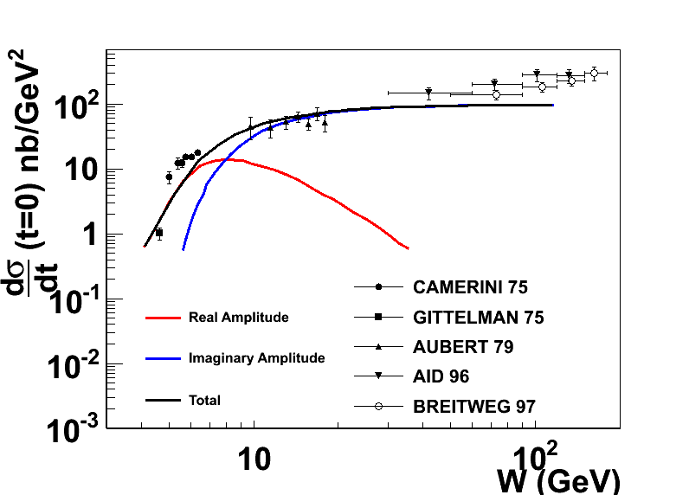
Another view: Reaction mechanism with FSI?
D. Kharzeev. Quarkonium interactions in QCD, 1995
D. Kharzeev, H. Satz, A. Syamtomov, and G. Zinovjev, Eur.Phys.J., C9:459–462, 1999
Imaginary part is related to the total cross section through optical theorem
Real part contains the conformal (trace) anomaly
Dominate the near threshold region
A measurement near threshold could shed light on the conformal anomaly
Notes:
Add the reference of the figure.

Slide 15
We propose to
Measure the t dependence and energy dependence of J/ψ cross sections near threshold.
Probe the nucleon strong fields in a non-perturbative region
Search for a possible enhancement of the cross section close to threshold
Shed some light on the conformal/trace anomaly
Establish a baseline for J/ψ production in the JLab energy range!
Bonuses:
Decay angular distribution of J/ψ
Interference with Bethe-Heitler term (real vs. imaginary)
Future Plans:
Search for J/ψ-Nuclei bound state
J/ψ medium modification

Slide 16
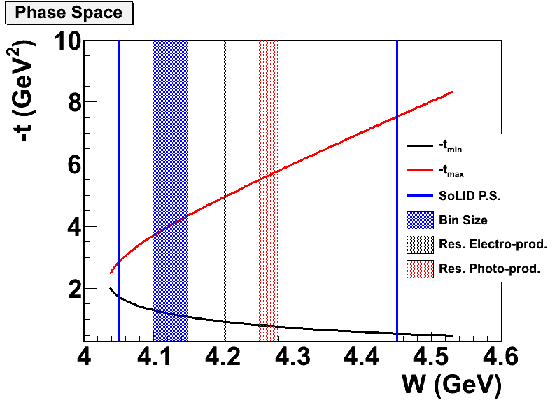
Electroproduction vs Photoproduction
Better resolution near threshold
use of a tagged photon beam
Larger coverage in t
Lower radiation budget
Less background (full exclusivity)
Near threshold

Slide 17
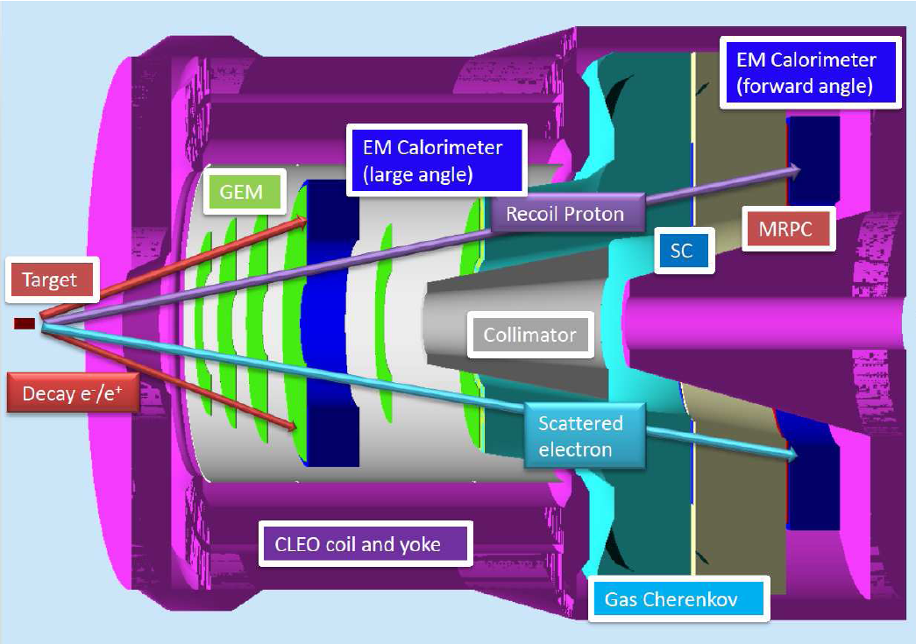
SoLID - Setup
Symmetric acceptance for e⁺ and e⁻

Slide 18
Experimental Overview
50 days of 3 beam on a 15 cm long LH₂ target at
10 more days include calibration/background run
SoLID design overall compatible with SIDIS with some changes
+10 cm of the radius of the first three GEM planes
Move large angle detector upstream by 12 cm
Opening angle at 26 degrees achieved by moving the front yoke forward
Main Trigger: Triple coincidence of e⁻e⁻e⁺
Additional trigger double coincidence (e⁺e⁻)

Slide 19
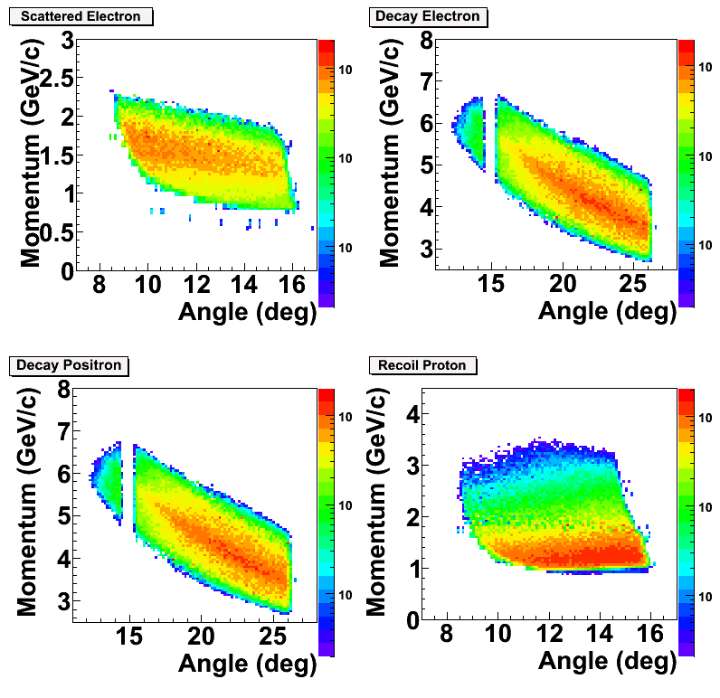
PID and Acceptance
Scattered electron:
Gas Č + Calorimeter @ forward angle
Decay electron/Positron:
Calorimeter only at large angle
Gas Č + Calorimeter at forward angle
Recoil proton:
100 ps TOF: 2 ns separation between p/K @ 2 GeV/c
~ 8m flight path
Main trigger rate is below 1 kHz with 50 ns coincidence window. Comparing to ~50 kHz design trigger rate for SIDIS.

Slide 20
Rates Estimates
Used equivalent photon approximation
is the virtual photon flux and is the Jacobian
Cross section is based on fits to data at high W within the 2-gluon exchange model

Slide 21
Event Counts @ 1x10³⁷ in 50 days
4-fold coincidence:
2g-only: 0.68 k events
2g + 3g: 2.9 k events
3-fold no proton:
2g-only: 2.1 k events
2g + 3g: 8.08 k events
 | Time (Hour) | Time (Day)
LH2 at 11 GeV | 1200 | 50
Dedicated Al dummy run | 72 | 3
Optics and detector check out | 72 | 3
Special low luminosity | 96 | 4
Total | 1440 | 60
3-fold
4-fold

Slide 22
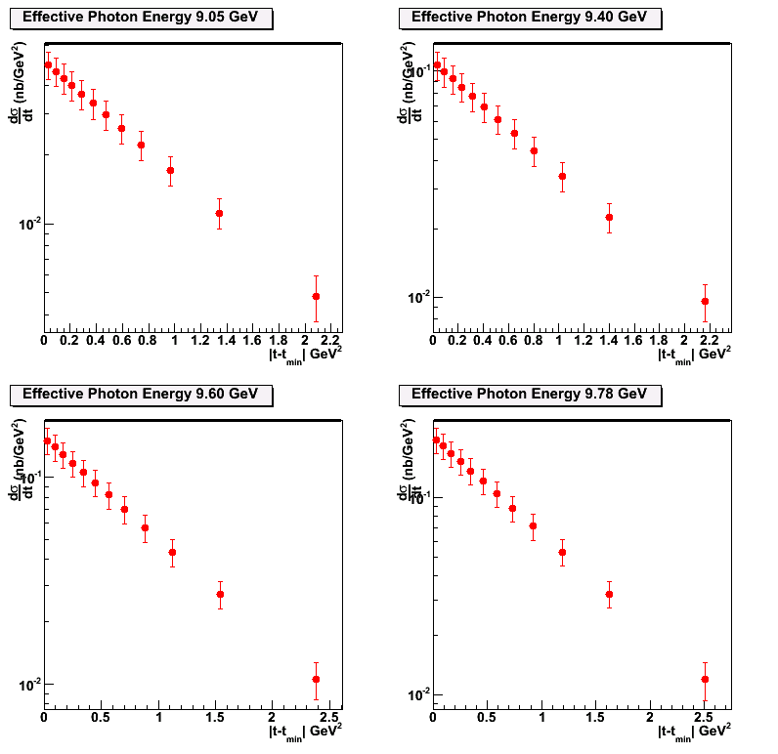
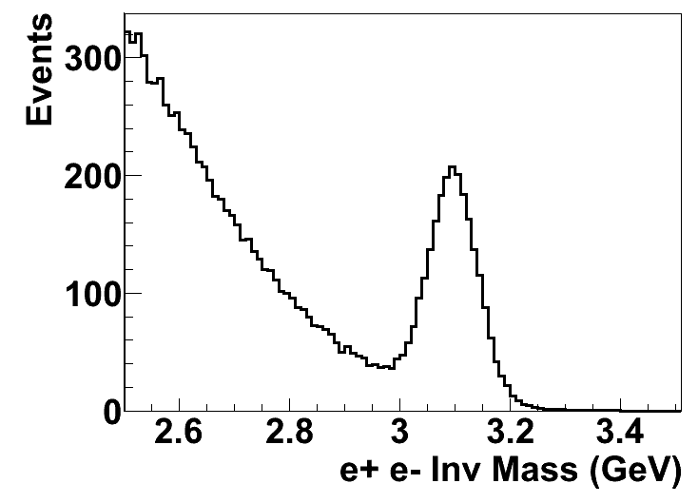
Projections of with 2-g model
Data will be first binned in t at different W (or effective photon energy) to study the t-dependence of the differential cross section
9.05 GeV
9.40 GeV
50 Days
9.60 GeV
9.78 GeV

Slide 23
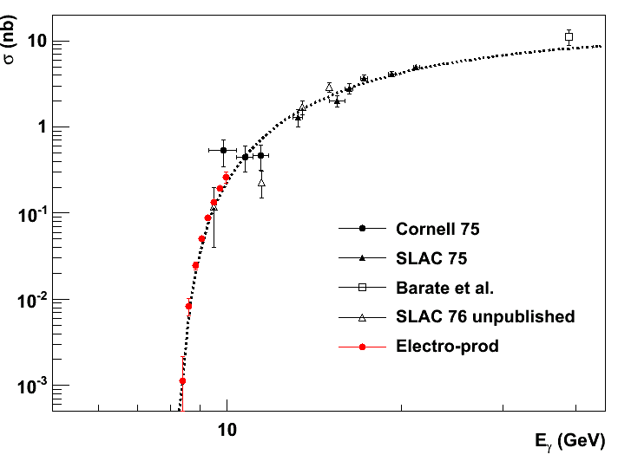
Projection of Total Cross Section
With < 0.01 GeV energy resolution in W and 8 energy bins in W to
study the threshold behavior of cross section.

Slide 24
Bonus: photoproduction

Slide 25
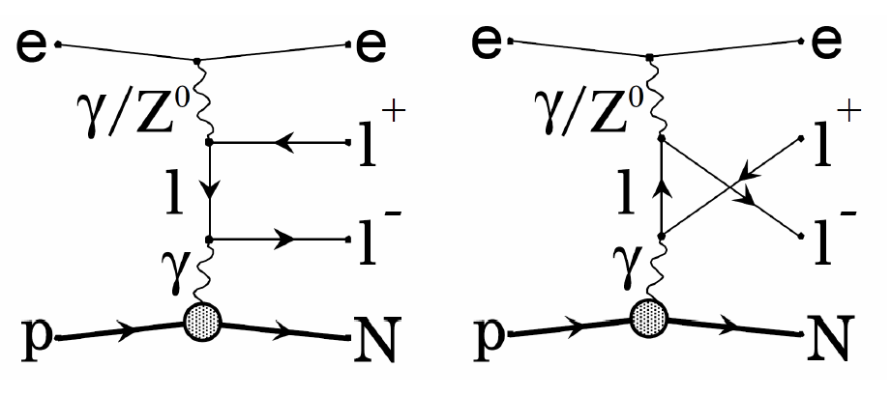
Physics Background
Due to large mass of J/ψ and near-threshold kinematics, little physics background
The main background is Bethe-Heitler term
B-H process calculated with GRAPE-Dilepton program. Compared with 2-gluon model assuming no threshold enhancement.
The t-dependence background level is acceptable.

Slide 26
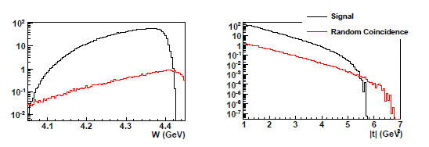
Random Coincidence Background
Studied with Pythia and can be subtracted.
Largest contribution coming from J/ψ photoproduction in random coincidence with a scattered electron.
With the same 2-gluon model, we calculated the random coincidence rate after all cuts and a 6 ns window.
Do not expect a problem either from physics (B-H) or random coincidence background!

Slide 27
Cross Section Validation
 | Bethe-Heitler | ω | ρ | φ | η
Cross Section | 0.1 ub | 1ub | 1ub | 50 nb | 10 ub
Decay Channel and BR | e⁺e⁻ 1.0 | e⁺e⁻ 7.30 10⁻⁵ | e⁺e⁻ 4.71 10⁻⁵ | e⁺e⁻ 2.97 10⁻⁴ | γγ 0.39
Compared to J/ψ | >10 | x2 | x1 | x0.5 | Large
SoLID capability | good | good | good | good | good
e+p elastic channel: (2.2 and 4.4 GeV beam)
SoLID Optics Calibration Channel for electrons
SIDIS charged pion (also DIS)
SIDIS program, comparing with Hall C measurements

Slide 28
Systematic Budget
Acceptance Effect: 10% for triple coincidence
Detector and Trigger Efficiency <2%
Target Luminosity: <2%
Contribution from Al wall <1%
Dummy run + target vertex Cut
Background Contamination ~0.5%
B-H background + Random Coincidence (measured directly)
Goal: 10-15% cross section measurements

Slide 29
Beam request
We request 50 days of beam on target to measure the electroproduction and bonus photoproduction of J/Psi at threshold
We request 10 days for Al dummy run, Optics and special low luminosity run
In total we request
50 + 10 days
 | Time (Hour) | Time (Day)
LH2 at 11 GeV | 1200 | 50
Dedicated Al dummy run | 72 | 3
Optics and detector check out | 72 | 3
Special low luminosity | 96 | 4
Total | 1440 | 60

