Slide 1
HPS
CLAS
CLAS12
Hall B Report
Volker D. Burkert
Jefferson Lab
Meeting of the JLab PAC39 June 18-22, 2012

Slide 2
Goals for 2012
Continue publishing high impact results
Complete the N* program on neutrons with polarized HD target
Electron test run with HDIce-IBC
Parasitic tests for HPS experiment (-> PAC presentation by HPS team)
Begin de-installation of CLAS in preparation for CLAS12
Offline software review for CLAS12

Slide 3
Physics publications since PAC38 (ref. Journals)
Collaboration publications
Evidence for the onset of color transparency in ρ⁰ electroproduction in nuclei, El Fassi et al., PLB 712 (2012) 326
Measurement of the neutron F₂^{n} structure function in spectator tagging, N. Baille et al., PRL 108 (2012) 199902
Measurement of generalized form factors near threshold in γp->nπ⁺ at high Q², K. Park et al., PRC 85 (2012) 035208
Branching Ratio of the Electromagnetic Decay of the Σ⁺(1385), D. Keller et al., PRD 85 (2012) 059903
Upper limits for the photoproduction of the Φ⁻⁻(1860) off the deuteron, H. Egiyan et al., PRC 85 (2012) 015205
Measurement of the nuclear mutiplicity ratio for K⁰_{s} hadronization in CLAS, A. Daniel et al., PLB 706 (2011) 26
Beam spin asymmetries in semi-inclusive π⁰ production, M. Aghasyan, et al., PLB 704 (2011) 397-402
Collaboration papers submitted for publications
Exclusive π⁰ electroproduction str. funct. and their relationship to Transversity GPDs, I. Bedlinsky et al. (PRL)
Deep exclusive π⁺ electroproduction off the proton at CLAS, K. Park et al., arXiv:1206.2326 (PRC)
A study of P₁₁(1440) and D₁₃(1520) resonances in ep->epπ⁺π⁻, V. Mokeev et al., arXiv:1205.3948 (PRC)
Comparison forward/backward pp pair knockout in 3He(e,e’pp)n, H. Baghdasaryan et al., arXiv:1202.5317 (PRC)
Review
Electroexcitation of nucleon resonances, I. Aznauryan and V. Burkert, Prog. Part. Nucl. Phys. 67 (2012) 1-54

Slide 4
N* photoproduction program ✔-published, ✔-acquired
 | σ | Σ | T | P | E | F | G | H | T_{x} | T_{z} | L_{x} | L_{z} | O_{x} | O_{z} | C_{x} | C_{z}
pπ⁰ | ✔ | ✓ | ✓ |  | ✓ | ✓ | ✓ | ✓
nπ⁺ | ✔ | ✓ | ✓ |  | ✓ | ✓ | ✓ | ✓
pη | ✔ | ✓ | ✓ |  | ✓ | ✓ | ✓ | ✓
pη’ | ✔ | ✓ | ✓ |  | ✓ | ✓ | ✓ | ✓
pω/φ | ✔ | ✓ | ✓ |  | ✓ | ✓ | ✓ | ✓
K⁺Λ | ✔ | ✓ | ✓ | ✔ | ✓ | ✓ | ✓ | ✓ | ✓ | ✓ | ✓ | ✓ | ✓ | ✓ | ✔ | ✔
K⁺Σ⁰ | ✔ | ✓ | ✓ | ✔ | ✓ | ✓ | ✓ | ✓ | ✓ | ✓ | ✓ | ✓ | ✓ | ✓ | ✔ | ✔
K^{0*}Σ⁺ | ✔ | ✓ |  |  |  |  |  |  |  |  | ✓ | ✓
pπ⁻ | ✔ | ✓ |  |  | ✓ | ✓ | ✓
pρ⁻ | ✓ | ✓ |  |  | ✓ | ✓ | ✓
K⁻Σ⁺ | ✓ | ✓ |  |  | ✓ | ✓ | ✓
K⁰Λ | ✓ | ✓ |  | ✓ | ✓ | ✓ | ✓ |  |  |  | ✓ | ✓ | ✓ | ✓ | ✓ | ✓
K⁰Σ⁰ | ✓ | ✓ |  | ✓ | ✓ | ✓ | ✓ |  |  |  | ✓ | ✓ | ✓ | ✓ | ✓ | ✓
K^{0*}Σ⁰ | ✓ | ✓
Proton targets
Neutron targets

Slide 5
CLAS results γp→K⁺Λ → K⁺pπ⁻
Bonn-Gatchina Coupled Channel Analysis, A.V. Anisovich et al, EPJ A48, 15 (2012)
(Includes nearly all new photoproduction data)
M. Mc Cracken et al. (CLAS), Phys. Rev. C 81, 025201, 2010

Slide 6
CLAS results γp→K⁺Λ → K⁺pπ⁻
Bonn-Gatchina Coupled Channel Analysis, A.V. Anisovich et al, EPJ A48, 15 (2012)
(Includes nearly all new photoproduction data)
M. Mc Cracken et al. (CLAS), Phys. Rev. C 81, 025201, 2010
D. Bradford et al. (CLAS), Phys.Rev. C75, 035205, 2007

Slide 7
Evidence for new N* states and couplings
State N((mass)J^{P} | PDG 2010 | PDG 2012 | KΛ | KΣ | Nγ
N(1710)1/2⁺ | *** (not seen in GW analysis) | *** | *** | ** | ***
N(1880)1/2⁺ |  | ** | ** | * | **
N(1895)1/2⁻ |  | ** | ** | * | ***
N(1900)3/2⁺ | ** | *** | *** | ** | ***
N(1875)3/2⁻ |  | *** | *** | ** | ***
N(2150)3/2⁻ |  | ** | ** |  | **
N(2000)5/2⁺ | * | *** | ** | * | **
N(2060)5/2⁻ |  | *** |  | ** | ***
Bonn-Gatchina Analysis – A.V. Anisovich et al., EPJ A48, 15 (2012)
(First coupled-channel analysis that includes nearly all new photoproduction data)

Slide 8
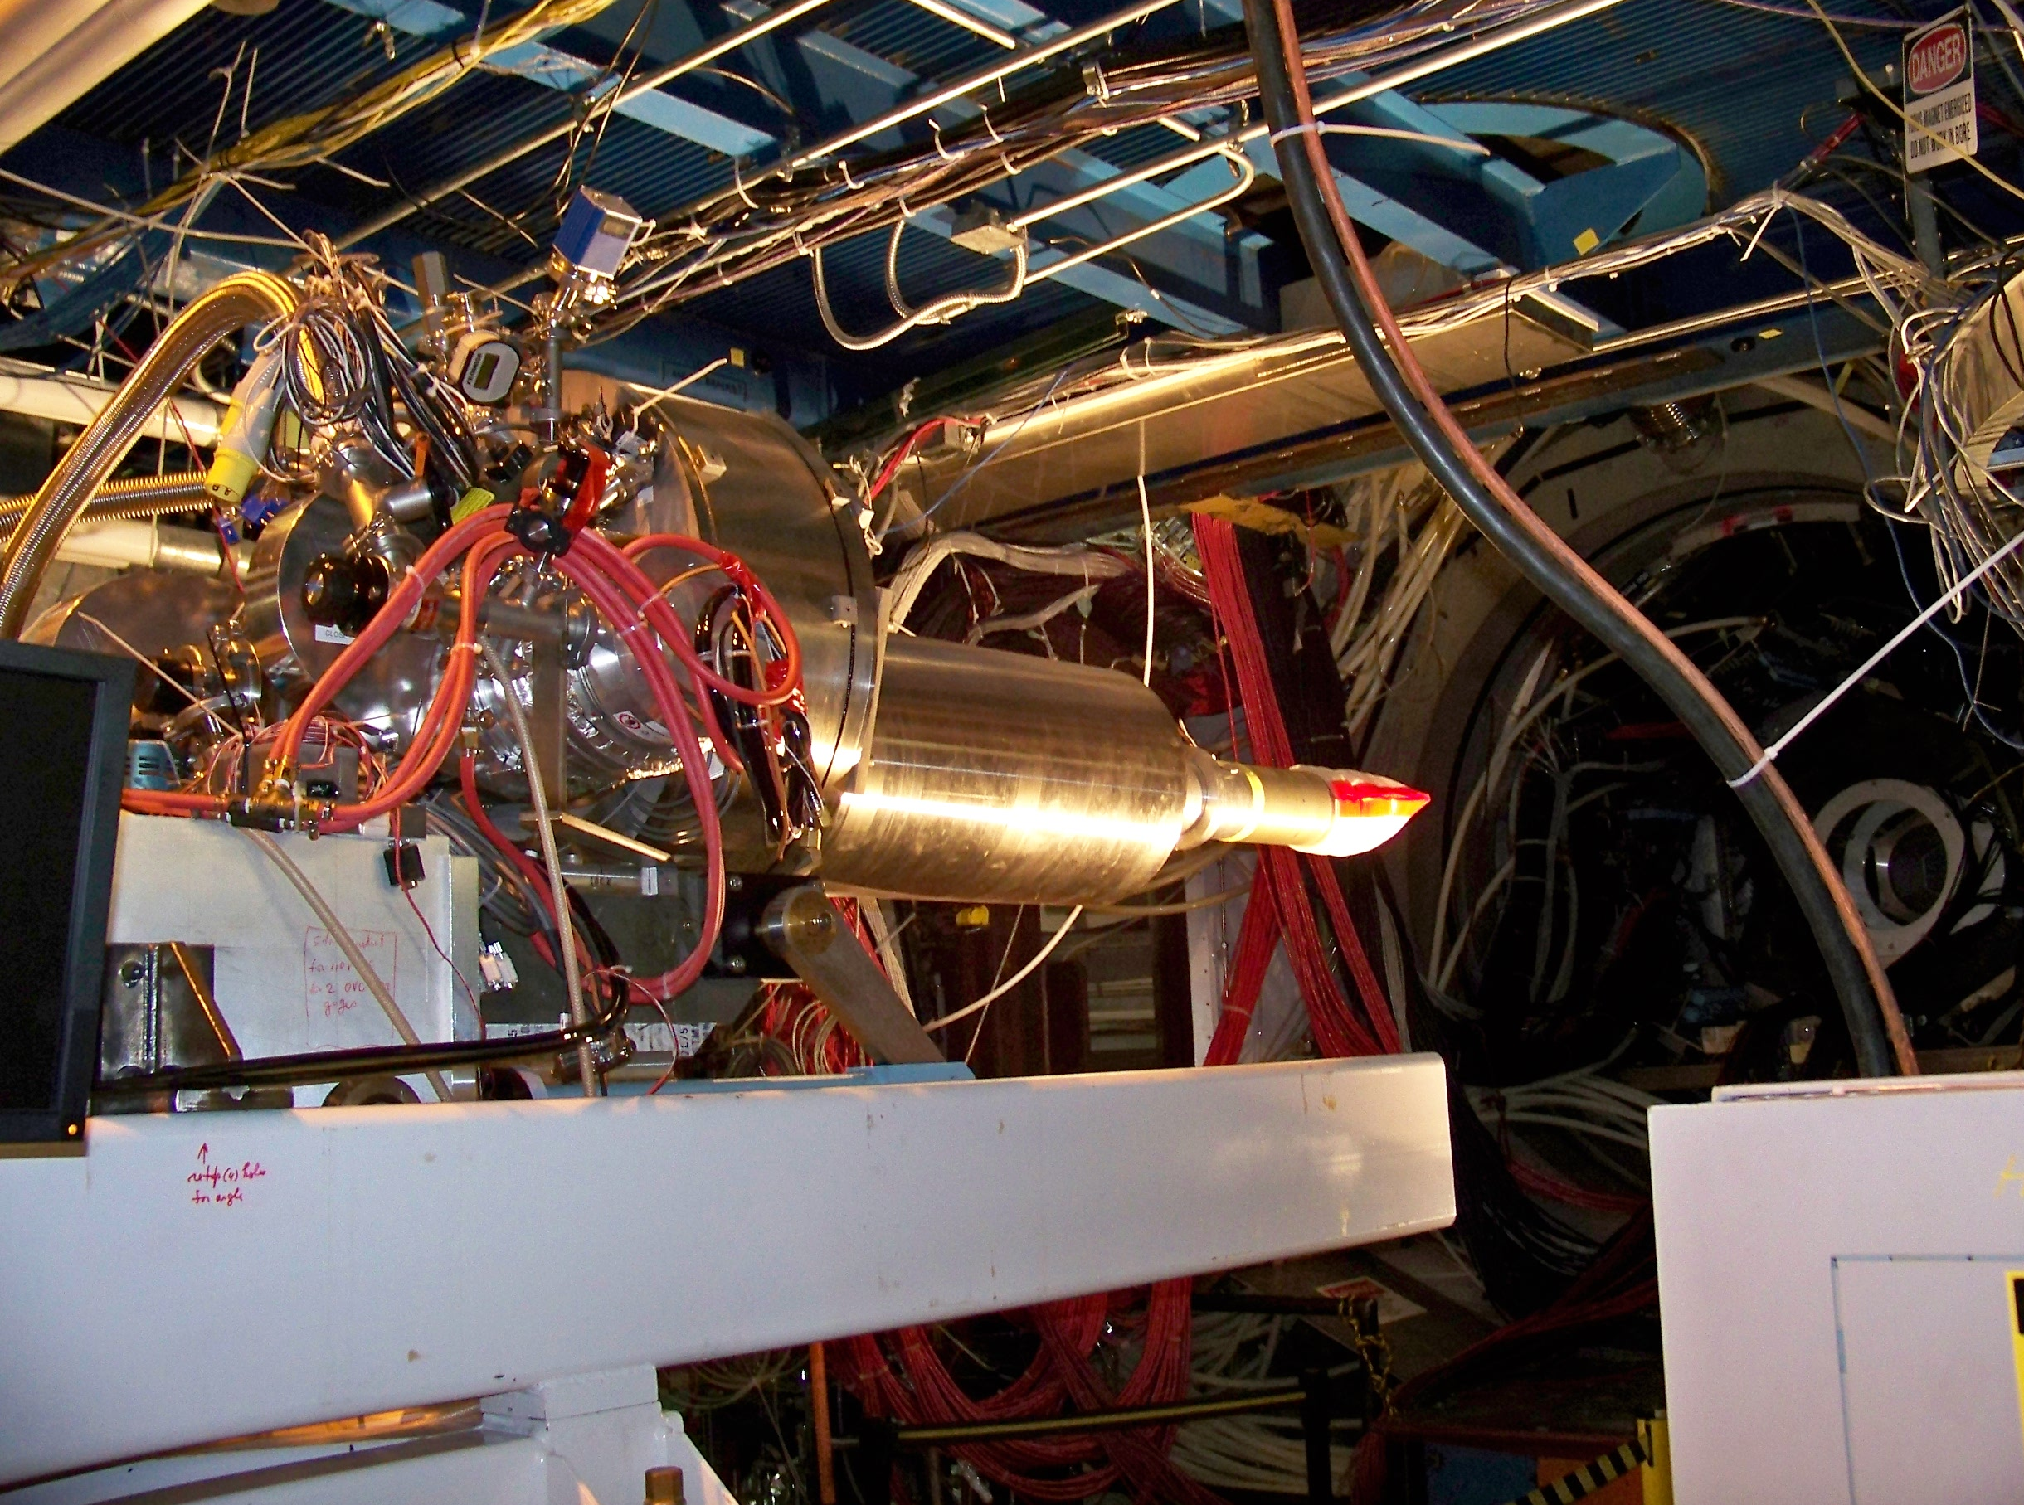
HDice operations during g14 / E06-101
• HD targets condensed, polarized
and aged to the Frozen-Spin state
in HDice Lab.
• transferred as solid, polarized HD
between cryostats; moved to Hall B
• In-Beam Cryostat (IBC) operates in
Hall at 50 mK, 0.9 tesla
• g14 ran from Nov/11 to May/12
with 15mm Ø ×50mm long HD cells
• γ-beam lifetimes ~ years with 10⁸ γ/s
• HD targets used for electron beam test in Feb/12 and Mar/12
➔ H polarization does not appear to suffer radiation damage with 1 nA; D does
➔ heat removal needs improvement – faster beam raster, larger diameter cell,
shorter cooling wires.

Slide 9
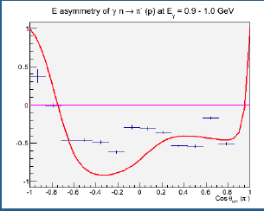
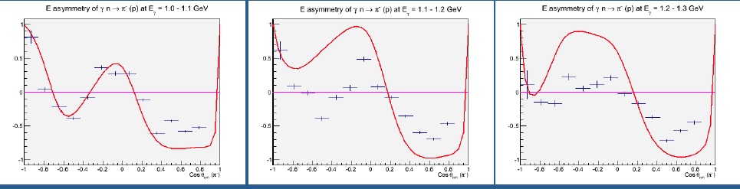
Double asymmetry E^{n} on neutron
Sample bins
W=1.635 GeV
W=1.690 GeV
γn π⁻p
“online” analysis
not to be quoted!
projections from SAID
W=1.745 GeV
W=1.800 GeV

Slide 10
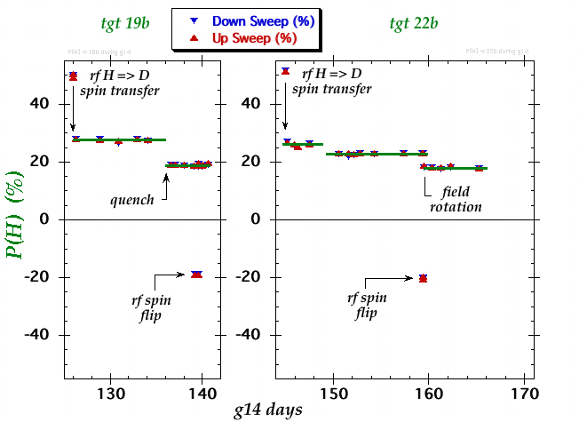
HD polarization during g14/E06-101
➔

Slide 11
Hall B experiments – run groups (6/18/2012)
Proposal | Physics | Contact | Rating | Days | Group | New equipment | Energy | Run Group | Target
E12-06-108 | Hard exclusive electro-production of π⁰, η | Stoler | B | 80 | 119 + 30 | RICH (1 sector) Forward tagger | 11 | A F. Sabatié | liquid H₂
E12-06-112 | Proton’s quark dynamics in SIDIS pion production | Avakian | A | 60
E12-06-119 | Deeply Virtual Compton Scattering | Sabatie | A | 80
E12-09-103 | Excitation of nucleon resonances at high Q² | Gothe | B+ | 40
E12-11-005 | Hadron spectroscopy with forward tagger | Battaglieri | A- | 119
PR12-12-001 | Timelike Compton Scatt. & J/ψ production in e+e- | Nadel-Turonski |  | 130
PR12-12-007 | Exclusive φ meson electroproduction with CLAS12 | Stoler |  | 60
PR12-12-008 | Photoproduction of the very strangest baryon | Guo |  | 80
E12-07-104 | Neutron magnetic form factor | Gilfoyle | A- | 30 | 90 | Neutron detector RICH (1 sector) Forward tagger | 11 | B K. Hafidi | liquid D₂ target
PR12-11-109 (a) | Dihadron DIS production | Avakian
E12-09-007a | Study of partonic distributions in SIDIS kaon production | Hafidi | A- | 56
E12-09-008 | Boer-Mulders asymmetry in K SIDIS w/ H and D targets | Contalbrigo | A- | TBA
E12-11-003 | DVCS on neutron target | Niccolai | A | 90
E12-06-109 | Longitudinal Spin Structure of the Nucleon | Kuhn | A | 80 | 170 | Polarized target RICH (1 sector) Forward tagger | 11 | C S. Kuhn | NH₃ ND₃
E12-06- 119(b) | DVCS on longitudinally polarized proton target | Sabatie | A | 120
E12-07-107 | Spin-Orbit Correl. with Longitudinally polarized target | Avakian | A- | 103
PR12-11-109 (b) | Dihadron studies on long. polarized target | Avakian
E12-09-007(b) | Study of partonic distributions using SIDIS K production | Hafidi | A- | 110
E12-09-009 | Spin-Orbit correlations in K production w/ pol. targets | Avakian | B+ | 103
E12-06-106 | Color transparency in exclusive vector meson production | Hafidi | B+ | 60 | 60 |  | 11 | D | Nuclear
E12-06-117 | Quark propagation and hadron formation | Brooks | A- | 60 | 60 |  | 11 | E | Nuclear
E12-10-102 | Free Neutron structure at large x | Bueltman | A | 40 | 40 | Radial TPC | 11 | F | Gas D₂
TOTAL run time |  |  |  | 1501 | 539 (569)

Slide 12
Hall B new proposals (6/18/2012)
Proposal | Physics | Contact | Rating | Days | Group | Equipment | Energy | Group | Target
C12-11-111 | SIDIS on transverse polarized target | M. Contalbrigo | C2 | 110 | 110 | Transverse target | 11 | RG-G | HD
PR12-12-009 | Transversity w/ di-hadron on transvere target | H. Avakian |  | 110
PR12-12-010 | DVCS with transverse polarized target in CLAS12 | L. Elouadrhriri |  | 110
All transverse target proposals |  |  |  | 330 | 110
C12-11-006 | Heavy Photon Search at Jefferson Lab (HPS) | J. Jaros | C2 | 180 | 180 | New setup in alcove | 2.2, 6.6 | RG-H | Nuclear
C12-11-106 | High Precision Measurement of the Proton Charge Radius | A. Gasparian | C2 | 15 | 15 | Primex | 1.1, 2.2 | RG-I | H2 gas
TOTAL PAC39 beam time request |  |  |  | 525 | 305

Slide 13
Summary of Hall B experiments/proposals
Proposal approved & cond. approved | PAC proposal days | PAC group days
PAC38 beam time for approved RG A-F | 1231 | 539
New proposals for RG A | 270 | 30
New proposals for RG G | 330 | 110
All CLAS12 proposals | 1831 | 679
PAC39 beam time request for RG H | 180 | 180
PAC39 beam time request for RG I | 15 | 15
All non-CLAS12 proposal | 195 | 195
All Hall B proposals: All CLAS12 + all non-CLAS12 PAC38 time approved + PAC39 time requested | 2026 | 874
Years needed to run the program either as individual experiments or as run groups (55% efficiency, 35 weeks/year, multiplicity=3) | 20.0 years | 8.7 years

Slide 14
Selection of run group A for first physics
LH2 target enables measurement of detector and tracking efficiencies and acceptances
  compare to well known cross sections, e.g. elastic p(e,ep), exclusive p(e,e’p)π⁰, p(e,e’π⁺)n, inclusive p(e,e’)X, …
Provides detector calibration in momentum, angle, through tracking, particle id, missing masses, e.g. ep->ep(π⁰, η, ω), eπ⁺(n), epπ⁺(π⁻)
Serves multitude of high impact experiments
Groups well organized and ready for expedient analysis

Slide 15
Hall B scheduling - tentative
During first 5 years all approved + proposed experiments would get part (or all) of approved time
Run Group | Days | 2015 | 2016 | 2017 | 2018 | 2019 | 2020 | 2021 | 2022 | 2023 | 2024
Total | 869
RG-A (proton) | 149
RG-B (deut.) | 90
RG-C (NH₃) | 120
RG-C-b (ND₃) | 50
RG-F (BoNuS) | 40
RG-E (Hadr.) | 60
RG-D (CT) | 60
RG-G (TT) | 110
RG-H (HPS) | 180
RG-I (ProRad) | 10
6/15
Assumption: Acceptable beam in use = 55% of scheduled time.

Slide 16
Expected 1st Papers from early run
Proposal | Physics | 1st conference paper | months (after run)
E12-06-119 | Deeply Virtual Compton Scattering | p(e,e’pγ), A_{LU}, GPD H | 4
E12-06-112 | Proton’s quark dynamics in SIDIS pion production | p(e,e’π⁺)X, A_{LU} | 4
E12-06-108 | Hard exclusive electro-production of π⁰, η | p(e,e’pπ⁰) A_{LU}, σ_{u}, σ_{LT}, σ_{TT}, σ_{e} | 9
E12-09-103 | Excitation of nucleon resonances at high Q² | p(e,e’π⁺)n, σ_{u}, σ_{LT}, σ_{TT}, σ_{e} | 12
E12-11-005 | Hadron spectroscopy with forward tagger | p(“γ”, π⁺π⁺π⁻)n, p(“γ”, Nπη) | 12
PR12-12-001 | Timelike Compton Scatt. & J/ψ production in e+e- | p(“γ”,pe⁺e⁻), yield | 6
PR12-12-007 | Exclusive φ meson electroproduction with CLAS12 | p(e,e’pφ), , σ_{u}, σ_{LT}, σ_{TT} | 12
PR12-12-008 | Photoproduction of the very strangest baryon | p(“γ”,Ξ, Ω), yield | 9

Slide 17
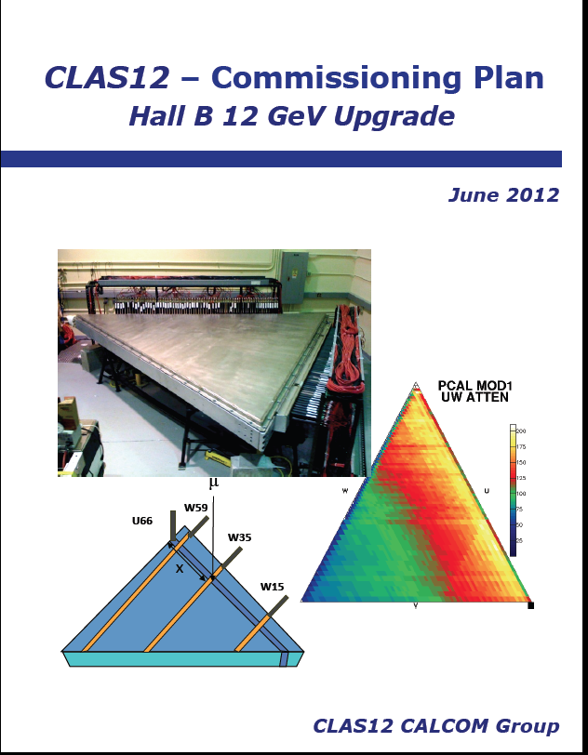
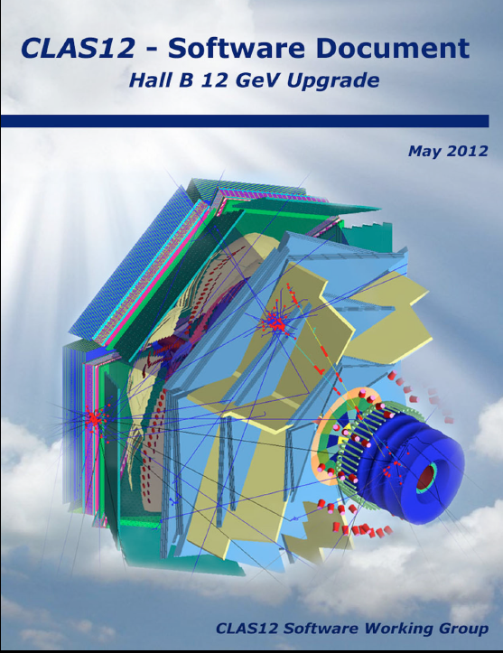
CLAS12 – CalCom & Software
https://www.jlab.org/conferences/12gevhbsr/

Slide 18
Concluding remarks
Hall B continues to produce high quality results covering a broad range of topics in hadronic/nuclear physics. Major recognition of the N* program in PDG 2012.
Completed a major run group (G14-HD) that measures KΛ photo production on polarized neutrons to access excited neutrons.
Major progress on the construction of the CLAS12 base equipment. Detector construction is >50% complete. Offline software reviewed, on track for series of planned “stress test” starting 10/2012 until 1/2014.
Additional user proposed detectors are entering the construction stage, RICH in prototyping stage undergoing beam tests at CERN.
Ran electron beam tests of HDIce cryostat. Conducted HPS tests parasitically to G14-HD.

Slide 19
Backup slides

Slide 20
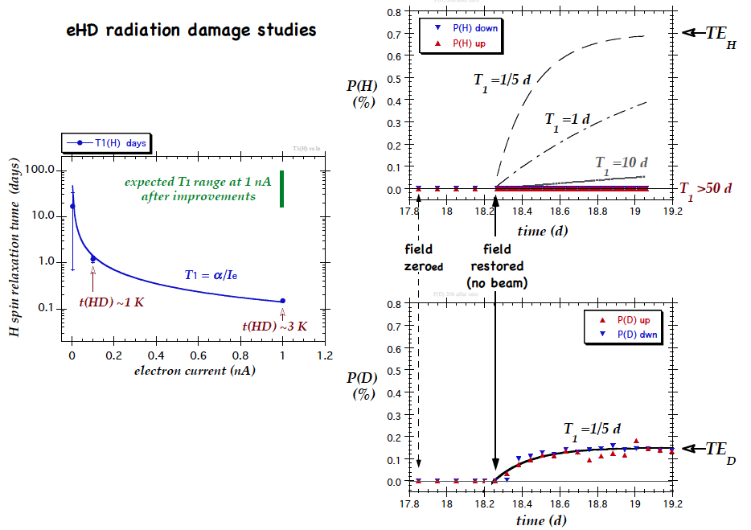
HD electron beam tests

Slide 21
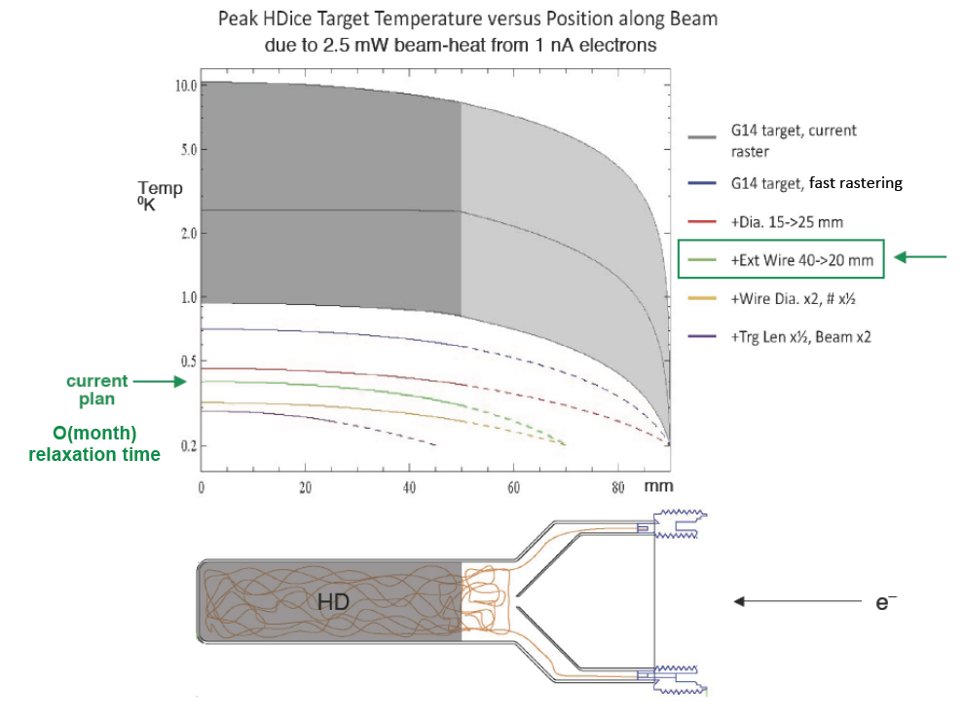
HD target improvements for e-beam

