Slide 1
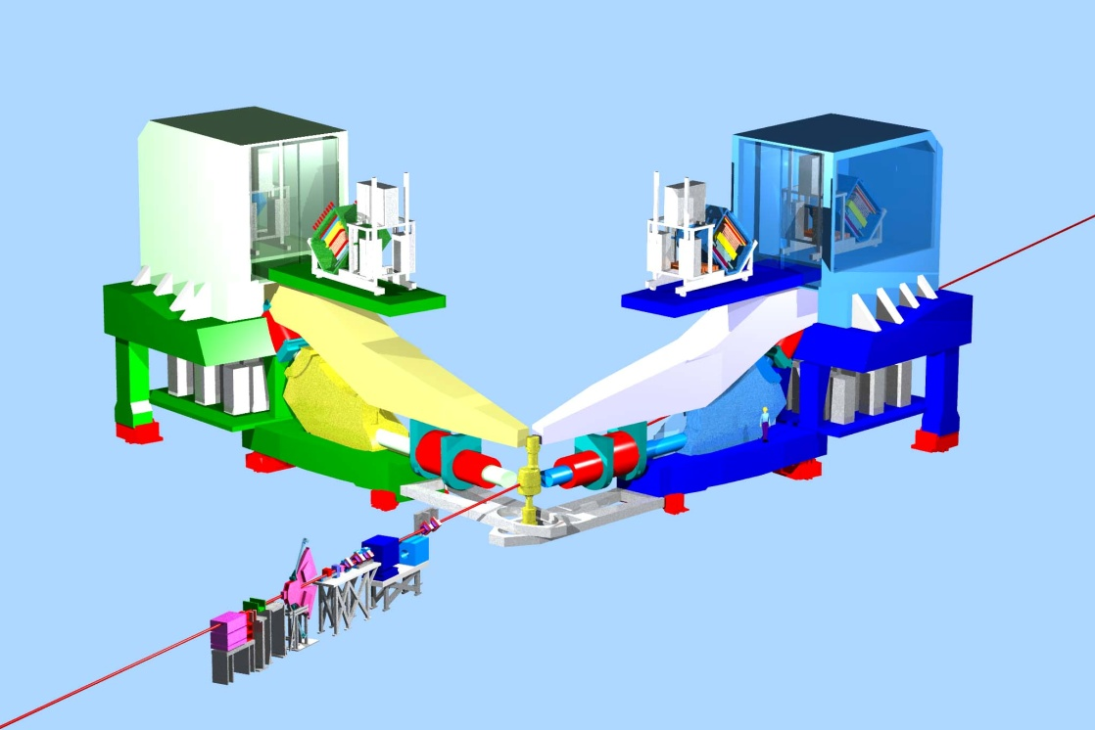
Hall A Status
and Early 12 GeV Running
Report to PAC39
Robert Michaels
Acting Hall A Leader
for 2 more weeks, and then: new Hall A Leader
Cynthia Keppel
starts July 1
Recent Activity
g2p / GEp
Future Physics Program
Schedule for Commissioning and Early 12 GeV
Thomas Jefferson National Accelerator Facility

Slide 2
Recent Activity in Hall A since PAC38
Aug 2011 - Oct 2011 Installation of g2p/GEp
Oct 2011 g2p /GEp polarized target: Failure of superconducting magnet
(shorts to ground)
Oct 13-14, 2011 Review of SuperBigbite Spectrometer (SBS) by DOE
favorable on science and technology,
needed work on project management, cost, schedule
Oct 2011 - Feb 2012 g2p/GEp target repairs went well.
Achieved 80% polarization at 5T.
Robust, long-lifetime target that is easier to service.
Mar 1 – May 18 Ran g2p/Gep. Collected 60% data,
but no “septum out” (higher Q²) points.
Apr 12 DOE approval of the SBS Project Management Plan
with glowing physics endorsement.
Proj. Mgt. Team: John LeRose, Bogdan Wojtsekhowski , Gordan Cates,
Kees deJager + Hall A Leader

Slide 3
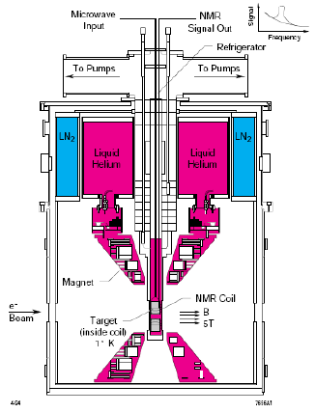
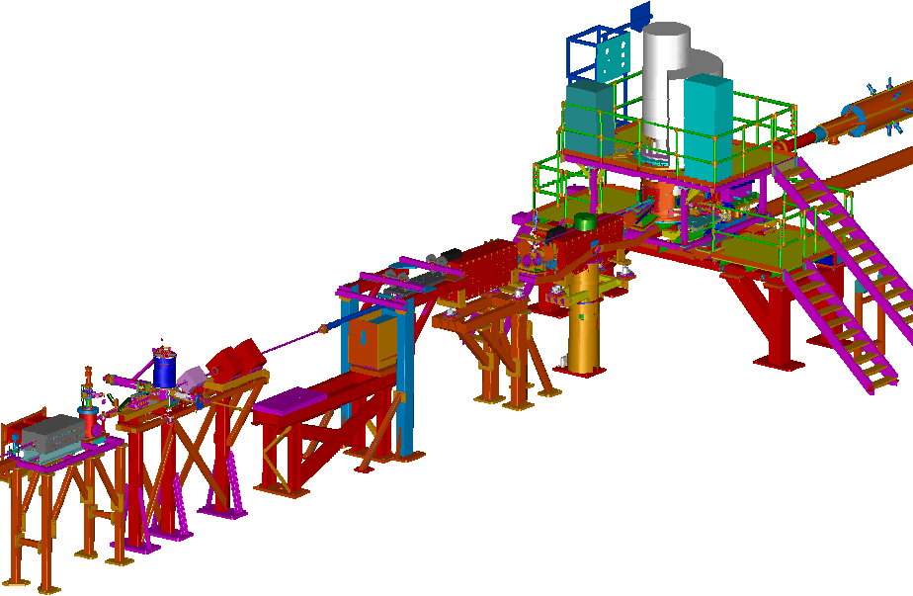
Low Q² g^{p}₂ and G^{E}_{p} Experiments (6 GeV)
Jian-Ping Chen
A. Camsonne
K. Slifer
D. Crabb
R. Gilman
G. Ron
D. Day
A. Sarty
J. Arrington
Uva/Jlab Polarized NH₃ Target
0.02 < Q² < 0.30 GeV²
Production Mar - May 2012
+ test run Dec 13 – 22, 2011
Overcame problems with target magnet, late beamline instrumentation, bracing of bellows, and septum failure
Modified Beamline in Hall A
^{Chicane Magnets}
^{Septum}
^{Low-current Monitors}
^{Local Beam dump}
Slow Raster

Slide 4
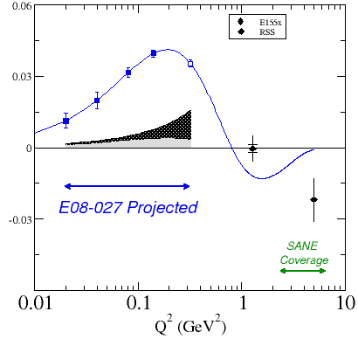
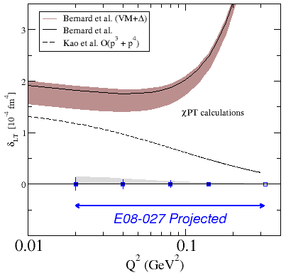
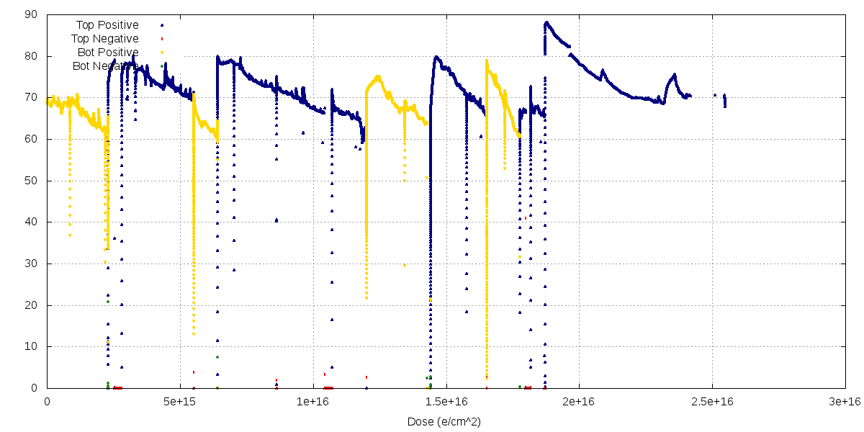
E08-027 : Proton g₂ Structure Function
Camsonne, Crabb, Chen, Slifer
Projected errors shown, not results of analysis.
data taken
not taken
not taken
BC Sum Rule
Spin Polarizability δ_{LT}
data taken
80 %
Target Polarization
vs beam dose

Slide 5
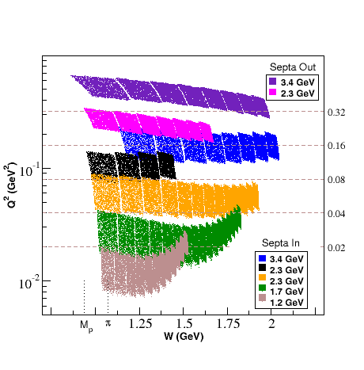
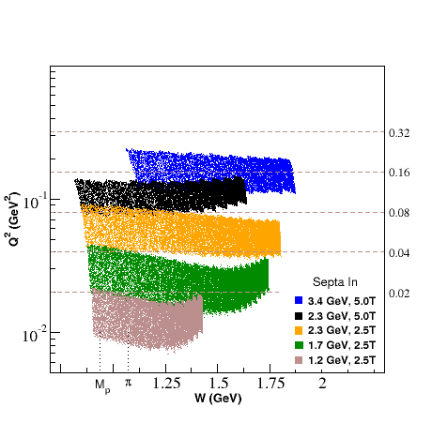
E08-027 : Proton g₂ Structure Function
Overall Data Collection
Planned
Achieved
No “septum out” running

Slide 6
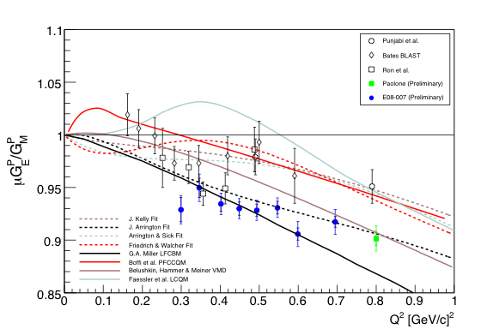
Experiment E08-007 - Part II
Higinbotham, Gilman, Ron, Day, Sarty, Arrington
Elastic H(e,e’p) experiment with electrons and polarized target
High statistical precision (<1%) beam-target asymmetry measurements
3 Q² data points: 0.015 ~ 0.06 (GeV/c)²
Part II
May-June 2012
Part I X. Zhan, (2011)
C

Slide 7
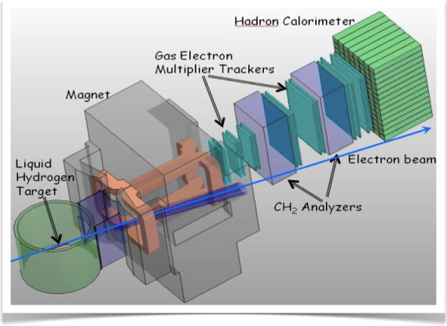
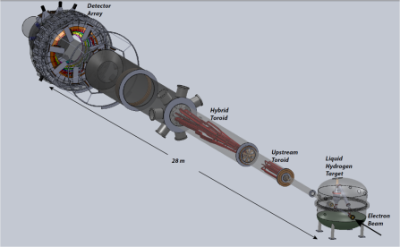
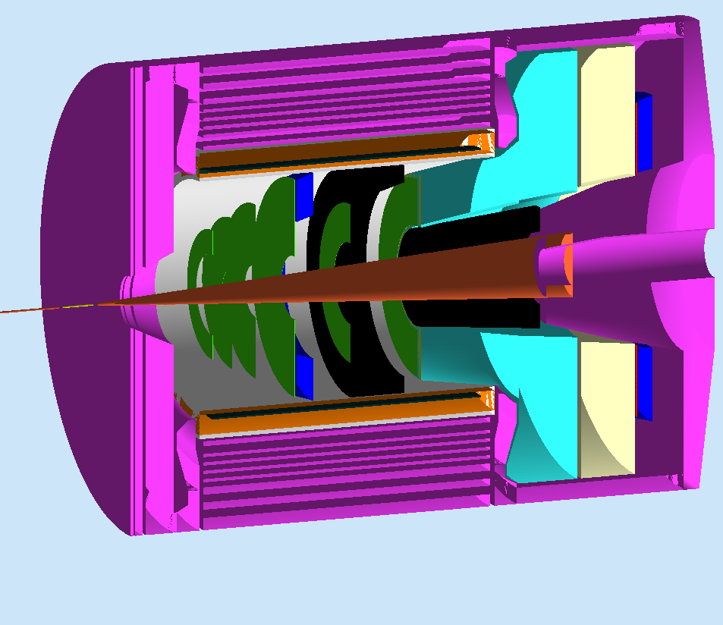
11 year view of Hall A
12 GeV Planning Committee
Ron Gilman (chair), Javier Gomez
Douglas Higinbotham, Charles Hyde
Nilanga Liyanage, Kent Paschke
SuperBigbite
SuperBigbite
MOLLER
g2p/GEp
16 mo. Shutdown
Early 12 GeV
Experiments
12 GeV Commissioning
MOLLER
-- Tritium --
Physics Beam to Hall A
SOLID
fiscal year
~Feb 2014
2011
2012
2013
2014
2015
2016
2017
2018
2019
2017
2021
2020
Thomas Jefferson National Accelerator Facility

Slide 8
Preliminary Plans for Early Beam in Hall A
Result of Hall A Collaboration planning process.
Further distillation is likely to be required.
E.g. G^{p}_{M} and DVCS require the least resources.
16 mo. Shutdown
12 GeV Commissioning
Early Experiments
APEX and/or PREX
A1n / DVCS
Dark Matter
Neutron Skin
Neutron Spin
Structure
Deeply Virtual Compton Scatt.
12 GeV Projects: 1. Moller polarimeter
2. Compton polarimeter
3. Energy Meas.Upgrade
SBS Experiments
EM Form Factors
at high Q²
SBS Project
SuperBigbite
11 GeV
Beam 1st to Hall A
FY 2013
FY 2014
FY 2015
FY 2016
FY 2017
Thomas Jefferson National Accelerator Facility
Robert Michaels, Hall A

Slide 9
Hall A Publications in 2012
H. Fonvielle, et.al. Virtual Compton Scattering and Generalized Polarizabilities of the Proton at
Q² = 0.92 and 1.76 GeV² arXiv:1205.3387 [nucl-ex]
S. Abrahamyan, et.al. Neutron Radius of 208Pb (PREX) PRL 108 (2012) 112502
C.J. Horowitz, et.al. Weak Charge Form Factor and Radius of 208Pb (PREX) PRC C85 (2012) 032501.
S. Ban et.al.. Parity Violating Electron Scattering Measurements of Neutron Densities J. Phys.
G39 014104 , 2012
N. Fomin et.al.. New measurements of high-momentum nucleons and short-range structures in nuclei PRL 108 (2012) 092502
Z. Ahmed et.al.. New Precision Limit on the Strange vector Form Factors of the Proton PRL 108 (2012) 102001
J. Huang, et.al. Beam-Target Double Spin Asymmetry A_LT in Charged Pion Production from Deep Inelastic Scattering on a Transversely Polarized He-3 Target at 1.4 < Q² <2.7 GeV². PRL 108 (2012) 052001
A.J.R. Puckett, et.al., Reanalysis of Proton Form Factor Ratio Data at Q² = 4.0, 4.8, and 5.6 GeV² PRC 85 (2012) 045203
M. Friend, et.al.. Upgraded photon detector with integrating readout NIM A676 (2012) 96

Slide 10
Hall A Publications in 2011
X. Qian, et.al., Single Spin Asymmetries in Charged Pion Production from Semi-Inclusive Deep Inelastic Scattering on a Transversely Polarized ³He Target. Phys.Rev.Lett.107:072003,2011
S. Abrahamyan, et.al. Search for new gauge boson in the A‘ Expt (APEX). Phys. Rev. Lett 107:191804, 2011
G. Ron et al. Low Q² measurements of the proton form factor ratio $mu_p G_E / G_M$. PRC 84 (2011) 055204
J. Arrington et al. Short-Range Nucleon-Nucleon Correlations arXiv:1104.1196 [nucl-ex]
L. B. Weinsten, et.al., Short Range Correlations and the EMC Effect Phys. Rev. Lett. 106: 052301, 2011
X. Zhan et al. Proton Elastic FF Ratio at low Q² Phys. Lett. B705 59 (2011)
M. Meziane et al. Effects Beyond Born in Pol. Transf. Obs. ep Elastic Phys. Rev. Lett 106. 132501, 2011
S. P. Malace, et.al. A precise extraction of the induced polarization in the ⁴He(e,e'p)³H reaction Phys.Rev.Lett.106:052501,2011
G.D. Cates, et.al., Flavor decomposition of elastic nucleon E&M form factors Phys.Rev.Lett.106:252003,2011
E. Fuchey, et.al., Exclusive Neutral Pion Electroproduction in the Deeply Virtual Regime Phys.Rev.C83:025201,2011
J. Glister, et.al. Polarization Obs in Deuteron Photodisintegration below 360 MeV Phys.Lett.B697:194-198,2011.

Slide 11
Expected Future Publications of Hall A
Transverse asymmetries from 4 nuclei (a byproduct of HAPPEX, PREX)
NIM article about PREX detector
PVDIS at 6 GeV, both a PRL and a longer archival article
NIM article about PVDIS DAQ
9Be(e, e'k+) from the hypernuclear collaboration .
E08-005: Transverse QE 3He(e,e'n)
E05-102: GEn (e,e')
E05-102: QE 3He(e,e'p) & 3He(e,e'd)
E05-015: Transverse QE (e,e')
E04-007: pi0
E07-006: Short Range Correlations 4He
E08-008: D(e,e'p) with Focal Plane Polarimeter
E08-009: 4He(e,e'p)
E08-010: H(e,e'p) N->Delta
E08-014: x>2 SRC with 48Ca & 40Ca
He-3(e,e'n) GEn – PRC paper with all four data points
GEn polarized He3 target – PRC or NIM paper
NIM paper about S1m s-shape counter
PRL on H(gamma,p+\pi^{^0})
Single Spin Asymmetry in DIS (E07-013)
SSA in inclusive hadron (Part of E06-010)
SSA in SIDIS production of K+- and proton (Part of E06-010)
Polarized 3He target for transversity (NIM)
E08-007: pol H(e,e') elastic – ran this Spring using polarized NH3 target
g2p experiment – ran this Spring using polarized NH3 target

Slide 12
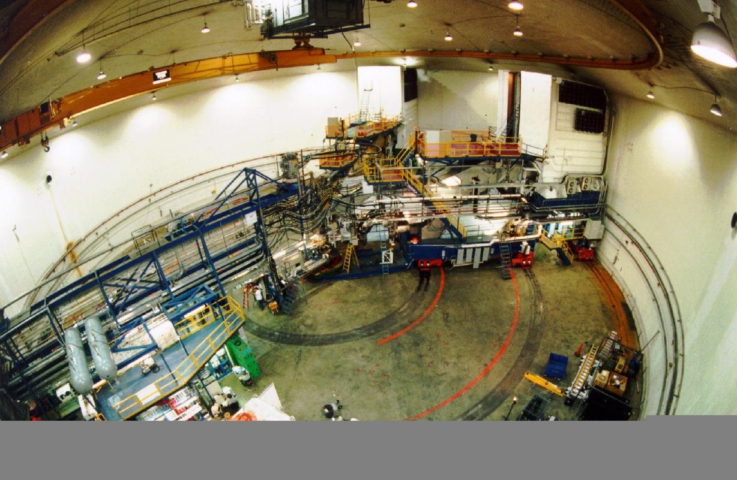
Summary : Hall A Status
Publications : ~10 per year last 2 years
expect another ~25 in next 2 years
g2p / GEp has been completed.
A “strawman” schedule for early 12 GeV has been presented
R. Michaels, PAC39
June 18, 2012

