Slide 1

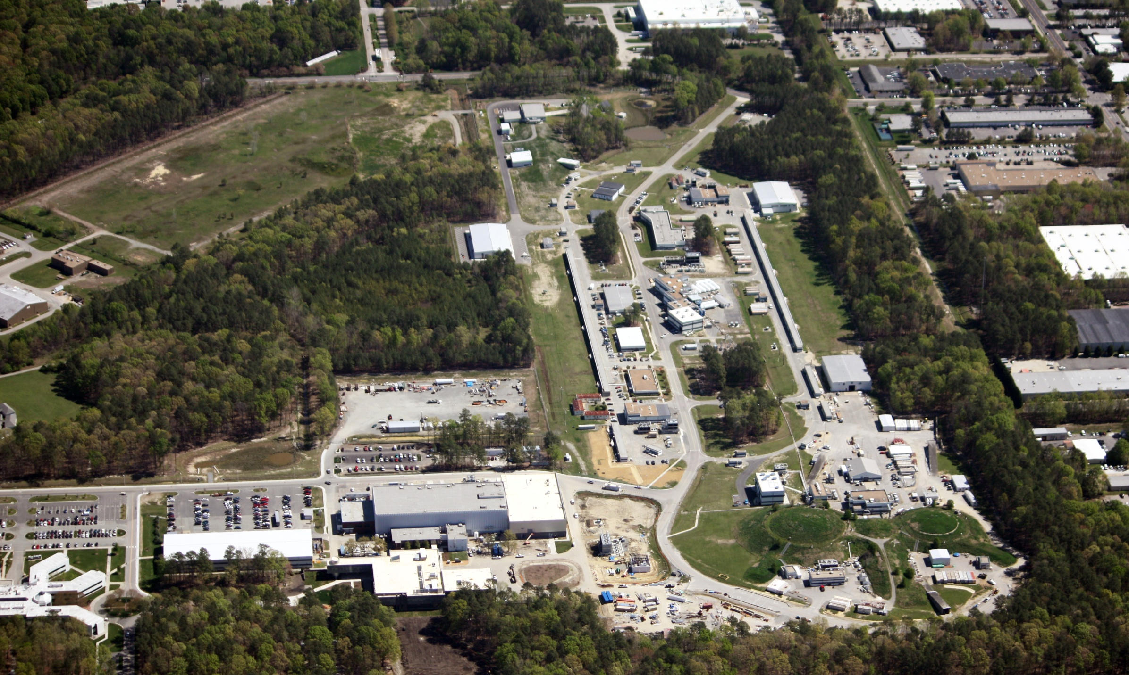
Jefferson Lab Director’s Comments
Hugh Montgomery
PAC 39
June 18, 2012

Slide 2
Jefferson Lab Organization
JSA Board of Directors
Chair
Diversity in
Leadership
Director
H. Montgomery
Deputy Director
Science & Tech
R. McKeown
Deputy Director
Operations and Chief Operating Officer
M. Dallas
Program Advisory Committee (PAC)
Human Resources
Internal Audit
Legal Counsel
Community Outreach, Science Education and Public Affairs
Experimental Physics
R. Ent
Theoretical & Computational Physics
M. Pennington
Free Electron
Laser
G. Neil
12 GeV Project Office
C. Rode
Chief Financial Officer & Business Srvs.
J. Scarcello
Environmental Safety, Health & Quality
M. Logue
Chief Information Officer/Chief
Technical Officer
R. Whitney
Facilities &
Logistics
J. Sprouse
Accelerator
A. Hutton
Engineering
W. Oren
Deputy:
P. Rossi
HALLS:
A: C. Keppel
B: V. Burkert
C: S. Wood
D: E. Chudakov
Deputy:
F. Pilat
Deputy:
D. Richards
Deputy:
G. Williams
Deputy:
A. Lung
APMs:
L. Harwood
R. Yasky
G. Young
Deputy:
L. Wells
Deputy:
R. May
Deputy:
C. Watson
Deputy:
T. Michalski

Slide 3
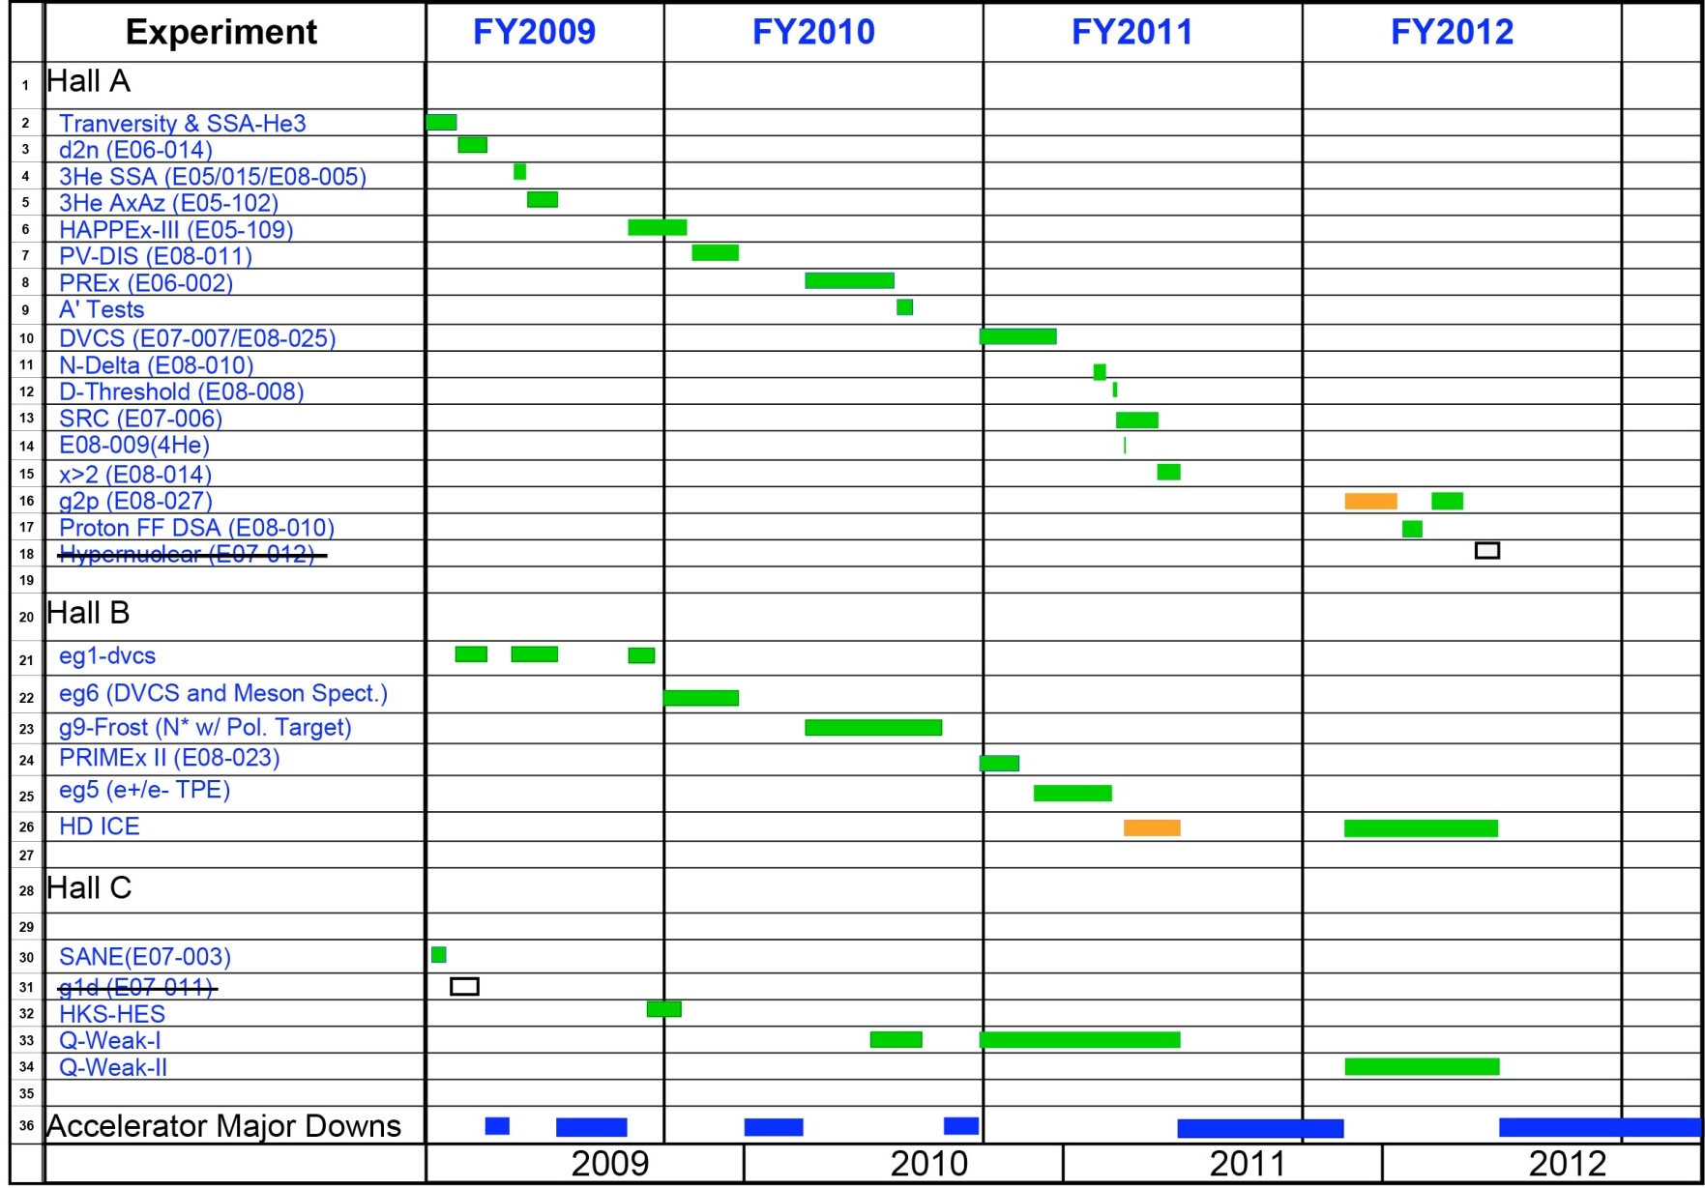
6 GeV Experimental Nuclear Physics Program (2009-12)
Successfully Completed!

Slide 4
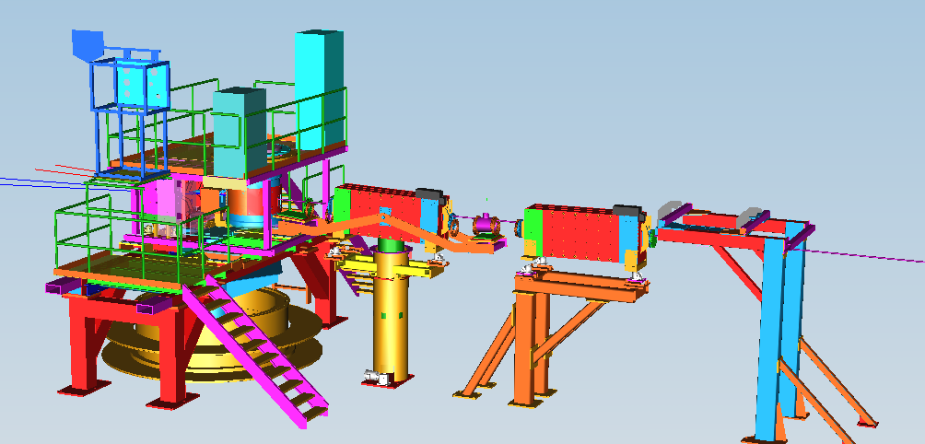
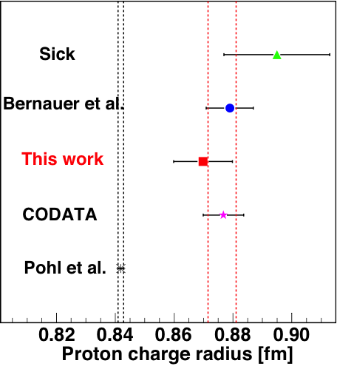
G2p/GEp: Major New Installation in Hall A
Strong Support from DOE/NP and User Contributions
Spin Polarizability : Major failure (>8σ) of χPT for neutron δ_{LT}. Need g₂ isospin separation to solve.
Hydrogen HyperFine Splitting : Lack of knowledge of g₂ at low Q² is one of the leading uncertainties.
Proton Charge Radius : one of the leading uncertainties in extraction of <R_{p}> from μ−H Lamb shift.
Septa
New Beam Diagnostics
(BPM,BCM,Harps,Tungsten Calo)
Chicane
Local Dump
Polarized Target
Major effort from JLab target group
to retrofit Hall B SC magnet after magnet failed

Slide 5
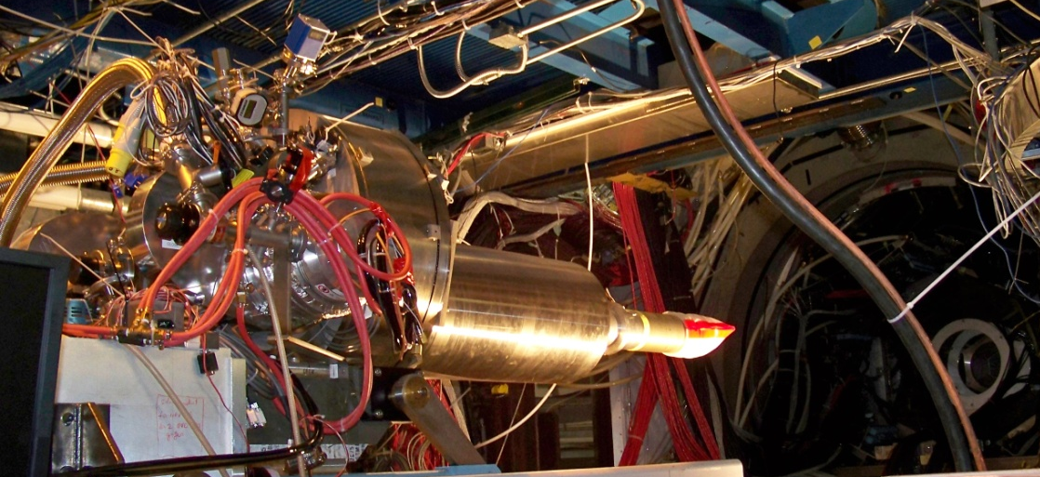
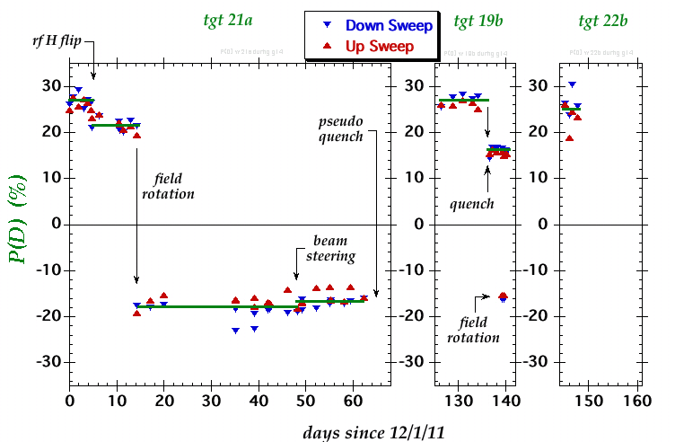
HDIce (g14, Hall B) Highlights
 | σ | Σ | T | P | E | F | G | H | T_{x} | T_{z} | L_{x} | L_{z} | O_{x} | O_{z} | C_{x} | C_{z}
pπ⁰ | ✔ | ✓ | ✓ |  | ✓ | ✓ | ✓ | ✓
nπ⁺ | ✔ | ✓ | ✓ |  | ✓ | ✓ | ✓ | ✓
pη | ✔ | ✓ | ✓ |  | ✓ | ✓ | ✓ | ✓
pη’ | ✔ | ✓ | ✓ |  | ✓ | ✓ | ✓ | ✓
pω | ✔ | ✓ | ✓ |  | ✓ | ✓ | ✓ | ✓
K⁺Λ | ✔ | ✓ | ✓ | ✔ | ✓ | ✓ | ✓ | ✓ | ✓ | ✓ | ✓ | ✓ | ✓ | ✓ | ✔ | ✔
K⁺Σ⁰ | ✔ | ✓ | ✓ | ✔ | ✓ | ✓ | ✓ | ✓ | ✓ | ✓ | ✓ | ✓ | ✓ | ✓ | ✔ | ✔
K^{0*}Σ⁺ | ✔ | ✓ |  |  |  |  |  |  |  |  | ✓ | ✓
pπ⁻ | ✔ | ✓ | ✓ |  | ✓ | ✓ | ✓ | ✓
pρ⁻ | ✓ | ✓ | ✓ |  | ✓ | ✓ | ✓ | ✓
K⁻Σ⁺ | ✓ | ✓ | ✓ |  | ✓ | ✓ | ✓ | ✓
K⁰Λ | ✓ | ✓ | ✓ | ✓ | ✓ | ✓ | ✓ | ✓ | ✓ | ✓ | ✓ | ✓ | ✓ | ✓ | ✓ | ✓
K⁰Σ⁰ | ✓ | ✓ | ✓ | ✓ | ✓ | ✓ | ✓ | ✓ | ✓ | ✓ | ✓ | ✓ | ✓ | ✓ | ✓ | ✓
K^{0*}Σ⁰ | ✓ | ✓
Proton targets
Neutron targets
✔ - HDIce

Slide 6
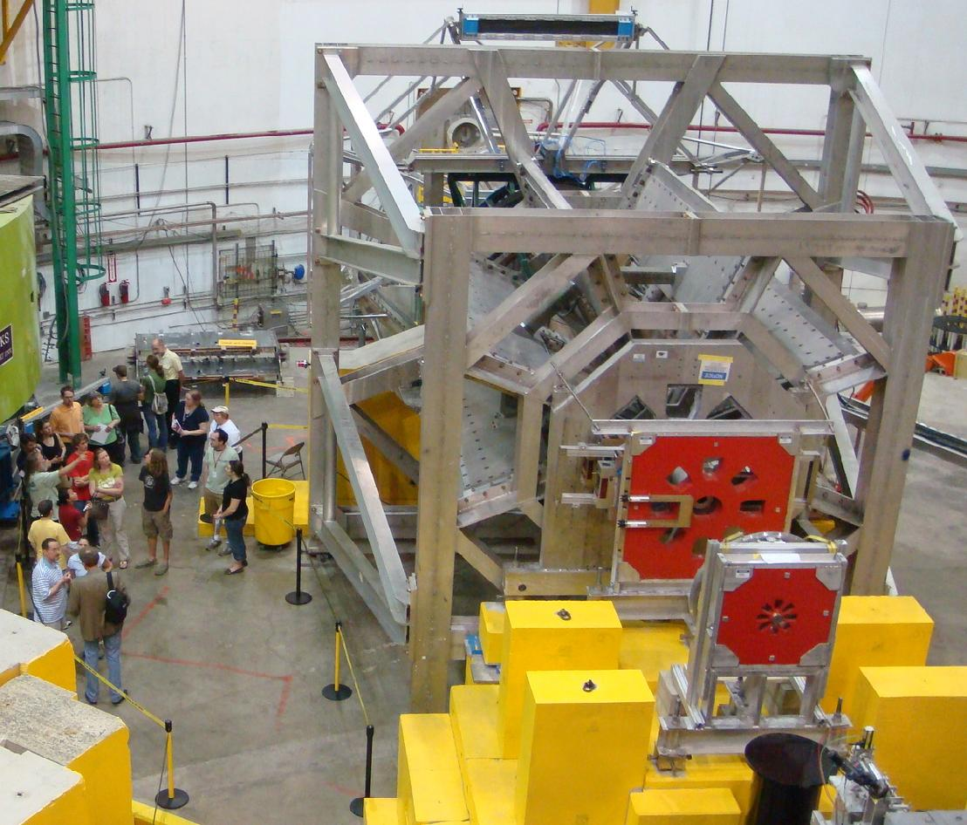
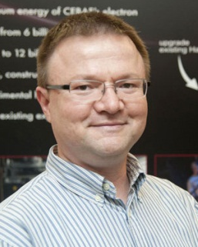
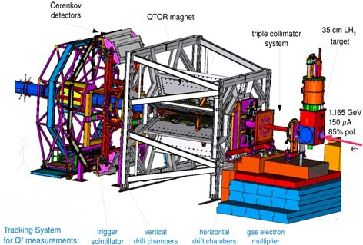
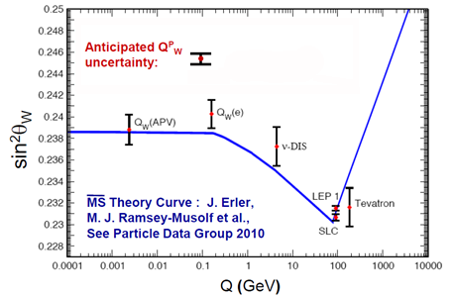
Qweak
Precise determination of
the weak charge of the proton
Q^{p}_{w} = (1 – 4 sin² θ_{W})
Silviu Covrig
DoE Early Career
Award 2012
lumi
monitors
lumi
monitors

Slide 7
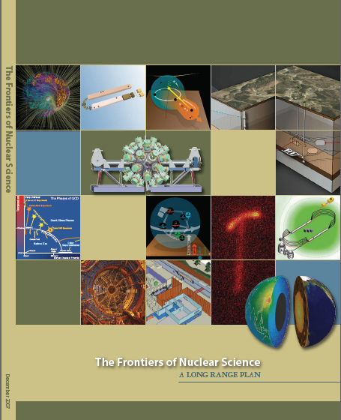
12 GeV Upgrade Project
Upgrade is designed to build on existing facility: vast majority of accelerator and experimental equipment have continued use
New Hall
Upgrade arc magnets
and supplies
Add 5 cryomodules
20 cryomodules
CHL upgrade
Maintain capability to deliver lower pass beam energies: 2.2, 4.4, 6.6….
Add arc
20 cryomodules
The completion of the 12 GeV Upgrade of CEBAF was ranked the highest priority in the 2007 NSAC Long Range Plan.
Add 5 cryomodules
Scope of the project includes:
Doubling the accelerator beam energy
New experimental Hall and beamline
Upgrades to existing Experimental Halls
Enhanced capabilities
in existing Halls

Slide 8
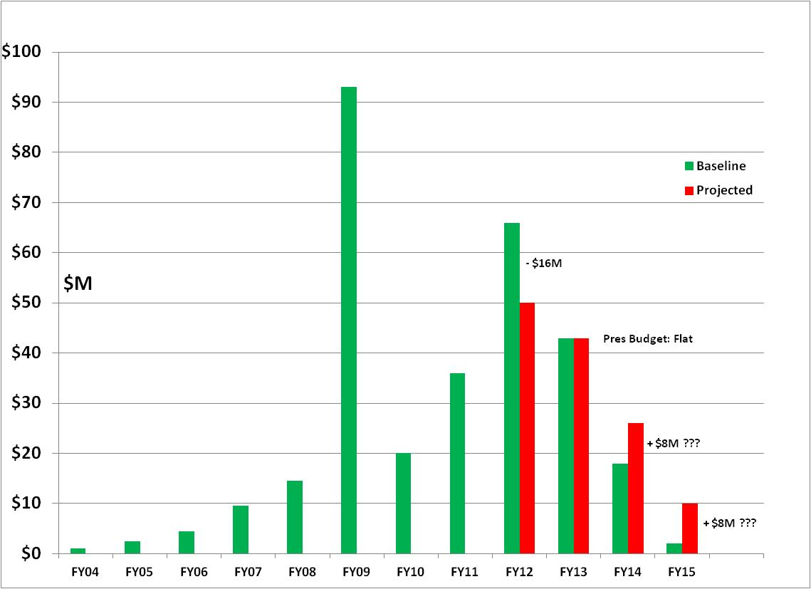
12 GeV - $310M TPC
FY12: reduction of $16M
FY13: Pres Request – no restoration
CD-4B may be at Risk
ARRA Shift of $65M
from FY10/11 to FY09

Slide 9
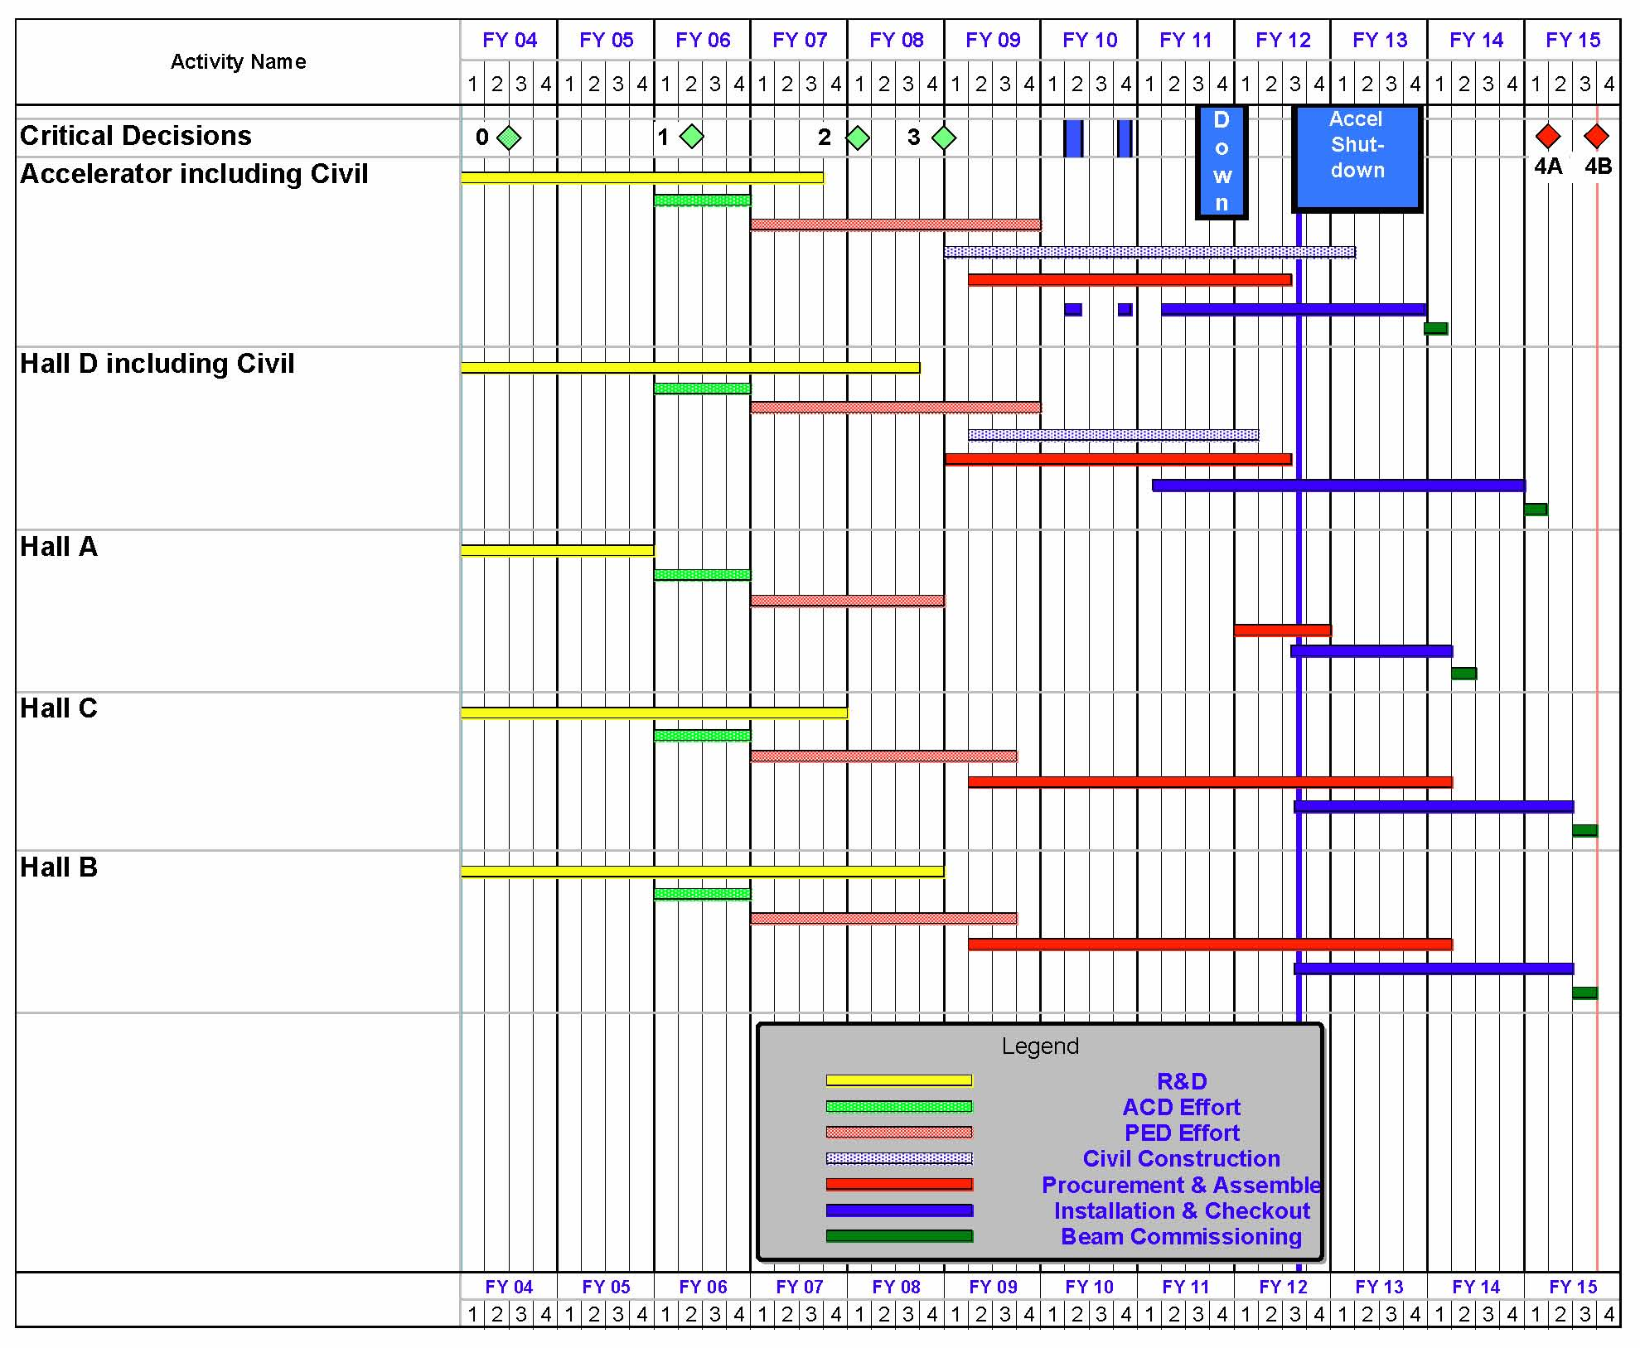
12 GeV Upgrade Project Schedule
FY12: reduction of $16M
FY13: Pres Request – no restoration
CD-4B may be at Risk
    12 16-month installation
    May 2012 - May Sept 2013
    Hall A commissioning start Oct 2013 Feb 2014
    Hall D commissioning start
    April 2014 Oct 2014
    Halls B & C commissioning start Oct 2014 Apr 2015
    Project Completion June 2015
Next DOE Project Review
June 21, 2012

Slide 10
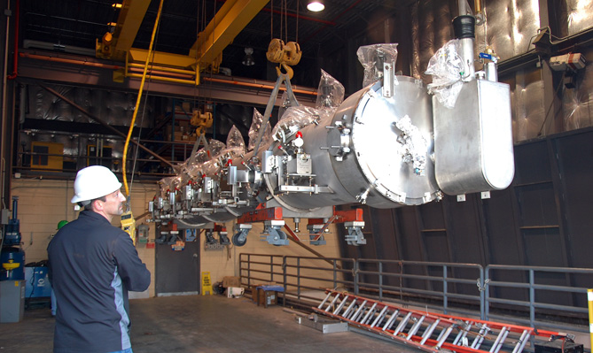
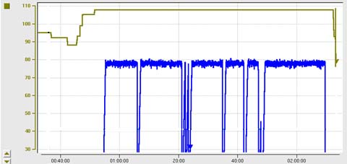
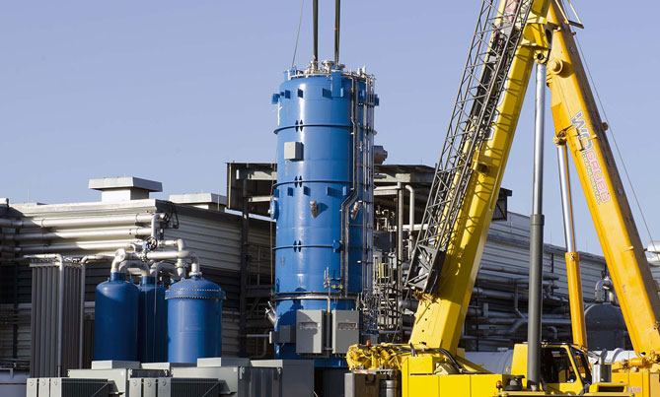
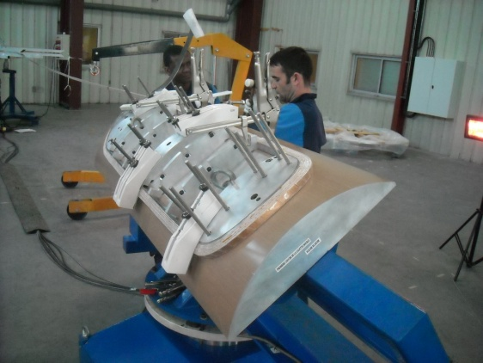
12 GeV Upgrade – Recent Progress
High gradient cryomodule performance
demonstrated in tunnel
◻ Met research beam spec. of 108 MeV @ 465 μA
Central Helium Liquefier-2 equipment in place
Hall D – equipment installation in progress
Superconducting magnets under construction
All major detector systems under construction
Third C100 Cryomodule
transferred to tunnel
C100 Cryomodule Energy Gain – May 18th
108 MeV
– 200
98 MeV
CHL-2
installation
– 150
ENERGY GAIN (MeV)
Beam Current/pass (μA)
– 100
– 50
TIME (in 20 minute increments)
Hall C Dipole
Magnet Coil

Slide 11
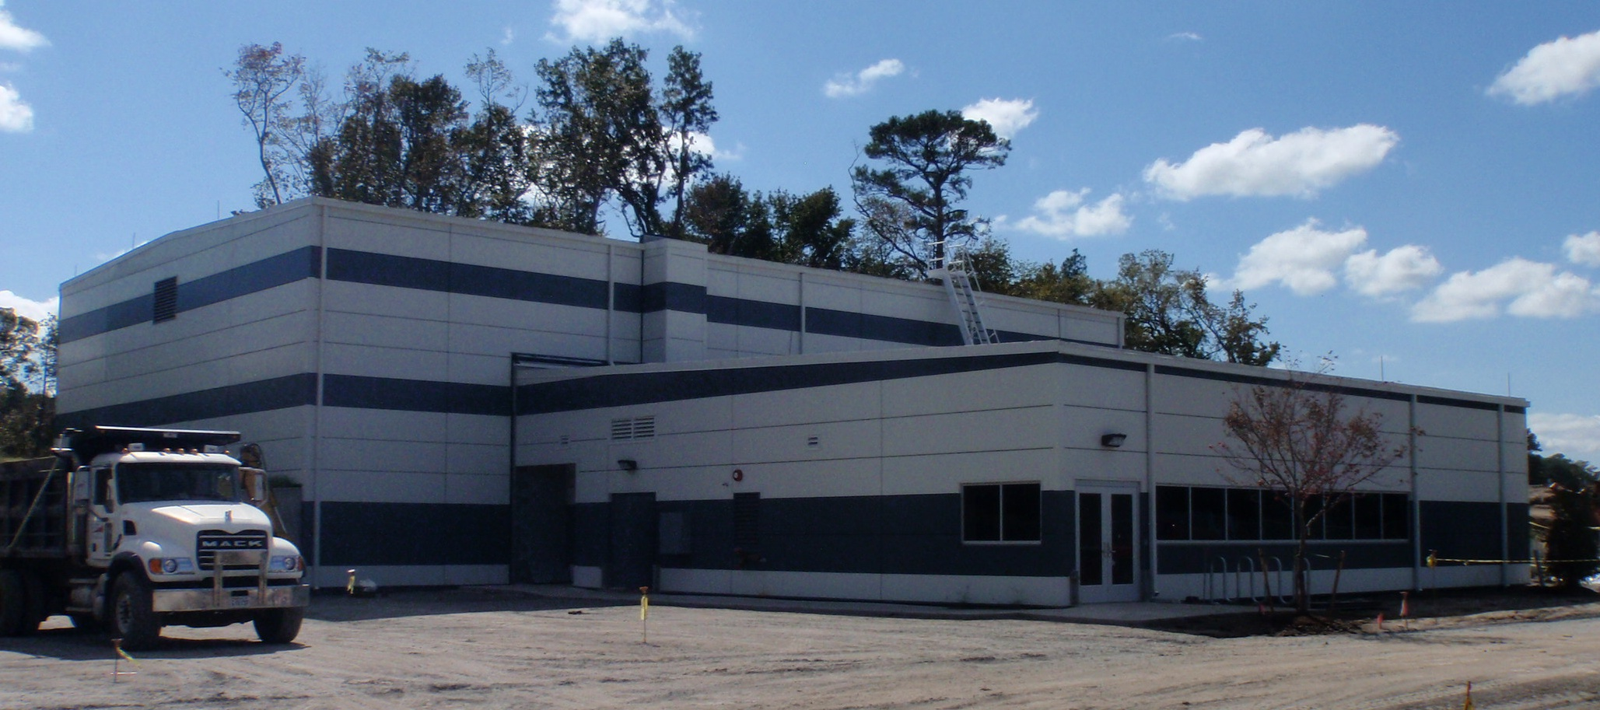
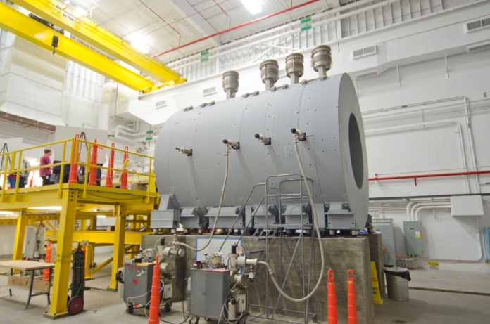
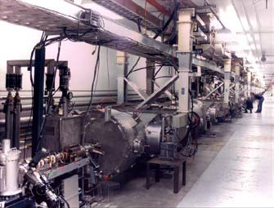
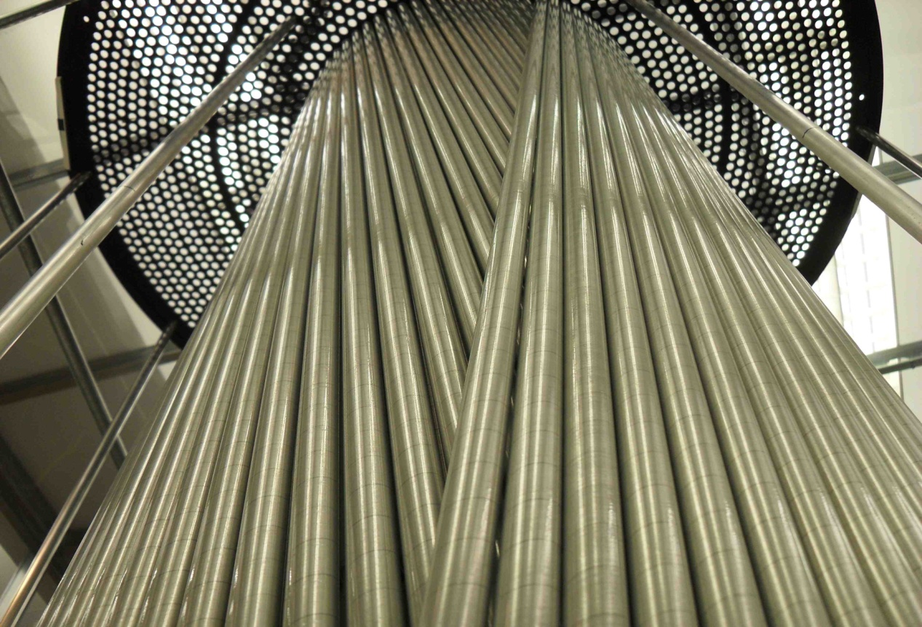
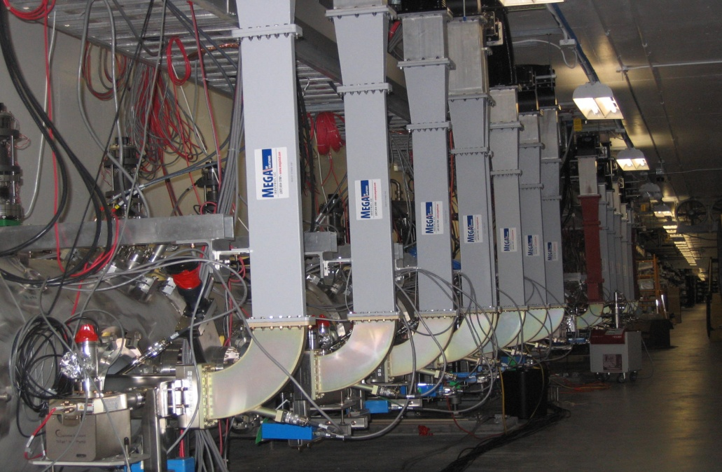
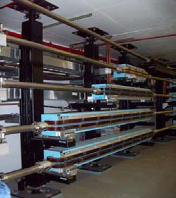
12 GeV Project Status
Hall D & Counting House
Hall D Interior
12 GeV Cryomodules
Cryomodule Waveguides
Arc Magnets
Hall D Drift Chamber
Performance Index: schedule 96%; cost 96%
Project Construction 58% complete
Civil 94% complete

Slide 12
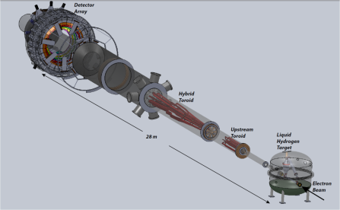
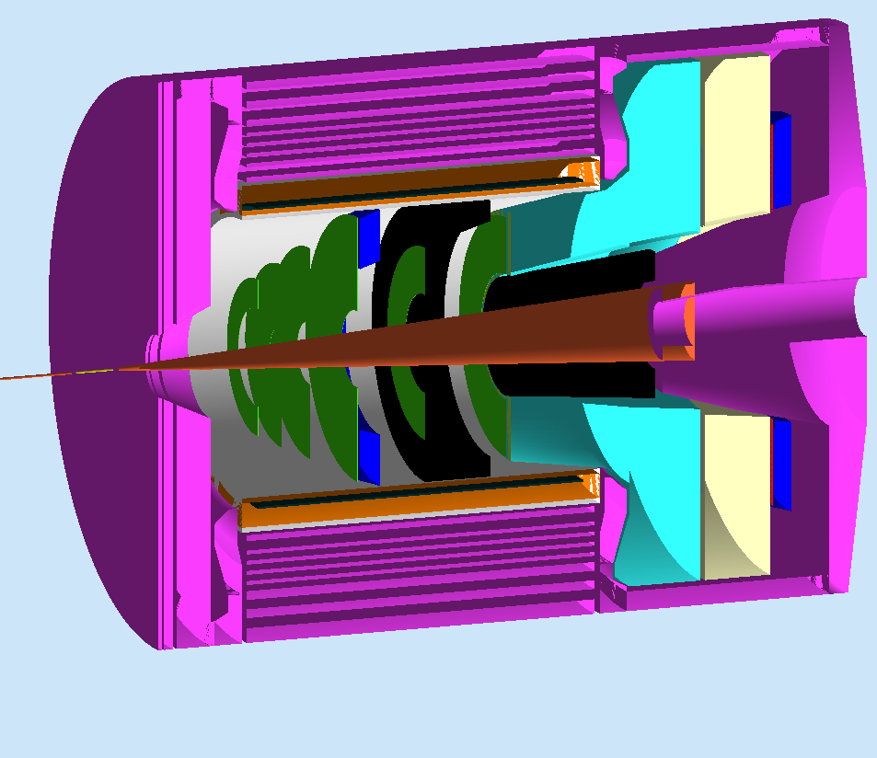
Planning for Future Projects
Future Hall A Large Installation Programs:
MOLLER
Parity Violating (PV) e-e scattering
Precise Standard Model test
- Submitted to DOE-ONP Sep. 2011
SoLID (PV e⁻ - q scattering + SIDIS)
PV e-quark + High Precision TMD Studies
- Chinese collaboration still developing
- CLEO solenoid under negotiation
- Directors review in Fall 2012?
Also ongoing:
HPS (Conditional approval - HEP): Parasitic test run completed
DarkLight : planning for Summer test run at FEL
π⁰ spectrometer (off SHMS carriage) NSF/MRI submitted
Windowless target for proton charge radius experiment NSF/MRI submitted
(Part of) Hall B Forward Tagger NSF/MRI Submitted

Slide 13
Planning for ancillary equipment
FY13-FY18 capital equipment plan including (parts of)
  Hall A: SBS basic, SBS neutron, SBS proton, Tritium target, …
  Hall B: Forward Tagger, Polarized target, one-sector RICH, HDIce-transverse
  Hall C: Beamline/Compton, Polarized 3He, Target upgrade, large experiments
  Hall D: L3 Farm, Forward Calorimeter upgrade, Cherenkov
  Division: fast pipelined electronics to rotate amongst Halls for experiments
Ongoing: planning for new/upgraded End Station Refrigerator for future high cryogenic demand experiments

Slide 14







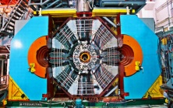
Jefferson Lab Physics Analysis Center
Definitive physics from high quality data demands precision analysis tools
hadron spectrum
GPDs, TMDs
Experiment
QCD
Pool world theoretical/phenomenological expertise
SAID
Bonn-
Gatchina
EBAC
Common, robust methodologies, especially in Amplitude Analysis
MAID
Train generation of experimentalists and theorists
global networking
to be led by Jefferson Lab
BESIII

Slide 15
Electron Ion Collider
NSAC 2007 Long-Range Plan:
“An Electron-Ion Collider (EIC) with polarized beams has been embraced by the U.S. nuclear science community as embodying the vision for reaching the next QCD frontier. EIC would provide unique capabilities for the study of QCD well beyond those available at existing facilities worldwide and complementary to those planned for the next generation of accelerators in Europe and Asia.”
Jefferson Lab and BNL are both developing “staged” designs
EIC Advisory Committee:
  Reports to Lab Directors from Jefferson Lab and BNL
Next NSAC Long Range Plan?

Slide 16
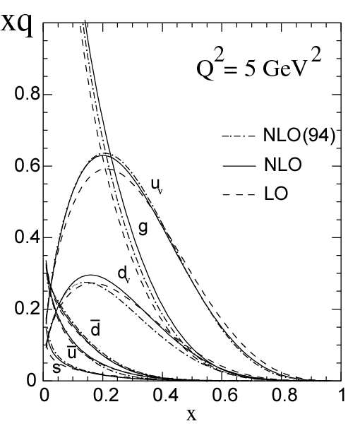

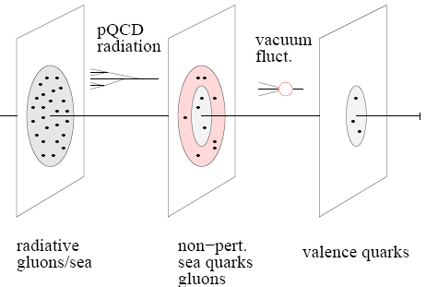
12 GeV ◻ EIC
With 12 GeV we study mostly the valence quark component
An EIC aims to study the sea quarks, gluons, and scale (Q²) dependence.
mEIC
EIC
12 GeV

Slide 17
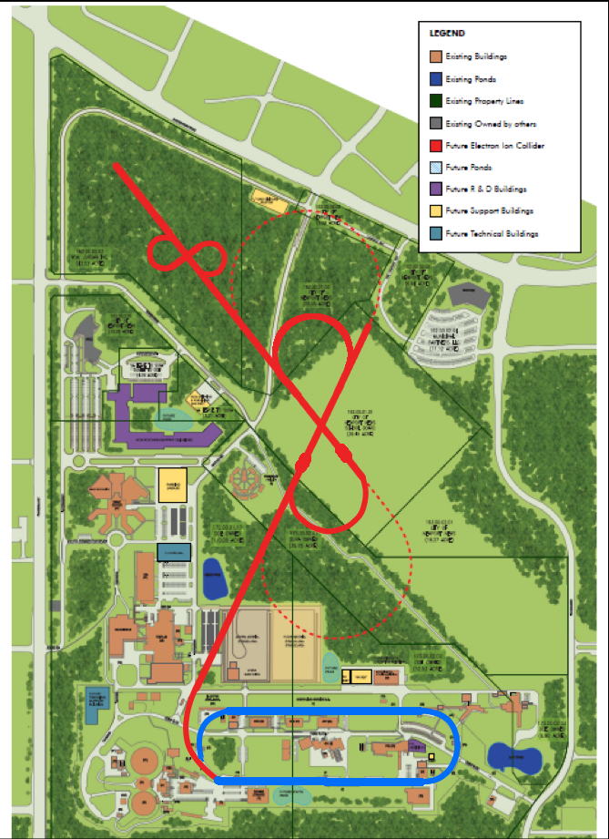
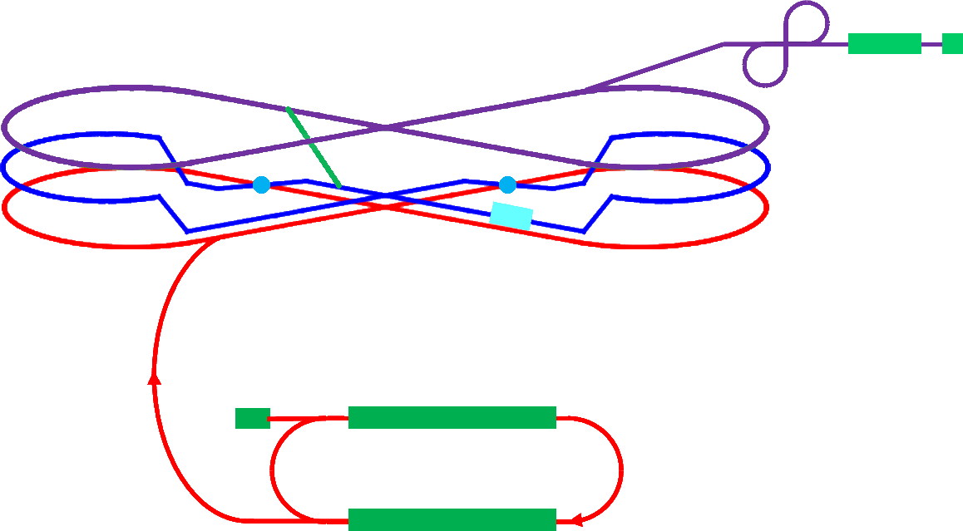
Medium Energy EIC@JLab
Warm large booster
(up to 20 GeV)
Transfer beam line
Pre-booster
SRF linac
Ion
source
Cold ion
collider ring
(up to 100 GeV)
Medium energy IP
Electron collider ring
(3 to 11 GeV)
Injector
12 GeV CEBAF
JLab Concept
Initial configuration (MEIC):
  3-11 GeV on 20-100 GeV ep/eA collider
  fully-polarized, longitudinal and transverse
  luminosity: up to few x 10³⁴ e-nucleons cm⁻² s⁻¹
    Upgradable to higher energies (250 GeV protons)

Slide 18
Jefferson Lab Electron Ion Collider
Activity Name | 2010 | 2011 | 2012 | 2013 | 2014 | 2015 | 2016 | 2017 | 2018 | 2019 | 2020 | 2021 | 2022 | 2023 | 2024 | 2025
12 GeV Upgrade
FRIB
EIC Physics Case
NSAC LRP
EIC CD0
EIC Machine Design/R&D
EIC CD1/Downsel
EIC CD2/CD3
EIC Construction
Initial configuration (MEIC):
  3-11 GeV on 20-100 GeV ep/eA collider
  fully-polarized, longitudinal and transverse
  luminosity: up to few x 10³⁴ e-nucleons cm⁻² s⁻¹
  Design Maturing
  User Driven Physics Case
  Integrated Detector
  Cost Estimate in progress

Slide 19
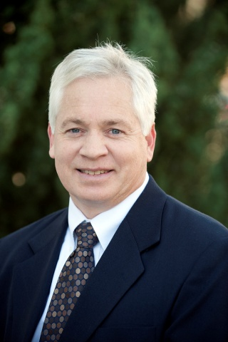
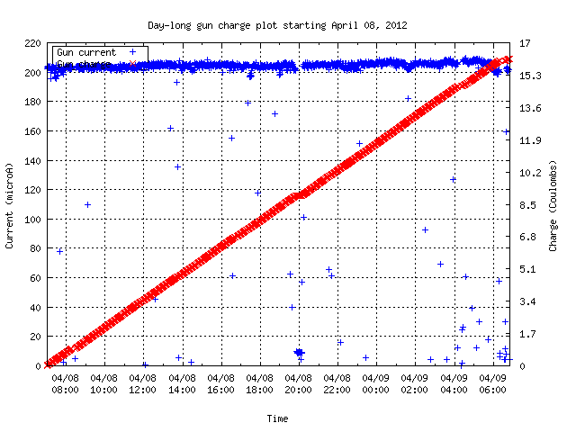

Polarized Electron Source
Matt Poelker
2011 E. O. Lawrence Award
Beam Current
Charge from photogun
Electron Gun Requirements
Ultrahigh vacuum
No field emission
Maintenance-free
24 Hours
Record Performance (2012): 180 μA at 89% polarization

Slide 20
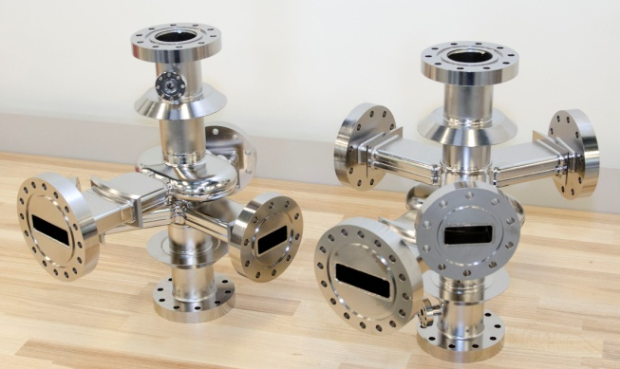
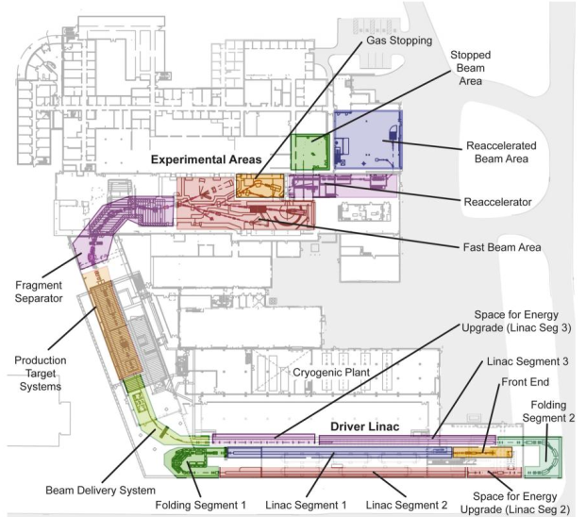
Superconducting RF Technology
12 GeV CEBAF Upgrade – 84 cavities
  All processed, most exceed 30 MV/m
  Cryomodule assembly ~70% complete
FRIB:
– Committed to do processing of all half-wave cavities
– In discussion re full cryomodule design, assembly, and testing
APS - construct crab cavity prototype
Project X - designed, constructed and tested new 650 MHz cavity shape to minimize multipacting
Next Generation Light Source - collaboration w/LBNL, FNAL, SLAC
ILC - leading gradient improvement effort
BES inverse compton scattering source – developing technology
European Spallation Source – in negotiations re spoke cavity R&D
7-cell cavity
Crab cavity prototype for APS
FRIB Layout

Slide 21
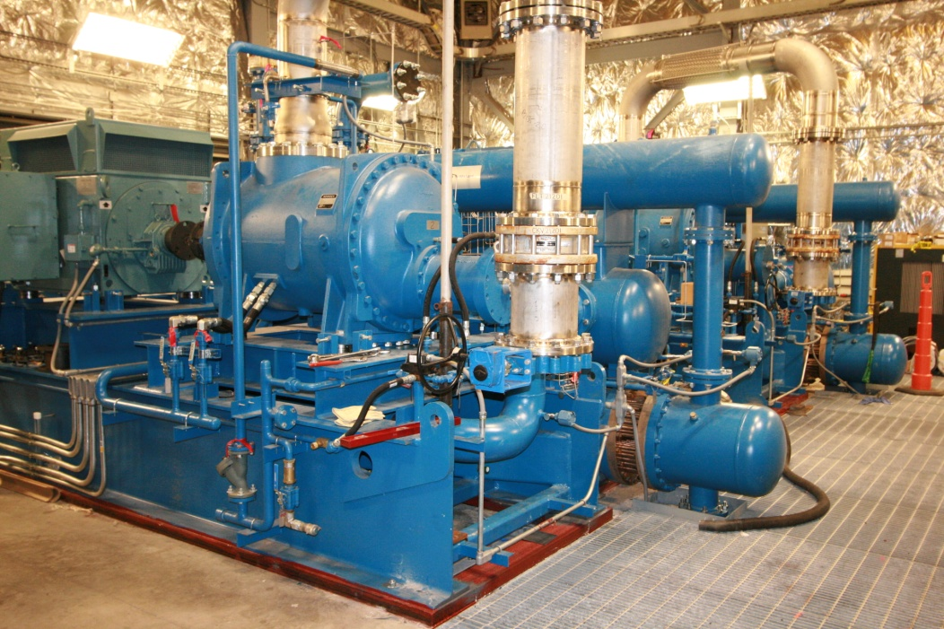
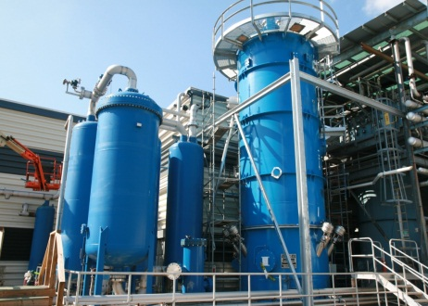
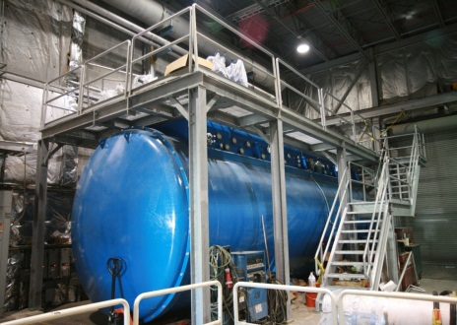
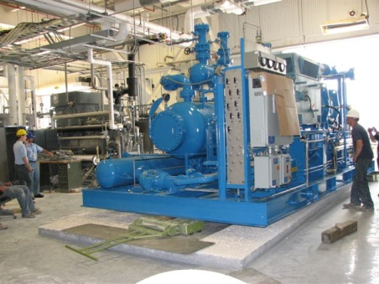
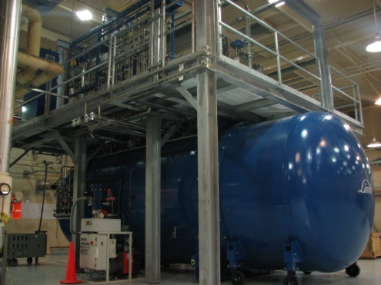
Cryogenics Projects
12 GeV Upgrade
  Doubles capacity of CHL
James Webb Telescope, NASA
  Improvements to the
  refrigeration plant to test
  components
FRIB
  Provide design and
  construction support
Next Generation Light Source
  Provide design and
  construction support
12 GeV Upper Coldbox
New CHL 12 GeV Compressors
12 GeV Lower Coldbox
Helium refrigerator system
for James Webb telescope testing

Slide 22
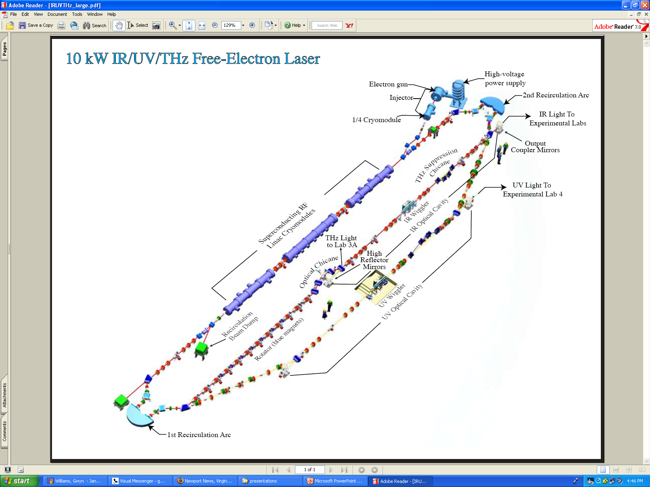
Free Electron Laser
Non-DOE Customers:
  US Department of Defense: ONR, JTO, USAF
Synergistic with TJNAF mission
  DarkLight experiment (A’ search)
  Development of improved Kr dating capability (ground water, arctic ice)
Free Electron Laser

Slide 23
Strategic Plan Status
Held town meetings with Physics, Theory, Accelerator, FEL divisions
Also held one for “Technology Development and Technical Infrastructure” – cryo, accelerator R&D, detector development, etc.
Open town meeting with users March 16
Lab leadership retreat in Summer 2012
JSA Science Council: Recommend broader scope

Slide 24
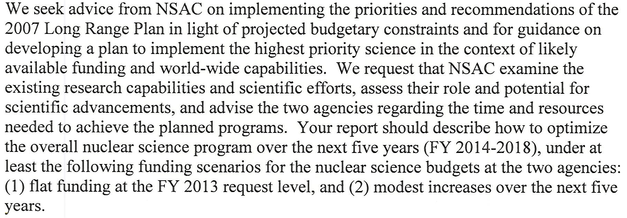
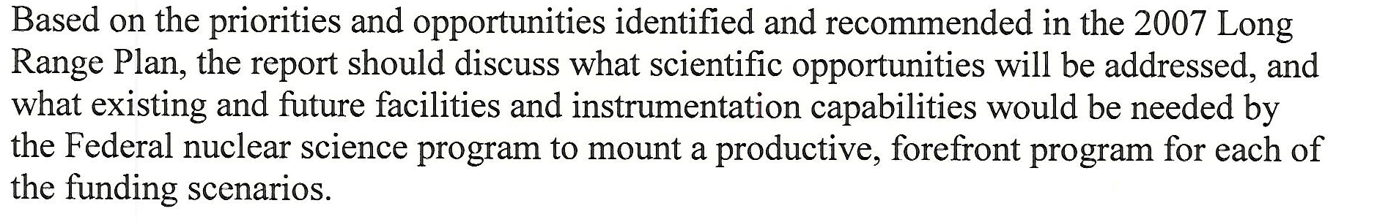
NSAC 2007 LRP Implementation

Slide 25
NSAC-2007-LRP Implementation Subcom
Nuclear Community Members
Joseph Carlson, Brad Fillipone, Stuart Freedman, Haiyan Gao, Donald Geesaman (ex officio, NSAC Chair), Barbara Jacak, Peter Jacobs, David Kaplan, Kirby Kemper, Krishna Kumar, Naomi Makins, Curtis Meyer, James Nagle, Witold Nazarewicz, Krishna Rajagopol, Michael Ramsey-Musolf, Lee Sobotka, Robert Tribble (Chair), Michael Wiescher, John Wilkerson
Members from Broader Scientific Community
Adam Burrows, George Crabtree

Slide 26

12 GeV Science
phenomenology
techniques (theory+exp)
standard model tests
Discovery
Potential
New
Defining the Science Program:
  Highest priority in 2007 NSAC Long Range Plan
  Seven Reviews: JLab Program Advisory Committees (PAC) 2006 through 2011
  Results: 48 experiments approved ; 7 conditionally approved
  PAC39 scheduled June 2012
  White paper for 2012 NSAC subcommittee (in progress)
Experiments for 4 Halls approved for more than
five years of operation beginning in FY15
Notes:
Like to give an overview of Jefferson Lab.
I can’t get going without saying something of the current status of the lab.
The dominant part of the talk will concern our 12 GeV Upgrade Project, the physics and the project status.
However, the technology which enables our nuclear physics and its enhancement also provides opportunities in the future
Photon Science
Accelerator Driven Systems
Nuclear Physics
Conclude

Slide 27
“White Paper”
Physics Opportunities with the
12 GeV Upgrade at Jefferson Lab
Preparation for 2012 NSAC activity
Update physics case for “NSAC audience”
Overview (3) – Pennington/Ent/BMcK
Meson Spectroscopy and Structure (5) – Meyer, Dudek
Nucleon Structure and Spectroscopy (10) – Meziani, Richards
QCD and Nuclei (5) – Weinstein, Miller
The Standard Model and Beyond (5) – Kumar, Essig
Appendix A: Experimental Equipment (10) – Young

Slide 28
Concerns
12 GeV
  Project
    Superconducting magnets
    Schedule
  Commissioning/Early Running → PAC
  5 Year Program → PAC
NSAC Exercise

