Slide 1
LBNE
Jim Strait
Fermilab
NuFact 2012
27 July 2012

Slide 2
Long-Baseline Neutrino Experiment Collaboration
Alabama: S.Habib, I.Stancu
Argonne: M.D’Agostino, G.Drake.Z.Djurcic, M.Goodman, V.Guarino, S.Magill, J.Paley, H.Sahoo, R.Talaga, M.Wetstein
Boston: E.Hazen, E.Kearns, S.Linden
Brookhaven: M.Bishai, R.Brown, H.Chen, M.Diwan, J.Dolph, G.Geronimo, R.Gill, R.Hackenburg, R.Hahn, S.Hans, Z.Isvan, D.Jaffe, S.Junnarkar, S.H.Kettell, F.Lanni, Y.Li, L.Littenberg, J.Ling, D.Makowiecki, W.Marciano, W.Morse, Z.Parsa, V.Radeka, S.Rescia, N.Samios,R.Sharma, N.Simos, J.Sondericker, J.Stewart, H.Tanaka, H.Themann, C.Thorn, B.Viren, S.White, E.Worcester, M.Yeh, B.Yu, C.Zhang
Caltech: R.McKeown, X.Qian
Cambridge: A.Blake, M.Thomson
Catania/INFN: V.Bellini, F.La Zia, F.Mammoliti, R.Potenza,
Chicago: E.Blucher, M.Strait
Colorado: S.Coleman, R.Johnson, S.Johnson, A.Marino, E.Zimmerman
Colorado State: M.Bass, B.E.Berger, J.Brack, N.Buchanan, D.Cherdack, J.Harton, W.Johnston, W.Toki, T.Wachala, D.Warner, R.J.Wilson
Columbia: R.Carr, L.Camillieri, C.Y.Chi, G.Karagiorgi, C.Mariani, M.Shaevitz, W.Sippach, W.Willis
Crookston: D.Demuth
Dakota State: B.Szcerbinska
Davis: M.Bergevin, R.Breedon, D.Danielson, J.Felde, C.Maesano, M.Tripanthi, R.Svoboda, M.Szydagis
Drexel: C.Lane, S.Perasso
Duke: T.Akiri, J.Fowler, A.Himmel, Z.Li, K.Scholberg, C.Walter, R.Wendell
Duluth: R.Gran, A.Habig
Fermilab: D.Allspach, M.Andrews, B.Baller, E.Berman, R.Bernstein, V.Bocean, M.Campbell, A.Chen, S.Childress, A.Drozhdin, T.Dykhuis, C.Escobar, H.Greenlee, A.Hahn, S.Hays, A.Heavey, J.Howell, P.Huhr, J.Hylen, C.James, M.Johnson, J.Johnstone, H.Jostlein, T.Junk, B.Kayser, M.Kirby, G.Koizumi, T.Lackowski, P.Lucas, B.Lundberg, T.Lundin, P.Mantsch, A.Marchionni, E .McCluskey, S.Moed Sher, N.Mokhov, C.Moore, J.Morfin, B.Norris, V.Papadimitriou, R.Plunkett, C.Polly, S.Pordes, O.Prokofiev, J.L.Raaf, G.Rameika, B.Rebel, D.Reitzner, K.Riesselmann, R.Rucinski, R.Schmidt, D.Schmitz, P.Shanahan, M.Stancari, A.Stefanik, J.Strait, S.Striganov, K.Vaziri, G.Velev, T.Wyman, G.Zeller, R.Zwaska
Hawai’i: S.Dye, J.Kumar, J.Learned, J.Maricic, S.Matsuno, R.Milincic, S.Pakvasa, M.Rosen, G.Varner
Houston: L.Whitehead
Indian Universities: V.Singh (BHU); B.Choudhary, S.Mandal (DU); B.Bhuyan [IIT(G)]; V.Bhatnagar, A.Kumar, S.Sahijpal(PU)
Indiana: W.Fox, C.Johnson, M.Messier, S.Mufson, J.Musser, R.Tayloe, J.Urheim
Iowa State: I.Anghel, G.S.Davies, M.Sanchez, T.Xin
IPMU/Tokyo: M.Vagins
Irvine: G.Carminati, W.Kropp, M.Smy, H.Sobel
Kansas State: T.Bolton, G.Horton-Smith
LBL: B.Fujikawa, V.M.Gehman, R.Kadel, D.Taylor
Livermore: A.Bernstein, R.Bionta, S.Dazeley, S.Ouedraogo
London: A.Holin, J.Thomas
Los Alamos: M.Akashi-Ronquest, S.Elliott, A.Friedland, G.Garvey, E.Guardincerri, T.Haines, D.Lee, W.Louis, C.Mauger, G.Mills, Z.Pavlovic, J.Ramsey, G.Sinnis, W.Sondheim, R.Van de Water, H.White, K.Yarritu
Louisiana: J.Insler, T.Kutter, W.Metcalf, M.Tzanov
Maryland: E.Blaufuss, S.Eno, R.Hellauer, T.Straszheim, G.Sullivan
Michigan State: E.Arrieta-Diaz, C.Bromberg, D.Edmunds, J.Huston, B.Page
Minnesota: M.Marshak, W.Miller
MIT: W.Barletta, J.Conrad, B.Jones, T.Katori, R.Lanza, A.Prakash, L.Winslow
NGA: S.Malys, S.Usman
New Mexico: J.Mathews
Notre Dame: J.Losecco
Oxford: G.Barr, J.de Jong, A.Weber
Pennsylvania: S.Grullon, J.Klein, K.Lande, T.Latorre, A.Mann, M.Newcomer, S.Seibert, R.vanBerg
Pittsburgh: D.Naples, V.Paolone
Princeton: Q.He, K.McDonald
Rensselaer: D.Kaminski, J.Napolitano, S.Salon, P.Stoler
Rochester: L.Loiacono, K.McFarland, G.Perdue
Sheffield: V.Kudryavtsev, M.Richardson, M.Robinson, N.Spooner, L.Thompson
SDMST: X.Bai, C.Christofferson, R.Corey, D.Tiedt
SMU.: T.Coan, T.Liu, J.Ye
South Carolina: H.Duyang, B.Mercurio, S.Mishra, R.Petti, C.Rosenfeld, X Tian
South Dakota: D.Barker, J.Goon, D.Mei, W.Wei, C.Zhang
South Dakota State: B.Bleakley, K.McTaggert
Syracuse: M.Artuso, S.Blusk, T.Skwarnicki, M.Soderberg, S.Stone
Tennessee: W.Bugg, T.Handler, A.Hatzikoutelis, Y.Kamyshkov
Texas: S.Kopp, K.Lang, R.Mehdiyev
Tufts: H.Gallagher, T.Kafka, W.Mann, J.Schnepps
UCLA: K.Arisaka, D.Cline, K.Lee, Y.Meng, A.Teymourian, H.Wang
Virginia Tech.: E.Guarnaccia, J.Link, D.Mohapatra
Washington: H.Berns, S.Enomoto, J.Kaspar, N.Tolich, H.K.Tseung
Wisconsin: B.Balantekin, F.Feyzi, K.Heeger, A.Karle, R.Maruyama, B.Paulos, D.Webber, C.Wendt
Yale: E.Church, B.Fleming, R.Guenette, K.Partyka, A.Szelc
347 Members
62 Institutions
25 US States
5 Countries
19 July 2012 (347)

Slide 3
Outline
Long-term goals and plans of the LBNE program
Reality and Vision collide: The Reconfiguration of LBNE
A phased approach to LBNE (and Project X)
LBNE Project status and next steps
Conclusions

Slide 4
LBNE – Neutrino Oscillation Goals
LBNE plans a comprehensive program to measure neutrino oscillations, to:
Measure full oscillation patterns in multiple channels, precisely constraining mixing angles and mass differences.
Search for CP violation both by measuring the parameter δ_{CP} and by observing differences in ν and ν─ oscillations.
Cleanly separate matter effects from CP-violating effects.

Slide 5
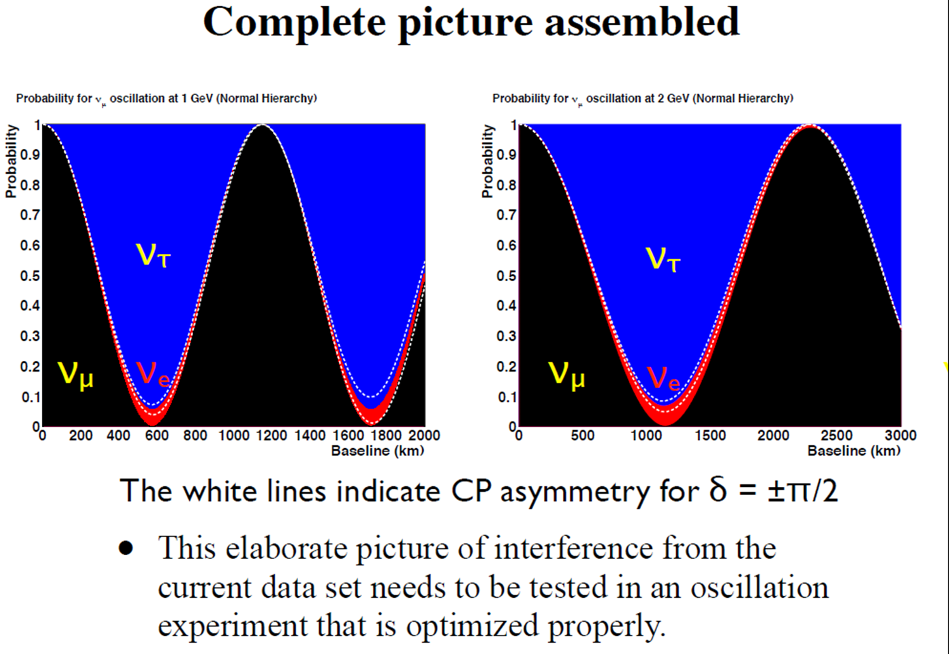
ν_{μ} → ν_{μ} => θ₂₃, |Δm²₃₂|
ν_{μ} → ν_{e} => θ₁₃, sign(Δm²₃₂), δ_{CP}
ν─_{μ} → ν─ _{e} => explicitly observe CP violation
ν_{μ} → ν_{τ} => does it all add up?

Slide 6
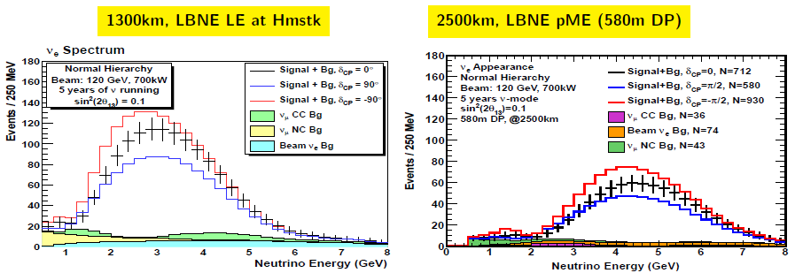
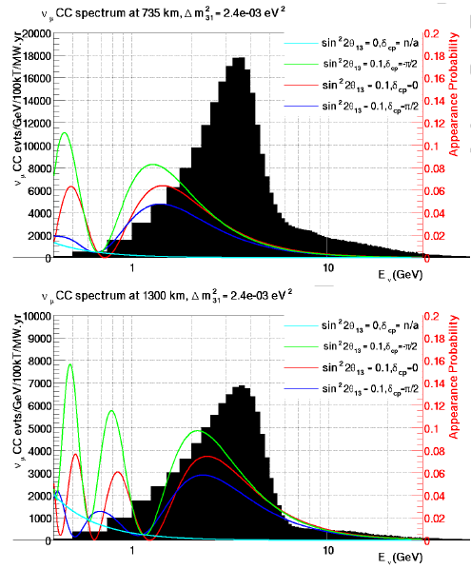
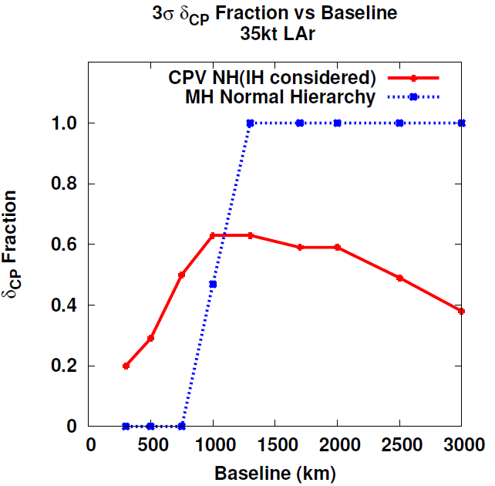
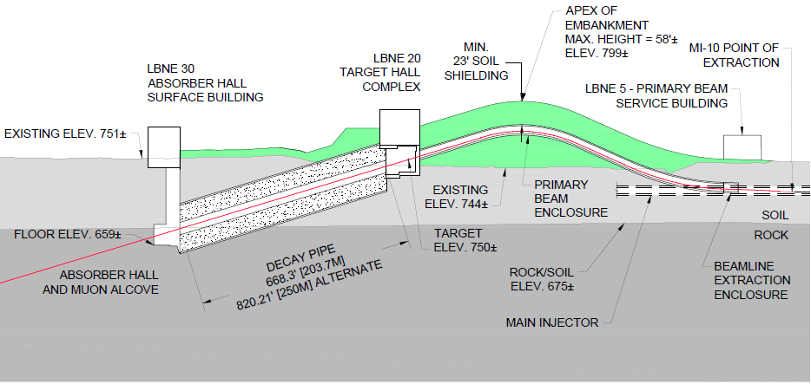
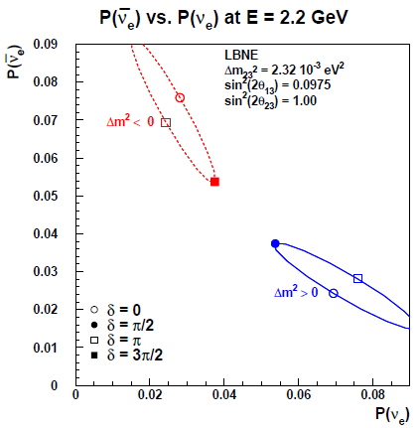
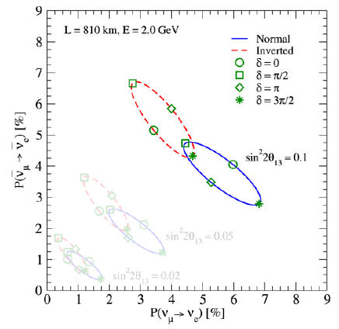
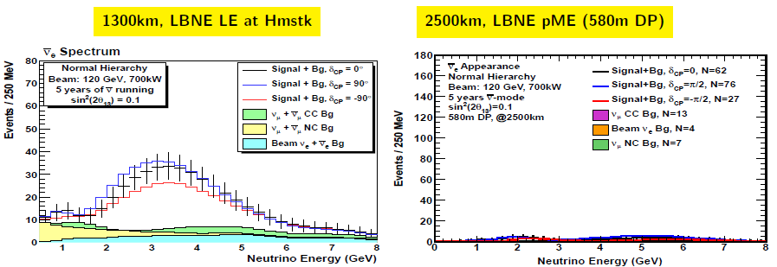
The Baseline
To do this we need the right baseline
Long enough to cleanly separate the ν / ν─ oscillation asymmetry due to the matter effect from CP-violating effect.
Long enough to put the first and if possible second oscillation maxima at “practical” energies.
Short enough that the matter effect does not dominate over the CP-violating effect.
Short enough that the beam is not too difficult to build (pitch angle).
=> 1300 km (Fermilab to Homestake) is “just right.”
To do this we need the right baseline
Long enough to cleanly separate the ν / ν─ oscillation asymmetry due to the matter effect from CP-violating effect.
Long enough to put the first and if possible second oscillation maxima at “practical” energies.
Short enough that the matter effect does not dominate over the CP-violating effect.
Short enough that the beam is not too difficult to build (pitch angle).
=> 1300 km (Fermilab to Homestake) is “just right.”
L = 1300 km

Slide 7
ν─_{e}
ν_{e}
ν_{μ}
ν─_{μ}

Slide 8
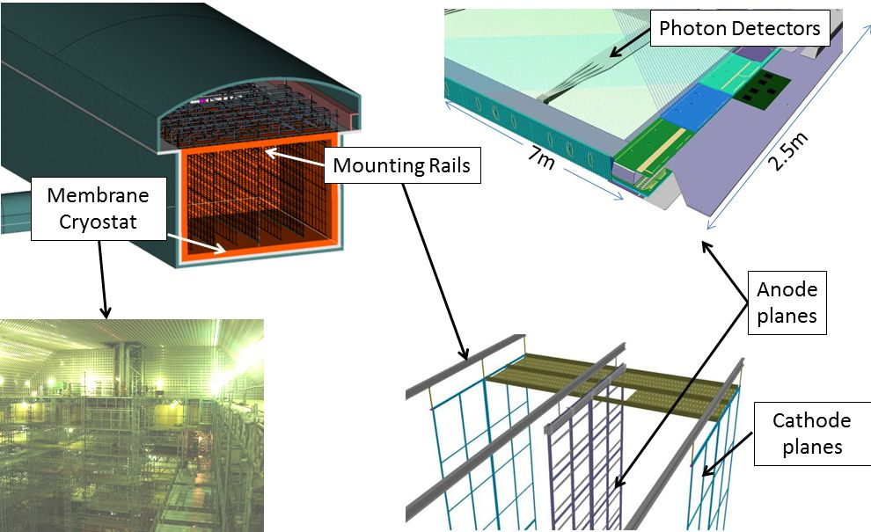
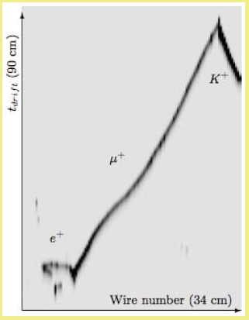
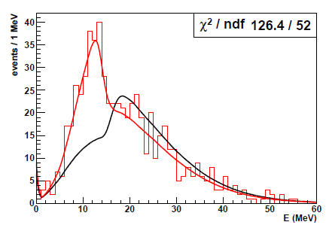
The Far Detector
We need a large, highly capable detector to provide:
High statistics for rare events (ν_{e} appearance and ν_{μ} survival at oscillation max)
Efficient detection of signal and rejection of backgrounds.
Reconstruction of complex final states
Placed at sufficient depth to suppress cosmic ray backgrounds to a negligible level.
=> 34 kton LAr TPC underground at Homestake.
Such a detector would be a powerful tool for other physics, including proton decay and supernova neutrinos.
We need a large, highly capable detector to provide:
High statistics for rare events (ν_{e} appearance and ν_{μ} survival at oscillation max)
Efficient detection of signal and rejection of backgrounds.
Reconstruction of complex final states
Placed at sufficient depth to suppress cosmic ray backgrounds to a negligible level.
=> 34 kton LAr TPC underground at Homestake.
Such a detector would be a powerful tool for other physics, including proton decay and supernova neutrinos.

Slide 9
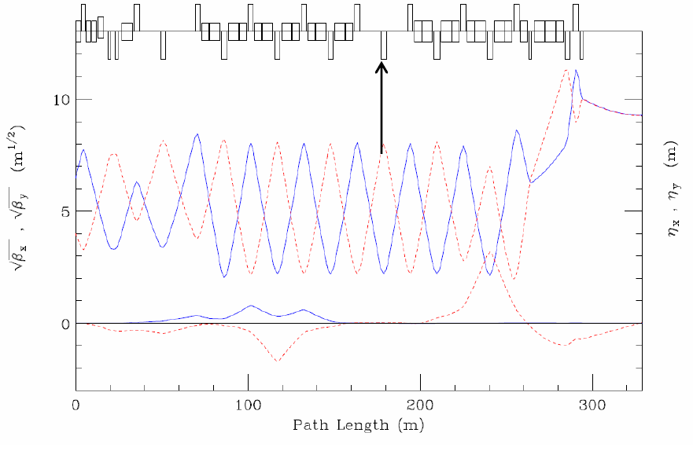
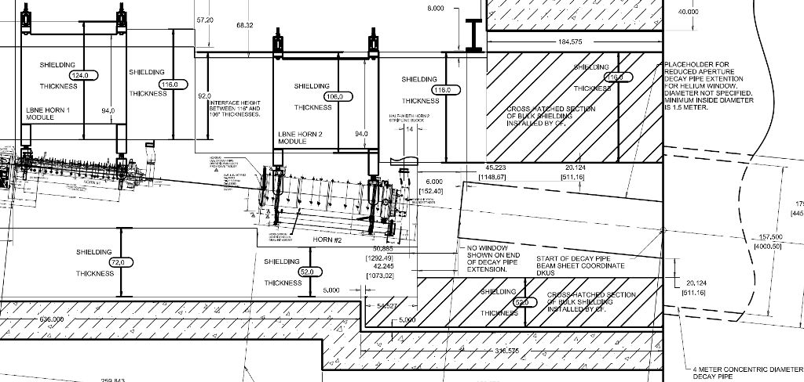
The Neutrino Beam
We need a high-power, broad-band, high-purity neutrino beam, sign-selected beam.
Broad-band, sign-selected => Horn Focused
Cover first and if possible second oscillation max => large diameter decay pipe to collect low energy pions
High purity => shorter decay pipe to reduce high-energy tail and minimize μ± → e ± ⁽ν^{─)} _{e} ⁽ν^{─)} _{μ} decay in flight.
Tunable over wide range of primary proton energy tunable spot size to optimize flux and allow study systematics.
Capable of handling ≥ 2.3 MW from Project X.
We need a high-power, broad-band, high-purity neutrino beam, sign-selected beam.
Broad-band, sign-selected => Horn Focused
Cover first and if possible second oscillation max => large diameter decay pipe to collect low energy pions
High purity => shorter decay pipe to reduce high-energy tail and minimize μ± → e ± ⁽ν^{─)} _{e} ⁽ν^{─)} _{μ} decay in flight.
Tunable over wide range of primary proton energy and tunable spot size to optimize flux and allow study systematics.
Capable of handling ≥ 2.3 MW from Project X.
200~250m
4 m dia.

Slide 10
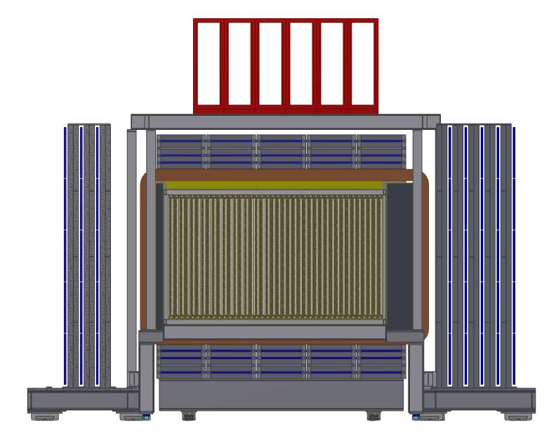
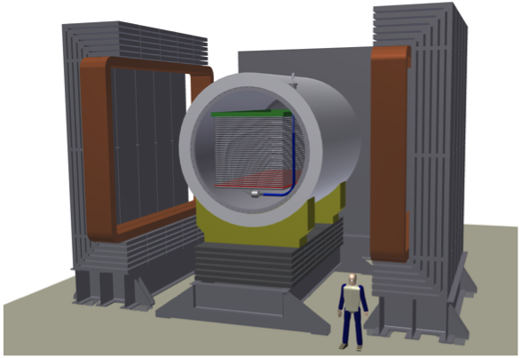
The Near Detector
We need a highly capable near detector to:
Measure the spectra of all species: ν_{μ}, ν_{e}, ν─_{μ}, ν─ _{e} => magnetized detector with good e± capability.
Measure events from the same target nucleus (Ar) and the same technique as the far detector.
Measure cross-sections necessary for oscillation measurements.
Two candidate detectors: - LAr TPC or - Straw Tube Tracker with embedded Ar Targets
We need a highly capable near detector to:
Measure the spectra of all species: ν_{μ}, ν_{e}, ν─_{μ}, ν─ _{e} => magnetized detector with good e± capability.
Measure events from the same target nucleus (Ar) and the same technique as the far detector.
Measure cross-sections necessary for oscillation measurements.
Two candidate detectors: - LAr TPC or - Straw Tube Tracker with embedded Ar Targets
Beam
Beam direction

Slide 11
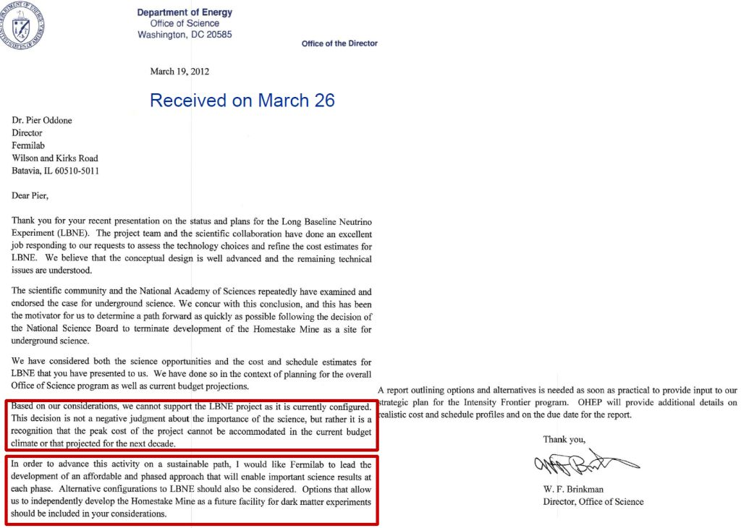
Vision Encounters Reality

Slide 12
Reconfiguring LBNE
http://www.fnal.gov/directorate/lbne_reconfiguration/index.shtml
Final Report nearly ready ... no changes in the conclusions
https://indico.fnal.gov/ conferenceDisplay.py?confId=5622

Slide 13
Reconfiguration Interim Report

Slide 14
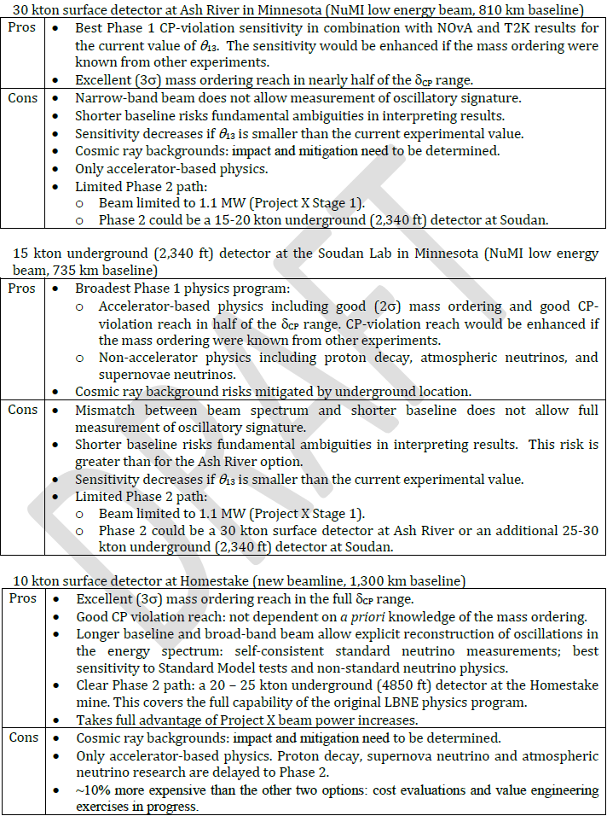
Pros and Cons
Fundamental Trade-offs
Larger detector on the surface vs. smaller underground
Use existing beamline => more $ for detectors in first phase vs. new beamline with desired baseline and upgrade path => less $ for detectors in first phase.

Slide 15
Steering Committee Conclusions
But there are risks:
First studies suggest that the risks are manageable, but work continues

Slide 16
Steering Committee Conclusions
Limitations:
*
Opportunities:
* Note that the cost increase of moving the detector underground is only ~15% of the total cost of the project. The cost of adding a high-performance near detector, including all civil construction, is similar.

Slide 17
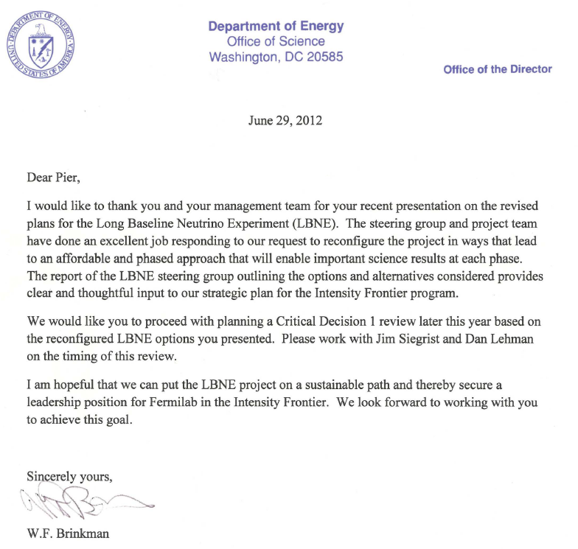
DOE Responds

Slide 18
Phased Program
The preferred configuration would be the first step in a phased program.
In the 1st phase, LBNE would determine the sign(Δm²₃₂) and measure δ_{CP}, as well as measuring other oscillation parameters: θ₁₃, θ₂₃, and |Δm²₃₂|. Subsequent phases would include:
Build a highly capable near neutrino detector, - reduce systematic errors on the oscillation measurements - enable a broad program of non-oscillation neutrino physics.
Increase the detector mass or increase the beam power (Project X) - add statistical precision to all of the neutrino measurements.
Add a large detector at the 4850 foot (4300 mwe) level at Homestake - enable proton decay, supernova neutrino, and other non-beam physics - further improve the precision of the main oscillation measurements - enable use of more difficult channels for a fully comprehensive program of oscillation measurements
The actual order and scope of the next phases would, of course, depend on physics, resources, and the interests of current and new collaborators.

Slide 19
Phased Program: Possible Example
1) 10 kt LAr detector on surface at Homestake + LBNE beamline (700 kW)
2) Near Neutrino Detector at Fermilab
3) Project X stage 1 → 1.1 MW LBNE beam
4) Additional 20-30 kt detector deep underground (4300 mwe)
Additional national or international collaborators could help accelerate the implementation of the full LBNE program.

Slide 20
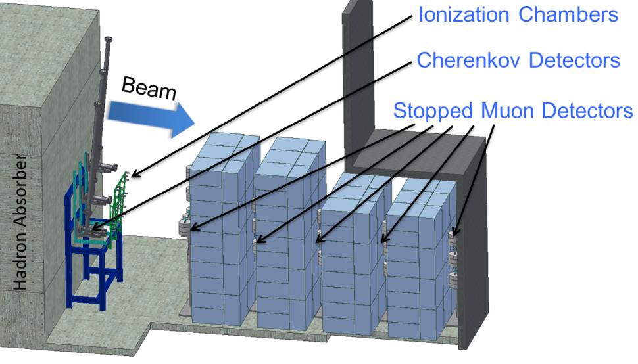
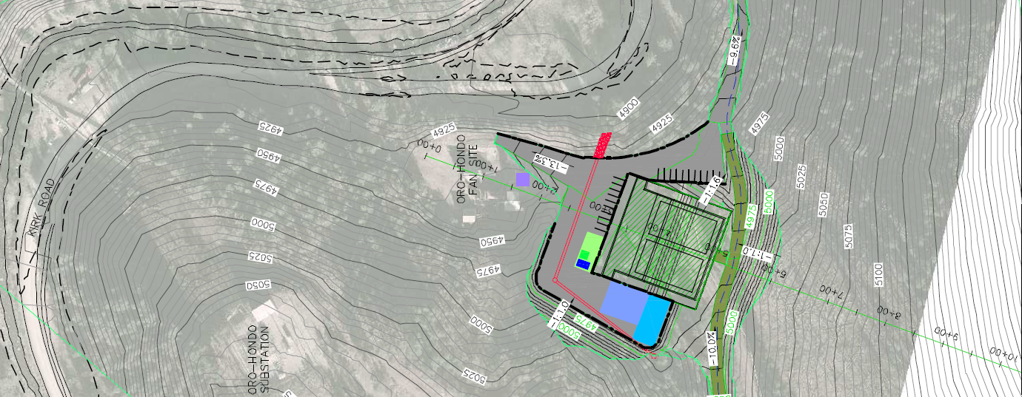
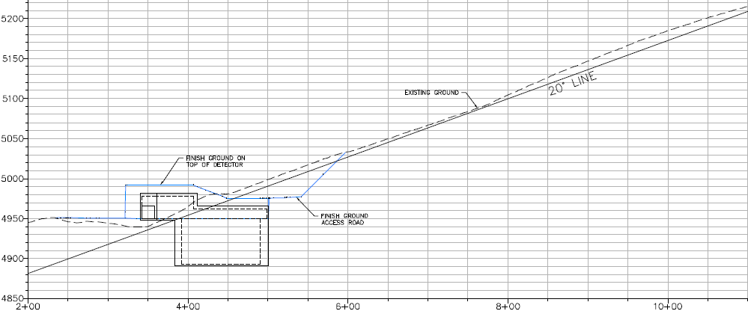
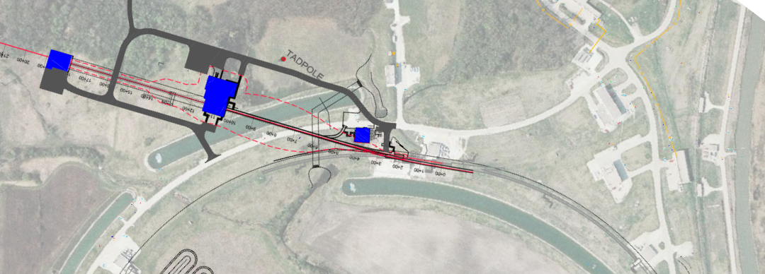
The LBNE Project
The LBNE Project is to deliver the first phase of this program:
A new neutrino beam at Fermilab: - Aimed at Homestake - Spectrum optimized for this distance - Upgradeable to ≥ 2.3 MW proton beam power
A 10 kt LAr TPC detector on the surface at Homestake - In a pit just below the natural grade - Shielded against hadronic and EM component of CR showers
The LBNE Project is to deliver the first phase of this program:
A new neutrino beam at Fermilab: - Aimed at Homestake - Spectrum optimized for this distance - Upgradeable to ≥ 2.3 MW proton beam power
A 10 kt LAr TPC detector on the surface at Homestake - In a pit just below the natural grade - Shielded against hadronic and EM component of CR showers
Tertiary muon detector to monitor the neutrino beam - ionization chambers - variable pressure gas Cherenkov detectors - stopped muon detectors
The LBNE Project is to deliver the first phase of this program:
A new neutrino beam at Fermilab: - Aimed at Homestake - Spectrum optimized for this distance - Upgradeable to ≥ 2.3 MW proton beam power
A 10 kt LAr TPC detector on the surface at Homestake - In a pit just below the natural grade - Shielded against hadronic and EM component of CR showers
Tertiary muon detector to monitor the neutrino beam - Ionization chambers - Variable pressure gas Cherenkov detectors - Stopped muon detectors
LAr TPC
ν beam
ν beam

Slide 21
The LBNE Project – Next Steps
The next step in the DOE project approval process is “CD-1,” which approves the conceptual design and overall cost scale and schedule of the Project.
We have been encouraged by DOE to achieve this milestone by the end of December 2012.
A prerequisite is to pass two major reviews:
Fermilab Director’s Review 25-27 September - Validates the design
DOE (“Lehman”) Review 30 October – 1 November - Validates the project plan
CD-1 will allow us to move forward to complete the design and to prepare for construction.

Slide 22
Summary
LBNE remains focused on its long-term goals:
Comprehensive program to measure neutrino oscillations - determine the mass hierarchy and look for CP violation - precision measurement of other oscillation parameters - test the validity of the three-neutrino mixing model
Search for baryon number violating processes
Measure neutrinos from astrophysical sources, especially from a core-collapse supernova in our galaxy
Fiscal constraints require us to approach our goals in a phased program
The LBNE Project will build the first phase, and is expecting DOE approval of “CD-1” this year.
New national or international collaborators could add scope to phase 1 or accelerate the implementation of later phases.

