Slide 1
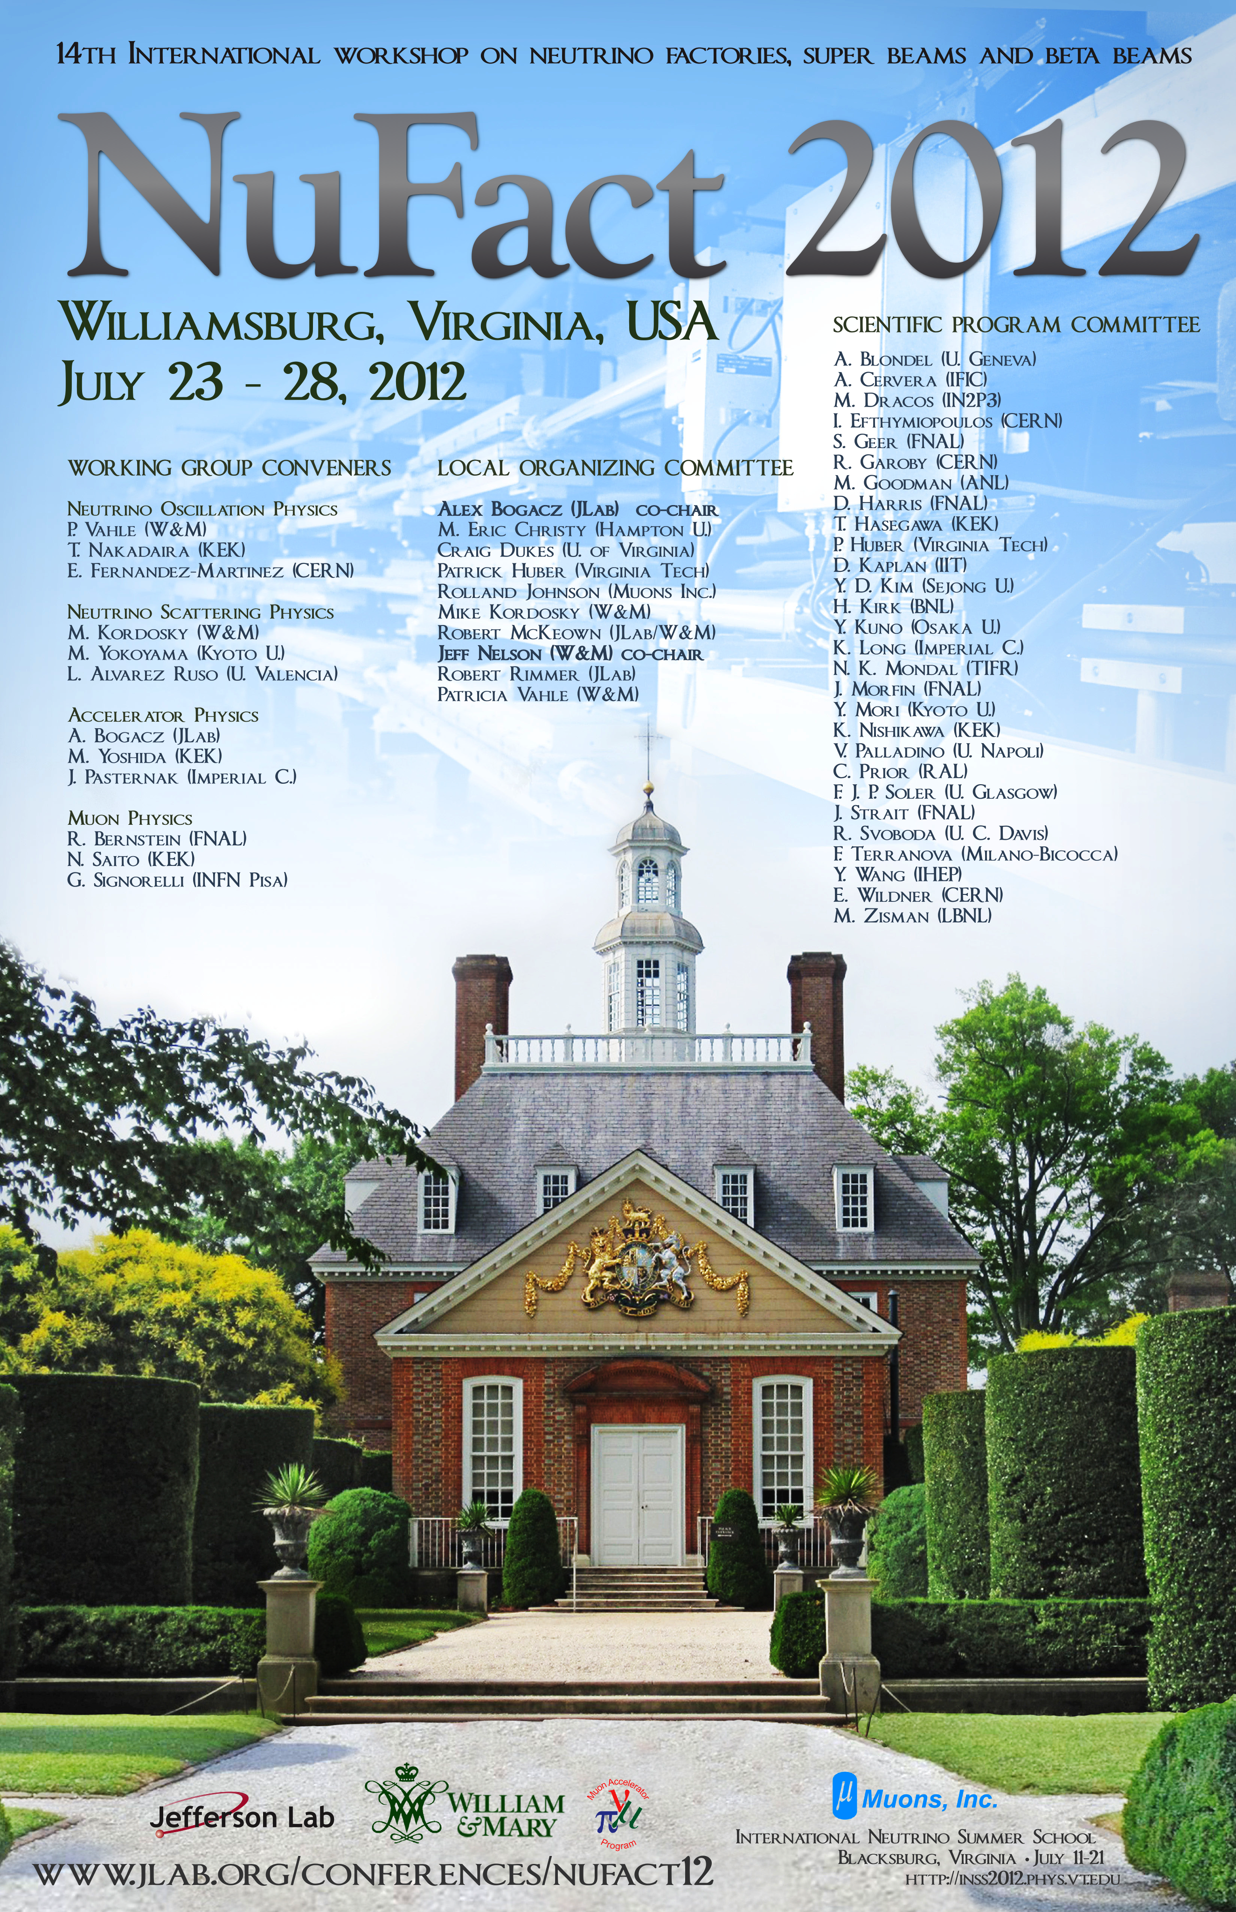
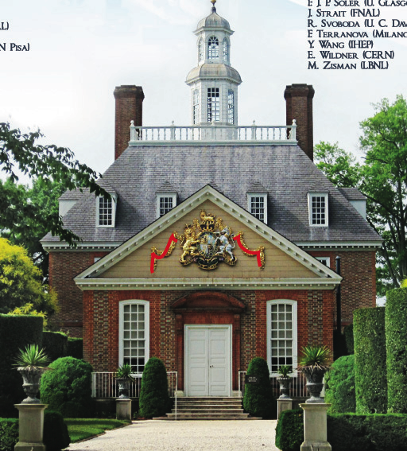
MUON PHYSICS AT NuFACT 2012 (WG4)
Opening Summary
RHB, G. Signorelli, N. Saito

Slide 2
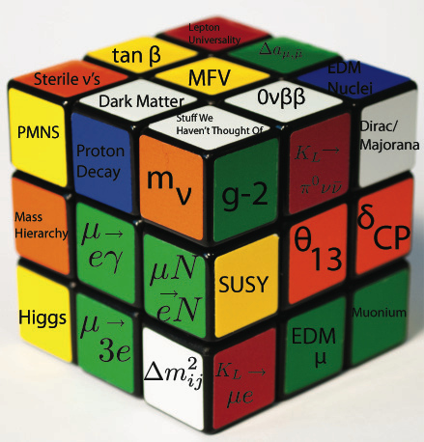
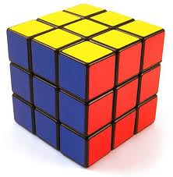
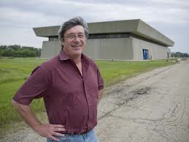
Purpose: Solve this Puzzle
μ

Slide 3
Precision Experiments Are Important! (at least from a survey of Nobel Prizes)
http://www.nybooks.com/articles/archives/2009/apr/09/leaping-into-the-grand-unknown/

Slide 4
Muons WG4: Goals
  What upcoming measurements would benefit from the muon flux at a neutrino factory?
    cLFV and non-cLFV
      μ →eγ , μ →3e, μN →eN conversion, g-2
    Proton radius/Lamb shift
    Muonium HFS
  How good should the measurements be?
    “If you can measure something an order of magnitude better, you should just do it” – Jim Cronin
    Most funding agencies and committees are not as smart as Cronin
      Therefore we need theory guidance on what to try for!
      Less flippantly, the large value of θ₁₃ is telling us something. We know cLFV and neutrino oscillations are connected, and both are connected to kaons and taus and g-2 and EDMs. So we will hear about those too
      (Calibbi, Gardner, Semertzidis in a joint WG1/2 Session Thursday AM)
  What technologies do we need and how are they related to NuFACT?

Slide 5
Basic cLFV muon experiments
Muon Decays: μ→eγ and : μ→3e
Muon Conversion: μN→eN
  Coherent process off nucleus, enhancement ∝ Z, monoenergetic electron
These have been studied since the muon was identified, starting with Pontecorvo. One would expect μ→eγ to be of order 10⁻⁴ from this process where the neutrino goes around a loop
This problem led directly to the 1962 Lederman/Schwartz/Steinberger et al. two-neutrino experiment, so you can see cLFV and neutrinos are closely related
Feinberg, 1958

Slide 6
cLFV Experiments
cLFV in the Muon System
MEG Expected 2013
10⁴ improvement
followed by additional
X100 followed by…
MEG 2018
~ 6e-14

Slide 7
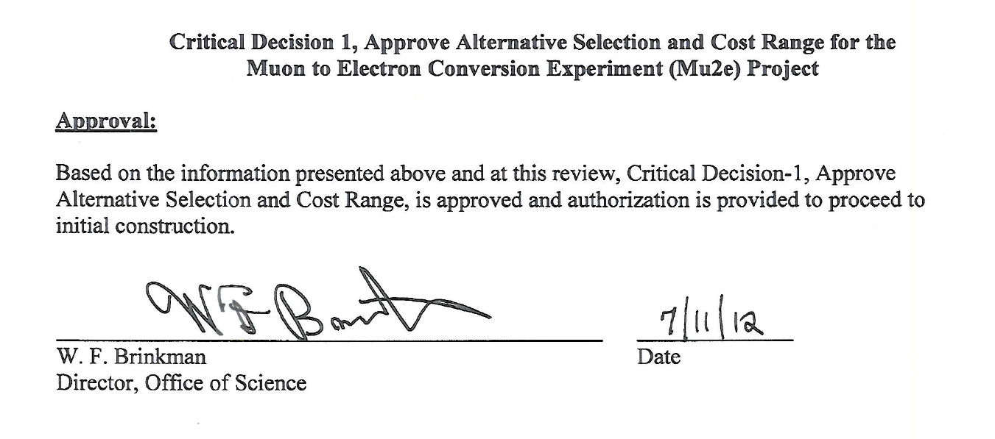
Shameless Plug for my cLFV experiment
Mu2e Gets CD-1!
With LBNE and g-2 to follow shortly
CD Process

Slide 8
cLFV for Dummies
Very generically, “loops” and contact-terms

Slide 9
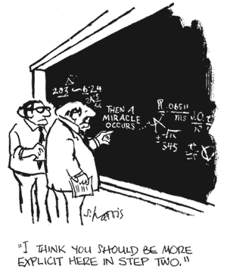
Why Do we Need More than One Experiment?
New version, A. de Gouvea
Note μ→eγ and μe (Mu2e)conversion (and μ→3e) are complementary
Suppose:
  Mu2e/3e, but not μ→eγ
    Contact! NP at a very high mass scale
  Both
    Loop!
  Neither
Λ (TeV)
Mu2e at PX, PRISM/PRIME
Mu2e, COMET
X10
In
Mass
scale
SINDRUM-II at PSI
(2006)
MEG at PSI (now!)
κ

Slide 10
μ→ 3e, μ→ eγ and μe conversion
All are probing >1000 TeV/c² mass scales

Slide 11
cLFV Talks
Baracchini, Tuesday 2PM
  and DeJongh, Wed 5PM
Wiedner, Tuesday 5PM
What is the State of the Art and How Can We Advance It?
  μ→eγ How far can MEG be advanced?
    What are the right methods?
      Convert the photon?
        Better resolution, lower rate
      Use EM Calorimetry
        Worse resolution than tracking
  μ→3e
  PSI LOI: active pixel tracker surrounding a target. Very similar reach to Mu2e but sensitivity to physics different!
      A novel experiment searching for the lepton
      flavour violating decay μ → eee
http://www.physi.uni-heidelberg.de/Forschung/he/mu3e/documents/LOI_Mu3e_PSI.pdf

Slide 12
cLFV Talks, continued
  μN→eN
    Growing program in US and Japan:
      Mu2e at FNAL
      MUSIC/COMET
      Intermediate Experiments: DeeMe and COMET Phase I
      “Extinction” in muon-electron conversion: “bursts and nothing in-between” at 10⁻¹⁰ or better
        Need to improve for future experiments: neutrino factory or FNAL Project X beams
    For additional x100 beyond, require new muon beams with small momentum bite
    To reduce pion contamination, technology of FFAGs or HCC or…
  And in the tau system: competitive and getting more so: BELLE-II and SuperB
      Hungerford, 2:35 Tuesday
      Sato, 3:30 Tuesday
      Aoki, Wed 3:00PM
      Kasper, 3:10 Tuesday
      Ankenbrandt, 9:00 AM Wed
      Luo, Blackmore, Pasternak Joint WG1/4 Wed AM
      Hayasaka, 2PM Wed
Notes:
Now I haven’t talked about taus. Taus are far better “per particle” than muons because of their mass, and GIM suppressions are far smaller. The flavor factories are extremely interesting and powerful complemens to muons and Prof Hayaska will tell us about what can be done at BELLE-II and SuperB.

Slide 13
Future Facilities for Muon Physics
Project X at FNAL: 1->3->8 GeV proton beams
  Enough protons for cLFV program with multiple experiments running simultaneously with neutrinos and kaons
  Also see Project X Summer Study: https://indico.fnal.gov/conferenceDisplay.py?confId=5276
J-PARC Program
  Many similar physics topics to Project X
  Will hear about several experiments discussed throughout NuFACT
PSI has upgrades planned as well, will hear about upgrades in mu->3e talk
Tschirhart,
Thursday 2:30 PM
Ikedo, Tuesday 5:30 PM
Wiedner, Tuesday 5PM

Slide 14
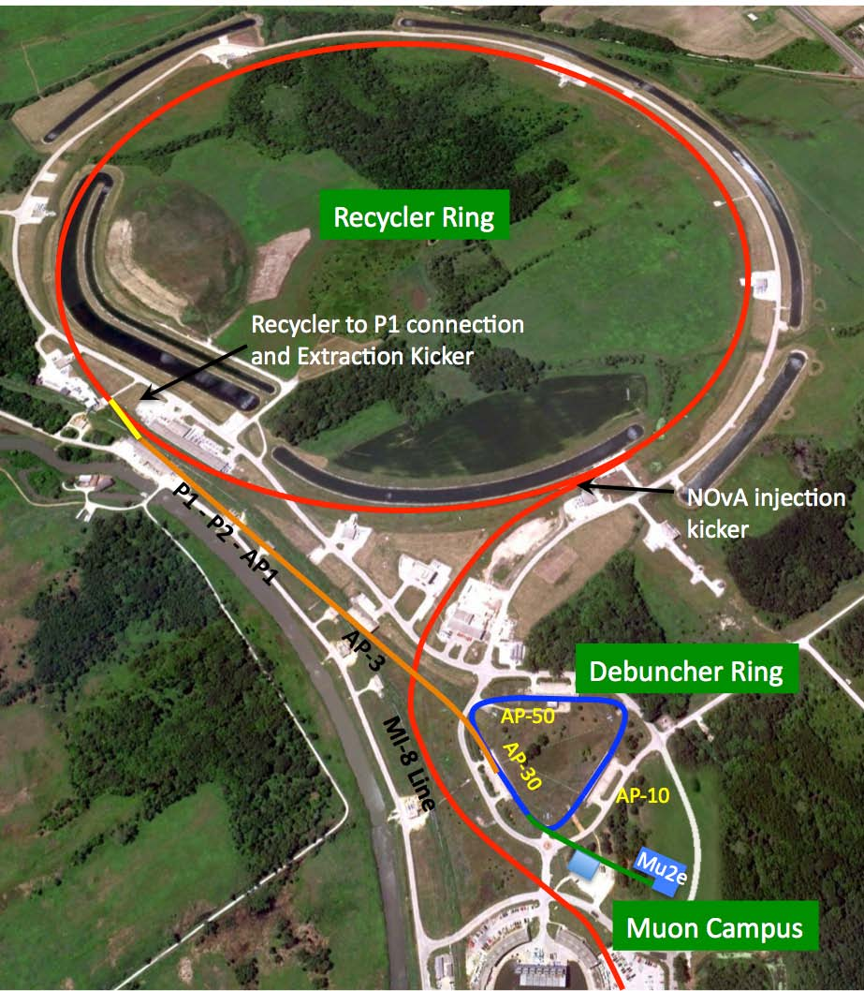
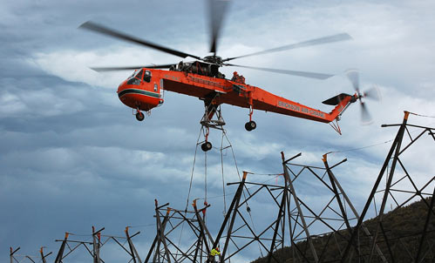
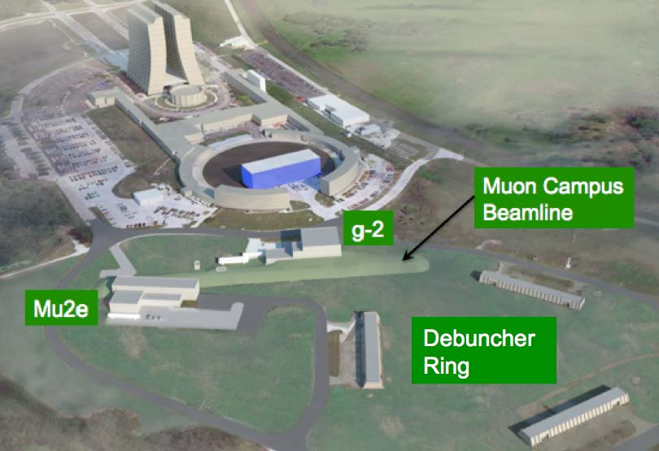
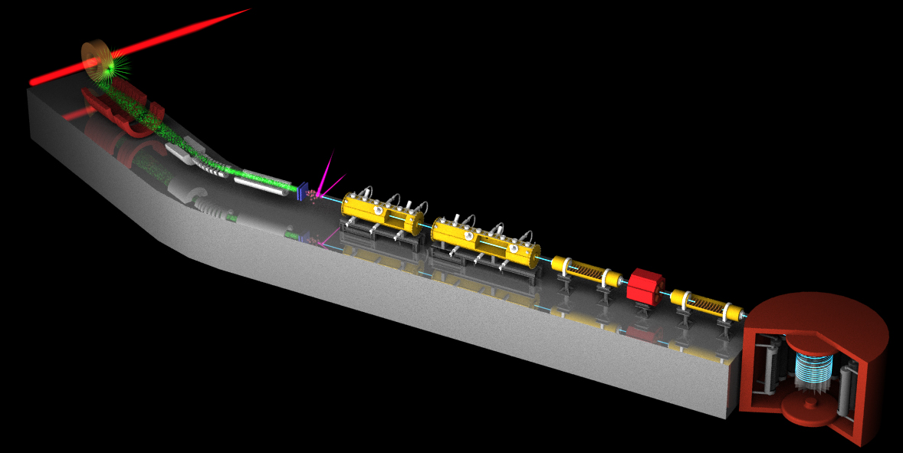
g-2: what’s next?
Progress on new g-2 experiment at FNAL
Current effect still at 3–3.5σ
  Uncertainty 0.54 ppm, dominated by statistics of 0.46 ppm
  Propose to get to 0.14 ppm experimental
    And progress on lattice HLBL (see PX Summer Study)
Status and plans: run at FNAL in next 5 years (Miller, Wed 3:30)
  What can be done next?
  Run negatives (systematics and CPT?)
Different, innovative method: cold g-2: (Tomono, wed 5:45)
  Input: MuHFS: (Mibe, Wed 4:30)
  Different systematics!
Surface muon beam
for cold g-2
14

Slide 15
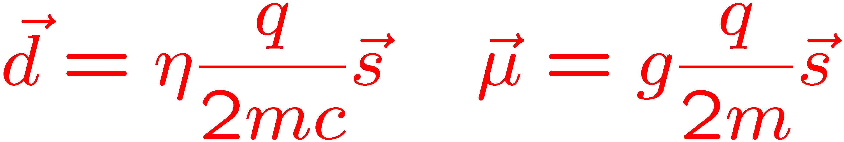
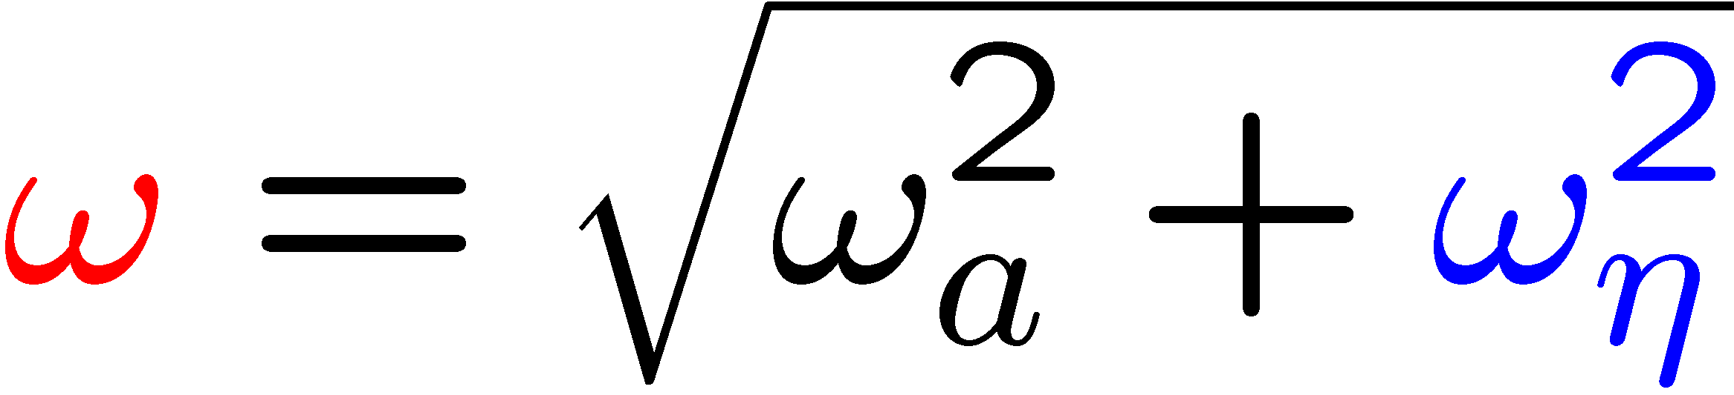
Next-Generation Muon EDM
 | E | B | μ or d
P | - | + | +
C | - | - | -
T | + | - | -
Assuming CPT, a non-zero d implies non-CKM CP violation
  Huge physics payoff
Current muon limit ~ 2 x 10⁻¹⁹
Need a new method (“frozen-spin”)
Choose radial E field to cancel all but η term, and spin will precess -> EDM to 10⁻²⁴ e-cm
Gardner, Thurs 9:30 joint WG1

Slide 16
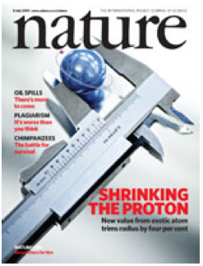
Proton Charge Radius
Charge Radius of Proton Extracted from Muonic Hydrogen:
  R. Pohl et al., Nature 466, 213 (2010)
Radius 5σ from the measurement in regular hydrogen
Electrons agree, muons disagree
  How good is the extraction from scattering measurement? Paz and Hill, http://arxiv.org/pdf/1008.4619.pdf
New forces? (Hill, Tuesday 12:30 PM )
Low energy muon beams in scattering experiments and/or muonic atoms, both natural territory for PX
 | r^{E}_{p} (fm) | Error
Muonic Lamb Shift | 0.84184 | 0.00067
Electron Lamb Shift | 0.8768 | 0.0069
Electron scattering | 0.879 | ~0.008
Electron Lamb Shift: J. C. Bernauer et al. [A1 Collaboration], Phys. Rev. Lett.105, 242001(2010).
Scattering: P. J. Mohr, B.N. Taylor and D. B. Newell, Rev. Mod.Phys. 80, 633 (2008)

Slide 17
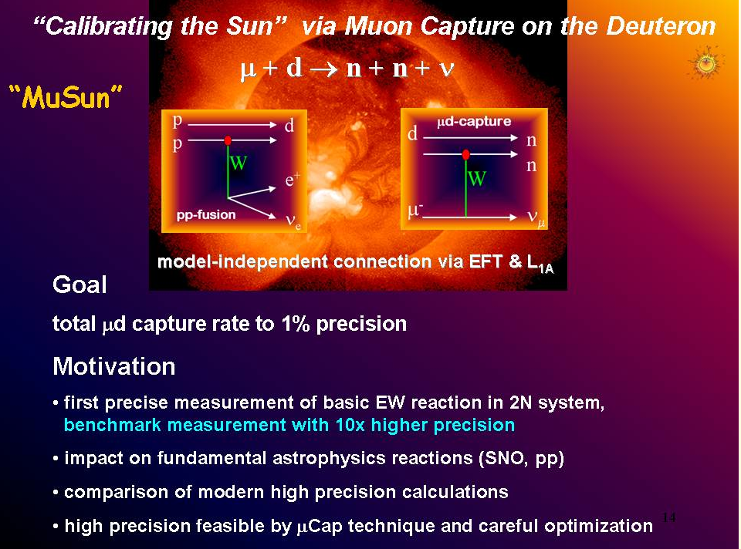
Other Physics
MuSun: measure the rate
to better than 1.5%, x10 better than existing
  Part of the MuLan, MuCap series at PSI
Carey, 12:00 PM Tuesday

Slide 18
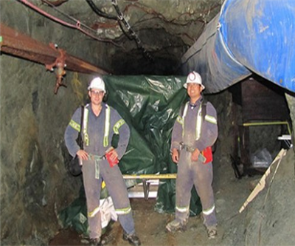
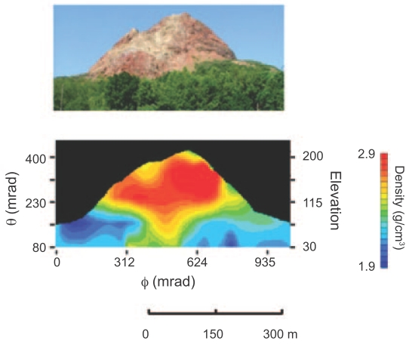
Other Physics
Using your PhD
for more than running ntuples
Muon Tomography
Looking for minerals: (Bryman, Tuesday 11:00AM)
Looking inside volcanoes with muons (Miyamoto, Tuesday 11:30 AM)

Slide 19
Beams and Solenoids
What is the status of cooling and how does the technology enable non-muon collider experiments?
  PRISM/PRIME/HCCs/Other
Would a next-generation muon-to-electron conversion experiment work with current technology?
  Examine Mu2e design
  Examine simulations of radiation damage to superconductors in Mu2e context
    What can we learn, or not learn, from Mu2e studies?
Berg, Roblin, Stratakis, Maloney, Friday AM (Joint WG3)
Lamm, Friday 10 AM
Pronskikh, Friday 10:30 AM (Joint WG3)

Slide 20
Summary
Muon experiments can address some of the most interesting questions in our field;
We need more intense muon beams of the sort that could be provided at a neutrino factory;
There is much overlap in the technologies of neutrino factories, muon colliders, and experiments discussed at this workshop. Upcoming experiments are already helping to develop the technology;
The worldwide muon program is gathering momentum and becoming stronger; at least the 1st and 2nd derivatives are positive!

